Slide 1
Interplanetary SmallSat Conference 2023 – BioSentinel
Matthew Napoli, PM
Andres Dono Perez (NAV Lead)
Jose Luis Alvarellos (NAV)
NASA Ames Research Center, Moffett Field, California
May 11, 2023

Slide 2
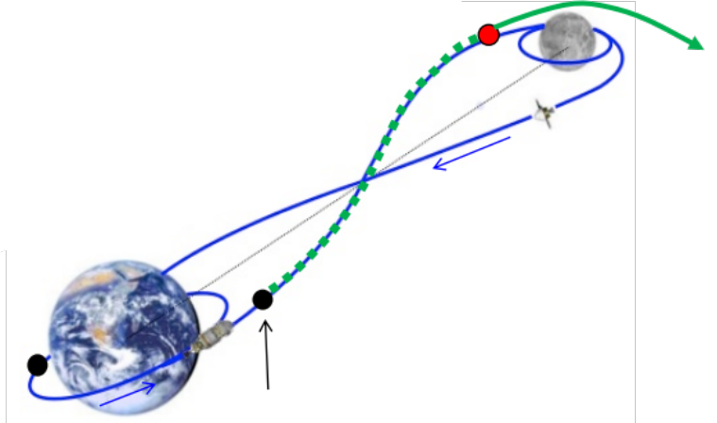
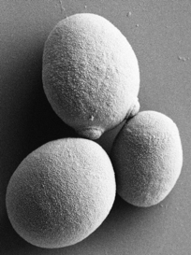
BioSentinel Mission
HQ Directorate: ESDMD Mars Campaign Development (MCD) (formerly AES)
Objective: develop a deep space tool with autonomous life support technologies to study the biological effects of the space radiation environment
NASA’s first biological study in interplanetary deep space
  First CubeSat to combine bio studies with autonomous capability & dosimetry beyond LEO
  Far beyond the protection of Earth’s magnetosphere
  BioSentinel allows to compare different radiation & gravitational environments (deep space, ISS, Earth surface)
BioSentinel escapes into a heliocentric orbit
Lunar transit
(3-7 days)
Distance to ISS: ~ 350 km
Distance to the Moon: ~385,000 km
Distance at 6 months: ~16,000,000 km
Secondary payload
deployment (L+4 hrs)
Notes:
Yeast image credit: Bob Hanel & Sergio Santa Maria, “BioSentinel – Spacecraft and BioSensor Flight Unit Development”, Interplanetary Small Sat Conference 2019.

Slide 3
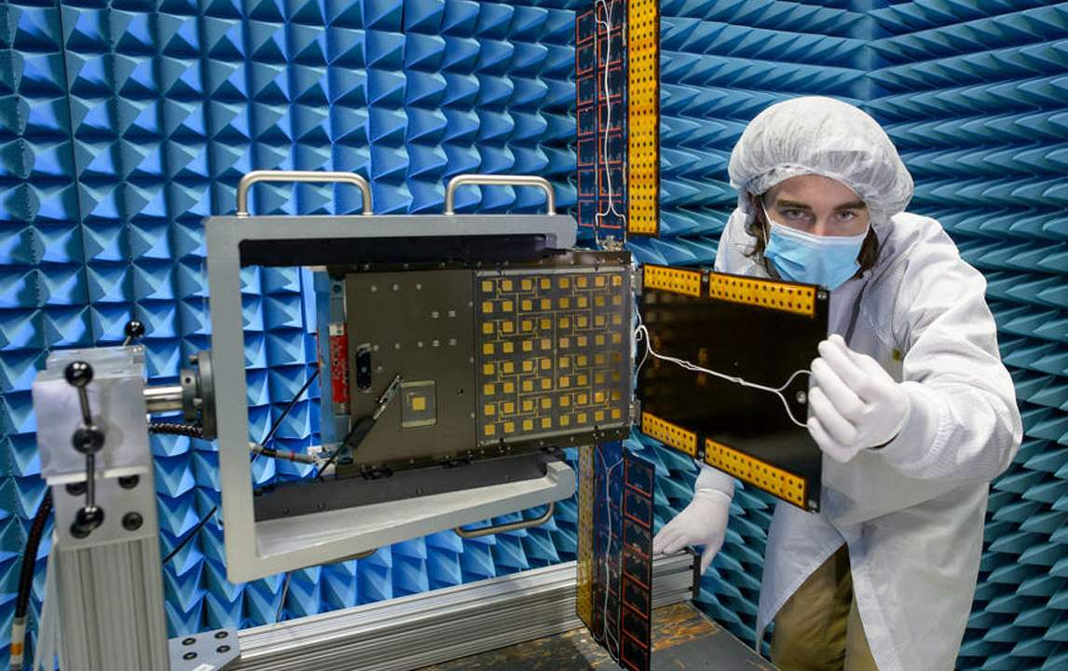
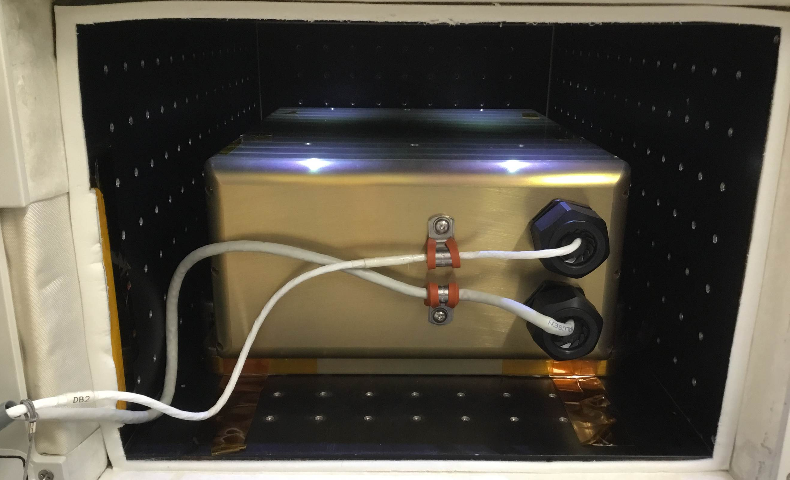
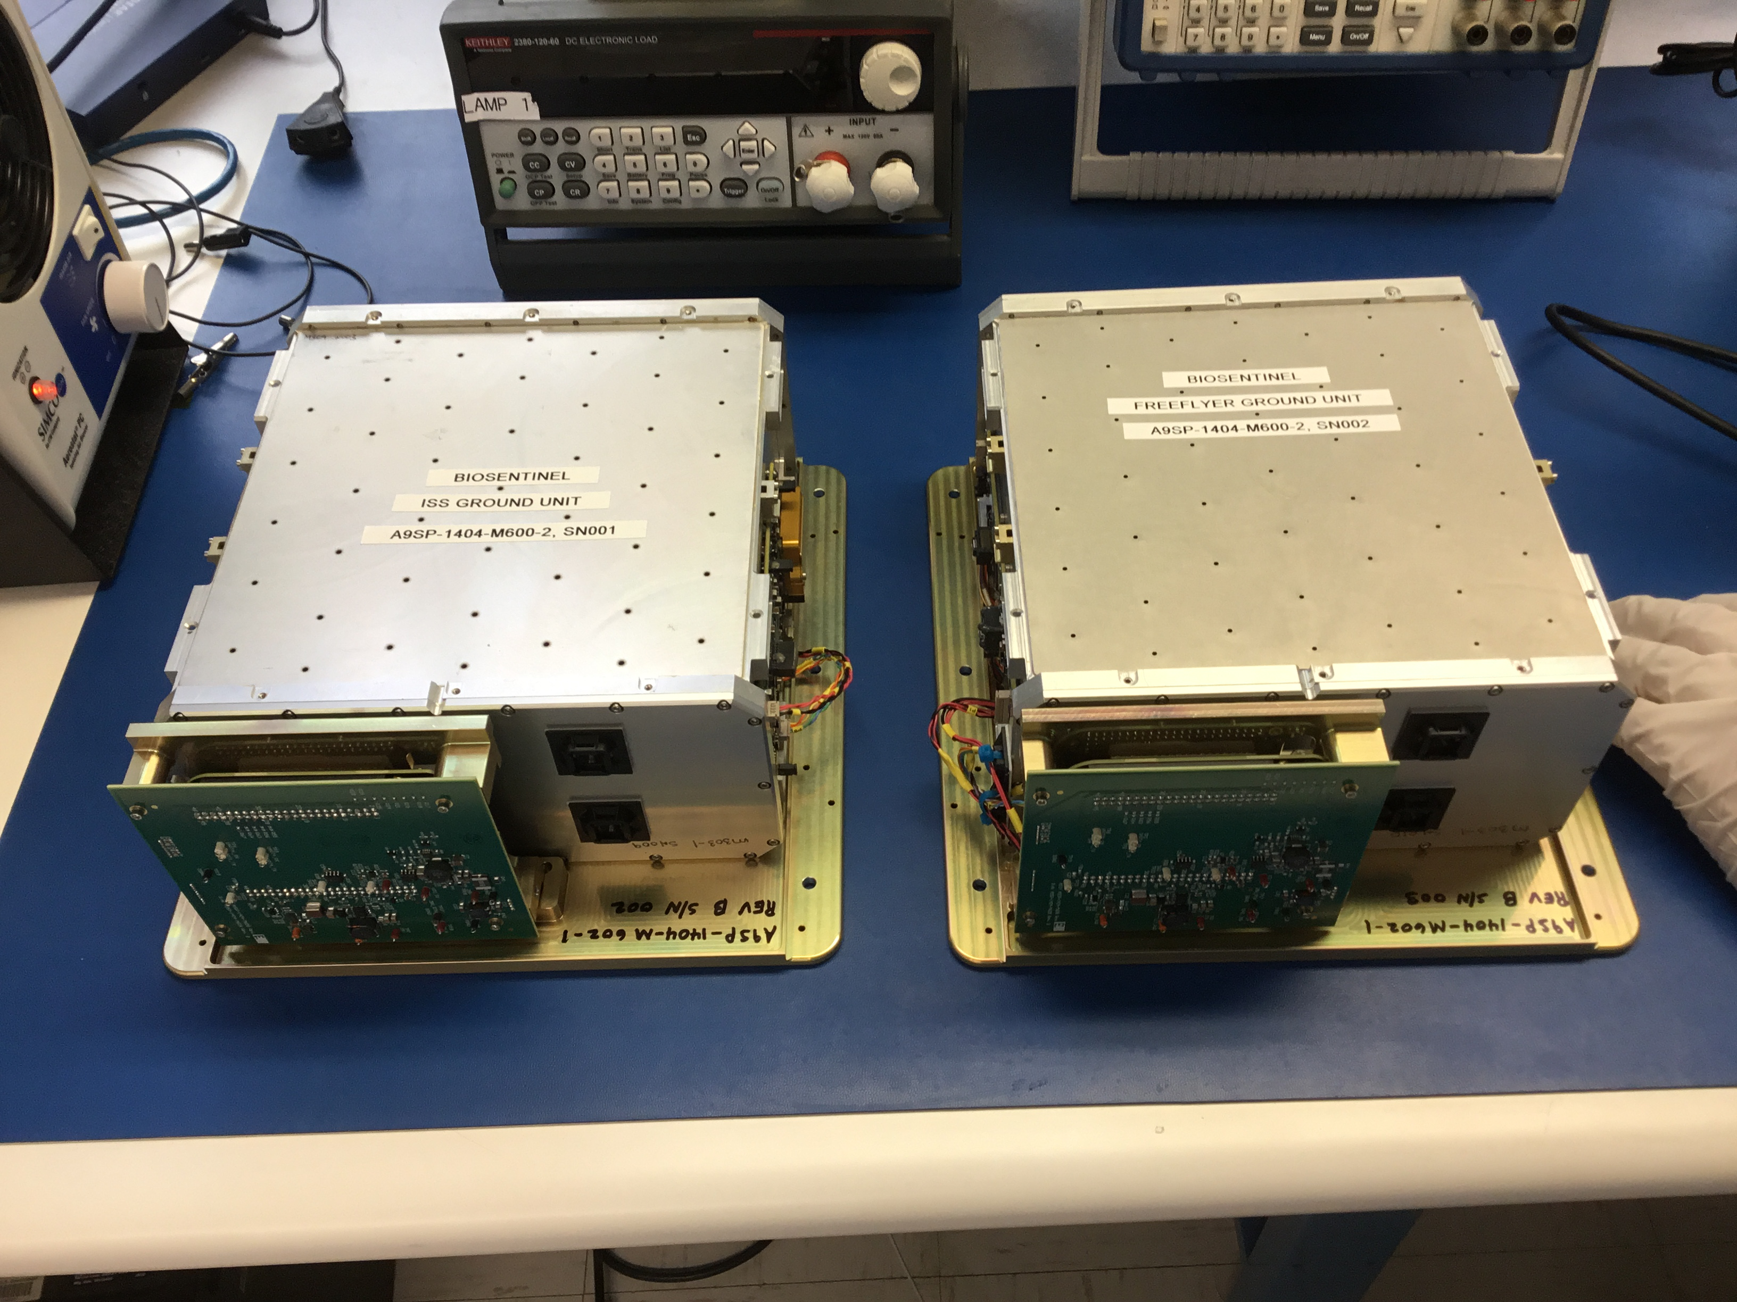
Project Description
BioSentinel is performing the first long-duration biology experiment in deep space. Its six-month science investigation is studying the effects of deep space radiation on a living organism, yeast. There are three segments to the project:
      Freeflyer Spacecraft - deep space experiment on Artemis 1
      ISS Segment - control experiment in LEO on the International Space Station
      Ground Segment – control experiment on ground
The three segments are all part of the BioSentinel mission and share identical BioSensor payloads.
Freeflyer Spacecraft ISS Segment Ground Segment
Notes:
Freeflyer Image Credit: NASA/Dominic Hart. ISS & Ground Image Credits: NASA/Jeff Homan

Slide 4
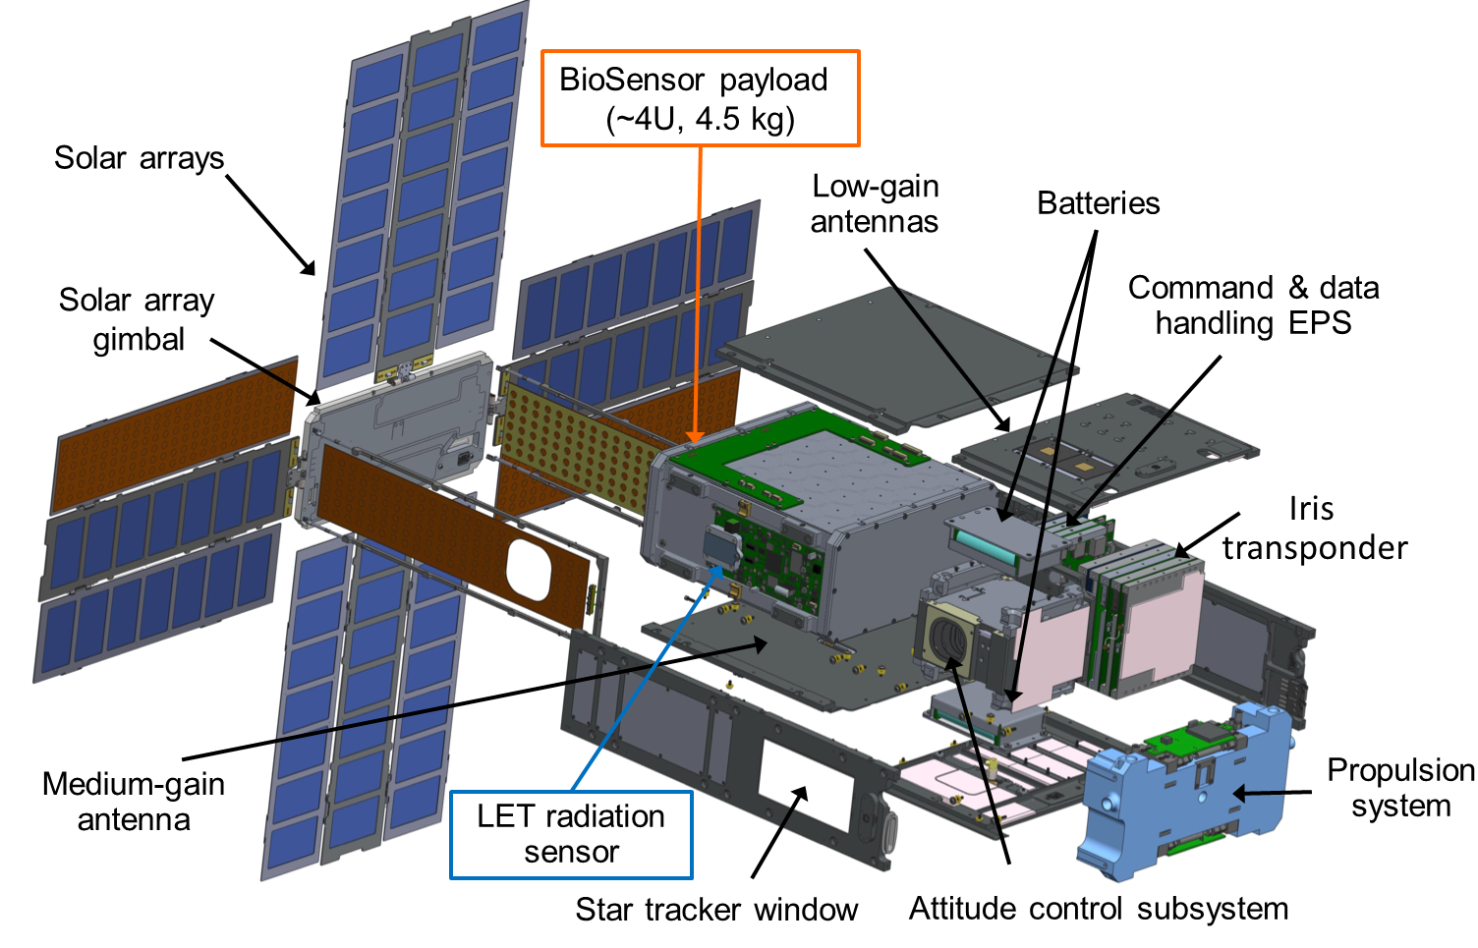
Project Description (Cont.)
Notes:
Image credit: Bob Hanel & Sergio Santa Maria, “BioSentinel – Spacecraft and BioSensor Flight Unit Development”, Interplanetary Small Sat Conference 2019.
LET: ‘Linear Energy Transfer’ spectrometer

Slide 5
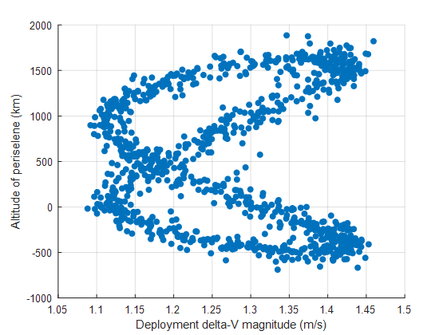
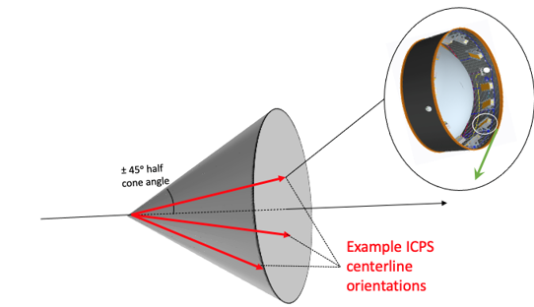
Lunar Impact Risk – Pre-Launch Analysis
Baseline CONOPS did not have a ΔV maneuver planned. Initial lunar impact risks of <10% was deemed an acceptable risk.
Monte Carlo analyses for 2022, for cases where altitude < 50 km:
  Aug 29th - 30%,
  Sept 2nd - 54%,
  Sept 5th - 56%,
  Nov 16th – 15% (actual launch date)
  Nov. 18th – 0%
  Nov. 19th – 0%
  Nov. 25th – 14%
August 29th Launch Deployment Variability
Lunar Impact

Slide 6
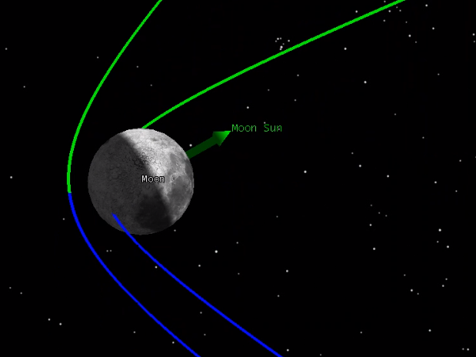
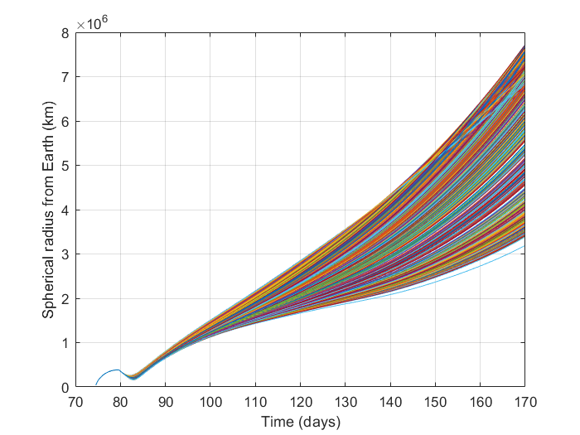
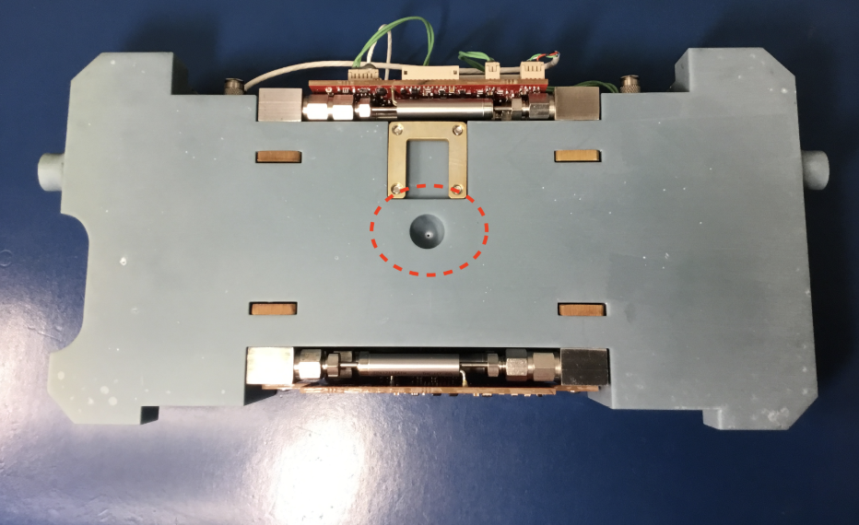
Lunar Impact Risk – Pre-Launch Analysis (Cont.)
Avoiding impact requires a ΔV maneuver shortly after deployment
  Earlier maneuver = less ΔV required
  ΔV attitude is assumed to always be required in the S/C velocity direction
Prop Subsystem:
  The capability for ΔV is possible because the propulsion system fortuitously included an extra rear nozzle that had not been planned for the nominal mission. Propellant is available for the maneuver because the mission was previously reduced from 18 months to 6 months.
  Available ΔV = 4.2 m/s (after allocating propellant for momentum unloading)
  Total ΔV = 5.9 m/s, of which 1.7 m/s is need for nominal operations of the 6 month mission.
Monte Carlo:
Earth distance vs time for a 3 burns case
Assumes Nov. 16th launch
  Propulsion Rear nozzle
Notes:
Propulsion System image credits: NASA/Terry Stevenson

Slide 7
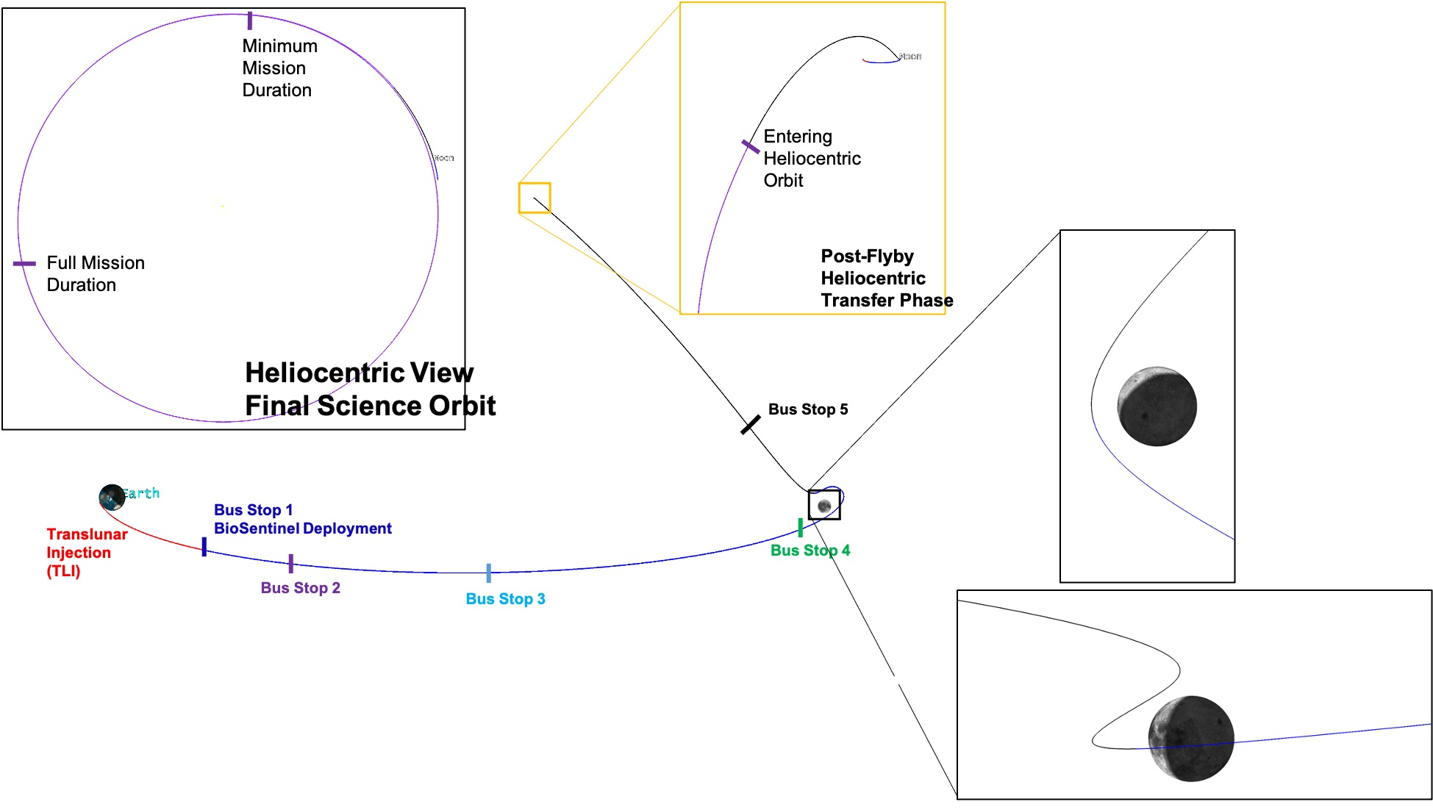
Sequence of Events
Event | Date/Time (UTC)
SLS Launch | 16-Nov-2022, 06:47:44
BioSentinel Deployment | 16-Nov-2022, 10:30:42
S/As deployment | 16-Nov-2022, 20:20:00
Lunar Flyby | 21-Nov-2022, 15:40:51
Lunar Eclipse start (duration: 36.5 mins) | 21-Nov-2022, 16:06:56
Science Ops starts | 5-Dec-2022, 16:00:00
Exit Earth’s Hill sphere | 12-Dec-2022, 10:30:00

Slide 8
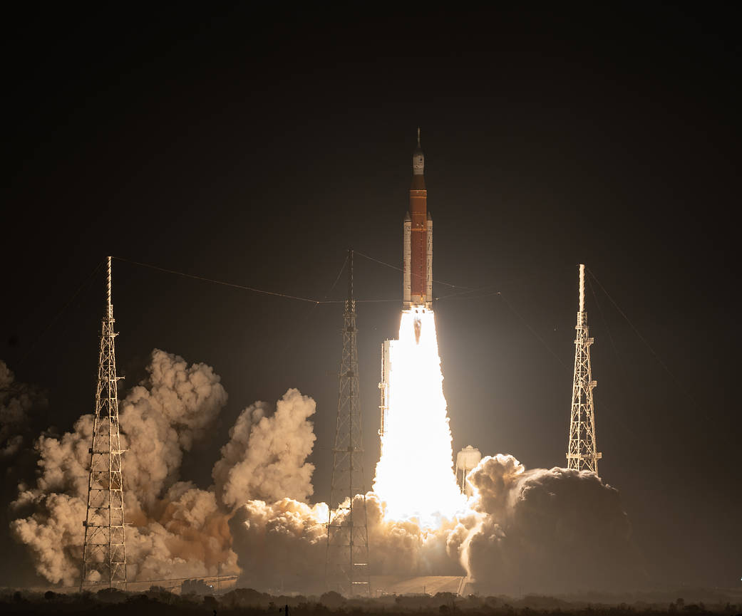
SLS launch: 16 Nov 2022
  SLS Block 1 launched 16-Nov-2022, part of Launch Period 28
  Launch occurred 06:47:44 UTC
  44 minutes into the two-hour launch window
Notes:
Image credit: Bill Ingals (https://www.nasa.gov/exploration/systems/sls/artemis-i-launch-0.html)

Slide 9
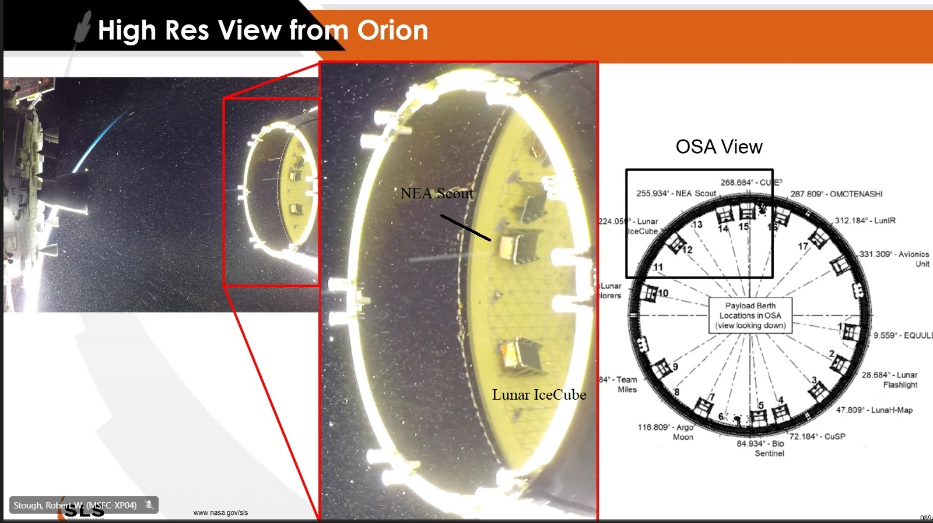
View from Orion
  BioSentinel deployment from ICPS dispenser #5
  16-Nov-2022, 10:30:42 UTC,
  3 hrs 43 minutes post-launch.
BioSentinel
Notes:
Image credit: NASA’s YouTube site

Slide 10
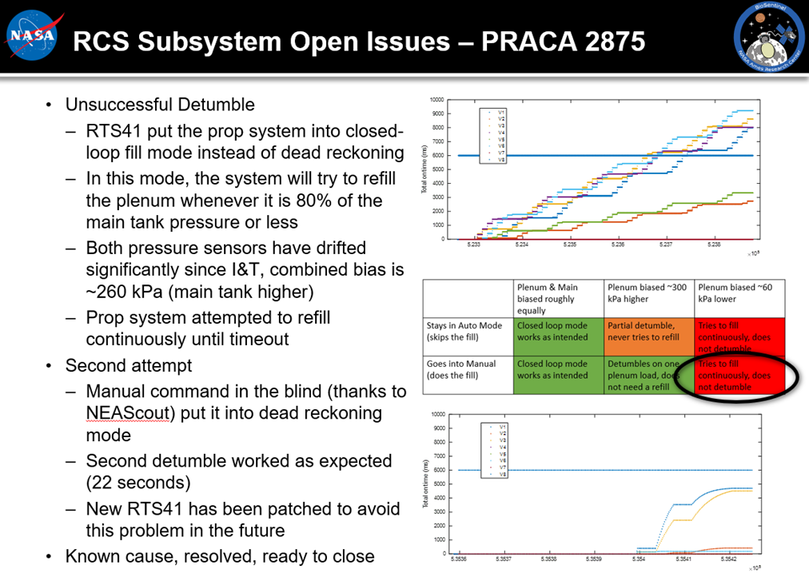
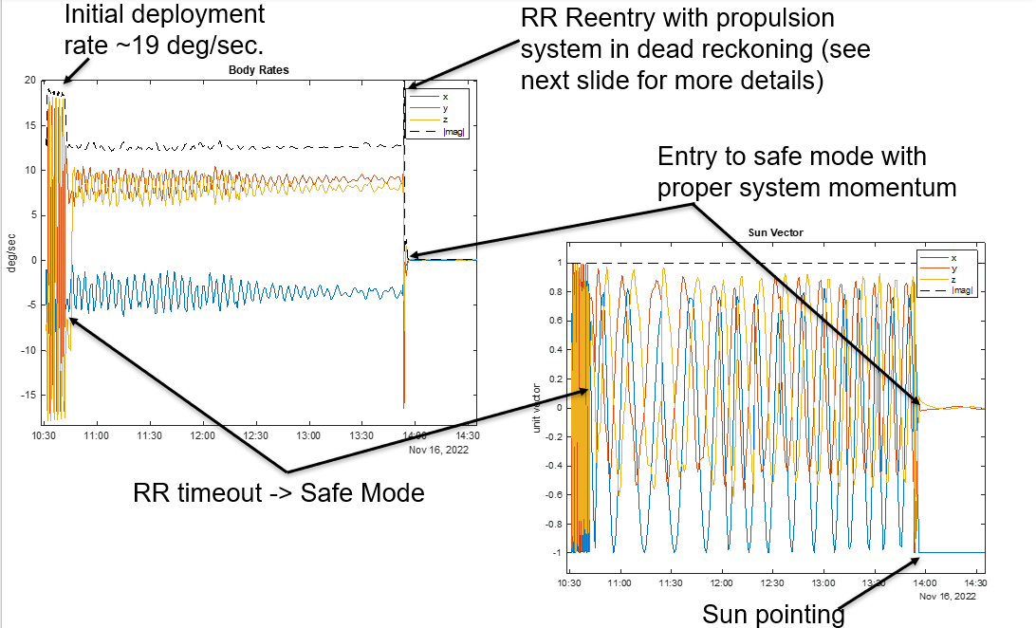
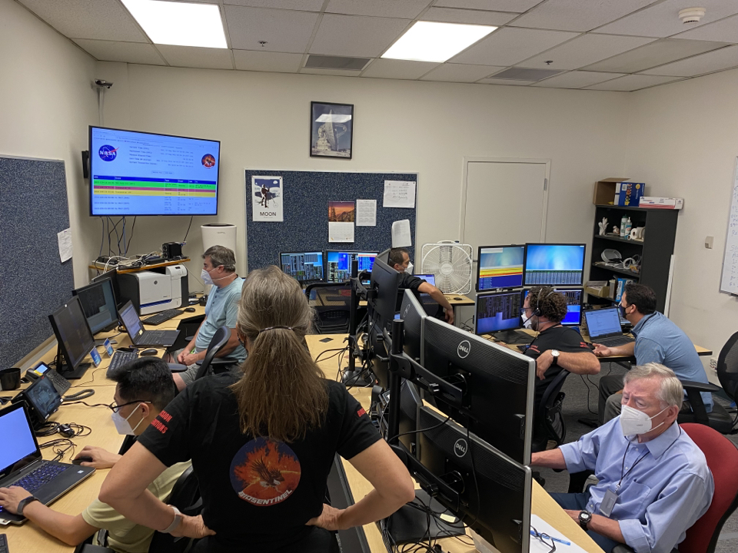
Initial Deployment – Tumbling Anomaly
Notes:
Mission Ops team credit: NASA/Matthew Napoli

Slide 11
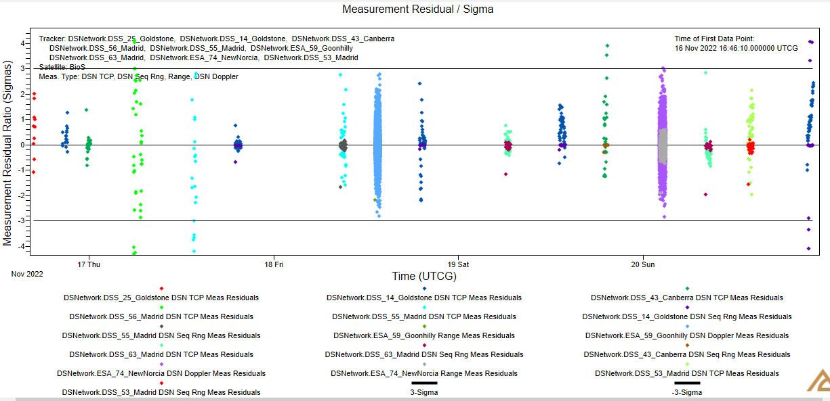
OD: Pre-Flyby
  Final pre-flyby OD includes TCP, Sequential Ranging, Doppler tracking data
  Tracking data from both DSN & ESA stations
  Separation orbit solution below (J2000):
Epoch | 16-Nov-2022, 10:30:42 UTC
a | 195,498.7 km
e | 0.964664
i | 30°.2527
Ω | 10°.9247
ω | 20°.4447
υ | 132°.984

Slide 12
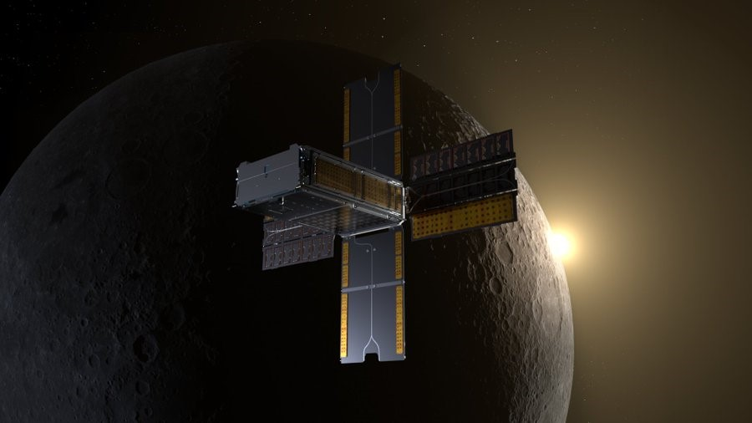
Lunar Flyby
    Flyby Epoch: 21-Nov-2022,
    15:40:39 UTC
    (5.22 days post BioSentinel
    deployment)
    Flyby Altitude: 406 km
    Thanks to NASA Eyes for
    the visualization tool!
    https://eyes.nasa.gov/apps/solar-system/#/sc_biosentinel

Slide 13
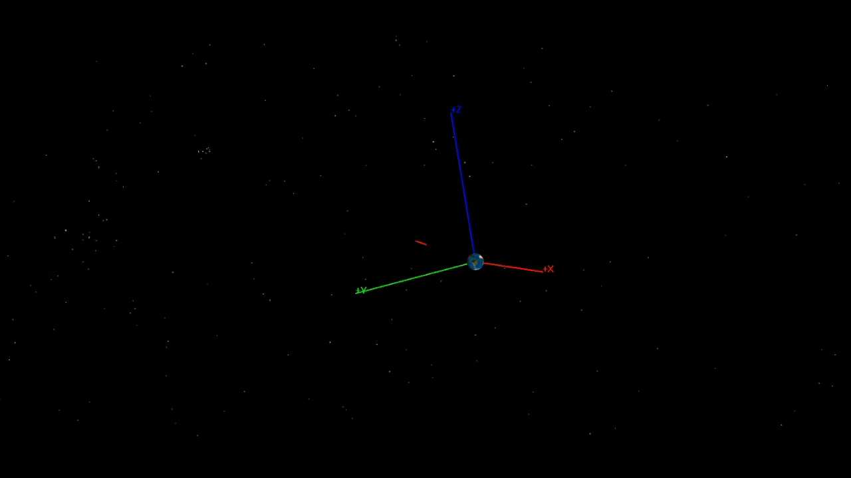
Flyby Animation
Notes:
Thanks to NASA/Rachel R. Gilbert for help with video editing!

Slide 14
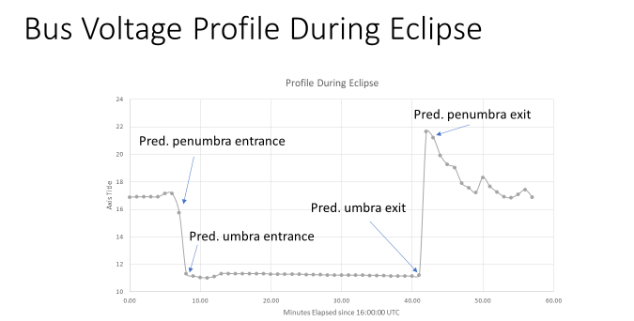
Eclipse
    Eclipse Start: 21-Nov-2022, 16:06:56 UTC
    Eclipse End: 21-Nov-2022, 16:43:23 UTC
    Eclipse Duration: 36.5 minutes
Notes:
Data points credits: NASA/S. Wu

Slide 15
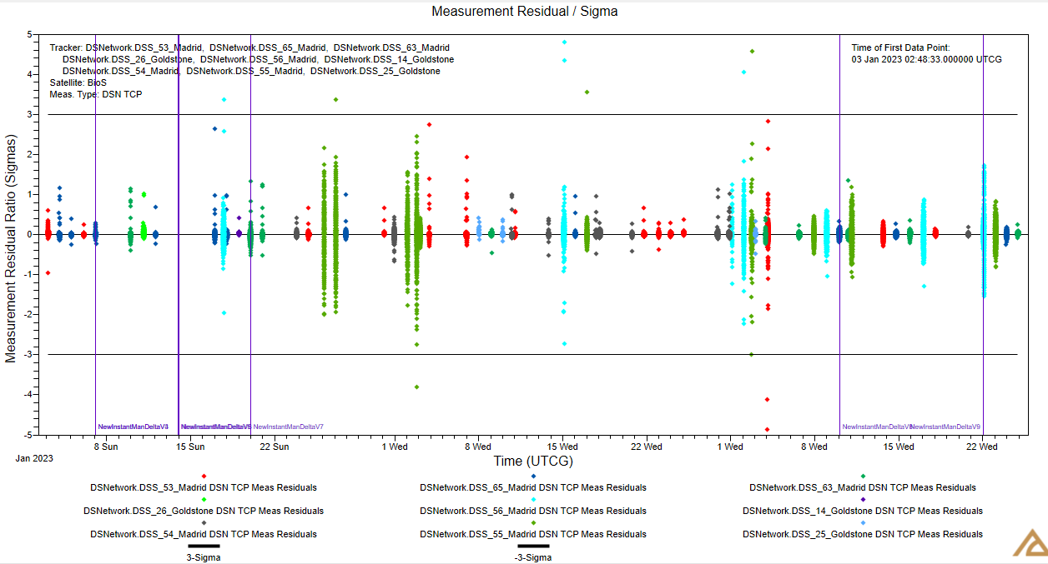
OD: Post-Flyby, Heliocentric
Orbit Determination (OD)
  Heliocentric OD includes only TCP data from DSN
  Vertical lines represent ΔH maneuvers (typical ΔV ~10⁻⁴ m/s)
  Current semi-major axis (15-May-2023) is 1.0176 AU
  Earth-trailing orbit
Notes:
TCP: Total Count Phase

Slide 16
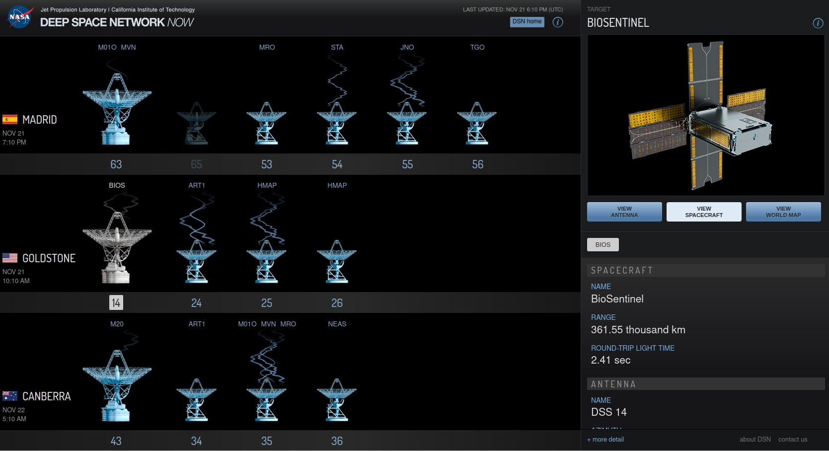
DSN Experience
DSN / ESA support
  99% successful comm passes
  NOPE and MIM have been very responsive to issues and continue to meet with team to work open issues
  Actual signal levels are ~3 dB higher than predicted for 8000 bps and 500 bps (changing) after the first few days
Notes:
NOPE: Network Operations Project Engineer. MIM: Mission Interface Manager

Slide 17
Navigation experience
Our CONOPS required us to decide whether to do a Lunar Avoidance Maneuver no later than our 5th pass. A robust ephemeris solution was needed. Initial state vector from the ICPS and complete tracking data was fundamental. More information about the attitude and deployment magnitude from ICPS would have improved Orbit Determination (OD).
ESA tracking data provided other type of measurements such as Ranging and 2-way Doppler that complemented the Sequential Ranging and TCP data provided by the DSN. This was proven useful to obtain an OD solution with higher degree of confidence.
After lunar flyby, OD adjustments had to be performed to accommodate the large ΔV incurred. Heliocentric orbit was achieved successfully, and ephemerides are being provided on a regular basis.
Campaign Nav support and collaboration among other CubeSat missions were very professional and useful. We would also like to highlight also the help from the Payload Office Trajectory team and the DSN team.
Great support to the NAV team from SEE

Slide 18
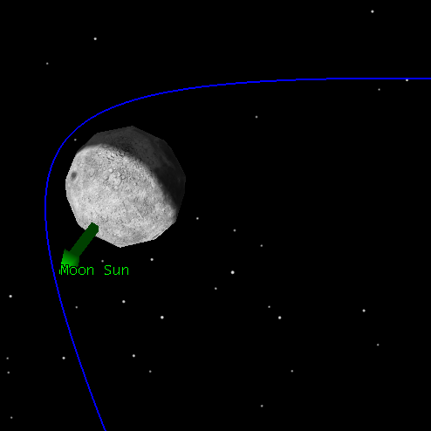
Mission Takeaways
  Favorable deployment trajectory for lunar flyby eliminated many of our top concerns.
  Very good performance of the IRIS radio.
  DSN /ESA support has exceeded expectations.
  Secondary community has been very supportive and collaborative.
  Currently working on a Mission Extension to study Deep Space Radiation
  Time was our enemy
  Yeast and BioSensor payload degraded over time.
  Battery degraded. Recharging in October was critical.
  Propulsion pressure sensors drifted over time.

Slide 19
Appendices
  Extra slides

Slide 20
Flight Tracker
Pass | Date/Time (UTC) | Station | Notes
1 | 16 Nov 2022320/11:41 | DSS-25 | Initial Acquisition. Rate reduction not complete, spacecraft tumbling.
1-extra | 16 Nov 2022320/13:52 | DSS-14 | Re-enabled rate reduction.
2 | 16-Nov-22 320/16:25 | DSS-25 | Confirmed rate reduction complete.
3 | 16-Nov-22 320/20:20 | DSS-14 | Deployed Solar Arrays
4 | 16 Nov 2022 320/23:20 | DSS-43
5 | 17 Nov 2022 321/06:05 | DSS-56 | First Orbit Determination after this pass. Lunar avoidance maneuver called-off. Transitioned to nominal pointing
…
 | 21 Nov 2022 325/15:41 |  | Lunar Flyby @ 406km periselene altitude
21 | 21 Nov 2022 17:15 | DSS-14 | Post Eclipse H&S nominal
…
54 | 05 Dec 2022 16:00 | DSS-65 | Science Phase - Experiment #1 Start
… | Over 100 successful comm passes and 3 experiments run to date. |  | Over 100 successful comm passes and 3 experiments run to date.

Slide 21
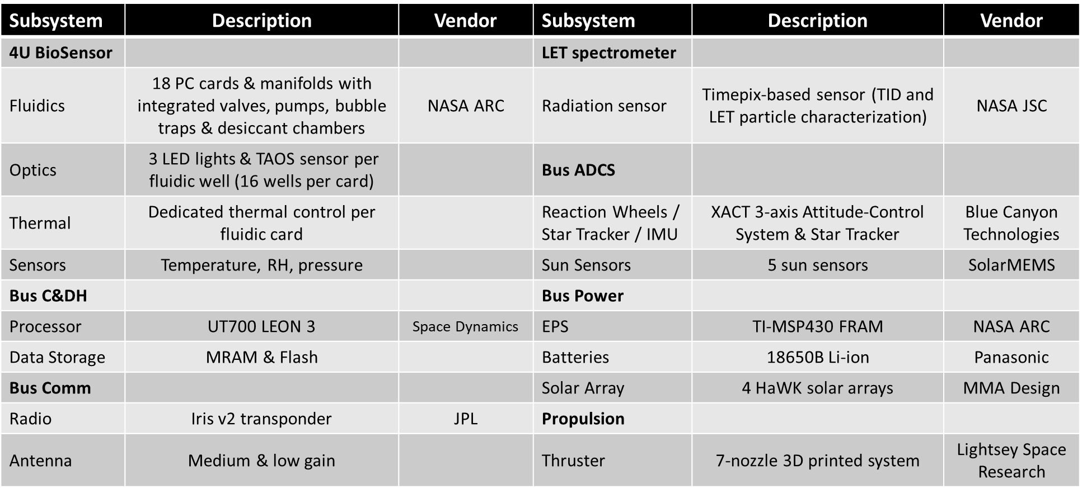
BioSentinel Subsystems

Slide 22
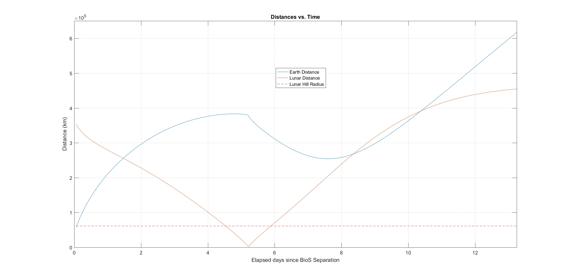
Distances to Earth and Moon (short-term)
Distance to Earth (blue curve) and Moon (red curve) vs. time since BioSentinel deployment
  The horizontal dashed red line at bottom represents the lunar Hill sphere radius
Min. post-flyby distance to Earth 254,000 km
Flyby
21-Nov-2022, 15:40:39 UTC

Slide 23
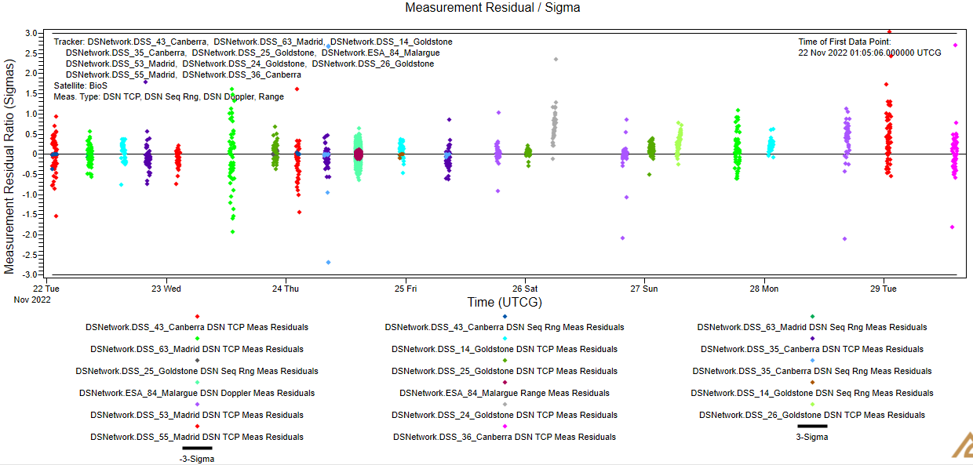
OD: Post-Flyby
  Post-flyby OD includes TCP, Sequential Ranging, Doppler tracking data
  Tracking data from both DSN & ESA stations

Slide 24
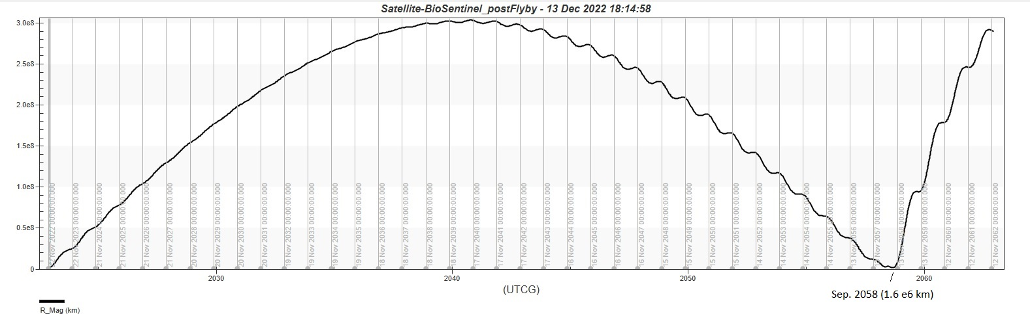
Distance to Earth (long-term)
Max. distance ~300e6 km in 2041
Min. distance post-flyby 1.6e6 km in 2058!

