Slide 1
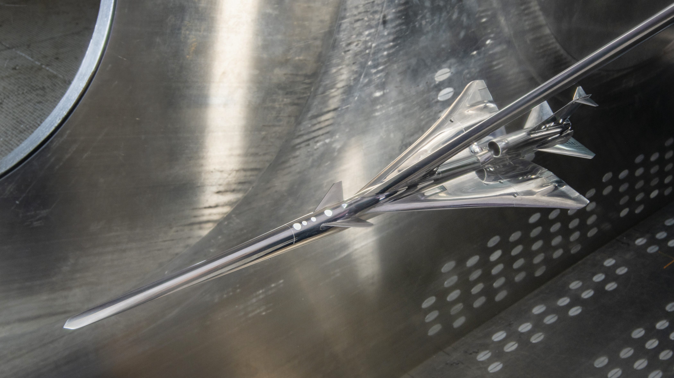
X-59 Sonic Boom Test Results from the NASA Glenn 8- by 6-Foot Supersonic Wind Tunnel
Note: Bright reflections in photo will be darkened…
Donald A. Durston — NASA Ames Research Center
John D. Wolter — NASA Glenn Research Center
Patrick R. Shea, Courtney S. Winski, Alaa A. Elmiligui, Melissa B. Carter,
Sarah L. Langston, Michael D. Bozeman — NASA Langley Research Center
AIAA Aviation Forum
San Diego, CA June 12–16, 2023
Notes:
Don Durston, Aero Eng at Ames
SB WT testing lead for CST Project
Here to talk about SB test of X-59 in Glenn tunnel
Like to acknowledge co-authors from Langley and Glenn who helped run the test and analyze the data

Slide 2


Outline
Test overview
  Objectives
  Models & support hardware
  Tunnel
Test techniques
  Model signature sweeps and spatial averaging
Results
  Repeatability and uncertainty
  Control surface deflections
  Effect of…
    Angle of attack
    Angle of roll
    Model height
    Mach number
  Blade vs. sting mount comparisons
  Humidity/dew point effects
Conclusions
This paper is derived from NASA/TM-20220012155, published in September 2022, publicly available:
Notes:
Paper is a shortened version of a NASA report I wrote, scan the code to download it
I’ll give you an overview of the test, model, & tunnel, talk about our test techniques, and share some results

Slide 3
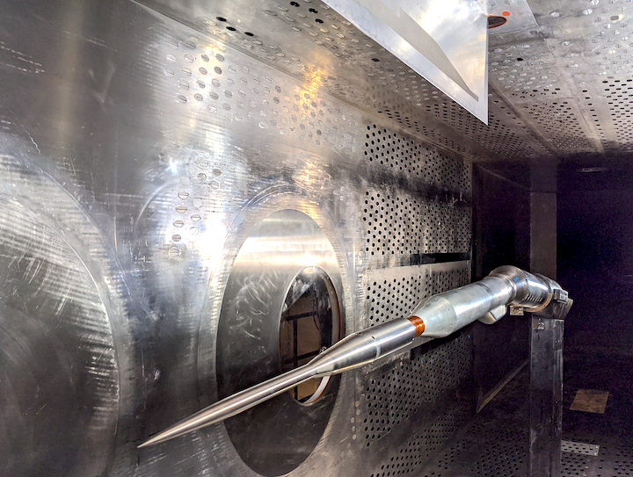
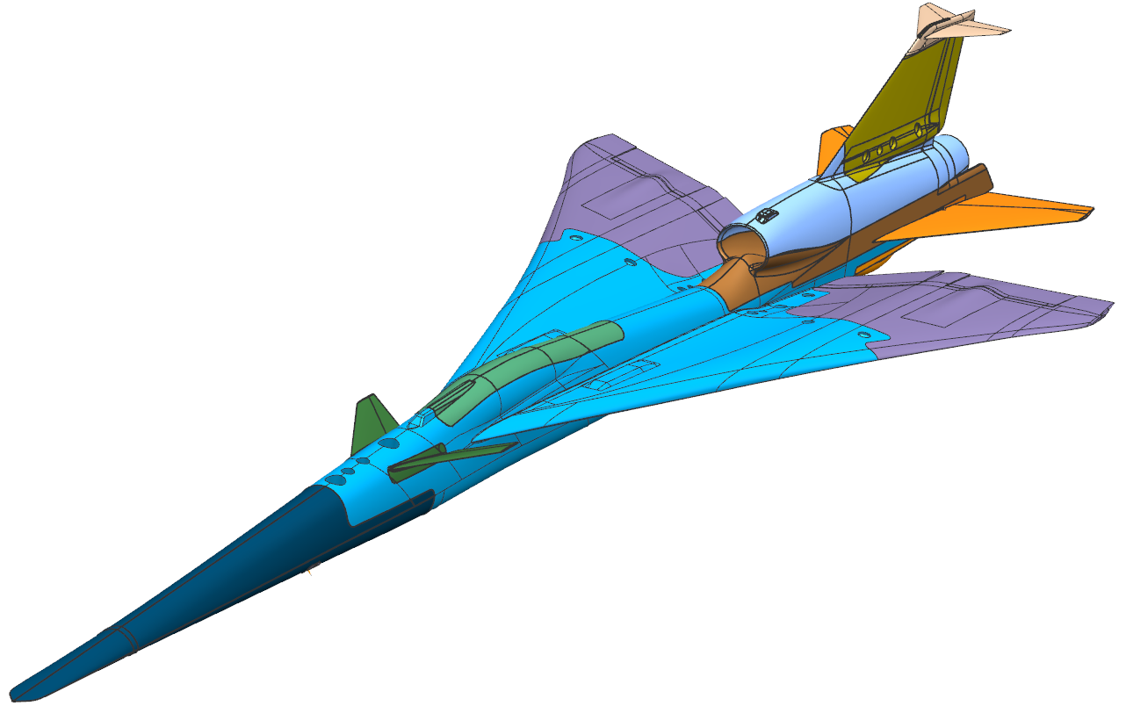
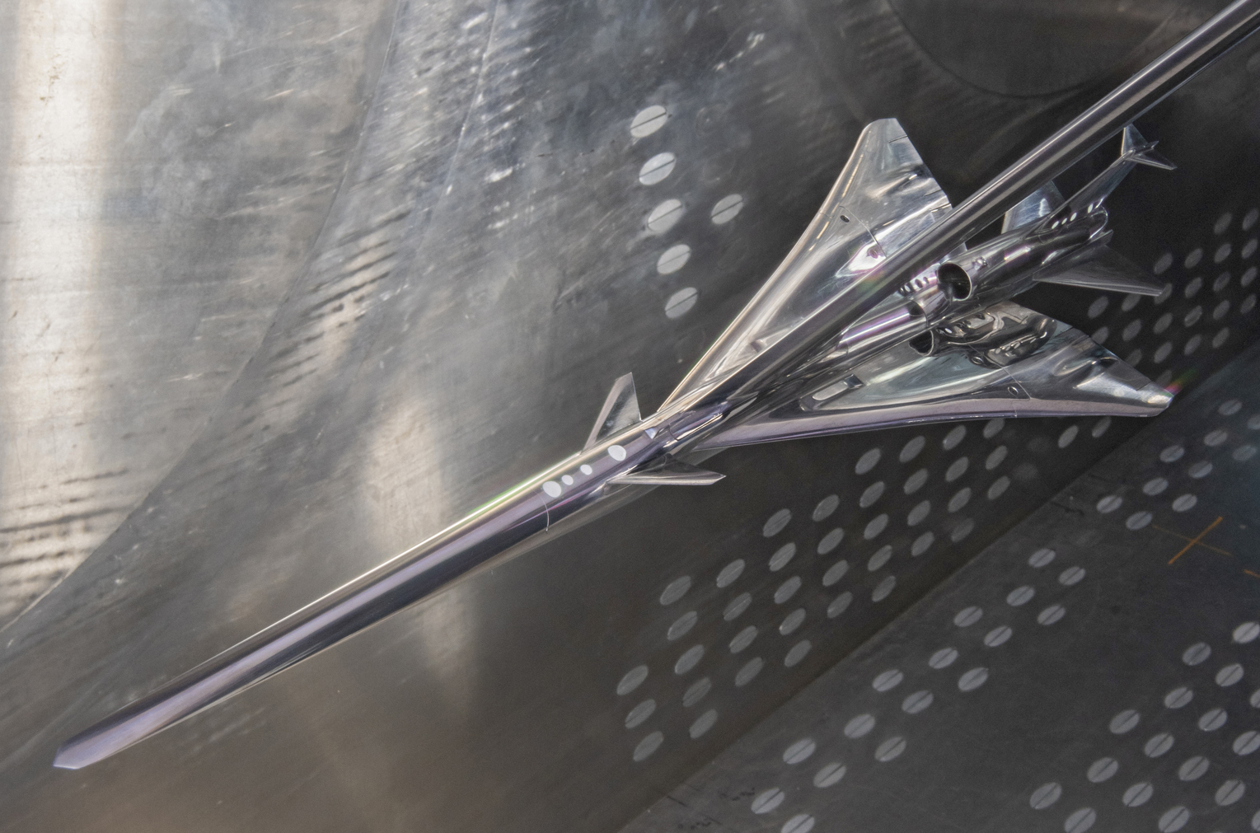
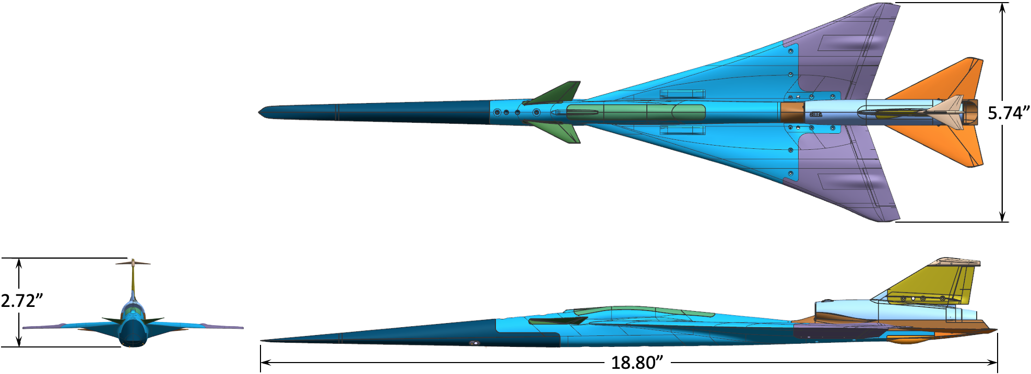
Test Overview
Objectives
Acquire near-field X-59 pressure signatures for CFD validation
Compare these wind-tunnel signatures with flight-test measurements
Acquire schlieren images to gain insight into X-59 shock and expansion waves and to provide validation images for CFD
Models
Boeing AS-2 body of revolution
Lockheed X-59 C612A 1.62%-scale model
14” Pressure Rail
AS-2 Model
X-59 Model
Notes:
Primary objective of test was to measure signatures at variety of test conditions — Mach number, angles of attack & roll, distances from rail
Signatures were for CFD validation and ultimately comparison to flight-test results
Took schlieren images to view shock flow field and compare to CFD
AS-2 model used as calibration body. Has a simple geometry with a known pressure signature, so it was used to verify that we were measuring signatures properly on the rail.
Rail shown in upper photo, mounted on the ceiling in 8x6 tunnel
X-59 model about 19” long, had alternate parts for control deflections

Slide 4
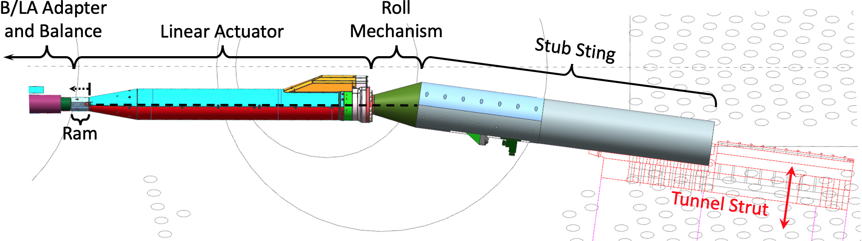
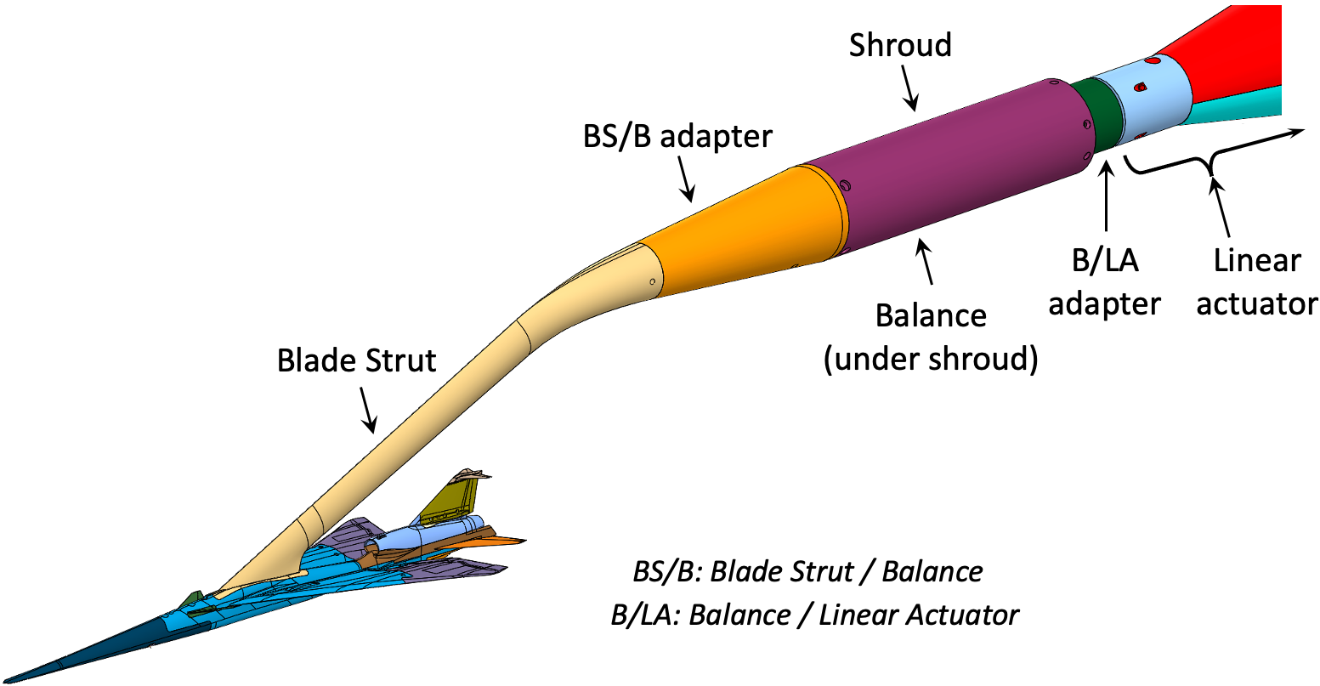
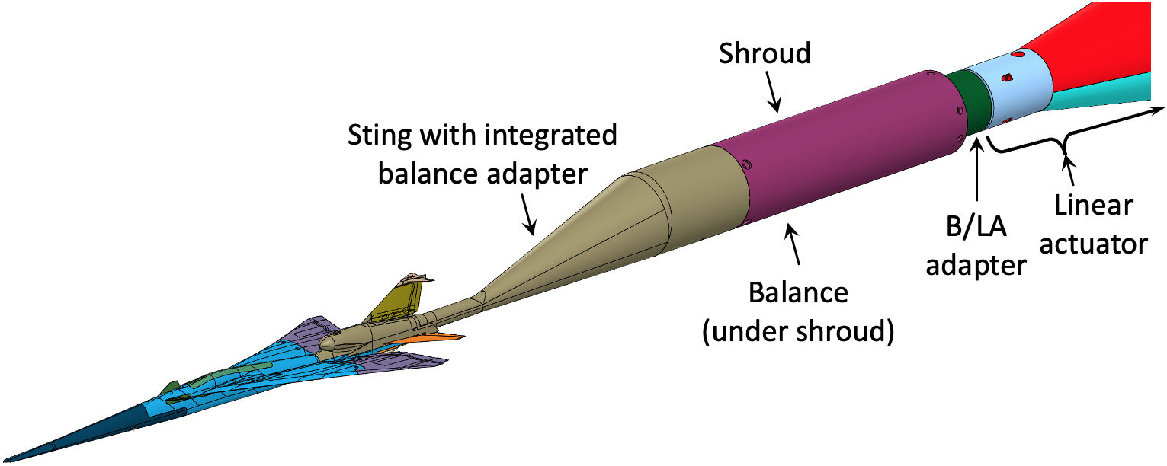
Model Supports
From tunnel strut going forward:
Stub sting (fixed)
Roll mechanism (360° roll)
Linear actuator (24” extension range)
Adapter, Langley 750 balance, shroud
Blade strut or sting mount
Notes:
Model was mounted on 8x6 tunnel strut
Roll mechanism allowed rolling model for off-track boom measurements
Linear actuator for moving model longitudinally to get signatures on different parts of the rail
Used Langley 750 balance primarily for normal force measurements to correct for sting & strut deflections
Model mounted on either a blade strut or a sting so that their combined signatures could mimic a free-air signature

Slide 5
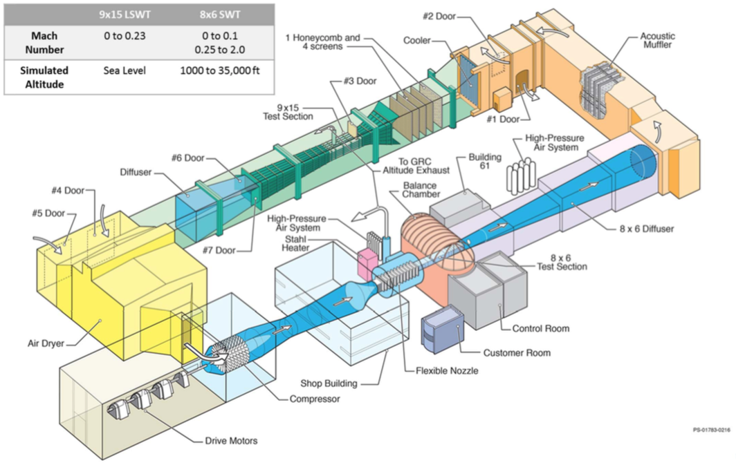
NASA Glenn Research Center 8- by 6-Foot Supersonic Wind Tunnel
Shares circuit with 9x15 Low-Speed Wind Tunnel
Atmospheric facility—no pressurization capability and not sealed from outside air
Air dryer consists of multiple beds of desiccant beads that absorb moisture
8x6 Mach range: 0 – 0.1 and 0.25 to 2.0
Powered by three 29,000 hp drive motors
7-stage axial compressor
2-dimensional vertical flex-wall nozzle
8x6 test section is 23.5’ long
  Supersonic solid-wall section 9’ long
  Transonic porous-wall section 14.5’ long
Notes:
Glenn 8x6 tunnel is part of a complex which includes 9x15 subsonic tunnel
Atmospheric facility, not sealed, so moist air enters tunnel while running
Air dryer with desiccant beads slows the rate of humidity increase but does not stop it
Mach range from low speed up to Mach 2
Very clean flow with symmetric flex-wall nozzle and long test section

Slide 6
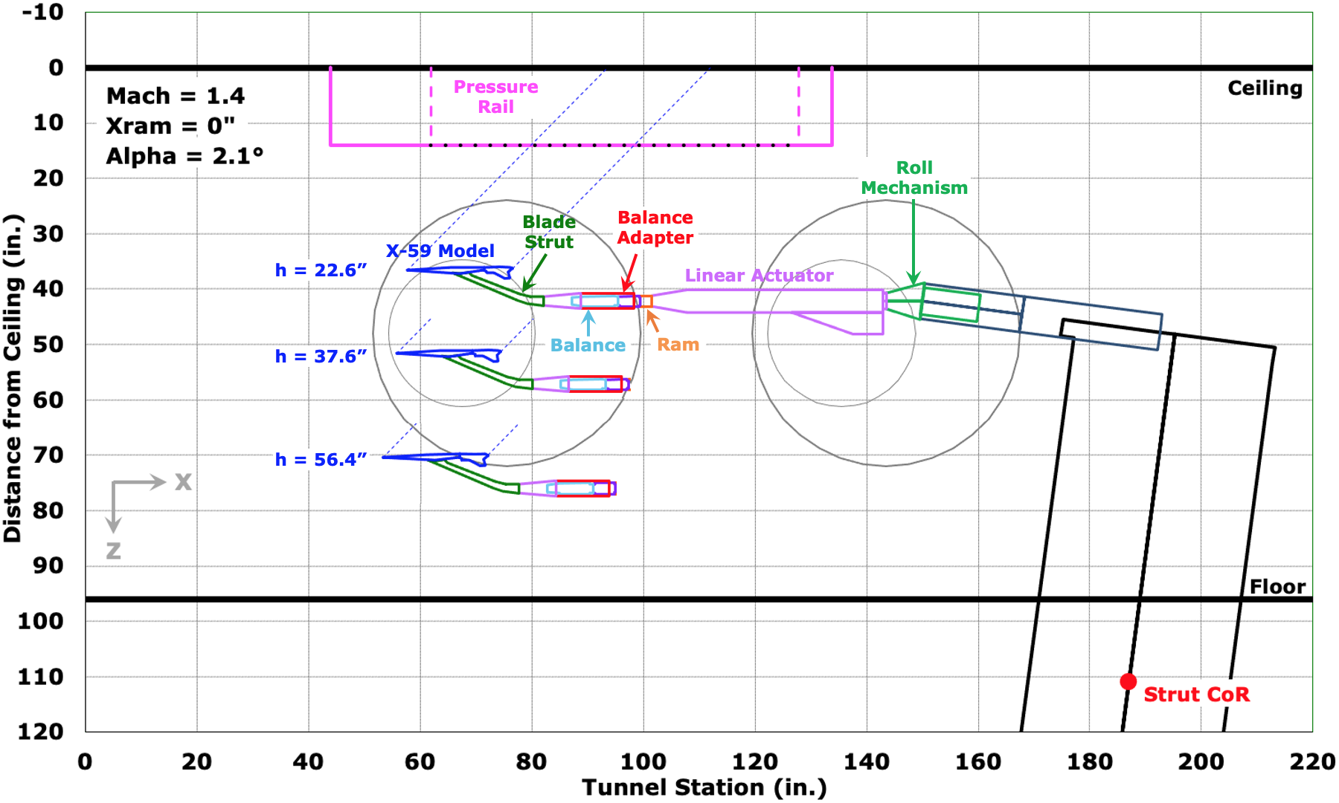
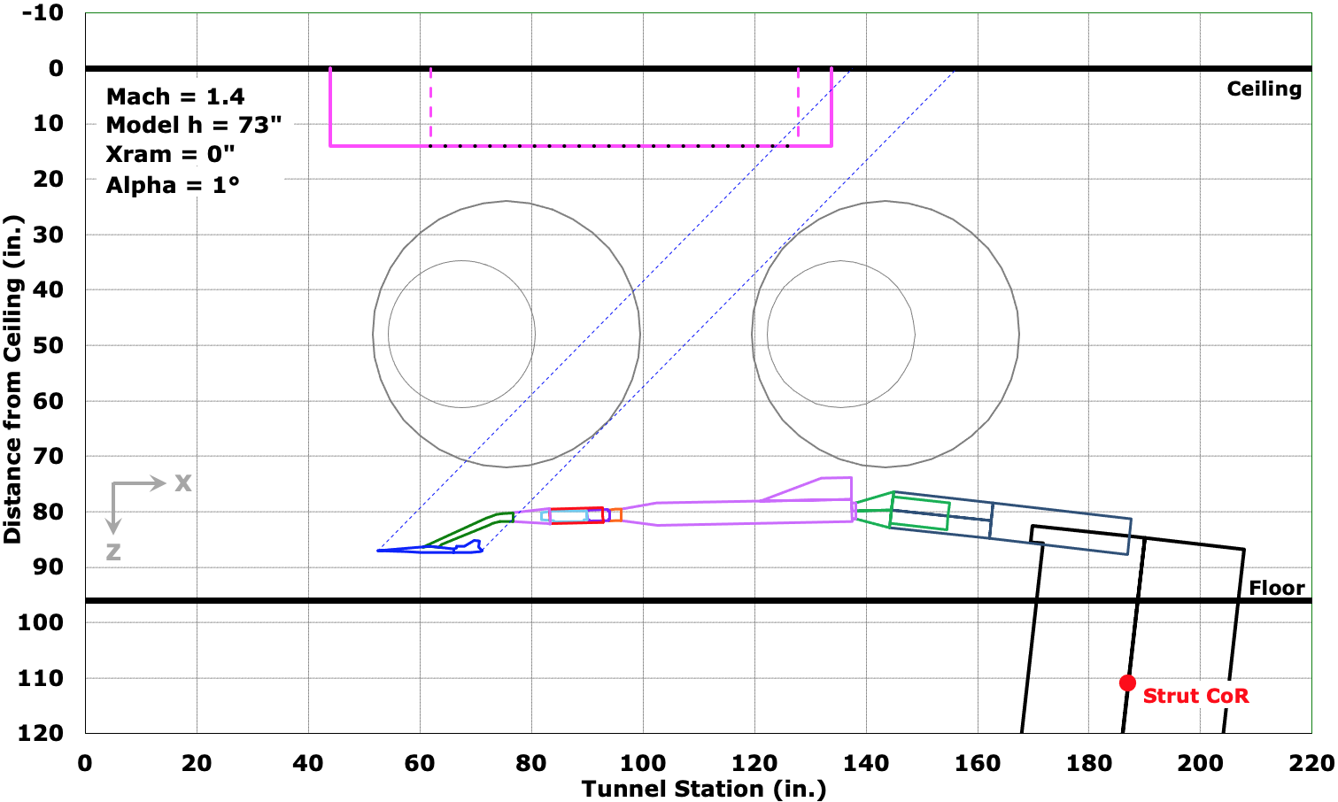
Model Positioning
Model signatures acquired at three heights relative to rail corresponding to h/L = 1.2, 2.0, 3.0 (close to strut min and max height limits)
Linear actuator ram extended over
8-inch ranges in X sweeps to get multiple signatures on different regions of the rail
Reference runs were taken with model as close to floor as possible with shocks toward rear of rail
Notes:
Model run at 3 heights to get near- to mid-field signatures
Ram extension allows X sweeps for multiple signatures to average
Reference run taken prior to series of runs for correction of signatures

Slide 7
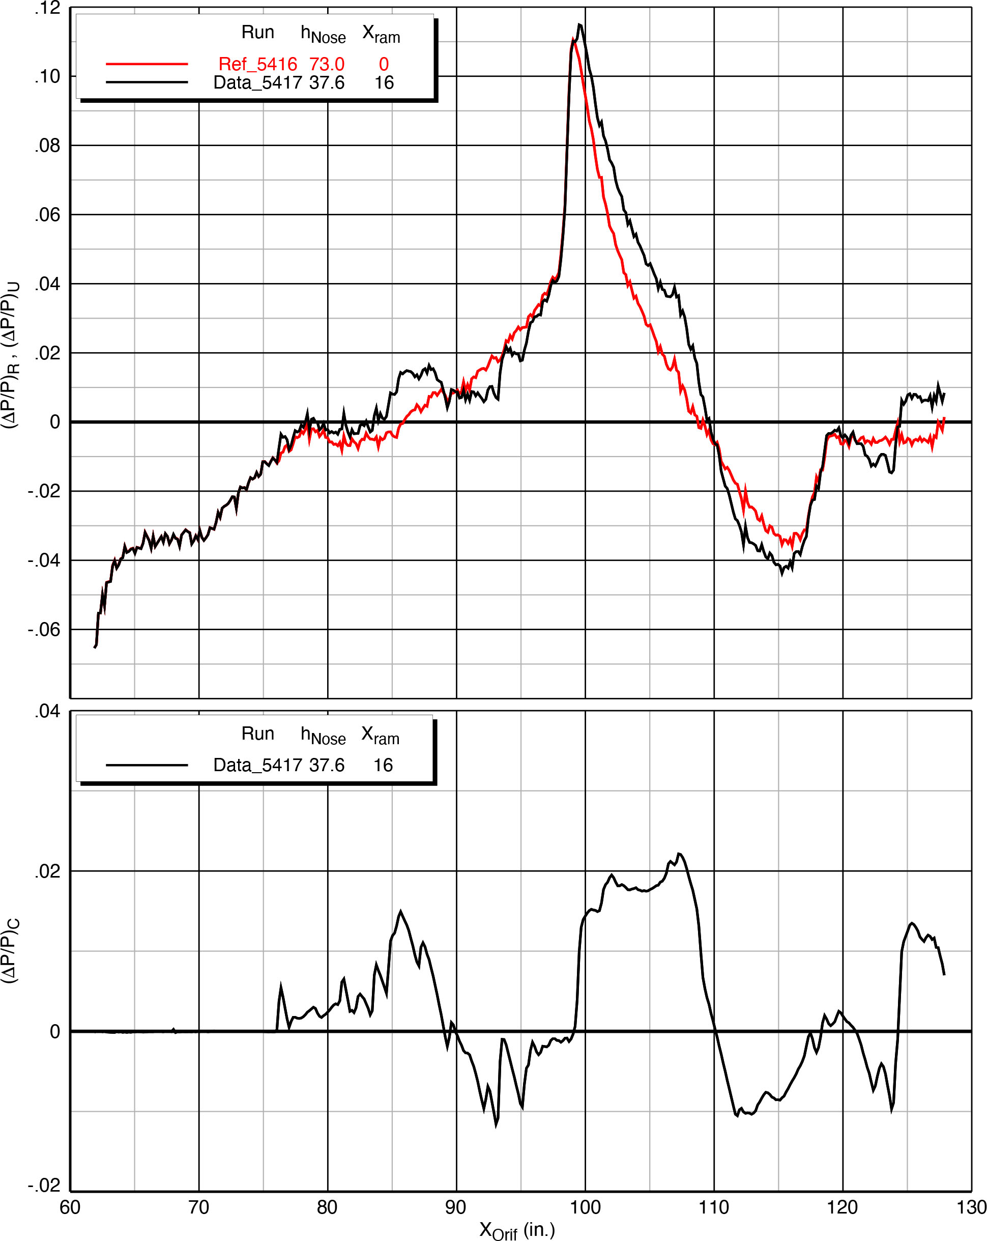
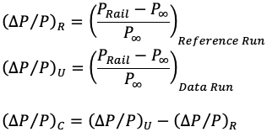
Reference and Data Runs
Reference Run
Rail leading-edge shock reflection
Reference run (in red) gives “empty” tunnel pressure signature on rail
Data run includes model signature
Difference between them is model signature alone
Note strong shock in tunnel at X = 100
— this is rail LE shock reflected off side walls
Steep gradient means small error in model shock X location can cause large difference in ΔP/P
Best for model signature to be ahead of this shock
Data Run
Model Shocks
Model
Support Hardware
Notes:
Ref run acquires empty tunnel signature without influence of model
Then model moved into position for data run
Difference between runs gives model signature
Note large shock in middle of upper signatures — from rail LE shock reflected off side walls
Best to move model in front of this region for best signatures

Slide 8
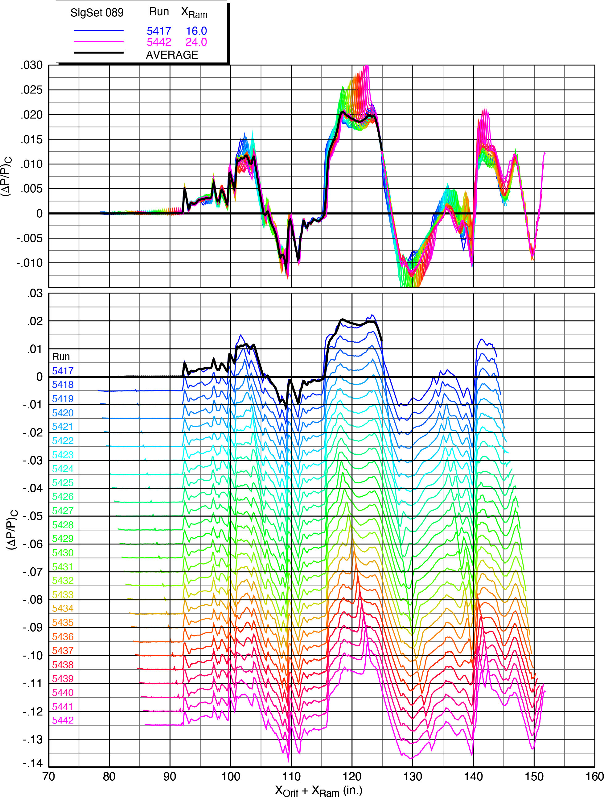
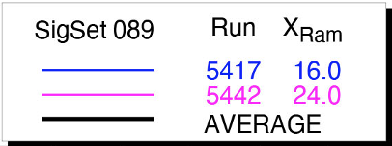
Spatial Averaging
Model
Support Hardware
Linear actuator ram moved in X sweep from 16” to 24” in this example
“SigSet” (Signature Set) consists of 26 signatures obtained on pressure rail
Signatures aligned by adding ram increment to rail orifice locations
Average pressure computed at each X location to get spatially-averaged signature
Pressure-ratio scatter among signatures is typically greatest in middle and aft regions
Notes:
Typically 26 runs acquired in X sweeps, usually 8” long
Signatures aligned by accounting for ram movement between runs
Then averages of pressures at constant X values gives spatially-averaged signature

Slide 9
Test Results
Repeatability and uncertainty estimation
Effects of …
  Control surface deflections
  Angle of attack
  Angle of roll
  Model height
  Mach number
Blade vs. sting mount comparisons
Humidity/Dew Point Effects

Slide 10
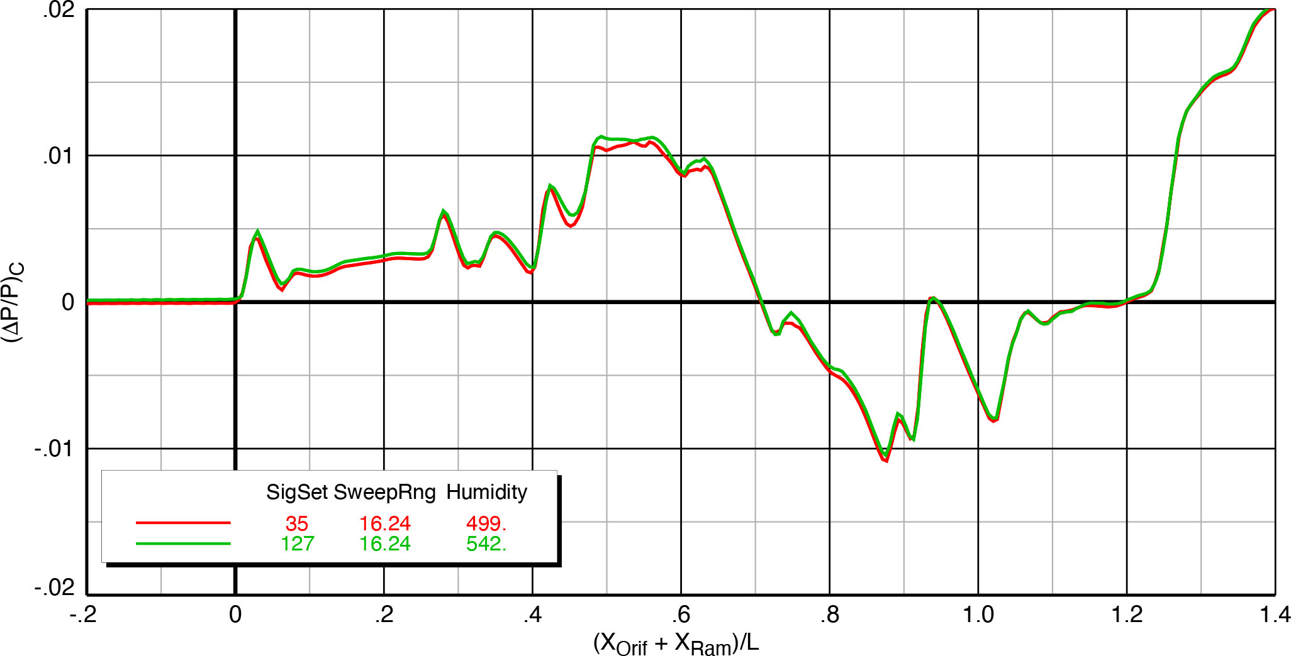
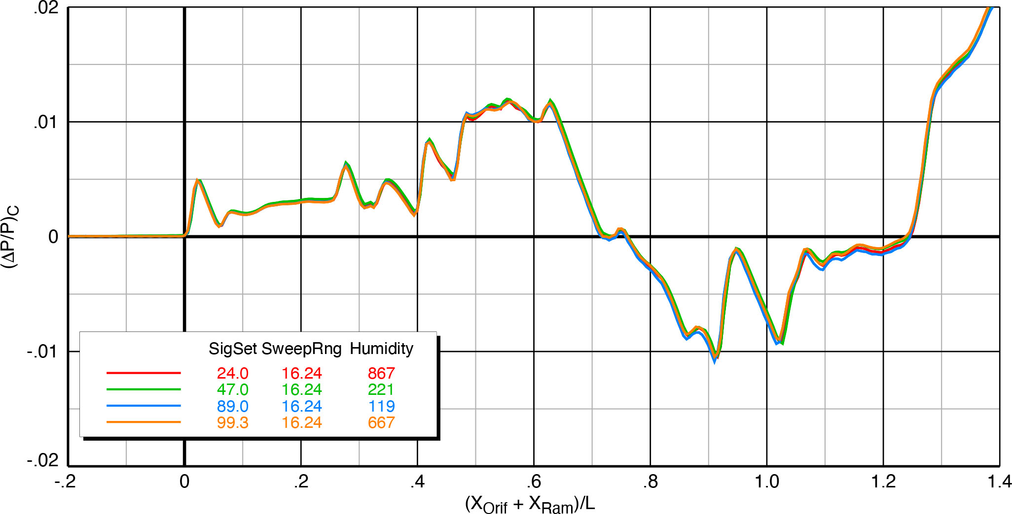
Repeatability
X-59 model on blade strut, Mach 1.36, h/L = 2, α = 1.8°, φ_{m2r} = 0°
Two SigSets at Mach 1.36 show good agreement except for slight variations in middle
Four SigSets at Mach 1.4 show excellent agreement
This repeatability is typical from this test as long as over same sweep range
Additional plots in NASA TM show similar repeatability
X-59 model on blade strut, Mach 1.4, h/L = 2, α = 2.1°, φ_{m2r} = 0°
Notes:
Repeatability was very good for signatures acquired over same X sweep range
Note the wide range of humidity in lower plot — didn’t make a difference among signatures

Slide 11
Uncertainty Analysis
Uncertainty estimation represents 95%-confidence bounds that a repeated averaged dataset will fall in range of ±2σ uncertainty band
Middle and aft part of signatures always show greater uncertainty
X-59 model on blade strut, Mach 1.4, h/L = 2, α = 2.1°, φ_{m2r} = 0°
= (ΔP/P)_{C}
Notes:
Based on measured data, the uncertainty band to 2 std deviations is pretty tight over length of signature
Slightly greater uncertainty in middle and aft part of signature, but flow field is complicated because of all the surfaces creating shock waves

Slide 12
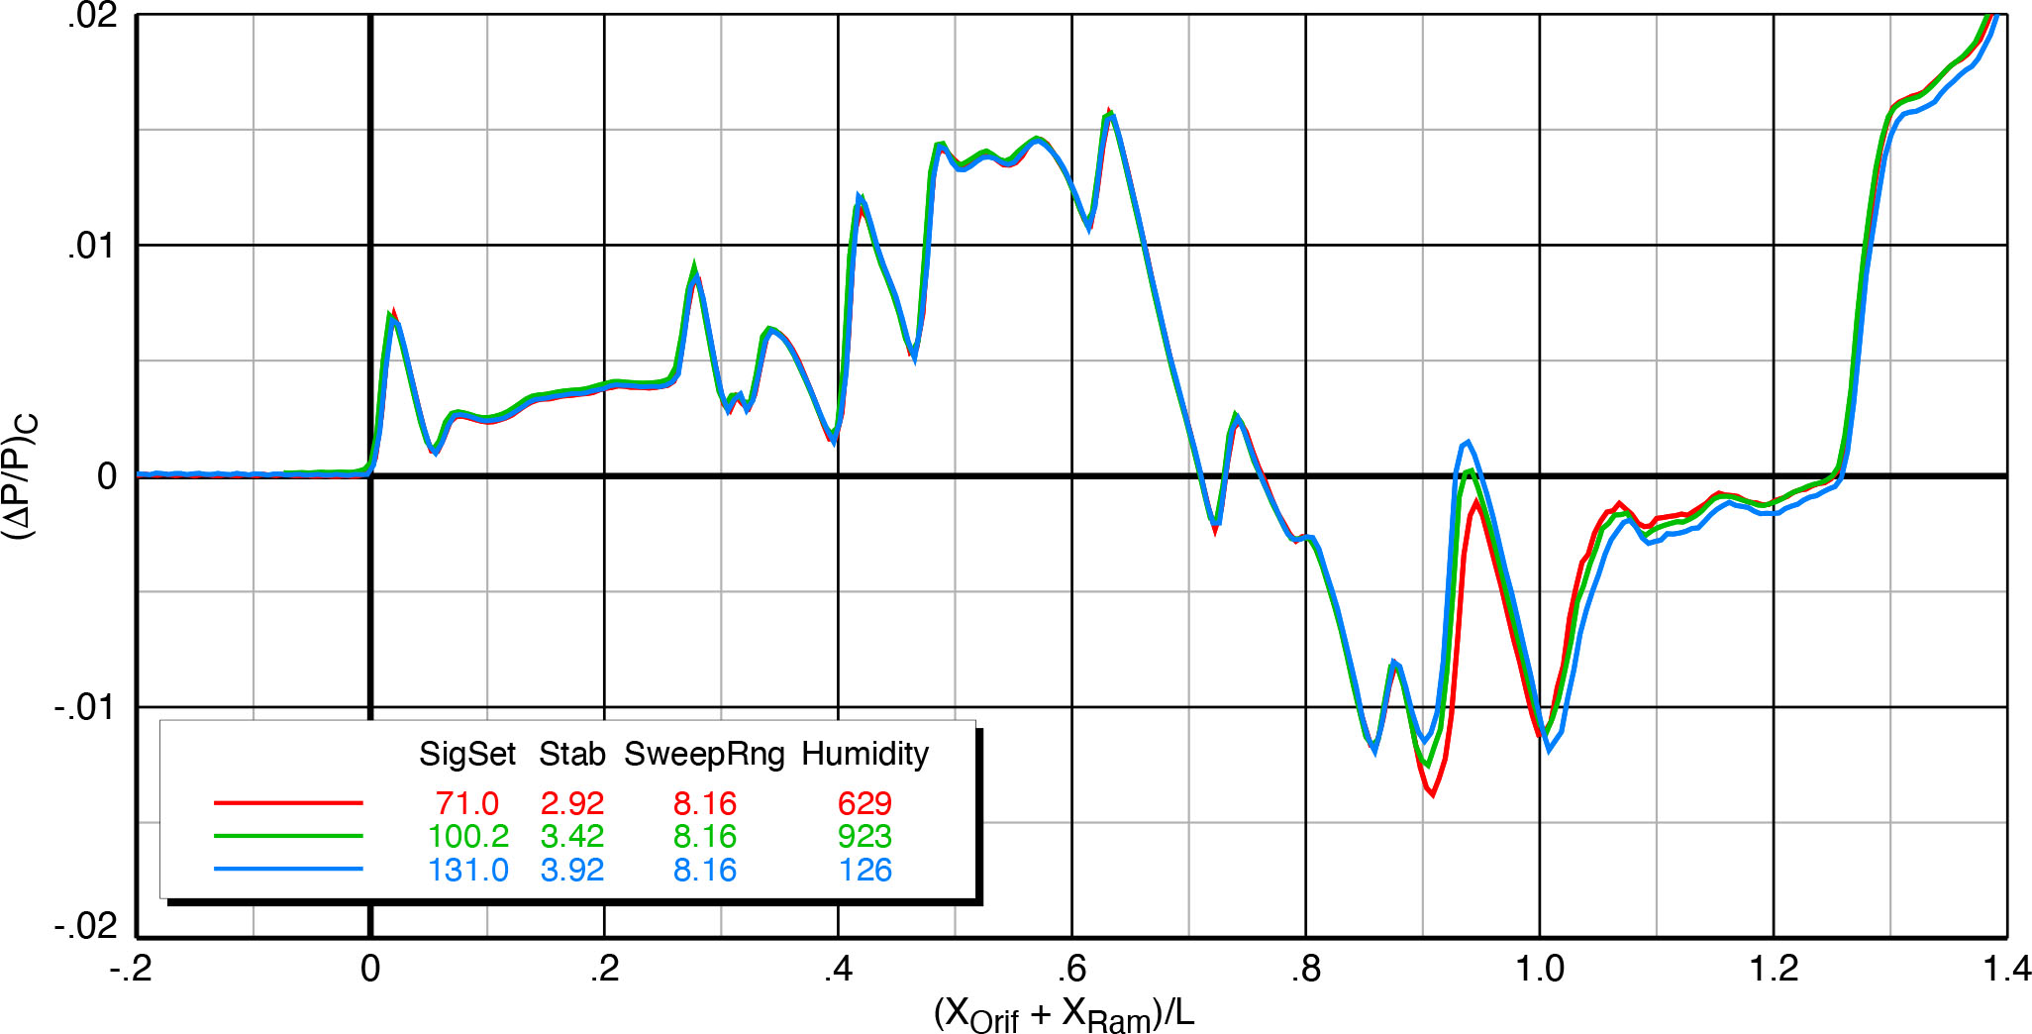
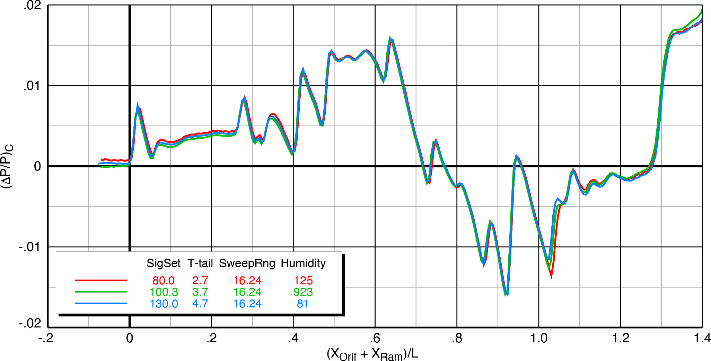
Effect of Stabilator and T-tail Deflections
Blade LE
Wing
Top of Blade Strut, transition to round
Canard
Shocks from aircraft surfaces identified on upper plot
Control surface nominal positions are the middle values in plot legends
Alternate deflections:
  0.5° for stabilators, flaps, and ailerons
  1.0° for T-tail
Small influences of stabilators and T-tail on pressure distributions at rear of signatures
Pressure increments allow determination of changes in sonic boom loudness
Nose
Inlet
Stab LE
T-tail
Air Data Probes
Wing TE
Stab TE
X-59 model on blade strut, Mach 1.4, h/L = 1.2, α = 2.1°, φ_{m2r} = 0°
Notes:
Effect of deflecting the 4 different control surfaces on the model pressure signatures are shown in these next 2 charts
Control surface settings are outlined in red in plot legends. ±0.5° stabilator deflections and ± 1° T-tail deflections.
Shocks from the various parts of the model are shown in top plot, and the influence of ±0.5° stabilator deflections is visible toward the rear of the signature
T-tail is much smaller, and its influence covers a smaller part of the signature

Slide 13
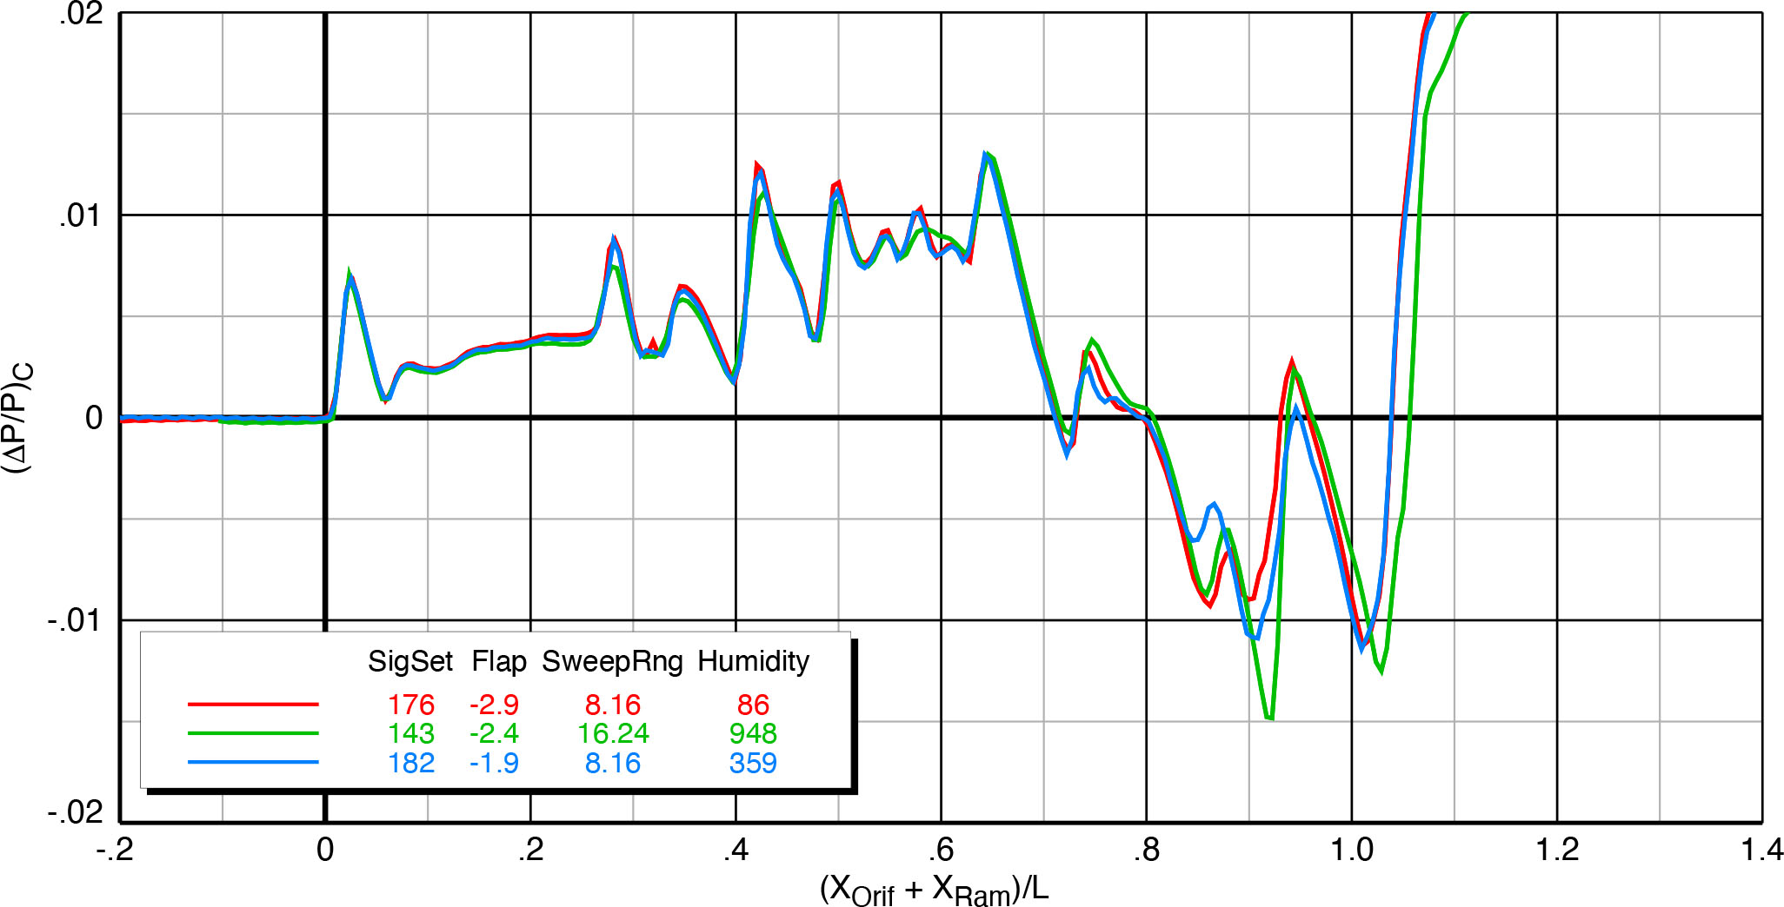
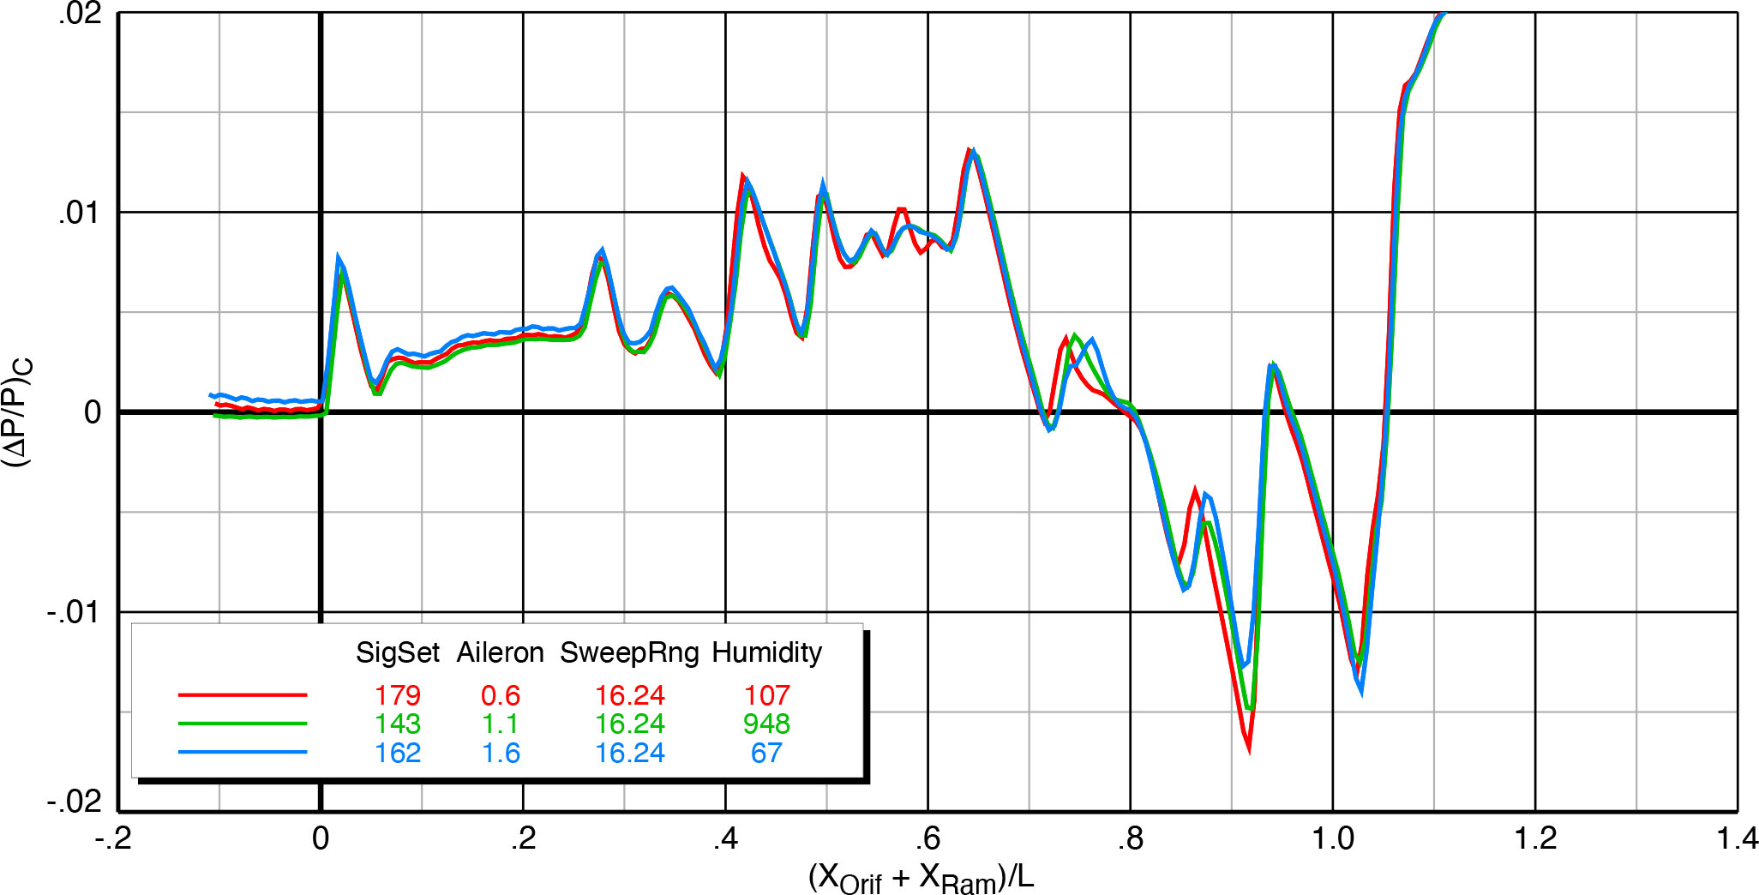
Effect of Flap and Aileron Deflections
Flap and aileron deflections influence signatures further forward and cause greater pressure differences than stab & T-tail
All of these deflections can be used for alternate trim combinations to optimize boom loudness
X-59 model on blade strut, Mach 1.4, h/L = 1.2, α = 2.1°, φ_{m2r} = 0°
Notes:
Flaps and ailerons were deflected ±0.5° and these are forward of the stab and T-tail so their influence starts earlier in the signatures
The purpose of testing these control deflections was not to look for aerodynamic effectiveness but rather to consider alternate combinations of trimming for level flight to optimize boom loudness

Slide 14
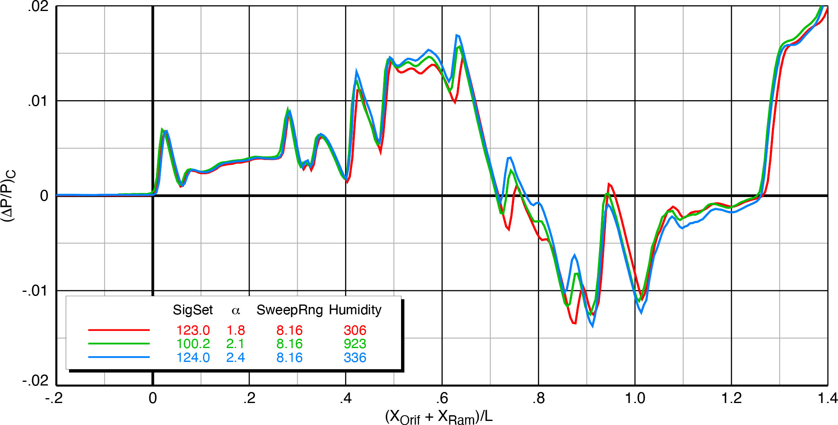
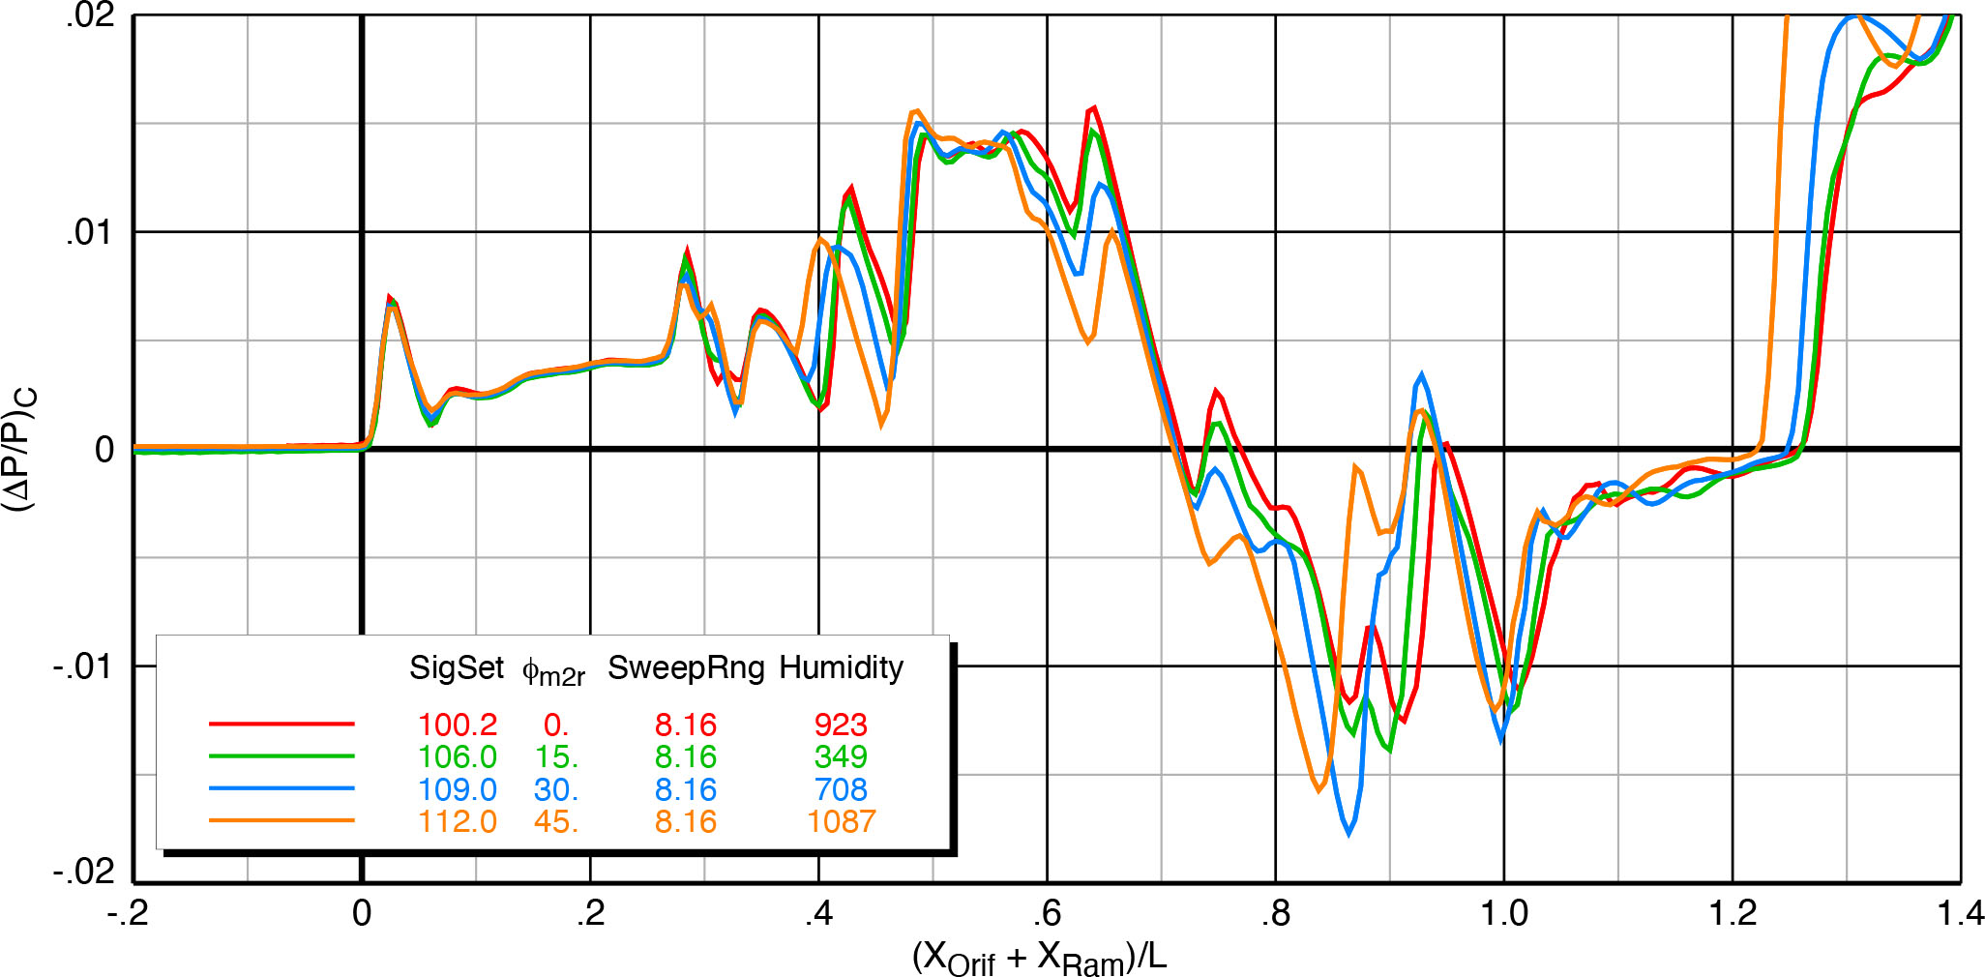
Effect of Angles of Attack & Roll
X-59 model on blade strut, Mach 1.4, h/L = 1.2, φ_{m2r} = 0°
Nominal cruise angle of attack = 2.1°
Increasing angle of attack causes shocks from lifting surfaces to move forward
φ_{m2r} is roll angle from model to pressure rail
Alternate roll angle data give indication of off-track signatures for evaluation of full-carpet sonic boom predictions
Highest shock peaks move aft as roll angle is increased
X-59 model on blade strut, Mach 1.4, h/L = 1.2, α = 2.1°
X-59 model on blade strut, Mach 1.4, h/L = 1.2, α = 2.1°
Notes:
Cruise alpha is 2.1°. Signatures at other angles show small increments of shocks moving forward and aft.
Model at roll angles relative to the rail was tested up to 45° off-track
In general, some of the shocks became smaller in magnitude and moved aft slightly with increasing roll angle
But the signature changes are complicated and would need to be propagated to the ground to calculate boom loudness as a function of off-track distance

Slide 15
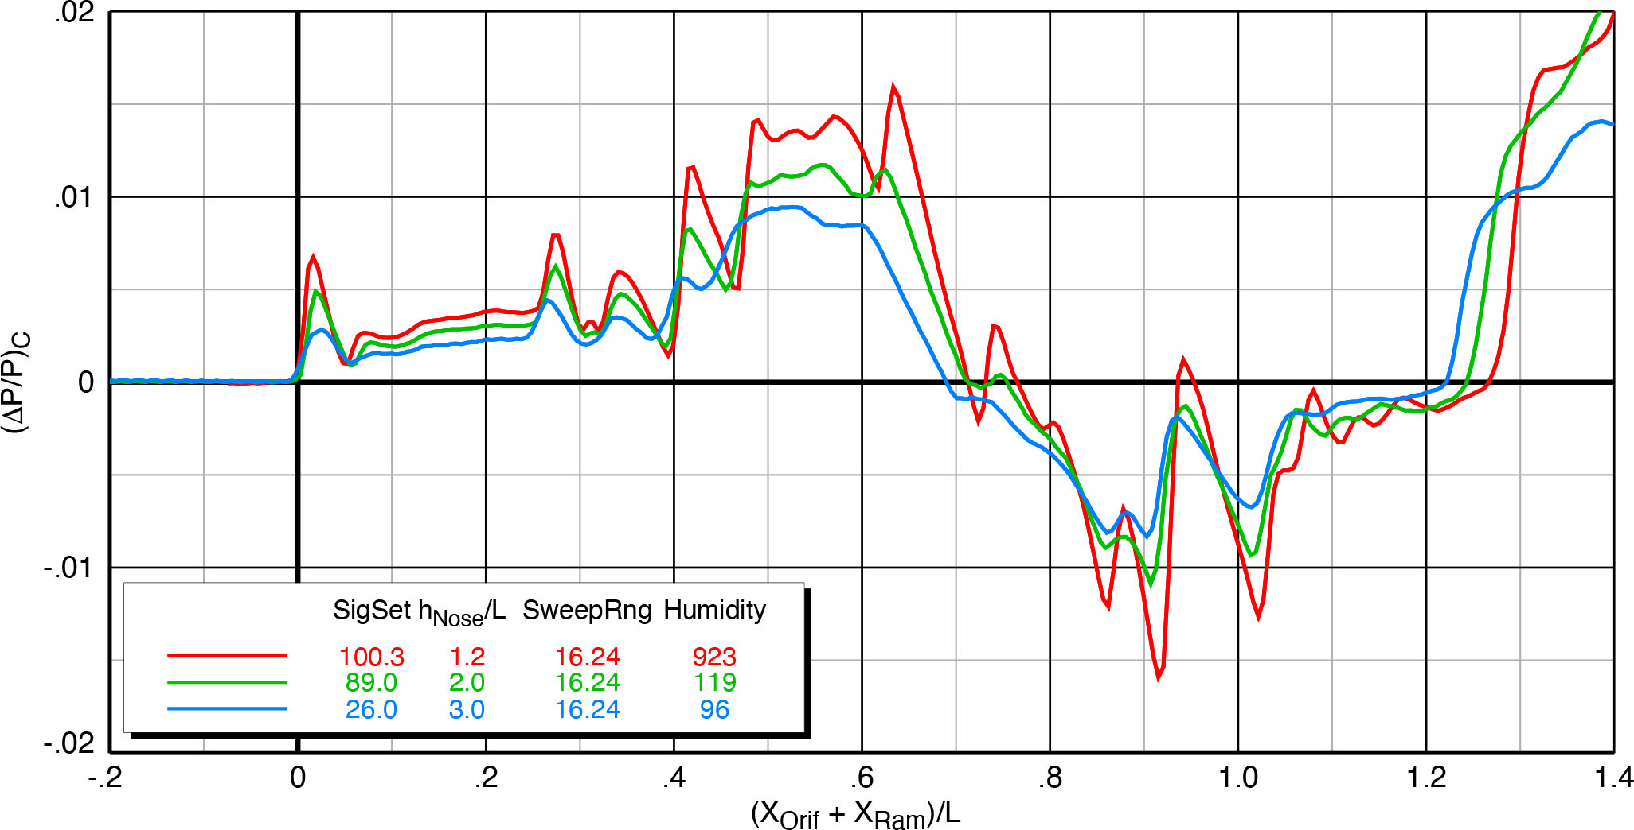
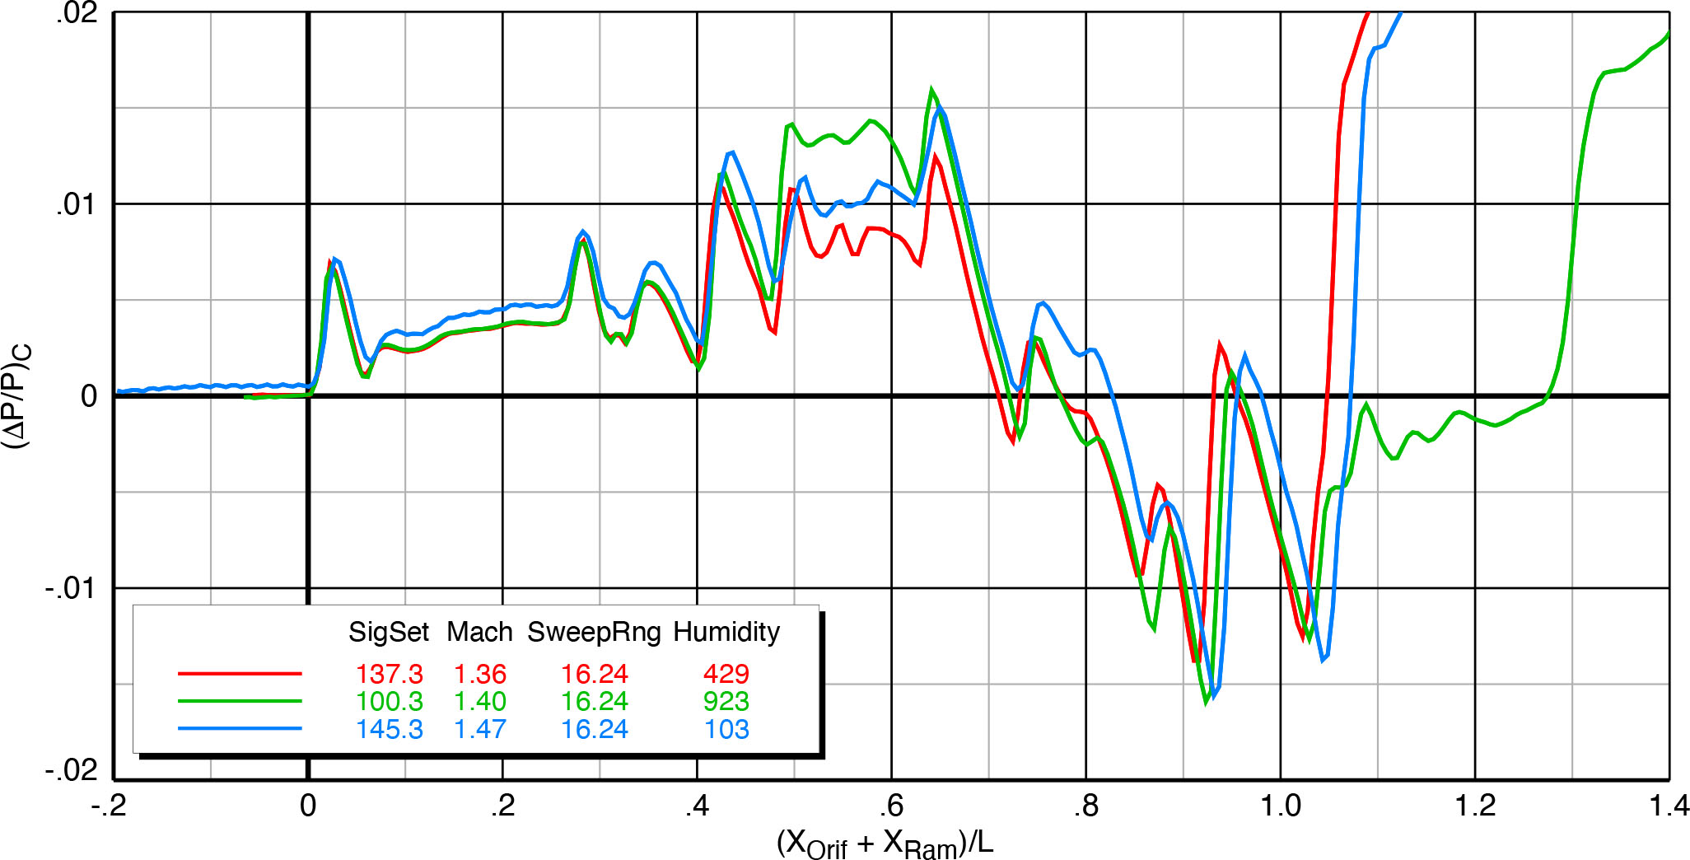
Effect of Height and Mach Number
X-59 model on blade strut, Mach 1.4, α = 2.1°, φ_{m2r} = 0°
Signatures obtained at three heights relative to rail. Model length = 18.80”
  h/L = 1.2: 22.6”
  h/L = 2.0: 37.6”
  h/L = 3.0: 56.4”
Large effect of height on signatures as shock strengths decrease with distance
Shock locations stay the same
Mach number effects show increasing shock strengths and mild stretching of the signatures
Plotted signatures are manually aligned at nose shocks but location on rail moved aft with increasing Mach number
X-59 model on blade strut, h/L = 1.2, α = 2.1°, φ_{m2r} = 0°
Notes:
Model was tested at 3 different heights from rail, from 1.2 to 3 body lengths
Signature pressures decrease significantly with height, as expected
Mach number effects show stronger and longer shocks

Slide 16
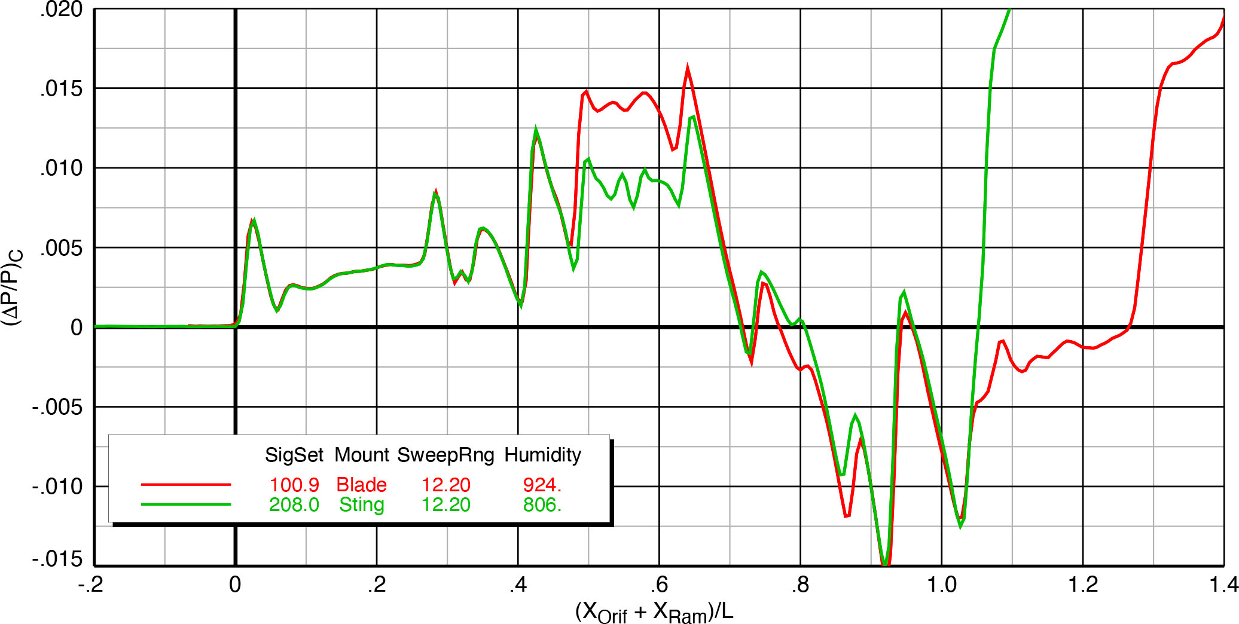
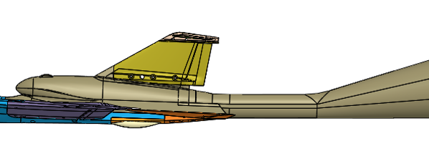
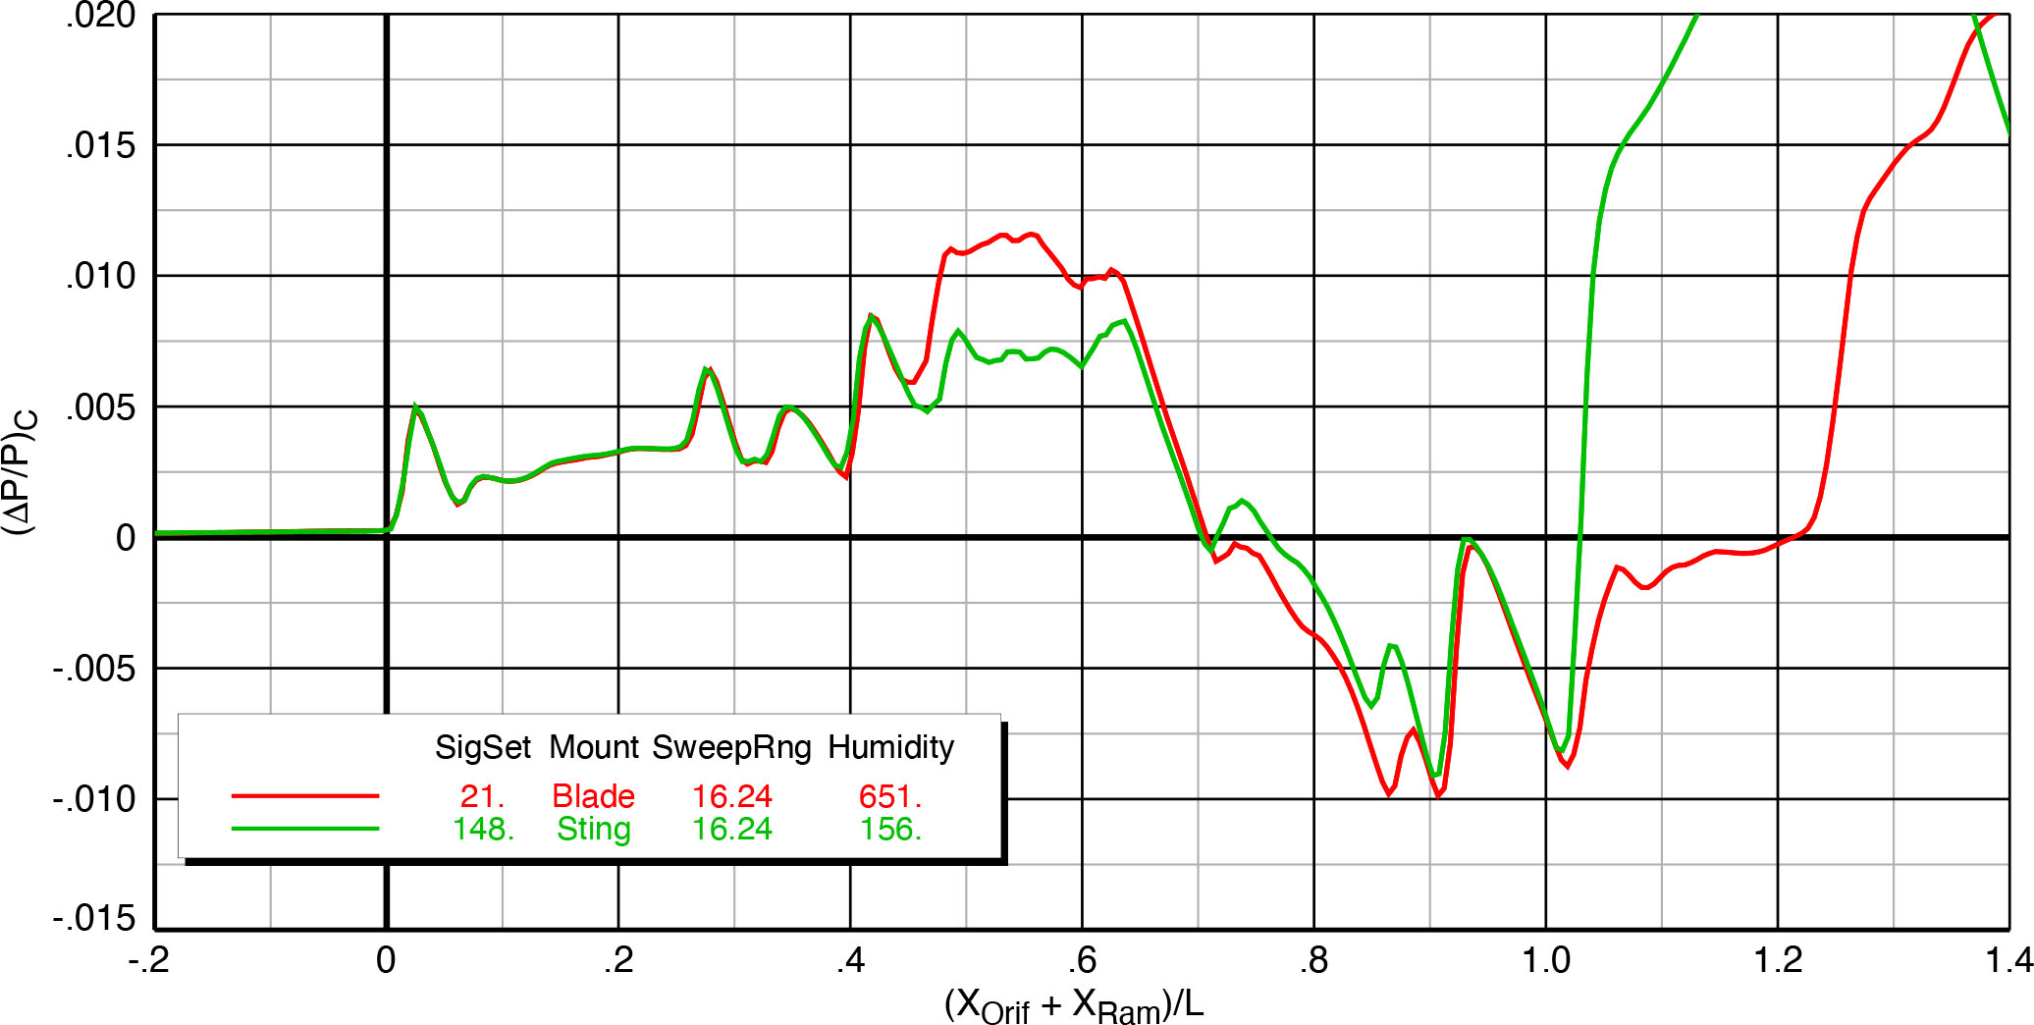
Comparison of Model Mounts
X-59 model, Mach 1.4, h/L = 1.2, α = 2.1°, φ_{m2r} = 0°
Blade mount causes large increase in inlet shock at X/L = 0.48
Blade influence continues all the way back to stabilator shock at X/L = 0.92
Sting shock overruns T-tail shock at X/L = 1.02 — caused by growth in sting area after constant section
Signatures have lower pressures overall at lower Mach number and greater height in second plot
X-59 model, Mach 1.36, h/L = 2.0, α = 2.1°, φ_{m2r} = 0°

Slide 17
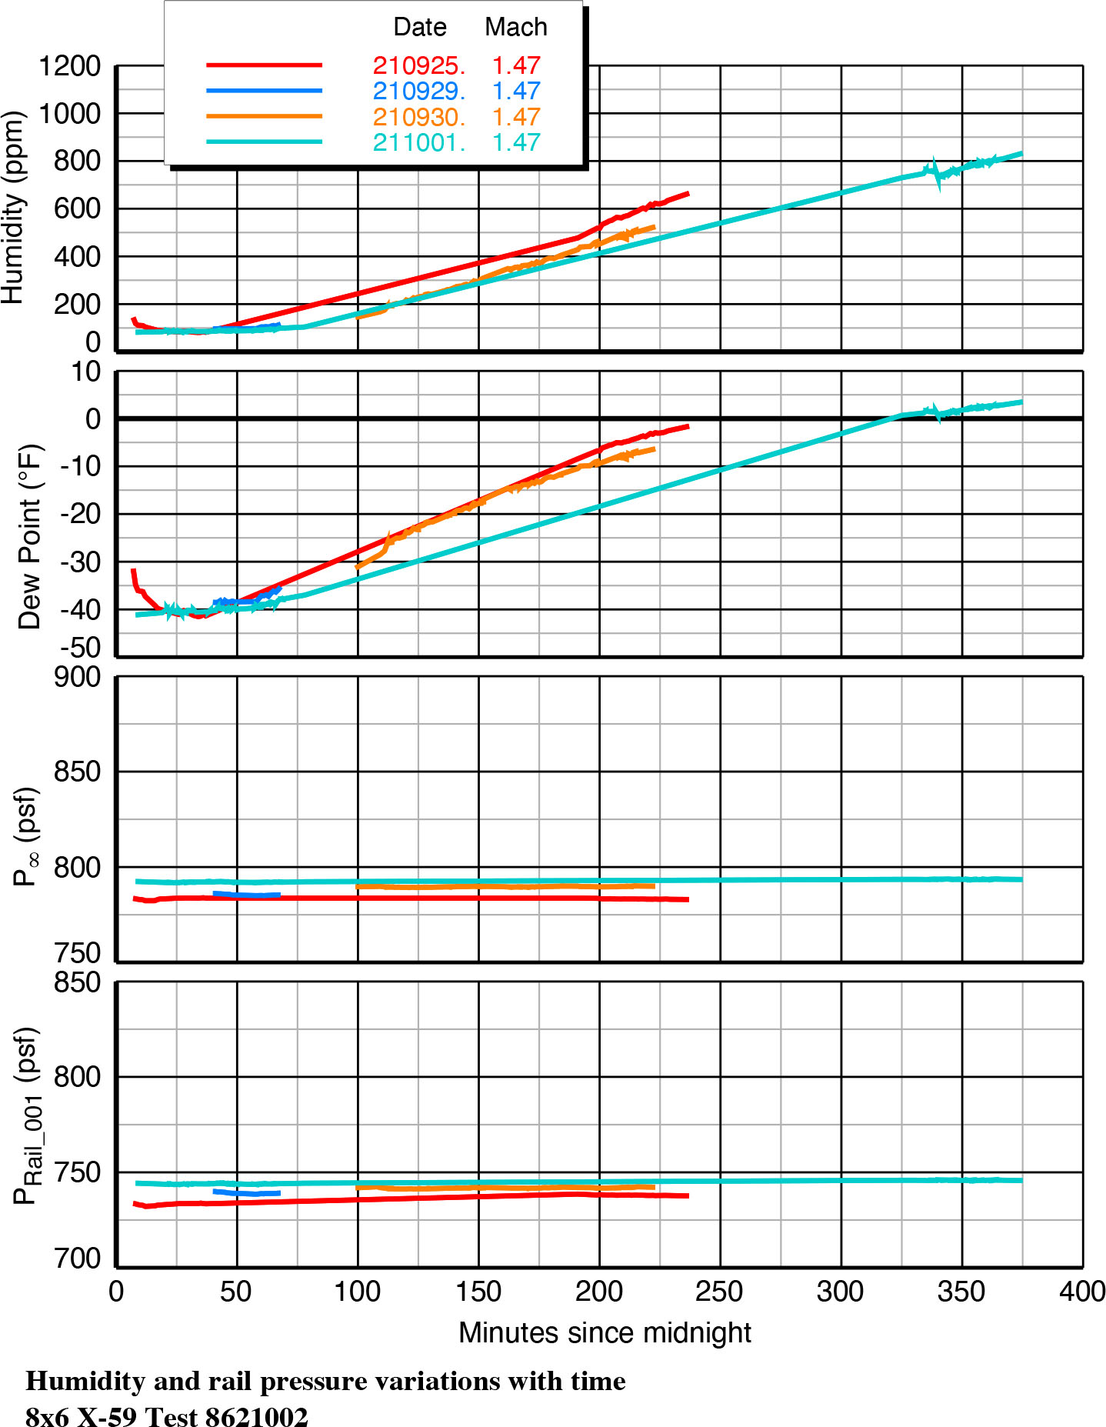
Effects of Humidity/Dew Point
Dates: yymmdd
Tunnel humidity for signatures on previous slides ranged from <100 ppm to >1000 ppm, yet there were no apparent effects on the signature comparisons
Plots at right show humidity and dew point increasing steadily during the Mach 1.47 runs on four different operating shifts
Tunnel static pressures were constant as were the rail orifice #001 pressures throughout each shift
Other rail orifices and other Mach numbers checked…same result
If there was an effect of humidity on pressure measurements, it should have been apparent here

Slide 18
Conclusions
First sonic boom test of X-59 airplane configuration successfully run in Glenn 8x6-Ft Supersonic Wind Tunnel in September/October 2021
196 spatially-averaged pressure signatures obtained during 5-1/2 weeks of test time
Test variations included Mach number, angles of attack and roll, model height, control deflections, and mounting support
Repeatability was generally very good
Signature quality was best toward forward end of ram extension range
Combination of blade strut and sting support signatures gives good indication of interference-free complete model signature
Large changes in humidity did not have any effect on the signatures
Test data suitable for validation of CFD codes predicting near-field X-59 sonic boom signatures

Slide 19


nasa.gov/quesst

