Slide 1


Modern Scientific Data Governance Framework
CC-BY-4.0
Rahul Ramachandran¹, Ge Peng², Shelby Bagwell², Abdelhak Marouane², Sumant Jha³, and Jerika Christman⁴
¹ NASA Marshall Space Flight Center (MSFC)
² The University of Alabama in Huntsville/MSFC IMPACT
³ USRA
⁴ Barrios Tech
EGU General Assembly 2023, Vienna, Austria
https://doi.org/10.5194/egusphere-egu23-2941(4/28/2023)

Slide 2
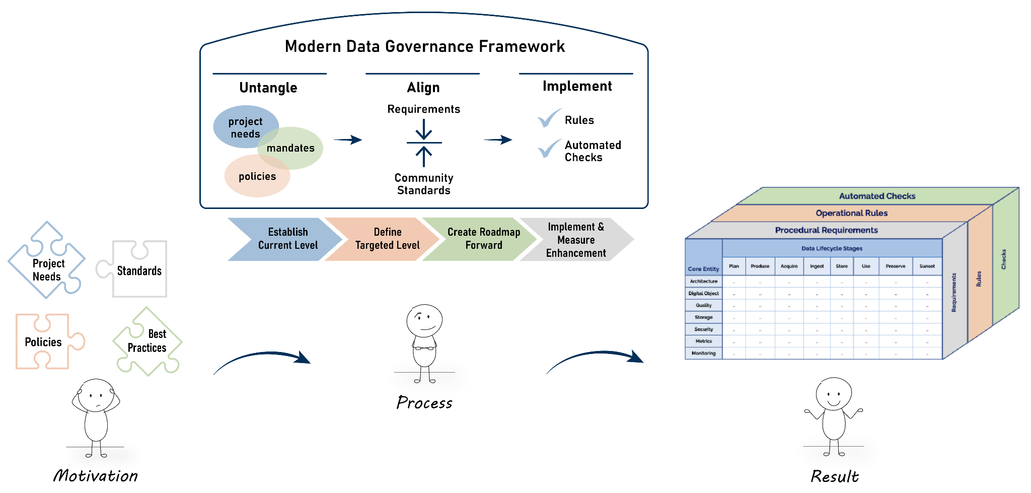
Modern Scientific Data Governance Framework
Process Drift -
“Normalization of
Deviation”

Slide 3
Data Governance Background
Different variations of definitions:
Data Management Body of Knowledge (DAMA International 2017): Data governance is defined as the exercise of authority and control (planning, monitoring, and enforcement) over management of data and the use of data and data-related resources, development and implementation of policies and decision rights over the use of data.
Gartner: Data governance is the specification of decision rights and an accountability framework to ensure the appropriate behavior in the valuation, creation, consumption and control of data and analytics.
Same meaning:
Data Governance enables an enterprise/organization to specify and enforce policies describing how data should be managed throughout its lifecycle

Slide 4
Current Challenges with Scientific Data Governance
Constantly changing U.S. Federal (and compliance) mandates include the OPEN Government Data Act (2018), which mandates machine-readable, open data format with open license, the Geospatial Data Act (2018), which mandates accessibility of all geospatial data, OMB (2013) Open Data Policy, and Federal Data Strategy 2021 Action Plan focused on mature data governance and data and infrastructure maturity.
Evolving organizational policies and strategies such as NASA’s Scientific Information Policy (aka. SPD-41a), which mandates that scientific information should be freely available and openly shared and compliant with FAIR principles.
So many best practices and standards include FAIR, STAC, UMM-C, and Vocabularies to choose from.
Data Governance quality drift ("Normalization of deviation") occurs over time due to the lack of explicit Data Management processes

Slide 5
Modern Data Governance Framework: Vision
A modern, comprehensive, and auditable science data governance framework that addresses actionable data management and stewardship requirements.
Designed to align with government mandates and organizational policies and can be measured in an automated manner.
Enables organizations to ensure effective management and stewardship of their science data while being aligned with best practices.
Offers a clear and cohesive vision for managing data in a way that is transparent and accountable, promoting trust and confidence in data-driven decision-making.

Slide 6
Guiding Principles
Enable just enough governance to facilitate, not impede, scientific progress.
Automate data workflows to optimize management costs and enable scaling with big data.
Incorporate quality checks throughout the data lifecycle management process.
Implement a metrics-driven approach to support decision-making on data retention and removal.
Support compliance with policies and regulations through dynamic monitoring and auditing check points.

Slide 7
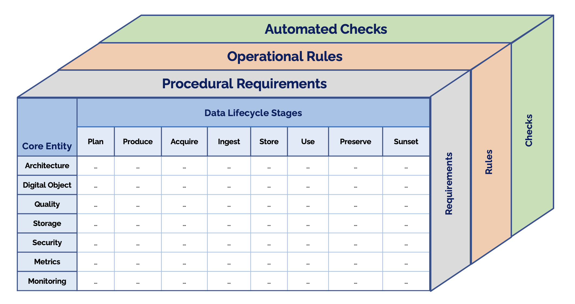
IMPACT Modern Data Governance Framework Conceptual Diagram

Slide 8
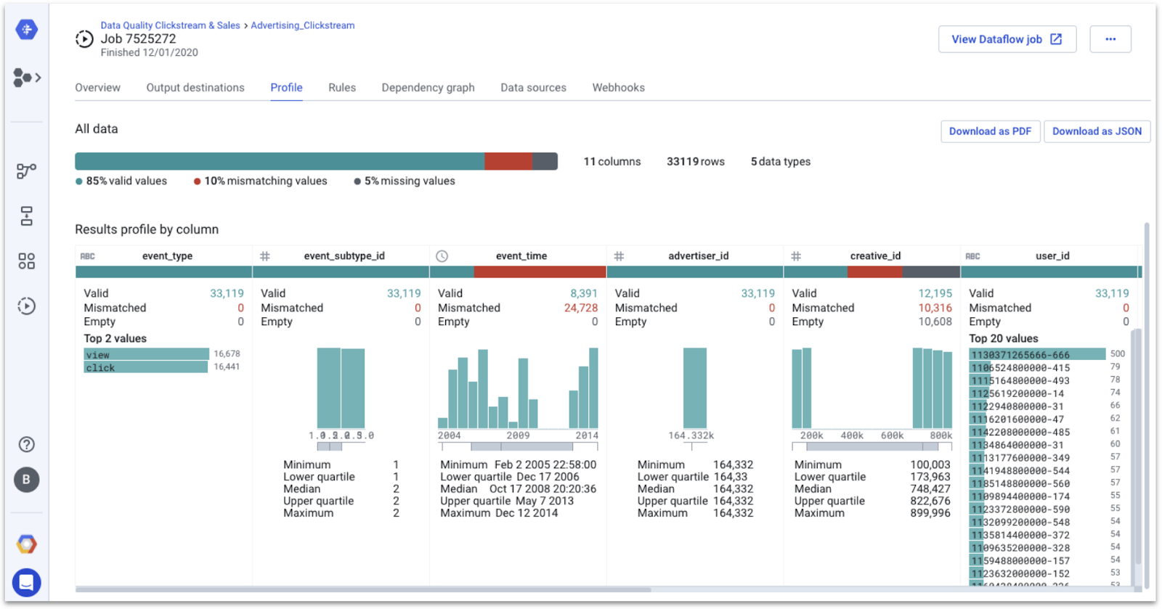
Modern-DGF Development Workflow
 | Plan | … | Sunset
Design |  |  | …
… |  |  | …
Monitoring | … | … | …
Untangle federal mandates, agency policies, and project data management and governance needs
Procedural Requirements
 | Plan | … | Sunset
Design |  |  | …
… |  |  | …
Monitoring | … | … | …
Align requirements with community standards and leading practices
Operational Rules
Automated Checks & Dashboard
Implement rules with automatable and scalable checks
Notes:
Dashboard image source: https://www.trifacta.com/blog/data-quality-trends-cloud-dataprep-data-studio/

Slide 9
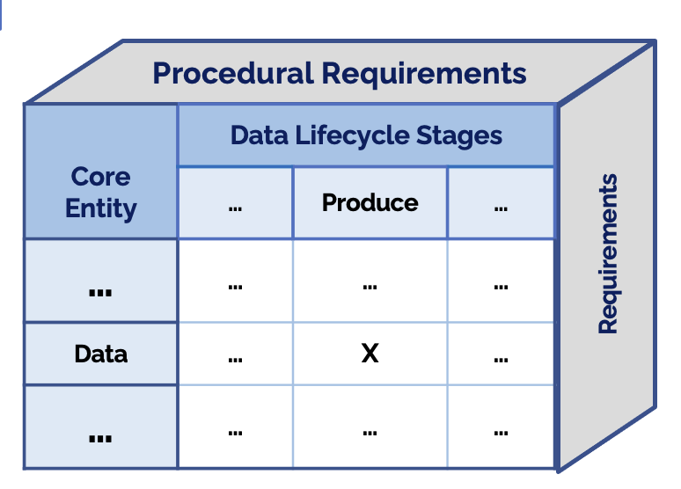
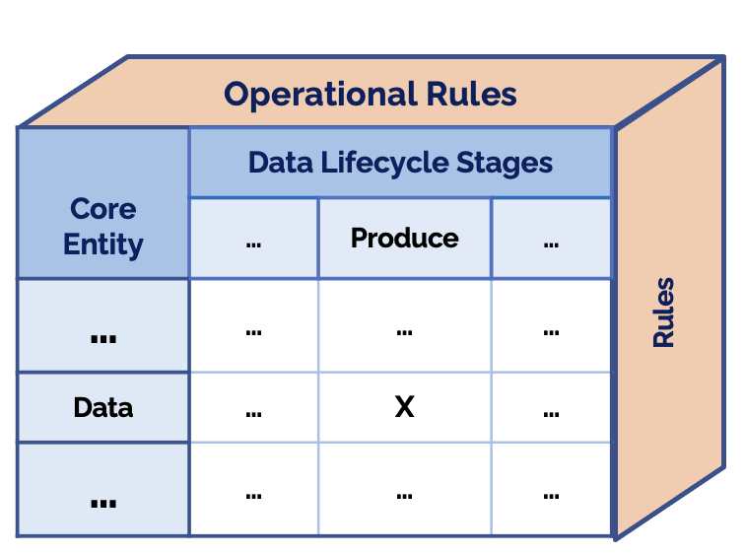
Envisioned Workflow for Users to Use The Framework To Improve Their Data Governance
Identify compliance requirements from policies/directives;
Select Core Entities and Lifecycle Stages relevant to the project;
Select project-specific requirements/rules;
Implement/utilize checks;
Identify Compliance
Requirements
E.g., NASA SPD-41a
E.g., Select NASA-approved non-proprietary, open, machine-actionable data formats.

Slide 10
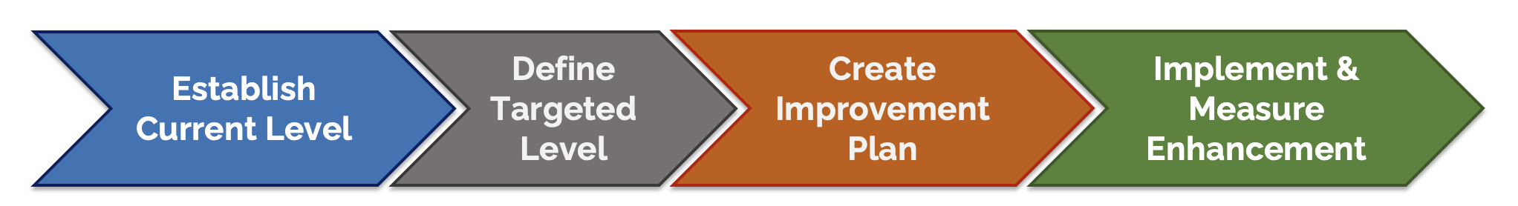
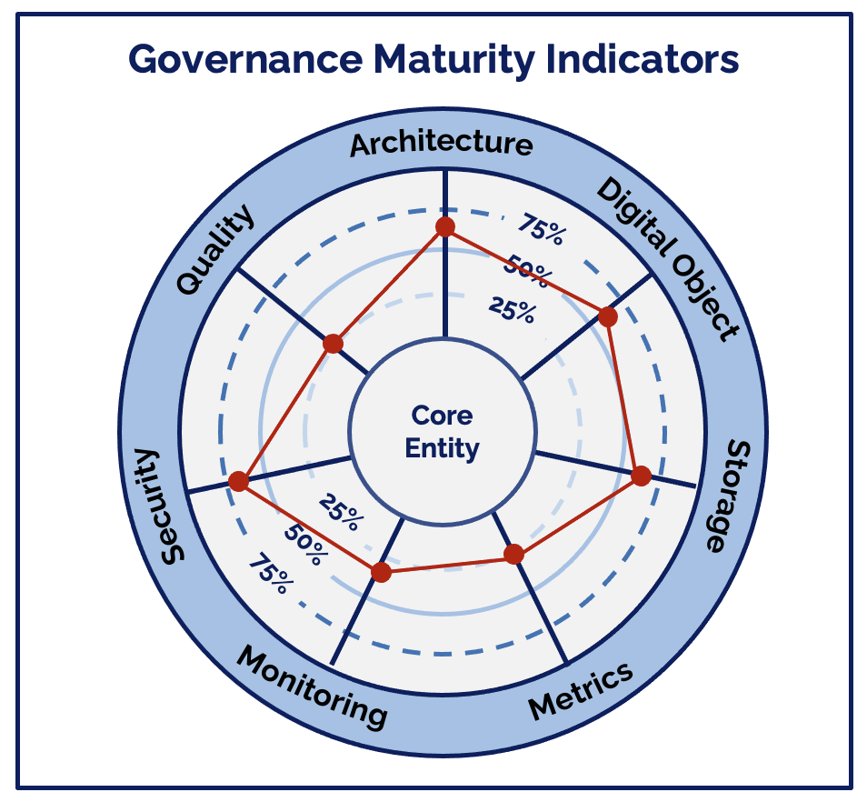
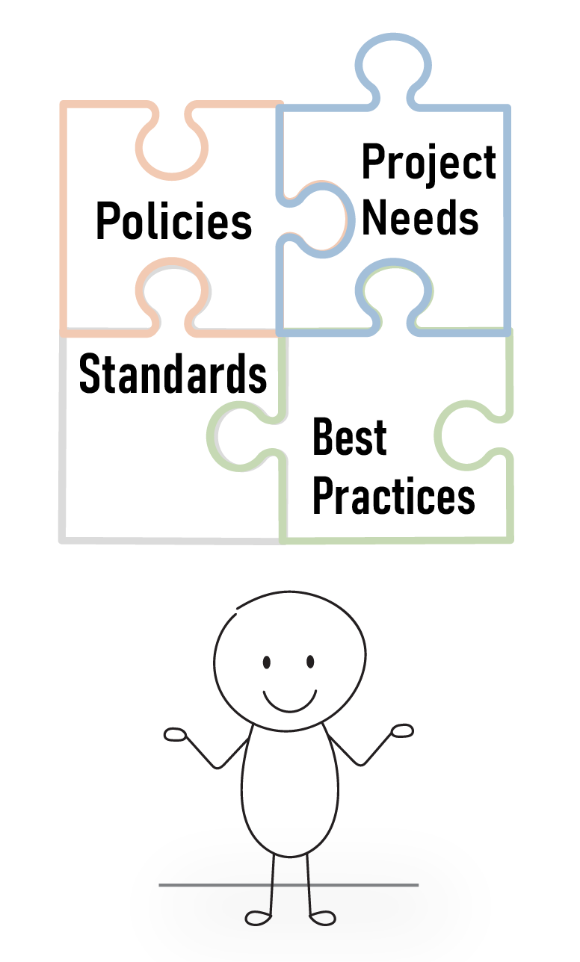
Envisioned Workflow for Users to Use The Framework To Improve Their Data Governance - Cont.

Slide 11
Current Status & Path Forward
Complete the initial version of procedural requirements and test them against an existing project
Aim to finalize a version of operational rules by the end of May
Plan to open up the documents via GitHub to allow the community to refine and improve them
Develop automated checks/validation libraries in the Fall to ensure compliance with the procedural requirements and operational rules.

Slide 12
Contact Information
rahul.ramachandran@nasa.gov
ge.peng@uah.edu
EGU General Assembly 2023, Vienna, Austria
https://doi.org/10.5194/egusphere-egu23-2941(4/28/2023)

