Slide 1
What’s Going on with Compact Fuel Element Environmental Test
(CFEET)
Presenter: Jamelle K.P. Williams

Slide 2
History of CFEET
CFEET 1.0
CFEET 2.0
CFEET 3.0
Vacuum and flowing H2 testing
BN susceptor
Flowing H2 and radioactive materials testing
BN insulator around tungsten susceptor
Flowing H2 and radioactive materials testing
Tungsten susceptor used for inductive heating
Enhanced safety and quality of vacuum system
NASA-Marshall Space Flight Center – Fuel Development Plan –May 13, 2020
Notes:
Introduced in 2012 by David Bradley at MSFC as a low cost alternative to Nuclear Thermal Rocket Element Environmental Simulator (NTREES)
Used to investigate high temperature survivability, mass losses, and temperature-induced changes in physical properties of the tested material occurring in the presence of hot gaseous hydrogen
Tested both radiative and non-radiative materials

Slide 3
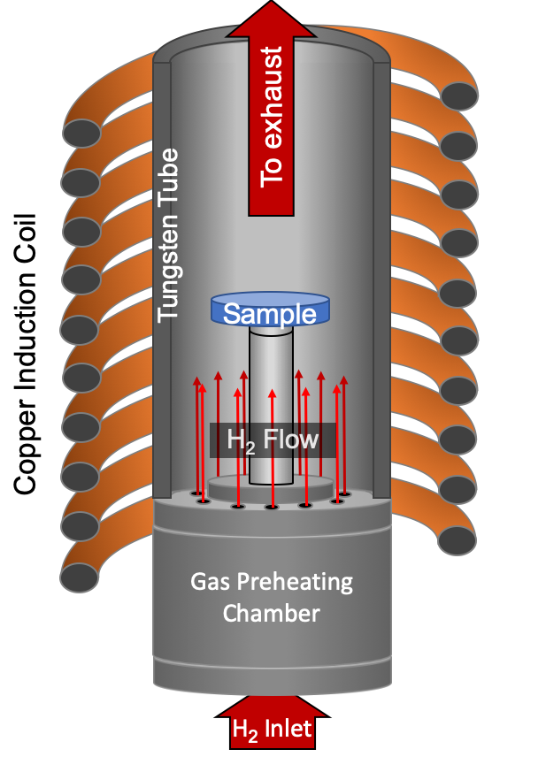
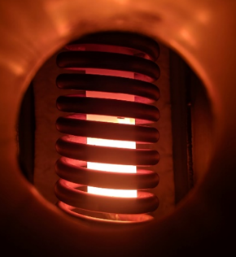
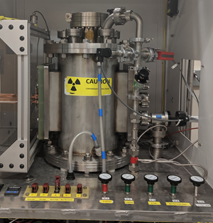
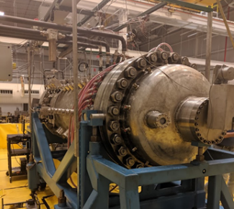
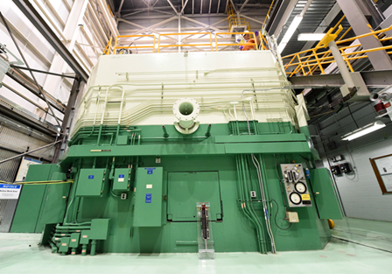
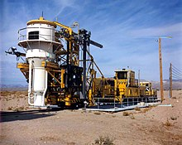
Introduction to CFEET
CFEET – Compact Fuel Element Environmental Test
Hot H2 furnace to test nuclear fuel and materials at temperatures ~2600K
Simulates the temperature and H₂ atmosphere inside a nuclear thermal engine
First test on nuclear fuel and materials of interest prior to scale up and nuclear reactor testing
CFEET schematic
CFEET (MSFC)
NTREES (MSFC)
TREAT Reactor (INL)
Ground Test Demonstration
NASA-Marshall Space Flight Center – Fuel Development Plan –May 13, 2020

Slide 4
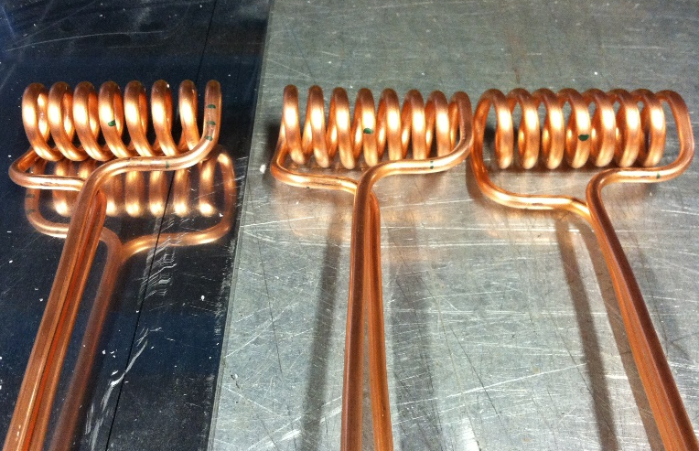
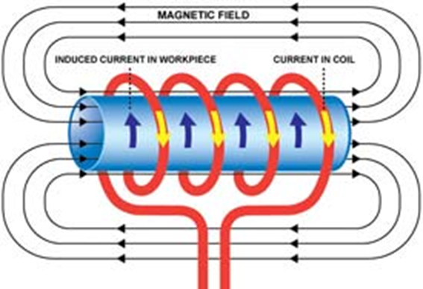
How CFEET Works
RF power supply sends an AC current through an inductor and the susceptor to be heated is placed inside the inductor.
Circulating eddy currents are induced within the tungsten susceptor.
Material is heated by thermal radiation that passes from the susceptor to the material.
These induced currents flow against the electrical resistivity of the metal, generating precise and localized heat without any direct contact between the part and the inductor.
W Susceptor
Fuel Material
(inside W susceptor)
NASA-Marshall Space Flight Center – Fuel Development Plan –May 13, 2020

Slide 5
How CFEET Works
CFEET Components:
Boron Nitride tube- sits at the hydrogen and argon flow through
Tungsten base pieces- composed of three pieces and sit inside the boron nitride tube
Tungsten pedestal- sits in the middle of the base
Setter – composed of the material being tested
Tungsten susceptor- sits on top of the base
Fuel material- materials tested thus far in CFEET ZrC, NbC, SiC, ZrdUC
W Susceptor
Boron Nitride tube
W base pieces
W pedestal
Graphite Setter

Slide 6
Validation
Pyrometers
Measures radiation from an object remotely
Essential to our work because most thermocouples cannot reach those high temperatures needed
Only thermocouple that comes close is Type K (-200°C to 1250°C )
Graphite analysis
No major reactions
Can maintain temperature at 2327°C (2500K)
Pyrometer Analysis
Williamson- temperature: 650-3000°C 700 and 800nm
Ircon- temperature: 600-3000°C 2 wavelength bands 850-1050nm 1000-1100nm
Far- temperature: 800-4000 °C 500-1000nm (500 channels)
Each pyrometer were placed with the exception of the Williamson was placed to monitor the sample and the susceptor
Final configuration: Far monitors the sample and the Ircon monitors the susceptor

Slide 7
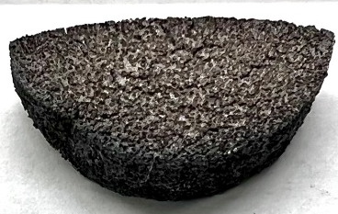
Material Tested | Temperature | Mass Loss | Image
ZrC | 1827°C or 2100K | Mass loss: 0.4mg
W-coated UN in Mo30W matrix | 2000°C or 2273K | Mass loss: 21.4mg
7-hole MoW (coated in Mo30W) | 2306°C or 2579K | Avg mass loss after 3hr 32.4mg
ZrdUC | 2327°C or 2600K | Initial mass loss: 62mg Avg mass loss after 3hr 1.62mg
Notes:
MoW After the first 1hr mass loss of 22.2mg
After the first 2hr mass loss of 38.3mg
After the first 3hr mass loss of 36.6mg

Slide 8
Summary
CFEET has undergone several modifications. These adjustments has given us a system that is reliable and robust
We have learned that the maximum temperature can be sample related
Our studies will continue to identify possible fuel materials suitable for nuclear thermal rockets

Slide 9
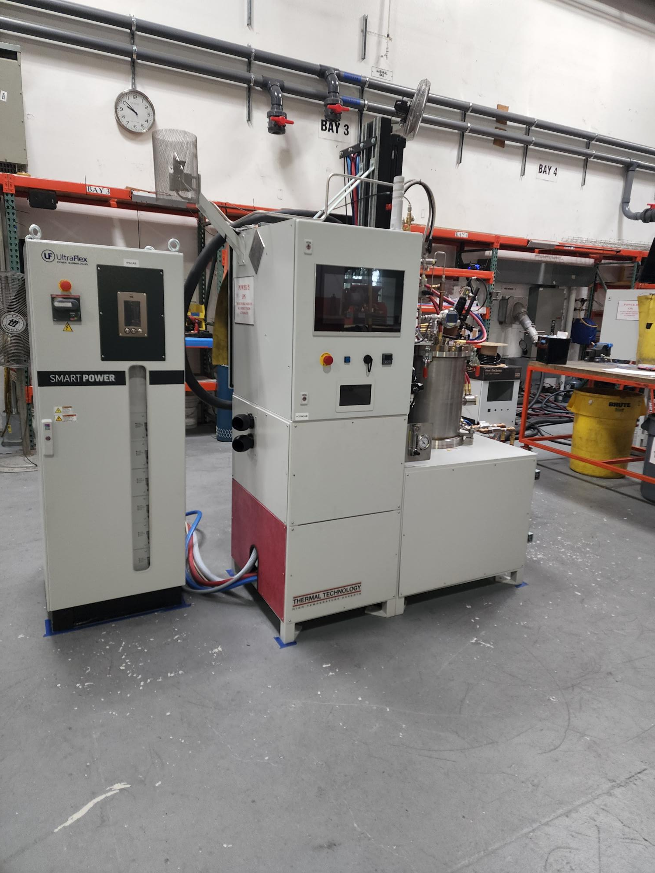
Hot Hydrogen Environmental Atmospheric Test (H₂EAT)
Thermal Technology LLC
Same manufacturer as sintering furnaces
Designed for a continuous operation up to 3000 C
Bell loading configuration allows for easy access to sample loading and coil
Easier more reliable loading
Improved cleaning / decontamination of chamber
Large sample zone of up to 2.5” diameter and 3” tall
Eurotherm controller for more accurate and customizable experiment profiles
Operation in hydrogen or inert gas
Gas purge protection of pyrometer window
Numerous interlocks and automated safety features to protect the user and equipment
Nationally Recognized Testing Laboratory (NRTL) certified

