Slide 1
Hardware Failure Analysis Process, Tools, & Techniques
Gregory Jerman, EM31 Failure Analysis SME
04-18-2023

Slide 2
Failure Analysis
“Everything is made of something, and something always fails.”
  What causes physical hardware to unexpectedly fail?
  The engineering of hardware requires the establishment of a series of assumptions.
  When the unexpected occurs, one or more of your assumptions are incorrect.
  Validating or invalidating engineering assumptions requires a physical and chemical understanding of the contributing factors behind a failure.
At Marshall, the Materials Science and Metallurgy Branch (EM31) specializes in the physical and chemical analysis of the materials used to construct aerospace hardware.
  MSFC is known for propulsion technology, so our broadest expertise lies with the analysis of liquid rocket engine components, and the attendant fuel and oxidizer tanks, ducts, and valves.
  In the last decade EM31 has played an integral part in commercial space flight failure analysis:
    2014 Orbital Antares launch explosion.
    2016 SpaceX Falcon 9 launch pad explosion.
    2021 Boeing Starliner valve failures that resulted in a scrubbed launch.
  Contemporary intra-agency collaborations include multiple International Space Station failures and analysis of failed Webb and IXPE telescope components.

Slide 3
Discipline Integration in Failure Analysis
Successful hardware failure analysis requires the integration of evidence collected by multiple disciplines.
For complex hardware, the needed disciplines can be spread across multiple NASA centers and multiple commercial entities.
In the recent Boeing Starliner valve failure investigation, work was integrated across the following:
  MSFC Materials & Processes Lab - CT-Scanning, valve force measurements, component dimensions, optical & electron microscopy, FTIR, ESCA, XRD, corrosion experimentation, and evidence integration.
  MSFC Propulsion Lab - Valve disassembly procedures & hardware disassembly.
  MSFC Safety & Quality - Safety monitoring equipment, disassembly verification with safety steps.
  Johnson Space Center - Materials support, valve engineering & operation support, Chief Engineer interface.
  White Sands Test Facility - Valve test support, historical test analysis, NTO safety support.
  Boeing - Propulsion and valve integration, historical valve analysis methods and results, safety support.
  Aerojet-Rocketdyne - Propulsion system and valve designer, valve testing and material degradation studies.
  Marotta - Valve manufacturer, disassembly support.
  Commercial Crew Program Office - Resource support.
The key to successful hardware failure analysis is multi-disciplinary evidence collection through several methods combined with consensus building across multiple organizations.

Slide 4
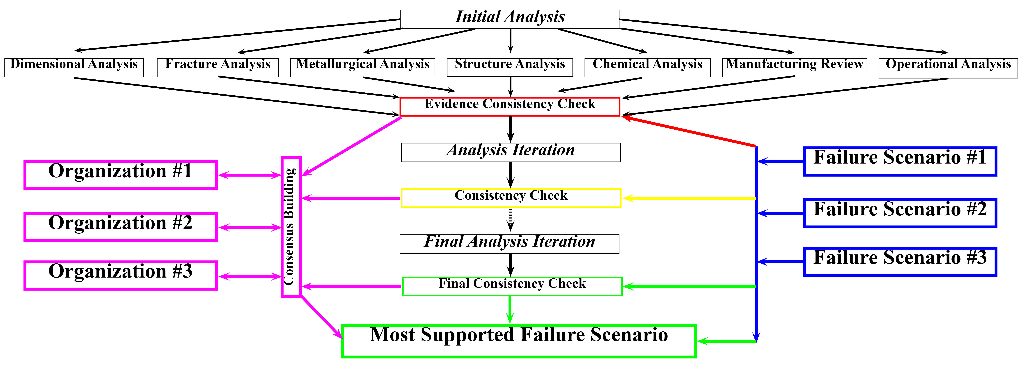
Iterative Approach to Failure Analysis
Collecting initial failure analysis data is always random.
To collect and categorize meaningful data requires iteration.
Data from multiple disciplines are used to refine and focus subsequent rounds of hardware analysis and testing.
Data collection constantly branches as fruitful results are tested for consistency and null paths are abandoned.

Slide 5
MSFC M&P Materials Expertise
Effective materials analysis in support of failure analysis requires an understanding of how materials work and how they can be damaged or degraded.
The MSFC Metallic Materials & Processes Division (EM30), encompasses diverse experience across a range of alloys and manufacturing processes.
  Aluminum alloy friction stir weld development in fuel and oxidizer tank manufacturing.
  Nickel based superalloys, copper alloys and titanium alloys used in additive manufacturing.
  Aluminum and titanium alloy liners used in Composite Overwrapped Pressure Vessels (COPVs).
  Hydrogen embrittlement experience coupled with on-site hydrogen testing capabilities.
  ^{Metal casting development.}
  Thermo-mechanical processing including rolling, forging, and extrusion.
  ^{Corrosion test experience.}
The Non-metallic Materials & Advanced Manufacturing Division (EM40) includes composite and ceramic materials and manufacturing experience.
Digital access to decades of material properties information through the Materials & Processes Technical Information System (MAPTIS)

Slide 6
MSFC M&P Analytical Expertise
Analytical expertise within the MSFC Materials & Processes Laboratory is split among three divisions:
EM20 – Materials Analysis & Test Division
  Non-Destructive Evaluation: x-ray, CT-scan, ultra-sound, & shearography
  Mechanical testing: tension, compression, torsion, LCF, HCF
  Tribology: high resolution dimensional measurements
  Chemical analysis through Inductively Coupled Plasma
  ^{Thermogravimetric Analysis}
EM30 – Metallic Materials & Processes Division
  ^{Optical Microscopy}
  Electron microscopy with EDS, WDS, and EBSD
  Micro-hardness: point, line, and area mapping
  Surface chemistry through ESCA & SIMS
  ^{X-ray diffraction}
  ^{Thermal diffusivity}
  Electrostatic levitator materials testing
EM40 – Nonmetallic Materials & Advanced Manufacturing Division
  ^{Plasma torch ablation testing}
  ASTM Thermal Protection System testing
  Bio-Safety Lab Level 2 (BSL2) microbiology lab
  Charged particle radiation testing.
  ^{UV exposure testing.}
  ^{Atomic oxygen exposure testing}
  ^{High velocity impact testing}
  Structured light scanning & photogrammetry

Slide 7
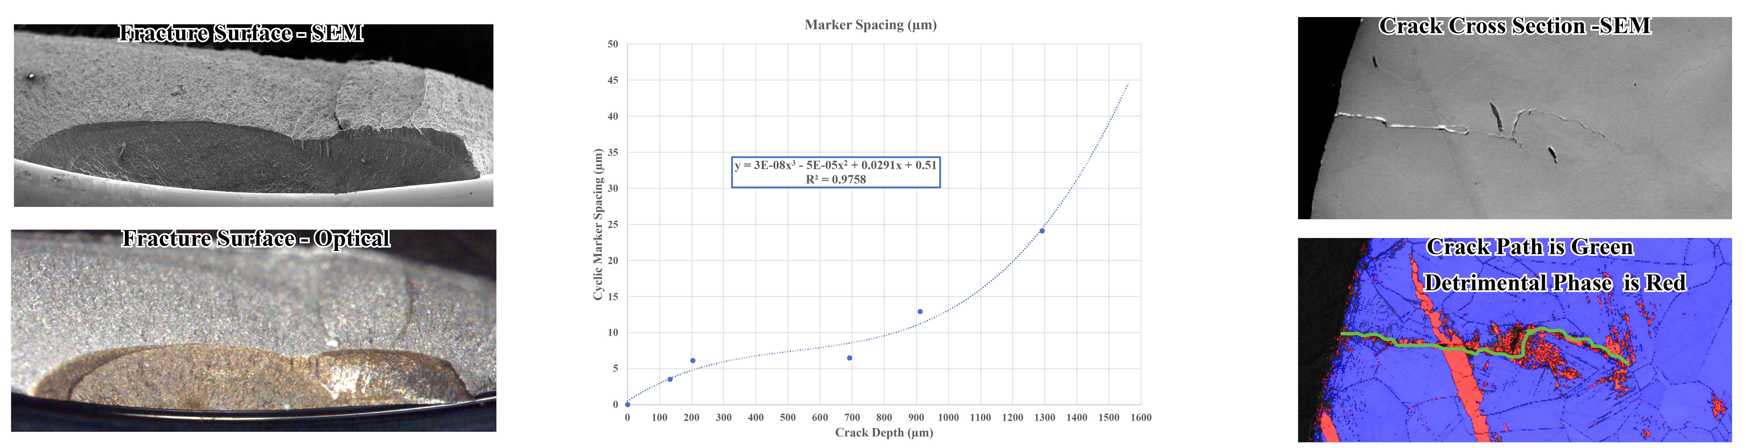
Fractography
By studying the physical and chemical features of fracture surfaces, we can establish a localized failure origin:
  Directionality - Fracture markings can denote the direction a fracture is moving thus revealing its origin.
  Discoloration - Discrete discoloration can reveal the origin and timing of the fracture progression.
  Defects - The presence of defects may indicate a microstructural weakness that influenced the fracture origin.
  Stress/Strain - Fracture features are variable and based on the localized stress and strain conditions.
  Fatigue - Cyclic markings can be used to model crack velocity.
Similar information can be collected from fracture cross sections.
  Crack interplay with the microstructure, defects, and detrimental phases can be documented.

Slide 8
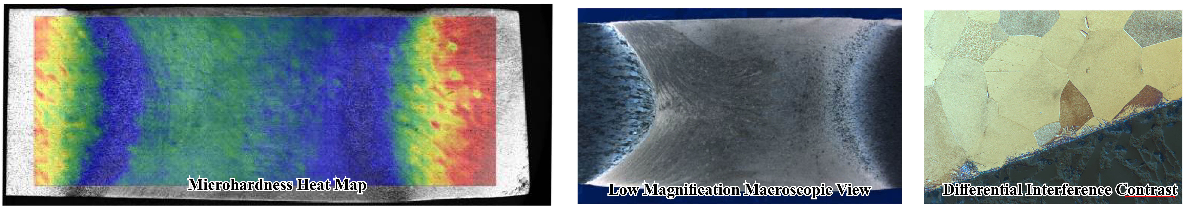
Metallography, Microscopy, and Microhardness
A full service metallography lab is available for sample preparation before microscopy:
  ^{Sample sectioning & mounting}
  Automated mechanical polishing and electro-polishing
  Etching for microstructural relief.
Multiple optical microscopy options are available:
  Stereomicroscopy allows live 3D surface observations of fractured materials.
  3D surface modeling and large area montage stitching.
  Medium and high magnification grain structure analysis.
  Differential Interference Contrast for identifying fine features and cracks in as-polished samples.
Robomet automated serial sectioning system for documenting three-dimensional microstructural features.
Microhardness analysis is available that documents property changes in metals due to processing and environmental exposure.

Slide 9
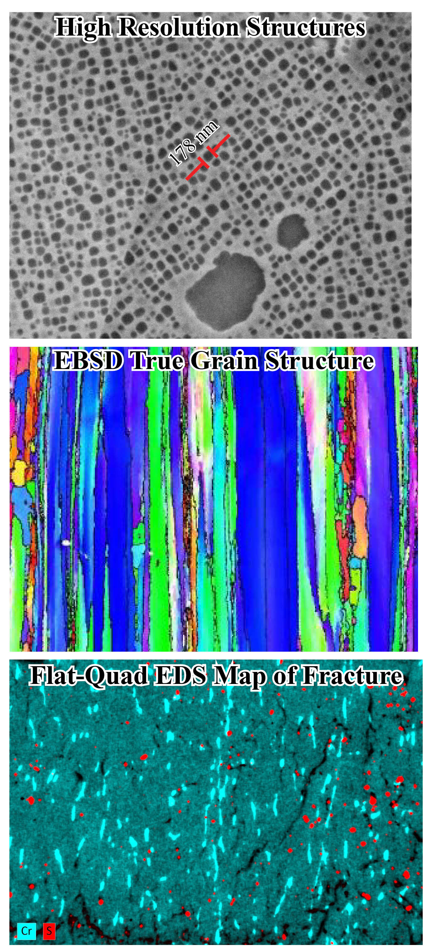
Microstructure & Surface Analysis
Scanning Electron Microscopy (SEM) with up to 0.7 nm resolution (7 atoms) is available for documentation of ultra-fine microstructural features.
  Low voltage SEM for beam sensitive materials and for high resolution x-ray mapping.
  Flat-Quad Energy Dispersive x-ray Spectroscopy (EDS) for high resolution x-ray mapping and for uniform analysis of rough fractures at up to 1,000,000 counts per second.
  High speed crystal structure analysis using Electron Backscatter Diffraction (EBSD) for true grain size analysis and residual strain analysis.
  SEM mechanical test system coupled with EBSD to document strain localization in stressed materials.
  Wavelength Dispersive x-ray Spectroscopy (WDS) capability for light element analysis, peak overlap deconvolution in complex superalloys, and trace analysis down to 0.01 weight percent.
Surface chemical analysis is available through Electron Spectroscopy for Chemical Analysis (ESCA), Auger Electron Spectroscopy (AES), and Secondary Ion Mass Spectroscopy (SIMS)

