Slide 1
The Challenges with Material Interfaces in a Nuclear Thermal Propulsion Engine Heat Exchanger
Space Technology Mission Directorate
Technology Demonstration Mission Program
Space Nuclear Propulsion Project
Sarah L. Langston, Carl C. Poteet, Julia E. Cline
NASA Langley Research Center
2023 Nuclear and Emerging Technologies for Space (NETS)

Slide 2

Outline
Background and Motivation
Interface Challenges
Proposed Solutions
Concluding Remarks

Slide 3
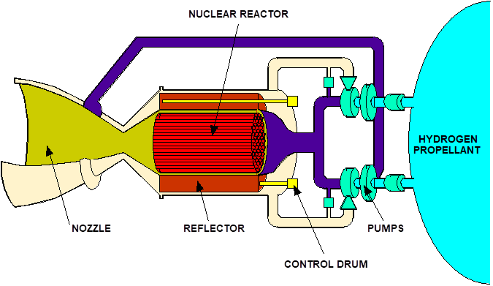
What is Nuclear Thermal Propulsion?
NASA is currently committed to developing critical technologies to send humans to cis-lunar space, Mars, and beyond
Nuclear Thermal Propulsion (NTP) is an enticing technology that would shorten crew transit time to Mars, as well as create additional abort options
NUCLEAR REACTOR
NTP Systems Work By:
Flowing a propellent through a nuclear reactor
Generating heat by nuclear fission to increase the temperature of the propellent
Exhausting the heated propellent through a nozzle to produce thrust
NOZZLE
H₂
PROPELLANT
PUMPS
REFLECTOR
CONTROL DRUM

Slide 4
NTP reactors operate at nearly 3000 K
Challenge: design, analyze, and manufacture the heat exchange tubes used in the reactor
Moderator reactor core consists of many fuel elements
Fuel elements are comprised of ~90 individual heat exchange tubes
Heat Exchange Tubes
Moderator Reactor Core
REACTOR
Fuel Element
H₂ Gas
H₂
Coating
CerCer
C/C Tube
Flow
H₂

Slide 5
Heat exchange tubes protect the fuel
Heat exchange tubes provide structural reinforcement and prevent corrosion of the nuclear fuel from the pressurized hydrogen propellent
Primary System Function: Nuclear Fuel (Ceramic-Ceramic, CerCer) heats hydrogen (H₂) gas
Heat Exchange Tubes
Material / Layer Functions
Carbon-Carbon (C/C) tube – structural backbone to fuel, protect CerCer from H₂ pressure
Coating – prevent H₂ from corroding C/C tube and prevent H₂ exposure to CerCer
H₂ – heated propellent
H₂ Gas
Coating
CerCer
C/C Tube
Flow
H₂

Slide 6
The use of dissimilar materials causes interface problems
Differences in material coefficients of thermal expansion (CTE) cause issues at two interfaces
CerCer to Tube Interface: A gap will open, cracks may form in CerCer
Tube to Coating Interface: Cracks will form
Pristine System
Cycled System
CerCer
One
Temperature Cycle
Gap
C/C Tube
H₂ Gas
H₂ Gas
Cracks
Coating
(NTP operation requires ~10 cycles)
All issues are derived from material CTE mismatch at mating interfaces
Tailoring C/C tube layup can modify CTE, but a direct match over the temperature range is not feasible

Slide 7
Flowing helium eliminates one interface issue but requires system redesign
Flowing helium (He) between the C/C tube and CerCer fuel
Utilize flowing He between CerCer and C/C tube to allow a gap while maintaining adequate heat transfer
Pros: Eliminates CerCer to C/C interface issue
Pitfalls: Helium must be hot and flowing – requires pumps/machinery that operate at these temperatures; may need an extra tank to carry helium; requires system redesign
CerCer
H₂ Gas
C/C Tube
H₂
Flow
Coating
He Gas
No single solution listed solves all problems and may create new problems

Slide 8
Restrained system reduces the fuel to C/C interface issue
Restrained System
Add C/C tube to outside of system, which will restrain CerCer expansion
Pros: Reduces CerCer to C/C interface issue
Pitfalls: Requires thick outer C/C tube; generally high stresses; CerCer crushing and gap still likely; does not address C/C to coating interface; additional C/C tube reduces amount of nuclear fuel in assembly
CerCer
H₂ Gas
C/C Tube
H₂
Flow
Coating
C/C Tube
No single solution listed solves all problems and may create new problems

Slide 9
A melt layer can eliminate the fuel to C/C interface issues
Melt Layer
Add an additional layer of material between CerCer and C/C that will melt prior to 1000K and expand prior to gap forming
Pros: Eliminates CerCer to C/C interface issue; moderately simple to integrate
Pitfalls: Have yet to identify a candidate melt layer material (matches neutronics, high thermal conductivity, appropriate CTE); does not address C/C to coating interface
CerCer
H₂ Gas
C/C Tube
H₂
Flow
Coating
Melt Layer
No single solution listed solves all problems and may create new problems

Slide 10
Inverting the system may improve both interface issues but requires major redesign
Inverted System
Have rods of CerCer fuel inside C/C tubes with H₂ gas flowing around coated C/C tube exterior
Pros: May improve both interface issues
Pitfalls: Complicated; change that effects rest of engine integration (likely requires major system redesign); high hoop stress in C/C tube; crushing will occur but may not be uniform; coating cracks may open during cooling
Fuel Element
H₂ Gas
CerCer
Coating
C/C Tube
No single solution listed solves all problems and may create new problems
Heat Exchange Tubes

Slide 11
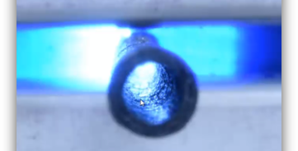
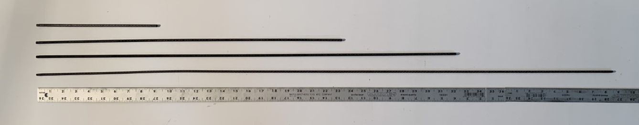
Concluding Remarks
Differences in CTE may lead to failure of the NTP system at material interfaces if not properly addressed
Multiple concepts have been presented to introduce additional compliance into the material system to prevent material cracking and/or failure with no clear solution
A better understanding of the mechanical behavior of the nuclear fuel material is needed to improve models and down select options

