Slide 1
Gabriella Teodoru
Pathways Presentation
4/25/2023

Slide 2

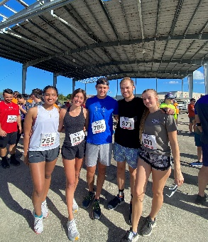
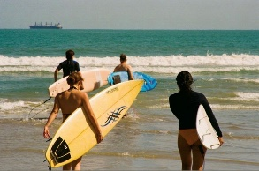
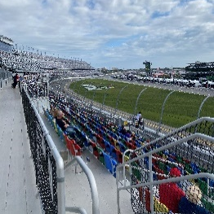
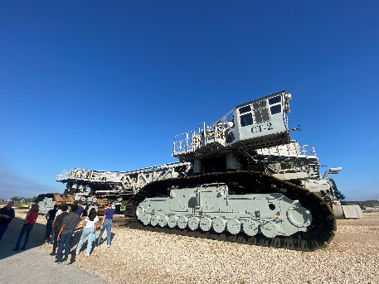
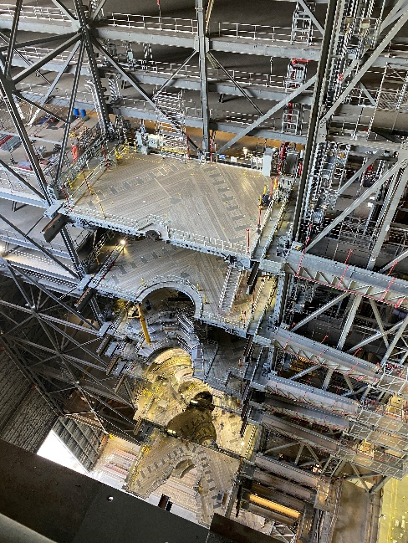
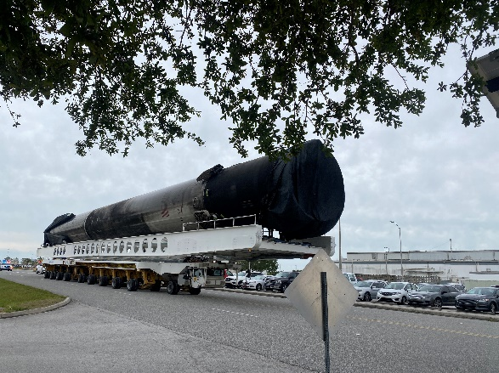
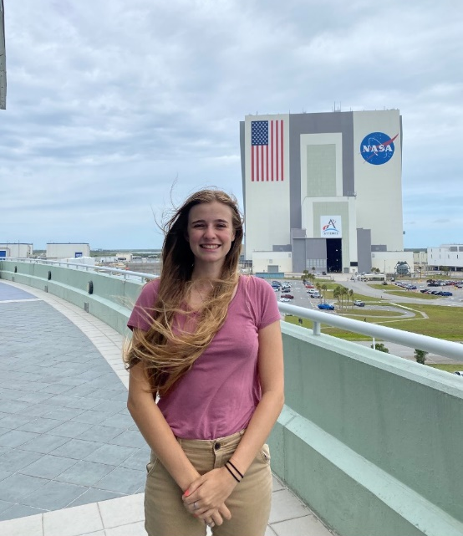
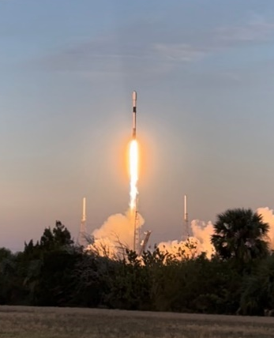
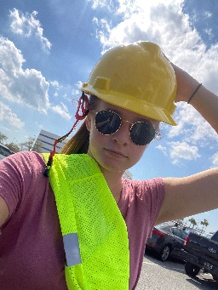
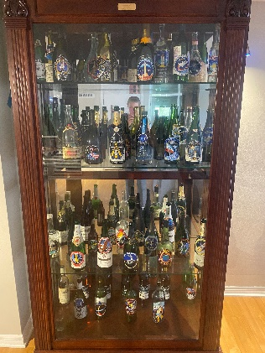
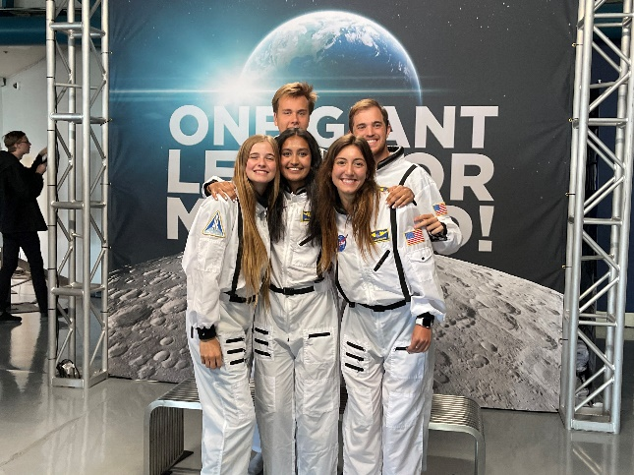
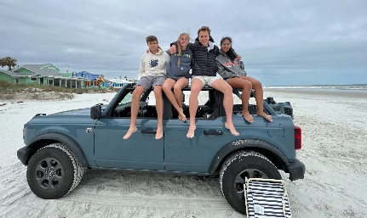
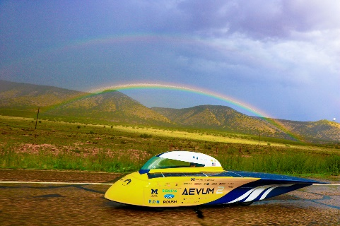
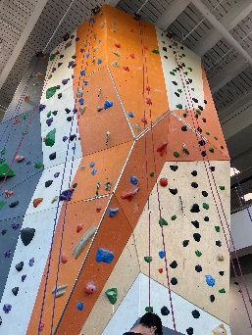
About Me
From Ann Arbor, MI
Junior at the University of Michigan
  Chemical Engineering
  Solar Car - Array
After Work:
Watch launches
Surf
Play tennis
First Time Animals Seen:
Alligator
Otter
Manatee
Armadillo
Gopher Tortoise

Slide 3
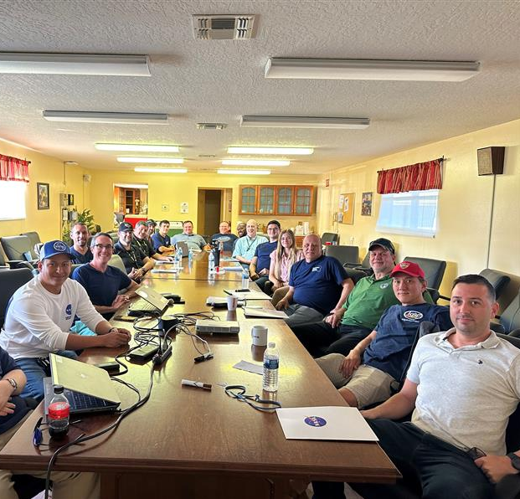
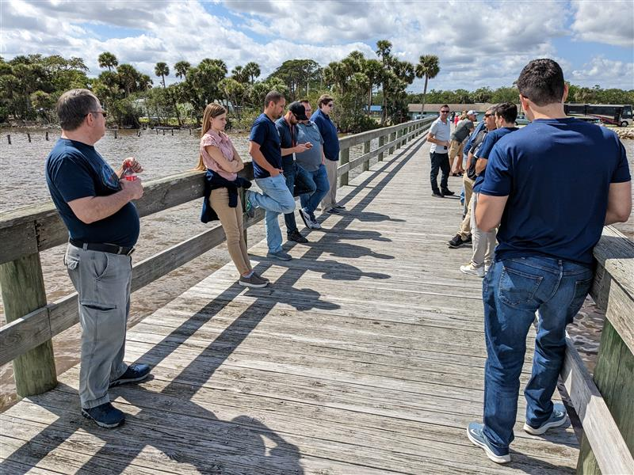
My Team
NE-XF
NE – Engineering Directorate
Commercial Crew, Artemis, Labs, Technical Integration
NE-X – Exploration Ground Systems
All of the systems that get Artemis
off the ground!
Offsite Day
NE-XF – Environmental & Life Support Systems
Fluids needed to support Artemis
Watching a Launch

Slide 4
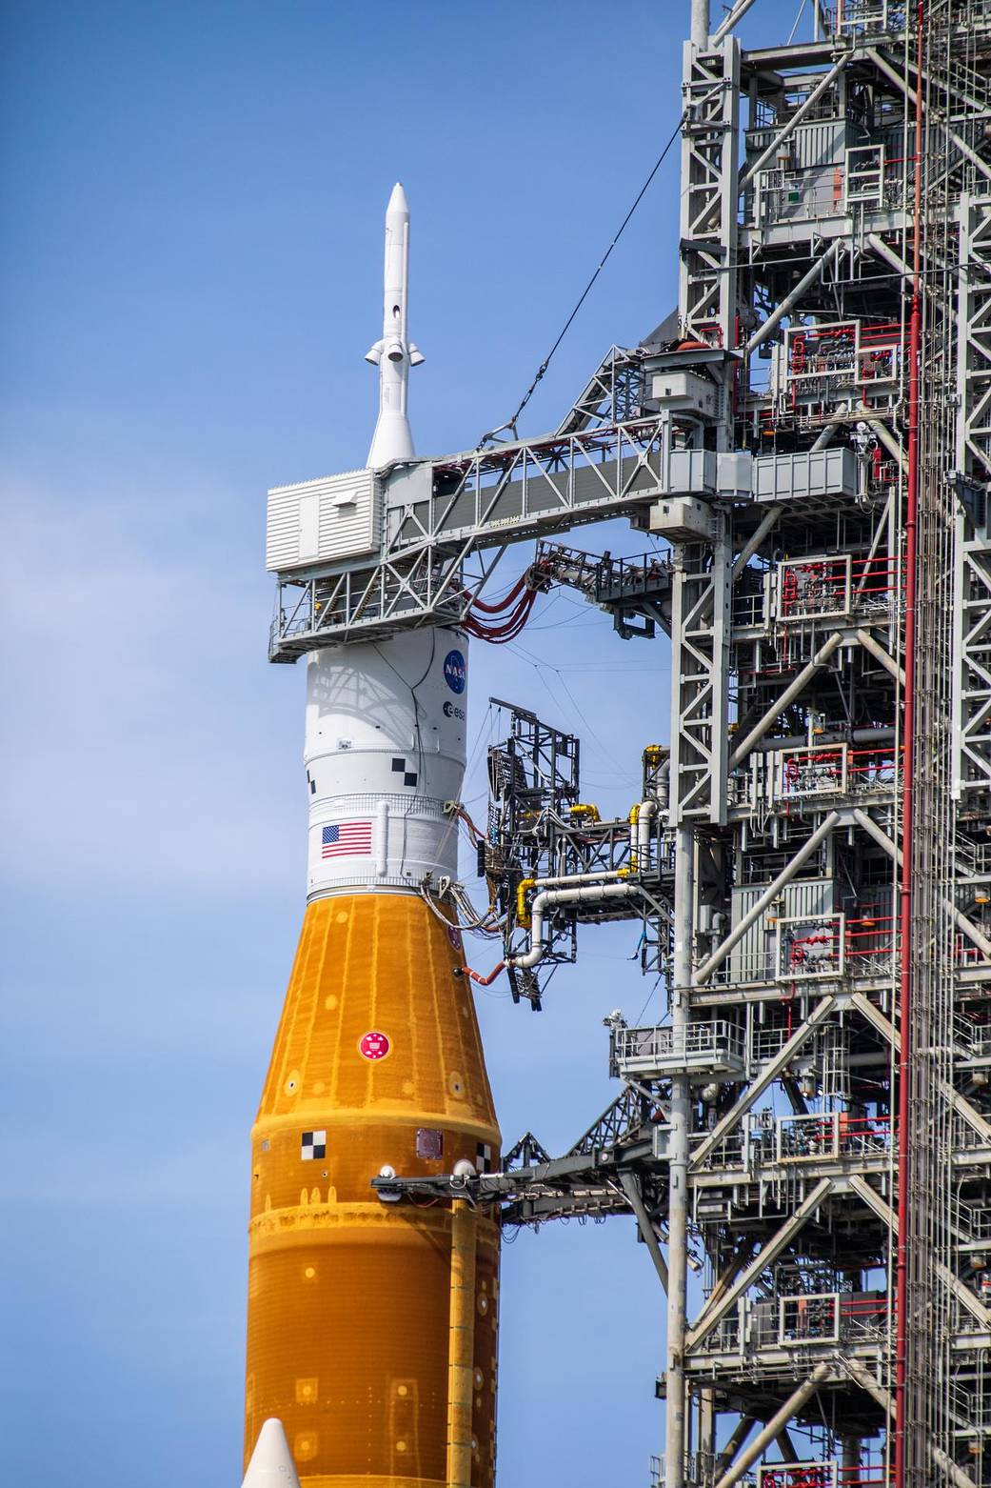
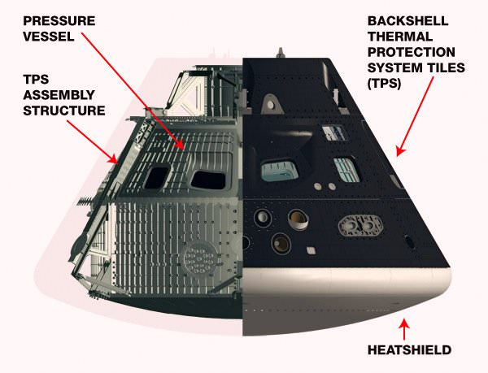
CMBP
Crew Module Backshell Purge
What is it?
A gaseous nitrogen purge into the Orion Capsule backshell to remove moisture and mitigate flammability hazard
The Problem
Vehicle imposed transient requirements for the temperature and energy deficit of nitrogen gas flowing into the spacecraft. Difficult to meet at low outside temperatures during startup.
My Solution
Calculator that imports data from the Launch Control Center to predict if we will meet the requirement

Slide 5
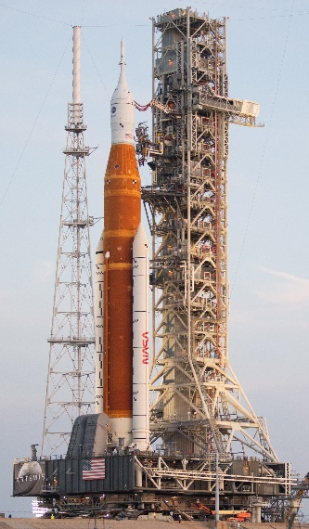
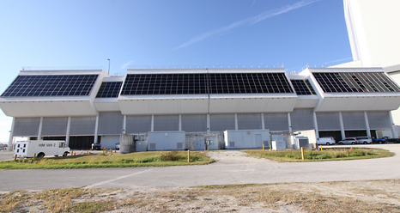
CMBP
~T-48 hours
Temp and Flowrate
Sensors
Temp and Flowrate Data
Calculator
Python Script
Launch Control Center
Vehicle on the Pad
Purge startup
Requirements met?
Yes or No
Launch procedure proceeds
Operation restart pending outdoor conditions

Slide 6
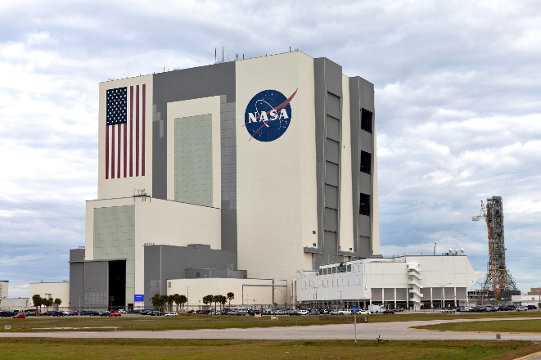
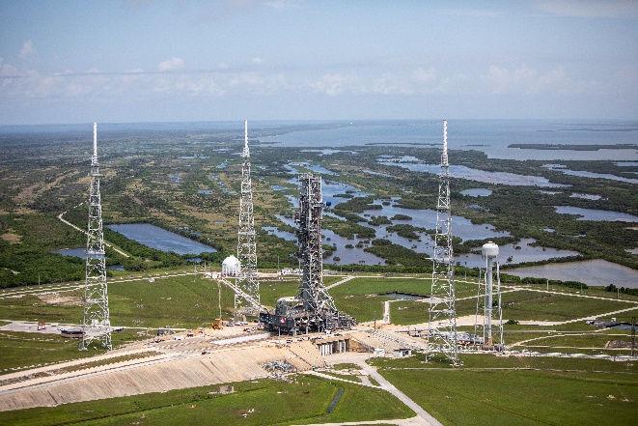
Gaseous Oxygen
Gaseous Oxygen Verification and Validation Procedure at the VAB and Pad
Why?
Facility systems need to be tested to ensure nominal operation before use
What?
The gaseous oxygen system for contingency Orion bottle fill
How?
Test procedure written
  Leak checks
  Remote operation capability
  Nominal pressures and flow rates
  Cleanliness

Slide 7
Lessons Learned
Look at the big picture
Subject matter experts
Adaptability
Get Help
Willingness to learn
Ask LOTS of questions
Get feedback often

Slide 8
Acknowledgements
Huge thank you to the following people who have made my experience at NASA so fantastic!
Brett Trahan – Mentor
Steve Anthony – Supervisor
Mai Miller – Pathways Coordinator
Ruben Jaca, Christian Nunez, Justin Archie – Help with my project
Entire NE-XF Team
Jill Giles and Stephen Aument – NE-X Intern Supervisors
All of the interns that have made this semester so amazing
All images courtesy of NASA and myself

