Slide 1


Thinking in Systems
Katherine Dickenson
04/25/2023

Slide 2

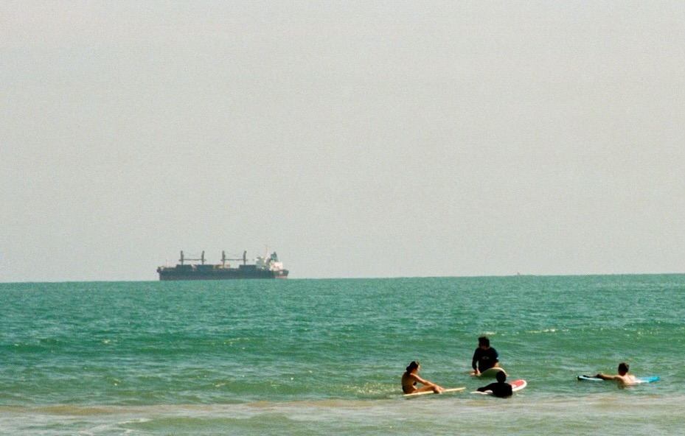



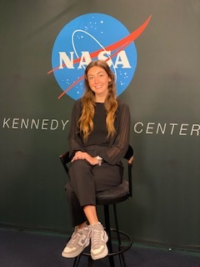
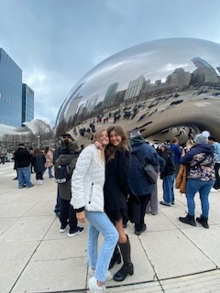
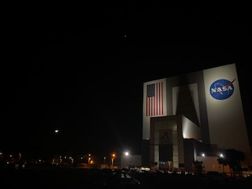
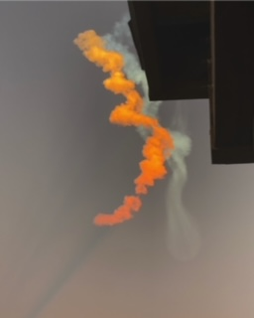
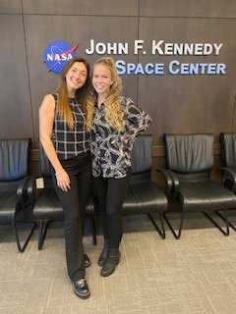
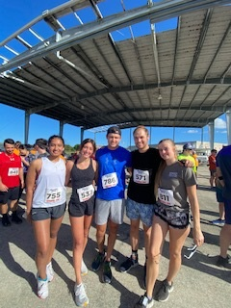
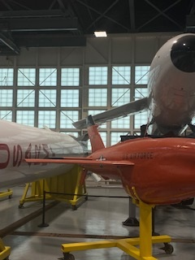
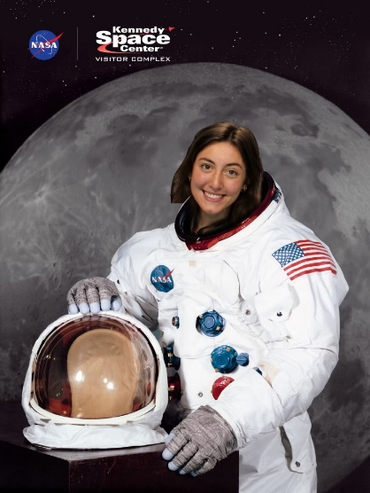
Introduction
Personal
Education
NASA
From GA
First Rotation
Likes to run, surf, thrift, travel and read
Georgia Tech
Junior
Major: Computer Science
Minor: Law, Science and Technology
In NE – TE (Systems Engineering and Integration)
Mentor: Jeffrey Crowder
Favorite Launch: Crew 6

Slide 3
Major Project – Assessment of Software Asset Management
Large scale assessment of COTS and OSS in use by EGS C3 to determine the proper authorization and asset management for use in the Artemis II Mission and onwards
Produced a quantitative analysis of findings so that an accurate determination of risk could be made
Appraised the process used to include software in the NASA ecosystem and located spots of weakness
  Worked to improve clarity and accuracy in these areas
Determined a new data structure or tool needed to be used
  Collaborated with employees within multiple different teams to assess feasibility
Began work towards new tool research and suitability

Slide 4
Process of Analysis
Authored a metric to compare known SW with assessed and cleared SW
Resultant Data
Due to the process in place?
Reauthor process for clarity
Adjust processes 5014 and 5020
Improved software security and thorough vetting process
Why not perfect overlap?
Due to human error?
Need clearer instructions
What is secure?
Due to the storage location of the SW?
Find new database
What will allow for efficient transfer?
New database to store information
What is in use?

Slide 5
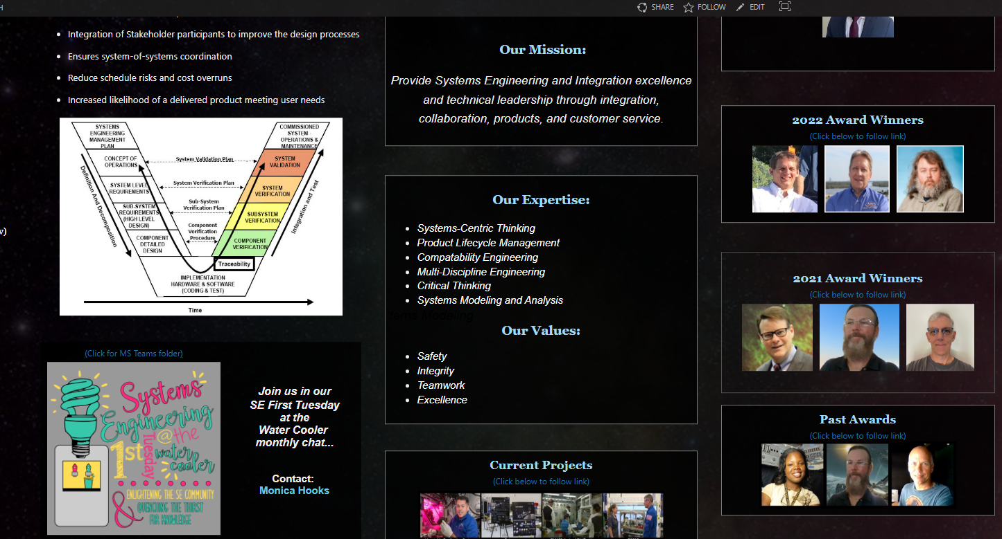
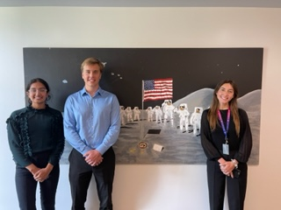
Other Deliverables
Rewrote the documentation that dictated how Limited Rights Data and Restricted Computer Software has to be legally represented in respect to Controlled Unclassified Information
  Had not been updated since 2015 when we still used Sensitive but Unclassified markings
Did UX work to better Team Sharepoint site
Helped rewrite the audit process that was used prior to assess
Consumer Off the Shelf Software and Open Source Software
Organized and took the lead on meetings with outside teams and organizations to encourage progress
Worked with PAXC to organize KSC’s first Intern Symposium
  Helped to establish schedules, networking and organized speakers such as Janet Petro

Slide 6
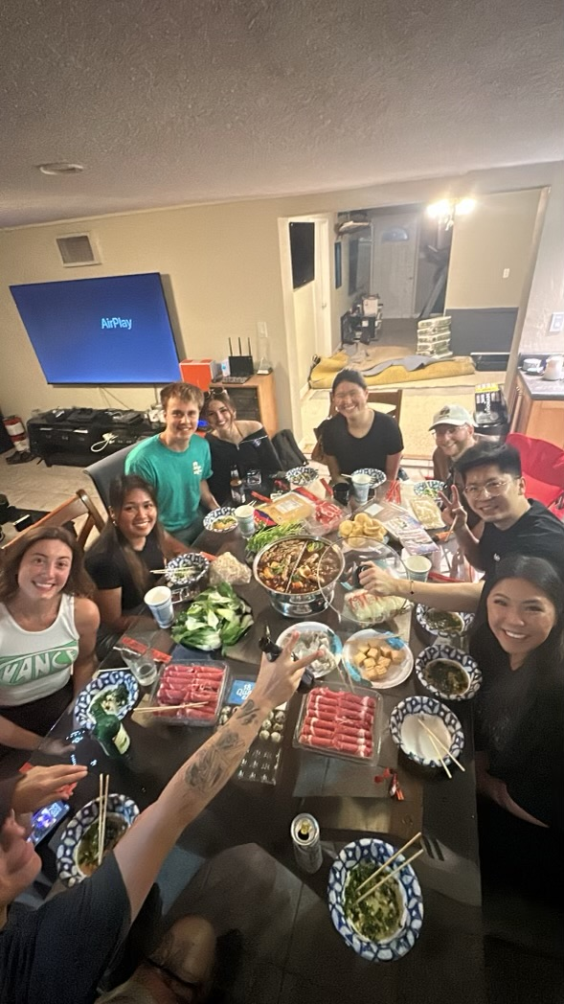
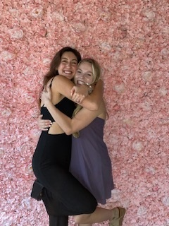
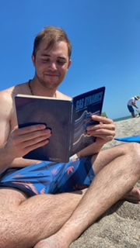
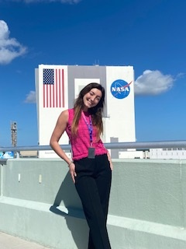
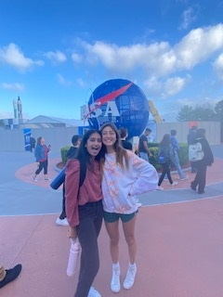
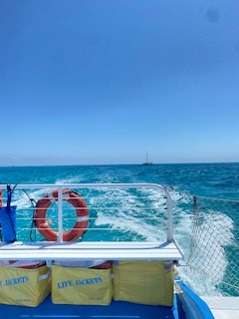
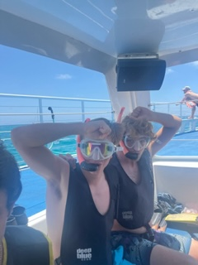
Acknowledgements
My mentor and friend Jeffrey Crowder who has served as an exceptional guide through this experience.
Mai Miller who has always gone above and beyond to support Pathways and myself.
My supervisor Coleman Dugger who has led the team and always taken the time to get to know me personally.
My friends and fellow Pathways interns Gabriella Teodoru, Krusha Patel and Serena Whitfield.
Questions or Comments?

