Slide 1
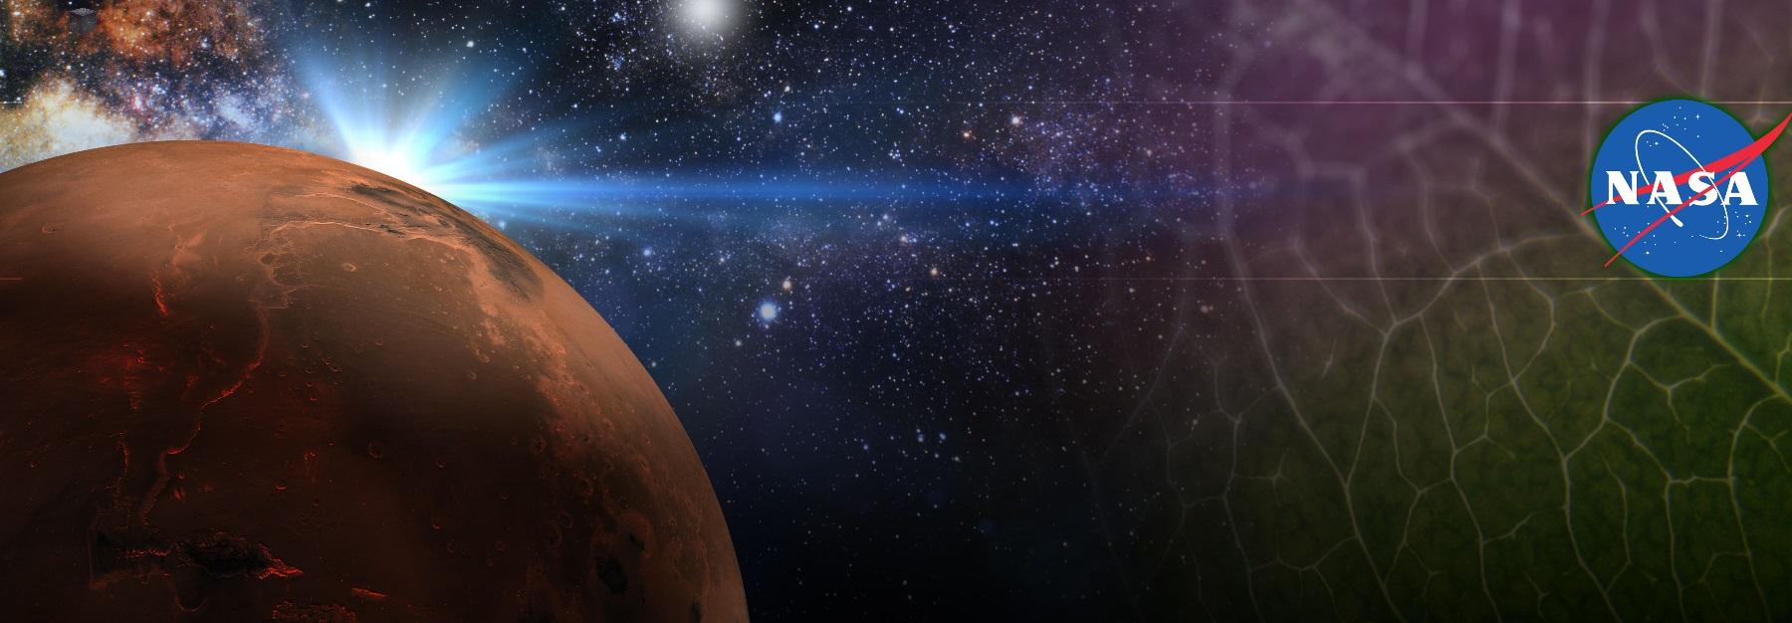
Space Crop Production And Exploration Food Systems
Ralph Fritsche
NASA, Kennedy Space Center, FL, USA

Slide 2
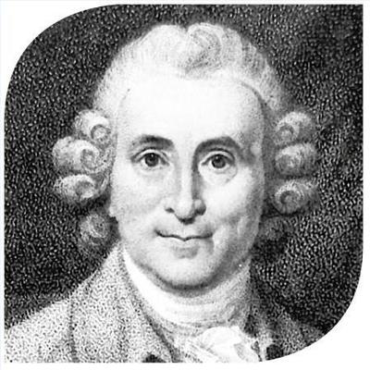

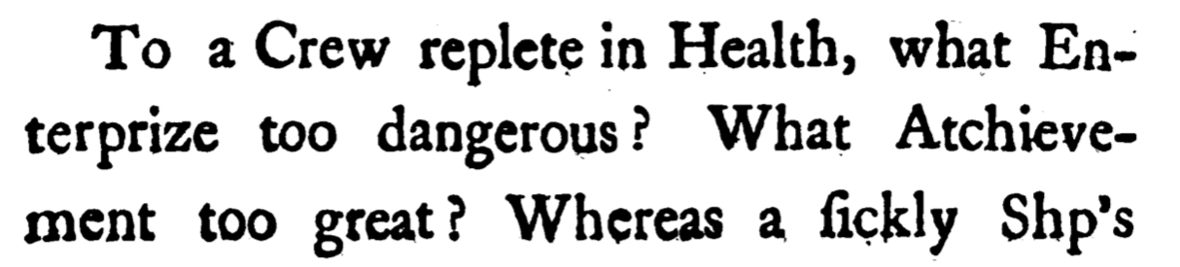
Long History of Nutrition and Crew Performance
James Lind was a Scottish Doctor and pioneer of naval hygiene in the Royal Navy. He was responsible for some of the first clinical trials which led to his theory that citrus fruits cured scurvy.
Lind was also a strong proponent for growing and incorporating fresh vegetables in the diet of sailors in order to maintain crew health and performance.
Notes:
Ralph
Ensure Food System Security on Long Duration Missions Beyond Low Earth Orbit (LEO)
Food and nutrition are the first line of defense for crew health and performance
Provide safe, nutritious and acceptable fresh food
Add variety to crew diet
Enhance morale
* Food security is the condition in which crew have continuous access to sufficient safe and nutritious food which meets both their dietary needs and food preferences in order to maintain peak health and performance.
Nutrient Supplementation of the Prepackaged Food System - Needed for: Deep Space Transport
Fresh produce supplements vitamins (B₁, K, C) and bioactive compounds that degrade in the stored food system on multi-year exploration missions
“Pick-and-Eat” crops that require no processing and minimal preparation will provide variety, customization, and psychological appeal
Enable testing and demonstration of dependable crop production before reliance on system.
Limiting factors are vehicle resources mass, power, volume, water, air, crew time
Caloric Replacement to Facilitate Earth Independence - Needed for: Long duration Surface missions on the Moon and Mars
Reduce up-mass associated with pre-packaged food
In addition to “pick and eat” crops, include staple crops that require processing and preparation
Bioregenerative capability will be required for long duration surface missions

Slide 3
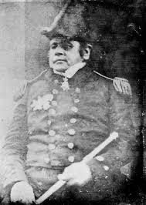
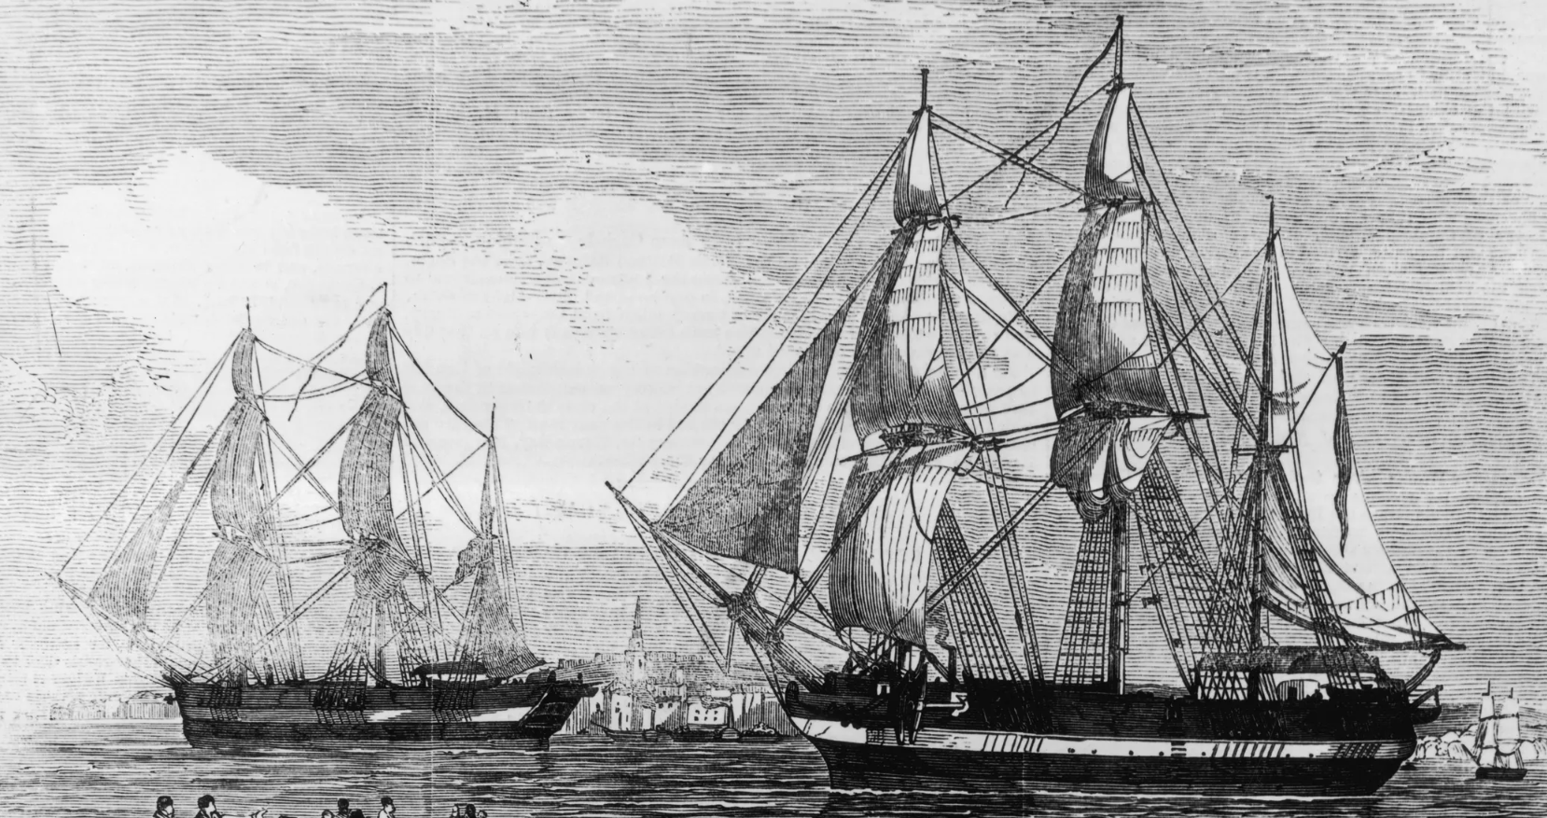
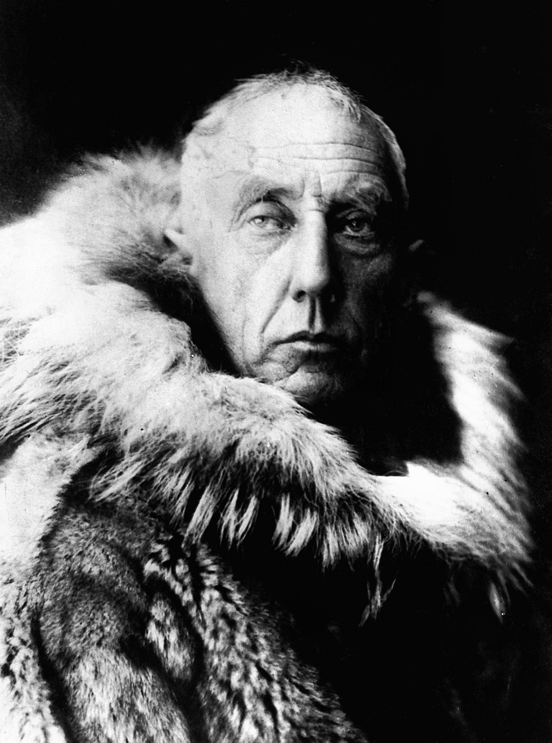
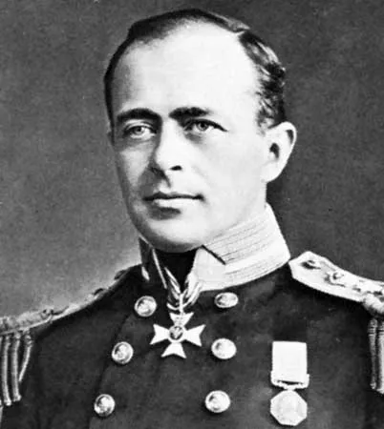
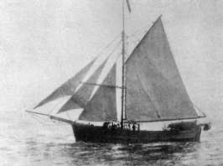
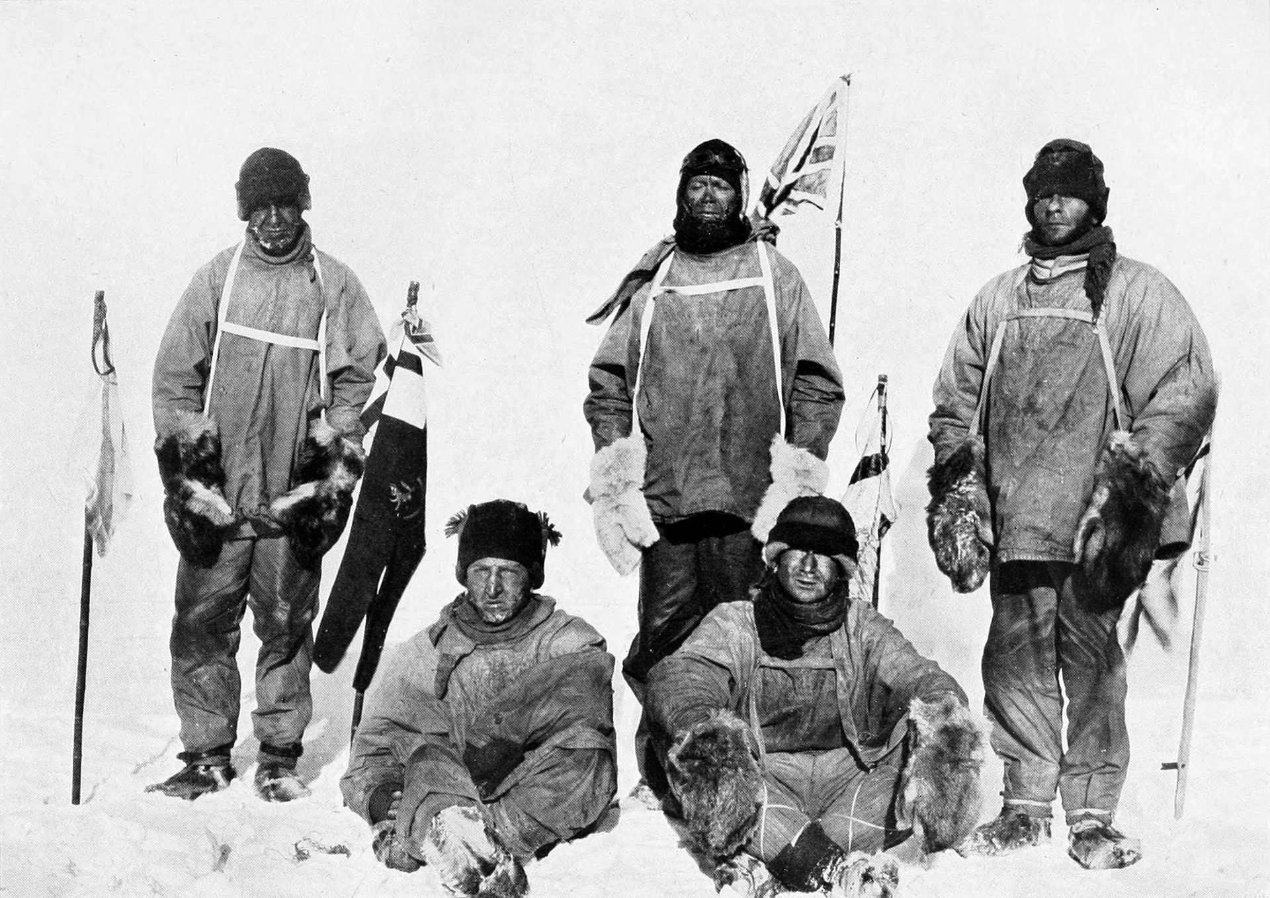
Lessons from Polar Exploration
Roald Amundsen
Keys to Success
Sir John Franklin
First to successfully traverse Canadas Northwest Passage
First to reach the south pole
Learn from the past
Understand the hazards
Identify mitigations
Validate technologies
Focus on Logistics
Plan and rehearse
Train, train, train
Methodically prepare
Luck
HMS Erebus and HMS Terror
Crew of 129 (all lost)
Robert Falcon Scott
Second to the south pole
He and 5 of his men perished during the return to camp
Gjoa
Crew of 7
Notes:
Ralph
Ensure Food System Security on Long Duration Missions Beyond Low Earth Orbit (LEO)
Food and nutrition are the first line of defense for crew health and performance
Provide safe, nutritious and acceptable fresh food
Add variety to crew diet
Enhance morale
* Food security is the condition in which crew have continuous access to sufficient safe and nutritious food which meets both their dietary needs and food preferences in order to maintain peak health and performance.
Nutrient Supplementation of the Prepackaged Food System - Needed for: Deep Space Transport
Fresh produce supplements vitamins (B₁, K, C) and bioactive compounds that degrade in the stored food system on multi-year exploration missions
“Pick-and-Eat” crops that require no processing and minimal preparation will provide variety, customization, and psychological appeal
Enable testing and demonstration of dependable crop production before reliance on system.
Limiting factors are vehicle resources mass, power, volume, water, air, crew time
Caloric Replacement to Facilitate Earth Independence - Needed for: Long duration Surface missions on the Moon and Mars
Reduce up-mass associated with pre-packaged food
In addition to “pick and eat” crops, include staple crops that require processing and preparation
Bioregenerative capability will be required for long duration surface missions

Slide 4
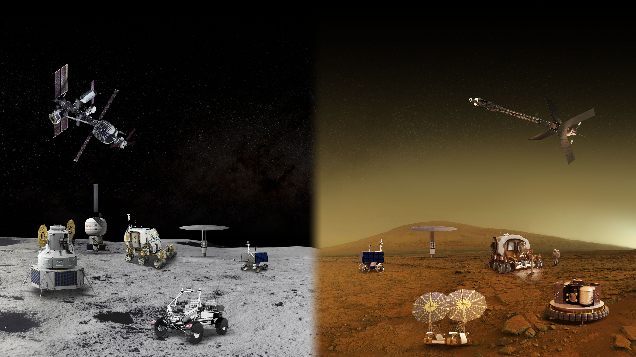
MOON AND MARS EXPLORATION
Operations on and around the Moon will help prepare for the first human mission to Mars
GATEWAY
Long Durations in Zero Gravity
TRANSIT HABITAT
and mars transit
Crew Size
Mobile Expedition Duration
Mobile Exploration Range
Surface
Habitat
Pressurized rover
Surface Fission Power
In-Situ Resource Utilization
Partial Gravity Operations
Human LandING system
Lunar
Terrain
vehicle
Autonomous Robotics Systems & Contingency Crew Transportation

Slide 5
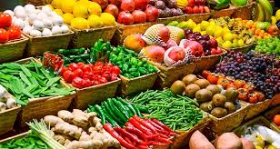
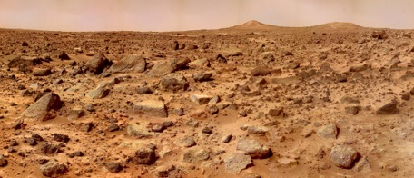
The Space Crop Production Vision
Ensure Food System Security on Long Duration Missions Beyond Low Earth Orbit (LEO)
Proper nutrition is critical to crew health and performance
Provide safe, nutritious and acceptable fresh food
Add variety to crew diet
Enhance morale
Notes:
Ralph
Ensure Food System Security on Long Duration Missions Beyond Low Earth Orbit (LEO)
Food and nutrition are the first line of defense for crew health and performance
Provide safe, nutritious and acceptable fresh food
Add variety to crew diet
Enhance morale
* Food security is the condition in which crew have continuous access to sufficient safe and nutritious food which meets both their dietary needs and food preferences in order to maintain peak health and performance.
Nutrient Supplementation of the Prepackaged Food System - Needed for: Deep Space Transport
Fresh produce supplements vitamins (B₁, K, C) and bioactive compounds that degrade in the stored food system on multi-year exploration missions
“Pick-and-Eat” crops that require no processing and minimal preparation will provide variety, customization, and psychological appeal
Enable testing and demonstration of dependable crop production before reliance on system.
Limiting factors are vehicle resources mass, power, volume, water, air, crew time
Caloric Replacement to Facilitate Earth Independence - Needed for: Long duration Surface missions on the Moon and Mars
Reduce up-mass associated with pre-packaged food
In addition to “pick and eat” crops, include staple crops that require processing and preparation
Bioregenerative capability will be required for long duration surface missions

Slide 6
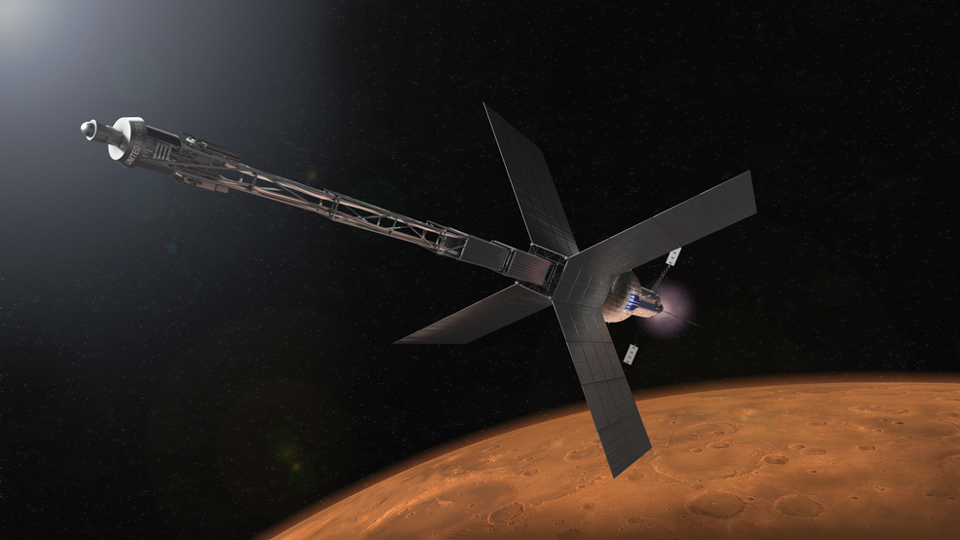
Near Term Goal
Nutrient Supplementation of the Prepackaged Food System
Identify and validate fresh produce to supplement key vitamins (B₁, K, C) and bioactive compounds that degrade in the stored food system on multi-year exploration missions.
Focus on “Pick-and-Eat” crops that require no processing and minimal preparation to provide variety, customization, and psychological appeal without adding food security risk or high resource demand.
Enable testing and demonstration of dependable
crop production before reliance on system.
Limiting factors are vehicle resources
mass, power, volume, water, air, crew time
Needed for:
Mars Transit Missions
Notes:
Ralph
Ensure Food System Security on Long Duration Missions Beyond Low Earth Orbit (LEO)
Food and nutrition are the first line of defense for crew health and performance
Provide safe, nutritious and acceptable fresh food
Add variety to crew diet
Enhance morale
* Food security is the condition in which crew have continuous access to sufficient safe and nutritious food which meets both their dietary needs and food preferences in order to maintain peak health and performance.
Nutrient Supplementation of the Prepackaged Food System - Needed for: Deep Space Transport
Fresh produce supplements vitamins (B₁, K, C) and bioactive compounds that degrade in the stored food system on multi-year exploration missions
“Pick-and-Eat” crops that require no processing and minimal preparation will provide variety, customization, and psychological appeal
Enable testing and demonstration of dependable crop production before reliance on system.
Limiting factors are vehicle resources mass, power, volume, water, air, crew time
Caloric Replacement to Facilitate Earth Independence - Needed for: Long duration Surface missions on the Moon and Mars
Reduce up-mass associated with pre-packaged food
In addition to “pick and eat” crops, include staple crops that require processing and preparation
Bioregenerative capability will be required for long duration surface missions

Slide 7
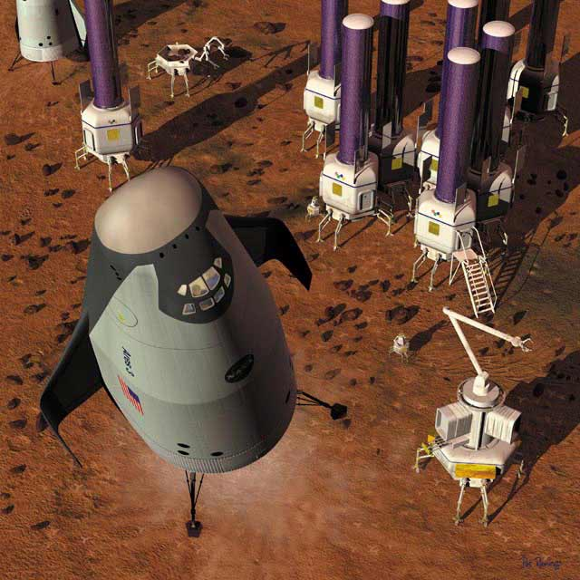
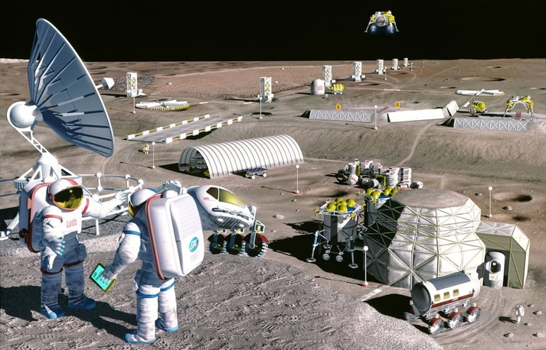
Long Term Goal
  Reduce up-mass associated with pre-packaged food
In addition to “pick and eat” crops, add staple crops that require processing and preparation
Caloric Replacement to Facilitate Earth Independence
Needed for: Long duration Surface missions on the Moon and Mars
Notes:
Ralph
Ensure Food System Security on Long Duration Missions Beyond Low Earth Orbit (LEO)
Food and nutrition are the first line of defense for crew health and performance
Provide safe, nutritious and acceptable fresh food
Add variety to crew diet
Enhance morale
* Food security is the condition in which crew have continuous access to sufficient safe and nutritious food which meets both their dietary needs and food preferences in order to maintain peak health and performance.
Nutrient Supplementation of the Prepackaged Food System - Needed for: Deep Space Transport
Fresh produce supplements vitamins (B₁, K, C) and bioactive compounds that degrade in the stored food system on multi-year exploration missions
“Pick-and-Eat” crops that require no processing and minimal preparation will provide variety, customization, and psychological appeal
Enable testing and demonstration of dependable crop production before reliance on system.
Limiting factors are vehicle resources mass, power, volume, water, air, crew time
Caloric Replacement to Facilitate Earth Independence - Needed for: Long duration Surface missions on the Moon and Mars
Reduce up-mass associated with pre-packaged food
In addition to “pick and eat” crops, include staple crops that require processing and preparation
Bioregenerative capability will be required for long duration surface missions

Slide 8
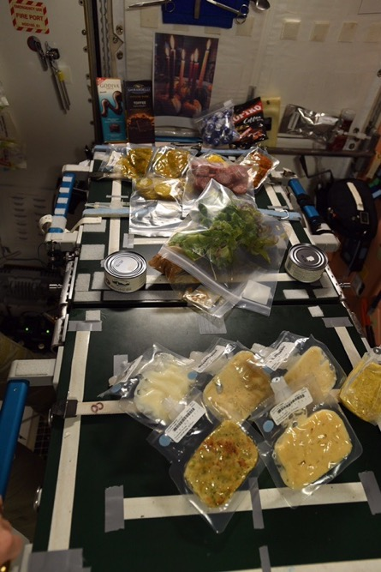
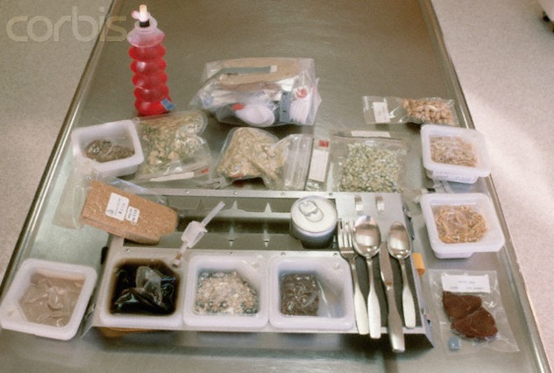
International Space Station Food System
No refrigerators or freezers for food storage
All food processed and prepackaged
Eight day menu cycle for six month mission
Fresh food only available at resupply
Notes:
Current focus is on the left-hand side of this chart, looking at pick-and-eat crops that require little additional equipment and grow at small scale. For surface systems we expect to broaden to the right-hand side and add calorie-rich staple crops. As we increase the number and types of crops, more growth space is needed, and plant health monitoring, automation of smart sensors, robotics, and data handling become critical.

Slide 9

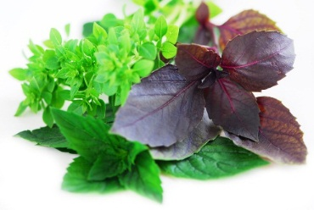
Space Crop Production Candidate Crops
Salad
Leafy Greens
Tomato
Pepper
Radish
Strawberry
Green Onion
Pea
Carrot
Lettuce, Chinese cabbage, Swiss chard, Mizuna, Spinach
Staple Crops
White Potato
Sweet Potato
Rice
Wheat
Dried Bean
Soybean
Peanut
MINIMAL PREPARATION / COOKING
SIGNIFICANT PREPARATION / COOKING
CONSUMED FRESH WITHOUT PROCESSING
Microgreens
Herbs
Basil
Mint
Chives
Dill
Notes:
Current focus is on the left-hand side of this chart, looking at pick-and-eat crops that require little additional equipment and grow at small scale. For surface systems we expect to broaden to the right-hand side and add calorie-rich staple crops. As we increase the number and types of crops, more growth space is needed, and plant health monitoring, automation of smart sensors, robotics, and data handling become critical.

Slide 10


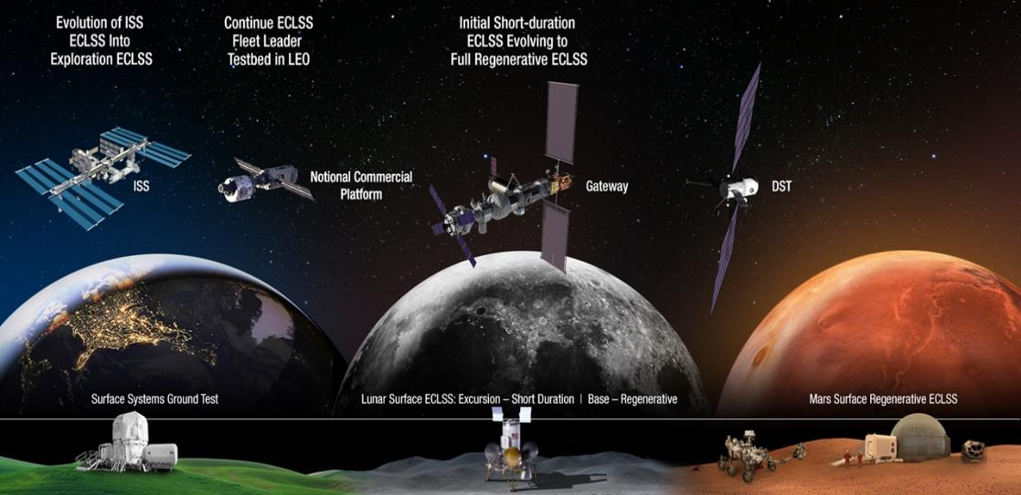


Space Crop Production Roadmap For Exploration
MARS TRANSIT (Crop Production)
GATEWAY (Plant Research)
Operational µg Food Production capability for pick-and-eat crops to supplement crew diet
ISS (Plant Research and H/W Technology)
Proving ground to study the effect of deep space radiation on pick-and-eat crops in µg
Identify challenges and solutions for growing pick-and-eat crops in µg to support crew nutrition
Scale: One to Two EXPRESS Racks (8-16 Lockers)
Scale: Single Locker
Scale: Single Locker to EXPRESS Rack (8 Lockers)
LUNAR SURFACE (Research/Production)
Ground (Plant Research and H/W Technology)
Develop and deploy operational partial gravity systems for both nutritional support and caloric replacement as both a source of food for long duration lunar missions and as a demonstration for Mars
MARTIAN SURFACE (Production)
Develop space crop production concepts and strategies in support of destinations along the exploration roadmap
Leverage Lunar Surface experience in Food Production systems to extend Earth Independence for Mars missions
Scale: Single Locker to Module
Scale: Single Locker to Module
Scale: Single Locker to Module

Slide 11
Space Crop Production Challenges
Deep Space
Water
Recycling
Radiation
Pressure
Micrometeorites
Surface
Dust
Regolith
Partial gravity
Microgravity
Fluid movement
No convection
Plant Size
High CO₂
Food Safety & Microbiome
Nutrient output
Sustainability
Abiotic stresses
Vehicle resources
Crew time
Waste
Initial lunar crop production will likely adapt systems developed and tested on ISS.
Lunar surface will allow testing in radiation and partial gravity environment and practice for “living off the land”.
Productivity
Stress tolerance
Environmental optimization
Crop scheduling
Crop

Slide 12
Key Areas of Research and Technology Development
Hardware and Growth System Technology
        Water and Nutrient Delivery
        Lighting Advancements
        Imaging Systems for Plant Health and Food Safety Monitoring (NDVI, Hyperspectral Imagery, Fluorescence)
        Component Reliability, Maintenance, and Miniaturization
        Sensor Development (Non-destructive sensing)
        Autonomy and Robotics
        Control Systems Development
Horticulture and Growth System Operations
        Cultivar Selection (Edible Biomass, Nutrient Content, Organoleptic Acceptability, Yield Verses Volume, Growth in Relevant Environments)
        Genetic Engineering (Optimization for Growth Environment, Stress Tolerance, etc.)
        Microbiome (Plant, Growth System, Vehicle, and Crew)
        Optimized Growth Recipes
        Food Safety and Protective Microbiome
Early Lunar Surface System Concepts Designed Now through ~2028, Validated ~2029 and Beyond

Slide 13
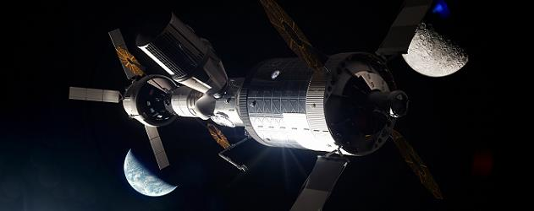
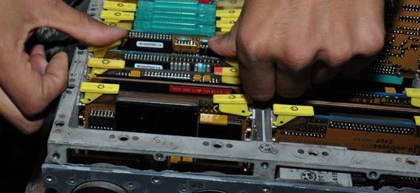
Challenges associated with Operations Beyond Low Earth Orbit (LEO)
As Distances Increase Access Decreases
The return journey from ISS (LEO) takes Hours
From the moon Days
From Mars Years
As Distances Increase Communications are Delayed
LEO virtually instantaneous
Moon 2.5 seconds round trip
Mars between 6 – 44 minutes round trip depending on distance
Reduce reliance on permanently staffed ground control centers
As Distances Increase Focus Changes from Replacement to Repair
Autonomy and robotics will be widely incorporated into all facets of crop production operations
Smart sensors will collect and provide real time information on plant health
As Distances Increase Systems and Software Controls will need to Detect, Decide and Do

Slide 14
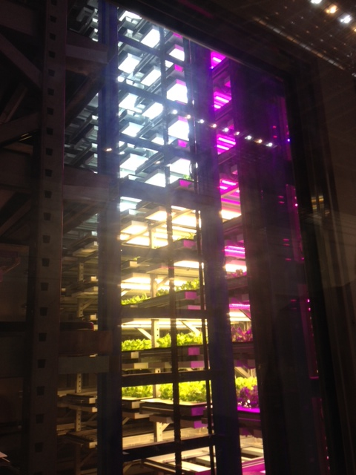
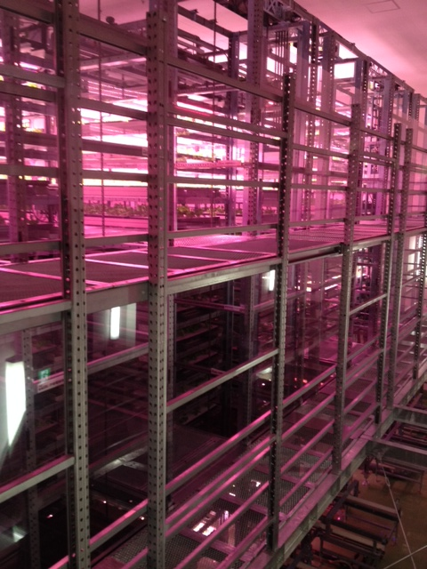
Plant Factories
Crops grow in similar densely packed layers in plant factories or vertical farms. We regularly exchange information with academic and industry researchers working in this area on food safety, sensors, automaton and control system technology development and crop selection.
Photos of Osaka Prefecture University training facility courtesy of Ray Wheeler

Slide 15
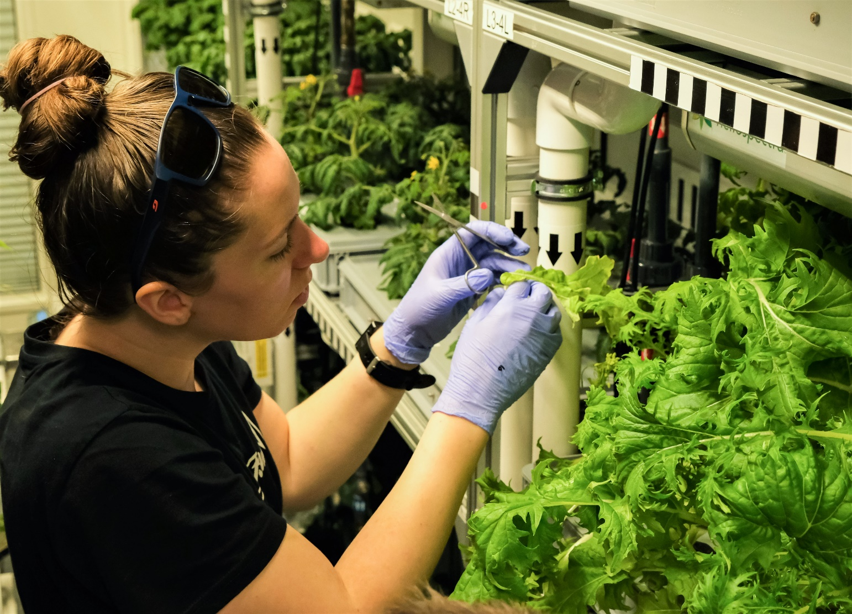
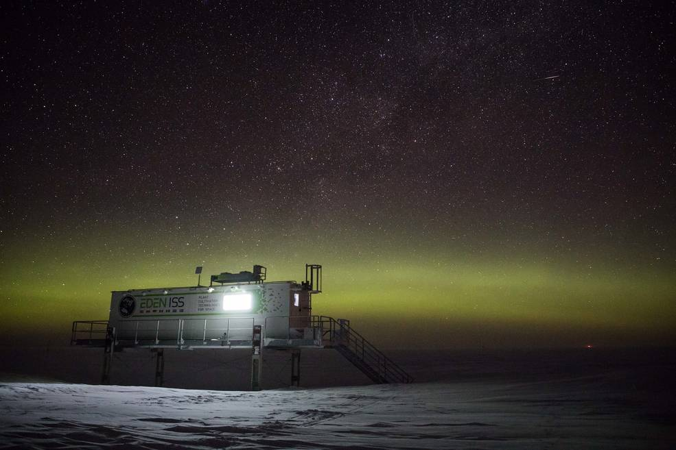
EDEN ISS Antarctic Greenhouse
The EDEN ISS facility recently tested in Antarctica is a similar concept. This DLR facility was created to conduct research into food production in deserts and cold regions, as well as exploring the possibility of growing fresh food in the hostile conditions on the Moon or Mars. By sending a KSC scientist to Antarctica to operate this facility we collected data on hardware performance, facility sanitization and operations, plant growth, microbial food safety, and human factors.
The EDEN ISS greenhouse, developed by the German Aerospace Center; DLR, in Antarctica since 2018.
Credit: Hanno Müller, AWI
Jess Buncheck – KSC scientist
Tending plants in EDEN ISS, 2021

Slide 16
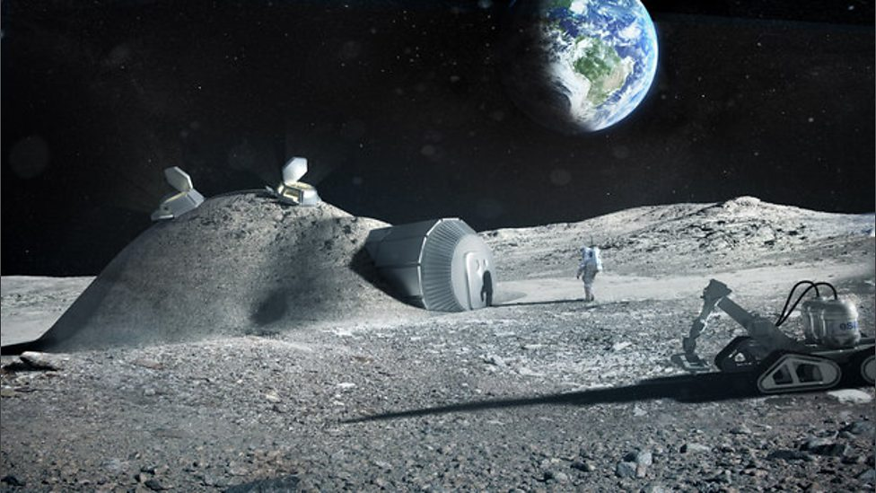
    Lunar Surface: The Moon as an Analog for Mars
    Early opportunities to perform research in the radiation and partial gravity environment are a priority
    Initial crop production capability will likely be an adaptation of the microgravity hydroponic systems developed on the ISS
    A lunar outpost three days from Earth will provide needed practice for "living off the land" before making the long trek to Mars
    A lunar habitat will serve to demonstrate technologies for a future Mars habitat
    Start with pick-and-eat crops and eventually include staple crops

Slide 17
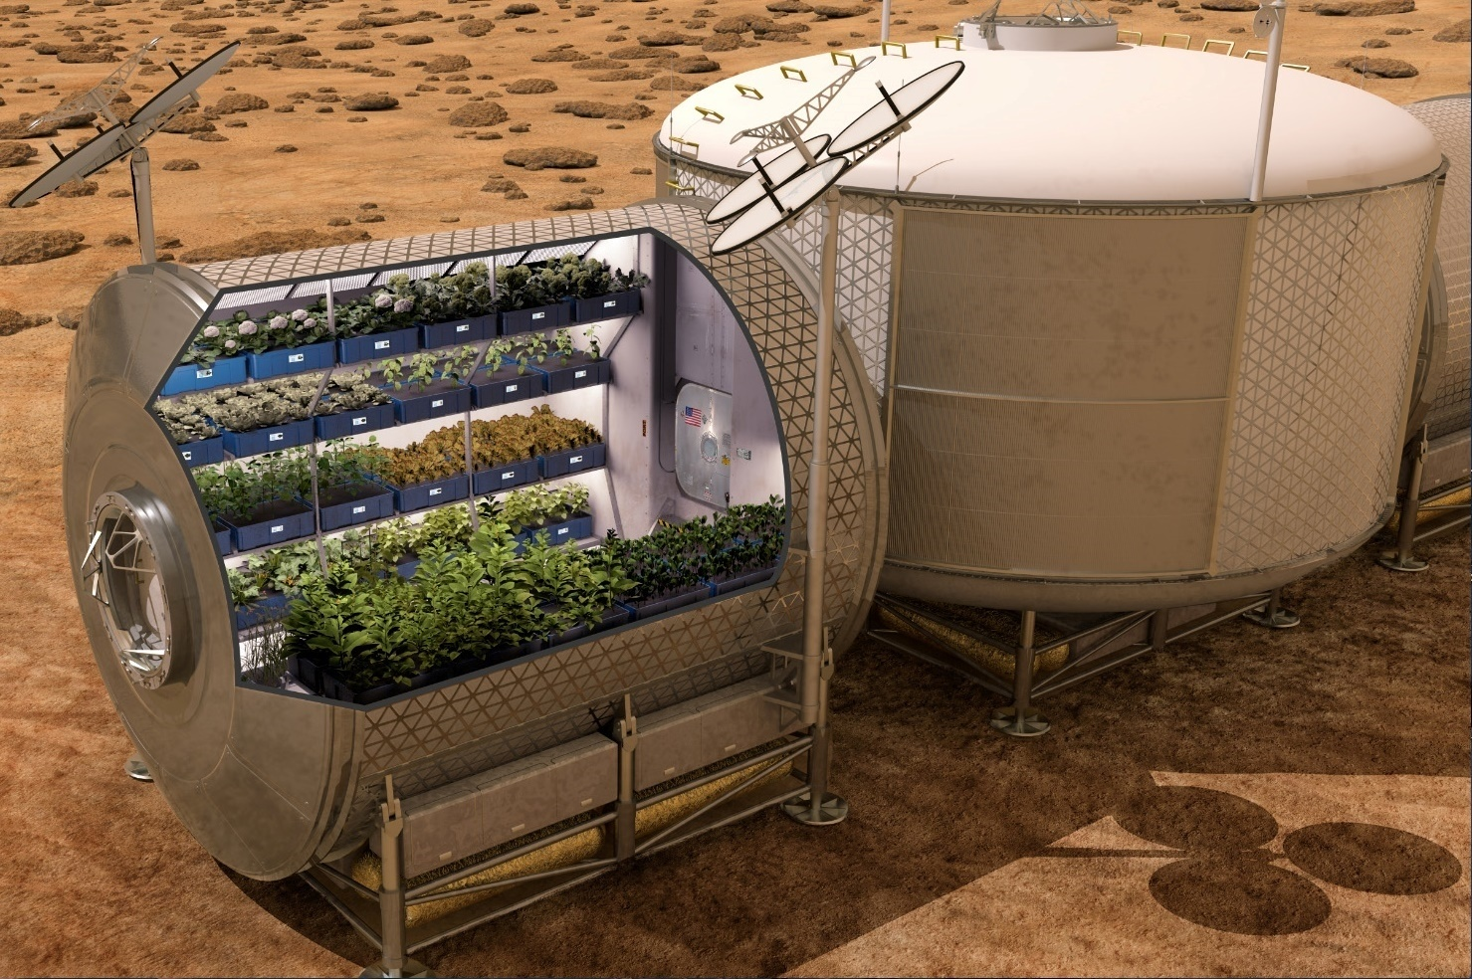
Another example of an early surface crop production facility but this time on Mars. It depicts plants growing in an enclosed module that could be launched on a rocket and provide sufficient fresh produce for crews. Water delivery and volume optimization become critical, and environmental control will create a habitat optimized for a variety of crops. Crops may be bred or engineered specifically for the space environment.

Slide 18
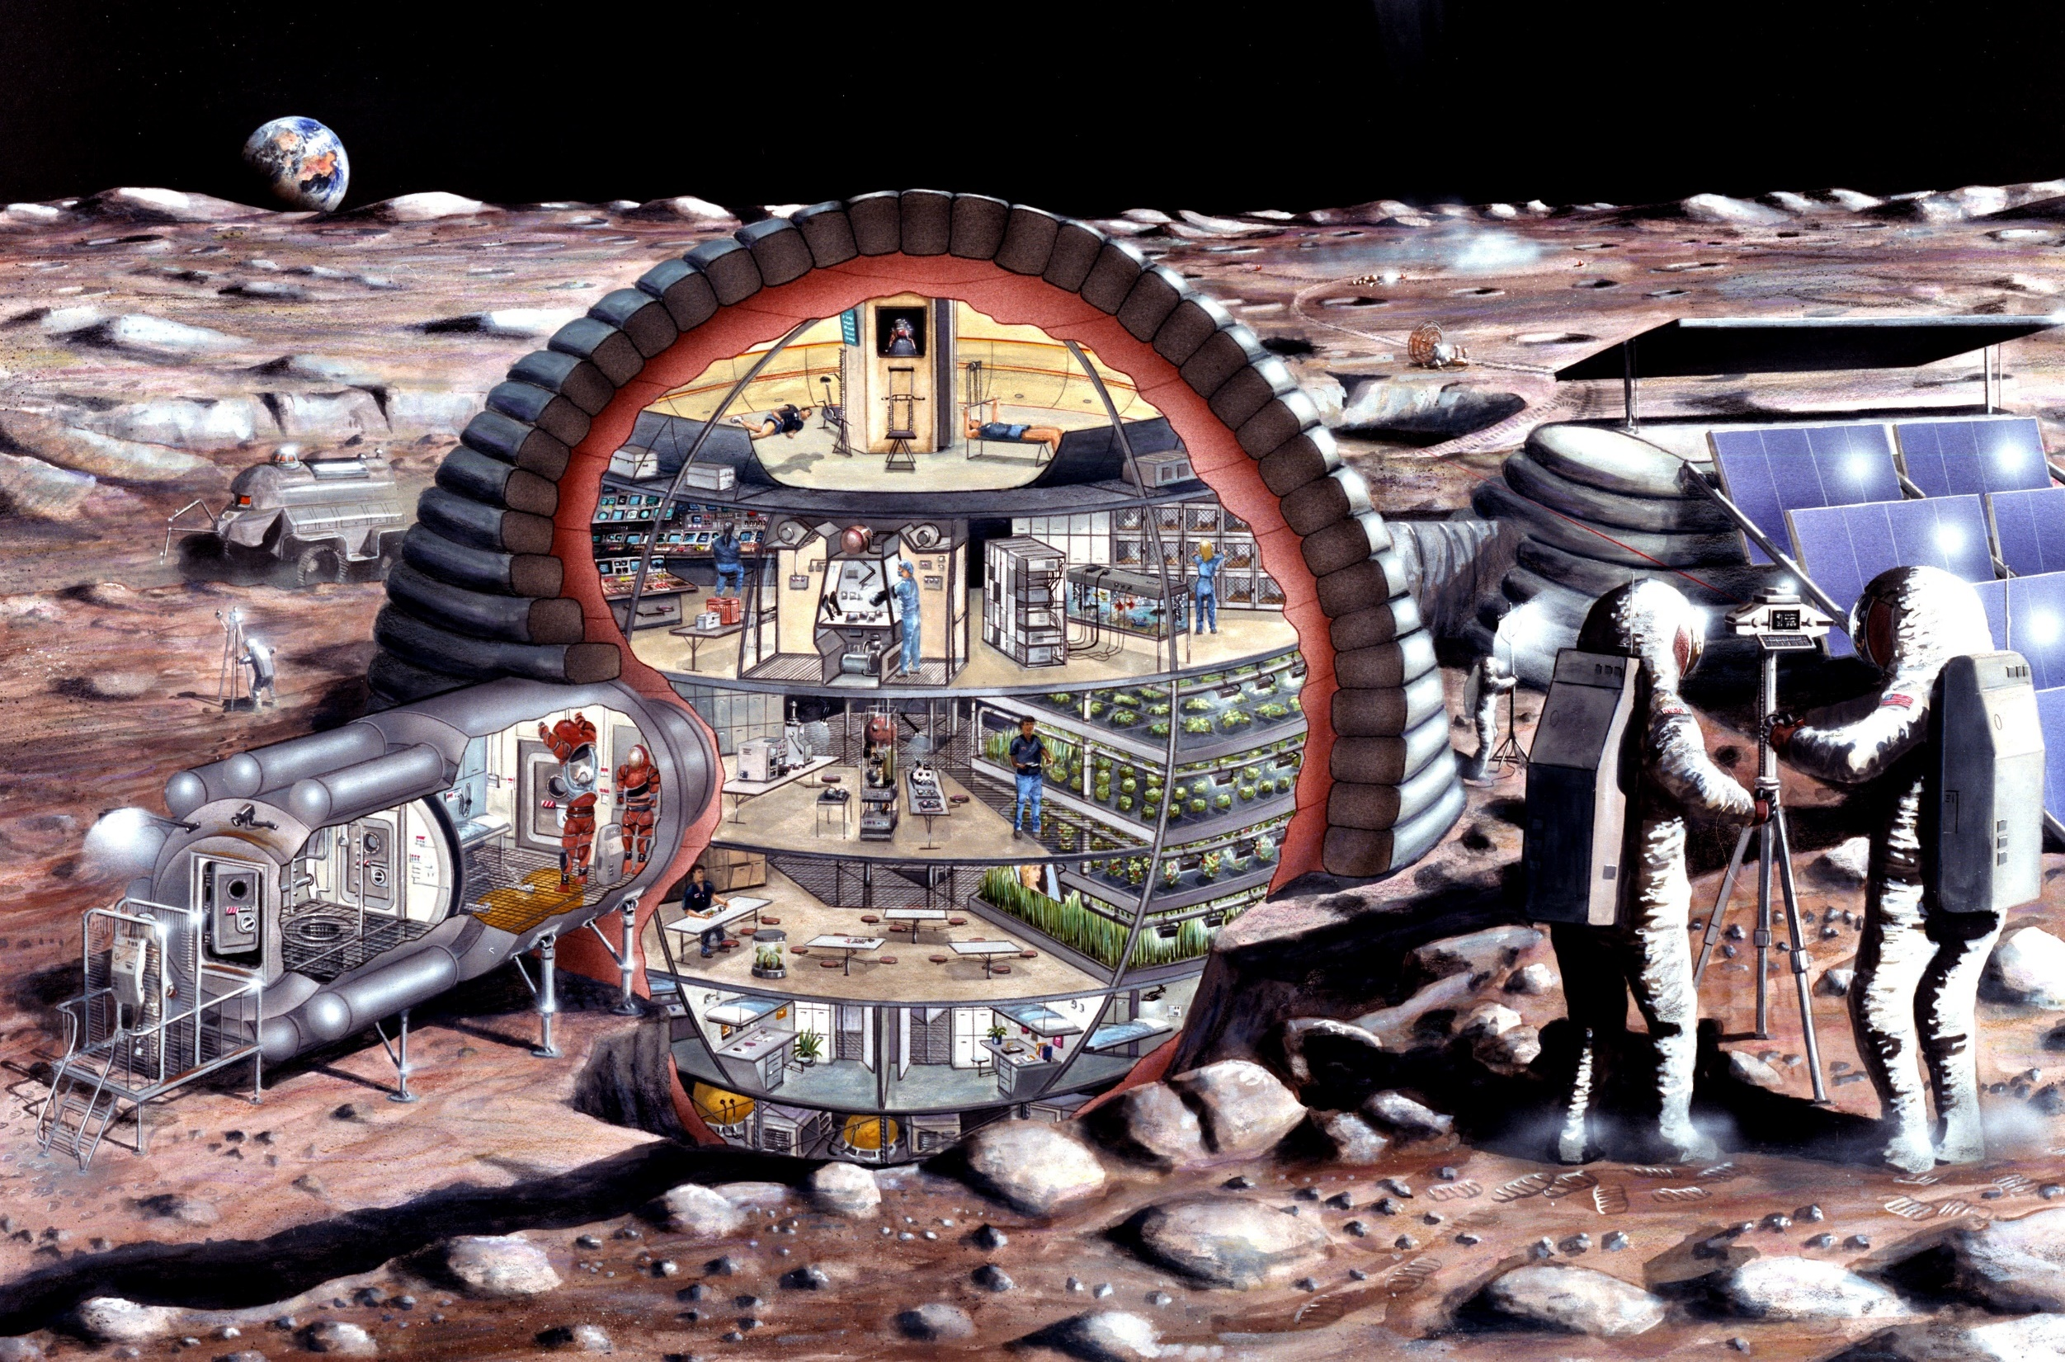
Artist’s concept of a permanently crewed surface habitat. Densely packed layers of plants are growing under electric lights in a protected structure with shielding from hazards like radiation, micrometeorites, and dust.

Slide 19
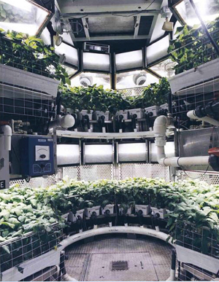
    Mars Surface: Crop Production as a Component of a Bioregenerative Life Support System
    Will use systems demonstrated and proven on the lunar surface
    and the trip to Mars
    Long term presence on Mars will result
    in a permanent bioregenerative capability
    as a part of a life support system
    Benefits of a bioregenerative system:
      Lower food stowage mass
      Water and waste treatment
      Air revitalization
      Improved nutrition and acceptability
      Personalized preparation
      Psychosocial benefit

Slide 20

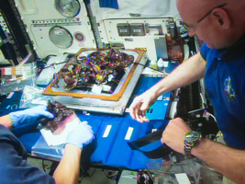
    How Space Crop Research Benefits Earth
    History
    LED lighting for plants was patented through NASA funding
    NASA use of Nutrient Film Technique (NFT) for Potato production led to the development of production techniques for seed potatoes
    Similar Challenges
      Limited Resources
      Need for Reliable, Efficient Production
      Time as a Resource (Humans Vs. Automation)
      Importance of Early Detection of Issues

Slide 21
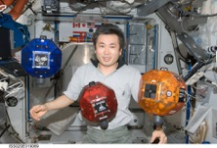
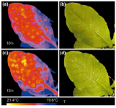
    Hardware and Growth System Technology
        Lighting Advancements
        Imaging Systems for Plant Health and Food Safety Monitoring (NDVI, Hyperspectral Imagery, Fluorescence)
        Component Reliability, Maintenance and Miniaturization
        Sensor Development
        Autonomy and Robotics
        Sensor Fusion
        Control Systems Development

Slide 22
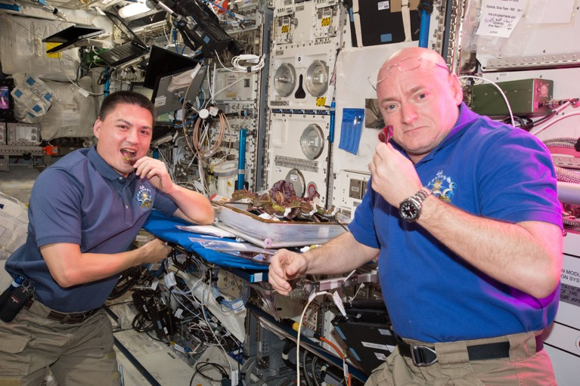
    Horticulture and Growth System Operations
  Cultivar selection (Edible Biomass, Yield Verses Volume)
  Genetic Engineering (Environmental Stress Tolerance)
  Microbiome (Plant, Growth System, Vehicle and Crew)
  Optimized Growth Recipes
  Food Safety

Slide 23
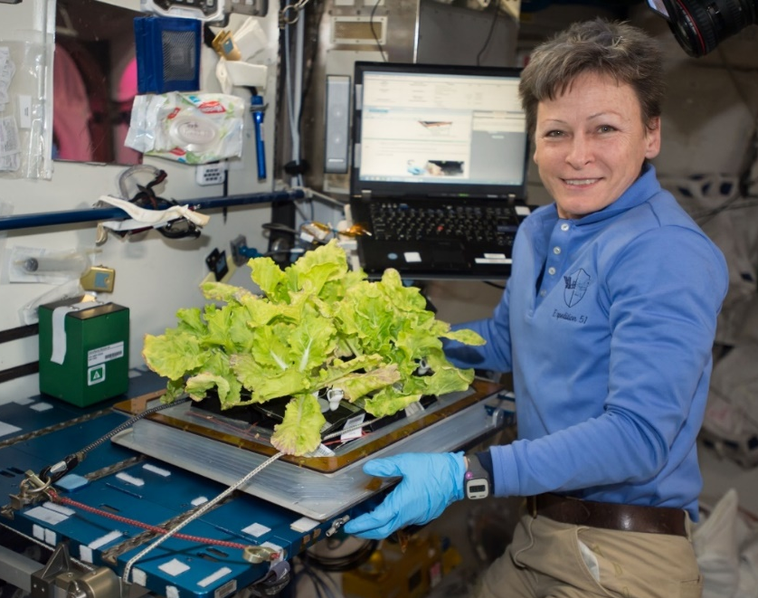
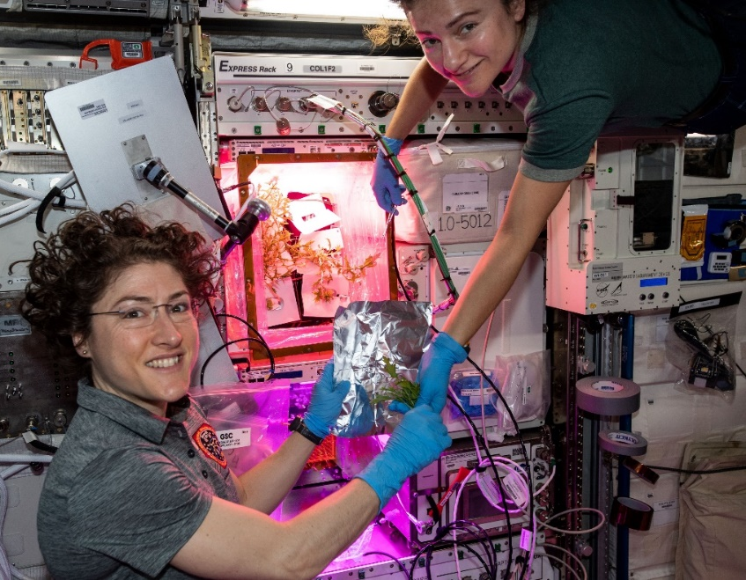
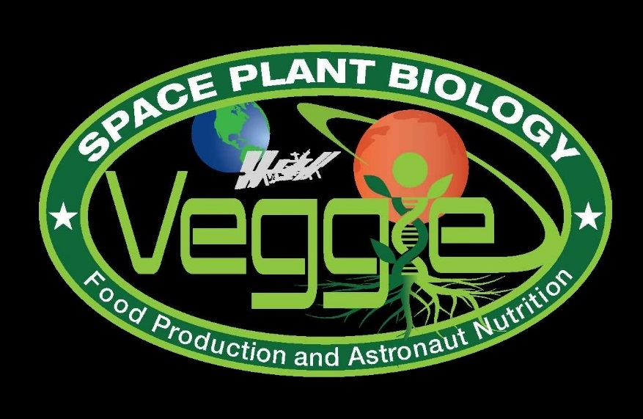
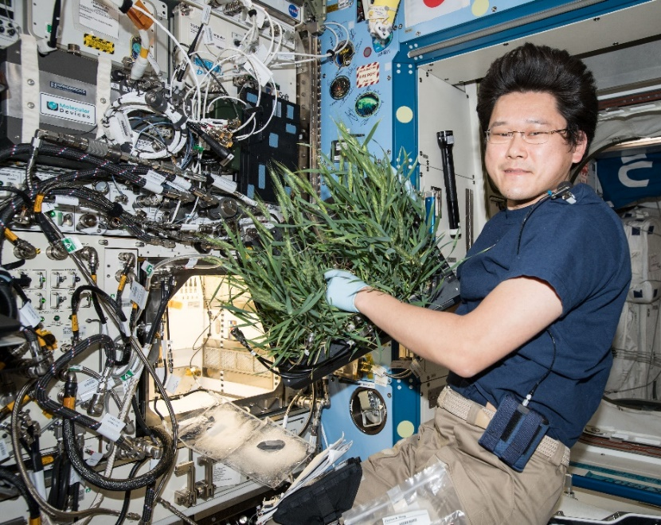
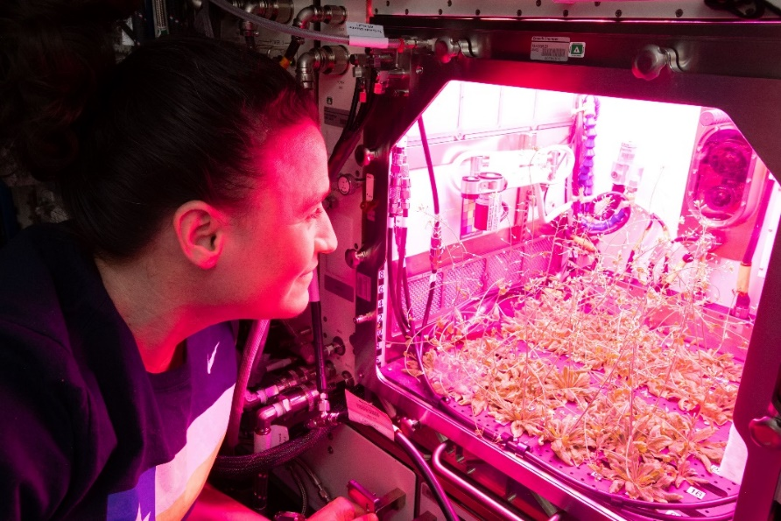
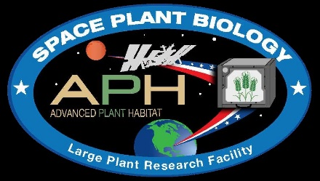
Current NASA Large Plant Research Capabilities On ISS
Notes:
Veggie and the Advanced Plant Habitat

Slide 24
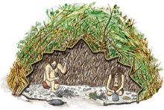

Ohalo III Vision
Ohalo III will be a water and nutrient delivery and volume optimization testbed for microgravity space crop production.
Ohalo III will also be a prototype for a future Mars transit vehicle crop production system.
  Moving from plant and crop research capabilities to crop production capabilities
Origin of the name:
“Ohalo” means “My Tent” in Hebrew.
Ohalo II is a 23,000 year old
archeological site of a settlement
Located on the sea of Galilee in Israel .
~150,000 specimens of plant remains have been collected.
While some species were wild, many would only thrive in agricultural land. Ohalo II represents the earliest evidence for small-scale plant cultivation, approximately 11,000 years before the agricultural revolution.
Ohalo III aims to take the first farms out of this world!

Slide 25
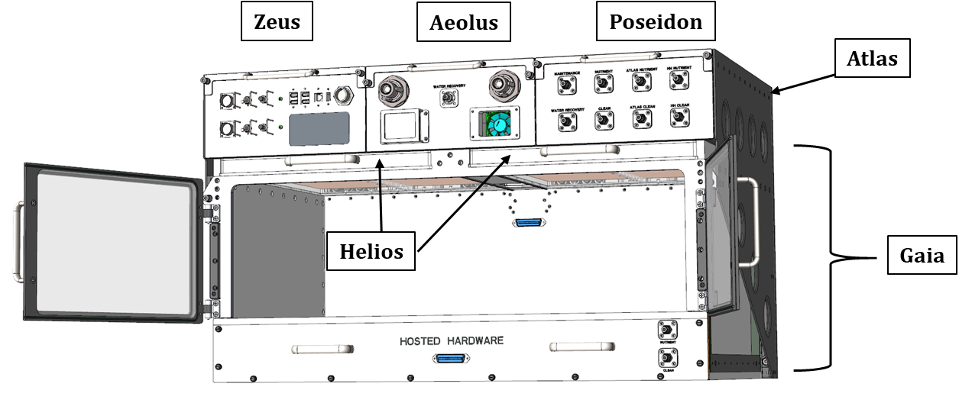
Flying soon on ISS – Ohalo III
Ohalo will be an operational crop production system testbed, pulling from both Veggie and APH
Ohalo consists of the following major subsystems:
  Power & electronics (Zeus) module
  Environmental control (Aeolus) module
  Water (Poseidon) module
  Growth chamber (Gaia)
  Two lighting (Helios) modules
  Support structure (Atlas)

Slide 26
Ohalo III Goals
Serve as an ISS platform for growing crops and performing technology demonstration
Maximize space crop harvest within a given volume
Minimize flight-crew operational and maintenance actions
Maximize operational and maintenance access
Use of modular concepts
Accommodate a variety of space crops
Capable of supporting staggered growth cycles
Have a minimum of a 5-year operating life

Slide 27
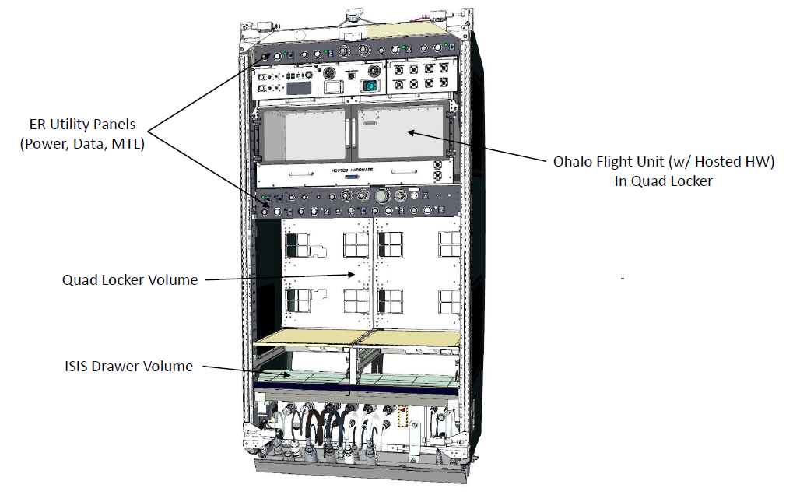

Slide 28
Ohalo III
Ohalo will be a larger capability ~ 2 x the size of APH (about 0.4m² growth area total) and it will have the flexibility to have both nursery and production areas.
It will have the capability of hosting a variety of different root zone subsystems
NASA has funded 2 projects to explore water and nutrient delivery and spatial optimization options to design these “hosted hardware” subsystems
Chamber atmosphere and growth lighting will be controlled

Slide 29
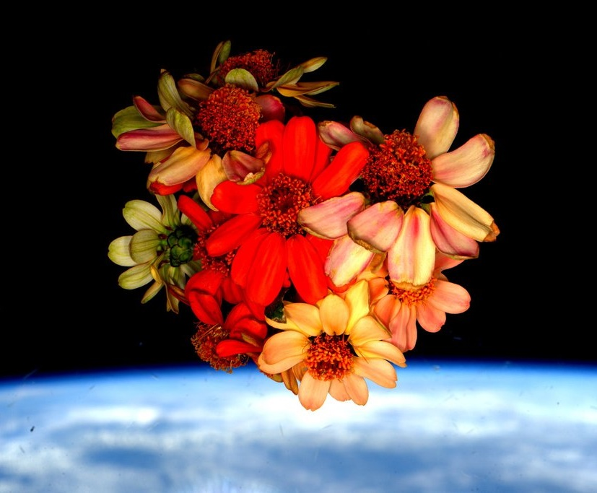
Thank you!

