Slide 1
Evaluation of Transport-Equation-Based Transition Models for High-Speed Boundary Layers Using OVERFLOW
Ethan Vogel, Meelan Choudhari, and Balaji Venkatachari
NASA Langley Research Center
AIAA Aviation Forum
APA 17 - Boundary-Layer Transition for Aerodynamic Applications I
June 13, 2023
Notes:
Record of Accomplishment for FW.2.L.03.02.009.
Note: this is the template used in FW to document the milestone completion. This is accompanied by a 1-page highlight slide.
BLUE text is wording from Presidents budget.

Slide 2
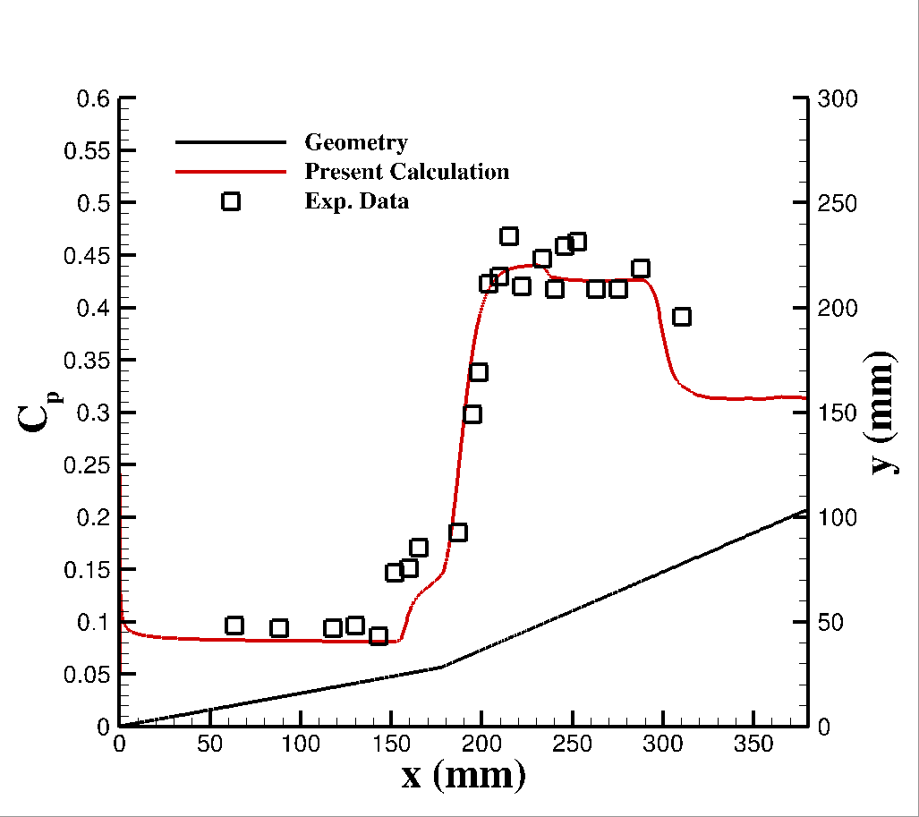
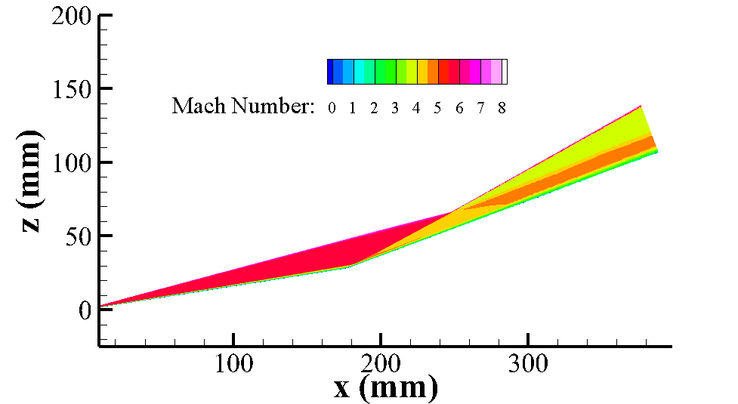
Outline
Introduction
Description of SST-𝛾 and SST-𝛾-𝜈_{L} Transition Models
Solver and Simulation Parameters
Investigation of Model Properties
Presentation of Experimental Test Cases
Summary and Observations
Ongoing/Future Work
Conclusions

Slide 3
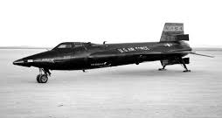
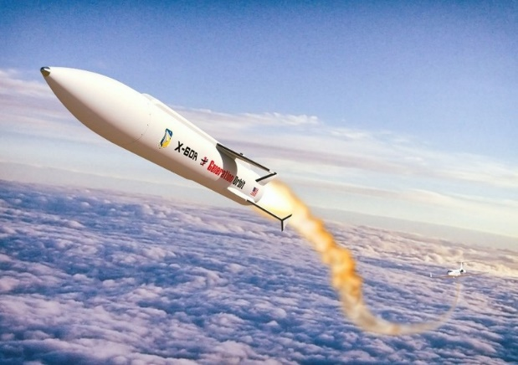
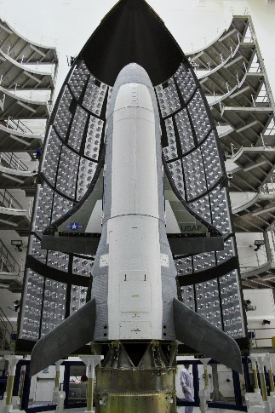
Introduction and Motivation
Transition prediction for high-speed flows is an ongoing challenge
Commonly-used transition models based on RANS-coupled transport equations are not valid for high-speed applications
Several extensions to high-speed boundary layers have been proposed very recently
Not implemented in widely available CFD solvers
Not independently evaluated
Not widely used
This study examines two of these models implemented in OVERFLOW 2.3 (SST-𝛾 and SST-𝛾-𝜈_{L})

Slide 4
Outline
Introduction
Description of SST-𝛾 and SST-𝛾-𝜈_{L} Transition Models
Solver and Simulation Parameters
Investigation of Model Properties
Presentation of Experimental Test Cases
Summary and Observations
Ongoing/Future Work
Conclusions

Slide 5
Transport-Based Transition Modeling
RANS-based CFD calculations can include transition prediction via additional transport equations that calculate intermittency, $γ$, that modifies the source terms in the RANS equation(s):
Accurate calculation of $γ$ relies on the prediction of transition onset by relevant mechanisms
Most commonly-used transition models are intended for low-subsonic to transonic Mach numbers
Additional transport quantities are usually modeled as well, which are used to calculate the production of $γ$
Currently, there is no thoroughly-vetted, widely-implemented transport model for the prediction of transition at hypersonic Mach numbers
$$\frac{∂(ρk)}{∂t}+\frac{∂(ρu_{j}k)}{∂x_{j}}={γP}_{k} −γ_{lm}E_{k}+Π_{cc}+ \frac{1}{Re}\frac{∂}{∂x_{j}} \left[\left(μ+{σ_{k}μ}_{t}\right)\frac{∂k}{∂x_{j}} \right]$$

Slide 6
SST-𝛾 model of Liu et al. (2022)
A single auxiliary transport equation is added
Hypersonic analogue of Menter’s 𝛾 model
Production is triggered when local vorticity Reynolds number exceeds a threshold
Effects of pressure gradient, nose radius, and surface temperature are modeled empirically via $f\left(M_{e},T_{e}\right)$ and $Re_{θ,c}$
Transition mechanisms involving 1st− and 2nd−mode instabilities are grouped together in streamwise onset function
Streamwise and crossflow modes are competitive
$$\frac{∂(ργ)}{∂t}+\frac{∂(ρu_{j}γ)}{∂x_{j}}=P_{γ} −E_{γ}+\frac{1}{Re}\frac{∂}{∂x_{j}} \left[\left(μ+μ_{t}\right)\frac{∂γ}{∂x_{j}} \right]$$
$$P_{γ}=C_{1} ρ F_{onset} γ(1 −γ)$$
$F_{onset}=f^{∗}(F_{onset, s} , F_{onset,cf})$
$$F_{onset,s}=\frac{Re_{V}}{f\left(M_{e},T_{e}\right)Re_{θ,c} }$$
$$F_{onset,cf}=\frac{ΔH_{cf}Re_{V}}{f\left(M_{e},T_{e}\right)C_{cf,crit}}$$
6

Slide 7
SST-𝛾-𝜈_{L} model of Qiao et al. (2021)
Two auxiliary transport equations are added
Extension of the early work by Warren and Hassan (1998), Papp and Dash (2002)
Production of $γ$ is triggered when $ν_{L}$ exceeds a threshold
Transport of $ν_{L}$ models the impact of bluntness, pressure gradient, and surface (& freestream) temperature
Transition mechanisms dominated by 1st , 2nd, and crossflow modes are treated separately
$τ_{L}$ constituents are calculated individually
All modes contribute additively to the production of $ν_{L}$.
$$\frac{∂(ργ)}{∂t}+\frac{∂(ρu_{j}γ)}{∂x_{j}}=P_{γ} −E_{γ}+\frac{1}{Re}\frac{∂}{∂x_{j}} \left[\left(μ+μ_{t}\right)\frac{∂γ}{∂x_{j}} \right]$$
$$P_{γ}=ρC_{1}F_{onset}\left(1−γ\right)−\ln{{\left(1−γ\right)}^{\frac{1}{3}}S}$$
$$F_{onset}=f^{∗}\left(\frac{ν_{L}}{ν}\right)$$
$$\frac{∂(ρν_{L})}{∂t}+\frac{∂(ρu_{j}ν_{L})}{∂x_{j}}=P_{ν_{L}} −E_{ν_{L}}+\frac{1}{Re}\frac{∂}{∂x_{j}} \left[ρσ_{1}\left(ν+σ_{ν_{L}}ν_{L}\right)\frac{∂ν_{L}}{∂x_{j}} \right]$$
$$P_{ν_{L}= }C_{μ} ρ τ_{L} S^{2}$$
$$τ_{L}=τ_{1}+τ_{2}+τ_{cf}$$
7

Slide 8
Outline
Introduction
Description of SST-𝛾 and SST-𝛾-𝜈_{L} Transition Models
Solver and Simulation Parameters
Investigation of Model Properties
Presentation of Experimental Test Cases
Summary and Observations
Ongoing/Future Work
Conclusions

Slide 9
OVERFLOW 2.3e Parameters
OVERFLOW 2.3e is modified to include both SST-𝛾 and SST-𝛾-𝜈_{L} models
All test cases are run with HLLE++, van Albada limiter, and SSOR
Mesh requirements estimated via grid refinement study for a single test case
Grids used here are generally much finer than those used in Liu et al. (2022) and Qiao et al. (2021)
For 𝛾-𝜈_{L} case, turbulence modeling time step has been reduced to 0.2 times the local flow time step
5 subiterations per flow time step are also used
Freestream-turbulence-sustaining terms and QCR are not used in this study
9

Slide 10
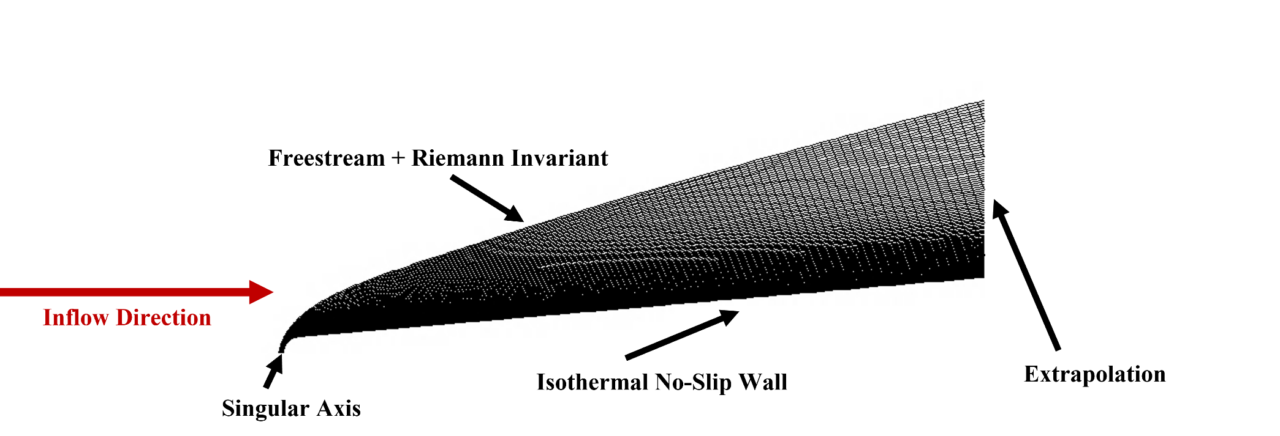
Simulation parameters
Requirements for Tu∞, μ_{T∞}, and 𝛾-𝜈_{L∞} are not the same for the SST-𝛾 and SST-𝛾-𝜈_{L} models
Values of Tu∞ reported by Liu el al. (2022) and Qiao et al. (2021) did not produce visual agreement in all cases, and freestream values were adjusted where appropriate to achieve the experimentally correct onset location
Cases use shock-aligned grids generated from laminar precursor runs to identify shock location
10

Slide 11
Outline
Introduction
Description of SST-𝛾 and SST-𝛾-𝜈_{L} Transition Models
Solver and Simulation Parameters
Investigation of Model Properties
Presentation of Experimental Test Cases
Summary and Observations
Ongoing/Future Work
Conclusions

Slide 12
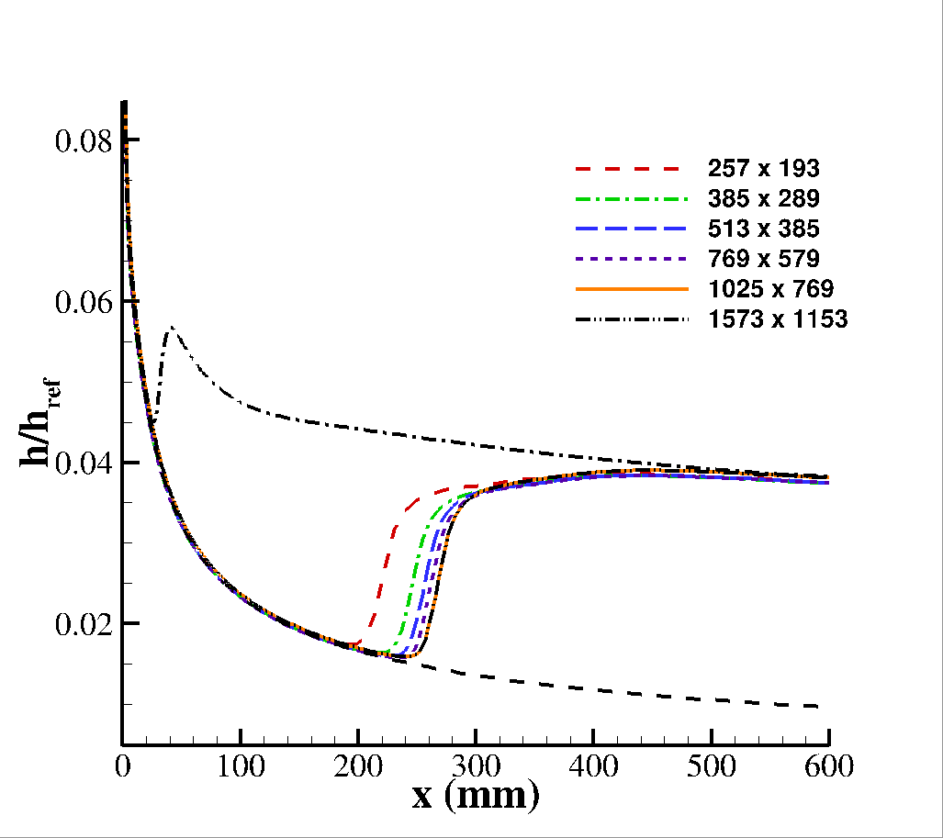
Grid Refinement Study: Hypersonic Cone
𝛾 model
𝛾-𝜈_{L} model
Case | Model | M∞ | Re (1/m) | QOI | Tu∞ | ν_{L, ∞} | Reference
LaRC M6 | 5-deg Straight Cone | 6.00 | 1.41E+7 | Stanton Number | 0.38 / 0.11 | 0.05 | Horvath et al. [4]
12

Slide 13
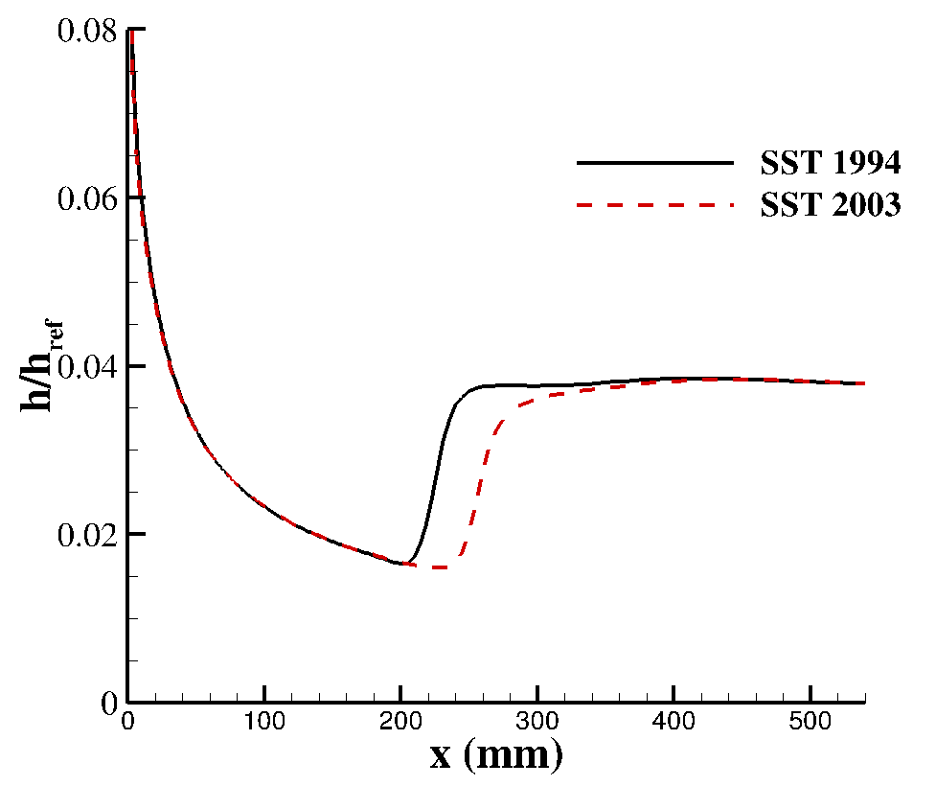
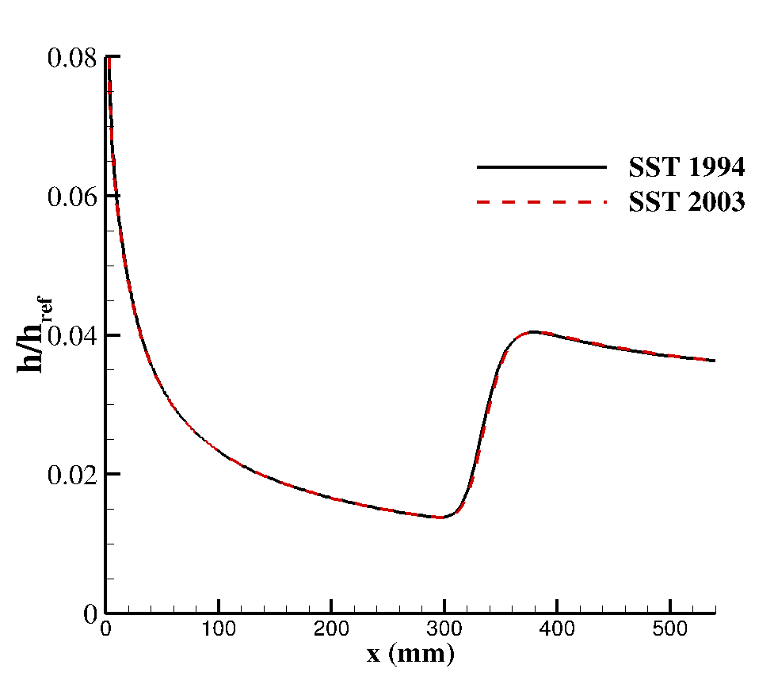
Influence of SST-Turbulence-Model Version
SST originally released in 1994, and was updated in 2003
OVERFLOW 2.3 distribution uses 2003 version only
Both models examined here were coupled only to SST-1994 in their initial presentation
Ideally transition model should be agnostic to turbulence model version
Some coupling may be inevitable
SST-1994 is reintroduced to OVERFLOW for consistency with original model presentations [Liu, 2022 and Qiao, 2021].
Case LaRC M6 Cone
𝛾 model
𝛾-𝜈_{L} model
13

Slide 14
Outline
Introduction
Description of SST-𝛾 and SST-𝛾-𝜈_{L} Transition Models
Solver and Simulation Parameters
Investigation of Model Properties
Presentation of Experimental Test Cases
Summary and Observations
Ongoing/Future Work
Conclusions

Slide 15
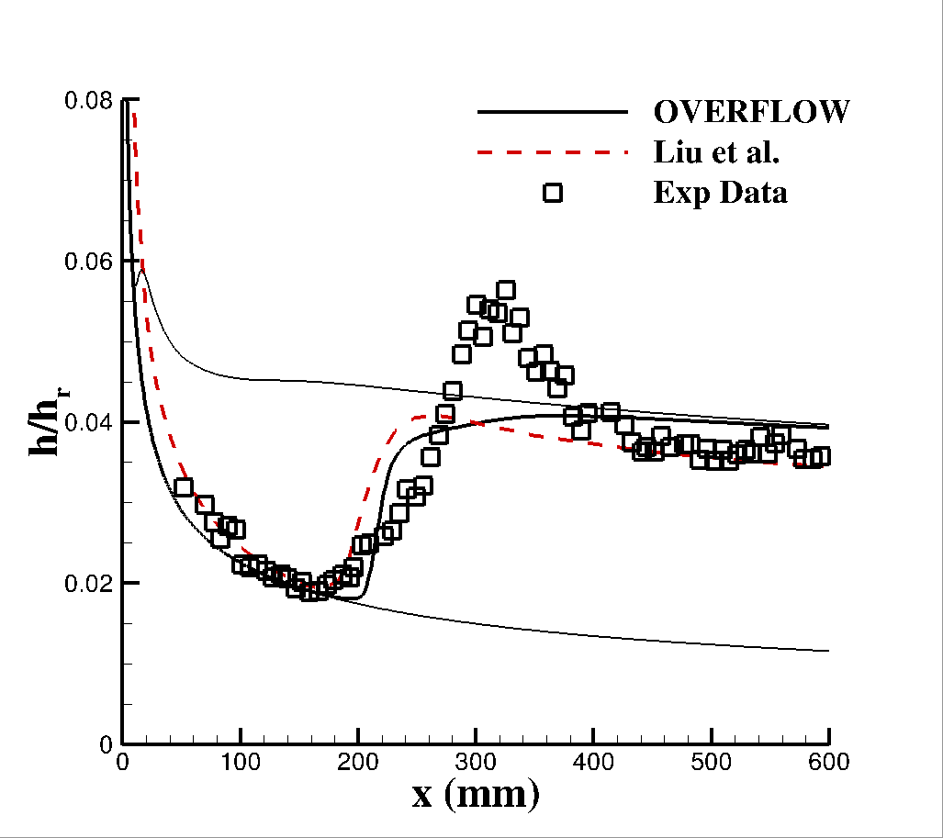
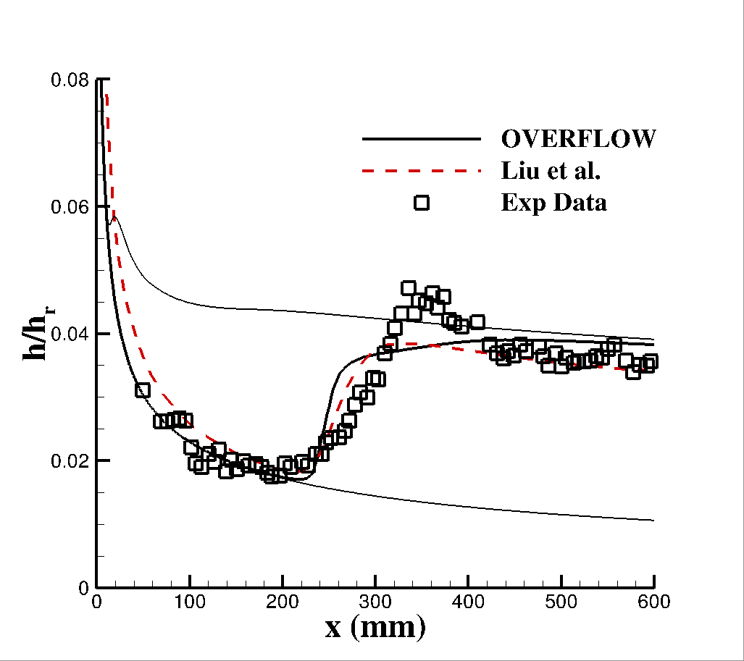
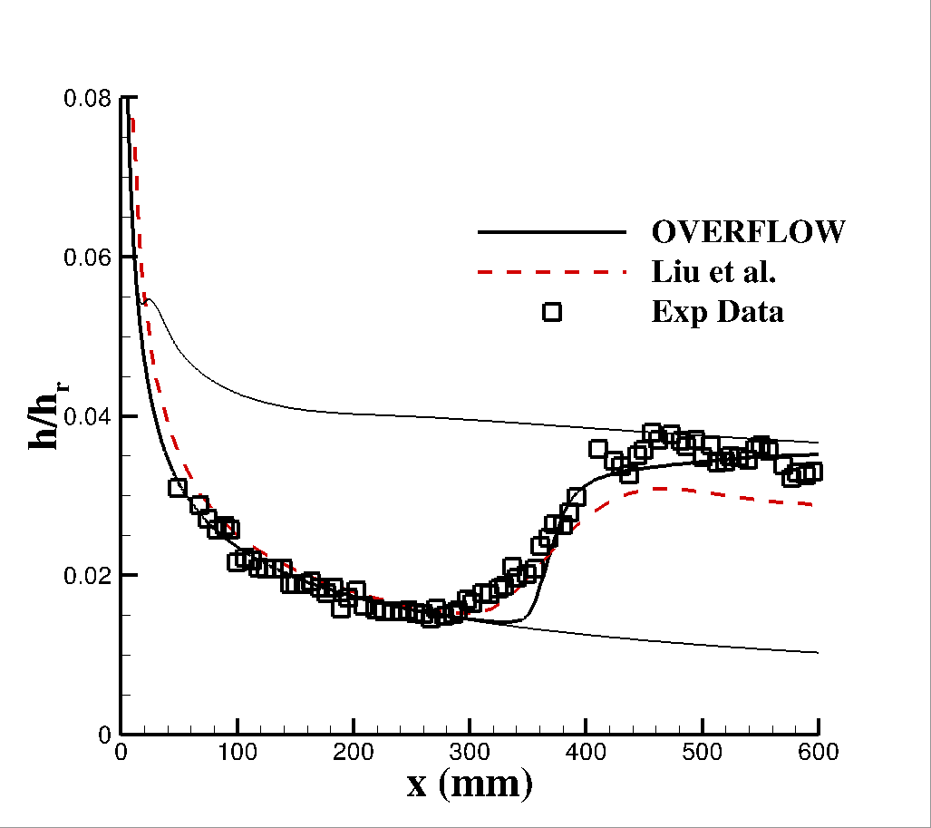
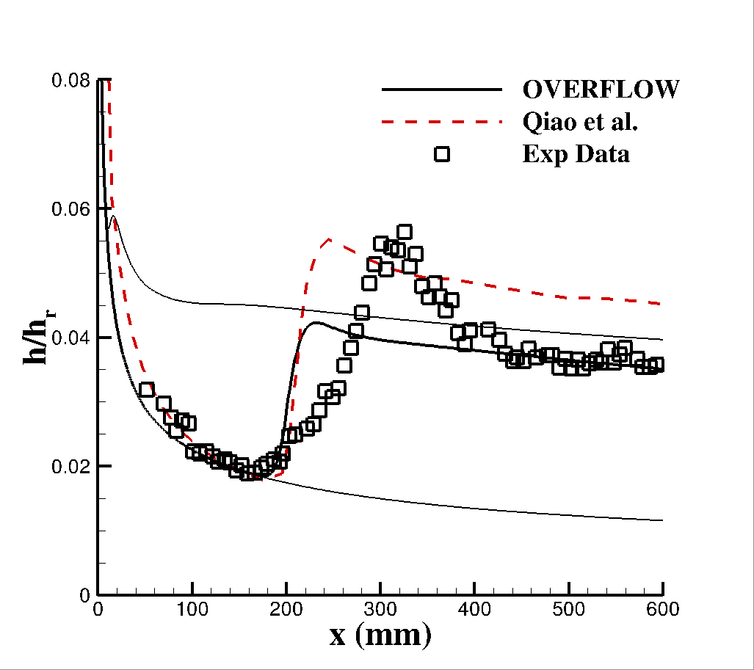
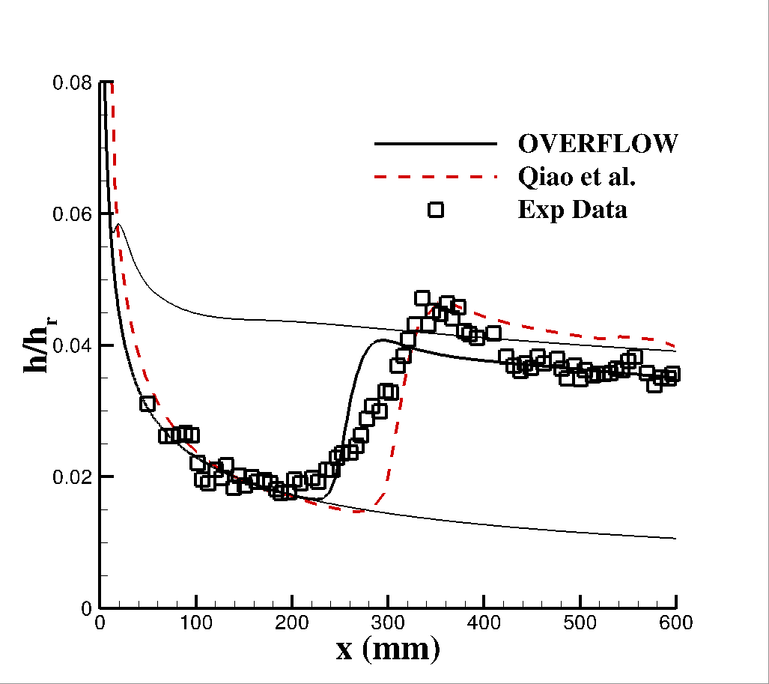
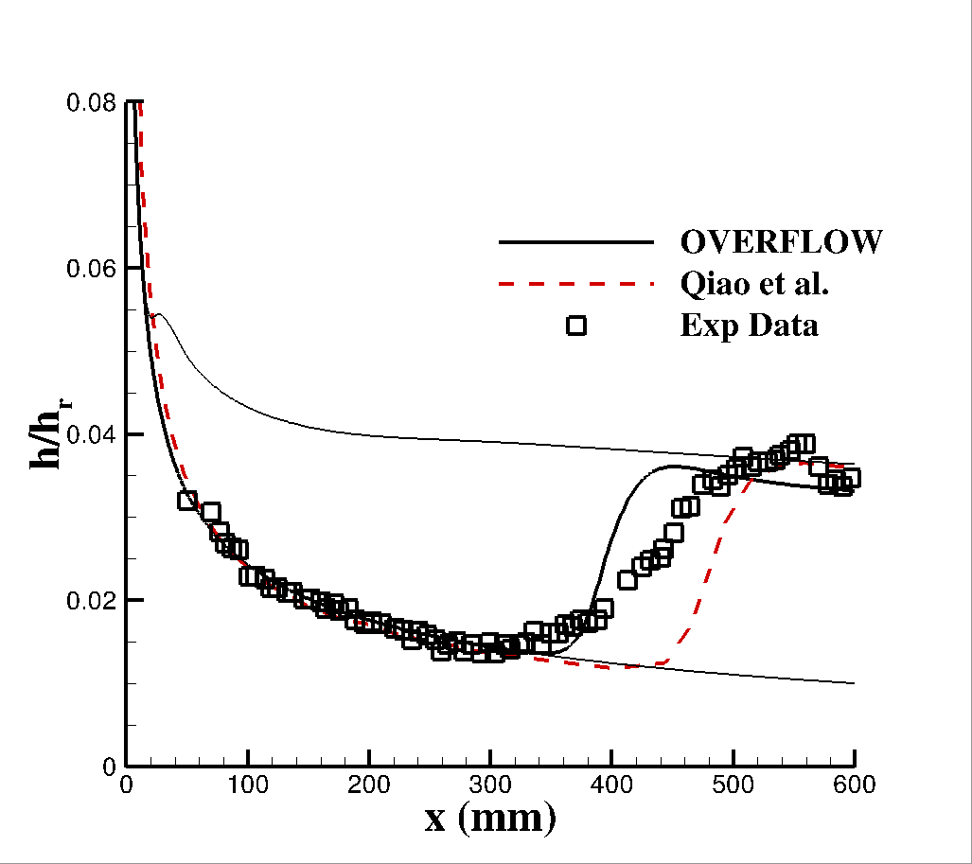
Hypersonic Transition Modeling: LaRC M6
𝛾 model
Decreasing Re∞
𝛾-𝜈_{L} model
Case | Model | M∞ | Re (1/m) | QOI | Tu∞ | ν_{L, ∞} | Reference
LaRC M6 | 5-deg Straight Cone | 6.00 | 1.05E+7 – 2.56E+7 | Stanton Number | 0.38 / 0.11 | 0.05 | Horvath et al. [4]
15

Slide 16
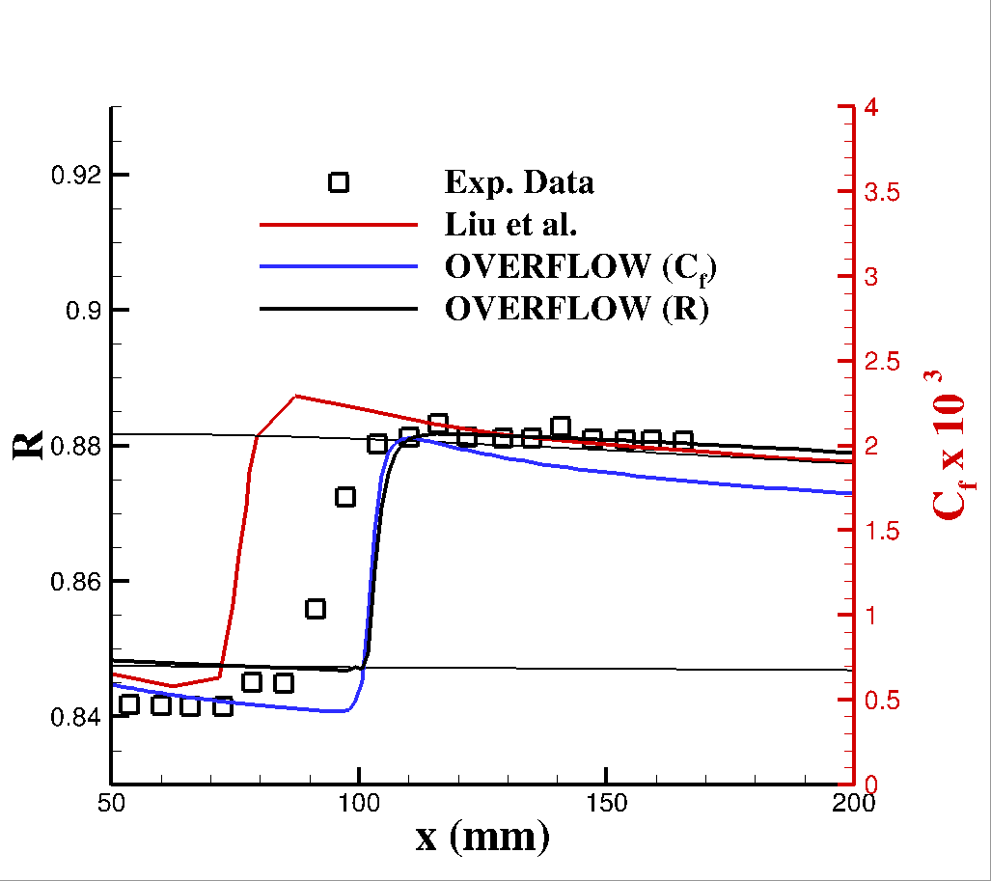
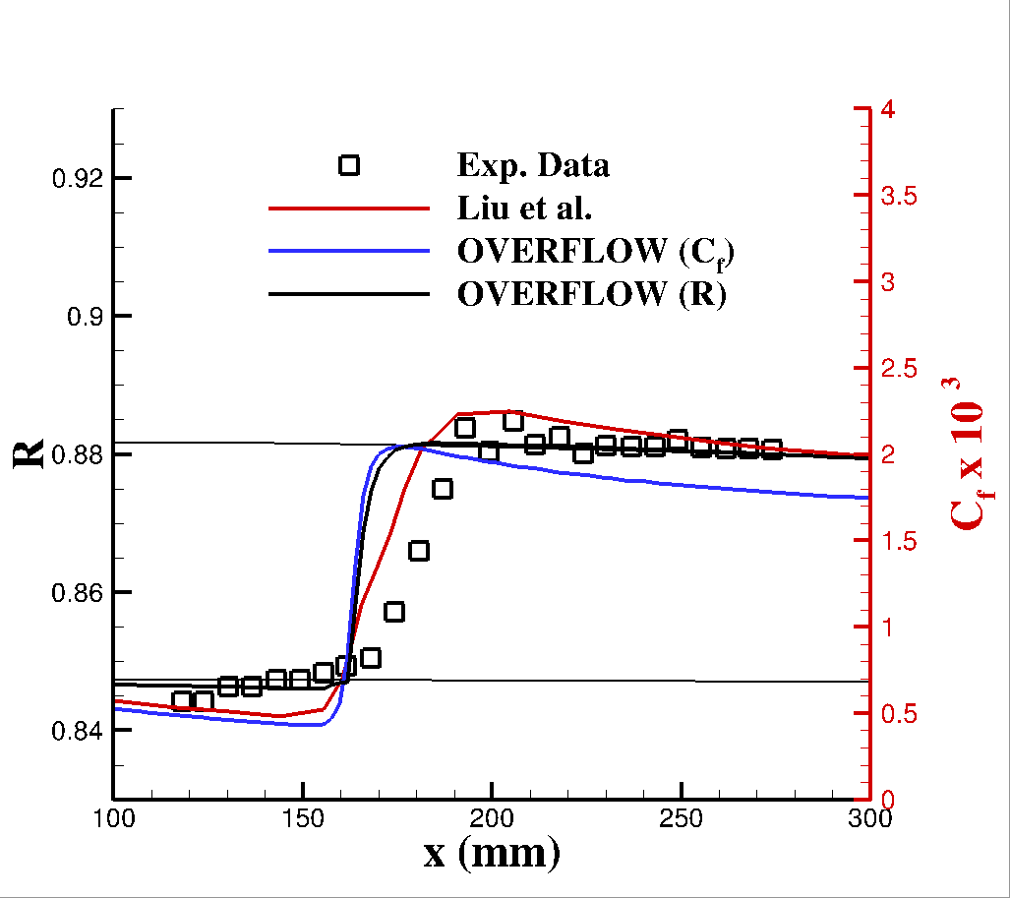
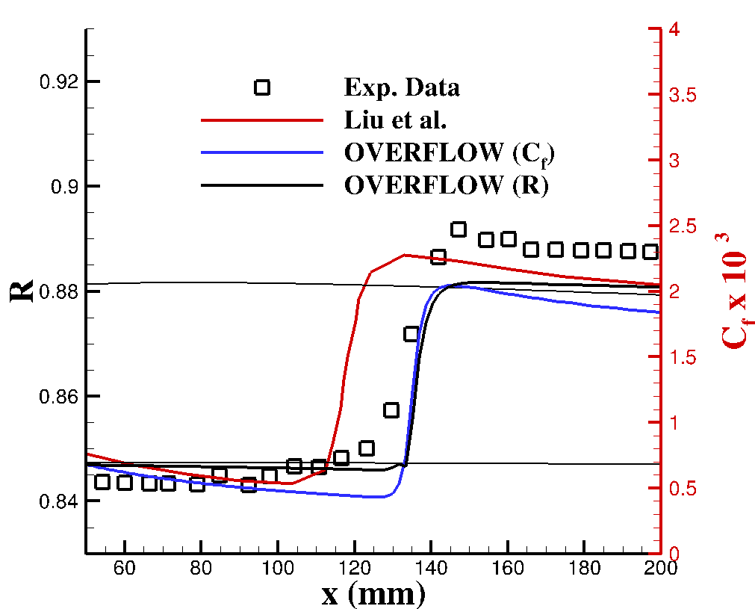
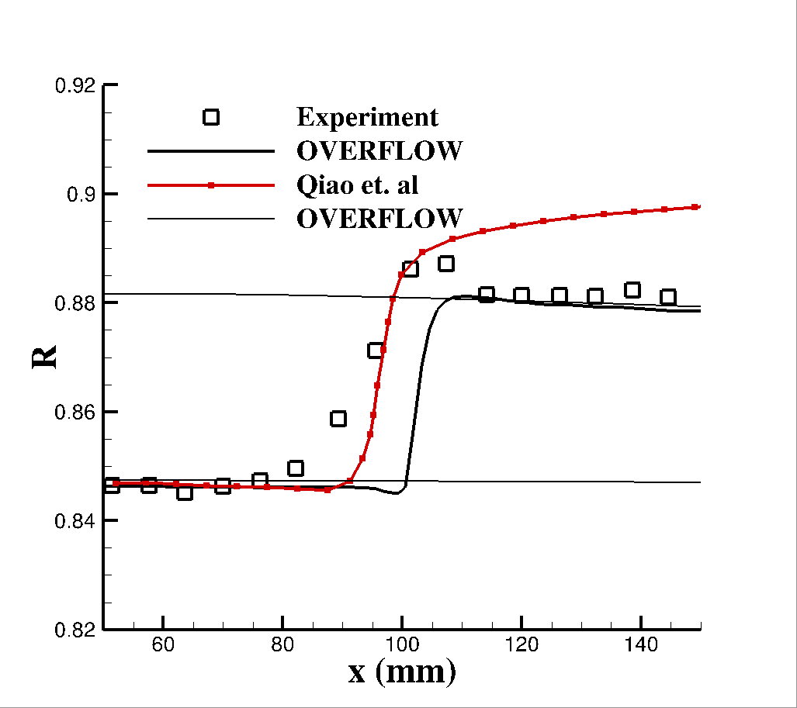
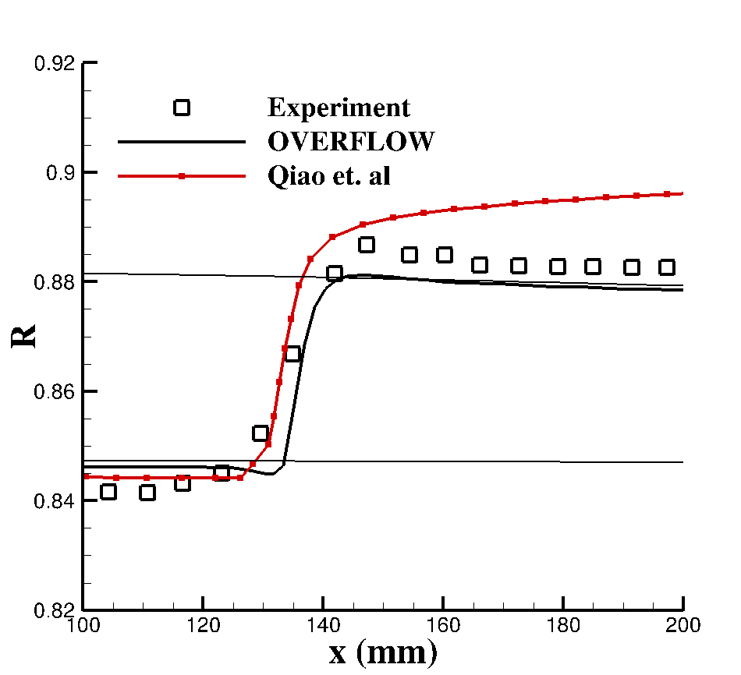
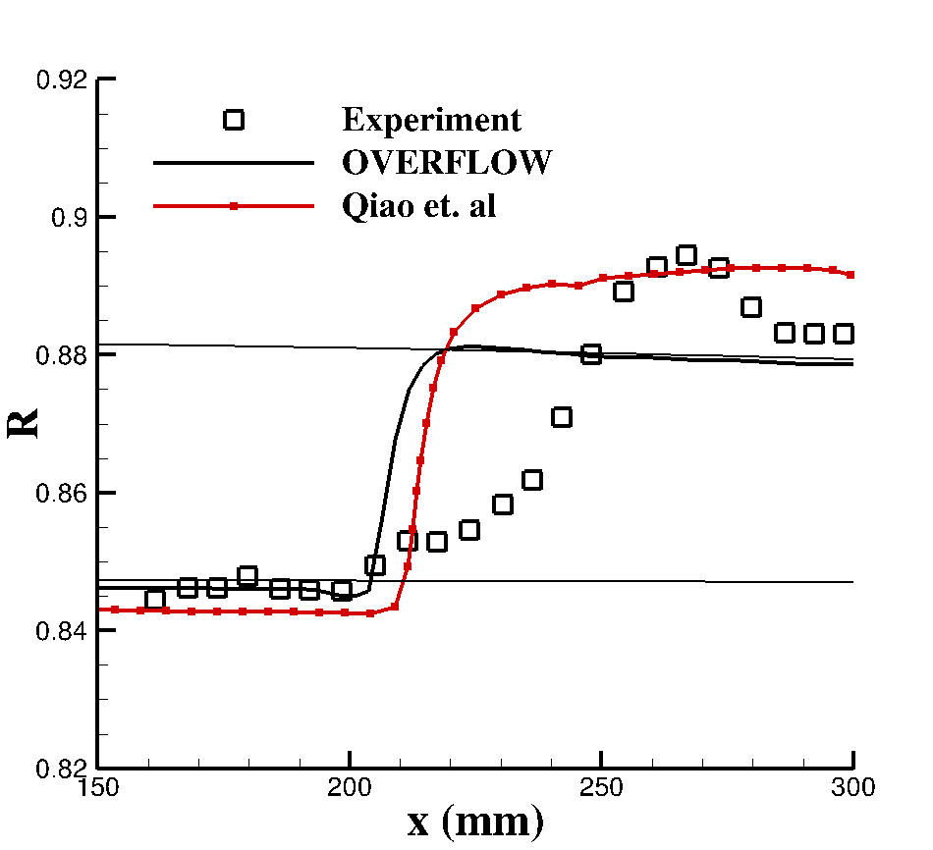
Supersonic Transition Modeling: LaRC-M3pt5
𝛾 model
Decreasing Re∞
𝛾-𝜈_{L} model
Case | Model | M∞ | Re (1/m) | QOI | Tu∞ | ν_{L, ∞} | Reference
LaRC M3.5 | 5-deg Straight Cone | 3.50 | 2.81E+7 - 7.8E+7 | Recovery Factor | 0.03 / 0.1 | 0.05 | Chen et al. [6]
16

Slide 17
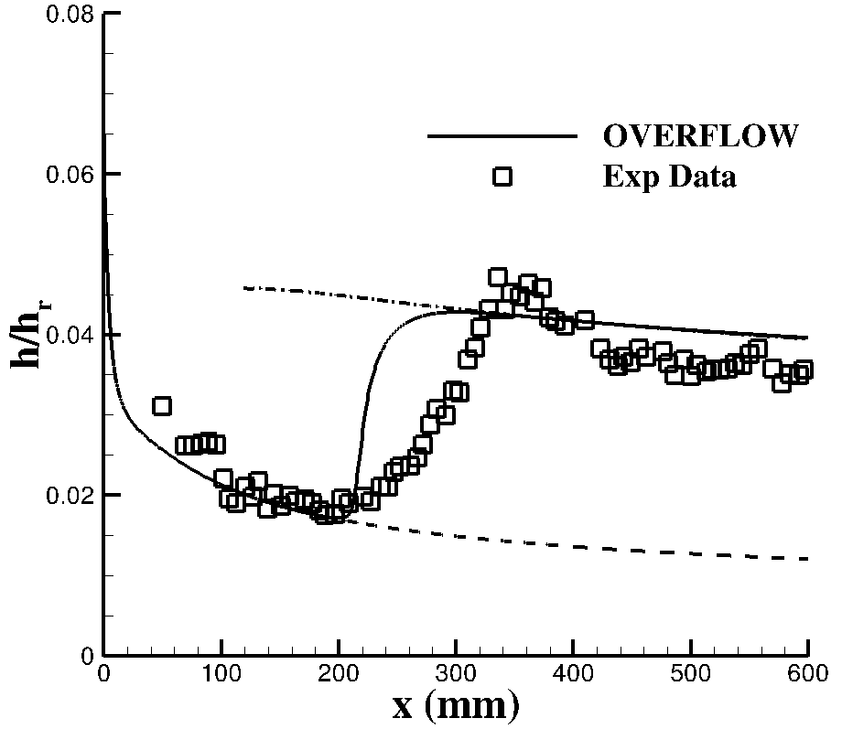
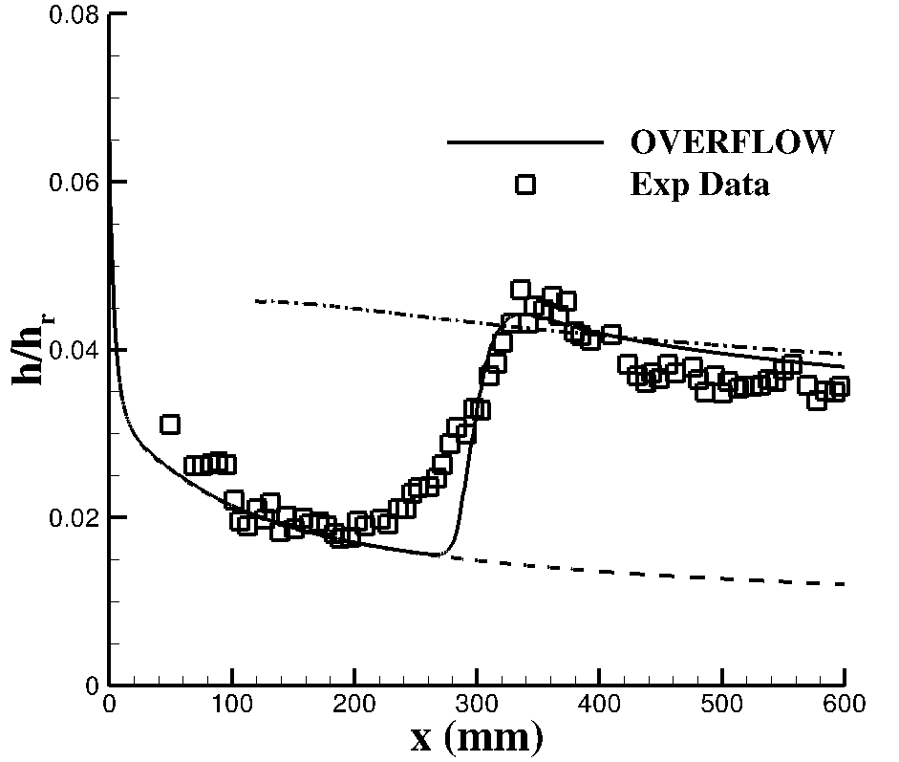
Impact of Nose Bluntness
𝛾 model
𝛾-𝜈_{L} model
Case | Model | M∞ | Re (1/m) | QOI | Tu∞ | ν_{L, ∞} | Reference
LaRC M6 | 5-deg Straight Cone | 6.00 | 1.05E+7 – 2.56E+7 | Stanton Number | 0.38 / 0.11 | 0.05 | Horvath et al. [4]
17

Slide 18
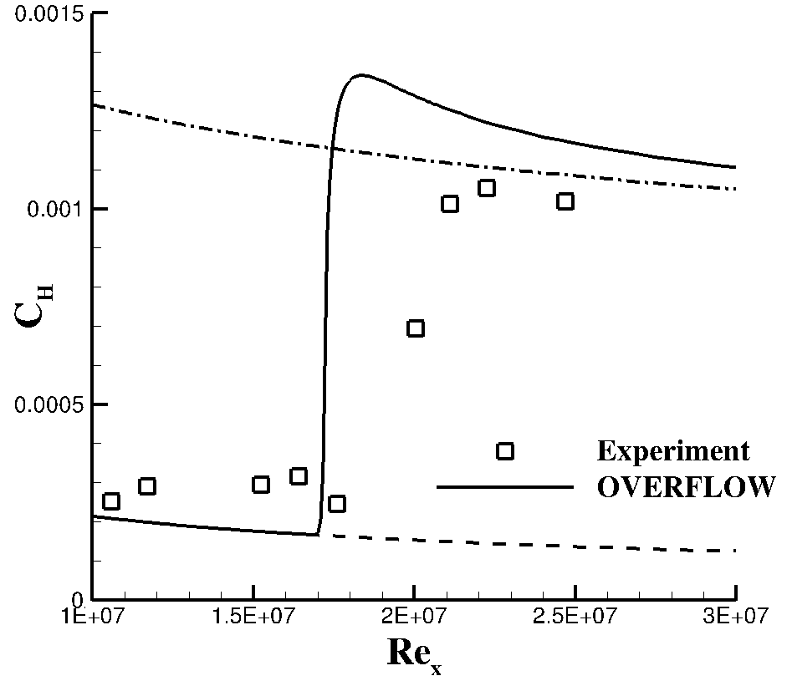
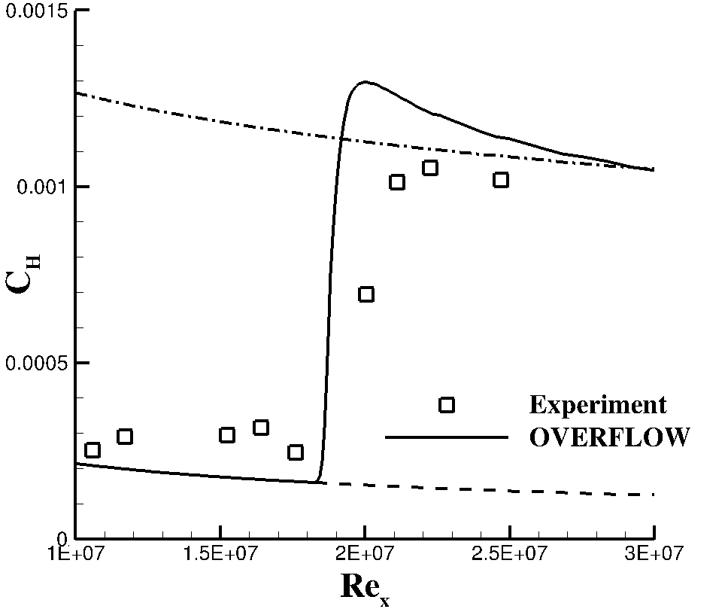
Evaluation of Model Accuracy for Flight Conditions
𝛾 model
𝛾-𝜈_{L} model
Case | Model | M∞ | Re (1/m) | QOI | Tu∞ | ν_{L, ∞} | Reference
HIFiRE – 1 | 7-deg Straight Cone | 5.31 | 1.17 E+7 | Stanton Number | 0.007 / 1.0 E-4 | 2.5 E-6 | Kimmel et al. [3]
18

Slide 19
Outline
Introduction
Description of SST-𝛾 and SST-𝛾-𝜈_{L} Transition Models
Solver and Simulation Parameters
Investigation of Model Properties
Presentation of Experimental Test Cases
Summary and Observations
Ongoing/Future Work
Conclusions

Slide 20
Summary and Observations - SST-𝛾 model
Computationally robust and straightforward to implement
Trends in transition modeling settings across cases are consistent with the noise levels of the facilities they are examined in
Extensible to flight given proper calibration
Achieves fully turbulent flow quantities for all cases examined
Relies on empirical correlations for many relevant flow phenomena
May not scale well with geometric complexity
Sensitive to version of SST (1994 vs 2003)
Grid convergence required significant grid resolution for the hypersonic test case examined
20

Slide 21
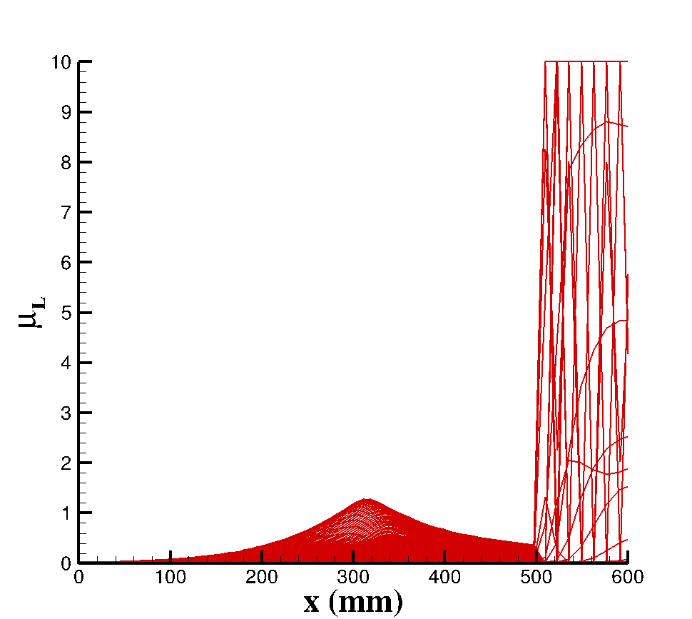
Summary and Observations - SST-𝛾-𝜈_{L} model
Captures nose bluntness-induced transition delay for the test case considered here without needing a correction
Insensitive to version of SST (1994 vs 2003)
Grid convergence achieved with reasonable resolution
Extensible to in-flight transition, given proper calibration/interpretation
Computationally not robust
Prone to divergence of transition modeling variables
Requires very small transition modeling time step
Relationship between freestream disturbance environment and transition modeling settings is unclear
Tends to fall short of surface quantities predicted for fully turbulent SST
21

Slide 22
Outline
Introduction
Description of SST-𝛾 and SST-𝛾-𝜈_{L} Transition Models
Solver and Simulation Parameters
Investigation of Model Properties
Presentation of Experimental Test Cases
Summary and Observations
Ongoing/Future Work
Conclusions

Slide 23
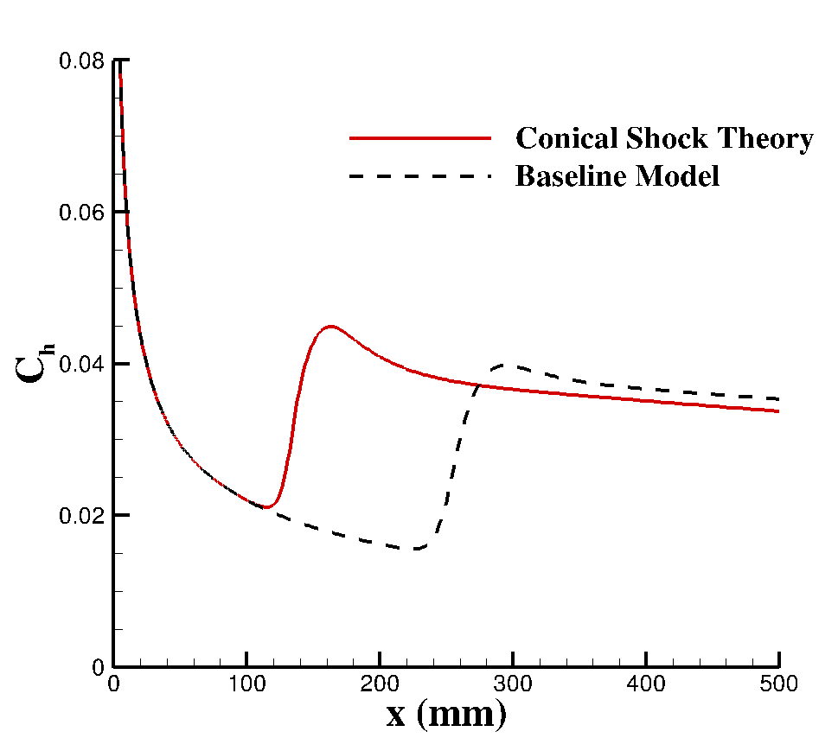
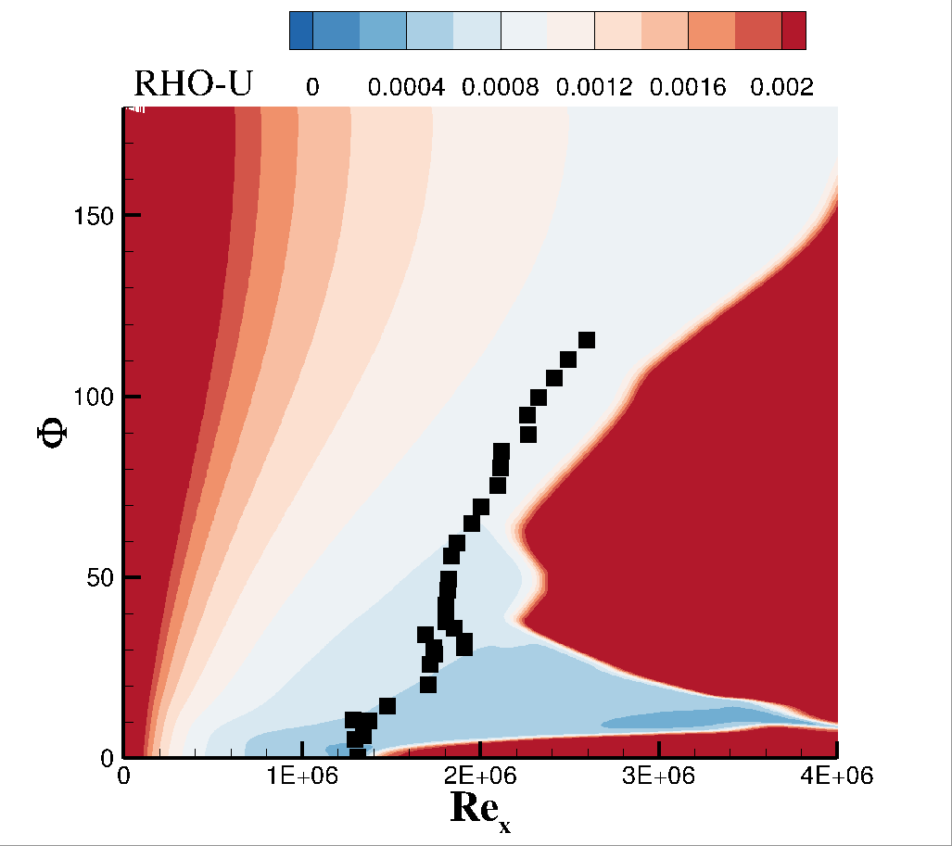
Ongoing Work
Verification data for 3 supersonic and 3 hypersonic studies is being generated and will be made available for others to compare implementations
Analysis of additional cases not included in Liu et al. (2022) and Qiao et al. (2021)
Particular focus on the extension of these models to flight conditions
Evaluation of crossflow cases
Shortcomings identified in this study are being investigated further to help develop improved models
Numerical shortcomings of SST-𝛾-𝜈_{L}
Isentropic calculation of BL edge conditions
Inability to predict heat-transfer overshoot near end of transition via either model
Overly narrow predicted transition zone
Mach 6 cone examined with 𝛾-𝜈_{L} model and analytic edge conditions
C_{f}
Mach 2 cone at angle-of-attack examined with 𝛾-𝜈_{L} model
23

Slide 24
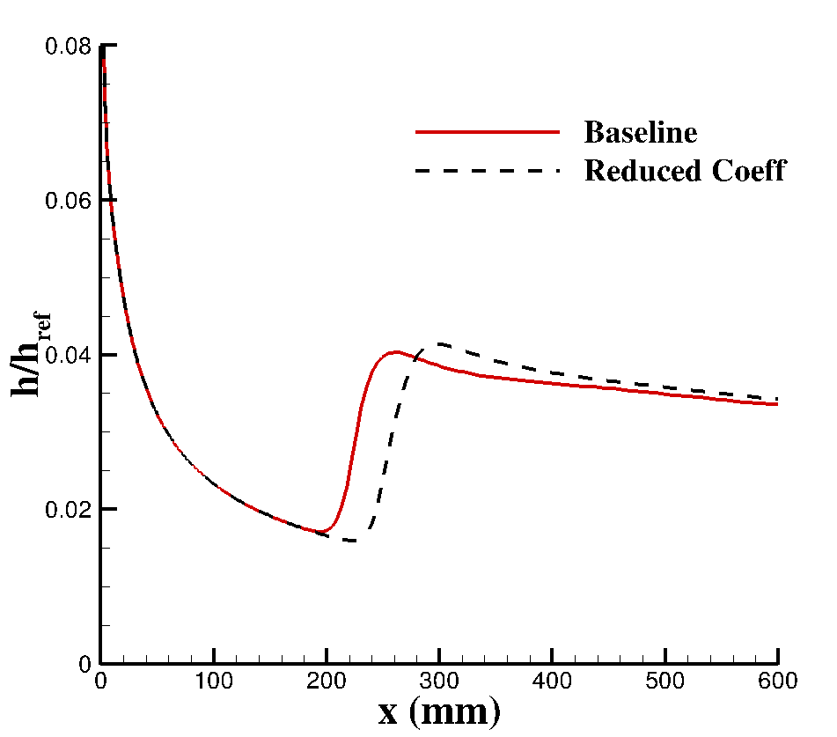
Conclusions
Both SST-𝛾 and SST-𝛾-𝜈_{L} models yield reasonable predictions for transition onset in the canonical test cases examined here
Transition zone characteristics are not predicted well in either case
Overshoot near end of transition is not accounted for
Transition zone is generally too narrow
Extension to complex geometries will require multiple obstacles to be overcome
Computational robustness, calculation of BL edge quantities, interpretation of transition modeling quantities, etc.
SST 𝛾-𝜈_{L} model likely better able to be extended to complex geometries, provided computational shortcomings can be overcome
Mach 6 cone examined with 𝛾-𝜈_{L} model with a modified diffusion coefficient
24

Slide 25
References
Kimmel, R. L., Adamczak, D., Paull, A., Paull, R., Shannon, J., adn Myles Frost, R. P., and Alesi, H., “HIFiRE-1 Ascent-Phase Boundary-Layer Tranition,” Journal of Spacecraft and Rockets, Vol. 52, No. 1, 2015. https://doi.org/10.2514/1.A32851.
Horvath, T. J., Berry, S. A., Hollis, B. R., Chang, C.-L., and Singer, B. A., “Boundary Layer Transition on Slender Cones in Conventional and Low Disturbance Mach 6 Wind Tunnels,” 32nd Fluid Dynamics Conference and Exhibit, American Institute of Aeronautics and Astronautics, 2002.
Chen, F.-J., Malik, M. R., and Beckwith, I. E., “Boundary-Layer Transition on a Cone and Flat Plate at Mach 3.5,” AIAA Journal, Vol. 27, No. 6, 1989.
Qiao, L., Xu, J., Bai, J., and Zhang, Y., “Fully Local Transition Closure Model for Hypersonic Boundary Layers Considering Crossflow Effects,” AIAA Journal, Vol. 59, No. 5, 2021. https://doi.org/10.2514/1.J059765.
Liu, Z., Lu, Y., Li, J., and Yan, C., “Local Correlation-Based Transition Model for High-Speed Flows,” AIAA Journal, Vol. 60, 2022. https://doi.org/10.2514/1.J060994.
25

Slide 26
Acknowledgements
This research is sponsored by the NASA Hypersonic Technology Project (HTP) and the NASA Transformative Tools and Technologies Project (TTT) under the Aeronautics Research Mission Directorate.
Computations included in this work were utilized the LaRC K midrange supercomputing cluster along with the computational resources provided by the NASA High-End Computing (HEC) Program through the NASA Advanced Supercomputing (NAS) Division at the Ames Research Center.
The authors acknowledge Joseph Derlaga for his assistance with the OVERFLOW source code
26

Slide 27
Thank you!

