Slide 1
Trajectory Optimization Methods and Applications at NASA Goddard
April 27th, 2023
Robert Pritchett

Slide 2
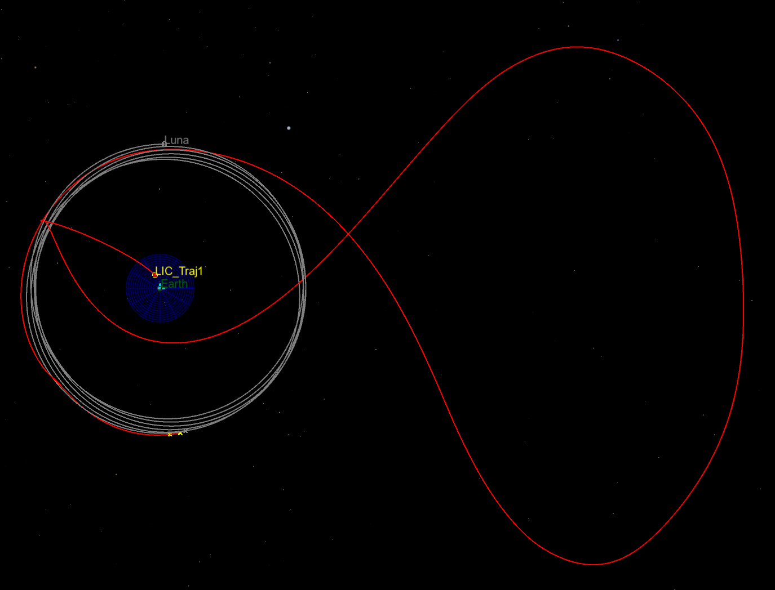
How To…
Design a low-thrust transfer to a lunar libration point orbit for a CubeSat?
Plan a low-thrust transfer and 10 year science mission that fulfills formation flying requirements?
Identify an extended mission target that can be reached with the remaining propellant?
Lunar IceCube Trajectory
Sun-Earth Rotating Frame
Notes:
To motivate our discussion today I’ll begin by introducing three trajectory design problems that we’ve encountered recently at Goddard. The first was for the Lunar IceCube mission, and was the challenge of how to design a low-thrust transfer for a CubeSat from its deployment near the Earth to a libration point orbit near the Moon. The second problem is for the planned LISA mission and concerns how to design low-thrust transfers for 3 independent spacecraft that deliver these spacecraft to science orbits which maintain the spacecraft in an equilateral triangle formation for a 10 year science mission intended to measure gravity waves. Finally, the OSIRIS-Rex mission will deliver its sample of the asteroid Bennu to Earth later this year, and, after the capsule is released, the carrier spacecraft will have some propellant remaining. The extra propellant raises the possibility of an extended mission, but how do we identify potential targets for such a mission that can be reached with the remaining propellant.
One thing all 3 of these trajectory design problems have in common is that they benefit from the application of optimization algorithms. Lunar IceCube and LISA use low-thrust solar electric propulsion while OSIRIS-REx uses high-thrust chemical engines, but in both cases we want to choose the timing, direction, and magnitude of maneuvers in a way that minimizes the amount of propellant required to achieve the mission objectives. By minimizing propellant usage we can free up spacecraft mass that can be devoted to science instruments or simply use the additional propellant to achieve other mission objectives.

Slide 3
The Challenge
Design spacecraft trajectories that achieve mission objectives while minimizing one or more parameters such as propellant consumption or time of flight.
What tools to use?
How to apply these tools?
Lunar IceCube Trajectory
Sun-Earth Rotating Frame
Notes:
How to design optimal spacecraft trajectories is a challenge encountered frequently in the field of mission design. We almost always want to optimize a trajectory such that one or more parameters such as propellant consumption or time of flight are minimized. This challenges raises two questions that we will address in today’s presentation. First, what tools can we use to solve spacecraft trajectory optimization problems. Second, how do we apply those tools. The application portion of this presentation will focus especially on how one of Goddard’s trajectory optimization tools was used for the Lunar IceCube mission. If there is time at the end I can talk more about the other two trajectory design problems I introduced on the previous slide as well.

Slide 4
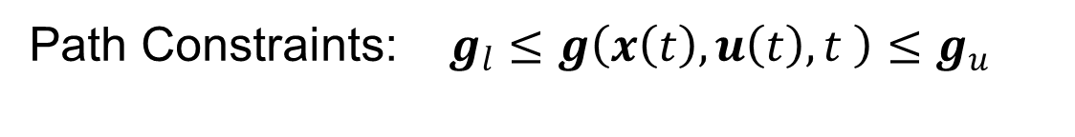
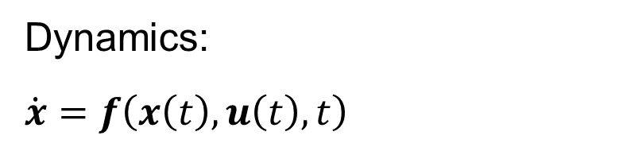
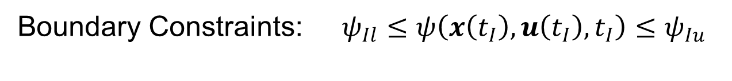



Background: The Optimal Control Problem
Cost: $min J= φ\left(x\left(t_{F}\right),t_{F}\right)+\int_{t_{I}}^{t_{F}}{L\left(x\left(t\right),u\left(t\right),t\right)dt}$
Terminal
Path
Dynamics:
$$\dot{x}=f\left(x\left(t\right),u\left(t\right),t\right)$$
$$t_{F}$$
Time
$$u\left(t\right)$$
States
Control
Path Constraints: $g_{l}≤g\left(x\left(t\right),u\left(t\right),t \right)≤g_{u}$
$$t_{I}$$
Boundary Constraints: $ψ_{Il}≤ψ\left(x\left(t_{I}\right),u\left(t_{I}\right),t_{I}\right)≤ψ_{Iu}$
Notes:
Before I discuss Lunar IceCube I am going to spend some time on optimization background, and this begins by introducing the optimal control problem. Fundamentally, an optimal control problem concerns the determination of a set of inputs to a system to extremize a desired parameter. The problem of low-thrust trajectory design perfectly fits this description. At each instant in time, the thrust vector of a low-thrust spacecraft, the input, must be selected to minimize a cost, typically propellant consumption or time of flight. The world is filled with optimization problems, both naturally occurring, such as light refracting through water, and human-made. Thus, significant effort has been invested in solving these problems. The modern field of optimal control theory originated in the 1690s when Johann Bernoulli challenged his fellow mathematicians to solve the brachistochrone problem. This prompting led to several solution methods, including ones by Issac Newton and Bernoulli himself, whose concepts are utilized to this day. The advent of computers in the 20th century spurred rapid advancement in the field of optimal control, leading to many new approaches for solving such problems. However, regardless of the method selected, all approaches require an initial mathematical formulation of the optimal control problem.

Slide 5
Background: Optimization Methods
 | Indirect Optimization | Direct Optimization | Global Optimization
Description | Apply Euler-Lagrange Theorem to create a Two-Point Boundary Value Problem (TPBVP) Solution of the TPBVP is a local optimal Oldest approach, developed in the 17th and 18th centuries Optimize then discretize | Recast the optimal control problem as a nonlinear programming (NLP) problem. Operate directly on the cost function Also called parameter optimization NLP solution methods include sequential quadratic programming (SQP) and interior point (IP) methods Discretize then optimize | Exploit heuristic methods to try to find a global optimal Also called evolutionary algorithms or metaheuristics Often based on processes observed in nature Examples include ant-colony, simulated annealing, and genetic algorithms Can produce good solutions given time, but a global optimal is difficult to verify
Indirect Optimization
Direct Optimization
Global Optimization
•
Apply Euler
-
Lagrange
•
Recast the optimal control
•
Exploit heuristic methods to
Theorem to create a Two
-
problem as a nonlinear
try to find a global optimal
Point Boundary Value
programming (NLP)
•
Also called evolutionary
Problem (TPBVP)
problem.
algorithms or metaheuristics
•
Solution of the TPBVP is a
•
Operate
directly
on the cost
•
Often based on processes
local optimal
function
observed in nature
•
Oldest approach, developed
•
Also called parameter
•
Examples include ant
-
Description
in the 17
th
and 18
th
centuries
optimization
colony, simulated annealing,
•
Optimize then discretize
•
NLP solution methods
and genetic algorithms
include sequential quadratic
•
Can produce good solutions
programming (SQP) and
given time, but a global
interior point (IP) methods
optimal is difficult to verify
•
Discretize then optimize
Notes:
Might be beneficial to also note differential dynamic programming as another optimization approach not discussed here.
Definition of heuristic technique from Wikipedia: any approach to problem solving or self-discovery that employs a practical method that is not guaranteed to be optimal, perfect, or rational, but is nevertheless sufficient for reaching an immediate, short-term goal or approximation. Where finding an optimal solution is impossible or impractical, heuristic methods can be used to speed up the process of finding a satisfactory solution. Heuristics can be mental shortcuts that ease the cognitive load of making a decision.
Also see Wikipedia definition of metaheuristics: Metaheuristic – Wikipedia
See Wikipedia on Minimal Surface of Revolution for visual explanation of why indirect method only gets you a local optimal. Minimal surface of revolution - Wikipedia

Slide 6
Background: Optimization Methods
 | Indirect Optimization | Direct Optimization | Global Optimization
Pro | Smaller problem size yields efficiency Provides control law Solution guaranteed to be a local optimal | Robust to poor initial guess Simple to setup Straightforward to incorporate problem changes | Can offer global optimal solution Do not require an initial guess
Con | Costate values are unintuitive Must rederive the two point boundary value problem if the problem changes Often requires a better initial guess than other methods | Produce large dimension problems More difficult to guarantee optimality | Computationally expensive Coarse approximation of the dynamics
Indirect Optimization
Direct Optimization
Global Optimization
•
Smaller problem size yields
•
Robust to poor initial guess
•
Can offer global optimal
efficiency
•
Simple to setup
solution
•
Provides control law
•
Straightforward to
•
Do not require an initial
Pro
•
Solution guaranteed to be a
incorporate problem
guess
local optimal
changes
•
Costate values are
•
Produce large dimension
•
Computationally expensive
unintuitive
problems
•
Coarse approximation of the
•
Must rederive the two point
•
More difficult to guarantee
dynamics
Con
boundary value problem if
optimality
the problem changes
•
Often requires a better initial
guess than other methods

Slide 7
Background: Transcription Methods
How do we turn the continuous optimal control method into a discrete problem that can be solved on a numerically?
The answer, transcription methods:
Shooting
Collocation
$$t_{F}$$
$$t_{I}$$

Slide 8
Background: Transcription Methods
Discretize the continuous problem into nodes:
$$t_{F}$$
$$t_{I}$$

Slide 9






Background: Transcription Methods
Each node is associated with a time, $t$, a state vector, $x_{1}$,
and a control vector, $u_{1}$. Note that $s$ is the number of segments.
$$x_{s+1}$$
$$x_{s}$$
$$t_{F}$$
$$x_{3}$$
$$x_{2}$$
$$x_{1}$$
$$t_{I}$$

Slide 10
Background: Transcription Methods
The optimization problem is now represented by this set of nodes.
$$x_{s+1}$$
$$x_{s}$$
$$t_{F}$$
$$x_{3}$$
$$x_{2}$$
$$x_{1}$$
$$t_{I}$$

Slide 11





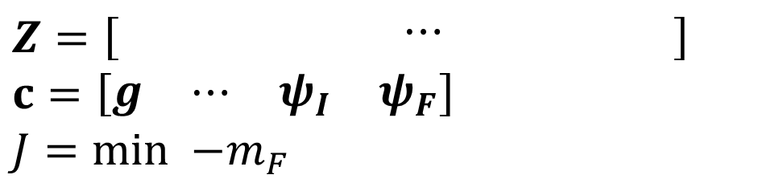

Background: Transcription Methods
States and controls are contained in the design variable vector, $Z$, and these are used to evaluate the constraints $c$, and the cost function, $J$.
$$x_{1}$$
$$x_{2}$$
$$x_{3}$$
$$x_{s}$$
$$x_{s+1}$$
$$t_{F}$$
$$Z=\left[\begin{matrix}x_{1} & x_{2} & x_{3} & ⋯ & x_{s} & x_{s+1}\end{matrix}\right]$$
$$c=\left[\begin{matrix}g & ⋯ & ψ_{I} & ψ_{F}\end{matrix}\right]$$
$$J=min {−m}_{F}$$
$$t_{I}$$
Notes:
Note that proper scaling makes a big difference for problem convergence

Slide 12





Background: Shooting Methods
Shooting methods explicitly propagate the dynamics, $\dot{x}=f\left(x\left(t\right),u\left(t\right),t\right)$, from one node to the next. Constraints are defined that enforce continuity between the states at the end of a propagation and the following node.
Versions of this method include: single shooting and multiple forward shooting (depicted above). Multiple shooting is also called parallel shooting.
$$c=\left[\begin{matrix}g & ⋯ & ψ_{I} & ψ_{F} & ∆_{i}\end{matrix}\right]$$
$$∆_{3}$$
$$∆_{2}$$
$$∆_{4}$$
$$∆_{1}$$

Slide 13




Background: Collocation Methods
Collocations methods use polynomials to approximate the dynamics, $\dot{x}=f\left(x\left(t\right),u\left(t\right),t\right)$. Constraints are defined that ensure the gradients of the polynomials match the gradients of the dynamics at specific defect points.
Many different types of polynomials can be used within a collocation method, examples include: Trapezoidal, Hermite-Simpson, Runge-Kutta, Gauss-Lobatto.
$$c=\left[\begin{matrix}g & ⋯ & ψ_{I} & ψ_{F} & ∆_{i}\end{matrix}\right]$$
$$∆_{2}$$
$$∆_{1}$$
$$∆_{4}$$
$$∆_{3}$$

Slide 14
Background: Shooting vs. Collocation Methods
Shooting Methods:
Use many integration steps
More straightforward to setup if using third-party explicit integration tools, e.g., Matlab’s ode suite of integrators
Typically employed for final high-fidelity trajectory validation step
Collocation Methods:
Number of integration steps equals the number of segments.
Lower number of integration steps generally makes these algorithms more likely to converge when given a poor initial guess
Notes:
Differences in implementation make a head-to-head comparison between the tools challenging

Slide 15
Background: Optimization Decision Tree
Optimal Control Problem
Optimize then discretize
Indirect Optimization
Direct Optimization
Discretize then optimize
Shooting
Collocation
Shooting
Collocation

Slide 16
Background: What if I Don’t Want to Optimize?
Optimal Control Problem
Shooting
Collocation
Newton’s Method or Minimum-Norm

Slide 17
Background: GSFC Trajectory Optimization Tools
Name | Type of Optimizer | Notes
GMAT | Direct Shooting | General Mission Analysis Tool (GMAT) Set up problems via a GUI, script interface, or API; source code in C++ Can create many varieties of direct shooting problems Includes high fidelity dynamical models used in operations Interactive 3D graphics Access open-source release on SourceForge
EMTG | Direct Shooting (Inner-Loop) Metaheuristic (Outer-Loop) | Evolutionary Mission Trajectory Generator (EMTG) Problems set up via a GUI or text file; source code in C++ Forward-backward or forward only shooting are used in the inner loop The outer loop algorithm is Monotonic Basin Hopping (MBH) Includes low fidelity dynamical models that enable a rapid search of the solution space and medium fidelity models for validating solutions Access open-source release on GitLab
Name
Type of Optimizer
Notes
•
General Mission Analysis Tool (GMAT)
•
Set up problems via a GUI, script interface, or API; source code in C++
•
Can create many varieties of direct shooting problems
GMAT
Direct Shooting
•
Includes high fidelity dynamical models used in operations
•
Interactive 3D graphics
•
Access open
-
source release on
SourceForge
•
Evolutionary Mission Trajectory Generator (EMTG)
Direct Shooting
•
Problems set up via a GUI or text file; source code in C++
•
Forward
-
(Inner
backward or forward only shooting are used in the inner loop
-
Loop)
EMTG
Metaheuristic
•
The outer loop algorithm is Monotonic Basin Hopping (MBH)
(Outer
•
Includes low fidelity dynamical models that enable a rapid search of the
-
Loop)
solution space and medium fidelity models for validating solutions
•
Access open
-
source release on
GitLab

Slide 18
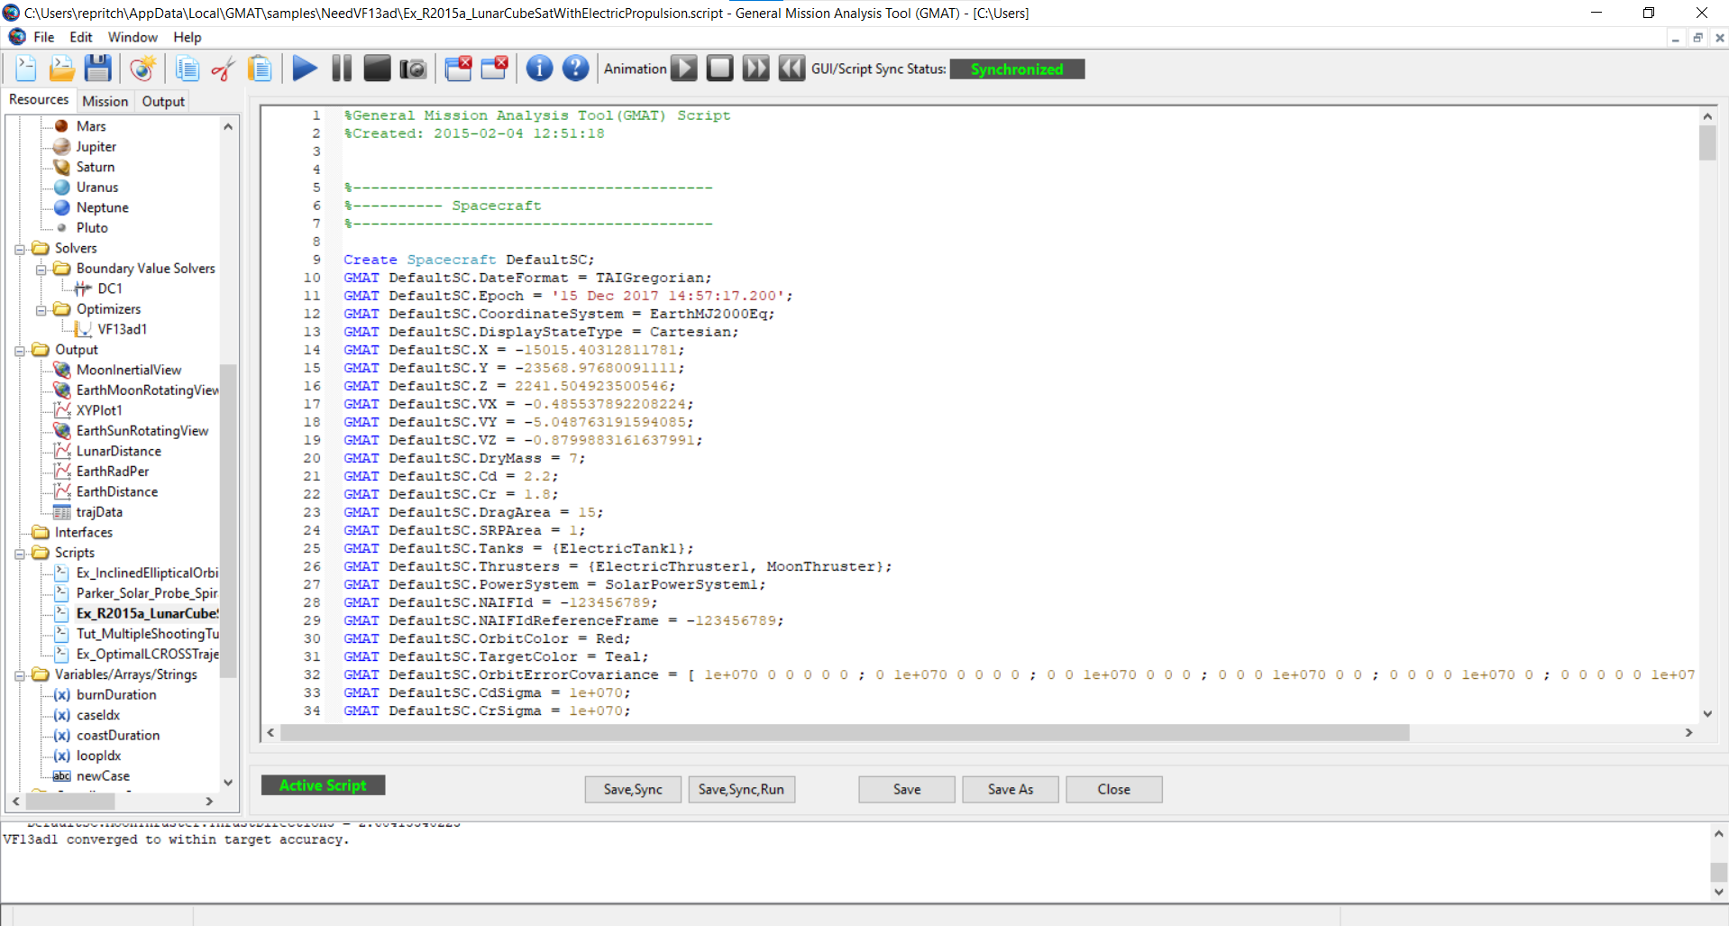
Background: GMAT Interface Example

Slide 19
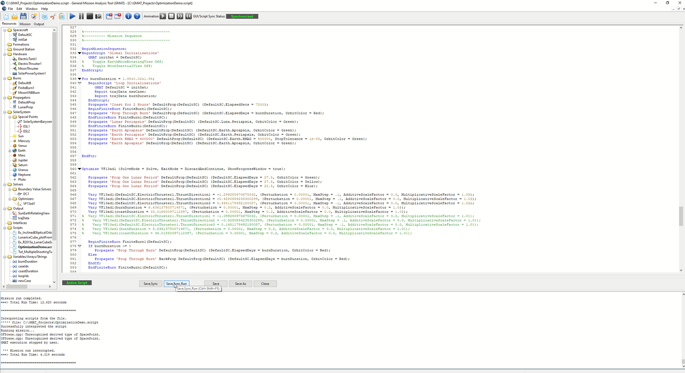
Background: GMAT Demonstration

Slide 20
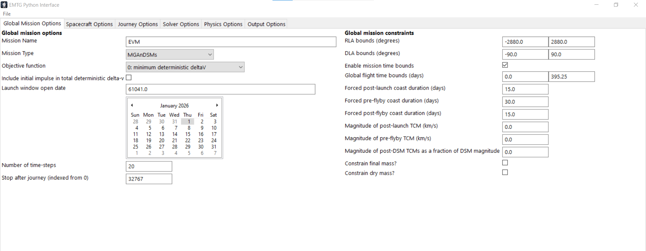
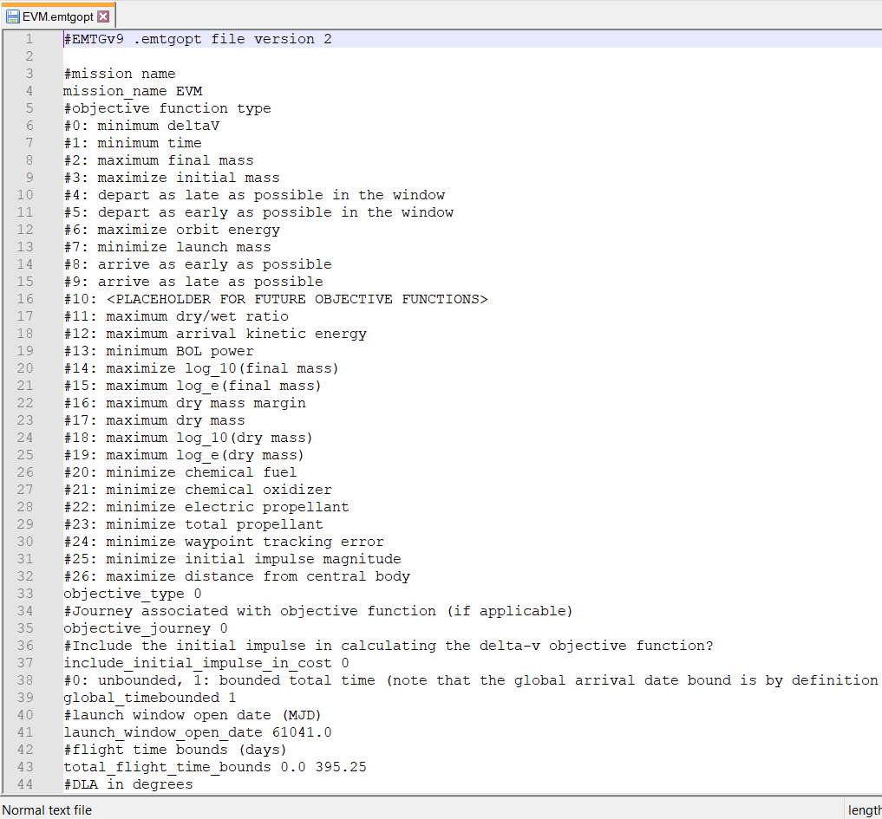
Background: EMTG Interface Example
Figure 2: EMTG Script
Figure 1: EMTG GUI

Slide 21
Background: GSFC Trajectory Optimization Tools
Name | Type of Optimizer | Notes
CSALT | Direct Collocation | Collocation Stand-Alone Library and Toolkit (CSALT) Set up problems as Matlab or C++ code, source code in C++ Hermite-Simpson, Lobatto IIIa, and Radau transcriptions available Matlab prototype version includes much of the same functionality as C++ tool, and enables easier problem setup C++ code included with GMAT source code; must be compiled separately
*PaSTA | Direct Shooting | Parametric Shooting Transcription Algorithm (PaSTA) Set up problems as Matlab or C++ code, source code in C++ Can create many varieties of direct shooting problems Uses same explicit integration algorithms as EMTG *Not currently available as an open-source tool
Name
Type of Optimizer
Notes
•
Collocation Stand
-
Alone Library and Toolkit (CSALT)
•
Set up problems as Matlab or C++ code, source code in C++
•
Hermite
-
Simpson,
Lobatto
IIIa, and
Radau
transcriptions available
CSALT
Direct Collocation
•
Matlab prototype version includes much of the same functionality as C++
tool, and enables easier problem setup
•
C++ code included with GMAT source
code; must be compiled separately
•
Parametric Shooting Transcription Algorithm (
PaSTA
)
•
Set up problems as Matlab or C++ code, source code in C++
•
Can create many varieties of direct shooting problems
*
PaSTA
Direct Shooting
•
Uses same explicit integration algorithms as EMTG
•
*Not
currently available as an open
-
source tool

Slide 22
Background: How to Decide What Tool to Use?
Guidelines:
What tool(s) have the needed features?
Example: Only GMAT and CSALT can optimize multiple spacecraft simultaneously.
How difficult is it to install the tool and set up a problem?
EMTG and GMAT offer GUIs and script/text interfaces while CSALT and PaSTA require writing Matlab or C++ code.
How good is the initial guess?
If only a poor initial guess is available then consider using direct collocation (CSALT), or direct shooting with a metaheuristic outer loop (EMTG).
Notes:
This slide is intended only for the internal presentation. Move to backup for public presentation.

Slide 23
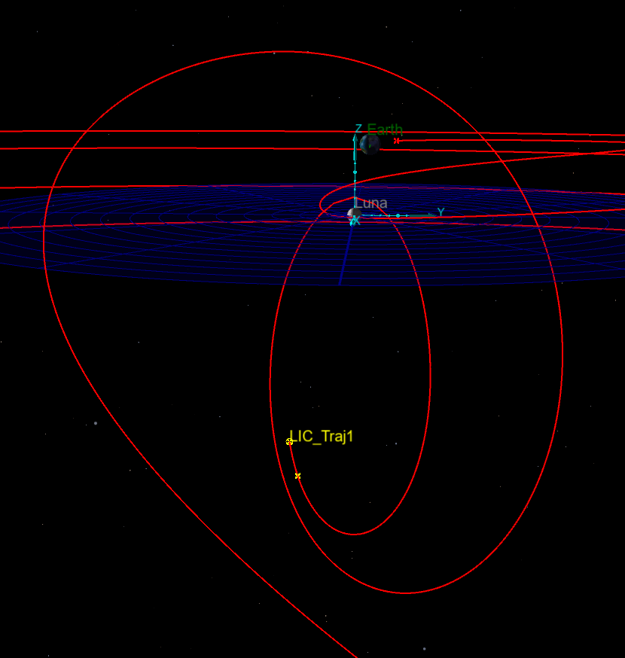
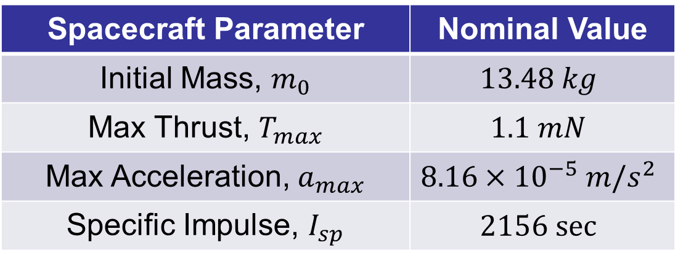
Applications: Lunar IceCube (LIC)
6U CubeSat with Busek ion engine
Secondary payload on Artemis-1
Science instruments intended to study transport of lunar volatiles
Spacecraft Parameter | Nominal Value
Initial Mass, $m_{0}$ | $$13.48 kg$$
Max Thrust, $T_{max}$ | $$1.1 mN$$
Max Acceleration, $a_{max}$ | $$8.16×{10}^{−5} m/s^{2}$$
Specific Impulse, $I_{sp}$ | $$2156 sec$$
Earth-Moon Rotating Frame

Slide 24
Applications: Lunar IceCube (LIC)
9:2 NRHO Insertion
Goal: Design a low-thrust transfer from deployment near the Earth to:
Low Lunar Orbit (LLO)
9:2 Synodic Resonance Near Rectilinear Halo Orbit (NRHO)
Challenge:
Large change in energy required
Primary payload takes priority
Cost Function: Maximum final mass
Tool: EMTG
Earth-Moon Rotating Frame

Slide 25
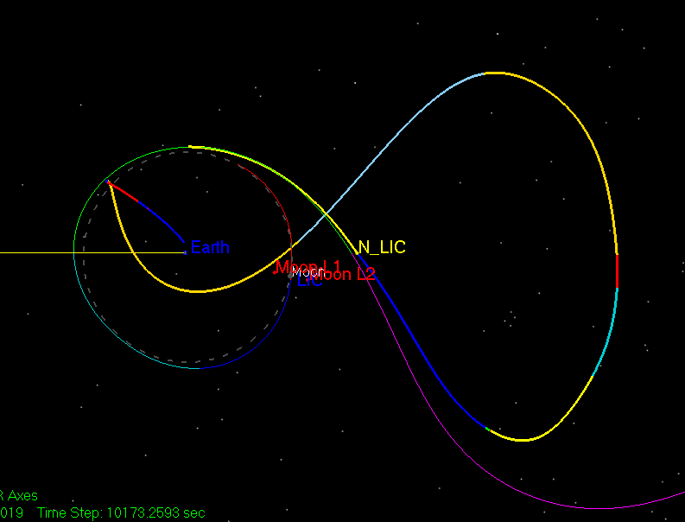
Applications: Lunar IceCube Initial Design
The initial design provided to an optimizer is critical to the success of the algorithm.
Much of the early trajectory design effort is devoted to the creation of an initial guess.
The initial guess for LIC was created by propagating forward from the deployment state and backward from the destination orbit.
Sun-Earth Rotating Frame

Slide 26
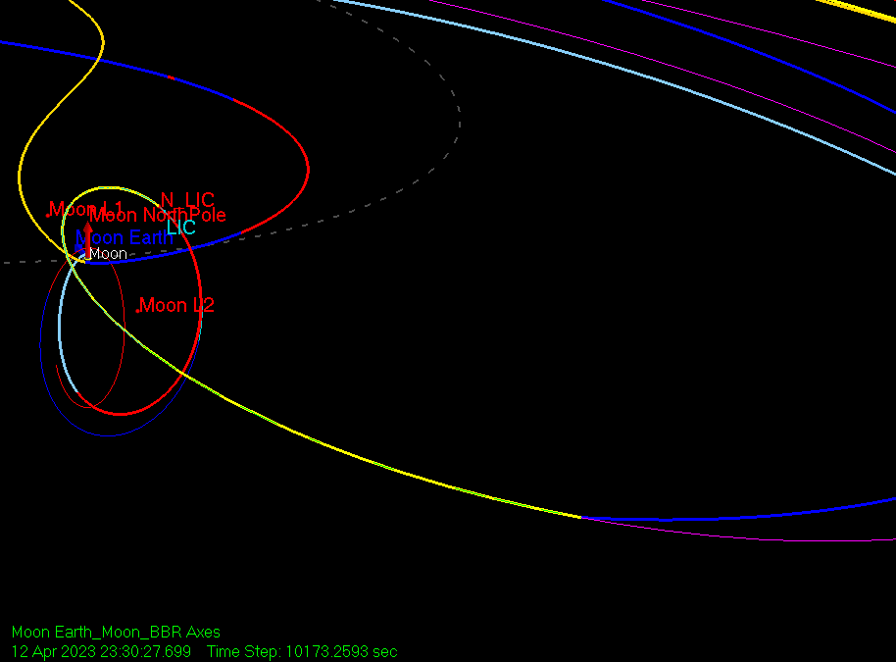
Applications: Lunar IceCube Initial Design
Earth-Moon Rotating Frame
Sun-Earth Rotating Frame

Slide 27
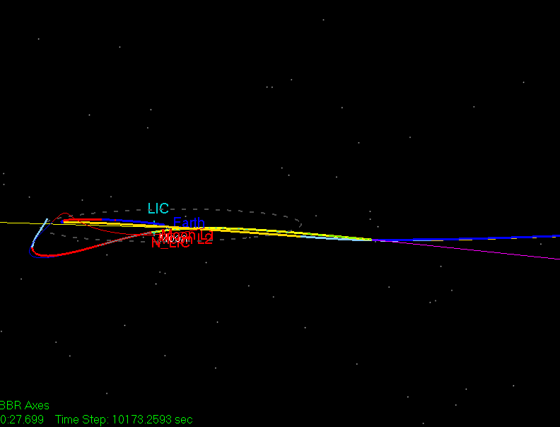
Applications: Lunar IceCube Initial Design
Variations in the initial thrust arc or the orbit departure location produced different forward and backward propagated arcs.
Trajectory segments with close intersections in states and epoch were selected.
Previous researchers explored various strategies for identifying close intersections.
Sun-Earth Rotating Frame
Notes:
Be sure to note that close intersections still include discontinuities in position, velocity, and/or epoch!

Slide 28
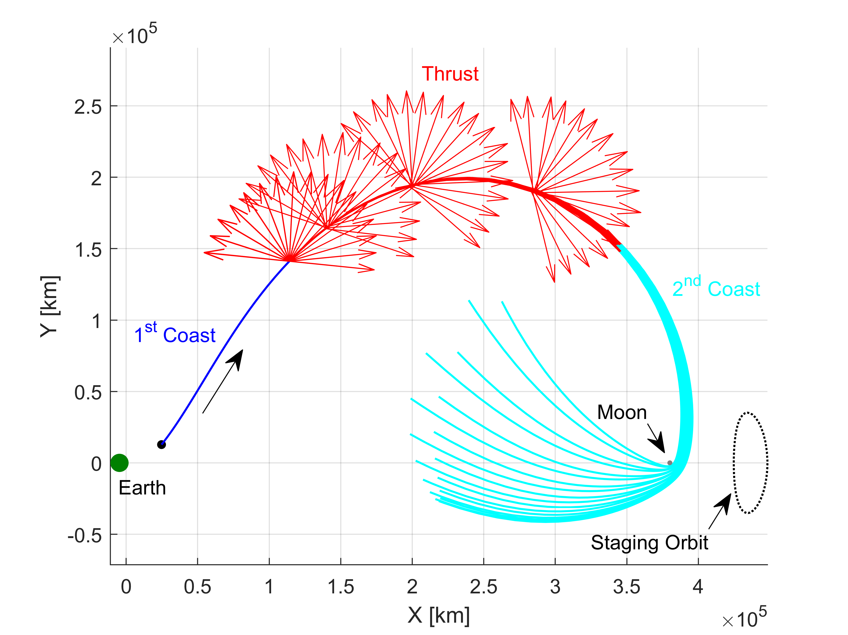
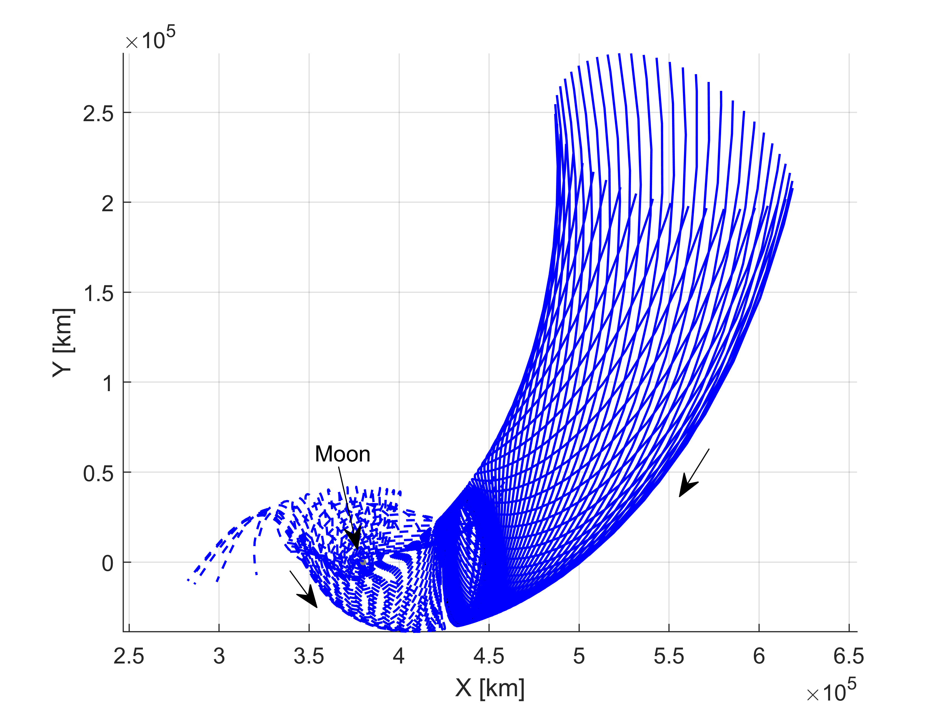


Applications: Lunar IceCube Previous Research
Forward Propagation
Backward Propagation
$$W^{S}$$
$$D$$

Slide 29
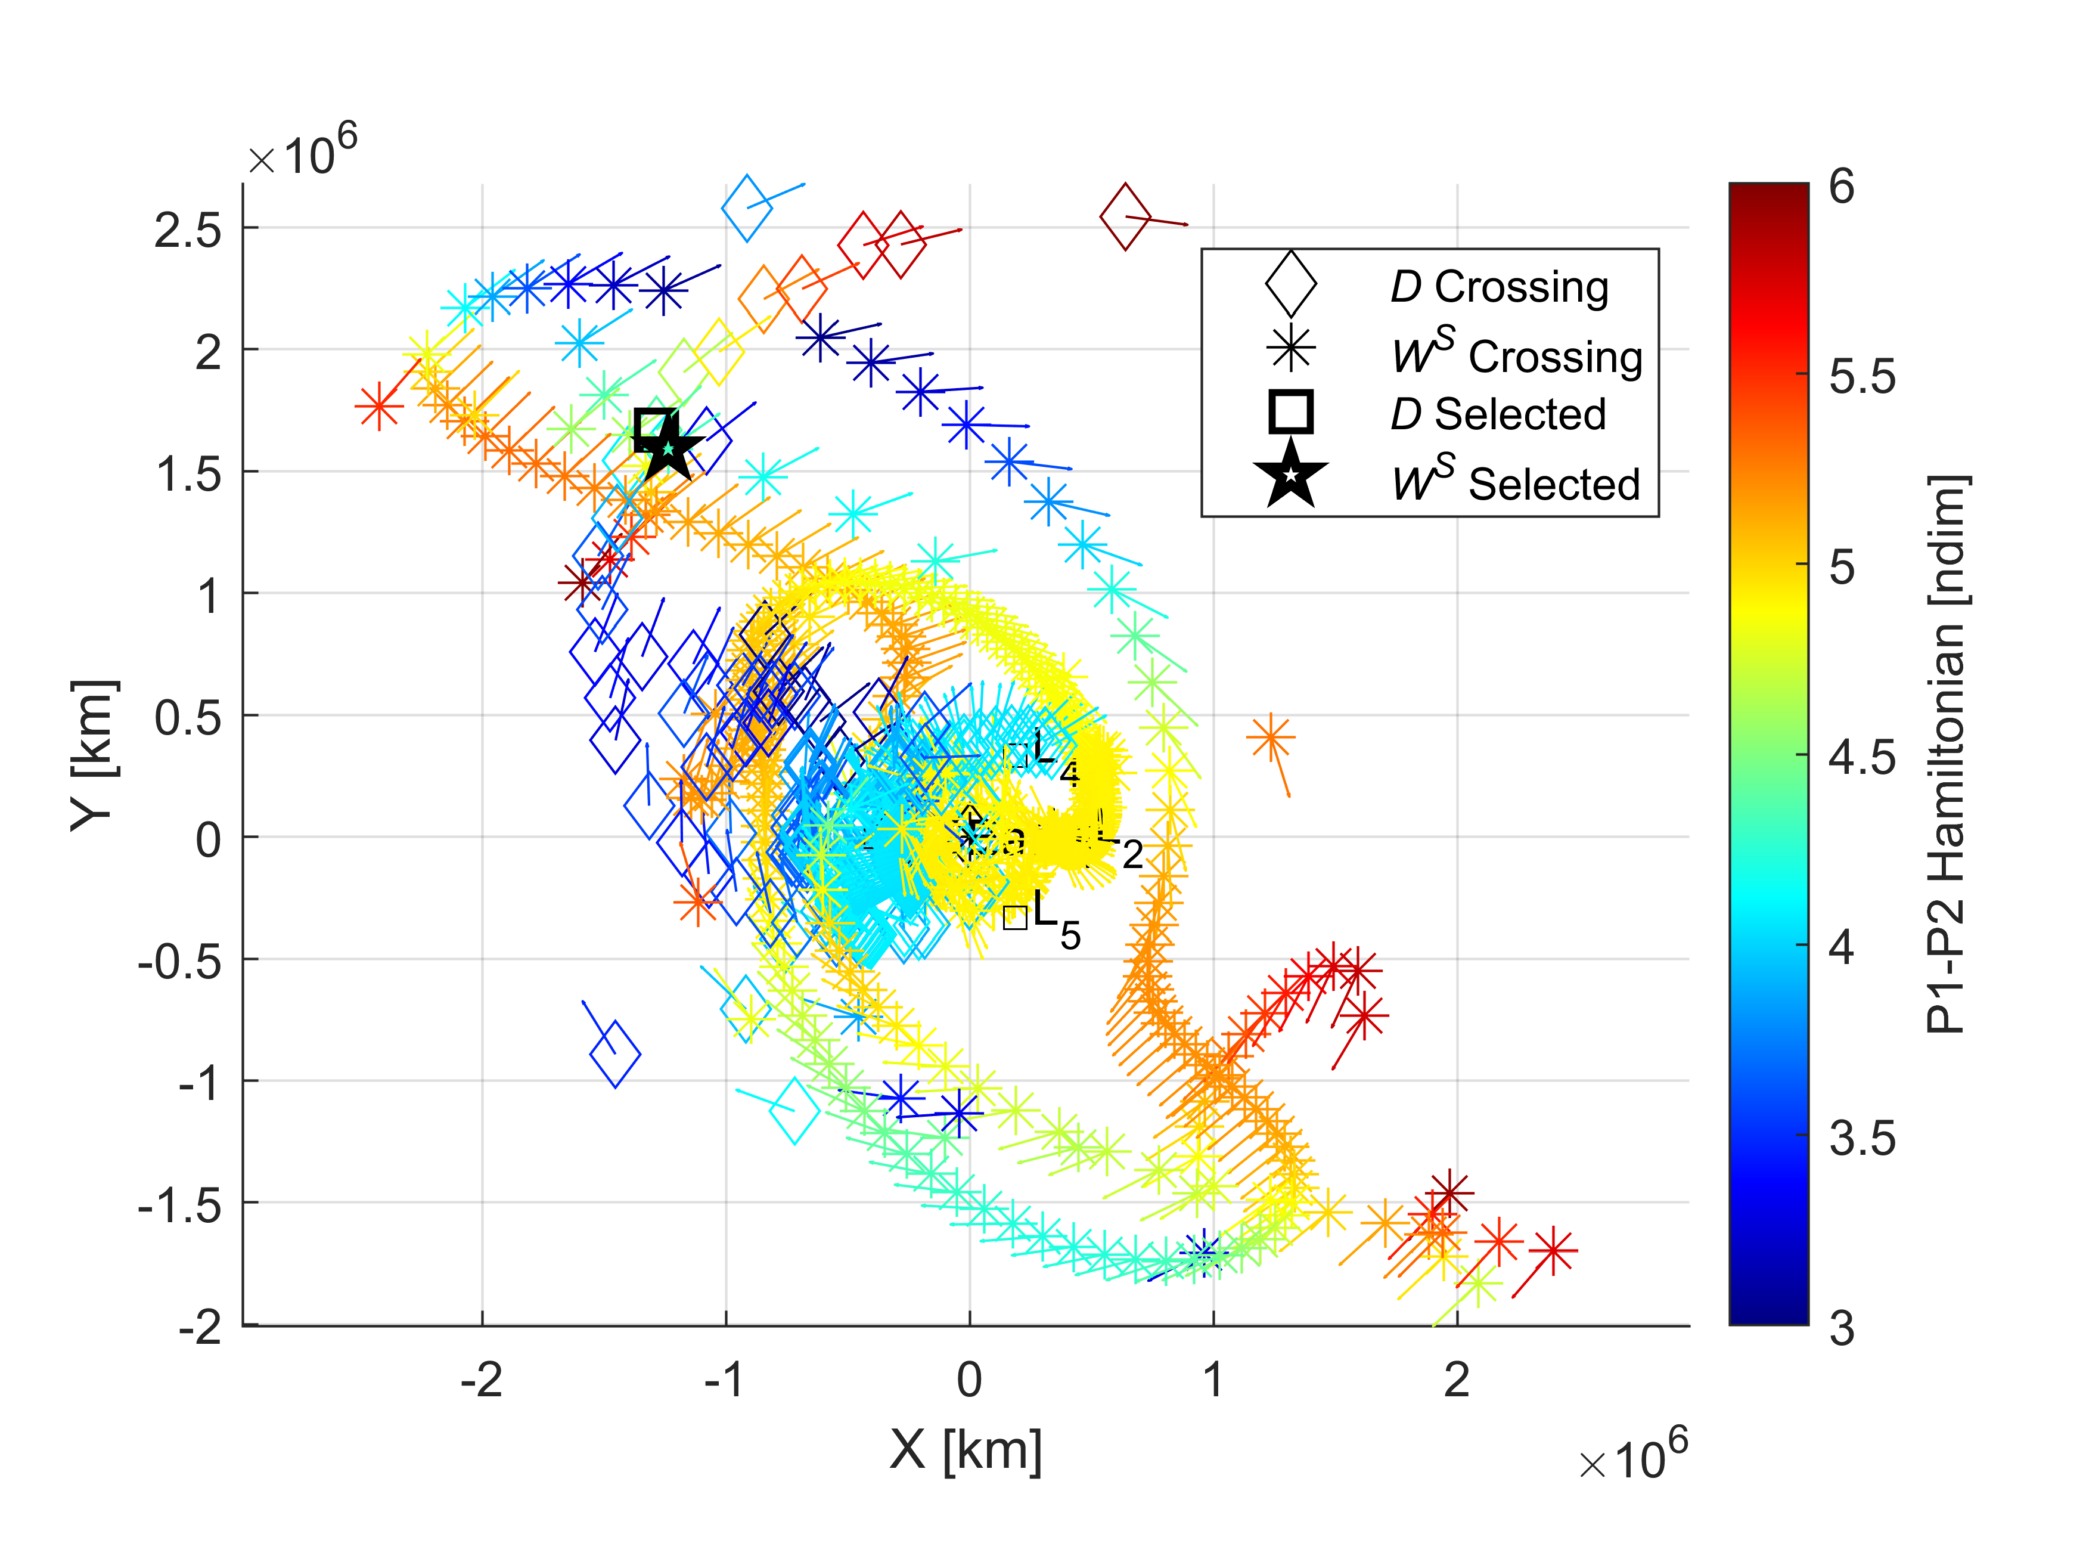
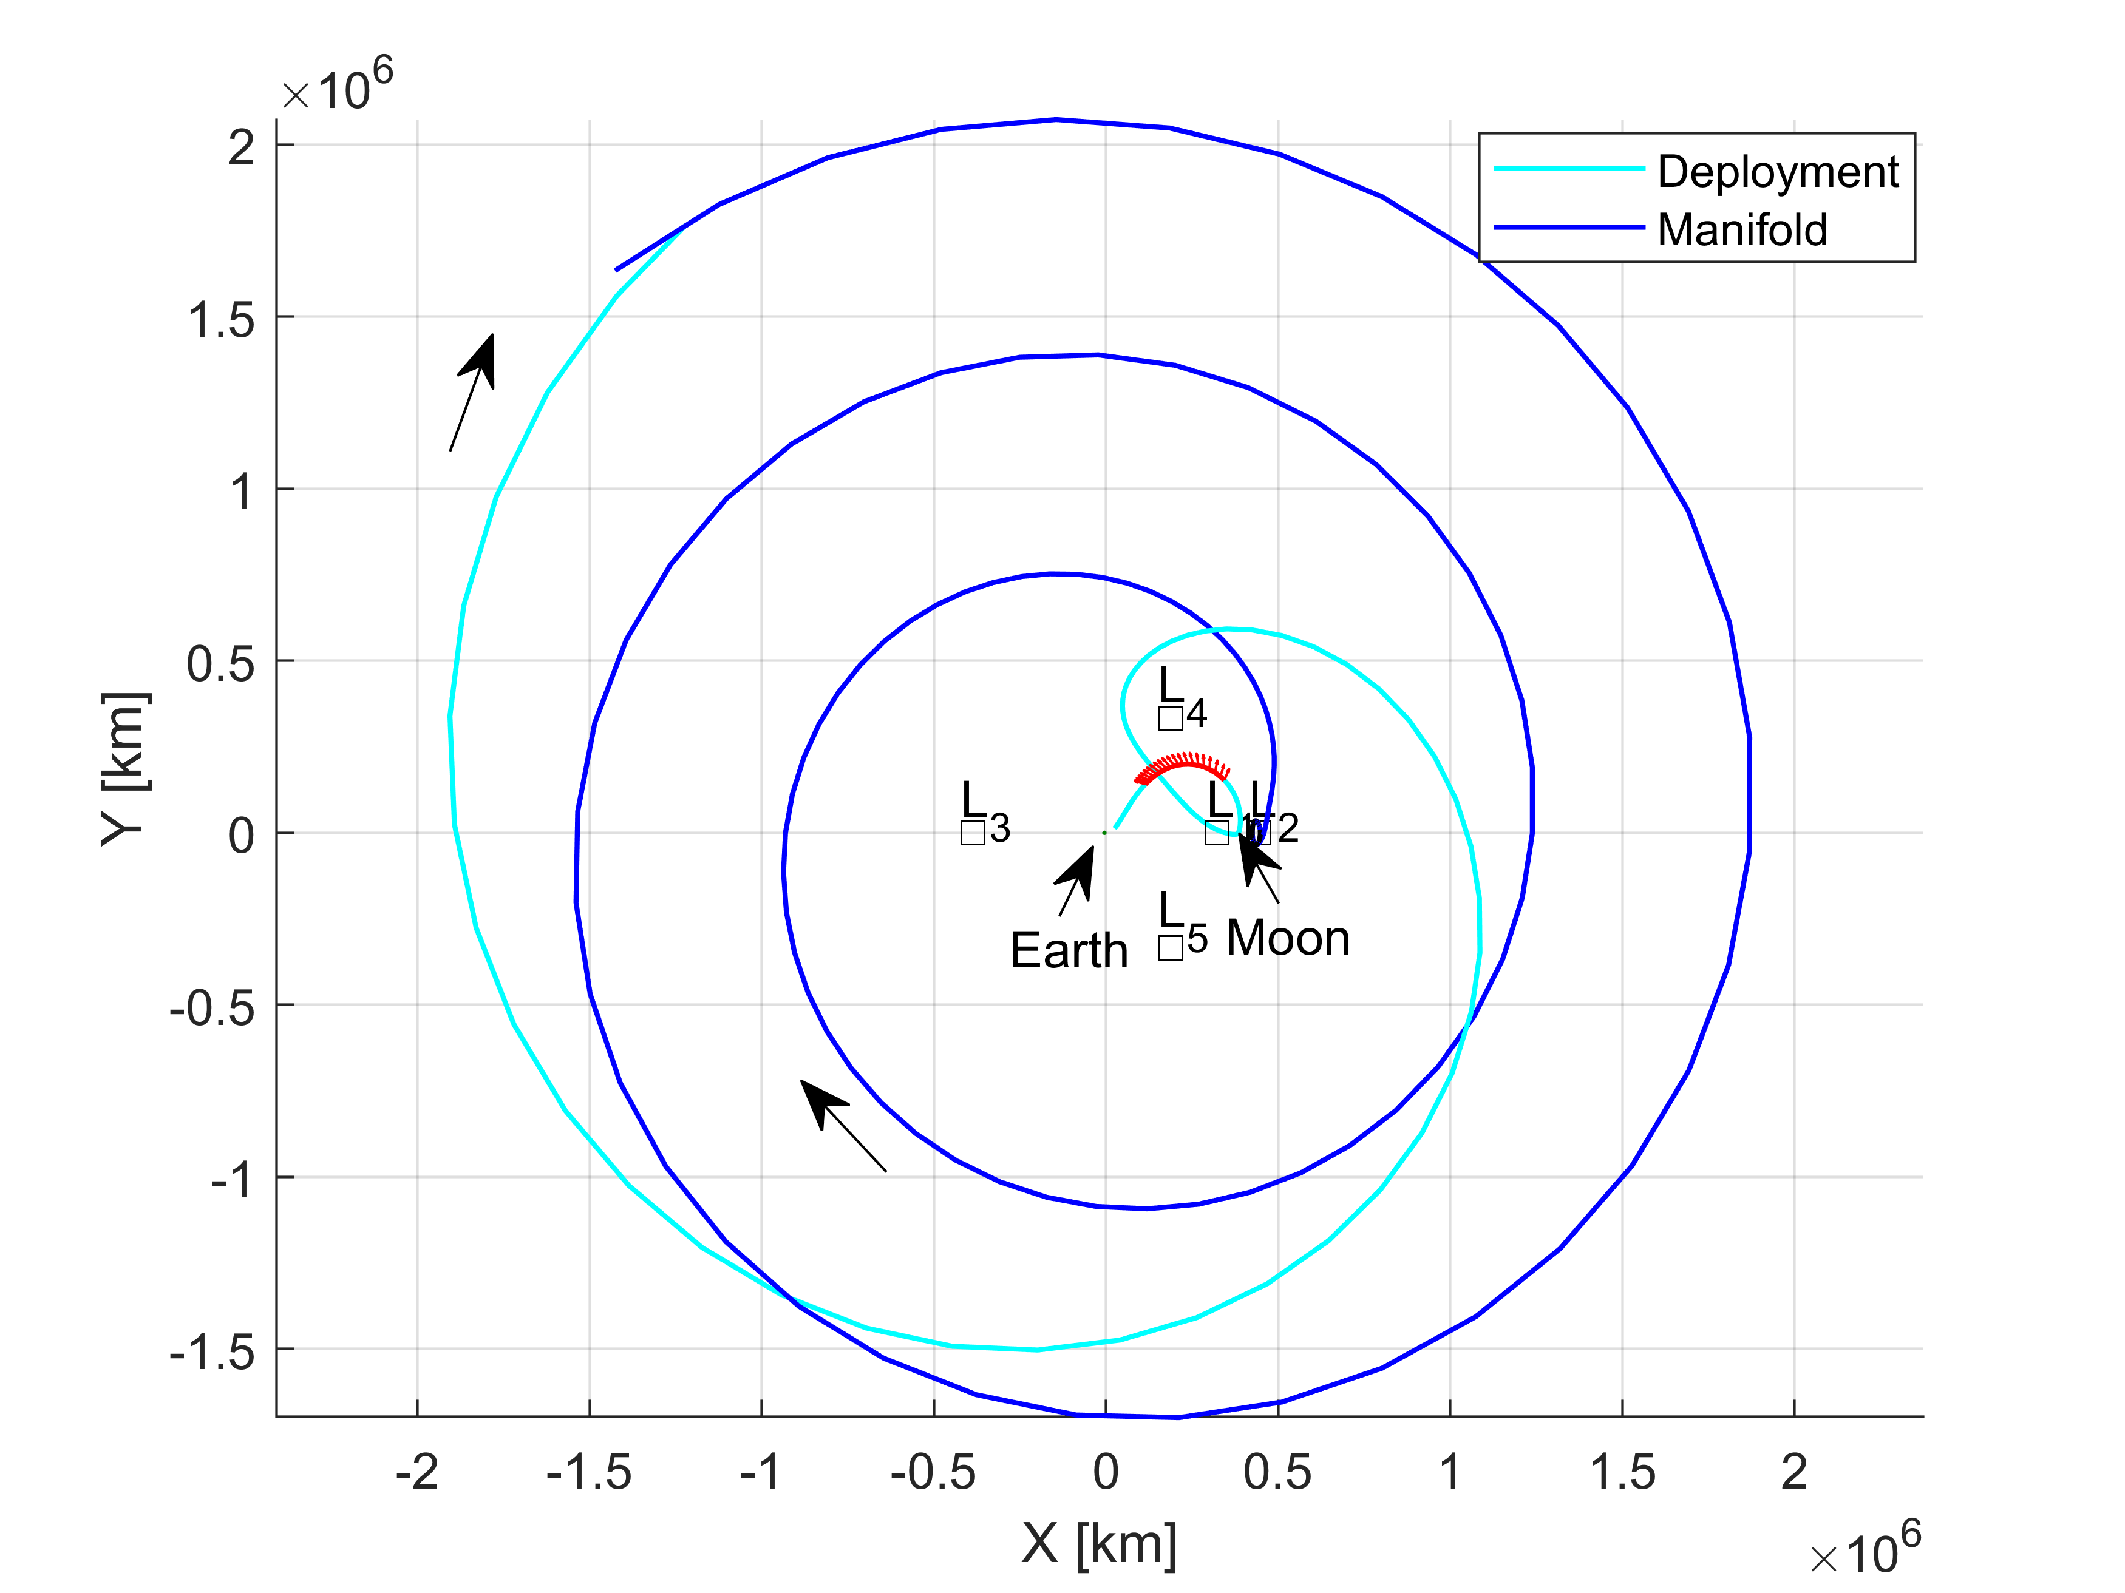
Applications: Lunar IceCube Previous Research
Map for Connecting Trajectories
Selected Trajectories from Map
Notes:
Discuss how the initial design shown here or the previous image provided by Dave is discretized into many segments to enable solution by the direct shooting algorithm

Slide 30
Applications: Lunar EMTG Optimization
Initial Design
EMTG Result
Notes:
EMTG was used to correct these designs into continuous trajectories that were optimized to maximize the mass delivered to the final orbit.
Constraints were added to the EMTG solution to limit the duration and frequency of low-thrust arcs.

Slide 31
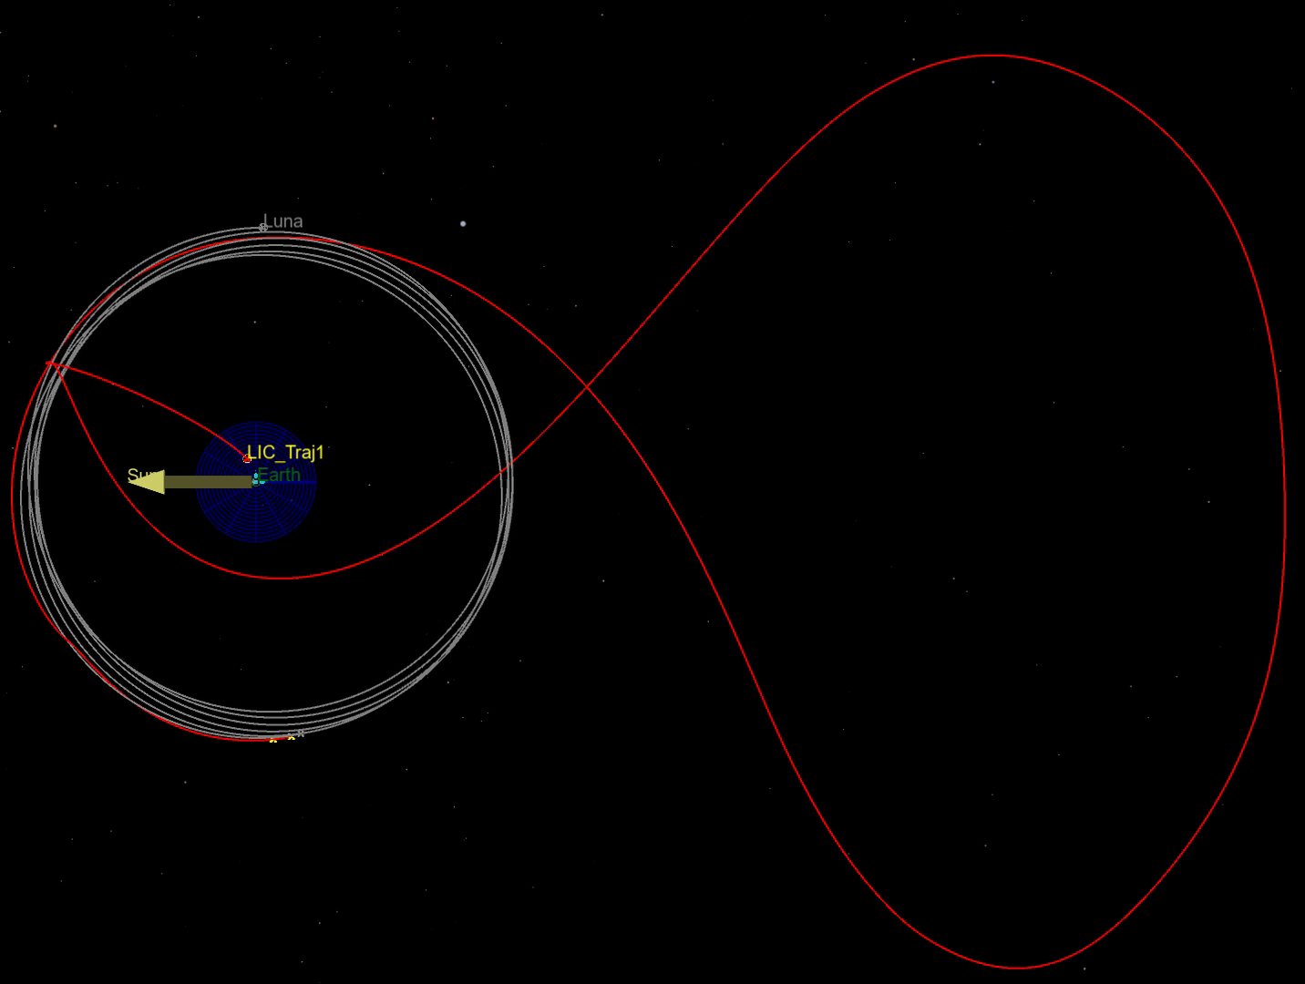
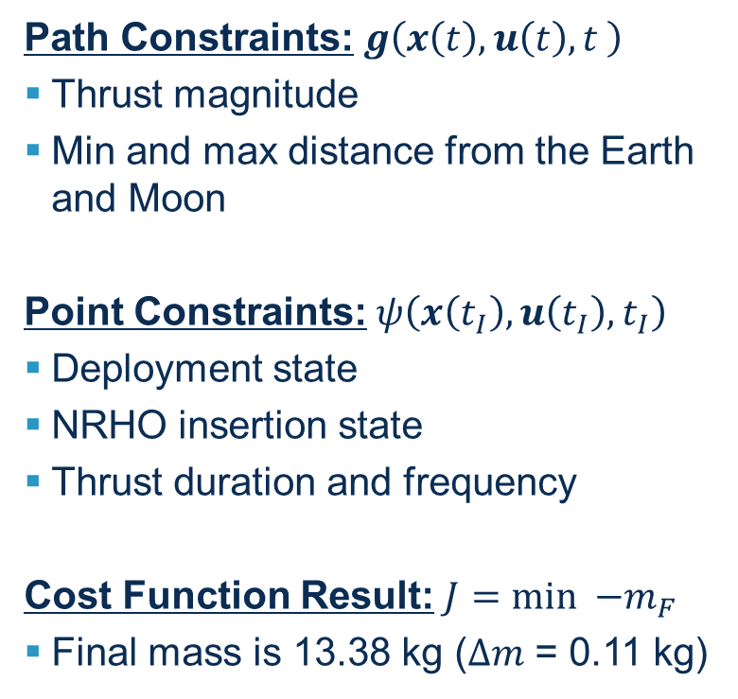
Applications: Lunar EMTG Optimization
Path Constraints: $g\left(x\left(t\right),u\left(t\right),t \right)$
Thrust magnitude
Min and max distance from the Earth and Moon
Point Constraints: $ψ\left(x\left(t_{I}\right),u\left(t_{I}\right),t_{I}\right)$
Deployment state
NRHO insertion state
Thrust duration and frequency
Cost Function Result: $J=min {−m}_{F}$
Final mass is 13.38 kg ($∆m$ = 0.11 kg)
EMTG Result
Notes:
EMTG was used to correct these designs into continuous trajectories that were optimized to maximize the mass delivered to the final orbit.
Constraints were added to the EMTG solution to limit the duration and frequency of low-thrust arcs.

Slide 32
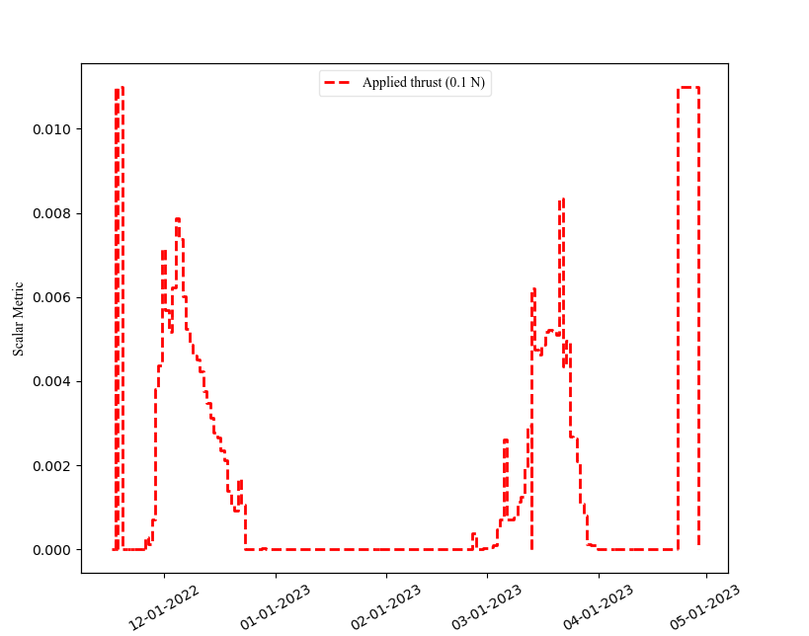
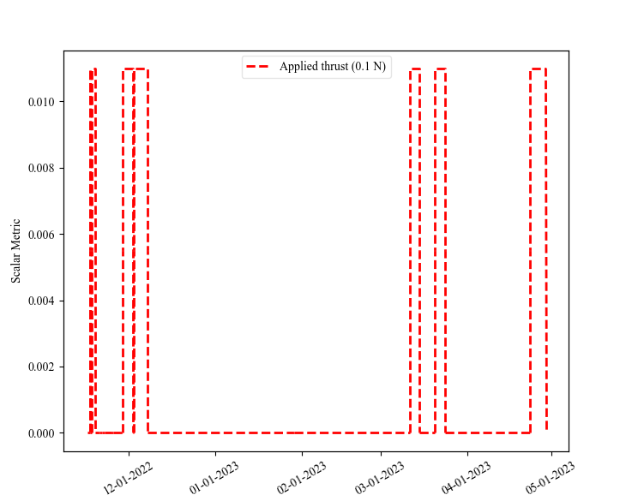
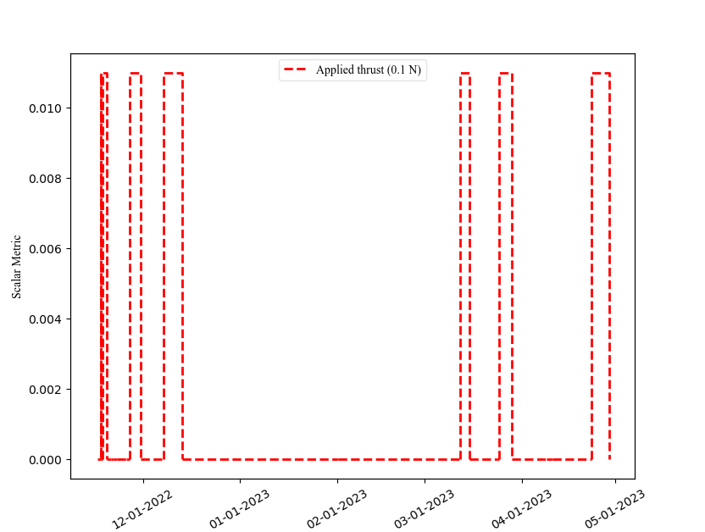
Applications: Lunar IceCube EMTG Optimization
Constrained Thrust Arc Duration & Frequency
Initial Optimization
Discrete Thrust Arcs

Slide 33
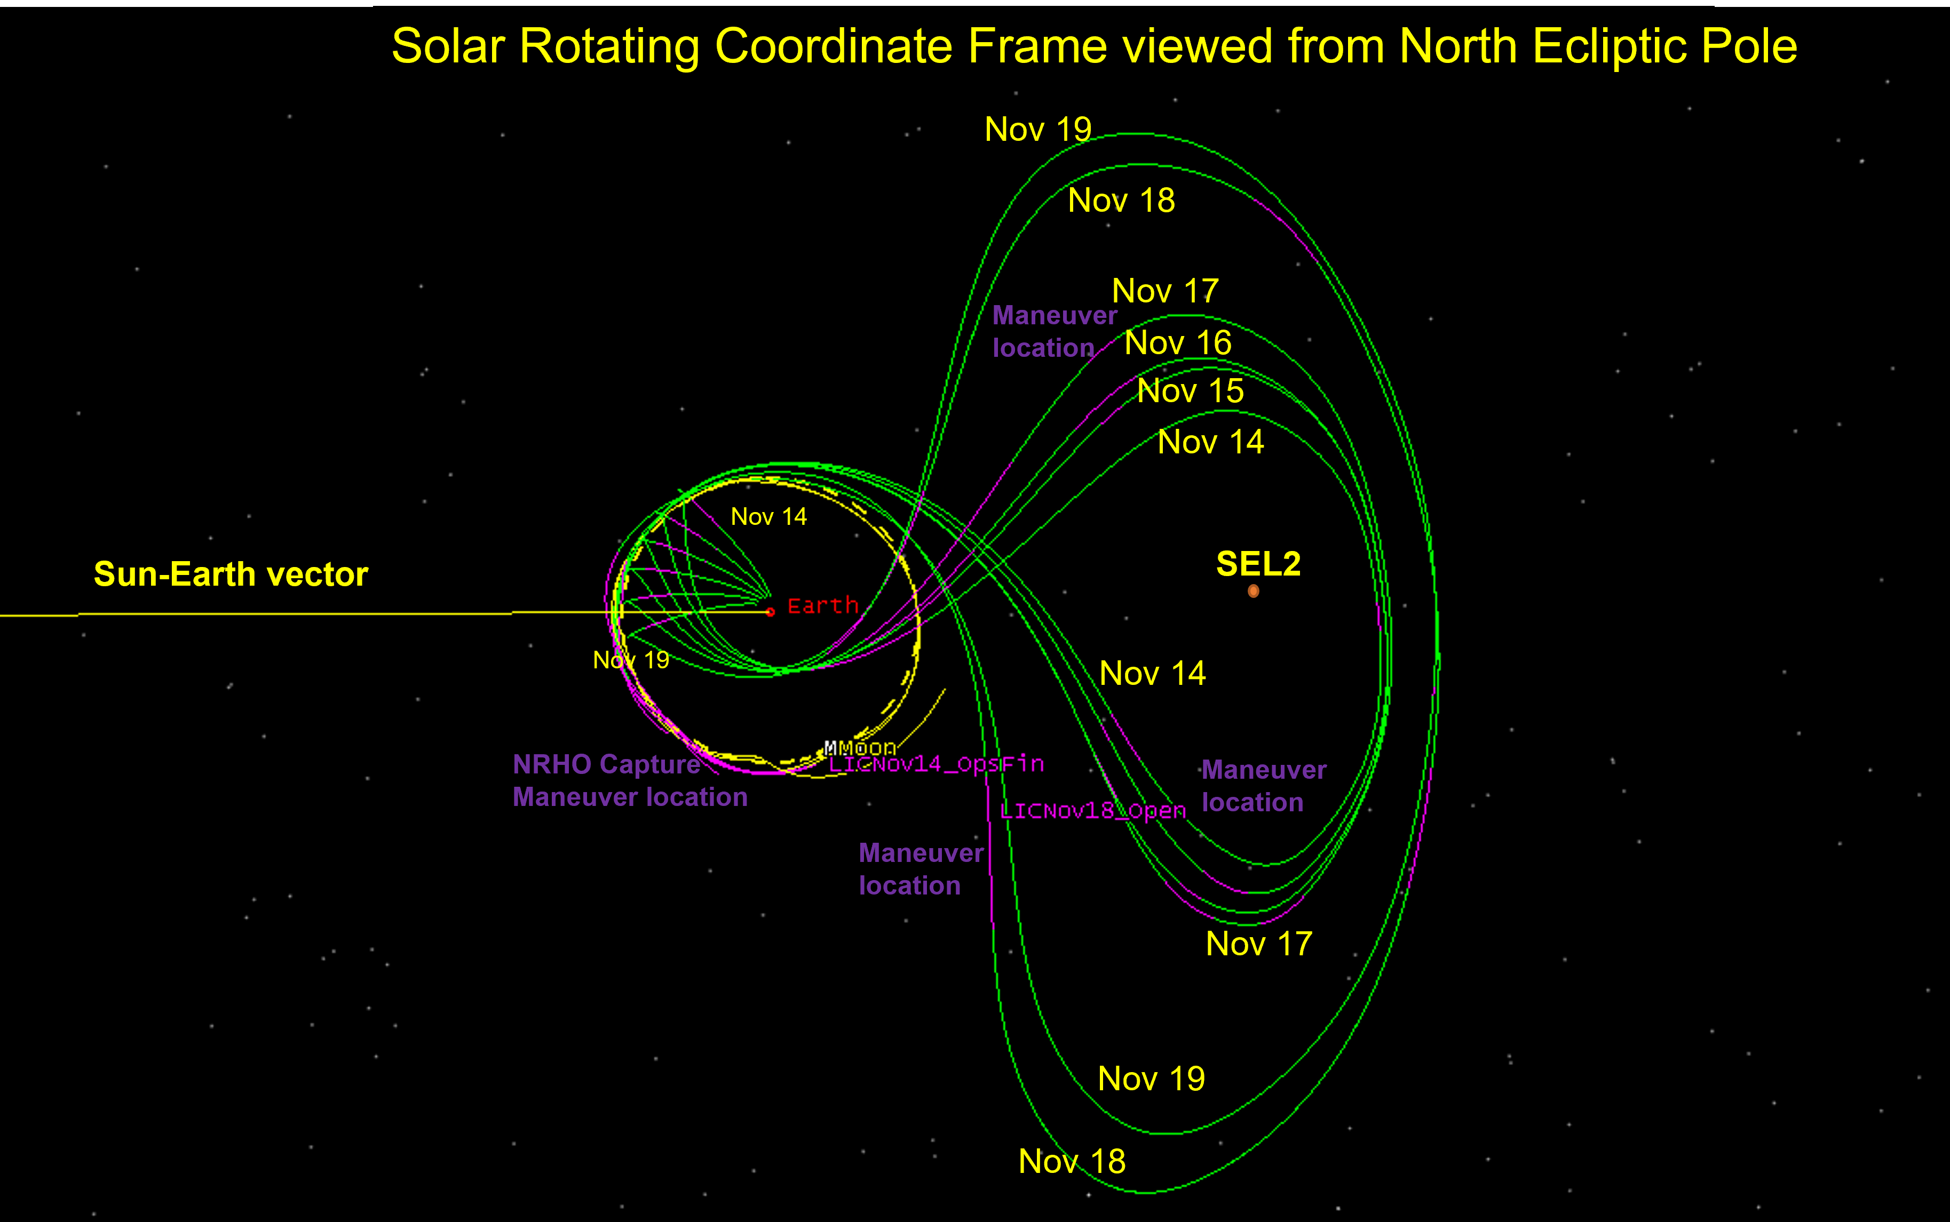
Applications: Lunar IceCube High-Fidelity Validation
EMTG results were reoptimized with a direct shooting scheme in Systems Tool Kit (STK)
Generally, close agreement was found between EMTG and STK results
STK trajectory was used for flight operations
Notes:
Launch Open cases shown
Launch Close cases are similar to each
Total Fuel (kg) use
Nov 14 ~ 0.084
Nov 15 ~ 0.093
Nov 16 ~ 0.120
Nov 17 ~ 0.142
Nov 18 ~ 0.143
Nov 19 ~ 0.047
DM1 and total maneuver duration (days)
Nov 14 ~ 1.51, 18.70
Nov 15 ~ 1.51, 20.67
Nov 16 ~ 1.40, 26.62
Nov 17 ~ 1.33, 31.55
Nov 18 ~ 1.40, 31.71
Nov 19 ~ 1.00, 10.48

Slide 34
Concluding Remarks
Spacecraft trajectory design frequently requires minimizing one or more parameters such as propellant consumption or time of flight.
A range of methods exist for solving this type of optimization problem, and the appropriate method is dependent upon the nature of the problem and the quality of the initial guess.
Goddard has developed a number of open-source tools that implement direct shooting or collocation algorithms and these tools are applied to many different flight projects and proposals.
Trajectory design for the Lunar IceCube mission applied direct shooting algorithms within EMTG to compute low-thrust transfer trajectories that delivered the spacecraft to its destination 9:2 NRHO

Slide 35
Acknowledgements
Lunar IceCube: Dave Folta, Sun Hur-Diaz, Jacob Englander
LISA: Noble Hatten, Samantha Rieger, Grant Hecht
OSIRIS-REx Extended Mission: Brian Sutter, Noble Hatten, Kyle Hughes, Kenneth Getzandanner, Jacob Englander, Alec Mudek, Daniel Wibben, Kenneth Williams, Miguel Benayas Penas, Michael Moreau, Dante Lauretta, Daniella DellaGiustina, Michael Nolan, Anjani T. Polit

Slide 36
References
Textbooks:
Practical Methods for Optimal Control and Estimation Using Nonlinear Programming, Betts
Spacecraft Trajectory Optimization, Conway
Optimal Control with Aerospace Applications, Longuski, Guzman, Prussing
Papers:
Pritchett, R. E. Strategies for Low-Thrust Transfer Design Based on Direct Collocation Techniques. Purdue University, 2020.
Folta, D. C., Bosanac, N., Cox, A., and Howell, K. C. “The Lunar IceCube Mission Challenge: Attaining Science Orbit Parameters From a Constrained Approach Trajectory.” Advances in the Astronautical Sciences, Vol. 160, 2017, pp. 3159–3178.

Slide 37
References
Papers (continued):
Folta, D. C., Bosanac, N., Cox, A., and Howell, K. C. “The Lunar IceCube Mission Design: Construction of Feasible Transfer Trajectories with a Constrained Departure.” Advances in the Astronautical Sciences, Vol. 158, 2016, pp. 1369–1387.
Martens, W., and Joffre, E. “Trajectory Design for the ESA LISA Mission.” The Journal of Astronautical Sciences, Vol. 68, 2021, pp. 402–443. https://doi.org/https://doi.org/10.1007/s40295-021-00263-2.
Galda, A. M., and Martens, W. Low-Thrust Transfer Design for the LISA Mission Via the Libration Points SEL1 and SEL2. 2022.
Sutter, B., Hatten, N., Hughes, K., Getzandanner, K. M., Englander, J., Mudek, A., Wibben, D., Williams, K., Penas, M. B., Moreau, M., Lauretta, D. S., DellaGiustina, D. N., Nolan, M., and Polit, A. T. OSIRIS-REx Extended Mission Trajectory Design & Target Search. 2022.

Slide 38


Slide 39
Backup Slides

Slide 40
Background: Optimization Methods
 | Indirect Optimization | Direct Optimization | Global Optimization
Description | Apply Euler-Lagrange Theorem to create a Two-Point Boundary Value Problem (TPBVP) Solution of the TPBVP is a local optimal Oldest approach, developed in the 17th and 18th centuries Optimize then discretize | Recast the optimal control problem as a nonlinear programming (NLP) problem. Operate directly on the cost function Also called parameter optimization NLP solution methods include sequential quadratic programming (SQP) and interior point (IP) methods Discretize then optimize | Exploit heuristic methods to try to find a global optimal Also called evolutionary algorithms or metaheuristics Often based on processes observed in nature Examples include ant-colony, simulated annealing, and genetic algorithms Can produce good solutions given time, but a global optimal is difficult to verify
Notes:
Might be beneficial to also note differential dynamic programming as another optimization approach not discussed here.
Definition of heuristic technique from Wikipedia: any approach to problem solving or self-discovery that employs a practical method that is not guaranteed to be optimal, perfect, or rational, but is nevertheless sufficient for reaching an immediate, short-term goal or approximation. Where finding an optimal solution is impossible or impractical, heuristic methods can be used to speed up the process of finding a satisfactory solution. Heuristics can be mental shortcuts that ease the cognitive load of making a decision.
Also see Wikipedia definition of metaheuristics: Metaheuristic - Wikipedia

Slide 41
Background: Optimization Methods
 | Indirect Optimization | Direct Optimization | Global Optimization
Pro | Smaller problem size yields efficiency Provides control law Solution guaranteed to be a local optimal | Robust to poor initial guess Simple to setup Straightforward to incorporate problem changes | Can offer global optimal solution Do not require an initial guess
Con | Costate values are unintuitive Must rederive the two point boundary value problem if the problem changes Often requires a better initial guess than other methods | Produce large dimension problems More difficult to guarantee optimality | Computationally expensive Coarse approximation of the dynamics

Slide 42
Background: Optimization Flowchart
Optimal Control Problem
Indirect Optimization
Shooting
Collocation
Shooting
Collocation
Direct Optimization

Slide 43
Background: GSFC Trajectory Optimization Tools
Name | Type of Optimizer | Notes
GMAT | Direct Shooting | General Mission Analysis Tool (GMAT) Set up problems via a GUI, script interface, or API; source code in C++ Can create many varieties of direct shooting problems Includes high fidelity dynamical models used in operations Interactive 3D graphics Access open-source release on SourceForge
EMTG | Direct Shooting (Inner-Loop) Metaheuristic (Outer-Loop) | Evolutionary Mission Trajectory Generator (EMTG) Problems set up via a GUI or text file; source code in C++ Forward-backward or forward only shooting are used in the inner loop The outer loop algorithm is Monotonic Basin Hopping (MBH) Includes low fidelity dynamical models that enable a rapid search of the solution space and medium fidelity models for validating solutions Access open-source release on GitLab

Slide 44
Background: GSFC Trajectory Optimization Tools
Name | Type of Optimizer | Notes
CSALT | Direct Collocation | Collocation Stand-Alone Library and Toolkit (CSALT) Set up problems as Matlab or C++ code, source code in C++ Hermite-Simpson, Lobatto IIIa, and Radau transcriptions available Matlab prototype version includes much of the same functionality as C++ tool, and enables easier problem setup C++ code included with GMAT source code; must be compiled separately
*PaSTA | Direct Shooting | Parametric Shooting Transcription Algorithm (PaSTA) Set up problems as Matlab or C++ code, source code in C++ Can create many varieties of direct shooting problems Uses same explicit integration algorithms as EMTG *Not currently available as an open-source tool

Slide 45
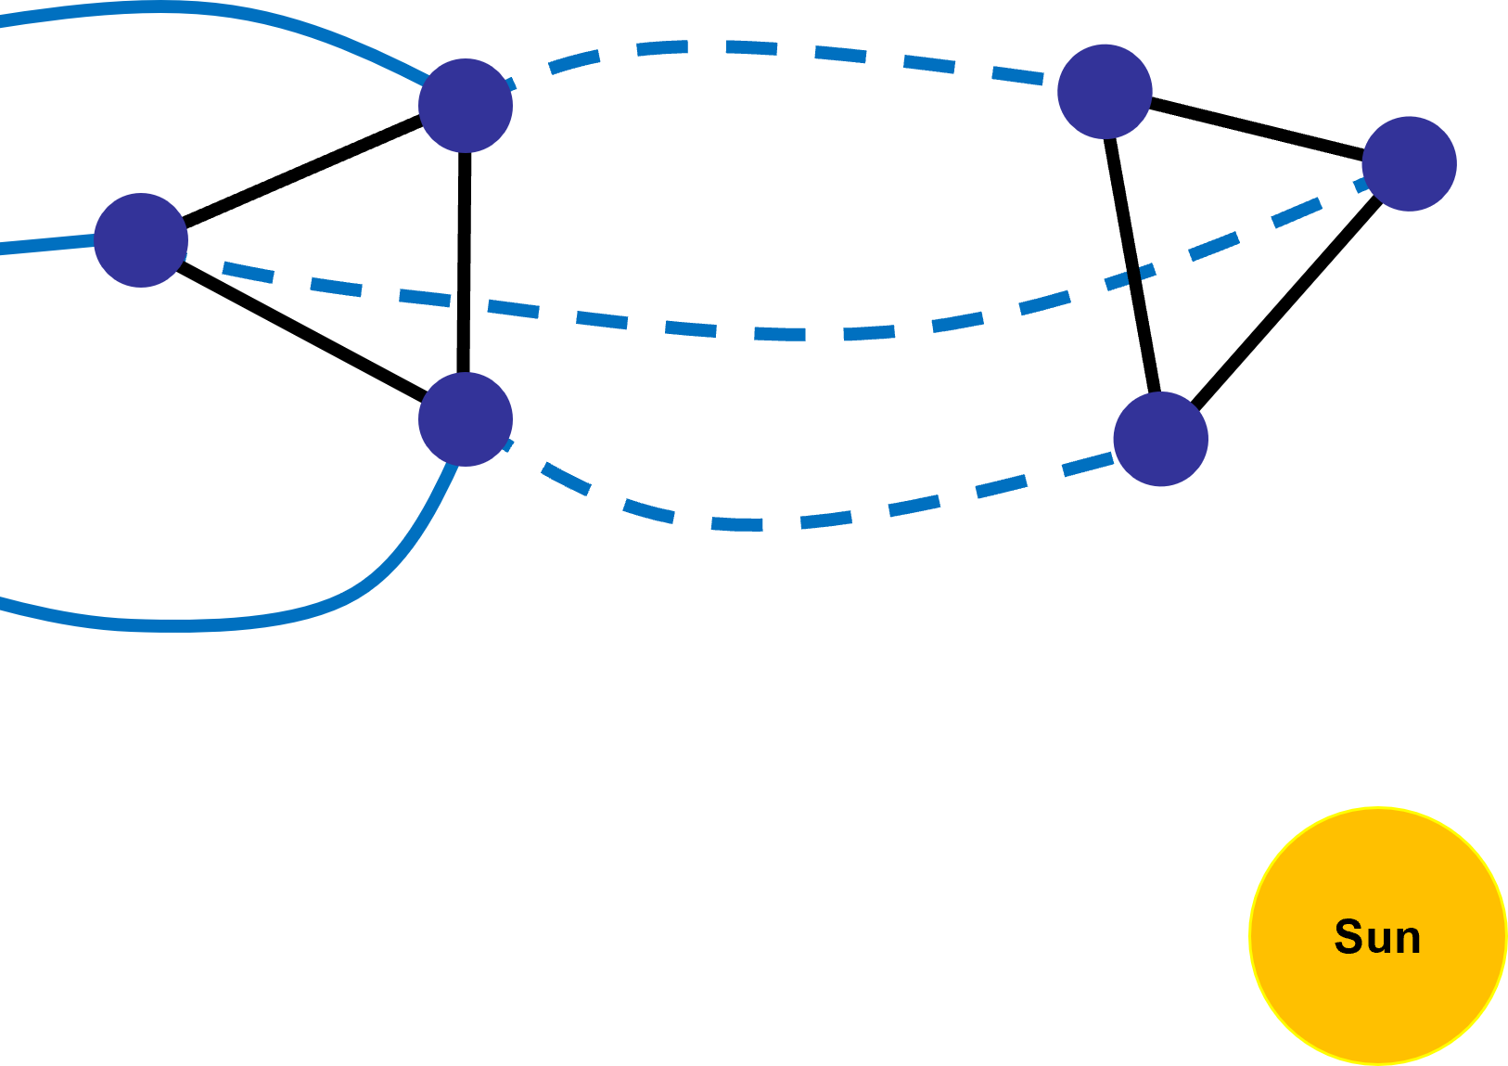
Applications: LISA
Goal: Design low-thrust transfers for 3 spacecraft that deliver them to science orbits that can be maintained for 10 years.
Challenge: Science orbits must enable the 3 spacecraft to maintain an equilateral triangle formation whose side lengths and distance from the Earth remain relatively constant.
Cost Function: Maximum final mass
Tool: CSALT
LISA Science Formation

Slide 46
Applications: LISA
The European Space Agency (ESA) is conducting mission design for the LISA mission
NASA is serving in a supplementary role
See papers by Martens, Joffre, and Galda on LISA mission design referenced at the end of this presentation
LISA Science Formation

Slide 47
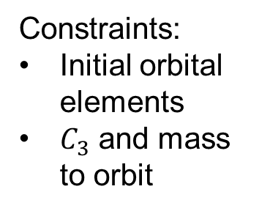
Applications: LISA Optimization Problem Setup
Phase 1
Launch
Phase 2
Low-Thrust Transfer
Phase 3
Science Orbit
Earth
Constraints:
Initial orbital elements
$C_{3}$ and mass to orbit
Constraints:
Thrust magnitude
Thrust pointing
Constraints:
Formation side length
Phase duration
Sun
Notes:
Discuss how the LISA problem demonstrates the following optimization problem features:
Multi-phase problem
Formation flight, spacecraft formation constraints are path constraints
The thrust pointing constraint is for the Sun Aspect Angle (SAA) which is required to be 90deg +/- 40 degrees

Slide 48
Applications: LISA Optimization Problem Setup
Phase 1
Launch
Phase 2
Low-Thrust Transfer
Phase 3
Science Orbit
Earth
Constraints:
Initial orbital elements
$C_{3}$ and mass to orbit
Constraints:
Thrust magnitude
Thrust pointing
Constraints:
Formation side length
Phase duration
Sun
Notes:
Discuss how the LISA problem demonstrates the following optimization problem features:
Multi-phase problem
Formation flight, spacecraft formation constraints are path constraints
The thrust pointing constraint is for the Sun Aspect Angle (SAA) which is required to be 90deg +/- 40 degrees

Slide 49
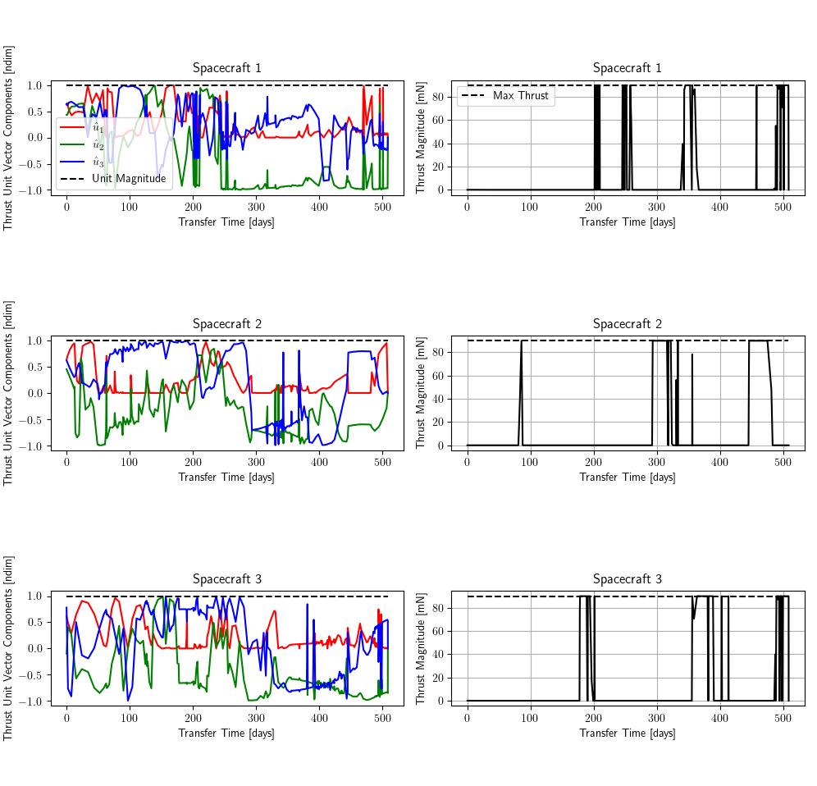
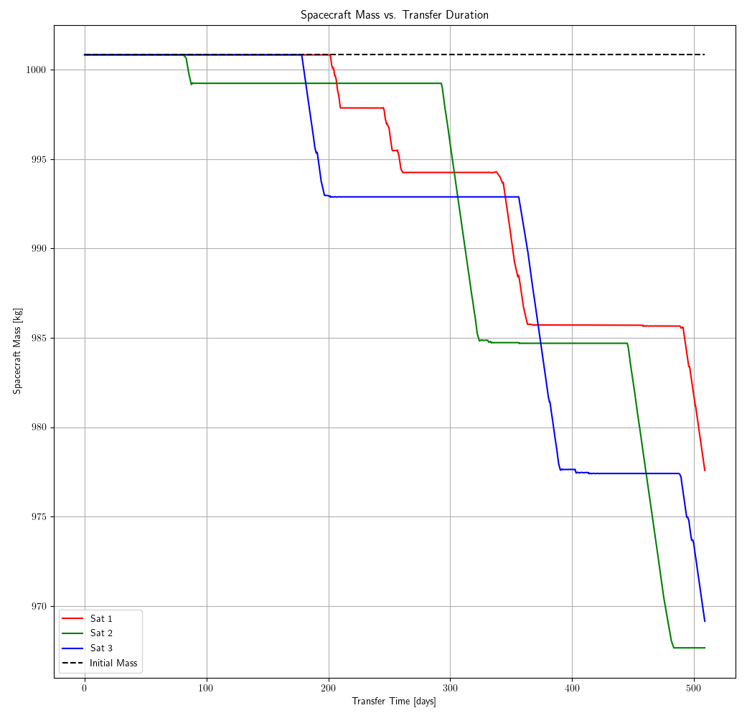
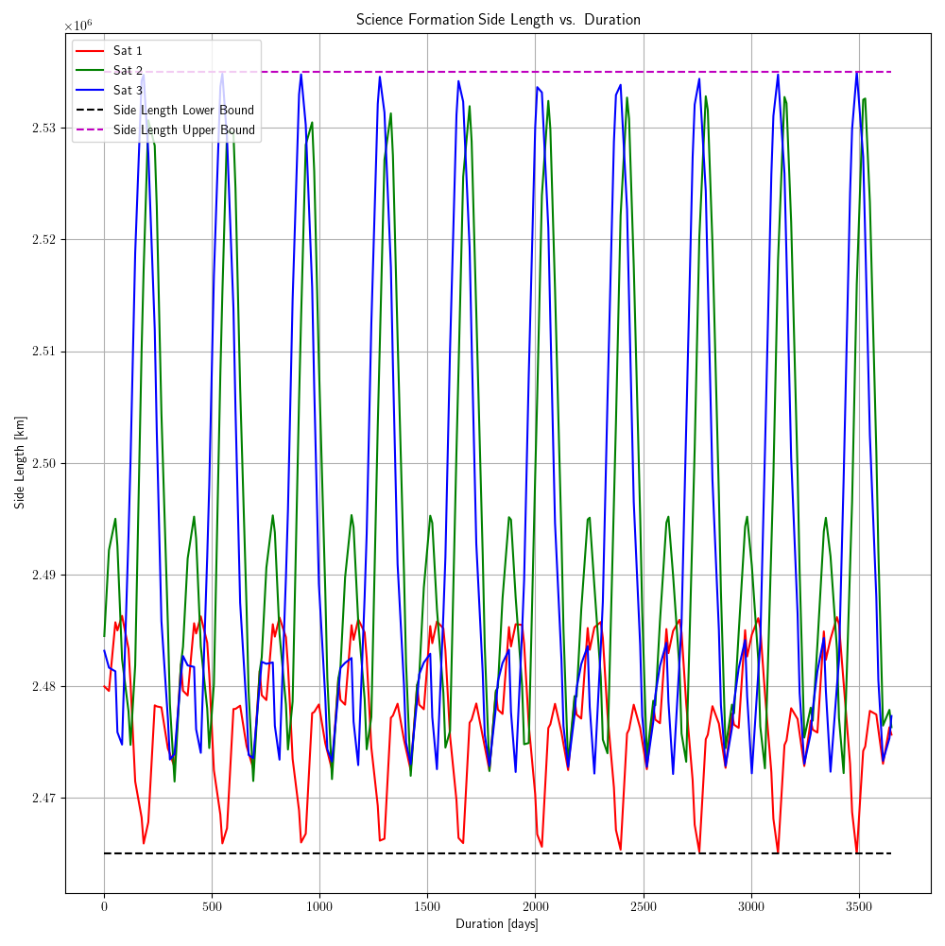
Applications: LISA Optimization Preliminary Results
Thrust Vector vs. Time
Spacecraft Mass vs. Time
Side Length vs. Duration

Slide 50
Applications: OSIRIS-REx Extended Mission
Carrier spacecraft will deliver the Sample Return Capsule (SRC) to Earth September 24th, 2023.
A divert maneuver is performed to avoid atmospheric entry and setup an extended mission.
Trajectory design engineer Brian Sutter at Lockheed Martin identified an Apophis rendezvous opportunity in 2029.
Is there a better option?

Slide 51
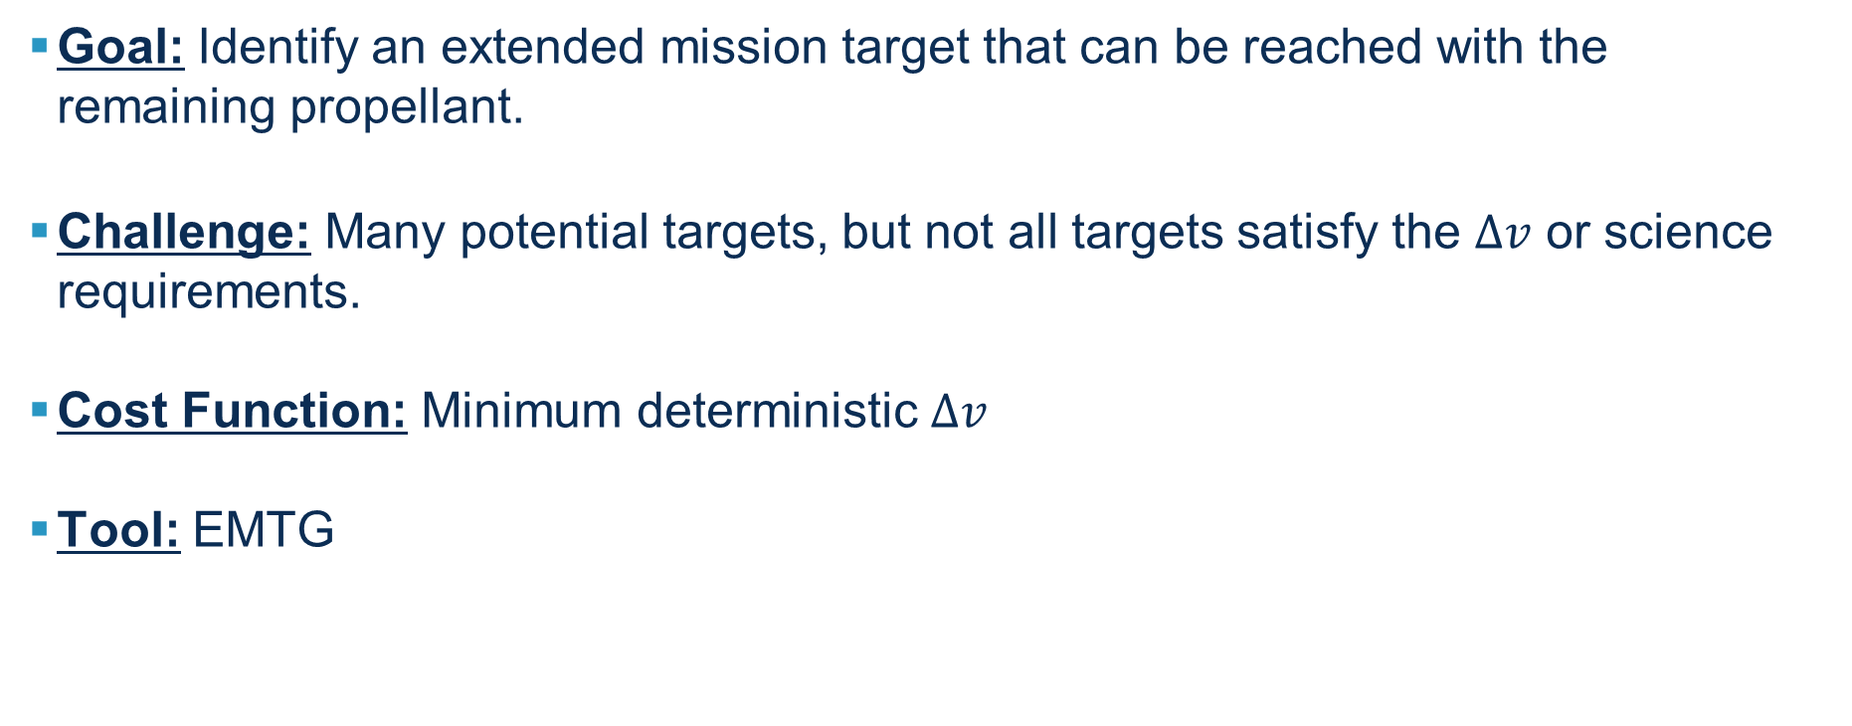
Applications: OSIRIS-REx Extended Mission
Goal: Identify an extended mission target that can be reached with the remaining propellant.
Challenge: Many potential targets, but not all targets satisfy the $∆v$ or science requirements.
Cost Function: Minimum deterministic $∆v$
Tool: EMTG

Slide 52
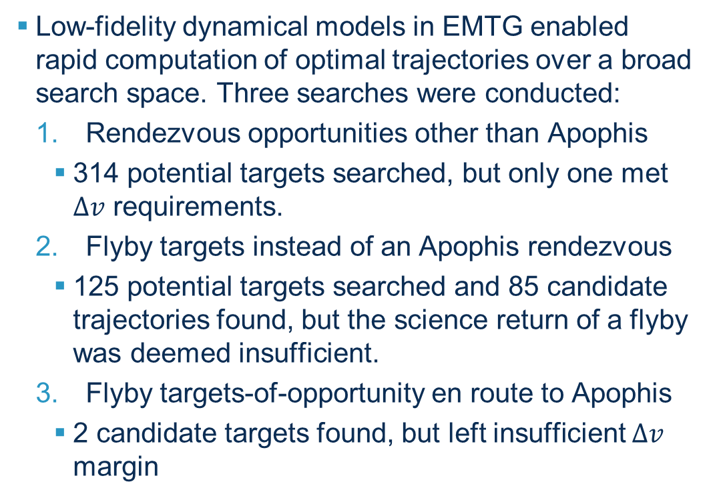
Applications: OSIRIS-REx Extended Mission
Low-fidelity dynamical models in EMTG enabled rapid computation of optimal trajectories over a broad search space. Three searches were conducted:
Rendezvous opportunities other than Apophis
314 potential targets searched, but only one met $∆v$ requirements.
Flyby targets instead of an Apophis rendezvous
125 potential targets searched and 85 candidate trajectories found, but the science return of a flyby was deemed insufficient.
Flyby targets-of-opportunity en route to Apophis
2 candidate targets found, but left insufficient $∆v$ margin
2.
4.
5.
1.
7.
3.
8.
6.
Credit: Sutter et al., 2022
Apophis Rendezvous Trajectory
Notes:
Emphasize here how the low-fidelity models available in EMTG enable rapid solves (or failures) of each optimization problem which makes the search for a global optimal practical.

