Slide 1
Overview of Community Response Test Campaign with NASA’s X-59 Aircraft
Nathan B. Cruze
NASA Langley Research Center
UC Davis Aircraft Noise and Emissions Symposium
Davis, CA
May 3, 2023

Slide 2
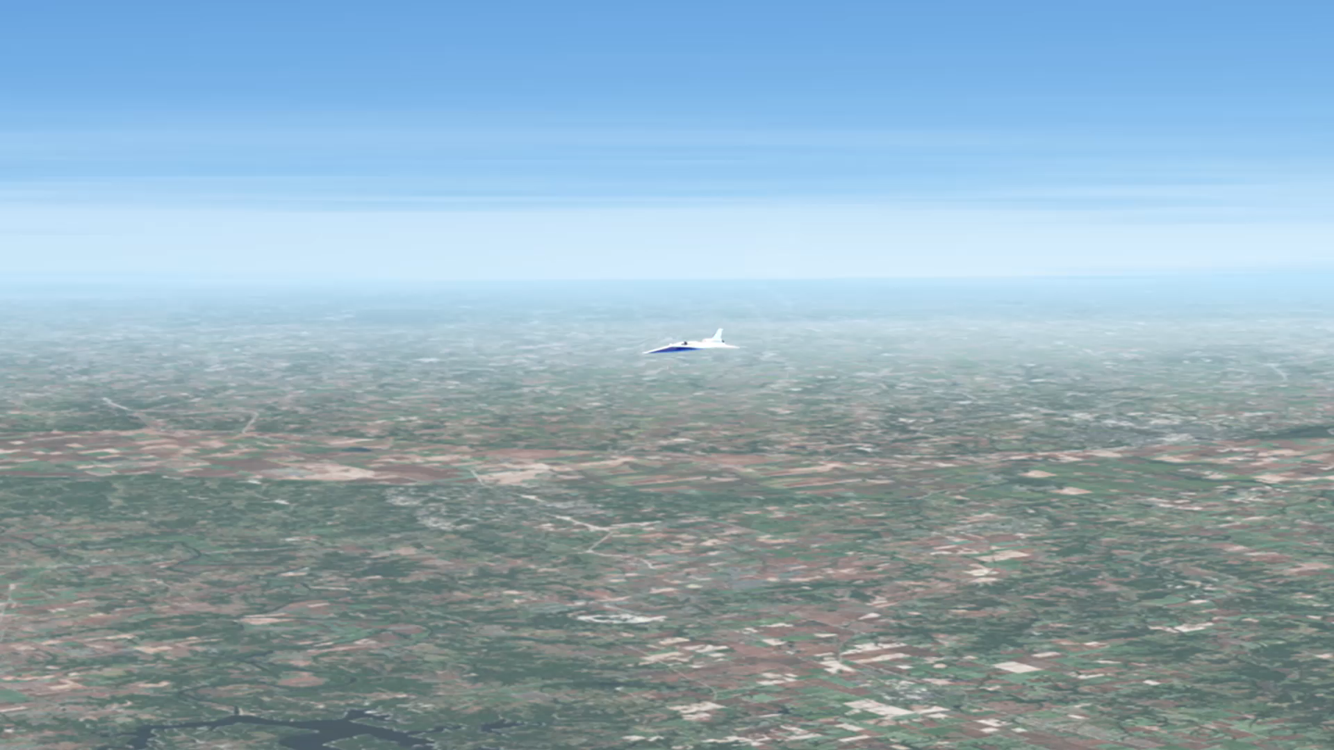
Sonic Boom Moves With The Aircraft

Slide 3
Speed Limit Or Noise Limit?
14 C.F.R.§91.817 Civil Aircraft Sonic Boom
No person may operate a civil aircraft in the United States at a true flight Mach number greater than 1…
In addition, no person may operate a civil aircraft for which the maximum operating limit M_{M0} exceeds a Mach number of 1, to or from an airport in the United States…
The Quesst mission will collect data to inform regulation of civil supersonic flight over land.

Slide 4
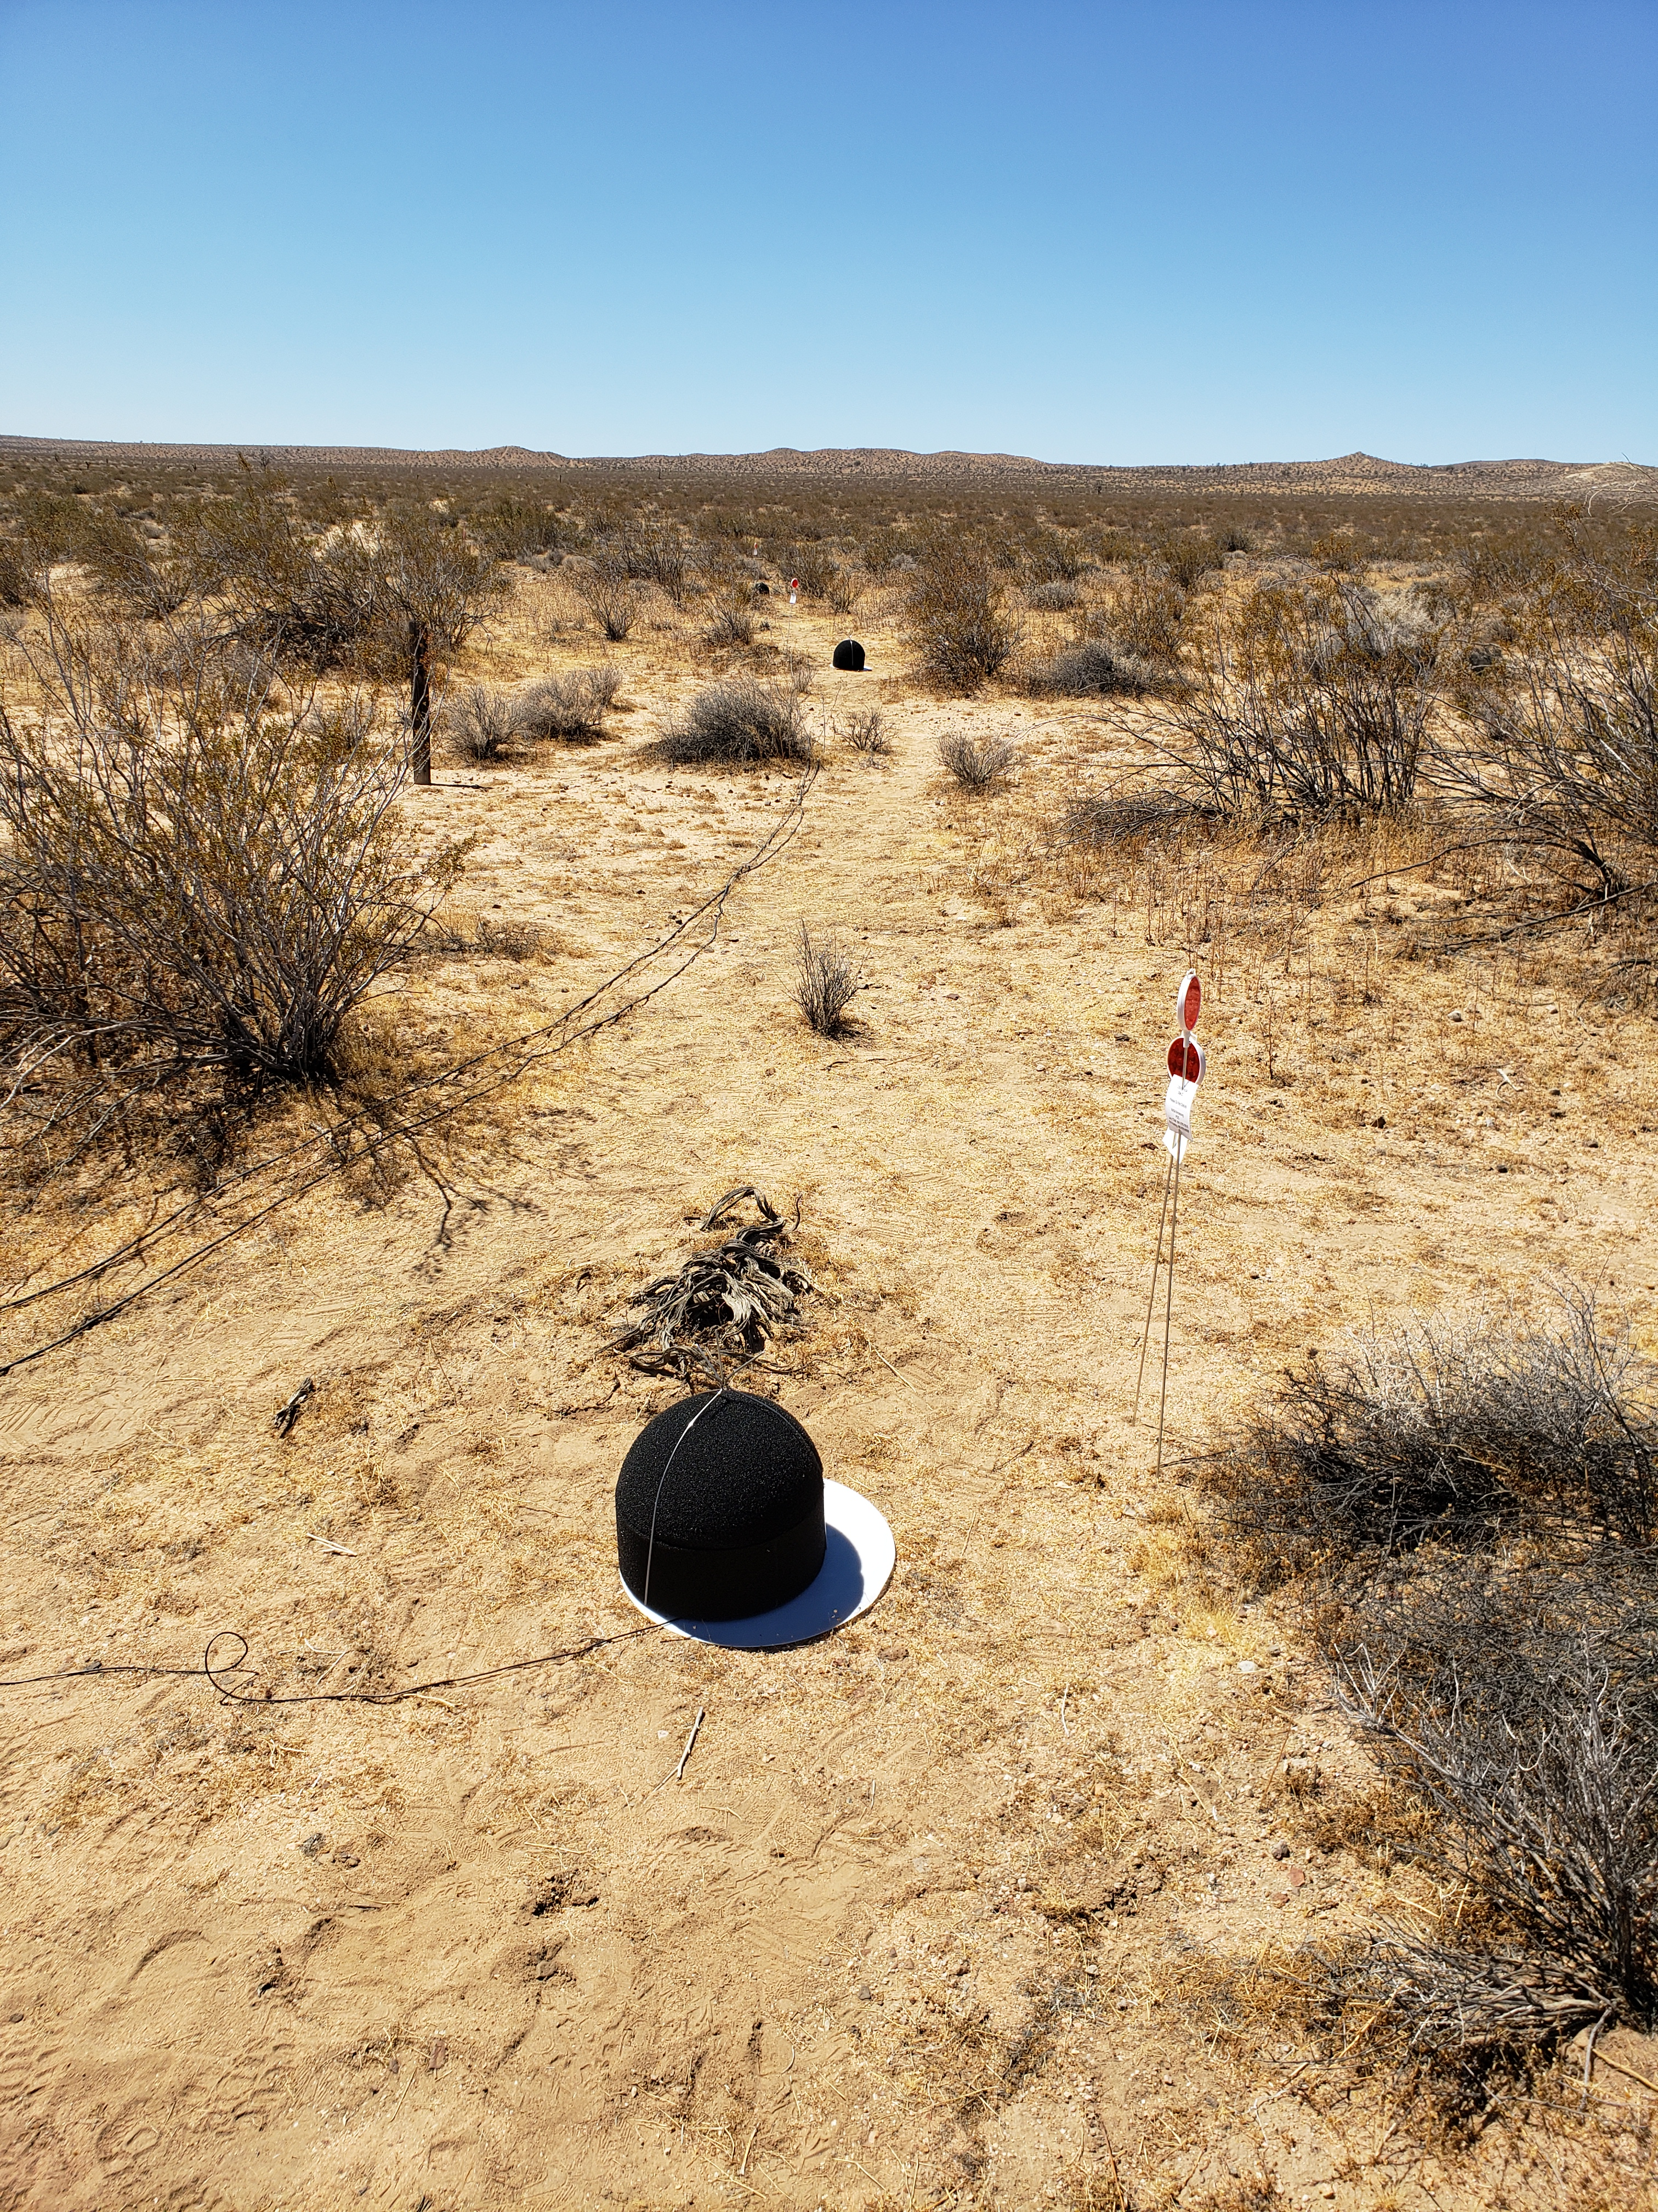
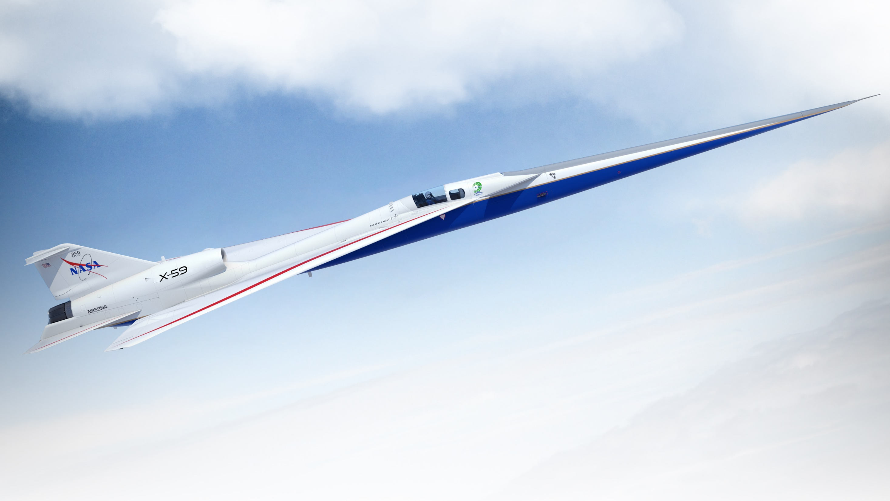
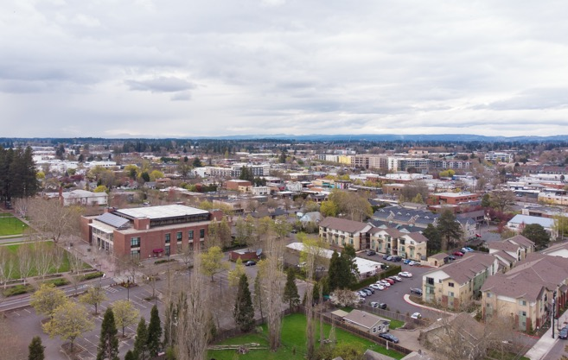
The Quesst Mission
Image Credit: Lockheed Martin
Phase 1—X-59 Aircraft Development
Phase 2—Acoustic Validation
Phase 3—Community Response
Detailed design
Fabrication, integration, ground test
Checkout flights
Subsonic envelope expansion
Supersonic envelope expansion
In-flight and ground measurements
Validation of X-59 signature and prediction tools
Development of acoustic prediction tools for Phase 3
Multiple campaigns across U.S.
Community response surveys
Ground measurements in communities
Data analysis
Database delivery for regulators

Slide 5
National and International Regulatory Entities
Federal Aviation Administration (FAA)
FAA Reauthorization Act of 2018—Pub. L. 115-254§181
Committee on Aviation Environmental Protection (CAEP)
Committee within International Civil Aviation Organization (ICAO)
FAA is United States representative to CAEP
NASA serves as technical advisor to FAA
NASA community test data support standards development
ICAO
Committee on Aviation Environmental Protection (CAEP)
Working Group 1: Noise
Supersonics Task Group (SSTG)
Procedures Subgroup
Instrumentation
Ad-hoc group

Slide 6
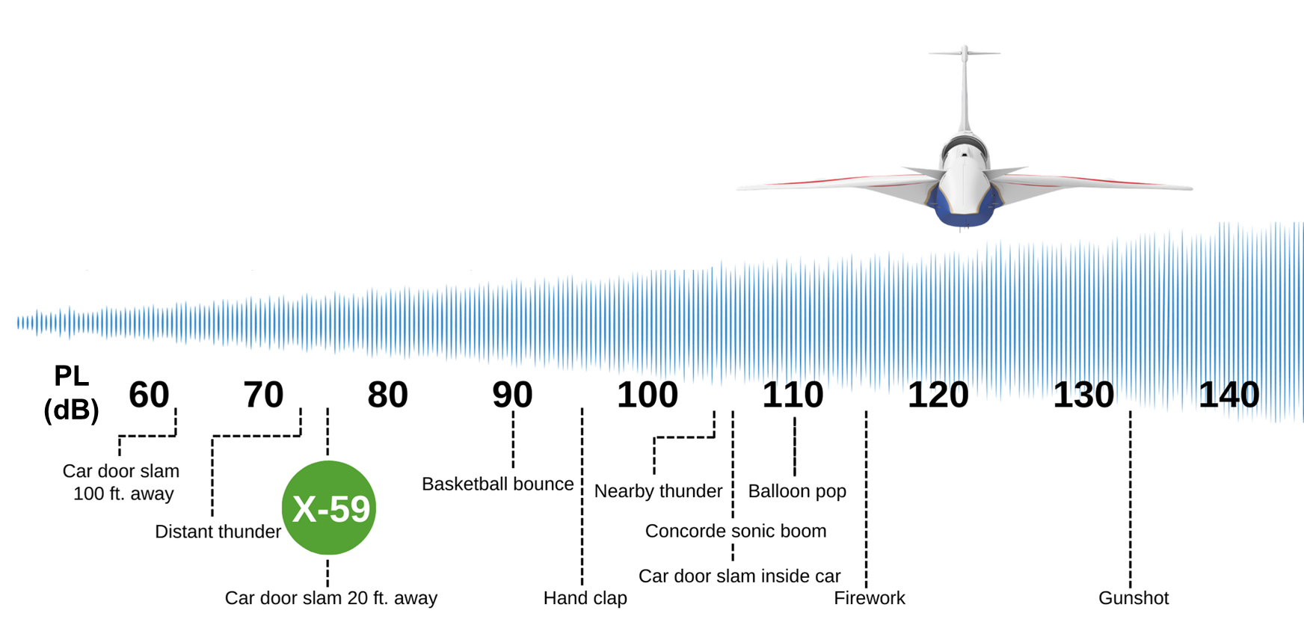
How Quiet Could Future Quiet Supersonic Transports Be?
Doebler and Rathsam (2019)

Slide 7
Community Testing Research Questions and Products
Produce dose-response models
Single flyover events
Cumulative dose
Assess effects on annoyance
Rattle, vibration, startle
Listening environment, time of day
Outside of mission scope
Sleep disturbance
Takeoff/landing noise, emissions
Response Metric
(annoyance level)
Dose Metric (noise level)

Slide 8
Airfield and Community Test Site Selection
Four to six planned tests in 2025-2027
Conduct first test from NASA Armstrong
Future airfields to be determined
Technical, aircraft-related constraints
Runway, airfield infrastructure
Emergency, alternate landing sites
Ensuring representativeness
Regional variation (Doebler et al. 2022b)
Demographic diversity
Notional Supersonic Flight Path
Decel Area
Recruitment
Region
~ 20 x ~30 nm
Climb/Accel Area
PoSTER ~50 x ~120 nm

Slide 9

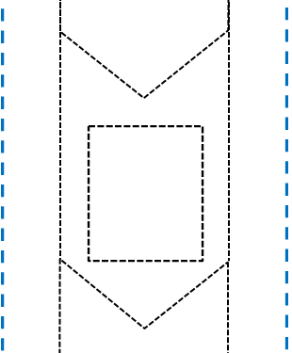





Collecting Responses With Longitudinal Surveys
Deceleration
Deploy repeated single-event, daily summary surveys
Near-real-time need for ~100 passes during one month
Survey modes: internet, custom smart phone apps
Population: all residents in recruitment region
Sample: panel of ~1,000 residents in community
Take every n^{th} household on sorted list
Within-household sampling
Acceleration/Climb
(Notional Figure)

Slide 10
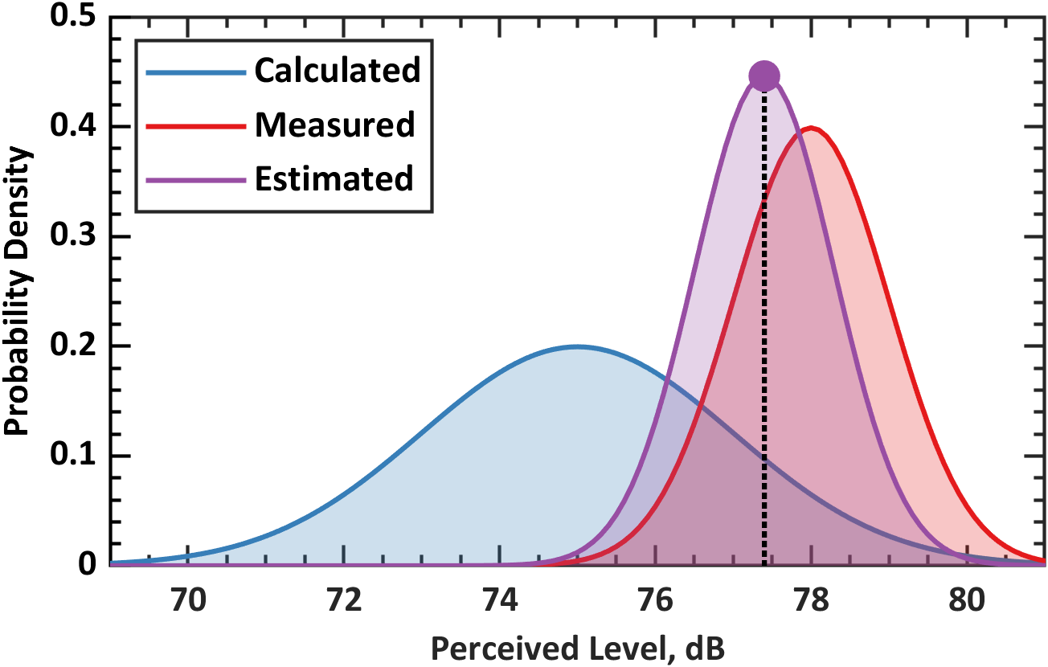
Noise Exposure Design, Estimation, and Analysis
Estimation, refinement of attainable noise levels
Noise exposure scheduling tool developed
Meteorological data needs identified
Progress of Ground Recording System (GRS)
Components of dose estimation and uncertainty
Probability Density
Uncertainty reduced for final estimated dose
Perceived Level (dB)
Source: Lympany et al. (2022b)

Slide 11
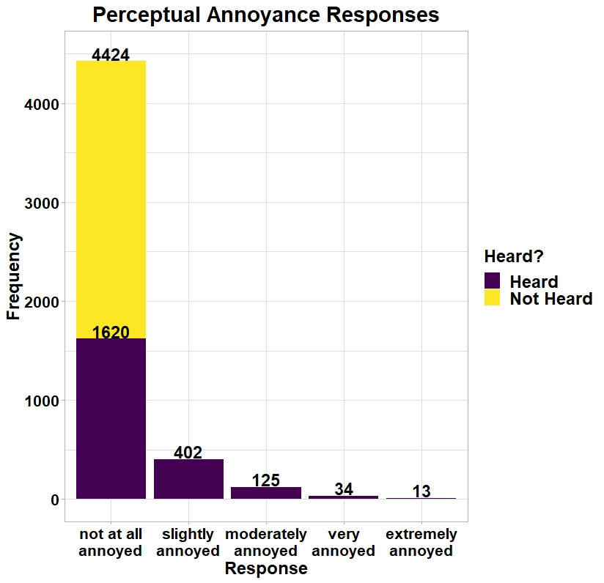
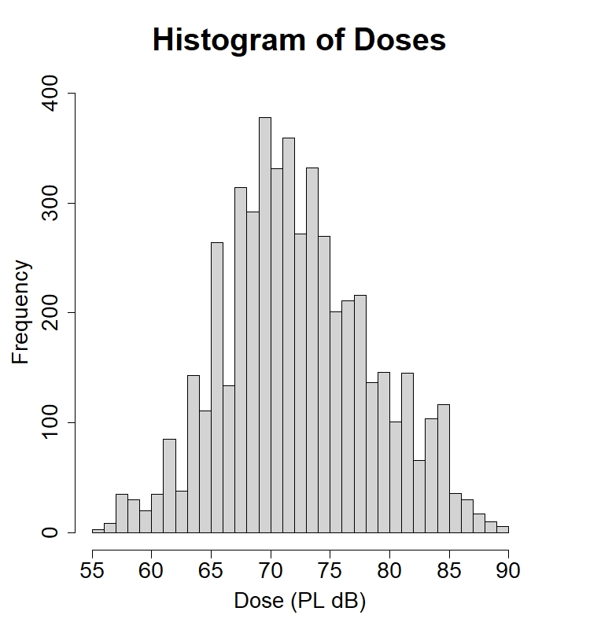
What Might We See in Collected Data?
Regulatory emphasis on the “Highly Annoyed”
Quiet Supersonic Flights 2018 Study (QSF18) in Galveston, TX
Page et al. (2020a,b), Lee et al. (2020)

Slide 12
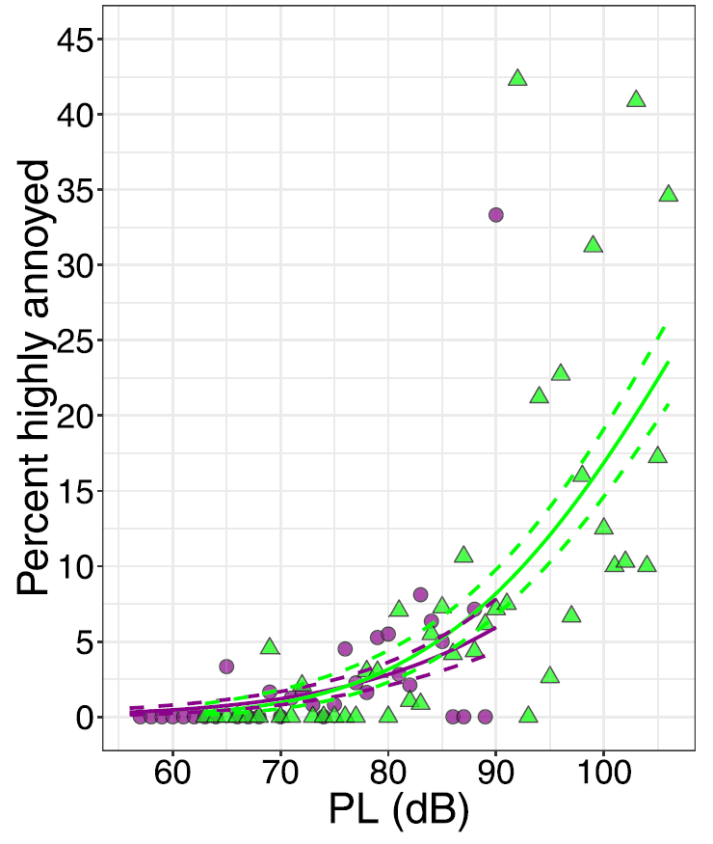
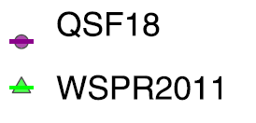
Dose Response Curves From Past NASA Studies
Waveforms and Sonic Boom Perception and Response 2011 at Edwards AFB
Page et al. (2014); comparison with QSF18 dose response curves in Lee et al. (2020)

Slide 13
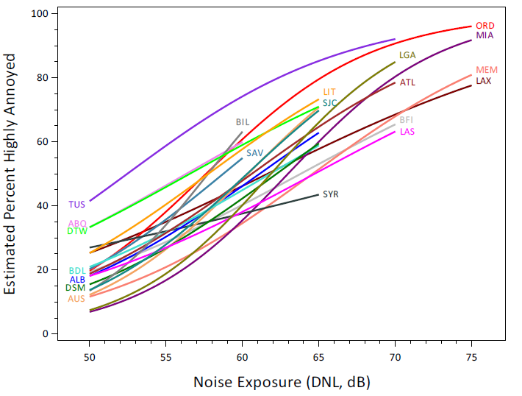
Toward National Dose Response Curves
Analysis of the Neighborhood Environmental Survey (Miller et al. 2021)
Note cumulative, A-weighted Day Night Level metric

Slide 14
Conclusions
Quesst mission culminates in community test campaigns
Anticipate first flight of the X-59 later this calendar year
Beginning in 2025, community testing will contribute data for regulation
If the speed limit restricting civil supersonic flights over land is replaced with a noise limit, what should that limit be?

Slide 15

Thank You!
https://www.nasa.gov/quesst
nathan.b.cruze@nasa.gov

Slide 16
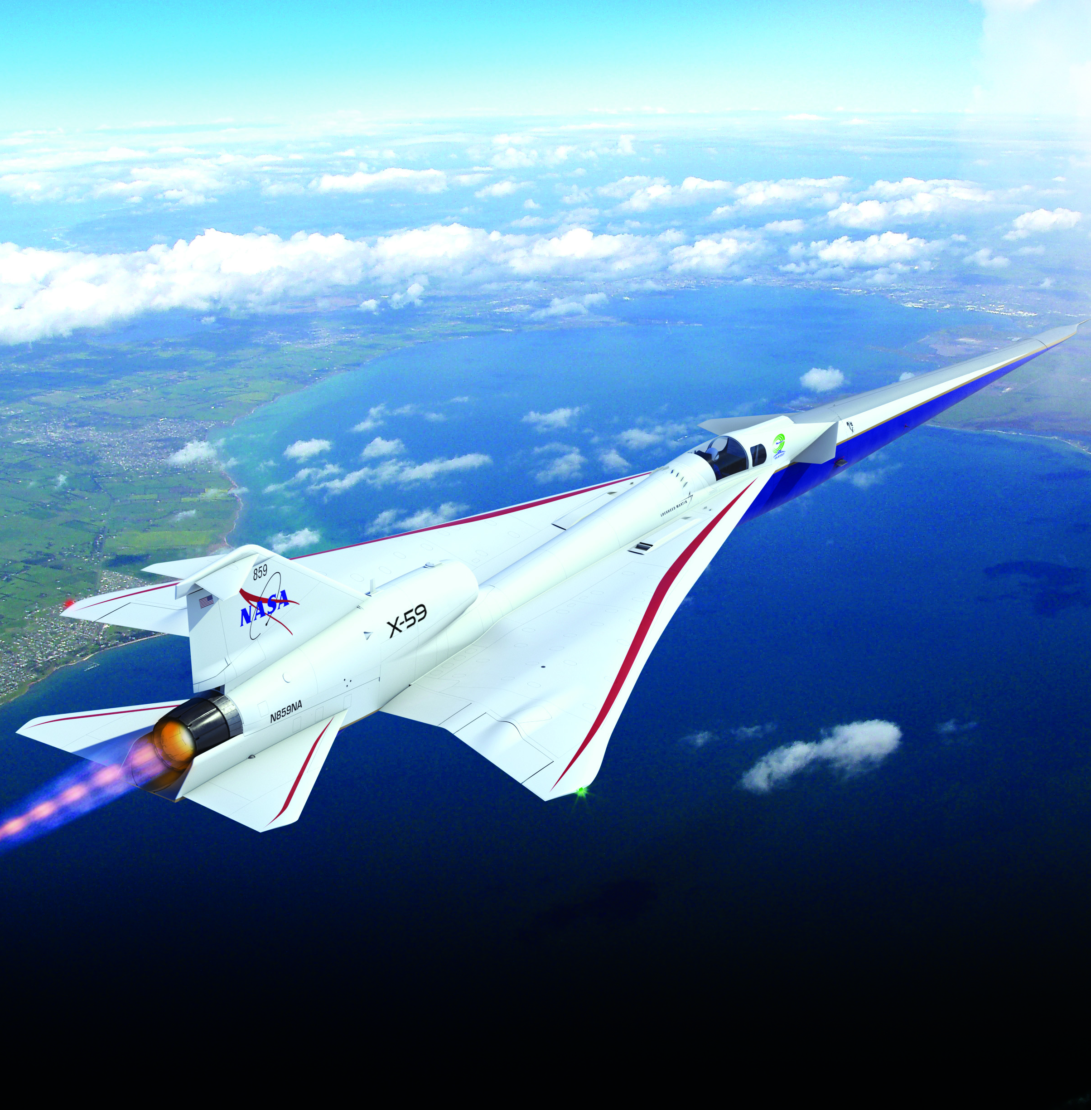
Supplement: NASA is Building the X-59 Research Aircraft
Flights will confirm that a full-scale supersonic aircraft can produce just a gentle sonic “thump”
Key data will be gathered on public perception of quiet supersonic flights in several cities across the nation
Length
99.7 feet long
Width
29.5 feet wingspan
Cruise Speed
Mach 1.4
Cruise Altitude
55,000 feet
Image Credit: Lockheed Martin

Slide 17
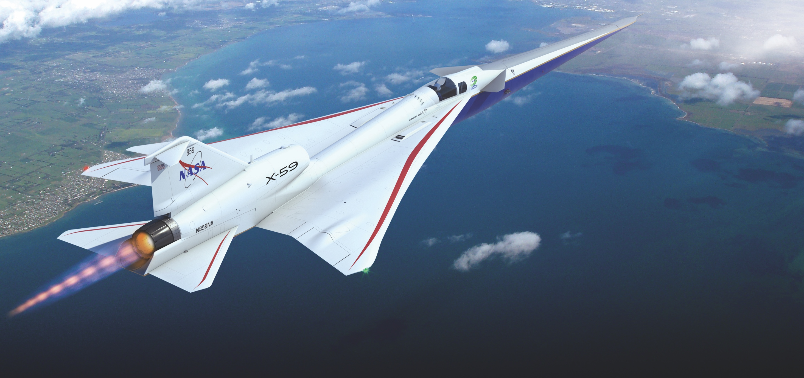
Supplement: X-59 Design Features Quiet design approaches adapted for a unique flight demonstrator
X-plane approach that meets key requirements in a cost-effective design
External and forward vision systems for forward visibility
T-38 aft canopy and ejection seat minimizes qualification cost and schedule
Long nose to shape forward shock
Fixed canard for nose-up trim at low-boom design point
Large, unitized skins reduce parts count and manufacturing cost
T-tail minimizes aft shock
F-16 landing gear and other systems from high performance aircraft minimize qualification cost and schedule
Wing shielding minimizes impact of inlet spillage on sonic boom
Single GE-F414 engine with standard nozzle minimizes cost and schedule
Conventional tail arrangement simplifies stability and control considerations
Image Credit: Lockheed Martin
17

Slide 18
References
Borsky, P. N. (1965). Community Reactions to Sonic Booms in the Oklahoma City Area. Research Report, National Opinion Research Center. Accession Number: AD0613620. https://apps.dtic.mil/sti/citations/AD0613620
Cruze, N. B., Ballard, K. M., Vaughn, A. B., Doebler, W. J., Rathsam, J., & Parker, P. A. (2022). Comparison of Likelihood Methods for Generalized Linear Mixed Models with Application to Quiet Supersonic Flights 2018 Data. Technical Memorandum, NASA Langley Research Center. NASA/TM–20220014998. https://ntrs.nasa.gov/citations/20220014998
Czech, J. J., Shah, G. H., & Richwine, D. M. (2022). NASA Quesst Mission–Site Selection Process for Community Testing. 183rd Meeting of the Acoustical Society of America. [Conference Presentation]. https://ntrs.nasa.gov/citations/20220018320
Doeber, W. J. and Rathsam, J. (2019) How Loud is X-59’s Shaped Sonic Boom. Proceedings of Meetings on Acoustics, Volume 36. https://doi.org/10.1121/2.0001265
Doebler, W. J., Vaughn, A. B., Ballard, K. M., & Rathsam, J. (2022a). Simulation and Application of Bayesian Dose Uncertainty Modeling for Low-Boom Community Noise Surveys. Proceedings of Meetings on Acoustics, Volume 45. https://doi.org/10.1121/2.0001592
Doebler, W. J., Wilson, S. R., Loubeau, A., & Sparrow, V. W. (2022b). Simulation and Regression Modeling of NASA’s X-59 Low-Boom Carpets Across America. Journal of Aircraft, 1–12. [First Online Access, October 10, 2022]. https://doi.org/10.2514/1.C036876
Ferg, R. & Opsomer, J. (2022). Modeling Approaches to Estimate Community Annoyance Due to Sonic Booms Using Data from Repeated Surveys. Seventh Italian Conference on Survey Methodology (ITACOSM 2022). [Presentation Slides]. https://ntrs.nasa.gov/citations/20220008195
Fidell, S. & Horonjeff, R. D. (2019). Field Evaluation of Sampling, Interviewing, and Flight Tracking of NASA’s Low Boom Flight Demonstrator Aircraft. Contractor Report, NASA Langley Research Center. NASA/CR-2019-220257. https://ntrs.nasa.gov/citations/20190001426
Harker, B. M., Lympany, S. V., & Page, J. A. (2022a). Performance Evaluation of a Shaped Sonic Boom Detector and Classifier. The Journal of the Acoustical Society of America, 152(4), A86. [Conference Presentation Abstract]. https://doi.org/10.1121/10.0015631
Harker, B. M., Lympany, S. V., & Page, J. A. (2022b). Performance Evaluation of a Shaped Sonic Boom Detector and Classifier. 183rd Meeting of the Acoustical Society of America. [Conference Presentation]. https://ntrs.nasa.gov/citations/20220017378
Klos, J. (2020). Recommendations for Using Noise Monitors to Estimate Noise Exposure During X-59 Community Tests. Technical Report, NASA Langley Research Center. NASA/TM–20205007926 Corrected Copy. https://ntrs.nasa.gov/citations/20205007926

Slide 19
References
Kryter, K. D., Johnson, P. J., & Young, J. R. (1968). Pyschological Experiments on Sonic Booms Conducted at Edwards Air Force Base. Research Report, Stanford Research Institute, Menlo Park, CA. Final Report, AD689844.
Lee, J., Rathsam, J., & Wilson, A. (2020). Bayesian Statistical Models for Community Annoyance Survey Data. The Journal of the Acoustical Society of America, 147(4), 2222–2234. https://doi.org/10.1121/10.0001021
Lympany, S. V. & Page, J. A. (2022a). Estimating Sonic Boom Metrics Across a Community Using a Kalman Filter. The Journal of the Acoustical Society of America, 152(4), A86. [Conference Presentation Abstract]. https://doi.org/10.1121/10.0015632
Lympany, S. V. & Page, J. A. (2022b). Estimating Sonic Boom Metrics Across a Community Using a Kalman Filter. 183rd Meeting of the Acoustical Society of America. [Conference Presentation]. https://ntrs.nasa.gov/citations/20220017380
Miller, N.P., Czech, J.J., Hellauer, K.M. Nicholas, B.L., Lohr, S., Broene, P., Morganstein, D., Kali, J., Zhu, X., Canort, D., Hudnall, J., & Melia, K. (2021) Analysis of the Neighborhood Environmental Survey. Technical Report, US Department of Transportation Federal Aviation Administration. DOT/FAA/TC-21/4. https://www.airporttech.tc.faa.gov/Products/Airport-Safety-Papers-Publications/Airport-Safety-Detail/ArtMID/3682/ArticleID/2845/Analysis-of-NES
Nixon, C. W. & Borsky, P. N. (1966). Effects of Sonic Boom on People: St. Louis, Missouri, 1961–1962. The Journal of the Acoustical Society of America, 39(5B), S51–S58. https://doi.org/10.1121/1.1914044
Page, J. A., Hodgdon, K. K., Hunte, R. P., Davis, D. E., Gaugler, T., Downs, R., Cowart, R. A., Maglieri, D. J., Hobbs, C., Baker, G., Collmar, M., Bradley, K. A., Sonak, B., Crom, D., & Cutler, C. (2020a). Quiet Supersonic Flights 2018 (QSF18) Test: Galveston, Texas Risk Reduction for Future Community Testing with a Low-Boom Flight Demonstration Vehicle. Contractor Report, NASA Langley Research Center. NASA/CR-2020-220589/Volume I. https://ntrs.nasa.gov/citations/20200003223
Page, J. A., Hodgdon, K. K., Hunte, R. P., Davis, D. E., Gaugler, T., Downs, R., Cowart, R. A., Maglieri, D. J., Hobbs, C., Baker, G., Collmar, M., Bradley, K. A., Sonak, B., Crom, D., & Cutler, C. (2020b). Quiet Supersonic Flights 2018 (QSF18) Test: Galveston, Texas Risk Reduction for Future Community Testing with a Low-Boom Flight Demonstration Vehicle. Contractor Report, NASA Langley Research Center. NASA/CR-2020-220589/Appendices/Volume II. https://ntrs.nasa.gov/citations/20200003224
Page, J. A., Hodgdon, K. K., Krecker, P., Cowart, R., Hobbs, C., Wilmer, C., Koening, C., Holmes, T., Gaugler, T., Shumway, D. L., Rosenberger, J. L., & Philips, D. (2014). Waveforms and Sonic Boom Perception and Response (WSPR): Low-Boom Community Response Program Pilot Test Design, Execution, and Analysis. Contractor Report, NASA Langley Research Center. NASA/CR-2014-218180. https://ntrs.nasa.gov/citations/20140002785

