Slide 1
Effects of Varying the Heat Transfer Coefficient on Engine Performance
Powering the Next Era of Space Exploration
Daria Nikitaeva
Corey Smith (Presenter), Matthew Duchek
Analytical Mechanics Associates, Inc.

Slide 2
Acknowledgements
This work was supported by NASA’s Space Technology Mission Directorate (STMD) through the Space Nuclear Propulsion (SNP) Project
Contract No. 80LARC17C0003
Task No. 10.020.000

Slide 3
Agenda
Introduction to Nuclear Thermal Propulsion (NTP) Modeling
Applicable Correlations for Nusselt Number
System Integration and Iterative Solution
X-NTP Heat Transfer Coefficient (HTC) Analysis
Conclusions and Future Work

Slide 4
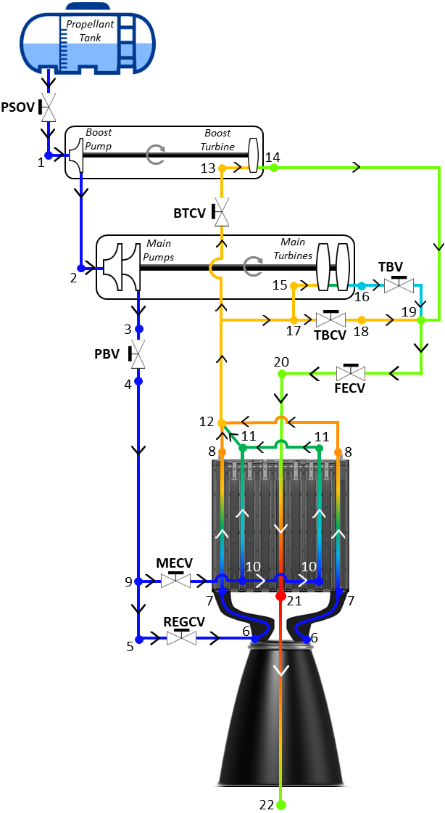
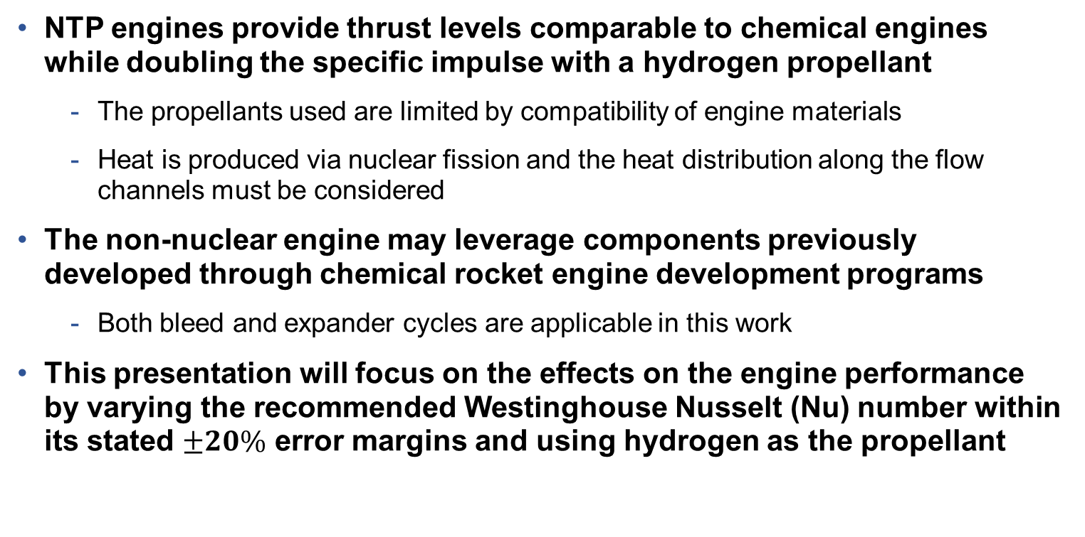
Nuclear Thermal Propulsion (NTP) Modeling Overview
NTP is a monopropellant system that relies on convective heat transfer from a reactor to the propellant to enable high in-space thrust and specific impulse.
NTP engines provide thrust levels comparable to chemical engines while doubling the specific impulse with a hydrogen propellant
  The propellants used are limited by compatibility of engine materials
  Heat is produced via nuclear fission and the heat distribution along the flow channels must be considered
The non-nuclear engine may leverage components previously developed through chemical rocket engine development programs
  Both bleed and expander cycles are applicable in this work
This presentation will focus on the effects on the engine performance by varying the recommended Westinghouse Nusselt (Nu) number within its stated $±20\%$ error margins and using hydrogen as the propellant

Slide 5
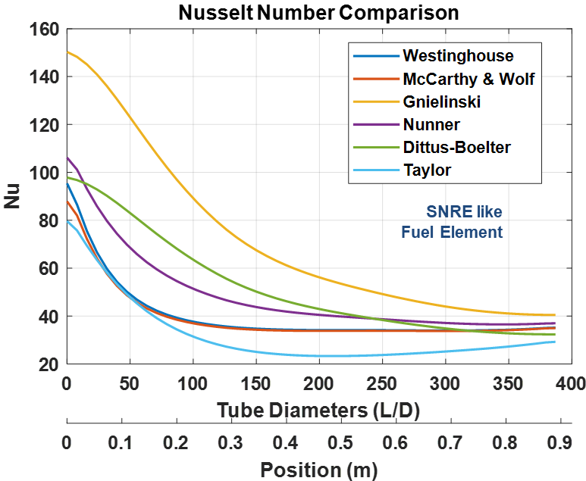
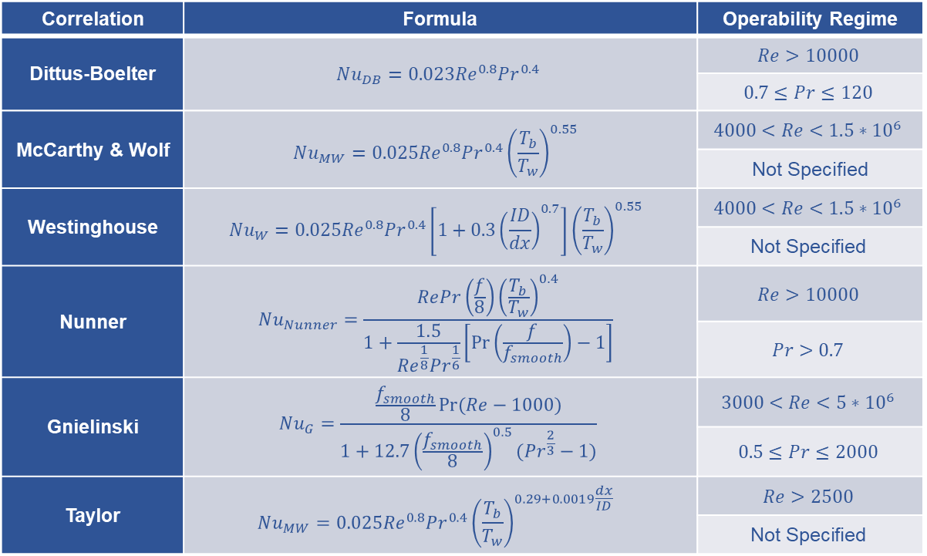
Applicable Correlations for Nusselt Number [11]
Turbulent heat transfer correlation options for gaseous working fluids in cylindrical tubes.
Correlation | Formula | Operability Regime
Dittus-Boelter | $$Nu_{DB}=0.023{Re}^{0.8}{Pr}^{0.4}$$ | $$Re>10000$$
 |  | $$0.7≤Pr≤120$$
McCarthy & Wolf | $$Nu_{MW}=0.025{Re}^{0.8}{Pr}^{0.4}{\left(\frac{T_{b}}{T_{w}}\right)}^{0.55}$$ | $$4000<Re<1.5∗{10}^{6}$$
 |  | Not Specified
Westinghouse | $$Nu_{W}=0.025{Re}^{0.8}{Pr}^{0.4}\left[1+0.3{\left(\frac{ID}{dx}\right)}^{0.7}\right]{\left(\frac{T_{b}}{T_{w}}\right)}^{0.55}$$ | $$4000<Re<1.5∗{10}^{6}$$
 |  | $$\text{Not} \text{Specified}$$
Nunner | $$Nu_{Nunner}=\frac{RePr\left(\frac{f}{8}\right){\left(\frac{T_{b}}{T_{w}}\right)}^{0.4}}{1+\frac{1.5}{{Re}^{\frac{1}{8}}{Pr}^{\frac{1}{6}}}\left[\operatorname{Pr}\left(\frac{f}{f_{smooth}}\right)−1\right]}$$ | $$Re>10000$$
 |  | $$Pr>0.7$$
Gnielinski | $$Nu_{G}=\frac{\frac{f_{smooth}}{8}Pr⁡(Re−1000)}{1+12.7{\left(\frac{f_{smooth}}{8}\right)}^{0.5}({Pr}^{\frac{2}{3}}−1)}$$ | $$3000<Re<5∗{10}^{6}$$
 |  | $$0.5≤Pr≤2000$$
Taylor | $$Nu_{MW}=0.025{Re}^{0.8}{Pr}^{0.4}{\left(\frac{T_{b}}{T_{w}}\right)}^{0.29+0.0019\frac{dx}{ID}}$$ | $$Re>2500$$
 |  | $$\text{Not} \text{Specified}$$
Many correlation options for Nusselt number exist and each result in different predicted heat transfer behavior.
5

Slide 6
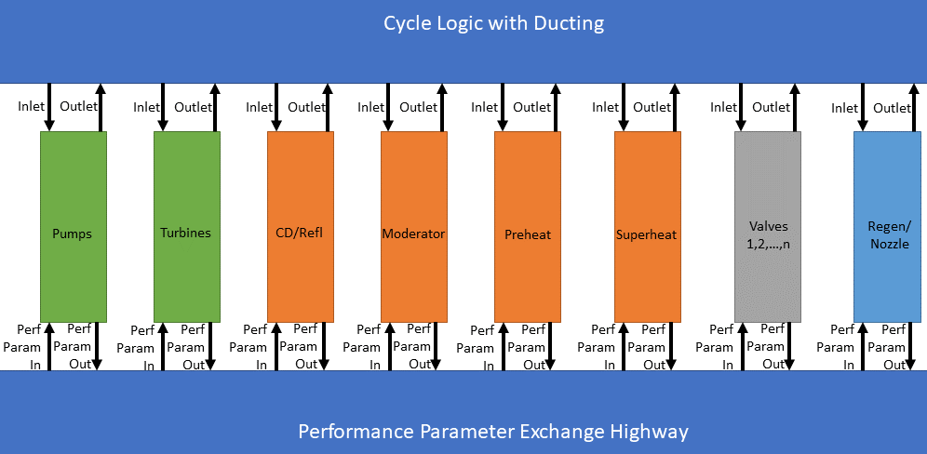
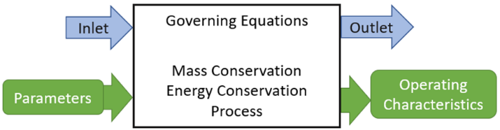
System Integration
Standalone components defined by a set of parameters with fluid states as inputs and outputs.
Based on the component parameters and fluid state inputs, the component provides its operating characteristics and fluid outputs INDEPENDENT of the model itself.
Each component is coded to have mass and energy conservation as well as a defined process (such as pump characteristics for pressurizing the fluid)
The components are assembled in the model and connected to each other by logic based on cycle specifications set by the user

Slide 7


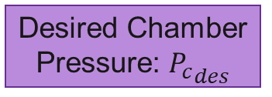

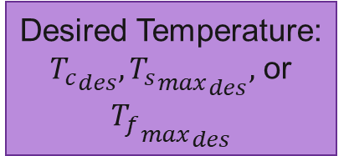

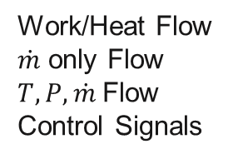

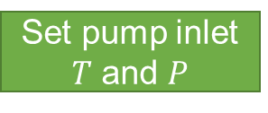
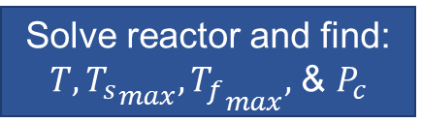
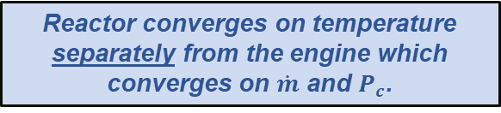
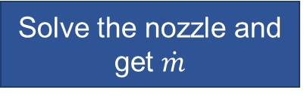



Iterative Solution
The NTP system performance is solved by performing double iteration.
Set pump inlet $T$ and $P$
Final Shutoff Valve
Pump
Turbine Circuit
Solve reactor and find: $T, {T_{s}}_{max}, {T_{f}}_{max},$ & $P_{c}$
Guess $\dot{m}$
Desired Chamber Pressure: ${P_{c}}_{des}$
Guess ${\dot{Q}}_{tot}$
Does $T_{X}$ match ${T_{X}}_{des}$?
Non-core channels
NO
Adjust ${\dot{Q}}_{tot}$
Desired Temperature: ${T_{c}}_{des},{{T_{s}}_{max}}_{des},$ or ${{T_{f}}_{max}}_{des}$
YES
Is $\dot{m}$ stable? Does $P_{c}$ match ${P_{c}}_{des}$?
NO
Does $P_{c}$ match ${P_{c}}_{des}$?
NO
Adjust FSV
YES
Legend
YES
Work/Heat Flow
$\dot{m}$ only Flow
$T, P, \dot{m}$Flow
Control Signals
Solve the nozzle and get $\dot{m}$
Reactor converges on temperature separately from the engine which converges on $\dot{m}$ and $P_{c}$.

Slide 8
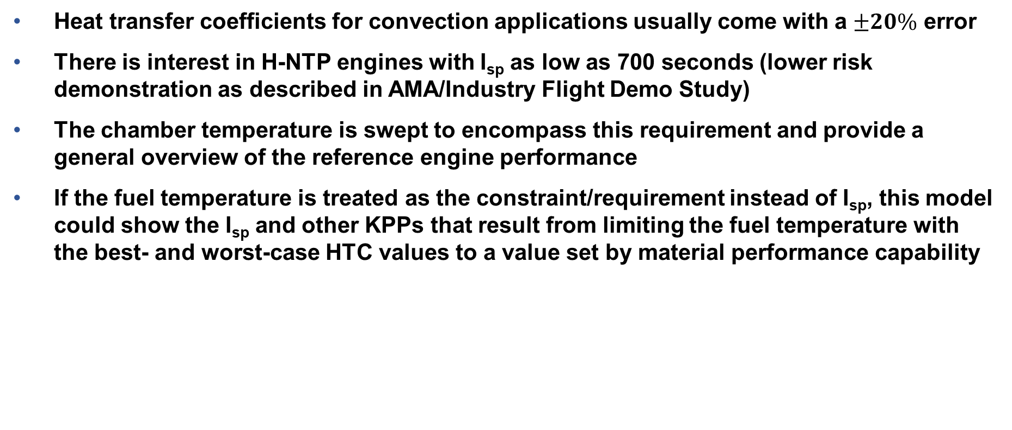
X-NTP HTC Analysis
Explores impact to internal components and provides upper and lower bounds on expected temperatures.
Heat transfer coefficients for convection applications usually come with a $±20\%$ error
There is interest in H-NTP engines with I_{sp} as low as 700 seconds (lower risk demonstration as described in AMA/Industry Flight Demo Study)
The chamber temperature is swept to encompass this requirement and provide a general overview of the reference engine performance
If the fuel temperature is treated as the constraint/requirement instead of I_{sp}, this model could show the I_{sp} and other KPPs that result from limiting the fuel temperature with the best- and worst-case HTC values to a value set by material performance capability

Slide 9
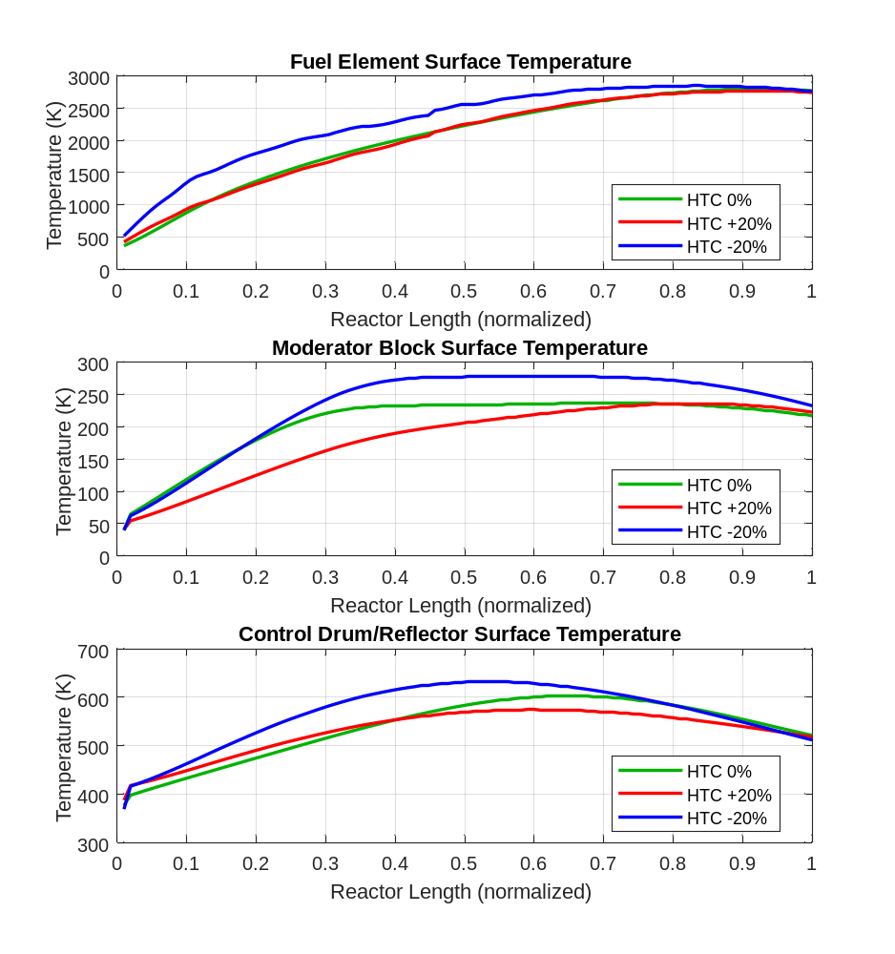
H-NTP HTC Variation (Westinghouse Correlation)
Using Reference Reactor / Engine Parameters and a 2700 K Chamber Temperature.
Chamber Temperature: 2700 K
Max Cladding Temperature (K)
HTC ±0% | 2804.9
HTC +20% | 2764.1
HTC -20% | 2861.3
Max Moderator Surface Temperature (K)
HTC ±0% | 237.0
HTC +20% | 236.0
HTC -20% | 277.7
Max CD/Reflector Surface Temperature (K)
HTC ±0% | 602.4
HTC +20% | 573.9
HTC -20% | 632.0
An increase in the HTC leads to a lower magnitude of temperature change than a decrease.

Slide 10
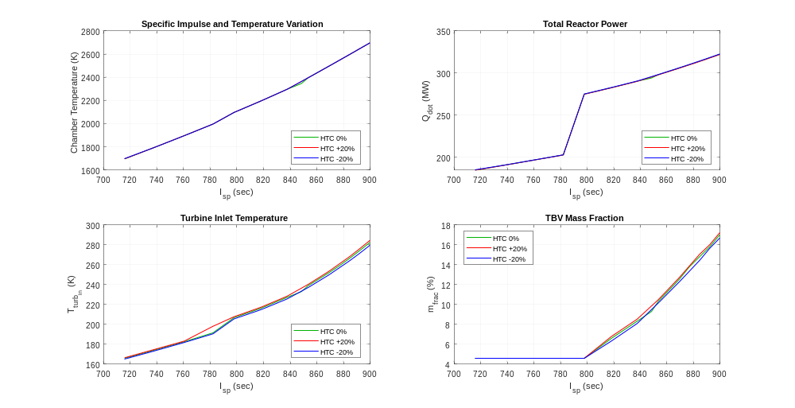
H-NTP HTC and I_{sp} Variation
Keeping the thrust the same lowers the net enthalpy entering the turbine, resulting in inadequate work produced.
Throat diameter decreased to restrict mass flow rate due to high power demand on turbomachinery.
Variation in HTC does not contribute to large variances in engine performance
The reference engine is not designed to support lower I_{sp} values, resulting in the turbine requiring more mass flow rate from decreased turbine inlet temperature
Due to an unoptimized system at lower specific impulse values, the turbine will require additional external power to support pump operation.

Slide 11
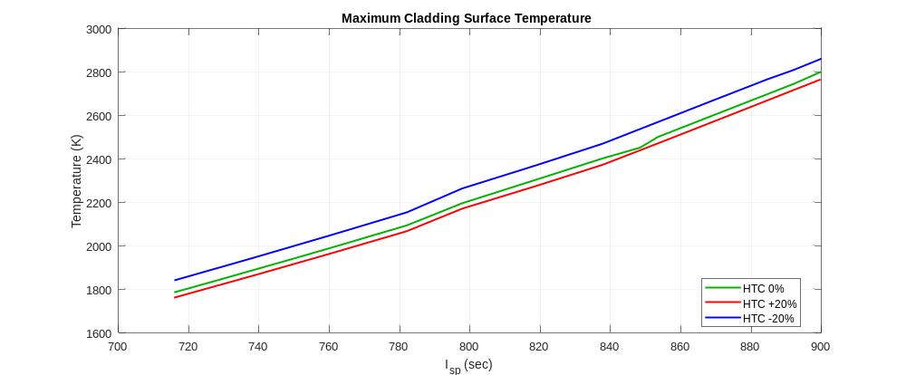
H-NTP HTC and I_{sp} Variation (Continued)
Prediction of the heat transfer coefficient and required chamber temperature impact the max clad temperature.
This result can be used to inform the maximum fuel temperature correlated to the specific impulse. However, an experiment could help narrow the temperature band with a more accurate approximation of the HTC than the recommended Westinghouse correlation.

Slide 12
X-NTP HTC Conclusions
Varying the HTC ±20% results in predictable maximum temperature trends (lower HTC results in higher material temperatures)
A decrease in HTC will result in a larger magnitude in temperature change than in increase
To maintain the same thrust at lower chamber temperatures:
  Reactor power decreases
  I_{sp} decreases
  Maximum fuel temperature decreases
  Mass flow rate increases
  Turbine inlet temperature decreases resulting in inadequate work produced to drive the engine

Slide 13
References
[1] Robbins, W. H., and Finger, H. B. An Historical Perspective of the NERVA Nuclear Rocket Engine Technology Program. Publication NASA-CR-187154. Analytical Engineering Corporation, 1991.
[2] Gustafson, J., Kreicicki, M., Swanson, R., Zilka, B., and Witter, J. K. Space Nuclear Propulsion Fuel and Moderator Development Plan Conceptual Testing Reference Design. Virtual Event, 2021.
[3] Nikitaeva, D., Smith, C., D., and Palomares, K. Nuclear Thermal Propulsion Turbomachinery Modeling. Cleveland, OH, 2022.
[4] Emrich, W. Jr. Principles of Nuclear Rocket Propulsion. Butterworth-Heinemann, Kidlington, Oxford, United Kingdom, 2016.
[5] Thomas, G. R. An Interim Study of Single Phase Heat Transfer Correlations Using Hydrogen. Publication WANL-TNR--056, 4233809. 1962, p. WANL-TNR--056, 4233809.
[6] Bartz, D. R. “A Simple Equation for Rapid Estimation of Rocket Nozzle Convective Heat Transfer Coefficients.” Journal of Jet Propulsion, Vol. 27, No. 1, 1957, pp. 49–53. https://doi.org/10.2514/8.12572.
[7] Balje´, O. E. “A Study on Design Criteria and Matching of Turbomachines: Part A—Similarity Relations and Design Criteria of Turbines.” Journal of Engineering for Power, Vol. 84, No. 1, 1962, pp. 83–102. https://doi.org/10.1115/1.3673386.
[8] Balje´, O. E. “A Study on Design Criteria and Matching of Turbomachines: Part B—Compressor and Pump Performance and Matching of Turbocomponents.” Journal of Engineering for Power, Vol. 84, No. 1, 1962, pp. 103–114. https://doi.org/10.1115/1.3673350.
[9] Moran, Michael J., Shapiro, Howard N., Boettner, Daisie D., and Bailey, Margaret B. Fundamentals of Engineering Thermodynamics. John Wiley & Sons, Inc, 2014.
[10] Bell, I. H., Wronski, J., Quoilin, S., and Lemort, V. “Pure and Psuedo-Pure Fluid Thermophysical Property Evaluation and the Open-Source Thermophysical Property Library CoolProp.” Industrial & Engineering Chemistry Research, Vol. 53, 2014, pp. 2498–2508. https://doi.org/10.1021/ie4033999.
[11] Nikitaeva, D., Smith, C., D., and Palomares, K. Comparison of Convective Heat Transfer Correlations and Their Application to Nuclear Thermal Propulsion. Cleveland, OH, 2022.

Slide 14
Questions?
Daria Nikitaeva (Lead Author)
daria.d.nikitaeva@ama-inc.com
Corey Smith (Presenter)
corey.d.smith@ama-inc.com | corey.d.smith@nasa.gov

Slide 15
BACK-UP

