Slide 1

NASA Digital Engineering Transformation
Terry R. Hill
May, 2023
“It is not necessary to change. Survival is not mandatory.”
(W. Edwards - Deming Institute, 2019)

Slide 2
Agenda
The Big Picture: DT and The Transformation of Engineering Quadrant
Transformation of Engineering – It takes a village …
Digital Engineering Framework
Things which have been accomplished
Integrated Digital Engineering (DE)
Orion Digital Twin
MBSE
The plan going forward
The Agency
Centers

Slide 3
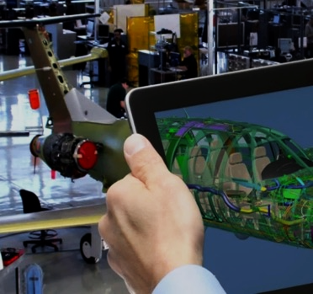
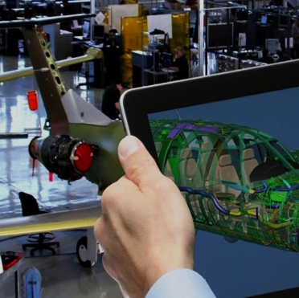

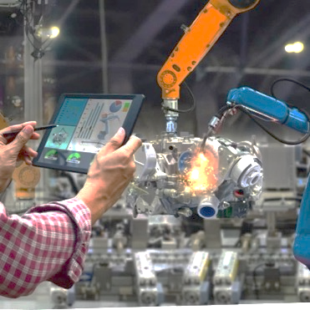

Proposed Transformation Targets – Digital Levers
Enable agile multi-center/partner engineering teams to solve frontier problems
Multiply science & technology breakthroughs by leveraging diverse global minds/advances
Enable agile multi-center/partner engineering teams to solve frontier problems
Transform Engineering
Transform Engineering
Transform Discovery
Executive Sponsors:
MDs, OCE, OSMA, Centers
Executive Sponsors:
OCS, OTPS, MDs, Centers
Transform Operations
Transform Governance
Optimize & synchronize our work environment to increase efficiencies & effectiveness between mission & mission support
Accelerate risk-informed,
self-consistent decision making
Executive Sponsors:
Chief of Staff/OES, CPMO, MDs
Executive Sponsors:
MSD, Centers, MSEOs
Notes:
Add role of exec sponsor own, execute their part & be exemplar/extend to others. description of each area needs to be revised/confirmed by sponsors

Slide 4
Transformation of Engineering – It Takes a Village
Transform Engineering
Contributions of the Centers
Lift & Shift from other Gov Agencies
NASA DT
Mission Directorates
CoPs
Office of Chief Eng.
NASA’s Digital Engineering Transformation Efforts
Notes:
Add role of exec sponsor own, execute their part & be exemplar/extend to others. description of each area needs to be revised/confirmed by sponsors

Slide 5
Transform Engineering – Areas of Focus
Need:
Goals (agreed to by EDs @ EMB 11-04-21):
Transform Engineering
Enable agile multi-center/partner engineering teams to solve frontier problems via integrated digital engineering
Establish Engineering Ecosystem Across the Engineering Life Cycle, including Best Practices
Formalize the Development, Integration, and Use of Models
Provide Integrated Engineering Data
Develop protocols and IT tools to enable collaboration
Evolve Culture and Workforce
Approach:
Objectives:
Inclusive, integrated multi-center/partner teams
Shared interoperable development environment that enables agile interdisciplinary modsim/test, rapid learning & diverse mission-driven approaches
Integrated cross-org, configuration managed, data-centric processes to rapidly & affordably develop/evaluate options & close complex designs
Authoritative, discoverable design/analysis/test artifacts with integrated confidence measures, and common taxonomies/ontologies.
Multi-fidelity digital twins to enable rapid concept-design-develop-build-test-evaluate-operate life-cycle engineering solutions & partner efforts
Tailorable to programs/projects
Address current Pain points
Achieve needed efficiencies
Fill capability gaps needed today and for tomorrow

Slide 6
Integrated Digital Engineering Framework per Lifecycle of a Project
Spans the lifecycle of project
Complex until you know how
Build slow, steady & smartly – don’t have to eat the elephant on day one.
Tailorable to specific program/project
Less errors in engineering (found in manufacturing & testing)
Increase speed of develop & delivery of missions
System Eng.
Digital thread and integrated data flow is represented via arrows

Slide 7
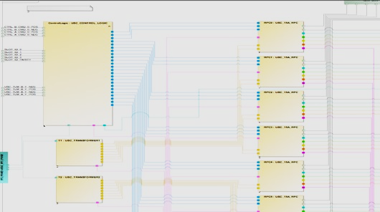
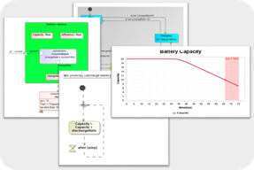
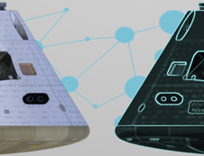
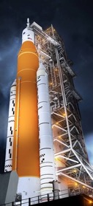
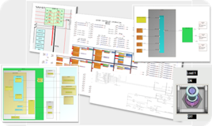
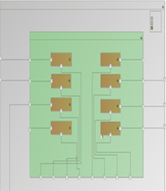

Orion DT Project 2021-2022 Plan & Milestones
FY2021
2022
March
April
May
June
July
August
September
October
November
December
January
February
March
April
May
June
July
August
September
EPS Schematics
Block Definitions
Hierarchy
Interfaces
Schematic Integration
June – Board interfaces & “Switch” details
July – Loads
Aug+ - Board internals
Development
Prototype
Depth Trade
Domain Research
EPS Simulation
Define Sim Scenario
Define behavior model
Develop GUI for live mission scenario
EPS Twin Integration
Telemetry Interface
Operational Data Interface
Parameter Definition
Artemis I Test Case
Feedback from live mission use by EPS engineering team
Further Subsystem Development
Multi-Domain Simulation
Tool Integration
Comprehensive Digital Twin Framework
EPS Digital Twin Validation/Evaluation
Model-Based Review
Live Reviews
Automated Audits
Initial proposal included 10 months of modeling and 8 months of validation per system.
Project Execution: Team finished modeling and initiated script-based verification in Dec-Jan ’22 per plan. Spring of ‘22 performed internal checks of the content that couldn't be verified using scripts, and delivered models, scripts and lessons learned to the NASA CoP.
Package for Agency Wide Use
Lessons Learned
Sanitized Model
Script Library
Reusable Components

Slide 8
Year 1 (FY22) Digital Engineering Activities
NASA Centers at COVID-19 Stage 3
FY22
MBSE @ Inter-Agency Working Group 11/16/21
MBE DT Brief to OCE 5/19/22
MBE Re-Org 6/07/22
MBE Site visits with JPL, SpaceX, Aerospace Corp., & NRO 8/01-04/22
Sep. 22
Integrated MBE Kickoff 1/31/22
MBE / MBSE Merger
Named Terry Hill – MBE Lead
12/15/21
MBE Funding 1/5/22
MBE Baselining as Integrated Team 2/17/22
NASA SE Workshop 4/04-08/22
NRO Brief of MBSE Infusion Effort 7/08/22
NRO Annual Summit 9/16/22
MBSE Brief to SELP
1/11/22
Summer Faculty Support for MBE Scope Refinement & Traceability to NGOs & Processes
Integrated MBSE into MBE and reorganized to DE to encompass whole lifecycle of engineering.
Multi-center PLM in NASA cloud Pilot
Orion DT completion of EPS
APPEL Tier 4 training available to workforce
Modeling of NPR 7123, 7120.5/.8 & 8705
NASA MBSE Modeling Handbook released
Agency benchmarking of toolchain capabilities
MBE
Navy 2/02/22
GSFC XRISM / JAXA Modeling 1/24/22
Sandia NL 2/22/22
MLT briefing to Navy/NAVSEA MBSE Modeling CoP. 3/20/22
Idaho NL 4/20/22
MBE Task 5
Cloud-Based Multi-Center PLM Pilot
DT Transforming
Eng. Sprint
ATP 5/10/22
Kickoff 5/25/22
MBE Task 1
Draft toolchain “architecture” 9/30/22
SOW Devel.
Benchmark Agency Toolchains and ident. Interoperability reqs. (WYE)
Presented Data Flow Concept to MB PM
11/03/21
Presented @ Transformation Tue
11/16/21
Leverages E-APMB survey data
Final product 11/15/22
Devel. & baseline of MBSE 3-Phased Plan w/resources needed
ATP 5/12/22
Kickoff 6/06/22
Piloting Complete 8/08/22
Modeling Initial Pass Complete 9/30/22
MBE Task 3
MBSE / MBE Data Flow Concept Development (FTE)
SOW Devel.
Model 7123 / 7120.5 & integrate with MB MA 8705 models (WYE)
Planning/Prep
Init. Model Arch.
Process Modeling
Model Integration
Finalize Modeling Drill Down & Plan for Process Optimization
Aerojet Rocketdyne 6/17/22
Northrop Grumman 5/25/22
GE Aviation 7/15/22
Pratt & Whitney 5/13/22
APPEL Mod. Requs for Tier 1-3 MBSE Training to use MagicDraw & align with Tier 4 Training
Booze-Allen 7/08/22
MBSE
Institute for Digital Enterprise Advancement Training and Development 7/08/22
APPEL Tier 4 MBSE Training Pilot
APPEL Tier 4 MBSE Training Available to NASA
MBE Task 2
MBSE External Training Benchmarking Activities (FTE)
MBSE NASA Handbook NASA-HDBK-1009 (FTE) Development and internal review
Agency-wide review 6/23-7/21 ‘22
Expect OCE to Sign by 9/30/22
Orion Demo to Orion Chief Engineer & VIO Office 11/12/21
Development of proposal for management of NASA-specific Standards in data-centric approach (FTE)
MBE Task 4
Presented @ Transformation Tue 11/16/21
Orion Demo to JSC Center Director 6/02/22
Transformation Tue Update 6/14/22
Demo to NRO 8/04/22
Orion Demo to MBSE CoP 5/25/22
Orion Digital Twin (FTE/WYE)
Blue Text - represents training benchmarking
Orion Demo to MB MA / OSMA w/ideas of how to generate fault trees 5/24/22
Orion Demo to Artemis MBSE Working Group 6/10/22
Demo to Gateway Management per request 7/29/22

Slide 9


Phased Integration Pilot of Commonly Used Engineering Tools
Phase I – FY22
Multi-Center PLM System Goals
✓
*
Phase I
Participating Centers:
KSC
JSC
GRC
Provide cloud-based repository to manage drawings, models and all project baselined artifacts including a release process workflow
Improve data accessibility
Integrate with agency systems and processes
(Launchpad, NAMS)
Broaden usage across centers improving system utilization
Manufacturing, Quality, EDCC users
Improve system security through consolidation
Reduce cost by only having one security plan
Multi-Center PLM
Phase I
✓
Phase I
MCAD
On Premise
*
Any mention of specific vendor tools doesn’t imply endorsement by NASA

Slide 10


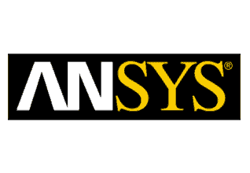













Phased Integration Pilot of Commonly Used Engineering Tools
✓
Code repository
Code Management
Trick
MONTE
✓
✓
Post2
VX Works (WSTS)
SysML Model Management
GN&C Software & Sim
Requirements Management
SysML Modeling
Analytics
Integrated System Goals
PLM
Utilizes federated credentialing to provide ability for domestic gov and industry partners can connect into our system for collaboration.
Deploy integrated analysis tools
Deploy GN&C development tools and software management platform (Teamcenter?) and linked to requirements.
Integration with One Big Idea/Project Luna
Multi-center, cloud-based enterprise license management
OCIO
✓
Federated IDP Credentialing (Access Control)
ET2TC
Phase II
ET2TC
Multi-Center PLM
ET2TC
Cloud License Management
✓
Trade names and trademarks are used in this report for identification only. Their usage does not constitute an official endorsement, either expressed or implied, by the National Aeronautics and Space Administration.
ECAD PLM
ECAD
SPDM
SPDM
On Premise /
On Premise /
Served from Cloud
Served from Cloud
SPDM – Simulation Product Data Management
ET2TC - Exiting tool to tool connector

Slide 11
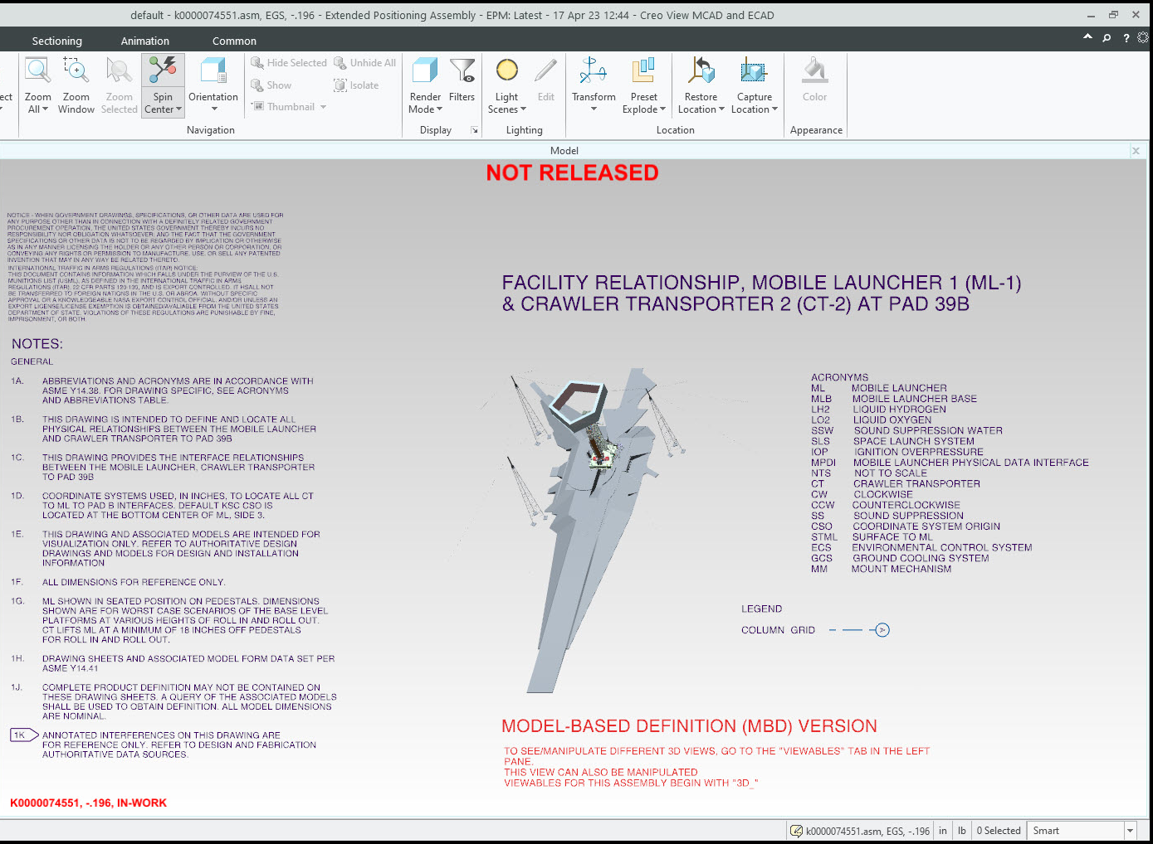
Very Large 3D Model Usage
Kennedy Space Center
Launch Pad model created from scanned point-cloud
Volumetric SLS model
As-Designed crawler and Launch Tower

Slide 12
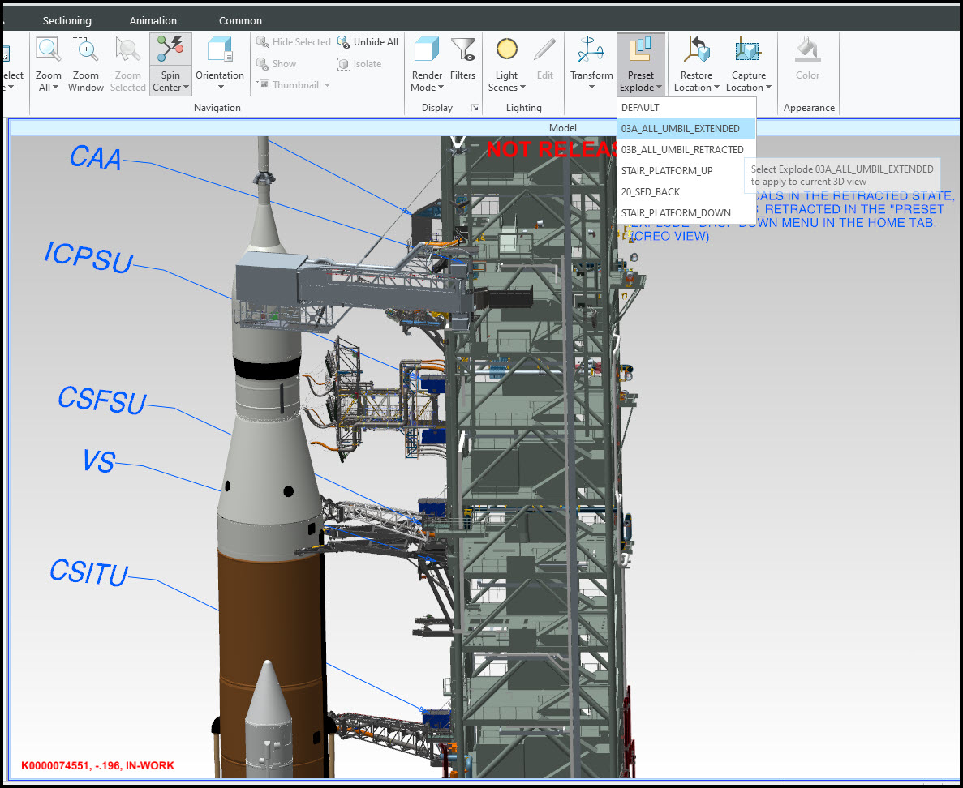
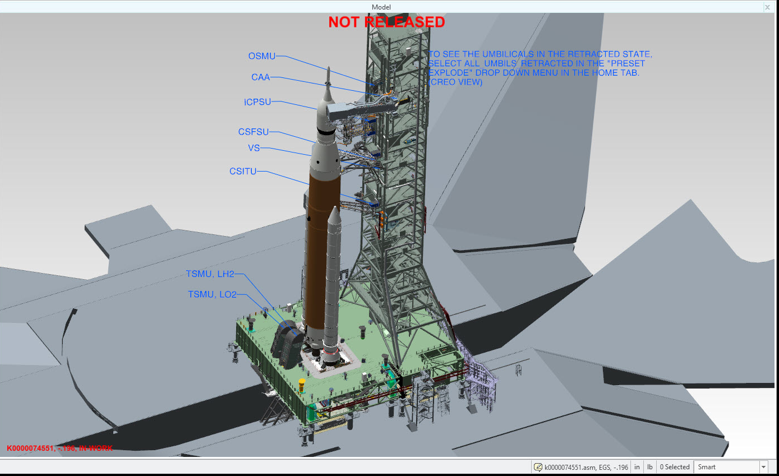
Very Large 3D Model Usage

Slide 13
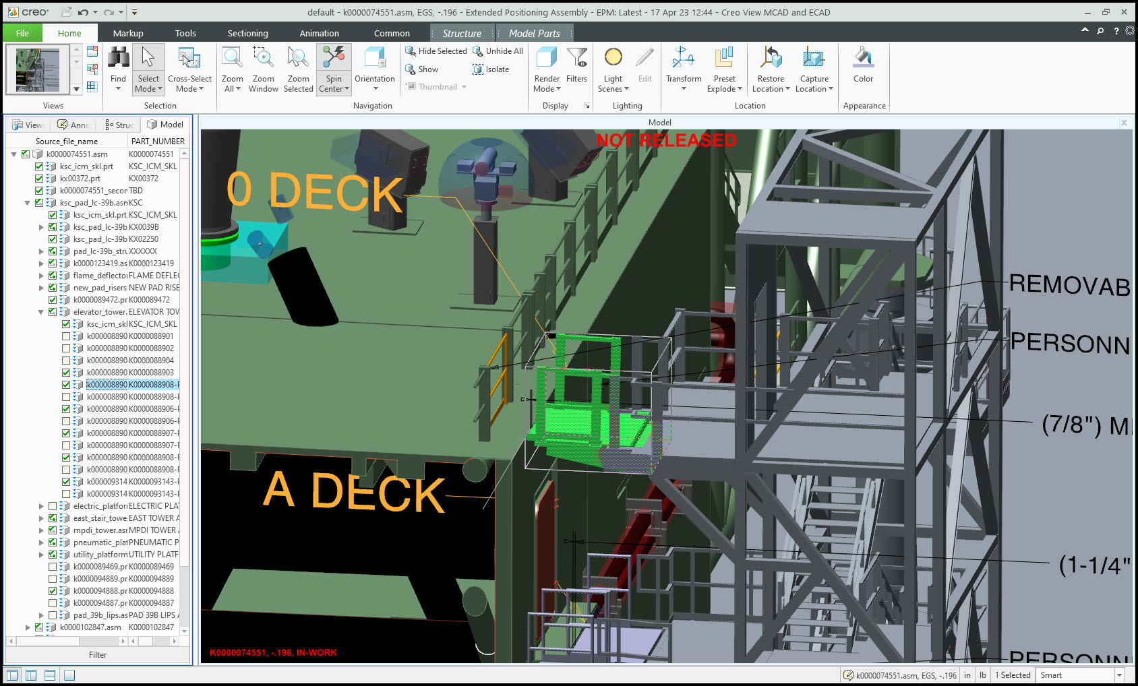
Very Large 3D Model Usage

Slide 14
Going Forward

Slide 15
FY23 Digital Engineering Plan
Close Partnership with the Center Engineering Directorates:
Direct involvement to better understand current capabilities, where they want to get to.
Leverage current capabilities of Centers with other Centers in need of the capability.
Formulate a plan for pilot projects which advance a Center’s needs and those of other Centers.
Complete Agency Process Mapping and perform Data-centric optimization, formulate interoperability requirements, and recommended toolchain with short list of tools per domain per project/program lifecycle.
Domestic Partners:
Release a RFI for recommendation for successful digital engineering toolchains to solution providers, to inform NASA’s internal recommendations in the event there are unknown unknowns to NASA in this area.
Release a RFI to domestic partners regarding how they would like to do business with NASA, collaborate, exchange data via contractual mechanisms to shape NASA’s near-term capabilities.
International Partners:
Engage to develop capability to securely collaborate and exchange information seamlessly.

Slide 16
FY23-25 DE Transformation Plan
Theme or Major initiative
Agency Activity
Notional / Pre-Decisional
Agency Planning Activity
Digital Transformation Workshop (Gov only) @ LaRC 10/25-27/22
RFI for how to do DE with NASA to Industry 12/XX/22
Recommended Center Activity
Sep. 25
DE EMB at Face 2 Face 11/30/22
DE EMB Status 11/10/22
DE
Understand lift-&-shift ops w/DoD
Plan lift-&-shift w/DoD
Execute lift-&-shift w/DoD
Eng. Digital Toolchains
Understand Center’s capability gaps – devel. Lift-&-shift ops.
Training
Invest to fill remaining gaps / infuse newly identified needed capabilities
Execute lift-&-shift from Center to Center
Finalize Center agreements of their contribution to solutions
Capabilities in 3 Years:
Cloud-base PLMs
Broad utilization of MBSE
Data-centric engineering workflows
Broad utilization of integrated Eng. toolchains
Federated Authoritative Sources of Truth
Finalize Agency Phase I toolchain baseline survey
Centers implement integrated digital engineering as baseline approach
Identify other tools which would benefit multiple centers to be in the cloud
Stand up N Cloud-Based Multi-Center tool environments (support E-APMB findings & recommendations
Cloud-Centric Solution Space
Cloud-Based Multi-Center PLM Governance & Sustainable business model
Support planning for centers interested in migrating
Center Migrations into Windchill cloud instance
Set up multi-center Cloud PLM for different vendor if desired by Centers
Center Migrations into Alt vendor cloud instance
Data & Processes
Centers understand where their ASoT are & data formats
Centers migrate data for core business processes into structured data constructs & federate
Centers understand core processes – map/model/ analyze for data centricity
Centers optimize processes & implement automation & dashboards
Centers integrate toolchains and structured data constructs for ASoT
Model & analyze 7123 / 7120.5 & integrate with MB MA 8705 models
Update of approved changes to NPRs
Provide Recommendations for update of NPRs
04/xx/23
Finalize interoperability and data format requirements
Explore unification of 7123, 7120.5/.8 & 8705 into centralized model flagged by discipline.
Update of approved changes to NPRs & training
MBSE
Support flow down modeling of Center processes from parent NPRs
Support flow down modeling of Center processes from parent NPRs
Understand lift-&-shift ops w/INCOSE
Execute lift-&-shift w/INCOSE
Understand lift-&-shift ops w/DoD
Execute lift-&-shift w/DoD
MBSE Capability Maturation
Perform rev 3 of MBSE Cap Asses.
Centers update local processes/documentation
Devel. Tier 5 APPEL Reqs.
Pilot Tier 5 MBSE APPEL Course
Centers implement MBSE as baseline approach on projects – hybrid approach for project reviews (models which produce trad. artifacts
Update NASA-HDBK-1004
Update NASA-HDBK-1009

Slide 17
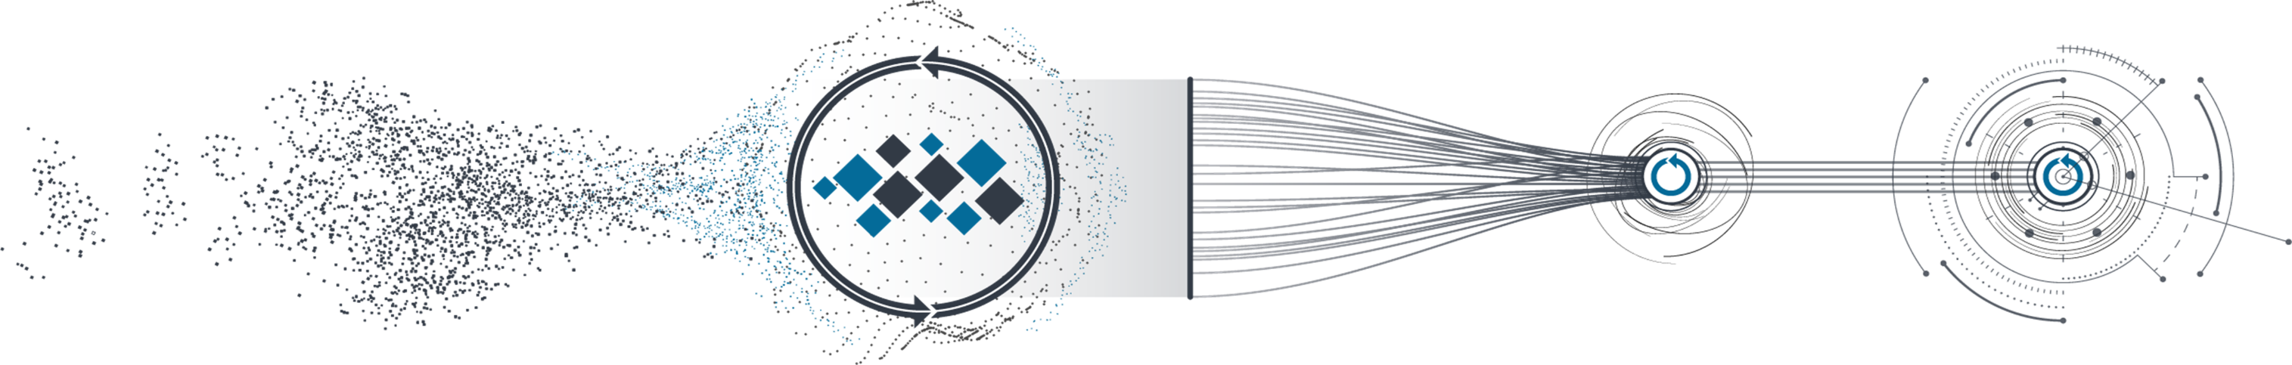
Simplified Digital Engineering Implementation Approach
Today’s practices
Model processes and baseline toolchains
Common host tools and link/pass data with minimal effort
Link in specialty / parametric tools
Domain fully-integrated tool chain and data-centric processes and data constructs
Identify your processes & tools by function and domain, and data repositories
Identify which primary tools are available to multiple people (server/cloud noted by blue circle). Identify needed interoperability between data repositories.
Data exchange between primary tools is automated or with minimal mouse clicks
Secondary / analytic tools are available in enterprise solution and are linked in with primary tool chain and digital twins
Consistent Digital Engineering Across the Agency
Seamless Data-centric Integration, collaboration, data exchange with Domestic and International Partners.
2024
2025
2023
Shift in Agency/Eng. Culture

Slide 18






REACH
NEW
HEIGHTS
NASA DIGITAL
TRANSFORMATION
REVEAL
THE
UNKNOWN
BENEFIT
ALL
HUMANKIND
Questions?

