Slide 1
AAM Digital Infrastructure & Architecture Efforts
Shivanjli Sharma, ATM-X Deputy Project Manager​

Slide 2
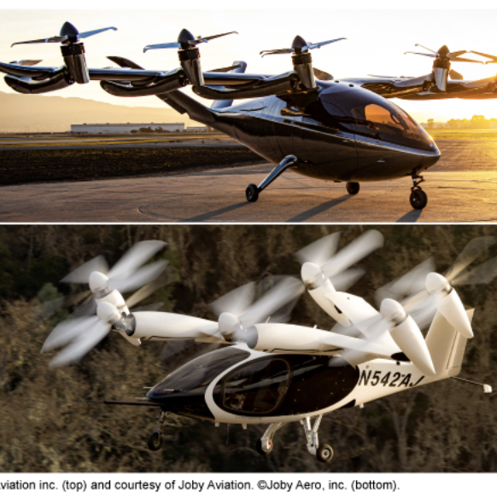
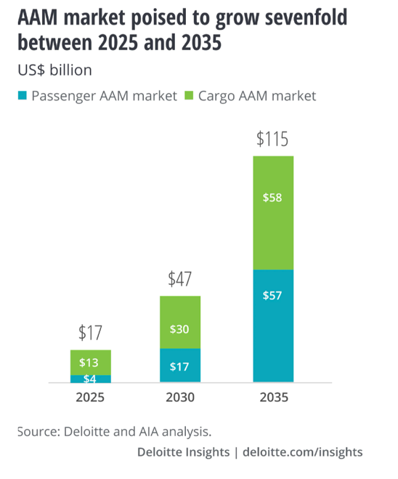
What is Advanced Air Mobility?
NASA defines Advanced Air Mobility (AAM) as safe, sustainable, affordable, and accessible aviation for transformational local and intraregional missions.
AAM is a broad term that covers several applications divided into an array of missions that may be performed in different types of aircraft flying between and over many different locations. AAM can encompass passenger transport, the movement of cargo or goods, and aerial work missions.

Slide 3
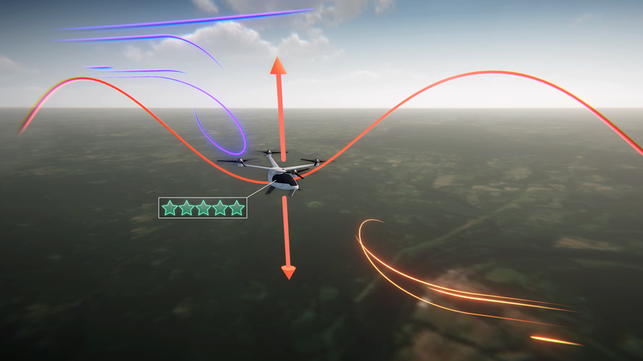

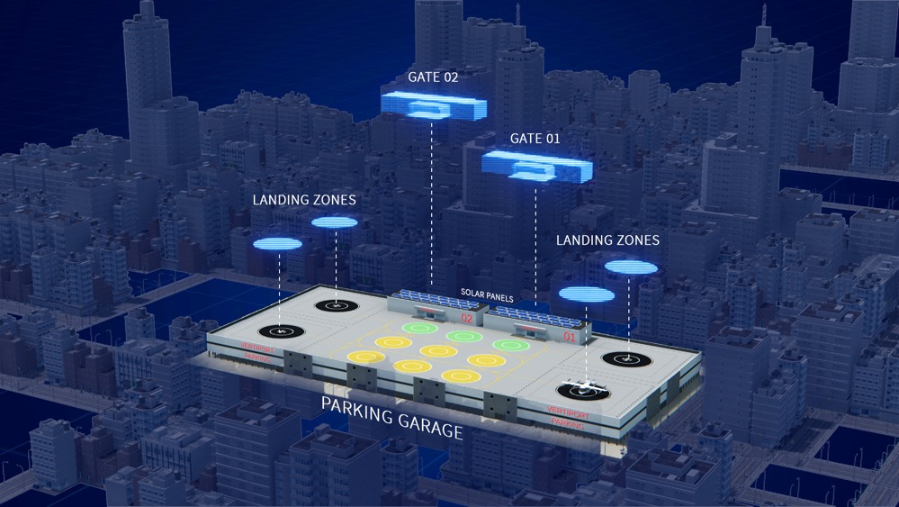
NASA is conducting research, development, and testing to ensure the U.S. has global leadership in the Advanced Air Mobility market = U.S. economic benefit
NASA’s Value
Accelerate technology: NASA is researching the total ecosystem through modeling, simulations, and flights to see how the pieces will work together in harmony (airspace, vertiports, aircraft, automation).
Accelerate policy and guidance: NASA is informing standards to enable regulators like the FAA to establish rules and policy.
Accelerate aviation leadership: NASA will help springboard the AAM industry to enable successful domestic industry business models.

Slide 4
Digital Infrastructure: Meaning & Implications
Intersection of hardware, software, and networks that enables the flow and use of data and information to support an organization’s operations.
Key Components:
Modes, methods, or pipes that enable communication
  Internet backbone and other modes of spectrum for sending data from one location to another
  Communication hardware and software, both terrestrial and space based
Capabilities that allow for use of this digital information
  Combination of on premise, cloud, hybrid, and edge computing
  Data aggregation and hosting
  Interfaces and protocols that enable access and understanding of data
Applications that create solutions using this available digital information
  Software services, algorithms, and tools that enable use of the data
Operational and data security

Slide 5
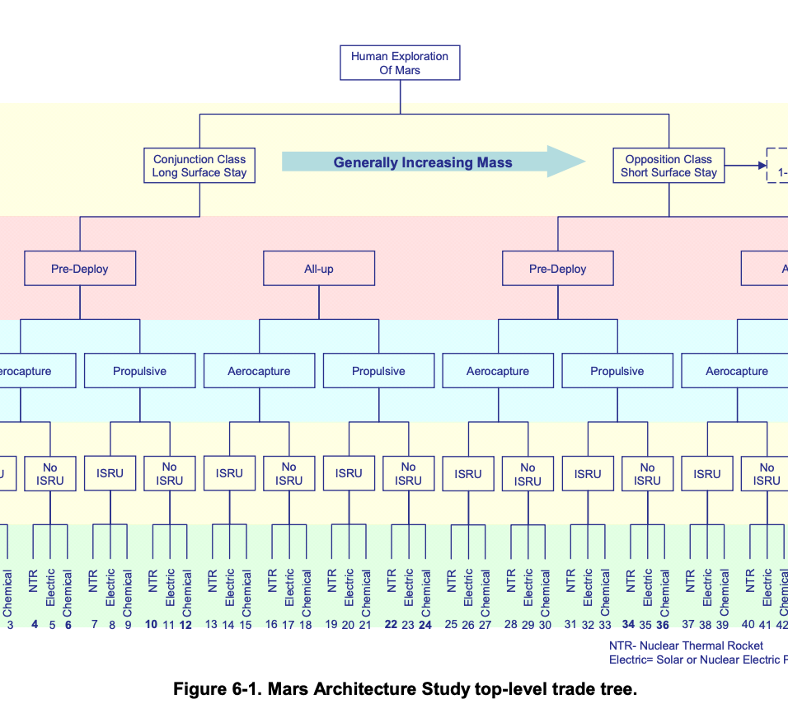
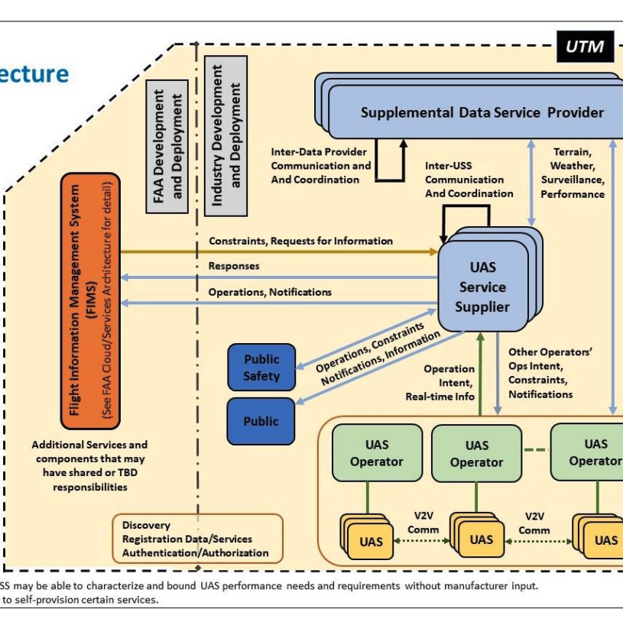
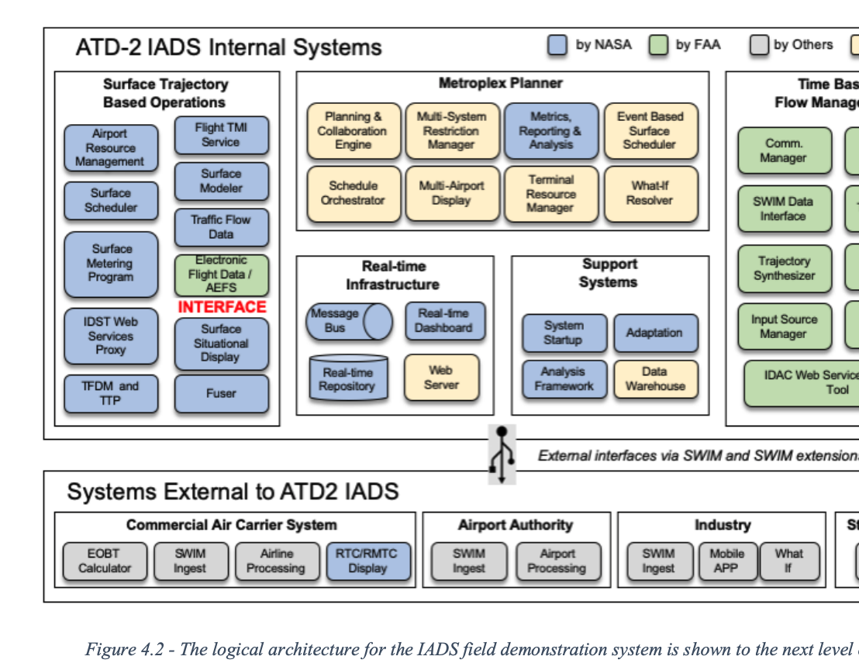
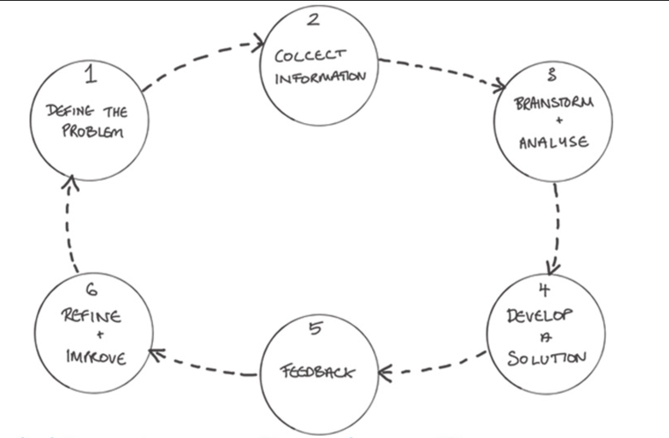
Architecture (System): Architecture is the high-level unifying structure that defines a system. It provides a set of rules, guidelines, and constraints that defines a cohesive and coherent structure consisting of constituent parts, relationships and connections that establish how those parts fit and work together. It addresses the concepts, properties and characteristics of the system and is represented by entities such as functions, functional flows, interfaces, relationships, resource flow items, physical elements, etc.
Notes:
https://www.nasa.gov/seh/appendix-b-glossary
https://www.firstinarchitecture.co.uk/wp-content/uploads/2018/10/Architecture-Design-Process-FI.jpg
https://www.faa.gov/sites/faa.gov/files/2022-08/UTM_ConOps_v2.pdf
https://aviationsystems.arc.nasa.gov/publications/2019/NASA-TM-2019-220355.pdf
https://www.nasa.gov/pdf/373665main_NASA-SP-2009-566.pdf

Slide 6
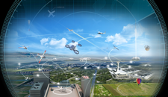




Framework for Integrated System Level Architecture
Total System Integration & Performance
FAA Aircraft Network Security Program
In-Time Aviation Safety Management Systems
Airspace Management
Fleet Management
Integrated System Architecture
Aircraft Technologies and Automation
Infrastructure
Communication, Navigation, Surveillance, SDSP
Vertiport/Airport Management
NASA’s role emphasizes an integrated system level approach to deliver requirements for total system performance.

Slide 7
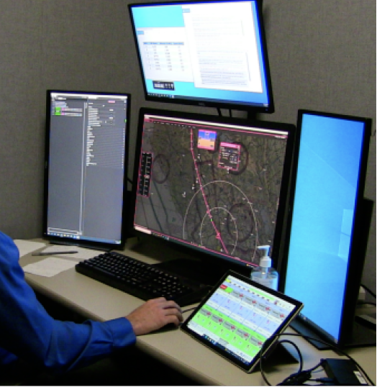


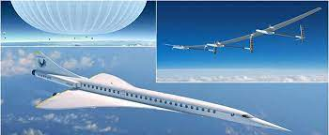





Digital Infrastructure to Support Multiple Use Cases
Automated Cargo Operations
Urban Air Mobility
Sustainable Conventional Operations
Upper Class E Operations
Evolving ATM Technology for the existing NAS and Developing Disruptive Capabilities for the Future NAS
Digital Services and Information Sharing
Novel Airspace Design and Frameworks
Communication Links & Information Protocols
Separation and Flow Management Algorithms

