Slide 1
Evaluation of Acoustic Propagation in Layered Media using Wave Confinement
1
Subhashini Chitta, Wave CPC, Inc, Tullahoma, TN, USA
Mary L. Houston, Analytical Mechanics Associates, Inc., Hampton, VA, USA
James H. Stephenson, U.S. Army Combat Capabilities Development Command,
Aviation & Missile Center, Hampton, VA, USA
John Steinhoff, Wave CPC, Inc, Tullahoma, TN
Distribution Statement A: Approved for Public Release

Slide 2
Outline
Problem Description
Long Range Propagation
Application to Rotorcraft Noise
Flight Test Comparisons
Conclusions

Slide 3
Problem Description
Homogeneous medium:
  Diverging straight line propagation
  Radius of curvature increases equally in all directions
  Amplitude loss is equal in all directions
cv

Slide 4
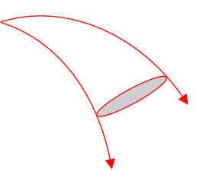
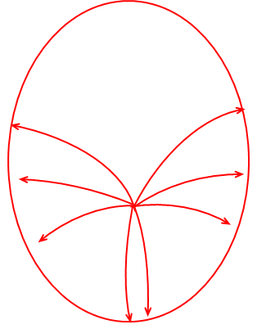
Problem Description
Homogeneous medium:
  Diverging straight line propagation
  Radius of curvature increases equally in all directions
  Amplitude loss is equal in all directions
Nonhomogeneous medium:
  Curved paths: Diverging or Converging
  Do not propagate equally in all directions
  Radius of curvature increases or decreases
  Amplitude loss is not equal in all directions
cv

Slide 5
Problem Description
Nonhomogeneous medium:
  Diverging (Example):
    Increasing speed of sound above and below source
    Higher amplitude loss at source height
  Converging (Example):
    Decreasing speed of sound above and below source
    Lower amplitude loss at source height
  Caustic regions:
    Converging regions that form an envelope
    Secondary sources that diffract
s
z
Speed of sound
z
s
Speed of sound

Slide 6
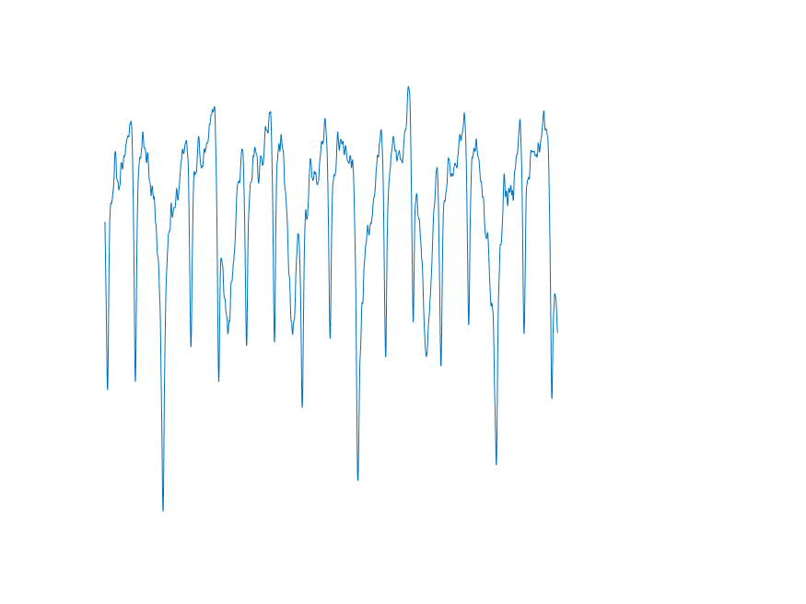
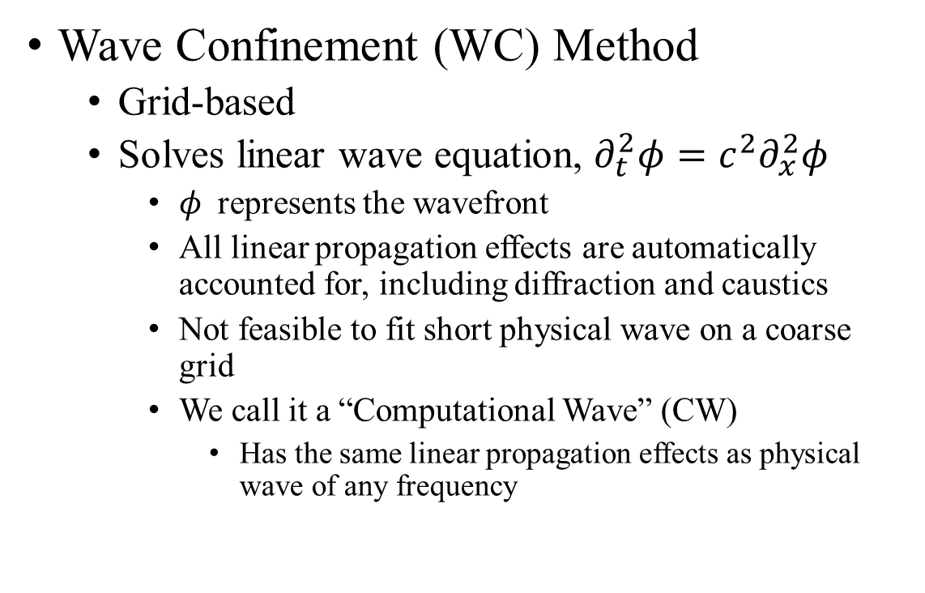
Long Range Propagation
Time evolution of a wavefront
Wave Confinement (WC) Method
  Grid-based
  Solves linear wave equation, $∂_{t}^{2}φ=c^{2}∂_{x}^{2}φ$
    $φ$ represents the wavefront
    All linear propagation effects are automatically accounted for, including diffraction and caustics
    Not feasible to fit short physical wave on a coarse grid
    We call it a “Computational Wave” (CW)
      Has the same linear propagation effects as physical wave of any frequency
S
Computational wave
Physical wave

Slide 7
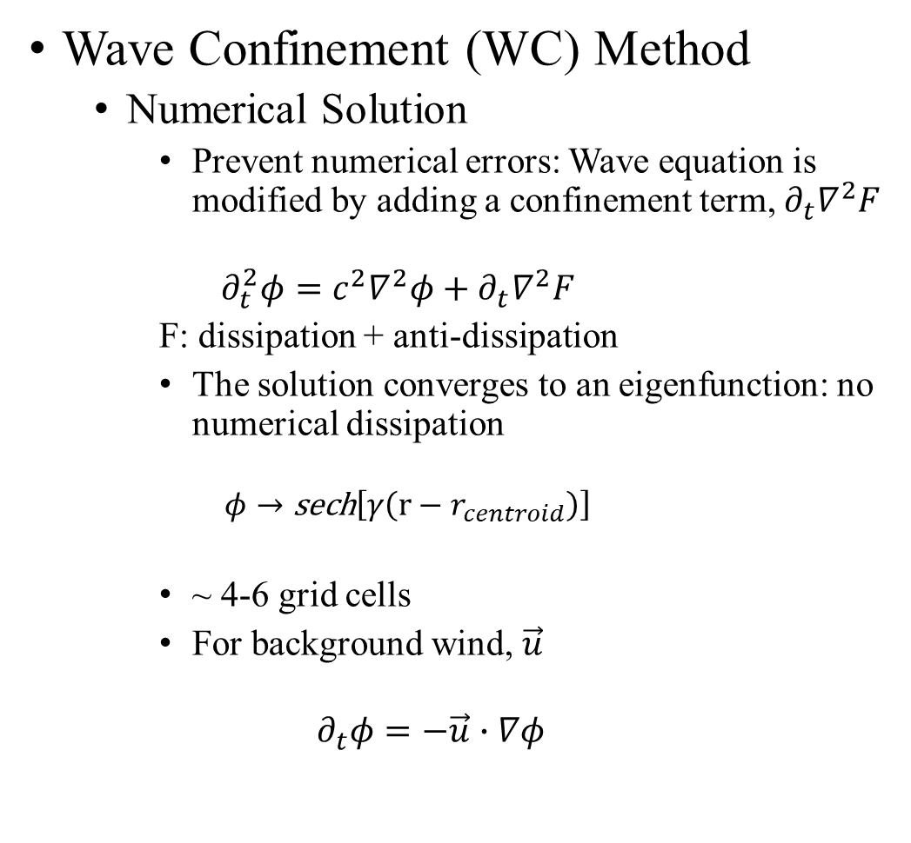
Long Range Propagation
Time evolution of a wavefront
Wave Confinement (WC) Method
  Numerical Solution
    Prevent numerical errors: Wave equation is modified by adding a confinement term, $∂_{t}∇^{2}F$
    $$∂_{t}^{2}φ=c^{2}∇^{2}φ+∂_{t}∇^{2}F$$
    F: dissipation + anti-dissipation
    The solution converges to an eigenfunction: no numerical dissipation
      $$φ→\text{sech}\left[γ\left(r−r_{centroid}\right)\right]$$
    ~ 4-6 grid cells
    For background wind, $\vec{u}$
  $$∂_{t}φ=−\vec{u}∙∇φ$$
S
Computational wave
Physical wave
4-6 grid cells

Slide 8
Long Range Propagation
Time evolution of a wavefront
Wave Confinement (WC) Method
  Numerical Solution
    Prevent numerical errors: Wave equation is modified by adding a confinement term, $∂_{t}∇^{2}F$
    $$∂_{t}^{2}φ=c^{2}∇^{2}φ+∂_{t}∇^{2}F$$
    F: dissipation + anti-dissipation
    The solution converges to an eigenfunction: no numerical dissipation
      $$φ→\text{sech}\left[γ\left(r−r_{centroid}\right)\right]$$
    ~ 4-6 grid cells
    For background wind, $\vec{u}$
  $$∂_{t}φ=−\vec{u}∙∇φ$$
S
centroid
Computational wave
Physical wave
4-6 grid cells

Slide 9

Long Range Propagation
Integral Calculations
  Ideal Case: Axisymmetric point source of amplitude, $A_{0}$:
    Amplitude of CW $=\frac{1}{r}$
    Amplitude of physical wave $=\frac{1}{r}∗A_{0}$
      $A_{0}$ can be specified as a function of frequency or time and independent of direction.
    SPL of physical wave
    Arrival time

Slide 10
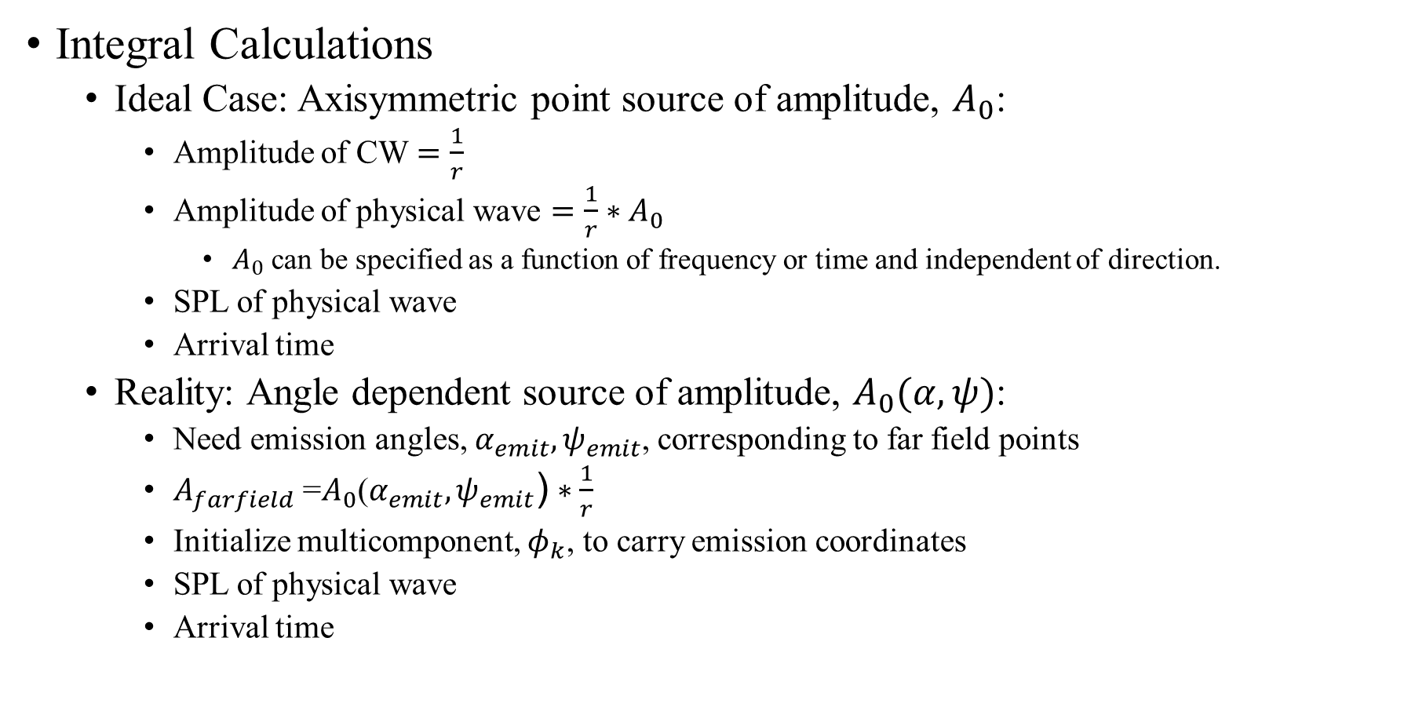

Long Range Propagation
Integral Calculations
  Ideal Case: Axisymmetric point source of amplitude, $A_{0}$:
    Amplitude of CW $=\frac{1}{r}$
    Amplitude of physical wave $=\frac{1}{r}∗A_{0}$
      $A_{0}$ can be specified as a function of frequency or time and independent of direction.
    SPL of physical wave
    Arrival time
  Reality: Angle dependent source of amplitude, $A_{0}(α,ψ)$:
    Need emission angles, $α_{emit},ψ_{emit}$, corresponding to far field points
    $A_{farfield}$ =$A_{0}\text{(}α_{emit},ψ_{emit}\text{)}∗\frac{1}{r}$
    Initialize multicomponent, $φ_{k}$, to carry emission coordinates
    SPL of physical wave
    Arrival time
$$\text{(}α_{emit},ψ_{emit}\text{)}$$
Ground

Slide 11
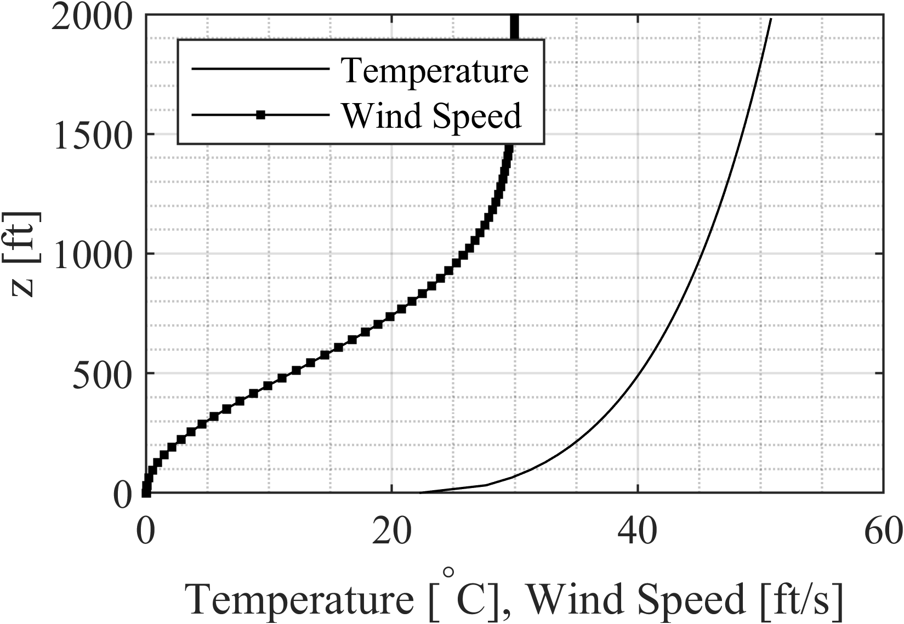
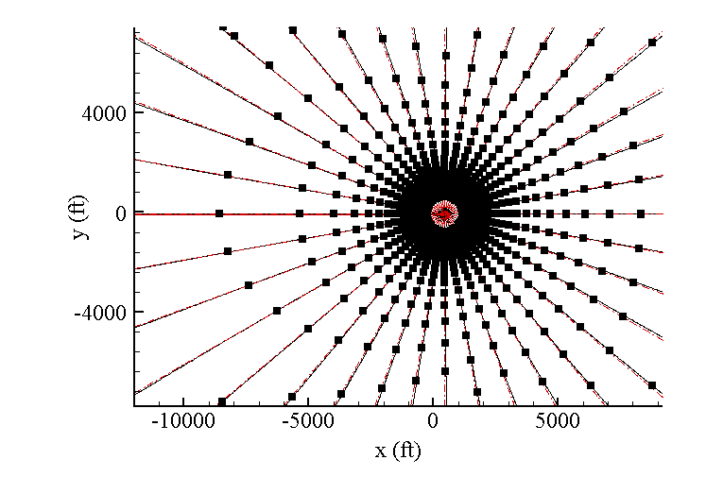
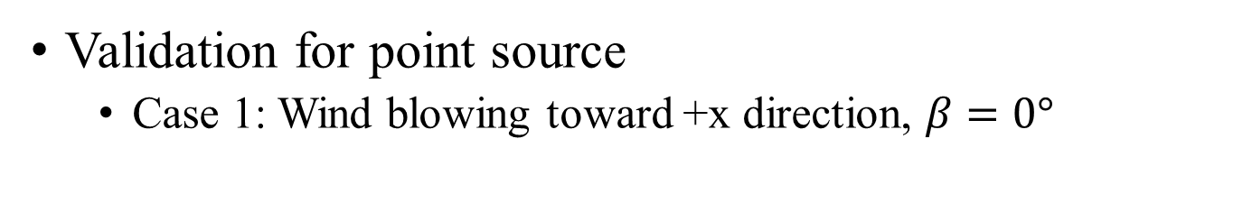

Long Range Propagation
Validation for point source
  Case 1: Wind blowing toward +x direction, $β=0°$
Azimuth angle contours
$$\vec{u}=(\left|u\right|,0)$$
Homogeneous medium
Ray markers
WC
Minimal deviation in azimuth angle due to wind

Slide 12
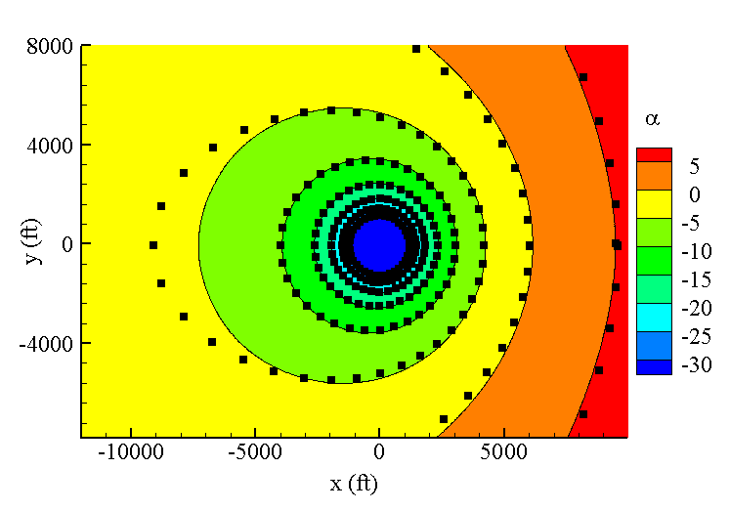
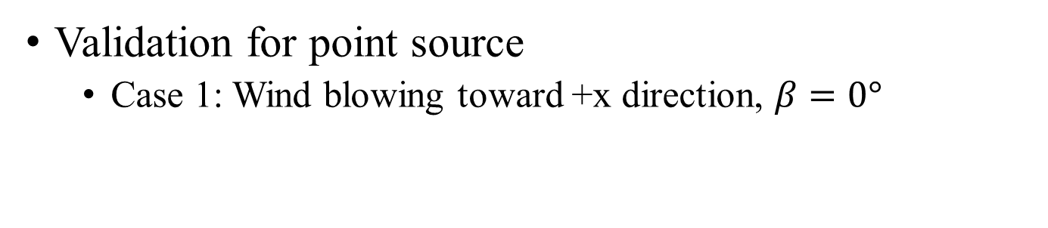
Long Range Propagation
Validation for point source
  Case 1: Wind blowing toward +x direction, $β=0°$
Elevation angle contours
$$\vec{u}=(\left|u\right|,0)$$
Ray markers
WC
Expanding (upward bending)
Contracting (downward bending)

Slide 13
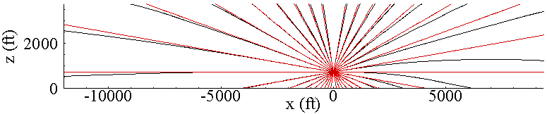
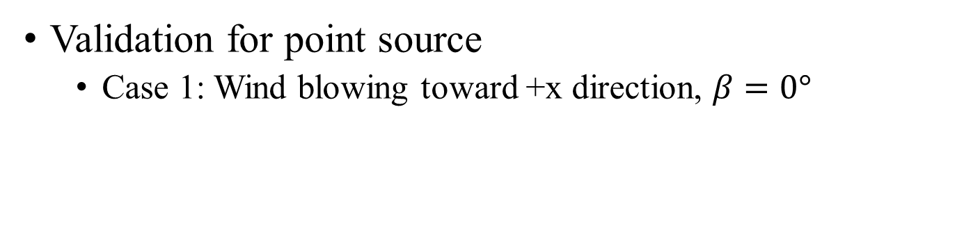
Long Range Propagation
Validation for point source
  Case 1: Wind blowing toward +x direction, $β=0°$
Elevation angle contours
$$\vec{u}=(\left|u\right|,0)$$
Homogeneous medium
Ray markers
WC

Slide 14
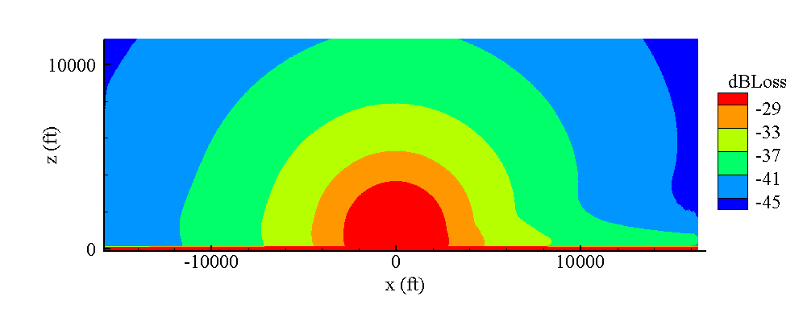
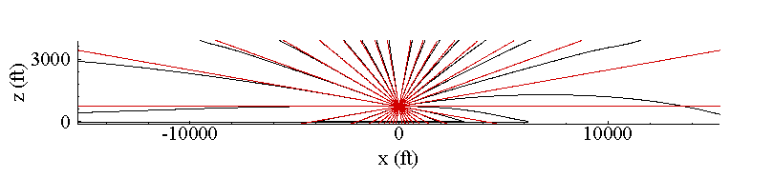

Long Range Propagation
Validation for point source
  Case 1: Wind blowing toward +x direction, $β=0°$
$$\vec{u}=(\left|u\right|,0)$$
Homogeneous medium
WC
Elevation angle contours
Downward bending
Amplitude loss is lower

Slide 15
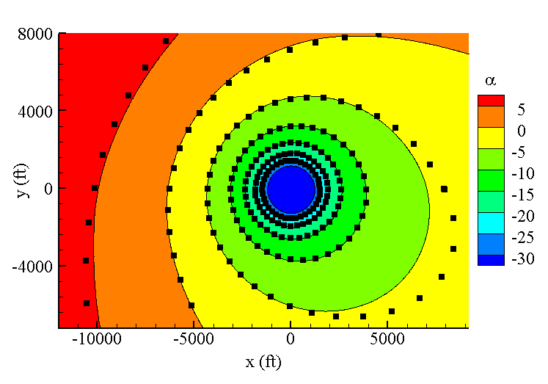
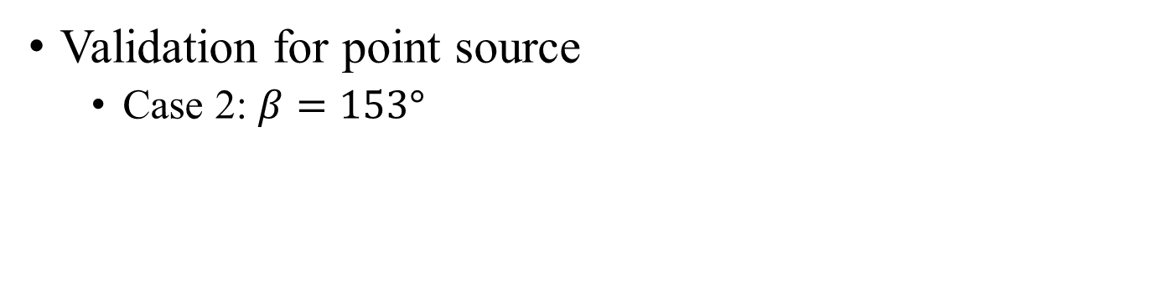

Long Range Propagation
Validation for point source
  Case 2: $β=153°$
Ray markers
Elevation angle contours
WC
$$\vec{u}$$

Slide 16

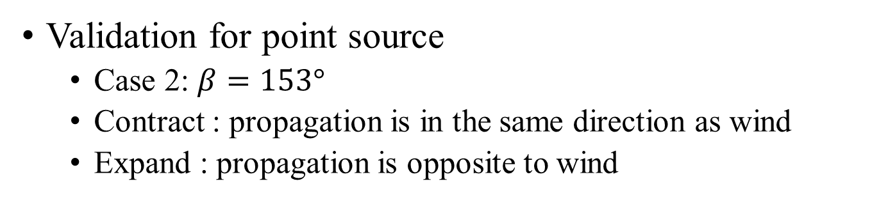
Long Range Propagation
Validation for point source
  Case 2: $β=153°$
  Contract : propagation is in the same direction as wind
  Expand : propagation is opposite to wind
Ray markers
Elevation angle contours
WC
$$\vec{u}$$
$$\vec{u}$$

Slide 17
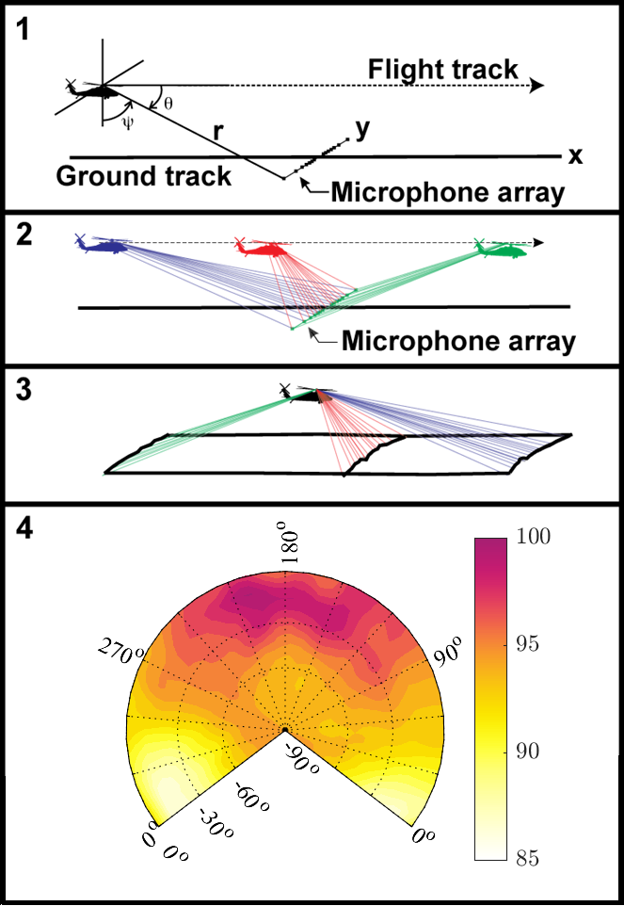
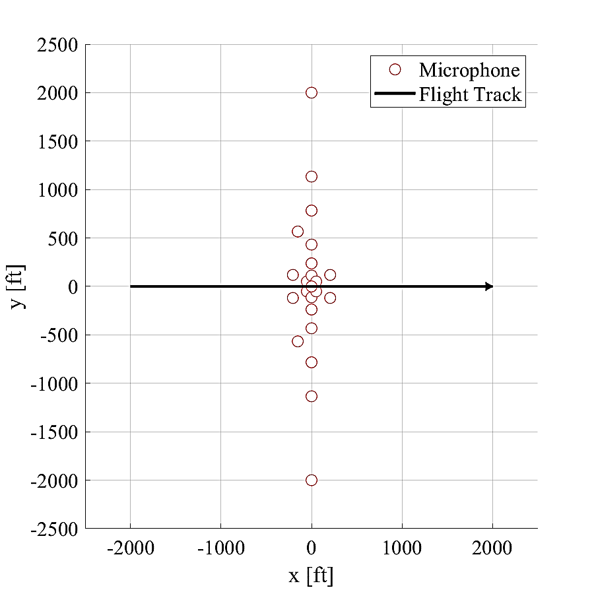
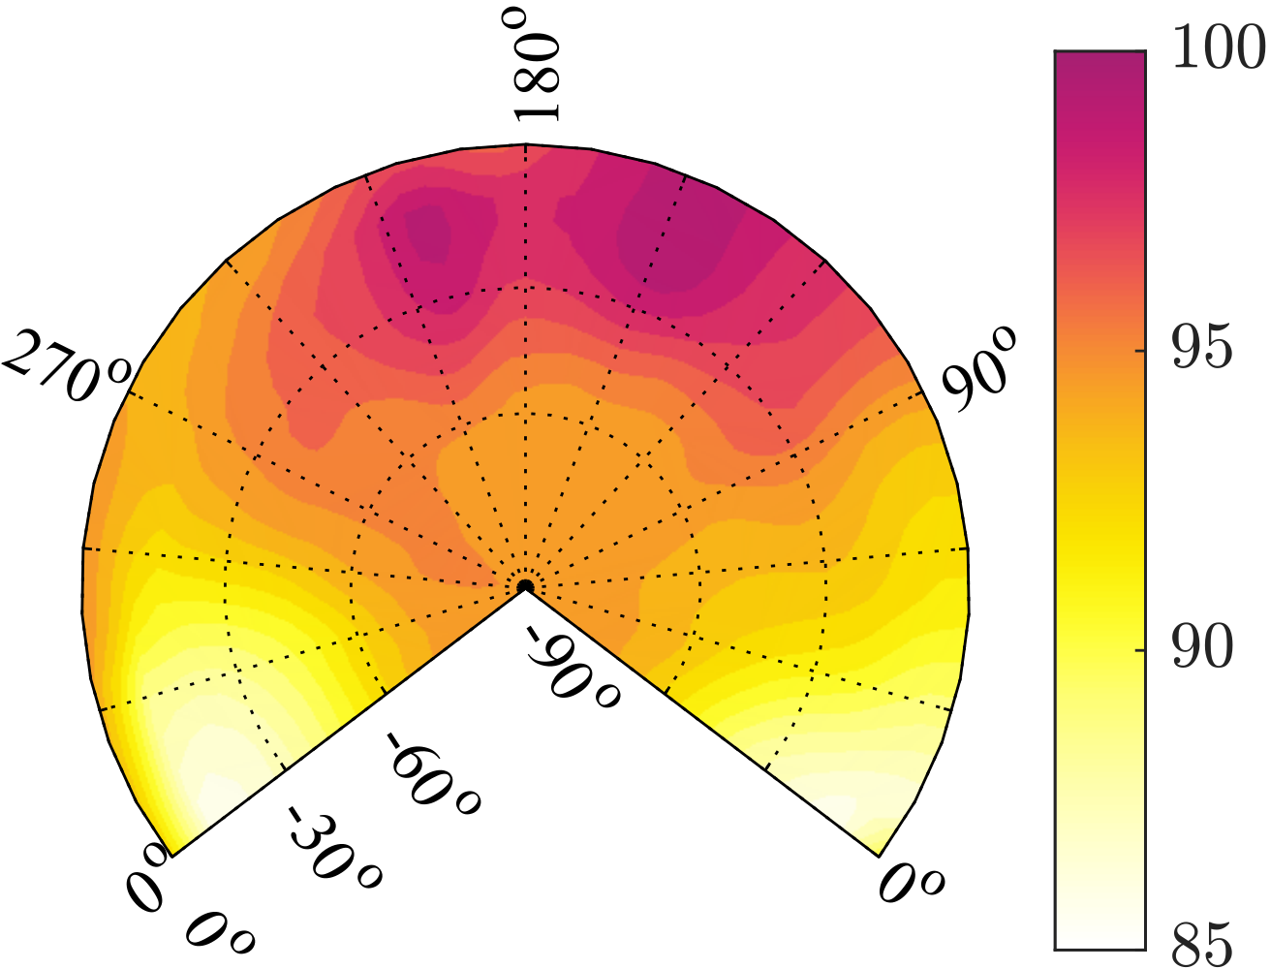
Application to Rotorcraft Noise
Source Spectra at R = 100 ft
  Linear microphone array deployed over bare, level ground
    Testing begins at dawn when winds are lowest
  Sound levels are recorded as the rotorcraft passes over the microphone array
    Each microphone is at a different emission angle
    Source noise data acquired between x = -2000 ft and x = 2000 ft
    Spectra taken every ½ second
OASPL [dB]

Slide 18
Application to Rotorcraft Noise
Source Spectra at R = 100 ft
  Noise is back propagated to
  representative hemisphere of 100 ft radius surrounding the aircraft
    (Assuming straight ray propagation)
  Propagation effects are removed
    Spherical spreading
    Atmospheric absorption
    Pressure doubling due to ground reflection
OASPL [dB]

Slide 19
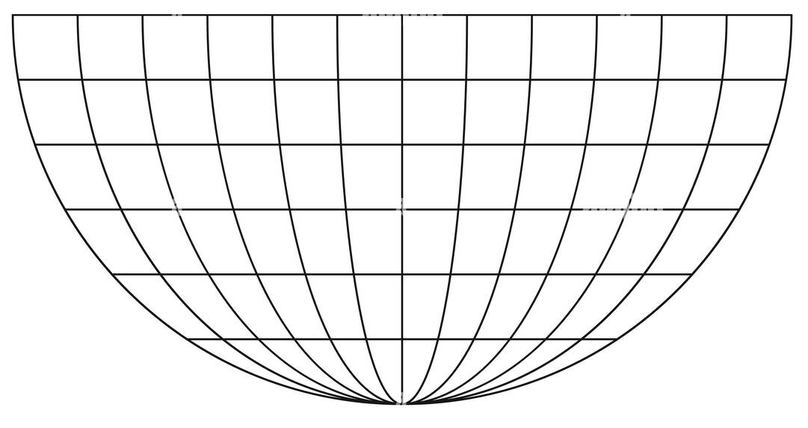


Application to Rotorcraft Noise
Far Field Spectra
  Inverse distance weighting scheme is used to provide spectra at emission coordinates $(α_{emit},ψ_{emit}\text{)}$
$${A_{farfield}=A}_{0}\text{(}α_{emit},ψ_{emit},ω\text{)}∗\frac{1}{r}∗R$$
$SPL\left(ω+ω_{dopp}\right)=SPL\text{(}α_{emit},ψ_{emit},ω\text{)}$ $+20log10\left(A_{emit}\right)$ $−{dBLoss}_{atm}\left(ω\right) l$
$$(α_{emit},ψ_{emit})$$
Ground

Slide 20
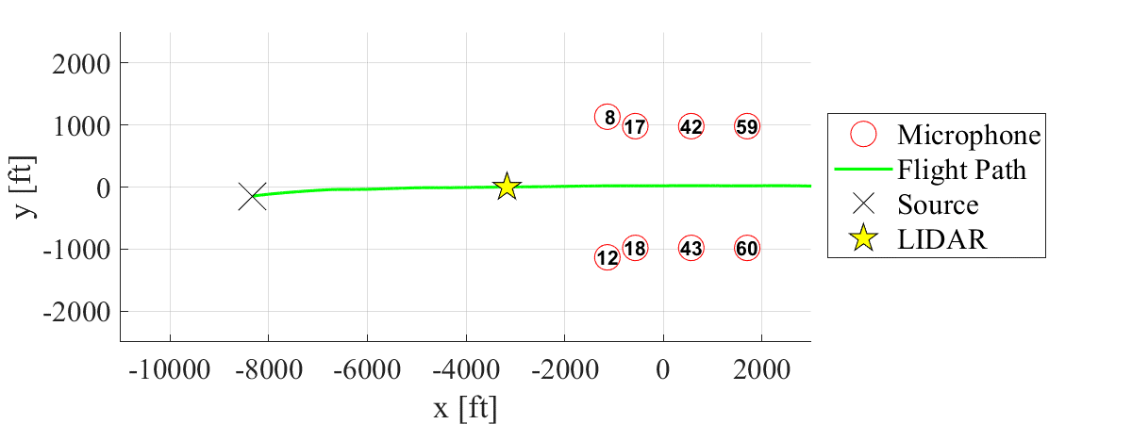
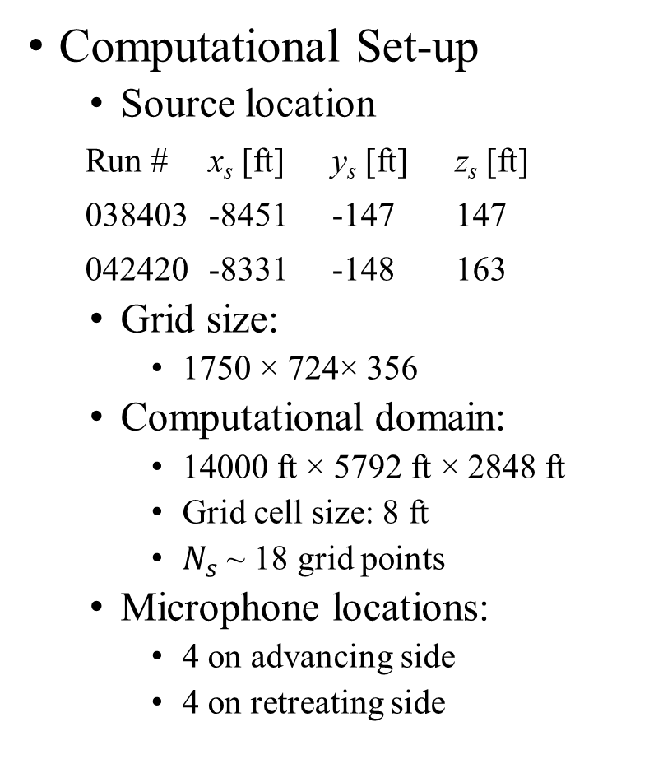
Flight Test Comparisons
Computational Set-up
  Source location
Run # x_{s} [ft] y_{s} [ft] z_{s} [ft]
038403 -8451 -147 147
042420 -8331 -148 163
  Grid size:
    1750 × 724× 356
  Computational domain:
    14000 ft × 5792 ft × 2848 ft
    Grid cell size: 8 ft
    $N_{s}$ ~ 18 grid points
  Microphone locations:
    4 on advancing side
    4 on retreating side
Mic # | x [ft] | y [ft] | z [ft] | Adjusted z [ft]
8 | -1120 | 1133 | -3 | 0
12 | -1127 | -1139 | 8 | 0
17 | -554 | 981 | -3 | 0
18 | -565 | -981 | 6 | 0
42 | 576 | 992 | -5 | 0
43 | 575 | -974 | 5 | 0
59 | 1705 | 977 | -5 | 0
60 | 1705 | -983 | 3 | 0

Slide 21
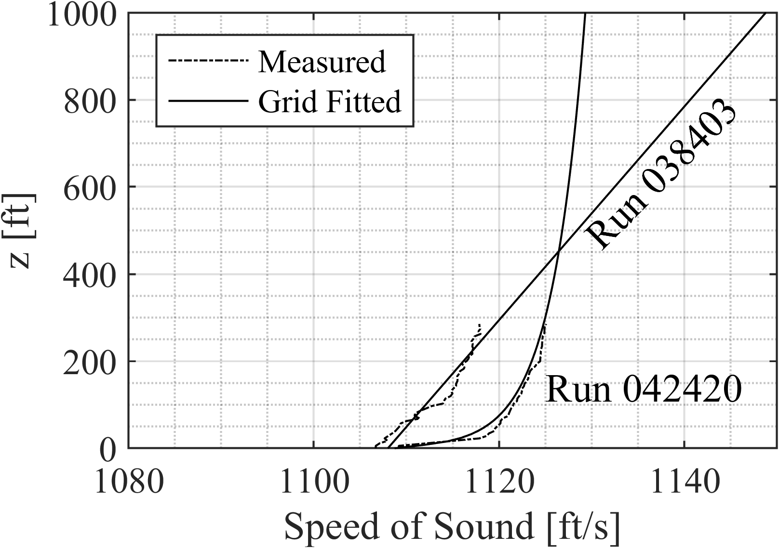
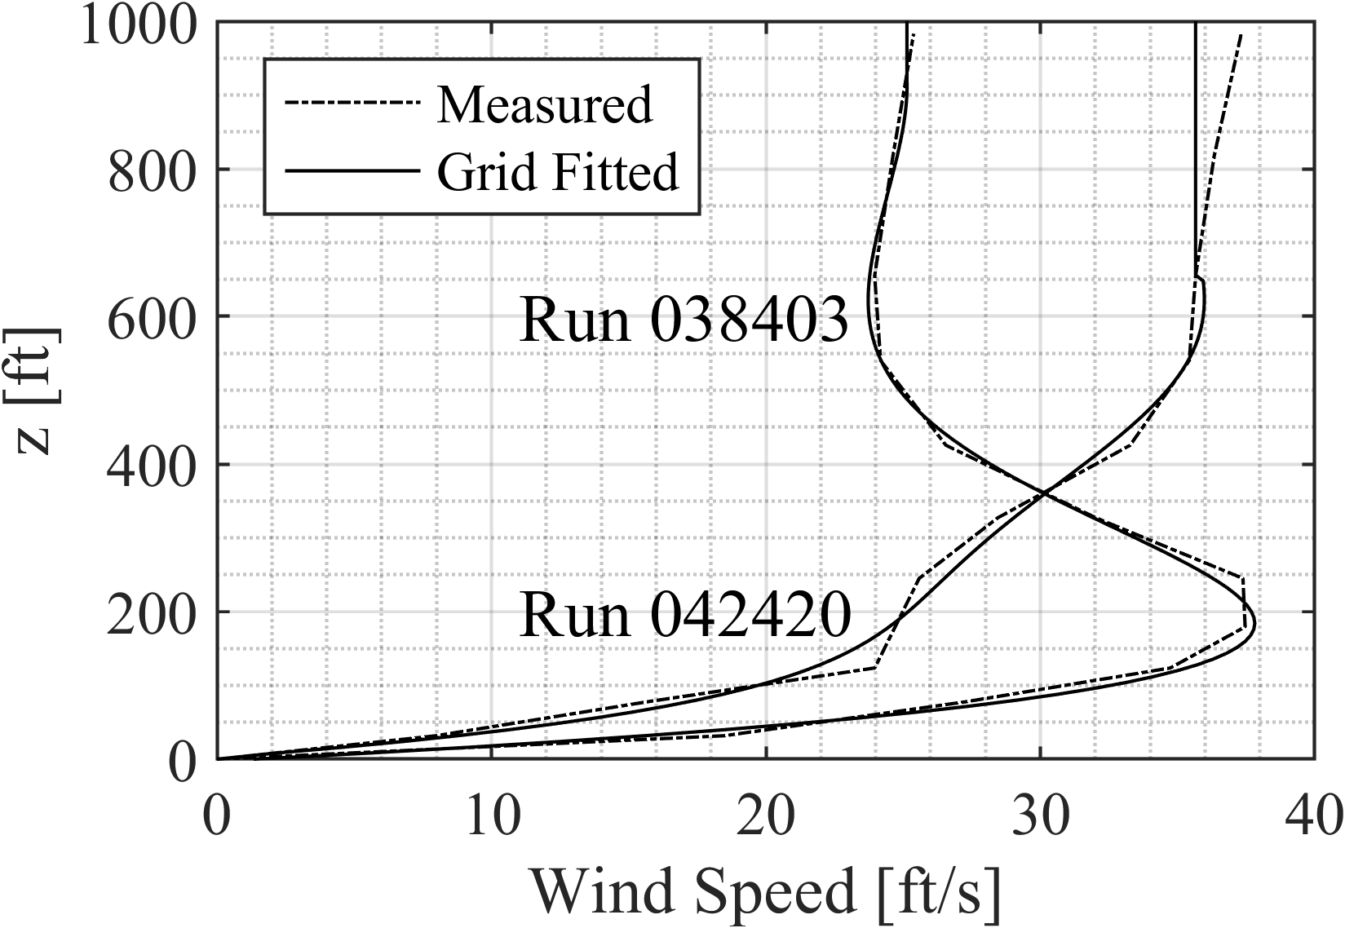
Flight Test Comparisons
Computational Set-up
  Atmospheric Conditions
    Variations are only in z direction
    Temperature is measured with 10 ft resolution over 500 ft
    Wind is measured at 12 altitudes over 1000 ft
    The data is fitted to a curve
  Ground Conditions
    Flat ground
    Perfectly reflecting

Slide 22
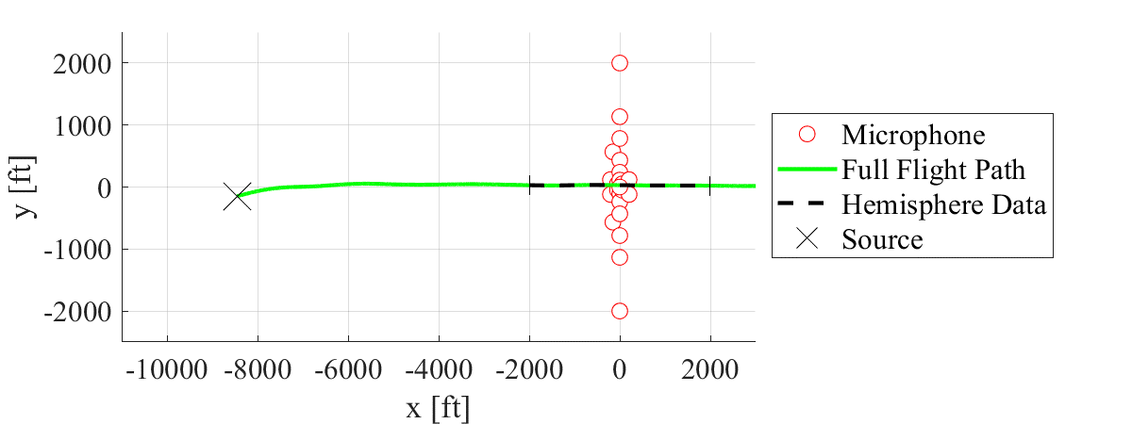
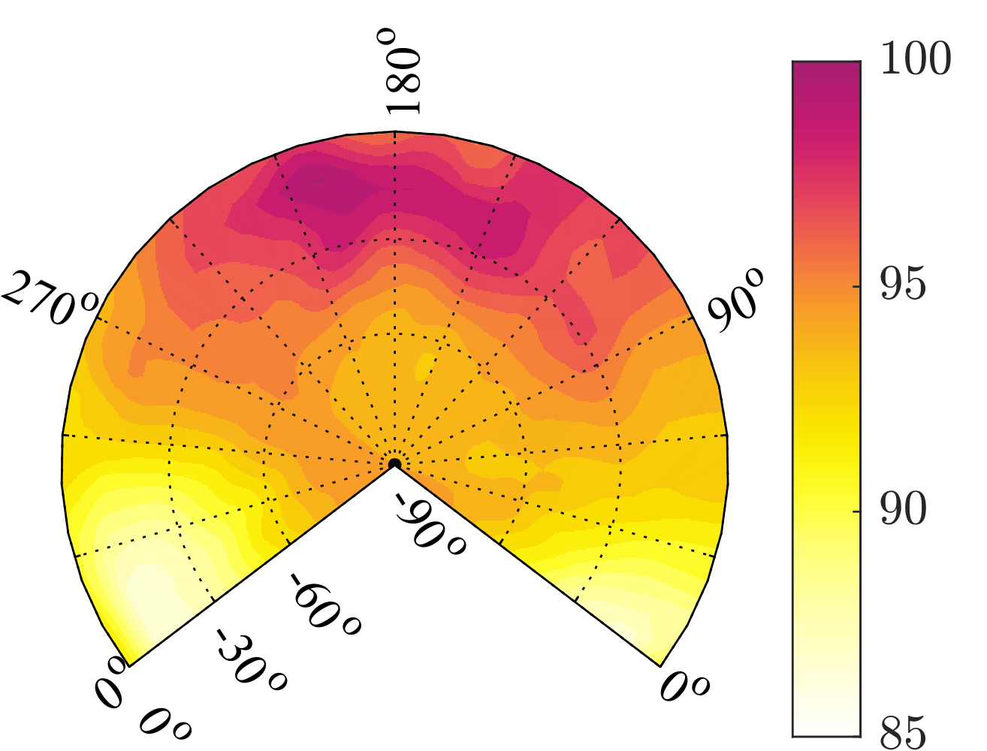
Flight Test Comparisons
Limitations
  Source variation due to
  wind
    Hemisphere data are measured
    ~7000 ft further than the
    source location
    Crosswind conditions can
    significantly impact the tail
    rotor source amplitudes
  Lack of information above the hemisphere
  Cannot extract separate emission angles in caustic/intersecting regions
  Perfectly reflecting ground is assumed
  No atmospheric turbulence is currently solved
OASPL [dB]
Notes:
Remove microphones used for comparison

Slide 23
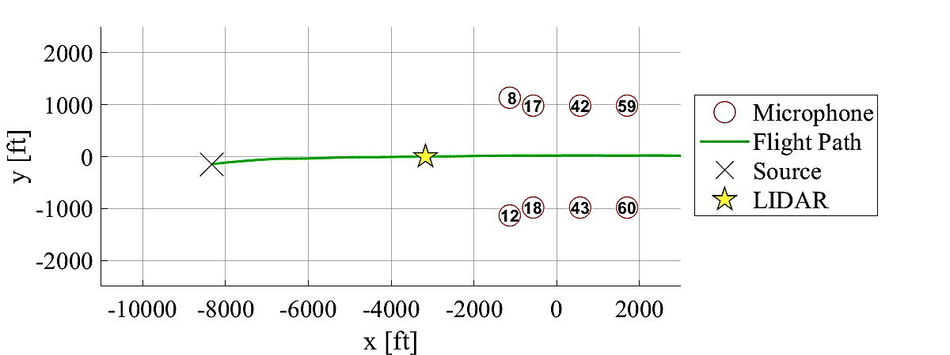
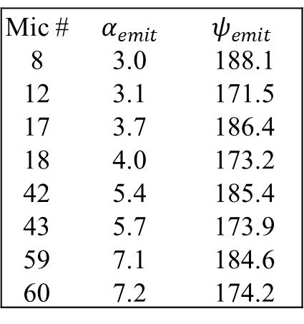
Flight Test Comparisons
Mic # | $α_{emit}$ | $$ψ_{emit}$$
8 | 3.0 | 188.1
12 | 3.1 | 171.5
17 | 3.7 | 186.4
18 | 4.0 | 173.2
42 | 5.4 | 185.4
43 | 5.7 | 173.9
59 | 7.1 | 184.6
60 | 7.2 | 174.2
Run 038403
OASPL [dB]
Notes:
Adjust the microphone locations

Slide 24
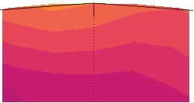
Flight Test Comparisons
Mic # | $α_{emit}$ | $$ψ_{emit}$$
8 | 3.0 | 188.1
12 | 3.1 | 171.5
17 | 3.7 | 186.4
18 | 4.0 | 173.2
42 | 5.4 | 185.4
43 | 5.7 | 173.9
59 | 7.1 | 184.6
60 | 7.2 | 174.2
Run 038403
59
60
8
12
Sound from a small region on the source hemisphere reaches the microphones
Emission coordinates for the microphones are outside the hemisphere
OASPL [dB]
Notes:
Adjust the microphone locations

Slide 25
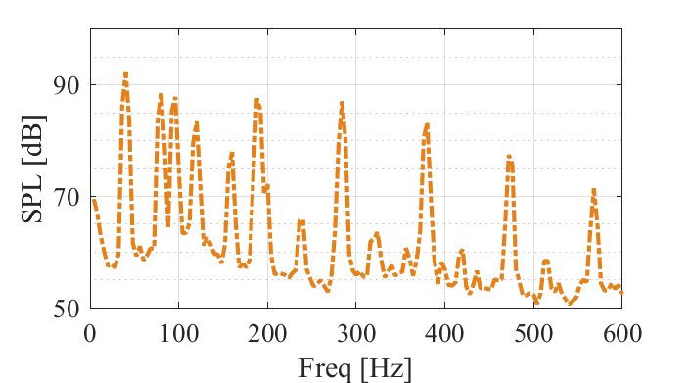

Flight Test Comparisons
Mic # | $α_{emit}$ | $$ψ_{emit}$$
8 | 3.0 | 188.1
12 | 3.1 | 171.5
17 | 3.7 | 186.4
18 | 4.0 | 173.2
42 | 5.4 | 185.4
43 | 5.7 | 173.9
59 | 7.1 | 184.6
60 | 7.2 | 174.2
Run 038403
59
60
8
12
Source SPL for relevant microphones
Mic 59
Sound from a small region on the source hemisphere reaches the microphones
Emission coordinates for the microphones are outside the hemisphere
OASPL [dB]
Mic 60
Notes:
Adjust the microphone locations

Slide 26
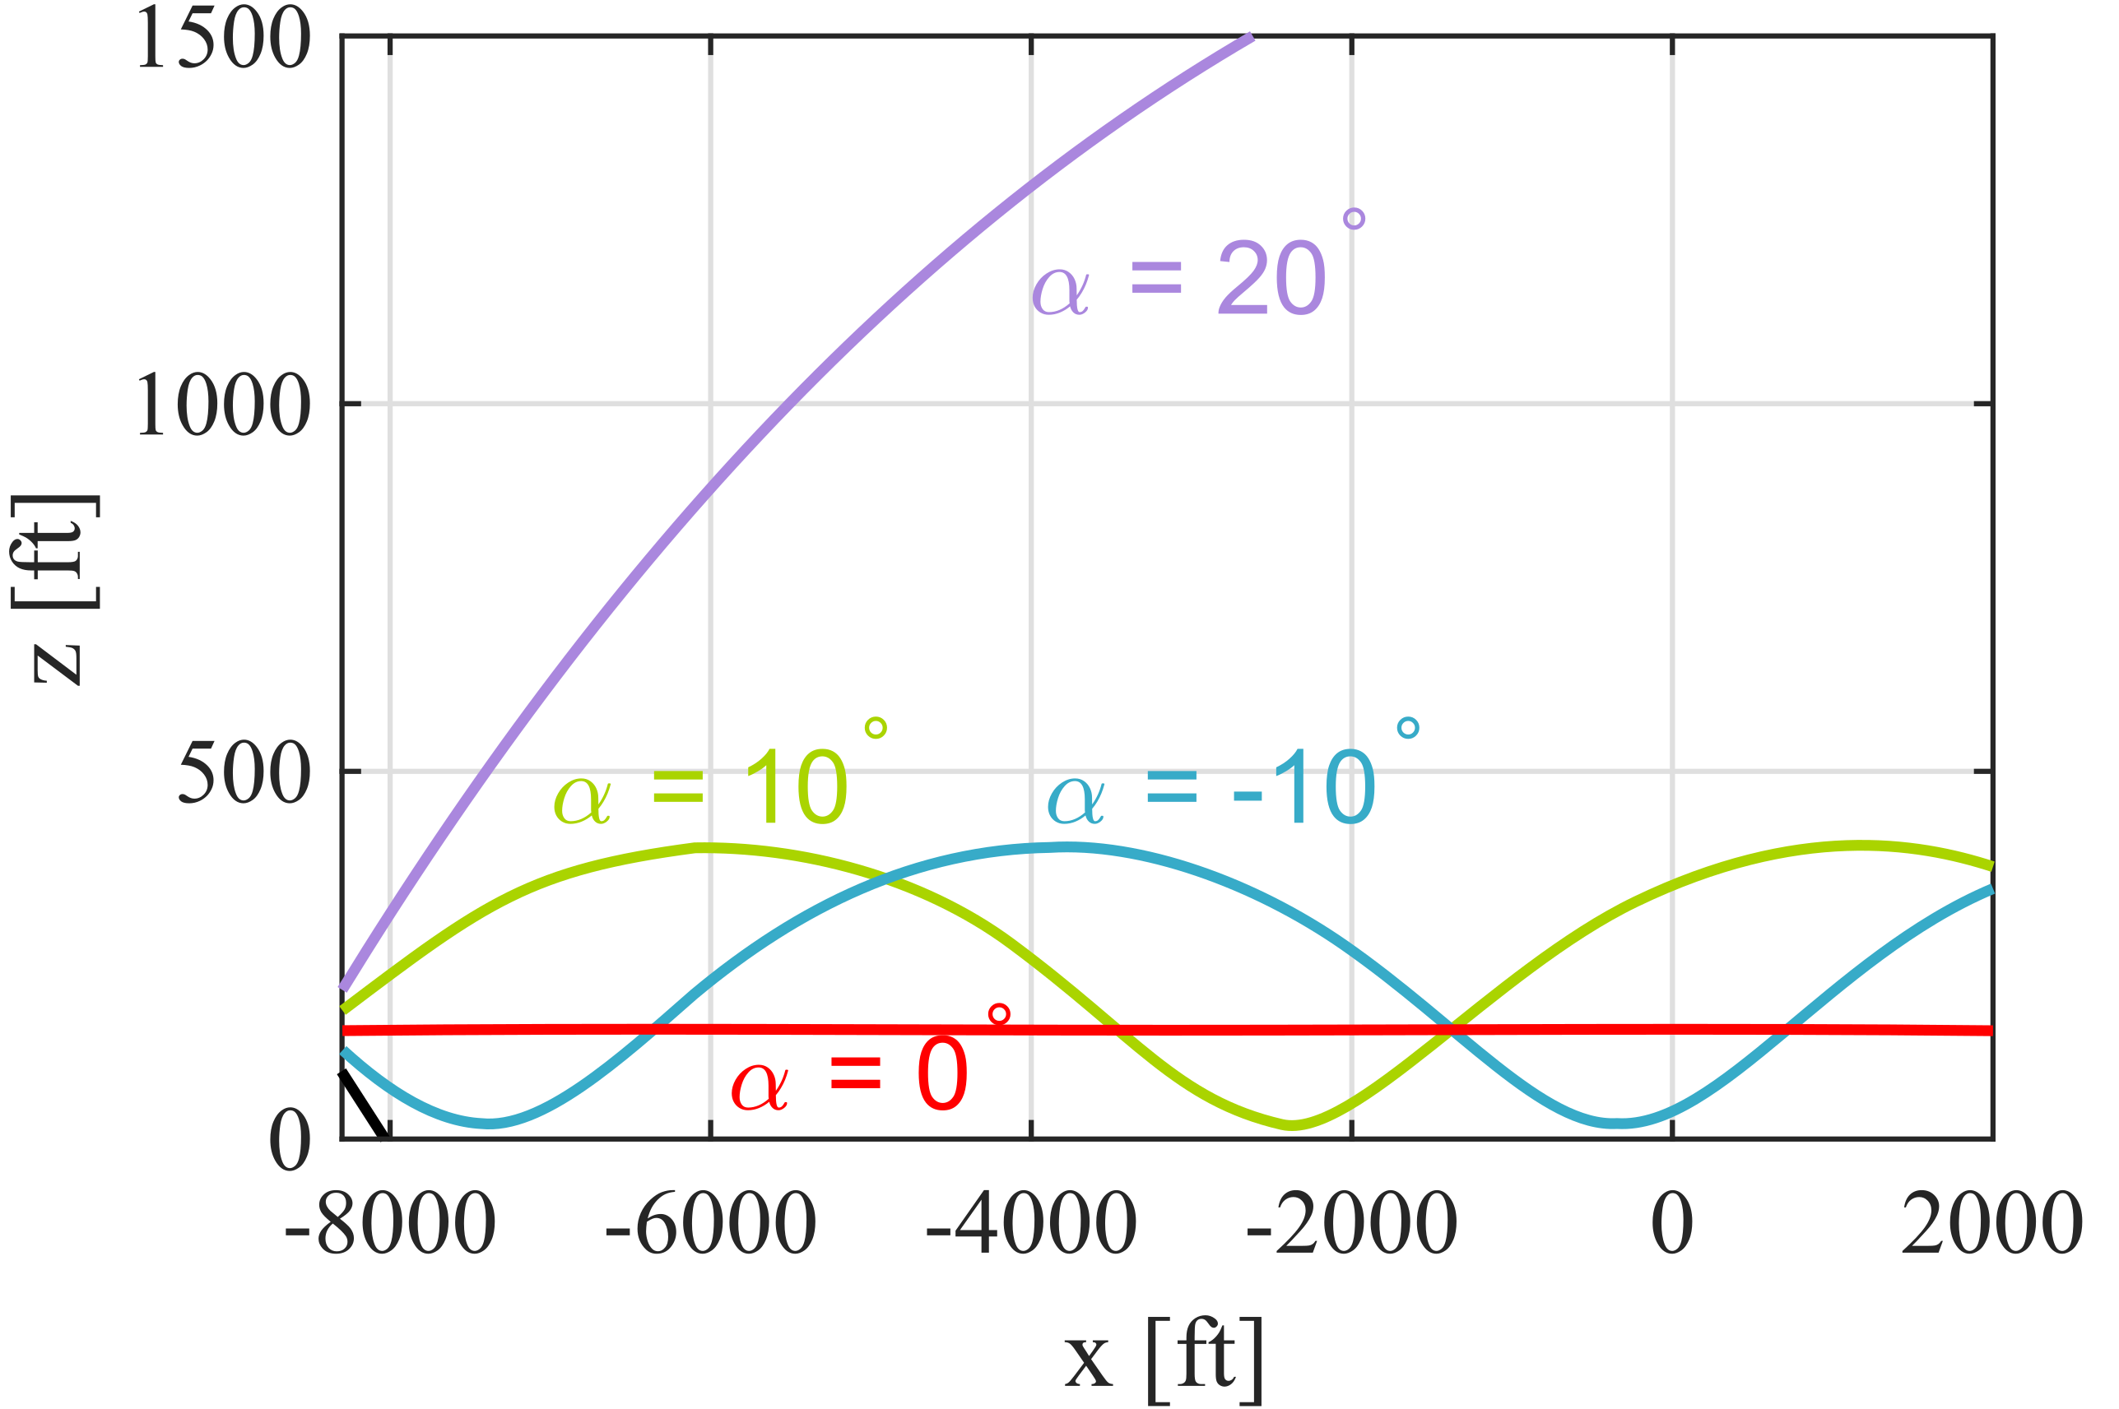
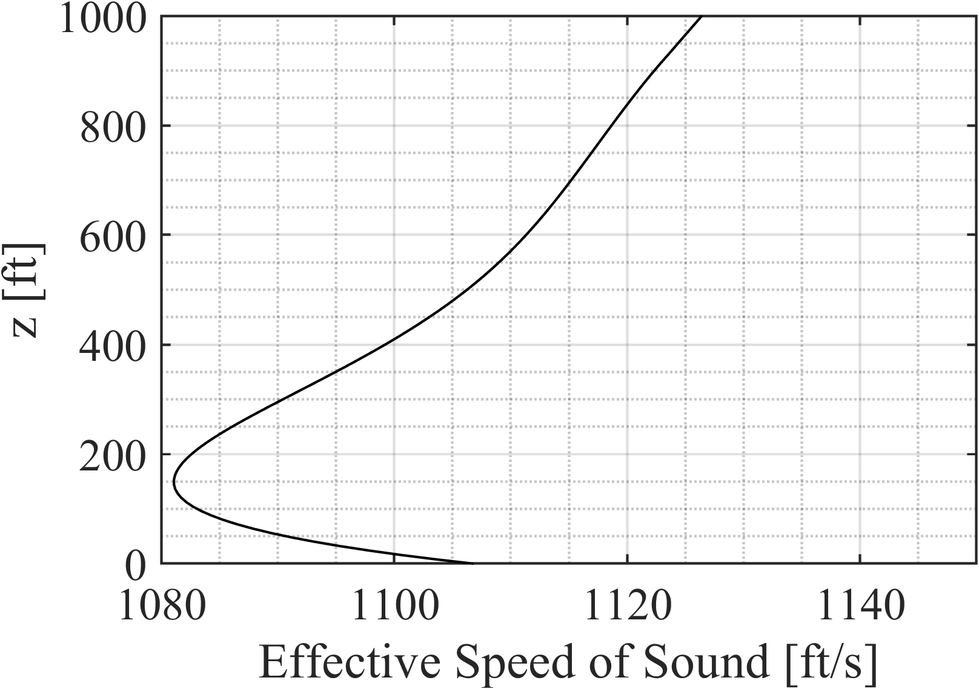
Flight Test Comparisons
On y = 0 plane
Run 038403

Slide 27
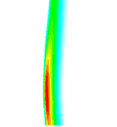
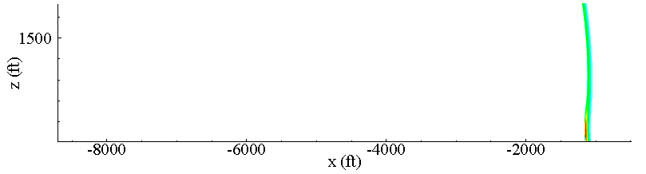
Flight Test Comparisons
On y = 0 plane
Run 038403
Time snapshot of CW
Stronger wave due to ducting

Slide 28
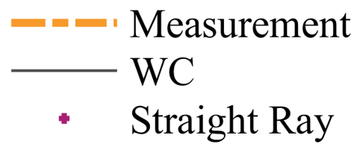
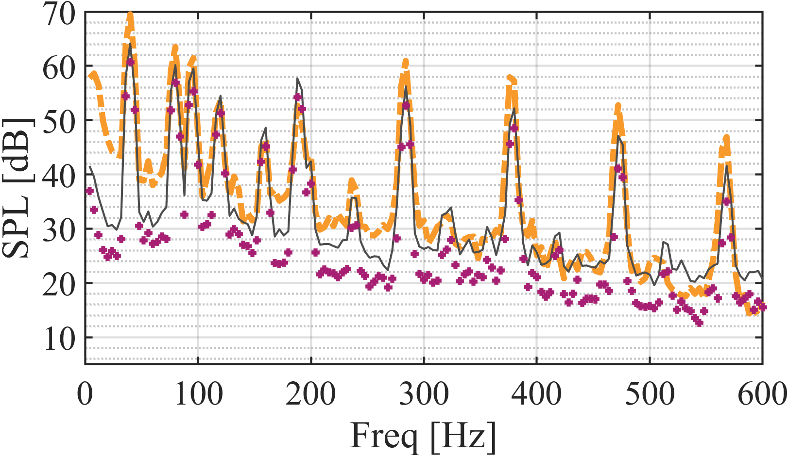
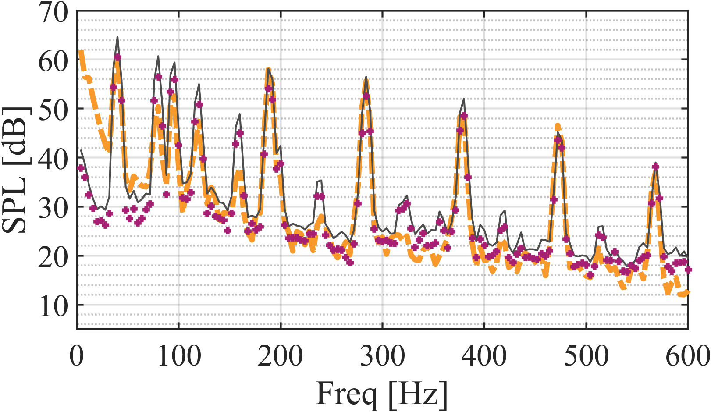
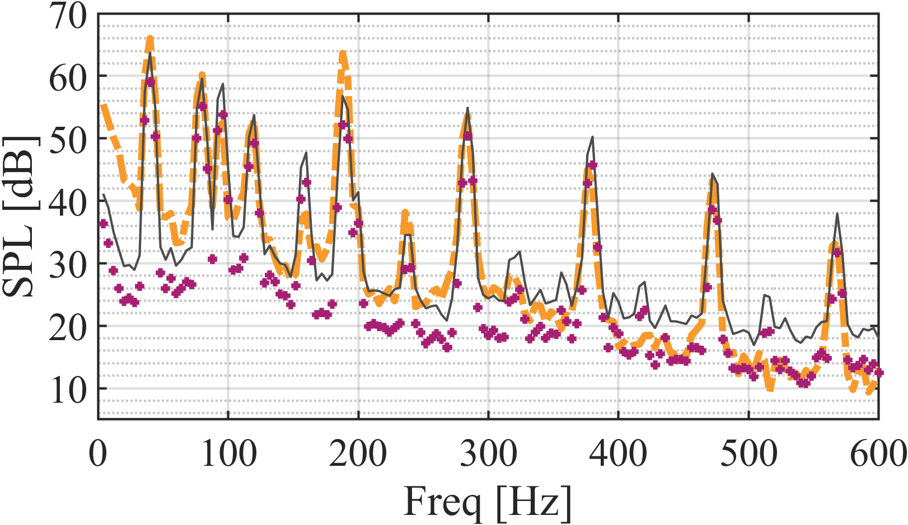
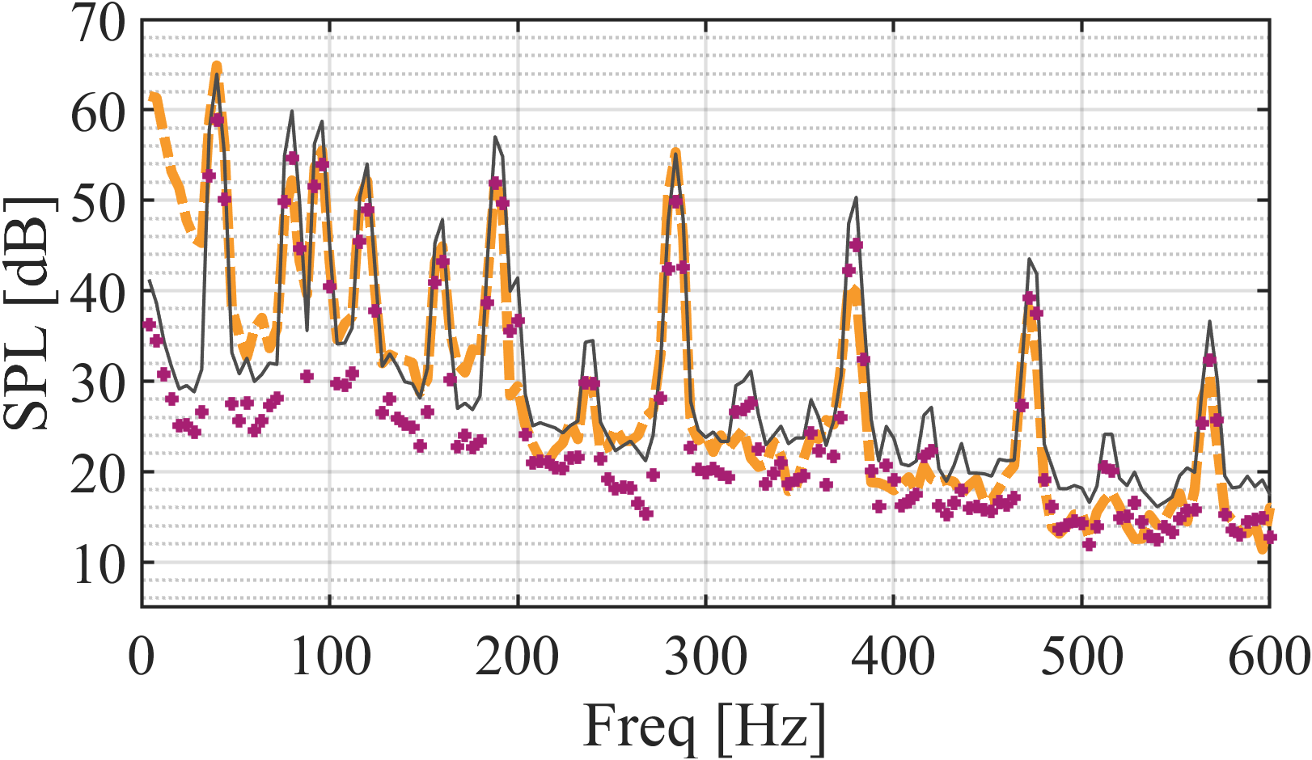
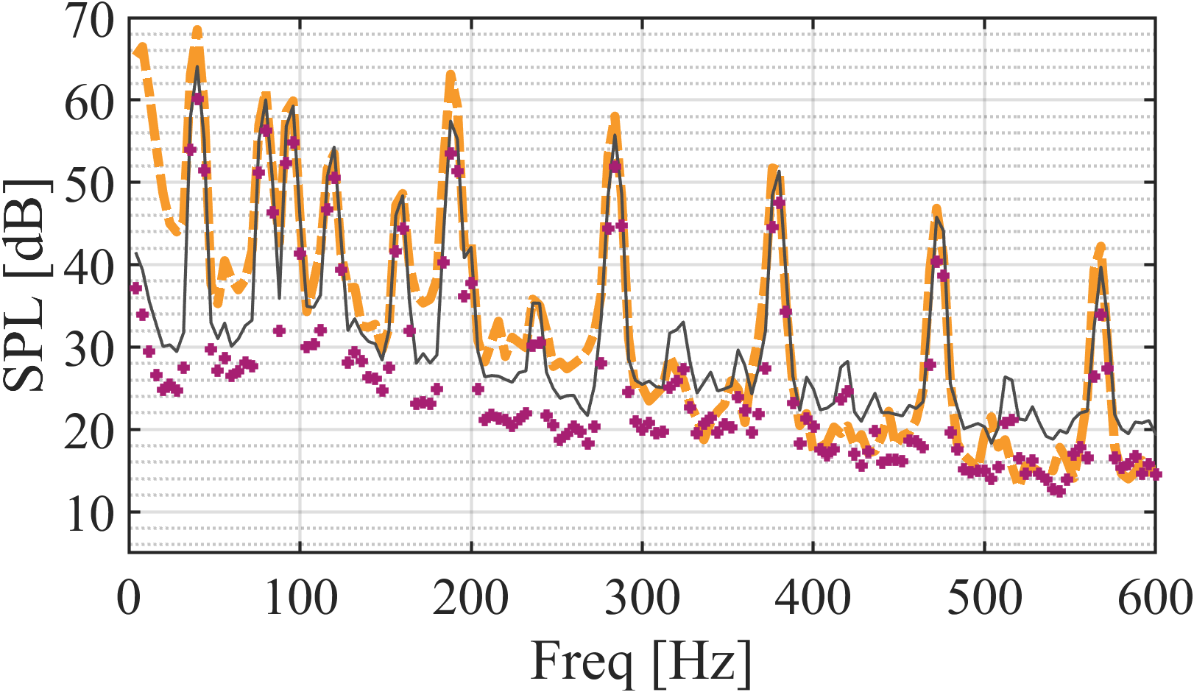
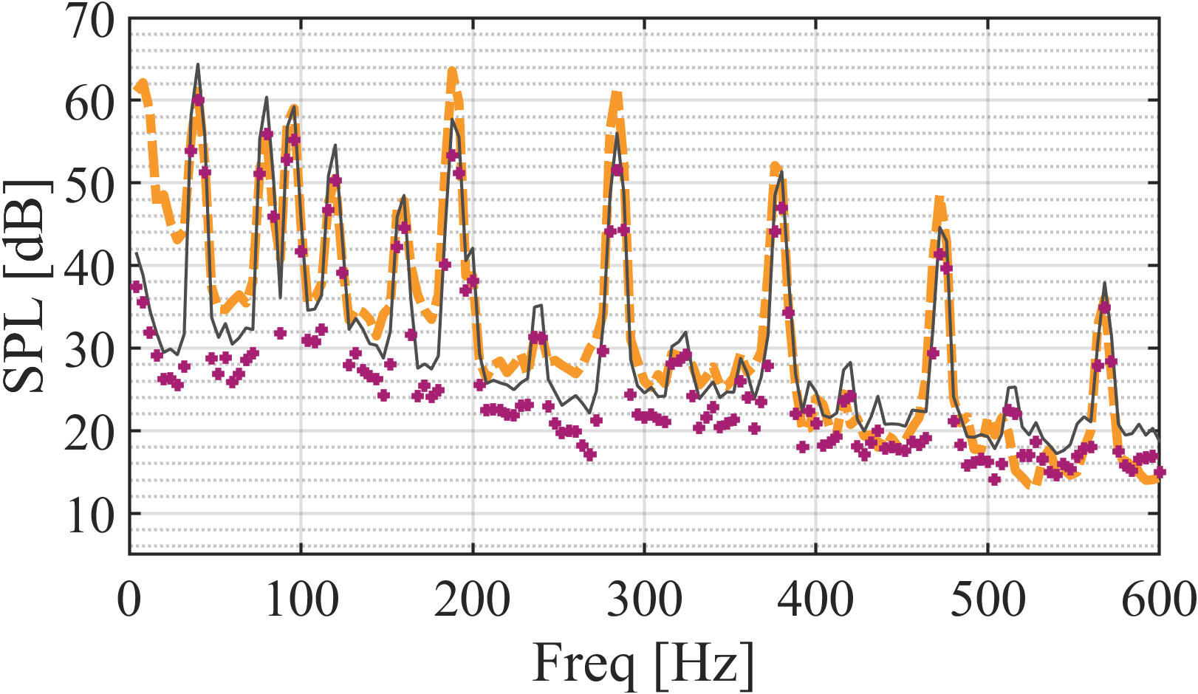
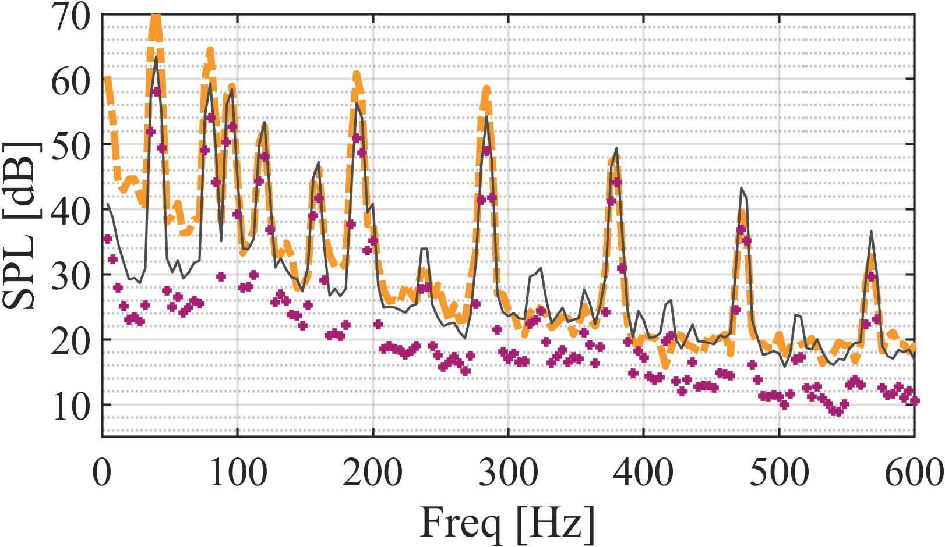
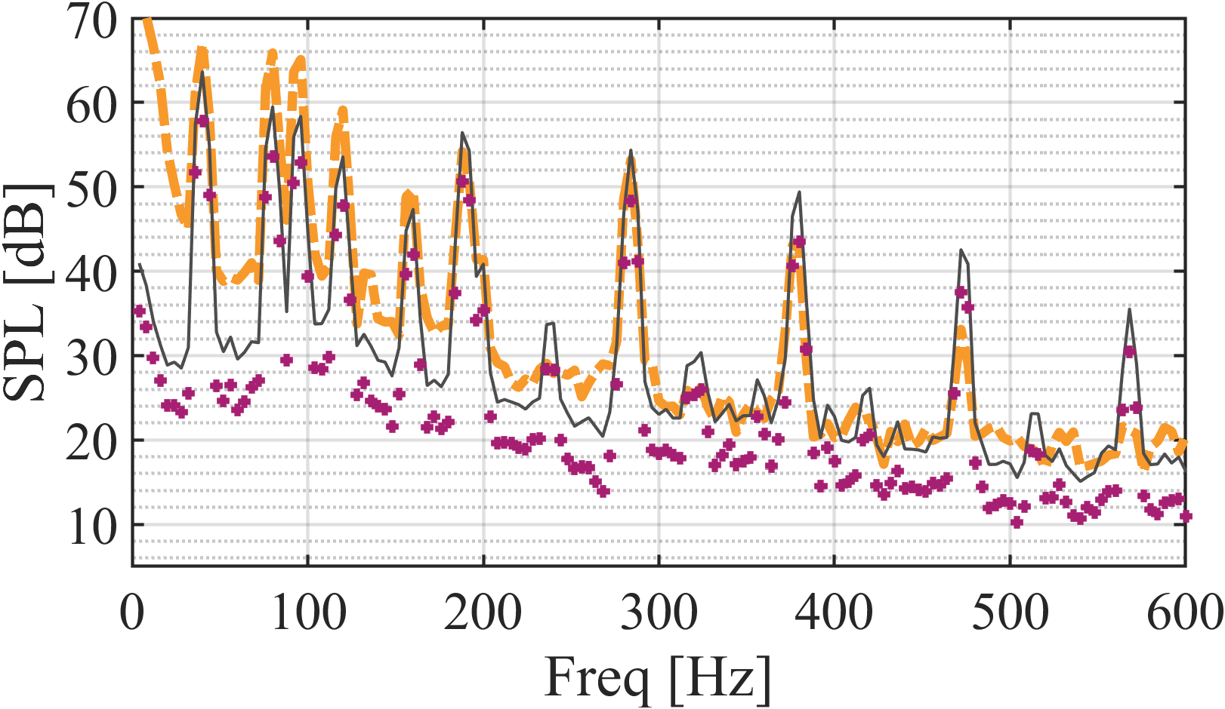
Flight Test Comparisons
Run 038403
Microphone 8 Microphone 12
Microphone 42 Microphone 43
Microphone 17 Microphone 18
Microphone 59 Microphone 60
Good agreement overall

Slide 29
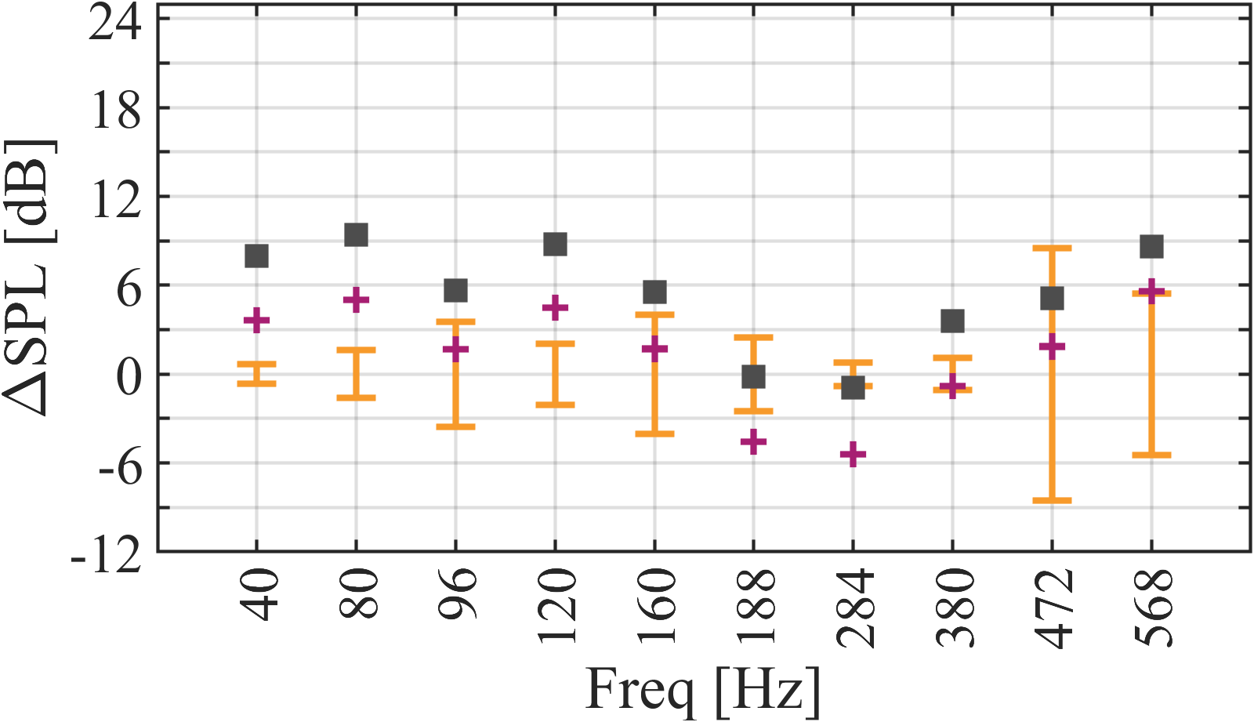
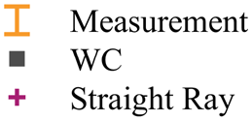
Flight Test Comparisons
Run 038403
  Standard deviation of each measured harmonic for 1.5 s of data is used for comparison
  Variation in amplitude is significant
Notes:
the variation in amplitude is significant over even 1.5 seconds of data"

Slide 30
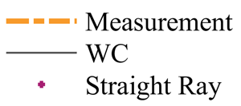


Flight Test Comparisons
Atmospheric ducting causes the signal to be 6 dB higher than straight ray
Good agreement overall
Measured main rotor harmonics stronger on retreating side: Source SPL same for both sides
Run 038403
Microphone 8 Microphone 12
Notes:
96, 192, 288, 384??

Slide 31

Flight Test Comparisons
Atmospheric ducting causes the signal to be 6 dB higher than straight ray
Good agreement overall
Measured main rotor harmonics stronger on retreating side: Source SPL same for both sides
Run 038403
Microphone 17 Microphone 18
Notes:
96, 192, 288, 384??

Slide 32


Flight Test Comparisons
Atmospheric ducting causes the signal to be 6 dB higher than straight ray
Good agreement overall
Measured main rotor harmonics stronger on retreating side: Source SPL same for both sides
Over prediction at higher tail rotor harmonics
  Source amplitudes of tail rotor harmonics are not corrected for wind
  Significant variation in TR harmonics present across 1.5 seconds of data
Run 038403
Microphone 42 Microphone 43
Notes:
96, 192, 288, 384??

Slide 33


Flight Test Comparisons
Atmospheric ducting causes the signal to be 6 dB higher than straight ray
Good agreement overall
Measured main rotor harmonics stronger on retreating side: Source SPL same for both sides
Over prediction at higher tail rotor harmonics
  Source amplitudes of tail rotor harmonics are not corrected for wind
  Significant variation in TR harmonics present across 1.5 seconds of data
Run 038403
Microphone 59 Microphone 60
Notes:
96, 192, 288, 384??

Slide 34





Flight Test Comparisons
Mic # | $$α_{emit}$$ | $$ψ_{emit}$$
8 | -2.8 | 190.5
12 | -3.1 | 174.7
17 | -2.9 | 189.1
18 | -3.1 | 176.4
42 | -3.0 | 187.1
43 | -3.0 | 177.0
59 | -3.1 | 185.0
60 | -3.0 | 177.1
Run 042420
$$180°$$
8
59
60
12
Source SPL for all microphones
OASPL [dB]

Slide 35




Flight Test Comparisons
On y = 0 plane
Run 042420
Time snapshot of CW
Caustic: Stronger wave
Upward bending: weaker wave

Slide 36




Flight Test Comparisons
Run 042420
Microphone 8 Microphone 12
Good agreement overall
Upward bending causes the signal to be 3 dB lower than straight ray

Slide 37




Flight Test Comparisons
Run 042420
Microphone 17 Microphone 18
Good agreement overall
Upward bending causes the signal to be 3 dB lower than straight ray

Slide 38




Flight Test Comparisons
Run 042420
Microphone 42 Microphone 43
Good agreement overall
Upward bending causes the signal to be 3 dB lower than straight ray
Over prediction at higher tail rotor harmonics
  Source amplitudes of tail rotor harmonics are not corrected for wind
  Significant variation in TR harmonics present across 1.5 seconds of data

Slide 39




Flight Test Comparisons
Run 042420
Microphone 59 Microphone 60
Good agreement overall
Upward bending causes the signal to be 3 dB lower than straight ray
Over prediction at higher tail rotor harmonics
  Source amplitudes of tail rotor harmonics are not corrected for wind
  Significant variation in TR harmonics present across 1.5 seconds of data

Slide 40
Conclusions
Validations for propagation show that WC can accurately capture propagation effects due to wind and temperature
WC method also compares quite favorably to measured acoustic emissions of rotorcraft vehicles even under adverse weather conditions
Crosswind conditions can significantly impact the tail rotor source amplitudes, which will significantly affect long range predictions
Sound from above the hemisphere can also reach ground when the there are duct-like atmospheric regions

Slide 41
Acknowledgments
Dr. Frank Caradonna
SBIR funding from Army Contracting Command under Contract # W911W6-19-C-0024

Slide 42






Long Range Propagation
Computational Set-up
SOURCE SPHERE
$$R_{cw}$$
$$S(x_{s},z_{s})$$
$$N_{s}$$
$$z$$
s
$$x$$
GROUND
    Immersed boundary

Slide 43
Long Range Propagation
Computational Set-up
SOURCE SPHERE
ABL
Solve advection equation along the normal direction
$$R_{cw}$$
ABL
ABL
$$S(x_{s},z_{s})$$
$$N_{s}$$
$$z$$
s
$$x$$
GROUND
    Immersed boundary

Slide 44


Elevation Angles for both Conditions
Elevation Angle contours for 038403 using WC
Elevation Angle contours for 042420 using ray tracing

Slide 45


Long Range Propagation
Integral Calculations
  Ideal Case: Axisymmetric point source of amplitude, $A_{0}$ :
    Amplitude of CW adjusted to point source, = $\int_{t}{φdt}=\frac{1}{r}$. Also, called as attenuation factor, $A_{f}$.
    Amplitude of physical wave, $A_{farfield}$ $=\frac{A_{0}}{r}$ or $A_{f}∗A_{0}$
      $A_{0}$ can be specified as a function of frequency or time and independent of direction.
    SPL of physical wave, ${dB}_{farfield}=20 \log_{10}\left(A_{farfield}\right)$
    Arrival time, $τ=\frac{\int_{t}{tφdt}}{\int_{t}{φdt}}$ ds
  Reality: Angle dependent source of amplitude, $A_{0}(θ,α)$ :
    Need emission angles, $θ_{emit}, {ψ }_{emit}$ corresponding to far field points.
    $A_{farfield}$ =$A_{0}\text{(}θ_{emit}, {ψ }_{emit}\text{)}∗A_{f}$,
    Initialize multicomponent, $φ_{k}$, to carry emission coordinates
$$\text{(}θ_{emit}, α_{emit}\text{)}$$
Ground

Slide 46

CW Propagating in Domain
46
CW on ground and x-z plane
  On x-z plane, there are direct and reflected wave fronts
  On ground plane, reflected and direct wavefronts are in phase

Slide 47

Flight Test Comparisons
On y = 0 plane
Run 038403
Intersecting waves overlap
Amplitude will be sum of the waves
Emission angles will be average values
Since the region of interest is so small, Source SPL will be the same for each one separately
Time snapshot of CW

