Slide 1
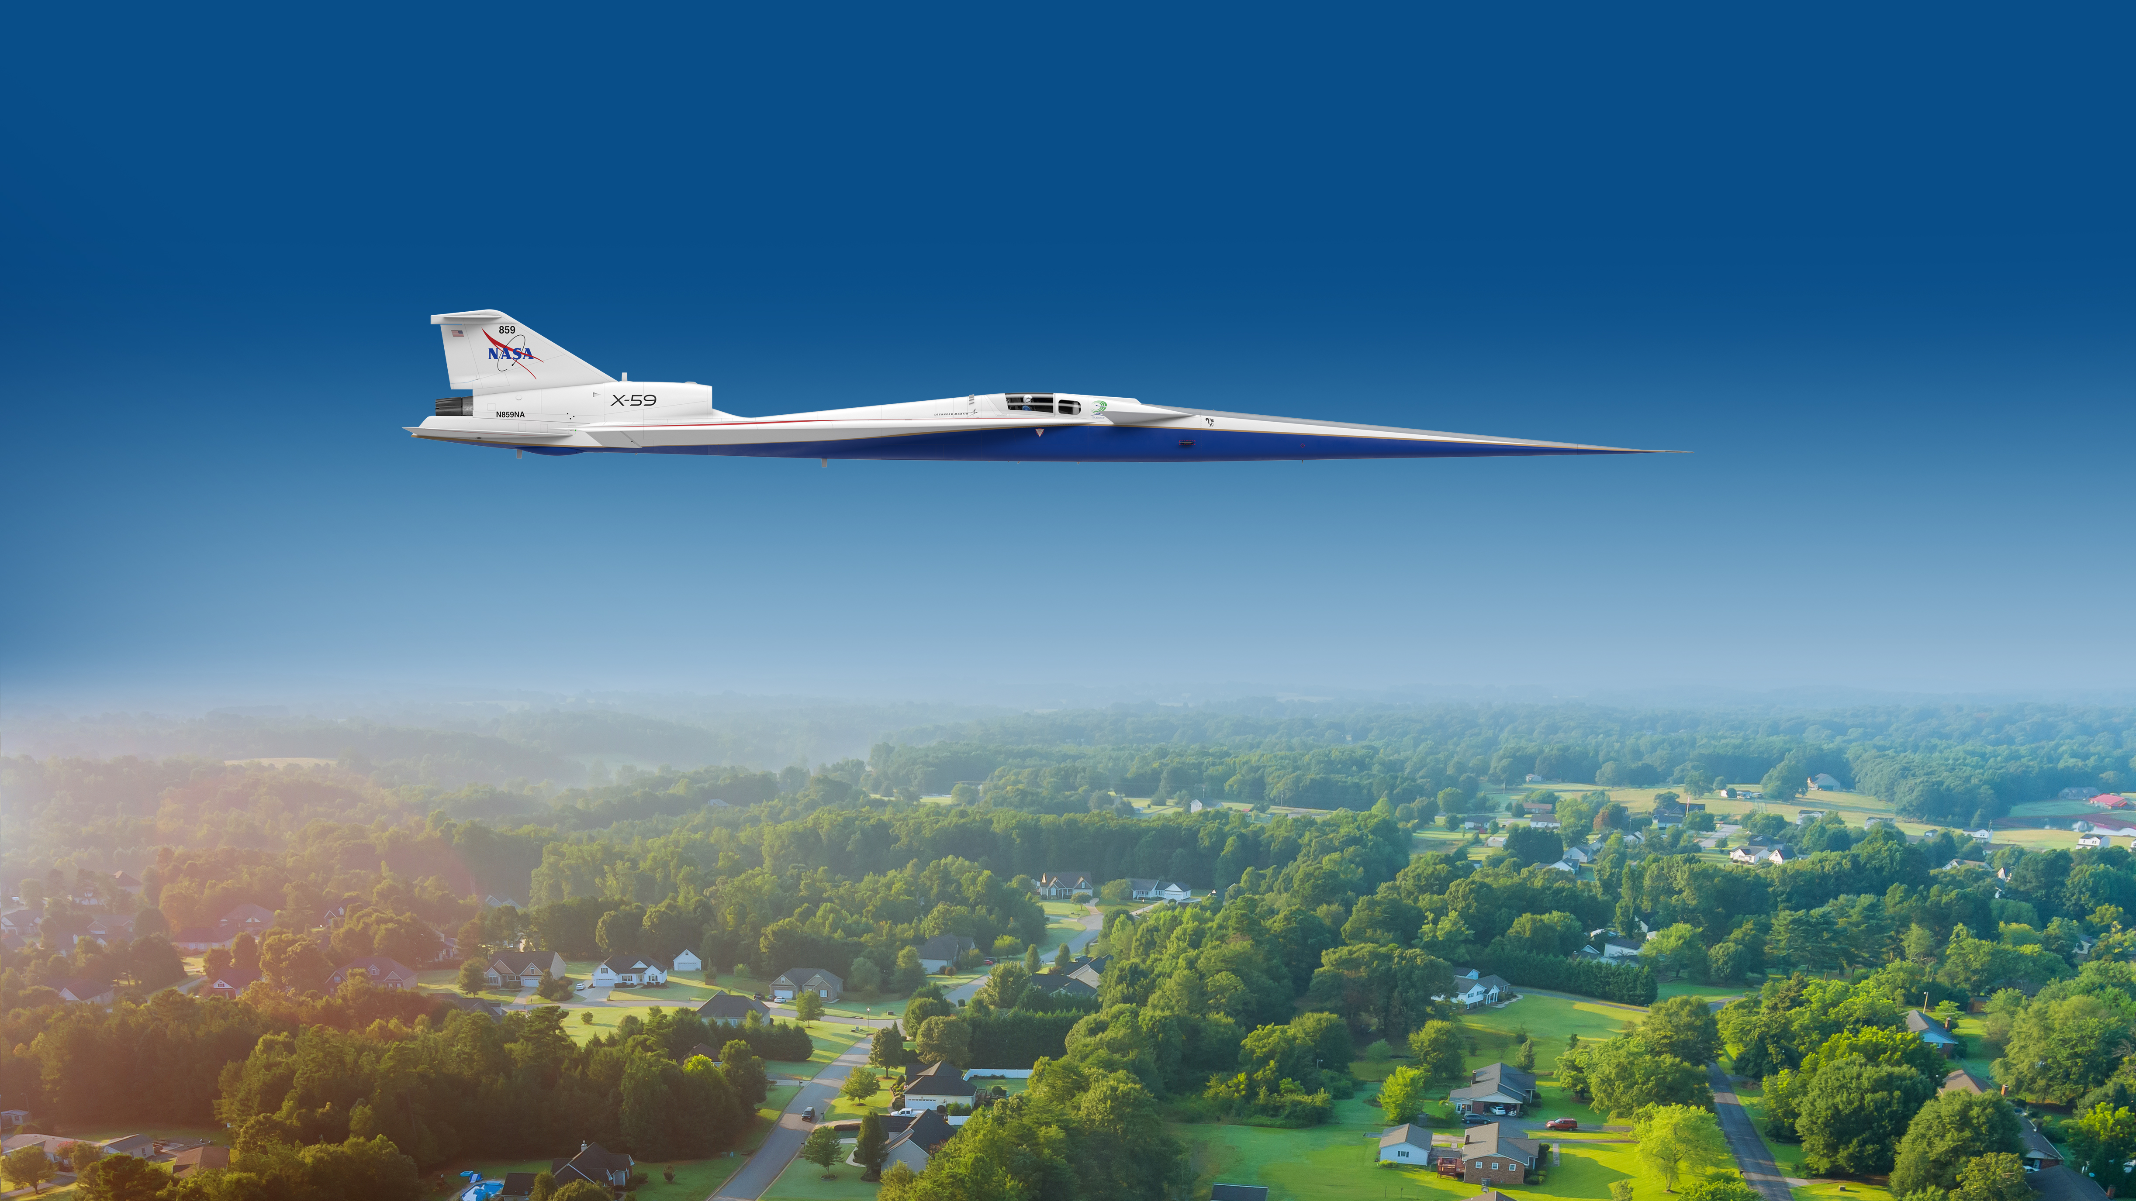

4pPA1 - Turbulence effects on shaped booms:
Central composite design of modeled atmospheric turbulence parameters for sonic boom propagation
Will Doebler¹, Peter Parker¹, Robert Downs², and Alexandra Loubeau¹
184th Meeting of the Acoustical Society of America
May 11, 2023
¹NASA Langley Research Center, ²US DOT Volpe National Transportation Systems Center
www.nasa.gov

Slide 2
Turbulence effects on shaped booms
4pPA1 Central composite design of modeled atmospheric turbulence parameters for sonic boom propagation
William Doebler, Peter Parker, Robert Downs, Alexandra Loubeau
4pPA2 Propagation simulations using KZKFourier
Robert Downs, Michael Barzach, Will Doebler, Peter Parker, Alexandra Loubeau, Joel Lonzaga
4pPA3 Finite impulse response filter development
Robert Downs, Michael Barzach, Jacob Klos, Joel Lonzaga, William Doebler, Peter Parker, Alexandra Loubeau
2

Slide 3
Outline
Background
  Turbulence and sonic boom modeling software (PCBoom, KZKFourier)
Collect data
  Turbulence parameters using atmospheric models
Design of Experiments approach
  Select turbulence parameters
Following presentations describe:
  KZKFourier propagation, improved FIR filter generation for PCBoom, and code validation
3

Slide 4
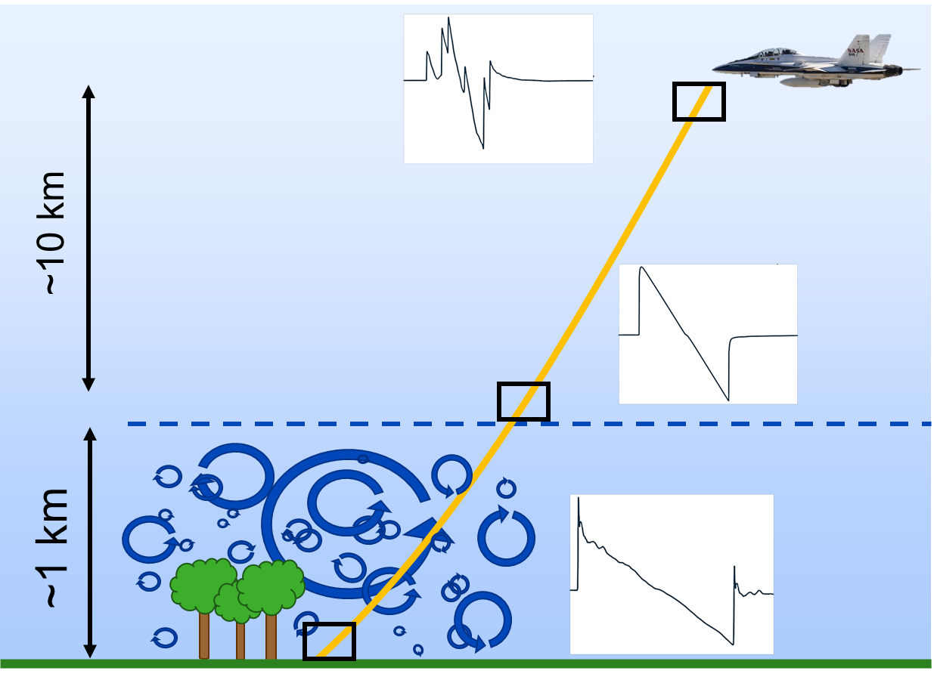
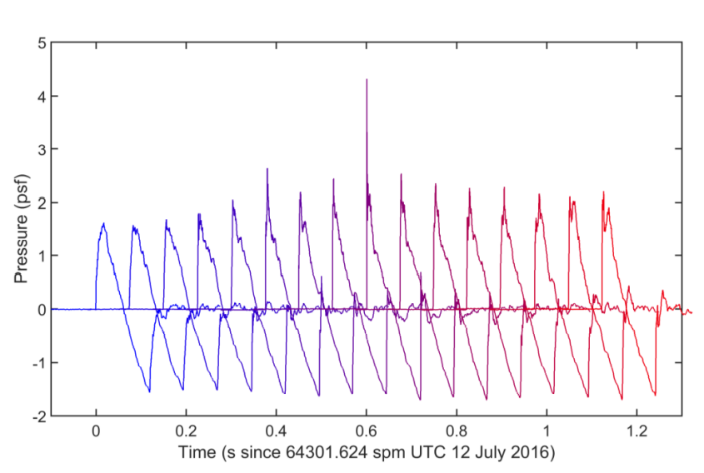
Turbulence causes spiking and rounding of N-wave booms
Need to predict loudness and variability for community noise surveys
Measurements from 16 microphones
spaced ~100 ft (30.5 m) apart
Atmospheric Boundary Layer
Image from NASA/CR-2022-220509
4

Slide 5
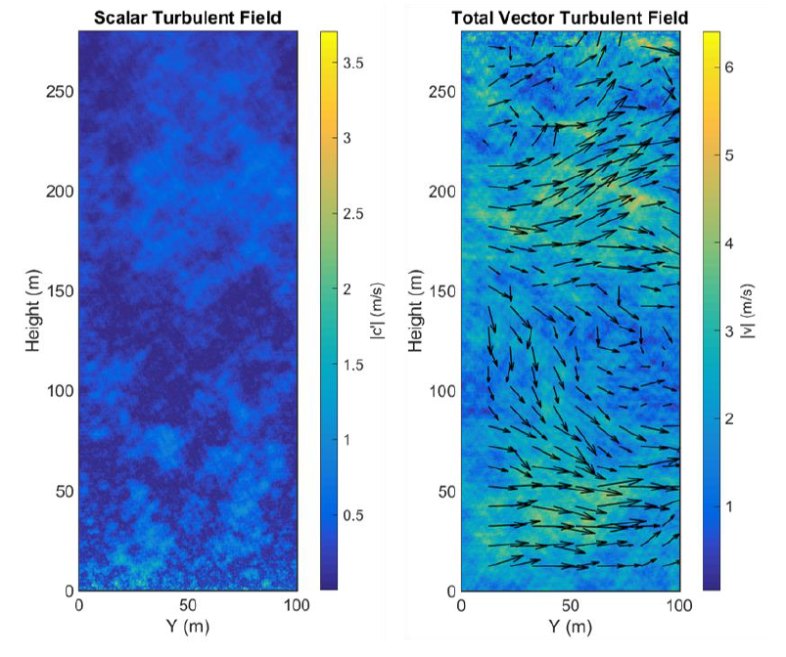
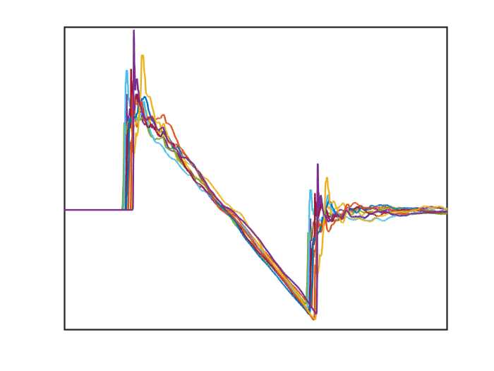
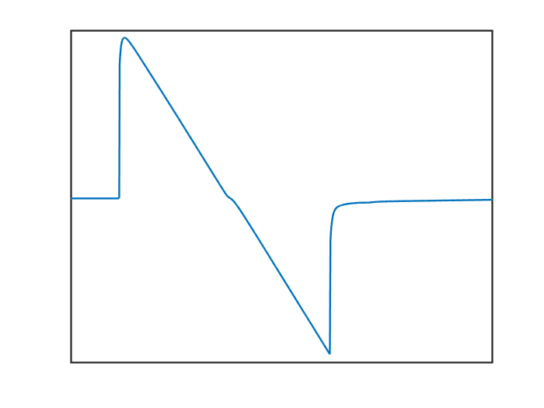
Stout and Sparrow’s KZKFourier turbulence model solves:
$$\frac{∂p}{∂z}=\frac{c_{0}}{2}\int_{−∞}^{τ}{∇_{⊥}^{2}p dτ′}+\frac{δ}{2c_{0}^{3}}\frac{∂^{2}p}{∂τ^{2}}+ \frac{βp}{ρ_{0}c_{0}^{3}}\frac{∂p}{∂τ}+\frac{c′}{c_{0}^{2}}\frac{∂p}{∂τ}+\frac{u_{z}}{c_{0}^{2}}\frac{∂p}{∂τ}−\frac{1}{c_{0}}\left(u_{⊥}∙∇_{⊥}p\right)+\sum_{ν}{\frac{c_{ν}^{′}}{c_{0}^{2}}\int_{−∞}^{τ}{\frac{∂^{2}p}{∂τ^{′2}}e^{−\frac{\left(τ−τ^{′}\right)}{t_{ν}}}dτ^{′}}}$$
diffraction
nonlinearity
relaxation
vector turbulence
scalar turbulence
thermoviscous absorption
Ambient Parameters
Turbulence Parameters
KZKFourier
Output
turbulized
waveforms
Input
plane
waveform
Image from NASA/CR-2022-220509
5

Slide 6


KZKFourier can take days to run.
FIR filters provide fast, approximate results.
Slower, $O(hours)$
KZKFourier
Method 1
Input
plane
waveform
Output
turbulized
waveforms
Faster, $O(msec)$
FIR Filter Bank
Filter 1
Ideally the same as KZKFourier results
Filter 2
Method 2
Input
plane
waveform
Filter 3
Output
turbulized
waveforms
Filter N
6

Slide 7
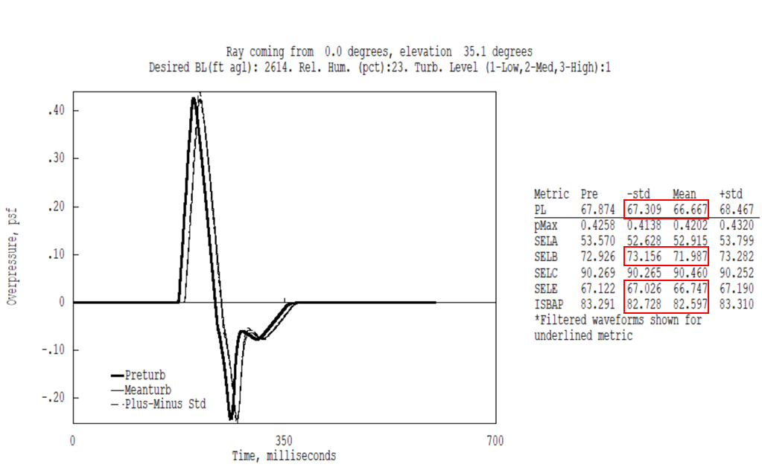
FIR Filters are implemented in PCBoom.
Current filters are inaccurate for shaped signatures.
Predicted level for -1 standard deviation is greater than the mean
7

Slide 8
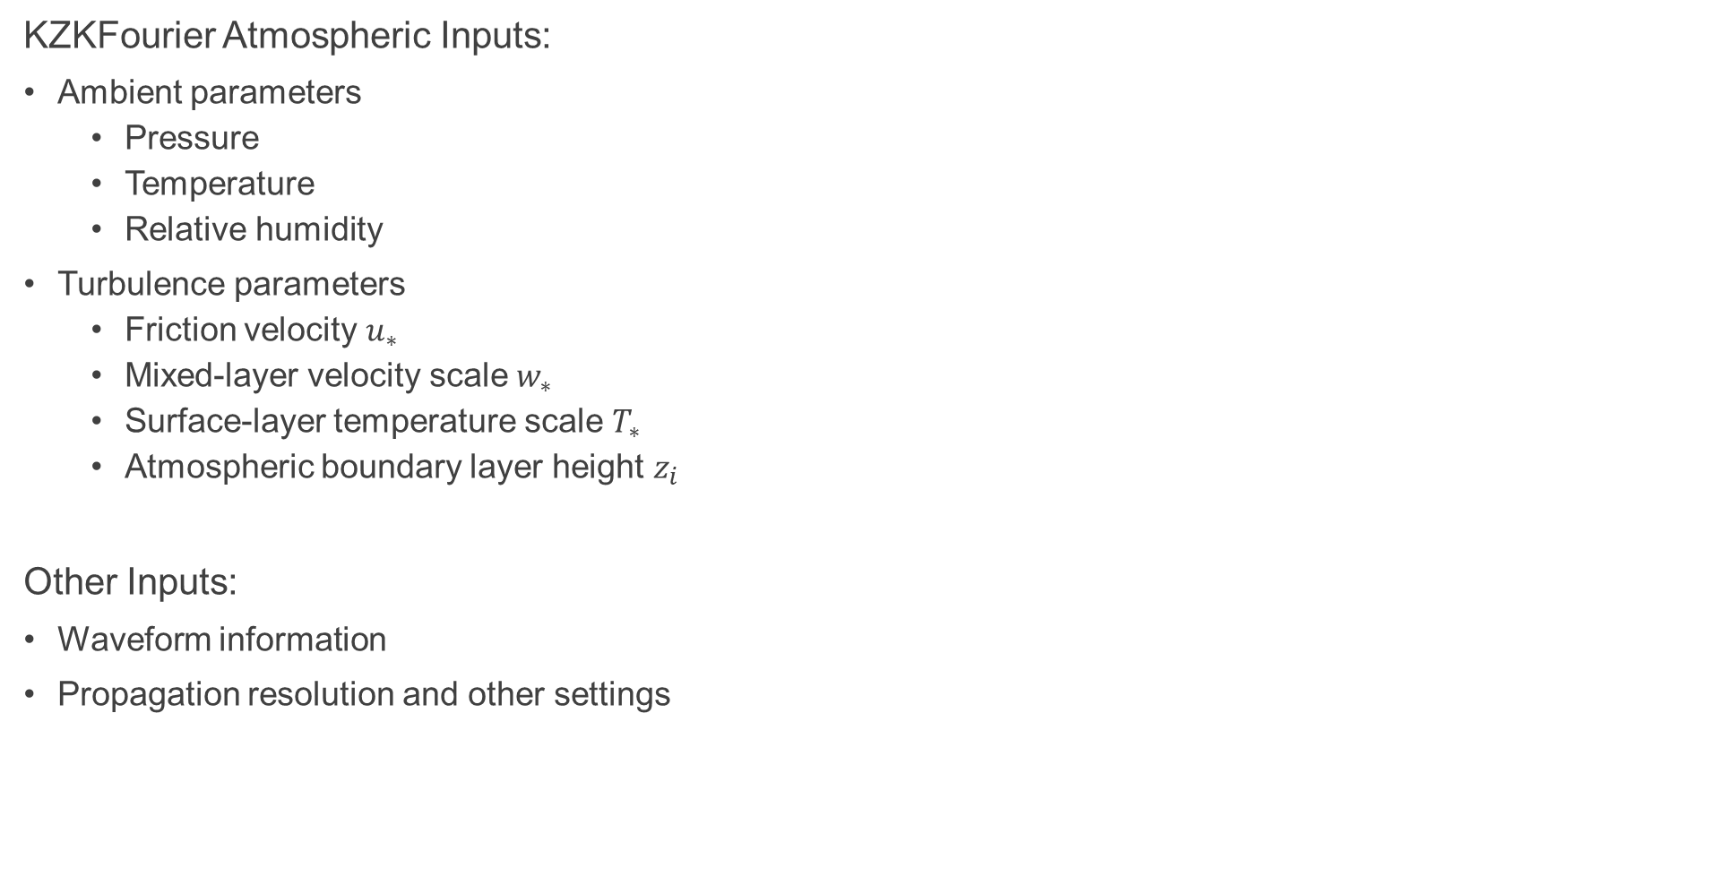
Improve PCBoom filters by sampling atmospheric KZKFourier inputs.
KZKFourier Atmospheric Inputs:
Ambient parameters
  Pressure
  Temperature
  Relative humidity
Turbulence parameters
  Friction velocity $u_{∗}$
  Mixed-layer velocity scale $w_{∗}$
  Surface-layer temperature scale $T_{∗}$
  Atmospheric boundary layer height $z_{i}$
Other Inputs:
Waveform information
Propagation resolution and other settings
What are typical daytime ranges
across the US?
Use Design of Experiments principles to efficiently sample these 7 factors to run KZKFourier and update FIR filters
8

Slide 9
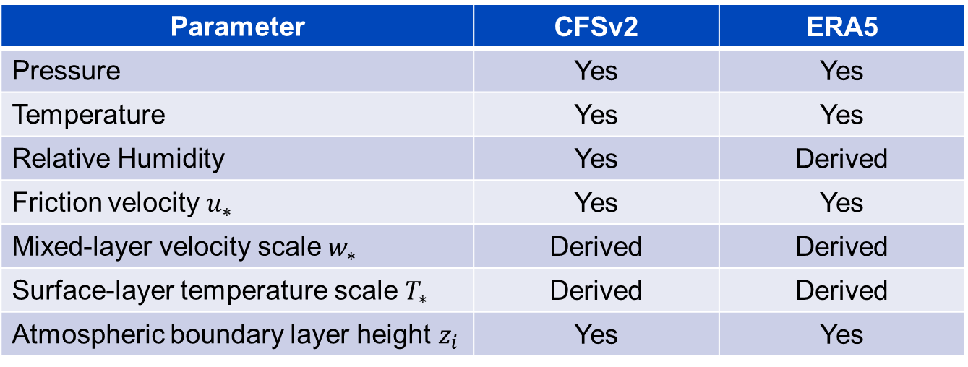
Ambient and turbulence quantities were collected or derived from atmospheric model databases.
Two databases used for more robust statistical results
  Climate Forecast System Version 2 (CFSv2)
  European Centre for Medium-range Weather Forecast Reanalysis 5 (ERA5)
Availability of KZKFourier Input Parameters
Parameter | CFSv2 | ERA5
Pressure | Yes | Yes
Temperature | Yes | Yes
Relative Humidity | Yes | Derived
Friction velocity $u_{∗}$ | Yes | Yes
Mixed-layer velocity scale $w_{∗}$ | Derived | Derived
Surface-layer temperature scale $T_{∗}$ | Derived | Derived
Atmospheric boundary layer height $z_{i}$ | Yes | Yes
9

Slide 10
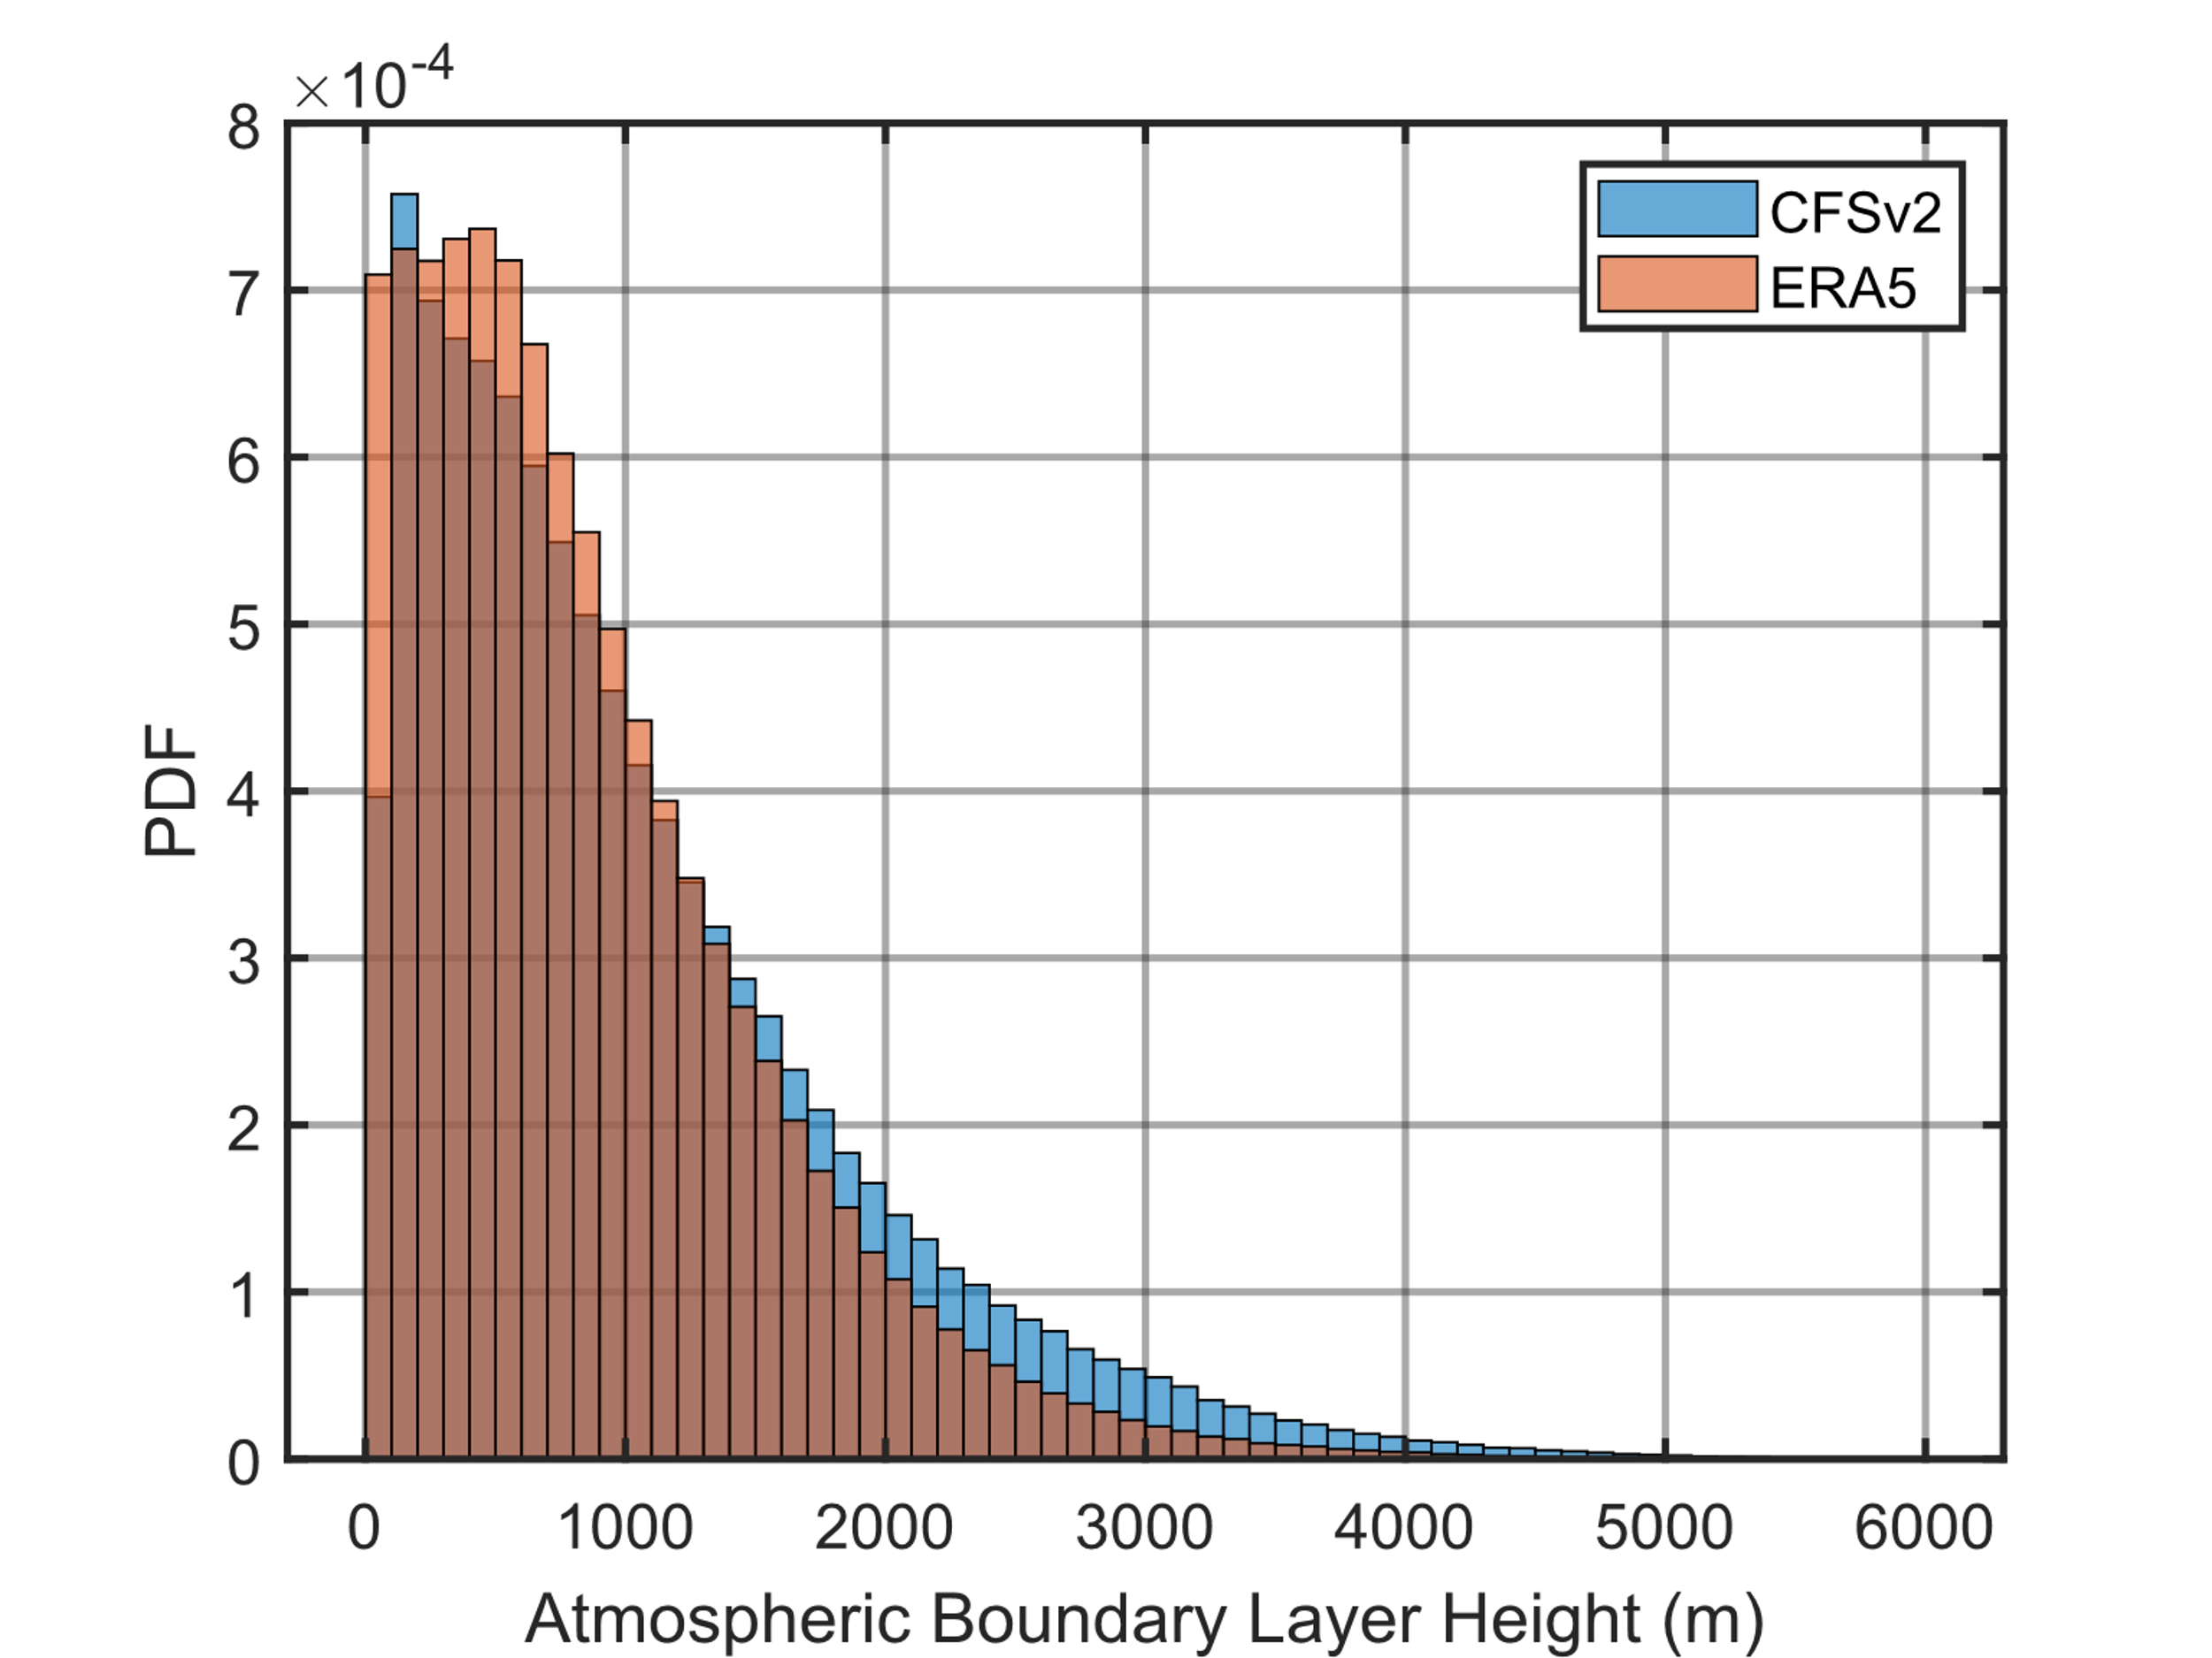
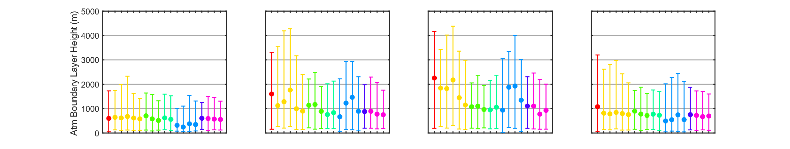
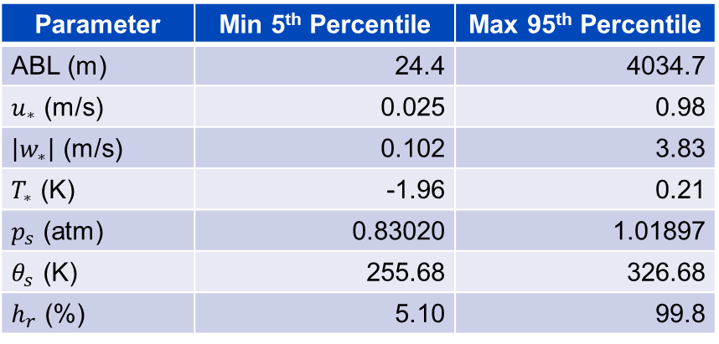
Daytime ambient and turbulence parameters were grouped by season and 5th and 95th percentiles of each were computed.
ERA5 and CFSv2 10-year, hourly, daytime, seasonally-pooled stats
Parameter | Min 5th Percentile | Max 95th Percentile
ABL (m) | 24.4 | 4034.7
$u_{∗}$ (m/s) | 0.025 | 0.98
$\left|w_{∗}\right|$ (m/s) | 0.102 | 3.83
$T_{∗}$ (K) | -1.96 | 0.21
$p_{s}$ (atm) | 0.83020 | 1.01897
$θ_{s}$ (K) | 255.68 | 326.68
$h_{r}$ (%) | 5.10 | 99.8
Winter
Spring
Summer
Fall
CFSv2 median and
5th to 95th percentiles
10
Location
Location
Location
Location

Slide 11
Daytime ambient and turbulence parameters were grouped by season and 5th and 95th percentiles of each were computed.
ERA5 and CFSv2 10-year, hourly, daytime, seasonally-pooled stats
Parameter | Min 5th Percentile | Max 95th Percentile
ABL (m) | 24.4 | 4034.7
$u_{∗}$ (m/s) | 0.025 | 0.98
$\left|w_{∗}\right|$ (m/s) | 0.102 | 3.83
$T_{∗}$ (K) | -1.96 | 0.21
$p_{s}$ (atm) | 0.83020 | 1.01897
$θ_{s}$ (K) | 255.68 | 326.68
$h_{r}$ (%) | 5.10 | 99.8
How to sample 7
factors efficiently?
Winter
Spring
Summer
Fall
CFSv2 median and
5th to 95th percentiles
11
Location
Location
Location
Location

Slide 12
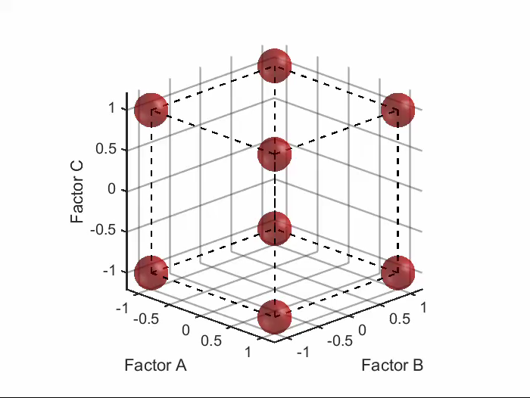
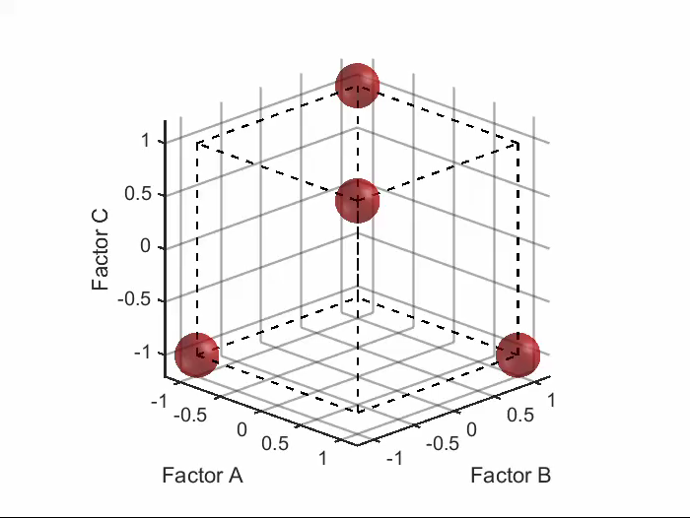
Use design of experiments principles to optimally sample KZKFourier inputs.
Example:
Full factorial
Fractional factorial
3 factors, 2 levels -> 8 cases, 8 unknowns
4 cases, 4 “aliased” unknowns
Response = 1 + A + B + C + AB + AC + BC + ABC
Response = [1 + ABC] + [A + BC] + [B + AC] + [C + AB]
Useful if interaction terms, e.g. AB, are negligible
Animated slide
12

Slide 13
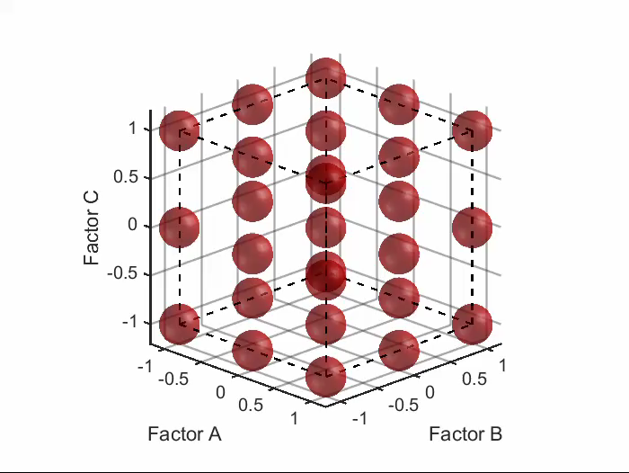
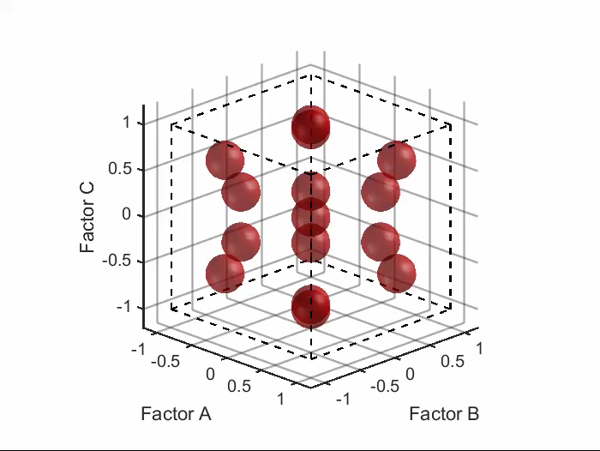
Use design of experiments principles to optimally sample KZKFourier inputs
Example:
Full factorial, 3 levels
Central Composite
3 factors, 3 levels -> 27 cases
15 cases
Response = 1 + A + B + C + A² + B² + C² + AB +AB + BC
Useful if some curvature is expected
and if extrema are lower priority
Animated slide
13

Slide 14
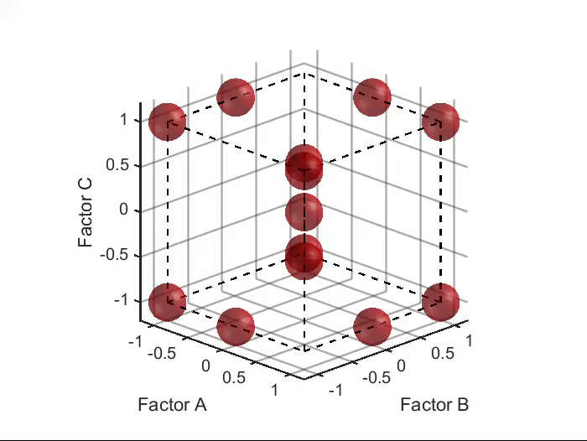
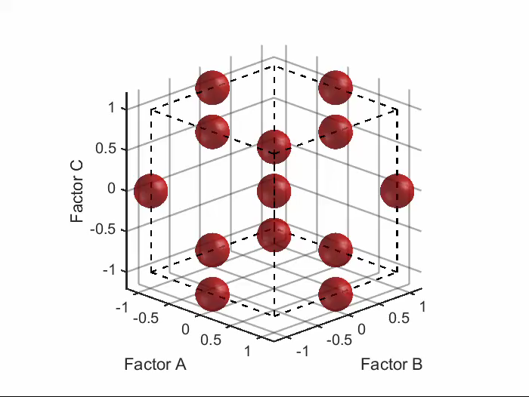
Other designs considered
Factorial
Fractional Factorial
Definitive Screening
Box-Behnken
Central Composite
Animated slide
14

Slide 15
Candidate designs to sample 7 KZKFourier inputs
 | Unique Cases | Factor Levels | Shape
Full Factorial | 3⁷=2187 5⁷=78125 | 3 or 5 | Cube
Definitive Screening Design | 21 | 3 | Reduced cube
Minimum-Run Resolution V (MR5) Fractional Factorial (FF) | 31 | 2+center point | Cube
Central Composite Design (CCD) with MR5 | 45 | 5 | Sphere
Box-Behnken | 57 | 3 | Sphere
CCD with Regular FF | 79 | 5 | Sphere
Chose CCD with MR5 because it avoids the unlikely extrema and requires only 45 cases to be run.
15

Slide 16
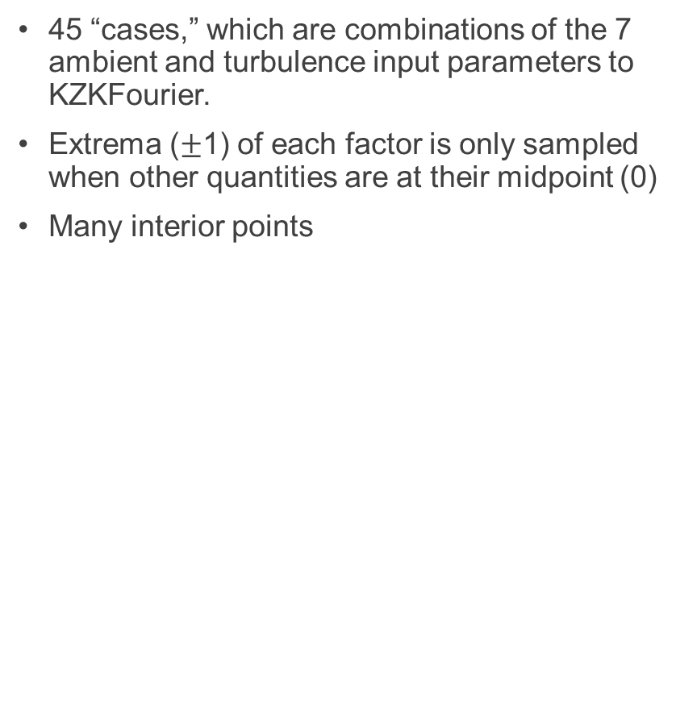
Central Composite Design
Case | Factor 1 | Factor 2 | Factor 3 | Factor 4 | Factor 5 | Factor 6 | Factor 7
1 | -0.61 | -0.61 | -0.61 | 0.61 | -0.61 | -0.61 | 0.61
2 | -0.61 | 0.61 | -0.61 | -0.61 | 0.61 | -0.61 | -0.61
3 | -0.61 | 0.61 | 0.61 | 0.61 | -0.61 | -0.61 | 0.61
4 | -0.61 | -0.61 | 0.61 | -0.61 | -0.61 | -0.61 | 0.61
5 | 0.61 | 0.61 | 0.61 | 0.61 | 0.61 | 0.61 | 0.61
6 | -0.61 | -0.61 | -0.61 | -0.61 | 0.61 | 0.61 | -0.61
7 | 0.61 | 0.61 | -0.61 | -0.61 | -0.61 | 0.61 | -0.61
8 | -0.61 | 0.61 | -0.61 | 0.61 | 0.61 | 0.61 | -0.61
9 | 0.61 | -0.61 | 0.61 | -0.61 | 0.61 | -0.61 | -0.61
10 | 0.61 | 0.61 | -0.61 | 0.61 | -0.61 | 0.61 | 0.61
11 | -0.61 | -0.61 | -0.61 | 0.61 | -0.61 | 0.61 | -0.61
12 | -0.61 | -0.61 | -0.61 | 0.61 | 0.61 | 0.61 | 0.61
13 | -0.61 | -0.61 | 0.61 | 0.61 | 0.61 | -0.61 | -0.61
14 | 0.61 | -0.61 | -0.61 | 0.61 | 0.61 | -0.61 | -0.61
15 | 0.61 | 0.61 | -0.61 | 0.61 | -0.61 | -0.61 | -0.61
16 | -0.61 | 0.61 | 0.61 | -0.61 | -0.61 | -0.61 | -0.61
17 | 0.61 | 0.61 | -0.61 | -0.61 | 0.61 | 0.61 | 0.61
18 | 0.61 | 0.61 | 0.61 | -0.61 | -0.61 | 0.61 | 0.61
19 | -0.61 | 0.61 | 0.61 | -0.61 | 0.61 | 0.61 | -0.61
20 | 0.61 | 0.61 | 0.61 | 0.61 | 0.61 | -0.61 | -0.61
21 | 0.61 | -0.61 | -0.61 | -0.61 | 0.61 | -0.61 | 0.61
22 | 0.61 | -0.61 | -0.61 | -0.61 | -0.61 | 0.61 | 0.61
23 | 0.61 | -0.61 | 0.61 | 0.61 | 0.61 | 0.61 | -0.61
24 | -0.61 | -0.61 | 0.61 | -0.61 | -0.61 | 0.61 | -0.61
25 | 0.61 | -0.61 | 0.61 | 0.61 | -0.61 | -0.61 | -0.61
26 | -0.61 | 0.61 | 0.61 | -0.61 | 0.61 | -0.61 | 0.61
27 | 0.61 | 0.61 | -0.61 | -0.61 | -0.61 | -0.61 | 0.61
28 | -0.61 | -0.61 | 0.61 | 0.61 | -0.61 | 0.61 | 0.61
29 | 0.61 | -0.61 | 0.61 | 0.61 | 0.61 | -0.61 | 0.61
30 | -0.61 | 0.61 | -0.61 | -0.61 | -0.61 | 0.61 | 0.61
31 | -1 | 0 | 0 | 0 | 0 | 0 | 0
32 | 1 | 0 | 0 | 0 | 0 | 0 | 0
33 | 0 | -1 | 0 | 0 | 0 | 0 | 0
34 | 0 | 1 | 0 | 0 | 0 | 0 | 0
35 | 0 | 0 | -1 | 0 | 0 | 0 | 0
36 | 0 | 0 | 1 | 0 | 0 | 0 | 0
37 | 0 | 0 | 0 | -1 | 0 | 0 | 0
38 | 0 | 0 | 0 | 1 | 0 | 0 | 0
39 | 0 | 0 | 0 | 0 | -1 | 0 | 0
40 | 0 | 0 | 0 | 0 | 1 | 0 | 0
41 | 0 | 0 | 0 | 0 | 0 | -1 | 0
42 | 0 | 0 | 0 | 0 | 0 | 1 | 0
43 | 0 | 0 | 0 | 0 | 0 | 0 | -1
44 | 0 | 0 | 0 | 0 | 0 | 0 | 1
45 | 0 | 0 | 0 | 0 | 0 | 0 | 0
45 “cases,” which are combinations of the 7 ambient and turbulence input parameters to KZKFourier.
Extrema ($±$1) of each factor is only sampled when other quantities are at their midpoint (0)
Many interior points
Normalized Factor Selection Table
Central Composite
Irregular fraction
Axial points
Animated slide
Center point
16

Slide 17
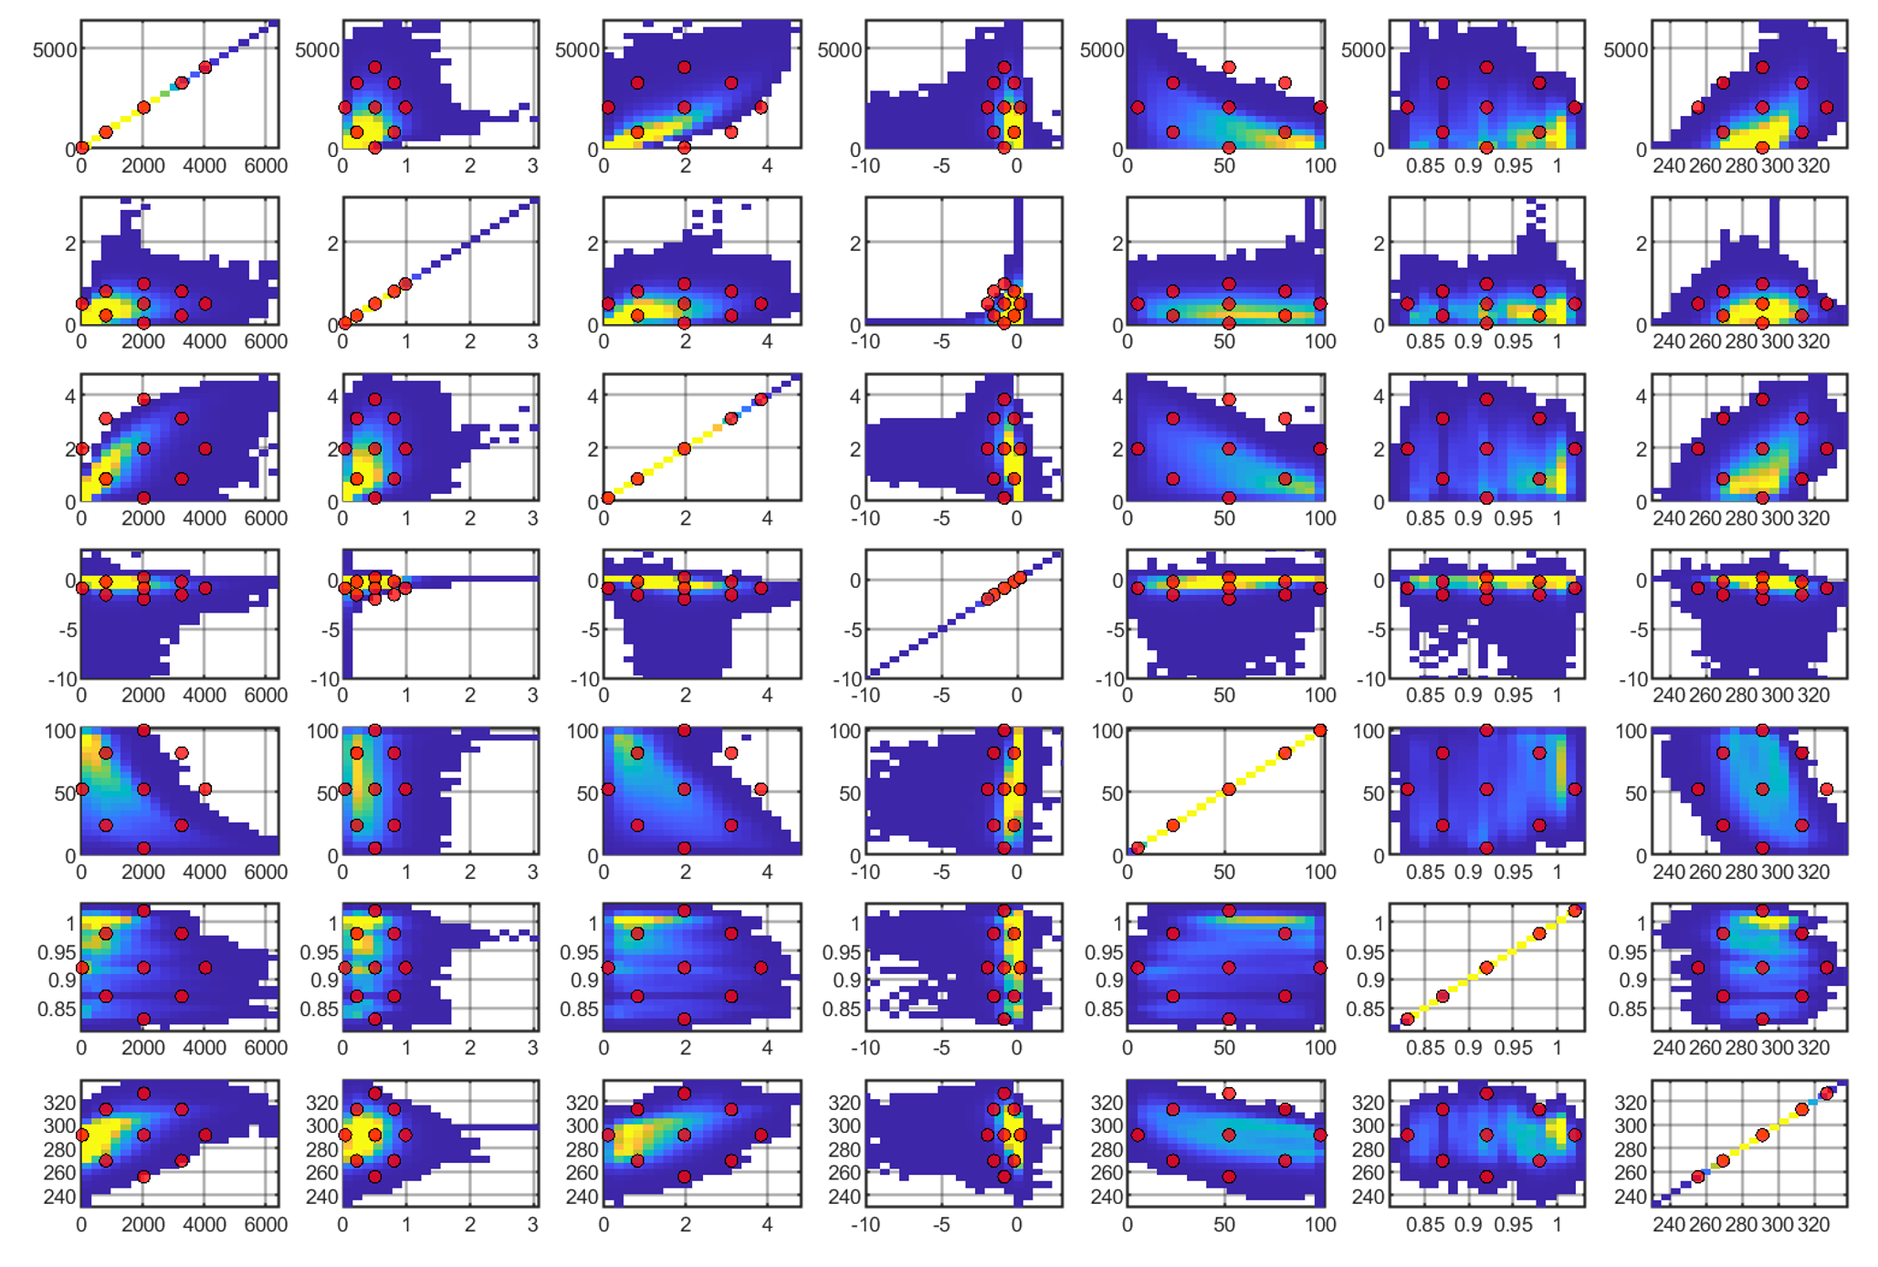












Ambient and turbulence parameter densities and CCD sampling points (red)
ABL (m)
$u_{∗}$ (m/s)
$w_{∗}$ (m/s)
$T_{∗}$ (K)
$h_{r}$ (%)
$p_{0}$ (atm)
$T_{0}$ (K)
ABL (m)
$u_{∗}$ (m/s)
$w_{∗}$ (m/s)
$T_{∗}$ (K)
$h_{r}$ (%)
$p_{0}$ (atm)
$T_{0}$ (K)
17

Slide 18
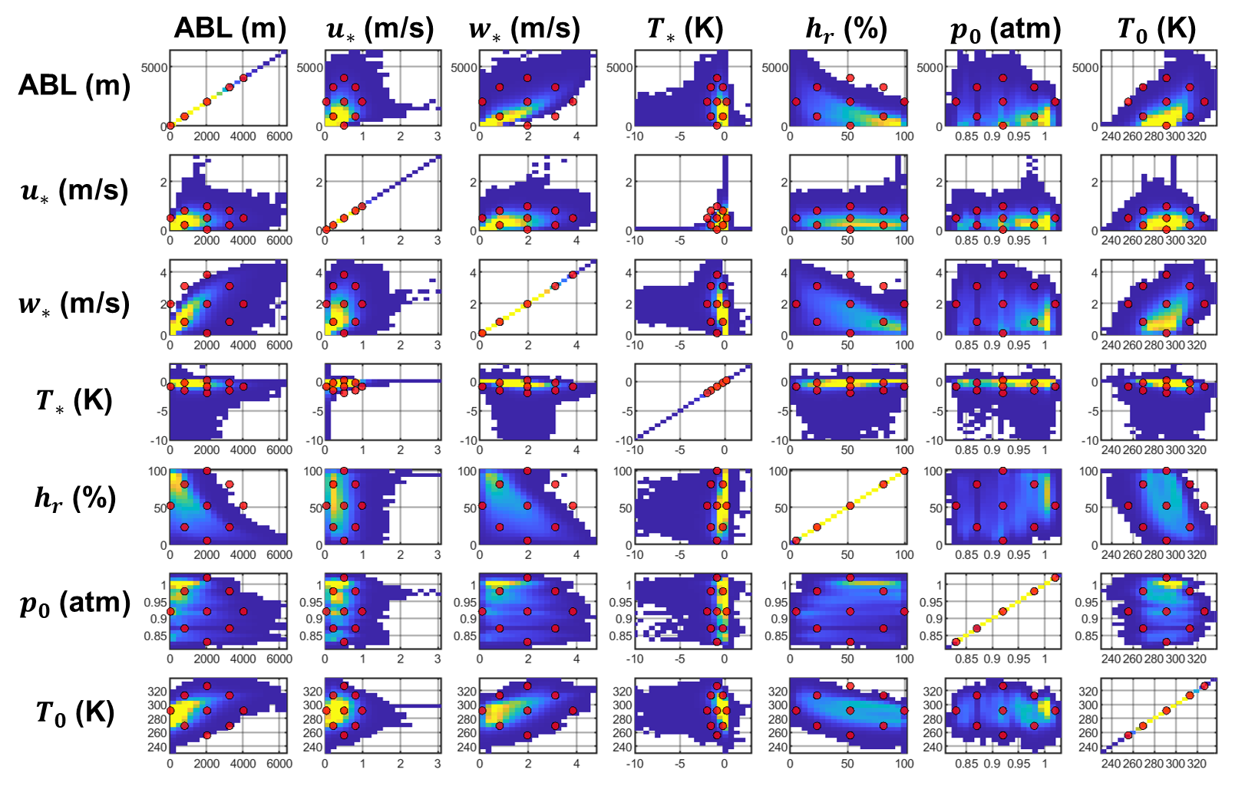
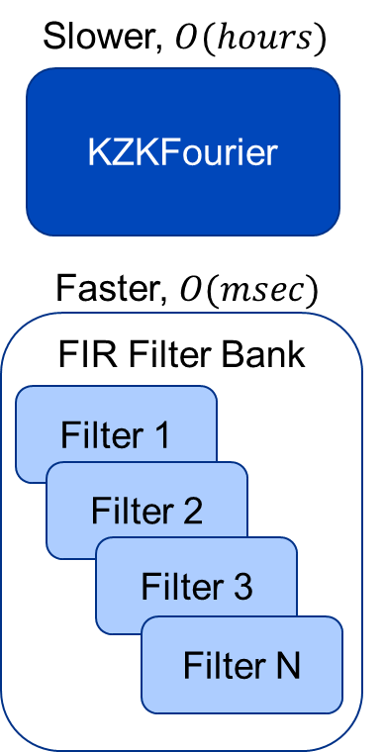
Next steps and summary
Next steps
  Propagate the 45 cases using KZKFourier
  Compute turbulence approximation filters
  Validate filters with additional cases
  Implement in PCBoom
Summary
PCBoom module: FiltView
N-wave filters ineffective for shaped supersonic waveforms
has few user-selectable atmospheric inputs
Collected turbulence parameters
Central Composite Design
Location
Animated slide
18

Slide 19

Quesst
william.j.doebler@nasa.gov
www.nasa.gov |
19
19

Slide 20
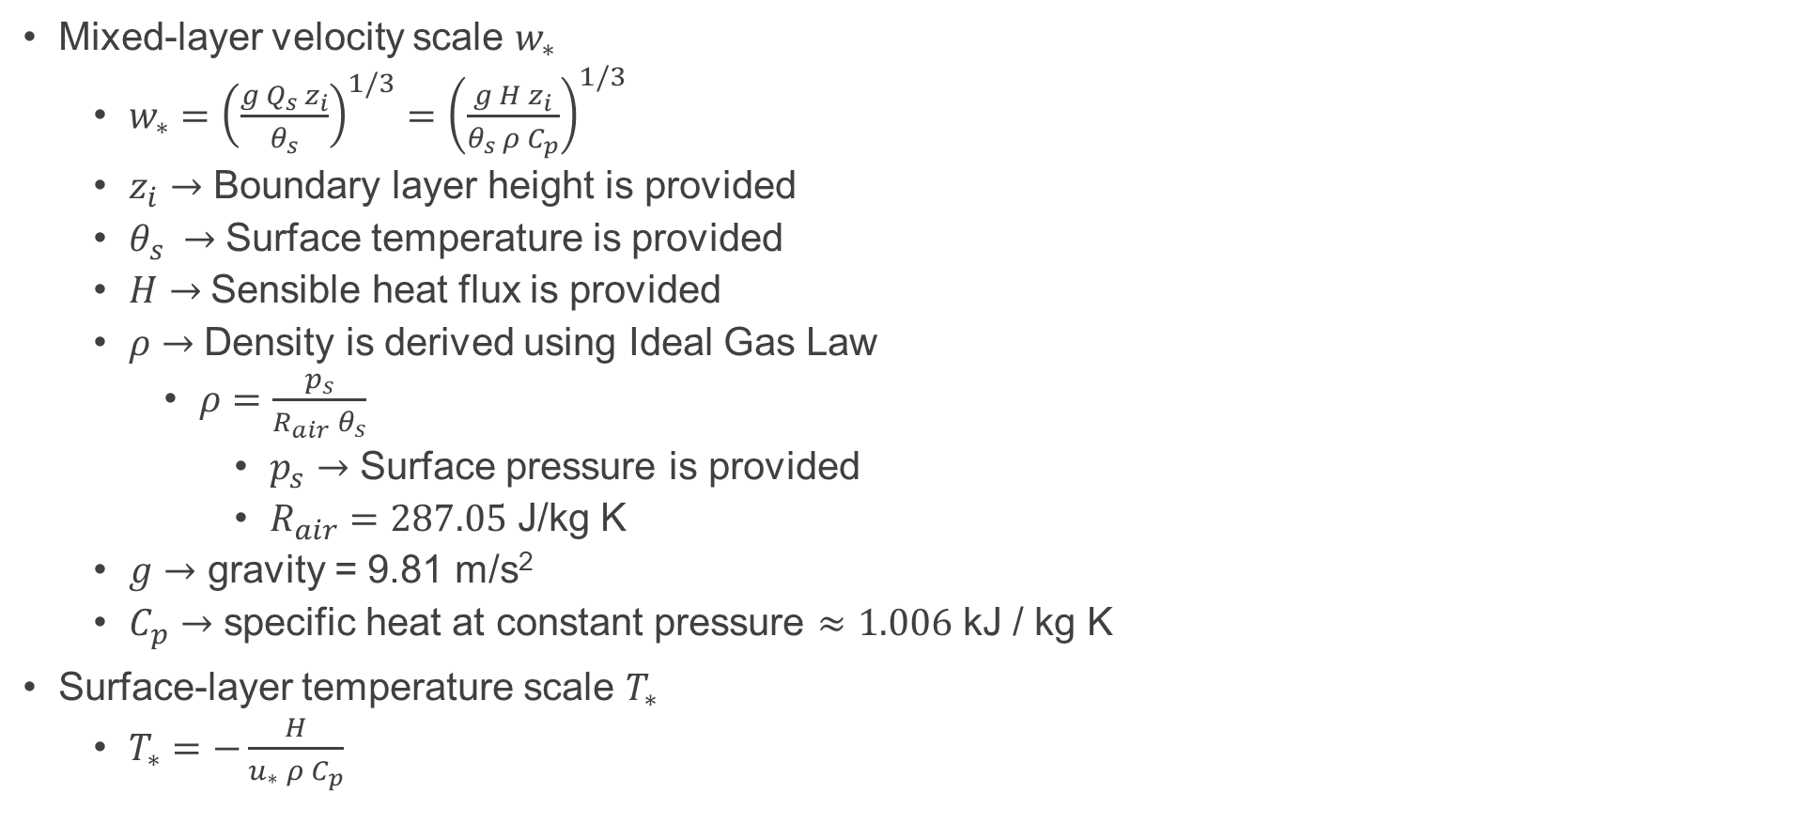
Derived parameters from CFSv2
Mixed-layer velocity scale $w_{∗}$
  $w_{∗}={\left(\frac{g Q_{s} z_{i}}{θ_{s}}\right)}^{1/3}={\left(\frac{g H z_{i}}{θ_{s }ρ C_{p}}\right)}^{1/3}$
  $z_{i}→$ Boundary layer height is provided
  $θ_{s} →$Surface temperature is provided
  $H→$Sensible heat flux is provided
  $ρ→$Density is derived using Ideal Gas Law
    $ρ=\frac{p_{s}}{R_{air} θ_{s}}$
      $p_{s}→$ Surface pressure is provided
      $R_{air}=287.05$ J/kg K
  $g→$ gravity = 9.81 m/s²
  $C_{p}→$ specific heat at constant pressure $≈1.006$ kJ / kg K
Surface-layer temperature scale $T_{∗}$
  $T_{∗}=−\frac{H}{u_{∗} ρ C_{p}}$
20

Slide 21
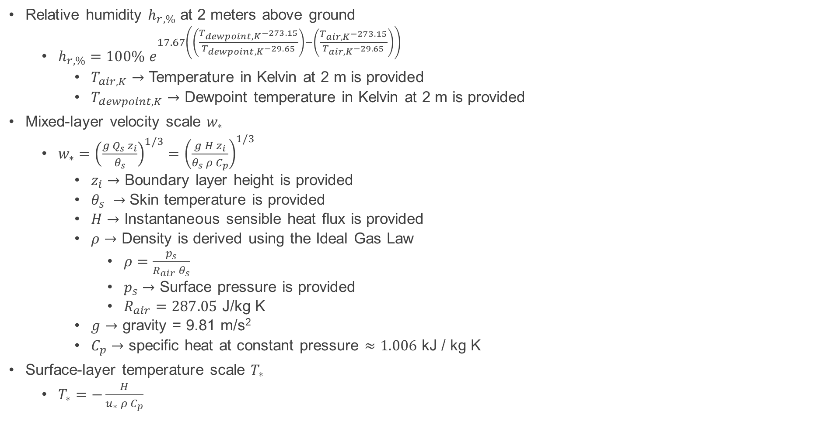
Derived parameters from ERA5
Relative humidity $h_{r,\%}$ at 2 meters above ground
  $h_{r,\%}=100\% e^{17.67\left(\left(\frac{T_{dewpoint,K}−273.15}{T_{dewpoint,K}−29.65}\right)−\left(\frac{T_{air,K}−273.15}{T_{air,K}−29.65}\right)\right)}$
    $T_{air,K}→$ Temperature in Kelvin at 2 m is provided
    $T_{dewpoint,K}→$ Dewpoint temperature in Kelvin at 2 m is provided
Mixed-layer velocity scale $w_{∗}$
  $w_{∗}={\left(\frac{g Q_{s} z_{i}}{θ_{s}}\right)}^{1/3}={\left(\frac{g H z_{i}}{θ_{s }ρ C_{p}}\right)}^{1/3}$
    $z_{i}→$ Boundary layer height is provided
    $θ_{s} →$Skin temperature is provided
    $H→$ Instantaneous sensible heat flux is provided
    $ρ→$ Density is derived using the Ideal Gas Law
      $ρ=\frac{p_{s}}{R_{air} θ_{s}}$
      $p_{s}→$ Surface pressure is provided
      $R_{air}=287.05$ J/kg K
    $g→$ gravity = 9.81 m/s²
    $C_{p}→$ specific heat at constant pressure $≈1.006$ kJ / kg K
Surface-layer temperature scale $T_{∗}$
  $T_{∗}=−\frac{H}{u_{∗} ρ C_{p}}$
21

Slide 22

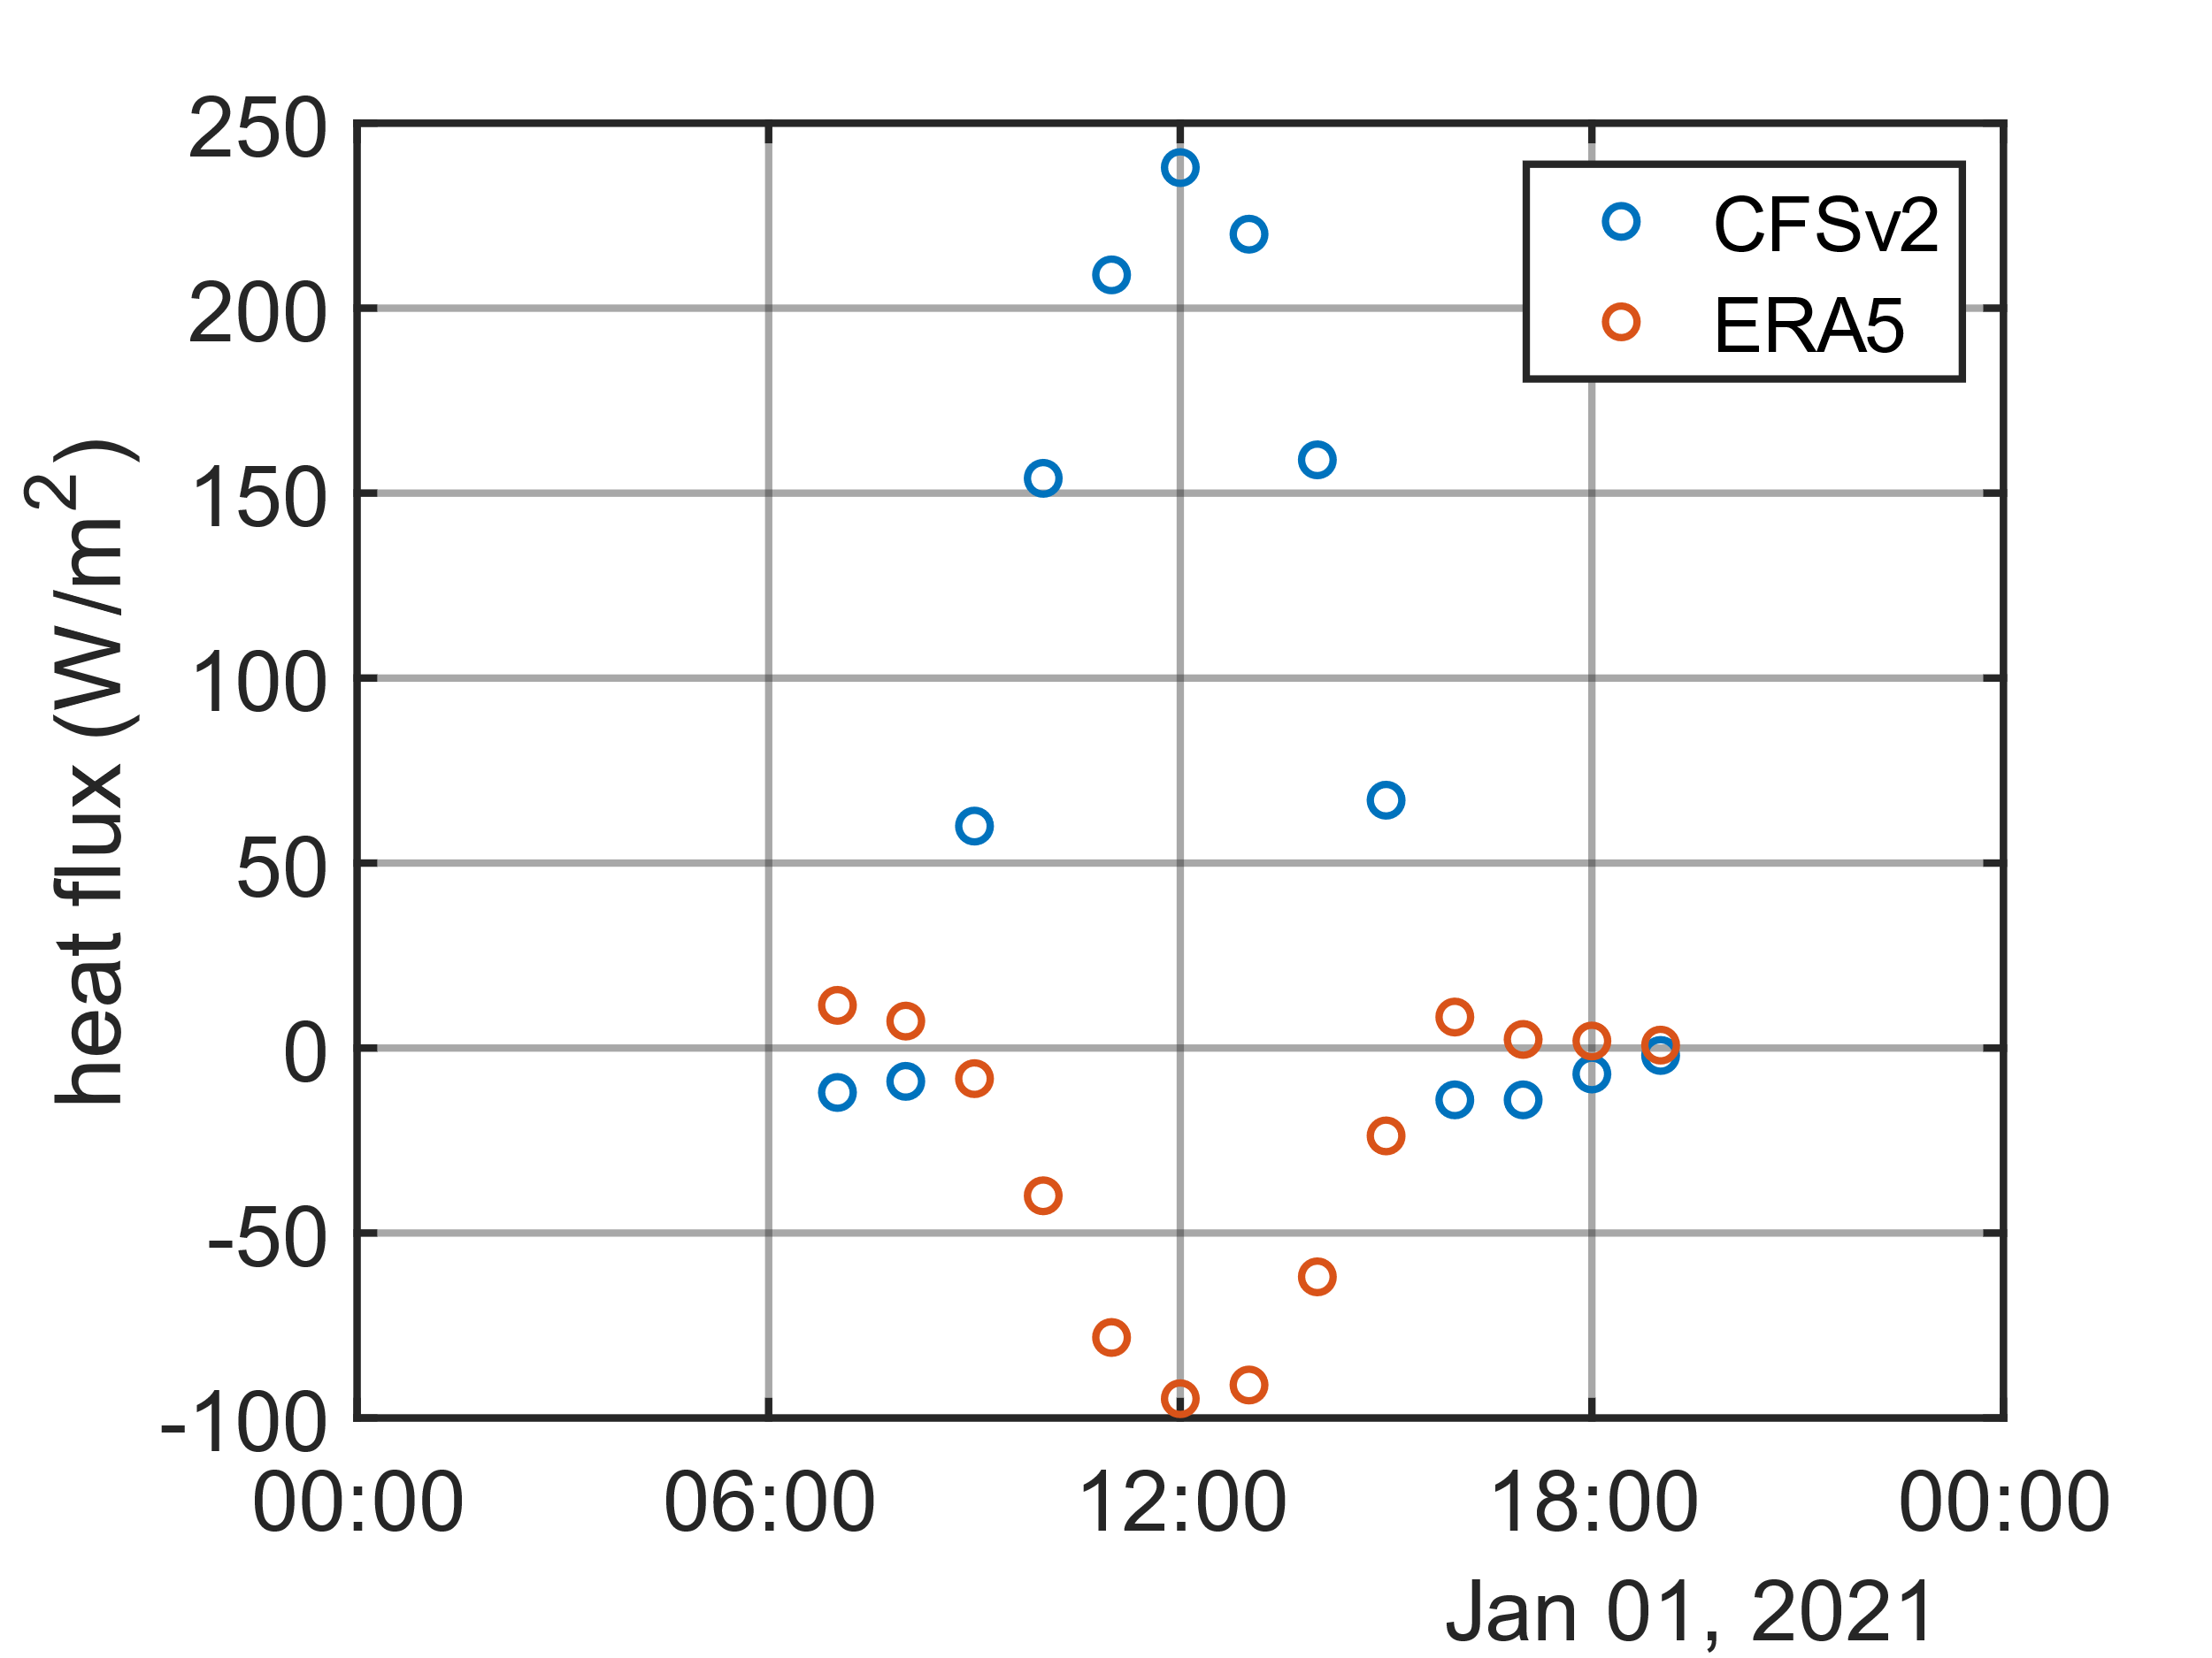




Note on heat flux sign convention
CFSv2 and ERA5 heat flux have opposite sign convention
  “The ECMWF convention for vertical fluxes is positive downwards”
Ostashev and Wilson (2016), “the sensible heat flux [is] from the surface to the overlying air”
Need to multiply ERA5 heat flux by -1 to match Ostashev and Wilson model used in KZKFourier
+
CFSv2
ERA5
KZKFourier sign convention:
Heat flux from the surface to the air
22

