Slide 1
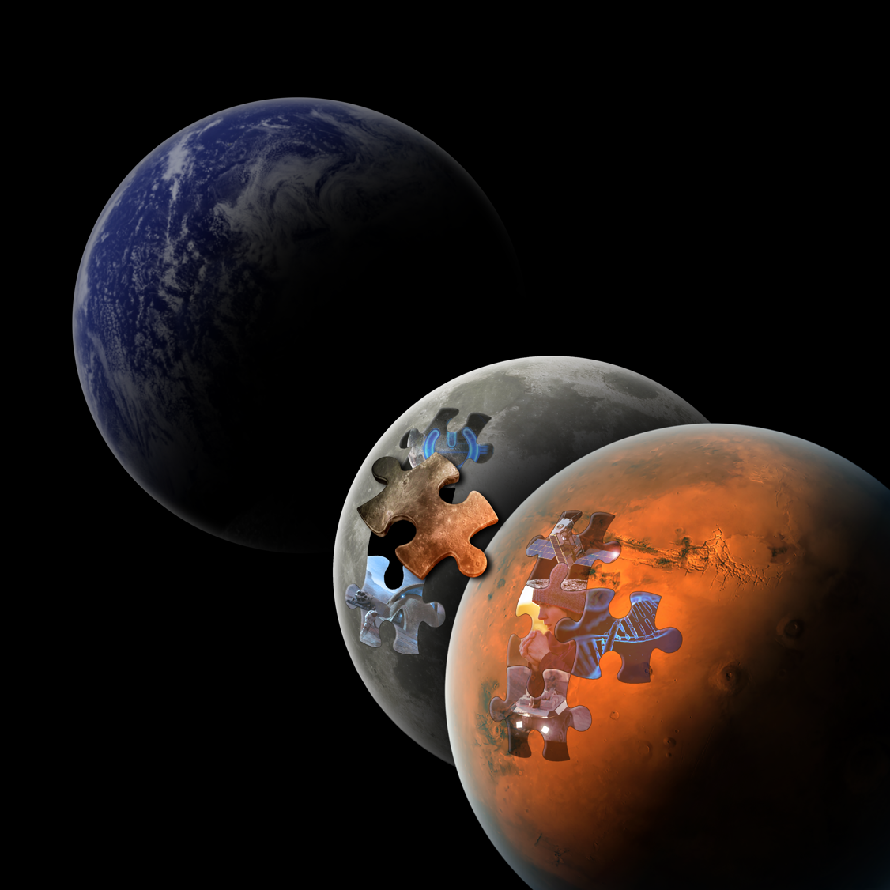


NASA Centennial Challenges
Daring you to ask
What if?
Angela Herblet, Challenge Manager
04/26/2023

Slide 2
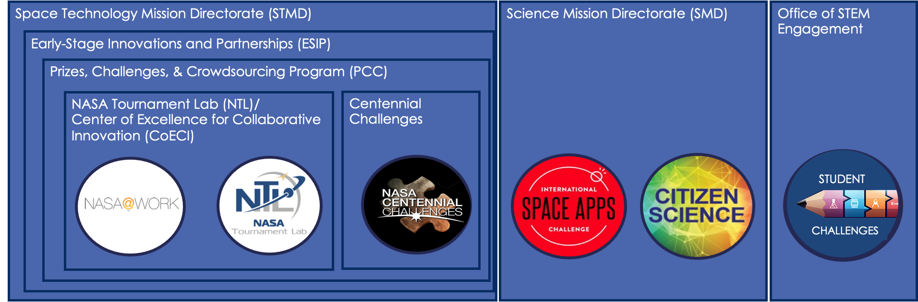

NASA Crowdsourcing Landscape
In the NASA Organization Structure
These opportunities can be accessed by the public on the
NASA Solve website: www.nasa.gov/solve

Slide 3
Centennial Challenges
Established to conduct prize competitions in support of the Vision for Space Exploration and ongoing NASA programs
Although the first competition was started in 2005, development of the program started in 2003 to commemorate …

Slide 4
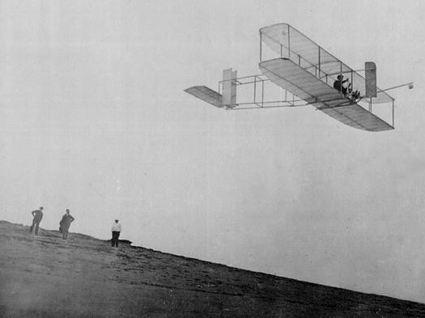
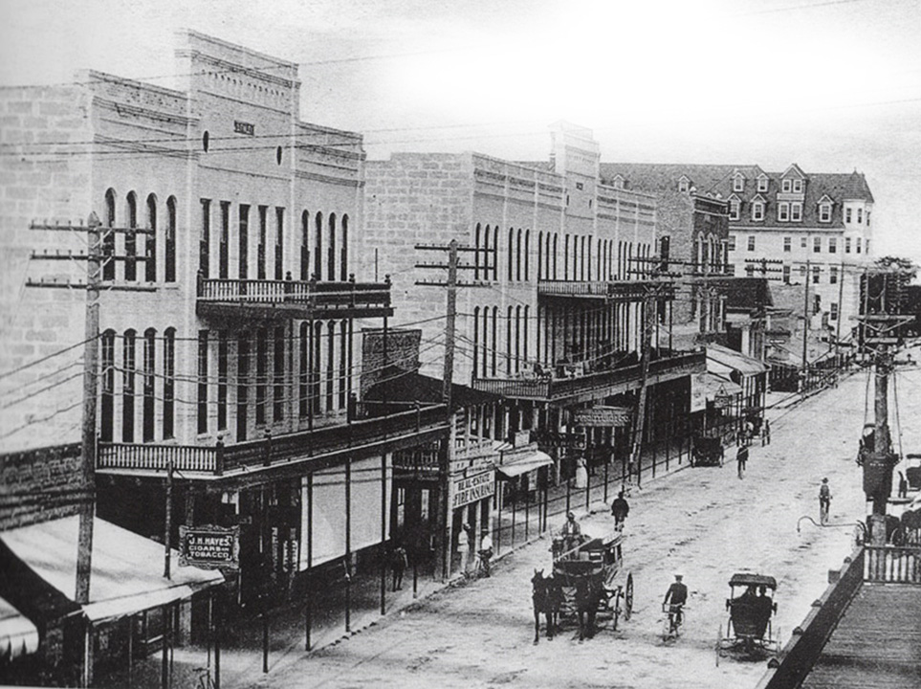
The Centennial of Flight
… when life looked like this.
The Wright “Flyer”
An aircraft built of wood, powered by
hand made propellers flew at Kitty Hawk,
North Carolina, on December 17, 1903,
making a 12-second flight.
In the early 1900s, brothers and bicycle builders Wilbur and Orville Wright revolutionized the world with the first successful airplane.

Slide 5
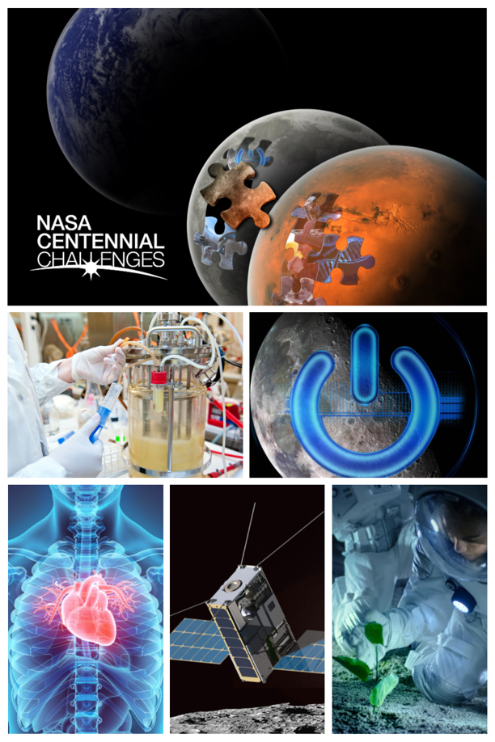
About Centennial Challenges
Centennial Challenges were established in 2004 as NASA’s first prize program called to conduct prize competitions in support of the Vision for Space Exploration and ongoing NASA programs and missions.
Centennial Challenges seek novel solutions from diverse, multi-disciplinary and non-traditional sources including individual citizens as well as those in academia, industry, and other government agencies.
The size and structure of the prize competitions took inspiration from the Orteig Prize and Ansari X Prize.
Past and current Centennial Challenges have addressed propulsion, robotics, communications and navigation, human health, science instrumentation, nanotech, materials and structure, and aerodynamics.
The Centennial Challenges Program Office is located at Marshall Space Flight Center in Huntsville, Alabama
  Consists of an in-house team of challenge design and management specialists to take the challenge from ideation and development through execution.
  Engagements, collaborations and partnerships internal and external to NASA are critical to success

Slide 6
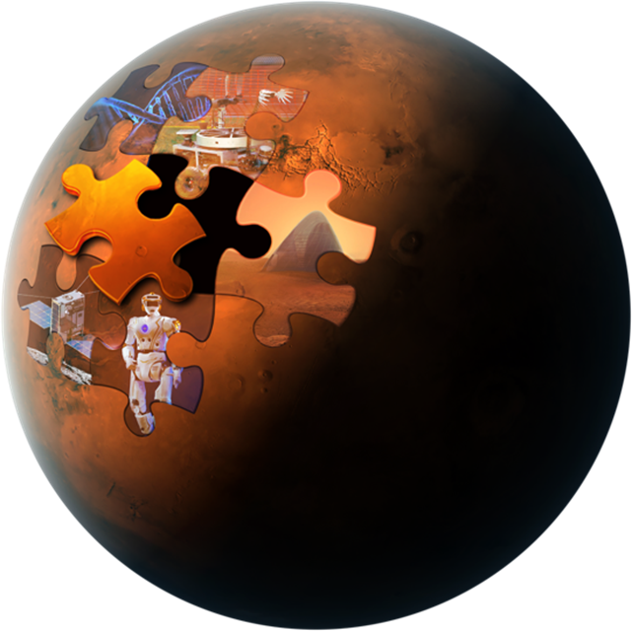
Goal:
Stimulate research and technology solutions to support NASA missions and inspire new national aerospace capabilities through public prize competitions.
Objectives:
Expand the pool of potential solutions to meet identified NASA research and technology needs
Stimulate new capabilities and commercial markets for the Nation
Cultivate a broader, more diverse community of innovators contributing to NASA and aerospace activities

Slide 7
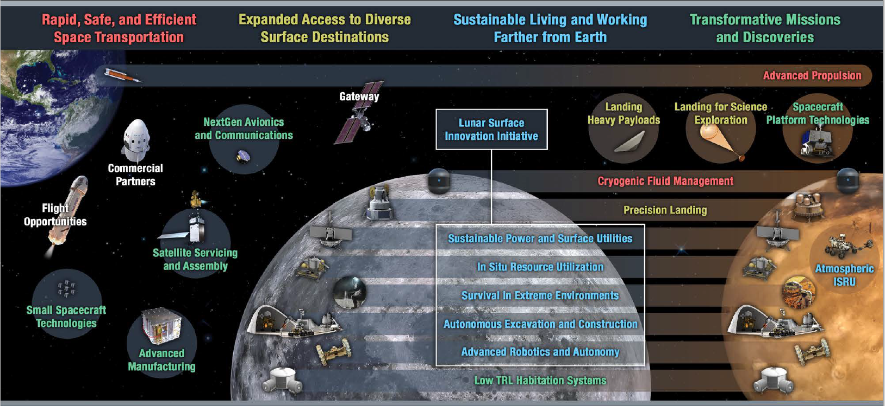

Slide 8





Optimized Competition Design Process to Maximize Outside of NASA Collaborations and Strong Alignment with NASA’s Needs
IDEATION
FORMULATION
DEVELOPMENT
ACTIVE
CLOSE
  Assemble challenge core team (internal NASA); select lead Center
  Assessment of technology State-of-the-Art
  Discussion of technology gaps w/ NASA’s Subject Matter Experts (SME)
  Define initial competitions concept
  Define preliminary competition scope and concept
  Estimate, resources and define requirements
  Involves SME at/outside of NASA and assembles a challenge working team
  Finalize scope, concept, resources requirements
  Authority to proceed (ATP) given by STMD senior management
  Partnerships finalized
  Prize purse assigned
  STMD approves opening the challenge at DPMC
  Challenge announced/ Registration is opened
  Work with judges, competitors and partners
  Competition activities (virtual and/or face-to-face)
  Winners announced
  Competitors connected with NASA SME
  Challenge completed
  Lessons learned documented
  Challenge report completed

Slide 9




Centennial Challenges recruitment and promotion
WEB PRODUCTS:
  NASA Web Feature
  NASA360 Video
  Instagram/Facebook Stories
  Fact Sheet
WEBSITES & SOCIAL MEDIA
  NASA Solve
  NASA Prize
  NASA Artemis
  NASA flagship
  NASA Marshall
  Challenge Website
LISTSERVS
  NASA Solve
  Centennial Challenges past competitors
  Ideation Workshop Attendee List
  STMD
  HEO
  SBIR/STTR
  LSIC
  Tech Transfer Office
CONFERENCES
  Identified by CC
  Attended by SMEs
  Suggested by participating teams
PUBLICATIONS & BLOGS:
  Press Release
  Media Opportunities
  Op-Ed Opportunities
  Mining and Construction focused publications
SUPPORTED OUTREACH
  Allied Organization
  Supporting Partners
  External Organization (ex: Space Grant Consortia)

Slide 10
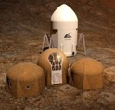

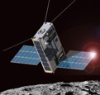

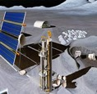


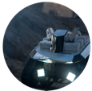
NASA Centennial Challenges
Spurring Innovation in space technology (with terrestrial applications) through prized competitions
3D-Printed Habitat*
$3.1M
CO₂ Conversion
$1M
Cube Quest
$5M
Watts On The Moon
Up to $5 M
Break the Ice Lunar Challenge
Up to $3.5 M
Space Food Challenge*
Up to $3 M
Vascular Tissue*
$500K
Space Robotics*
$1.9M
COMPLETED
ACTIVE
*Competitions supported by Allied Organizations

Slide 11
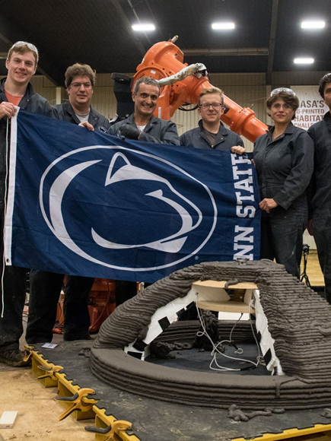
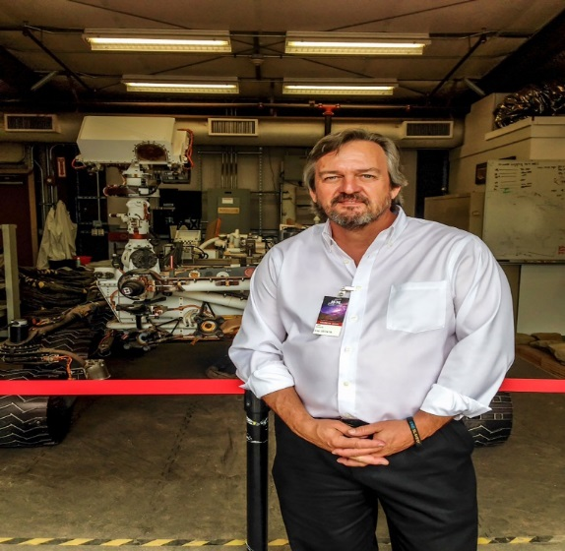

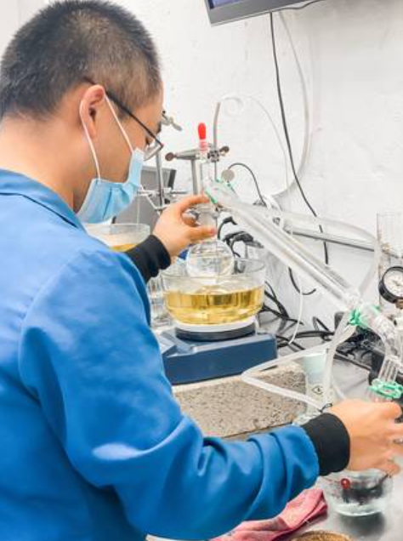
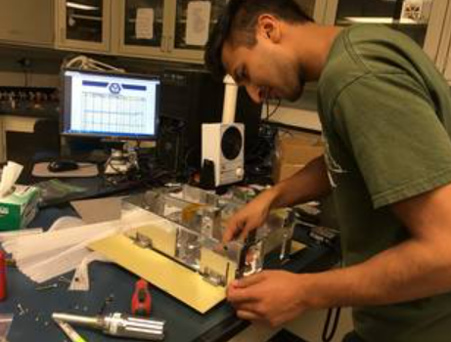
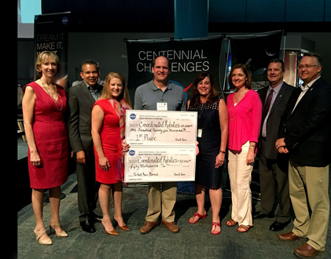

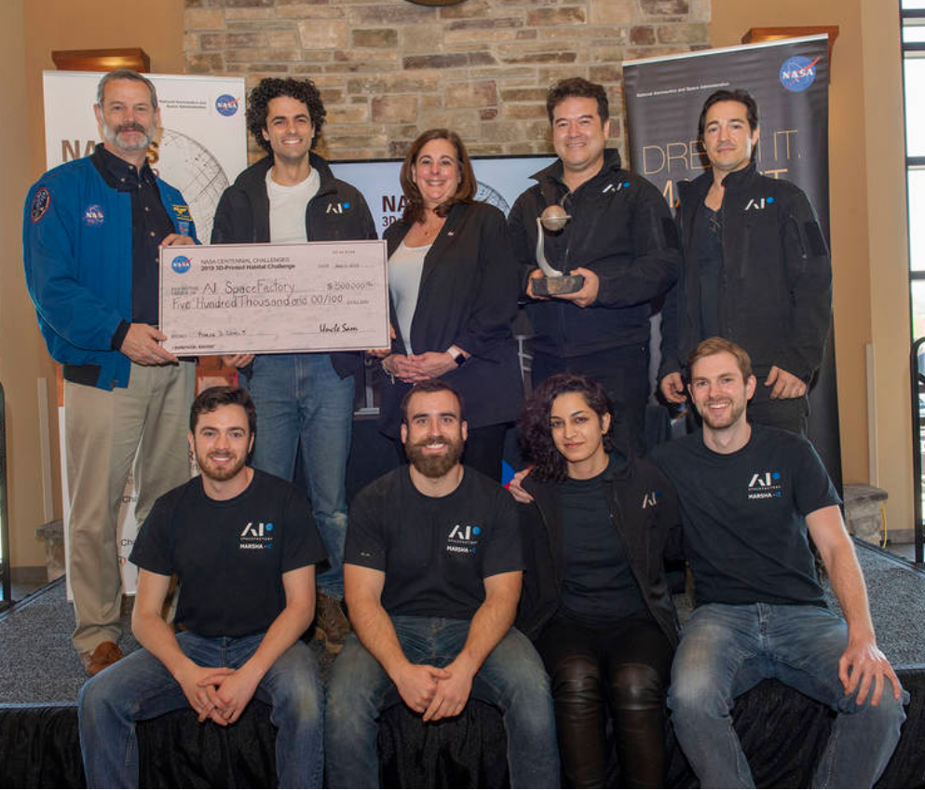
What motivates people to compete?
Guts.
Glory.
Good.
Gold.

Slide 12
Centennial Challenges
provide more than a prize purse

Slide 13
Current Active Centennial Challenges
Watts on the Moon
Prize Purse: up to $5M
Lead Center: Glenn Research Center
Develop and demonstrate sustainable energy storage, distribution, and management on the lunar surface
Phase 2, Level 2 Competition In-Progress
Break the Ice Lunar
Prize Purse: up to $3.5M
Lead Center: Marshall Space Flight Center
Develop and demonstrate autonomous icy regolith excavation technologies for near-term lunar missions that address key operational elements and environmental constraints
Phase 2, Level 2
Competition In-Progress
Deep Space Food
Prize Purse: up to $3M
Lead Center: Kennedy Space Center
Develop and demonstrate novel food production technologies, systems, and/or approaches for long duration space exploration missions.
Phase 2 Awards
Phase 3 Development
Nasa.gov/winit

Slide 14
Partnerships Through the Centennial Challenges Process
Ideation Workshop Participant
  Ideation workshops take a broad potential topic area, and narrow it down to more focused challenge topics
  Rely on expertise internal and external to NASA
  Opportunity to engage with NASA in a new way
  Meet and interact with experts internal and external to NASA
Allied Organization
  THE partner organization to NASA
  Support CC’s development and execution of the challenge and engage with and manage the competitors
  Engage for-profit organizations and Venture Capitalists interested in the developing technologies
Supporting Partner
  Partner with the Allied Organization to provide support for the challenge and/or teams

Slide 15
Partnerships Through the Centennial Challenges Process
Competitor
  Compete in a Centennial Challenge as a team of solvers
  Opportunity to win prize money from NASA
  Engage with other experts and solvers
Judge
  Review the submissions and demonstrations first-hand
  Once a team is no longer participating in the challenge, they are “fair game”
Team Support
  Be the “catcher” for the new and emerging technologies
  Connect with brilliant and creative solvers from around the world
  Support a team through the phases of competition

Slide 16

Break the Ice Lunar Challenge
Lead Center: Marshall Space Flight Center

Slide 17




Thank You!
@NASAPrize
/NASACC
NASAPrize
www.nasa.gov/winit

Slide 18
Supplemental Information

Slide 19

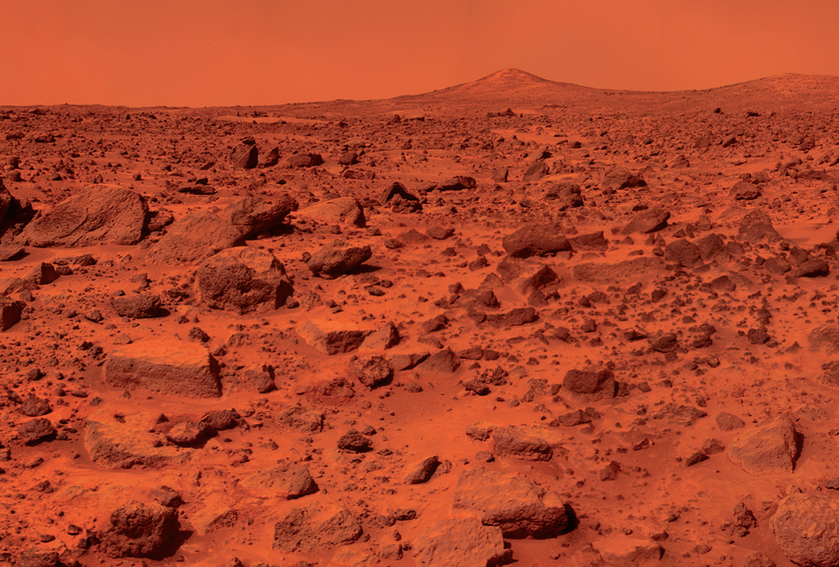

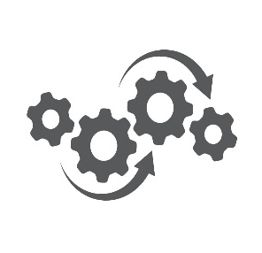


Program Impacts
People: Inspiring a Workforce for NASA and the Nation
Engages NASA workforce into implementation of innovative solutions
Invite experts outside of NASA to push State of the Art
Develop entrepreneurs for space and earth applications
Technology: Accelerating Development/ Raising the Bar
Promote technical exchanges
Advance the nation’s capabilities/solving complex technology needs
Demonstrate a variety of technology solutions
Innovation: Involving the Nation
Involve non-traditional participants; paying only for success
Combine expertise across diverse disciplines
Foster commercial applications among participants
Communication: Reaching the Public
Engage communities in NASA missions
Communicate NASA’s message to industry and the public
Garner media attention for NASA and participants

Slide 20
Centennial Challenges Impacts
SPACE CENTER HOUSTON – ALLIED ORGANIZATION, NASA Space Robotics Challenge
Reason for partnering on the challenge: To grow and expand current student robotics programs; establish a presence in the growing Space Economy in Houston; continue to strengthen the relationship with NASA
Resulting Benefit and Proudest Moment: Supporting the NASA Challenge was a game-changer for SCH. Learnings were directly used to drive new strategies and approaches for student engagement and competitions through an Innovation Gateway community science initiative; Positioned SCH to partner with the Conrad Foundation on the Conrad Entrepreneurship Competition.
CATERPILLAR - CHALLENGE SPONSOR, NASA 3D-Printed Habitat Challenge
Reason for sponsoring the challenge: To be at the forefront of something that could disrupt the construction industry
Resulting Benefits: Able to enhance the company’s understanding of 3D printing; Received significant publicity given their association with NASA; Allowed Caterpillar to turn the public lens toward the innovation aspect of their company
ICON – COMPETITOR TEAM, NASA 3D-Printed Habitat Challenge
“Participating in the NASA's 3D Printed Habitat Centennial Challenge was one of the more catalytic experiences that ICON has gone through as we continue to develop what we believe will be a paradigm shifting technology. This program has been a model for what it can look like for large government agencies to engage innovative private-sector enterprise in serious work. Our company is better for having participated in the Centennial Challenge.”
- Jason Ballard, CEO, Co-Founder, ICON
DEPARTMENT OF ENERGY – Phase 1 Judge, NASA CO2 Conversion Challenge
“One of the hardest problems you have given the community…these proposals are among the cream of the crop we have ever seen.”

Slide 21

Centennial Challenges
Centennial Challenges
Strive to be audacious and inspirational with a focus on long-range NASA missions and goals.
Seek to identify, develop and demonstrate novel technologies that have the potential to push boundaries while positioning NASA as an innovative thought leader.
Supported by the collaboration of internal subject matter experts alongside external experts from aerospace and beyond.
Focus on NASA’s needs and also potential terrestrial applications and opportunities for the betterment of the nation and the world.
NASA in-house staff at MSFC directly lead and manage the ideation, development and execution of the competitions.
Utilize a hands-on grassroots approach to identify and cultivate diverse communities of potential competitors, participants, partners and other stakeholders who will continue to engage with and develop the demonstrated technologies after the competition ends.
Strategic Challenges
Multi-Year, Multi-Million-Dollar Challenges Designed to Incentivize Development and Demonstration of Complex, High-Risk, High-Impact Solutions
What you can get:
Solutions to Complex Problems
Technology Advancement
Industrial/Startup Base Formation
Demonstrated Solutions to Previously Unsolved Problems

Slide 22
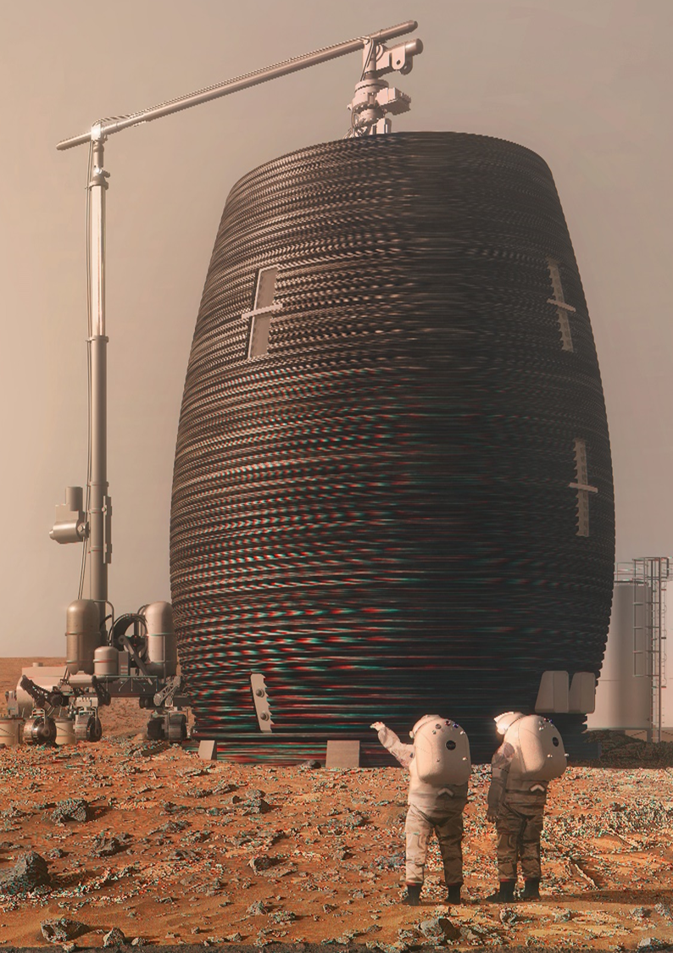

3D-Printed Habitat Centennial Challenge
60 Teams Competed • $2.06M Awarded
Lead Centers: MSFC & KSC
Build a habitat-like structure using 3D printing technology and materials found on the surface of Mars in order to advance the technologies available for future long duration missions.
IMPACTS
Successful demonstration of safe and innovative new material compositions for 3D printing pressure vessels on a large scale with application to NASA missions and Earth construction.
Demonstration of processes and equipment for large-scale vertical autonomous construction.
Diversity/innovation in viable designs of realistic planetary Habitats.
Innovative use of modeling software common to the construction industry as a more comprehensive design tool than the software commonly used by the aerospace industry for Additive Manufacturing technologies.
Demonstration of new software and control algorithms for depositing material in a non-two-dimensional layer.
Several new businesses developed and advanced.
Additional NASA contracts and demonstrations:
  CHAPEA analog (HEOMD)
  MMPACT (STMD, GCD, SBIR Ph3) for a first demonstration mission (DM-1) in 2026
  ACO contract (KSC) to work on polymer-based concretes
  2022 MSFC CAN to look at fabrication technologies for outfitting of habitats
after construction on the Moon
What will home look like…on Mars?

Slide 23

Vascular Tissue Centennial Challenge
22 Teams Competed • $400,000 Awarded
Lead Center: AMES
Produce an in vitro vascularized tissue that is > 1 centimeter in thickness in all dimensions at the launch of the trial and maintain >75% survival of the required parenchymal cells throughout a 30-calendar day period.
Teams were also tasked to complete 3 successful trials.
IMPACTS
Two teams from WFIRM won first and second place for their successful demonstrations of vascularized liver tissue
The successful virtual judging process demonstrated how “LiveScience” can be utilized in future Challenge and grant making opportunities.
Relationships developed with other government agencies, are leading to additional NASA collaborations.
Several small start-ups developed and significantly evolved via VTC.
The VTC Allied Organization, Methuselah Foundation, established follow-on prize to continue pushing the technology.
As of May 2020, research uncovered it was “one of its kind” in the world.
The capability to vascularized tissues has been noted as the
"holy grail" of tissue engineering.
CASIS will fly the winning solutions to ISS for further research
Infusion into potential LEO Commercial contract through Allied Org,
if CASIS flight is successful.
What if space held the key to revolutionizing medicine for better health?
Notes:
Conducting the virtual judging process created a great opportunity to learn how “LiveScience” can be utilized in future Challenge and grant making opportunities.
Relationships developed with other government agencies, especially DoD, DARPA, VA, NIH and NSF are leading to other NASA collaborations among the ISS National Lab, Human Research Program, and the SMD/Biological and Physical Sciences Division, Translational Sciences.
Several small start-ups, such as Volumetric- acquired in 2021 for $400M, were developed and significantly evolved via VTC. Volumetric is now on the cover of Science Magazine
The VTC was such a success that the Methuselah Foundation established a Tissues on a Chip prize and conversations for collaboration have been initiated with NASA SMD, NIH, NCATS, FDA, and BARDA
As of May 2020, research uncovered it was “one of its kind” in the world, (volume, duration, and production of key metabolites simultaneously).
The capability to vascularized tissues has been noted as the "holy grail" of tissue engineering.

Slide 24

Watts on the Moon Centennial Challenge
2 Phases • 47 Teams • $5,000,000 Prize Purse
Lead Center: GRC
Incentivize new solutions for electrical and thermal energy distribution, management, and storage that address NASA technology needs and can progress toward flight readiness and future operation on the lunar surface.
COMPETITION IN-PROGRESS
Phase 1 awarded a total of $500,000 to 7 teams with top design concepts.
Phase 2, Level 1 awarded $200,000 each to 7 teams who submitted successful concepts for transmission and storage of energy on the lunar surface.
Phase 2, Level 2 will allow winners from Level 1 to demonstrate their concepts to judges in the spring of 2023. Up to 4 teams will receive a prize of $400K each and can advance to Level 3.
Phase 2, Level 3 requires teams to test a full scale model in a vacuum chamber at Glenn Research Center. First place will receive a 1M Prize Purse with second place receiving $500K.
Maximizing system efficiency and minimizing system mass will be important.
The challenge seeks advanced technologies that are well-positioned to progress toward flight readiness and future operations on the lunar surface.
What if sunrise was 350 hours away?

