Slide 1

Improvements to the
LAURA Mesh Adaptation
Algorithm
Kyle Thompson, Adam Wise, Brian Hollis, and Andrew Hinkle
NASA Langley Research Center, Aerothermodynamics Branch
AIAA Aviation Forum, June 12-16 2023

Slide 2
Background
Langley Aerothermodynamic Upwind Relaxation Algorithm
  Structured multiblock 2nd-order finite-volume solver
  Reacting flow solver, with ablation and radiation modeling
  Automated mesh adaptation and shock alignment
  Version 5.x series written in Fortran95 with MPI
  LAURA includes ray-tracing capabilities

Slide 3
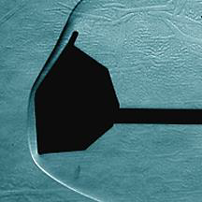
Entry, Descent and Landing Applications
Entry, Descent and Landing (EDL) applications involve simulating vehicles in hypersonic conditions with
  strong bow shock
  thin boundary layer
  large wake region
Flow Direction
Mars Entry Vehicle Schlieren

Slide 4
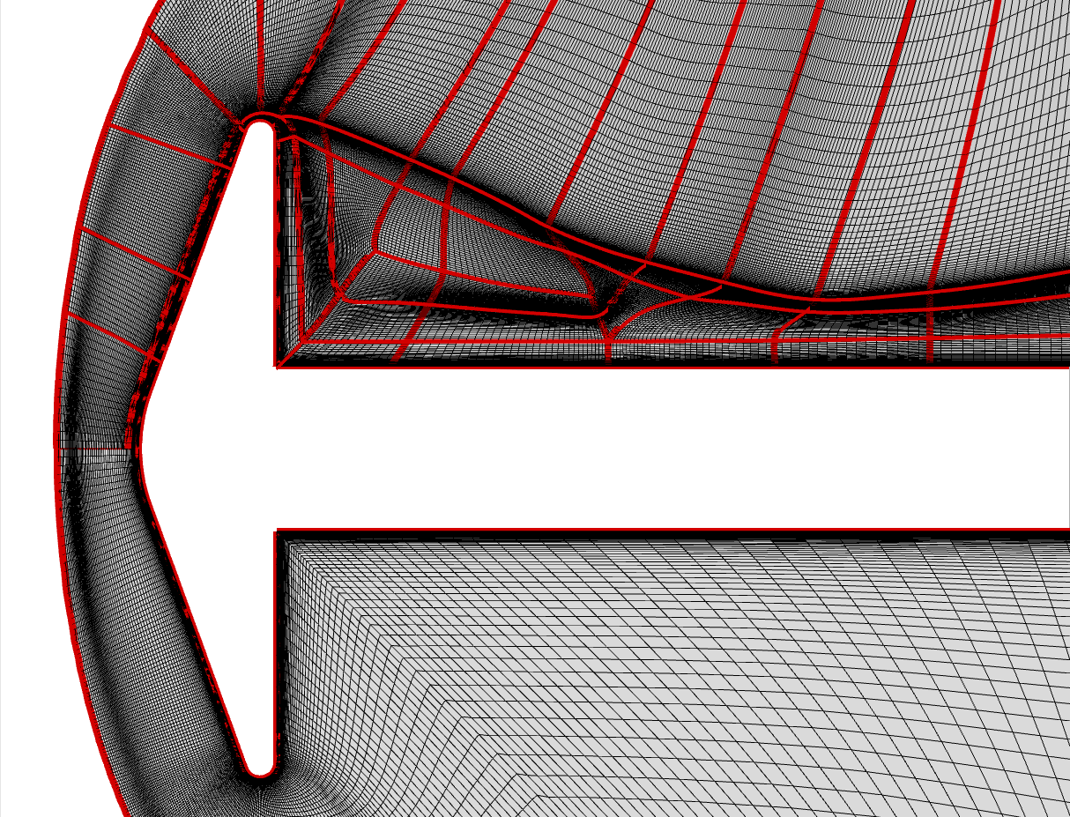
Motivation
We want to grid this
But LAURA adaptation algorithm requires this
❌ grid lines span multiple blocks
✅ grid lines span domain
Notes:
Clarify what coupling the forebody and wake means.

Slide 5
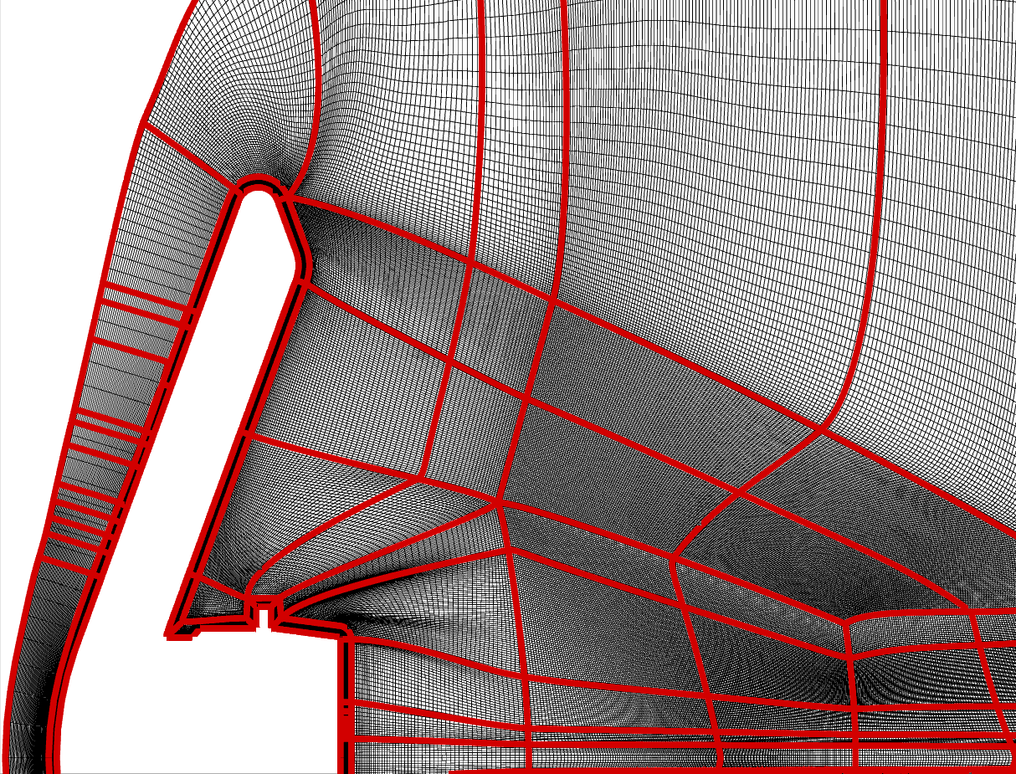
Motivation
Early use case: Low-earth Orbit Flight Test of an Inflatable Decelerator (LOFTID) vehicle aft-side heating
  Very difficult or impossible to generate a point-matched multiblock structured grid on complex vehicle geometry
  Difficult to decouple the forebody and wake regions with lines spanning domain
  Need a way to target near body adaptation separately from shock-alignment
Stacked Block Grid for LOFTID Vehicle
Notes:
Clarify what a HIAD is, give better context on what LOFTID is.

Slide 6
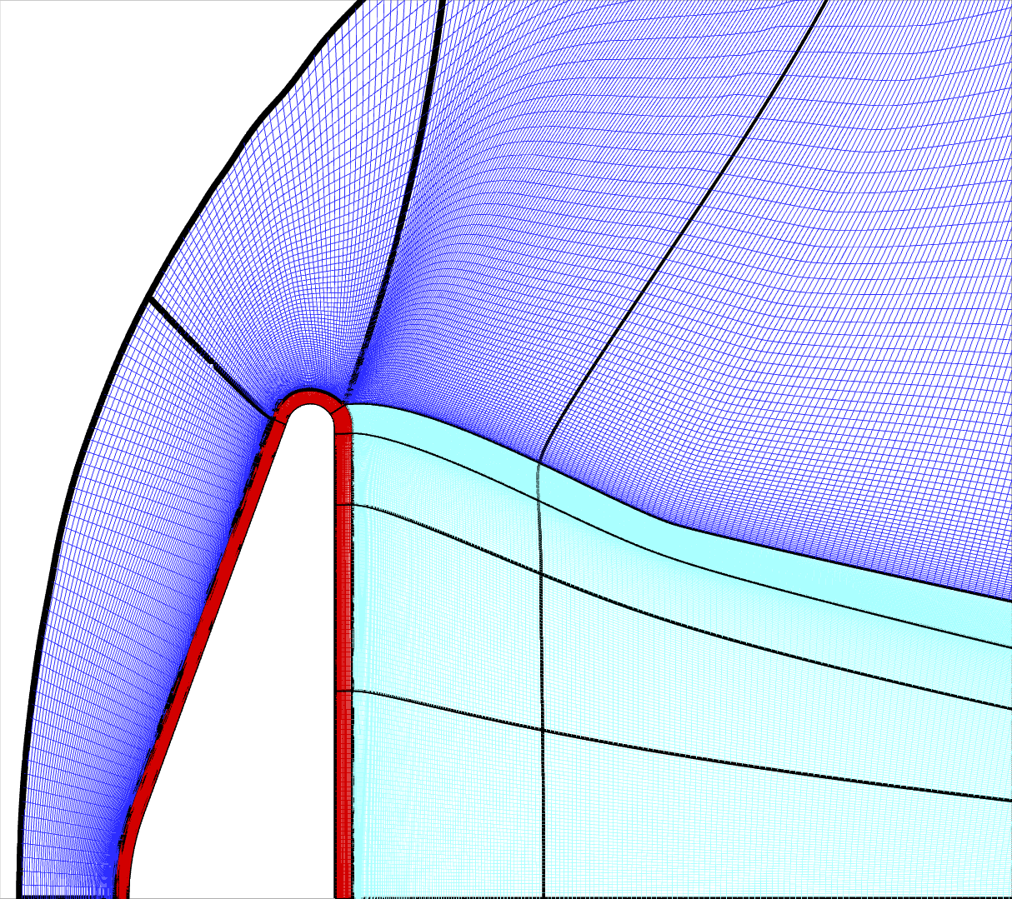
Structured Grid Adaptation Enhancements
‘Stacked’-block structured grid; Connectivity is more complicated than a simple stacking.
  Previous LAURA adaptation required grid lines spanning the domain from surface to outer grid boundary
Core principle: apply different adaptation algorithm based on block classification
  Blue: shock-align the grid and possibly cluster near the shock
  Red: Cluster points near surface to resolve boundary layers
  Teal: No adaptation performed
Stacked-block structured grid decouples forebody grid from wake region grid
  New adaptation method is enabling when it is impossible to build a structured mesh that conforms to the conventional LAURA grid adaptation requirements
Shock Alignment Region
No Adaptation
Near-wall Region
Notes:
Mention that the block boundaries don’t move (on the top and bottom)
Blue: outer boundary moves and sides move
Red: only sides move
Teal: nothing moves

Slide 7
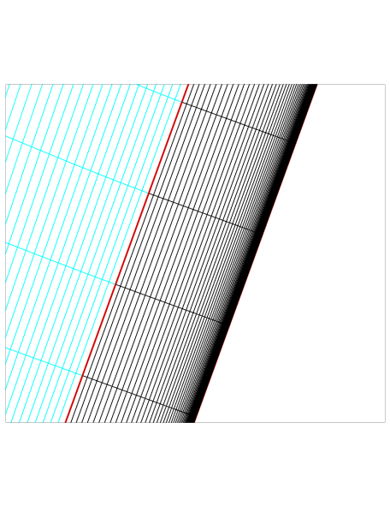
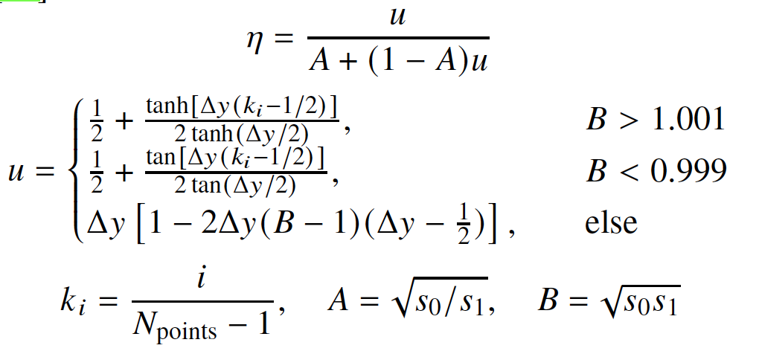
Near-wall Adaptation
Spacing determined by initial mesh
Spacing determined by target cell Reynolds number
Near-wall region block
Vinokur’s two-sided stretching function
Points redistributed via two-sided stretching function of Vinokur¹
  Wall spacing determined by a user-specified target cell Reynolds number
  Final spacing determined by initial mesh, to allow reversibility
¹Vinokur, M., “On one-dimensional stretching functions for finite-difference calculations,” Journal of Computational Physics, Vol. 50, No. 2, 1983, pp. 215–234.

Slide 8
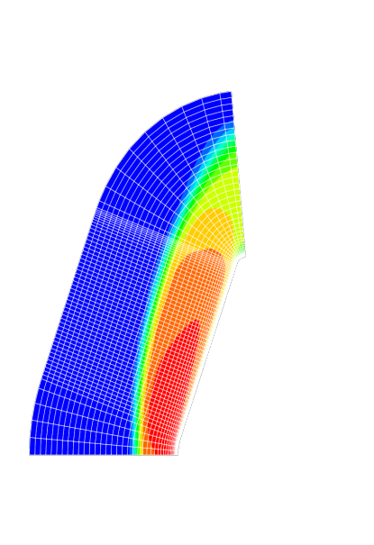
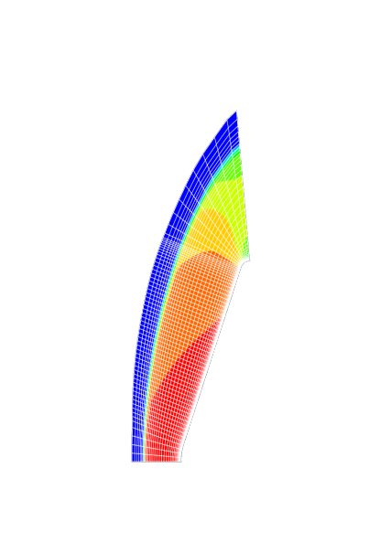

Shock Alignment
Points moved along body-normal, piecewise-linear lines after rescaling total line length to match a target shock arc length
  Distributed using a geometric growth rate, determined by a Newton solve
  Initial spacing along line left unchanged to ensure reversibility
Original mesh
Adapted mesh

Slide 9
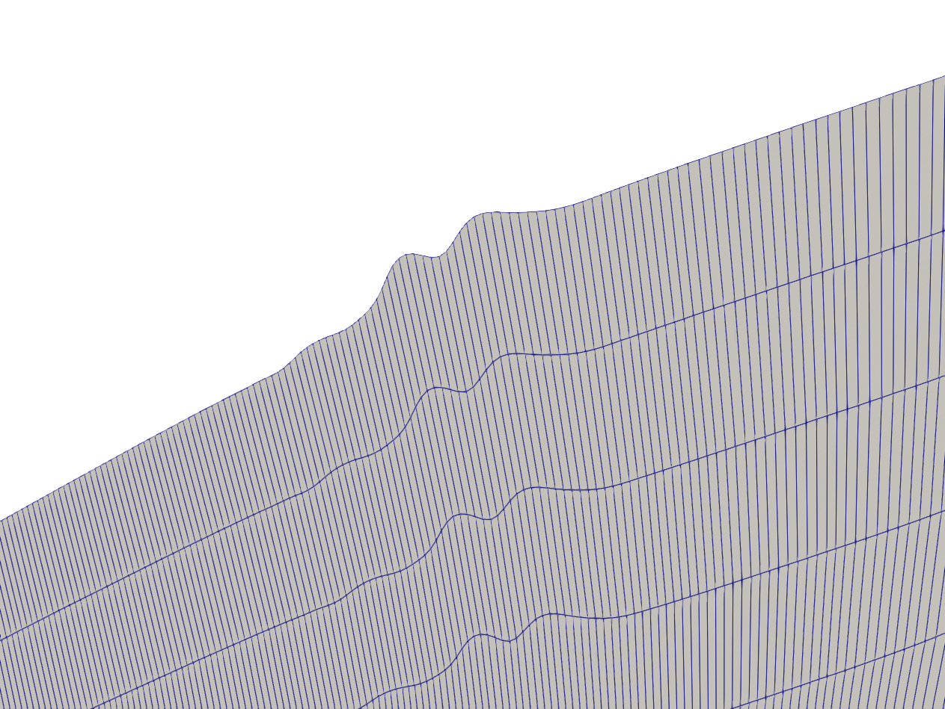
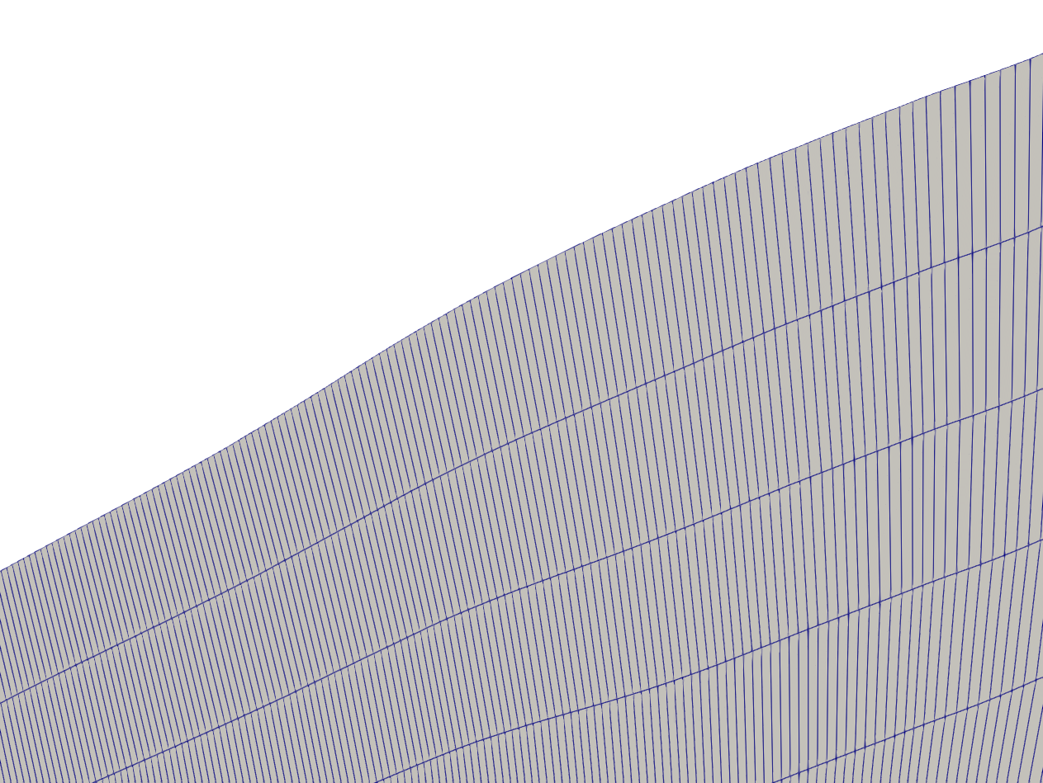
Smoothing Outer Domain Boundary
Before Taubin Smoothing
After Taubin Smoothing
Taubin¹ smoothing applied to line length scalings to smooth outer domain boundary during shock alignment
¹Taubin, G., “Curve and surface smoothing without shrinkage,” Proceedings of IEEE International Conference on Computer Vision, 1995, pp. 852–857.

Slide 10
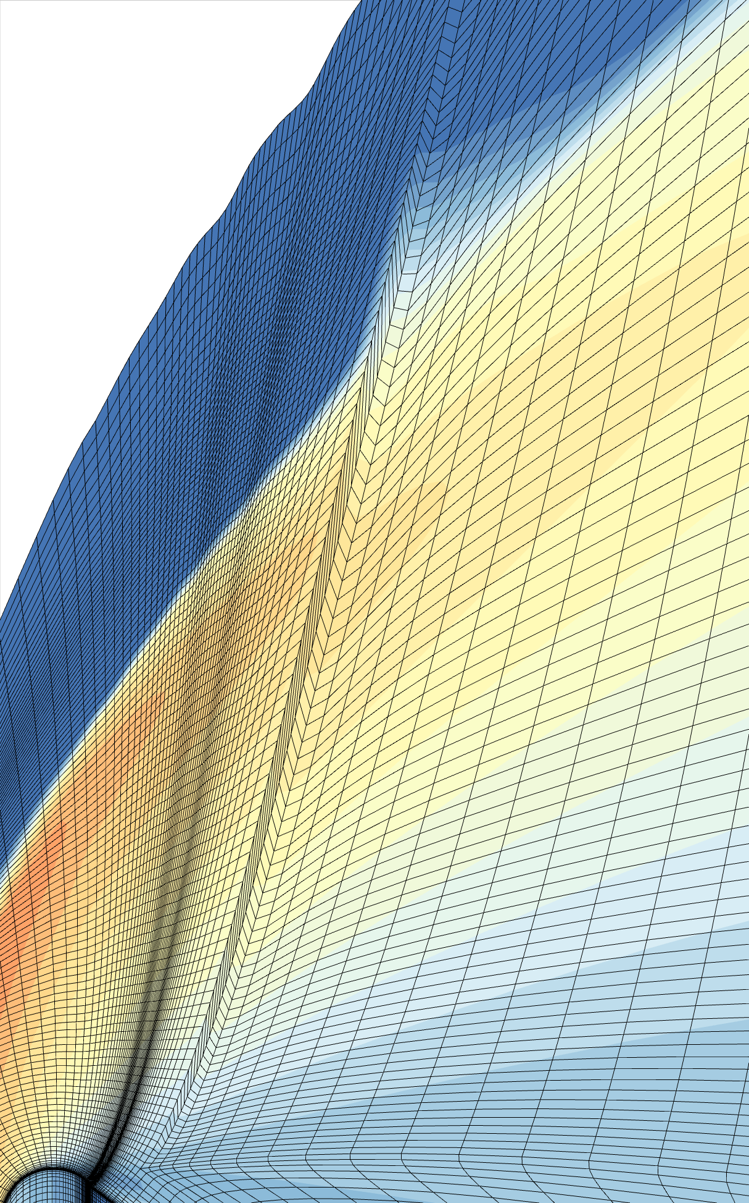
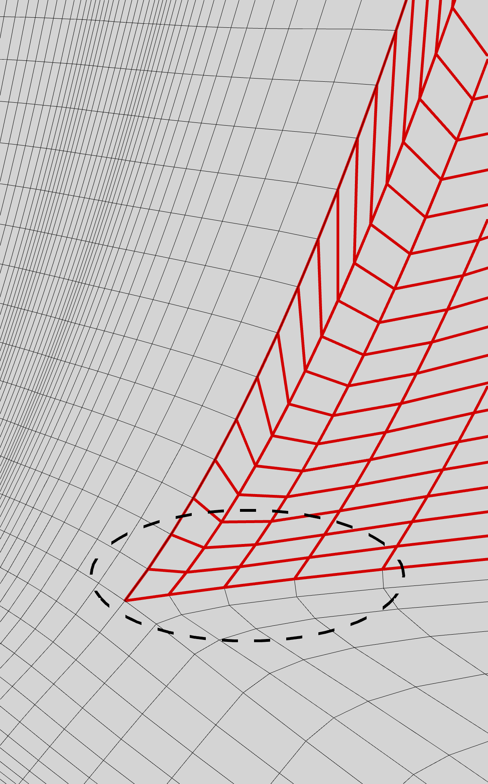
Post-Adaptation Grid Skewness Issue
Example of breakdown of the adaptation algorithm
  Irregular initial spacing causes large variation in the geometric growth distribution functions
  Common occurrence when grid is generated using a smoothing technique
Example of skewness introduced by adaptation
Cause: Irregular cell spacing at base of block

Slide 11
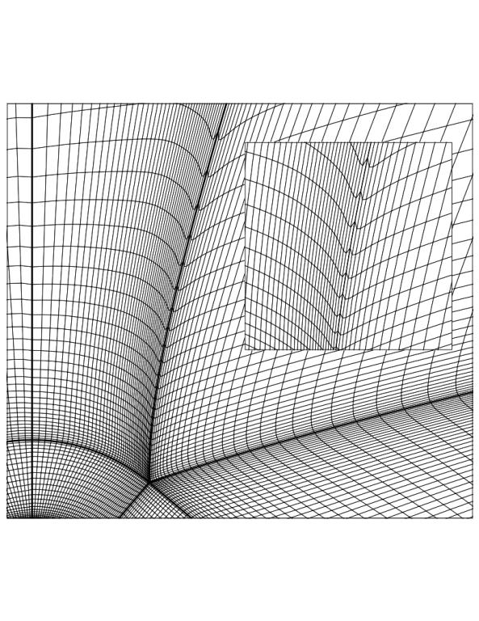

Post-Adaptation Grid Skewness Correction
Without bilinear interpolation
With bilinear interpolation
Solution: use bilinear interpolation to smooth the initial spacings

Slide 12
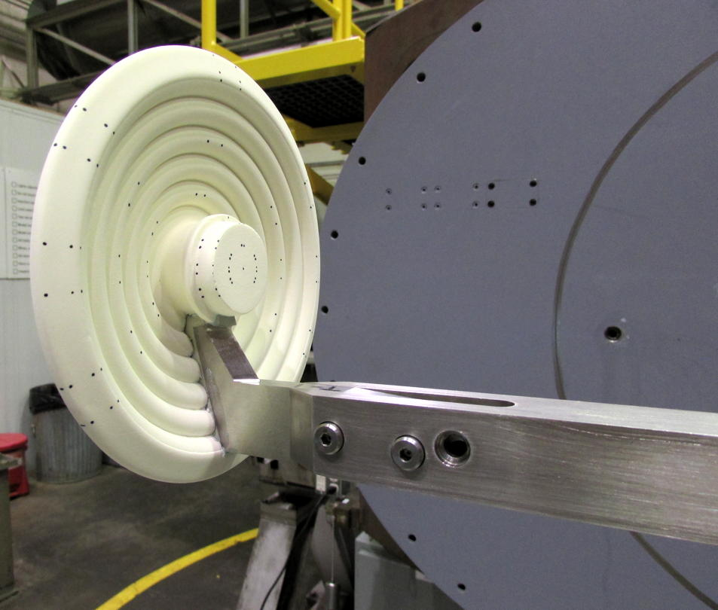
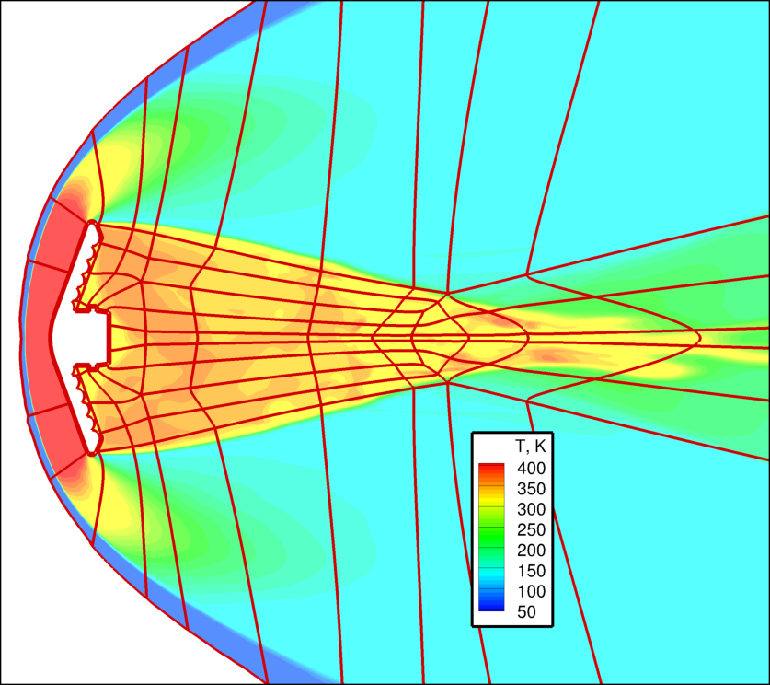
Demonstration Case: LOFTID Wind Tunnel Test
LOFTID toroidal shape and adapter ring necessitated a stacked block topology
  Aeroheating data were obtained using global phosphor thermography in the 31-Inch Mach 10 Air Tunnel of the NASA Langley Aerothermodynamic Laboratory (LAL)
Block topology and temperature contours
Wind tunnel model [Credit: NASA]
Notes:
The uncertainty is relatively higher due to viewing angle AND the low heating level. The phosphor technique is not calibrated for the low heating levels (low signal-to-noise)

Slide 13
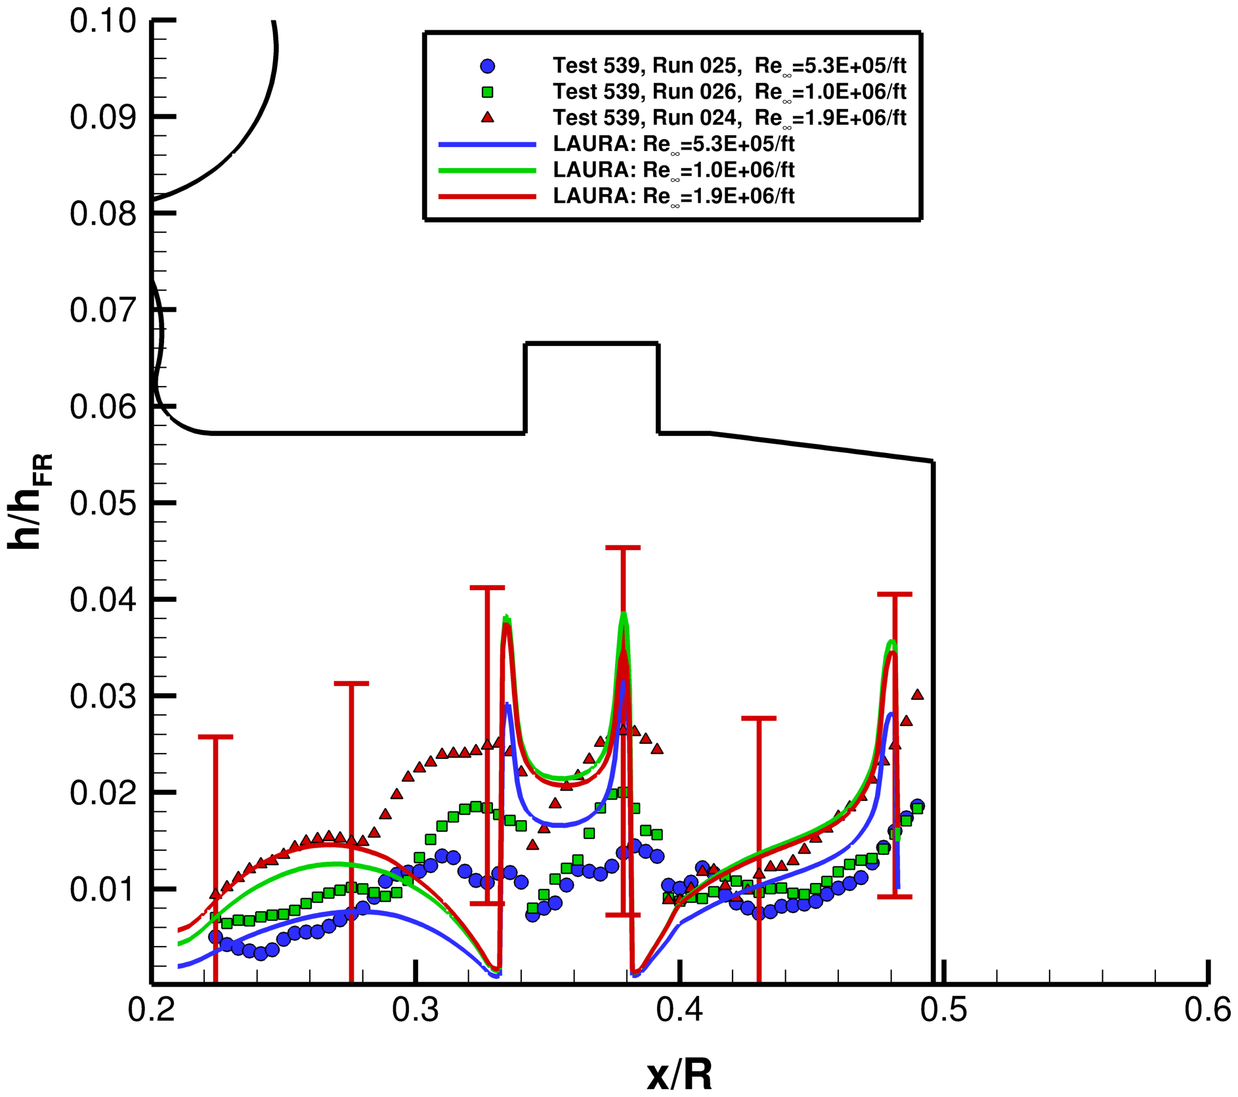
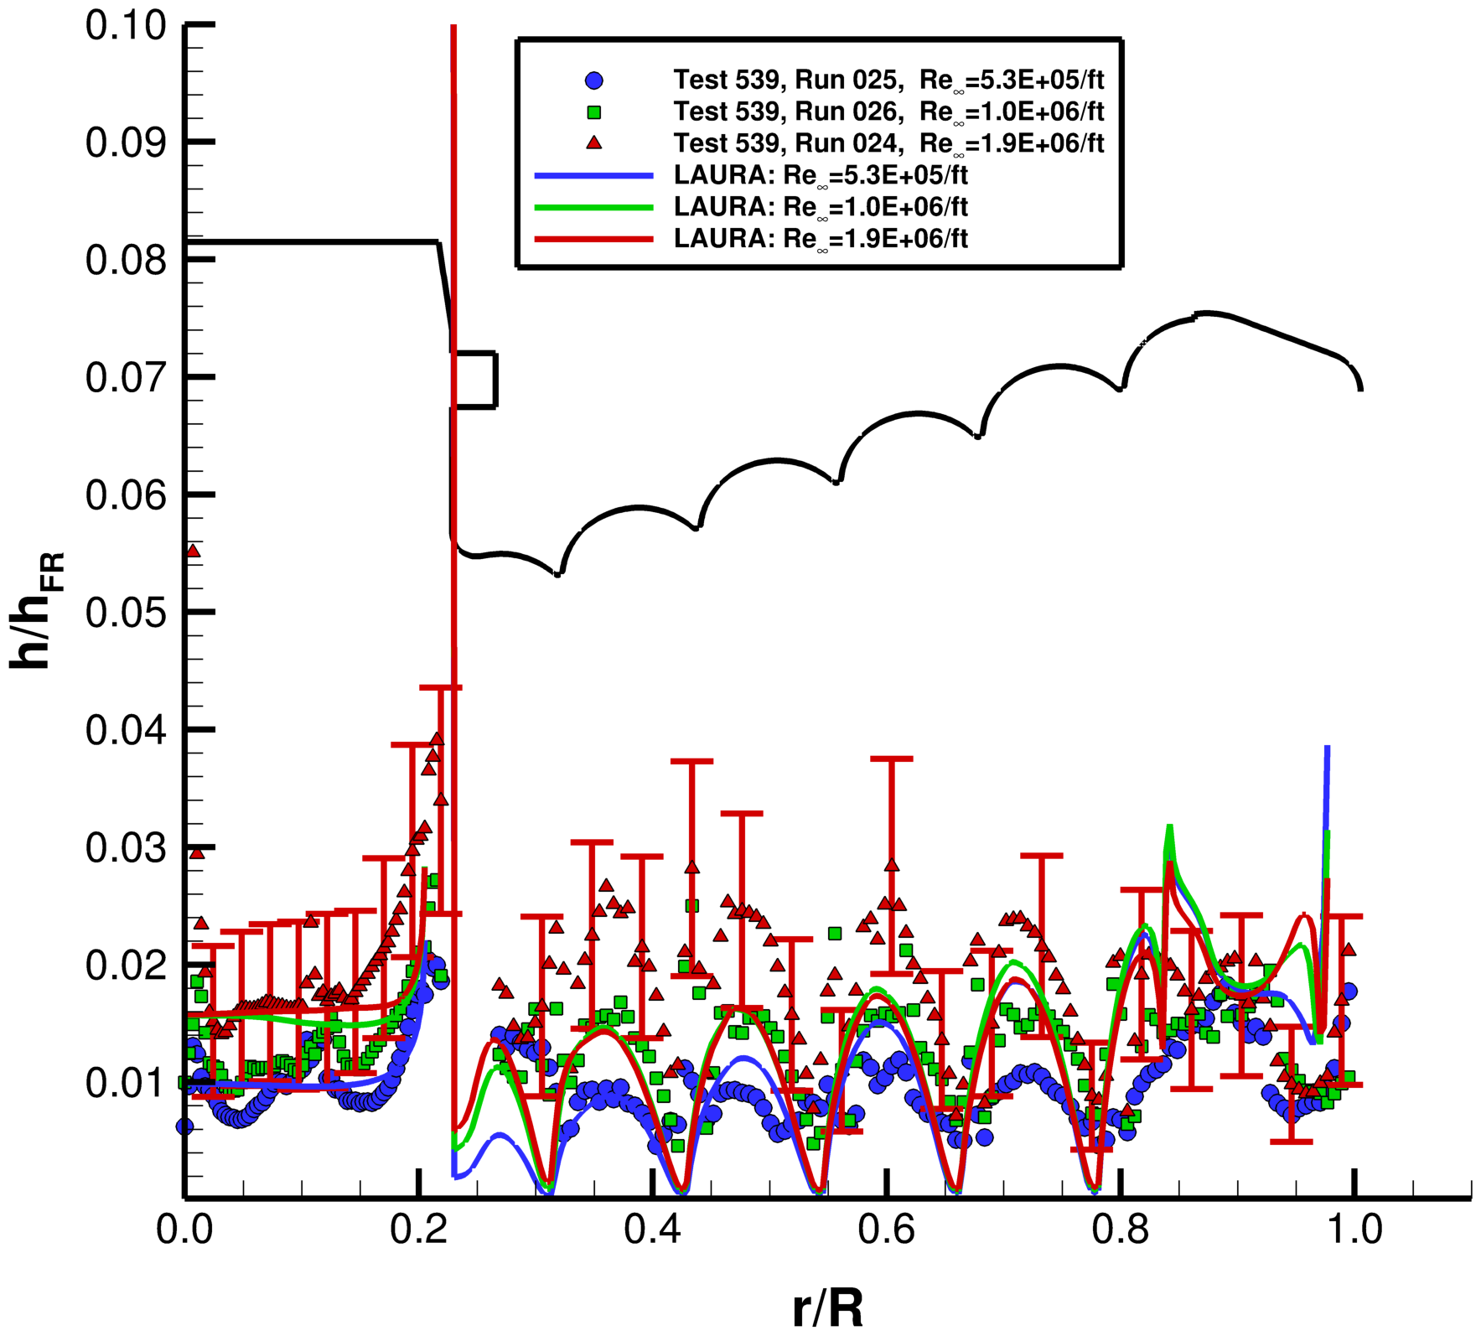
Demonstration Case: LOFTID Wind Tunnel Test
Wind tunnel model [Credit: NASA]
Centerbody Payload
Aeroshell Backface
LAURA predictions mostly within experimental uncertainty
  Larger than usual experimental uncertainty due to viewing angle and low heating on backface
  Discrepancies at toroid peaks at high Re condition can be explained by the growth in turbulence in the separated wake shear layer (all LAURA solutions were laminar)
Notes:
Add the picture of the model to this slide
Direct focus that this was enabling.

Slide 14
Summary
LAURA mesh adaptation capability enhanced to remove restriction that body-normal lines must span the domain
  Planned to be released in next version of LAURA
Specialized algorithms implemented for near-wall blocks and blocks to be aligned with the bow shock
  Bilinear interpolation used to correct skewness issue
Stacked block topology is enabling for meshing complex vehicle geometries, particular in cases with wake regions
  LAURA aft-side heating predictions compare favorably with LOFTID wind tunnel experimental data, demonstrating the efficacy of the new stacked block mesh adaptation capability

Slide 15
Acknowledgments
The authors would like to thank the Entry Systems Modeling Project within the NASA Game Changing Development Program, Space Technology Mission Directorate for their funding and support
The authors would like to thank Dr. Cameron Druyor for his help designing and implementing early versions of the stacked block adaptation algorithm
The authors would also like to thank Dr. Alireza Mazaheri and Victor Lessard for helpful discussions involving structured mesh adaptation and general LAURA capabilities in past versions of the code

