Slide 1
PolCube Tech Demo Status
Snorre Stamnes, PI
Vianni Ricano Cadenas, Deputy PI
Yongxiang Hu, Project Scientist
April 6, 2023

Slide 2
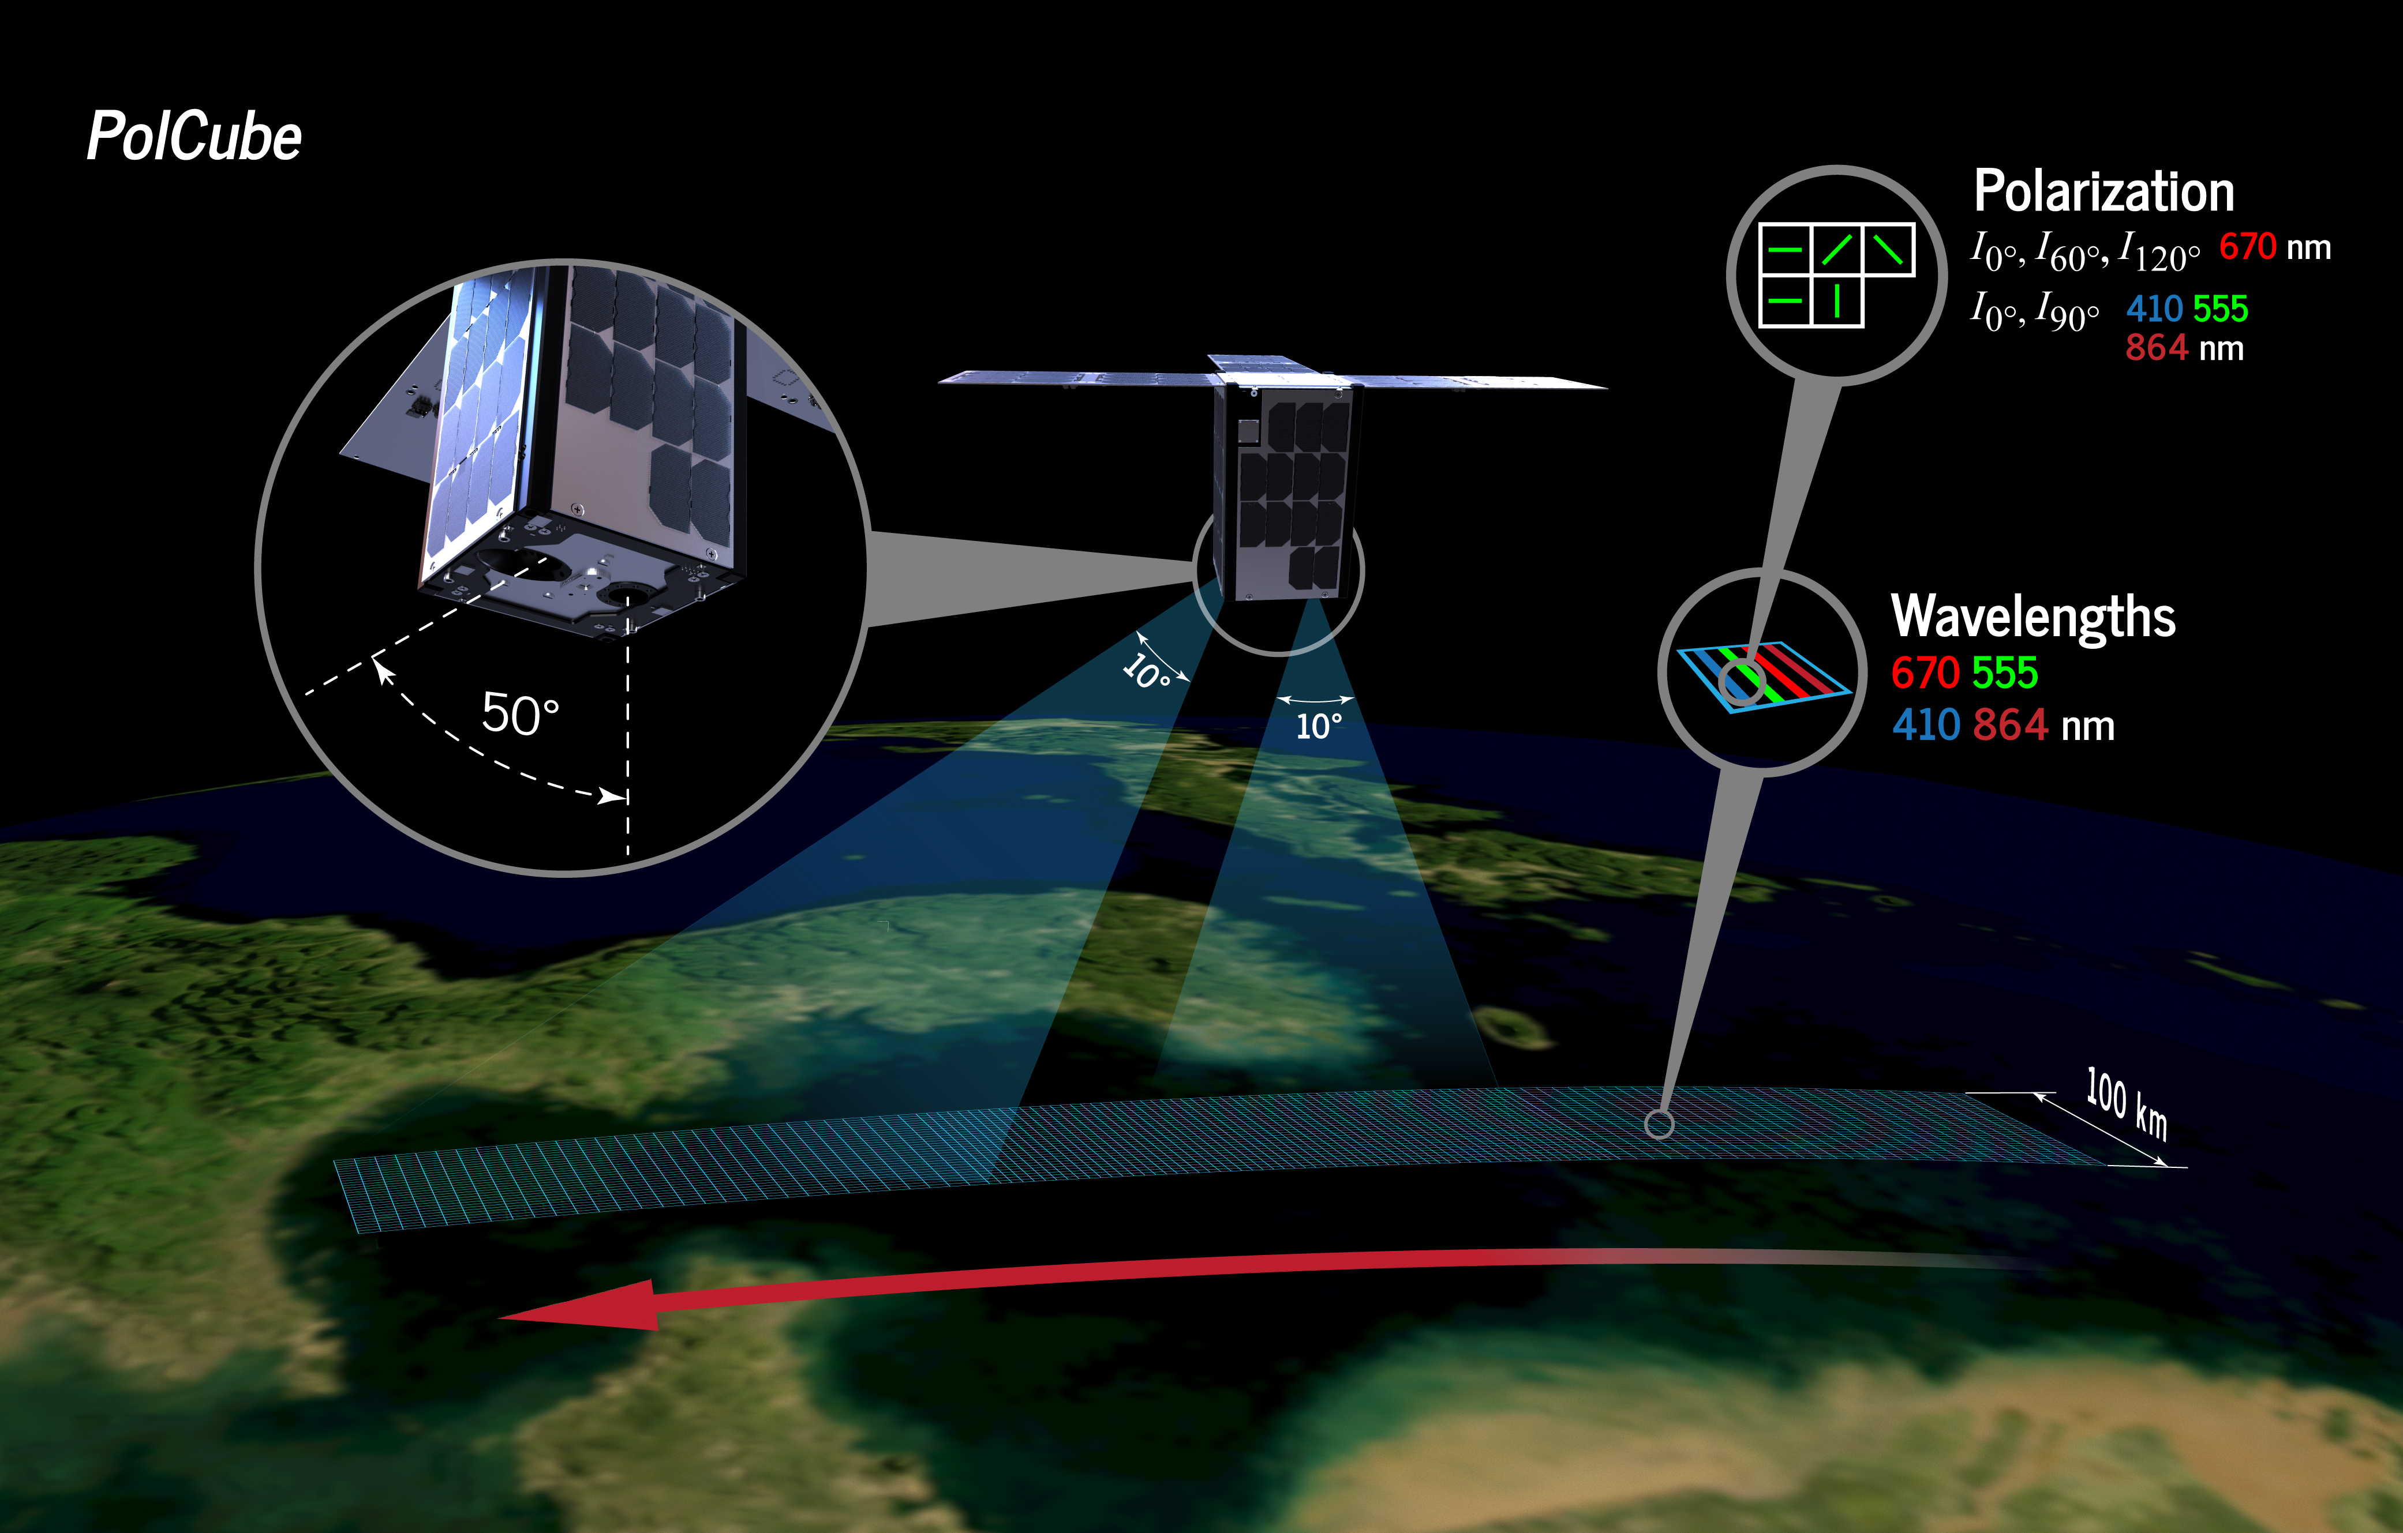
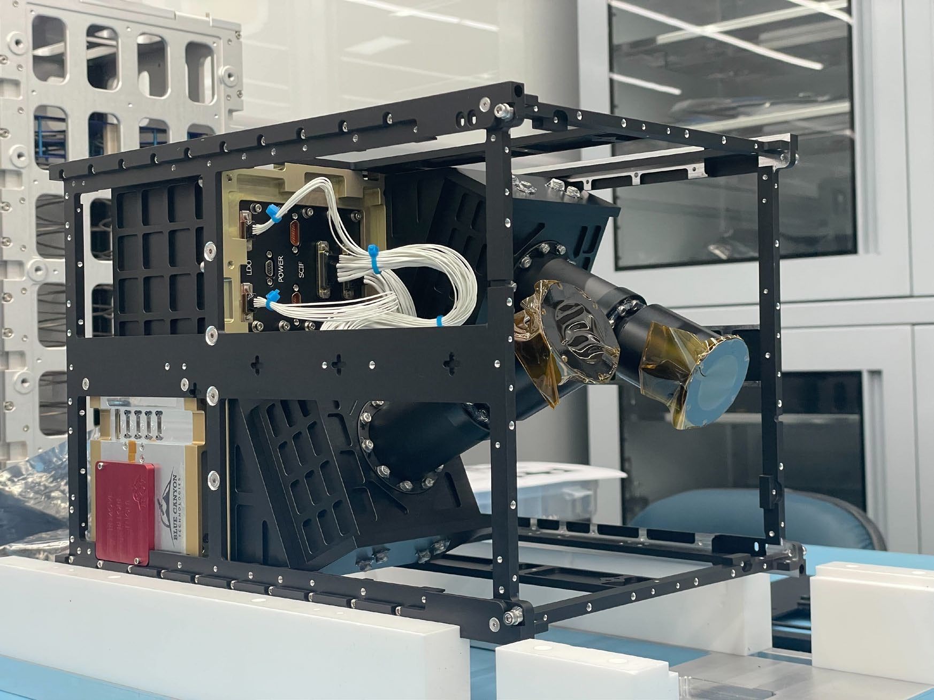
PolCube Overview
PolCube is a contributed, flight-ready instrument & spacecraft
  PolCube polarimeter instrument
  12U CubeSat bus
Collaboration between NASA Langley with the Korea Astronomy and Space Science Institute (KASI) for Earth Science
  Based on the PolCam polarimeter onboard the Korean Pathfinder Lunar Observatory (KPLO) launching in August 2022
Where we are now
  PolCube design finalized (Stamnes et al., 2021)
  MAPP polarimetry remote sensing algorithm initially designed for the NASA GISS Research Scanning Polarimeter (RSP) was selected for PACE polarimeters, AOS/A-CCP study
  The PolCube polarimeter instrument flight model is complete and finished environmental testing at the manufacturer in South Korea
  KASI plans to contribute the PolCube polarimeter instrument integrated into a CubeSat bus to NASA Langley (delivery in September 2023 timeframe)
  Collaborations with NASA GISS/GSFC and Hampton University (HBCU)
The PolCube 12U CubeSat
is built on heritage from the PolCam polarimeter on the KPLO lunar mission (NASA/South Korea)

Slide 3
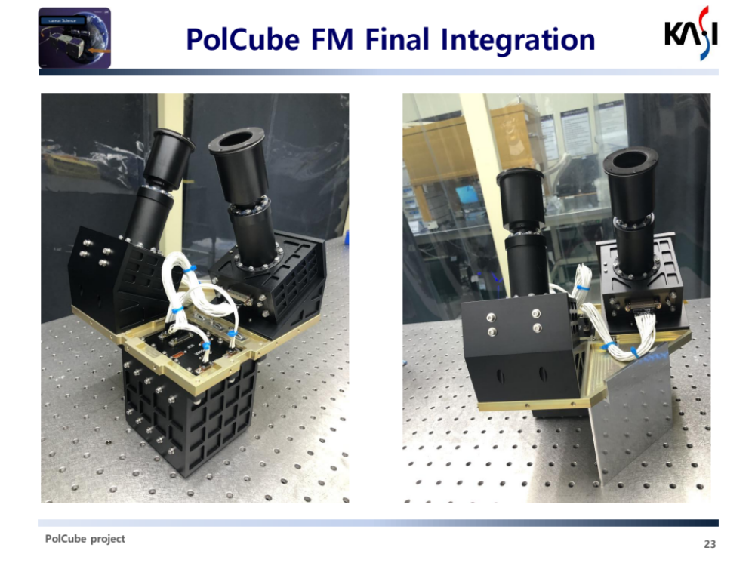
PolCube Value: AQ, AC, SK/HU partnerships
NASA Strategic Objective 1.1 - Understanding the Earth System and its Climate. Low-cost pathfinding science and applications expansions of air quality (AQ) and atmospheric correction (AC) using small pixel polarimetry together with lidar measurements, with a focus on coastal urban areas and green shipping corridors
NASA STEM Engagement Strategic Goal 2.0 – build a diverse future STEM workforce by engaging students in authentic learning experiences with NASA’s people, content and facilities. PolCube will educate the next generation of young scientists at Hampton University (HBCU) in polarimetric and lidar remote sensing, and artificial intelligence. PolCube will provide direct on-the-job training in spaceborne polarimetry for its early-career-led team.
PolCube will significantly strengthen our South Korean partnership in Earth Science, air quality (ASIA-AQ), and climate science. PolCube has heritage from PolCam, a polarimeter successfully observing the moon as part of the joint NASA-KARI Danuri mission. Busan City is heavily invested in the success of PolCube for monitoring of air quality, water quality, and supporting the technological development of its cubesat industry. Dr. Thomas Zurbuchen was personally briefed on PolCube by the President of KASI.
Investment in PolCube can reduce uncertainties in PACE air quality applications by studying how to upscale PACE’s coarse spatial resolution polarimeter data to PolCube’s fine spatial scale, will enhance the utility of lidar data by developing neural network methods that map polarimeter data to lidar cloud and aerosol profiles, and will lead to the availability of low-cost polarimetry for all future NASA missions. NASA Strategic Objective 1.3 – Ensure NASA’s Science Data are Accessible to All and Practical Benefits to Society.
PolCube Flight Model (courtesy of KASI)

Slide 4
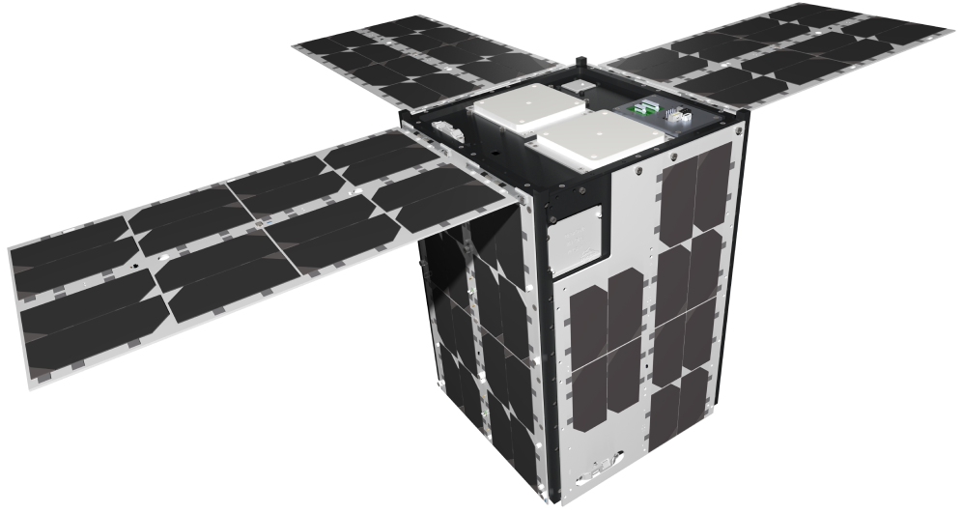
Comparison of PolCube and Planned NASA Instruments
 | PolCube (CubeSat) | HARP (CubeSat) | MAIA (hosted) | HARP-2 (PACE) | SPEXone (PACE)
Dynamic tasking | ✓ | ✓
Resolution (km^2) | ~0.3 x 0.3 | 3 x 3 | 1 x 1 | 5.2 x 5.2 | 5.2 x 5.2
Swath (km) | 100 | 900 | Select locations | 2400 | 100
Quantify global aerosol properties | ✓ |  |  | ✓ | ✓
AQ (Air Quality; PM2.5) | ✓ |  | ✓
Oceans / winds | ✓ | ✓ |  | ✓ | ✓
Low-cost | ✓ | ✓ |  | ✓
Early-Career PI/Team | ✓
Emphasizes exploration, disaster response | ✓
AI/deep learning | ✓ |  | ✓ | ✓ | ✓
PolCube is a contributed, flight-ready 12U CubeSat + polarimeter instrument
Low-cost pathfinding science and applications expansion of air quality
Significant polarimetric algorithm advances using HPC and AI/ML to address coupled atmosphere-ocean/land/cryosphere science
Notes:
PolCube falls in between HARP CubeSat and MAIA in that it has no moving parts and global coverage like HARP, but has very high spatial resolution for air quality like MAIA.
We have an early-career team, and we want to use AI/deep learning and cloud computing to reduce latencies, explore new phenomena, make new discoveries, and respond to natural disasters and current events across the US and the globe.

Slide 5







Organizations and Responsibilities
LaRC
Science and Data Products
International Framework Agreement
Launch Vehicle
Bus-Launch Vehicle AI&T
PolCube Instrument Calibration
Operations
Outreach
Space Act Agreement Polarimetry Annex
L3 Science and Data Products
L2 Value-added Science and Data Product Enhancements
PolCube Instrument
Science and Data Products
PolCube Instrument Calibration
Busan Metropolitan City
GSFC-GISS
12U BusanSat-B
PolCube Instrument Calibration
L2 Science and Data Products
Operations
Research and Analysis Program (Jack Kaye)
Radiation Sciences Program (Hal Maring)

Slide 6
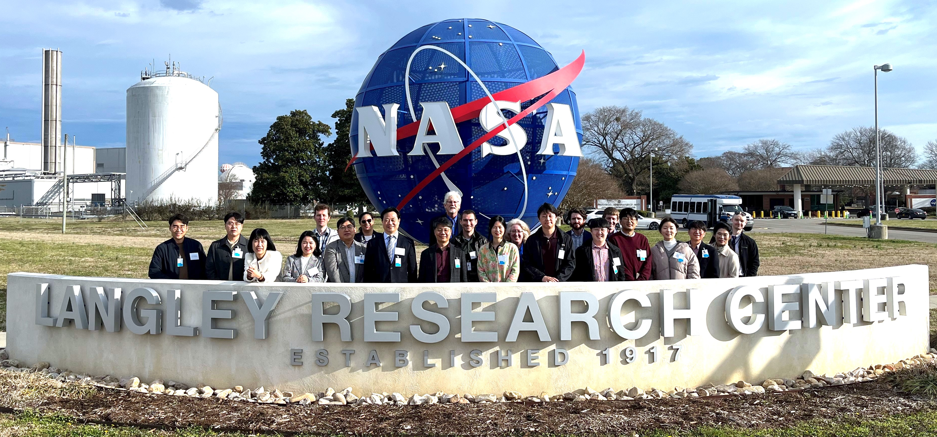
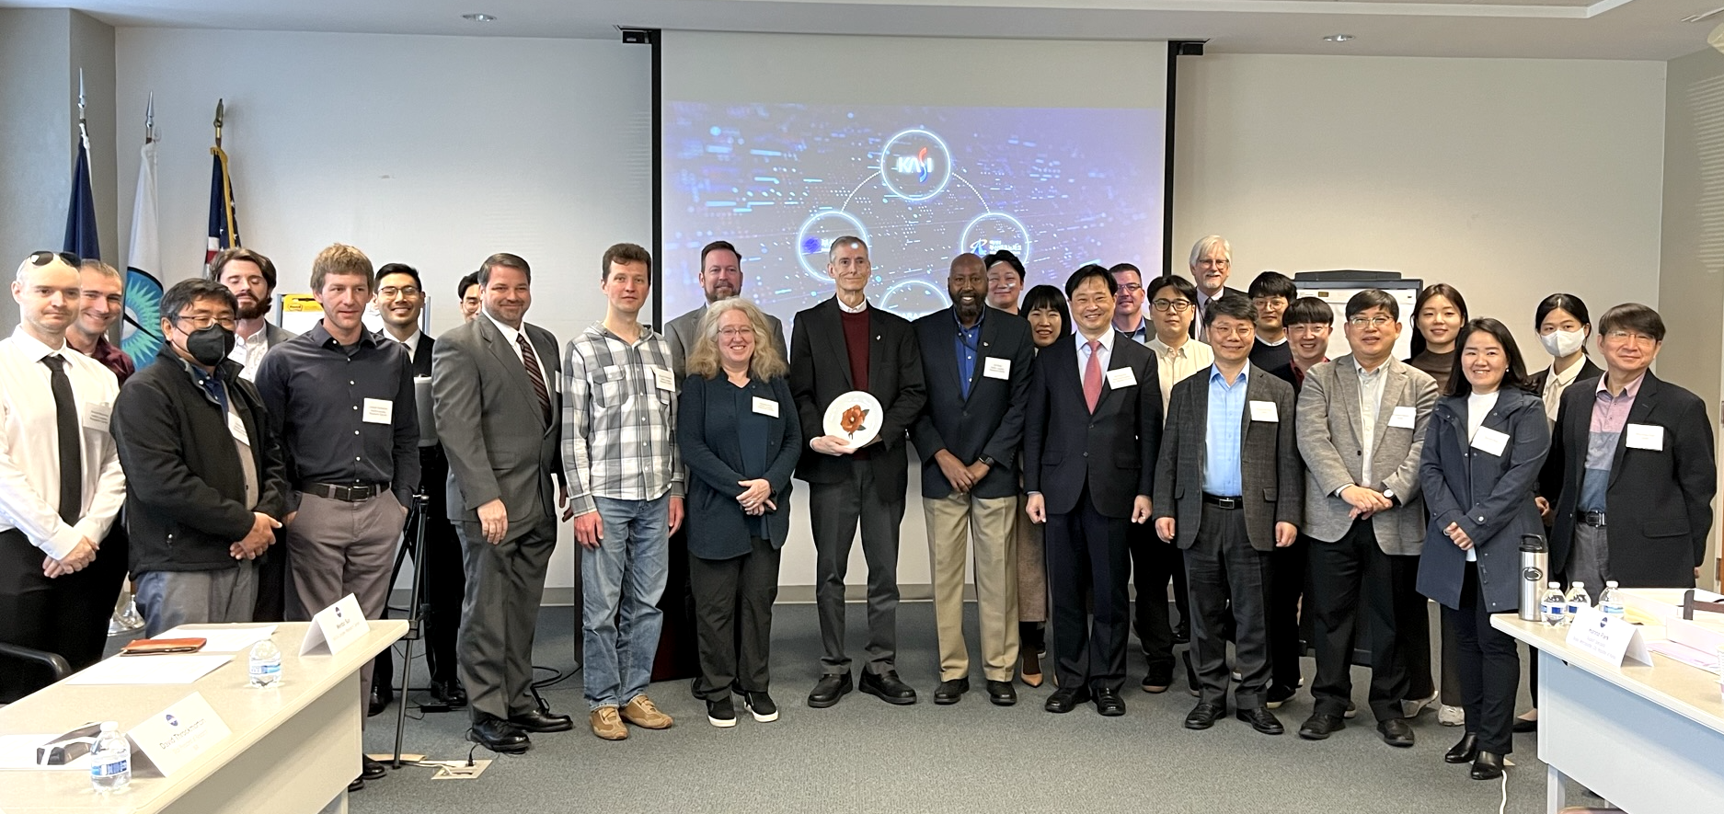
Technical Interchange Meeting – Feb. 14-16
The purpose of the Technical Interchange Meeting (TIM) was to obtain technical information necessary to develop the NASA foundational documents
Participating organizations: NASA LaRC, NASA ESTO, and 15 individuals representing Busan Metropolitan City, KASI, Busan TechnoPark, and Nara Space Technology
TIM discussions focused on the Spacecraft Review End Item Data Package (EIDP), PolCube Instrument Review End Item Data Package (EIDP), Spacecraft Contamination and Handling Requirements, Payload Integration and Testing, Instrument Calibration, NASA Launch Vehicle Selection Process (presented by KSC Rideshare Office), CONOPS, Science Data Management, and Algorithms

Slide 7
Science objectives and questions (provisional) | Scientific Measurement Requirements (GVs) | Instrument Functional Requirements (observables) [1-sigma uncertainty] | Investigation Functional Baseline Requirements | Modeling and Analysis Activities/Tools
Objective 1. Quantify air quality and aerosol and ocean product capabilities of PolCube. Question: How do PM2.5 and Na-CCN relationships depend on aerosol optical/microphysical properties? Deliverable: Improved PM2.5 and aerosol optical and microphysical and ocean products at fine spatial resolution of targeted disaster and gap areas across the Earth. | Aerosol optical and microphysical properties: fine-mode (0.08), sea salt (0.04), dust AOD at 555 nm (0.04); fine/sea salt/dust effective radius (0.06, 1.3, 1.2 um); aerosol top height (1.4 km); fine-mode SSA (0.036). Ocean products: wind speed (1.1 m/s) and chlorophyll-a concentration (2.4 mg/m^3). Quantify PM2.5 products. (Expected 1-sigma performance in parenthesis.) | Multispectral deep blue VIS-NIR, multiangle polarimeter measurements of the total radiance [2%] and degree of linear polarization [0.005] from PolCube. | 1. 3 months of PolCube polarimeter data in the ACTIVATE region 2. Collocated HSRL-2 and RSP data from the following airborne campaigns: ACTIVATE, ORACLES, NAAMES, and CAMP2Ex 3. Collocated CALIOP and POLDER-3/PARASOL data 4. Collocated airborne HSRL or satellite lidar data from ICESat-2 or EarthCARE for validation | PolCube-MAPP algorithm: Stamnes et al., 2018; Stamnes et al., 2021; Stamnes et al., 2023 (submitted)
Objective 2. Assess advanced AI remote sensing capability to retrieve lidar-like 3d aerosol and cloud properties for aerosol transport and atmospheric dynamics studies. Question: How well can we determine atmospheric motion using 2d maps of lidar-like vertical profiles of aerosol and cloud properties? Deliverable: 3-dimensional lidar-like aerosol and cloud properties of targeted areas across the Earth. | Vertically-resolved lidar-like backscatter and extinction Cloud top height, cloud top pressure, cloud optical depth, cloud motion vector, cloud top droplet effective radius | Same as Objective 1. Collocated POLDER-3/PARASOL and CALIOP cloud data Airborne RSP polarimeter data, subsetted to PolCube Collocated airborne HSRL-2 vertically-resolved extinction coefficient and lidar backscatter coefficient and depolarization |  | Hu et al., 2021 Stamnes et al., 2018b

Slide 8
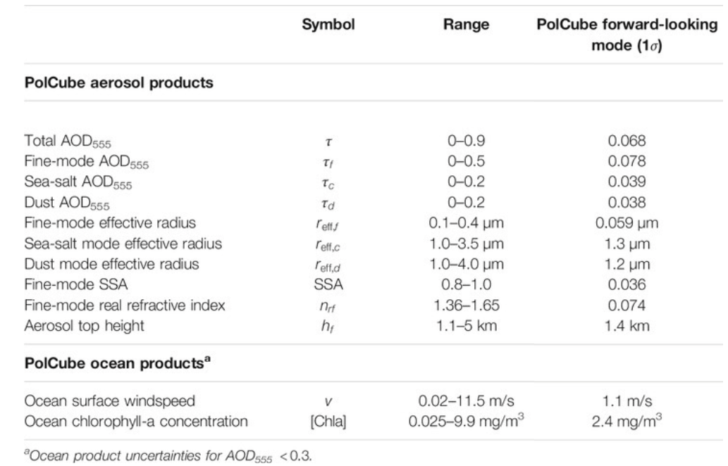
Our team is finalizing an algorithm that can create PolCube aerosol/cloud/AQ PM2.5 products..
Stamnes et al., 2021, Simultaneous aerosol and ocean properties from the PolCube CubeSat polarimeter. Frontiers in Remote Sensing, 2, p.709040
Briggs, Causey, Cawdery, Entner et al., 2022, Use of Satellite Polarimeter Observations in Air Quality Monitoring (University of Virginia Capstone paper)

Slide 9
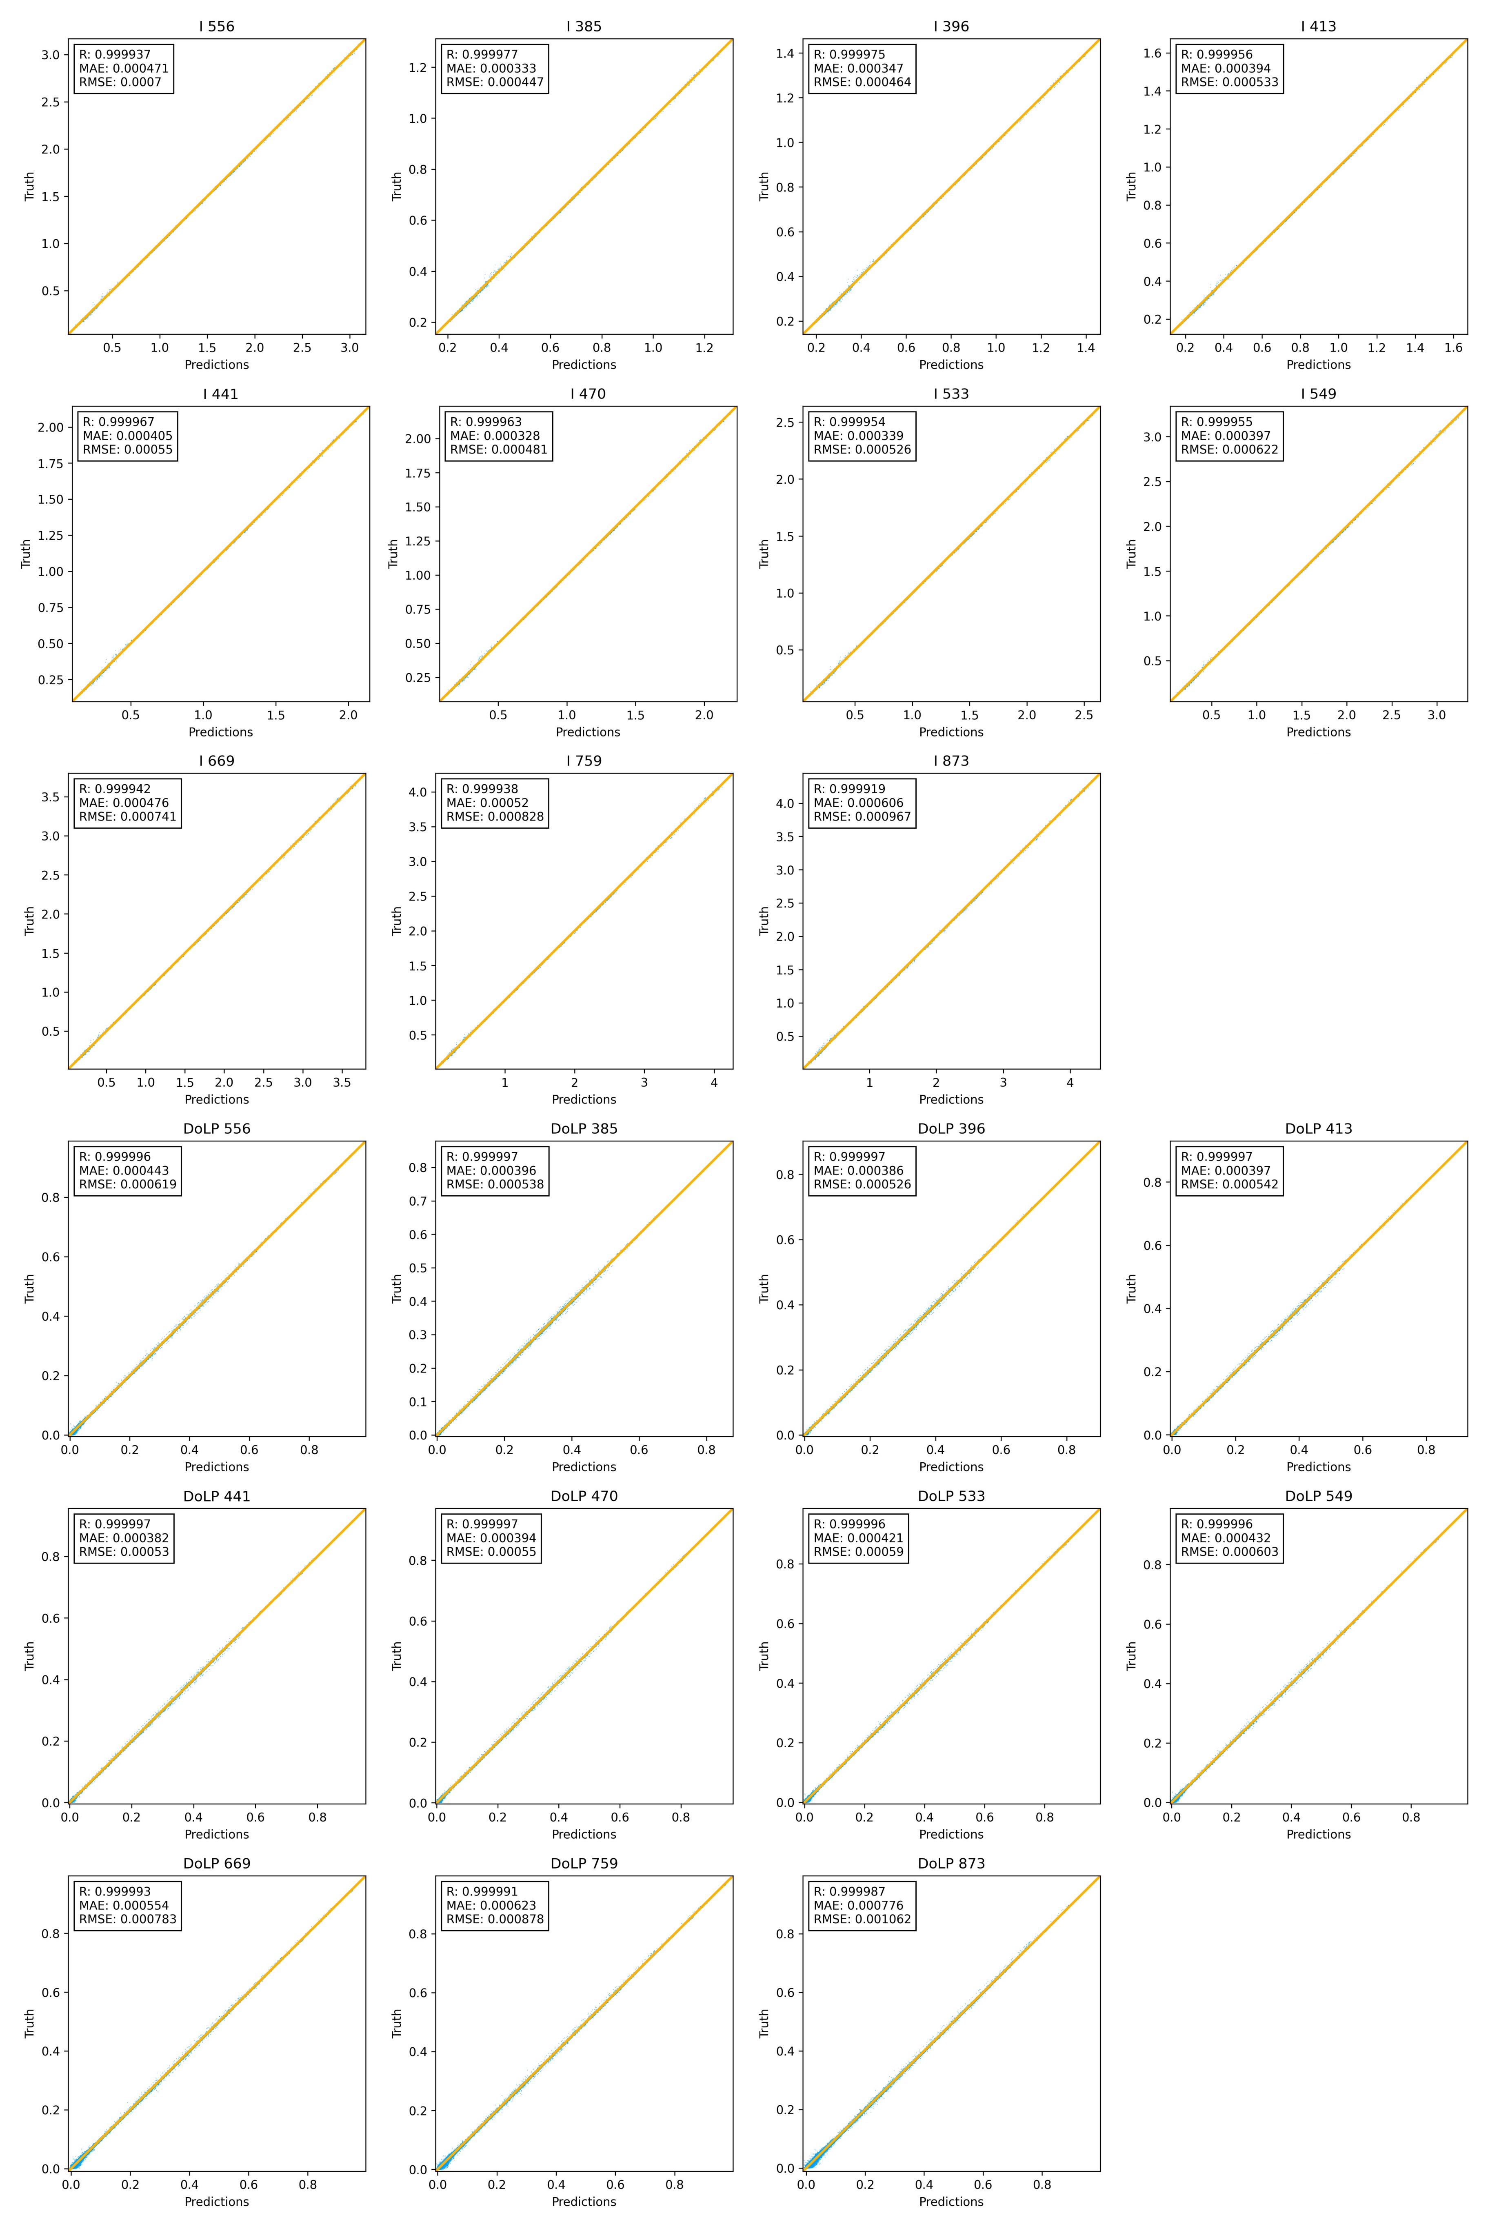
… and uses neural networks so that solutions are possible in 1 second compared to 1 hour (Gao et al., 2021; Stamnes et al., 2023, submitted.)
The Science Directorate at NASA's Langley Research Center
9

Slide 10
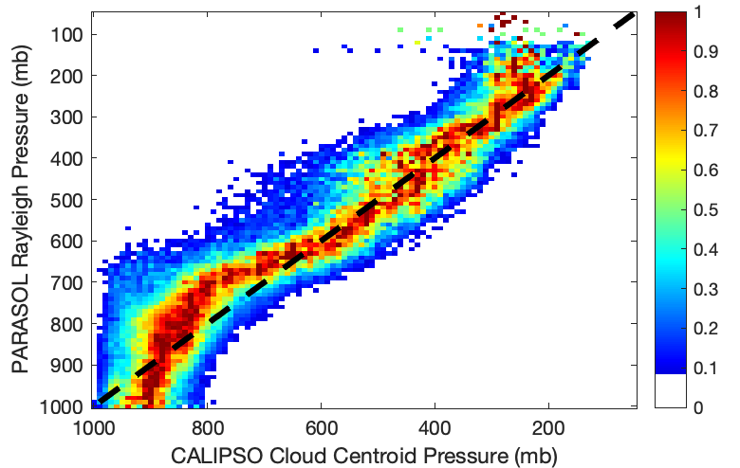
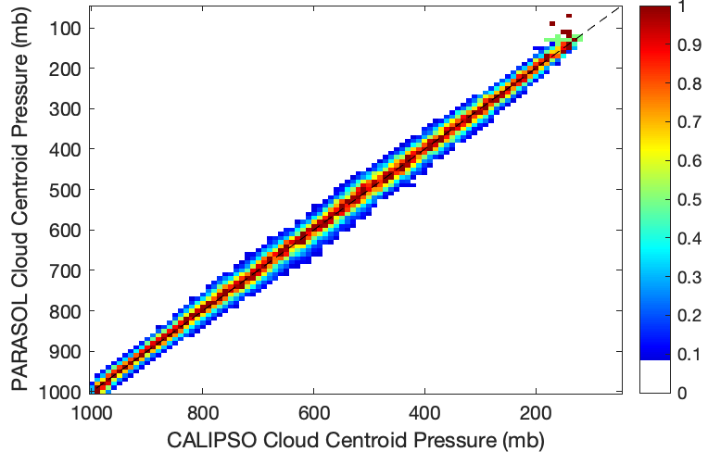
Furthermore, lidar data can be used to train polarimeter data..
.. to significantly outperform conventional retrievals for cloud top height and pressure.

Slide 11
PolCube Synergy with NASA Missions
MAIA
  Aligns with planned air quality observations
  Consider using PolCube to close gaps (Busan City)
Plankton, Aerosol, Cloud, ocean Ecosystem (PACE)
  Coastal areas need 1 x 1 km^2 resolution
  ICESat-2 and EarthCARE/ATLID for synergistic atmosphere/ocean properties
Atmosphere Observing System (AOS)
  ICESat-2 and EarthCARE/ATLID for synergistic aerosol/cloud properties
Surface Biology and Geology (SBG)
  Working with David Thompson (EMIT/AVIRIS/PRISM team), his postdoc, and Xu Liu on polarimeter+hyperspectral retrievals using HyspIRI data
  PolCube can improve SBG’s atmospheric correction capabilities to reduce uncertainties in surface reflectances and water-leaving radiances

Slide 12
Hampton University team
HU team (funding level ~$300k/year for 3 years)
  Co-Is Geddis, Loughman, Le
  2-3 undergraduate students
  1-2 graduate students
  Up to 1 postdoc
Possible 3-year projects (not an exhaustive list, let’s discuss..)
  Synergy with HU ground-based AERONET/Pandora/AQ/lidar measurements
  Engineering / Physics
    Polarimetric/Radiometric calibration lab set-up, testing and documentation
    PolCube engineering qualified model (EQM) calibration and validation
  Atmospheric and Planetary Science / Chemistry / Physics
    PolCube Air quality (PM2.5) products
    Improved PolCube aerosol products using SAGE stratospheric aerosol products
    PolCube Water quality products (e.g. Chla)
  Computer science
    PolCube instrument simulator (e.g. using Jupyter Notebook + widgets)
    PolCube machine learning / AI remote sensing retrieval algorithms (clouds/land/algal blooms)

Slide 13
