Slide 1
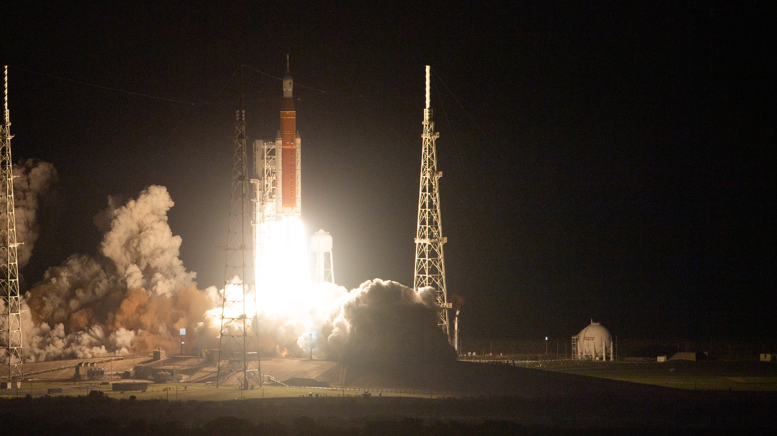

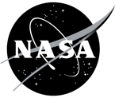
SPACE
Launch
System
Test Like You Fly
Jay Hollenbeck
Space Launch System
May 11, 2023
Notes:
Thank you for this opportunity to talk the Artemis lunar exploration campaign. There’s a lot going on right now, so let’s get to it. Today we are talking about the backbone of deep space exploration, our current status, and our future plans.
Fifty years ago, we pioneered a path to the Moon, cutting through the notions of science fiction and showing us all what was possible.
Today, the calling to explore is even greater – to go farther, we must be able to sustain missions of greater distance and duration.
We are again pushing the bounds of humanity.
At 01:47:44 Eastern on November 16 – we took the first step to return humans to deep space and created a blueprint for a long-term human presence – expanding exploration throughout the solar system. Artemis I LAUNCHED!

Slide 2
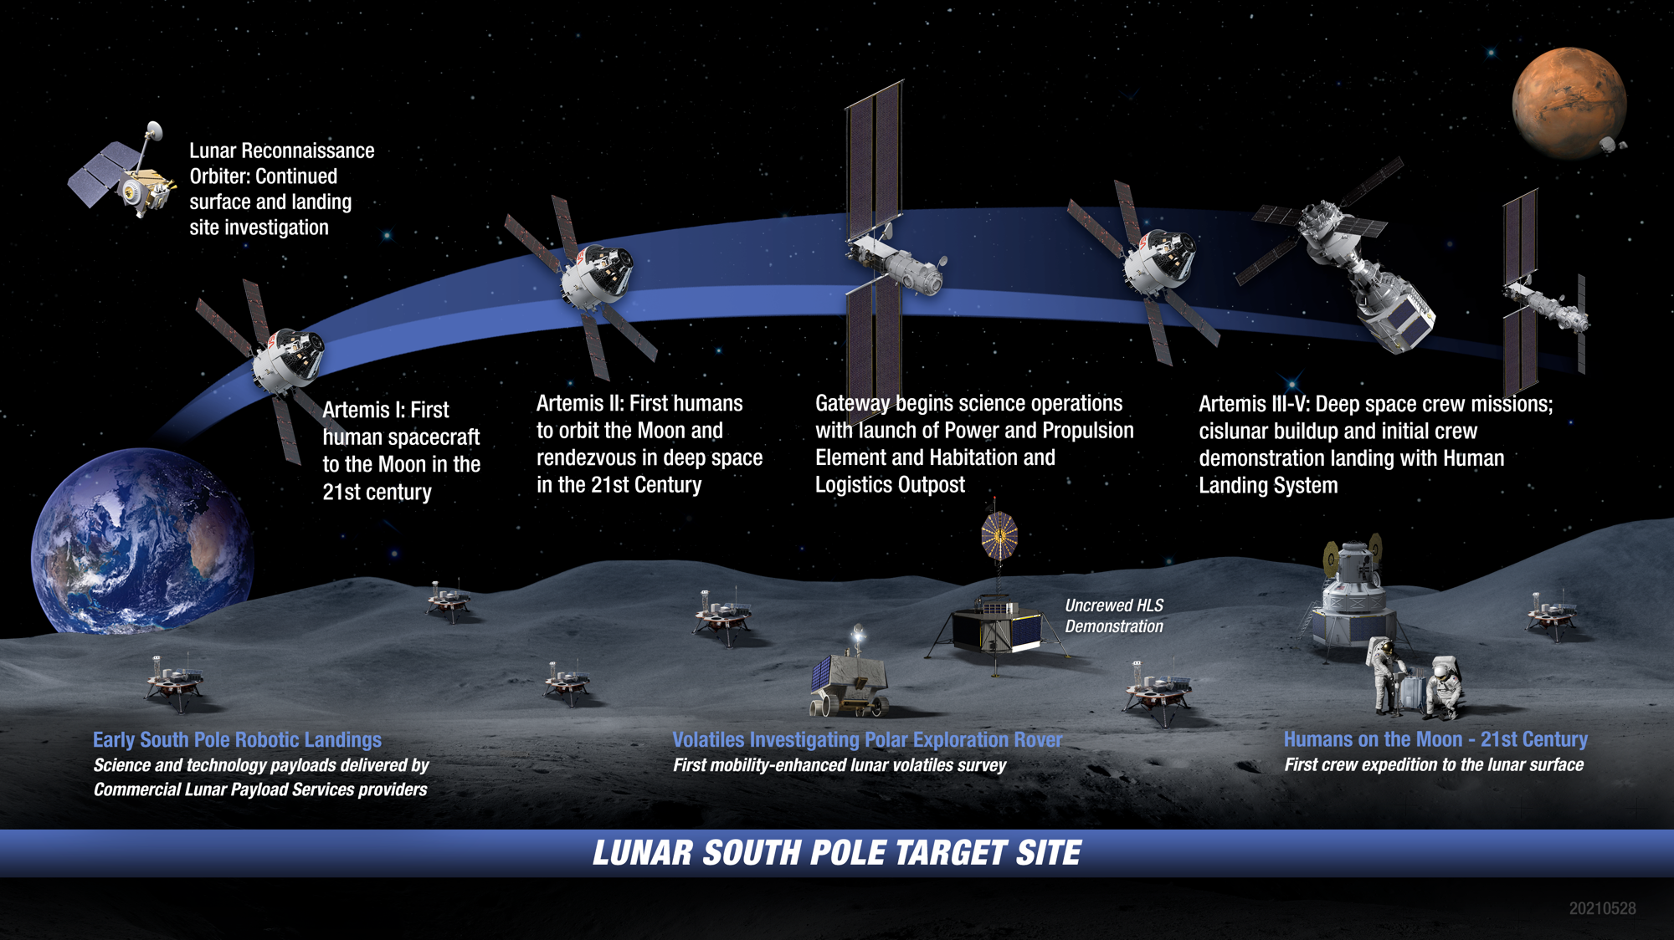
ARTEMIS: LANDING HUMANS ON THE MOON
Notes:
Artemis I was the first in a series of missions designed to return astronauts to the Moon and deep space.
The Artemis series of missions will take place over several years. Artemis consists of a series of innovative technologies that will advance sustainability on the missions with robotic scouts paving the way.
For a series of firsts for the 21st Century…
First human spacecraft to the Moon in the 21st Century
First humans to orbit the Moon and rendezvous in deep space
First lunar outpost
First crewed missions to the lunar surface in the 21st century
And, all the while – the CLPS (pronounced "clips") missions will be going on. Commercial Lunar Payload Service providers delivering science and technology payloads at the lunar South Pole.

Slide 3
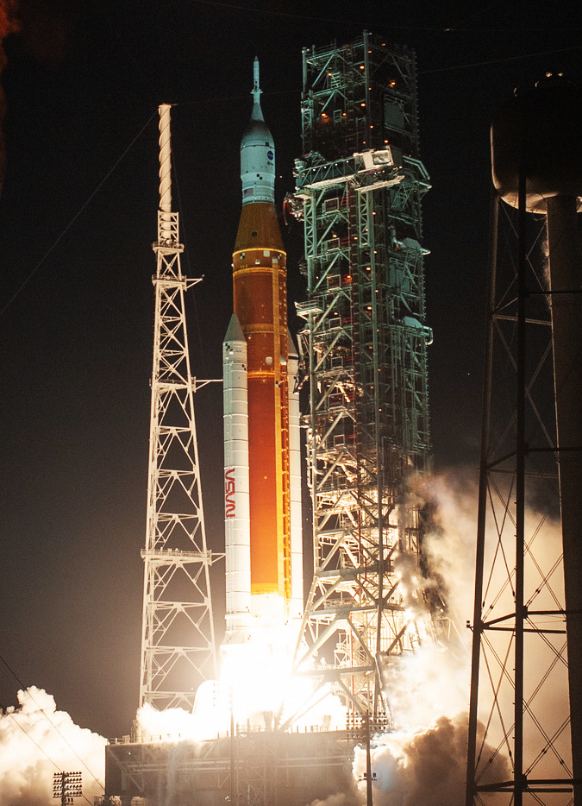
BACKBONE OF ARTEMIS
HUMAN DEEP SPACE EXPLORATION CAPABILITY
ORION
The only spacecraft capable of carrying and sustaining crew on missions to deep space, providing emergency abort capability, and safe re-entry from lunar return velocities.
SLS
The only rocket with the power and capability required to carry astronauts to deep space onboard the Orion spacecraft in a single launch.
NATIONAL CAPABILITY
The SLS and Orion programs (including Exploration Ground Systems at NASA’s Kennedy Space Center) leverage over 3,800 suppliers and over 60,000 workers across all 50 states.
Notes:
Built by America - for America – in the public eye – for a new generation of space explorers. The Space Launch System is America’s rocket.
SLS is the only exploration-class vehicle capable of sending humans to deep space along with the large systems necessary to live and work in deep space in a single launch.
SLS has the power and capacity to lift large and complex payloads, reducing the number of launches and in-space operations needed to send people and hardware beyond Earth orbit.
SLS stands at 322’ tall, weighing in at 5.75 million pounds and boasting 8.8m lbs. of thrust.
Orion is the only spacecraft capable of sustaining human life in deep space.
Exploration Ground Systems – provide the technology, skill and equipment to launch SLS and recover Orion.
With all that power and capability, SLS is the only rocket capable of fulfilling the missions of the Artemis program.

Slide 4

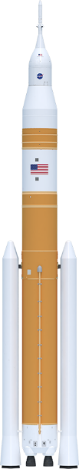
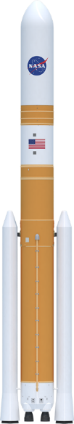



evolution for future exploration
Payload to LEO
95 t (209.4k lbs)
95 t (209.4k lbs)
105 t (231.4k lbs)
105 t (231.4k lbs)
130 t (286.6k lbs)
130 t (286.6k lbs)
Payload to TLI/Moon
> 27 t (59.5k lbs)
> 27 t (59.5k lbs)
38 t (83.7k lbs)
42 t (92.5k lbs)
> 43 t (94.7k lbs)
> 46 t (101.4k lbs)
Payload Volume
516 ft³ (14.6 m³)
8,118 ft³ (229.9 m³)
10,100 ft³ (286 m³)**
21,930 ft³ (621.1 m³)
10,100 ft³ (286 m³)**
34,910 ft³ (988 m³)
Low-Earth Orbit (LEO) represents a typical 200-km circular orbit at 28.5 degrees inclination.
Trans-Lunar Injection (TLI) is a propulsive maneuver used to set a spacecraft on a trajectory that will cause it to arrive at the Moon. A spacecraft performs TLI to begin a lunar transfer from a low circular parking orbit around Earth.
The numbers depicted here indicate the mass capability at the Trans-Lunar Injection point.
** Not including Orion/Service
Module volume
SLS Block 1 Crew
SLS Block 1 Cargo
SLS Block 1B Crew
SLS Block 1B Cargo
SLS Block 2 Crew
SLS Block 2 Cargo
Maximum Thrust
8.8 M lbs
8.8 M lbs
9.2 M lbs
9.2 M lbs
9.5 M lbs
9.5 M lbs
Notes:
SLS more capable than commercial vehicles; a unique asset for space exploration
VOLUME
Twice the volume of any contemporary launch vehicle
Enables habitat modules, large-aperture telescopes, robust science package on robotic probes, etc.
Even the USA in B1B offers as much volume for payloads as industry-standard 5m fairings
MASS
Initial capability > 27 metric tons (59,525 lbs.) to TLI; current U.S. launch vehicle maximum is 16-20 t [20 is generous] **
Evolved SLS will offer Mars-enabling capability of > 46 t (101,413 lbs.) to TLI
ENERGY
SLS offers reduced transit times to the outer solar system by half or greater (2-3 years for Europa instead of 7-8)
Heavy-lift reduces complexity and risk associated with payload design, ground infrastructure, and in-space operations
Provides the best opportunity for mission success
*Current U.S. launch vehicle maximum is ~16-20 t** (Falcon Heavy) to TLI
Block 1 = 23% greater mass than FH estimate
Block 1B = 38-42 t to TLI (crew or cargo) -- 50% more mass (40 t)
Block 2 = >55% more mass than FH

Slide 5
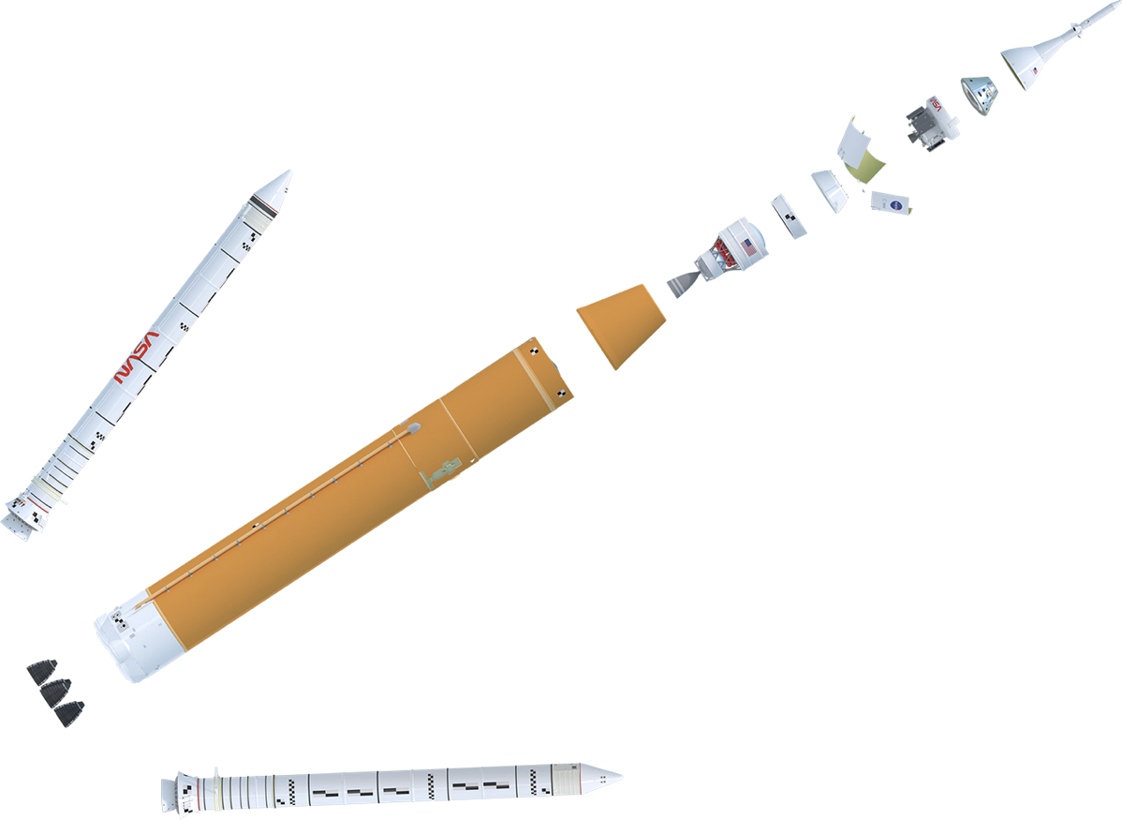
NASA’S SPACE LAUNCH SYSTEM
BACKBONE OF DEEP SPACE EXPLORATION
BLOCK 1 CONFIGURATION
Launch Abort System (LAS)
Crew Module (CM)
Service Module (SM)
Encapsulated Service Module (ESM) Panels
Spacecraft Adapter
Orion Stage Adapter
Orion Multi-Purpose
Crew Vehicle
Lockheed Martin
RL10 Engine
Aerojet Rocketdyne
5 Segment Solid Rocket Booster (2)
Northrop Grumman
Interim Cryogenic
Propulsion Stage (ICPS)
Boeing/United Launch Alliance
Launch Vehicle Stage Adapter
Teledyne Brown Engineering
Core Stage & Avionics
Boeing
RS-25 Engine (4)
Aerojet Rocketdyne
Notes:
Expanded view of Block 1
Visible are the major elements of the Artemis I vehicle – solid rocket boosters, core stage (engine section, LH tank, intertank, LOX tank, forward skirt), LVSA and ICPS, OSA, and Orion/SM/LAS.
Block 1 is more capable than any current launch vehicle, able to deliver >27 metric tons (59.5k lbs.) direct to the Moon.
Our first mission, Artemis I, took the Orion crew vehicle farther into space than humans or any spacecraft built for humans have ever ventured before.
Block 1 is just the first of larger more powerful configurations that will support human exploration of Mars.

Slide 6
SLS Test Program Philosophy
SLS Testing Program set up to answer critical questions, feed design cycles, verify structural models, for qualification, and for integrated vehicle verification
  Tests are used to answer questions that can’t easily be answered by analytical models, empirical or historical data, and when it is cheaper than other options
Development testing
  Largely driven by Design Cycle needs, or risk reduction
  Aerodynamics, AeroThermal (base heating & high Mach aeroheating), venting, Lift-off acoustics
  Test philosophy since the beginning is to include best known Block 1B configurations when reasonable
Structural Tests
  Philosophy is to test to known configurations of Block 1B loads
  Select structures tested to best estimate of Block 2 loads (e.g. intertank – thrust carry through)
  Block 1 specific structures tested to FoS 1.4 or greater (e.g. ICPS)
  When appropriate, Structural tests to failure (e.g. LH2, intertank, CS engine section, LO2)
Qualification Testing
  Vibration test qualification scaled to max q trajectory enclosure of all B1 and B1B vehicles
  Block 2 trajectory currently limited to vibroacoustics design trajectory for B1
Select components and structures are known to need requal for Block 1B
IAS testing – covered in IAS portion of SE&I discussion
Notes:
But how does one build a brand new rocket system like the SLS? How does testing play a fundamental role in ensuring hardware that is both safe and successful? The Program adopted a specific test philosophy to gain real-world knowledge of how the hardware might behave under specific circumstances.

Slide 7
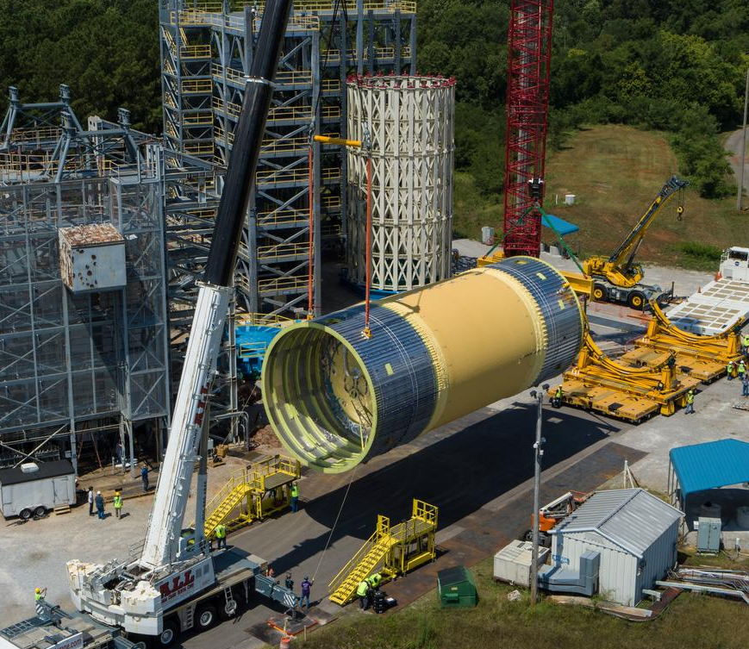
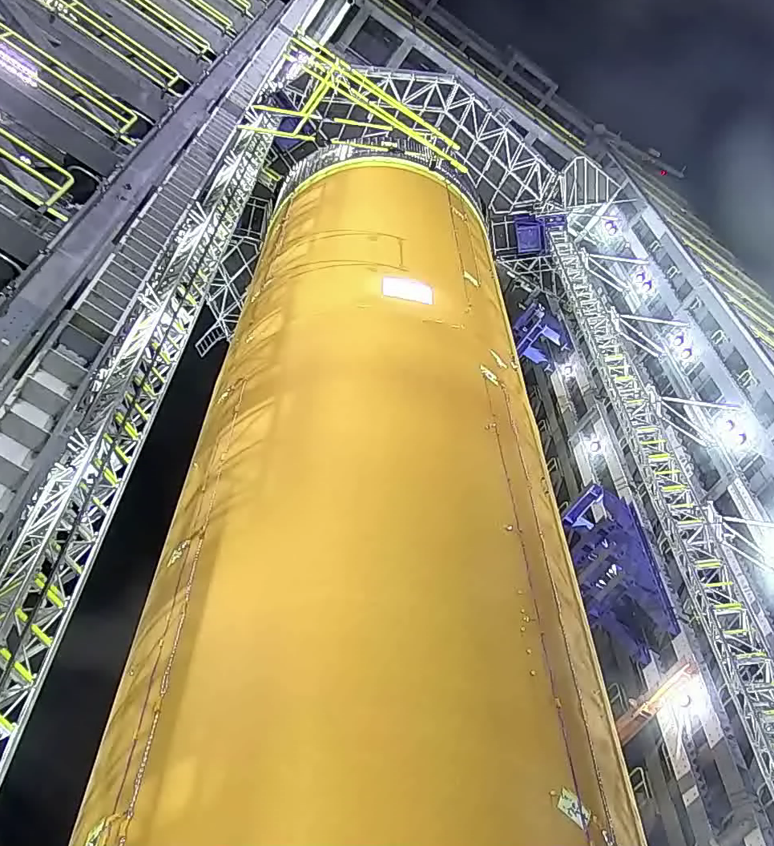
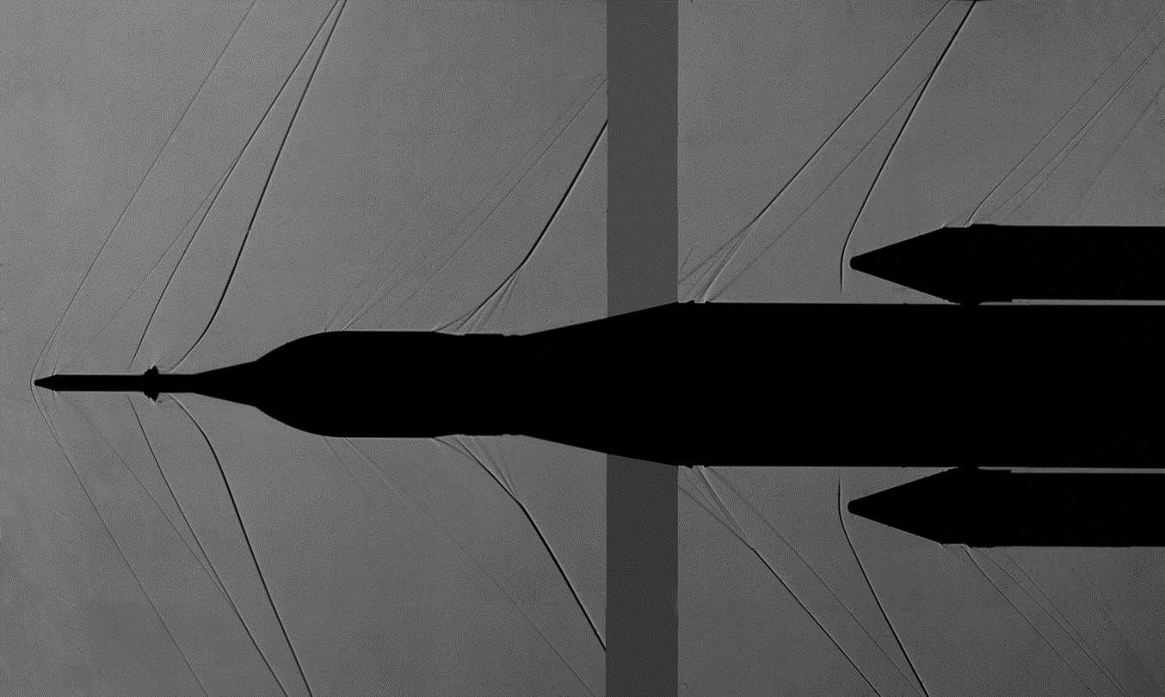
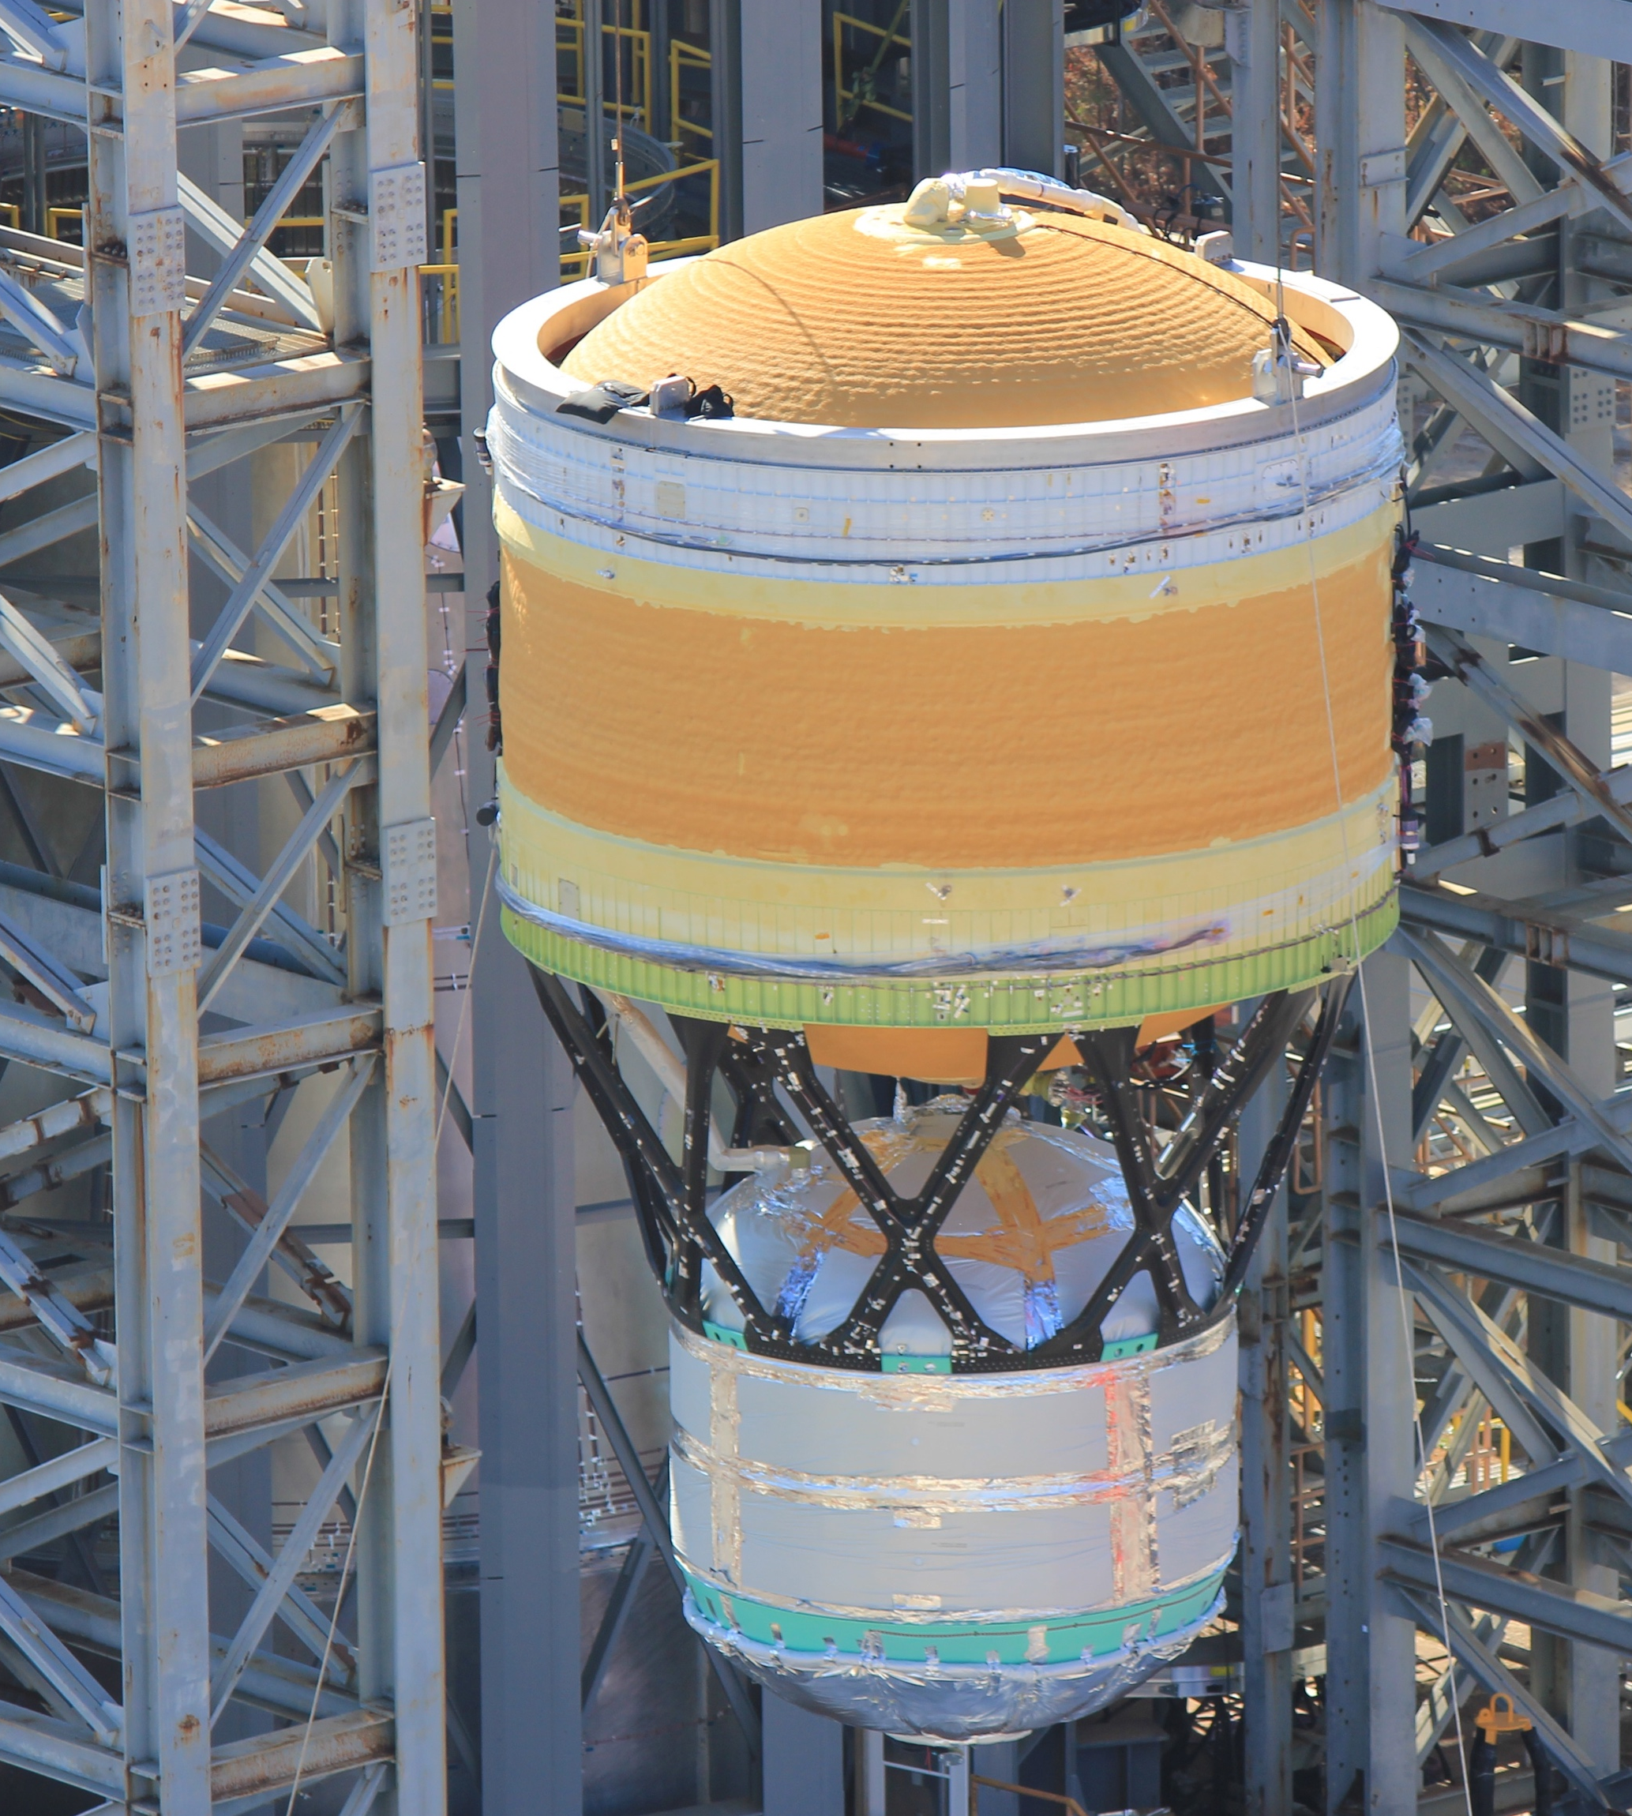
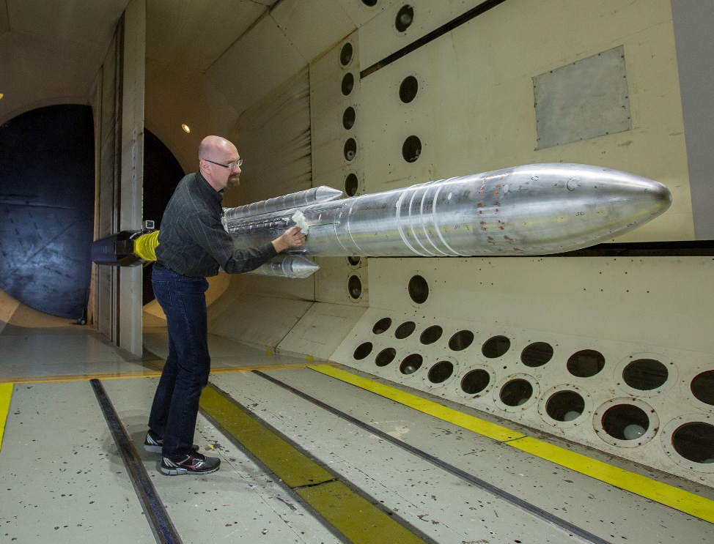
SLS TEST PROGRAM
Notes:
From wind tunnel to flight hardware, testing is a big part of making SLS safe for astronauts.
Before the vehicle can fly, its components will have been structurally tested to ensure they can survive the extreme pressures and loads experienced in flight.
SLS structural qualification testing at Marshall complete, largest test campaign at MSFC since Space Shuttle. Five structural test articles underwent 199 separate test cases, and more than 421 gigabytes of data were collected to add to computer models used to design the rocket and optimize it in the future.
Software is tested in a flight-like test environment, and then again on the flight hardware to ensure everything functions as needed to send crew to space.
RS-25 engines adaptation hotfire series complete: 2015 – 2019 at Stennis to adapt the RS-25 to SLS performance and environment requirements and develop a modern engine controller and software. Tests also included new engine flight controller development and flight controller qualification as well as development parts for restart engine program. Total of 32 tests totaling nearly 15,000 seconds of hot-fire time.
Eight-test Green Run series at Stennis ending with a simulated launch hot fire test will prove Core Stage 1 is ready for Artemis I.
The 5-segment boosters for SLS underwent both hot and cold firings early in the program. A Flight Support Booster will be test fired in September to qualify a new propellant vendor for future flights.

Slide 8
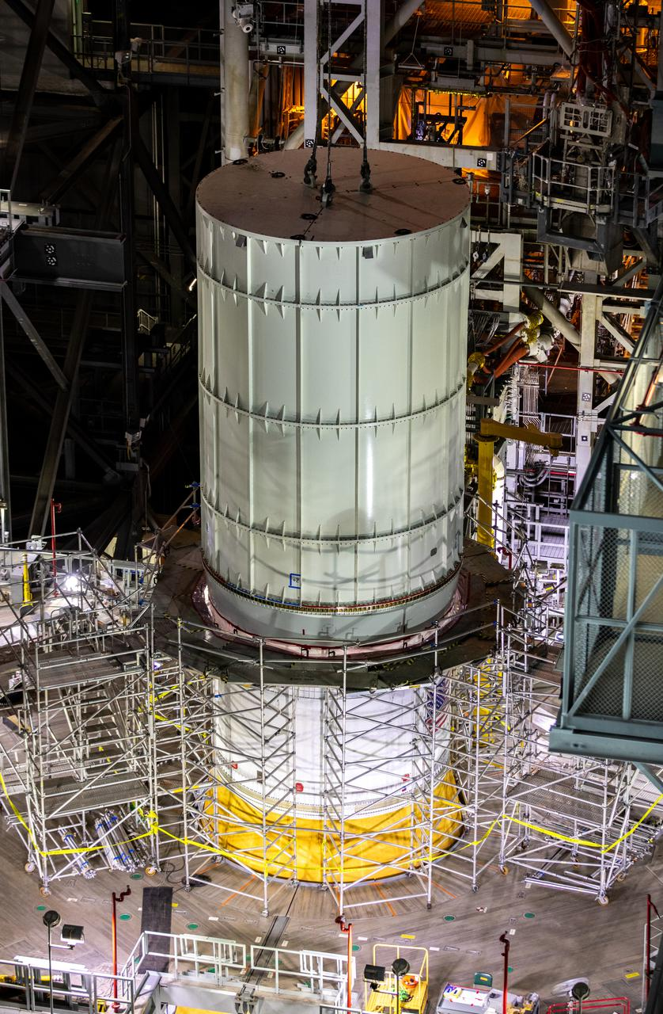
TESTED BEFORE FLIGHT
Comprehensive Test Program
Green Run test series at Stennis Space Center
Integrated Test and Check-Out series
  Modal Testing
  Interface Verification
  Communications End-to-end
  Umbilical Release and Retract
Dynamic Roll-out Test
Wet Dress Rehearsal
Cryo-Demo Test
Notes:
SLS was rigorously tested, and its performance is validated from the material level to each individual component, and from structure, to system, to integrated vehicle. The SLS Program completed the largest structural testing campaign since the space shuttle.

Slide 9
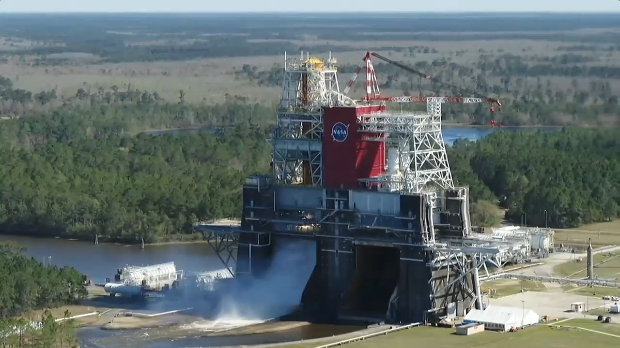
Notes:
Green Run Video at Stennis Space Center – 30 seconds, no sound
A series of 8 tests in 2020 and early 2021 were conducted to fully test the Artemis I core stage in Stennis Space Center in Mississippi. All eight major Green Run tests have been completed, with a 67-second hot fire test occurring on Jan. 16, 2021, and a full-duration eight-minute (499.6 seconds) hot fire on Thursday, Mar. 18. All four engines ignited successfully and produced 1.6 million pounds of thrust.
Green Run included several first-time events for the world’s largest rocket stage:
• First propellant fill-up for the LOX and LH2 tanks
• First end-to-end flow test of propellants and other fluids through the complete stage
• First operational test of FLIGHT avionics
• First firing of all four RS-25 engines together
In addition to the hot fire, other tests as part of Green Run included vibration testing, leak and functional checks, hydraulics and thrust vector control, safing, simulated countdown and wet dress rehearsal during which propellants were flowed through the stage but not ignited.
When Green Run was complete and the core stage was verified, the core stage was sent to Kennedy. There, all the disparate elements of Artemis I were put together, culminating in a launch!

Slide 10
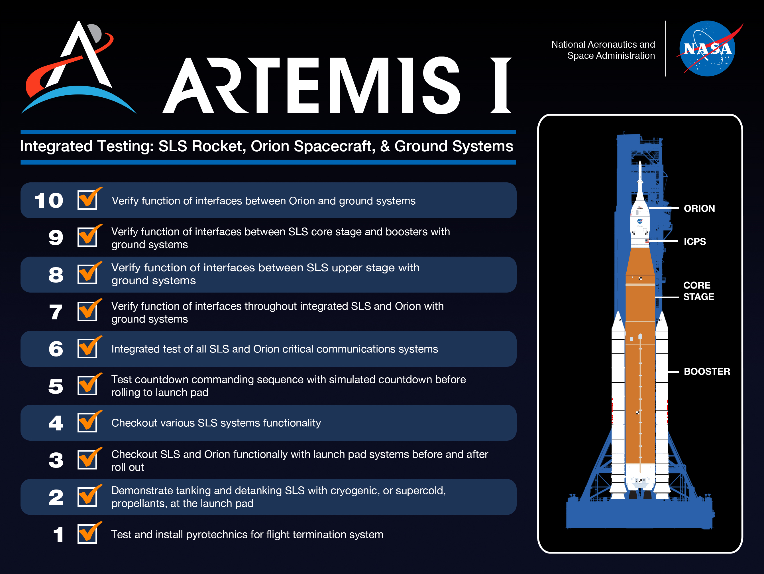
Notes:
SLS and the Orion spacecraft underwent integrated testing inside the Vehicle Assembly Building at NASA’s Kennedy Space Center in Florida to ensure they were “go” for launch of the Artemis I mission.
After stacking the Orion atop the SLS rocket, the engineers completed several tests to ensure the rocket and spacecraft are ready to roll to the launch pad ahead of the Artemis I wet dress rehearsal. These tests included ensuring Orion, the core stage, and boosters can communicate with the ground systems and verification testing to make sure all the pieces of the rocket and spacecraft can power up and connect to the consoles in the Launch Control Center.

Slide 11
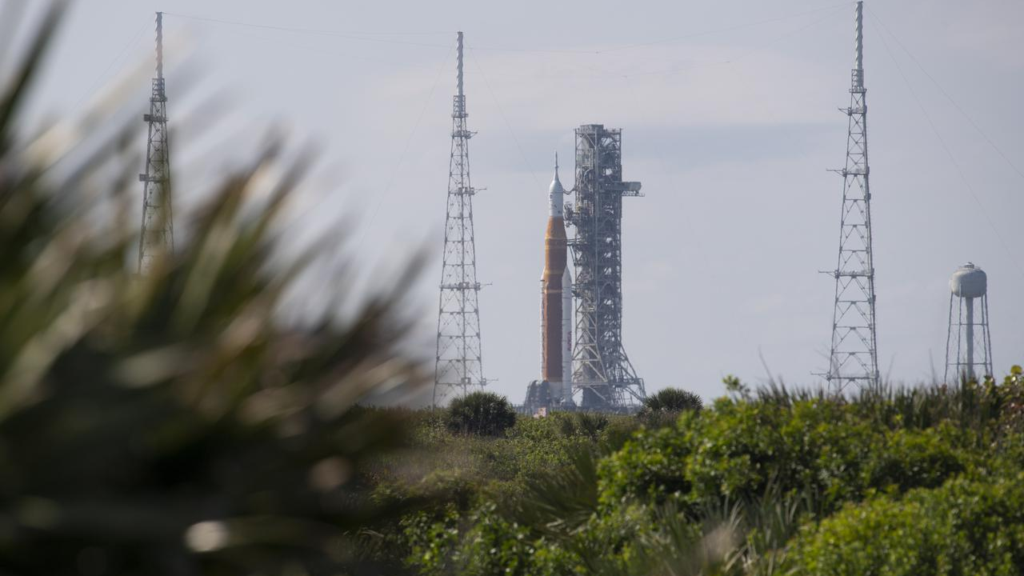
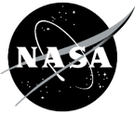
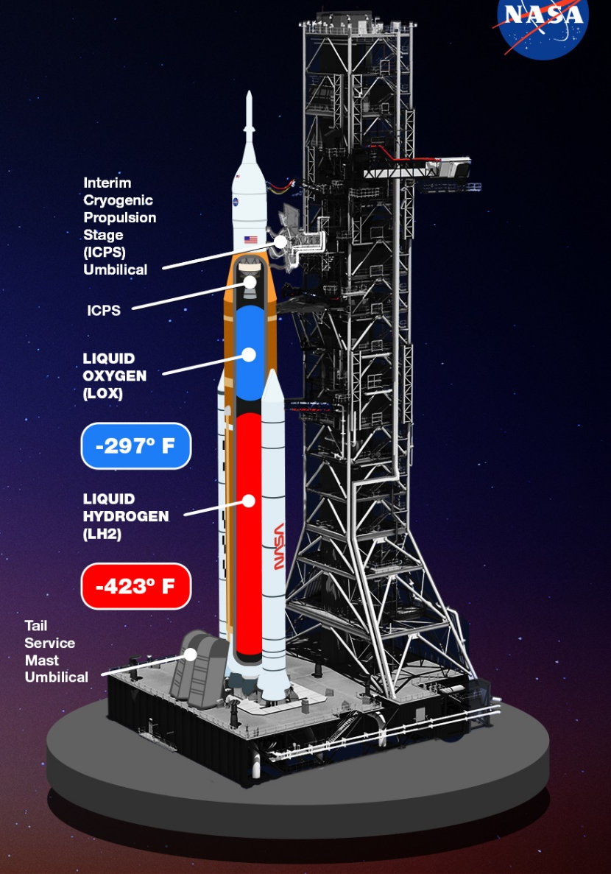
Wet Dress Rehearsal
Tested the new propellant system with the Artemis I SLS rocket and Orion spacecraft for the first time
Instruments measured the effects of super-cold propellants on SLS and the mobile launcher
Engineers checked out the propulsion system, flight computers, communications, safety, and other systems
Teams at the Launch Control Center and other sites practiced countdown procedures
Notes:
The WDR test was the last major test before the Artemis I launch. In a typical WDR, SLS will be fully fueled with over 730,000 gallons of cryogenic propellant in the core stage and ICPS, followed by a countdown, recycle, and de-tanking of the cryogenic propellant.
WDR allowed NASA to fuel and fully test, short of igniting the engines and boosters, the integrated SLS, KSC launch facilities, and Eastern Range through countdown. WDR also provided NASA with the opportunity to measure structural stress on the rocket during tanking and exposure to wind.
WDR also gave the teams an opportunity to practice operational procedures prior to launch, including loading propellant into the rocket’s tanks, conducting a full launch countdown, demonstrating the ability to recycle the countdown clock, and draining the tanks to practice the timelines and procedures the team will use for launch.

Slide 12
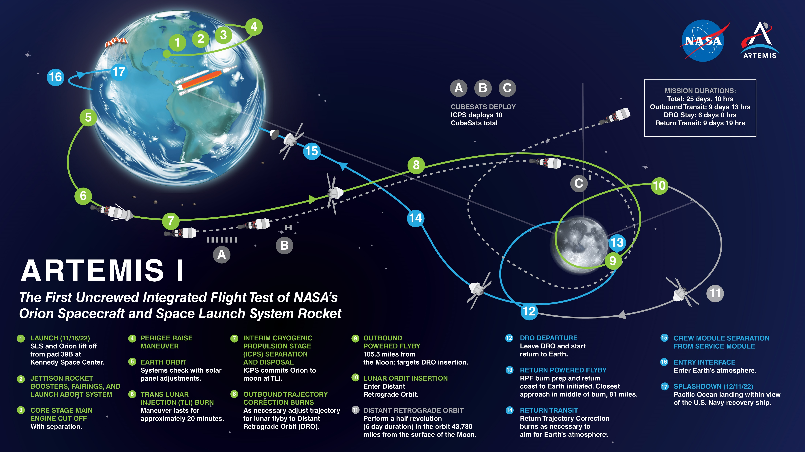
Notes:
This is the Artemis I mission map.
After launching from the Kennedy Space Center, Orion orbited Earth to complete system check-outs.
Followed by a 18-minute trans-lunar injection burn to set us on the path to the Moon.
Along the way, Orion separated from the upper stage and deployed several secondary payloads to study the Moon and radiation environments and conduct technology demonstrations.
Once at the Moon, we came in close for a lunar fly-by, around 80.6 nautical miles off the surface, before heading out to distant retrograde orbit, 38,000 nautical miles beyond the far side of the Moon...farther than any human-rated spacecraft has ever traveled.
Over the course of the mission: Orion traveled over 268,000 miles from Earth, stayed in space longer than any human spacecraft has without docking to a space station, and returned home faster and hotter than ever before.
Orion left the distant retrograde orbit and performed return trajectory correction burns as necessary to aim for Earth, before entering the atmosphere and splashing down in the Pacific Ocean, where it was recovered by a U.S. interagency team, made up of Navy, Air Force, and NASA engineers and technicians.

Slide 13
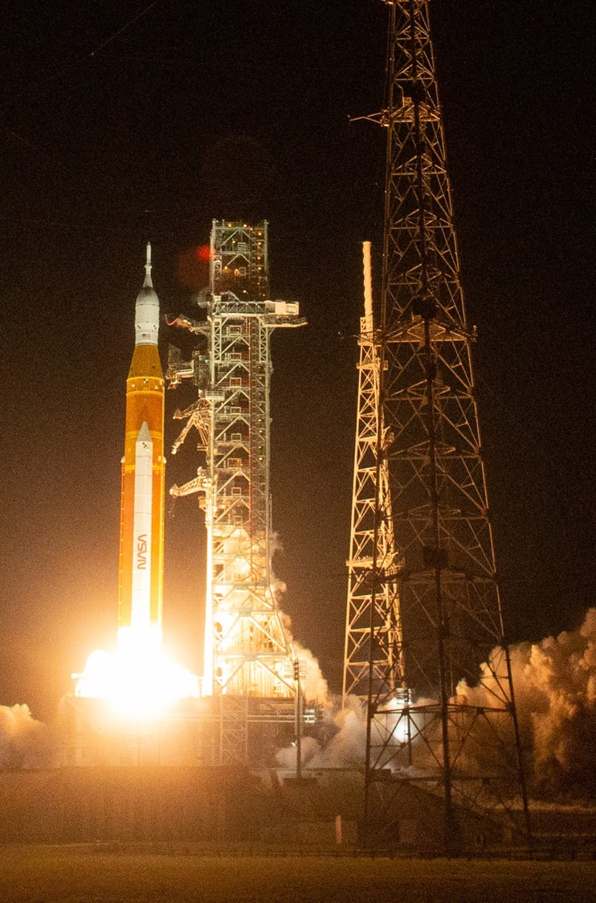
ARTEMIS I
MISSION COMPLETE:
The Artemis I mission launched on November 16, 2022, and the Orion spacecraft successfully splashed down on December 11, 2022.
FIRSTS:
Uncrewed integrated flight test of the Space Launch System (SLS) rocket, Orion spacecraft, and Exploration Ground Systems (EGS) at Kennedy Space Center
Demonstration of Orion heatshield at lunar
re-entry conditions
NEW ELEMENTS:
SLS rocket Block 1 configuration
Orion crew spacecraft
Mobile Launcher 1 and upgraded ground systems
Notes:
The primary goal of the Artemis I mission was to test Orion’s heatshield and ensure it is safe for astronauts returning from the Moon. But there were other objectives.
We needed to:
Learn how Orion flies in space, especially in the deep space and lunar-vicinity environments
Recover Orion at the end of the mission
We needed to test the ground systems...(and we DID!)
And, most relevant to us – we needed to test the Space Launch System.
The Artemis I Mission Manager, Mike Sarafin, said that the heatshield’s job is to take out all the energy Orion had from its journey to the Moon.
It was our job - SLS’s job - to give it that energy.

Slide 14
ARTEMIS I FLIGHT
Nov. 16, 2022
The solid rocket boosters provided just over nominal performance to separation.
The core stage inserted ICPS and Orion into an initial Earth orbit at a velocity of 25,579.86 ft./sec – 6.58 ft./sec off nominal.
  Orbital insertion velocity was 2.9 miles shy of the nominal target.
Nominal separation of Orion occurred following the TLI burn.
Nominal performance of the boosters, core stage, ICPS, and flight software.
Bottom Line: This machine did the job we designed it to do.
POST-FLIGHT DATA INDICATES THAT SLS IS READY TO SUPPORT A CREWED FLIGHT ON ARTEMIS II.
Notes:
We are still assessing flight data, but preliminary post-flight data indicate that all SLS systems performed exceptionally and that the SLS rocket is ready to support crewed flight on Artemis II.
Booster Performance Statistics
Burned out within 0.4 seconds of each other (action time)
Hit peak thrust within 0.1 seconds of each other
Performed within one-quarter of a percent of each other during ascent
The 50-psi separation que was within .04 seconds for all pressure gauges (3 each) for both boosters
The core stage was the big new development in the SLS Program, and it performed exceptionally well.
The SLS core stage’s 999 sensors and 45 miles of cable executed all functions
The RS-25s performed magnificently. Here are some statistics from launch:
- RS-25 engines’ thrust and mixture ratio control valves were within 0.5% of pre-flight predicted values
- Internal pressures and temperatures were within 2% of pre-flight predicted values
The ICPS, using its RL10 engine, gave Orion the final shove it needed to go out to the Moon.
Extremely precise injection accuracy
Three burns first raised Orion and ICPS’s perigee, then performed trans-lunar injection, and the final burn was the heliocentric disposal burn
During the burn, the RL10 set a record for the longest duration burn of that engine at approximately 18 minutes.
The flight software of the rocket is really the unsung hero of the entire system. It doesn’t produce smoke and fire, but without it, nothing happens. Some statistics from the flight software:
Overall performance was basically down the middle of predictions
Transition from GLS to ALS was smooth, and all ALS functions were performed without issue
Mission execution was nominal
No avionic hardware issues during flight
Excellent core stage LH2 and LOX closed loop ullage control
No trigger level “close calls” in the abort monitor system
Imagery
Collected 31 TB for all SLS Artemis I chill/launch related imagery (ground cameras including IR, HSD, digitized film, HD video, airborne, vehicle cameras)

Slide 15
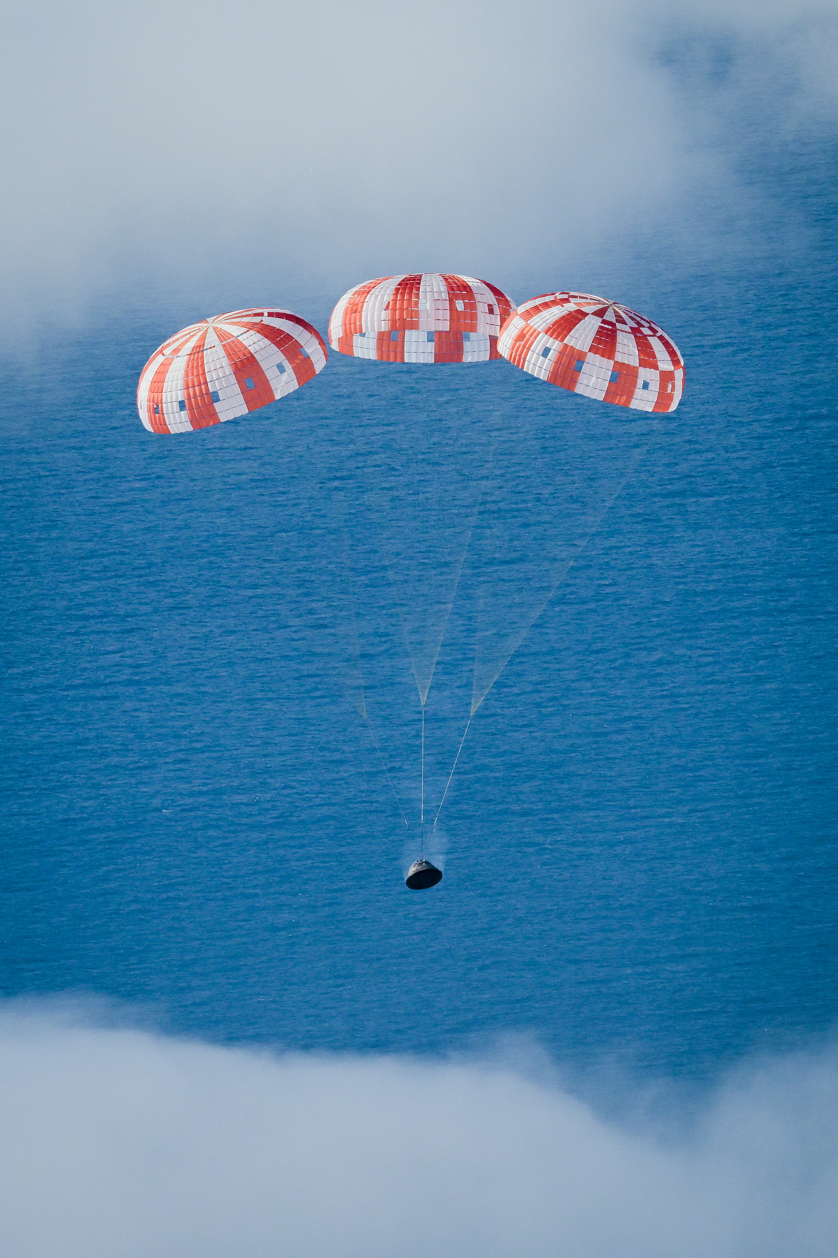
TESTED | PROVEN | READY
PRELIMINARY DATA INDICATES THAT ORION IS READY TO SUPPORT A CREWED FLIGHT ON ARTEMIS II.
Re-entry systems slowed Orion from
25,000 mph → 20 mph in 20 minutes
In-space systems exceeded pre-flight
performance expectations
Max distance from Earth: 268,563 miles
(broke Apollo 13 record)
Distance traveled: 1.4 million miles
Precision splashdown off the coast of
Baja, California
Notes:
The Orion team also continues to assess flight data and work through some in-flight anomalies.
But, like the rocket, Orion’s post-flight data indicates that Orion’s systems performed very well, and even exceeded some preflight performance expectations and set a few records along the way.
The data shows it is ready to support crew on Artemis II.

Slide 16
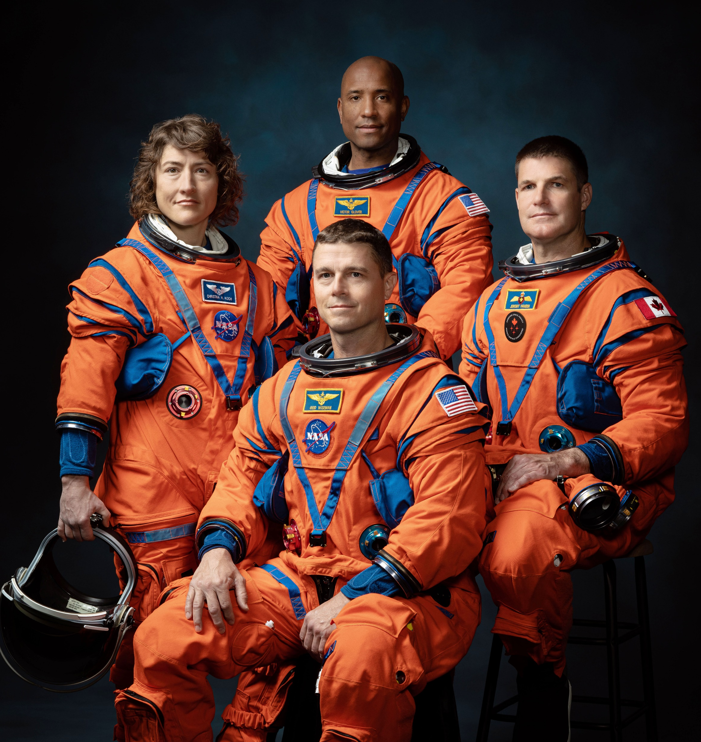
ARTEMIS II
FIRSTS:
Crewed integrated flight test of the Space Launch System (SLS) rocket, Orion spacecraft, and Exploration Ground Systems (EGS) at Kennedy Space Center
Demonstration of Orion life support systems
Collection of human data in lunar orbit, transit to and from the Moon, and through reentry and splashdown
NEW ELEMENTS:
Orion life support systems
Launch Complex 39B emergency egress system for crew and new liquid hydrogen system
COMMON ELEMENTS:
SLS rocket Block 1 configuration
Orion crew spacecraft
Mobile Launcher 1 and upgraded ground systems
Notes:
The bottom line? SLS IS READY TO SUPPORT A CREWED FLIGHT ON ARTEMIS II.
And here’s the crew…
Left to right: Mission Specialist 1 NASA’s Christina Koch, Pilot Victor Glover, Commander Reid Wiseman, and the Canadian Space Agency's Jeremy Hansen as Mission Specialist 2
.Artemis II will be the first time we launch astronauts on SLS and Orion.
This lunar flyby mission will require the astronauts to check out, evaluate, and test the Orion spacecraft systems in the deep space environment.
They will even checkout how the vehicle handles...a little test drive in space.

Slide 17
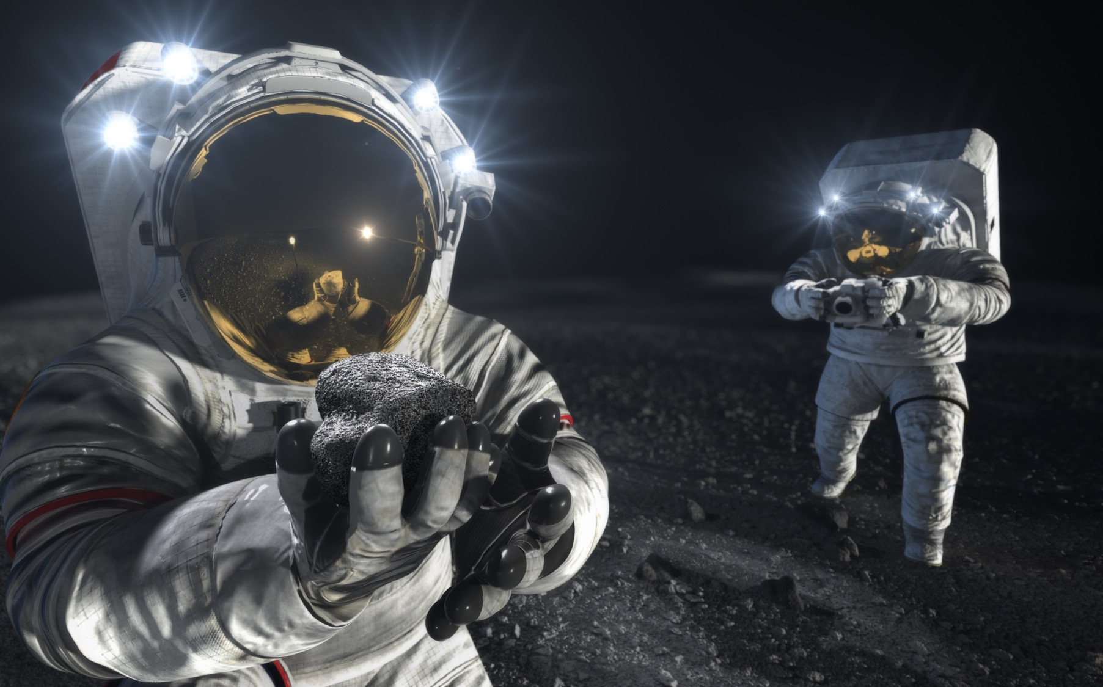
ARTEMIS III
FIRSTS:
Human landing in South Pole region
Orion to human landing system direct mission
Use of Near Rectilinear Halo Orbit (NRHO)
Four astronauts to lunar orbit
Two astronauts to lunar surface to collect scientific samples and data
NEW ELEMENTS:
Use of Orion full-up rendezvous, proximity operations, and docking systems
Enhanced European Service Module
SpaceX Starship human landing system (HLS)
Axiom advanced spacesuits and support systems
COMMON ELEMENTS:
SLS rocket Block 1 configuration
Orion crew spacecraft
Mobile Launcher 1 and upgraded ground systems
Notes:
After that – Artemis III.
And, if all goes according to plan, a return of astronauts to the lunar surface with the first woman and person of color setting foot on the Moon.
Launching on SLS and onboard Orion, they will travel out to the Moon where they will rendezvous with their lunar lander
Two of the four astronauts will descend to the surface while two will remain on Orion in the near rectilinear halo orbit
Following completion of the surface operations, the new moonwalkers will launch on the lander, rendezvous in lunar orbit with Orion – and return home.

Slide 18
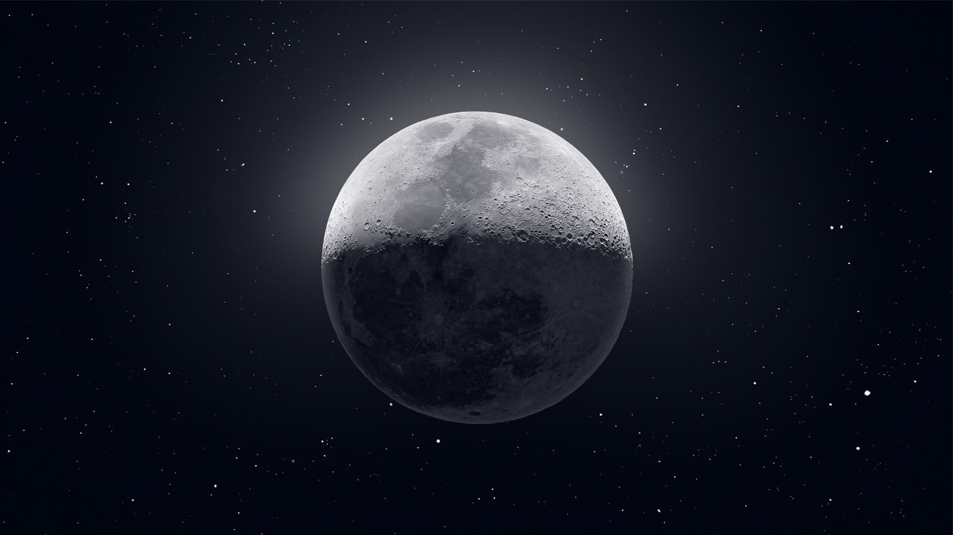
We came in peace.
We return for all humanity.
Add your own thank you, contact info, and resource links here…
Add your center social handle here…
Image credit: Andrew McCarthy
Notes:
Artemis is one of the most complex endeavors that humanity has ever embarked upon, and it’s not just America’s endeavor – it’s a global endeavor.
I appreciate the opportunity to talk with you today here at Student Launch. You ARE the Artemis generation. We’re taking this next step together. This is just the beginning...

Slide 19
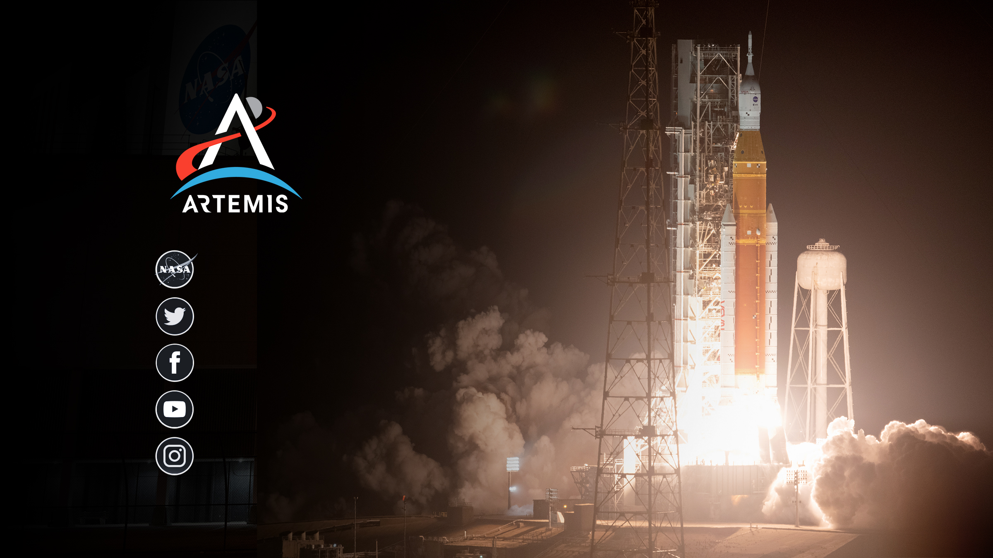
nasa.gov/artemis
@NASAArtemis
NASA Artemis
youtube.com/nasa
@NASAArtemis
Notes:
The best way to keep up to date with SLS news is to follow us on social media, shown here.
Any questions?

