Slide 1
Human Systems Integrations (HSI)
Framework and Training
Shifting the View of HSI for Better Implementation
Presented by:
Tony Thomas
NASA LaRC HSI
May 10, 2023
© Copyright to Anthony T Thomas
Notes:
Intro to me, my background, what I think I’ve noted.
We’ve been training and working in an 8th domain, although inconsistently at best.

Slide 2
Recent Assessments
Capabilities Based Assessment Report 2018
Identified 5 gaps areas
  Gap 1: Institutionalize an HSI Body of Knowledge
  Gap 2: Standardize Best Practices across the Services
  Gap 3: HSI Workforce Development
  Gap 4: HSI Tools and Processes to Support HSI Analyses Early in Acq
  Gap 5: Implement Outreach and Marketing function
National Commission for Military Aviation Safety (NCMAS) Report 2020
Assessed Mishaps from 2013 to 2020 with Losses of:
  224 Lives, $11.6B, and 186 Aircraft

Slide 3
Assessment Findings for HSI
Needs/Goals
General Causes
Long Term Affects
HSI Value Unknown or Lost on Leadership
Common Message to Stakeholders/Leadership
Human Performance
Total System Performance
Total Ownership Cost
Program/Project Schedule
Confidence in System Operation
Workarounds become common
Training Time
Maintenance and Support Time
Unexpected Outcomes
Potential Mishaps
Quantitative Tools and Metrics needed
HSI Not Early enough in Acq
Better predict System and Mission performance
HSI Framework, Architecture, Domain broadening
Requirements, Manpower, OPTEMPO, Fatigue, Training
Organizational Issues and Operational Processes

Slide 4
HSI Implementation Problems
1. Misconceptions about HSI, its value, and where it begins
The misconceptions contribute to late starts and limited HSI support
Activities not completed or supported by HSI
HSI Continues to be an after thought / “check in box”… until something happens
2. Unbalanced Approach to HSI
In addition to activities that do not get accomplished with HSI participation:
Outside Influences affect Human Performance, often not accounted for with HSI Domains
Changes in technology and organizational processes/regulations happen across the Product Life Cycle, causing operational performance to drift

Slide 5
Misconceptions about HSI
“It’s the same as Human Factors Engineering”
“HSI only applies to programs with human operators”
“It’s HMI or Human Machine Interface”
“I’m a human, so I must be an expert”
“HSI is just for displays ”
“HS-I – Must not start until Implementation or Production Phase”
Misconceptions about HSI leads to:
  HSI SMEs included too late in the Product Life Cycle
  Not identified early: System Personnel, Domains effects/tradespace, HSI Focus Areas
  Limited HSI activities

Slide 6
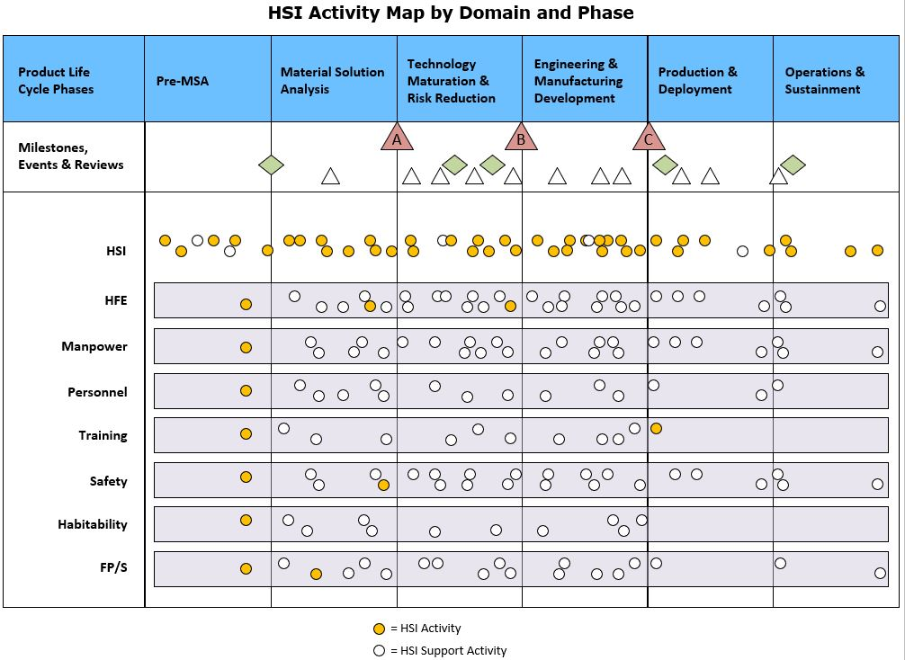
HSI in the Product Life Cycle
HSI must be considered early and often in the conceptual design and requirements development phases of system design and acquisition
Most HSI Activities occur Pre-Material Solution Analysis though Engineering & Manufacturing Development
Very few HSI activities at Production & Deployment Phase and on
When HSI introduced late, missed opportunities
  In risk identification/mitigation
  Design tradespace analysis

Slide 7
Unbalanced Approach to HSI
Outside Influences affect Human Performance
DOTmLPF-P Analysis includes additional domains for consideration in determining material solution (Start of Process/Pre-MSA)
Socio-Technical Systems Framework assesses System Performance from the aspects of both Socio and Technical elements (Production)
Provided a mishap occurrence, Human Factors Analysis and Classification System (HFACS) reviews several areas outside of the Unsafe Act performed that leads to the mishap (Usually during Operations)
Changes in Technology, Processes, and Organizations
From start of Program, changes not identified/tracked affecting operational performance

Slide 8
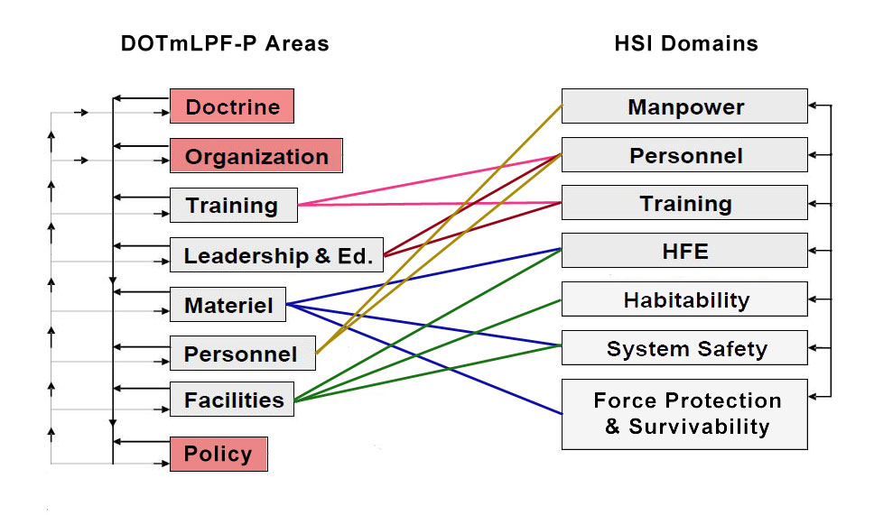
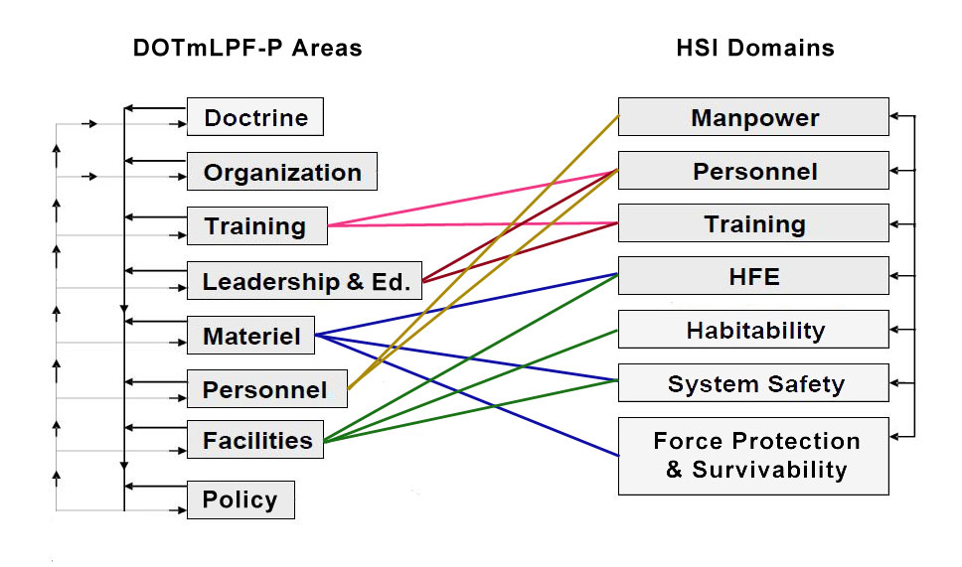
DOTmLPF-P
Doctrine, Organization, Training, material, Leadership and Education, Personnel, Facilities, Policy
DOTmLPF-P Analysis recommends a material or non-material approach to fill a capability; Considers all HSI Domains [AcqNotes]
Cross-walk Analysis to Domains; effects usually go both ways
DO-P areas have a one-way effect on Human Centered Design, but not accounted for in HSI
AcqNotes: JCIDS Process, DOTMLPF-P Analysis - https://acqnotes.com/acqnote/acquisitions/dotmlpf-analysis

Slide 9
Socio-Technical Systems Framework¹
Application of Organizational Psychology to predict Human Error
Framework comprised of both socio elements (left side) and technical elements (right side)
Assesses system performance (in Production) with other outside influences
Some HSI cross-over, but not fully covered in the domains
Socio Elements
Technical Elements
People
Technology
Culture
Infrastructure
Goals
Processes
¹Hexagonal socio-technical systems framework (adapted from Clegg 1979; Challenger et al. 2010; Davis et al. 2014)

Slide 10
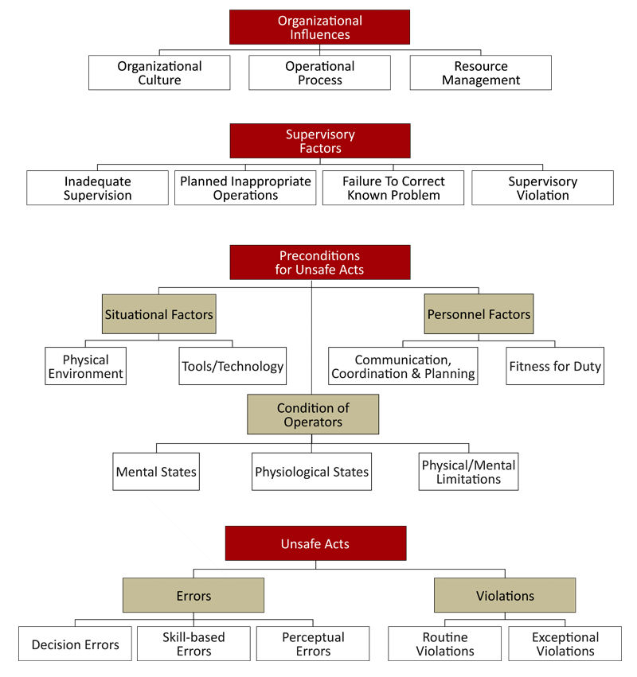
HFACS Framework
HFACS used in Mishap Investigations
Usually initiated by Safety offices; occurs during Operations and Support phase
Covers Organizational Influences, Supervisory Factors, and Preconditions
How many changes to Organizational processes, regulations, and technology occurred between program inception and operation phase?
What are we doing for prevention?
https://www.hfacs.com/hfacs-framework.html

Slide 11
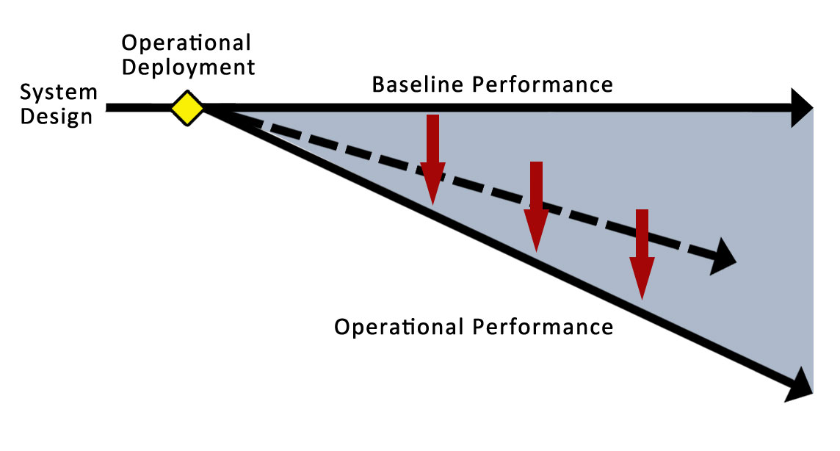
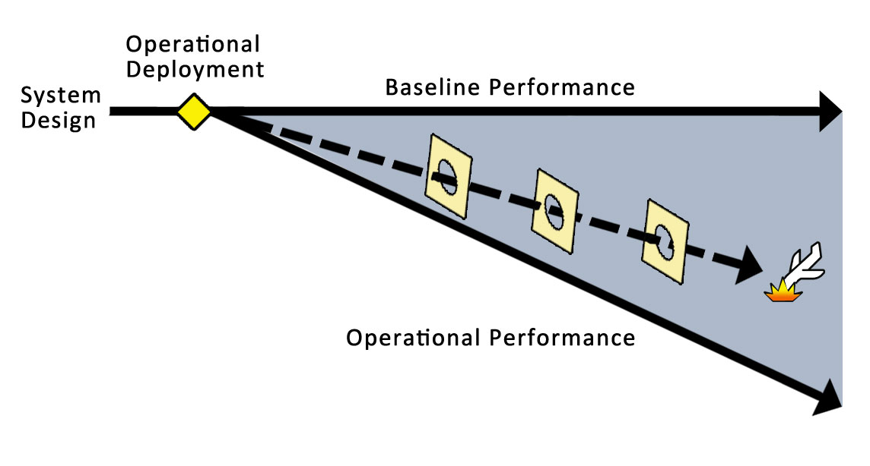

Operational Performance Drifts
Practical Drift²
Baseline performance of a system drifts
away from its original design
A consequence of real-life operations
and changes in the operational and
regulatory environment
“the slow steady uncoupling of practice
from written procedure” [Snook 2000] allowing
the practice to become “legitimized through unremarkable repetition”
Changes in Technology, Training, Processes, Policies and Regulations
Practical Drift is to be expected over long term operation
Regular assessment of drift can help identify risks to the system (Operational Assessments)
²Snook, Scott A. 2000. Friendly fire: The accidental shootdown of US Black Hawks over northern Iraq. Princeton, USA. Princeton University Press,

Slide 12
Operational Assessments
How could Operational Assessments be conducted?
Invest Stakeholders (PM, Safety, Ops Leads)
Assess from Operator standpoint (include maintenance/support)
  Health monitoring, fatigue, OpsTempo, manning, support services, new tech, new policies, new processes
  Use HFACS to identify problem areas (before the Unsafe Act)
Assess several operating sites
  Small/Large
  High Activity/Low Activity
Identify the shifts in the Operational Performance
Recommend solutions or engineering changes to adjust for operational shift

Slide 13
Our Next Step in Discovery
NASA beginning new research with Complex Systems Engineers
  Review current HSI Activities and HSI Support Activities
  Review other early Phase Activities that HSI should be supporting
    NOTE: NASA SE Project Life Cycle similar to DoD Acquisition Life Cycle
  Identify potential new Key Activities that supports HSI Early starts and the Human Performance during operations
NASA Training Development
  HSI 101 for anyone
  HSI 200 and 300 courses for Workforce development
  HSI for PMs and Leaders
    Will include early HSI activities needed to support Programs/Projects

Slide 14
Identify Additional Key Activities
Research with Complex Systems Engineers will include:
Review Pre-Program activities similar to DOTmLPF-P
Review Socio-Technical Systems Framework activities
Review the HFACS framework for potential activities
Currently Identified
Operational Assessments may be conducted to adjust to Operational Performance shifts
Align activities into a structured framework for HSI and PM Training
Future collaboration opportunity with services to cover DOTmLPF-P analysis

Slide 15
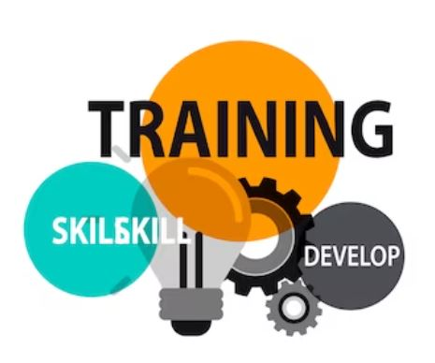
Training Development
Training for PMs and Leaders will include:
What is HSI and the Misconceptions about HSI
  Show the chart and missed opportunities
PM/Leadership equities in HSI
  System Personnel or Target Audience
  Specific Activities that support an early start to HSI
  Human-centered design in Risk Identification/Mitigation
Discuss how Organizational Policies and Processes affect the long term design, operational performance, and human performance
  Include those Key Activities identified from research; placed in a new bucket

Slide 16
Notional HSI Domain – “8th Domain”
Policy, Process, and Organization (PPO)
  Policies, regulations, and internal processes change with new technology, new science, new challenges, and new organizations
  Changes don’t always occur outside the Acquisition Product Lifecycle, but within or as a result of it
  Relevant activities review how these changes may affect human performance during system operation, affecting system and mission performance
  Earliest activities occur Pre-MSA and make sense to Acq Community
  HSI may already support some of activities, if brought in early
    CONOPS development, review and interview legacy system users/leadership, review lessons learned and mishap reports, support AoA/CBA, derive human performance metrics, review operational processes and policy changes

Slide 17
Examples of Affected Designs & Ops
Policy changes that were necessary
OBOGS new MIL-STD-3050 (Technology affected operations)
  Unexplained Physiological Episodes; hypoxia-like symptoms
  Required Aeronautical Engineers, Safety Engineers, Crew
  Systems Engineers, Flight Physiologists/Doctors, and more
  Many hours and meetings debating the standards
USAF Woman’s Initiative Team (WIT) support for
Anthropometric design changes (Policy affects designs)
  Changes how we design pilot and crew systems in the future to accommodate the population from which the USAF wants to recruit
  Changes to Air Force Instruction (AFI) 63-101/20-101
Physiological Episodes
Reported 2013-2018
USAF – 719
USN – 699
From NCMAS Report 2020

Slide 18

Examples of Affected Designs & Ops
Accidents caused Policy shifts
Space Shuttle Columbia (Processes affected operations)
  Reliance on past success as a substitute for sound
  engineering practices; “Normalization of deviance”
  “NASA created the Technical Authority process to ensure
  that the engineering, health, and safety communities
  have an independent, influential role in providing
  alternate perspectives during the decision-making
  process.” https://appel.nasa.gov/technical-authority/
USS John McCain (Processes affected operations) https://news.usni.org/2019/08/06/ntsb-
lack-of-navy-oversight-training-were-primary-causes-of-fatal-mccain-collision

Slide 19
Policy, Process, and Organization Defined
PPO Definition to be used for PM/Leadership training:
The organizational policies, processes, and practices that, in concert with operational requirements, effect human performance in the operation of a system or the system design concept, and when considered throughout the product life cycle, helps create and maintain safe operational parameters free from restrictions, limitations, or the need for alternative solutions.
NOTE: PPO will always be noted to be an “unofficial domain” or the “8th Domain”

Slide 20
Possible Activities to Place in PPO
Assess Personnel readiness, Mission tempo, and any funding issues
Participate in CONOPS development for the Mission and Functional Task Analysis
Assess current Policies that effect the nature of the design and any potential human touch points
Identify all system stakeholders, including sponsors, gaining organization(s), and user communities
Assess legacy systems; interview users and leadership on usability issues, workarounds, and expectations for a new system
Review Lessons Learned and any previous mishaps reports
Conduct Human Systems evaluations of new technology that may be included in the system design
Define Human performance requirements thresholds and objectives
Bottom Line: For training, PPO will act as a bucket to align the activities and their importance to Programs/Projects

Slide 21
Training Goals for PMs and Leaders
Specific training “HSI for Leaders” to show new progress in the field of HSI
Support the education of the next generation of PMs and Leads in understanding HSI
Clear picture of primary activities within all domains that HSI will support and WHY
Develop a case for increased value of HSI
Create a common message to the Acquisition Community
Create a fully integrated HSI assessment capability

Slide 22
Final Thoughts
Going Forward
NASA, currently developing training to include leadership equities in HSI, the necessary early HSI activities, and new Key Activities from research listed as part of a notional domain to PM, CE, LSE
Evaluate the training with PMs and Leadership to determine effectiveness
Share results and lessons learned with the larger HSI community
Recommendation: HSI Communities (Joint and Industry) collaborate with NASA on the identification of new Key Activities to support Early HSI Start and Human Performance as a result of Operational Performance Shifts

Slide 23

End Presentation
Tony Thomas, HSI Lead and Training Design
Anthony.thomas@nasa.gov

