Slide 1
Materials Selection
Commercial Lunar Payload Services (CLPS) Technical Workshop
Miria Finckenor
miria.finckenor@nasa.gov
May 2023

Slide 2
Purpose
The purpose of this presentation is to give a broad overview of spacecraft materials and materials selection processes.
The information in this presentation is intended to assist the CLPS vendors in their mission to provide access to the Moon. This NASA Tech Workshop does not provide formal direction in regards to materials requirements.
NASA Subject Matter Experts provide guidance, suggestions, and best practices that will be educational and informative to help assist commercial vendors during their design, development, testing, and integration.
The data is not all-inclusive, i.e. I can’t cover 100% of all materials.
The main reference for this work is Aerospace Materials and Applications, edited by Dr. Biliyar Bhat, available from AIAA.
Notes:
The Aerospace Materials book also has a chapter on materials for launch vehicles.

Slide 3
Agenda
Spacecraft design and materials requirements
Flammability and outgassing considerations
Structural materials
Thermal control materials
Thermal protection materials
Radiation shielding
Meteoroid/orbital debris shielding
Optical materials
Solar array materials
Lubricants
Seal materials
Adhesives
Lessons learned
Notes:
Avionic materials are being covered in another presentation.

Slide 4
Spacecraft Materials 101
Test what you fly, fly what you test
Cheaper to choose the right material during design than to replace a material after the build
The right material for one environment may not be durable in a different environment.
  Cross-program Design Specification For Natural Environments (DSNE) SLS-SPEC-159
NASA design drawings have a M&P signature/approval block.
As drawings are released, a materials list, called a Materials Identification and Usage List (MIUL), for the project is generated.
  This includes processes such as anodizing or chemical conversion coating (e.g., alodining).
  Each material has a unique material code in MAPTIS, e.g. Stainless steel 302/304 (CRES 302/304) series as used in fasteners are material code 10334
Notes:
How do we make sure that our spacecraft is going to survive? How do we choose the right material from the beginning rather than a costly last-minute substitute? And I will keep hammering this point, a material may be great in one environment and fail in another. The DSNE is the SLS environment definition, and it’s divided into the different areas, including launch site, lunar orbit, deep space, etc. Materials used in critical applications, such as life-limited materials, safety- and fracture-critical parts, liquid oxygen/gaseous oxygen (LOX /GOX) batch-sensitive materials, or materials requiring treatment to prevent hydrogen embrittlement, should be traceable by lot through all critical processing steps and the end-item application.

Slide 5
NASA-STD-6016
NASA-STD-6016 Standard Materials and Processes Requirements for Spacecraft
Comprehensive standard for all kinds of materials (aluminum, steel, titanium, beryllium, superalloys, nonmetallics, composites, etc.) and processes (forging, casting, corrosion protection, heat treat, etc.)
Also covers verification testing and packaging
Some of it is more applicable to manned spacecraft, but it is still useful for unmanned vehicles.
Planetary protection would not be applicable for the Moon but would be for Mars, other Exploration targets
Notes:
Planetary protection is minimizing microbes, spores, other biological materials.

Slide 6
Useful NASA/MSFC Standards
MSFC-STD-3679 Process Specification-Welding Aerospace Flight Hardware
NASA-STD-5006 General Welding Requirements for Aerospace Materials
NASA-STD-5009 Nondestructive Evaluation Requirements for Fracture-Critical Metallic Components
NASA-STD-5017 Design And Development Requirements For Mechanisms
NASA-STD-5019 Fracture Control Requirements for Spaceflight Hardware
NASA-STD-5020 Requirements for Threaded Fastening Systems in Spaceflight Hardware
NASA-STD-6012 Corrosion Protection for Space Flight Hardware
NASA-STD-6030 Additive Manufacturing Requirements for Spaceflight Systems
NASA-STD-6033 Additive Manufacturing Requirements for Equipment and Facility Control

Slide 7
Spacecraft Design and Materials Requirements
Resources for material and component selection
GIDEP - Government-Industry Data Exchange Program
  Alerts on all kinds of products and vendors
  Material shortages and obsolescence
  Defective materials
  Recalls
  Counterfeits
  Noncompliance with process specifications
  Foreign object debris (FOD) potential
  Suppliers with continued or egregious violations are placed on suspect contractor list and face debarment
Notes:
GIDEP pronounced guy-dep. Noncompliance with process specs include failing to batch-test things like fasteners, failure to follow military specs for heat-treat or anodizing

Slide 8
Materials Obsolescence
EPA regulations can impact material availability and performance.
  Chlorofluorocarbons (CFCs) like Freon were replaced with hydrochlorofluorocarbons (HCFCs), which in turn are being replaced with aqueous cleaners, hydrofluoroether compounds, and others.
  Removal of perfluorooctanoic acid (PFOA) from the Teflon manufacturing process affected over 900 products in the MAPTIS database.
  3M is ceasing production of per- and polyfluoroalkyls (PFAs) in 2025.
Vendors can move facilities or close entirely.
Maintain good communication with vendors.
If possible, be aware of long lead times and purchase parts accordingly.

Slide 9
Flammability and Outgassing
NASA-STD-6001 Flammability, Offgassing, and Compatibility Requirements and Test Procedures
Formerly known as NHB (NASA Handbook) 8060.1
Created after the Apollo 1 fire, this handbook, now standard, calls out the specific materials tests for spacecraft such as flammability in both normal and oxygen-enriched environments, toxicity, and odor.
Tables 1 and 2 in NASA-STD-6001 call out the NASA-required and supplemental tests for each material depending on use, e.g. habitable compartment, breathing gases, reactive fluids such as hypergols.
X-1A and X-2 test planes were lost due to a gasket in the engine becoming explosively unstable when exposed to LOX.
Notes:
Materials selection is made following NASA-STD-6016 then tested per NASA-STD-6001. What tests need to be performed will depend on where the material will be used. Materials for an unmanned vehicle will not need toxicity or odor testing but may need fluid compatibility testing.

Slide 10
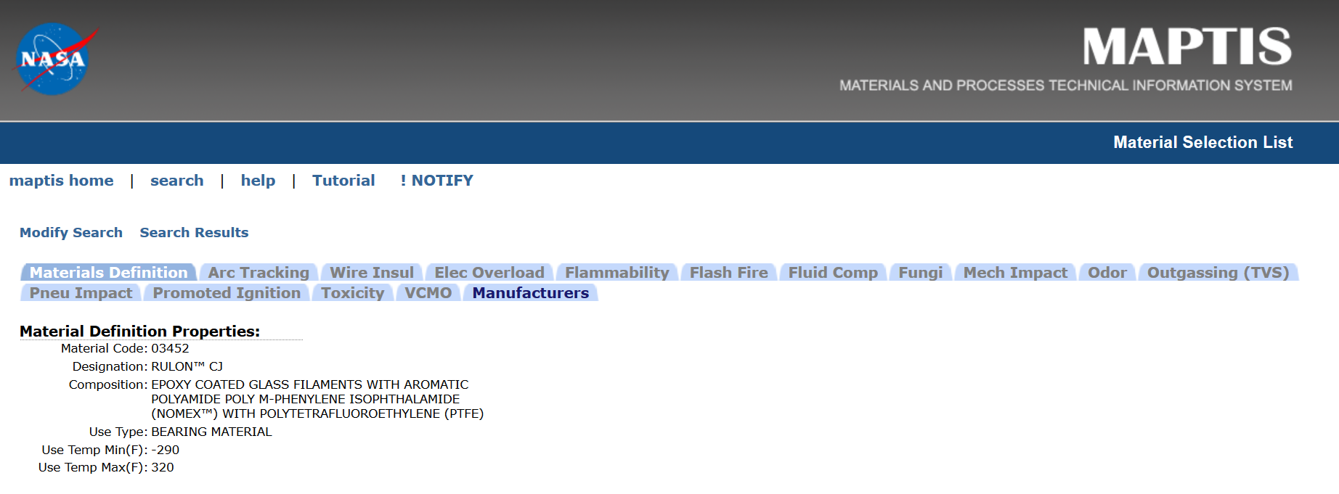
Flammability and Outgassing
NASA-STD-6001 test results can be found in the Materials and Processes Technical Information Service
https://maptis.nasa.gov/
Notes:
One of the databases in MAPTIS is the Materials Selection database. You can look up materials by use, by trade name, or by composition. Obsolete names can also be searched, for example Chemglaze A-276 paint is now known as Aeroglaze A-276, and both names are in the record. For some materials, the use temperature is given. This started with the old NHB 8060.1 testing, so there’s arc tracking and other wire insulation tests, flammability and other oxygen compatibility tests.

Slide 11
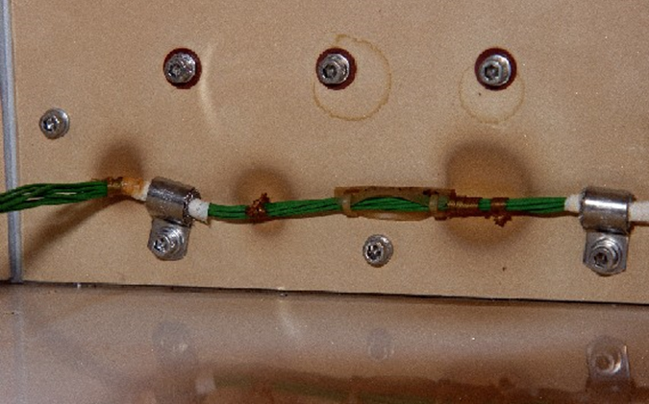
Outgassing
Offgassing = volatile release in atmosphere (concern for astronauts)
Outgassing = volatile release in space
The vacuum of space will cause outgassing. The outgassed molecules then deposit on line‑of‑sight surfaces and are more likely to deposit on cold surfaces. This molecular contamination can affect optical properties of vehicle and payload surfaces and spacecraft performance, particularly for sensitive optics.
Notes:
Offgassing is like a new car smell. If you have sensitive optics on board, a star-tracker, a camera, a window, a charge coupled device, you’re going to want to pay attention to material outgassing.

Slide 12
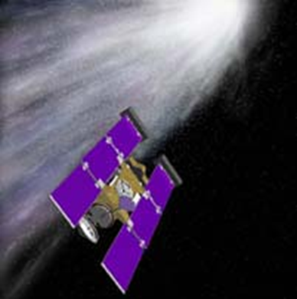
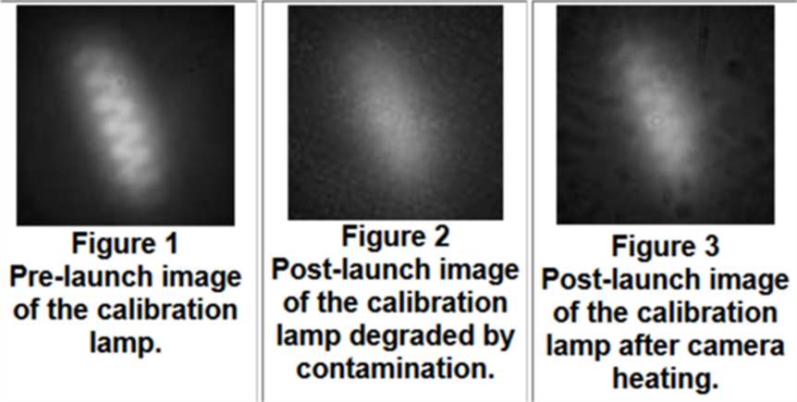
Outgassing – Lesson Learned
Stardust Navigation Camera
Contamination from material outgassing degraded camera from being able to detect 10th visual magnitude stars to 7th.
Heating cycles and orienting surfaces towards the sun helped drive off the volatiles.
Camera could then detect 9th visual magnitude, no loss of science

Slide 13
Structural Materials
Any part where structural failure would lead to catastrophic failure needs fracture control.
Fracture control includes nondestructive evaluation (NDE) for flaw or crack detection. NDE includes eddy current, fluorescent penetrant, magnetic particle, radiography, and ultrasonics.
Fracture control is not needed for those materials that are non-structural and not subject to cracking, e.g., MLI blankets.
Be mindful of materials with a shelf life. Generally, lower storage temperature and lower humidity extends the shelf life, as does minimizing exposure to light (both sunlight and fluorescent lighting).

Slide 14
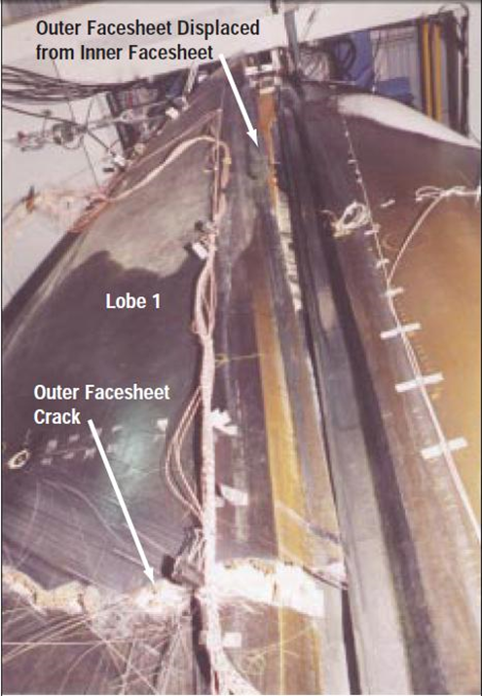
Structural Materials – Lesson Learned
X-33 honeycomb composite tank
Need closed cell cores (dependent on application) and redundant permeation barriers in cryogenic applications to eliminate cryopumping.
When the X-33 tank was filled during testing, liquid hydrogen leaked through microcracks in the inner facesheet, and the nitrogen purge gas was pulled through microcracks in the outer facesheet to fill the core. When the tank was drained and started warming, the core pressure increased to the point of failure, when the outer facesheet and core separated and peeled away from the inner facesheet.
Notes:
Cryopumping is “the influx of gas into an unclosed volume resulting from the vacuum generated when cryogenic temperatures liquefy and condense the gas on the cryogenic boundaries of that volume.”

Slide 15
Structural Materials
The 5000-series aluminum alloys containing more than 3% magnesium shall not be used in applications where the temperature exceeds 66 °C (150 °F), because grain boundary precipitation above this temperature can create stress-corrosion sensitivity.
Same for the 300-series corrosion-resistant (CRES) stainless steel – they should not be used at temperatures above 370 °C (700 °F) for extended periods of time.
Chlorinated solvents can cause stress corrosion cracking of titanium. This includes chlorine in tap water.
Protective coatings may only delay onset of stress corrosion, not entirely prevent it.
Surface treatments such as carburizing or nitriding may increase susceptibility to stress corrosion cracking.
Notes:
Some highlights from the NASA-STD-6016 document here.

Slide 16
Corrosion Protection
Alodine ≠ Anodize
Chemical conversion coatings per MIL-DTL-5541, e.g. Alodine, Iridite, Chem film, Boegel, Bonderite, are brushed on or the part is dipped.
Anodic coatings per MIL-A-8625 (sometimes called MIL-PRF-8625) involve the part being submerged in an acid solution and electrical current passed through it. Types and classes in the MIL spec call out the type of acid and whether dye is used, i.e., Type II Class 2 is dyed sulfuric acid anodized aluminum. Usually the color is called out per Federal Standard 595B.
Anodic coatings may cause a reduction in fatigue life - understand the design and application prior to using anodic coatings.
Notes:
Older chemical conversion coatings use hexavalent chromium, newer ones do not. Be aware that some thermal control coatings may require bare metal for adhesion, you will need to mask these areas from conversion coating application.

Slide 17
Manufacturability
Use geometric dimensioning and tolerancing.
Choose dimensions close to standard stock.
Use common angles if possible, 45° as opposed to 40°
Limit decimal places to the specificity required, use realistic tolerance levels. Be aware of tolerance stackup.
Create a separate drawing for finishing if complex masking or several processes are used on one part.
Design for assembly and disassembly, including personnel access and wrench clearance
Think ahead with coating holes, blind holes, and difficult masking requirements.
Rounding edges implies no radius requirement and permits adhesion of an adequate thickness of protective coatings. All that is needed is simple wording on drawings such as ‘Remove all burrs and sharp edges.’
Notes:
Example of standard stock dimensions – don’t pick 57 mil aluminum, increase to 63 mils or decrease to 50 mils and adjust stiffeners.

Slide 18
Manufacturability
Keep weld length to a minimum.
Select a weld joint with the least amount of filler.
Allow for shrinkage and distortion.
When using structural I and H beams, be aware of the irregular dimensions of the mill-supplied beams and call out your tolerances accordingly.
Consider additive manufacturing as a method to reduce cost, schedule, and number of manufacturing steps.
Understand handling and packaging requirements for electrostatic sensitive parts.
Be aware of your shop limitations – size and weight, forklift and crane capacity, capabilities for heat treat, surface treat, paint, cleaning, packaging.

Slide 19
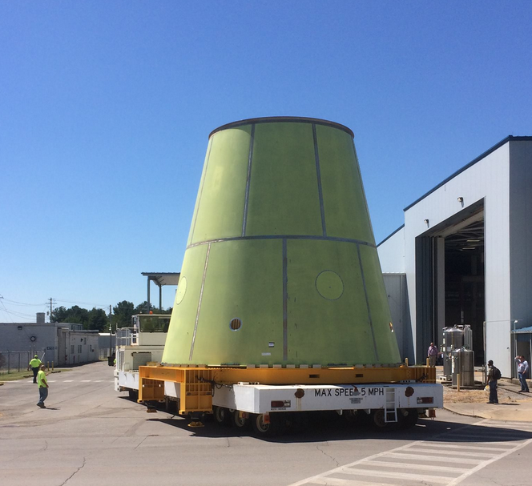
Will it fit?
…yes
Photo courtesy of C. Bahr
Notes:
This is the Launch Vehicle Stage Adapter (LVSA) heading into one of our buildings for foam spray. Did we have accurate dimensions for the crawler, the support frame, the LVSA itself, the building door? Does the door move enough out of the way? Will there be interference from light fixtures?

Slide 20
Thermal Control
Apply system requirements for worst-case space environments.
    Special attention:
      to differences in thermal expansion coefficients for deployable retention devices/release mechanisms.
      to thermal effects on wiring, interconnects and solder joints
      to thermal gradients in deployable structures/mechanisms
      to glass transition temperatures for polymeric materials
If thermal modeling is not yet available, assume +/- 100 ºC.
Cold surfaces may act as “getter” for molecular contamination.
Thermal cycling can cause cracking, crazing, delamination, and other mechanical problems, particularly in assemblies where there is mismatch in the coefficient of thermal expansion.
Notes:
Some of these are really obvious, but I’m repeating them here anyway. Getter means more likely to deposit there.

Slide 21



Thermal Environment
Be aware of beginning of life to end of life changes in optical properties.
  Increase in solar absorptance α_{s} due to UV darkening or contamination will result in warmer surface.
Solar absorptance α_{s} is the fraction of incident solar radiation that is absorbed by the material, generally measured between 250 and 2500 nanometers.
Infrared emittance ε_{IR} is a measure of the rate heat is irradiated (emitted from) a material, generally measured in the 3 to 30 micron wavelengths.
The lower the ratio of alpha over epsilon, the smaller the thermal variance.
Solar reflectance
Infrared emittance
Solar absorptance
Notes:
Solar absorptance is 1 minus the solar reflectance for materials that aren’t transmissive.

Slide 22
Thermal Control
Optical Properties for Common Spacecraft Materials
Material | Solar Absorptance α_{s} | Infrared Emittance ε_{IR}
10 mil silver/Teflon | 0.10 | 0.80
Chem. conv. coated (Iridite) aluminum | 0.30 – 0.50 | 0.04 – 0.07
Sulfuric acid anodized aluminum | 0.50 – 0.60 | 0.75 – 0.85
Z93P white thermal control coating | 0.15 | 0.91
Z93P – contaminated | 0.20 – 0.40 | 0.91
Aluminized beta cloth | 0.35 | 0.85
RM-550-IB black thermal control coating | 0.97 | 0.91
Gold/Kapton | 0.30 | 0.02
Notes:
Not all silver/Teflon is alike, the thinner the Teflon, the lower the emittance. Here I have 10 mil thick silver/Teflon, the emittance for 2 mil silver/Teflon is 0.60. Z93P is a common radiator coating, but you have to keep it clean because it will darken in the presence of molecular contamination. Beta cloth is a glass cloth used as a cover for multi-layer insulation thermal blankets. RM-550-IB is a black coating for absorbing light or for contrast in a docking target. Gold/Kapton is the shiny stuff you see in pictures of the Apollo lunar module.

Slide 23
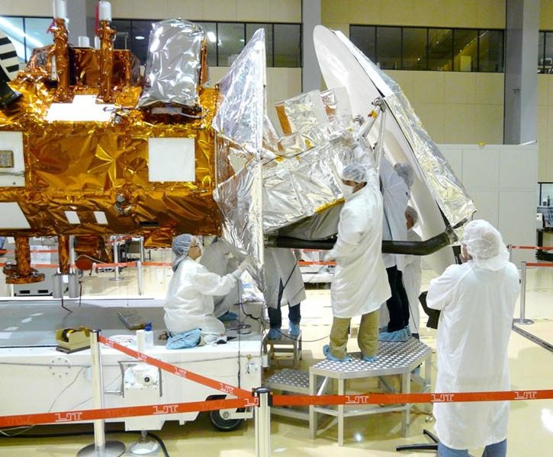
Thermal Control
Multi-layer insulation design
NASA-TP-209263 “Multilayer Insulation Material Guidelines”
Options for standard blanket layers, thread selection
Hook and loop tape fasteners, tie downs, etc.
Electrical bonding and grounding
Space environmental effects concerns
MLI blanket installation on Aquarius probe

Slide 24
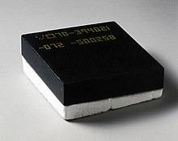
Thermal Protection
Thermal protection is specific to launch and landing heating.
Thermal protection can be:
Tiles
  Fragile, needs to be water-proofed
  Can be formed in various densities
Ceramic-matrix composites (CMCs)
Ablatives
  Honeycomb material with a resin or polymer injected into each cell.
  Avcoat used on Apollo and Orion capsules
  Phenolic-impregnated carbon ablator (PICA) Stardust sample return capsule
  SLA-561V used on the Viking landers.
Notes:
Heat shield materials selection is dependent on the peak heat flux and stagnation pressure during reentry, as well as mechanical strength, density, entry angle, and the shape of the heat shield (i.e., blunt-body, sphere-cone, biconic, or non-axisymmetric).

Slide 25
Radiation Shielding
Higher Z (higher atomic number) materials protect from galactic cosmic rays, trapped radiation, solar flare, etc.
Lower Z materials protect from beta particles and Bremsstrahlung radiation.
For unmanned missions, focus on radiation shielding for avionics to prevent single event upsets, latchups, etc.
  COTS (Commercial Off the Shelf) electronics are not rad hard
  Use static rather than dynamic random access memory (RAM)
  MOSFET transistors can accumulate charge and end up permanently open or closed
  Hamming code to look for bit flips
  Watchdog timer to resolve latchups without human intervention
Notes:
The Juno probe has an electronics “vault” with 1-cm thick titanium to withstand the intense radiation around Jupiter.

Slide 26
Meteoroids and Space Debris
The fundamental method of protecting a spacecraft from hypervelocity impact is the Whipple shield. The sacrificial bumper breaks up the impacting particle into smaller pieces or, in case of extremely high impact velocities, vapor. The number of bumpers and the spacing between them and the pressure wall or other critical hardware will be determined by desired probability of no penetration (PNP) and spacecraft weight and volume constraints.
MLI, honeycomb, or augmented shield
Bumper
.
Pressure wall
Impact particle
Notes:
A thick wall would be too heavy and really not stop particles the way a Whipple shield can. This outer shield layer or bumper breaks up the impact particle into smaller pieces or can even vaporize it. On Space Station this middle layer has layers of Kevlar and Nextel fabric just like a bulletproof vest. This absorbs all the impact particles or at least slows them down and protects the pressure wall.

Slide 27
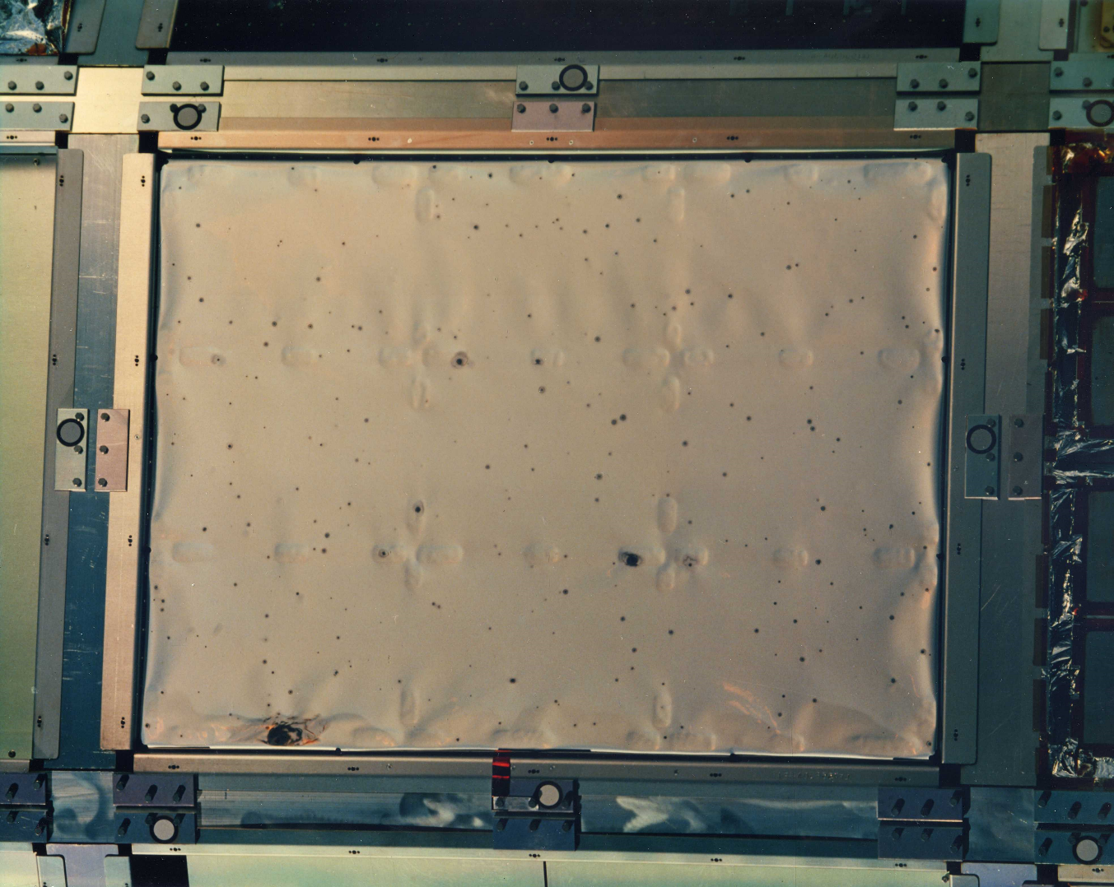
Space Debris
Penetration of thin film materials like this 5 mil silver/Teflon blanket from LDEF
.
Notes:
This is one of the leading edge experiments on the Long Duration Exposure Facility (LDEF), and that’s over 300 impacts in a 3 foot by 4 foot area. This is a silver/Teflon blanket, and at each penetration, atomic oxygen oxidized the exposed silver, so the black areas are discolorations around a smaller hole. This eventually affects the thermal performance of the blanket. The leading edge (ram) gets a lot more impacts than the trailing edge (wake)

Slide 28
Optical Materials
Window materials, such as quartz, fused silica, and sapphire, should have low impurity content.
  Radiation reacts with the impurities to degrade transmission.
Cerium oxide coating may improve durability.
An optical solar reflector (OSR) is a second-surface mirror where the metal, usually aluminum or silver, is protected by a layer of quartz.
  Can be used for thermal control where metallized Teflon won’t work
Minimize particulate (dust) and molecular (outgassing) contamination particularly in line-of-sight to sensitive optics

Slide 29
Solar Array Materials
Recent years have seen significant improvement in power output and durability for solar cells:
CIGS - copper indium gallium (di)selenide
IMM - inverted metamorphic multijunction
GaAs – gallium arsenide
Triple-junction GaInP/GaAs/Ge
High efficiency silicon
Cerium oxide-doped cover glass to improve durability.
Minimize contamination, electrical arcing, and interconnect degradation.

Slide 30
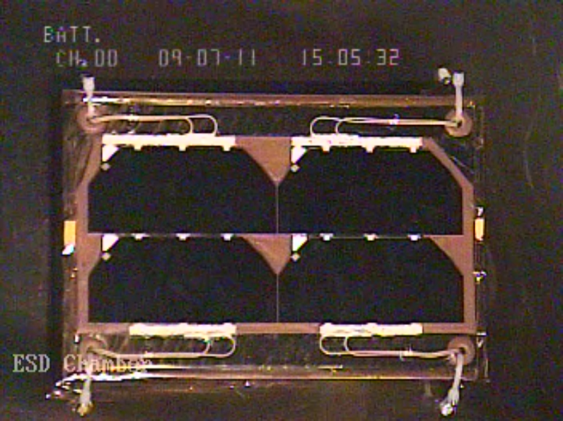
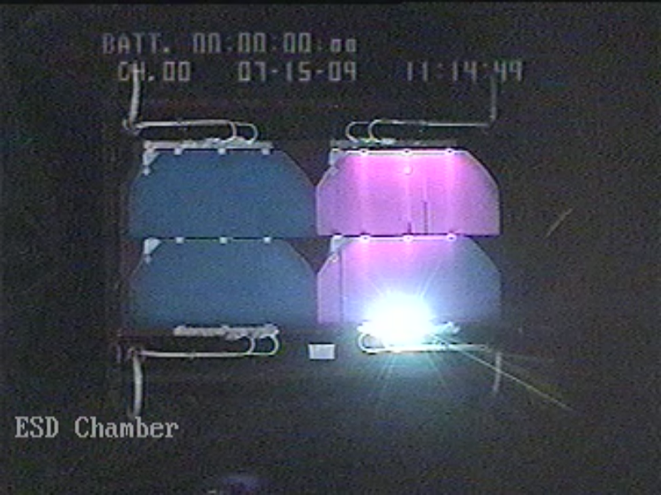
Arcing in Solar Arrays
Electro-static Discharges (ESD) can occur on GEO satellites due to the very high charging levels in the environment.
A poor design of an external spacecraft system can lead to an ESD event that can permanently damage the system.
MSFC frequently tests systems (like solar arrays) for ESD generation.
Pre-test view of a solar array coupon in MSFC’s ESD Test Chamber
ESD generation (arcing) on a solar array coupon in a GEO environment

Slide 31
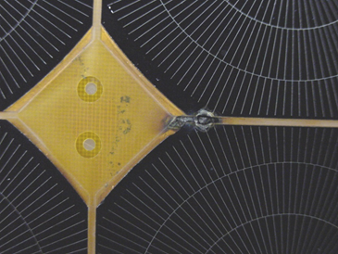
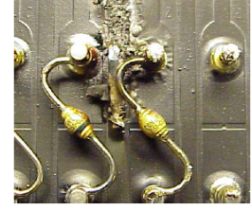
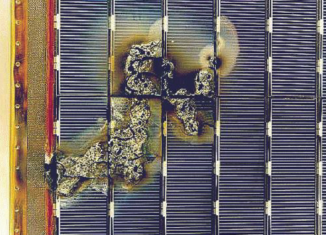
Solar Array Damage Due to
Electro-static Discharge (ESD)
ESD damage (close-up) on ISS solar array sample
Credit: J. Michael Bodeau
Credit: T. Schneider
ESD damaged solar array diode board
ESD damage on a European Space Agency satellite solar array
Credit: ESA
Notes:
When I previously talked about string spacing, the difference in voltage between adjacent strings, the blocking diodes, these are lessons learned from solar arrays like these. There is also a synergism between meteoroid/debris impact and plasma where an arc can occur because of an impact.

Slide 32
Designing to Mitigate ESD
Mitigation of Charging
Use cable shields of aluminum or copper foil (not metallized plastic).
Shields should be terminated when they enter the spacecraft structure from the outside and carefully grounded at the entry point with a 360-deg EMC connector.
Braid shields on wires should be soldered to any overall shield wrap and grounded at the entrances to the spacecraft.
Standard coaxial shielding is insufficient.
Electrically bond components or use grounding straps.
Do not use bearings for a ground path. For a rotating joint, route grounding path through at least two slip rings.
Check the ground system continuity during fabrication and again after integration.
Limit use of dielectrics like Teflon and Kapton.

Slide 33
Designing to Mitigate ESD
Preventing Arcing Due to Plasma
Use low voltage (<55 V) systems.
Solar array strings should be laid out so that no two adjacent cells have a voltage difference > 40V.
Room temperature vulcanizing (RTV) silicone “grout” between adjacent solar cells and strings to block sustained arcs.
Blocking diodes in each string, so that if arcing occurs, it is not sustained.
Verify new designs in a simulated plasma environment with maximum array voltage or highest floating potential.
Use electrically conductive or at least static-dissipative materials.
  Make sure the conductive coating is directly on metal, not a non-conductive primer
Notes:
RTV silicone is great for protecting solar arrays, but you need to be careful if it’s line-of-sight to sensitive optics.

Slide 34
Lessons Learned - Wiring
An electrical fire during STS-61-A Spacelab D-1 mission in 1985 led to a better awareness of insulation fraying and abrading. During this incident, when the insulation was worn through, the wire short-circuited and caught fire, but the breaker did not trip.
Kapton wire insulation is fine for low voltage wire but may be a concern for higher voltage use such as power cables.

Slide 35
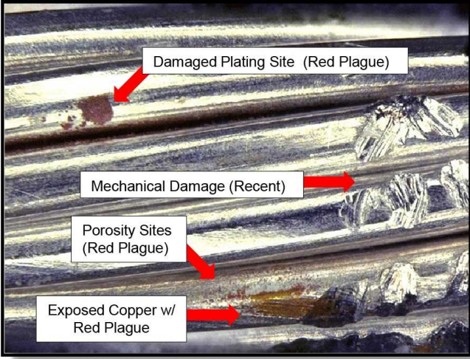
Lessons Learned - Wiring
Be aware of tin whisker/tin pest formation. Pure tin plating is subject to a crystal instability problem which increases at colder temperatures. It can be prevented by adding small amounts of lead, bismuth, or antimony to the tin. Applying a conformal coating such as Arathane 5750 to a thickness of 2 to 3 mils also prevents tin whiskers.
Be aware of “red plague” corrosion of silver plated copper wire, especially if improperly stored.
  Other factors include poor crimping, poor plating control, mechanical damage during handling.
Photo courtesy of NASA/JSC R. W. Cooke
Notes:
This crystal transformation results in an expansion of the crystal lattice. This expansion causes the tin plating to crack and spall off the substrate. It can short out micro-electronics and produce FOD. It is the likely cause of the failure of three Hughes HS-601 commercial communications satellites due to intermittent electrical shorts.

Slide 36
Tribology Recommendations
    NASA Space Mechanisms Handbook and Reference Guide
        https://www.grc.nasa.gov/WWW/spacemech/CD-info.html
      AIAA S-114-2005 Moving Mechanical Assemblies for Space and Launch Vehicles
All ferrous material bearings should employ a corrosion-resistant steel
Recommended typical greases with flight history are Braycote 600, 601, 602, 815Z
Recommend solid lubricants for cryogenic temperature use, such as gold, silver (if not in low Earth orbit), molybdenum disulfide, fluoropolymers, ultrahigh molecular weight polyethylene (UHMWPE), etc.
Graphite-based lubricants will not work in vacuum due to the lack of moisture and will become abrasive.
Liquid lubricants have limited temperature range. If you must use a liquid, the lower the volatility, the better.
Notes:
Some commonly used liquid lubricants include perfluoropolyethers (PFPE’s), multiple alkylated cyclopentane (MAC), and polyalphaolefins (PAO’s).

Slide 37
Tribology (Mechanisms and Lubricants)
Lessons
Most deployable structure/mechanism anomalies are due to:
Insufficient torque margins
Non-redundancy of motion producing elements
Snagging
Stiction (static friction)
Binding
Thermal cases ignored
Improper lubrication

Slide 38
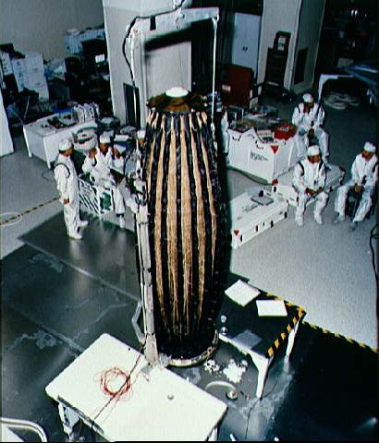
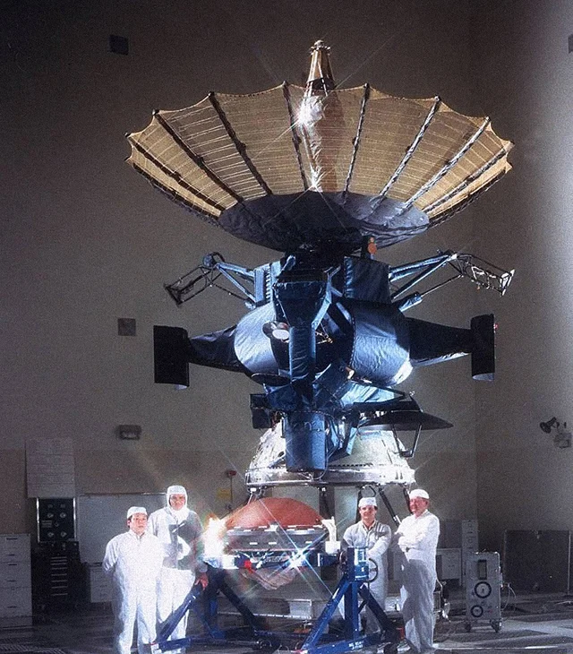
Tribology Lesson Learned
Galileo high-gain antenna failed to deploy, likely due to long storage after Challenger accident.
Notes:
Galileo was built with a low-gain, backup antenna, which saved the mission.

Slide 39
Seals
Seal materials for propulsion elements not addressed here.
Any seal material used in hydraulic systems should be checked for fluid compatibility.
In general, seals are made of metal or elastomer.
  Metal seals can be made of soft aluminum, copper, or stainless steel, although nickel, Monel, and Inconel have been used in the past.
  A wide variety of elastomeric seal materials is available, including butyl rubber, silicone, Viton, Teflon, Kel-F fluoropolymer, and Neoprene.
  Elastomeric seal materials to be used on windows should be thermal vacuum baked prior to flight to minimize outgassing.

Slide 40
Adhesives
Structural adhesives, such as those used in honeycomb laminate manufacture
  Two-part epoxies, modified phenolics, or thermosetting resins
Epoxies can be highly customized, for example, by adding aluminum oxide filler to improve thermal conductivity.
Epoxy-amine or amide polymer adhesive systems will react with copper and result in blue to green corrosion products.
The adhesive should have adequate elasticity to compensate for two substrates with different CTE.
Surface preparation should be strictly followed.
Be aware of limited pot life, exothermic reactions, and solvent resistance.

Slide 41
Adhesives
Non-structural adhesives
3M 966 acrylic is commonly used in commercially available thermal control tapes.
3M 9703 is an electrically conductive version.
Arclad 8026, NuSil CV-1144, and DC93-500 are common silicone adhesives.
Polyurethanes work well in low temperatures but are sensitive to moisture
Cyanoacrylates – good strength, fast setting, but poor solvent resistance and poor durability on some surfaces.
Polyimides work well in high temperatures but have low peel strength and sometimes require high temp cure.
Notes:
3M 966 is sometimes Y966.

Slide 42
Particulate Contamination
For many spacecraft, only particulate contamination requirement is “visibly clean” for Earth activities.
Choose materials that do not shed particles
  Don’t add to space debris problem
  Test in vacuum chamber before use
Start with clean materials and assemble in a clean room
  Much easier to keep clean than to try to clean it afterwards
  Choose the right clean room class per ISO 14644-1
  Choose the right level of clean room materials
    Smocks vs. full “bunny suits”, hair nets, shoe covers, etc.
    Use clean room gloves, not “exam gloves”, even if they are “powder-free”
  Witness samples and particle counters for monitoring

Slide 43
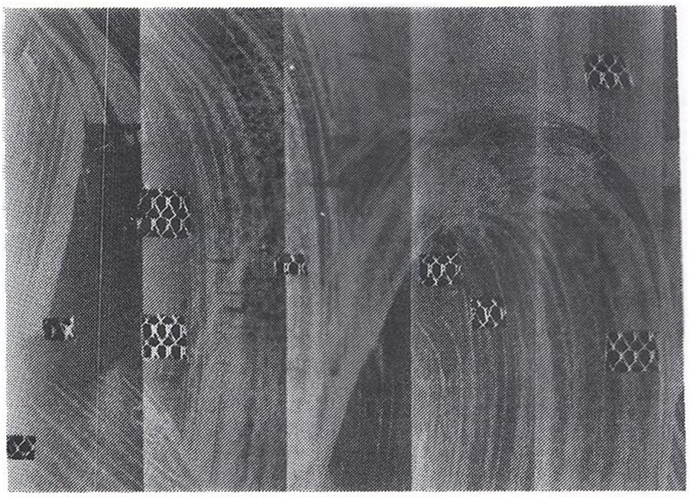
Ground Support Equipment
Be mindful of what touches flight hardware
Particulate in cleaning solvents
  Not all solvents are created equal - hardware store isopropyl alcohol may leave residue or have other chemicals in the mix
  Choose at least an American Chemical Society (ACS) graded solvent for purity
When cleaning hardware, change wipes frequently so you're not smearing contamination around.
Returned hardware from Solar Max Mission.
Samples removed for analysis.

Slide 44
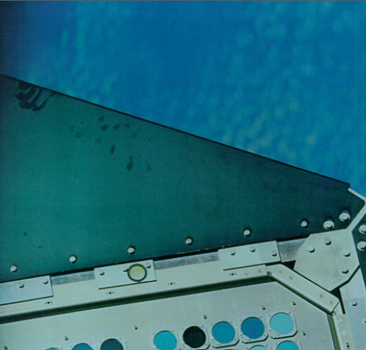
Ground Support Equipment
Be mindful of what touches flight hardware
Lesson learned: LDEF tray cover silicone seals
  Experiments had covers in place during integration
  Unbaked seals on the tray covers left a silicone residue on the trays, which then reacted with the space environment
Gloves on!

Slide 45
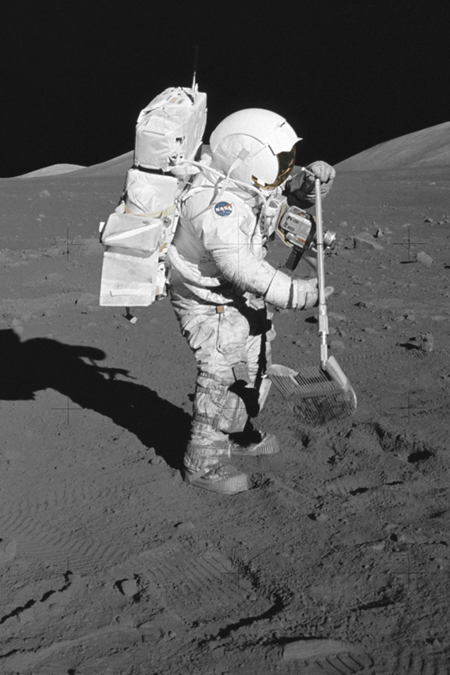
So if you’re going to the Moon…
Test:
Vacuum/outgassing
Thermal cycling
Solar wind radiation
Transit through van Allen belts
Ultraviolet radiation
Meteoroid impact
Dust mitigation for surface operations
Check the DSNE for exact environments.
Notes:
Unless you have a long dwell time in low Earth orbit, atomic oxygen testing is not needed.

Slide 46
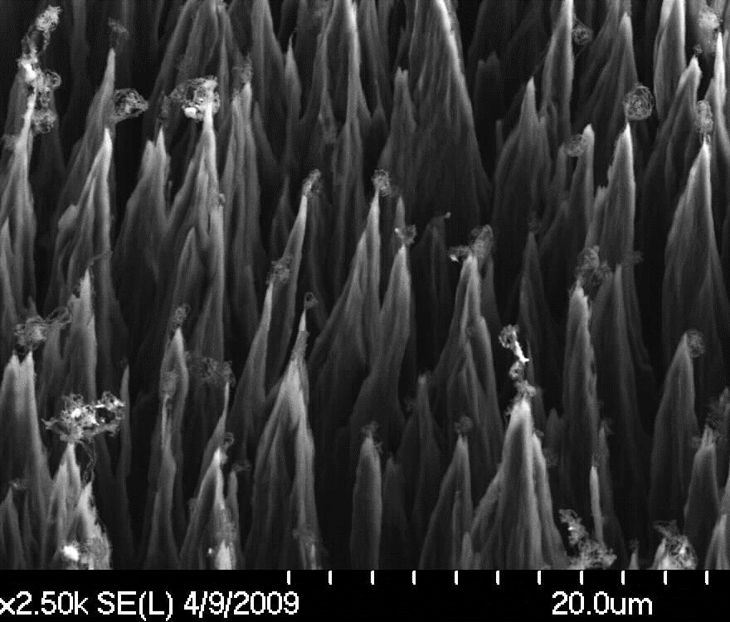
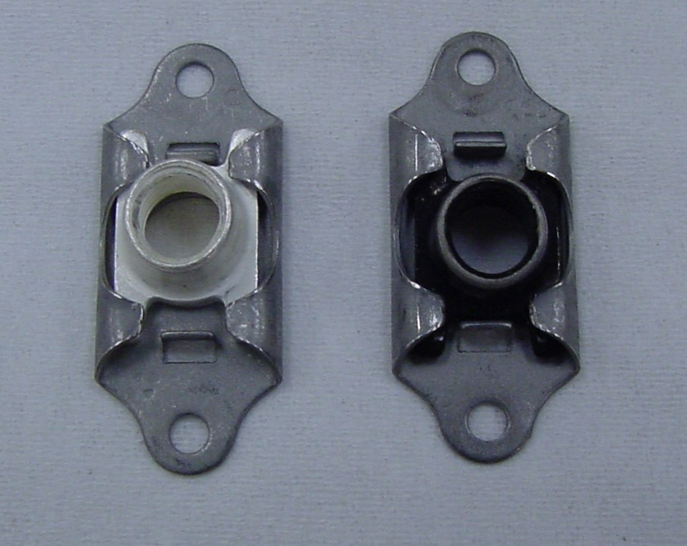
Any Dwell Time in Low Earth Orbit?
If spending any time in low Earth orbit, be aware that atomic oxygen (AO) reacts with most non-metallic materials and some metals
  Any material with carbon, nitrogen, sulfur, and some fluorine bonds, breaking those bonds and eroding the material
  Oxidizes many metals, especially destructive to silver and osmium
SEM photo of AO-eroded pyrolytic graphite
Unexposed and AO-exposed silver-plated nutplate
Notes:
AO erodes materials by breaking the bonds, whether single, double, or triple-bond carbon, bonds with nitrogen, sulfur, hydrogen, polymers with oxygen in the backbone. If you look at the polymers under scanning electron microscope, it usually has a roughened surface, kind of like shag carpet, where the material has been removed. It also reacts with a lot of metals, including aluminum, nickel, especially copper, silver, and osmium.

Slide 47
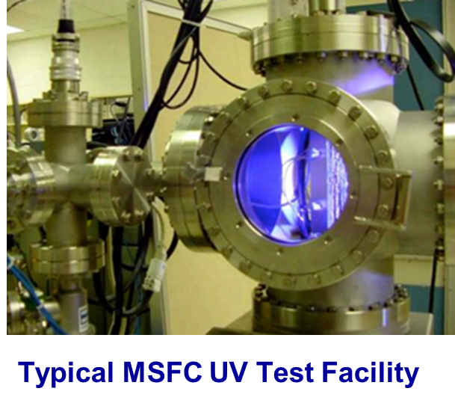
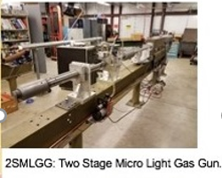
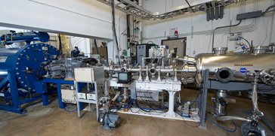
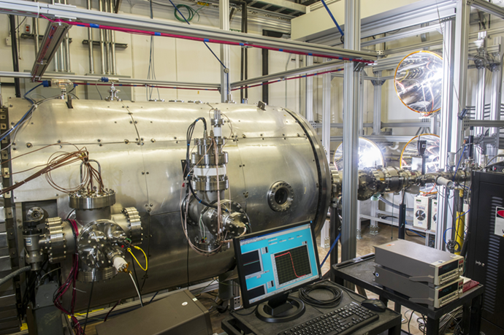
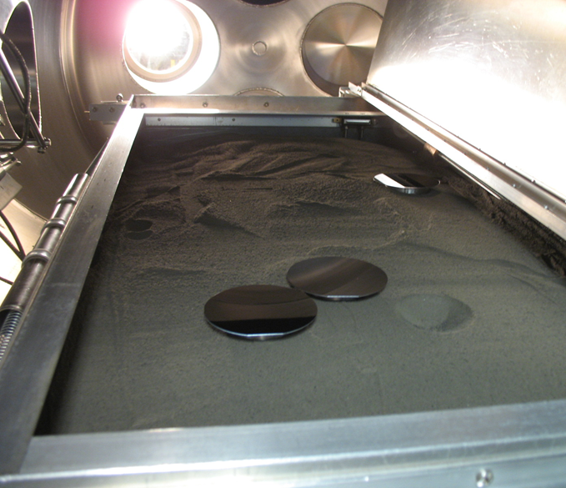
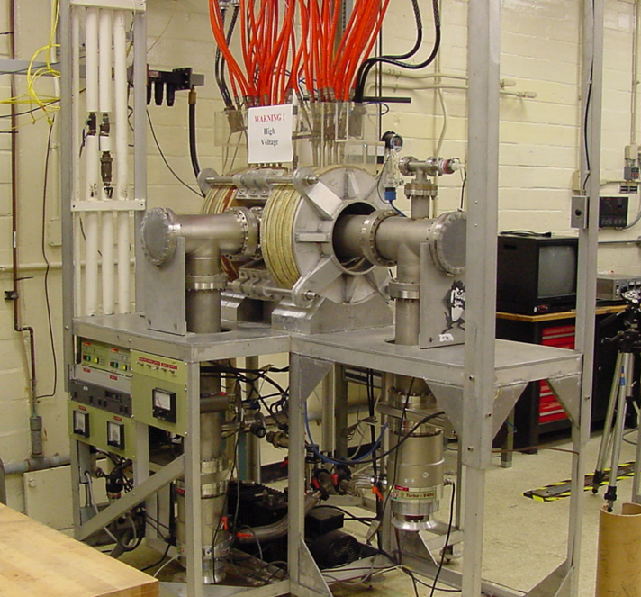
MSFC Space Environmental Effects Capabilities
MSFC is a world-class leader in space environmental effects and can perform testing of materials and components through Space Act Agreements and Cooperative Agreements.
Combined Environmental Effects Facility
High Intensity Solar Environment Test
Lunar Environment Test System
Atomic Oxygen Beam Facility
Notes:
Test what you fly, fly what you test.

Slide 48
Contact Info
SEE Team Lead Mary Nehls mary.nehls@nasa.gov
Miria Finckenor miria.finckenor@nasa.gov

Slide 49
Other References
“RED PLAGUE CONTROL PLAN (RPCP): The Control of Cuprous / Cupric Oxide Corrosion (Red Plague) in Silver-Coated Copper Wire, Cable, and Harness Assemblies”, Robert Wm. Cooke, JSC-CN-19990, 2010.
Vaughn, T., “Manufacturing Development Challenges for Exploration”, presentation to the Ares Program Manager Review, July 17, 2009.
“Final Report of the X-33 Liquid Hydrogen Tank Test Investigation Team,” NASA Marshall Space Flight Center, Huntsville, AL 35812, May 2000.
Bedingfield, K. L., Leach, R. D., and Alexander, M. B. (eds.), “Spacecraft System Failures and Anomalies Attributed to the Natural Space Environment,” NASA Reference Publication 1390, August 1996.
Finckenor, M. M., and Dooling, D., “Multilayer Insulation Material Guidelines,” NASA TP-1999-209263, April 1999.
Laub, B., and E. Venkatapathy, E., “Thermal Protection System Technology and Facility Needs for Demanding Future Planetary Missions,” International Workshop on Planetary Probe Atmospheric Entry and Descent Trajectory Analysis and Science, Lisbon, Portugal, 6-9 October 2003.
Christiansen, E. L., “Handbook for Designing MMOD Protection,” NASA JSC- 64399, Jan. 2009.
Bailey, S., and Raffaelle, R., “Space Solar Cells and Arrays,”, In Handbook of Photovoltaic Science and Engineering, 2nd Edition, edited by A. Luque and S. Hegedus, Sheila Bailey and Ryne Raffaelle, Wiley, New York, 2011.
McMurtrey, E. L., “Lubrication Handbook for the Space Industry,” NASA TM-86556, Dec. 1985.
Fusaro, R. L., “NASA Space Mechanisms Handbook,” NASA TP-1999-206988, July 1999, particularly Chapters 15 and 22.

