Slide 1
Absorption Laser Differential Interferometry for Simultaneous Colinear Flow Property and Fluctuation Measurements
Joshua M. Weisberger, Gregory C. Herring, Brett F. Bathel, and Amanda Chou
NASA Langley Research Center
AIAA 2023 AVIATION Forum

Slide 2
Motivation for Combined Absorption and LDI Measurements
Interferometry measurements are sensitive to small changes in optical path length through a flow of interest
  Used extensively in hypersonic test facilities for freestream characterization and boundary layer transition measurements
Ongoing efforts to characterize FLDI systems since their re-introduction as a flow diagnostic in 2013
Two motivations for this work
  1) Link the fluctuation measurements from interferometry to mean flow properties
  2) Provide a simultaneous measurement of interferometry and wind tunnel freestream conditions for wind tunnel facility operators and simulations
End goal of measurement:
  Provide simultaneous, colinear measurements of both flow fluctuations (small optical path length changes) and flow gas properties (temperature, pressure, concentration)

Slide 3
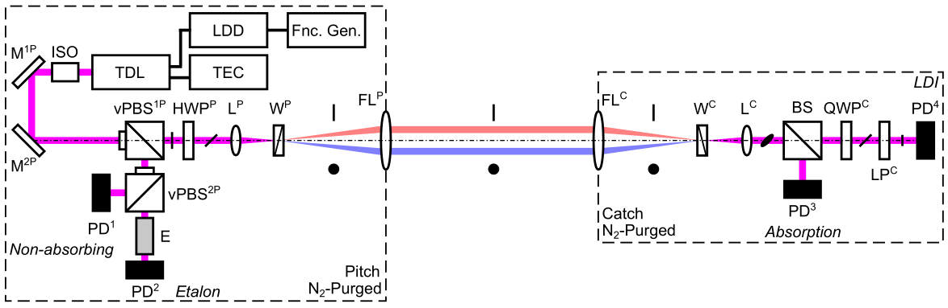
Absorption Laser Differential Interferometer (A-LDI)
Tunable diode laser (760 nm) used for simultaneous, colinear absorption and LDI measurements
  Probes O₂ absorption transitions using both direct absorption and wavelength modulation spectroscopy (DAS and WMS)
All photodiodes acquire signal simultaneously (adjustable signal using vPBS^{1P} and vPBS^{2P}
  Photodiodes PD¹, PD², and PD³ used for absorption
  Photodiode PD⁴ used for LDI

Slide 4
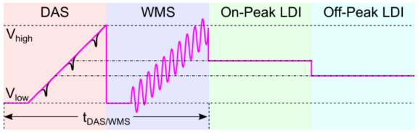
Laser Tuning Waveforms
Typical LDI/FLDI systems use a constant laser output power
  No absorption due to any gas species at these wavelengths (532 nm, 630 nm)
Changing injection current to laser changes output power and thus wavelength
Absorption measurements using ramping injection current (red, blue)
  Direct absorption spectroscopy (DAS) is easiest method, but suffers from lower SNR for weak absorption
  Wavelength modulation spectroscopy (WMS) is more difficult to implement, but results in lower detection limits, ideal for weak absorption of O₂ and small changes in flow properties
Constant injection current absorption measurements can be ideal for simultaneous LDI measurements
  Green: On-peak LDI places wavelength at the linecenter of an absorption feature
  Blue: Off-peak LDI places wavelength outside any absorption features (most like conventional LDI/FLDI measurements)

Slide 5
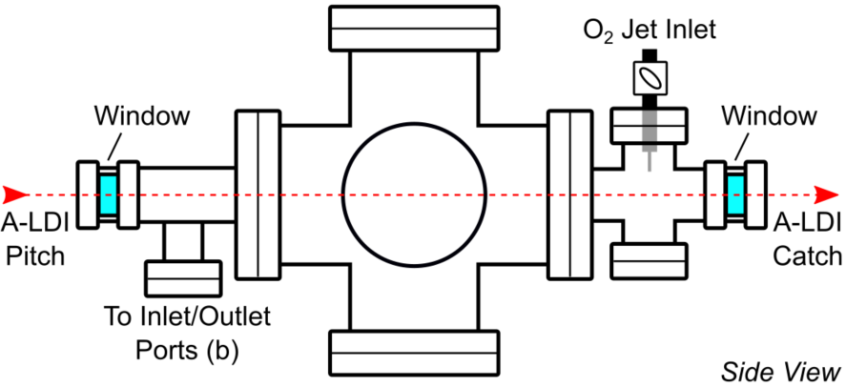
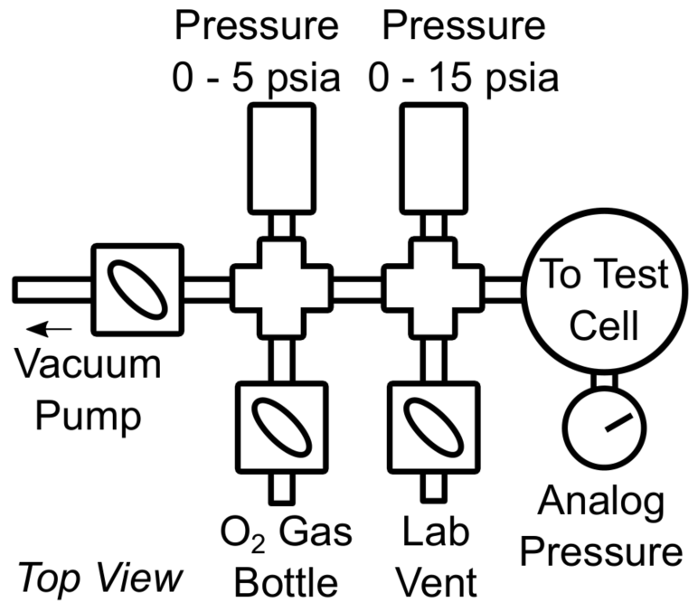
Test Facilities // Test Cell and Probe Calibration Tunnel
Sub-atmospheric, pressure-controlled test cell
  Control pressure using oil-free vacuum pump between 1 atm and 0.01 atm
  Pressure sensor (0 – 15 psia)
  Window-to-window path length of 63.5 cm
  O₂ jet inlet
Probe Calibration Tunnel
  Free jet nozzle, diameter 76 mm
  Test section width (window-to-window) 715 mm
  Window diameter 203 mm
  Changing stagnation pressure with constant stagnation temperature

Slide 6
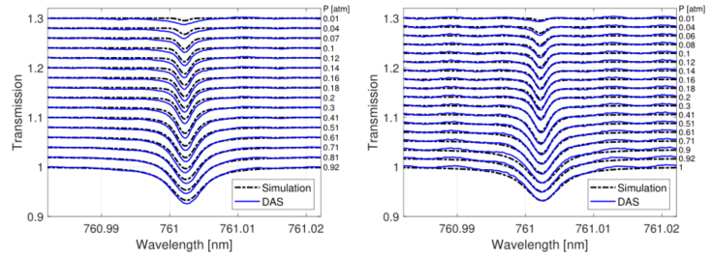
Test Cell // DAS
Central absorption peak plotted (out of three in scan range)
  Dash-dot black: HITRAN line-by-line simulations
  Solid blue: experimental measurements
Top Plot:
  Cell-exterior path length not purged
  Absorption outside cell (21% O₂) and inside cell (100% O₂)
  Simulations of cell absorption under-predict measured absorption
Bottom Plot:
  Cell-exterior path length purged with non-absorbing N₂ gas
  Absorption only occurring inside cell (100% O₂)
  Simulations and measured absorption match well
Critical to purge pitch and catch sides of A-LDI system with non-absorbing gas
DAS measurements validated with simulations of expected absorption

Slide 7
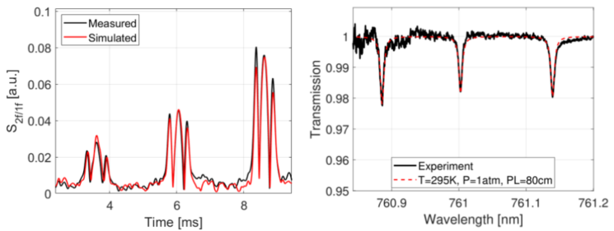
Test Cell // WMS Quantitative
Comparison of WMS simulations and measured data (top plot) show good agreement
  T = 295 K, P = 1 atm, PL = 80 cm, X_{O2} = 21% (air)
Side lobes of WMS signal exhibit slight discrepancies
  Likely due to errors in etalon wavelength calibration (from PD²)
Use same simulation from top plot to compare with DAS data in bottom plot
  Three absorption peaks in wavelength scan range have good agreement between simulations and experimental measurements
WMS
DAS
WMS can be used for quantitative evaluation of gas properties
DAS and WMS measurements compare well with identical simulated gas properties

Slide 8
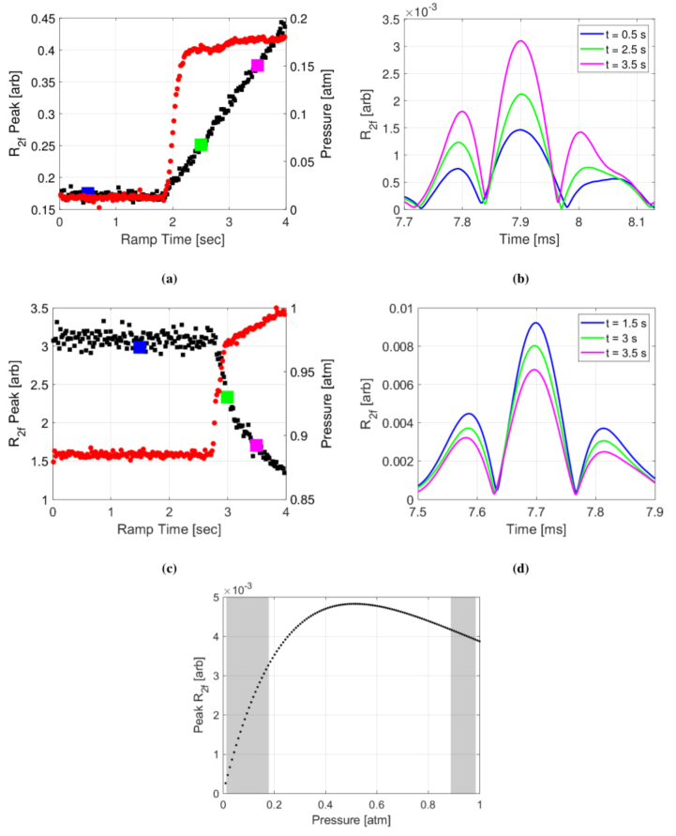
Test Cell // WMS Qualitative
Pressure data (red) only used to indicate opening of valve and introduction of O₂ into test cell
Top plots:
  At low pressure, increase in pressure corresponds to increase in WMS second harmonic signal peak value
  WMS R_{2f} signal plotted in top-right plot for three selected times
Middle plots:
  At high pressure, increase in pressure corresponds to decrease in WMS second harmonic signal peak value
Bottom plot:
  Shaded regions validate trend of increasing (left) and decreasing (right) R_{2f} peaks
WMS can be used as reliable transient absorption measurement
Need to perform quantitative simulations to validate testing

Slide 9
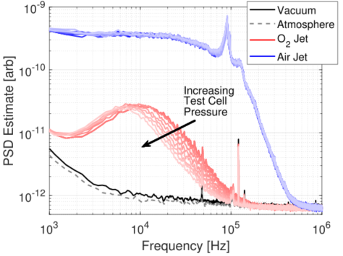
Test Cell // LDI
PSD spectra for various interference measurements from the LDI photodiode (PD⁴)
Test cell pressure increased over time (decreasing saturation of colors in plot)
High pressure compressed air jet outside test cell (blue) exhibits same shape for all test cell pressures
O₂ jet exhausting into test cell exhibits decreasing frequency content as test cell pressure increases
  Expected due to smaller jet stagnation pressure ratio

Slide 10
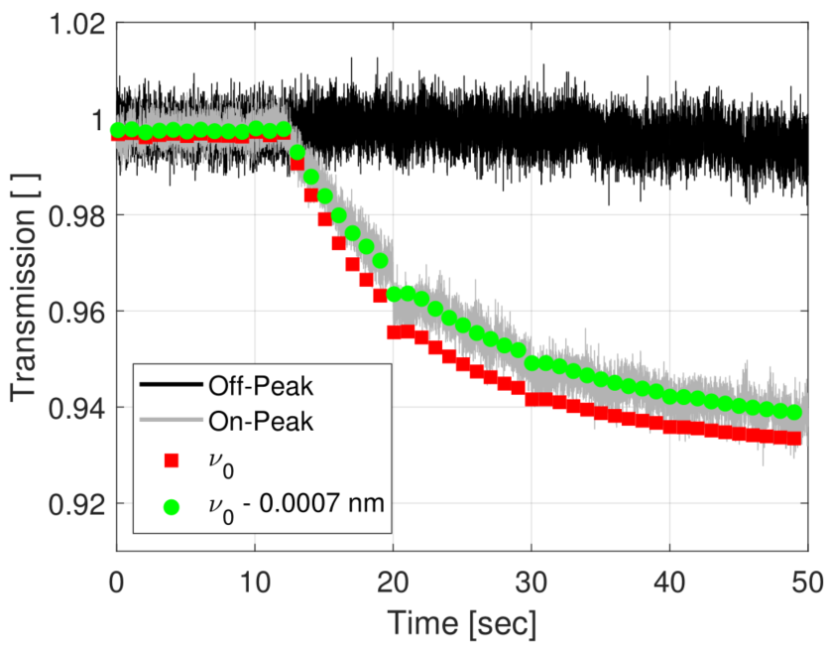
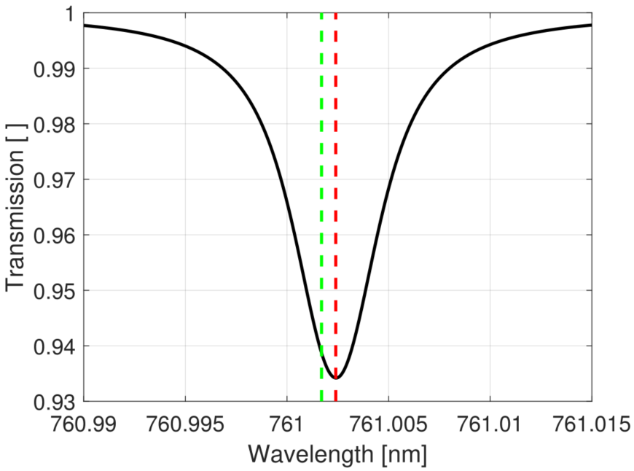
Test Cell // Constant Injection Current DAS
Constant injection current set to two values:
  Off-peak (black) : voltage corresponds to wavelength outside any absorption features
  On-peak (gray) : voltage corresponds to wavelength at absorption feature linecenter
Top plot:
  Transmission from single wavelength measurement
  No interference signal on absorption photodiode (PD³)
  Simulated absorption from linecenter (red squares) shows correct trend, but incorrect values
  Shifting wavelength by 0.0007 nm results in correct trend and correct transmission values
Bottom plot:
  Dashed lines correspond to colored markers in top plot
  Small change in emission wavelength of laser results in large difference in transmission
Can measure absorption of O₂ without scanning wavelength
Absorption measurements at sampling rate of LDI

Slide 11
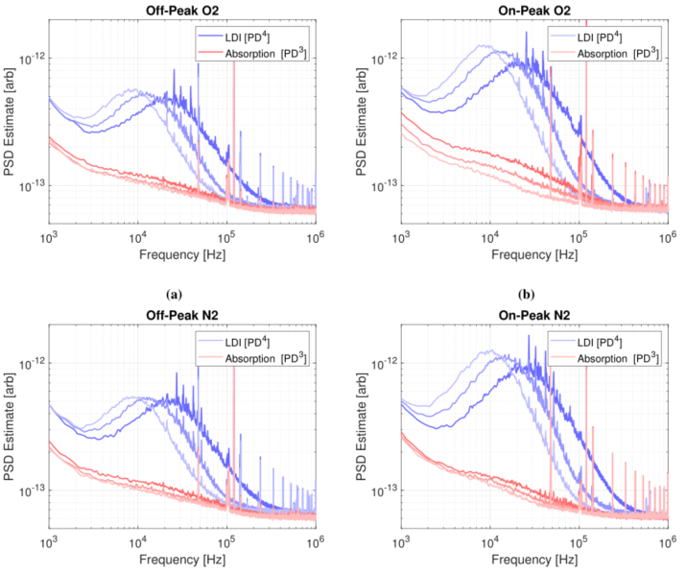
Test Cell // Constant Injection Current DAS
Two jets exhausting into test cell path length of A-LDI system
  O₂ jet and N₂ jet, at same stagnation pressure
Off-peak and on-peak data taken with LDI and absorption photodiodes
All LDI signal (blue) shows sensitivity to flow fluctuations, as expected
Only absorption measurement (red) that exhibits sensitivity to flow is on-peak O₂
  Demonstrates that absorption measurement is sensitive to a different quantity than the LDI
  Sensitive to changes in O₂ absorption over the laser path length, not optical path length changes
LDI : optical path length changes
Absorption: O₂ absorption changes over path length

Slide 12
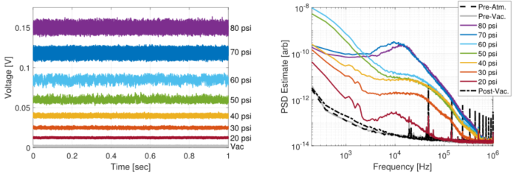
Probe Calibration Tunnel // LDI (Constant Current)
Using constant injection current, at wavelength outside O₂ absorption features (off-peak)
Top plot:
  One second data acquisition for vacuum (no-flow) and various tunnel stagnation pressures, with stagnation temperature at 100 ºF
Bottom plot
  PSD spectra for measured data, with three no-flow background datasets
  Post-run vacuum (dash-dot) higher amplitude due to valve leak
  Increased low frequency values for 50/60 psi due to nozzle transition with high-amplitude, low frequency turbulent spots
Conventional LDI measurement sensitive to flow fluctuations
Tunnel operating characteristics verified by IR imaging, pitot probes, and schlieren imaging

Slide 13
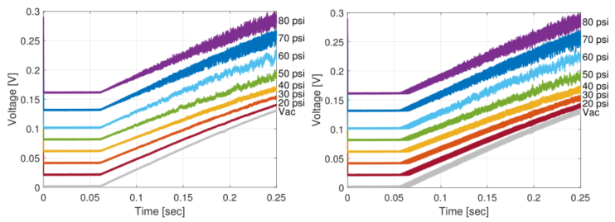
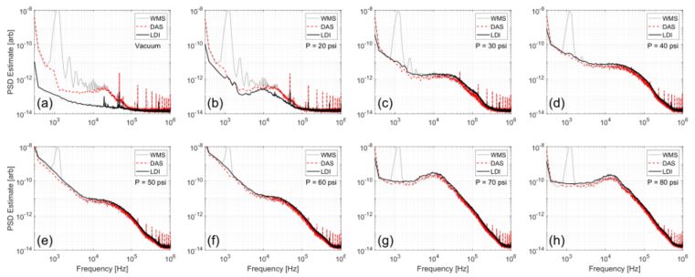
Probe Calibration Tunnel // LDI (Modulation)
Data taken with LDI photodiode (PD4)
DAS and WMS laser injection current ramping used (top plots)
PSD plots at every tunnel stagnation pressure (bottom plots)
  Compare LDI (constant current), DAS, and WMS
Large differences at vacuum and low pressure
At higher pressure, all three PSD estimates similar
  Only difference is peak at WMS modulation frequency

Slide 14
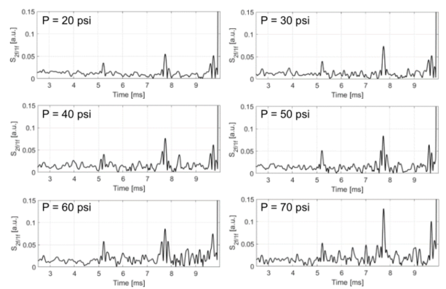
Probe Calibration Tunnel // WMS
WMS data acquired at various tunnel stagnation pressures
Two absorption peaks visible in laser scan range
  5 ms and 7.8 ms
WMS signal is first harmonic-normalized second harmonic signal (S_{2f/1f})
WMS peak signal increases with increasing pressure
  Sensitive to wind tunnel flow
  Background noise decreases SNR
WMS absorption measurement sensitive to changing freestream flow properties
Improvements to WMS measurement have been made, and wind tunnel data will be taken again

Slide 15
Conclusions
Absorption laser differential interferometer successfully constructed and demonstrated using:
  Sub-atmospheric pressure-controlled test cell
  Probe Calibration Tunnel free jet Mach 3.5 flow
Independent absorption (DAS and WMS) measurements validated using known O₂ test gas concentration and pressure-controlled test section
LDI measurements are sensitive to flow fluctuations and optical path length changes
Simultaneous, colinear absorption and LDI measurements are feasible, and provide measurements of different physical quantities
  LDI : Optical path length changes resulting in a measure of flow fluctuations
  Absorption: Changes in O₂ absorption, and insensitive to optical path length changes due to index of refraction
Probe Calibration Tunnel measurements demonstrated LDI and absorption measurements independently
  Future measurements will use most up-to-date system

