Slide 1
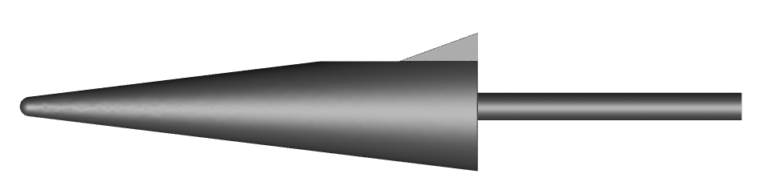

CFD Validation of a Hypersonic Cone-Slice-Flap Variable Geometry Configuration
Laura White
and
Thomas West, Matthew Rhode, Elizabeth Rieken
NASA Langley Research Center
Jacob Lampenfield, and Daniel Rodriguez
Analytical Mechanics Associates
June 14, 2023
AIAA Aviation 2023

Slide 2
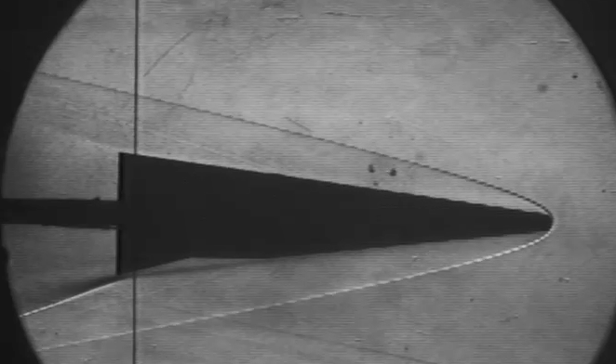
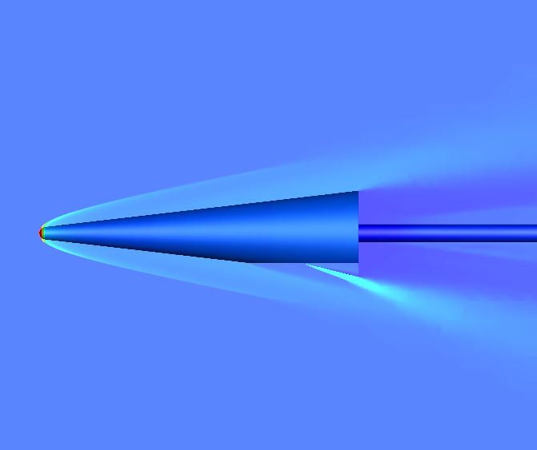
Introduction
Model validation determines the degree of accuracy between the real world and the simulation
This work focuses on quantifying model-form uncertainty for a cone-slice-flap hypersonic design through a validation approach for lift, drag, and pitching moment coefficients
The validation method captures differences between experimental and simulation data with aleatory and epistemic uncertainty included in the data
Validation

Slide 3
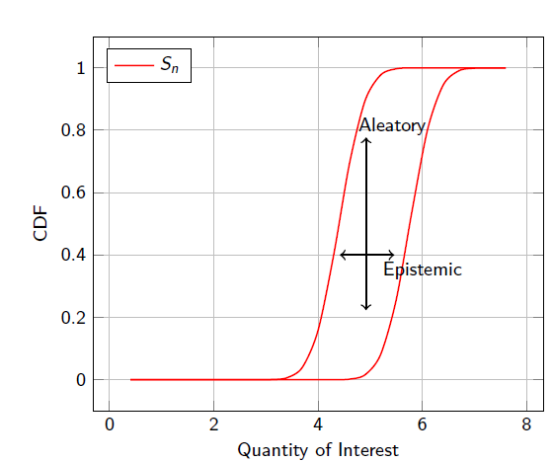
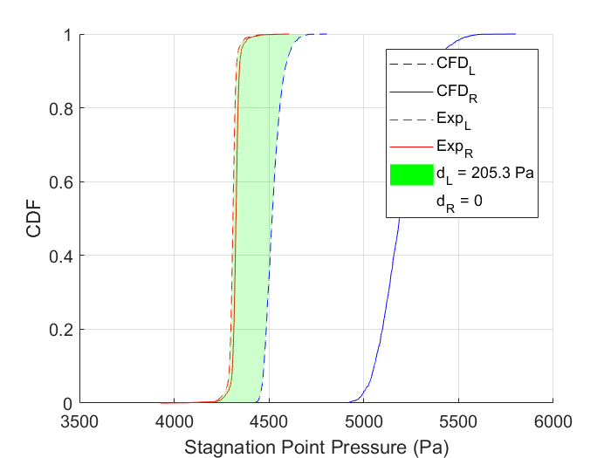
Uncertainty Quantification
Uncertainty types
Epistemic Uncertainty
  aka systematic uncertainty
  Lack of knowledge
  Due to items, one could know in principal but does not know in practice
  Ex: impact of radiation on humans, human error in trajectory
Aleatory Uncertainty
  aka stochastic uncertainty
  Irreducible variability inherent in nature
  Represent unknowns that differ each time the same experiment is run
  Ex: flipping a coin, measurement error
Mixed Uncertainty
  A combination of aleatory and epistemic uncertainty exist corresponding to different inputs into the system
  The end form is a probability box with multiple possible distributions that could be represent the true quantity of interest distribution
Model-form Uncertainty
  Modeling and quantification of the uncertainties about the ability of a computational model to truly represent the physics underlying the problem to be solved
Model-form uncertainty

Slide 4
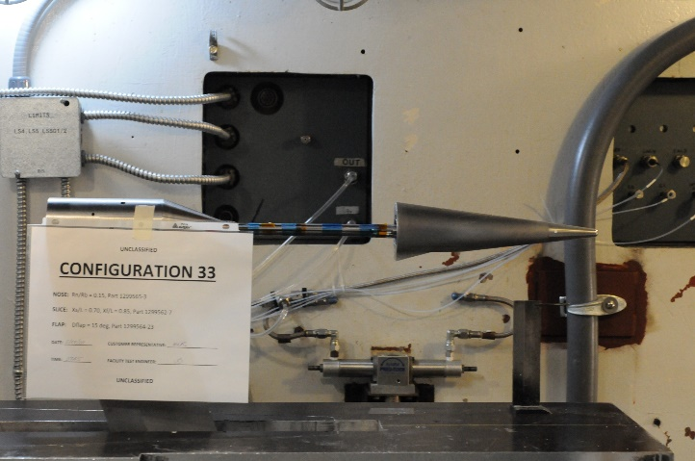
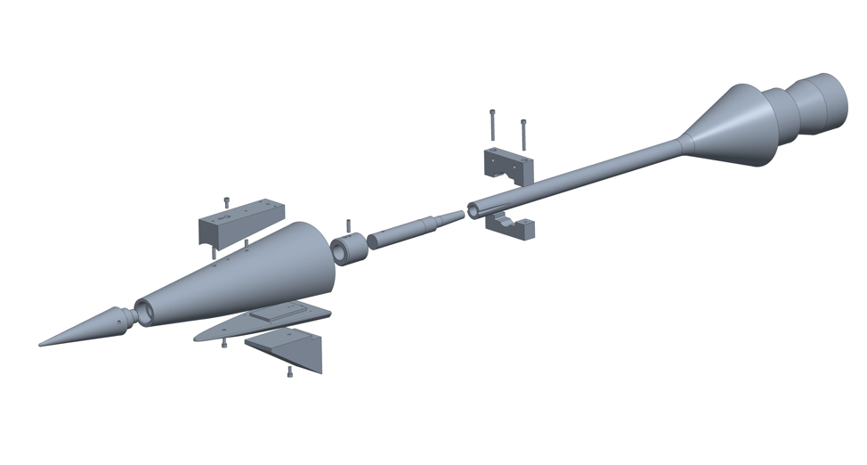
Experimental Setup
Test was conducted in the 20-Inch Mach 6 Tunnel at NASA Langley Research Center
The experiment consisted of 33 different geometrical configurations
Nose radius
Slice leading edge location
Flap leading edge location
Flap deflection angle
Wind tunnel conditions
Reynolds number: 2.5 mil/ft and 4 mil/ft
Temperature: 860 R
Mach: 6
Uncertainty was determined through the calorically perfect gas, isentropic flow relations and repeated runs

Slide 5
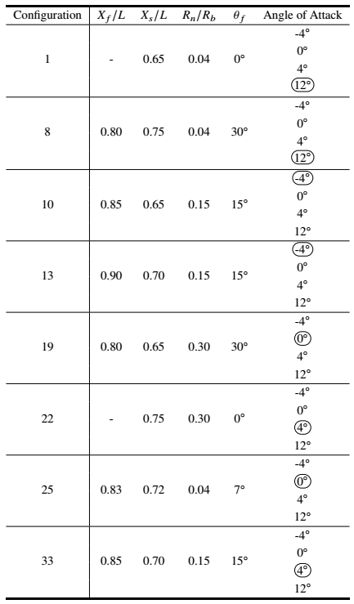
Simulation Setup
VULCAN-CFD was used for a UQ turbulence parameter study (circled in table) and for anchoring the drag for the inviscid study
The inviscid study was done with Cart3D with adjoint-based grid refinement and was used to study all the configurations
These configurations were chosen for the UQ study, because they cover the entire geometric design space

Slide 6
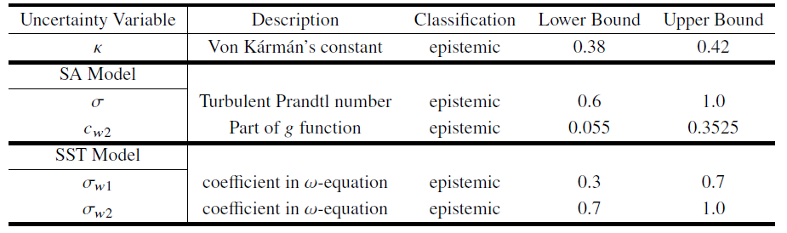
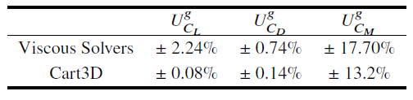
VULCAN-CFD Uncertainty Study
Two driving sources of uncertainty for VULCAN-CFD:
Grid uncertainty
Turbulence parameter uncertainty
  Two turbulence models studied: Spalart-Allmaras (SA) and Menter Shear-Stress Transport (SST) Models
These uncertainties were combined to make a grid + turbulence parameter uncertainty
Turbulence parameter uncertainty
Grid uncertainty

Slide 7
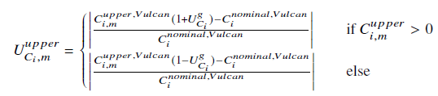
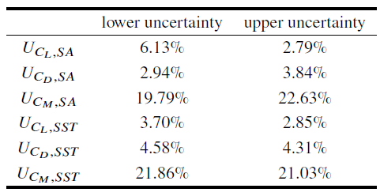
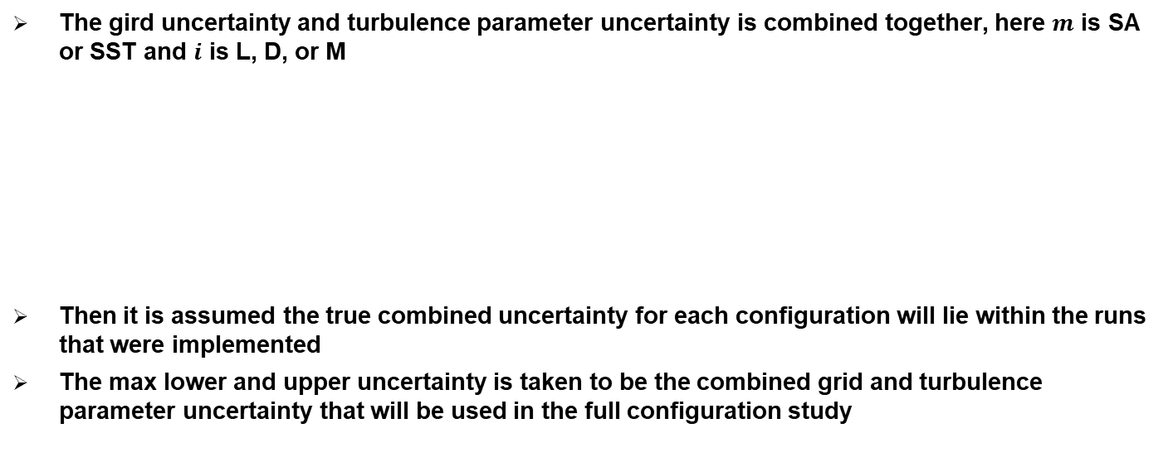
VULCAN-CFD Uncertainty Study
The gird uncertainty and turbulence parameter uncertainty is combined together, here $m$ is SA or SST and $i$ is L, D, or M
Then it is assumed the true combined uncertainty for each configuration will lie within the runs that were implemented
The max lower and upper uncertainty is taken to be the combined grid and turbulence parameter uncertainty that will be used in the full configuration study
Final total combined grid and turbulence parameter uncertainty

Slide 8


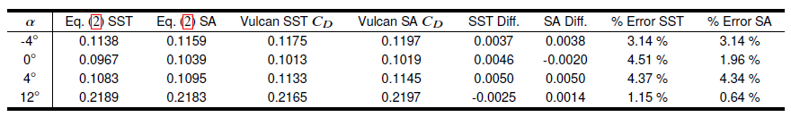
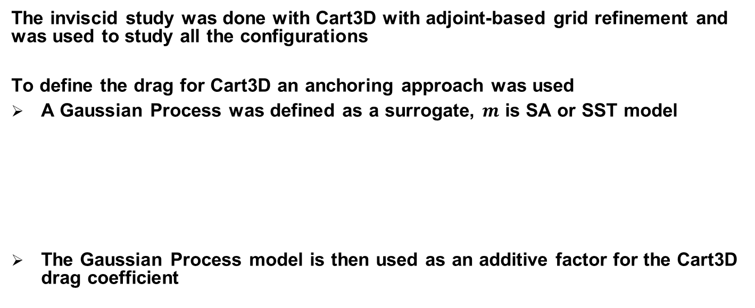
Inviscid Anchoring Approach
The inviscid study was done with Cart3D with adjoint-based grid refinement and was used to study all the configurations
To define the drag for Cart3D an anchoring approach was used
A Gaussian Process was defined as a surrogate, $m$ is SA or SST model
The Gaussian Process model is then used as an additive factor for the Cart3D drag coefficient
Geometric
parameters
Boundary
Conditions
Verification of the anchoring approach

Slide 9
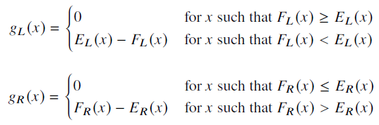

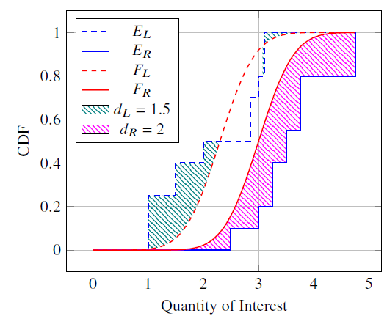
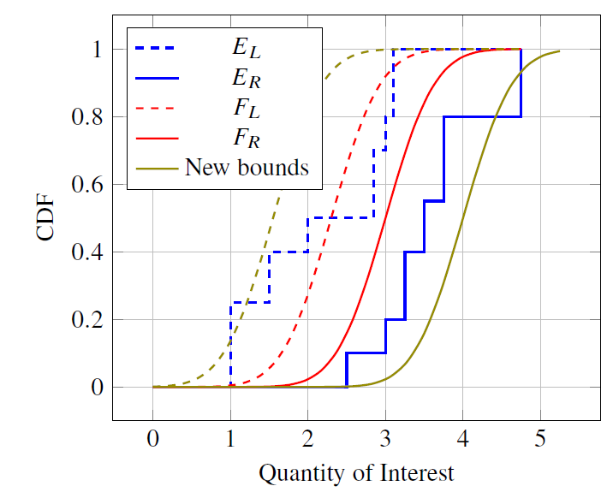
Validation Methodology
This work uses a validation metric proposed by Brune et al. in 2019
This metric handles disagreement between the left and right bounds of the prediction and experimental distributions separately
This gives a left and right model-form uncertainty which can be added to the uncertainty intervals
Take F(x) to represent the CFD’s distribution and E(x) to represent the experiment’s distributions (CDFs)
Note: This is just an example problem

Slide 10
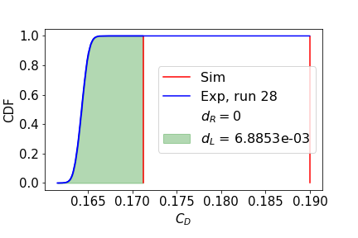
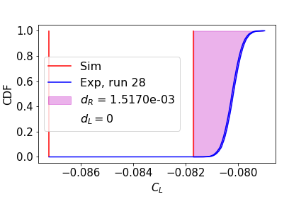
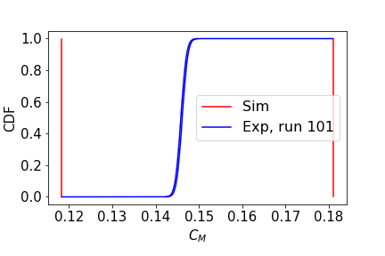
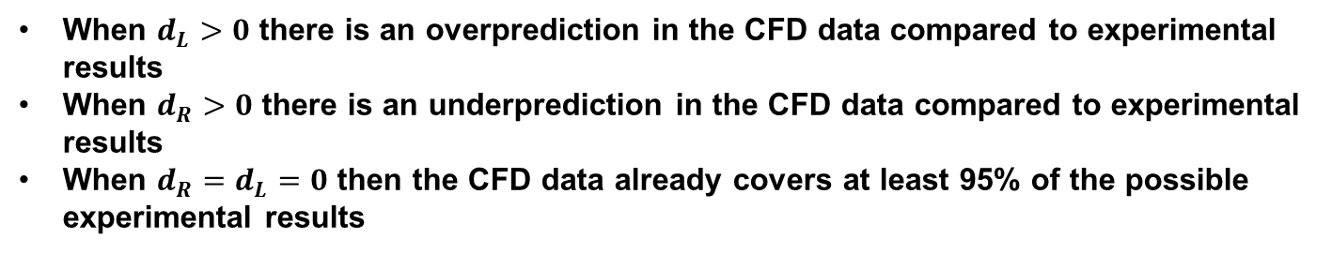
Selected Validation Results
When $d_{L}>0$ there is an overprediction in the CFD data compared to experimental results
When $d_{R}>0$ there is an underprediction in the CFD data compared to experimental results
When $d_{R}=d_{L}=0$ then the CFD data already covers at least 95% of the possible experimental results

Slide 11
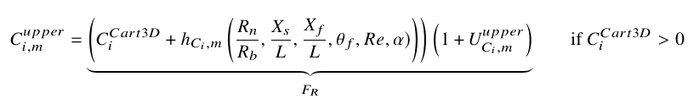


Full Configuration Uncertainty
For the full configuration Cart3D analysis is performed and the anchoring approach is applied to the drag coefficient
Then the VULCAN-CFD uncertainty analysis is used to capture the multifidelity method uncertainty
The new upper and lower coefficients become:
Combined VULCAN-CFD grid and turbulence parameter uncertainty
Anchoring Approach
Note:
$$F_{L}$$
$$F_{R}$$

Slide 12
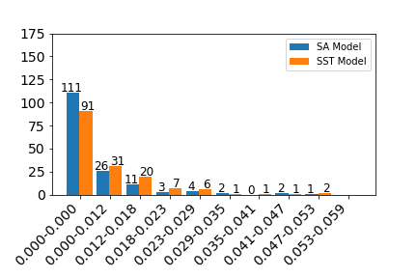
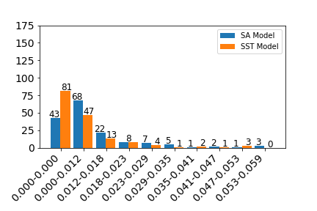
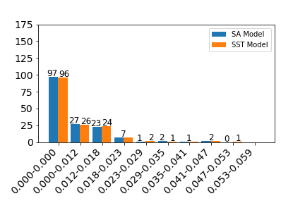




Selected Results
Histogram plots of the SA and SST validation metric
$$d_{C_{L}L}$$
$$d_{C_{D}L}$$
$$d_{C_{M}R}$$
Takeaways
For the lift and drag both turbulence models overpredicted when compared to the experimental data
For the pitching moment both turbulence models underpredicted when compared to the experimental data

Slide 13
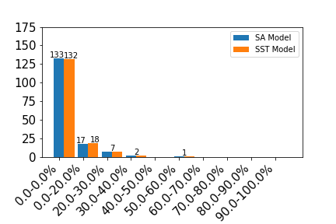
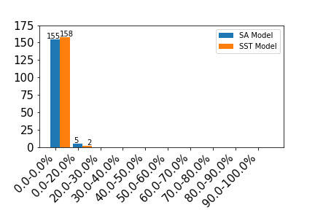
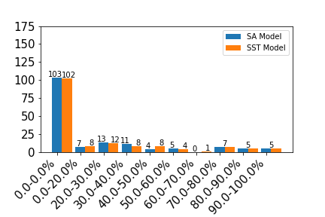



Selected Results
Histogram plots of the percent change in total uncertainty for SA and SST model
$$U_{C_{L}L}$$
$$U_{C_{D}L}$$
$$U_{C_{M}R}$$
Takeaways
The moment has the largest percent change in uncertainty, because it’s magnitude is of the order $10^{−2}$ or smaller
The lift coefficient showed the second highest percent change followed by the drag coefficient

Slide 14
Conclusions
The results showed that both turbulence models typically overpredicted for lift and drag coefficient and underpredicted for moment coefficient
The percent change in the overall uncertainty with the model-form uncertainty added was 20% or less for the drag coefficient and 60% or less for the lift coefficient
For the moment coefficient the change in uncertainty was largest due to values are close to zero, but in most cases there was less than 80% change
The work here shows a computationally efficient way to assess model-form uncertainty for a configuration with several geometrical changes
Future practitioners can use the conclusions of this work to determine what turbulence model to use for a similar hypersonic design
Future work would be to analyze why some of the larger discrepancies exist with a higher fidelity analysis

Slide 15
Acknowledgements
Co-authors: Thomas West, Matthew Rhode, Elizabeth Rieken, Jacob Lampenfield, and Daniel Rodriguez
Robert Baurle and Aaron Erb for their insights and directions regarding the CFD work
Hypersonics Technology Project under the Aeronautics Research Mission Directorate at NASA for funding this work

Slide 16

Questions?

