Slide 1
Title Page
Small Business Innovation Research/Small Business Technology Transfer (SBIR/STTR) Program Update
Jason L. Kessler, Program Executive | May 16, 2023

Slide 2
Agenda
Program Overview
FY22: Awards and Impact
FY23: Where We Are So Far
Success Stories

Slide 3
Program Overview

Slide 4











What is the SBIR/STTR Program?
Highly competitive program that encourages domestic small businesses to engage in Federal Research/Research and Development (R/R&D) with the potential for commercialization
Small Business Innovation Research (SBIR)
  Has been around since 1980s
  NASA is 1 of 11 participating agencies
  Must be a Small Business Concern (SBC) with 500 employees or less and legally established in the U.S.
Small Business Technology Transfer (STTR)
  Established in the 1990s; created to facilitate cooperative R&D between small businesses and U.S. research institutions (RIs)
  NASA is 1 of 6 participating agencies
  The partnering research institution must be in the U.S. and be a nonprofit college or university, domestic nonprofit research organization, or a federally funded R&D Center (FFRDC)
Approximately $3 billion invested per year
by participating agencies
SBIR + STTR Programs
Department
of Defense (DOD)
Department
of Health and Human Services (HHS)
Department
of Energy (DOE)
National Aeronautics
and Space Administration
(NASA)
National Science Foundation (NSF)
Department
of Agriculture (USDA)
SBIR Program Only
Department
of Education (ED)
Department
of Transportation (DOT)
Environmental Protection Agency (EPA)
Department
of Homeland Security (DHS)
Department
of Commerce (DOC)
Notes:
As a quick refresher, both SBIR and STTR are congressionally mandated programs with several important purposes:
We stimulate technological innovation in the private sector,
Strengthen the role of small businesses in federal R&D,
Increase the commercial application of research results,
Foster technology transfer between small businesses and research institutions, and
Foster and encourage participation of socially and economically disadvantaged persons and women-owned small businesses.

Slide 5
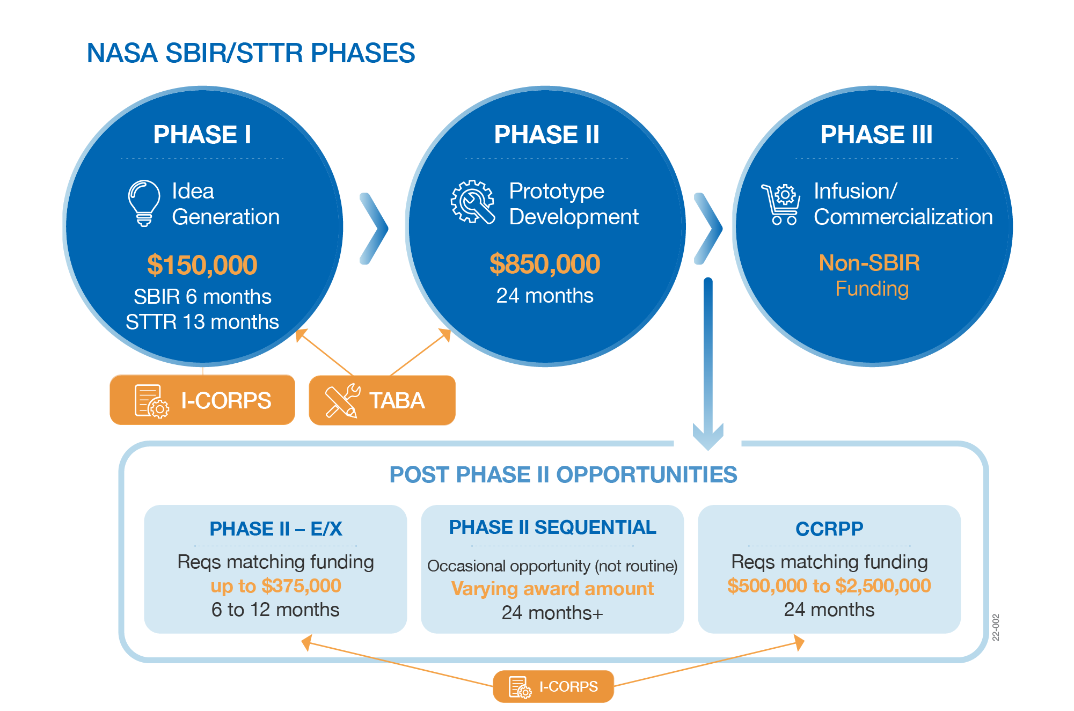
Program Phases
Up to $1 million for Phase I and II and nearly $3 million or more for Post Phase II opportunities!
Notes:
As a quick centering, these are the opportunities for funding that we currently offer….

Slide 6
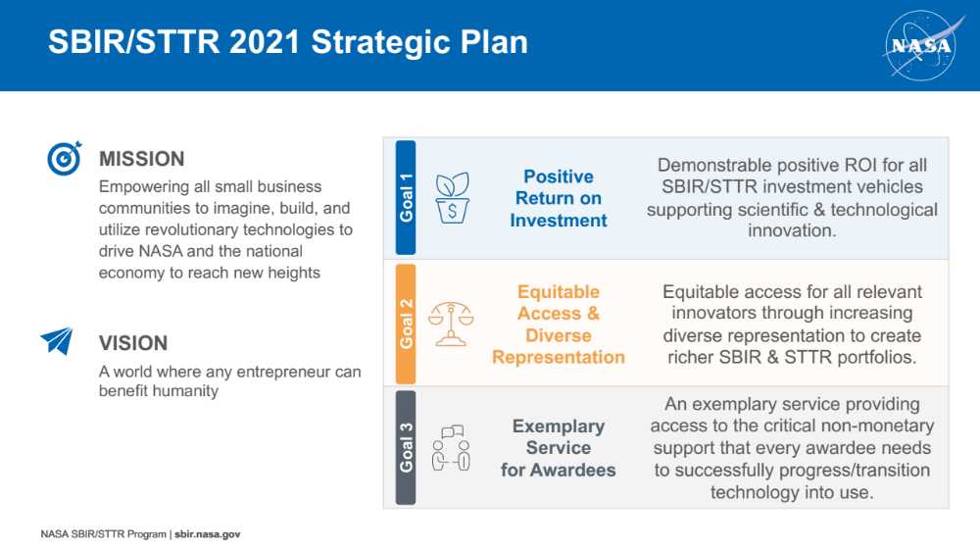
Updated Program Strategy
Notes:
NASA SBIR/STTR underwent a strategic refresh over the past few years, and came up with the mission, vision, and goals you see on the screen to guide our program.

Slide 7
Program Reauthorization
The SBIR and STTR programs were established in 1982 and 1992, respectively.
Congress has consistently passed Reauthorization extensions, most recently in late September 2022, as the programs were set to expire on September 30, 2022.
The SBIR and STTR Extension Act authorized the programs through September 30, 2025.
  The bill requires agencies with an SBIR or STTR program to assess the security risks presented by applicants with financial ties or obligations to certain foreign countries. The programs may not make awards to businesses with certain connections to foreign entities.
  Specifically, assessing the cybersecurity practices, patent analysis, employee analysis, and foreign ownership of a small business concern seeking an award.
  Not later than 270 days after the date of enactment of this Act (27 June 2023), each Federal agency with an SBIR or STTR program must take a risk based approach as appropriate in implementing a due diligence program

Slide 8
FY22: Awards and Impact

Slide 9
FY22 Program Awards
Program | # of Awards | $ Value of Awards | Investor Funds
SBIR Phase I | 278 | $42,160,686 | $0
SBIR Phase II | 124 | $95,443,491 | $0
STTR Phase I | 53 | $8,101,656 | $0
STTR Phase II | 20 | $15,043,314 | $0
SBIR Phase II-E | 44 | $11,146,181 | $11,831,885
STTR Phase II-E | 7 | $1,839,438 | $1,995,330
CCRPP | 6 | $8,025,433 | $8,879,301
Sequentials | 7 | $29,339,400 | $0
SBIR Phase III | 66 | $0 | $22,319,624
STTR Phase III | 8 | $0 | $2,720,460
Totals |  | $211,099,599 | $47,746,600
Notes:
Now looking specifically at this past fiscal year…
NASA SBIR/STTR invested more than $210 million in small businesses and research institutions in FY22. Specifically, 278 SBIR and 53 STTR Phase I contracts were awarded to 257 U.S. small business and 41 research institutions to establish the scientific, technical, and commercial feasibility of each proposed innovation. 24% of the selected research institutions are classified as Minority Serving Institutions, and 25% of the selected small businesses are from underrepresented groups, including minority- and women-owned businesses. Additionally, the program made 124 SBIR and 20 STTR Phase II awards to further expand upon prior Phase I work. More than $50 million was awarded via post-Phase II opportunities to continue technology development towards a NASA mission and/or commercialization.

Slide 10


2022 Phase I & II SBIR/STTR Awards
Separated the SBIR and STTR solicitations to make the difference between programs and different proposal requirements clearer
Separated Phase I and Phase II solicitations to allow for adjustment of requirements before Phase II, if needed
Increased Phase I and Phase II funding
1,392 Proposals/278 Awards
25% underrepresented SBCs
24% First Time Awardees
71% with < 50 employees
SBIR Phase I
$42.2
Million
288 Proposals/124 Awards
22% underrepresented SBCs
72% with < 50 employees
SBIR Phase II
$95.4
Million
131 Proposals/53 Awards
21% underrepresented SBCs
19% partnered with HBCU/MSI
26% First Time Awardees
77% with < 50 employees
STTR Phase I
$8.1
Million
55 Proposals/20 Awards
10% underrepresented SBCs
15% partnered with HBCU/MSI
85% with < 50 employees
STTR Phase II
$15.0
Million
Notes:
The bullets at the top of this slide speak to what changed in FY22…

Slide 11
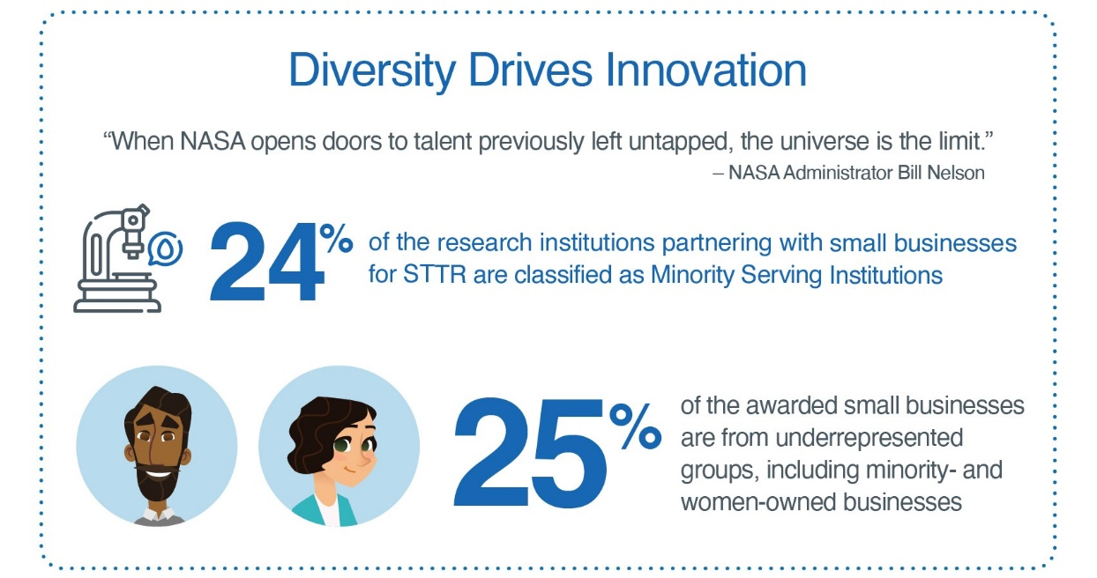
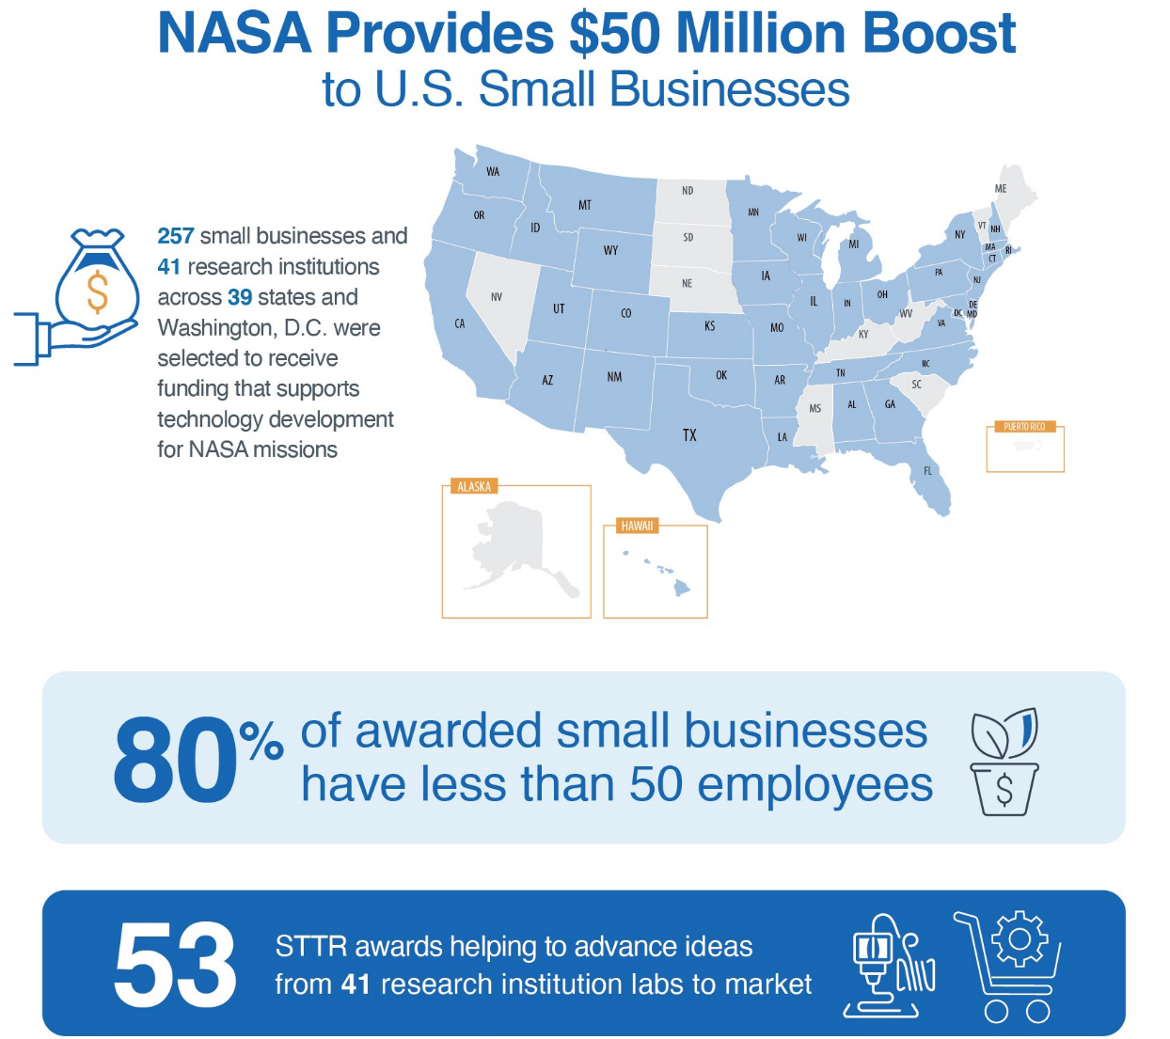
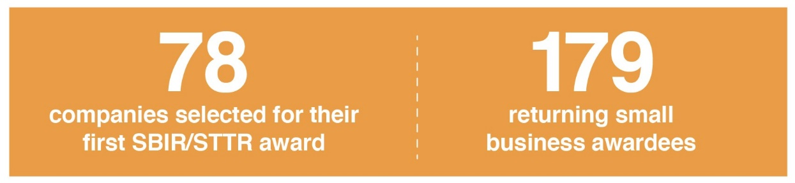
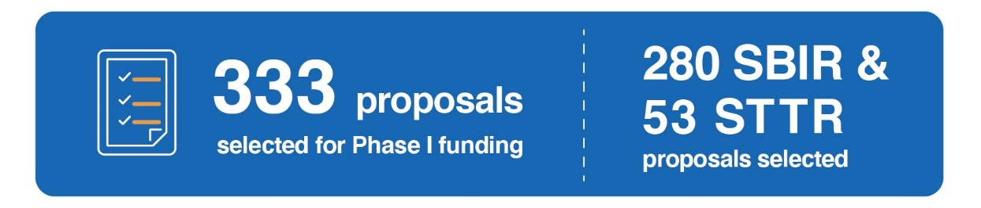
Spotlight: 2022 Phase I Awardees
Notes:
Let me tell you more about our 2022 Phase I awardees.
257 small businesses and 41 research institutions across 39 states and Washington, D.C. were selected to receive funding.
Of those 257 small businesses, 80% have less than 50 employees.
24% of the STTR research institution partners were Minority Serving Institutions, and 25% of the awarded small businesses were from underrepresented groups, including minority-owned and women-owned small businesses.

Slide 12
2022 Post Phase II Highlights
Developed a Sequential Technical Need Area (TNA) in partnership with SMD focused on the Administrator’s priority around climate change
Interest in Phase II-E for both SBIR and STTR exceeded planned budget
  Demonstrates strong interest in furthering the development of SBIR/STTR-Funded technologies
  Was able to meet demand by shifting funds from CCRPP and Phase I/II
51 Awards
$13.0M SBIR/STTR Funding
$13.8M Investor Funding
($5.9M NASA Investors)
Phase II-E
6 Awards
$8.0M SBIR/STTR Funding
$8.9M Investor Funding
($2.7M NASA Investors)
CCRPP
7 Awards
$29.3M SBIR/STTR Funding
Sequentials
74 Awards
$25.0M Investor Funding*
Phase III
*II-E Match = 21 awards/$3.7M and CCRPP Match = 4 awards/$1.9M
Notes:
Again, the bullets at the top of this slide speak to what changed in FY22…

Slide 13
FY23: Where We Are So Far

Slide 14
FY23 Big Picture Updates
FY23 Program Award Status
2022 M-STTR Awards | 10/25/22
  Highlights: Total of nearly $600,000 to 10 MSIs
2022 NASA SBIR Ignite | 11/16/22
  Highlights: Total of nearly $2 million to 12 small businesses
2022 SBIR Phase II | 4/11/23
  Highlights: Total of about $98 million to 112 proposals/92 unique small businesses
2023 SBIR/STTR Phase I | Scheduled for June 2023
2023 Sequentials | Scheduled for July 2023
(FY24) 2022 STTR Phase II | Scheduled for November 2023
“Firsts” for the Program in FY23
Made first NASA SBIR Ignite awards; the 2023 NASA SBIR Ignite solicitation will be open August – September 2023, with awards being made early in FY24*
Participated in inaugural MPLAN awards (the evolution of M-STTR awards offered in FY21 and FY22)*
*See following slides for more information on both

Slide 15
Spotlight: NASA SBIR Ignite
Highlights
  Launched in FY22, first awards made in FY23
  Encourages participation from product-driven companies not looking at NASA as their primary customer
  Places a heavy emphasis on commercial viability during review and scoring
  Streamlines the application process by shortening the solicitation and the proposal requirements
  Features the same three phases and funding levels as the main NASA SBIR/STTR solicitations
Key Differences from our Mainline Solicitation
  Commercialization: Seeks tech that will stimulate the market and for which NASA is not the primary customer.
  Engagement: Includes direct engagement with a panel of experts for down-selected companies.
  Topics: Features a select few topics relevant to emerging commercial markets in aerospace.
  Less Prescriptive Solicitation: Encourages companies to maintain their go-to-market strategies
  Shorter Proposal: Requires a short proposal and a slide deck in response to the solicitation
  Accelerated Award Schedule: Phase II proposal due earlier in the Phase I period, allowing Phase II awards to be made faster
Notes:
The NASA SBIR/STTR program is in its second year offering SBIR Ignite—a new way for small businesses that have a commercially-viable technology idea to use NASA as a stepping stone in their path towards commercial success. With a greater emphasis on commercialization, SBIR Ignite funds U.S. early-stage, high-risk technology development to help make companies and their technologies more attractive to private sector investors, customers, and partners.
Note that this is an opportunity offered exclusively to small businesses through SBIR right now; there is no STTR equivalent.
What makes Ignite different from the program’s mainline solicitation? A few things.
First is the heightened focus on commercialization. While the NASA SBIR/STTR Phase I solicitations also evaluate commercial potential and feasibility, many technologies address a specific NASA challenge or need and have a goal of getting infused into a NASA mission or being sustained with NASA as a key customer. The Ignite solicitation seeks technologies that will stimulate the market and where NASA is not the primary customer.
The solicitation and submission processes are also different—there are fewer topics, a less prescriptive solicitation, a shorter proposal, and an accelerated award schedule.
But, while these differences exist, the phases and funding amounts are the same as the mainline—up to $150K in Phase I, $850K in Phase II, etc.
The next SBIR Ignite solicitation is expected to open this summer.

Slide 16
Spotlight: MPLAN
The Minority University Research and Education Project Partnership Annual Notification (MPLAN) connects is designed to connect Minority Serving Institutions (MSIs) with NASA Mission Directorates and promotes research collaboration.
  This is the first year MPLAN awards are being offered.
MPLAN features topic areas from three NASA Mission Directorates; STMD’s MPLAN opportunity is the evolution of previous years’ M-STTR planning grants (offered in FY21 and FY22).
MPLAN awards provide up to $50,000 in funding (to be shared with a small business) and NASA guidance to MSIs in preparation for larger funding opportunities like the NASA STTR solicitation.
The 2023 NASA MPLAN solicitation is open now through May 30, 2023.
Notes:
Feedback from past program participants indicated that one of the persistent challenges faced when applying to STTR is the need to both build a partnership and co-create a strong technology proposal so quickly. The M-PLAN planning grants intend to address that challenge by cultivating partnerships and enabling the two sides to engage in substantive conversations about shared areas of interest, goals, and long-term outcomes before applying for a Phase I award.

Slide 17




Due Diligence Plan Overview
Collect new SBA approved disclosures:
  Completed as part of their proposal submission
  May request additional information within forms that facilitate assessment process
In parallel to technical review, conduct Risk Assessment based on risk threshold:
  Review of disclosures
  Utilize customized tool(s) to search commercially available sources of information for:
    Ownership or Investment
    Personnel
    Cybersecurity concerns
    Patent analysis
    Are the technologies critical to national security?

Slide 18
Success Stories: Infusion & Commercialization

Slide 19
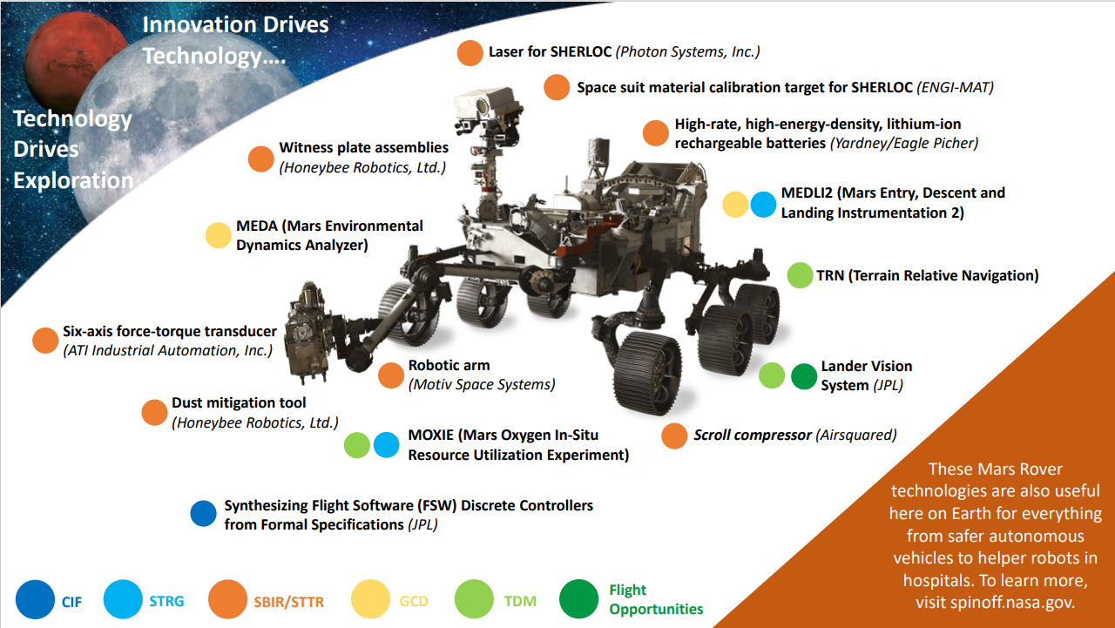
We Promote Infusion into NASA’s Missions
Notes:
Our program is an important part of many of NASA’s most ambitious missions. For example, the NASA Perseverance Rover has several science missions and functions with numerous areas of focus, including detection of extinct life, collection of Martian soil samples for return to Earth for more rigorous analysis, experimentation with oxygen generation from the Martian atmosphere, and the deployment of a small helicopter to assist in the identification of areas for further exploration.
You can see all the SBIR/STTR-derived technologies in orange alongside the technologies supported by other STMD programs.

Slide 20
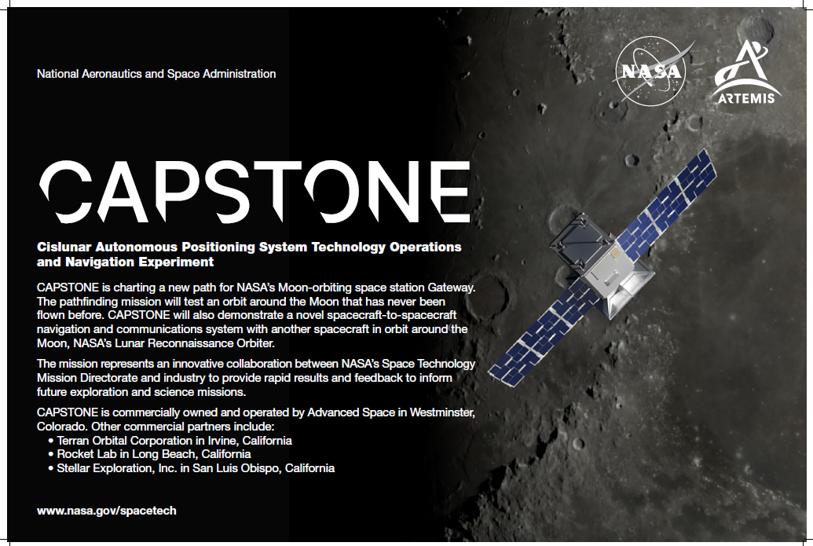
Notes:
As you all know, CAPSTONE will be the first spacecraft to fly a unique orbit around the Moon that will be used for Gateway, NASA’s future Moon-orbiting outpost. This mission is owned and operated by former SBIR awardee Advanced Space, LLC, based in Westminster, CO. Advanced Space began working with the NASA SBIR program in 2015 and since then has received 18 SBIR/STTR contracts to fund a host of projects.
For example, a key software being tested on the mission – the Cislunar Autonomous Positioning System (or CAPS) – was developed by Advanced Space through NASA’s SBIR program. CAPS will allow future spacecraft to determine their location without having to rely exclusively on tracking from Earth, allowing them to perform on their own without needing as much support from the ground.
Advanced Space’s work on CAPSTONE was also supported by a NASA SBIR Phase III contract funded by NASA’s Small Spacecraft Technology Program. The company has also received support for other initiatives through STTR.
Many of the other partners on CAPSTONE are alums of NASA’s SBIR/STTR program as well, including companies like Stellar Exploration, Inc., who received SBIR funding that led to the development and building of CAPSTONE’s propulsion system. When CAPSTONE launches, it will demonstrate the advantages of NASA’s investments in small business collaborations and represent a starting point for the next stage of lunar exploration.
I want to share a quote that we have found especially meaningful from Chris Baker, the Program Executive of both Small Spacecraft Technology Program and the Flight Opportunities Program. “The interplay between small businesses and small spacecraft has driven this industry. These innovative, faster, lower cost missions simply would not exist without the leadership of the small business, start-up, and academic communities.”
Notes on the other two “commercial partners” listed on the slide:
Rocket Lab received nearly $100,000 in SBIR funding from the Department of Defense in 2015 which led to their ability to use their launch complex in New Zealand to send the CubeSat beyond Earth
Terran Orbital Corp developed the CubeSat that is used on CAPSTONE and their contributions are “supported in partnership with Advanced Space through its SBIR contract”; they are also a recipient of seven SBIR/STTR contracts with NASA for other projects

Slide 21
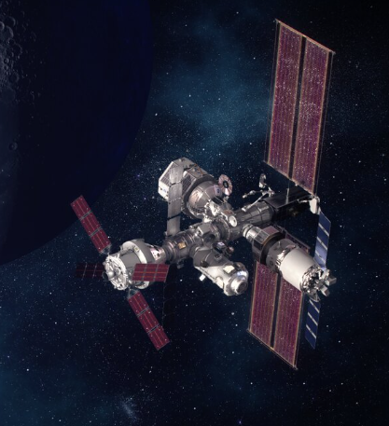
SBIR Sequential Phase II: Technology for Gateway
  Robust System Health Management for Deep Space Missions - Qualtech Systems, Inc. (QSI)
    The firm has been awarded a “follow-on” Phase III contract for $350,000 to implement its technology in support of NASA Gateway. The Phase III project will complete work to infuse the fault management technology developed under this Lunar Sequential SBIR project into the Gateway Vehicle System Manager (VSM) flight software that will be launched into Lunar orbit in 2025. The project will collaborate with the Gateway Program to assist with flight software integration, test, verification and certification of the product as a part of the on-board safety-critical software. The project will provide rapid response issue resolution for any problems that may arise during test and integration, provide expertise in best use of the technology, and develop any new or improved features required by NASA that are identified during Gateway autonomous fault management software development.
    It was determined by Gateway to fund this Phase III before the Sequential effort was complete such that this would be an immediate follow-on to the Sequential effort to support Gateway, a critical asset in NASA’s Artemis Program. This will also serve to certify and demonstrate this capability which may then have a wide range of applications to other NASA missions and assets.

Slide 22
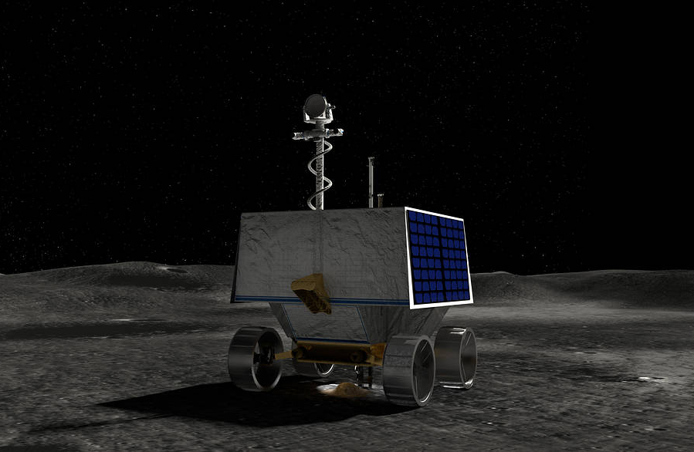
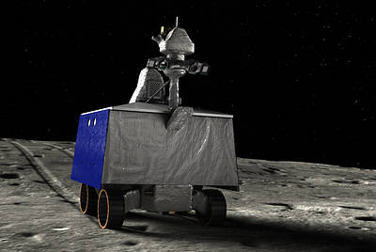
SBIR Sequential Phase II: Technology for VIPER
  Rover Slip Estimation and Traction Control for Optimal Mobility in Lunar Environments - Protoinnovations, LLC
    The firm has been awarded a “follow-on” Phase III contract for $775,000 to implement its technology on the NASA VIPER mission. This Phase III contract will focus on extending and adapting SBIR innovations developed by ProtoInnovations to support the NASA Volatiles Investigating Polar Exploration Rover (VIPER) mission. These technologies are needed by VIPER to improve the mission’s rover locomotion performance, particularly for traversing terrain with uncertain terramechanical properties and hazards. VIPER is a lunar rover mission that will prospect for water ice near the South Pole of the Moon. VIPER represents the first resource mapping mission on another celestial body and is scheduled to launch in late 2023.
    Due to the development status of VIPER and the progress of this Sequential award, it was determined that this technology was at a state where it could address a risk that VIPER had been carrying. This accelerated development advanced the technology to a state where it could be infused into VIPER (whose development had been ongoing) in a timely manner to support the mission. Note that it was determined to make this Phase III award and begin the infusion of the technology even before the completion of the Sequential Phase II effort! The potential impact on the VIPER mission and the progress to date was deemed significant enough to warrant that infusion.

Slide 23
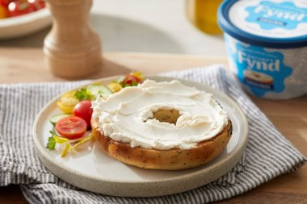
We Promote Commercialization in the Marketplace
A microbe found in Yellowstone National Park during NASA-funded research is now the basis of a fungal protein from which Chicago-based Nature’s Fynd produces meat-alternative breakfast patties and non-dairy cream cheese. The protein is also growing on the International Space Station as potential astronaut food, and the company believes it could one day help ensure sustainable nutrition globally.
Nature’s Fynd partnered with Montana State University on STTR Phase I & II contracts to further develop a system that cultivates a unique fungus to form a dense, edible protein​. As a result of the STTR work, they received additional NASA funding to test the protein on the ISS.
The small business has secured more than $500M in external investments, including from a fund established by Bill Gates to help stop climate change as well as a sustainable investment firm co-founded by Al Gore​.
In 2021, they launched their meatless and dairy-free foods in retailers​.
Notes:
An example of the impact we’re making for everyday Americans--offering new items for them to buy in the grocery store and feed their families. If you have a Sprouts or Whole Foods around you, you may be able to find their cream cheese or vegan breakfast patties!

Slide 24
Questions
Jason L. Kessler, Program Executive
Jason.L.Kessler@nasa.gov

