Slide 1
Designing with Human
Resilience in Mind
Jon Holbrook, PhD
National Aeronautics and Space Administration

Slide 2
The importance of thinking about safety thinking
Safety Thinking
Design Decisions & Safety Policies
Affects
Affects
Affects
Data Collection & Analysis
Learning
Affects

Slide 3
To Err is Human…
Claybrook & Kildare (Science, 2018)
  “… humans are inherently bad at monitoring semi-autonomous systems and are readily distracted.”
  Note: The cited reference (Cunningham & Regan, 2015) doesn’t actually speak to this being “inherent”…
“To fast forward to the safest possible operational state … network operators will be interested in the path that realizes full machine autonomy as quickly as possible.” (Uber, 2016)
  Note: Accordingly, it’s a safety imperative to get those error-prone humans out of the safety loop!
Notes:
Inherent: existing in someone or something as a permanent and inseparable element, quality, or attribute.

Slide 4

Did millions of years of natural selection go wrong?
?
H. habilis
H. heidelbergensis
H. sapiens sapiens
H. sapiens errorum?
H. erectus
H. sapiens
2.5 million years ago
Today
Image credit (left image): Creative Commons Attribution-Share Alike 3.0 Unported license

Slide 5
The mind is a successful adaptive system
Natural selection produces computational systems that solve adaptive problems reliably, quickly, and efficiently, but those systems are functionally specialized (Cosmides & Tooby, 2013)
Often-cited examples of what humans are “bad at” may actually reflect highly adaptive, evolutionarily successful cognitive processes
Fitts (1951): “Human operators are poor monitors when all they have to do is watch the performance of automatic equipment.”
  Evolutionary psychology studies suggest a monitoring system better tuned to ancestral than modern priorities (New et al., 2007; Cosmides & Tooby, 1996)
  Automatic equipment monitoring is poorly aligned with what our mental computational system evolved to do

Slide 6
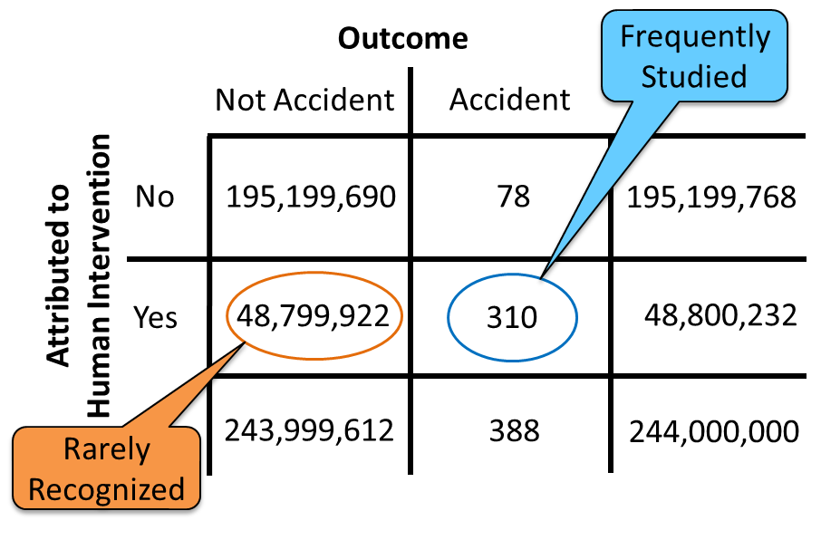
Humans produce safety far more often than they reduce it
Human error has been implicated in up to 80% of accidents in civil and military aviation¹
Pilots intervene to manage aircraft malfunctions on 20% of normal flights²
World-wide jet data from 2007-2016³
  244 million departures
  388 accidents
Learn more: Holbrook, J. (2021). Exploring methods to collect and analyze data on human contributions to aviation safety. In Proceedings of the 2021 International Symposium on Aviation Psychology. https://aviation-psychology.org/wp-content/uploads/2021/05/ISAP_2021_Proceedings_FINAL.pdf
(1) Weigmann & Shappell, 2003; (2) PARC/CAST, 2013; (3) Boeing, 2017

Slide 7
Absence of evidence evidence of absence
When we characterize safety only in terms of errors and failures, we ignore the vast majority of human impacts on the system
When design or policy decisions are based only on failure data, they are based on a very small sample of systematically non-representative data
Sampling bias: Results based on non-random samples can be erroneously attributed to the phenomenon under study rather than to the method of sampling
Removing or restricting the only demonstrated reliable source of safety-producing behavior without first understanding the capability being removed or restricted introduces unknown risks

Slide 8

Consequences of focusing on human error
RO
ER
R
Designs intended to “protect” the system from “error-prone” humans can design out the capability for humans to effectively intervene/adapt, which is a far more common behavior.

Slide 9
Identifying “useful” sources of data
What data about safety-producing behaviors can we collect and analyze?
  What data do we already collect, but could analyze differently?
  What data could we collect and analyze, but do not?
  Observer-, operator-, & system-generated data
How can we measure the “productive safety” capability of a system?
  How do operators prevent, prepare for, and recover from failure?
  How do operators create and leverage safety-building opportunities?
  How does the design of the system (hardware, software, training, procedures, policies, etc.) support or hinder exercising these capabilities?

Slide 10
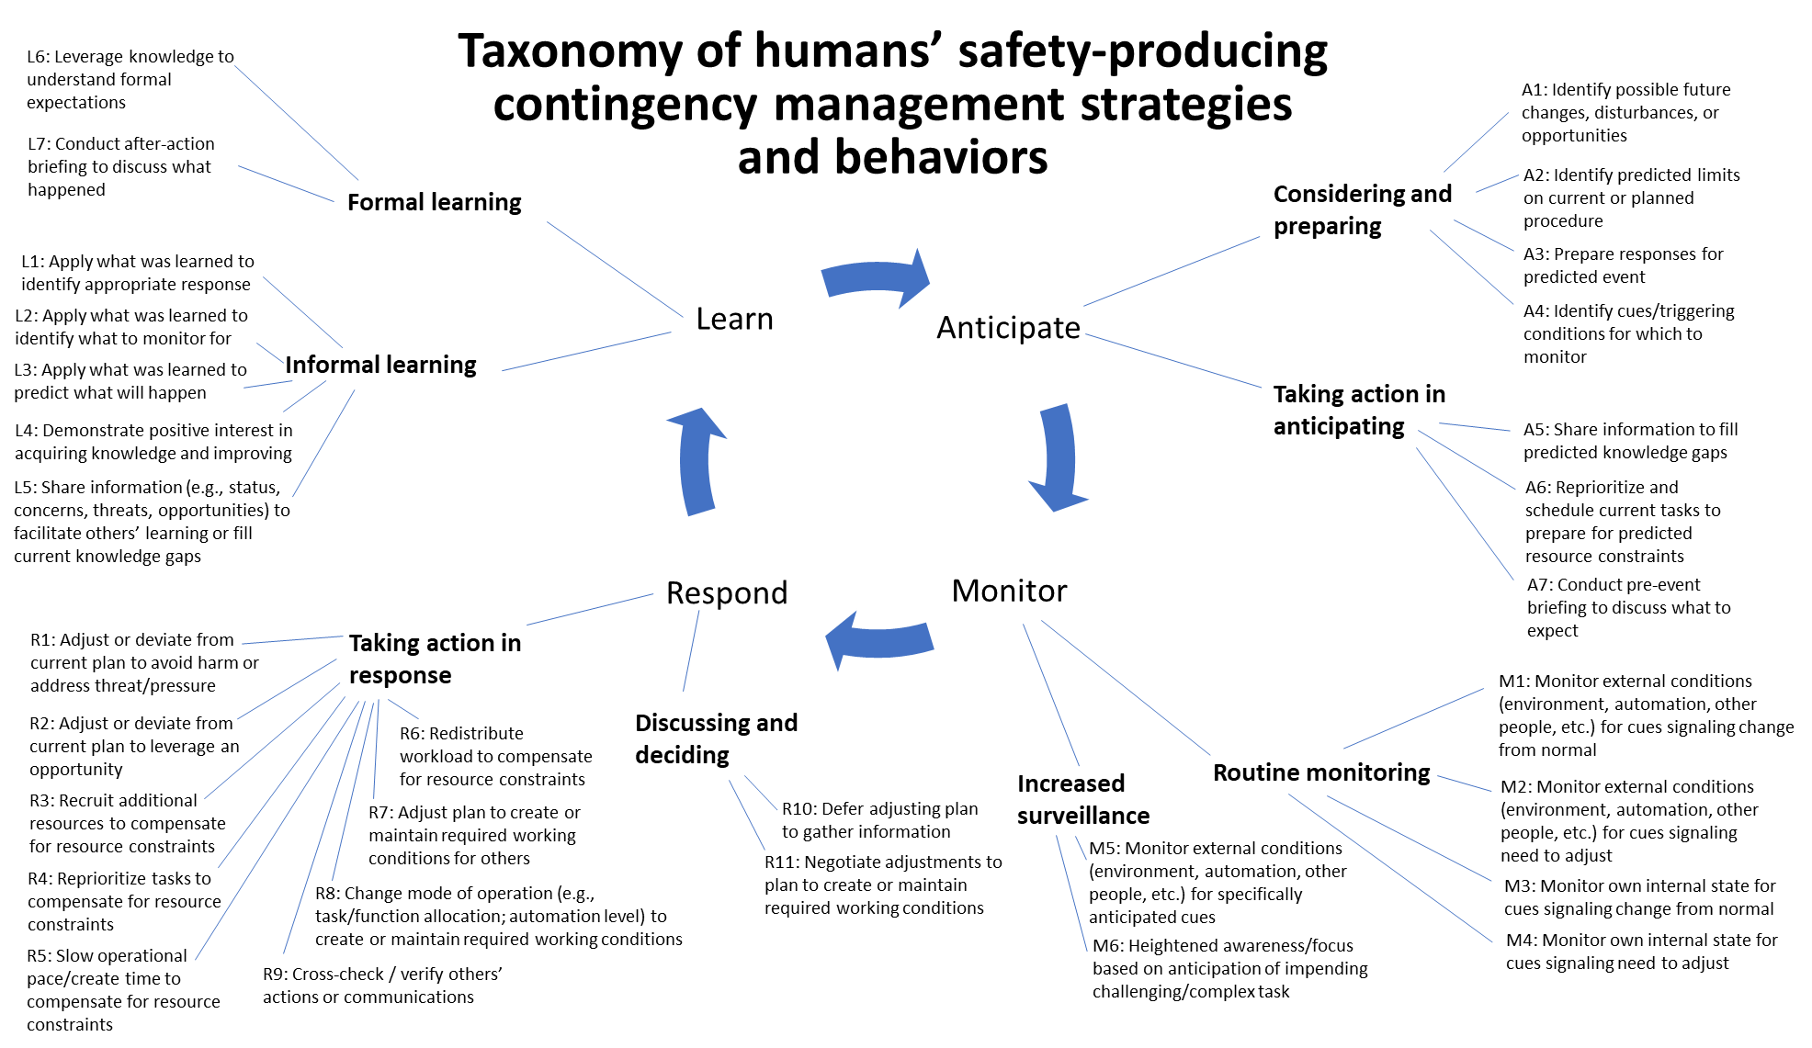
Building a knowledge framework: What to look for
Compiled from: American Airlines Department of Flight Safety, 2021; Holbrook, et al., 2019; Hollnagel, 2011; Kiernan, et al., 2020

Slide 11
Observer-generated data
Do different knowledge frameworks provide different insights?
Line Operations Safety Audit
Observation of everyday work
Conducted by trained observer who is also a domain expert
Focus on threats and errors
  How are they managed?
  How are they linked to undesired states?
Learning & Improvement Teams
Observation of everyday work
Conducted by trained observer who is also a domain expert
Focus on resilient performance
  How is (expected and unexpected) variability successfully managed?
Learn more:
International Civil Aviation Organization (2002). Line operations safety audit (LOSA), Doc 9803, AN/761, Montreal: ICAO.
American Airlines Department of Flight Safety (2021). Charting a New Approach: What Goes Well and Why at American Airlines, A white paper outlining the second phase of AA’s Learning and Improvement Team (LIT).

Slide 12

Operator-generated data
Coding UNDESIRED
Behaviors/States
ASRS Report #1433006
We had 9000 ft selected on the MCP as the bottom altitude for the arrival. At some point before BURRZ the airplane began descending below FL240. We were briefing a possible runway change and did not stop the descent until FL236. At the same time ATC called and asked about our altitude. I replied that we were trying to control altitude and would call him back. The airplane was not responsive through the MCP panel at all. The controller cleared us to descend to FL230. At that time he instructed us to call Washington Center and gave us a phone number. I replied that we were busy trying to control the altitude of the aircraft and would call him back. We then received the phone number and switched to Atlanta Center and had an uneventful approach and landing. We wrote up the MCP and altitude hold in the logbook and contacted maintenance. I do not know the outcome as we had to swap airplanes for our next leg. The CHSLY arrival is all but unusable in the A320 series. There needs to be a software change and the controllers need to stick with their procedures and stop issuing so many speed and altitude restrictions in conjunction with the arrival.
…What happened …is a daily occurrence now covered in Company communications about crew actions to mitigate the deviation. In this particular case, the aircraft's descent could not be controlled.
Coding DESIRED
Behaviors/States
Loss of situation awareness
Anticipate – Conduct pre-event briefing to discuss what to expect
Distraction
Monitor – Environment for cues signaling change from normal
High workload
Monitor – Own internal state
Respond – Reprioritize tasks to compensate for resource constraints
Learn – Share information to facilitate others’ learning
Learn – Understand formal expectations

Slide 13
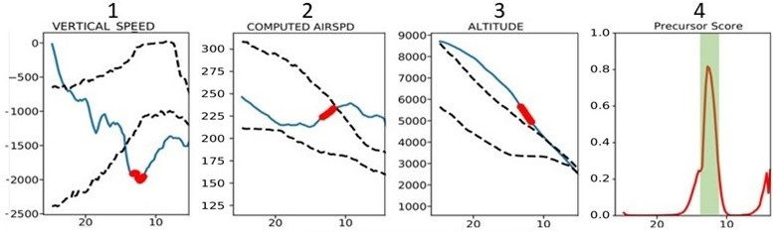
System-generated data
High-speed exceedance at 1000 ft
Used sample of 1000 flights, half with adverse event and half without
Algorithm detects high-probability predictors of a pre-defined adverse event
Non-event flights examined for high precursor probabilities
Pilot transferred aircraft energy from altitude to speed, preserving capability to reduce energy further by introducing drag

Slide 14
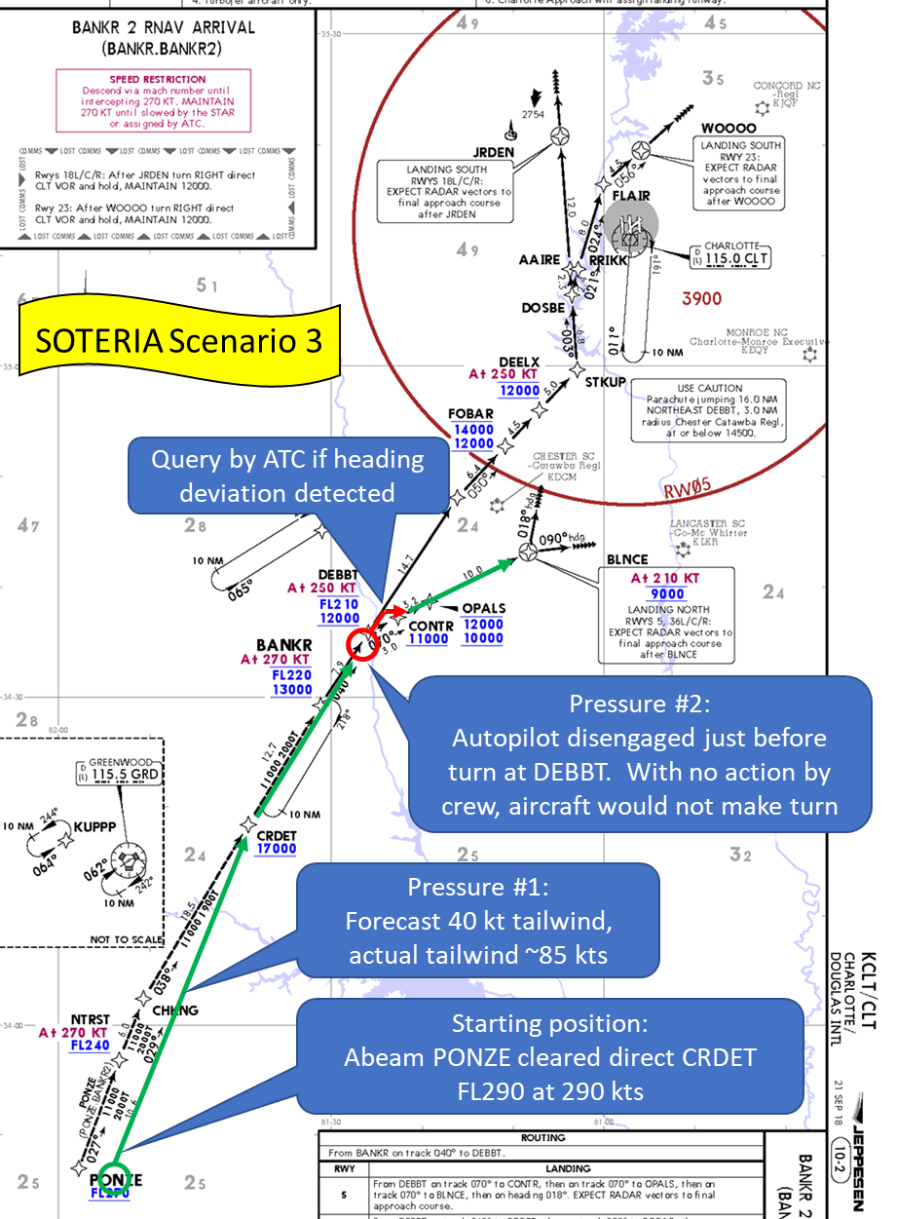
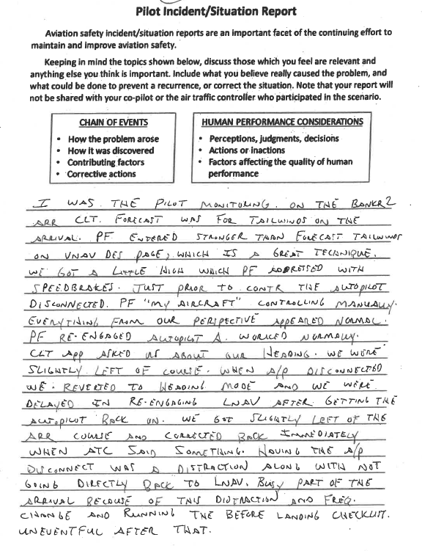
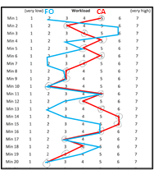
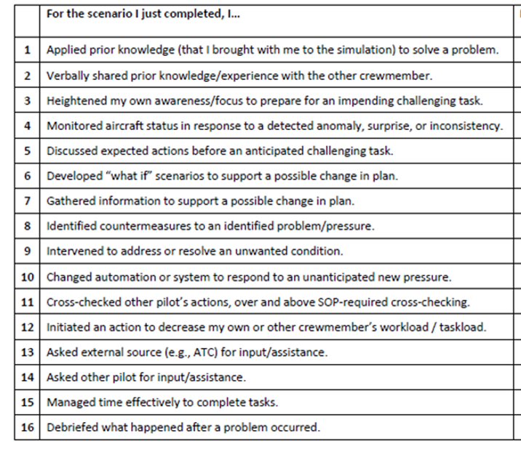
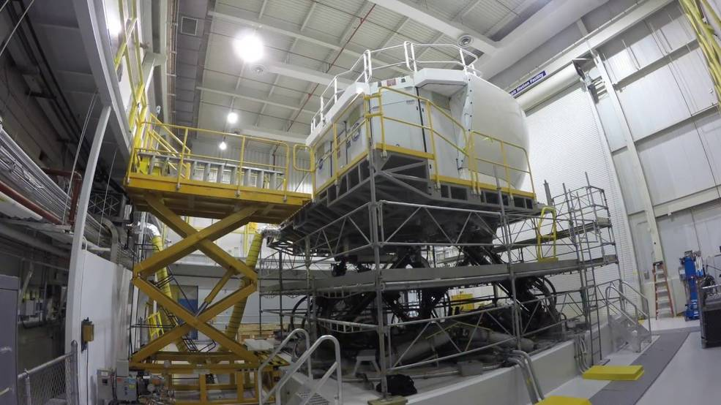
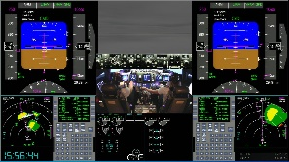
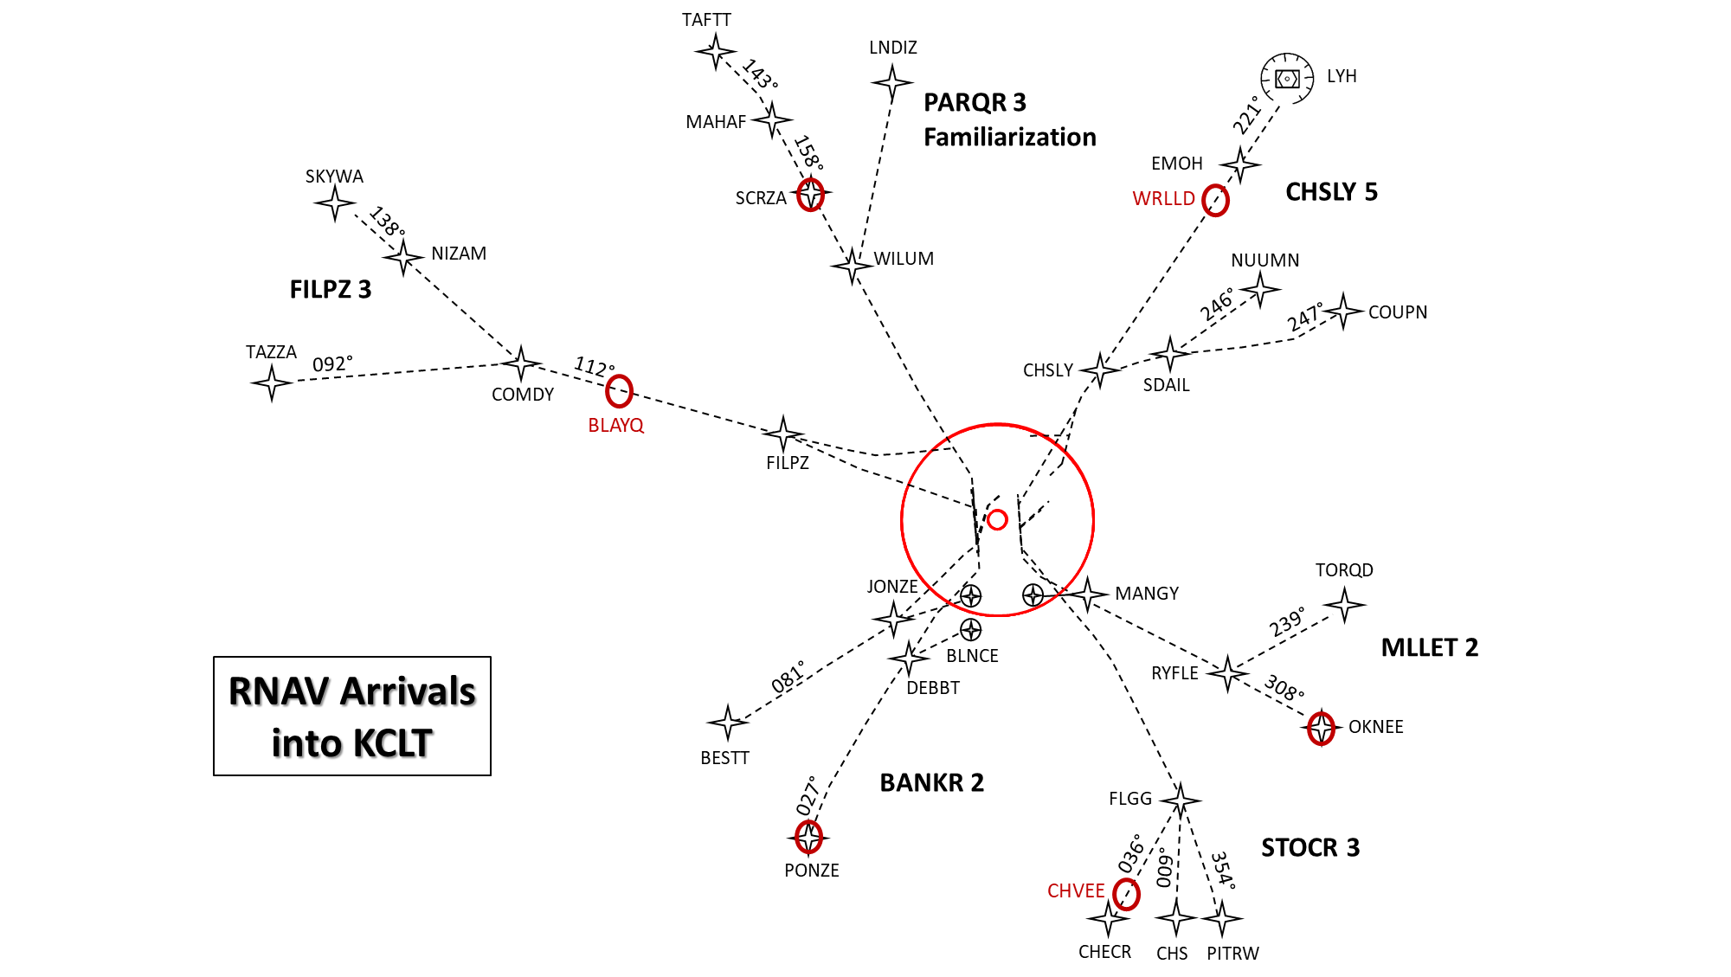
Simulations to systematically explore insights
Motivation and Objectives
Outcome
Test concept assumptions
Validate insights from behavioral field observation
Identify systematic, repeatable measures generalizable to many safety-critical domains
Data testbed for identifying approaches for measuring the actions and strategies that operators use to successfully anticipate, monitor for, respond to, and learn from events in their environment
Approach
12 B737 flight crews took part in a 1.5-day study, using a high-fidelity B737 motion-base simulator
Participating flight crews flew a series of eight 20-minute scenarios based on arrivals into Charlotte Airport.
Each scenario was designed to contain at least 2 manageable “pressures”
Impact
Assess methods for learning from what happens, not just from what fails
Potential to massively expand the pool of safety-relevant data, which can
  Enhance timeliness of safety learning
  Reduce risk of sampling bias
  Inform system design
For more information: Jon Holbrook, PhD
jon.holbrook@nasa.gov | 757-864-9275
All images, credit: NASA

Slide 15
Key Take-Aways
When we characterize safety only in terms of errors and failures
  We ignore the vast majority of human impacts on the system
  We restrict opportunities to learn
  Our design decisions and safety policies can be affected
When we systematically restrict opportunities to learn, not only do we learn less and less often, but we can draw misleading conclusions
Many opportunities exist to collect and analyze largely unexploited data on desired behaviors
Understanding everyday performance is critical to the design of systems that effectively preserve the capability for humans to intervene/adapt to sustain safe operations.

Slide 16
Thank you!

