Slide 1

Nonlinear Acoustic Propagation in Low-Density Media
Joel B. Lonzaga
NASA Langley Research Center
Hampton, Virginia
184th Meeting of the Acoustical Soc. of America
Chicago, IL
May 8-12, 2023
joel.b.lonzaga@nasa.gov

Slide 2
Outline
Motivation
  Burgers equation is inadequate for secondary booms
Nonlinearity increases with altitude
  Modeling of secondary booms accounting for interaction of the field with itself at two different field points
Derivation of the finite amplitude speed of sound
  Green’s function of the full, nonlinear wave equation
  Self-energy
  Effects on the acoustic field of the correction to the sound speed
Conclusion
Notes:
To give you some background materials,
NASA is building the X-59 aircraft

Slide 3
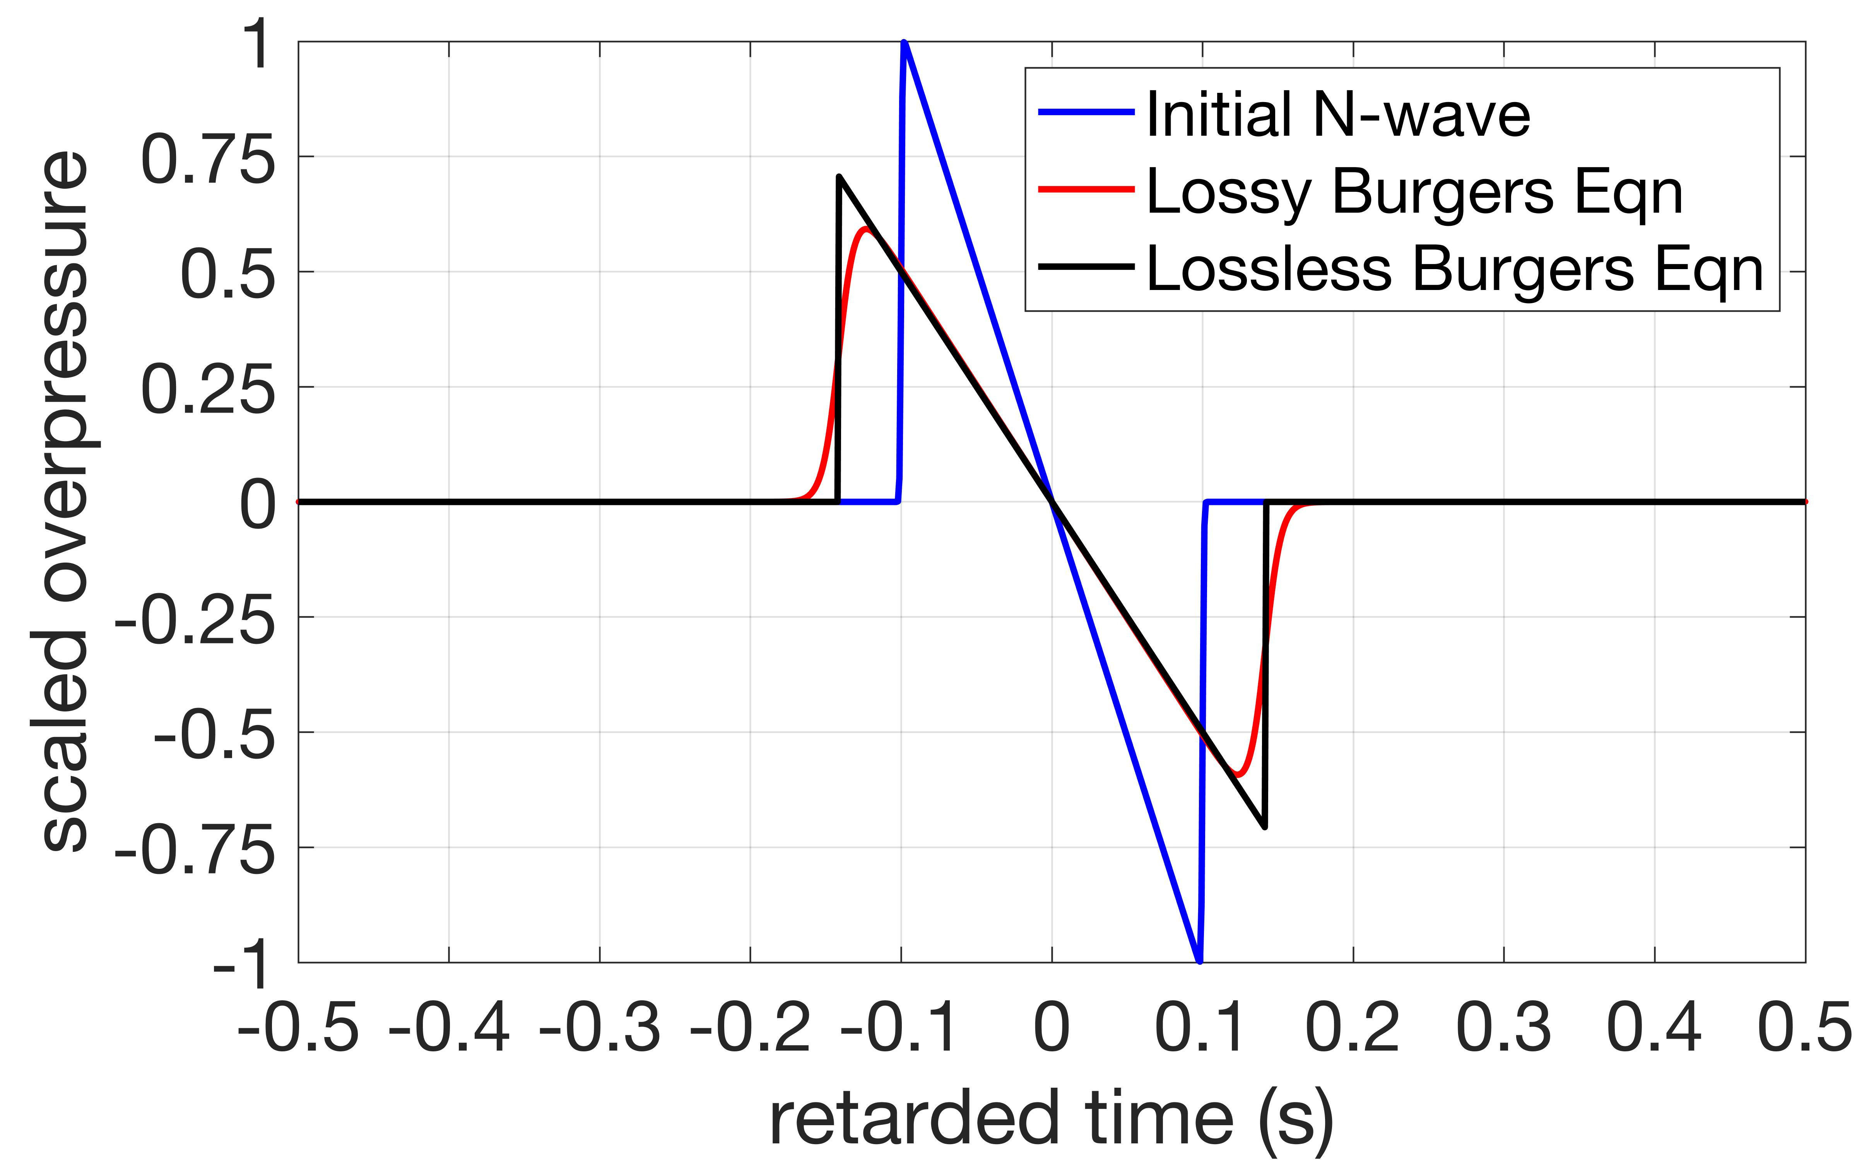
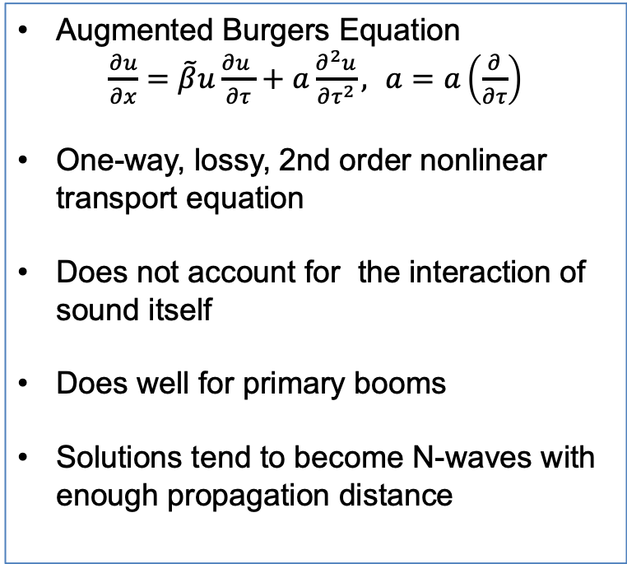
Existing Nonlinear Wave Equation for Sonic Booms
Augmented Burgers Equation
$\frac{∂u}{∂x}=\tilde{β}u\frac{{∂u}^{ }}{∂τ}+a\frac{∂^{2}u}{∂τ^{2}},$ $a=a\left(\frac{∂}{∂τ}\right)$
One-way, lossy, 2nd order nonlinear transport equation
Does not account for the interaction of sound itself
Does well for primary booms
Solutions tend to become N-waves with enough propagation distance
Lossy and Lossless Solutions

Slide 4
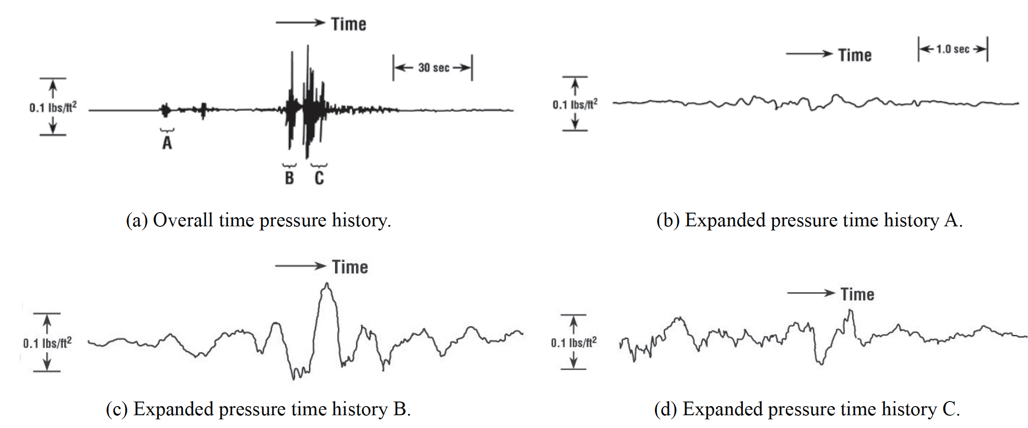
Characteristics of Secondary Booms
Typical of recorded secondary booms from a supersonic Concorde plane
Different arrivals from the same event
Do not resemble an N-wave
Source: Maglieri et al., “Sonic Boom: Six Decades of Research," NASA SP-2014-622

Slide 5
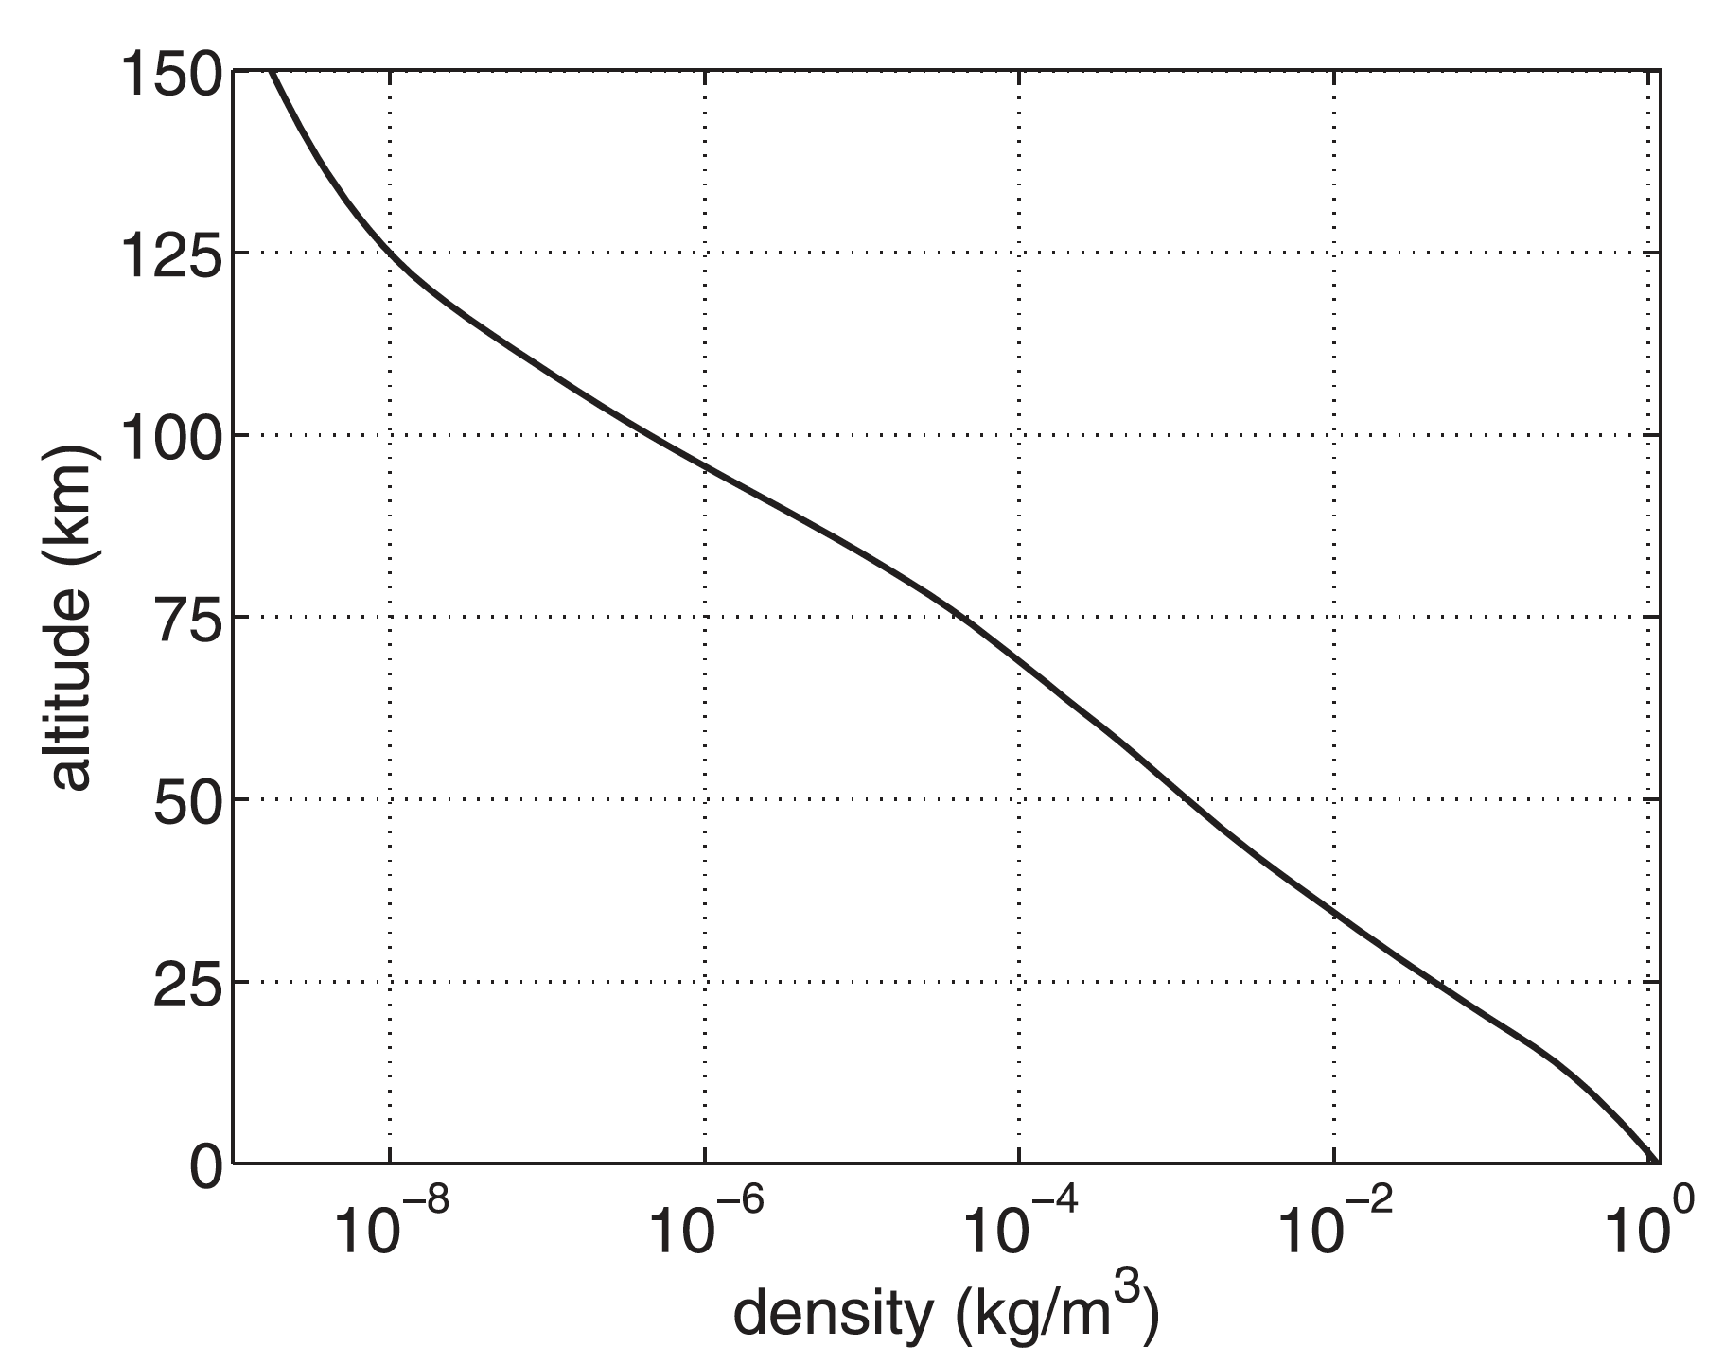
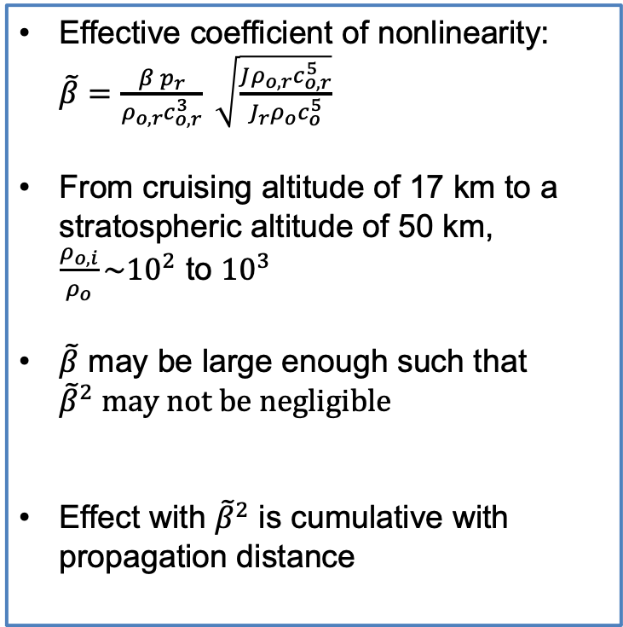
Effective Coefficient of Nonlinearity in the Stratified Atmosphere
Effective coefficient of nonlinearity: $\tilde{β}=\frac{β p_{r}}{ρ_{o,r}c_{o,r}^{3}} \sqrt{\frac{Jρ_{o,r}c_{o,r}^{5}}{{J_{r}ρ}_{o}c_{o}^{5}}}$
From cruising altitude of 17 km to a stratospheric altitude of 50 km, $\frac{ρ_{o,i}}{ρ_{o}}\sim {10}^{2}$ to ${10}^{3}$
$\tilde{β}$ may be large enough such that ${\tilde{β}}^{2} may not be negligible$
Effect with ${\tilde{β}}^{2}$ is cumulative with propagation distance
Ref: Lonzaga et al., Modelling waveforms of infrasound arrivals from impulsive sources
using weakly non-linear ray theory, Geophys. J. Int. (2015) 200, 1347–1361.

Slide 6
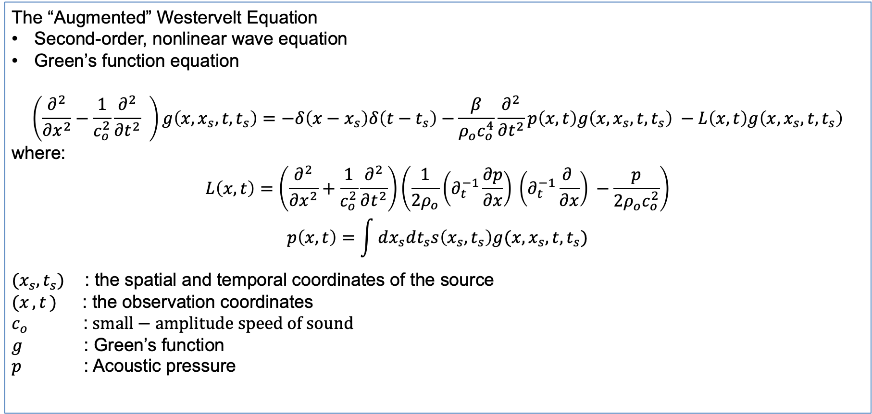
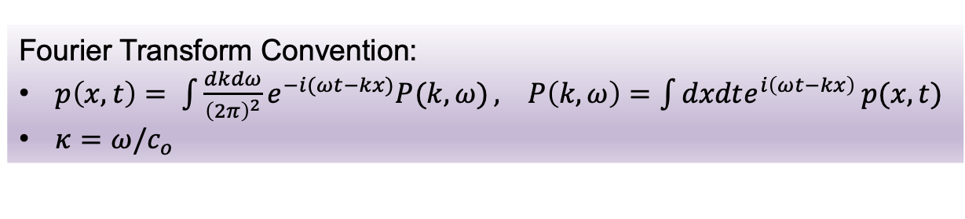
Green’s Function For Finite-Amplitude Speed of Sound
The “Augmented” Westervelt Equation
Second-order, nonlinear wave equation
Green’s function equation
$$\left(\frac{∂^{2}}{∂x^{2}}−\frac{1}{c_{o}^{2}}\frac{∂^{2}}{∂t^{2}} \right)g\left(x,x_{s},t,t_{s}\right)=−δ\left(x−x_{s}\right)δ\left(t−t_{s}\right)−\frac{β}{ρ_{o}c_{o}^{4}}\frac{∂^{2}}{∂t^{2}}p\left(x,t\right)g\left(x,x_{s},t,t_{s}\right) −L\left(x,t\right)g\left(x,x_{s},t,t_{s}\right)$$
where:
$$L\left(x,t\right)=\left(\frac{∂^{2}}{∂x^{2}}+\frac{1}{c_{o}^{2}}\frac{∂^{2}}{∂t^{2}}\right)\left(\frac{1}{2ρ_{o}}{\left(∂_{t}^{−1}\frac{∂p}{∂x}\right)}^{ }{\left(∂_{t}^{−1}\frac{∂ }{∂x}\right)}^{ }−\frac{p}{{2ρ_{o}c}_{o}^{2}}\right)$$
$$p\left(x,t\right)=\int{dx_{s}dt_{s}s\left(x_{s},t_{s}\right)g(x,x_{s},t,t_{s})}$$
$(x_{s},t_{s})$ : the spatial and temporal coordinates of the source
$(x_{ },t_{ })$ : the observation coordinates
$c_{o}$ :$small−amplitude speed of sound$
$g$ : Green’s function
$p$ : Acoustic pressure
Fourier Transform Convention:
$p\left(x,t\right)= \int{\frac{dkdω}{{\left(2π\right)}^{2}}e^{−i(ωt−kx)}P(k,ω)}, P\left(k,ω\right)=\int{dxdte^{i\left(ωt−kx\right)}}p(x,t)$
$κ=ω/c_{o}$
Ref: Aanonsen et al., Distortion and harmonic generation in the near-field of a finite amplitude sound beam, JASA 75, 749-768 (1984).

Slide 7
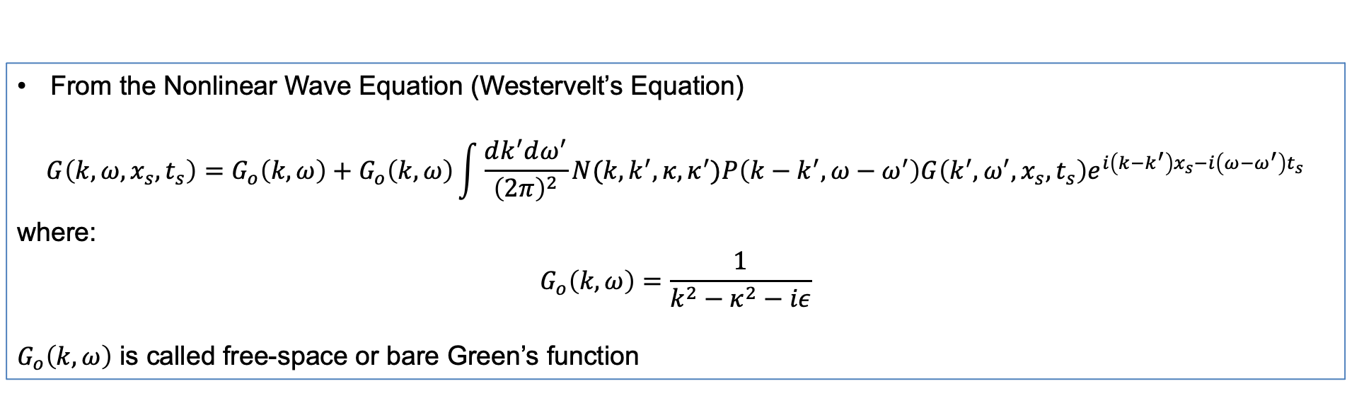
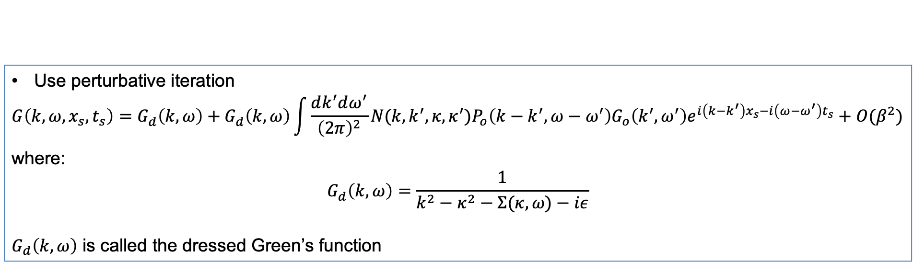
Green’s Function in Fourier Space
From the Nonlinear Wave Equation (Westervelt’s Equation)
$$G\left(k,ω,x_{s},t_{s}\right)=G_{o}\left(k,ω\right)+G_{o}\left(k,ω\right)\int{\frac{dk^{′}dω^{′}}{{\left(2π\right)}^{2}}}N(k,k^{′},κ,κ^{′})P\left(k−k^{′},ω−ω^{′}\right)G\left(k^{′},ω^{′},x_{s},t_{s}\right)e^{i\left(k−k^{′}\right)x_{s}−i\left(ω−ω^{′}\right)t_{s}}$$
where:
$$G_{o}\left(k,ω\right)=\frac{1}{k^{2}−κ^{2}−iε}$$
$G_{o}\left(k,ω\right)$ is called free-space or bare Green’s function
Use perturbative iteration
$$G\left(k,ω,x_{s},t_{s}\right)=G_{d}^{ }\left(k,ω\right)+G_{d}^{ }\left(k,ω\right)\int{\frac{dk^{′}dω^{′}}{{\left(2π\right)}^{2}}}N(k,k^{′},κ,κ^{′})P_{o}\left(k−k^{′},ω−ω^{′}\right)G_{o}\left(k^{′},ω^{′}\right)e^{i\left(k−k^{′}\right)x_{s}−i\left(ω−ω^{′}\right)t_{s}}+O(β^{2})$$
where:
$$G_{d}^{ }\left(k,ω\right)=\frac{1}{k^{2}−κ^{2}−Σ(κ,ω)−iε}$$
$G_{d}\left(k,ω\right)$ is called the dressed Green’s function

Slide 8
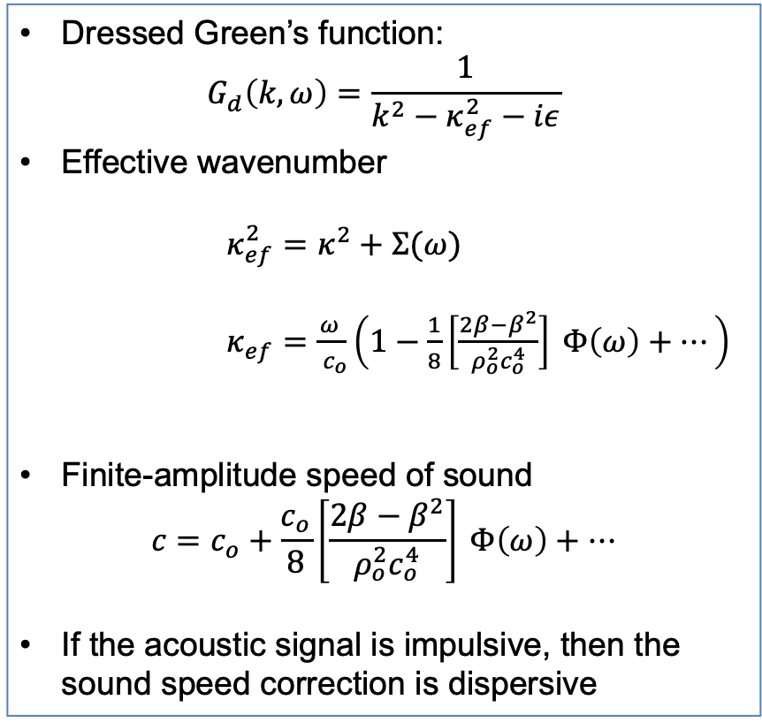
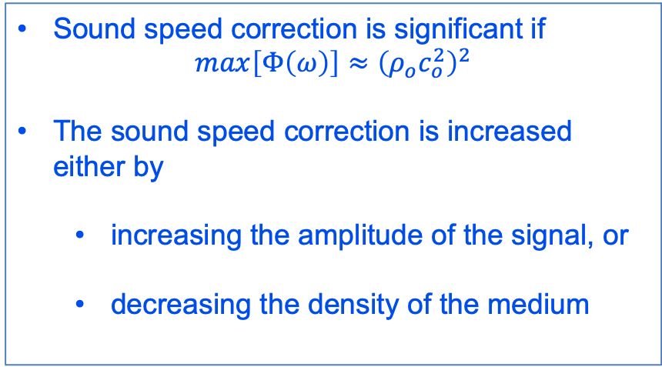
Finite-Amplitude Speed of Sound
Dressed Green’s function:
$$G_{d}^{ }\left(k,ω\right)=\frac{1}{k^{2}−κ_{ef}^{2}−iε}$$
Effective wavenumber
$κ_{ef}^{2}=κ^{2}+Σ(ω)$
$κ_{ef}=\frac{ω^{ }}{ c_{o}}\left(1−\frac{1}{8}{\left[\frac{2β−β^{2}}{ρ_{o}^{2}c_{o}^{4}}\right]}^{ }Φ\left(ω\right)+⋯\right)$
Finite-amplitude speed of sound
$$c=c_{o}+\frac{c_{o}}{8}{\left[\frac{2β−β^{2}}{ρ_{o}^{2}c_{o}^{4}}\right]}^{ }Φ\left(ω\right)+⋯$$
If the acoustic signal is impulsive, then the sound speed correction is dispersive
Sound speed correction is significant if
$$max\left[Φ\left(ω\right)\right]≈{\left(ρ_{o}^{ }c_{o}^{2}\right)}^{2}$$
The sound speed correction is increased either by
  increasing the amplitude of the signal, or
  decreasing the density of the medium

Slide 9
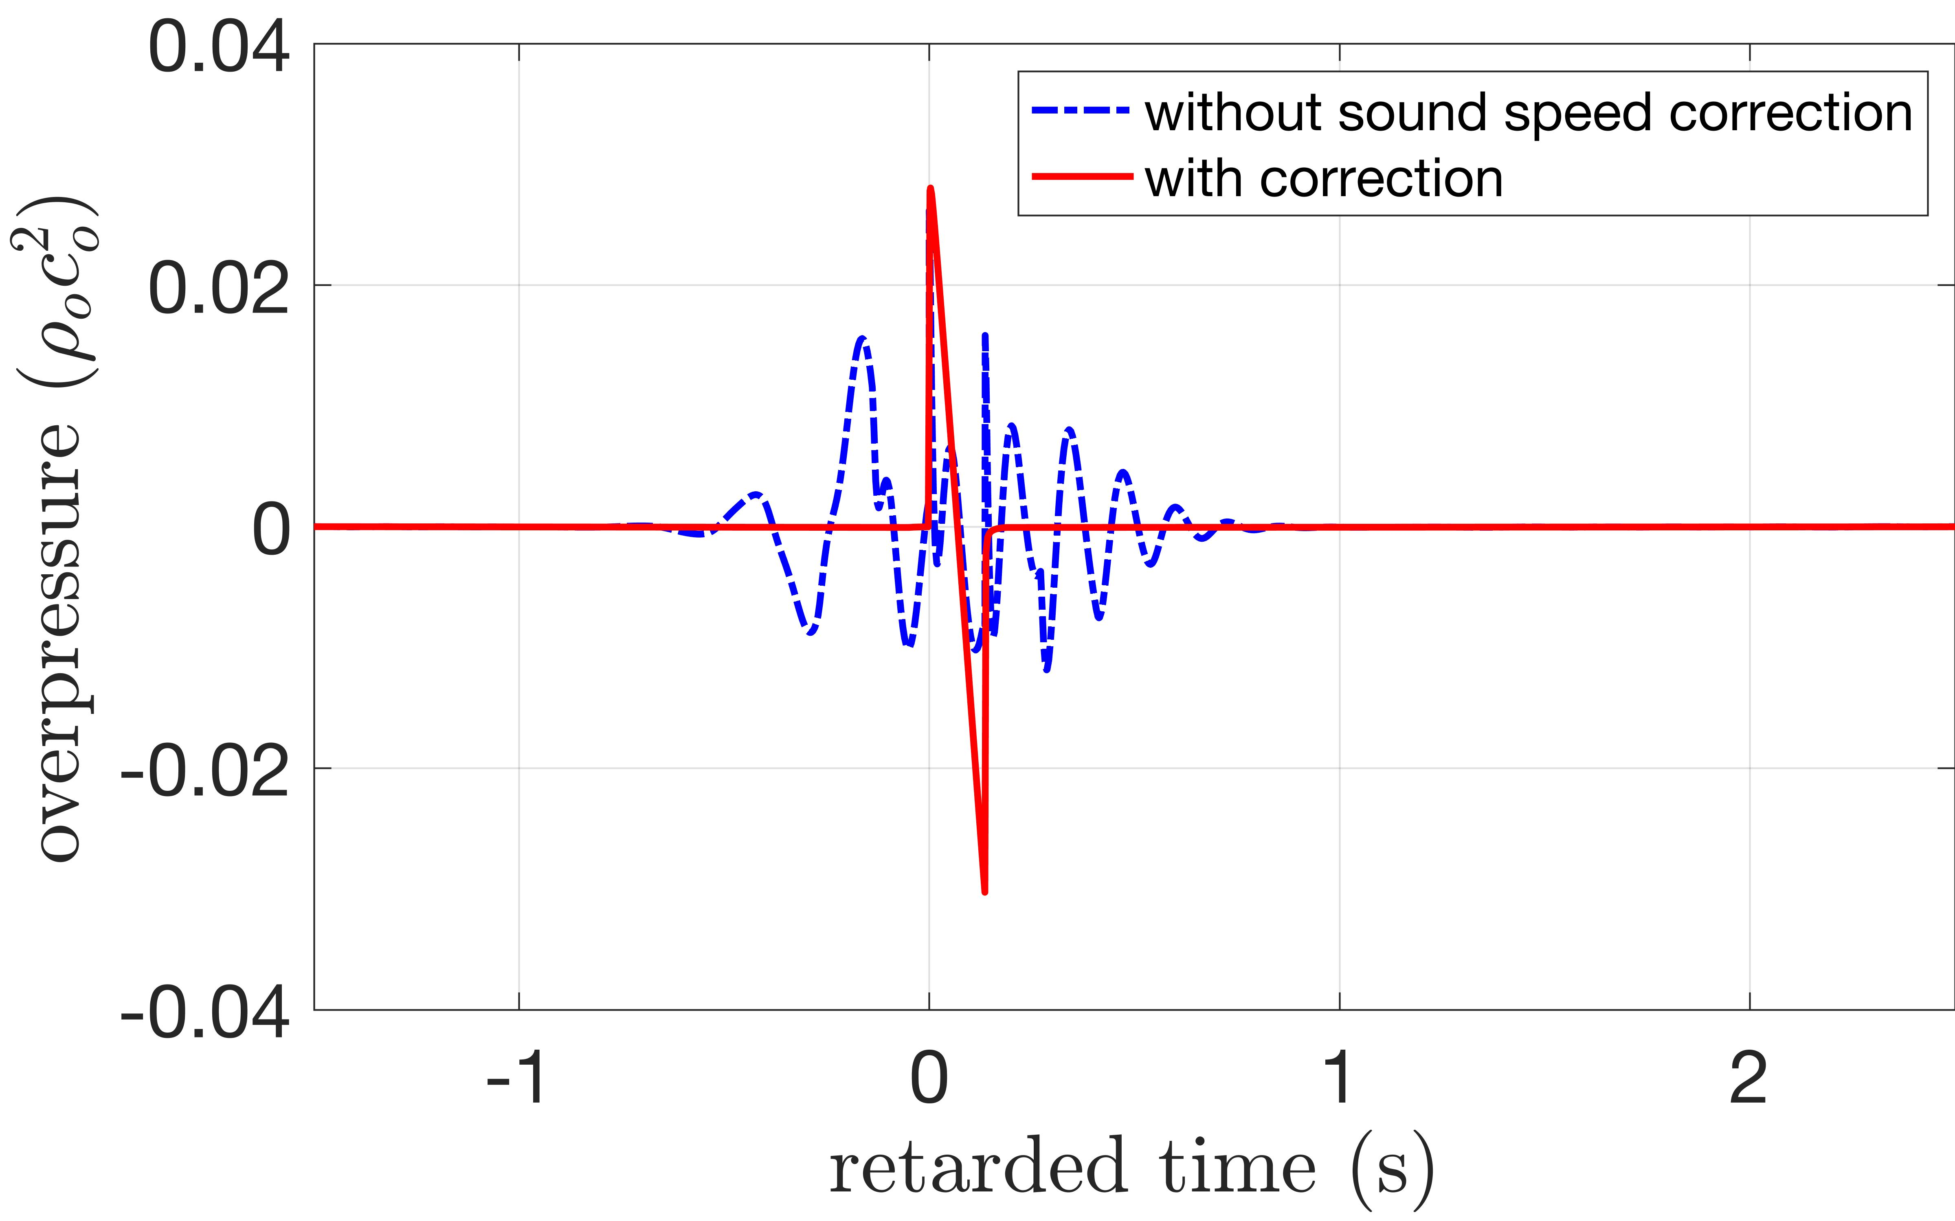
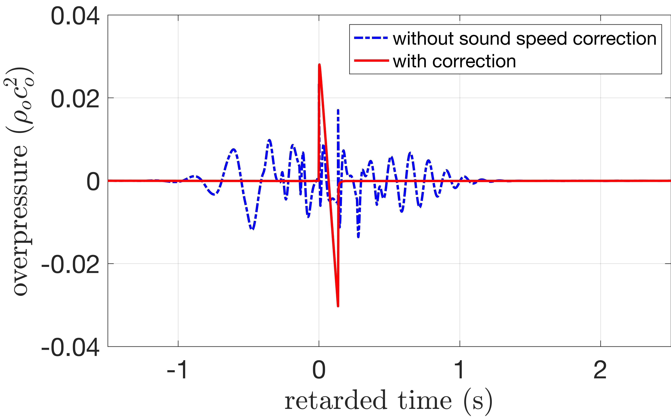
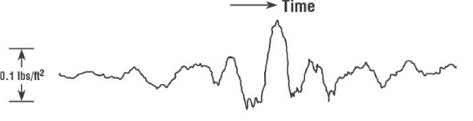
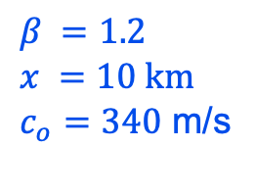
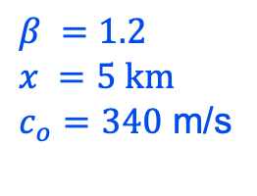
Nonlinear Medium and Propagation Distance
Red: no correction
Blue: with correction
Red: no correction
Blue: with correction
$$β =1.2$$
$$x =5 km$$
$c_{o}=340$ m/s
$$β =1.2$$
$$x =10 km$$
$c_{o}=340$ m/s
Effects with and without the sound speed correction
Figure on the left: propagation distance = 5 km
Figure on the right: propagation distance =10 km
Signal duration tends to double itself with doubling of the propagation distance
Recorded Secondary Boom

Slide 10
Conclusion
Measured secondary booms from the Concorde typically do not resemble N-waves, which can be modeled using a Burgers equation
To model secondary booms, the augmented Westervelt equation is used
  Obtained the acoustic analog of the self-energy from the dressed Green’s function
  Derived the finite-amplitude speed of sound
  Frequency-dependent for impulsive signals
Future work
  account for geometrical spreading and atmospheric absorption
  validate theory with measured data

Slide 11
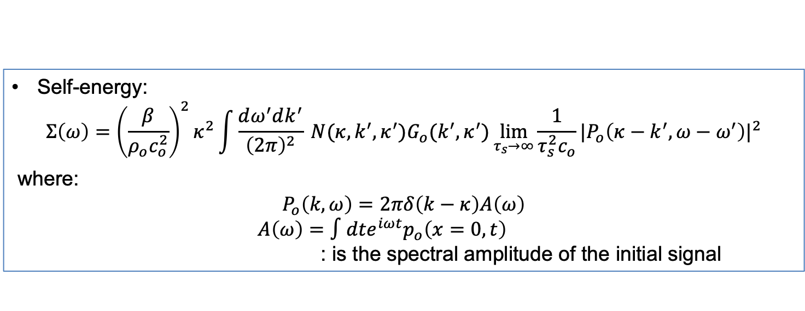
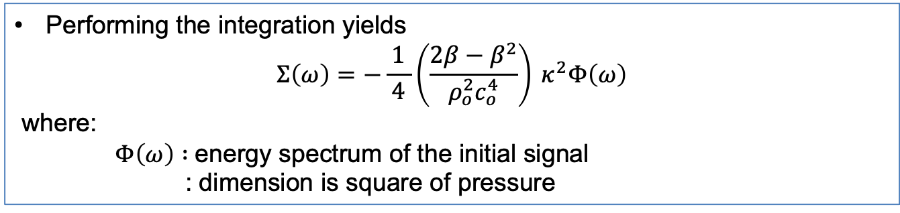
Self-Energy: Effect of the interaction of sound with itself
Self-energy:
$$Σ\left(ω\right)={\left(\frac{β}{ρ_{o}c_{o}^{2}}\right)}^{2}κ^{2}\int{\frac{dω^{′}dk^{′}}{{\left(2π\right)}^{2}} }N(κ,k^{′},κ^{′})G_{o}(k^{′},κ^{′})\lim_{τ_{s}→∞}{\frac{1}{τ_{s}^{2}c_{o}}}|P_{o}\left(κ−k^{′},ω−ω^{′}\right)|^{2}$$
where:
$$P_{o}\left(k,ω\right)=2πδ\left(k−κ\right)A\left(ω\right)$$
$A\left(ω\right)=∫dt{e^{iωt}p}_{o}\left(x=0,t\right)$
: is the spectral amplitude of the initial signal
Performing the integration yields
$$Σ\left(ω\right)=−\frac{1}{ 4 }{\left(\frac{2β−β^{2}}{ρ_{o}^{2}c_{o}^{4}}\right)}^{ }κ^{2}Φ\left(ω\right)$$
where:
$Φ\left(ω\right) :$energy spectrum of the initial signal
: dimension is square of pressure

