Slide 1
Strategies for Improving
Safety Learning
Jon Holbrook, PhD
National Aeronautics and Space Administration

Slide 2


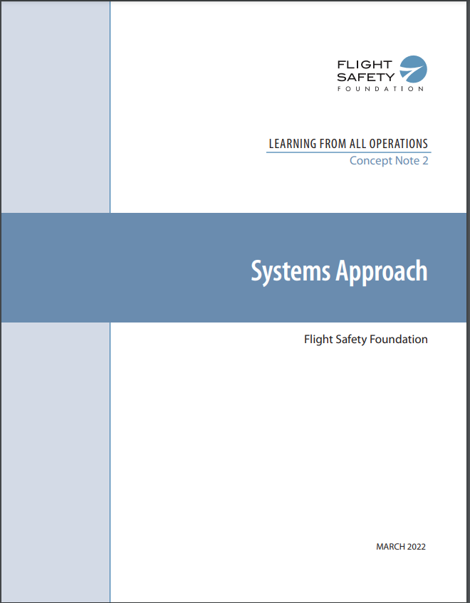


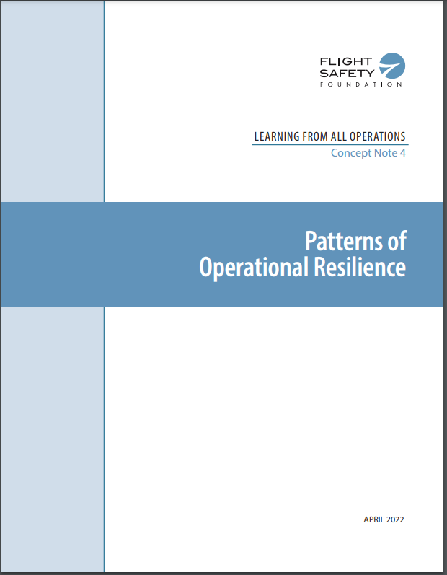
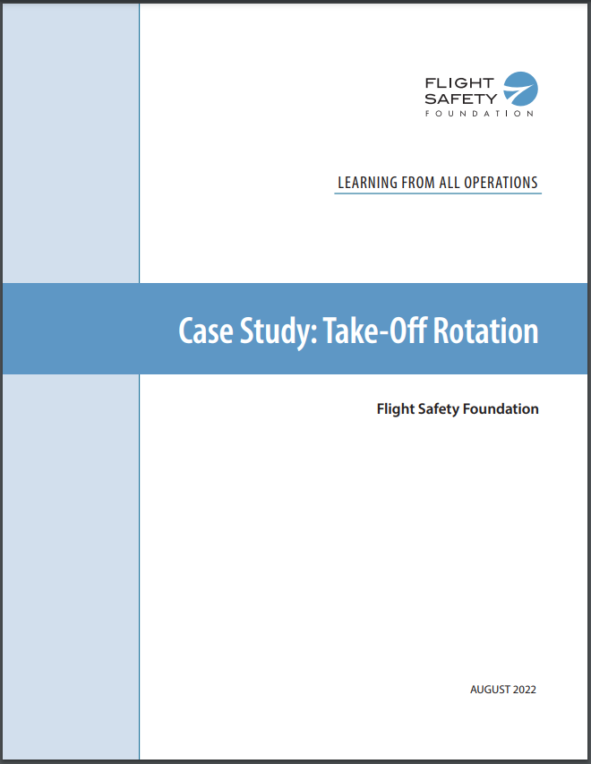

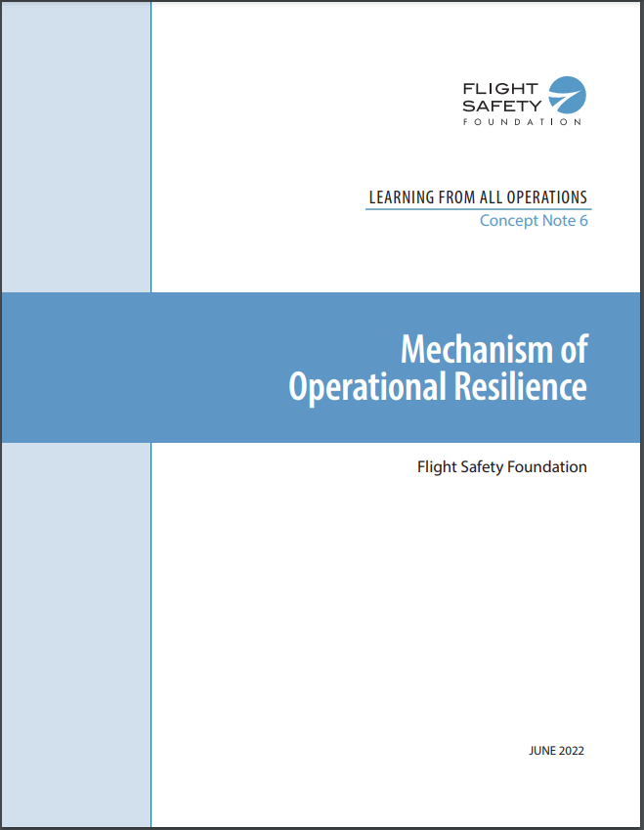
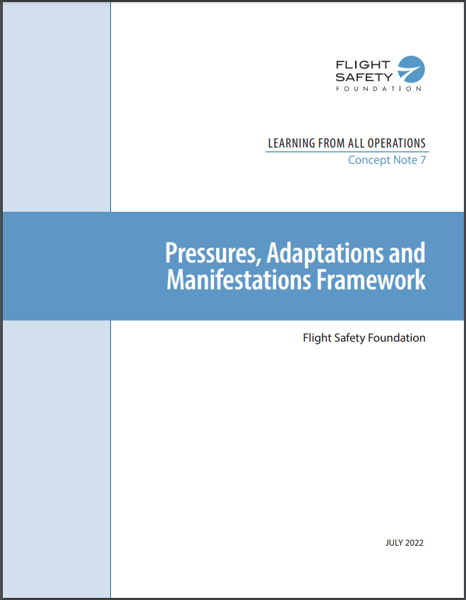
Learning from All Operations
POC for the FSF LAO initiative:
Tzvetomir Blajev (blajev@flightsafety.org)
White paper
Concept Notes
Case Study
https://flightsafety.org/toolkits-resources/learning-from-all-operations/

Slide 3
Expanding learning opportunities
Build upon or complement existing approaches to collect, analyze, manage, & disseminate safety data
  Observations of work
  Event investigation
  Surveys & audits
  Expanded use of system data
What are the learning principles that help us get the most out of those safety data?
How do we turn safety data into safety learning?

Slide 4
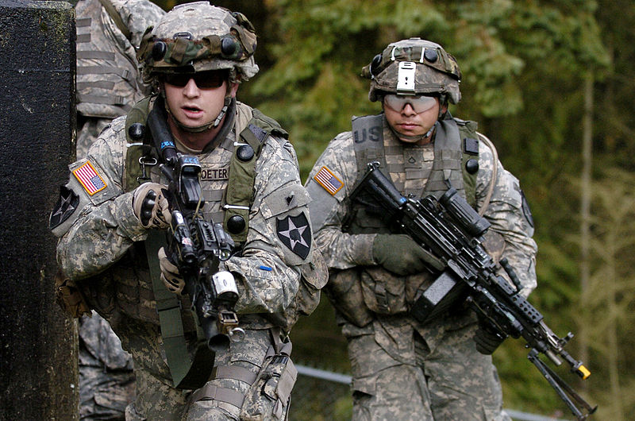
Incorporate learning from success & failure in debriefs
After-Event Reviews: Drawing Lessons From Successful and Failed Experience (Ellis & Davidi, 2005).
Soldiers’ navigation performance improved more when debriefed on failures and successes compared with only failures
Before the study, soldiers’ mental models of failed events were richer than for successful events, but this gap closed after the study
What Can You Do?
Structured debriefs could include
  What was planned and expected to happen?
  What actually happened?
  What surprised us?
  What went well and why?
  What can be improved and how?
  What did we learn that would help others?
  Probes of trade-off decisions, such as “When we decided to [take action X], how did it turn out?”
Image credit: US Army (2008). Public Domain

Slide 5
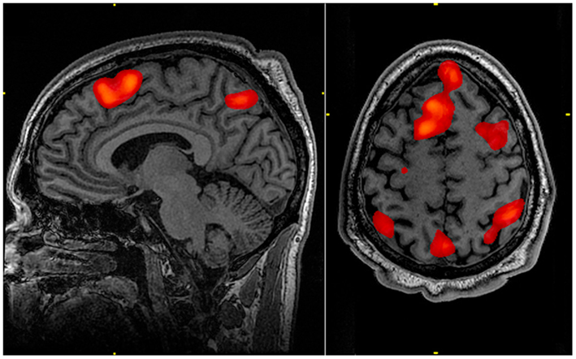
Use of stories to support learning
Reading Stories Activates Neural Representations of Visual and Motor Experiences (Speer et al., 2009).
Recorded brain activity using functional magnetic resonance imaging (fMRI) while participants read short narratives
The same brain regions activate when people perform, observe, imagine, or read about real-world activities
What Can You Do?
Use of stories in lessons learned
  Enrich anomaly reporting and resolution processes
  Learning experiences can be frequent, interactive, reflective, and designed to build expert decision-making and professional judgement
  Improve how an organization builds and maintains collective memory, deep knowledge, and a larger repertoire of decision-making strategies
Image credit: John Graner (2010). Public Domain

Slide 6
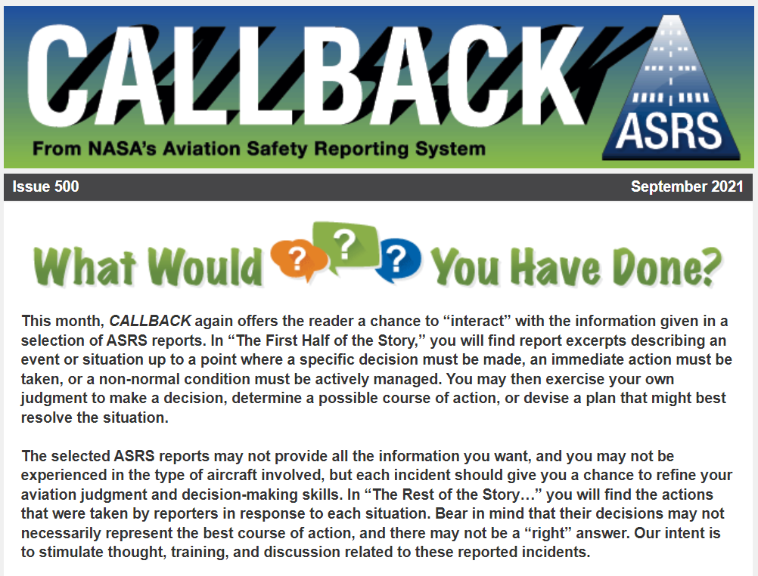
Improving individual learning
Factors that impact individual learning
Motivation (Weiner, 1966)
Prior knowledge (Cohen, 1981)
Rehearsal and practice (Craik & Lockhart, 1972)
Elaboration (e.g., Yogo & Fujihara, 2008; McLeod et al., 2010)
Spacing out your practice (e.g., Ebbinghaus, 1885)
Organizing information (e.g., Bellezza, 1981)
Sleep (e.g., Abel & Bauml, 2013)
Learn more:
https://asrs.arc.nasa.gov/publications/callback.html

Slide 7
Getting the most out of learning opportunities
“What are you learning?” vs. “How are you learning?”
“Cognitively active” learning is generally superior to “cognitively passive” learning in educational settings (Stanger-Hall, 2012)
Implications for
  How we should collect, organize, and share knowledge
  Assumptions about operators learning from on-the-job experiences
Cognitively Passive
I previewed the material ahead of time
I came to class
I read the assigned text
Cognitively Active
I asked myself “how does this work?” and “why does it work this way?”
I wrote my own study questions
I fit all the facts into the bigger picture
I closed my notes and tested how much I remembered

Slide 8

Leverage active learning
The First Half of the Story…
I was Pilot Flying and set thrust for takeoff, pressed the TOGA button to engage takeoff thrust, and noticed the right thrust [lever] did not fully advance. I called, “Check thrust.” The Captain noticed that the Number 2 Engine would not achieve takeoff thrust.

Slide 9
Leverage active learning
The Rest of the Story…
[The Captain] called, “100 knots,” but I noticed he was heads down at the engine gauges, and I called, “V1.” I achieved Vr, and he called for a rejected takeoff. I said, “Negative, we are past V1.” He pushed the thrust levers to full thrust, and we rotated without incident. I disconnected autothrottles and was able to achieve climb thrust for the climb to cruise altitude. At cruise, the Captain called Maintenance Control to discuss the issue, and they told us that the aircraft [recently] had a similar incident.... We continued the flight without incident and debriefed the situation at cruise. We talked about the fact that we were at such a light weight and the speeds V1 and Vr came so much earlier than normal.
The First Half of the Story…
I was Pilot Flying and set thrust for takeoff, pressed the TOGA button to engage takeoff thrust, and noticed the right thrust [lever] did not fully advance. I called, “Check thrust.” The Captain noticed that the Number 2 Engine would not achieve takeoff thrust.

Slide 10
Leverage active learning
What Else Could You Ask…
…after reading the rest of the story?
How does your solution compare with what the event crew did?
What else could the event crew have done?
Of all the solutions you came up with, which do you think would have worked best? Why?
What do you think were the “learning moments” or “teachable moments” in this situation?
What could you take from this situation to add to your own “strategy toolbox”?
I was Pilot Flying and set thrust for takeoff, pressed the TOGA button to engage takeoff thrust, and noticed the right thrust [lever] did not fully advance. I called, “Check thrust.” The Captain noticed that the Number 2 Engine would not achieve takeoff thrust.
[The Captain] called, “100 knots,” but I noticed he was heads down at the engine gauges, and I called, “V1.” I achieved Vr, and he called for a rejected takeoff. I said, “Negative, we are past V1.” He pushed the thrust levers to full thrust, and we rotated without incident. I disconnected autothrottles and was able to achieve climb thrust for the climb to cruise altitude. At cruise, the Captain called Maintenance Control to discuss the issue, and they told us that the aircraft [recently] had a similar incident.... We continued the flight without incident and debriefed the situation at cruise. We talked about the fact that we were at such a light weight and the speeds V1 and Vr came so much earlier than normal.
Does this situation remind you of one that you have personally experienced? What do you think contributed to your situation working out successfully or unsuccessfully?

Slide 11
Key Take-Aways
Learning from All Operations expands our understanding of what constitutes a safety-relevant event
Expanding opportunities for collection, analysis, and dissemination of safety data also expands opportunities for safety learning
Applying established principles of learning, such as “active learning” can help to make the most of safety learning opportunities
  Individuals can apply these principles to reinforce learning from their own and others’ experiences
  Organizations can apply these principles through policies that help preserve, reinforce, extend, and expand good practices

Slide 12
Thank you!

