Slide 1
Architecture Approach for Human Mars Missions
Patrick R. Chai
Exploration Systems Development Mission Directorate
Strategy & Architecture Office, Mars Architecture Team

Slide 2
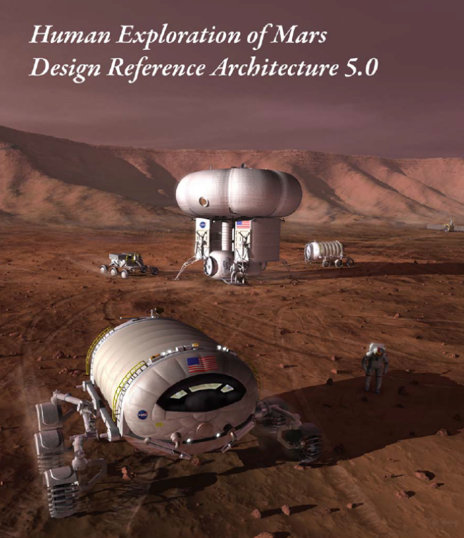
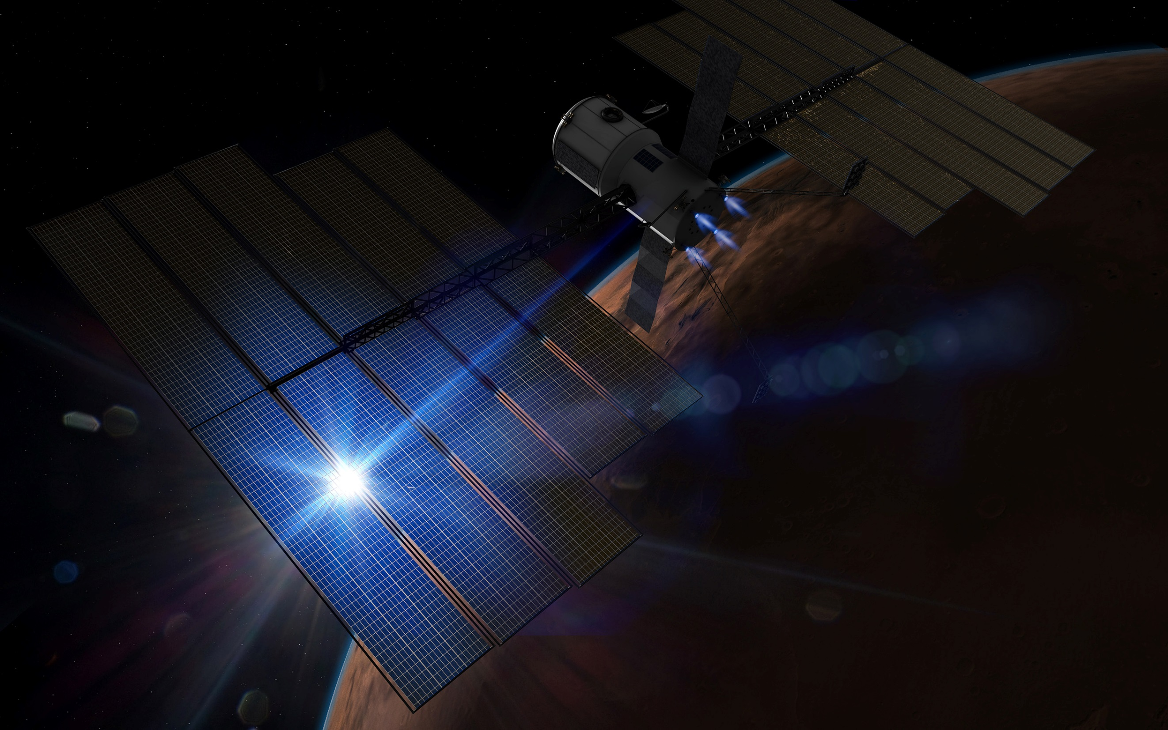
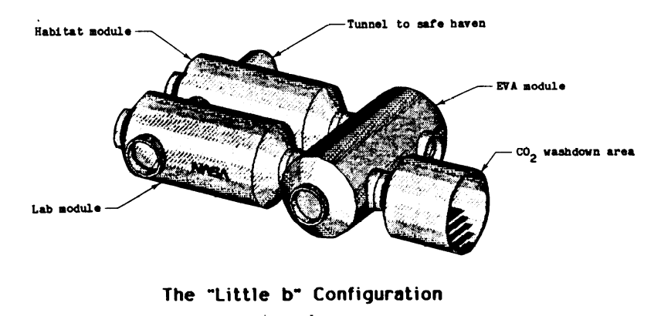
Historical Mars Architecture Approach
Von Braun Mars (1969)
Optimized around Apollo extensibility
Design Reference Architecture 5 (2009) Optimized around a long-duration stay with minimal Mars landed mass
Mars Base Study (1987) Optimized around ISS module extensibility
Evolvable Mars Campaign (2016)
Optimized around minimal Earth- launched mass and Solar Electric propulsion extensibility
Strategy & Architecture Office – Mars Architecture Team
2

Slide 3







Current Mars Architecture Team Approach
To define the Mars Architecture,
we must answer 6 key questions
WHY
We Go
WHO
We Send
WHERE
We Go
HOW
We Get There & Back
WHEN
We Go
WHAT
We Do There
The answer to each question requires one or more decisions—but all of these decisions are interrelated, and order matters
Strategy & Architecture Office – Mars Architecture Team
3

Slide 4
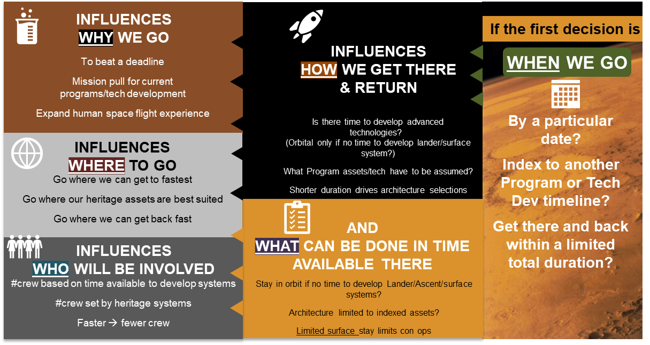
Strategy & Architecture Office – Mars Architecture Team
4

Slide 5
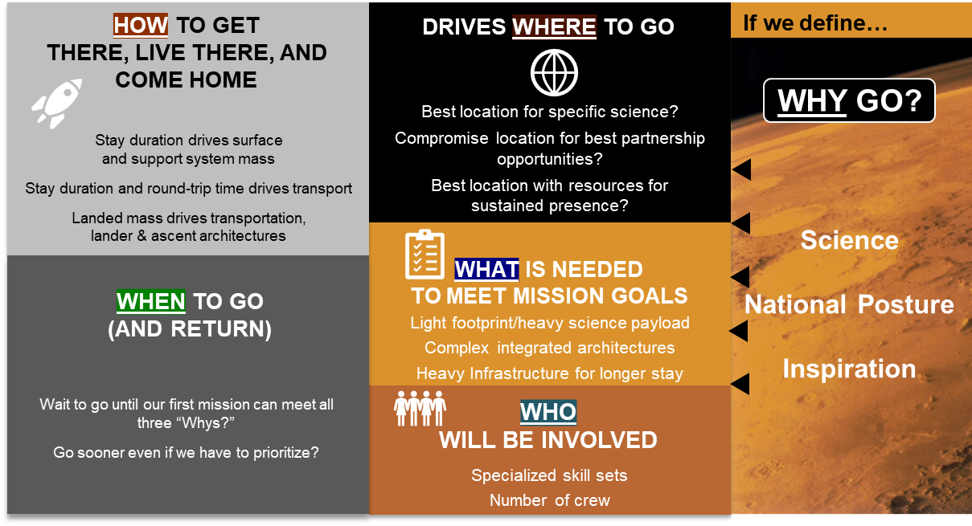
Strategy & Architecture Office – Mars Architecture Team
5

Slide 6
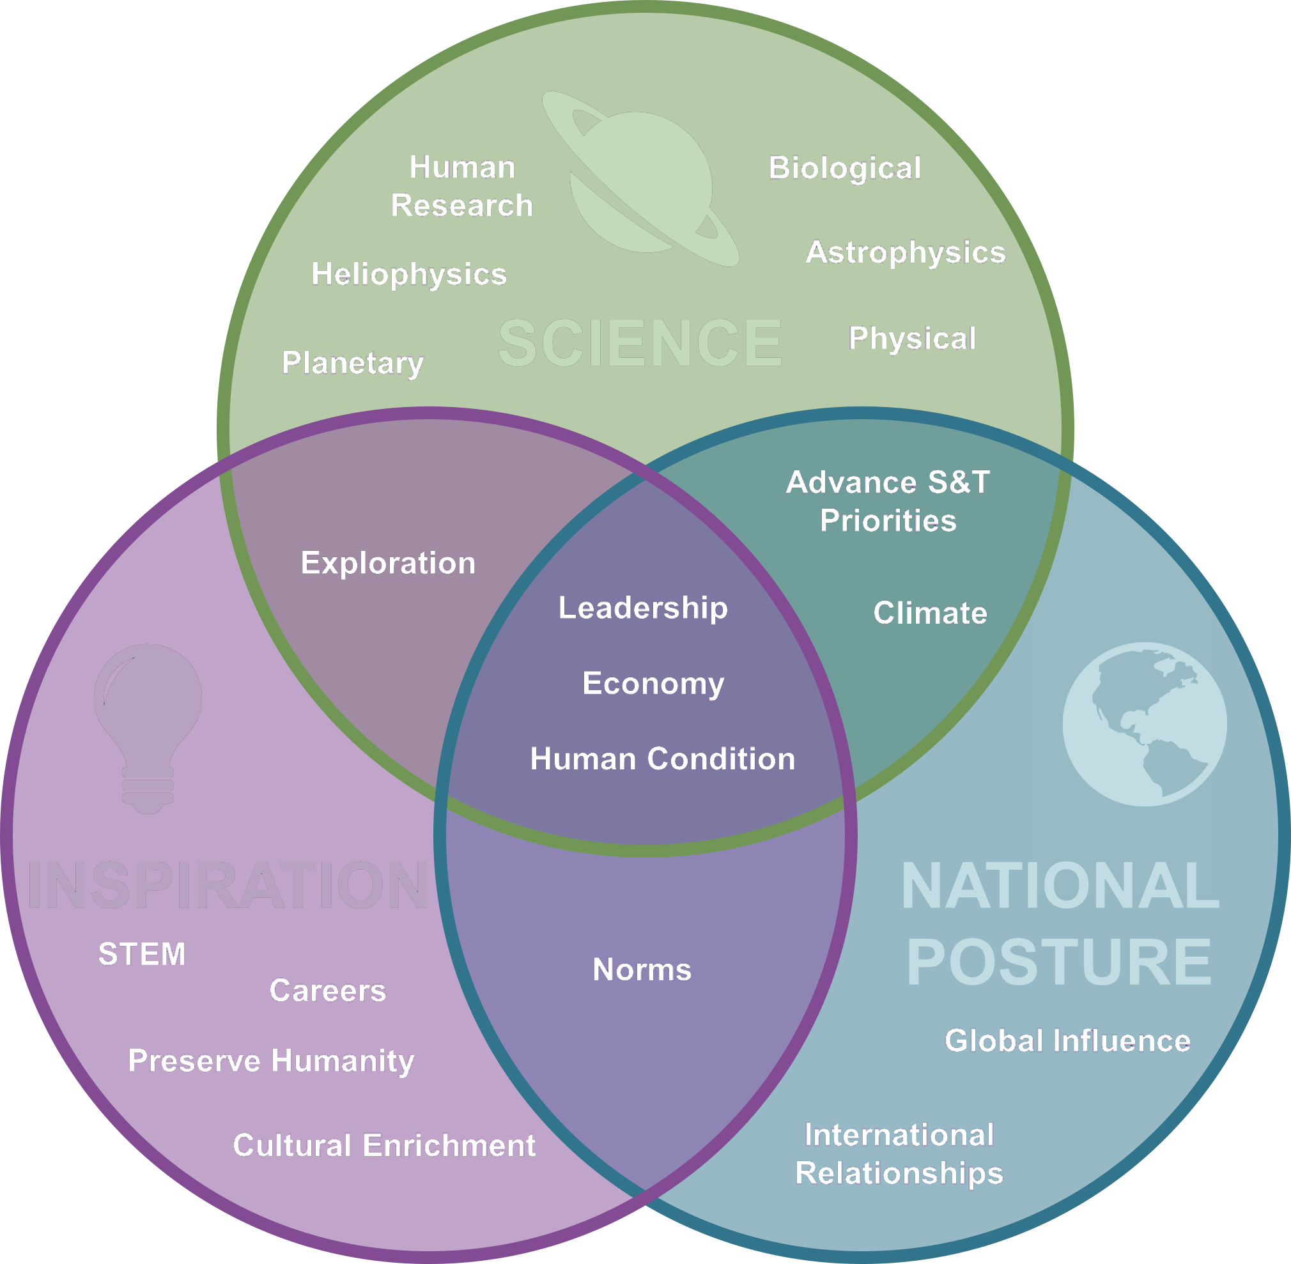

Architecting from the Right
WHY
We Go
WHO
We Send
WHERE
We Go
HOW
We Get There & Back
WHEN
We Go
WHAT
We Do There
The answers to “Why?” have been defined in the Agency’s Moon-to-Mars Objectives
go.nasa.gov/3zzSNhp
Strategy & Architecture Office – Mars Architecture Team
6
Notes:
From COSPAR Planetary Protection Workshop charts (Dec 1-3, 2020), added the words “First” and “Concept” to the title

Slide 7
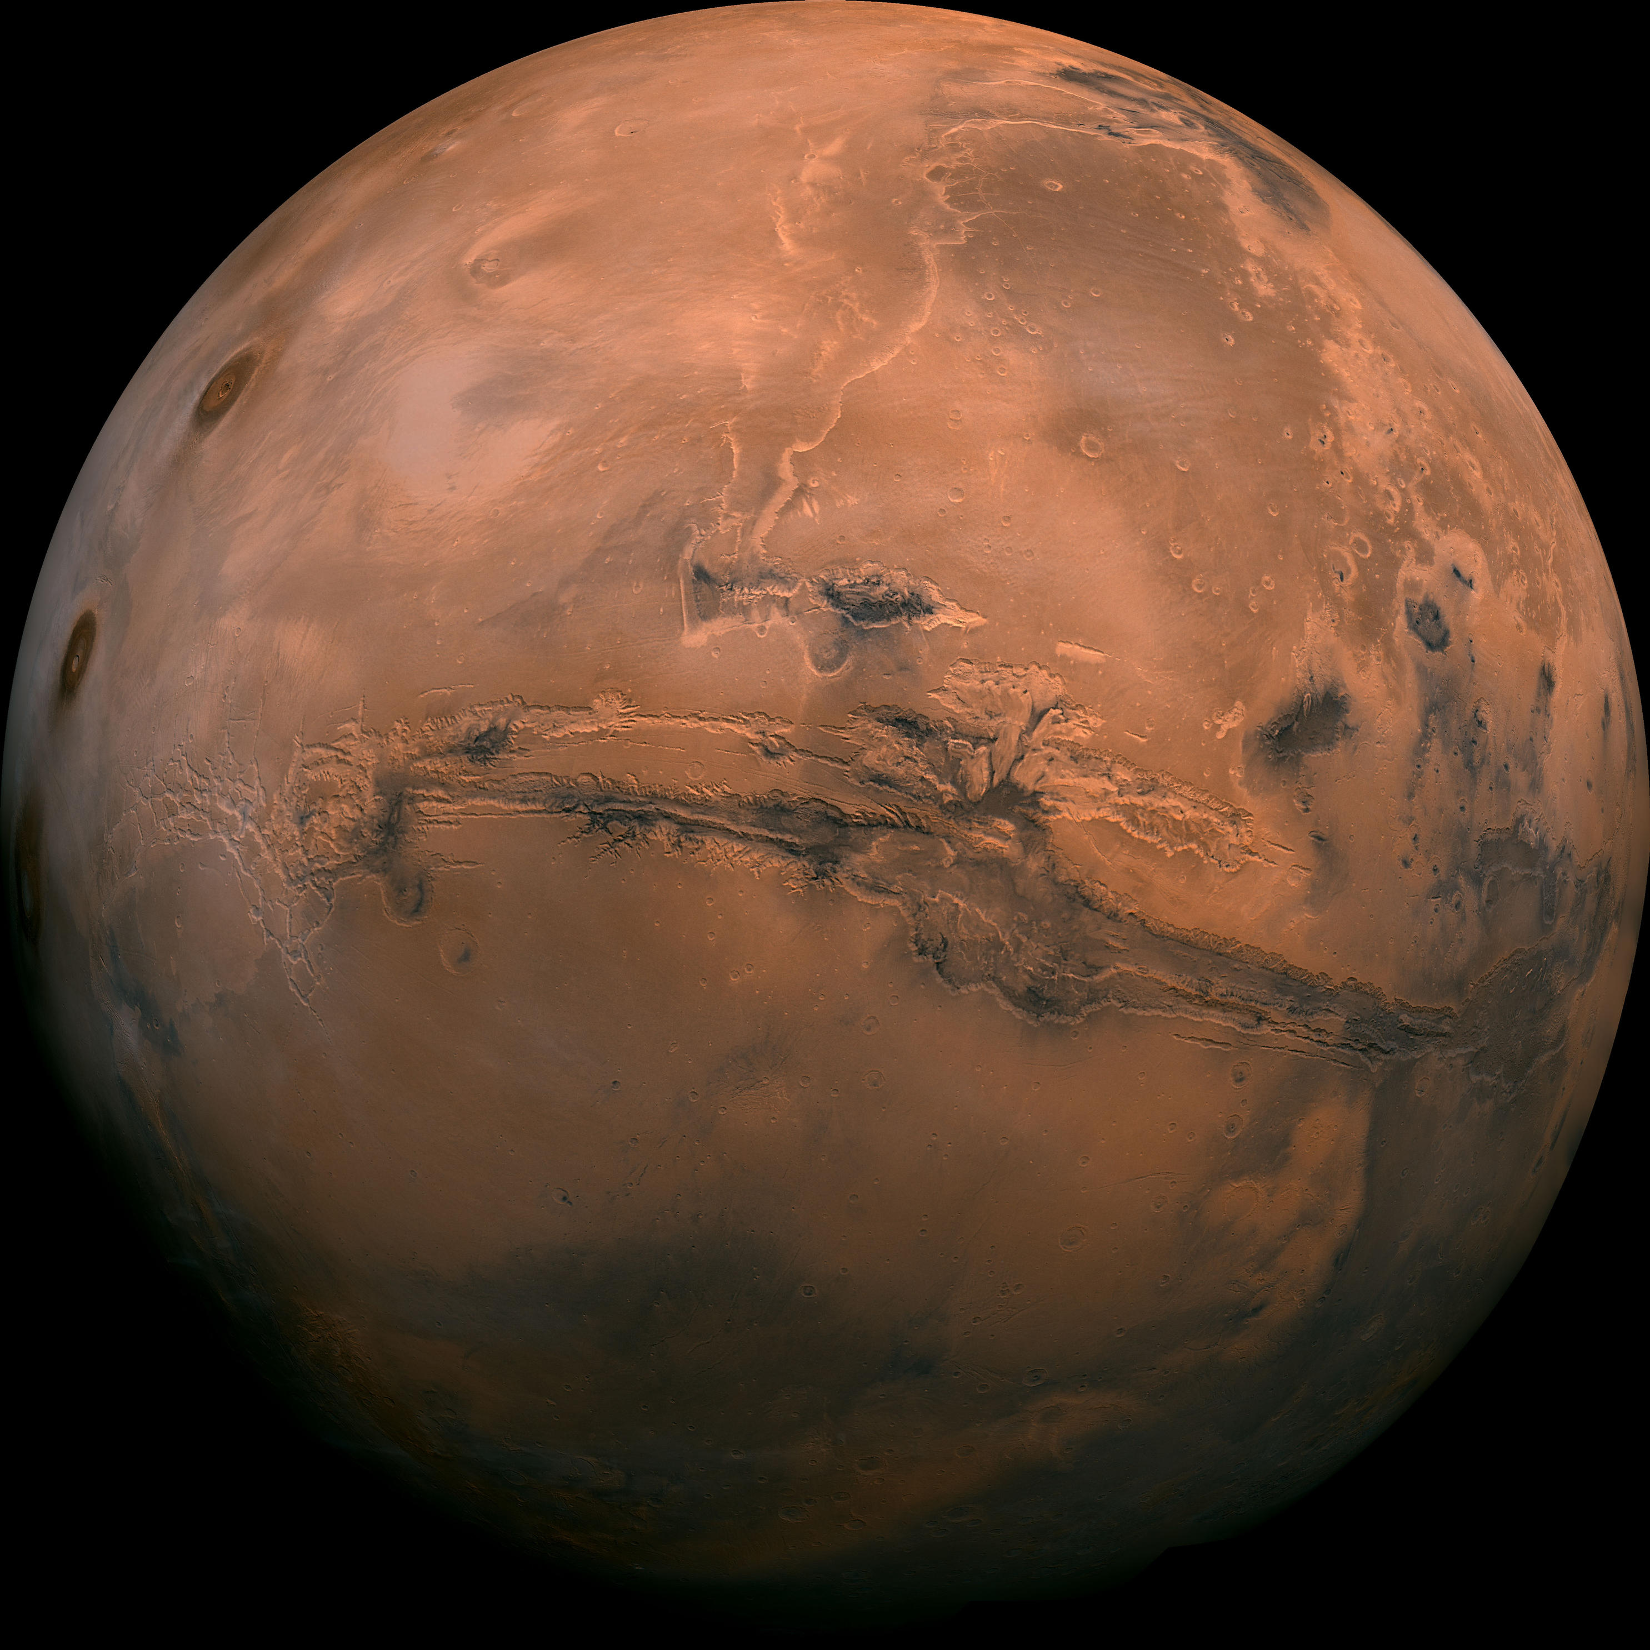
Mars Architecture Considerations

Slide 8

Click to Play
Strategy & Architecture Office – Mars Architecture Team

Slide 9
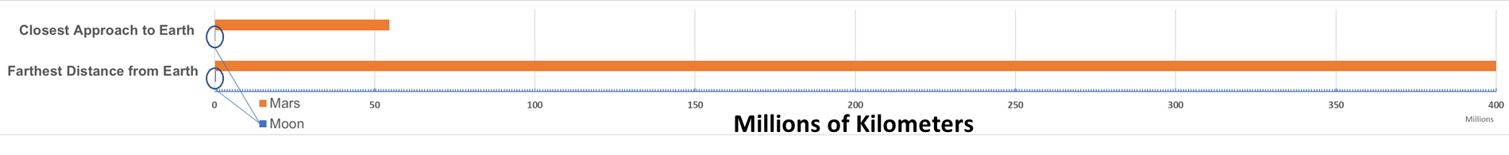
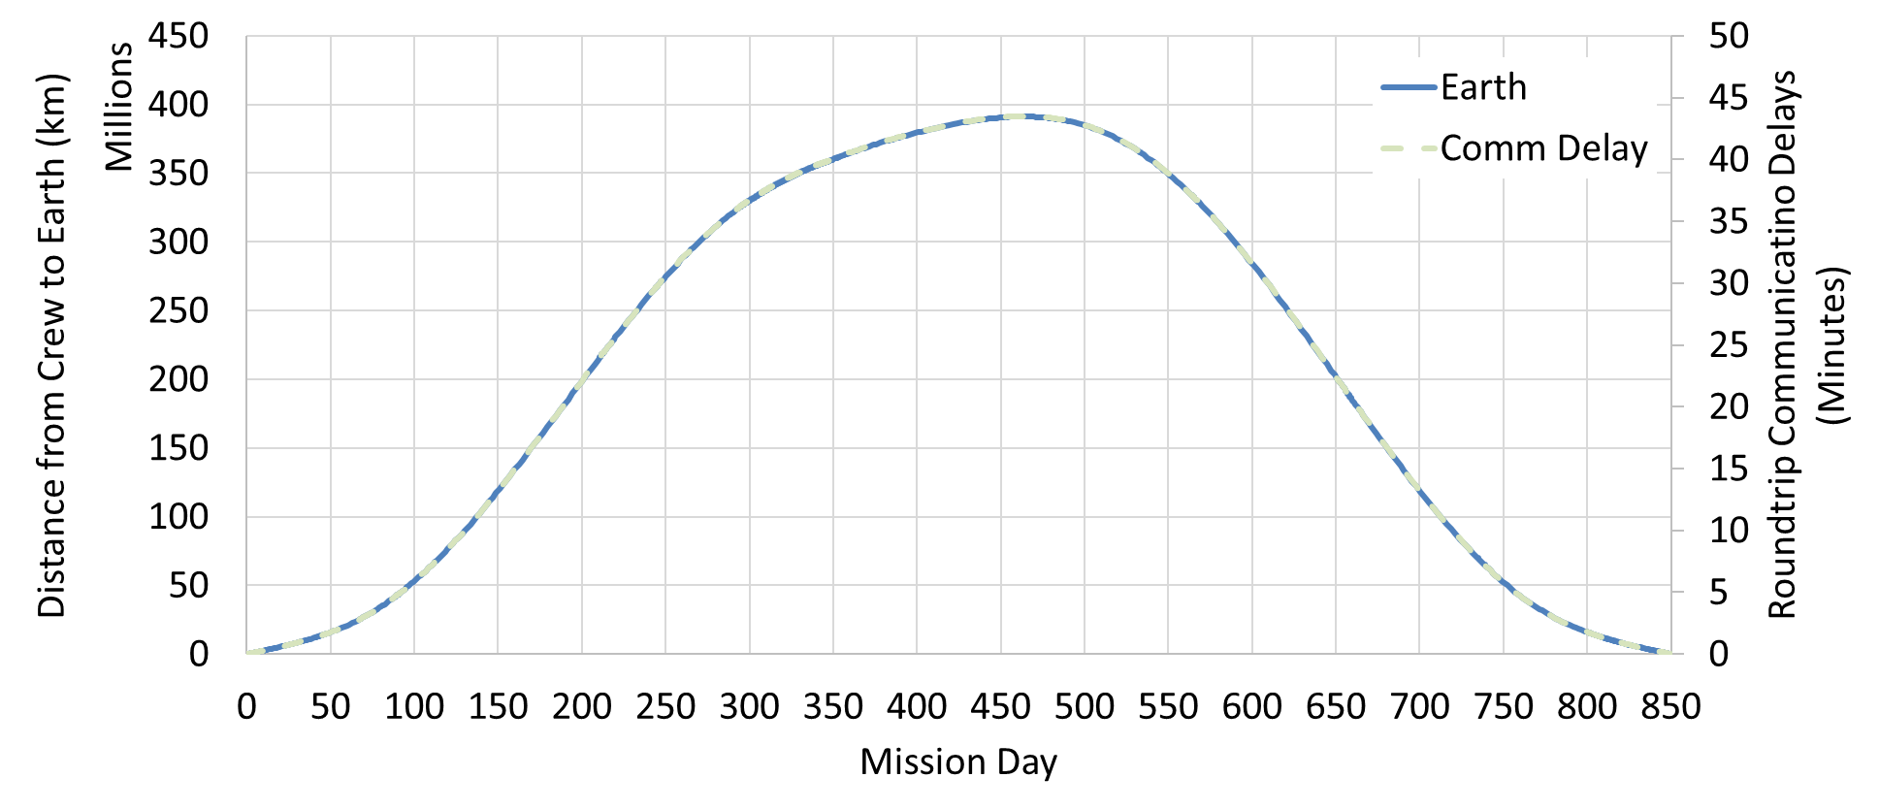

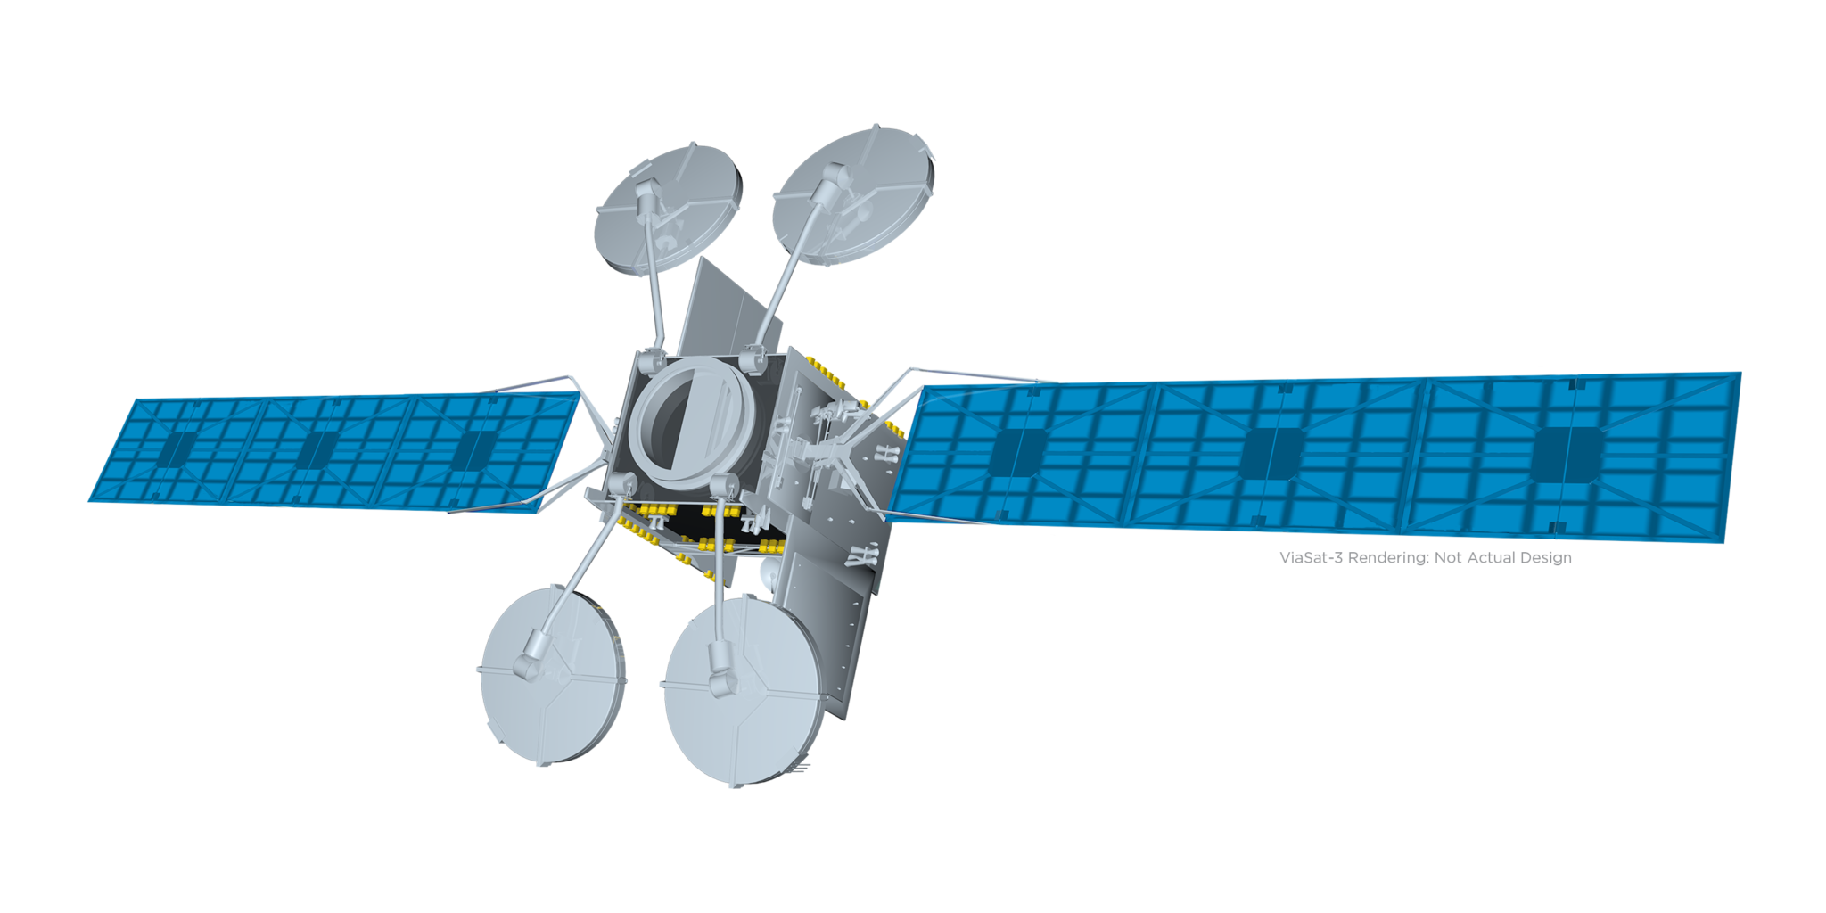

How/When – Mars Distance Considerations
Mars is much farther from Earth than the Moon is
 | Closest Approach to Earth | Farthest Distance from Earth | Typical Round-Trip “Odometer” Reading | Round-trip Duration
Moon | 360,000 km | 405,000 km | 1,900,000 km | Weeks
Mars | 54,600,000 km | 400,000,000 km | 1,800,000,000 km | Years
Communications delay is proportional to how far away from Earth we are
Mars is so far from home there is no way to abort quickly to Earth
  Mars missions will be at least
  twice as long as our longest duration experience base
  Pack for a long trip:
  on-demand resupply is not possible
~35-40 Minutes Roundtrip Delay when Crew is at Mars
Strategy & Architecture Office – Mars Architecture Team
9

Slide 10
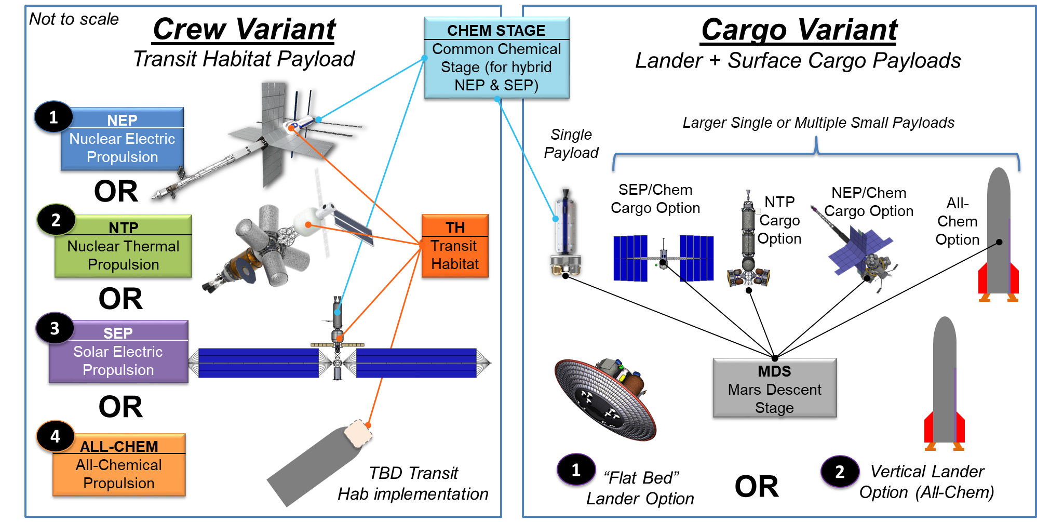
How – Transportation Considerations
Trade space includes 4 transportation options, 2 lander options, and a range of surface systems
Strategy & Architecture Office – Mars Architecture Team
10

Slide 11
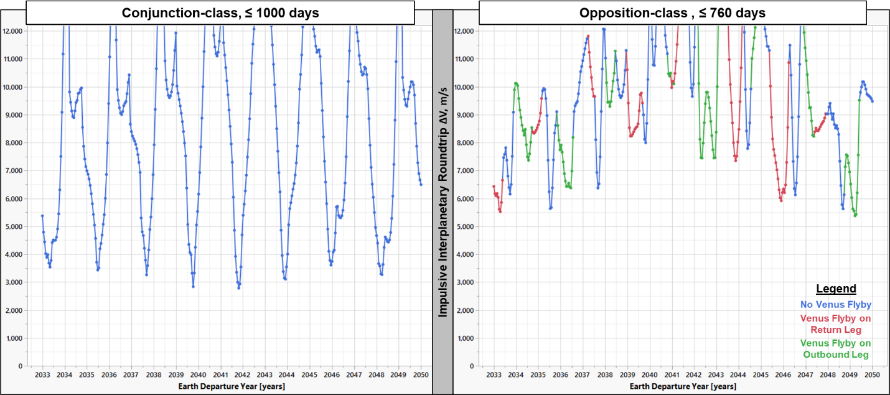
When – Mission Opportunity Considerations
Increasing Energy = Exponential Increase in Mass Required
Multiple ISS Mass Needed
For Higher Energy Missions
Minimum Energy Long-Stay Class, ~ 3 Years Roundtrip
High Energy Short-Stay Class, ~ 2 Years Roundtrip
2039 Example from the Video
Higher energy missions aimed at reducing total trip time also means shorter Mars vicinity stay time, and variation to energy need is much higher, meaning more challenging to plan
Roundtrip mission opportunities are available every 2-ish years, Long-Stay at Mars vicinity to await optimal return planetary alignment
“When” is a very complicated decision to address.
What are the acceptable roundtrip duration? What are the Surface Cargo pre-deployment needs?
How many rockets do we have and how often can we launch them? What is the performance of the transportation system?
11
Strategy & Architecture Office – Mars Architecture Team
Notes:
Image included in Mars Transportation white paper https://www.nasa.gov/sites/default/files/atoms/files/acr22-wp-mars-transportation.pdf

Slide 12
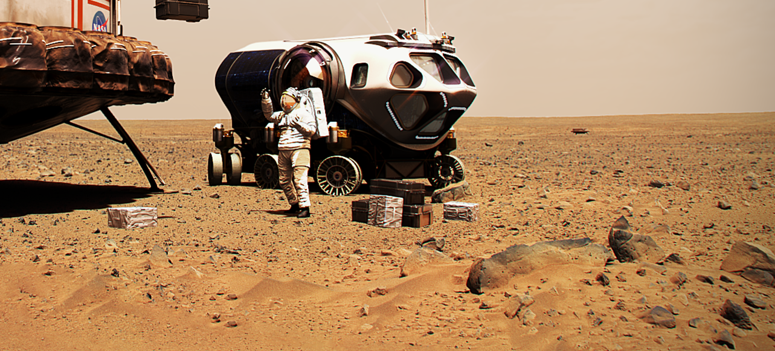
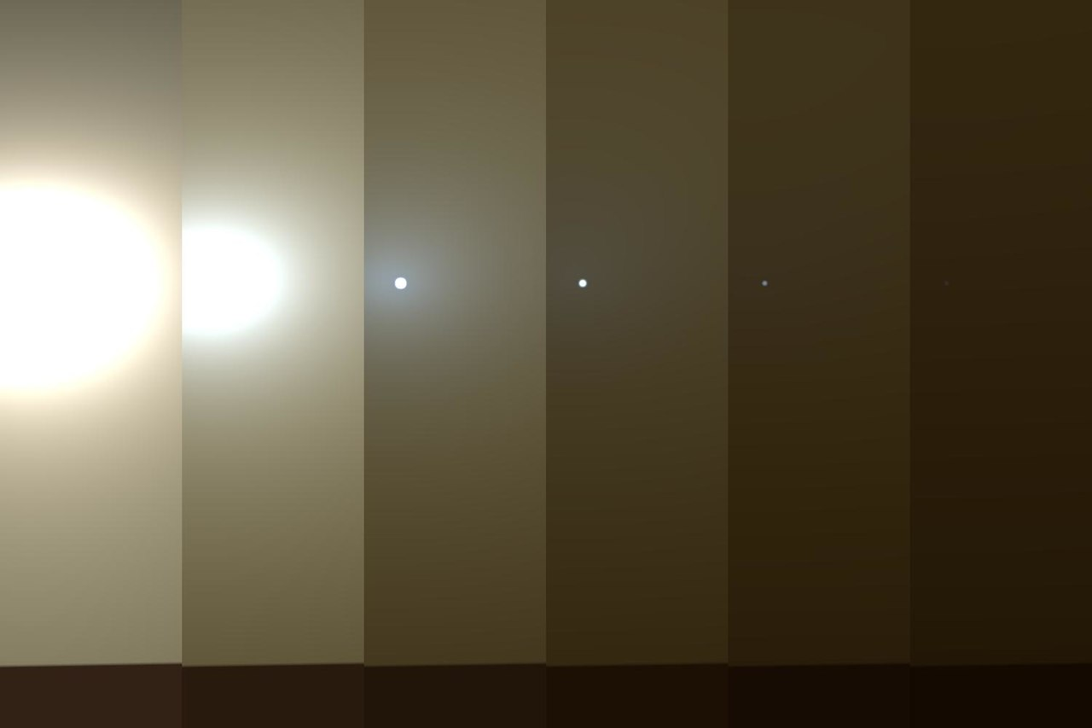


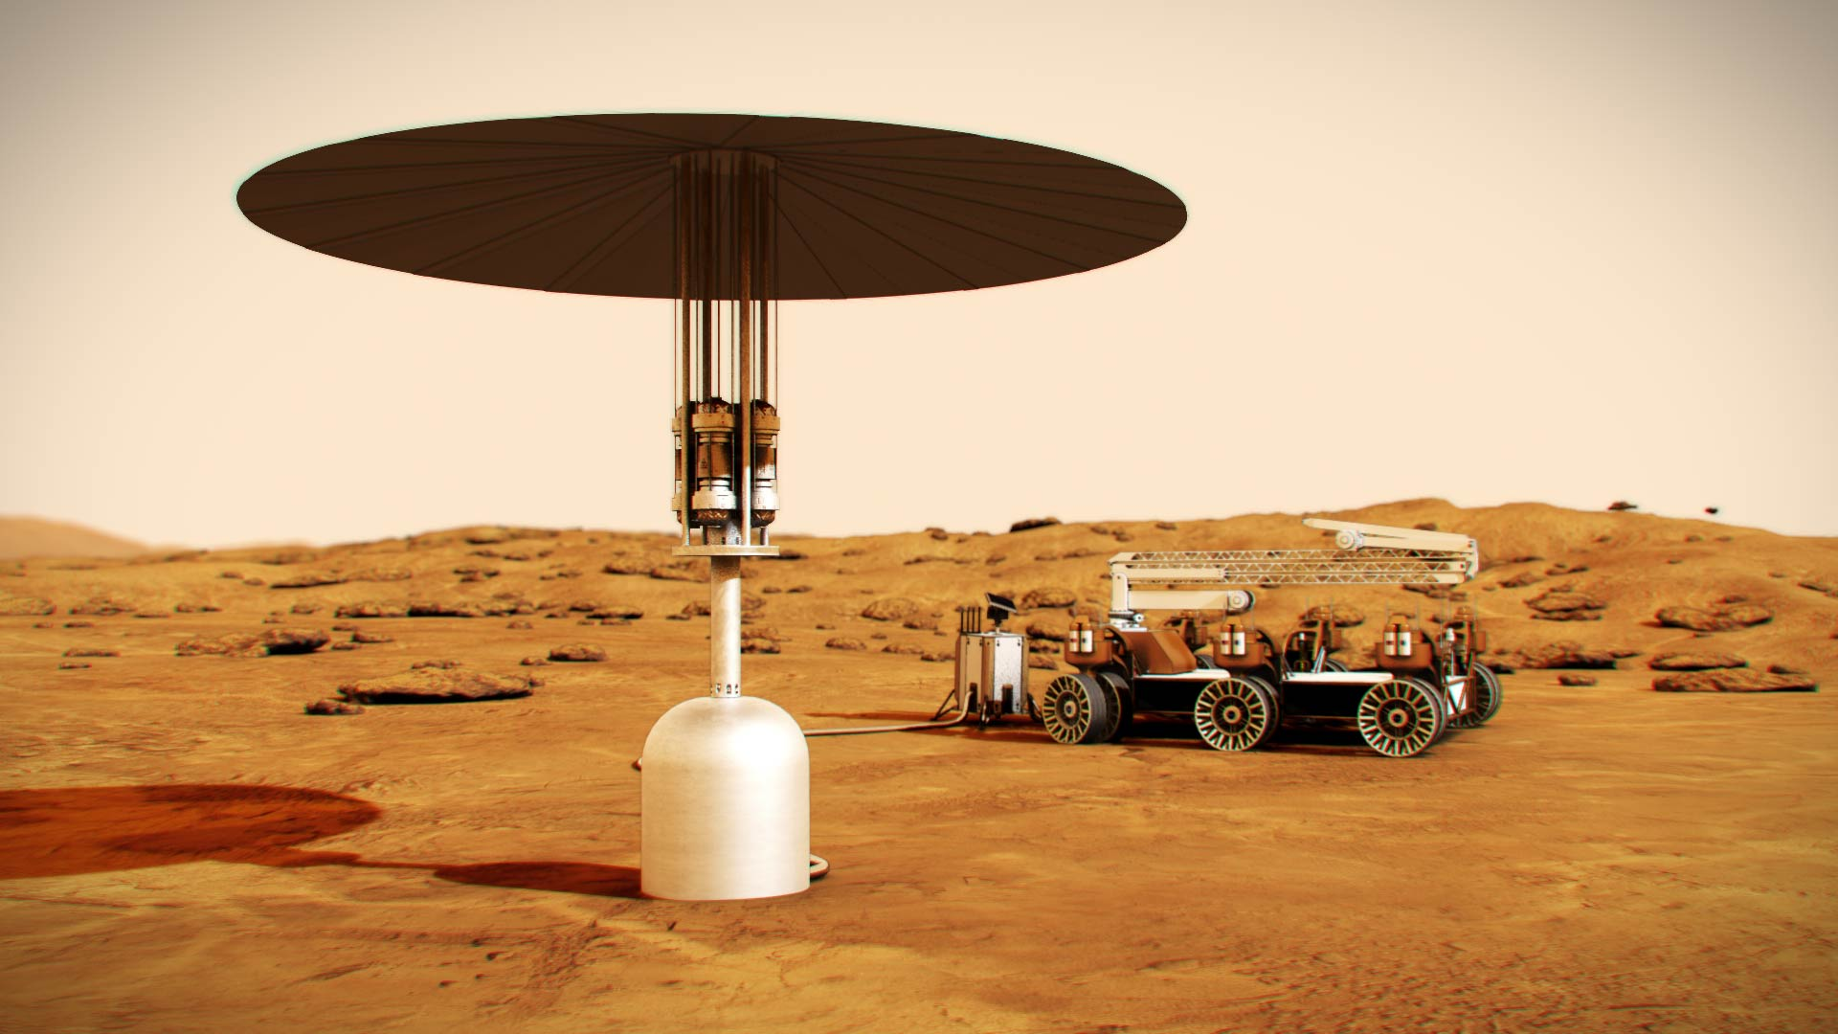
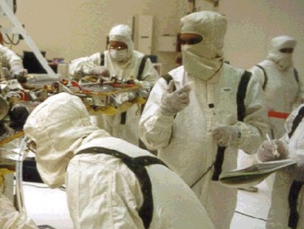
What/Where – Surface Considerations
Opportunity’s view of the Sun during it’s fatal dust storm encounter
TERRAIN HAZARDS
DUST STORMS
Sand traps, dramatic elevation changes, line of sight comm
Reduced visibility,
solar energy disruption, material abrasion
PLANETARY PROTECTION
Protect science from the humans & protect humans from Mars
There may be no surface habitat in a short-stay, first mission architecture: 2 crew could live in a pressurized rover for 30 sols
COMMUNICATIONS LATENCY/BLACKOUT
NASA STMD is developing Fission Surface Power (FSP) for Moon and Mars
Up to 44 minutes roundtrip comm, periodic communications blackout, low data rates
Strategy & Architecture Office – Mars Architecture Team
12
Notes:
Unchanged from Nov-2020 Ascend Mars panel charts

Slide 13
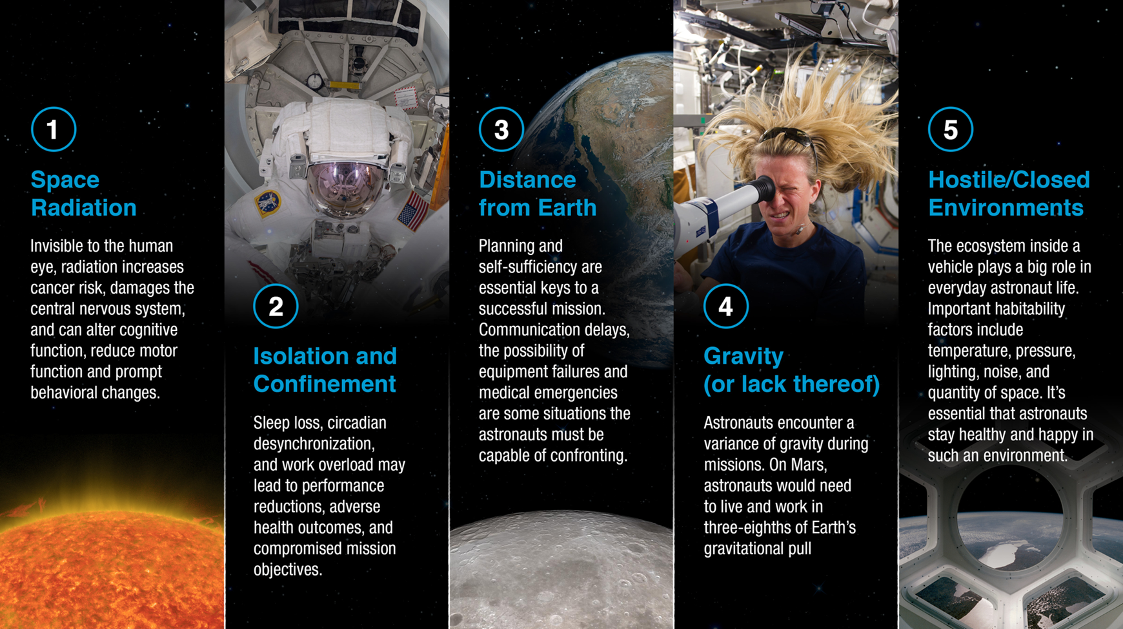
Who – Crew Considerations
How many crew to send to Mars?
  Need to send enough crew to:
      Complete mission objectives and tasks
      Maintain nominal vehicle functions
      Be able to respond to contingency events
How many crew to land on the surface of Mars?
    Perhaps some stay in orbit, some to surface and all / some do EVAs, or
    All go to surface, all / some do EVAs,
What roles do they need to be trained for?
Spaceflight Humans Systems RISKs
Strategy & Architecture Office – Mars Architecture Team
13

Slide 14

Summary
Mars Architecture / Mission Planning is like a balloon animal
  A decision on one element/area will ripple
  across the architecture
Mars crews will be away from Earth at least 2x longer than human spaceflight mission experience to date
Mars surface exploration will be similar to lunar exploration, but with some key differences:
  More gravity - No resupply - Limited abort options
  More weather - More planetary protection - Less sunlight
  Different departure windows - Longer comm lags/disruptions
Mars transit will be similar to ISS / Gateway operations, but with some key differences:
  Fewer departure windows - Limited abort options - Longer microgravity / radiation exposure durations
  Longer comm lags / disruptions - No resupply - Much, much longer distances and durations
Strategy & Architecture Office – Mars Architecture Team
14

Slide 15
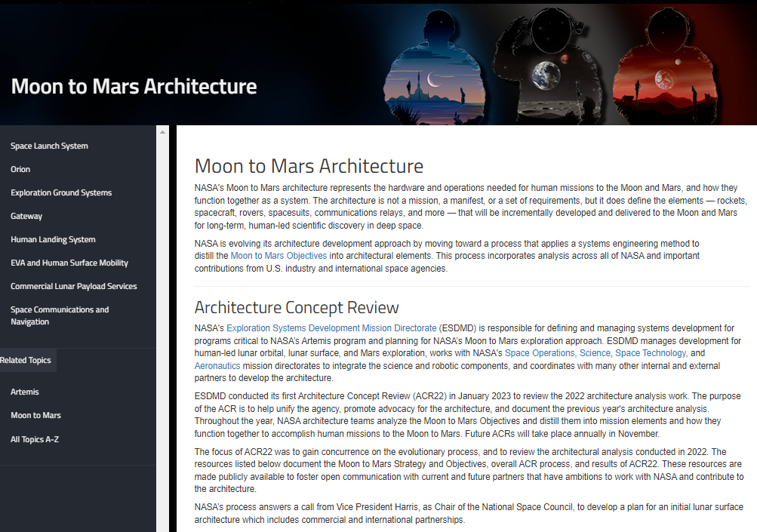
Interested in Learning More?
Visit NASA’s Moon to Mars Architecture page:
  Moon to Mars Objectives
  Architecture Definition Document ESDMD-001
  Various short white papers on several Mars related topics
NASA.gov/MoonToMarsArchitecture
Strategy & Architecture Office – Mars Architecture Team
15

Slide 16
Questions?
Artist’s Vision

