Slide 1
Influence of the Perception, Observer Position, and Broadband Self-Noise on Low-Fidelity UAM Vehicle Perception-Influenced-Design (PID) Optimization
Acknowledgments:
Transformational Tools and Technologies (TTT) project
Leonard V. Lopes
Daniel J. Ingraham
NASA Langley Research Center, Aeroacoustics Branch
Hampton, VA 23681
leonard.v.lopes@nasa.gov
NASA Glenn Research Center, Acoustics Branch
Cleveland, OH 44135
daniel.j.ingraham@nasa.gov

Slide 2

Advanced Air Mobility (AAM) Challenge
Opportunities of AAM vehicles are numerous
  Large-sized vehicles for intraregional transportation
  Medium-sized vehicles for urban and rural applications (UAM)
  Small-sized vehicles for package deliveries and surveillance (sUAS)
AAM challenges aeronautics community with unique challenges in performance and community impact
  Safety
  Reliability
  Automation
  Community impact (noise)

Slide 3
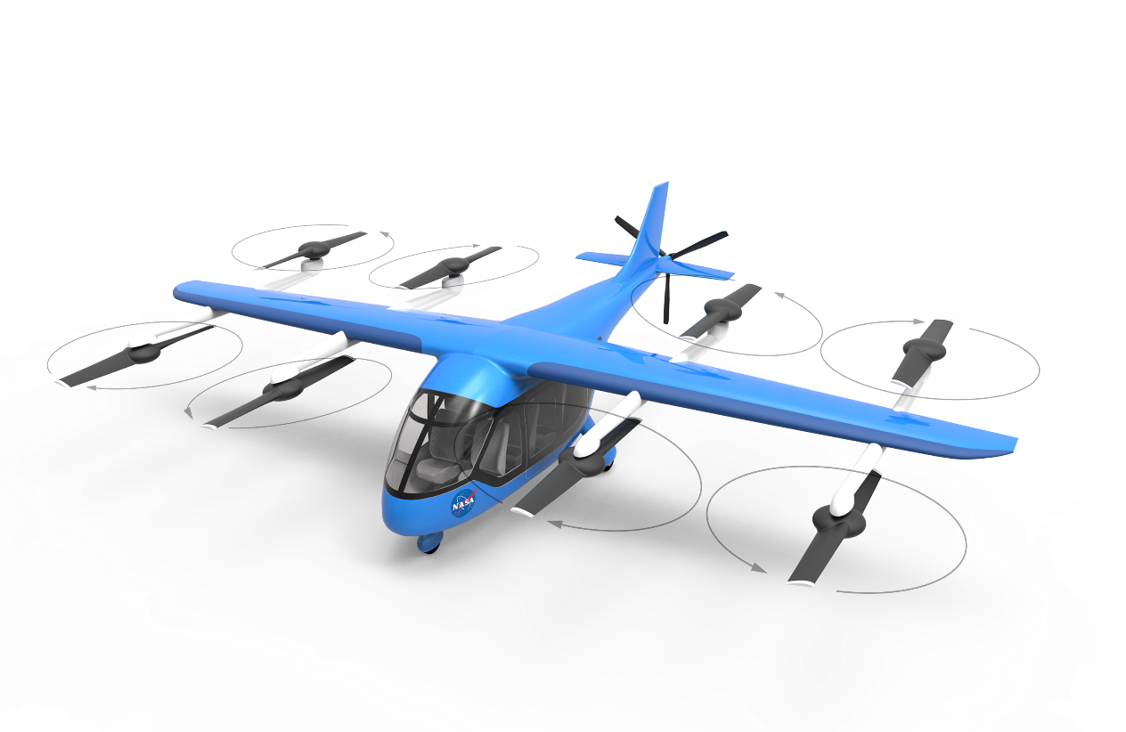
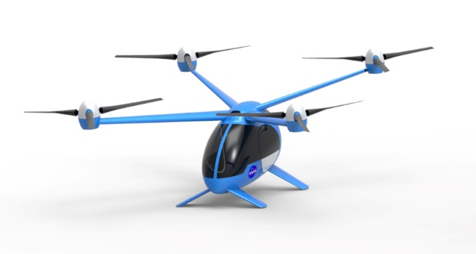
AAM Challenge
Traditional large transport vehicles limit design opportunities
  Tube and wing
  Not the case with hybrid wing or TTBW designs
Large helicopters and multirotor vehicles do have design opportunities but are limited also
  Traditional main/tail configurations
  X-rotors, tandem, etc.
AAM vehicles offer significantly more design opportunities
  Rotor count, placement, blade count, rotation direction
  Wing design and placement, installation effects
  Blade shape and rotor sizing
AAM vehicles also have significantly different flight mission requirements
Offers opportunity to design from the ground up
What can our design tools predict?
What do our design tools miss?
  Does validation data exist?
  What about scale? Full vehicle vs component?
  Let’s start with an isolated proprotor
Silva, C. and Johnson, W., "Practical Conceptual Design of Quieter Urban VTOL Aircraft," Vertical Flight Society’s 77th Annual Forum & Technology Display, Vertical Flight Society, Fairfax, VA, USA, 2021

Slide 4
Outline
Motivation
Gradient-Based, Acoustically-Constrained Multidisciplinary Design Optimization
Previous Work and Current Fidelity Augmentations
Design Parameter Sweeps
Proprotor Design Optimization with Human Perception and Broadband Self-Noise
Conclusion

Slide 5
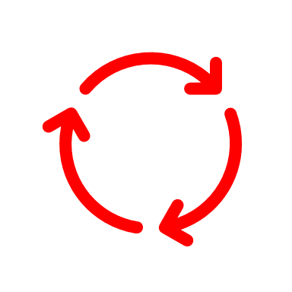
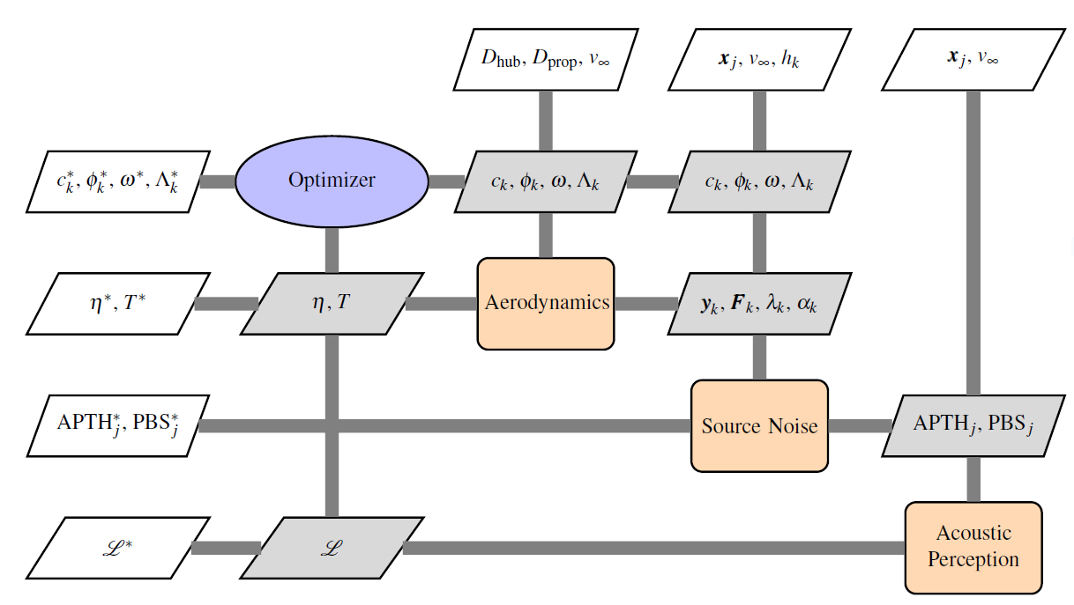
Multidisciplinary Design Optimization
Proprotor
Extended Design Structure Matrix
(XDSM)
Optimizer
(SNOPT)
Aerodynamics
Source Noise
Acoustic Perception

Slide 6
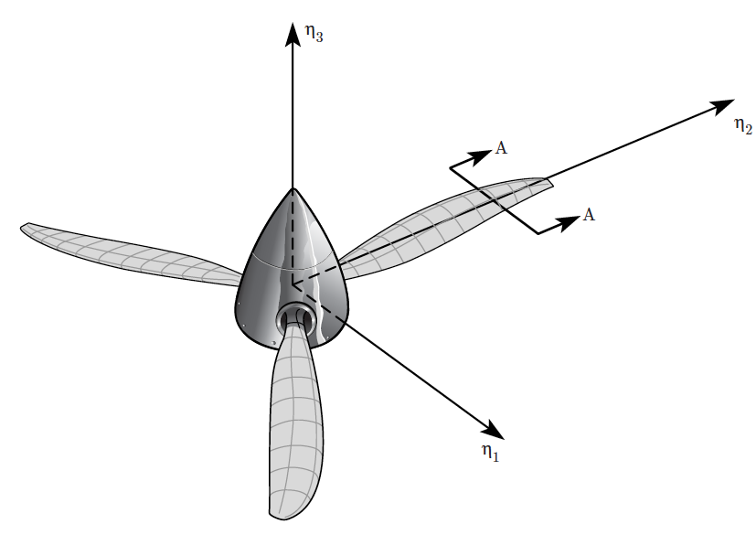
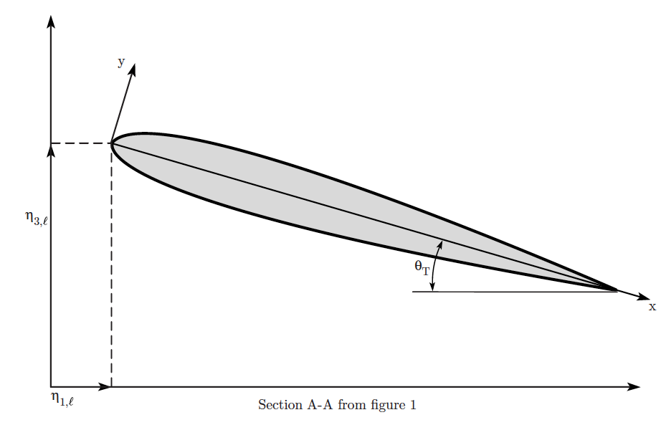
Aerodynamics
Publicly Available codes highlighted in red
Blade element momentum theory (BEMT)
  Implementation:
    CCBlade.jl from A. Ning, BYU
  Advantages:
    Robust (important for multidisciplinary optimization)
    Accurate (for simple configuration: single rotor, on-axis flow)
    Derivatives available via automatic differentiation (AD)
    Very easy to use
  Disadvantages:
    Can’t do multiple rotors, installation effects
0
0

Slide 7
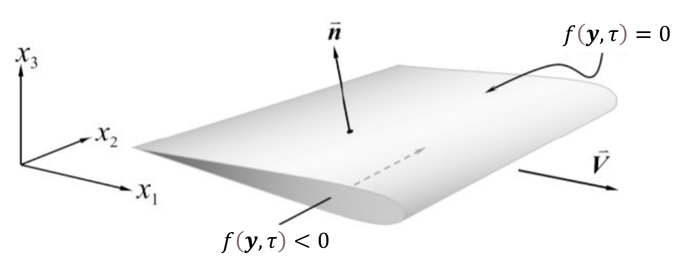
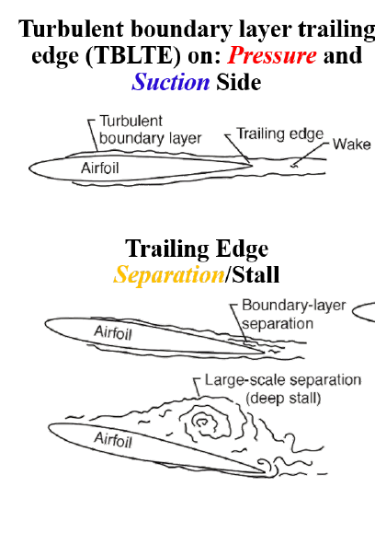
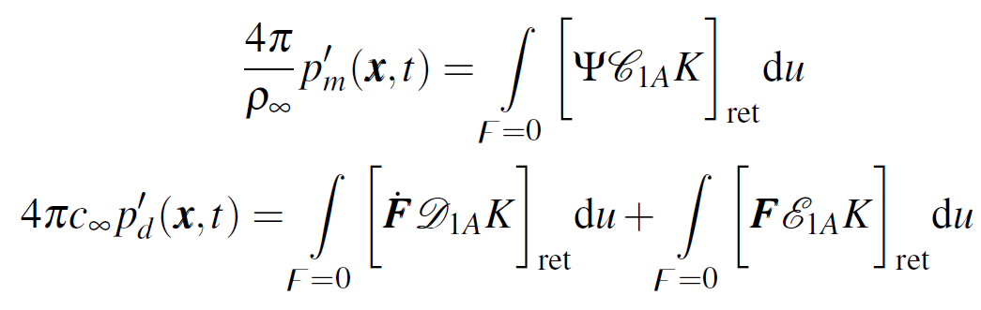


Source Noise
Publicly Available codes highlighted in red
Tonal Noise
Broadband Self Noise
ANOPP2 Formulation 1A IFM (AF1AIFM):
ANOPP2 Self-Noise IFM (ASNIFM):
Farassat’s Formulation 1A (F1A): Compact and Nondeforming Blade
Where , , and are functions of and and their source time derivatives
Brooks, T. F., Pope, D. S., and Marcolini, M. A., “Airfoil Self-Noise and Prediction,” NASA RP 1218, National Aeronautics and Space Administration, July 1989.
Pettingill, N. A., Zawodny, N. S., Thurman, C. S., and Lopes, L. V., “Acoustic and Performance Characteristics of an Ideally Twisted Rotor in Hover,” January 11–12 & 19–21 2021, AIAA Paper No. 2021-1928, presented at AIAA Scitech 2021 Forum. doi:10.2514/6.2021-1928.
Lopes, L. V., “ANOPP2 Farassat Formulations Internal Functional Modules (AFFIFMs) Reference Manual,” NASA TM 2021-0021111, National Aeronautics and Space Administration, December 2021.
Lopes, L. V., “Compact Assumption Applied to the Monopole Term of Farassat’s Formulations,” Journal of Aircraft, Vol. 54, No. 5, September 2017, pp. 1649–1663, doi:10.2514/1.C034048.

Slide 8
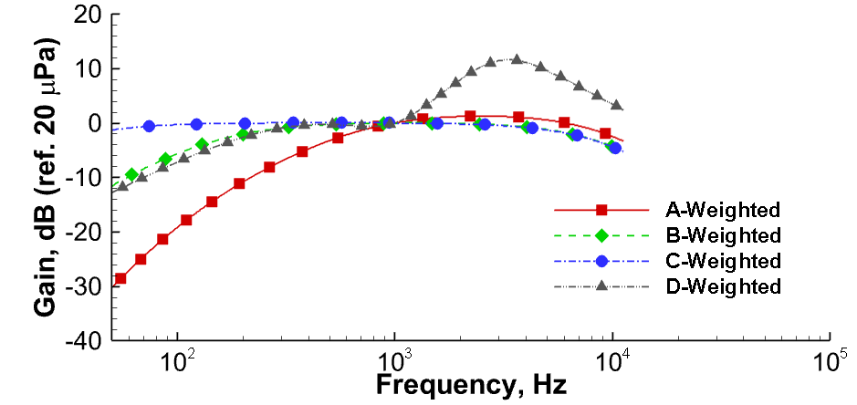
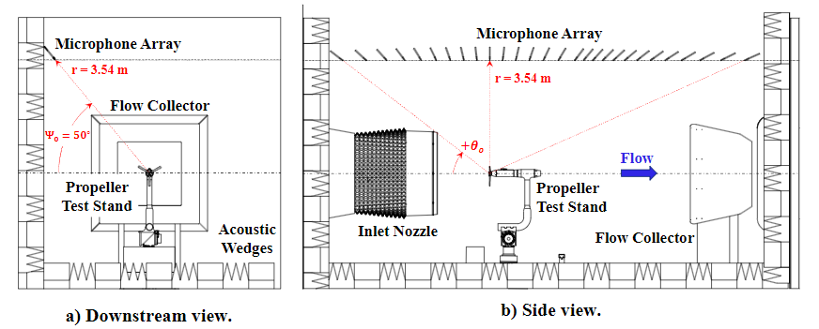
Acoustic Perception
Publicly available codes highlighted in red
Different acoustic constraints that can be utilized
ANOPP2 Acoustic Analysis Utility (AAAU)
  Handle calculation of several derived metrics (OASPL)
  Combine metrics from different sources
  Frequency weighting
  Multiple observer positions
  Fully backwards differentiated
Lopes, L. V. and Burley, C. L., “ANOPP2’s User’s Manual,” NASA TM 2016-219342, National Aeronautics and Space Administration, October 2016.
Litherland, B. L., Borer, N. K., and Zawodny, N. S., “X-57 ‘Maxwell’ High-Lift Propeller Testing and Model Development,” August 2-6, 2021, AIAA Paper No. 2021-3193, presented at AIAA AVIATION 2021 Forum. doi:10.2514/6.2021-3193

Slide 9
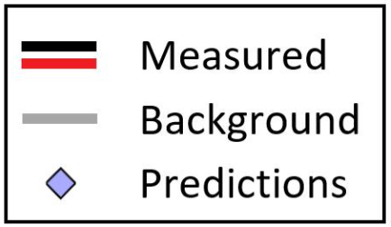
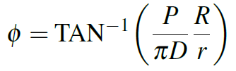
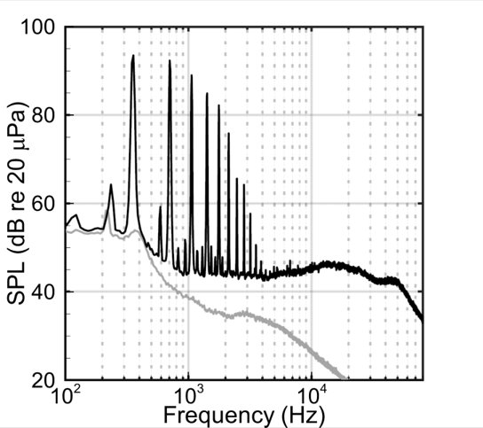
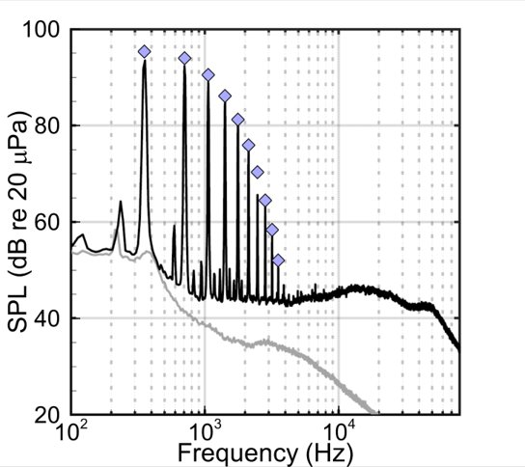
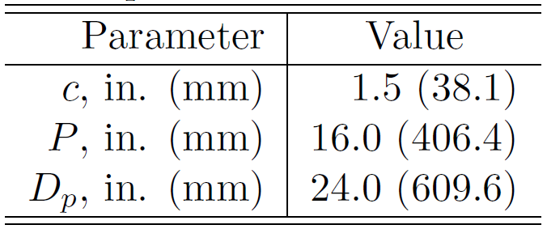
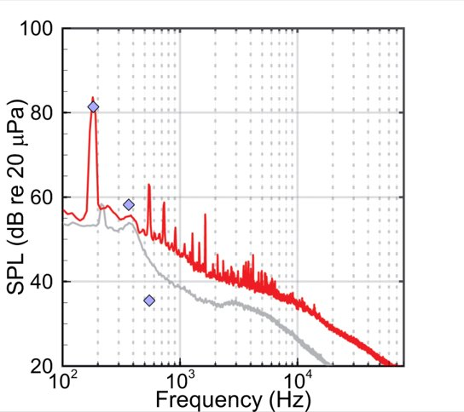
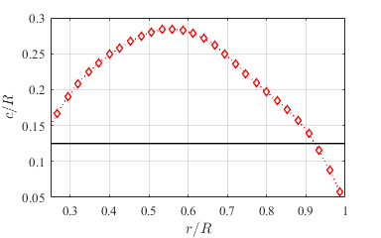
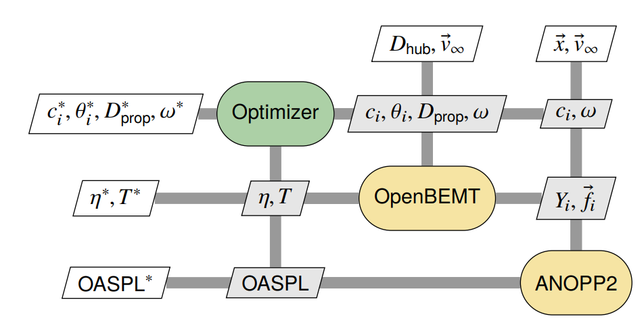
Experimental Design Validation Campaign
Analysis Using Optimization Tools
Baseline Geometry
Baseline Tunnel Entry
Baseline Data
[Source: NASA]
Validation Data
Optimization Tunnel Entry
Optimized Geometry
Design Optimization
Aero
Acoustics
[Source: NASA]
Zawodny, N. S., Pettingill, N. A., Lopes, L. V., and Ingraham, D. J., “Experimental Validation of an Acoustically and Aerodynamically Optimized UAM Proprotor. Part 1: Test Setup and Results,” NASA TM 2022-0015637, National Aeronautics and Space Administration, February 2023.
Blake, J. D., Thurman, C. S., Zawodny, N. S., and Lopes, L. V., “Broadband Predictions of an Optimized Proprotor in Hover and Forward Flight,” June 12–16 2023, accepted for publication at the 2023 AIAA Aviation Forum and Exposition.

Slide 10
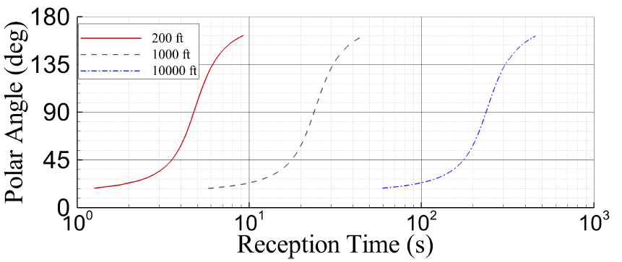

Augmenting Problem (Adding Fidelity)
Source Noise
  Previous Work: Included tonal noise only
  Challenge: AAM proprotors emit significant broadband noise
Human Perception
  Previous Work: Unweighted objective function emphasized low frequency noise
  Challenge: The human ear attenuates low-frequency and emphasizes mid-frequency
Observer Position
  Previous Work: In-plane observer position was primarily studied
  Challenge: AAM vehicles emit noise received by observers at a range of observer positions

Slide 11
Augmenting Problem (Adding Fidelity)
Source Noise
  Tonal only, broadband only, total (tonal + broadband)
Human Perception
  Unweighted and A-weighted (shifted to full scale)
Observer Position
  In-plane and out-of-plane (45°) observer position
Does tonal noise still dominate proprotor design?
Are there any local minima in design space?
Objective
  Efficiency
Constraints
  Thrust
  Acoustic
Design Parameters
  RPM
  Chord length (6 radial stations)
  Pitch angle (6 radial stations)
Parameter sweeps will reveal behavior of predicted noise.
  Pick configuration (i.e., unweighted, in-plane observer)
  Modify baseline (C24ND) design
    Hold pitch angle constant and vary RPM and chord length (uniformly)
    Hold chord length constant and vary RPM and pitch angle (uniformly via collective)
    Hold RPM constant and vary pitch angle uniformly (uniformly via collective) and chord length (uniformly)
  Study efficiency and noise looking for local minima or failed thrust constraint

Slide 12
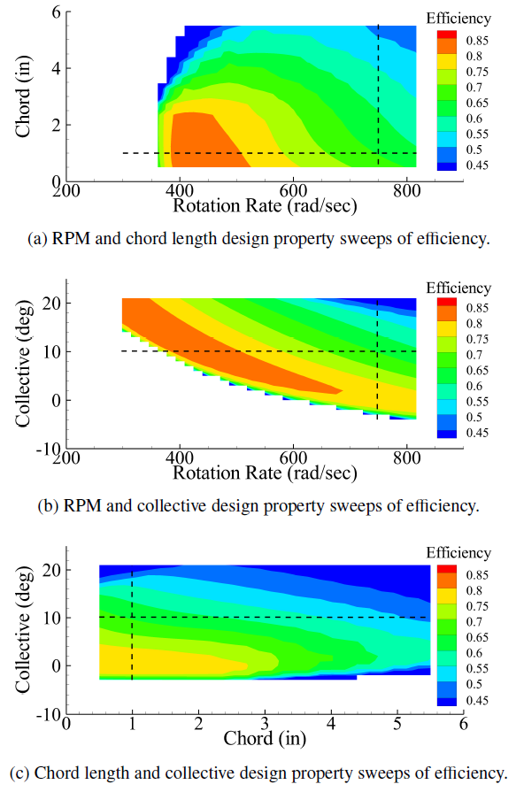
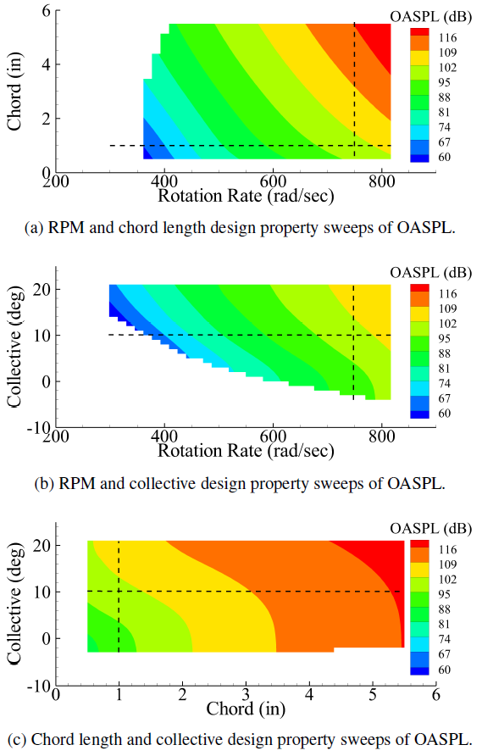
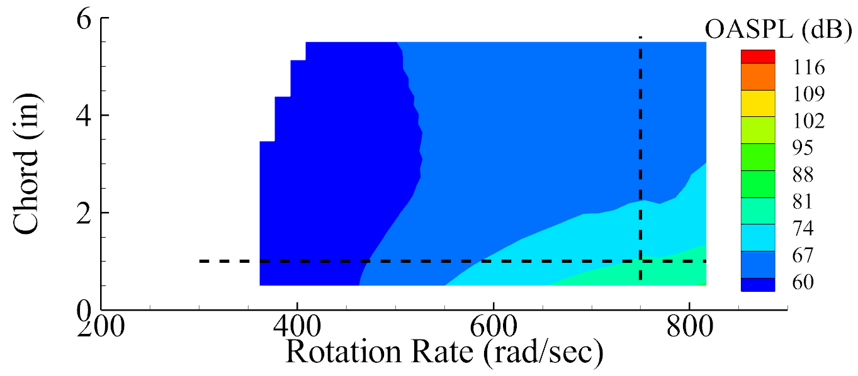
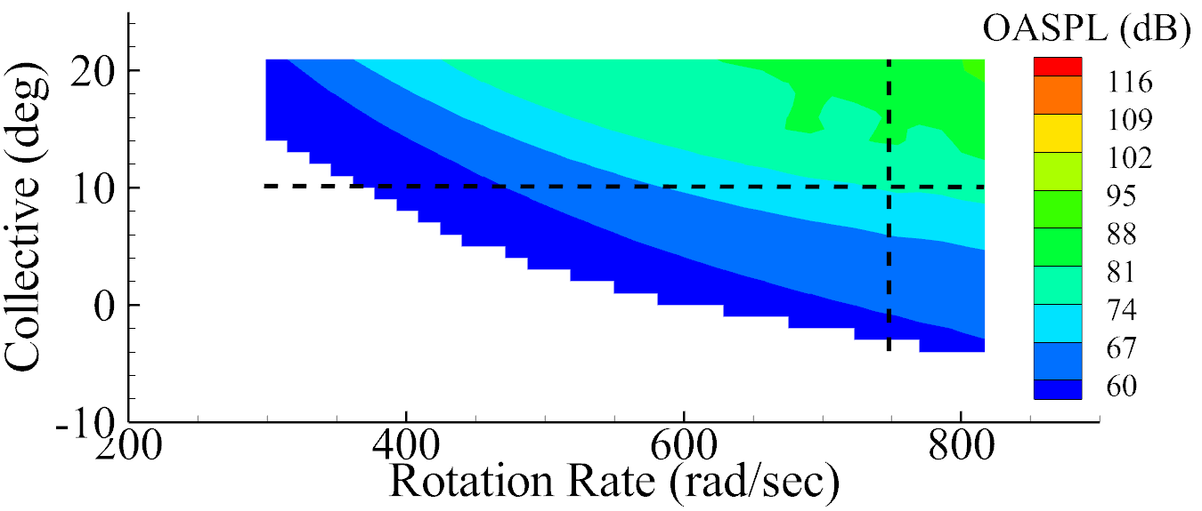
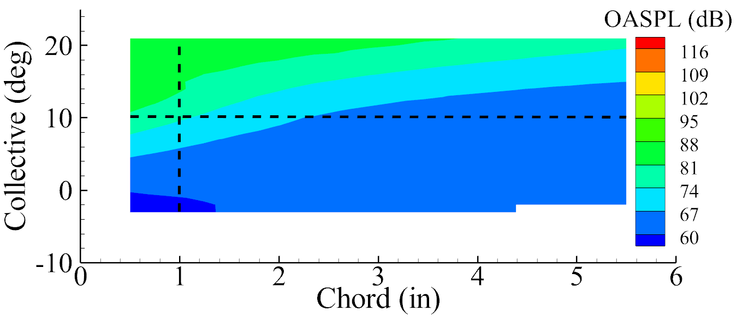
Parameter Sweeps (in-plane, unweighted)
Efficiency
Tonal Noise
Broadband Noise
Collective Constant
Chord Length Constant
RPM Constant
Answer: Efficiency and noise are smooth curves
Answer: Tonal noise dominates (as expected)

Slide 13
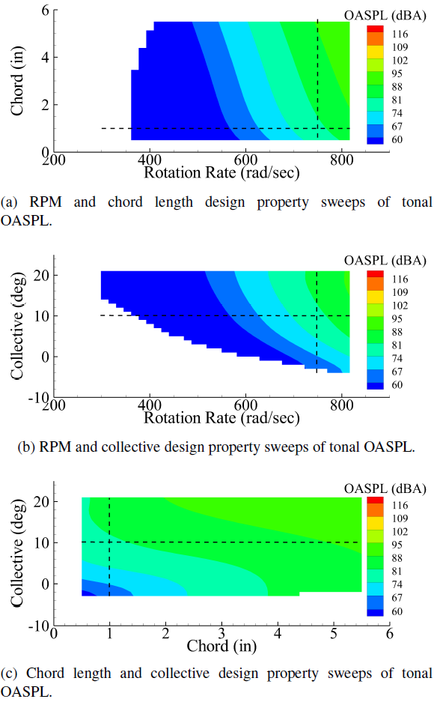
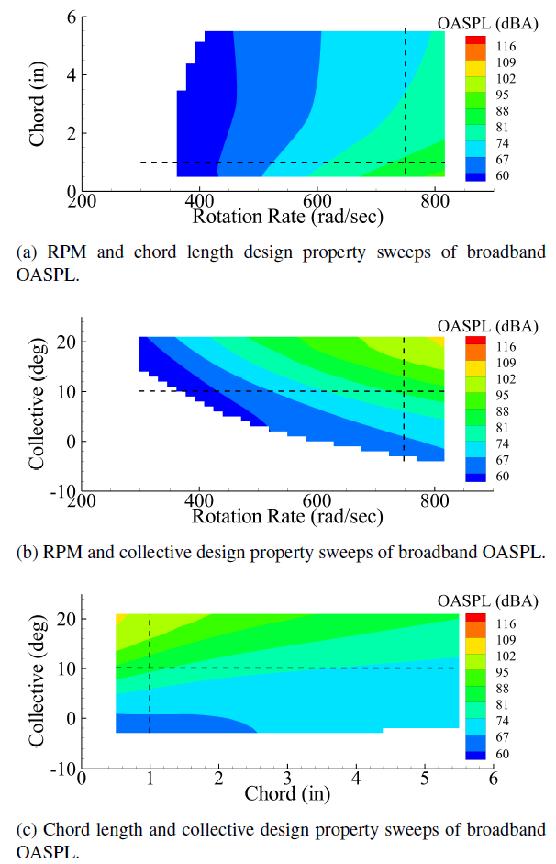
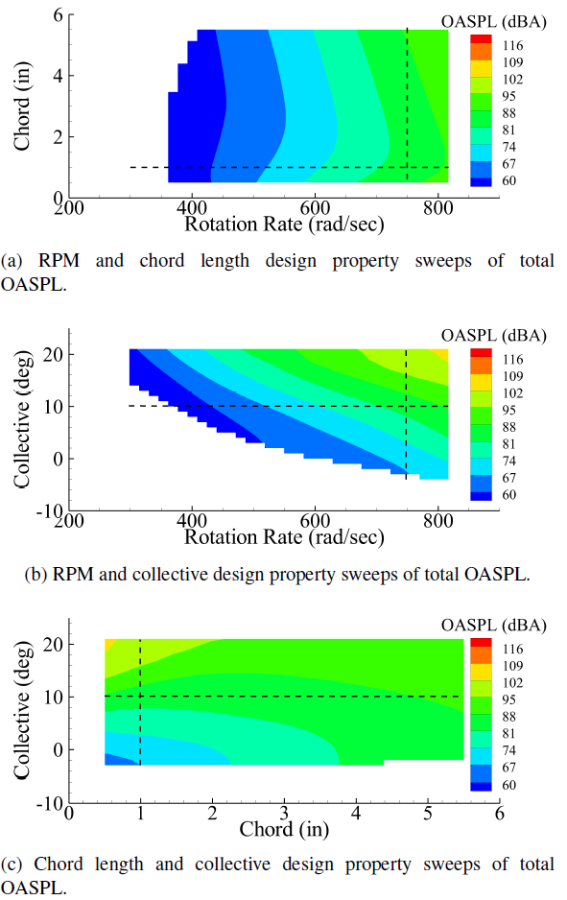
Parameter Sweeps (out-of-plane, A-weighting)
Tonal Noise
Broadband Noise
Total Noise
Collective Constant
If we perform a design optimization, which will win?
Chord Length Constant
RPM Constant
Answer: All noise are smooth curves
Answer: Both tonal and broadband noise important, depends on design

Slide 14
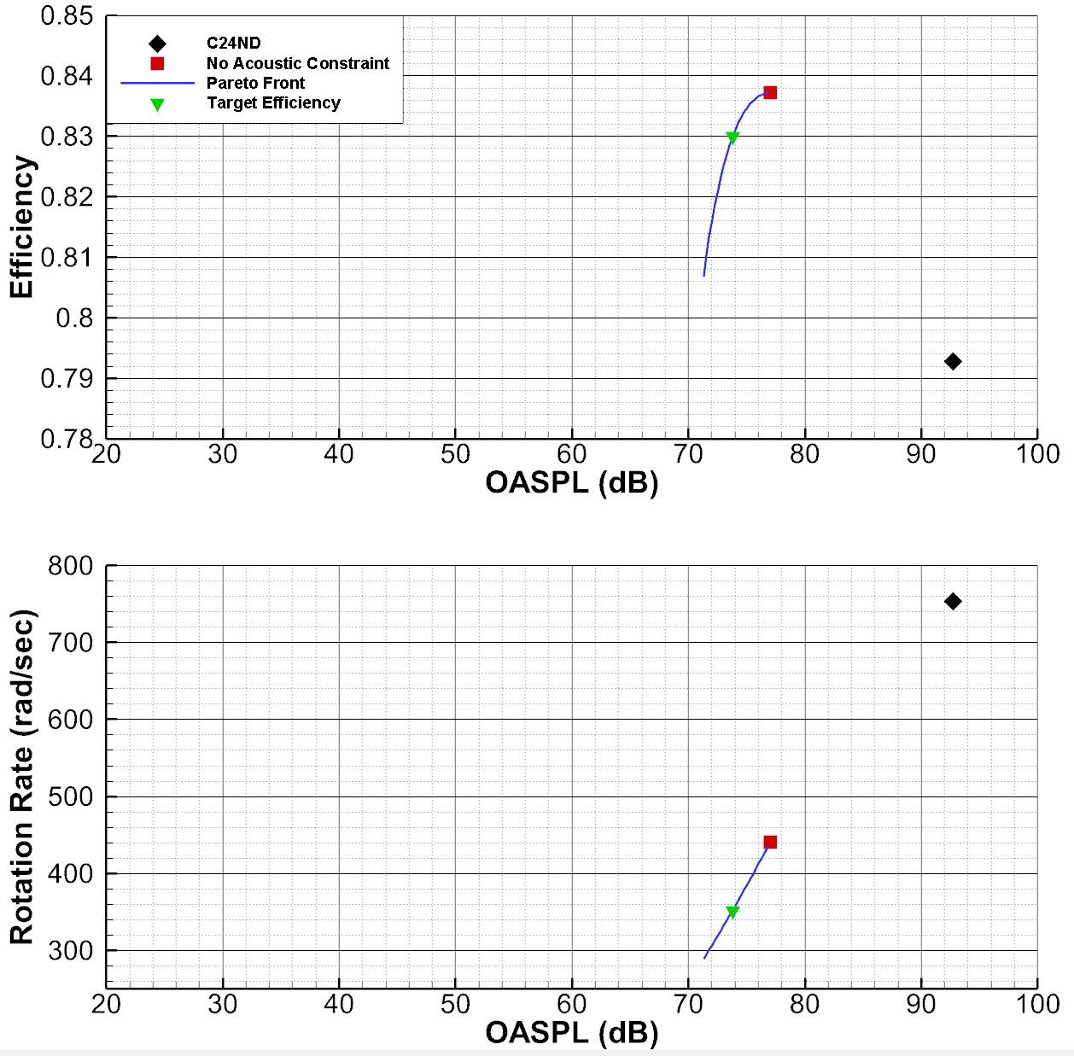
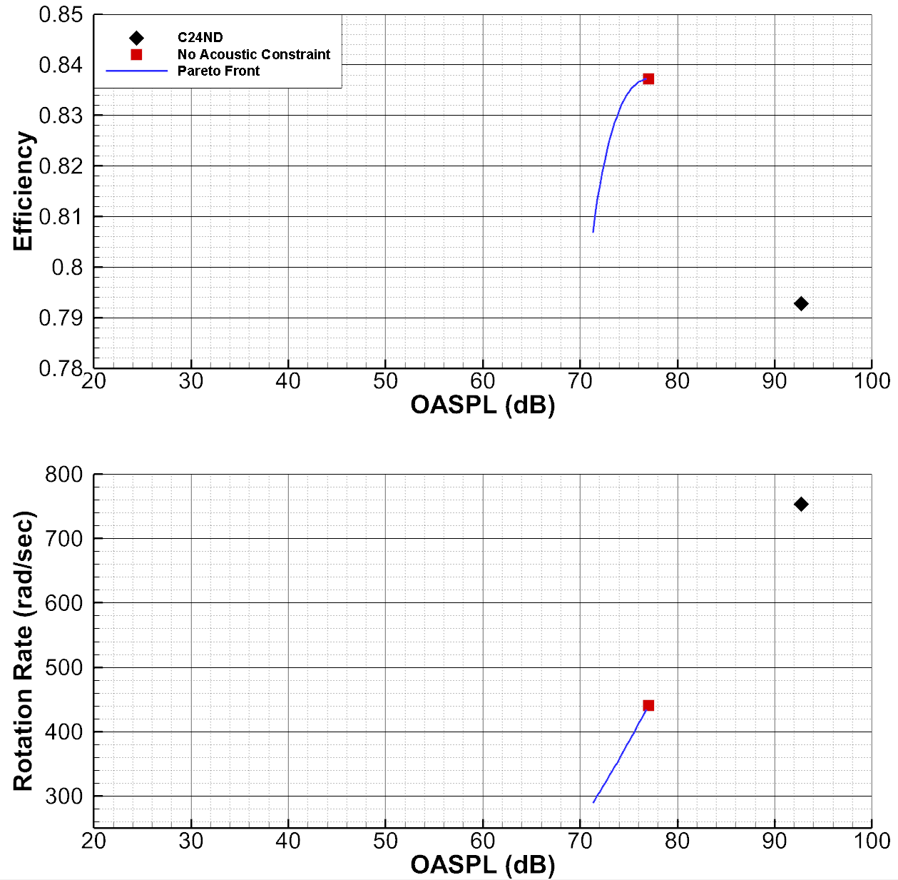
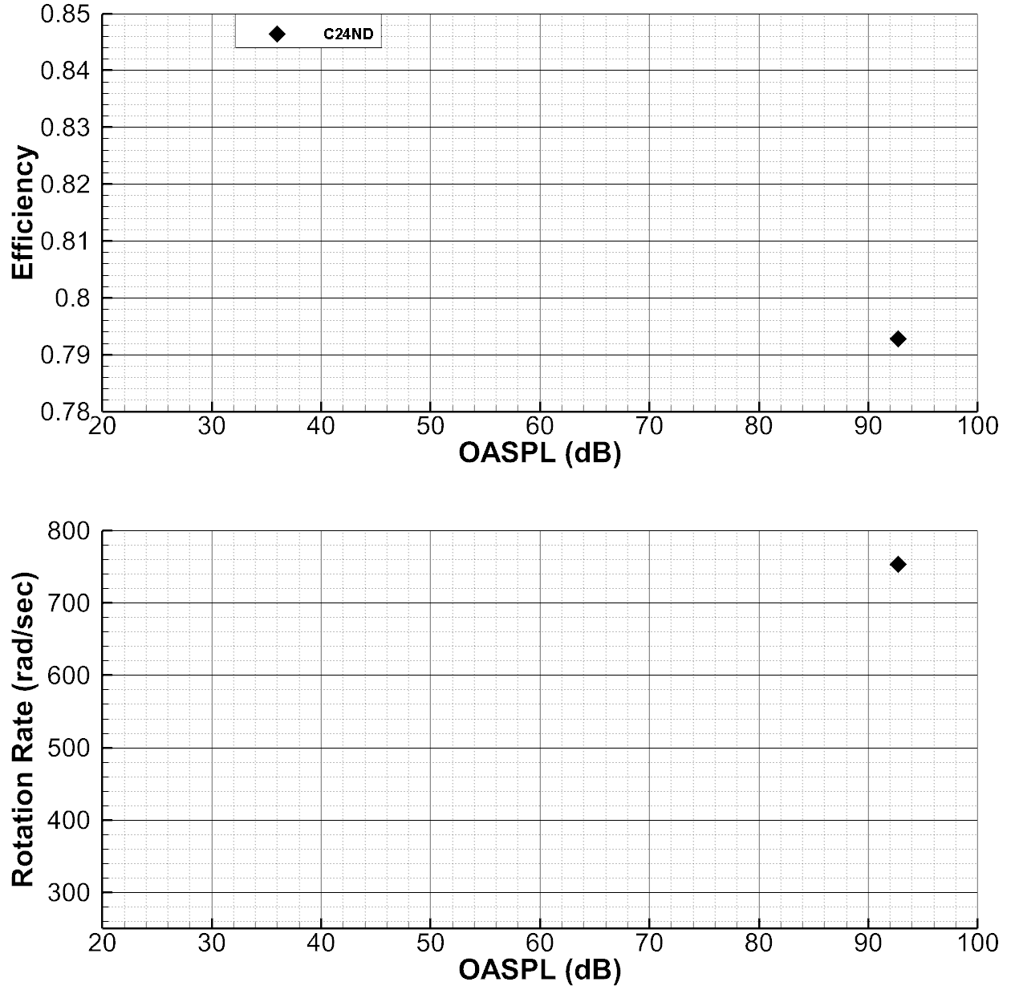
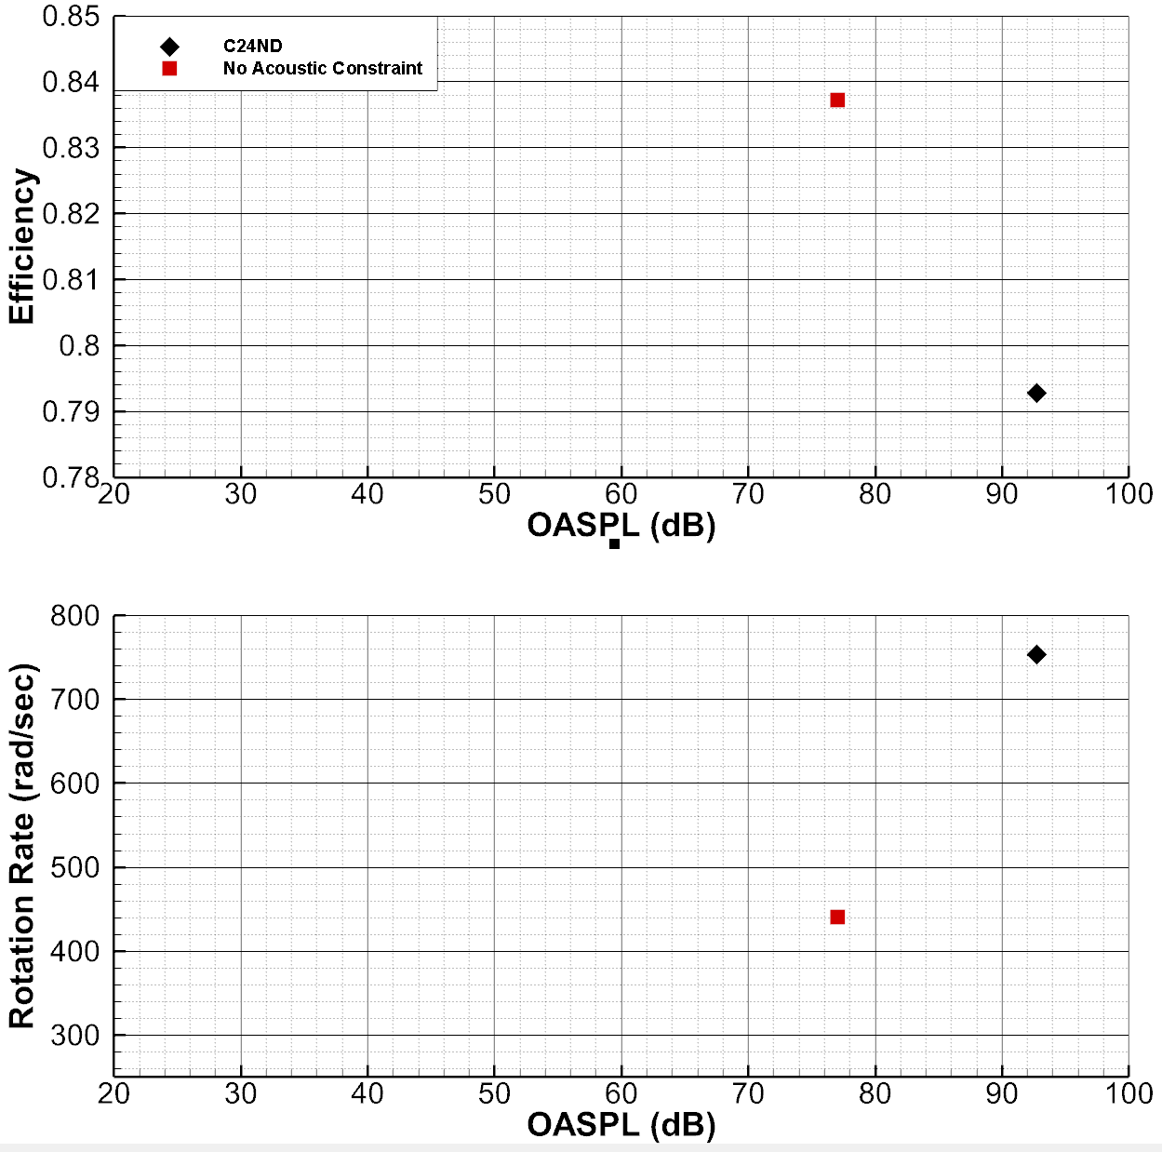
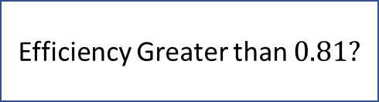



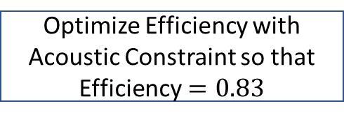
Defining a Pareto Front
Perform Baseline Analysis (C24ND)
Acoustic constraint (OASPL or OASPLA)
Optimize Efficiency without Acoustic Constraint
$${}_{0}$$
$$n=1$$
Optimize Efficiency with New Acoustic Constraint
$${}_{n}={}_{n−1}−∆$$
Yes
Efficiency Greater than $0.81?$
No
Optimize Efficiency with Acoustic Constraint so that
Efficiency$=0.83$

Slide 15
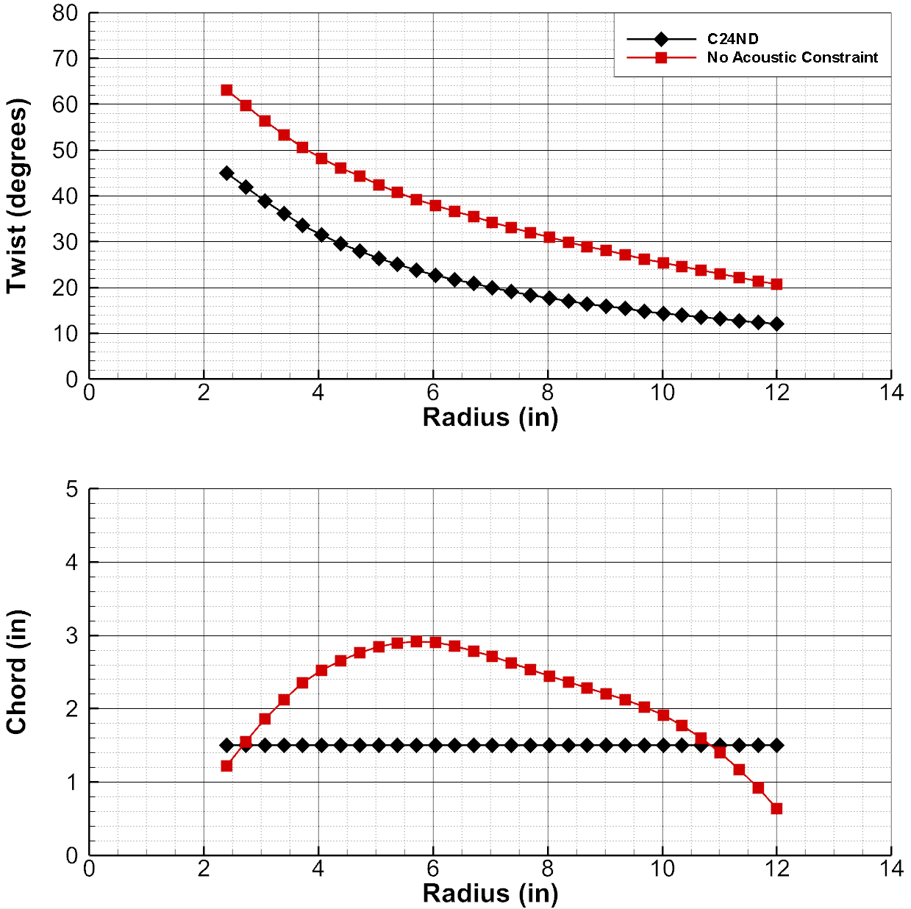
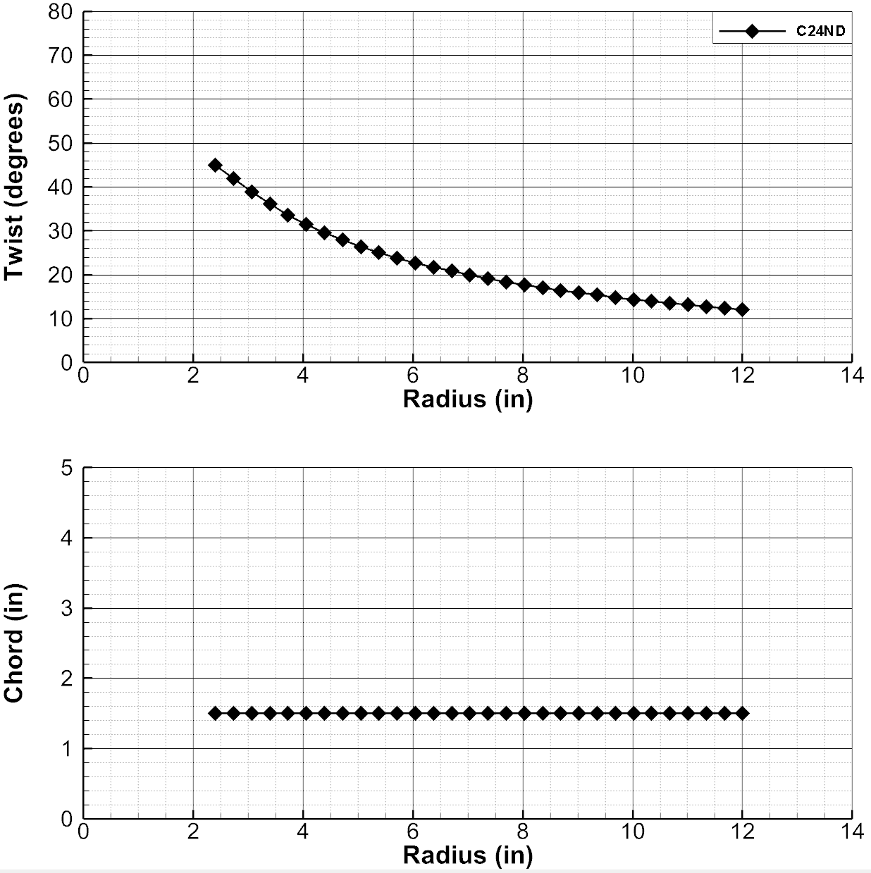
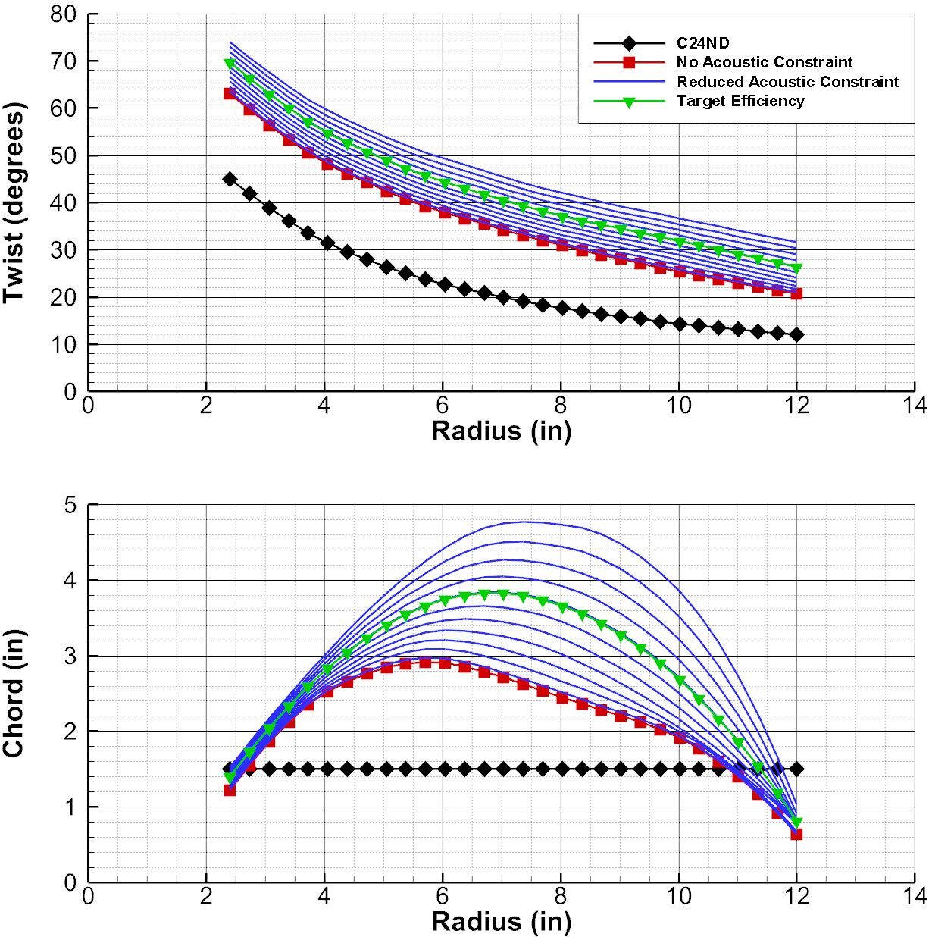
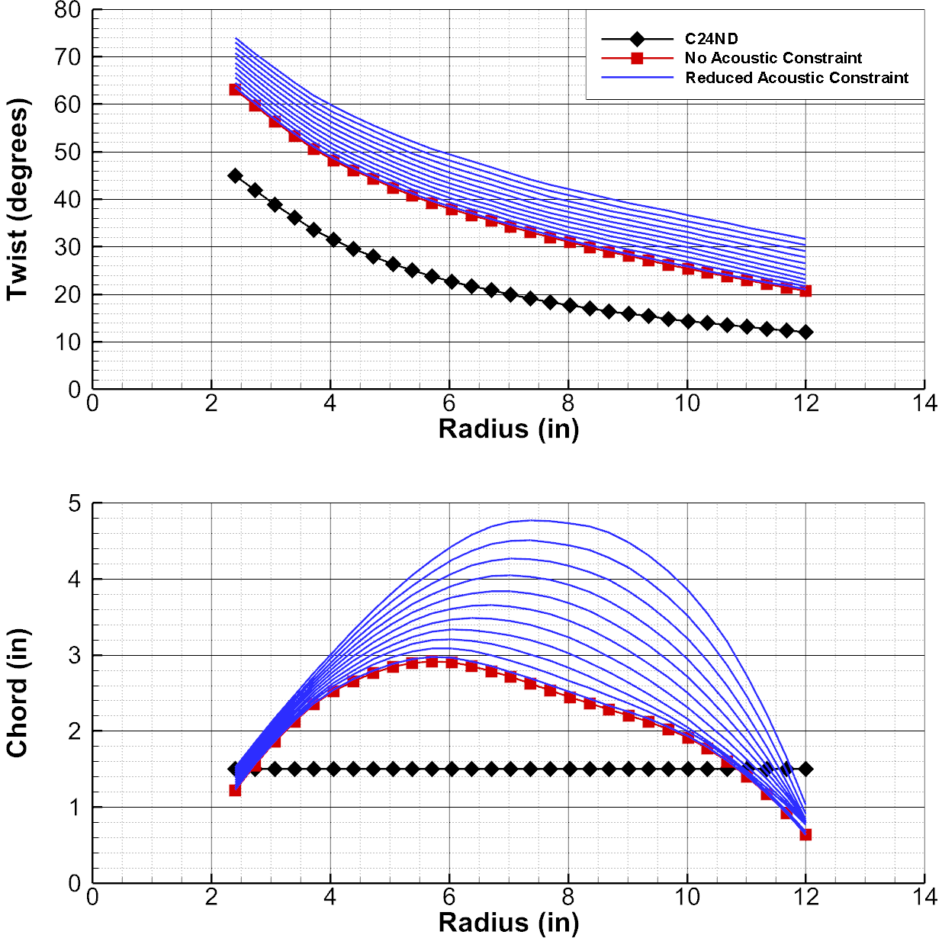
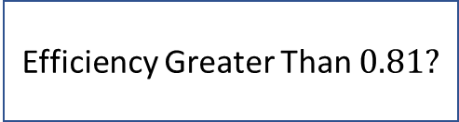
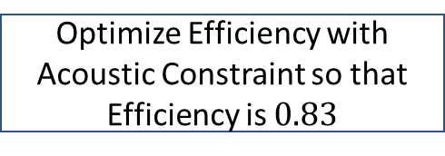
Defining a Pareto Front
Perform Baseline Analysis (C24ND)
Acoustic constraint (OASPL or OASPLA)
Optimize Efficiency without Acoustic Constraint
$${}_{0}$$
$$n=1$$
Optimize Efficiency with New Acoustic Constraint
$${}_{n}={}_{n−1}−∆$$
Yes
Efficiency Greater Than $0.81?$
No
Optimize Efficiency with Acoustic Constraint so that Efficiency is $0.83$

Slide 16
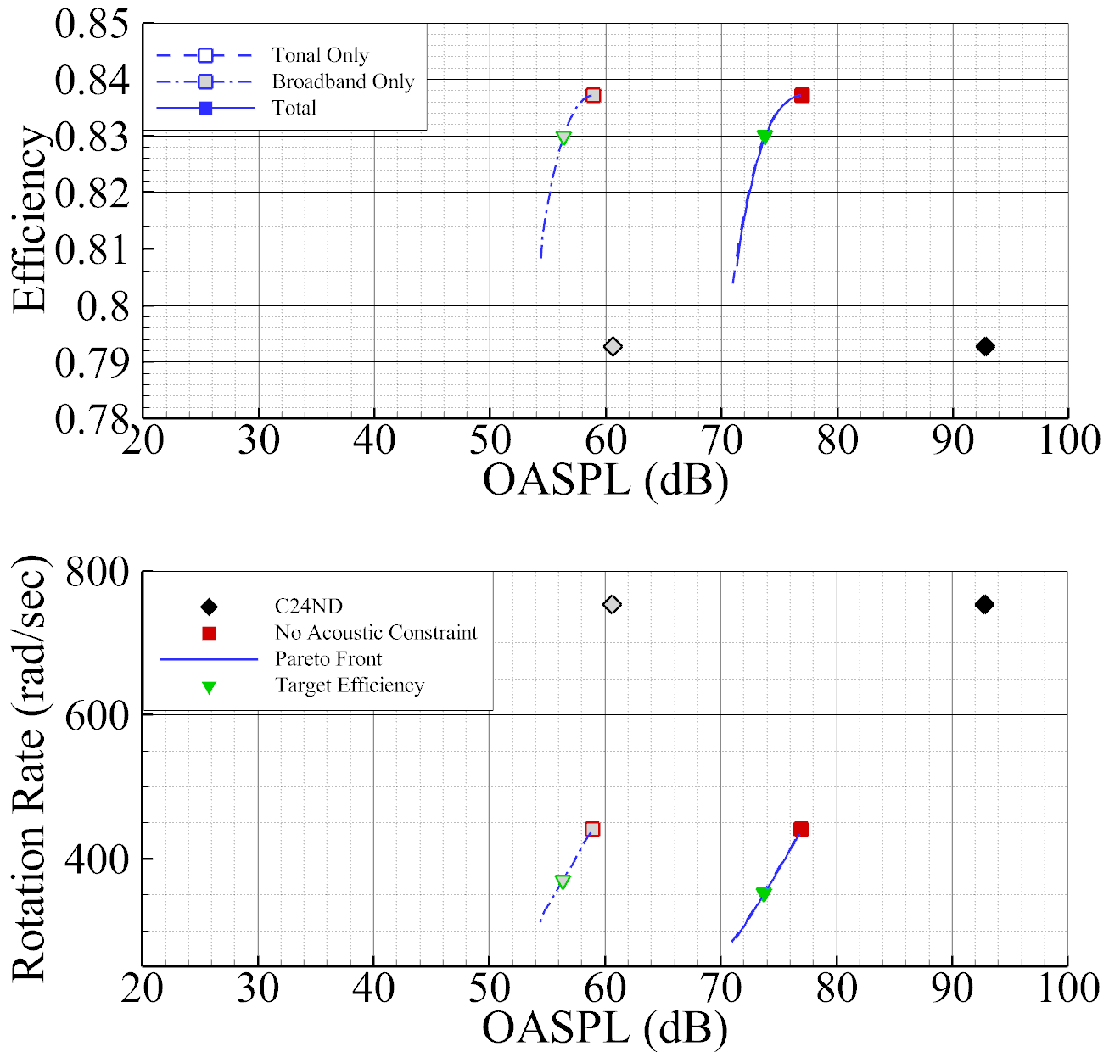
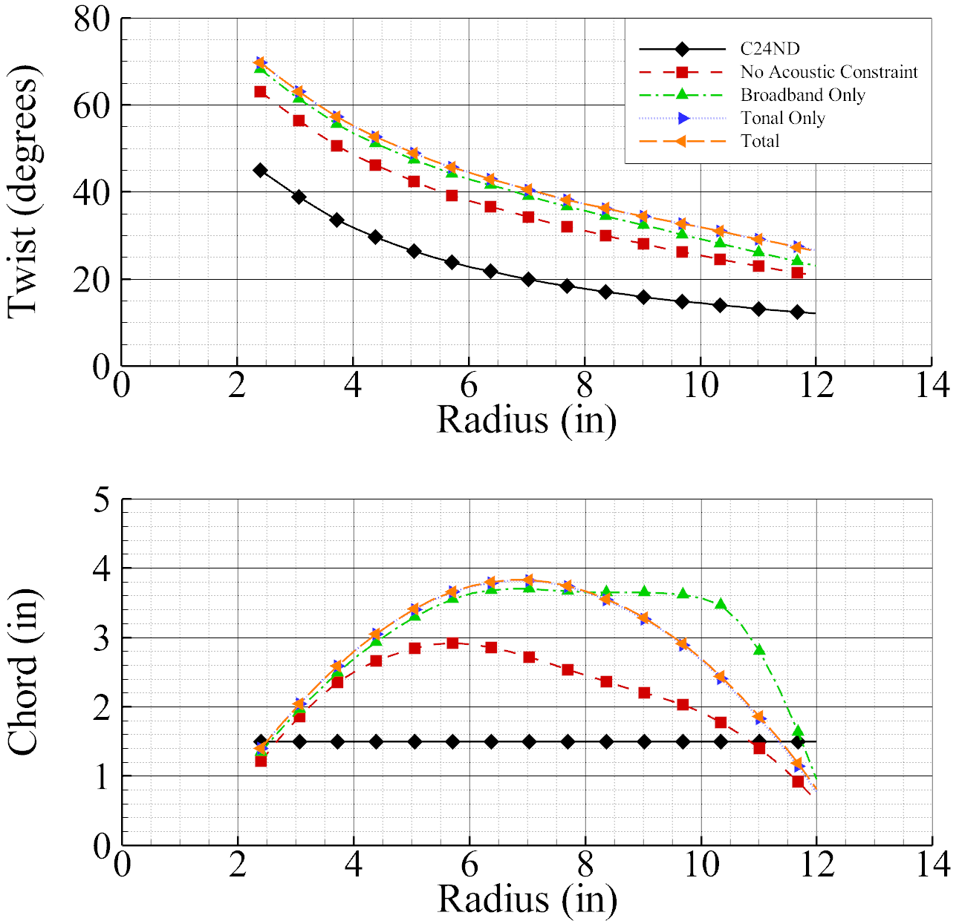
In-Plane, Unweighted

Slide 17
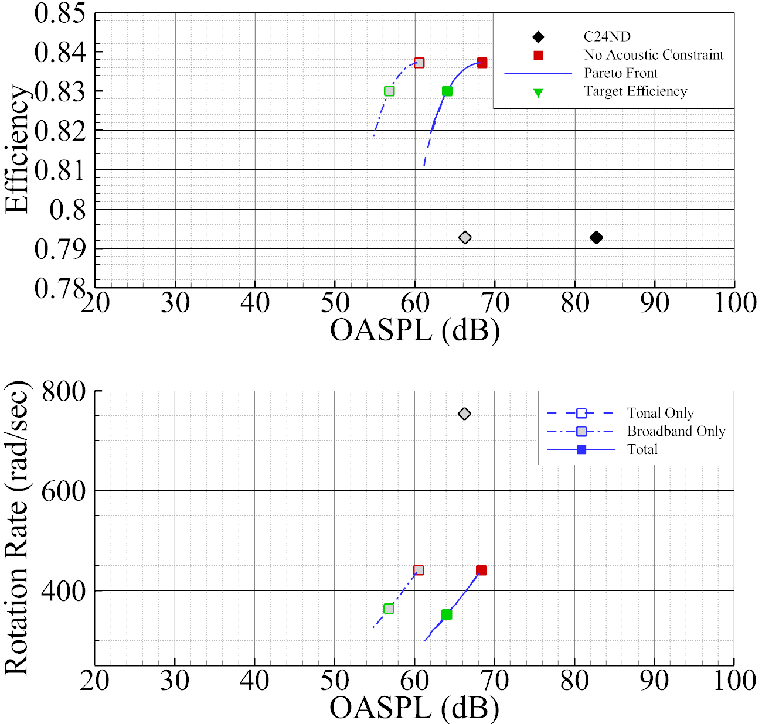

Out-Of-Plane, Unweighted

Slide 18
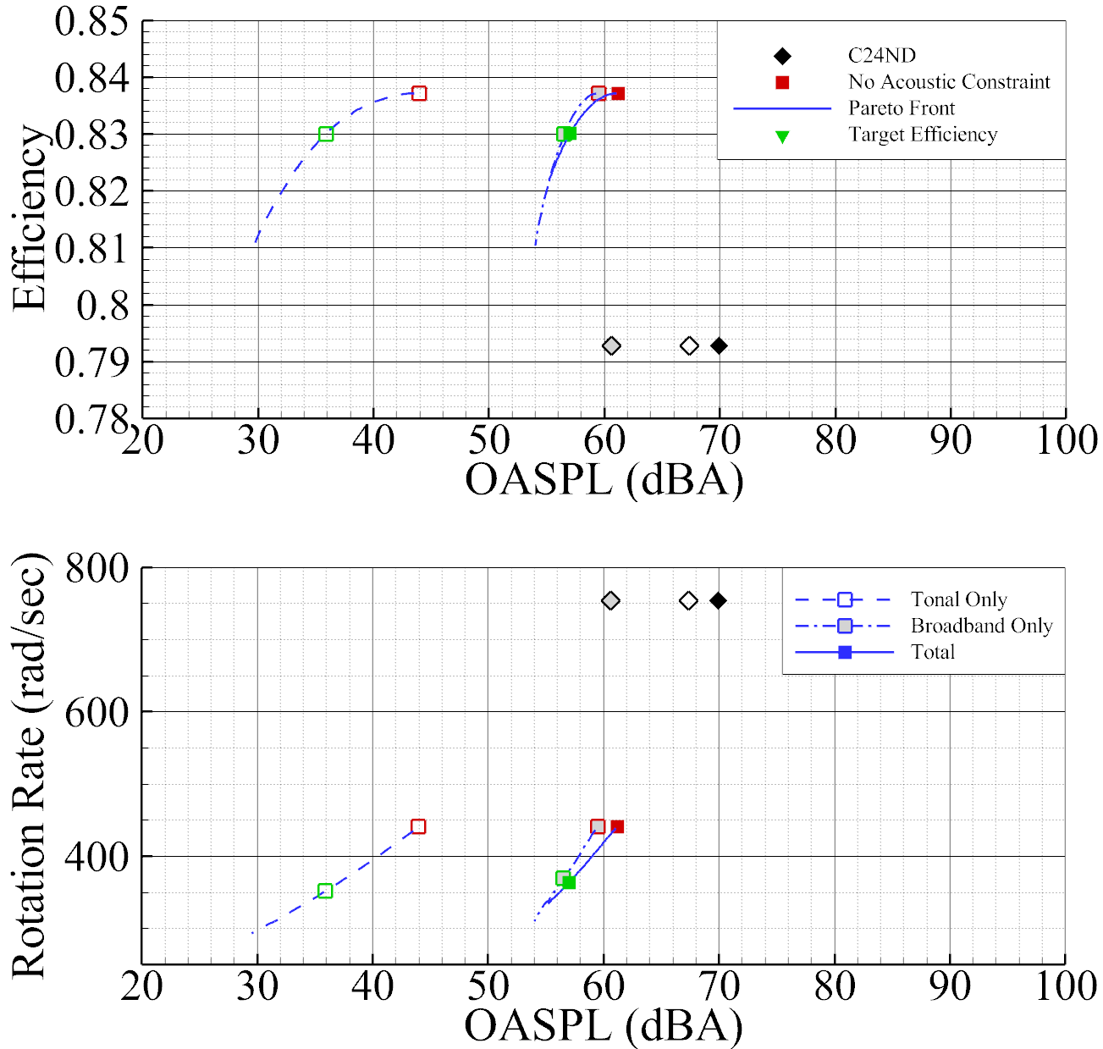
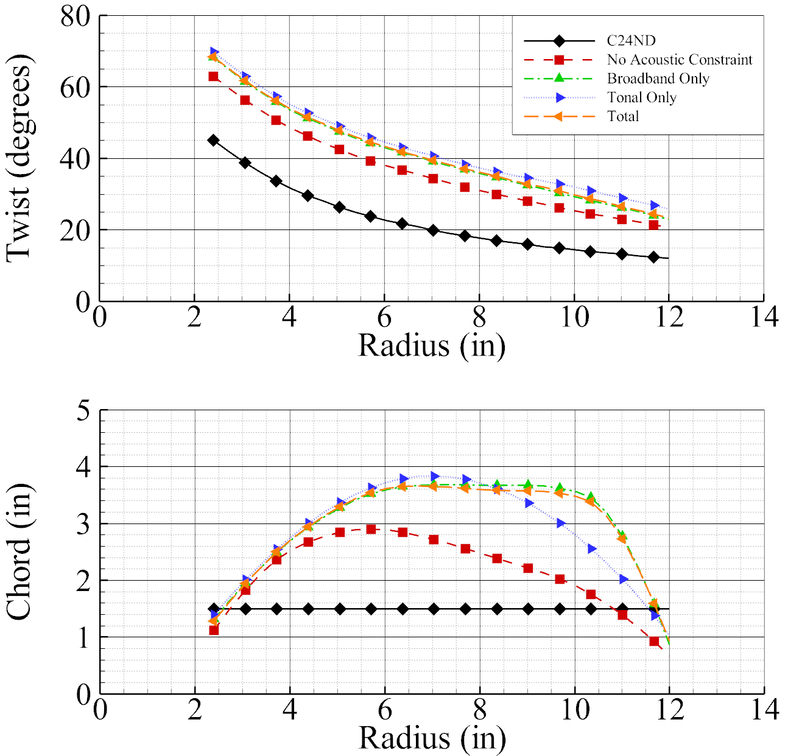
Out-Of-Plane, A-Weighted

Slide 19
Conclusion and Future Work
Conclusions
Demonstration of gradient-based, acoustic-influenced AAM proprotor design optimization
In-plane, tonal only, unweighted optimization shows significant decrease in tonal noise without loss of performance
  Verified by tunnel measurements in LSAWT
Broadband noise trends are smooth in regions of design space
Broadband noise influences acoustic objective function only when frequency weighting and out-of-plane observer positions included
Future Work
Verify broadband-influenced isolated proprotor design with LSAWT experiment
Include installation of single proprotor (in front of wing) in design cycle

