Slide 1
Effects of Random Micron-Sized Roughness on Swept-Wing Transition
Jenna Eppink
NASA Langley Research Center
Supported by the Revolutionary Computational Aerosciences Discipline under NASA’s Transformational Tools and Technologies Project
Copyright 2023 United States Government as represented by the Administrator of the National Aeronautics and Space Administration. No copyright is claimed in the United States under Title 17, U.S. Code. All Other Rights Reserved. Published by the American Institute of Aeronautics and Astronautics, Inc. with permission.

Slide 2
Motivation and Objectives
Background & Motivation:
Improving transition models for swept wing flows requires more data on the impact of surface roughness.
Stationary crossflow instabilities are known to be highly sensitive to micron-sized distributed roughness.
  Radeztsky et al.¹ achieved significant delays in transition by polishing the model surface from 3.3 μm RMS down to 0.25 μm RMS.
It is not clear how best to quantify or characterize the roughness in a way that can be used to successfully predict transition. Usually a single number, root-mean-square (RMS) is used.
Objectives:
Study the impact of micron-sized roughness on stationary-crossflow dominated transition.
Create roughness distributions with some control over the parameters (RMS, peak-to-peak, correlation length), to study the impact of different parameters.
  Roughness panels are reusable and detailed (3D) characterizations are planned.
RANS simulations are being performed on this same geometry (see Marie Denison’s talk, Mon. morning, CFD-02), and DNS computations are planned for the future.
¹Radeztsky, R., Reibert, M., and Saric, W., “Effect of Isolated Micron-Sized Roughness on Transition in Swept-Wing Flows,” AIAA Journal, Vol. 37, No. 11, 1999, pp. 1370–1377.

Slide 3
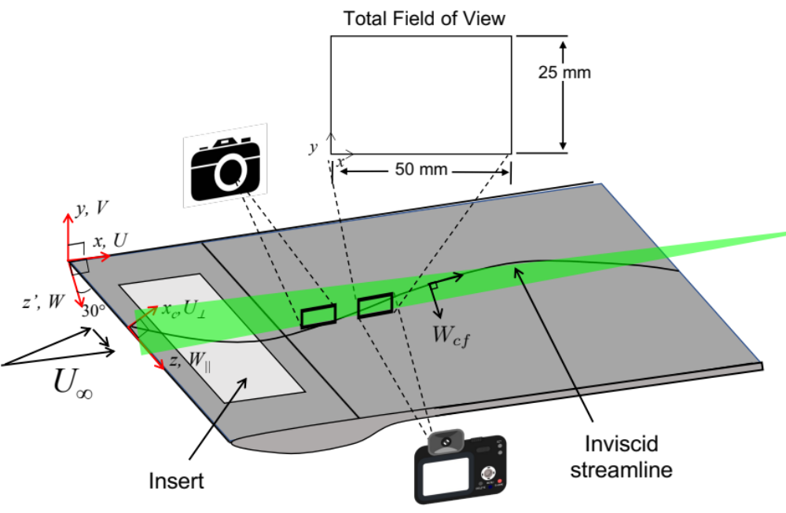
Experiment Setup
High-speed double-pulsed Nd:YLF laser.
2D PIV setup: Two high-speed 4-megapixel cameras with 300 mm lenses.
Flow seeded downstream of the test section using an oil-based fog machine.
500 image pairs acquired at 0.5 kHz
Data processed using 16x16 pixel interrogation regions with 50% overlap.
Three-plane polynomial calibration.
All PIV hardware is mounted on a translation system that allows motion in all three directions.
Multiple (120) streamwise planes of data acquired at 8-9 measurement regions for each insert, separated by 0.866 mm in z.
Swept flat plate model with ceiling liner
2x3 ft tunnel at NASA Langley, U∞=26 m/s
Roughness insert extends from x/c=0.0175 to 0.15, spanning 457 mm (middle half of model)

Slide 4
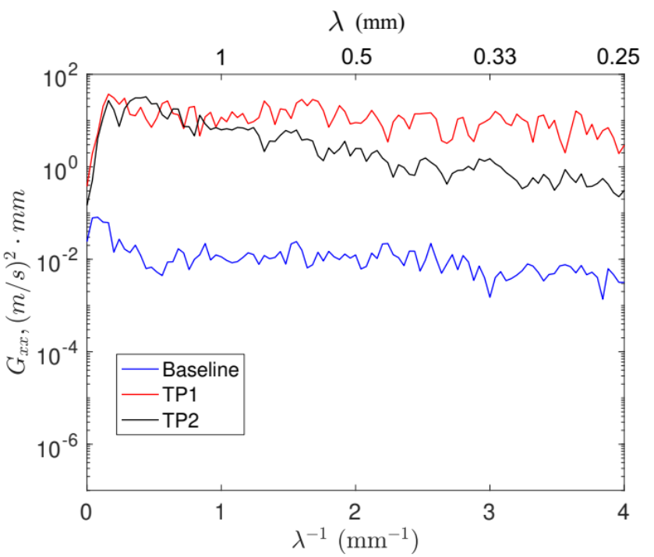
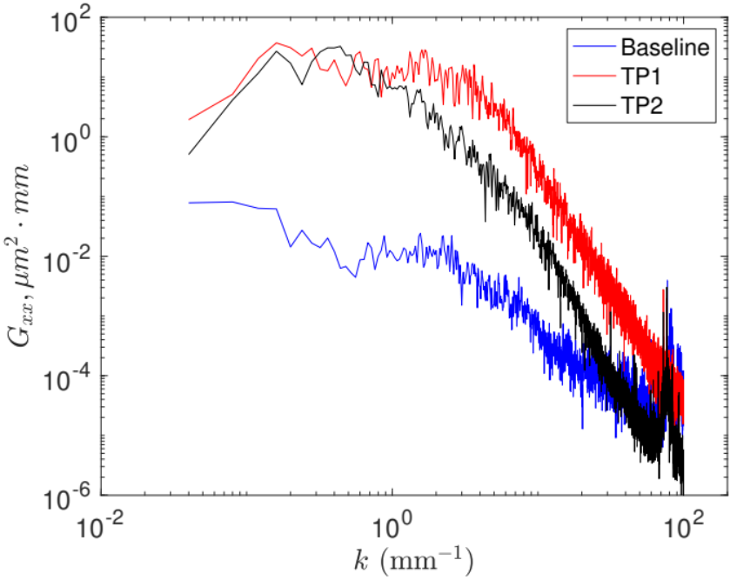
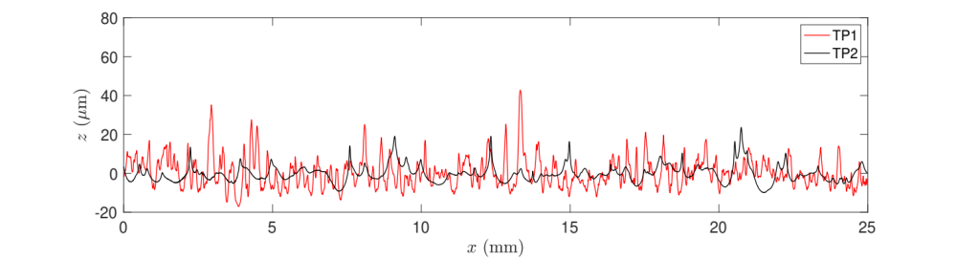

Surface Roughness Panels
Surface roughness panels were fabricated out of 0.4-mm thick aluminum sheet metal, wire EDM cut to the shape of the insert.
Panel surfaces were sprayed with nanoparticle coatings of varying formulations
  Test Panel 1 (TP1): 5 weight percent fumed silica particles
  Test Panel 2 (TP2): 7.5 weight percent 70 micron diameter glass spheres
  Baseline: no roughness coating applied
Panel | RMS (μm) | Peak-to-peak (μm) | Correlation length (μm)
Baseline | 0.42 | 1.79 | 153
TP1 | 8.64 | 39.36 | 385
TP2 | 4.78 | 20.68 | 1029
Wavenumber spectra
Sample roughness trace:

Slide 5
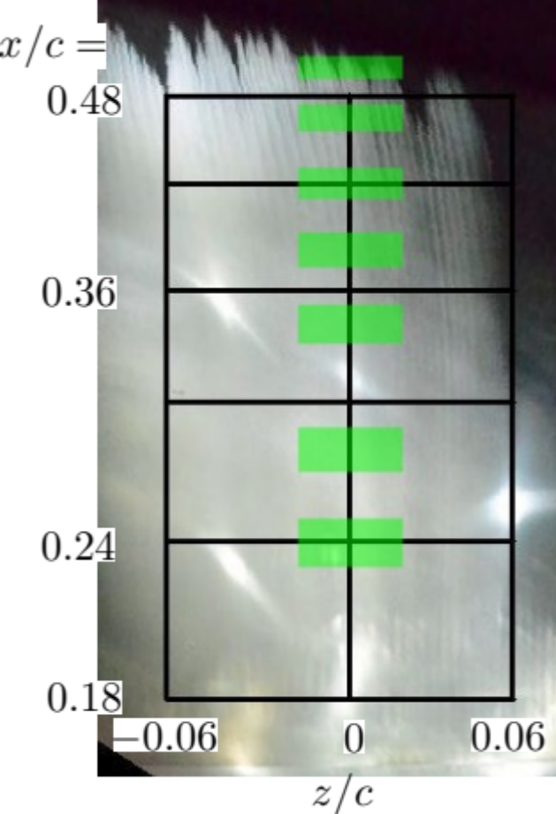
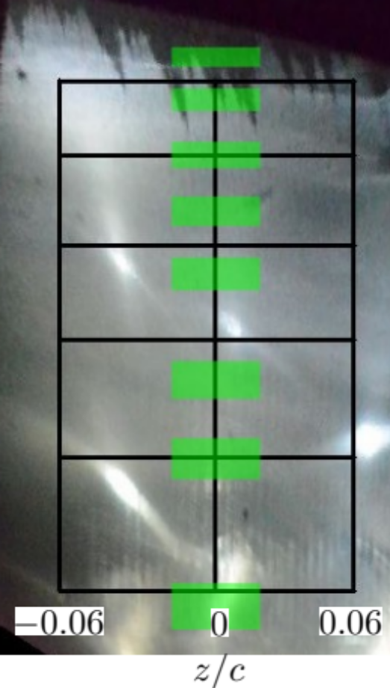
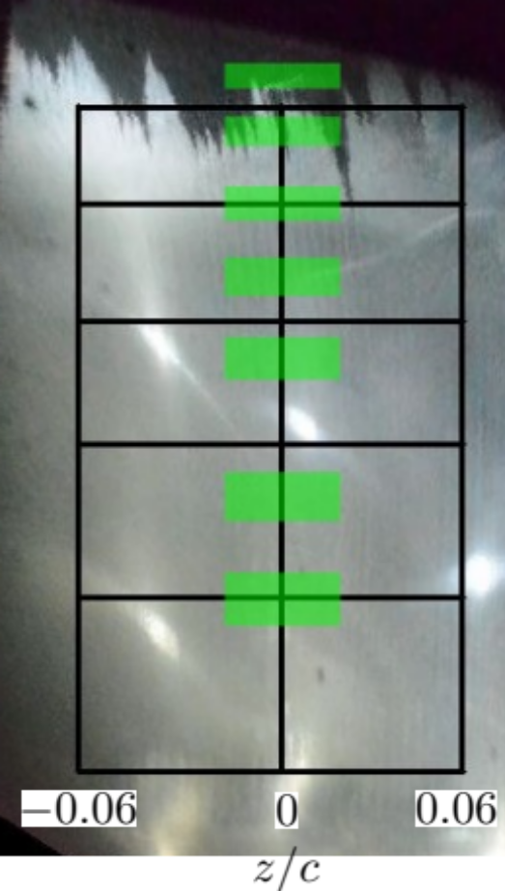
Transition Location Results
Baseline
TP1
TP2
FLOW
Average transition
locations:
(meas. region/PIV only)
0.5/0.5
0.498/0.474
0.48/0.471

Slide 6
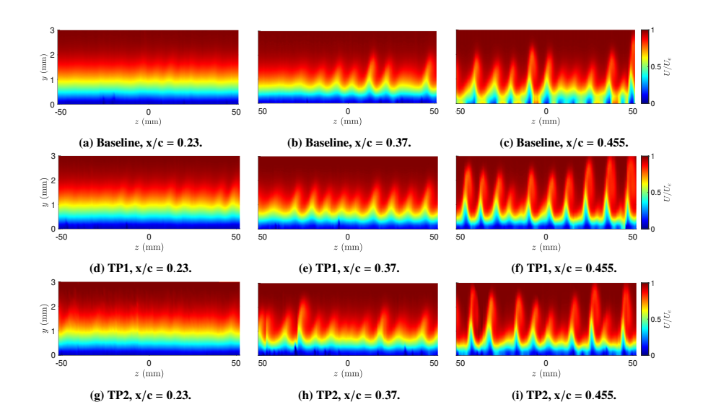
Boundary-Layer Measurements
x/c=0.23
x/c=0.37
x/c=0.455
Baseline:
TP1:
TP2:

Slide 7
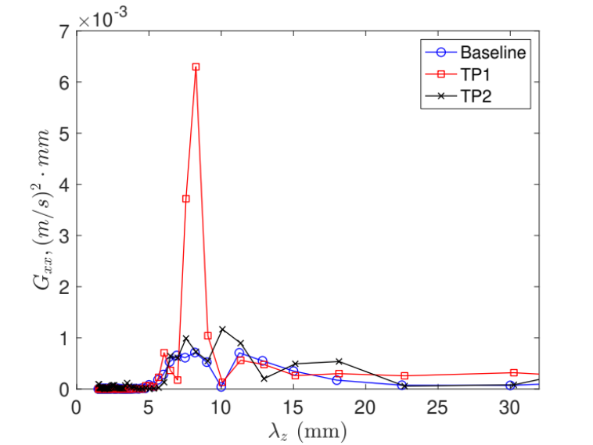
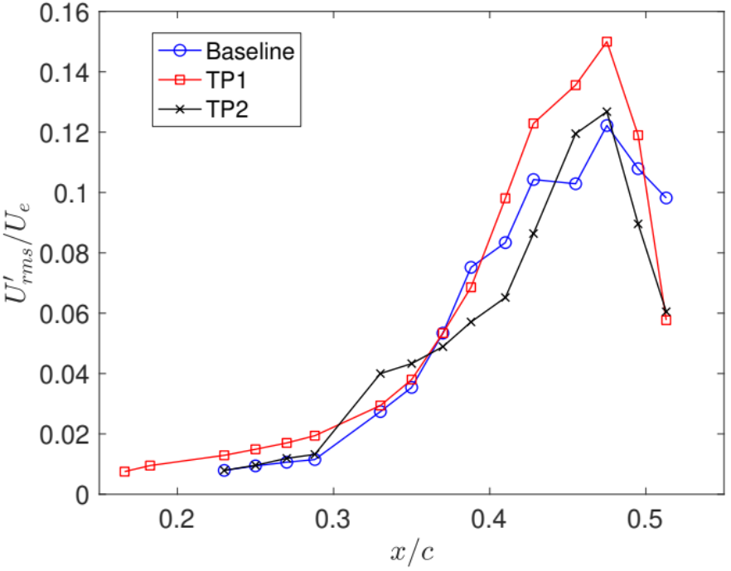
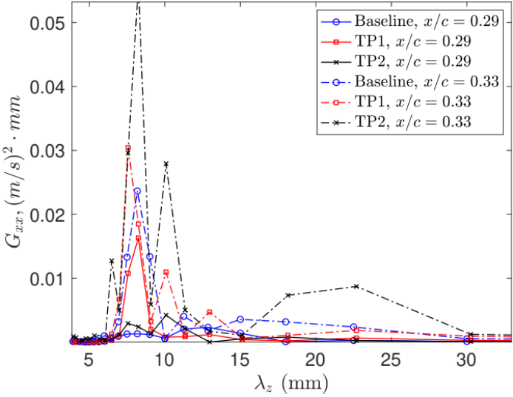
Stationary Crossflow Instabilities
Wavelength spectra
λ_{z}=5 to 20 mm
x/c=0.23
x/c=0.29
and 0.33

Slide 8
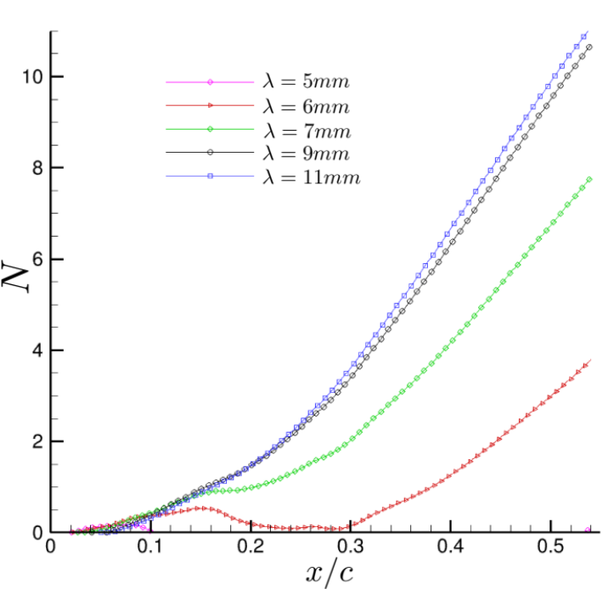
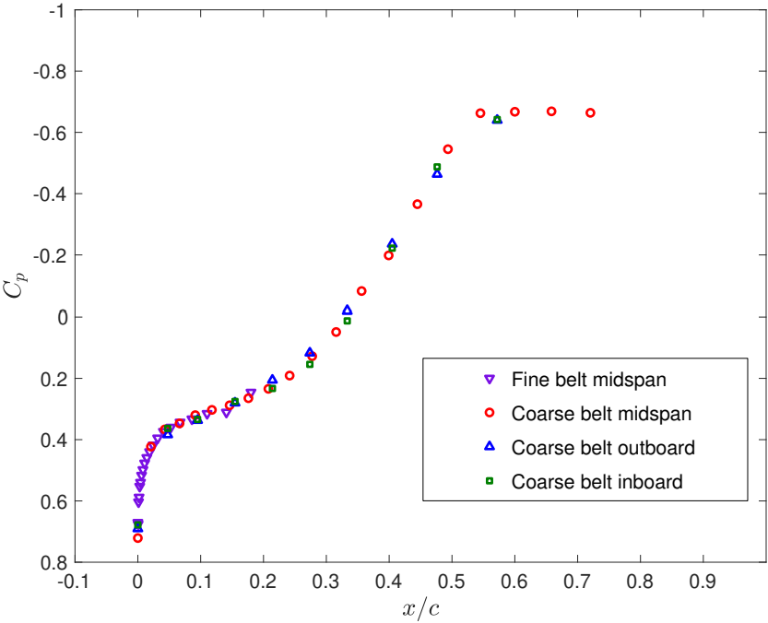
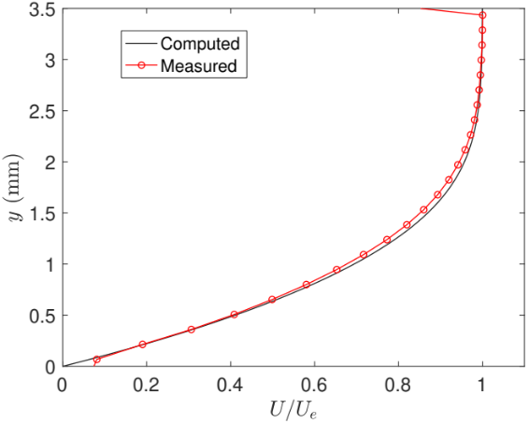
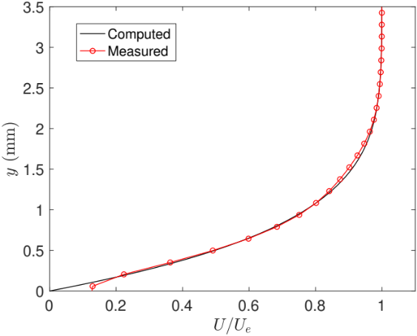
Stability Computations
Goal: to estimate initial amplitudes of stationary crossflow instabilities based on downstream amplitudes
Input: Experimental midspan C_{p} distribution
Codes: BLSTA (infinite swept wing assumption), LASTRAC (nonlinear PSE)
x/c=0.23
x/c=0.41

Slide 9
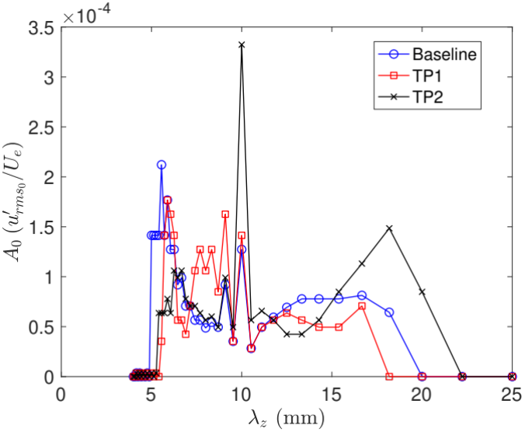
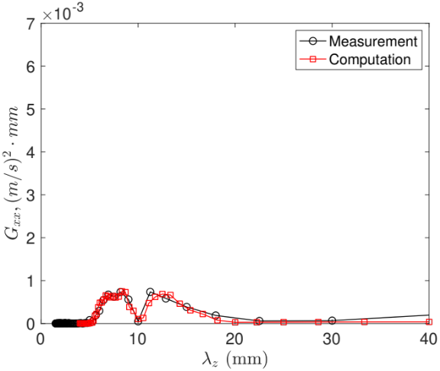
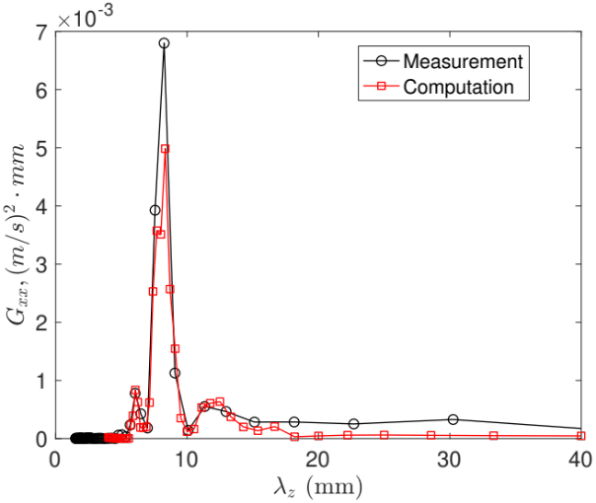
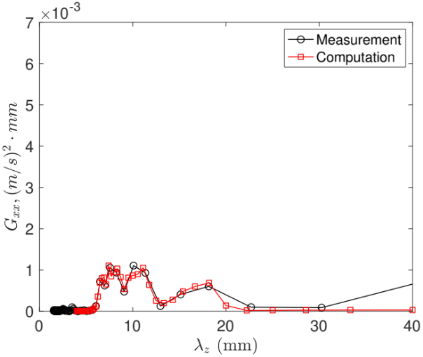
Attempt #1: Match amplitudes at x/c=0.23
50 modes are initialized using 200 mm as the fundamental wavelength.
Input amplitudes (x/c=0.0214) are manually tuned to match the measured wavelength spectra at x/c=0.23 from λ_{z}=5 to 20 mm.
Predicted initial amplitudes:
Baseline
TP1
TP2

Slide 10
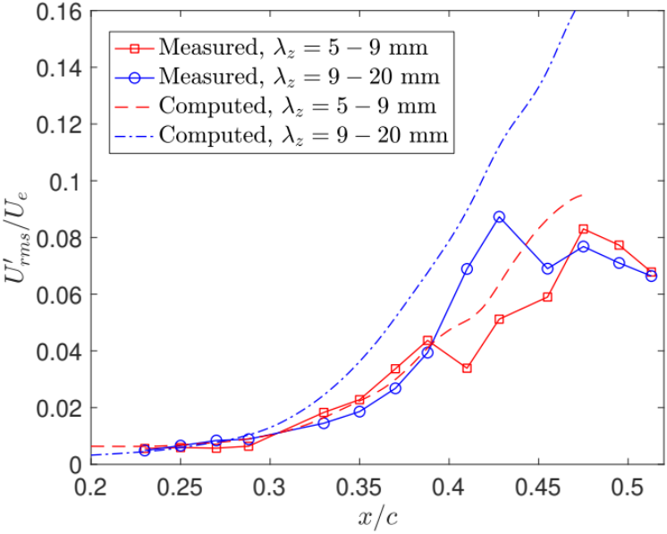
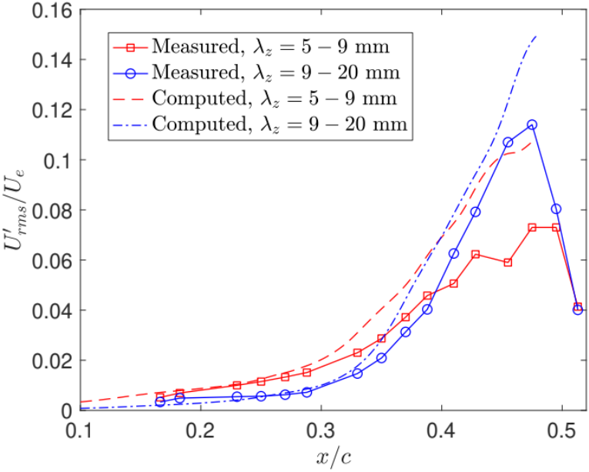
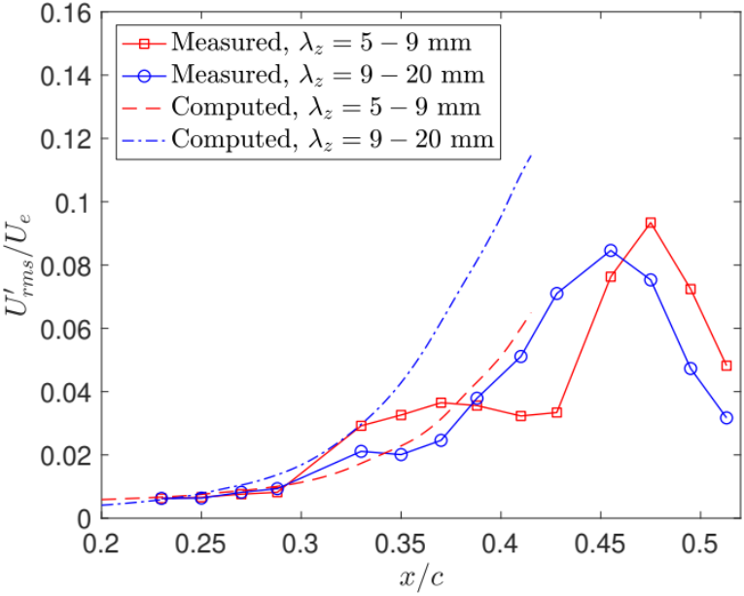
Attempt #1: Match amplitudes at x/c=0.23
Downstream growth is compared between measurements and computations, integrating over larger wavelength ranges to account for slight shifts that occur in measured primary wavelength.
In all cases, the results do not agree well, especially beyond x/c=0.3
Baseline
TP1
TP2

Slide 11
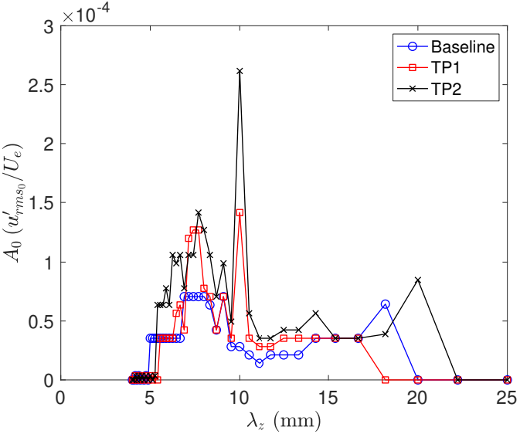
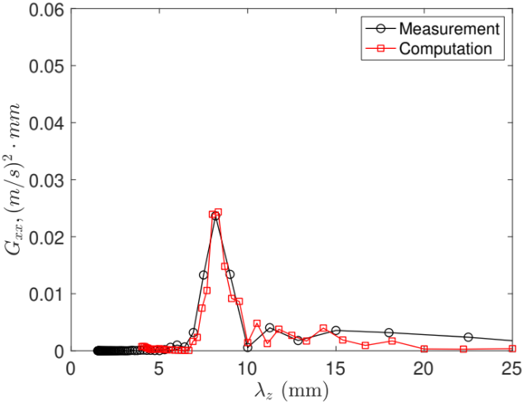
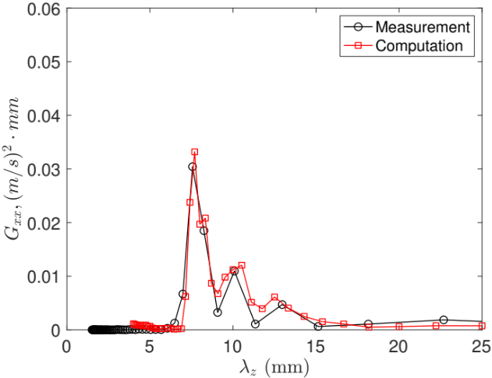
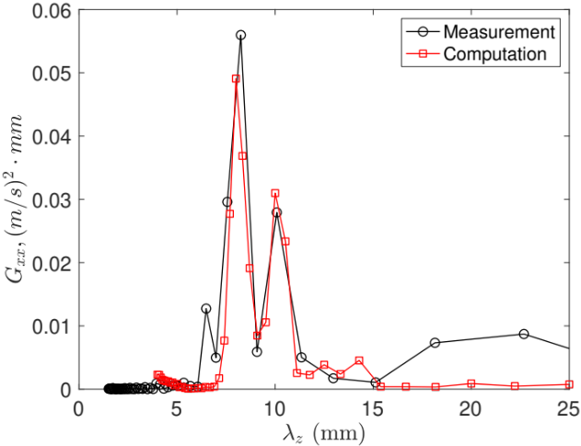
Attempt #3: Match amplitudes at x/c=0.33
Input amplitudes are manually tuned to match the measured wavelength spectra at x/c=0.33 from λ_{z}=6.5 to 20 mm.
Predicted initial amplitudes:
Baseline
TP1
TP2

Slide 12
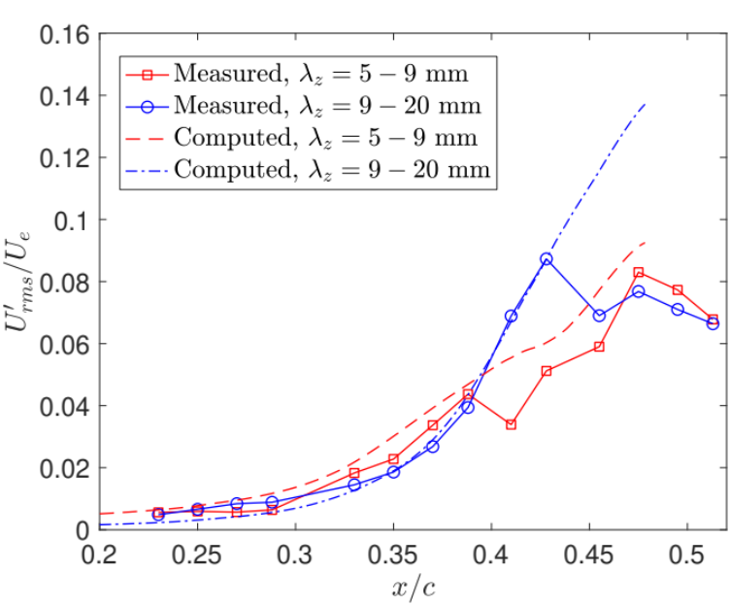
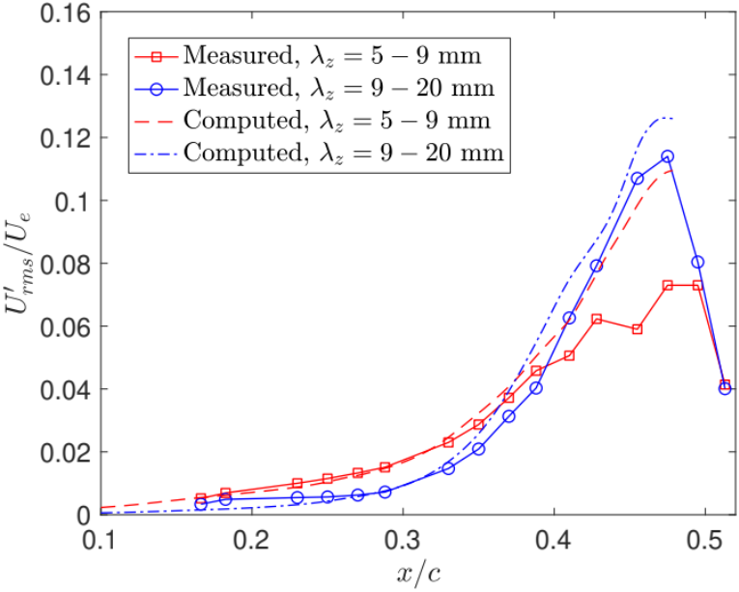
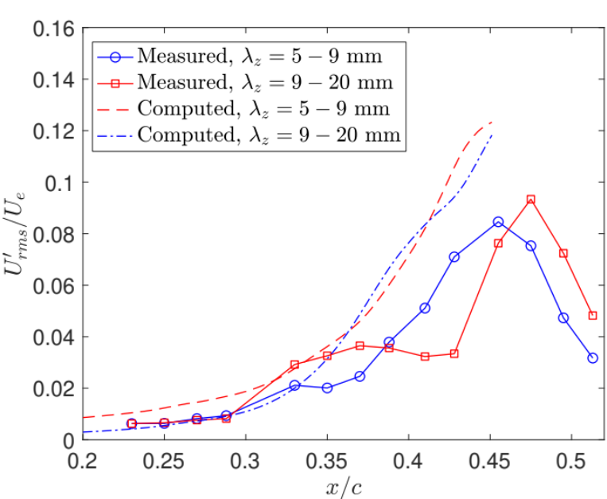
Attempt #3: Match amplitudes at x/c=0.33
Downstream growth is compared between measurements and computations, integrating over larger wavelength ranges to account for slight shifts that occur in measured primary wavelength.
Baseline and TP1 cases agree much better, except the saturation amplitude is still significantly overpredicted in some cases.
Large discrepancies still exist for TP2
Baseline
TP1
TP2

Slide 13
Conclusions & Future Work
Elevated roughness levels of approximately 4 and 8 μm RMS did not lead to significant changes in the transition front location.
Differences were observed in the stationary crossflow instability amplitudes and wavelengths
  TP1 caused a significant increase in the stationary crossflow instability amplitudes at the farthest upstream measurement locations.
  TP2 amplitudes were similar to the baseline case, but contained more energy at 10 mm than the other two cases.
  TP1 resulted in a larger saturation amplitude compared to the other two cases.
Smaller wavelength initial amplitudes are likely overpredicted due to the low growth rate near the leading edge
  Illustrates the difficulty with characterizing roughness for a range of conditions based on results from one or a small range of conditions or a single pressure distribution.
Future work will include repeated runs with the existing roughness panels, fabrication and testing of higher-RMS roughness panels, time-resolved measurements to characterize traveling crossflow, and comparisons with computations.

Slide 14
Acknowledgments
This work was performed under the Revolutionary Computational Aerosciences discipline in the Transformational Tools and Technologies Project of the NASA Transformative Aeronautics Concepts Program.
The author would like to thank the following individuals:
  Dr. Chris Wohl from the Advanced Materials and Processing Branch at NASA Langley for his ongoing assistance with the roughness panel fabrication.
  Dr. Chung-Sheng Yao from the Flow Physics and Control Branch for his assistance with the PIV setup.

