Slide 1
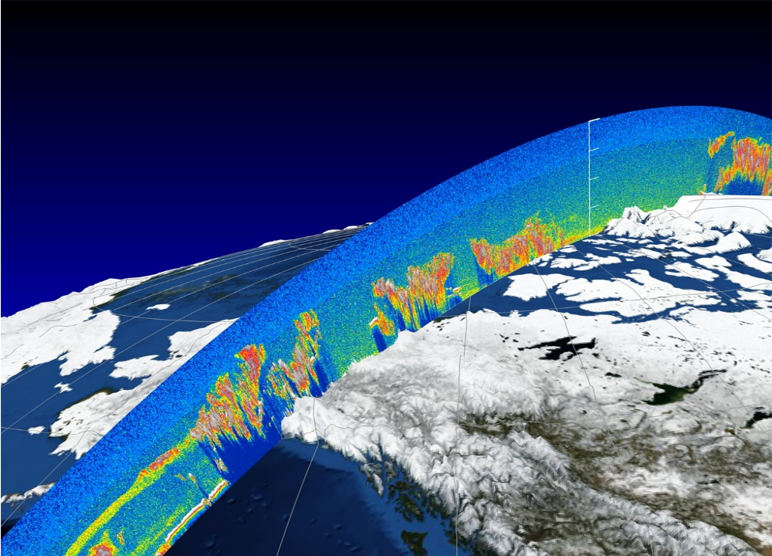
NASA’s Space-based Lidar Observations: Science and Applications
Ali H Omar
& Lidar Science Working Group at NASA Langley

Slide 2
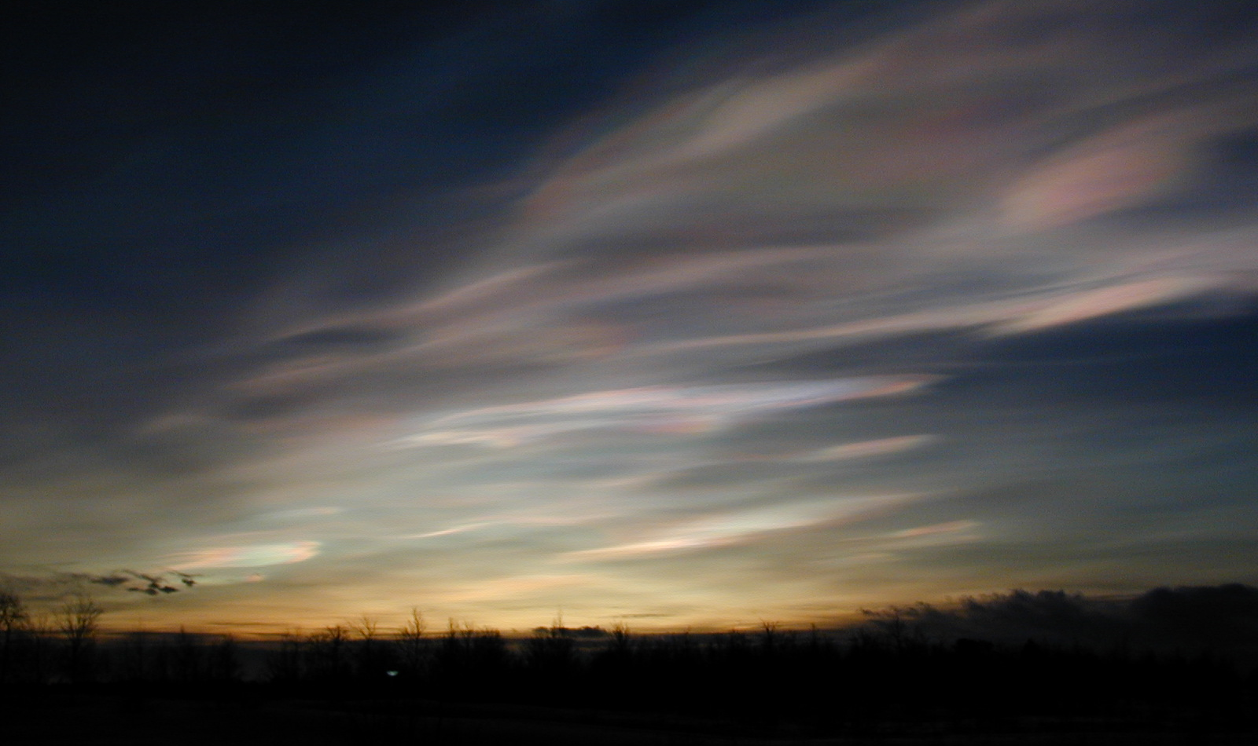

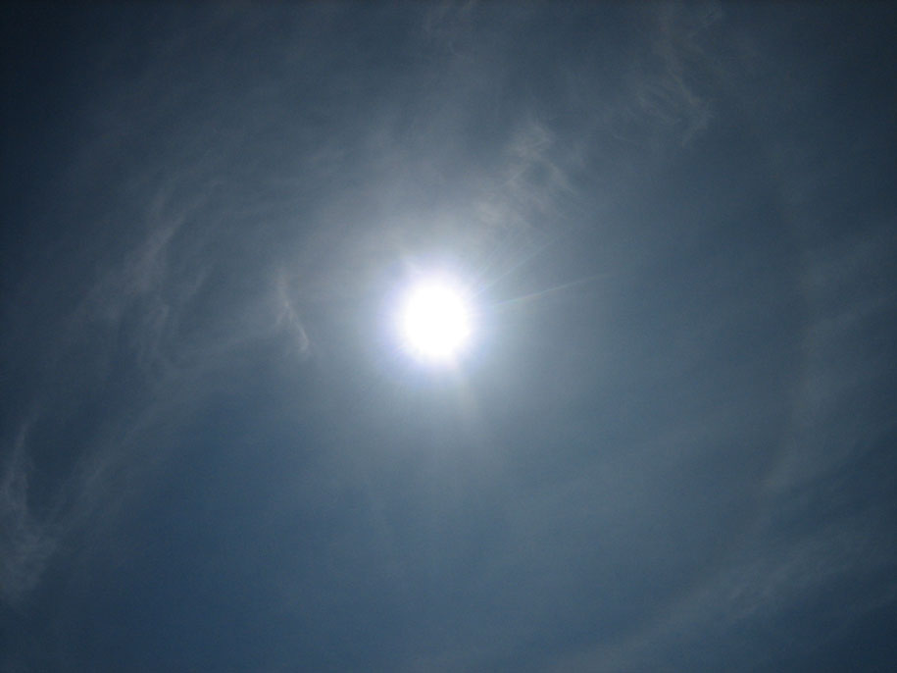

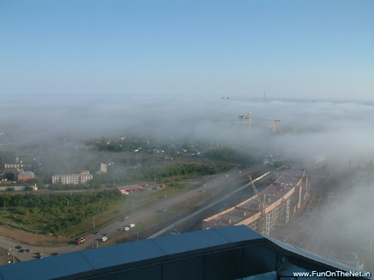
Lidar Detects a Wide Range of Features in the Atmosphere
Cumulus Embedded in Aerosol
Cirrus Clouds
Polar Stratospheric Clouds
Multi-Level Cloud Decks
Long Range Dust Transport

Slide 3
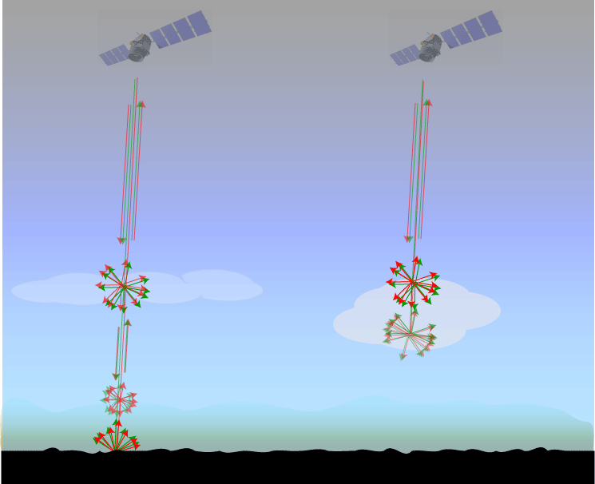
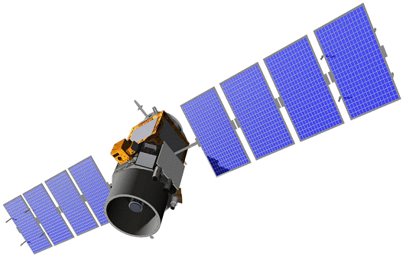


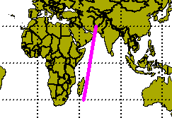
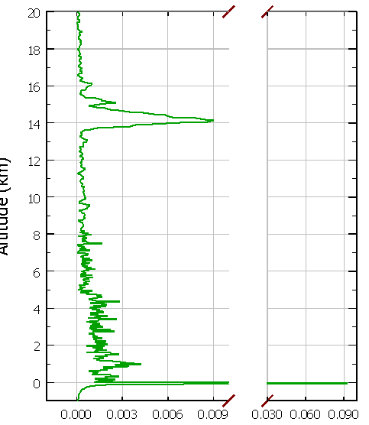
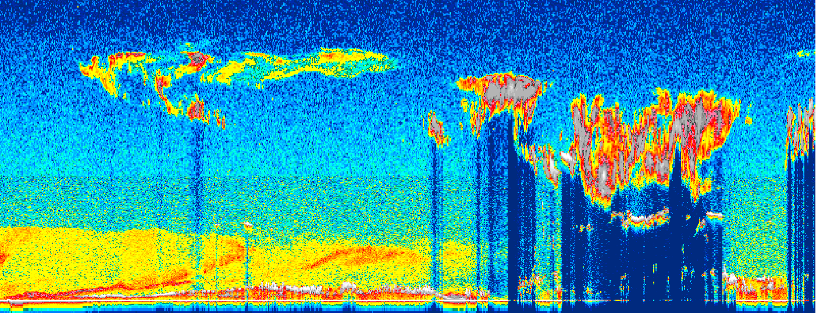
Typical Cloud and Aerosol Detection in the Earth’s Atmosphere from a CALIPSO Orbit
532 nm
1064 nm
“Clear Air”
Aerosols
Clouds
Cloud
Altitude
Aerosol
Surface
20° N
15° N
10° N
5° N
0°
5° S
Courtesy of Mark Vaughan
Notes:
quote from NASA’s Science Mission Directorate web site (http://science.hq.nasa.gov/earth-sun/science/index.html)
the public face of NASA is space exploration – bright & flashy rocket launches coupled with cool satellites. the “observation” part is well captured by NASA PR; however, the “understanding and modeling” aspects are less well known…

Slide 4





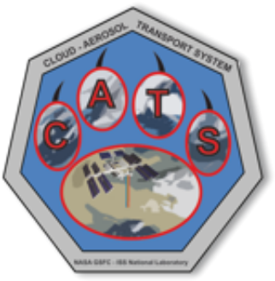

NASA Lidars in Space –
Past and Present
LITE on Space Shuttle (1994): Proof of Concept
CALIPSO (2006-): Clouds and aerosols
CATS Mission (2015-17): in-space technology demonstration of affordable payloads on the ISS
GEDI – Ecosystem lidar (2018-)
ICESat Missions (2003 and 2018-):
Altimeter for mapping snow and glacier
Notes:
GEDI - forest canopy height, canopy vertical structure, and surface elevation; carbon and water cycling processes, biodiversity, and habitat.
CATS holds the record for most shots in space (200 billion)

Slide 5
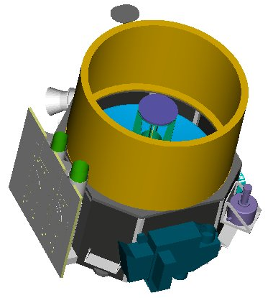
CALIPSO (April 2006 - )
Payload - Near Nadir Viewing Instruments
Lidar
Imaging Infrared Radiometer (IIR)
High-resolution image (swath product)
CALIOP
Cloud-Aerosol Lidar with Orthogonal Polarization
1 meter
Vertical profiles of atmosphere
CALIOP
Receiver Telescope
2 wavelength polarization sensitive lidar:
1064 nm, 532 nm (parallel and perpendicular)
WFC
0.13 mrad FOV (surface spot 90 m)
CALIOP
Laser Transmitter
IIR
Wide Field Camera (WFC)
High-resolution image (125m resolution)
CALIPSO Payload
Notes:
WFC developed an anomaly on April 11, 2020 was powered off and never recovered.

Slide 6
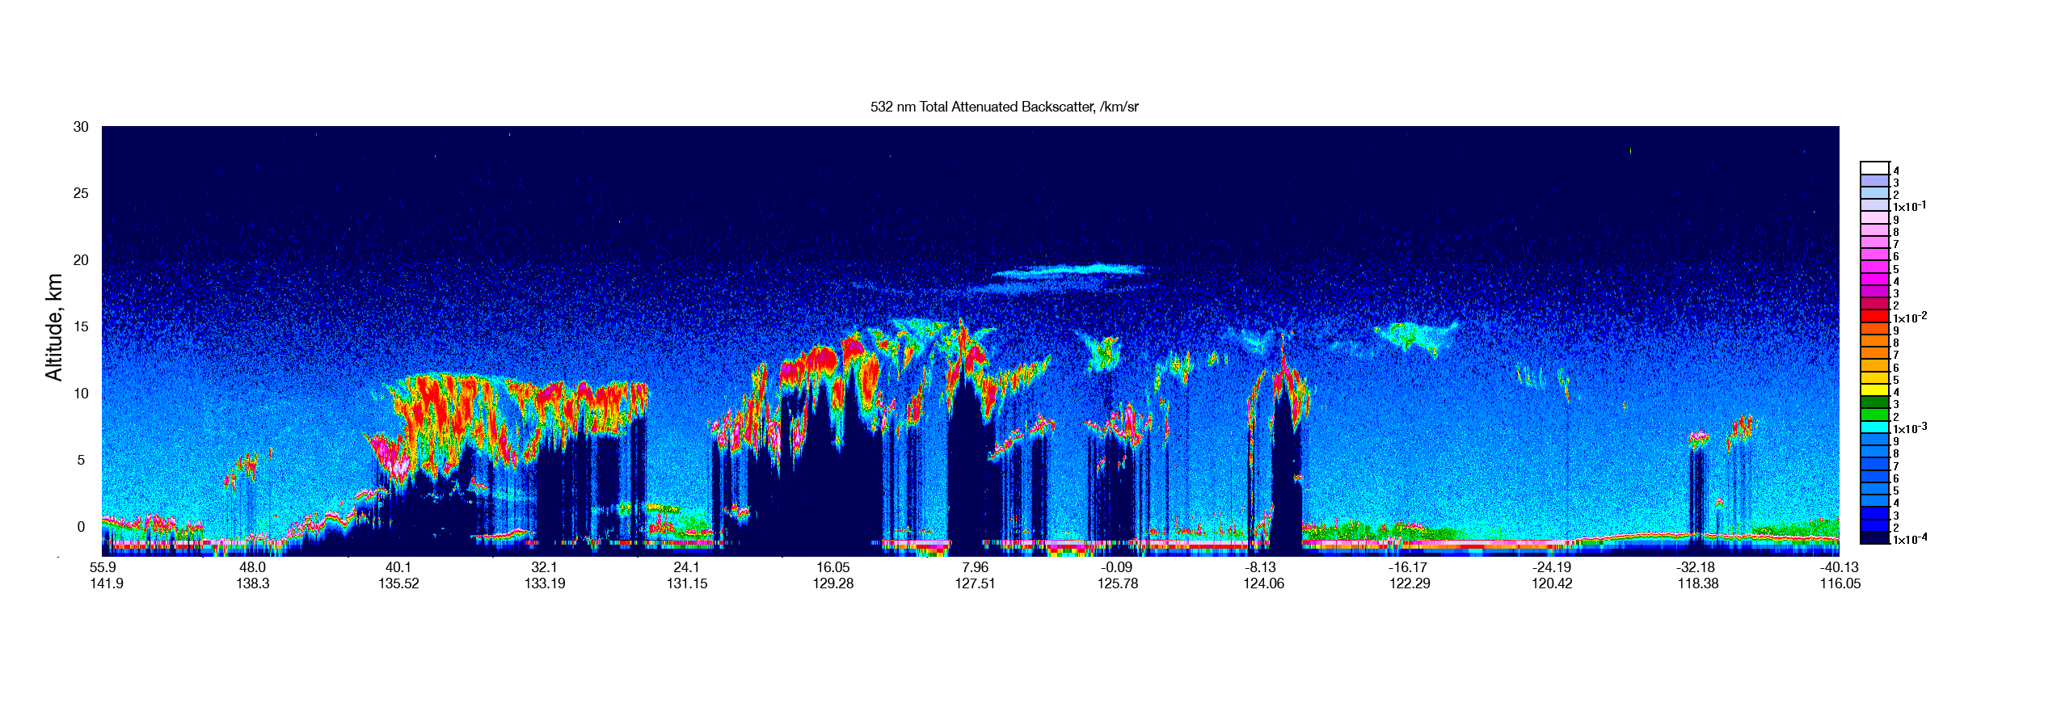
CALIOP “First Light”
7 June, 2006 – CALIOP ‘First Light’
Volcanic aerosol
Cirrus
Water
Aerosol
22 July, 2006 – Initial release of data to Science Team
5 September, 2006 – Public release of browse images
8 December, 2006 – First public release of science data

Slide 7
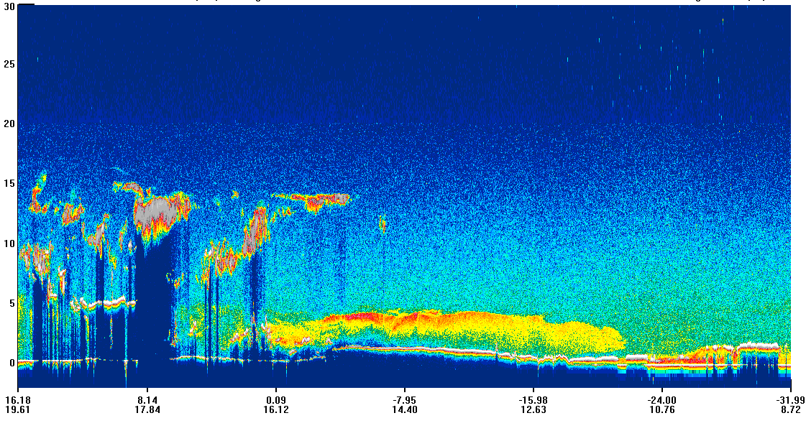
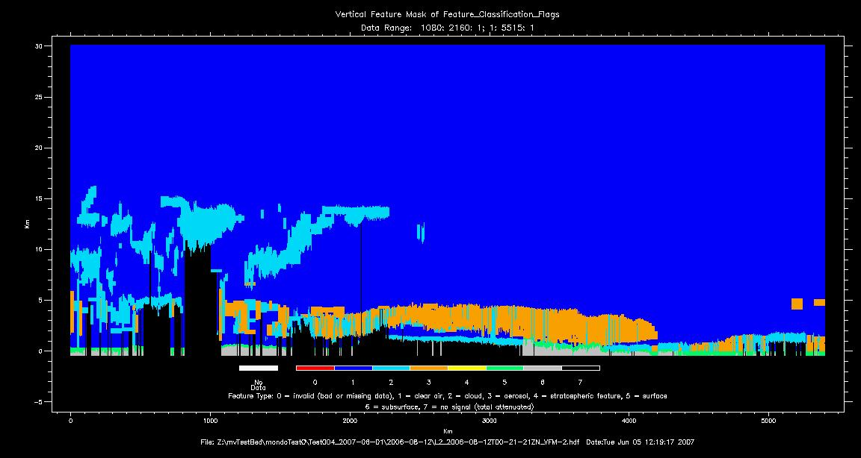
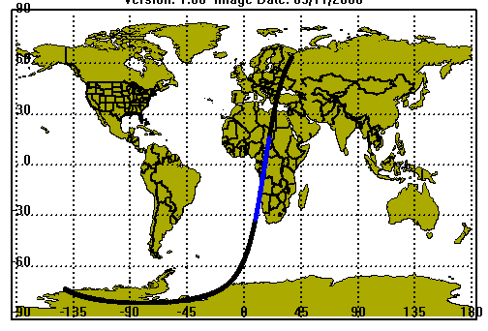
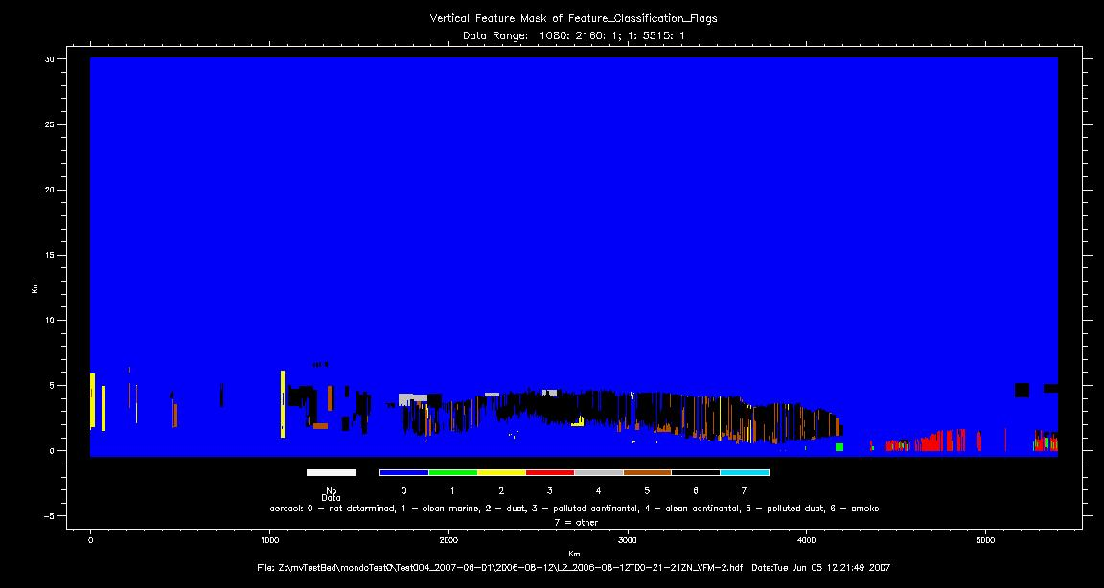
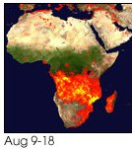
Aerosol Vertical Feature Mask
532 nm Backscatter
20060812
Cloud Aerosol Discrimination
15-
Aerosol Subtypes
10-
Smoke
5-
Polluted Continental
0-
Marine
Dust
Polluted
Continental
Clean
Continental
Polluted
Dust
Smoke

Slide 8
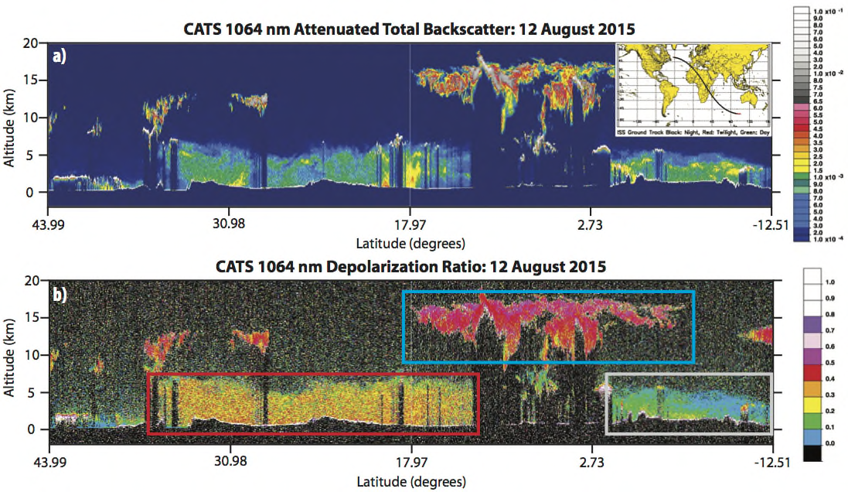
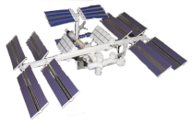
Cloud-Aerosol Transport System (CATS)
CATS Level 1 Data Products
Backscatter: 532, 1064 nm
Depolarization: 1064 nm
L2 Products: 1064 nm
Laser 2 Operation:
Cirrus
Dust
415 km
Smoke
15 m diameter
The CATS lidar operated semi-continuously on the International Space Station 2015-17 demonstrating the feasibility of affordable lidar on the ISS
Courtesy of John Yorks, Matt McGill and the CATS team

Slide 9
Lidar Observations of Dust
Observations suggest a doubling of dust over much of the globe during the 20th century (Mahowald et al., 2010)
Contributes to the aerosol direct and indirect radiative forcing
Affects African Easterly Waves and the development of tropical storms
Dust-radiation interactions are known to enhance convective strength
Dust emission rates have increased in North Africa since 1950’s (Mukhopadhyay and Kreycik, 2008)
Dust is a source of nutrients for both phytoplankton (Fe) and the Amazon basin (P) [Yu et al.]
CALIPSO’s measurements of dust properties are robust, and the length of the record is significant both seasonally and inter-annually
Measurements useful for assimilation (into) and validation of dust transport models

Slide 10
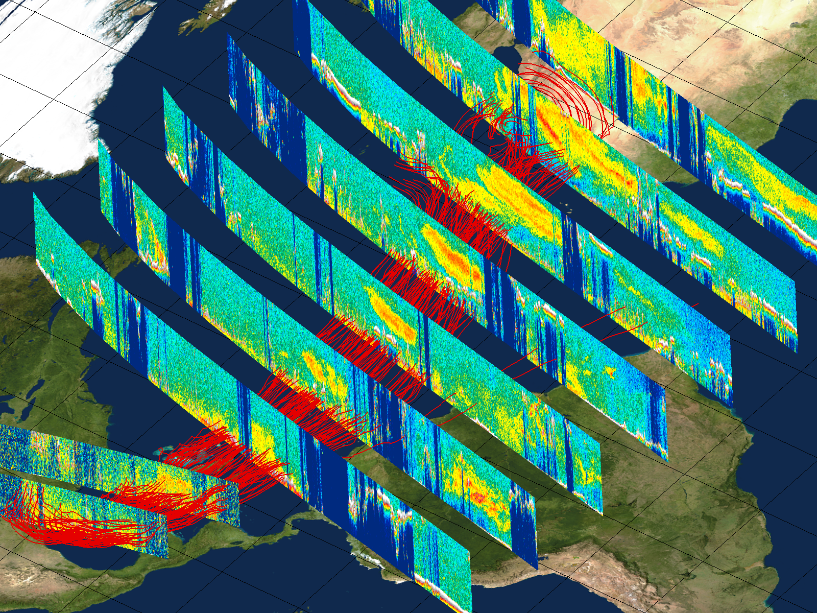
Example of Applications: dust transport
Aug 17
Aug 18
Aug 19
Aug 20
Aug 21
Aug 25
Aug 22
5 km
Aug 28
3 km
Aug 23

Slide 11
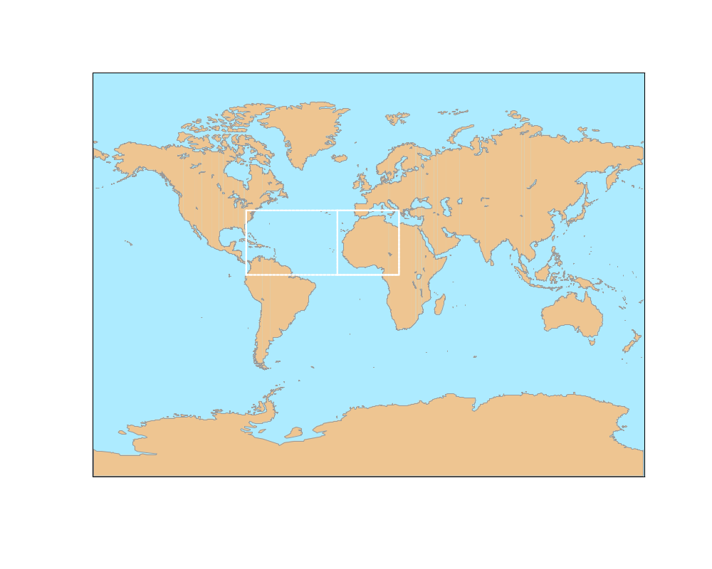
Study Domains: Source and
Transport Regions
source (Lat 0º to 40º Lon -20º to 20º)
transport region (Lat 0º to 40º Lon -80º to -20º)
Transport Region
Source Region
Notes:
CALIPSO Region of Study – Transport Region Lat 0, 40 Lon -80, -20; Source Region Lat 0, 40 Lon -20, 20

Slide 12
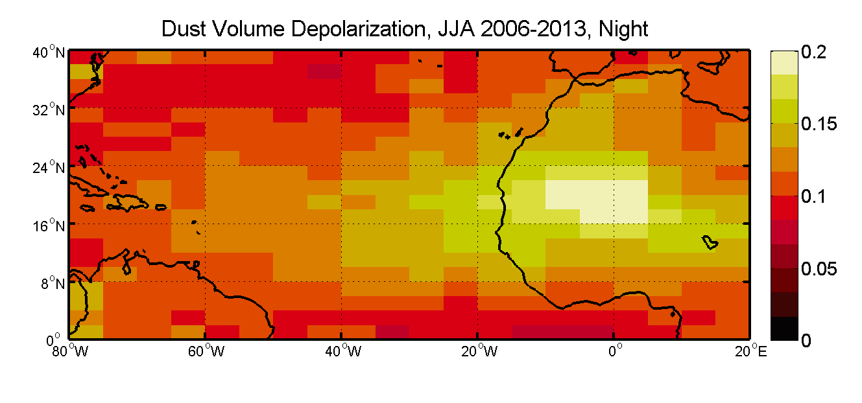
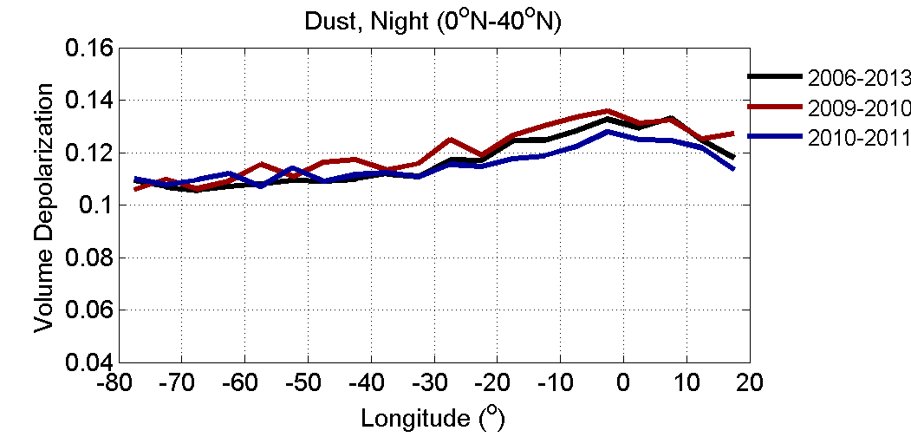
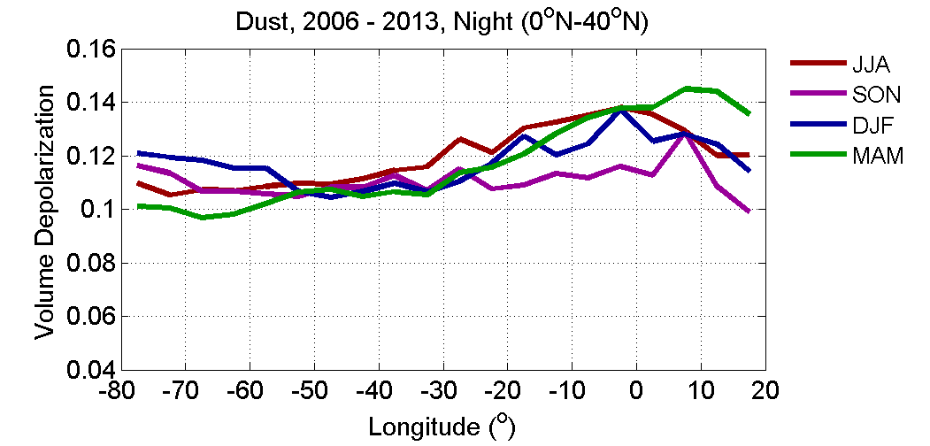
Changes in pure dust particle shape
The dust volume depolarization ratio is fairly uniform throughout the source and transport regions
VDR is varies between 0.14 to 0.11 from the source to the transport regions
80
Dust 2006-2013
2006-2013
Jun-Jul-Aug
Sep-Oct-Nov
2009-2010
2010-2011
Dec-Jan-Feb
Jun-Jul-Aug
20

Slide 13
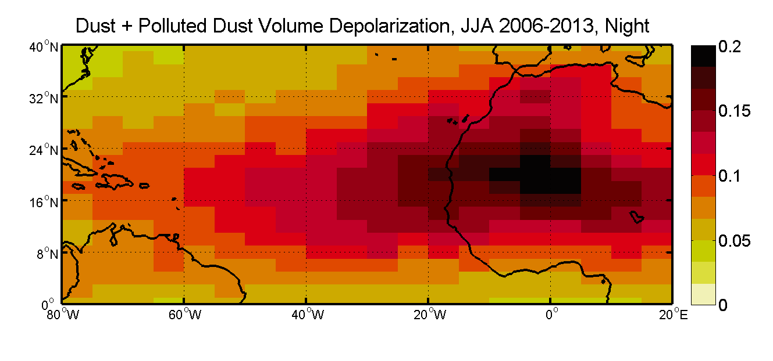
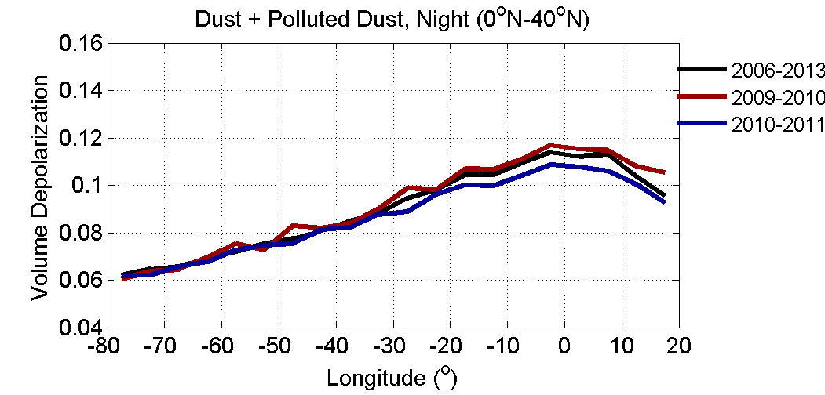
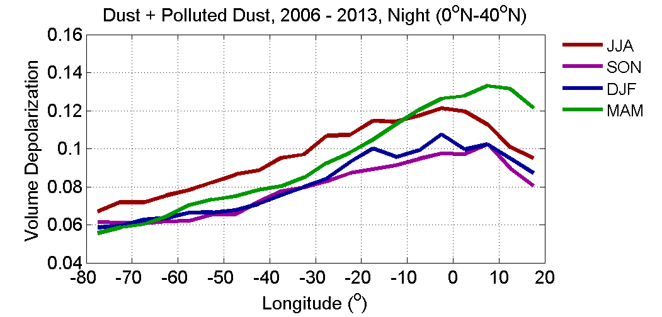
Changes in mixed dust particle shape
Off the coast the VDR decreases linearly with distance away from the source
VDR is varies between 0.12 to 0.06 from the source to the transport regions
2006-2013
Jun-Jul-Aug
Dec-Jan-Feb
Sep-Oct-Nov
Jun-Jul-Aug
2006-2013
2009-2010
2010-2011
20
Notes:
While pure dust is relatively stable, dust mixtures change shape – become more spherical with transport

Slide 14
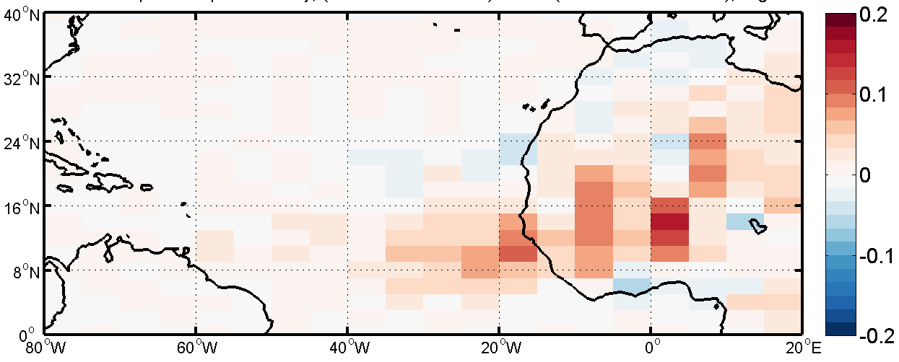

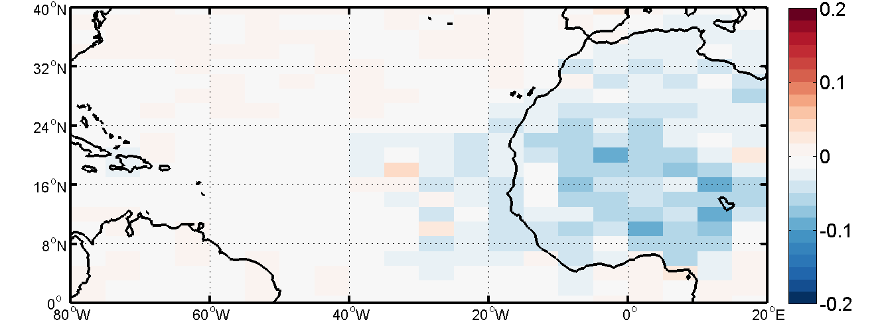
Dust AOD Anomalies 2009 and 2010
Dust AOD Anomaly =
[Dec2009 to Nov2010] - [Dec2006 to Nov2013]
2009-2010
More dust than the
mean
Dust AOD Anomaly=
[Dec2009 to Nov2010] - [Dec2006 to Nov2013]
2010-2011
Less dust than the
mean

Slide 15
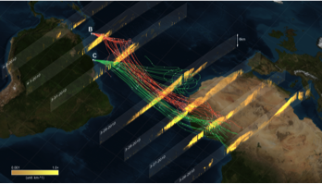
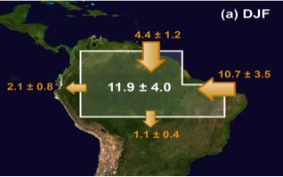
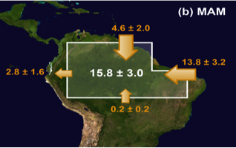
Saharan Dust Transport to the Amazon Rainforest
CALIPSO lidar reveals the 3-D characteristics of dust transport across Atlantic Ocean.
2007-2013 CALIPSO data were to estimate dust import into and export from Amazon Basin.
27.7 million tons of dust is deposited in the Amazon rainforest annually.
The Saharan dust feeds the Amazon rainforest with an estimated 22,000 tons of phosphorus, replenishing the leak of this plant-essential nutrient by rains and flooding.

Slide 16
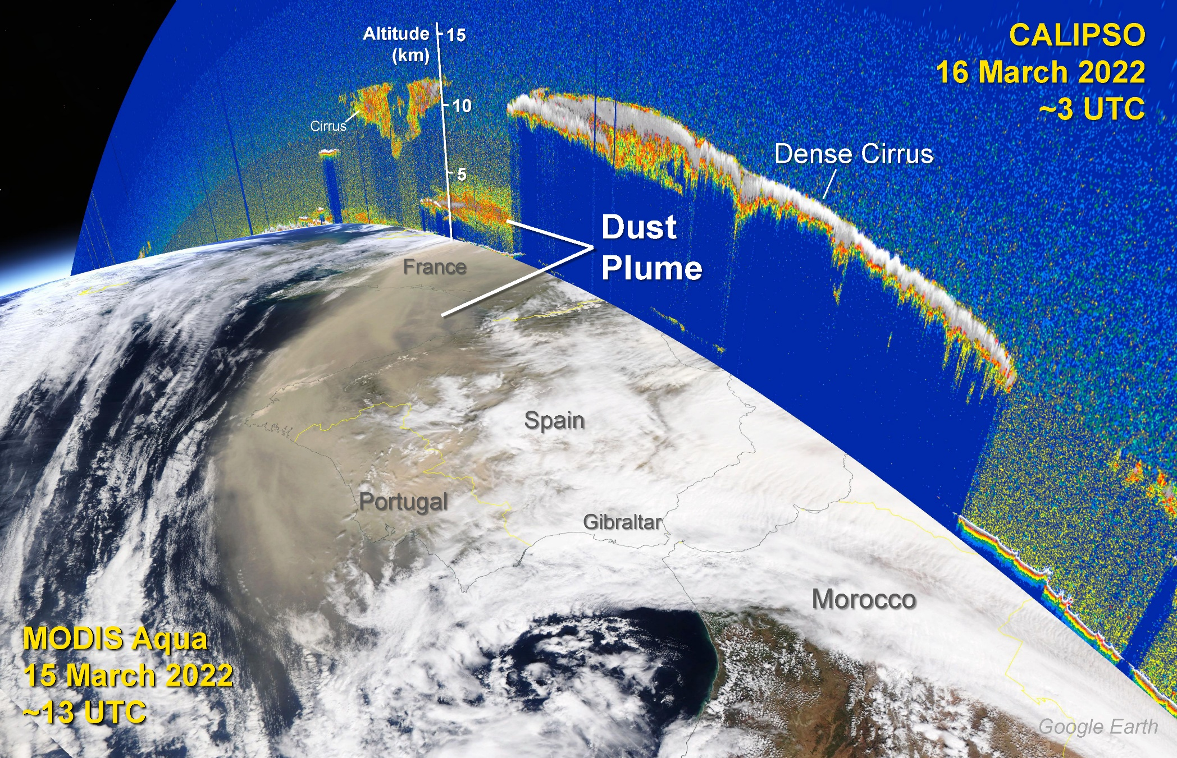
Lidar Observation of Saharan Dust in Europe

Slide 17
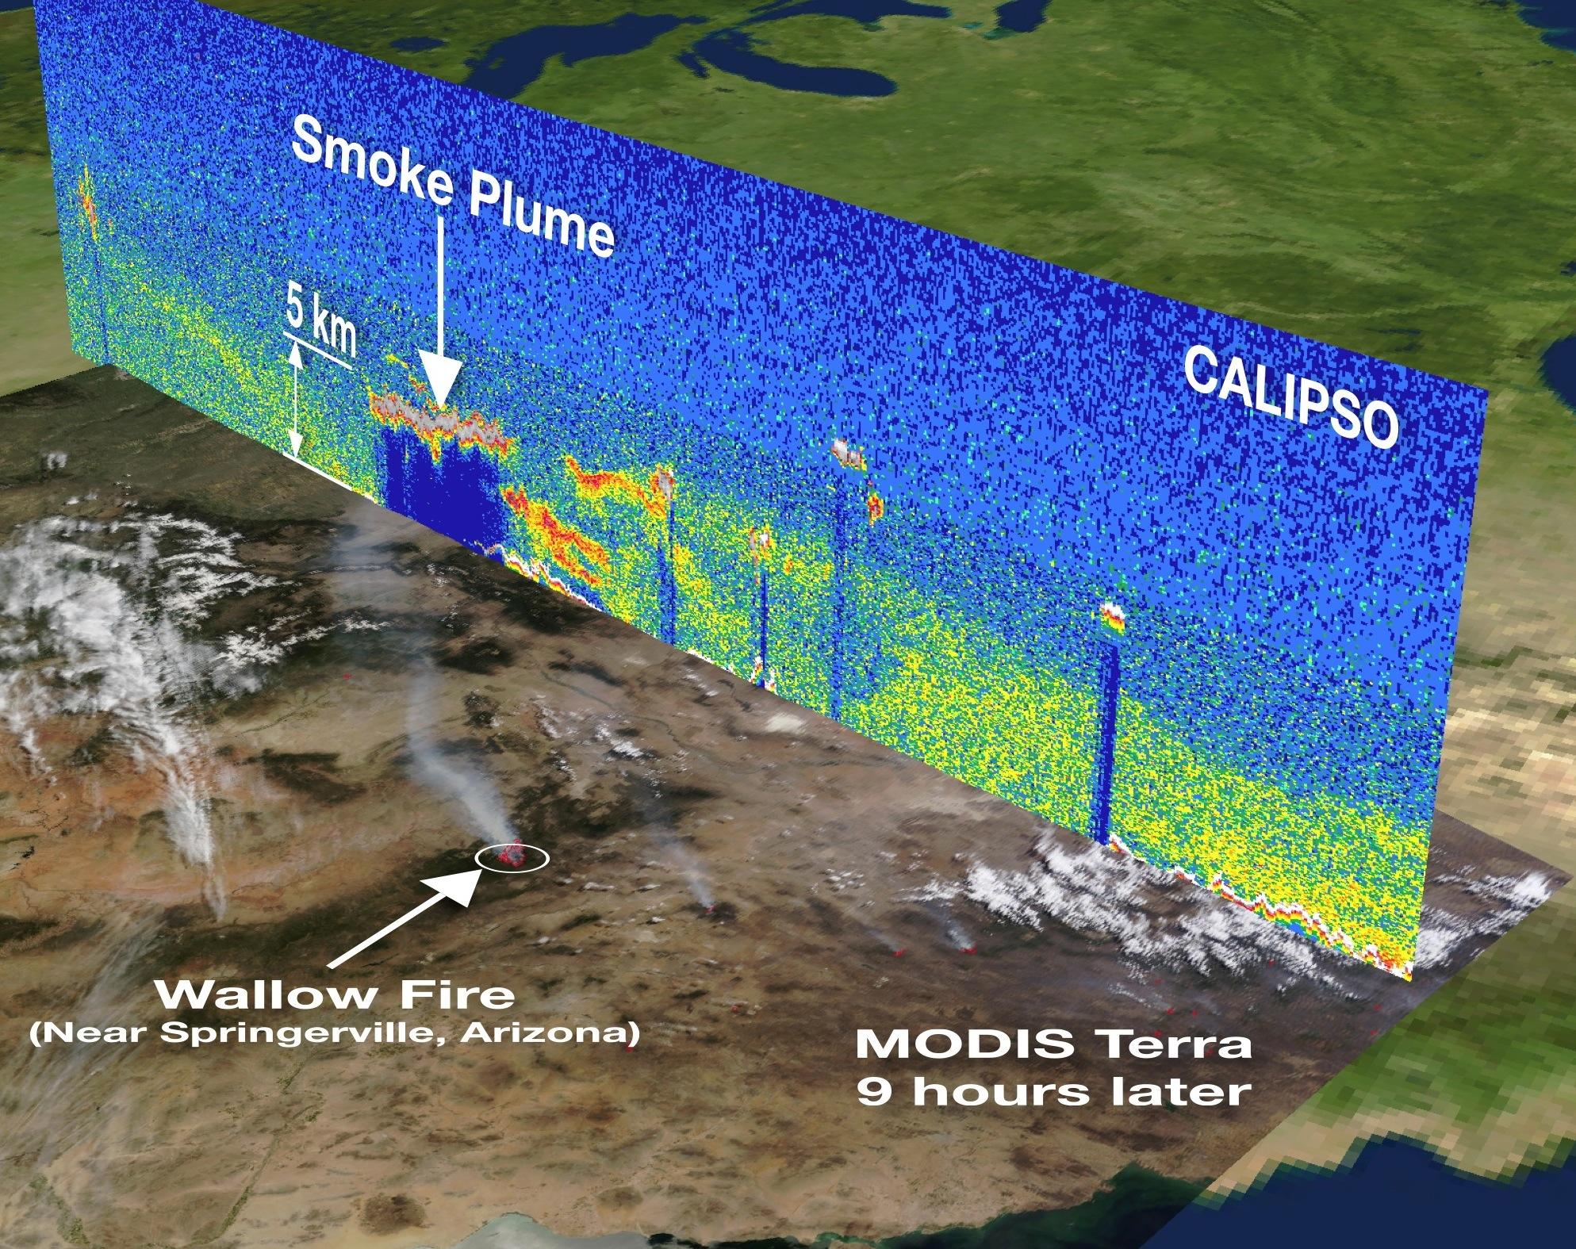
Lidar Observation of Fresh Smoke

Slide 18
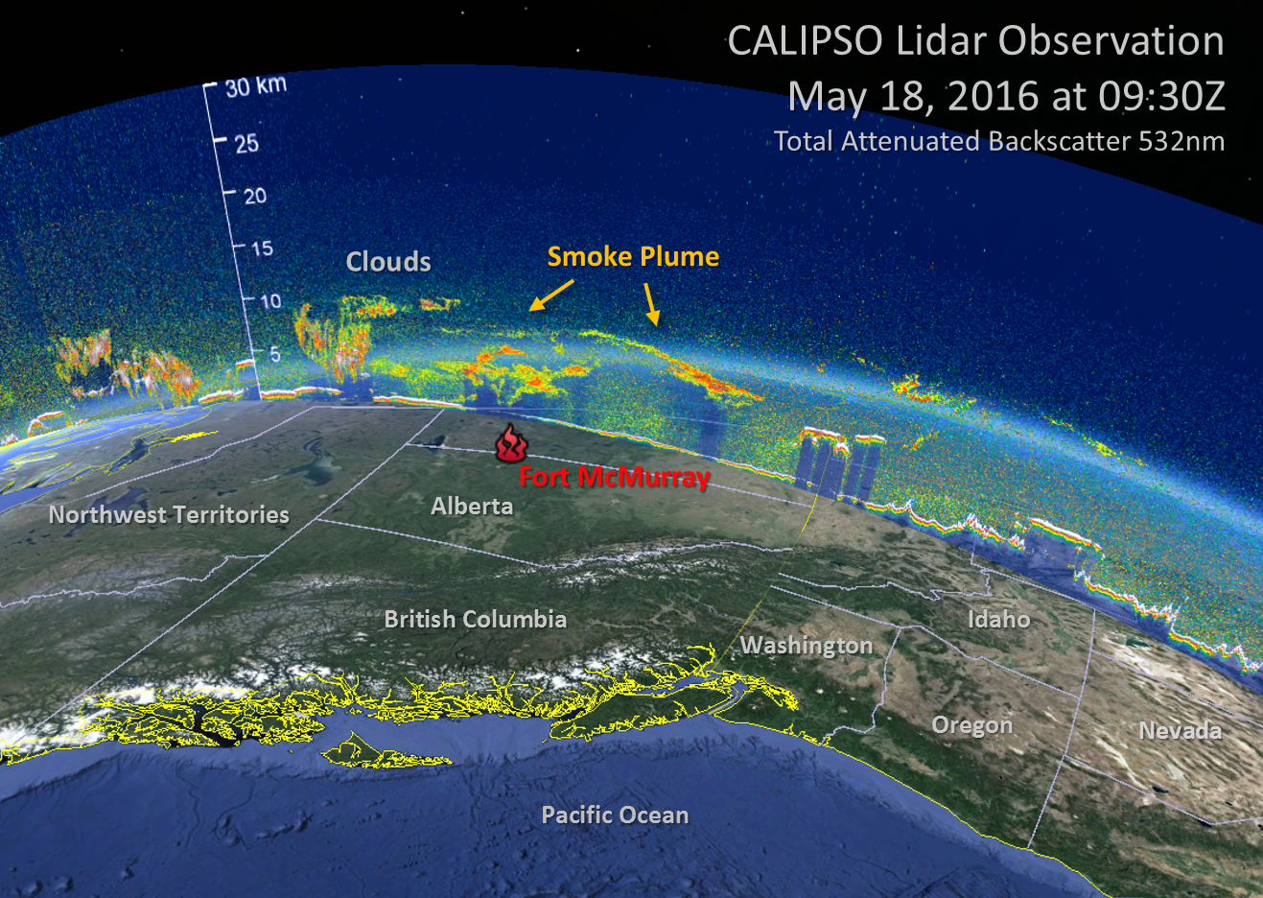
Lidar Observation of Aged Smoke

Slide 19
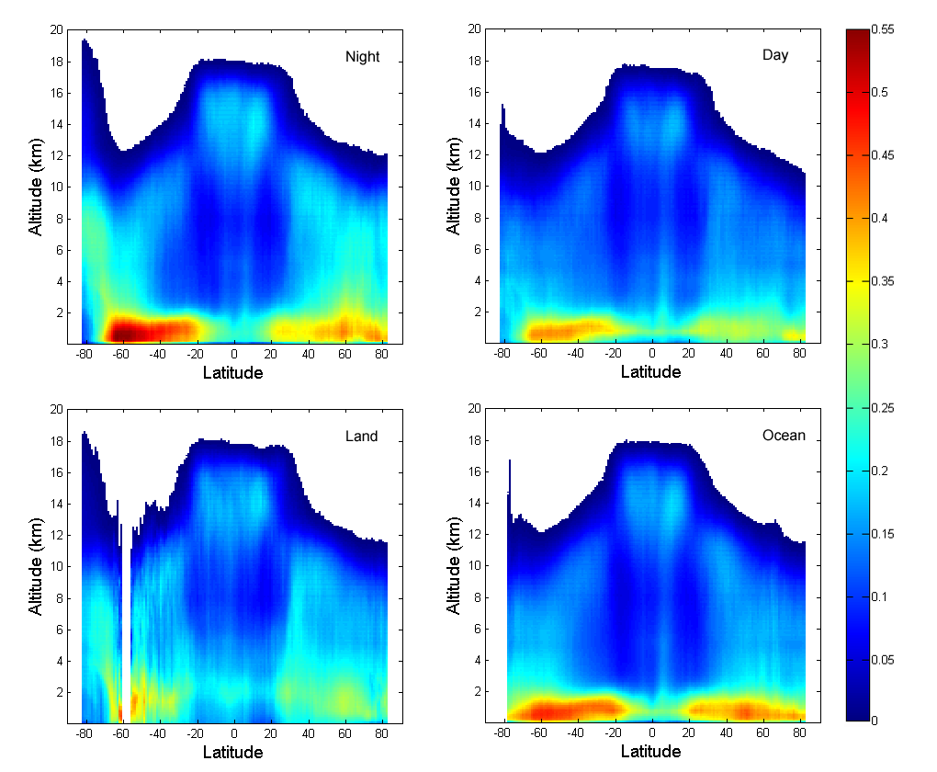
Vertical distribution of cloud fraction

Slide 20
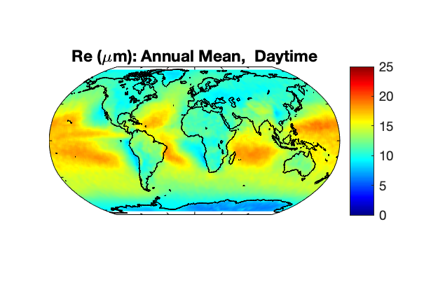
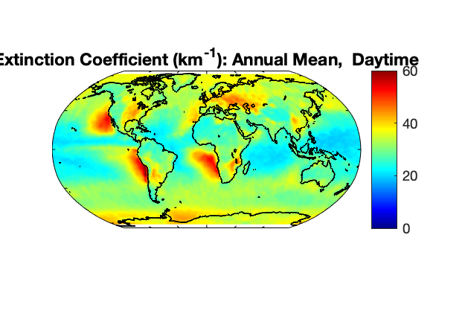
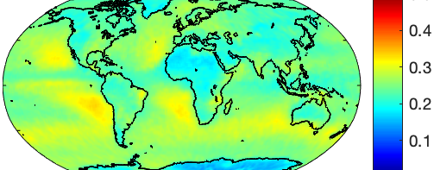
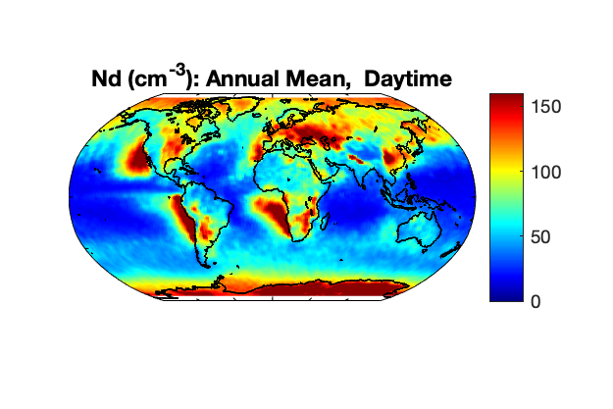
Cloud Microphysical Properties retrieved from CALIPSO
Droplet Radius
Extinction Coefficients
Cloud Water Content
Droplet Number Concentration

Slide 21
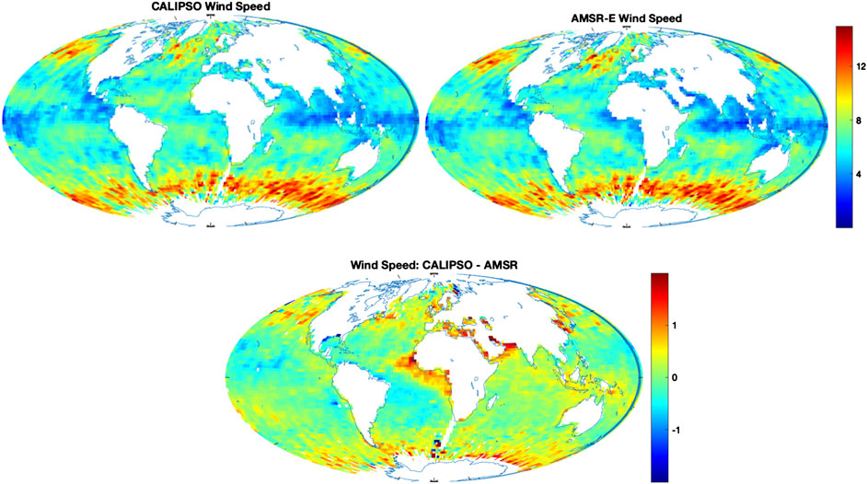
Ocean Surface Wind Speed: Relation between Sea Surface Lidar Backscatter γ and Mean Square Wave Slope
Surface Backscatter γ =
laser power * atmospheric attenuation * sea surface Fresnel reflectivity

Slide 22
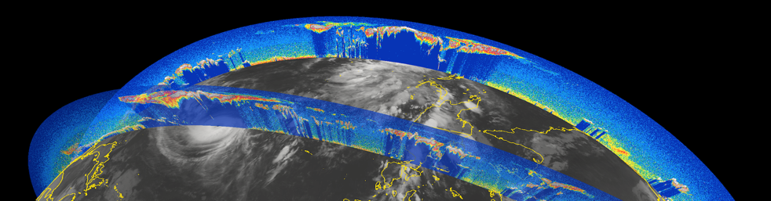
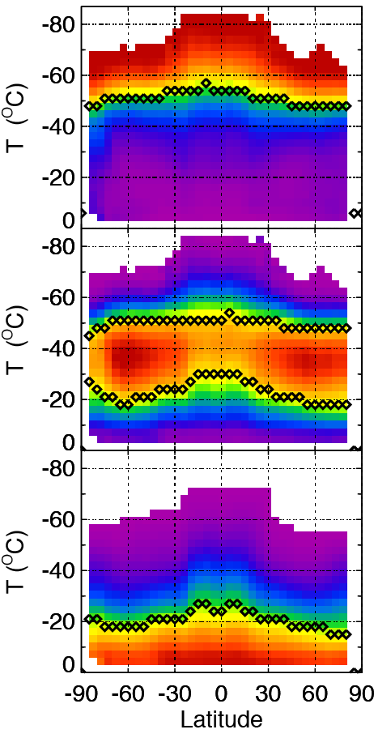
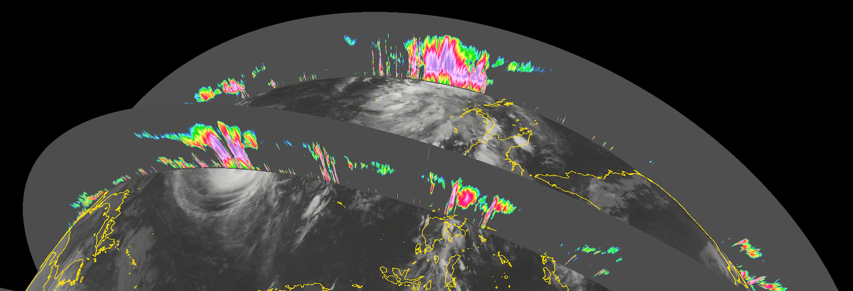
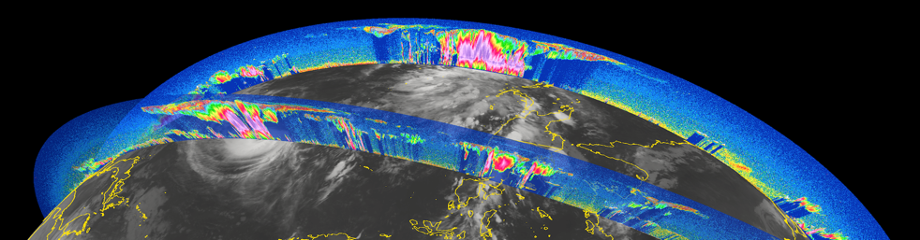
Complementarity of Lidar and Cloud Profiling Radar
Probability of cloud detection as a function of temperature
CALIPSO Lidar only
lidar-only
CloudSat Radar only
(95 GHz/W-band)
lidar+radar
CALIPSO and CloudSat
radar-only
Heymsfeld et al., 2014

Slide 23
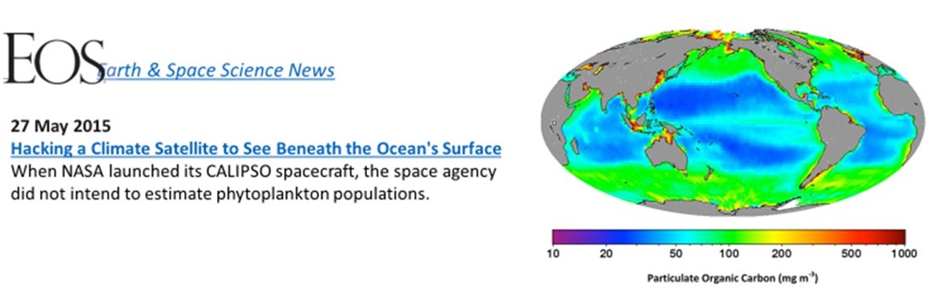
Ocean carbon biomass: what’s new from space-based lidar measurements
Vertical profiling capability: altitude resolved signal that is proportional to the backscatter cross-section.
Cross polarization ocean signals are primarily a result of particulate backscatter / diffuse attenuation
Can make these measurements both day and night
Challenge: separating aerosols, ocean surface reflection and ocean particulate backscatter
Behrenfeld et al. (2013); Lu et al. (2014)

Slide 24
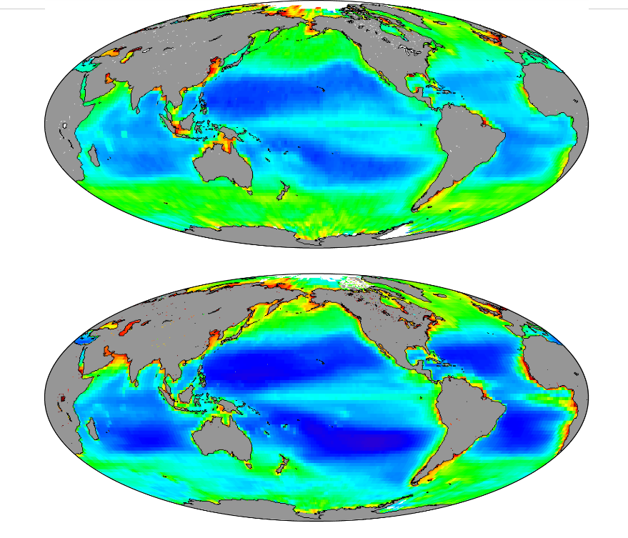
Novel Application : Lidar Ocean Measurements
CALIPSO
Particulate Organic Carbon (POC) retrieved from CALIOP spaceborne lidar compared favorably to the MODIS product
CALIOP retrievals pioneered by Yongxiang Hu
CALIOP retrievals are vertically-integrated (i.e., not vertically-resolved) due to coarse vertical resolution
MODIS
From Behrenfeld et al., 2013, Space-based lidar measurements of global ocean carbon stocks, GRL.
Also see Behrenfeld et al., 2016, Annual boom-bust cycles of polar phytoplankton biomass revealed by space-based lidar, Nat. Geosci.
Particulate Organic Carbon (mg m⁻³)
Data in each panel are climatological annual averages for the 2006 to 2012 period. Data are binned to 2° latitude by 2° longitude pixels.

Slide 25
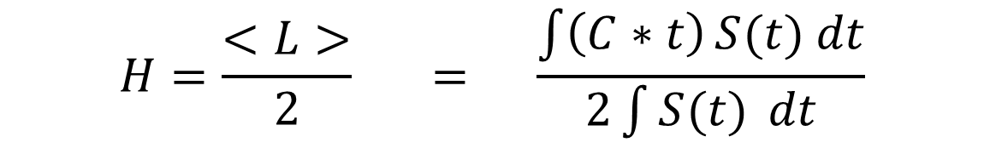
Novel Application : Lidar Snow Depth Measurements
Deriving Snow Depth H from Lidar Measurements of Average Distance <L> of Photons Traveling Inside Snow
$$H=\frac{<L>}{2} = \frac{\int{\left(C∗t\right)}S(t) dt}{2\int{S(t)} dt}$$
C: speed of light;
t: time laser light stayed inside snow;
S(t): snow backscatter signals (arbitrary unit) measured by lidar
Y. Hu, et al, Deriving Snow Depth From ICESat-2 Lidar Multiple Scattering Measurements. Frontiers in Remote Sensing, 3. https://doi.org/10.3389/frsen.2022.855159
X. Lu, et al, Deriving Snow Depth From ICESat-2 Lidar Multiple Scattering Measurements: Uncertainty Analyses. Frontiers in Remote Sensing, 3. https://doi.org/10.3389/frsen.2022.891481

Slide 26
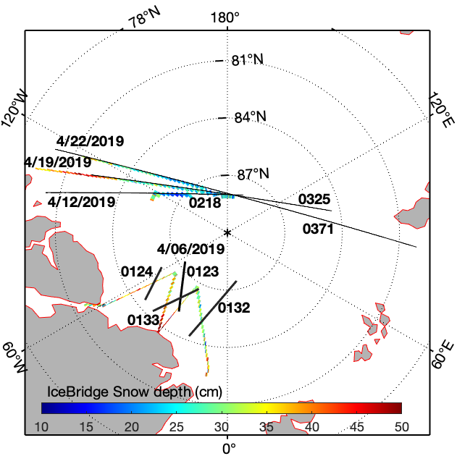
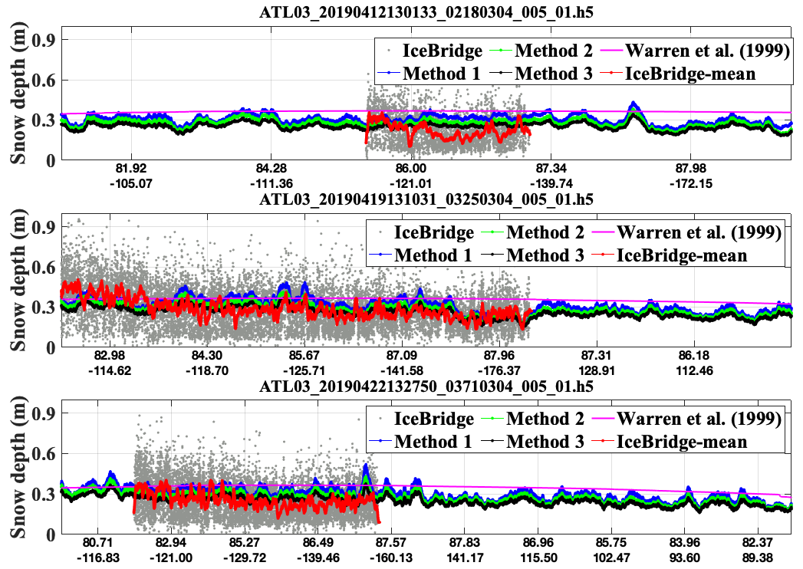
Evaluate the snow depth measurement concept: ICESat-2 <L>/2 vs IceBridge airborne snow product
Comparison of snow depth from three different sources: ICESat-2 snow depths (blue, green and black) from central strong beam, IceBridge snow depth (gray points, red curve), and climatology snow depth (pink) by Warren et al., (1999).

Slide 27




Novel Retrieval: Opaque Water Cloud Constrained Extinction
WC = above Water Cloud
SS = Single Scattering
NA = No Aerosol
δ_{I}= layer integrated depolarization ratio
S_{WC} ≅ 18.9 sr ± 0.25 sr (Hu et al. 2006)
Liu et al. 2014 ACP)

Slide 28

Melting pond over sea ice
Pond width
~81.8m
~2.14m melting pond depth
June 22, 2019
Melt pond characteristics in the Arctic of such as width, and depth retrieved from ICESat-2 data

Slide 29


Lidar / Passive Sensing Synergy: Training Passive Sensors
Cloud top pressure from POLDER: before training

Slide 30


Lidar / Passive Sensing Synergy: Training Passive Sensors
Cloud top pressure and cloud top height from POLDER: after training from lidar

Slide 31



April Wheat plants: 0.8~1.2m
ICESat-2 overflight of an irrigation project in Egypt (2019)
ICESat-2 six beams/ ground tracks
ICESat-2 Crops study
~0.8~1.2m
0.815 km
0.65 km
harvested
Wheat plants 0.6-1.2 m

Slide 32



Corn plants
ICESat-2 overflight of an irrigation project in Egypt (2020)
ICESat-2 Crops study
ICESat-2 six beams/ ground tracks
October Corn plants: 1.8-2.5 m
~1.8m-2.5m
0.514 km
0.67km
harvested

Slide 33



Complementarity of ICESat-2 & CALIOP bathymetry
CALIOP depolarization ratio
ICESat-2 Photon height
Seafloor
Seafloor
Reef edges

Slide 34

Retrieving atmospheric temperature profiles from backscatter lidar using LITE data
Motivation to retrieve temperatures from LITE data
Presence of very high cirrus clouds over the Tropics
Are the temperatures comparable to the polar temperatures and if so, are these clouds similar to PSCs
What are the implications for ozone chemistry and radiative transfer
Cirrus clouds surface area is suitable for the heterogeneous reactions of otherwise inert chlorine-containing compounds (e.g., HOCl, CIONO2, HCI) into reactive forms of chlorine (CIOy)

Slide 35


Data Analysis and Temperature Retrieval
1. Remove the aerosol effects from the molecular profile of backscatter
2. Derive temperature profiles directly from the molecular profile of backscatter
β_{m}(λ,z)=σ_{m}(λ)ρ(z) = 3.6 x 10⁻³¹ λ^{-4.0017} P(z)/T(z)
T(z) = 3.6 x 10⁻³¹ λ^{-4.0017} P(z)/(β_{m}(λ,z))

Slide 36




Temperature Retrievals – Results from LITE
Scattering Ratios
Temperatures (K)
Latitude
Method requires at least two wavelengths sensitive to molecules and aerosol particles
30
-30
. ' .
I I
I o O
o
I
..................................
' .
'
I I
,
o
' .
'
'
'
' ""' 0
'
'
I
'

Slide 37

Temperature Retrievals from Lidar Backscatter data - Omar & Gardner (2001)
Omar, Ali H and C. S. Gardner (2001) Observations by the Lidar In-Space Technology Experiment
(LITE) of high-altitude cirrus clouds over the equator in regions exhibiting extremely cold temperatures, J. Geophys. Res.

Slide 38
Summary
LITE successfully demonstrated the utility and feasibility of space lidar in 1994 and ushered in the successful era of NASA atmospheric lidars – CALIPSO, CATS,
CALIPSO and CATS have initiated a new era in Earth remote sensing with key profile observations of clouds and aerosols.
Discoveries enabled through these observations are revealing linkages between clouds and circulation and advancing our knowledge on cloud-aerosol interactions
CALIPSO subsurface ocean measurements has ushered in a new era of ocean lidar observations hitherto unavailable to the ocean sciences
ICESat 2 has demonstrated a number of innovative key terrestrial applications not the least of which are snow depth estimates, ice melt ponds, agricultural crop heights
Building upon great strides made with CALIPSO, NASA is pursuing a new International Earth System Observatory – AOS with additional lidar capabilities
Advances in the last five years in HSRL and DIAL systems for aerosol absorption and trace gas measurements (O₃, H₂0, CH₄) suggest these are ready for space applications, enabling progress in climate studies and extending benefits to society

