Slide 1
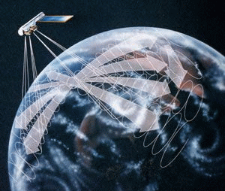

CERES Angular Distribution Model Working Group Report
Wenying Su
Wenying.Su-1@nasa.gov
NASA LaRC, Hampton VA
Zachary Eitzen Lusheng Liang Sergio Sejas
SSAI, Hampton VA

Slide 2
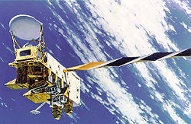
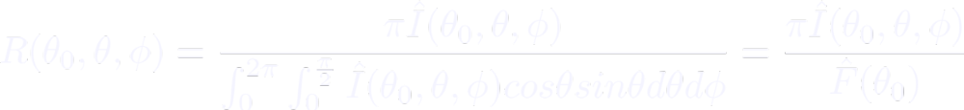

From radiance to flux: angular distribution models
Sort observed radiances into angular bins over different scene types;
Integrate radiance over all θ and ϕ to estimate the anisotropic factor for each scene type:
For each radiance measurement, first determine the scene type, then apply scene type dependent anisotropic factor to observed radiance to derive TOA flux:
θ
θ₀
ϕ
rotating azimuth plane

Slide 3
Outline
NPP SW ADMs and their impact on flux
Rearchitect the shortwave inversion code, with the focus on snow/ice scene identification
Merged LW surface emissivity datasets for Ed5

Slide 4
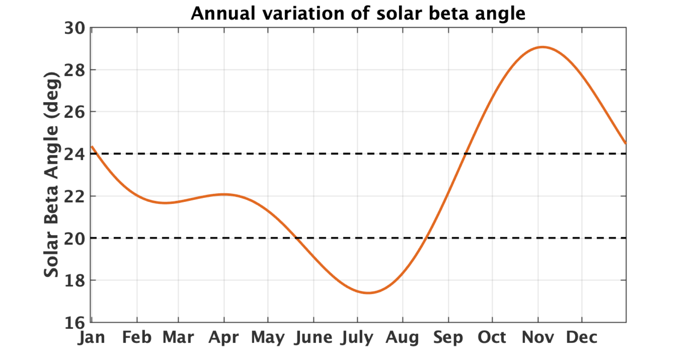
NPP ADMs
NPP FM5 started to collect RAPS data in fall of 2019.
CERES instrument on NPP is in restricted biaxial scan since March 24, 2020, to avoid viewing the spacecraft antenna, and to minimize the instrument degradation.
  For solar beta angle < 24°:
    Clock angle: 25°-169°, cone angle: 0°-64°
    Clock angle: 205°-349°, cone angle: 0°-64°
  For solar beta angle ≥ 24°
    Clock angle: 25°-180°, cone angle 0°-64°
    Clock angle: 205°-360°, cone angle 0°-64°

Slide 5
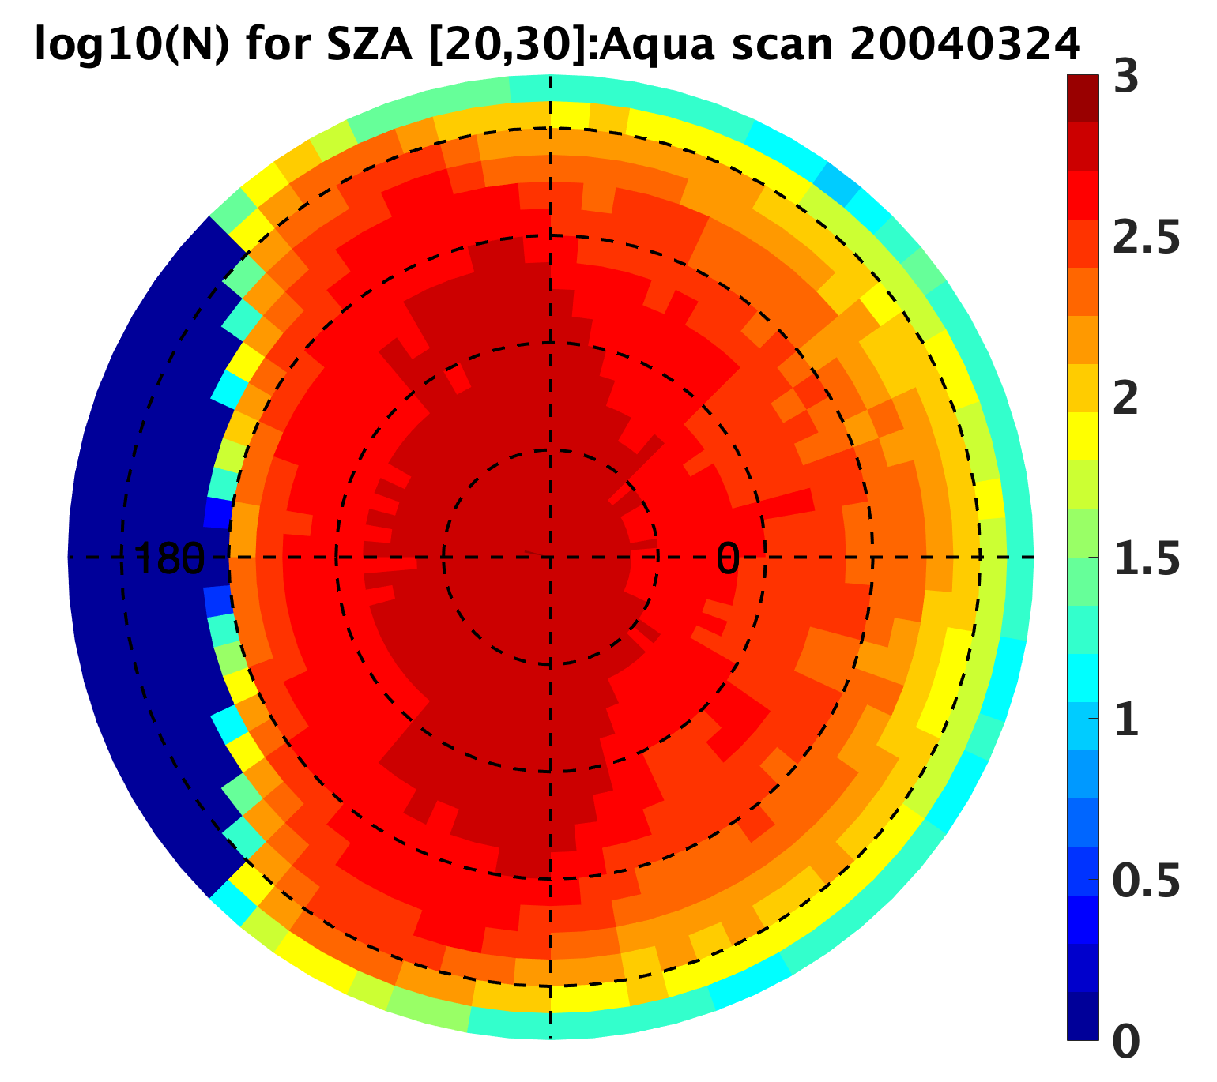
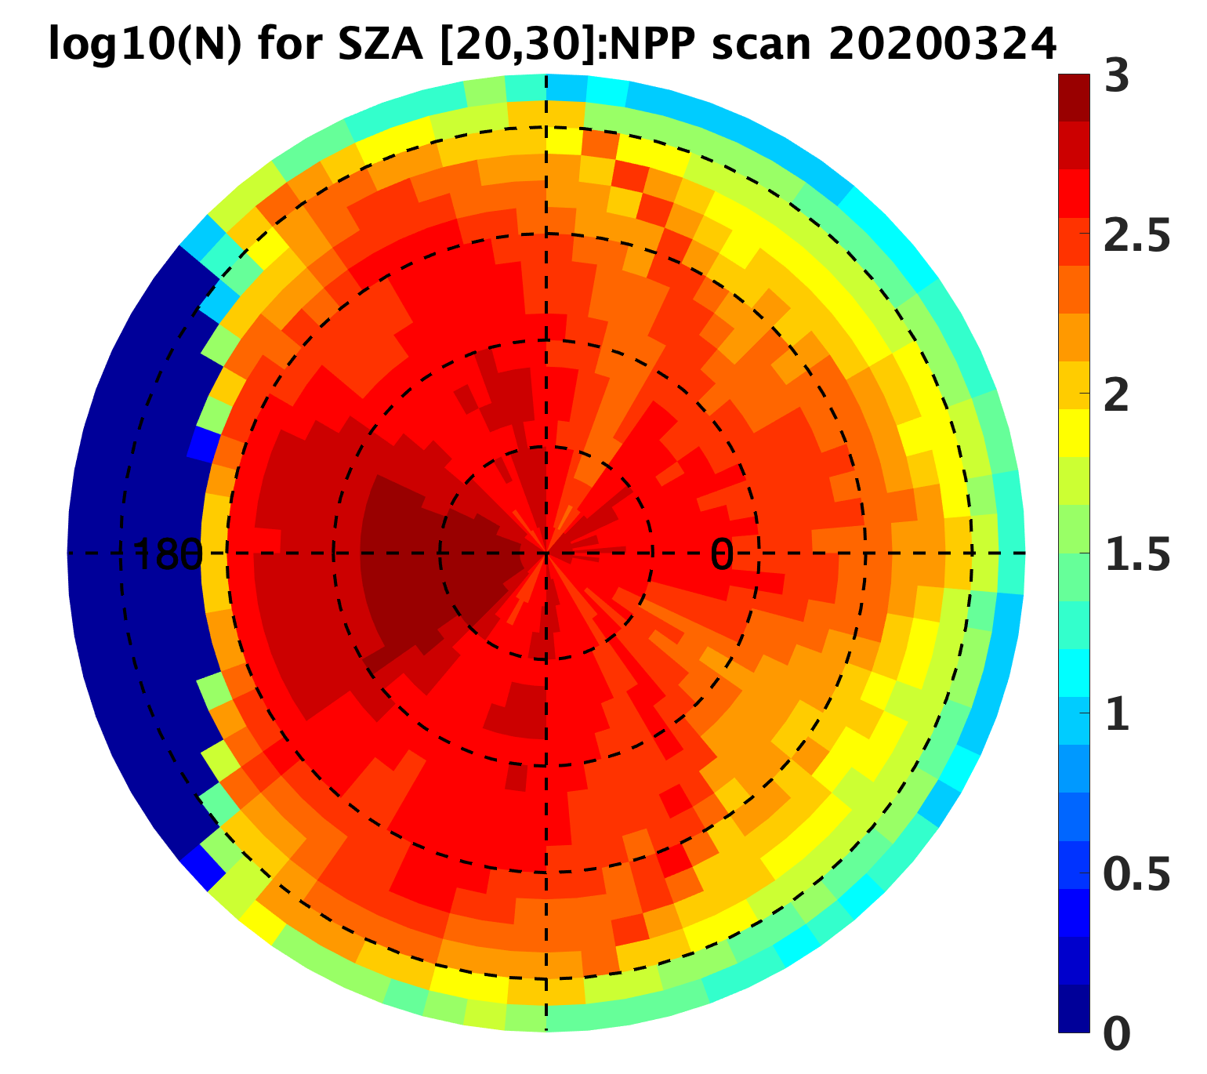
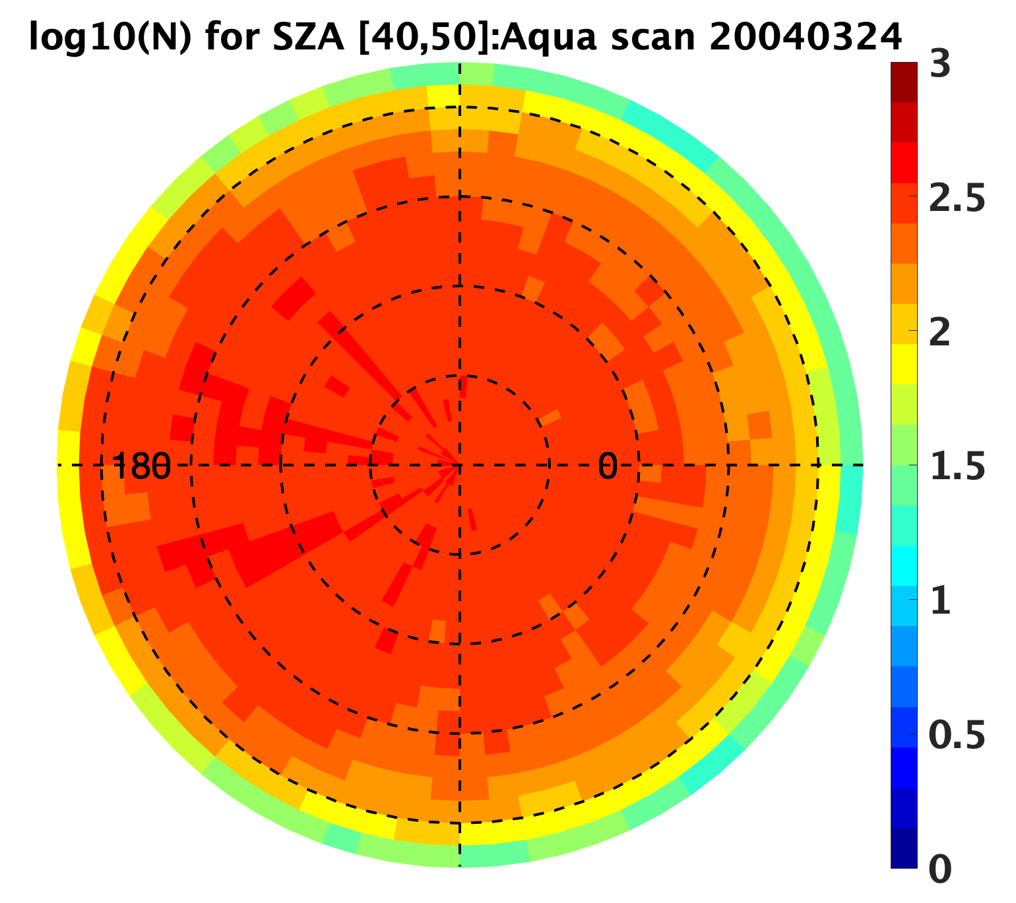
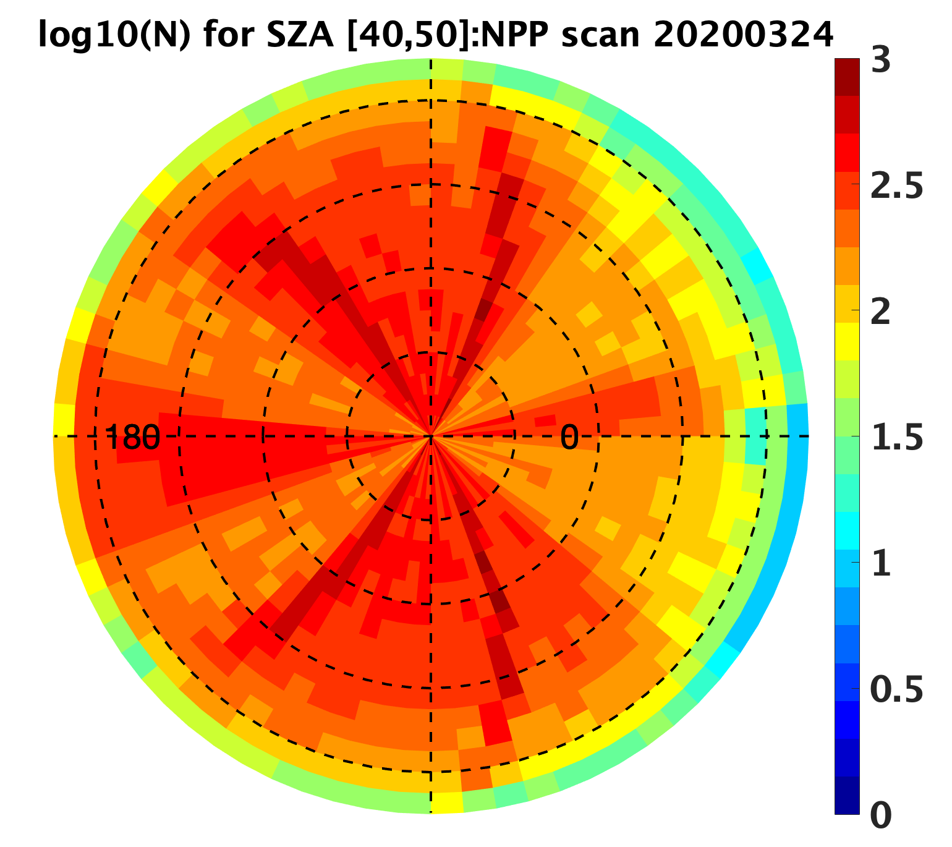
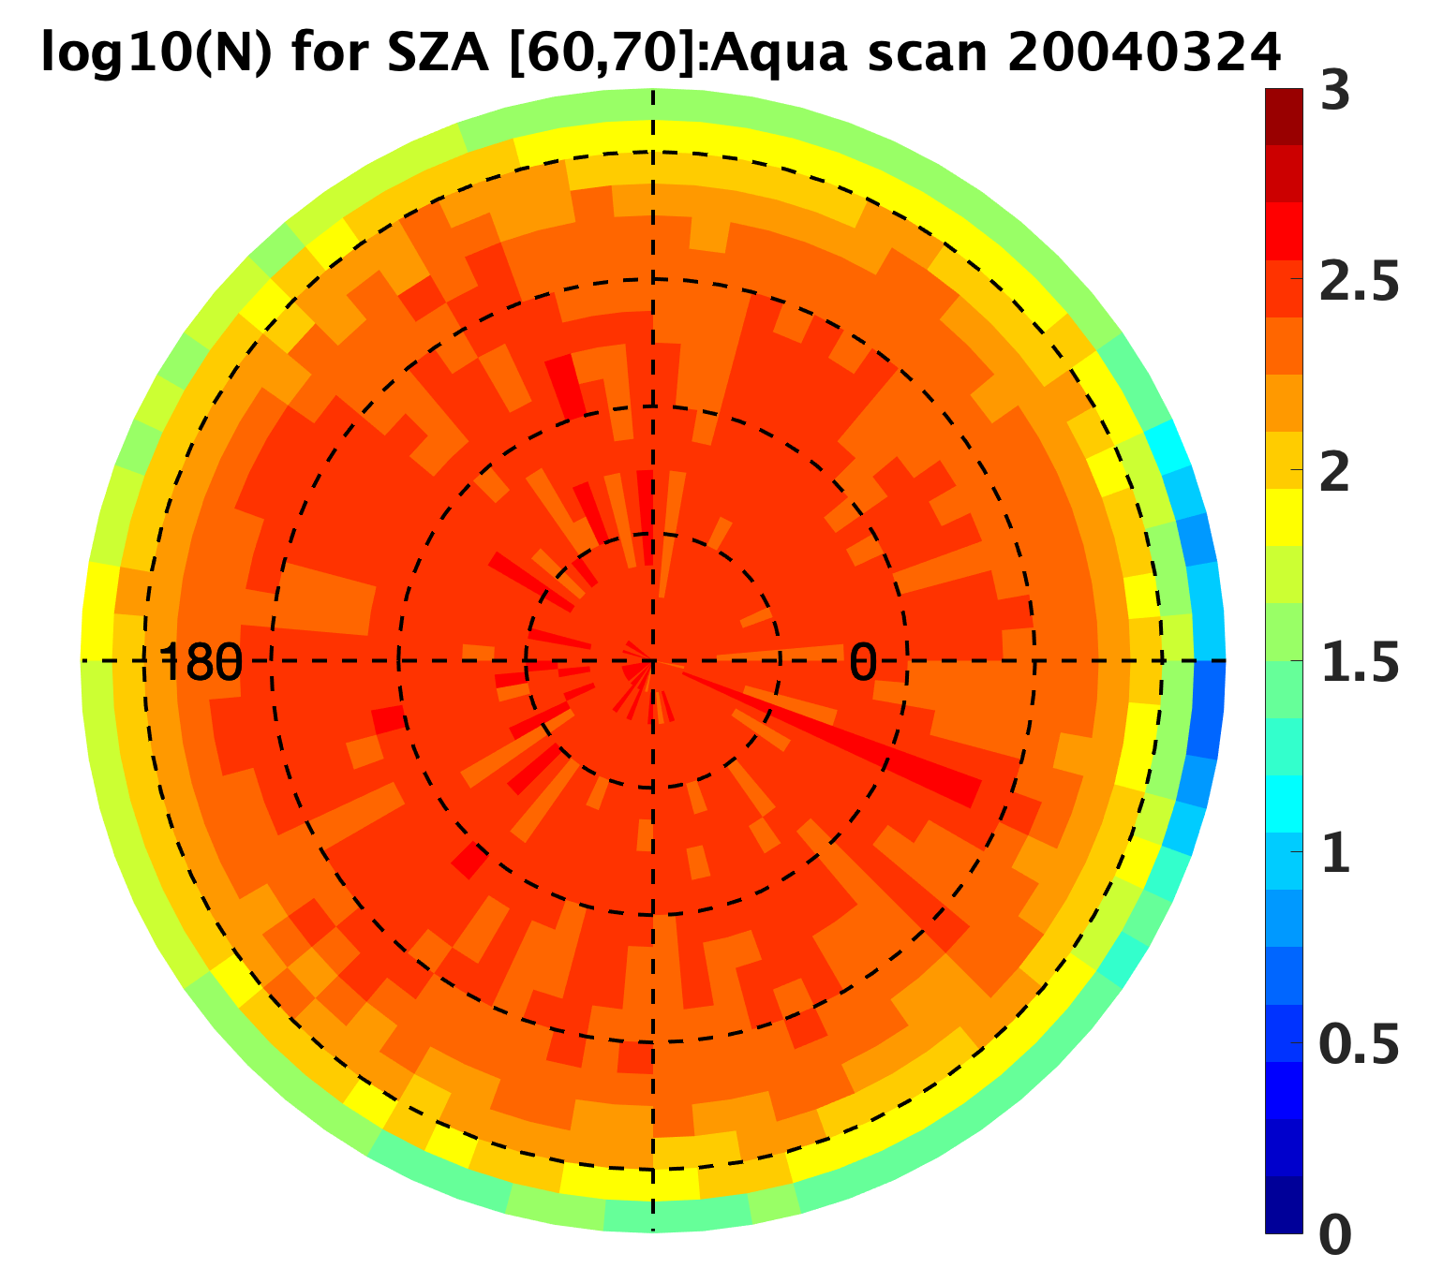
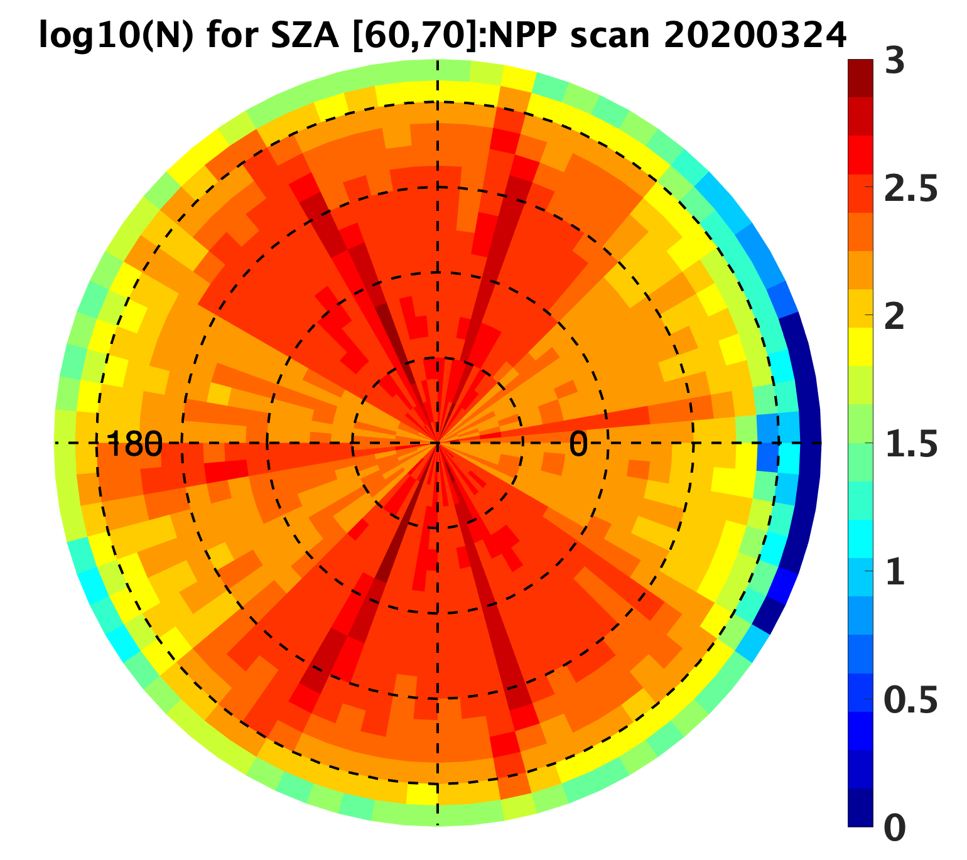
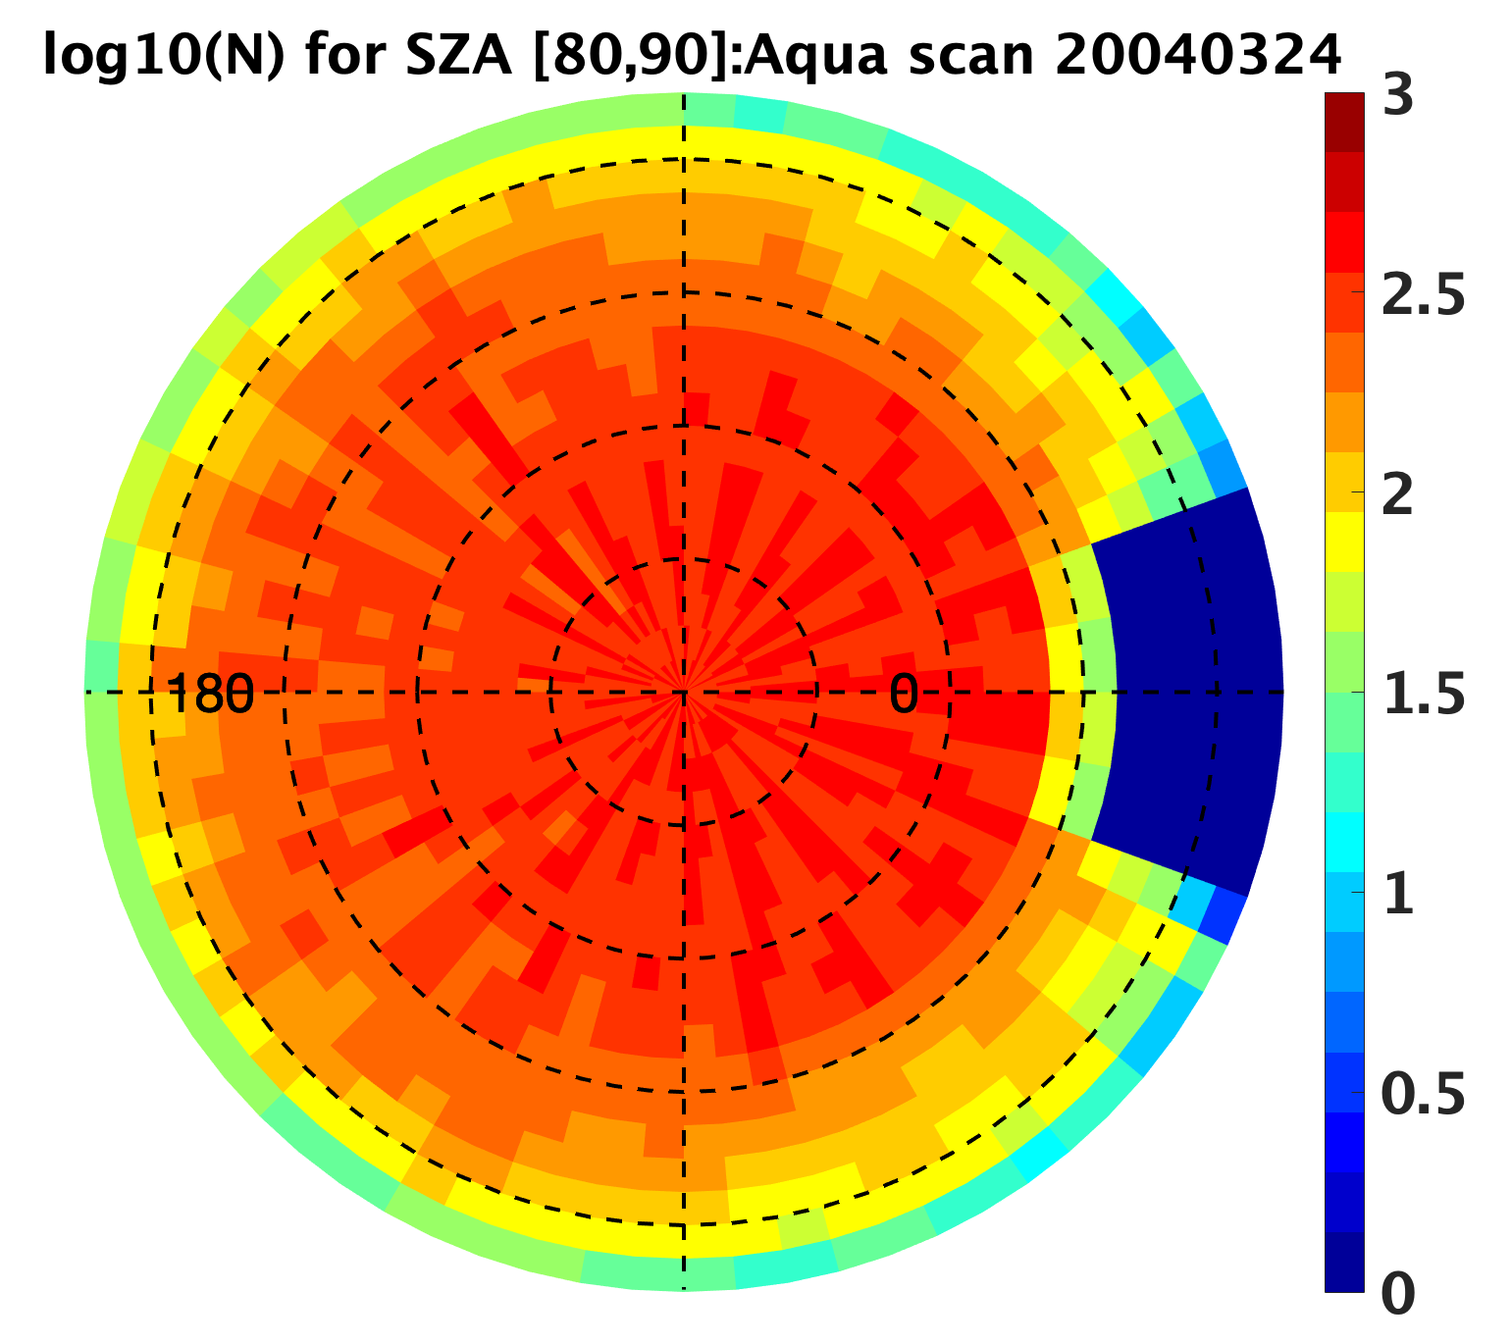
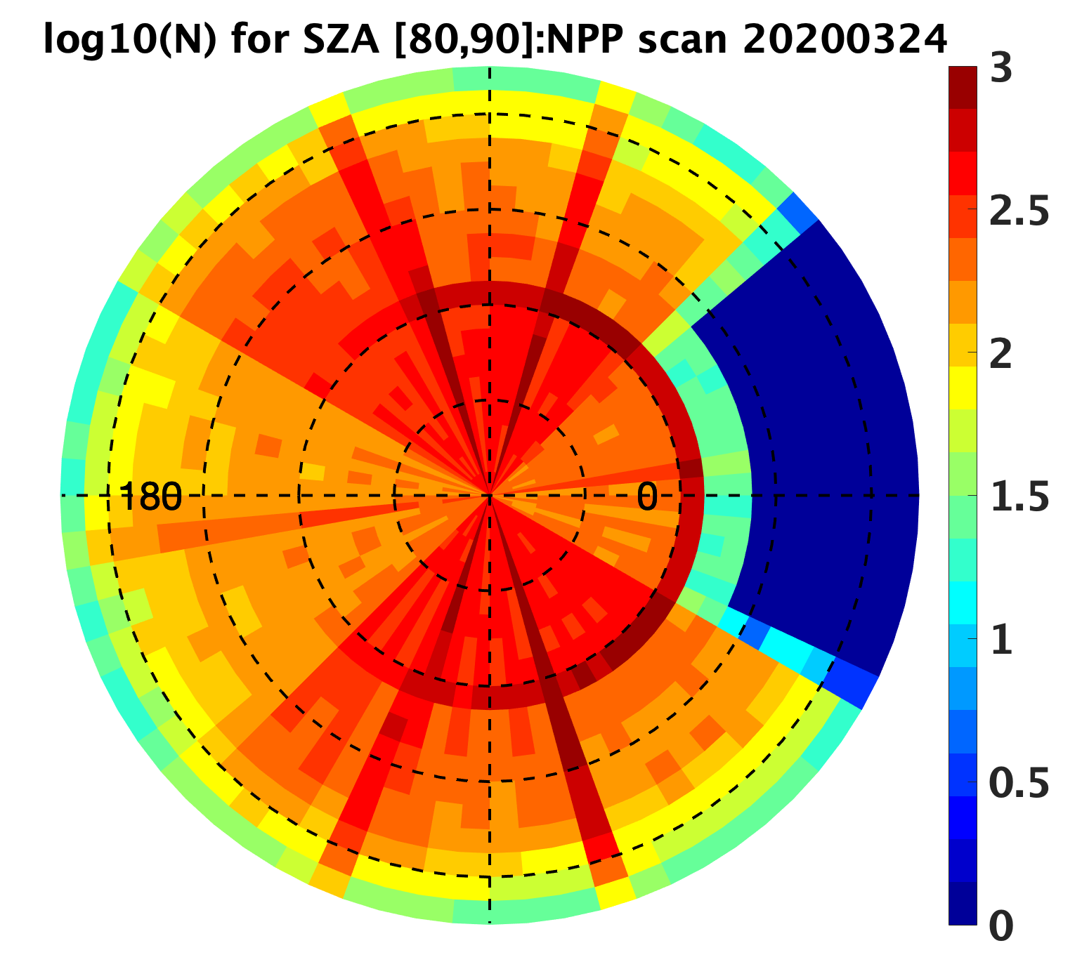
Sample number comparison between NPP (20200324) and Aqua (20040324)
Aqua scan SZA : [20,30] NPP scan SZA: [20,30]
Aqua scan SZA : [40,50] NPP scan SZA: [40,50]
Aqua scan SZA : [60,70] NPP scan SZA: [60,70]
Aqua scan SZA : [80,90] NPP scan SZA: [80,90]

Slide 6
Developing NPP SW ADMs
Using NPP FM5 Ed2A data from 201601-202207 to develop SW NPP ADMs using the Ed4 Terra/Aqua methodology.
NPP fluxes inverted using NPP ADMs are compared with fluxes in NPP Ed2A product that used Ed4 Aqua ADMs.
Differences are shown as NPP ADMs – Aqua ADMs. Positive means NPP flux will increase when reprocessing using NPP ADMs.

Slide 7
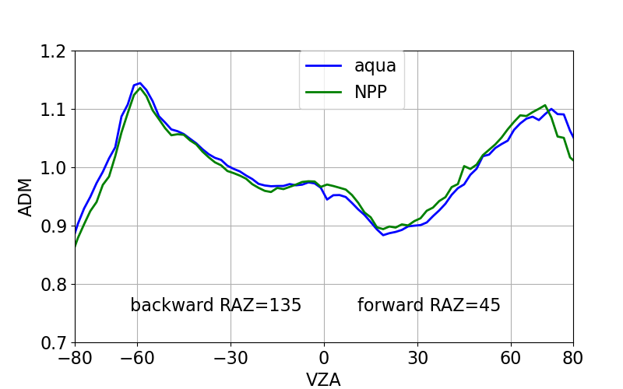
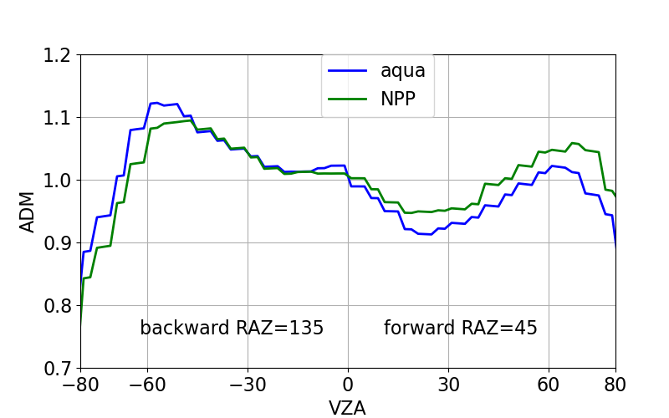
Differences in SW Anisotropic Factors Between NPP and Aqua
SZA=40°
Overcast with cloud optical depth of 10
Ocean land

Slide 8
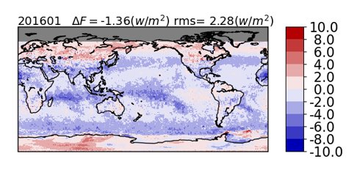
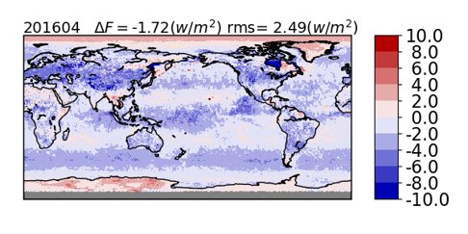
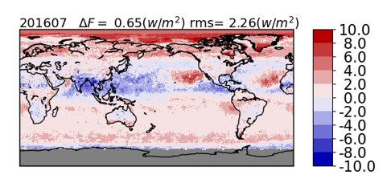
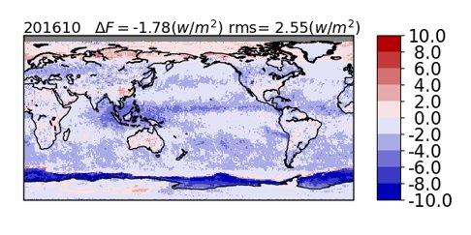
Instantaneous NPP flux difference due to ADMs: NPP ADM-Aqua ADM
Notes:
Global monthly mean instantaneous NPP SW fluxes inverted from NPP ADMs can differ from those inverted from Aqua ADMs by more than 1.5 Wm-2, with the regional fluxes differ up to 10 Wm-2. Large regional differences are mostly over snow/ice surface due to significant cloud property differences between VIIRS and MODIS.

Slide 9


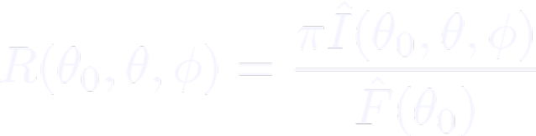

Direct Integration for SW Flux
Construct two sets of regional (10° X 10°) all-sky ADMs by season (e.g. DJF, MAM, JJA, and SON) from
  CERES measured radiances
  ADM predicted radiances
Both sets of regional all-sky ADMs have the same sampling
Apply regional ADMs to crosstrack data of the middle month of the season to determine the fluxes
Compare fluxes derived from these two sets of ADMs

Slide 10
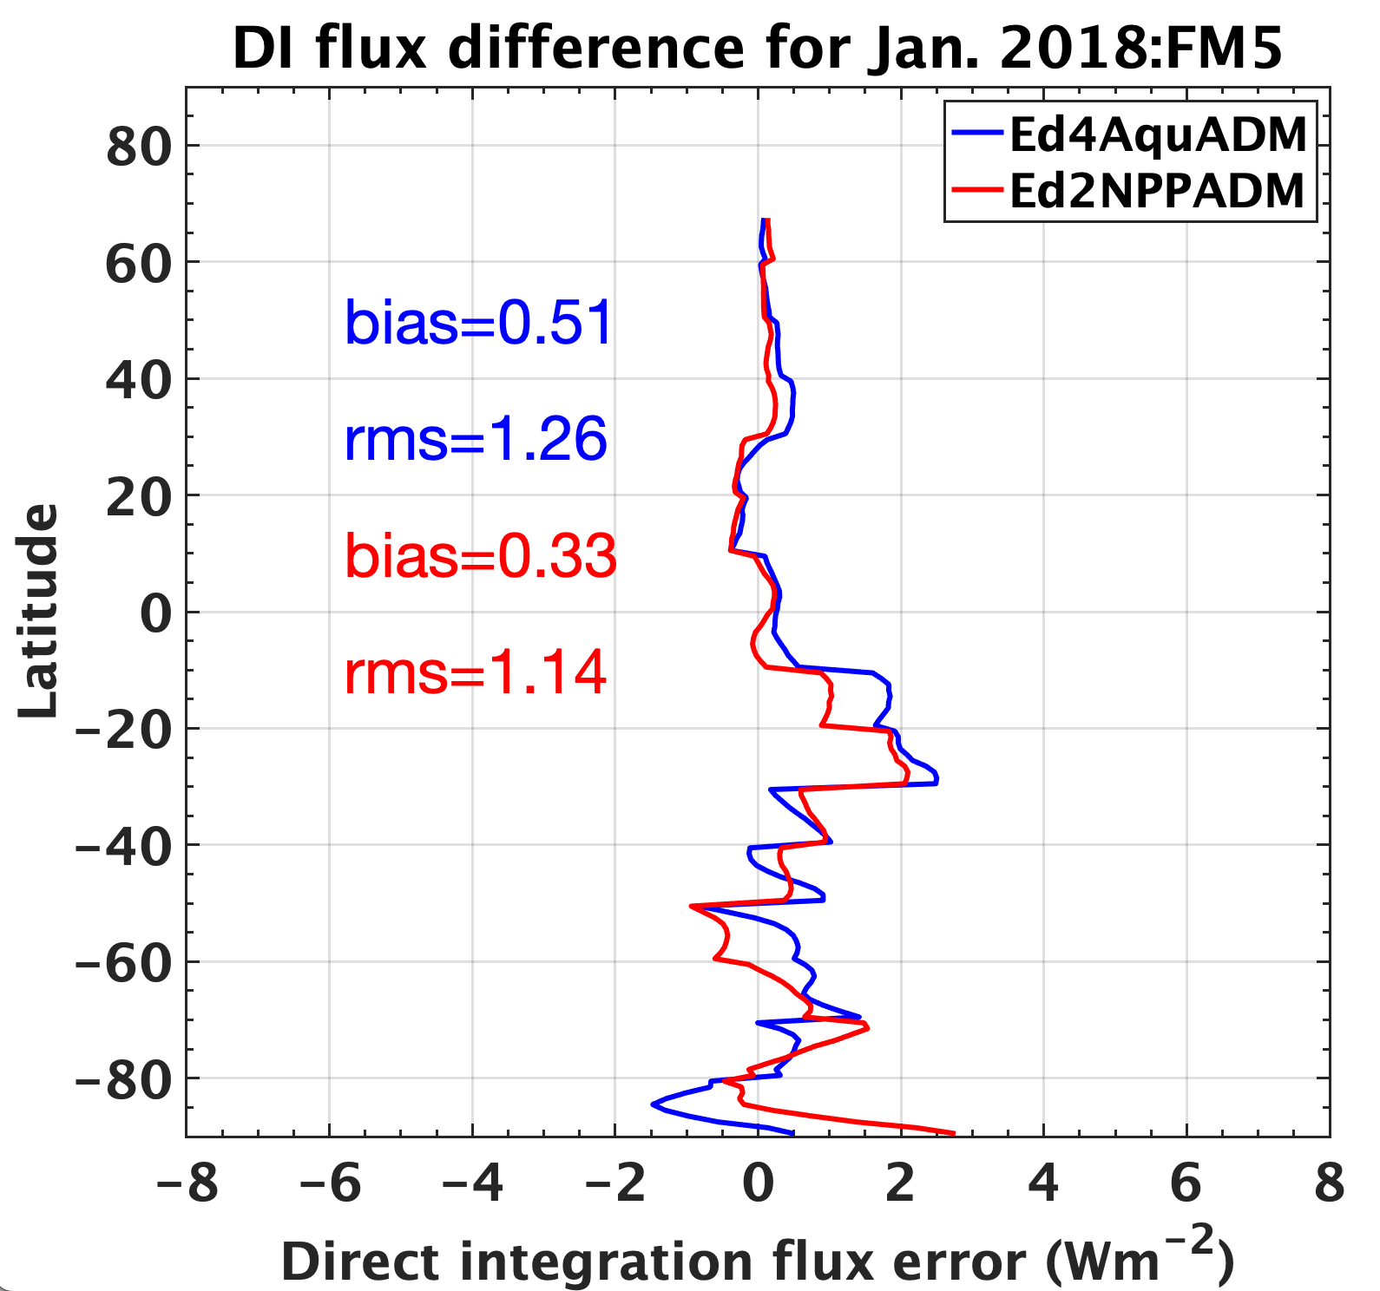
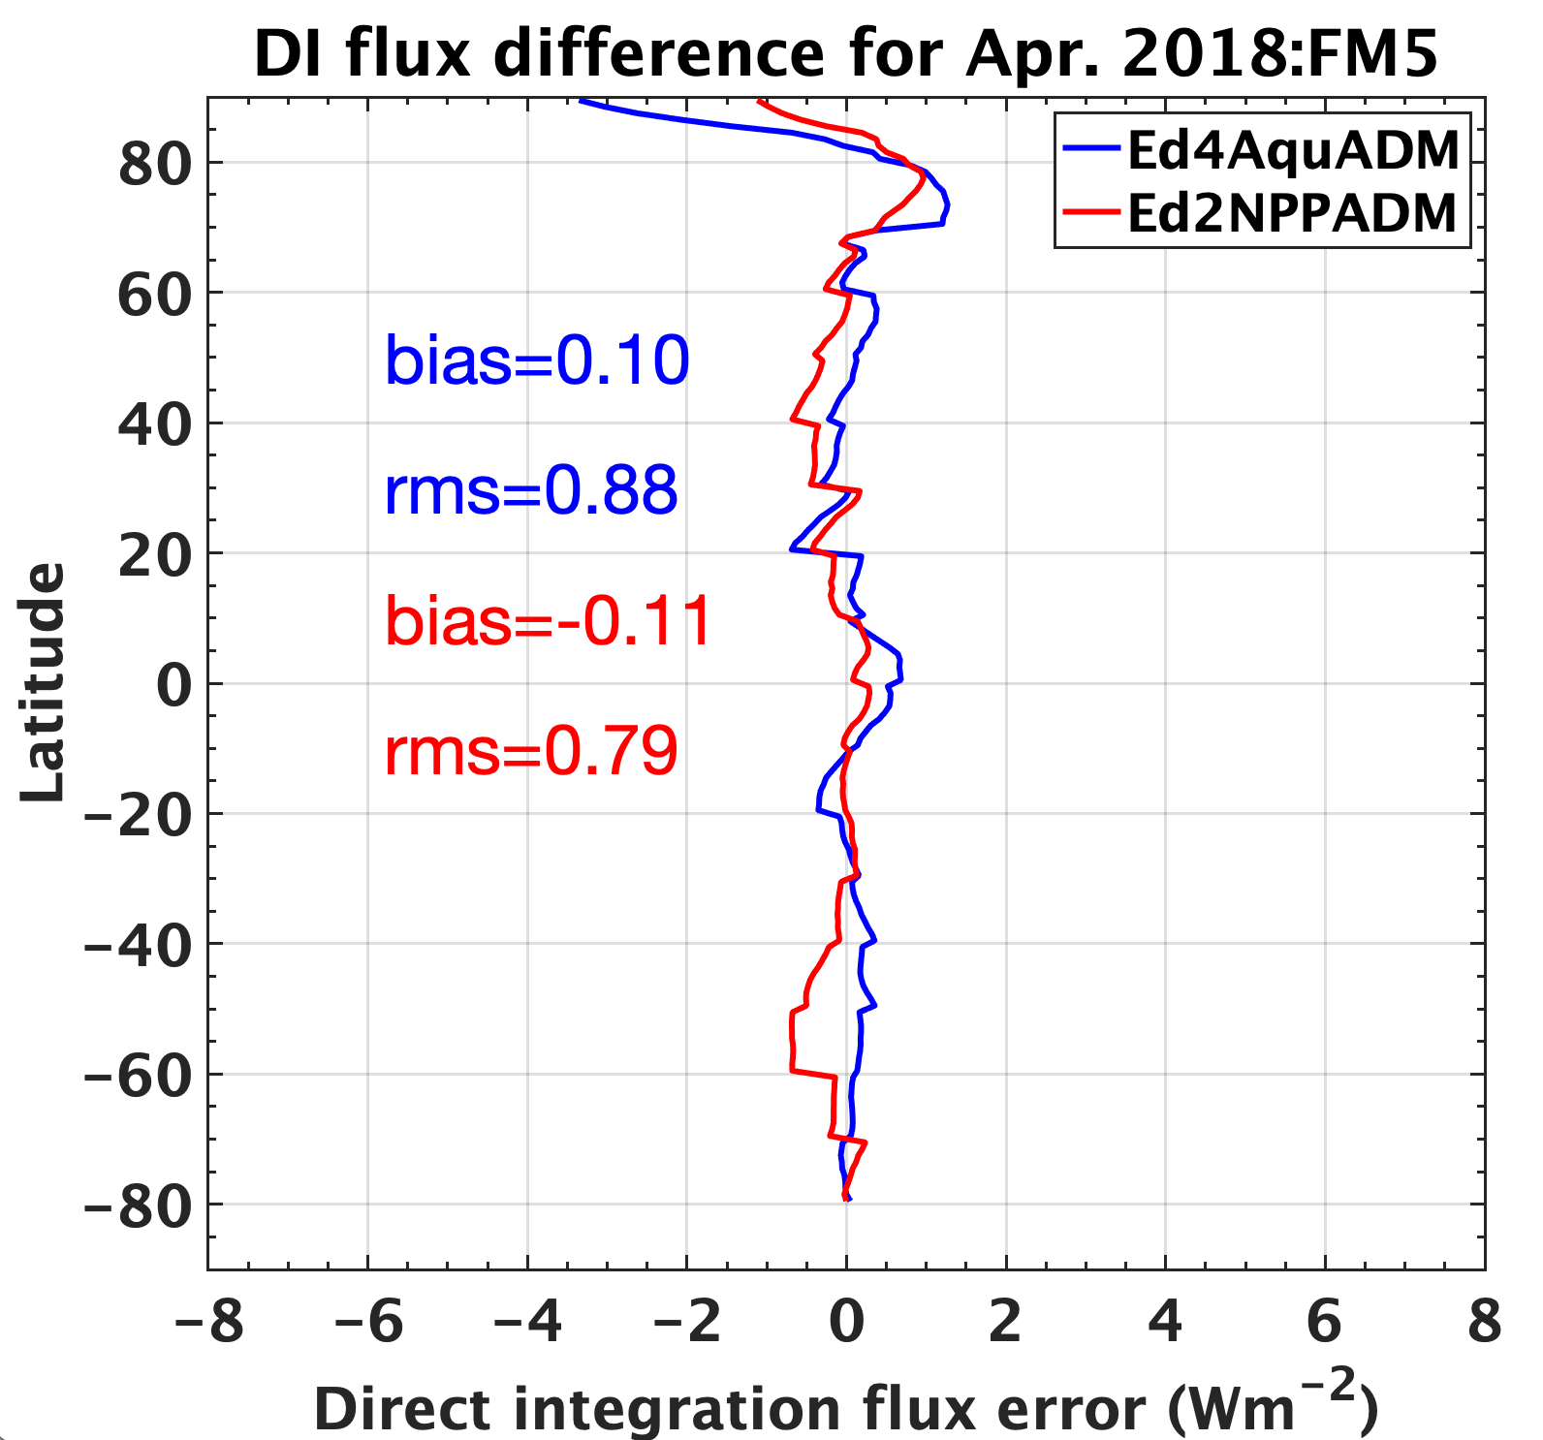
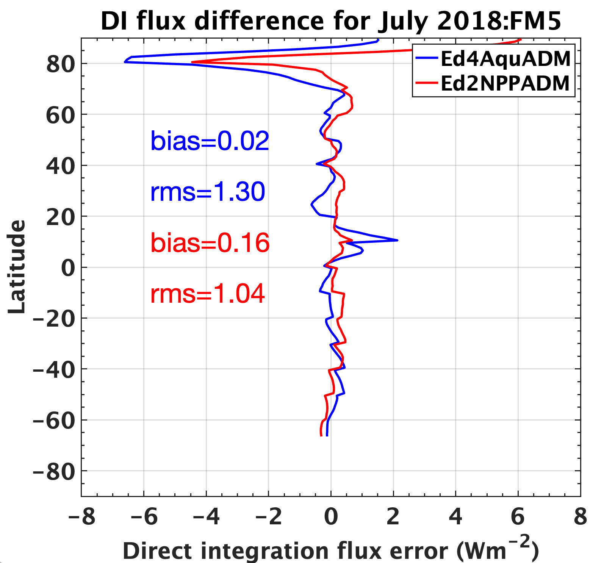
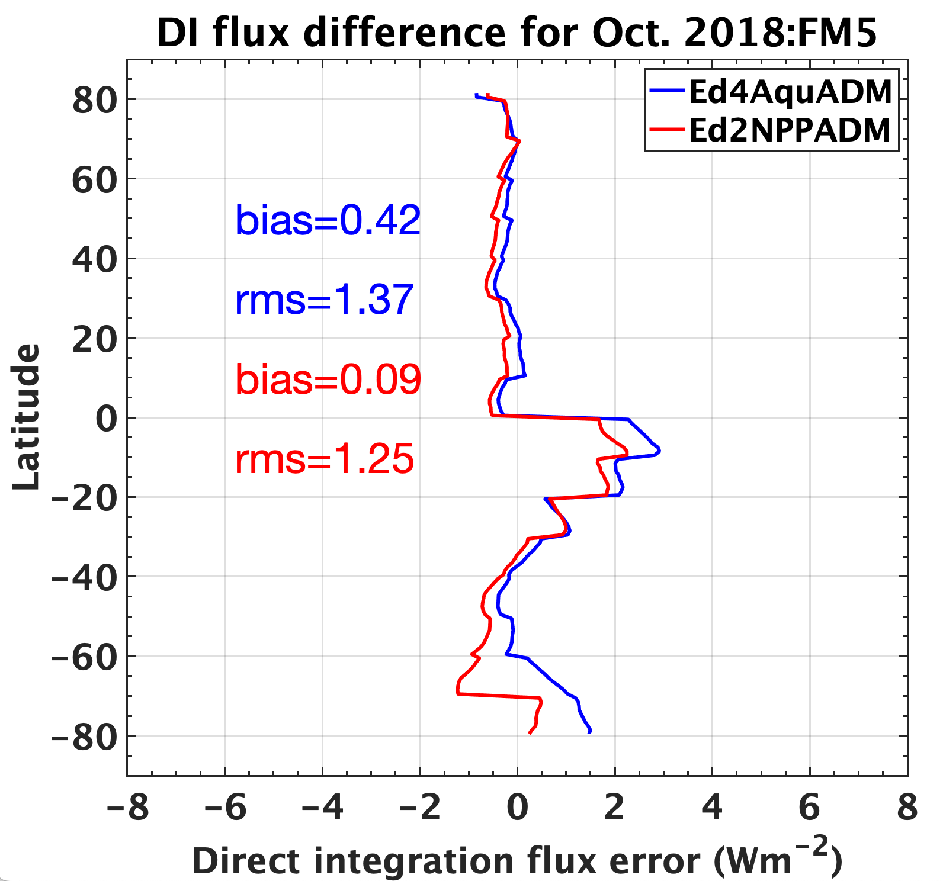
Direct integration SW flux error for 2018 NPP FM5
Flux errors are defined as the flux difference inverted from predicted radiance ADM and from observed radiance ADM
Zonal mean flux errors from NPP ADMs are generally smaller than those from Aqua ADMs
Global mean flux errors from NPP ADMs are smaller than those from Aqua ADMs by about 10-20%

Slide 11
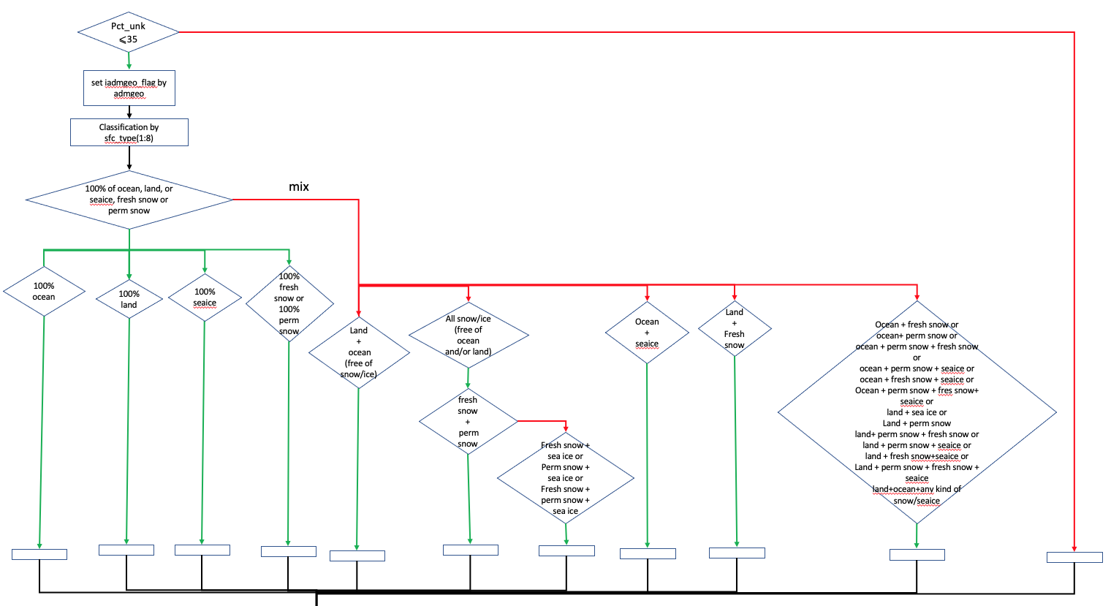
Rearchitect the shortwave inversion code

Slide 12
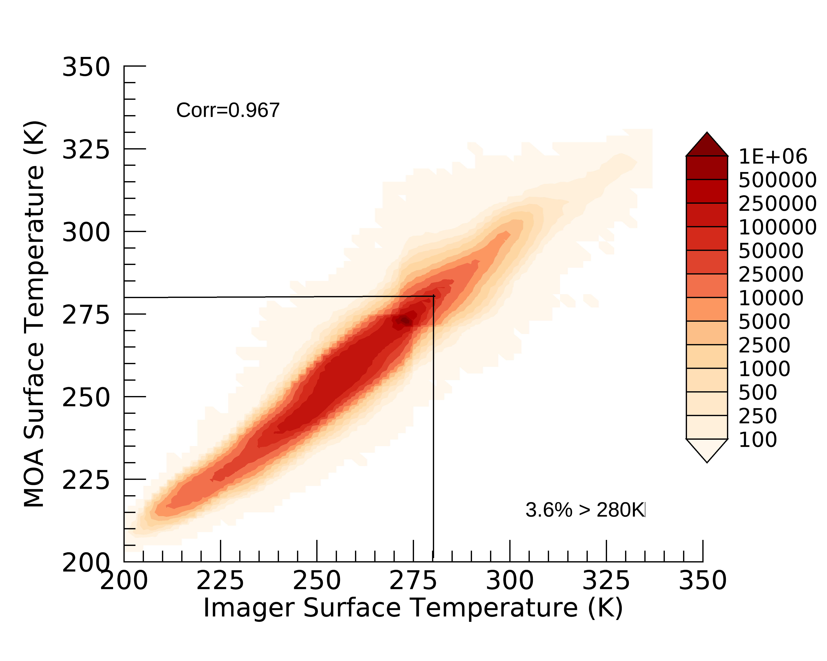

Snow ice variables used for inversion
Scene identification relies on multiple variables, including imager- and microwave-based snow and ice fractions, and surface skin temperature from imager retrieval and reanalysis
When imager- and microwave-based snow and ice information contradicts each other, surface skin temperature is used to aid scene identification
Imager snow/ice>0%
MW snow/ice>0%
R=0.967
R=0.962
3.6%>280k
2.7%>280k
Notes:
Four seasonal months of 2010
280 K is used in the get_sw_flux code as a threshold indicating the temperature is too warm for snow/ice.

Slide 13
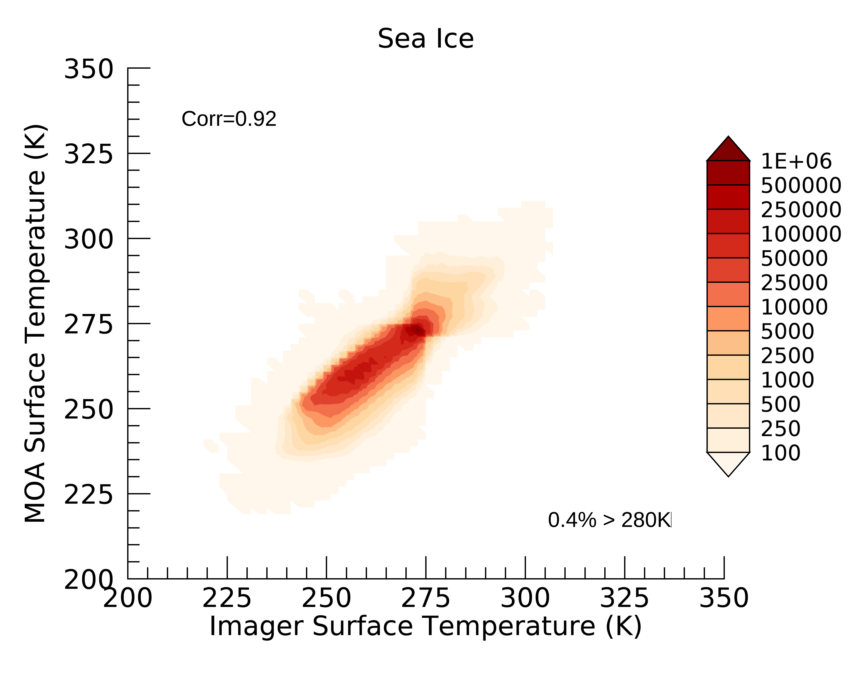
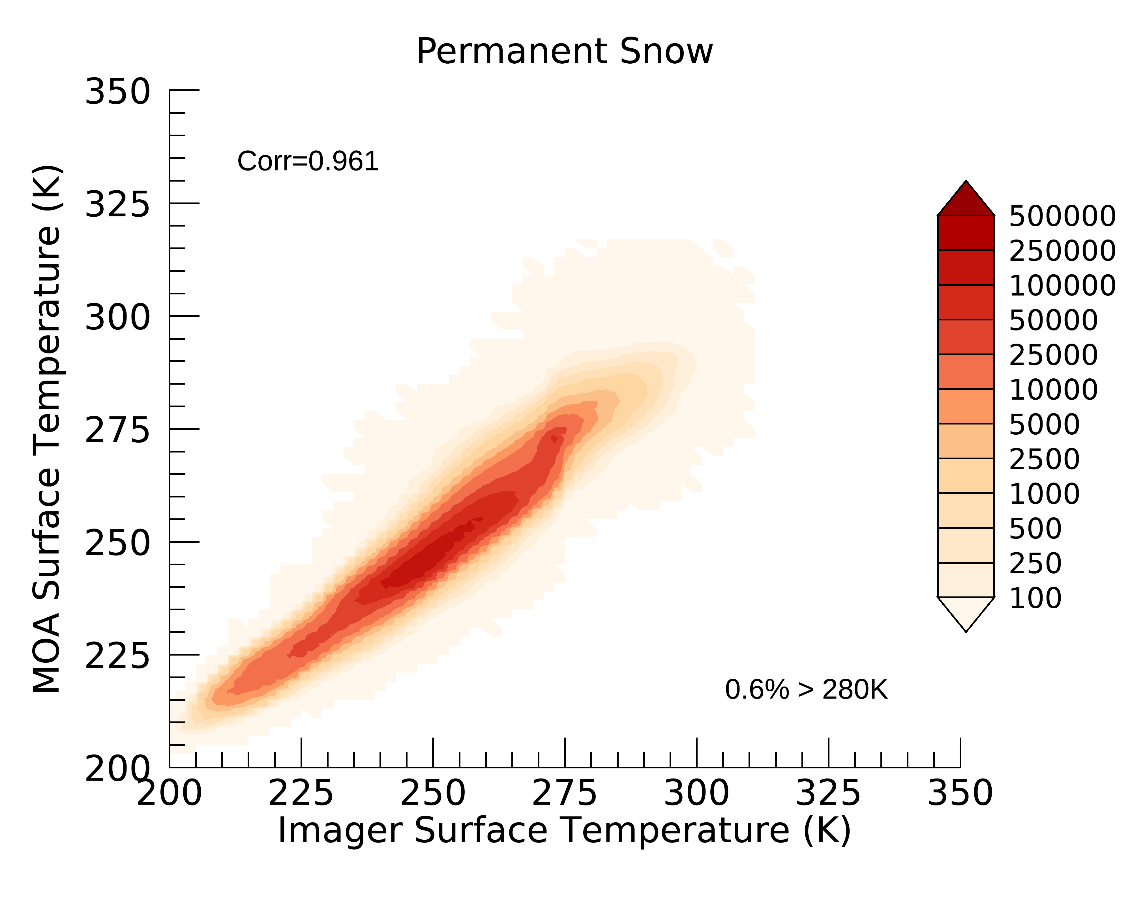
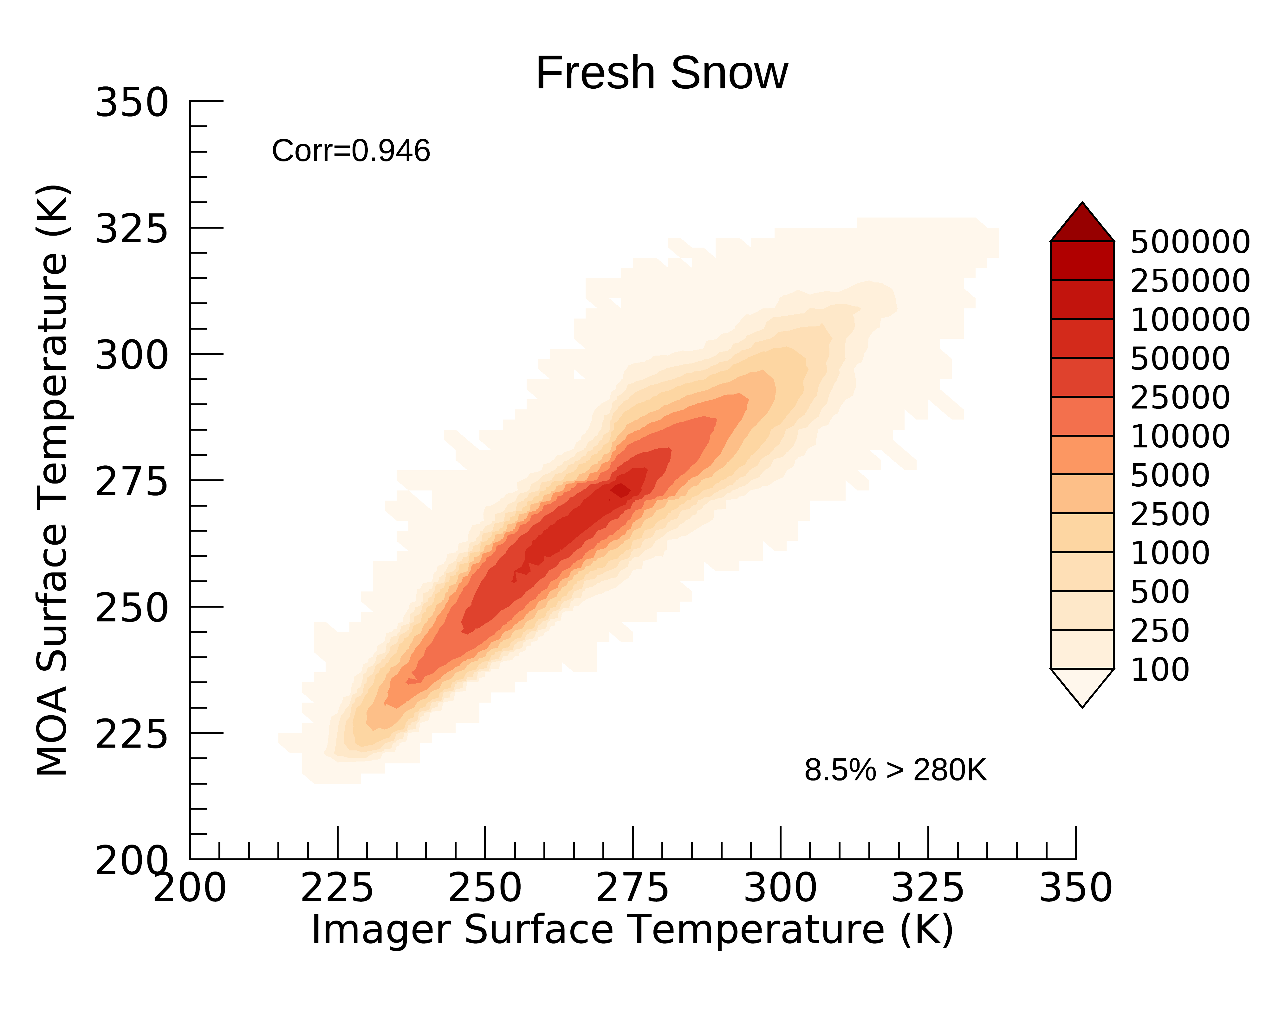
Percentage of snow/ice footprints with surface temperature > 280k
Small percentage of footprints that were identified as sea ice and permanent snow by microwave have surface temperature greater than 280 K.
Fresh snow footprints show large percentage with surface temperature over 280 K.
MW snow/ice>0%
Sea Ice
R=0.962
R=0.92
2.7%>280k
0.4%>280k
Perm Snow
Fresh Snow
R=0.96
R=0.94
0.6%>280k
8.5%>280k
Notes:
There is a relatively large (non-negligible) amount of snow/ice footprints with both temperature variables above 280 K. ​
Fresh snow footprints have the largest % of footprints above 280 K.​

Slide 14
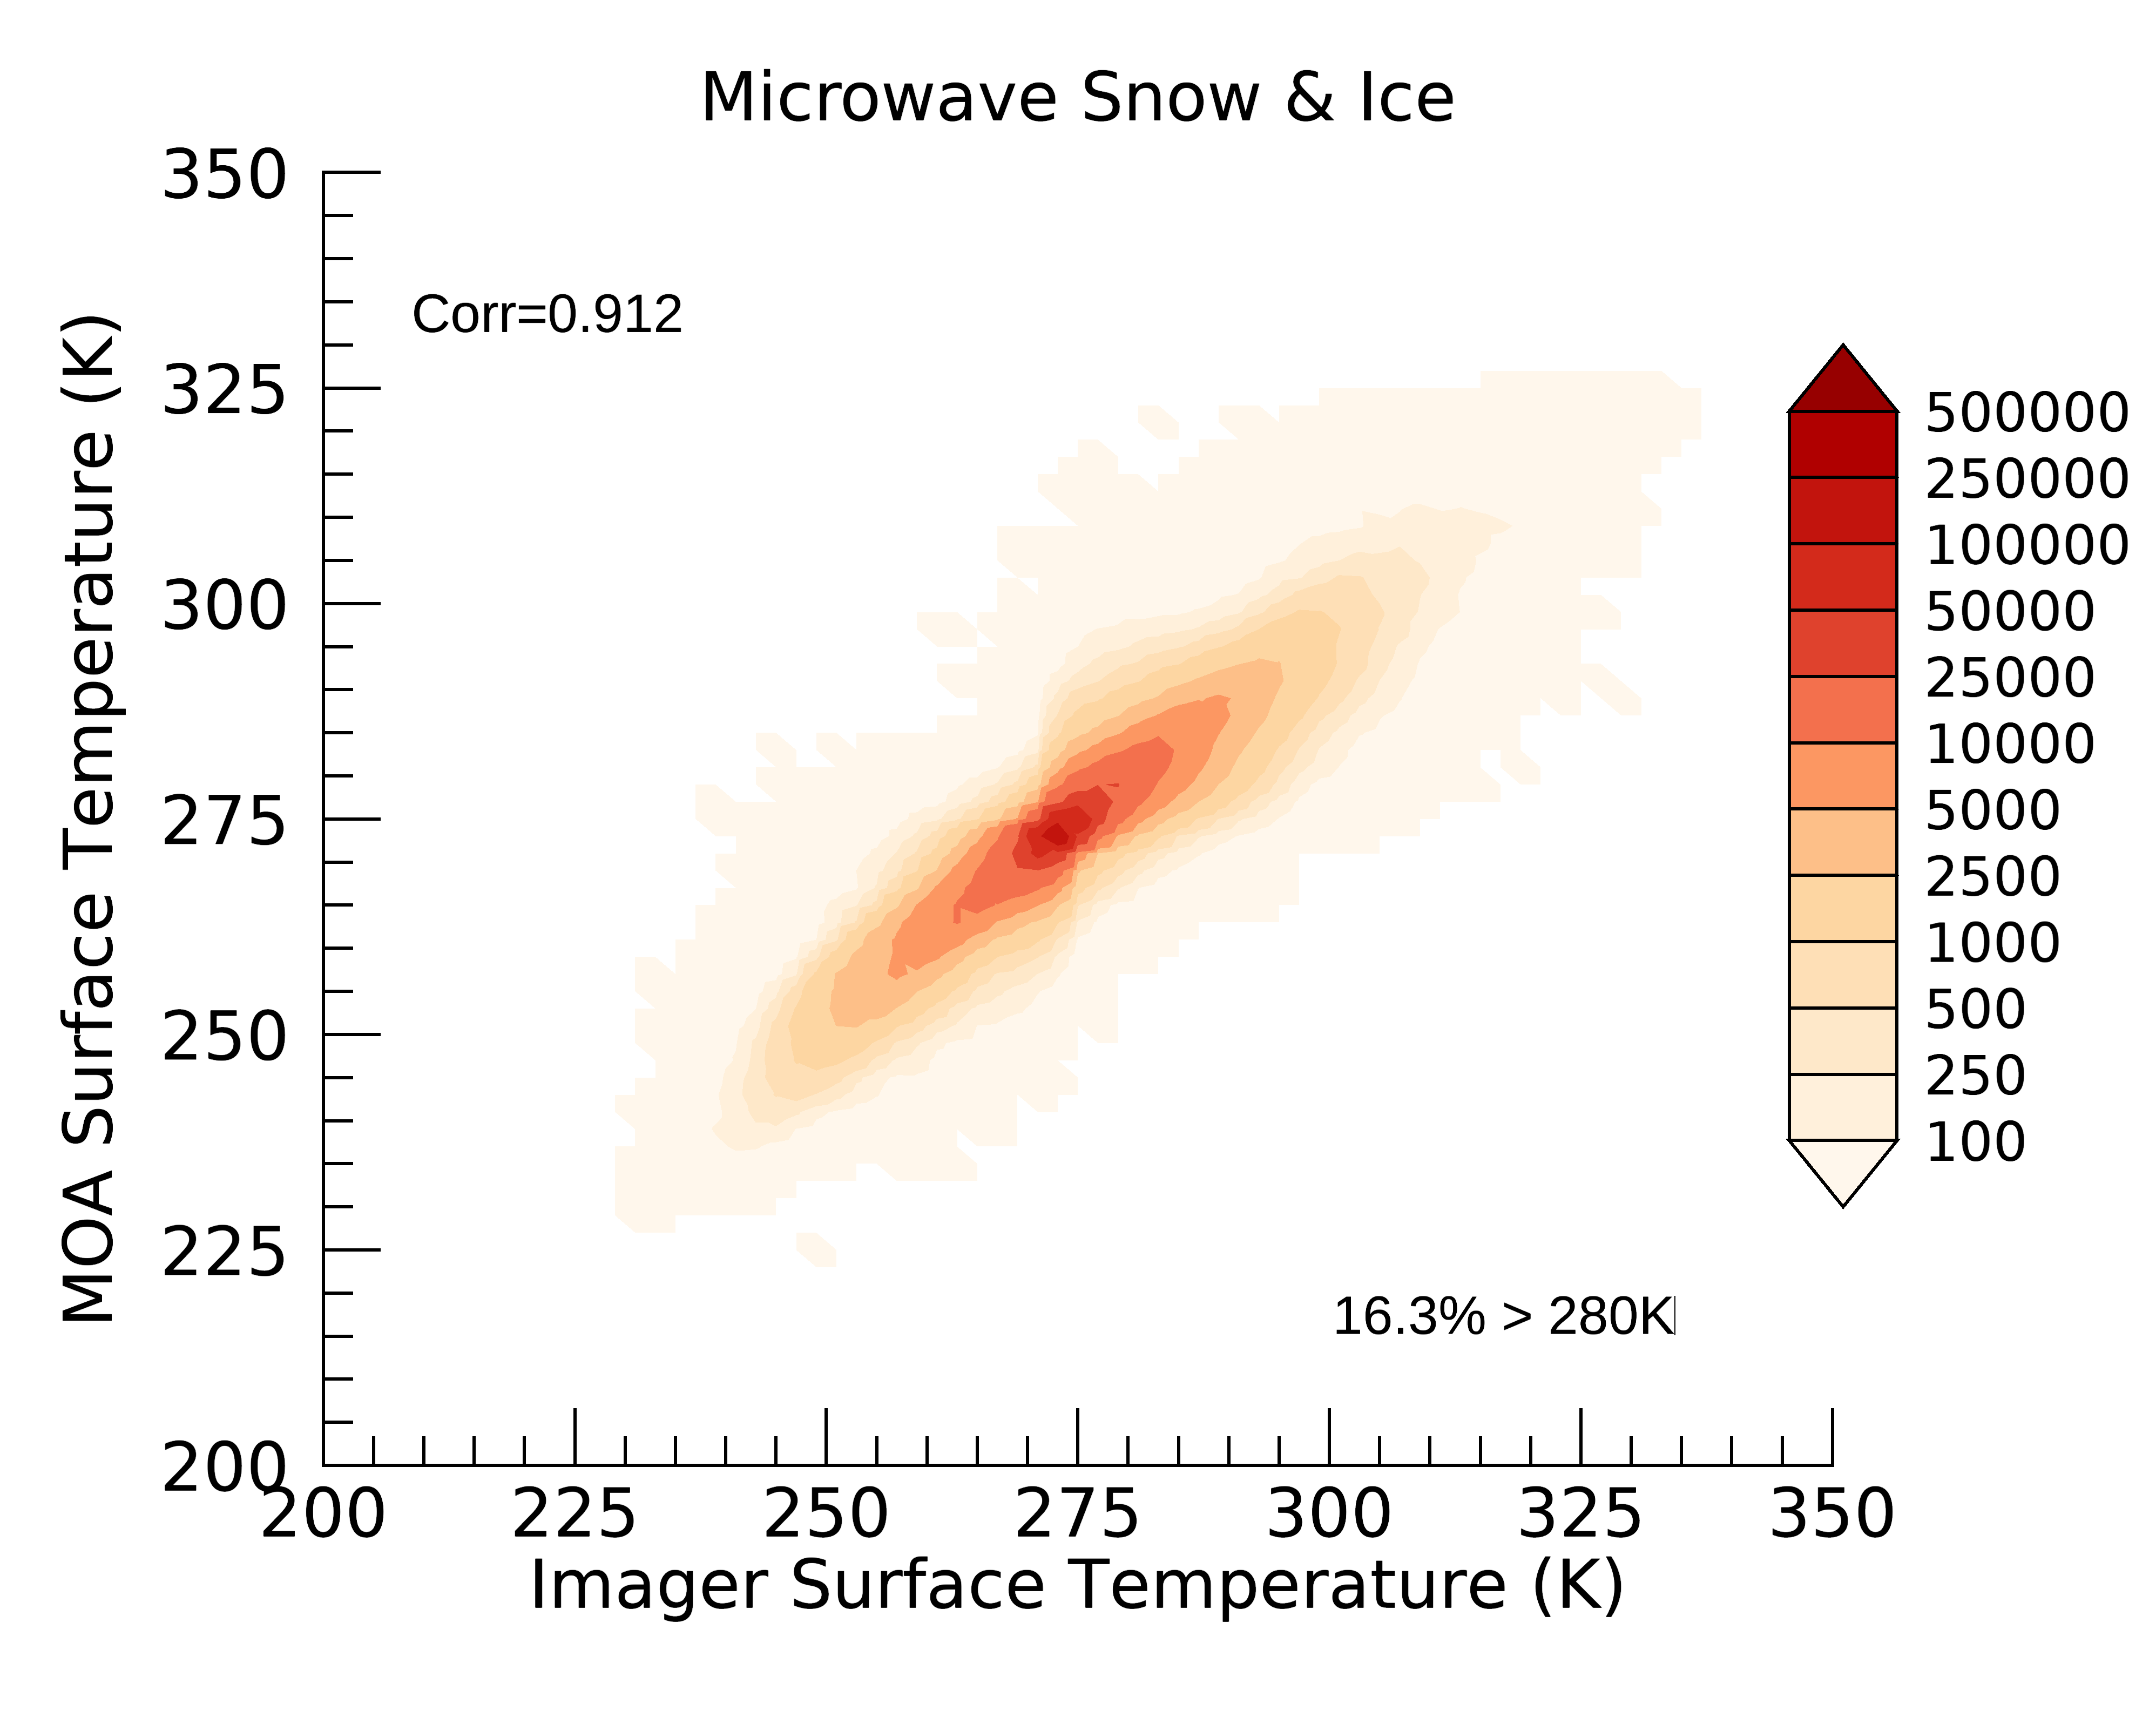
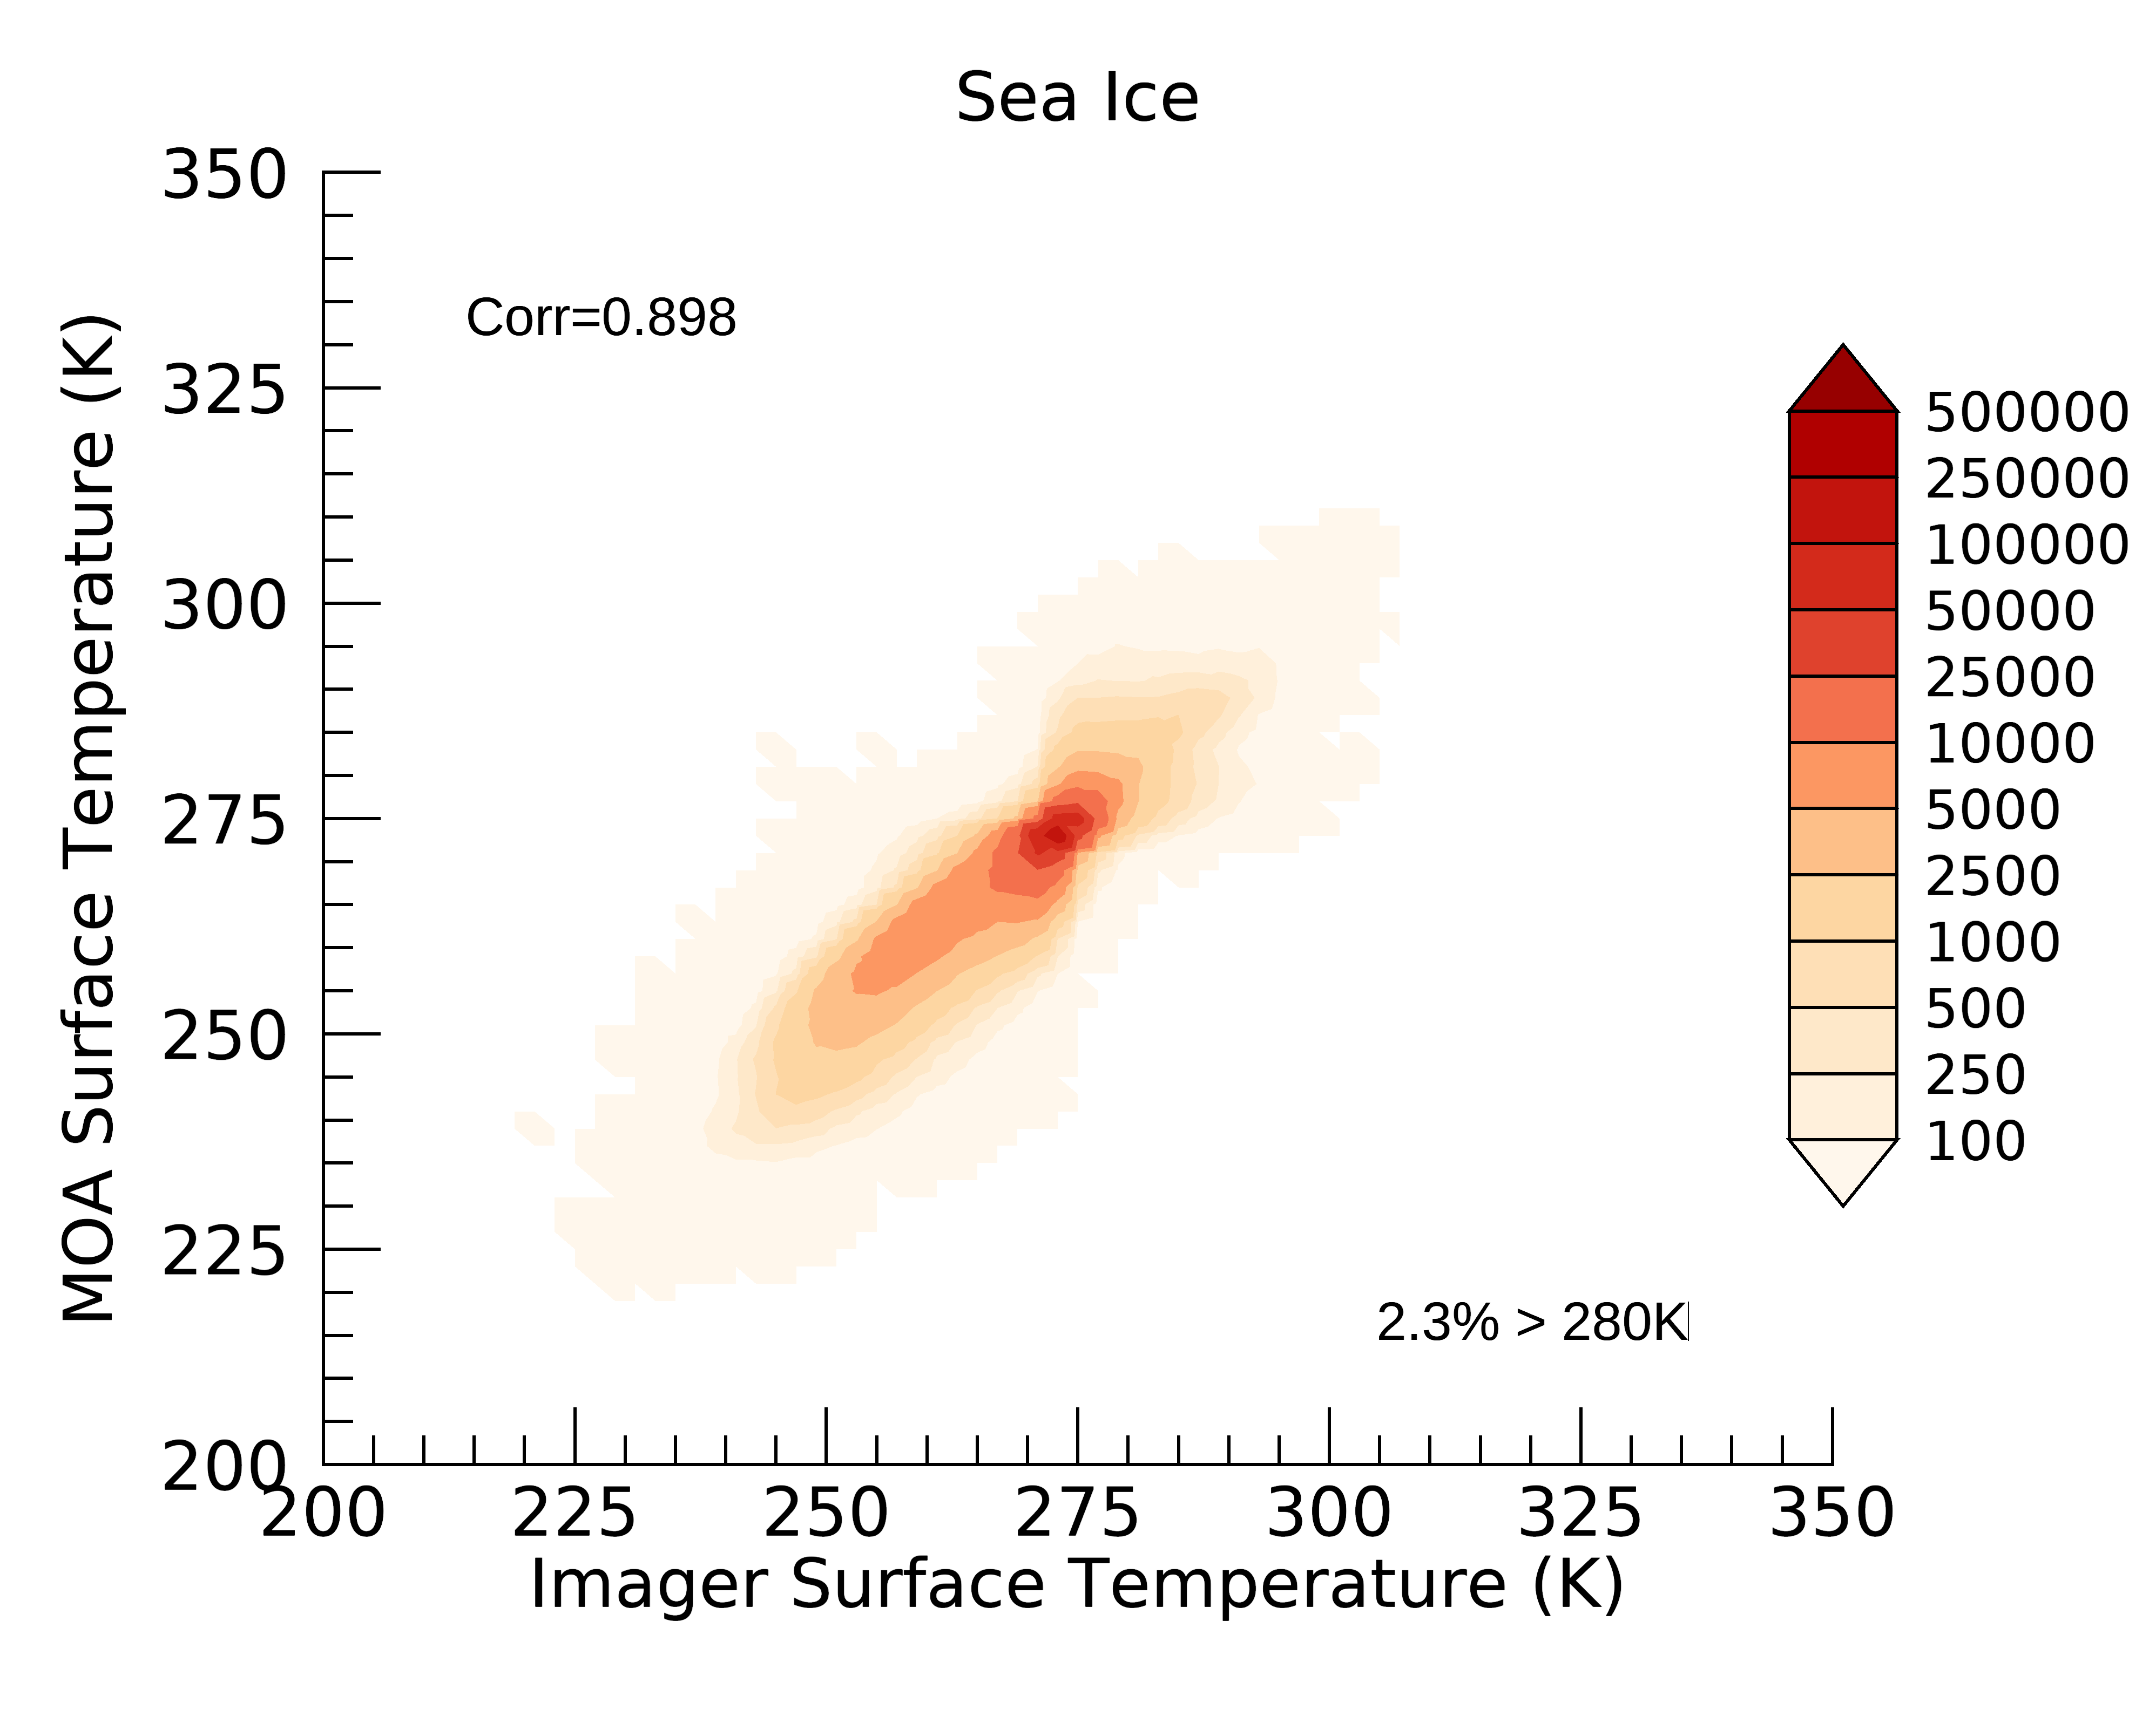
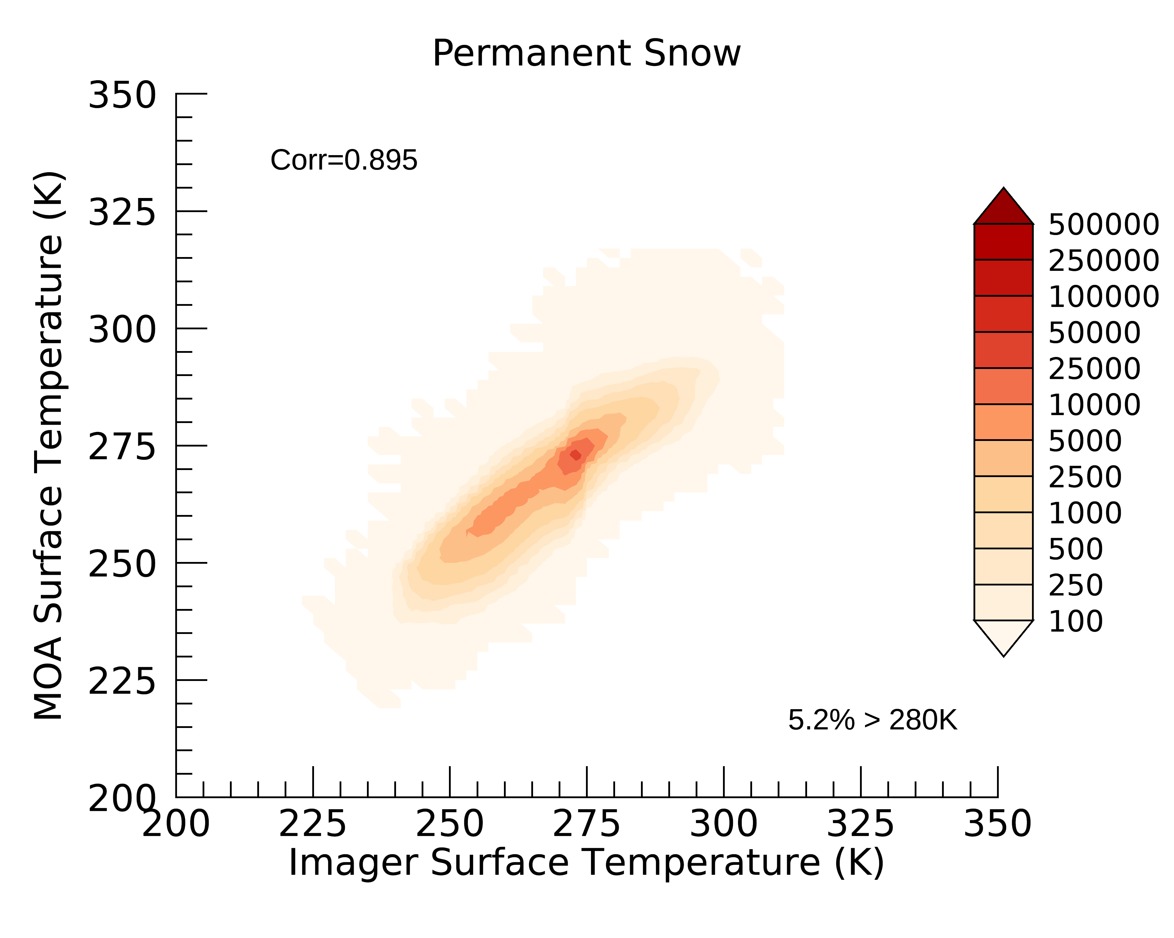
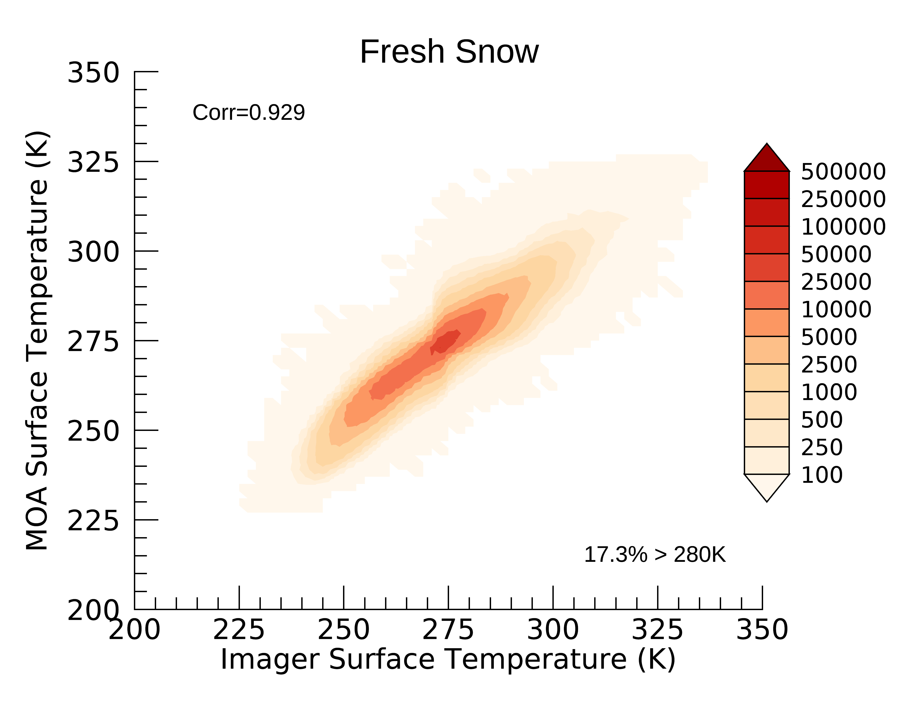
Partial snow/ice footprints are more likely to have surface temperature >280 K
MW Snow/Ice [1, 25]
Sea Ice
R=0.92
R=0.898
16.3%>280k
2.3%>280k
Perm Snow
Fresh Snow
R=0.895
R=0.929
5.2%>280k
17.3%>280k

Slide 15
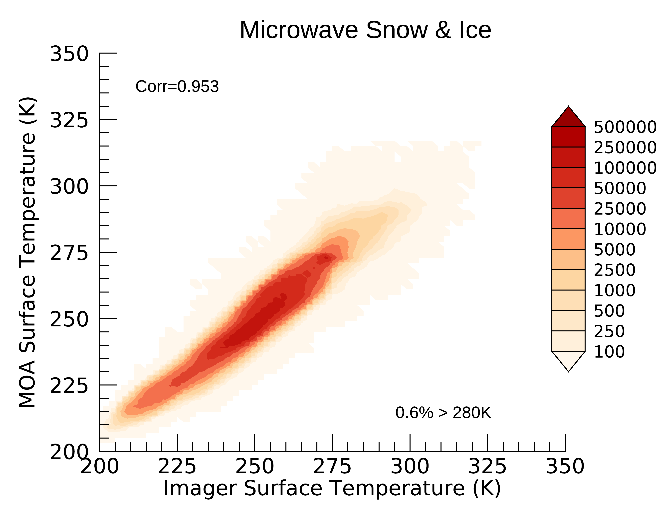
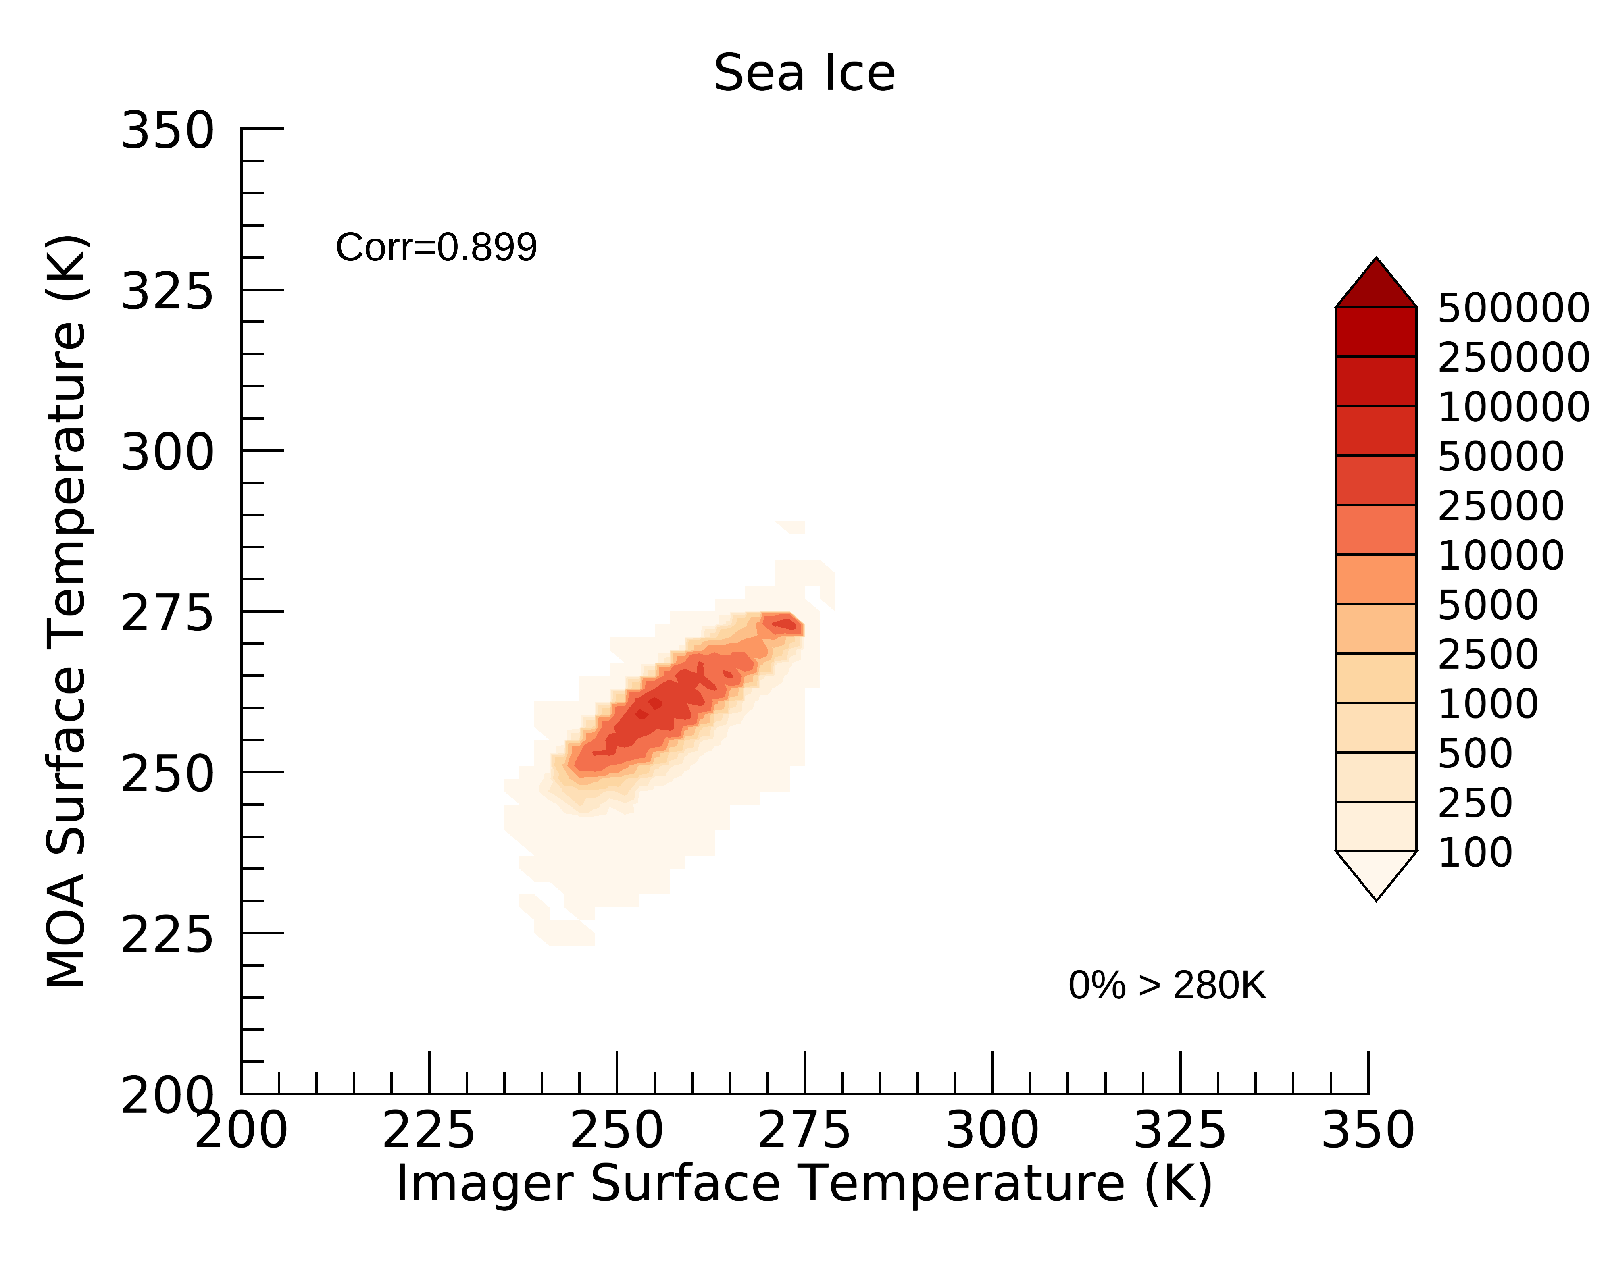
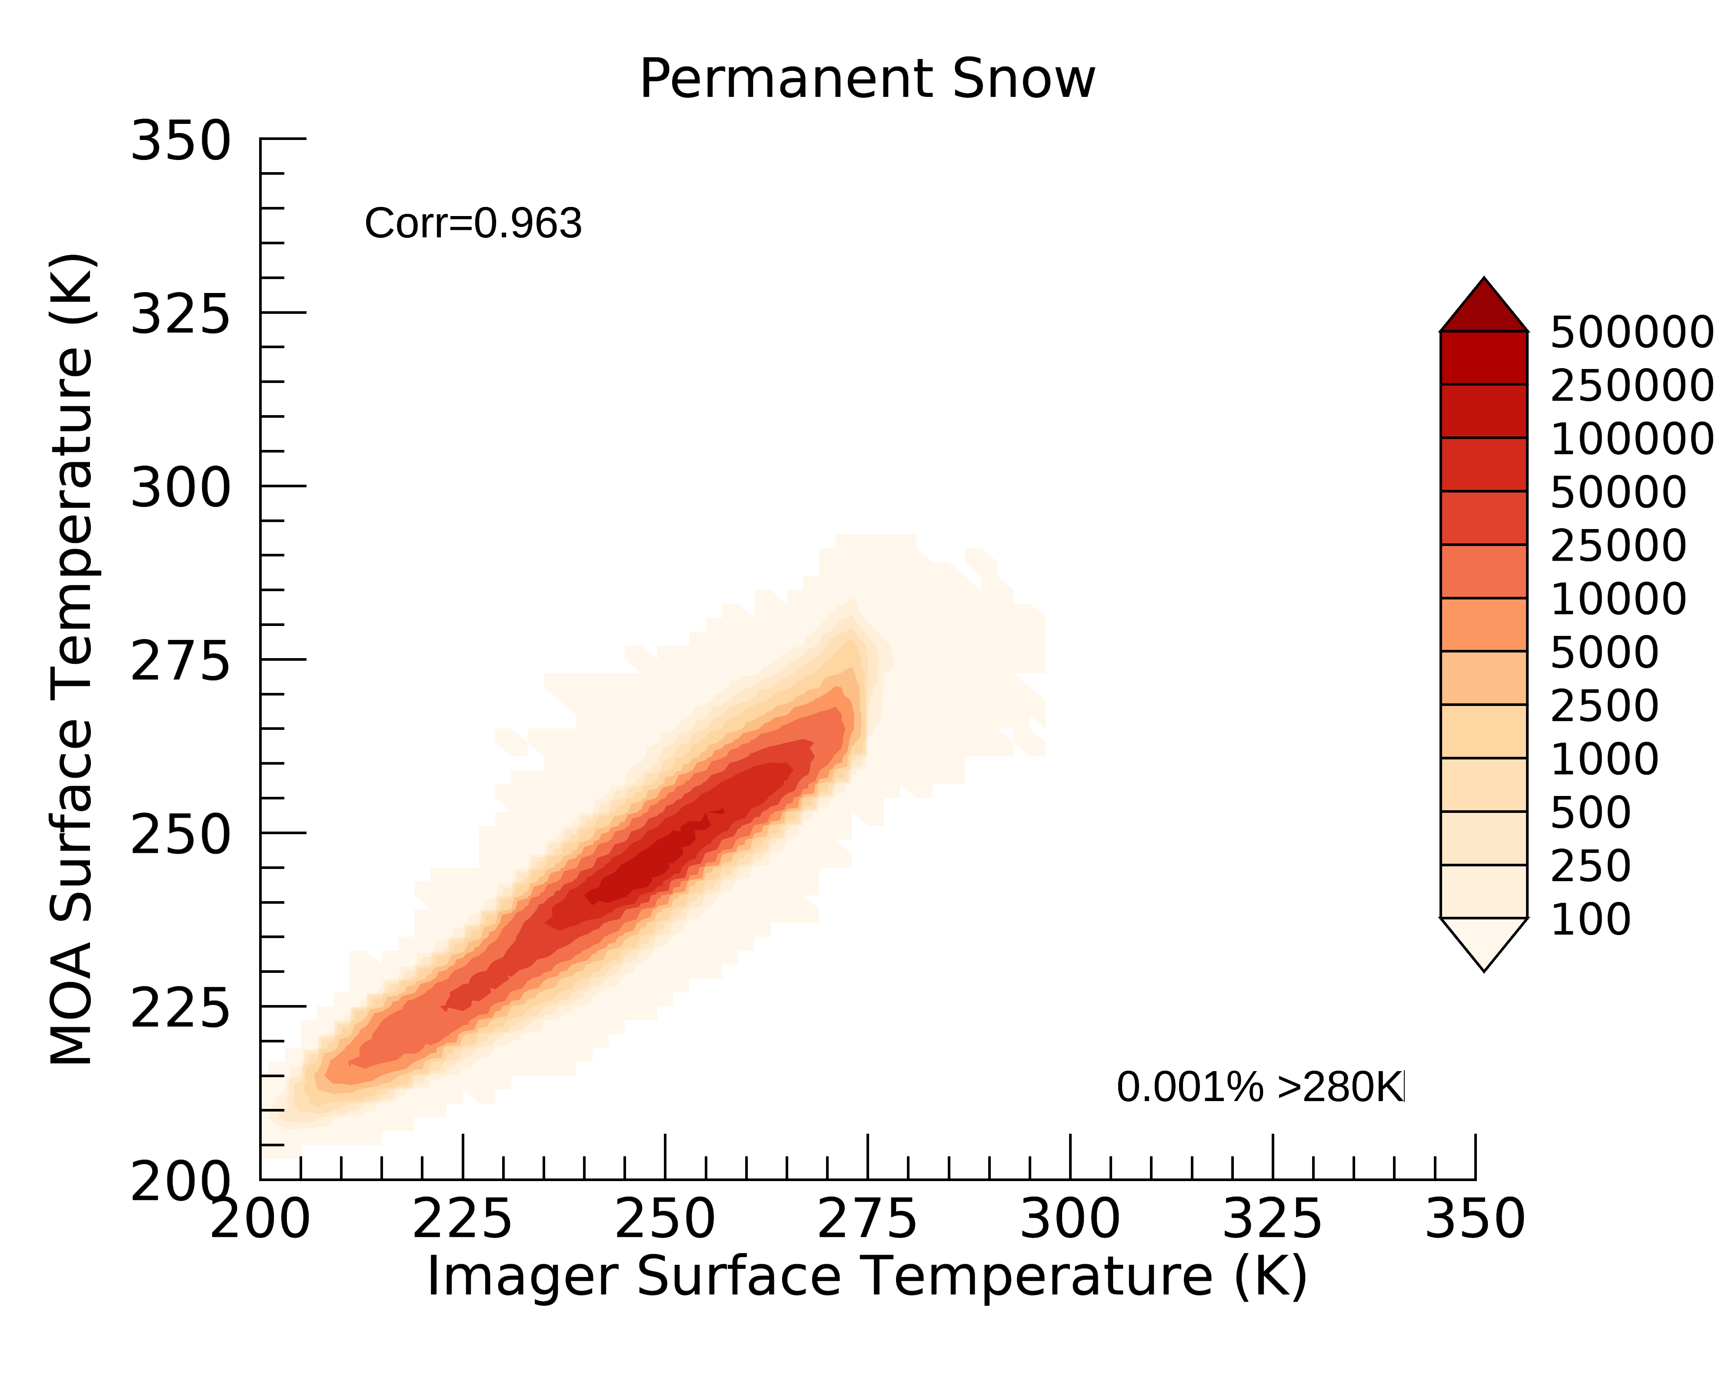
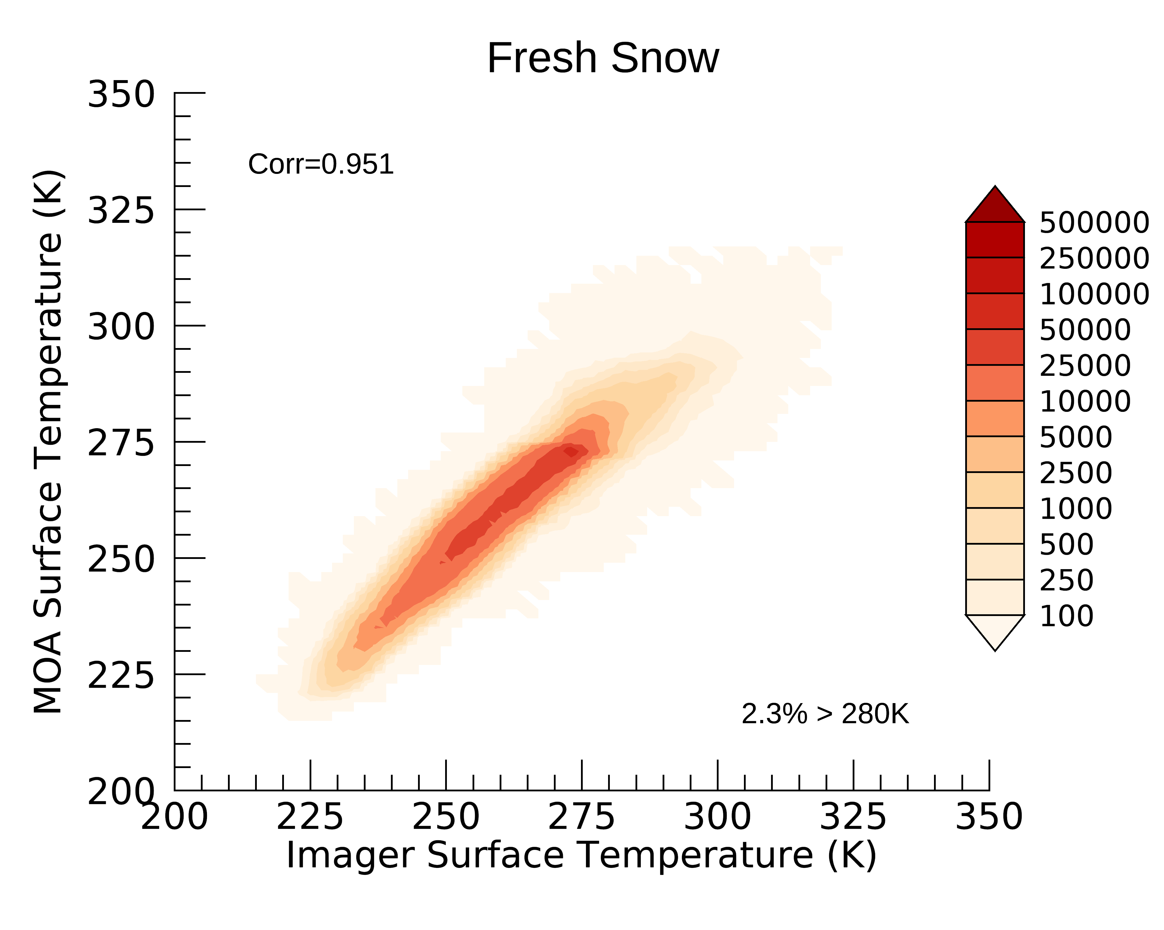
100% snow/ice footprints almost all have surface temperature <280 K
MW Snow/Ice [100]
Sea Ice
R=0.95
R=0.90
0.6%>280k
0%>280k
Perm Snow
Fresh Snow
R=0.96
R=0.95
0.001%>280k
2.3%>280k

Slide 16
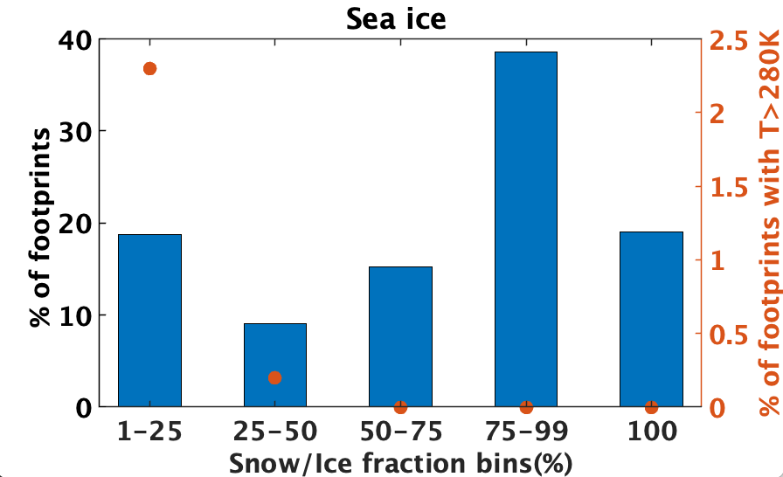
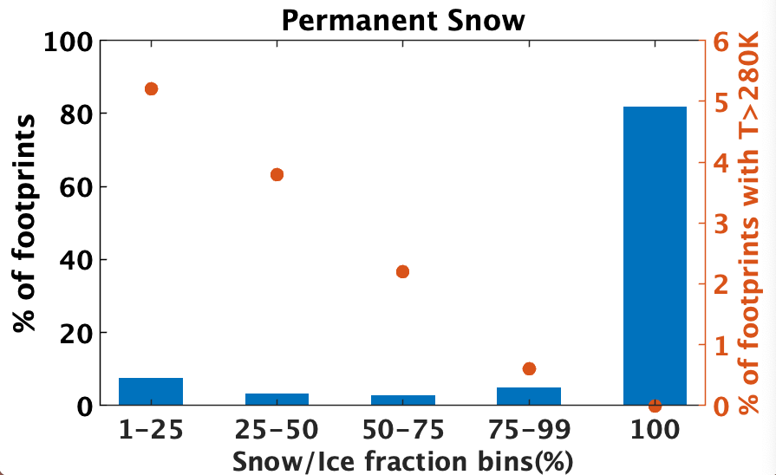
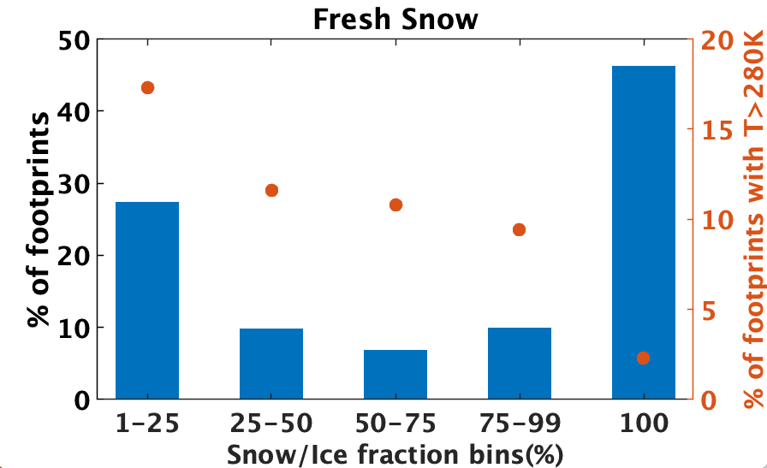
Large percentage of fresh snow footprints with T>280K
For 100% snow/ice fractions, 280 K is a good threshold indicating that the temperature is too warm for snow/ice.​
For smaller snow/ice fractions, significant percentage of footprints (especially fresh snow) have temperature greater than 280 K.
Temperature threshold will be reevaluated for Ed5 (possibly snow/ice fraction-based thresholds).
Notes:
However, for smaller percentages of snow/ice, the temperature could be above 280 K because the part of the footprint not covered by snow/ice is at a temperature above 280 K. Thus, we must be careful when applying this threshold for footprints with partial snow/ice coverage.​
The % of footprints with T>280 K is greatest when the snow or sea ice represents a small fraction of the footprint area.

Slide 17
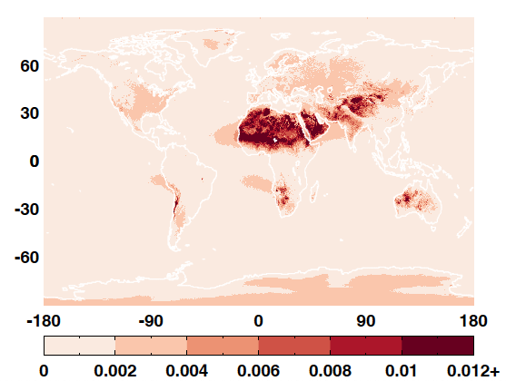
Surface emissivity
The LW and WN emissivity is an input for the cloudy-sky LW ADMs.
For Edition 4 and earlier editions, a single value of emissivity was assigned to each IGBP type for both the LW and WN channels.
For Edition 5, a merged surface emissivity database is developed from IASI data and from theoretical calculation:
  Monthly climatology of surface emissivity based on 10 years of IASI hyperspectral data between 3.62 µm and 15.5 µm (Zhou et al. 2011, 2013)
  Theoretical calculation based on Fresnel equations and the spectrally dependent indices of refraction for water, snow/ice, and desert (Huang et al. 2016)
Range of monthly surface emissivity from IASI
Highest monthly – Lowest monthly emissivity
Notes:
which will allow for the emissivity to change with season and vary within each IGBP type. This is especially important for arid and semi-arid land areas.
The Zhou 10-year climatology of surface emissivity based on IASI hyperspectral data gives monthly 0.25° x 0.25° values of emissivity at 0.25 cm⁻¹ resolution from 645 cm⁻¹ to 2760 cm⁻¹. This was converted to LW channel emissivity by first calculating average emissivity over the 12 Fu-Liou bands, and then averaging the band averages over the LW, using a weighting factor:

Slide 18
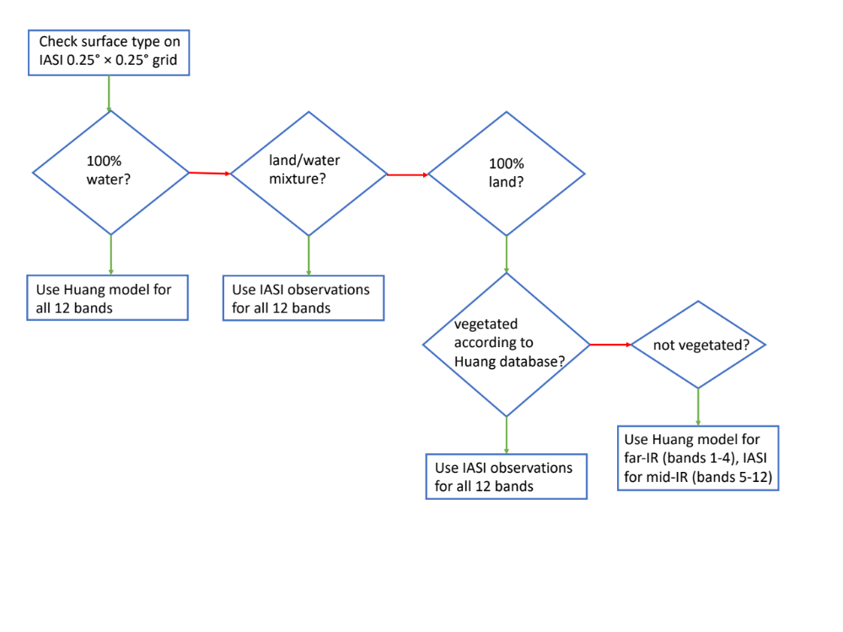
Merged monthly surface emissivity dataset
Surface emissivity values for the 12 Fu-Liou bands
They are weighted to provided the broadband LW and WN emissivity values
The spatial resolution of the merged dataset is 0.25°by 0.25°
Notes:
The 0.25° x 0.25° IASI land/water mask is initially used. IASI provides emissivities from 645-2762 cm⁻¹.
For grid cells that are 100% water, the Huang-calculated water emissivity is used for all 12 Fu-Liou bins.
For grid cells that are partially water and partially land, the IASI retrieved emissivity is used for the 9 Fu-Liou bins that it has emissivity, and then the far-IR bins (0-280, 280-400, 400-540 cm⁻¹) are assumed to have the same emissivity as the 540-670 cm⁻¹ bin.
For grid cells that are 100% on vegetated land, there are no far-IR measurements or calculations. The IASI dataset is used for these cases.
For grid cells 100% land that have non-vegetated surfaces (permanent snow, ice, desert), there are Huang calcualtions for the far-IR bands. For these surfaces, the IASI-retrieved emissivity is used for Fu-Liou bands 5-12 (670-2200 cm⁻¹) and the Huang emissivity is used for bands 1-4 (0-670 cm⁻¹).
Fresh snow and sea ice are not explicitly taken into account, though the IASI climatology should include some effects of snow. For situations where the SSF indicates fresh snow or sea ice, I suggest overwriting with the Huang-calculated medium-grain snow or sea ice emissivity.

Slide 19
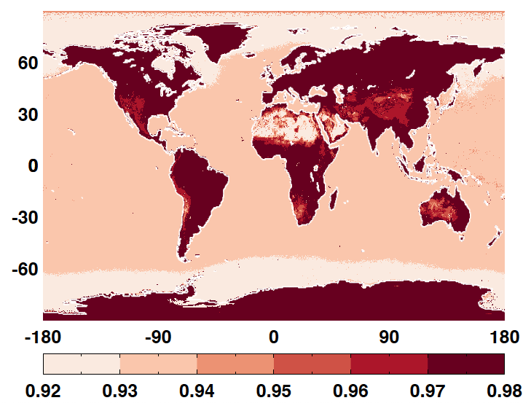
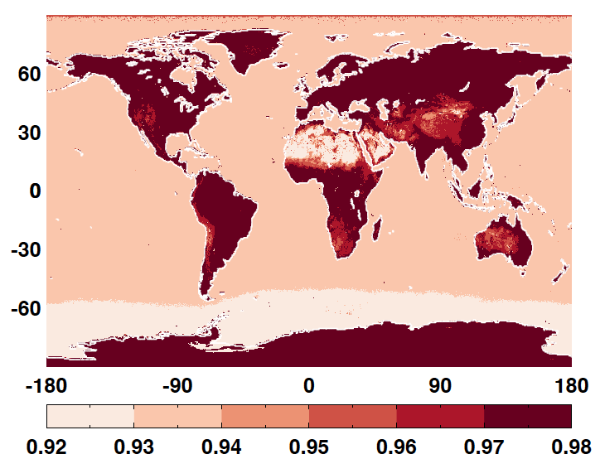
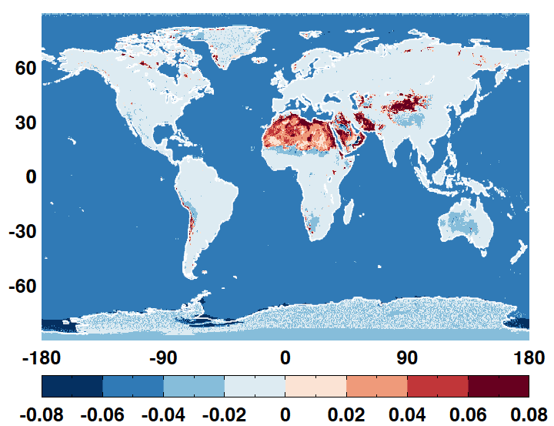
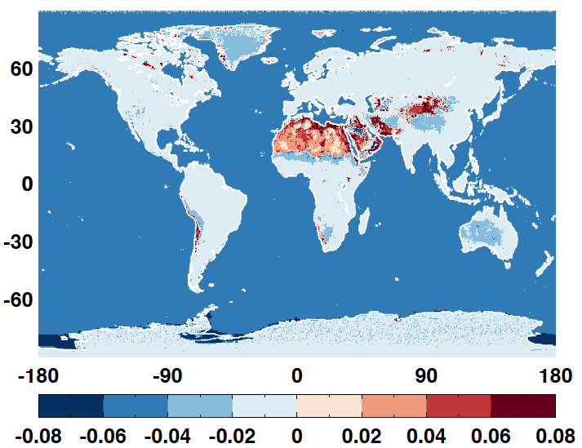
Emissivity difference between the merged dataset and the Ed.4 dataset
Merged emissivity is significantly lower than that used in Edition 4 over water;
Merged emissivity is slightly lower than that used in Edition 4 over most land areas;
Merged emissivity is significantly higher than that used in Edition 4 over most desert regions.
Merged
Merged
-
Ed4
Jan July

Slide 20
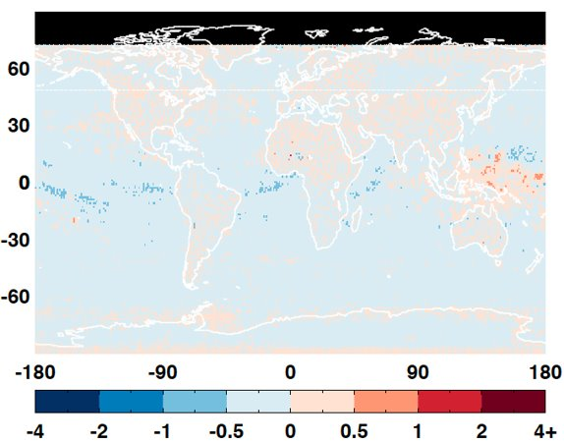
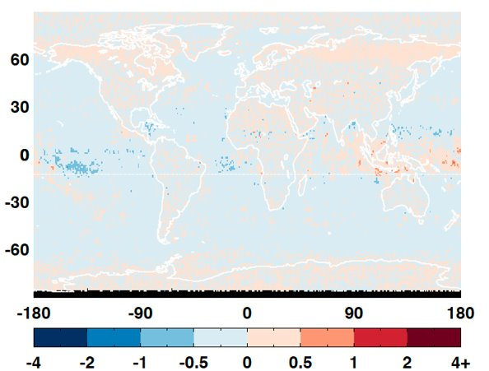
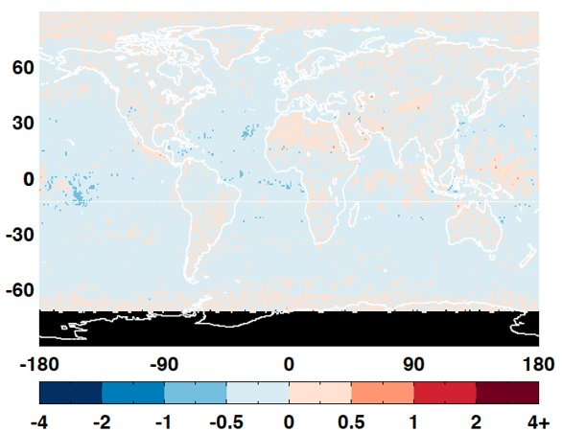
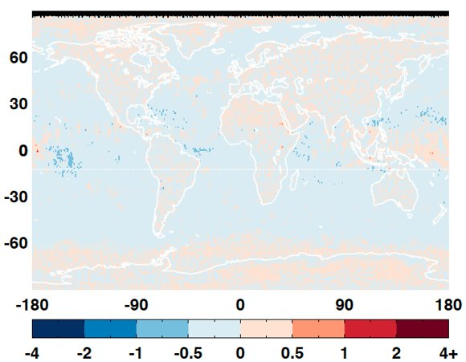
Impact of surface emissivity on daytime LW flux inversion is small
Bias is less than 0.1 Wm-2.
RMS is less than 1.2 Wm-2.
Jan Apr
July Oct

Slide 21
Summary
Developed a set of NPP SW ADMs based on NPP cross track and RAPS data and the VIIRS cloud properties for scene identification.
Global monthly mean instantaneous NPP SW fluxes inverted from NPP ADMs can differ from those inverted from Aqua ADMs by more than 1.5 Wm⁻², with the regional fluxes differ up to 10 Wm⁻². Large regional differences are mostly over snow/ice surface due to significant cloud property differences between VIIRS and MODIS.
Global mean flux errors from NPP ADMs are smaller than those from Aqua ADMs by about 10-20%.
Merged monthly surface emissivity based on IASI and theoretical calculation will be used for CERES Ed 5 processing. Merged emissivity is significantly lower than that used in Edition 4 over water and is significantly higher than that used in Edition 4 over most desert regions.

