Slide 1
A hybrid transfer function procedure for broadband auralization within small flight vehicle interiors
Albert R. Allen
Siddhartha Krishnamurthy
NASA Langley Research Center
Hampton, VA 23681, USA

Slide 2
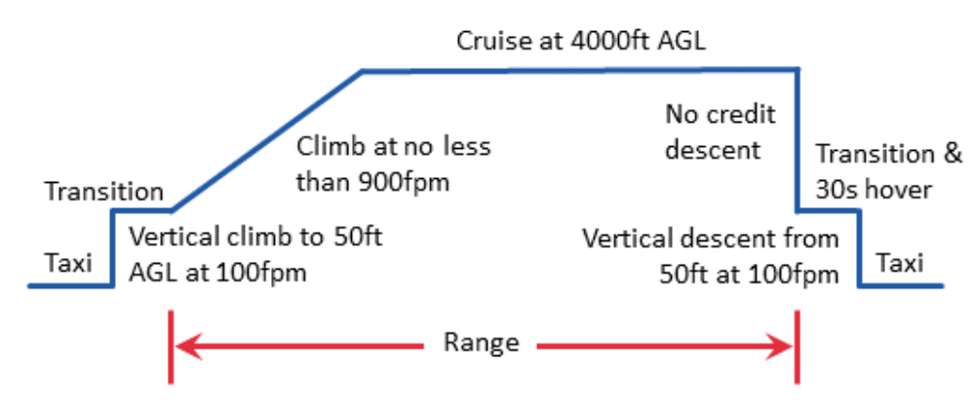
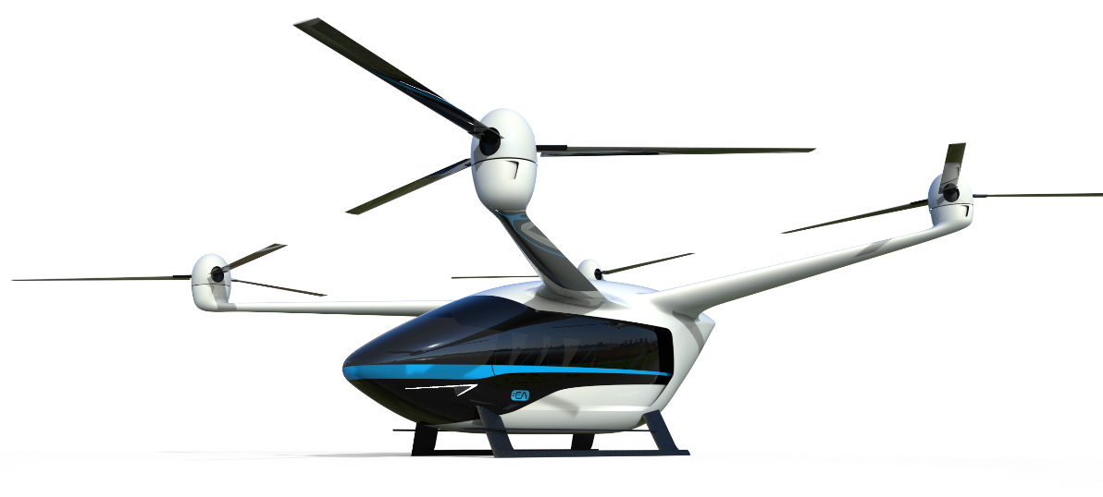
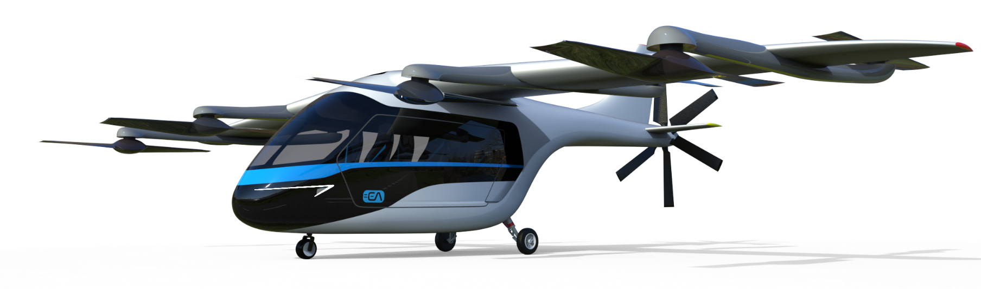
Background
Urban Air Mobility
  short, low altitude missions
  small-medium complement
  multiple electric propulsors
  VTOL, hover, and cruise capabilities
  https://www.nasa.gov/uam-overview/
37.5 nmi

Slide 3
Motivation and Goals
UAM community (exterior) noise has received significant interest, but interior cabin noise is also expected to be an issue
  Numerous propulsor noise sources near fuselage
  Electric drive systems with rapidly varying RPM
Existing UAM cabin flight recordings are limited in availability
  Early design stage interior auralization is desired
Interior auralization by simulation
  Utilize existing, widely used vibroacoustic simulation techniques
  Ability to accept general excitations
  Broad frequency range for auralization

Slide 4
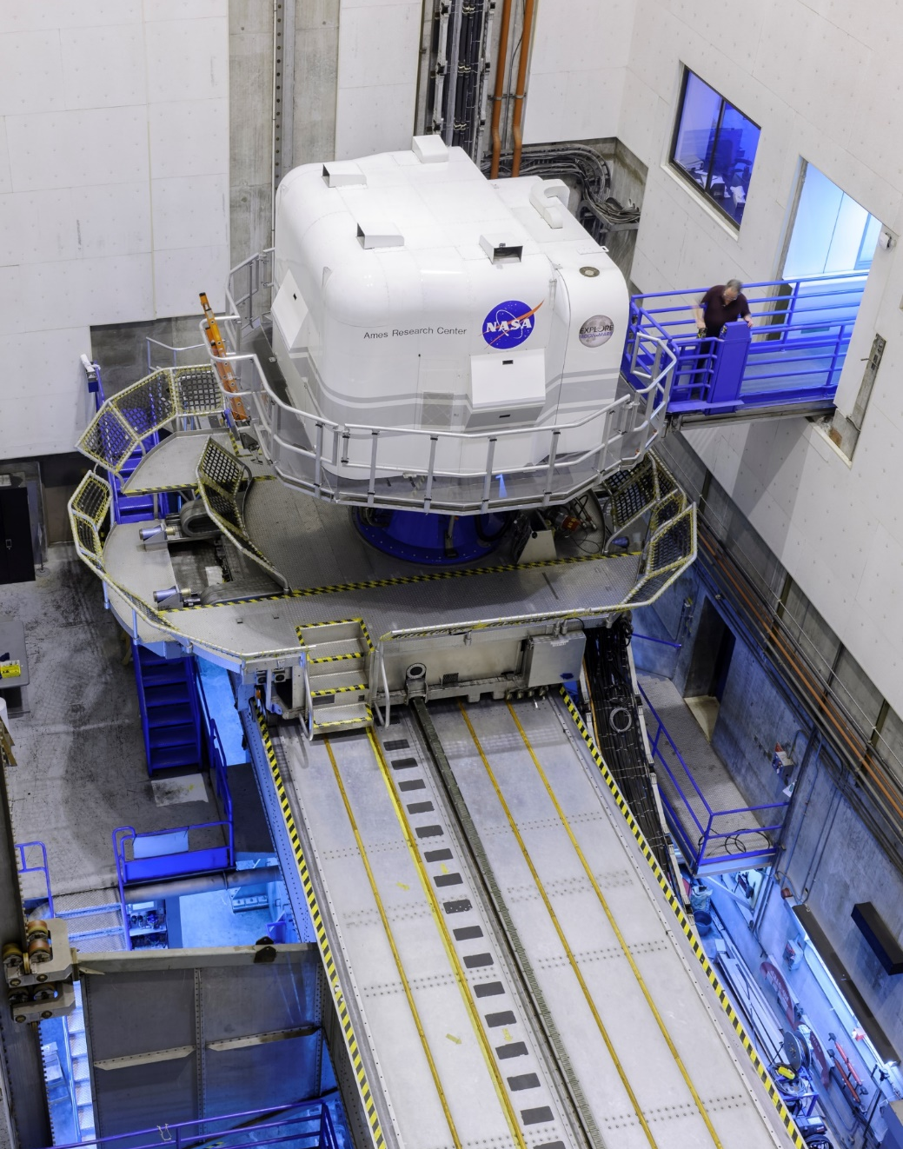
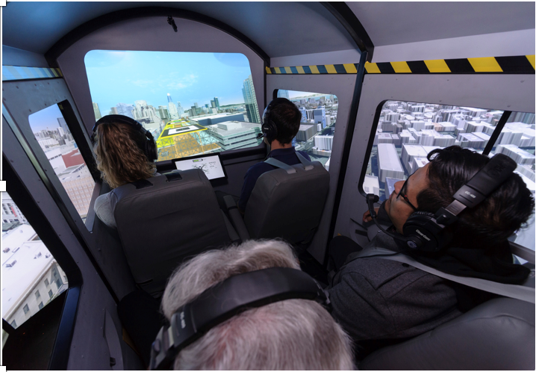
Possible Applications
Flight simulators
Psychoacoustic testing
Design guidance
https://www.nasa.gov/offices/setmo/facilities/vertical_motion_simulator

Slide 5
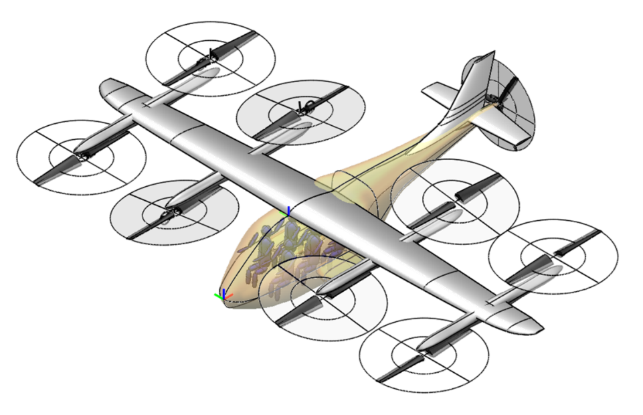
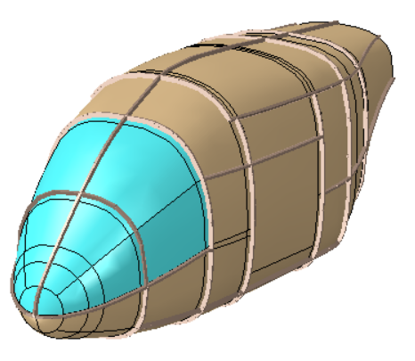
Scenario Considered
6-passenger UAM Lift+Cruise reference vehicle*
Simplifications & assumptions
  carbon laminate skin & frames
  acrylic windshields
  wing, tail, & interior trim removed
  frequency independent damping
  no fuselage scattering
*C. Silva et al., VTOL Urban Air Mobility concept vehicles for technology development. In Proceedings of the 2018 Aviation Technology, Integration, and Operations Conference, Atlanta, GA, June 2018.

Slide 6
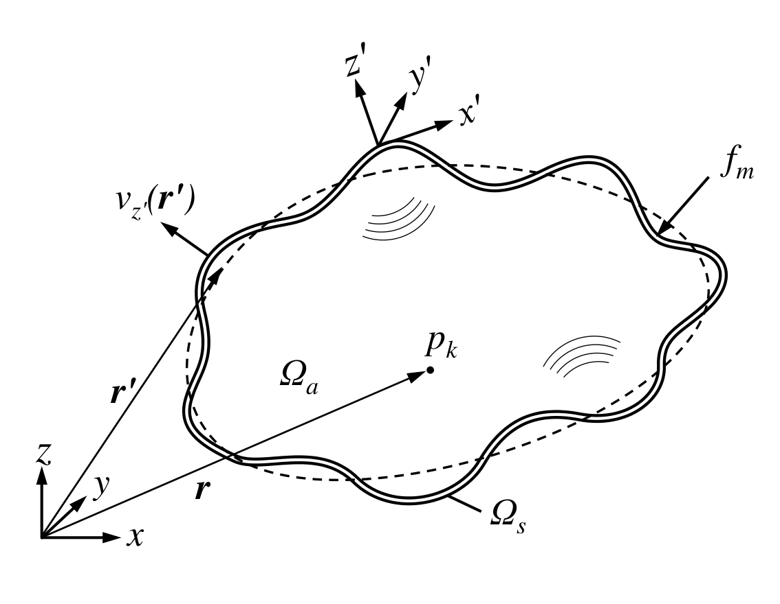
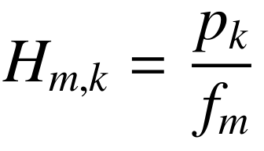

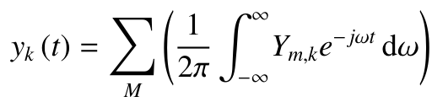
Modeling Procedure
transfer function dataset
unit normal force
discretized excitation field
(IFFT & sum contributions)

Slide 7
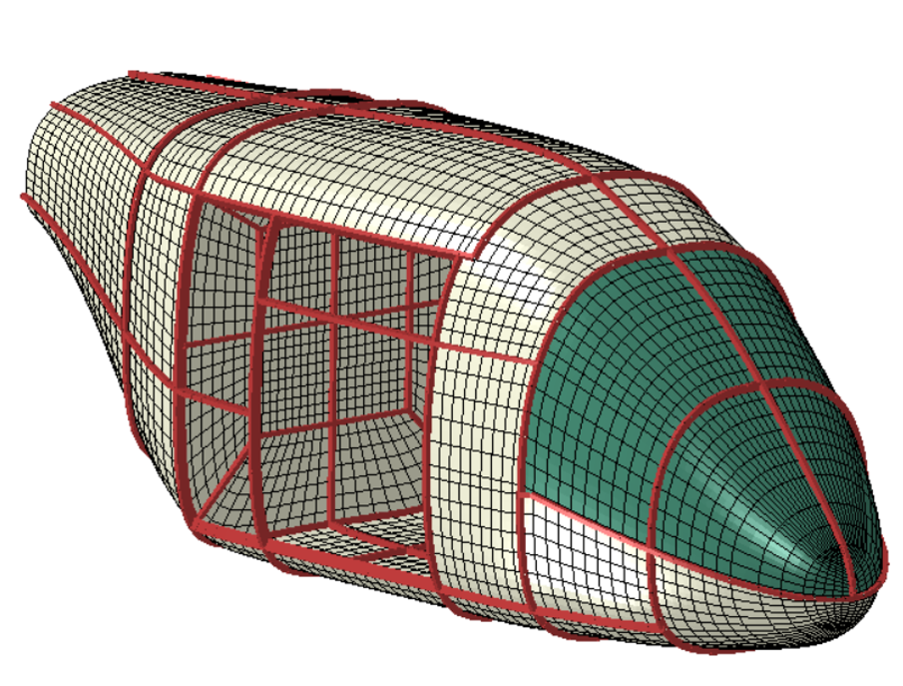
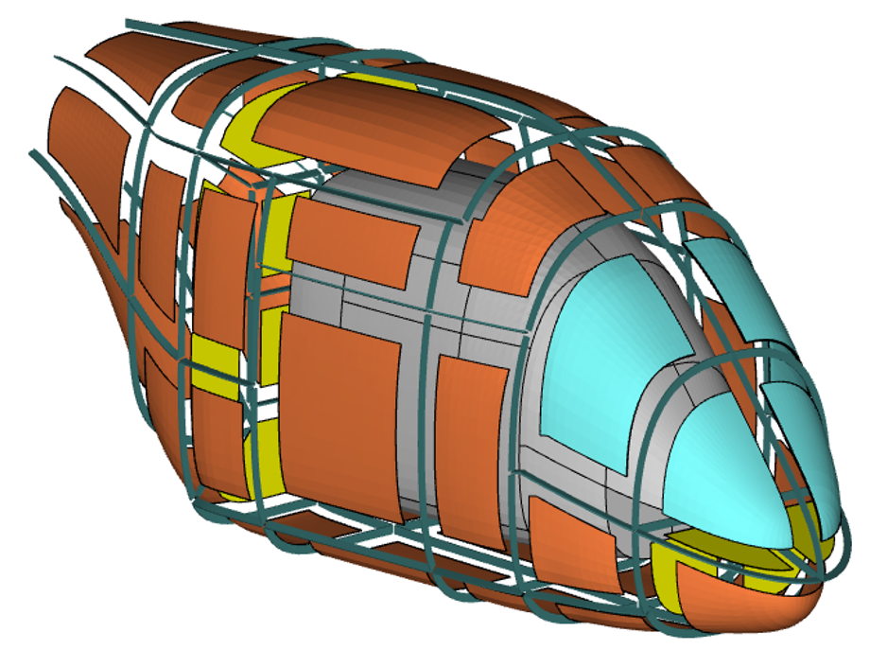
Hybrid Modeling Procedure
Finite Element Analysis
Statistical Energy Analysis
low frequencies
high frequencies
point-by-point response
phase information retained
model building and execution difficult at high frequencies
subsystem average response
phase information is lost
smaller matrices, fast solve times

Slide 8
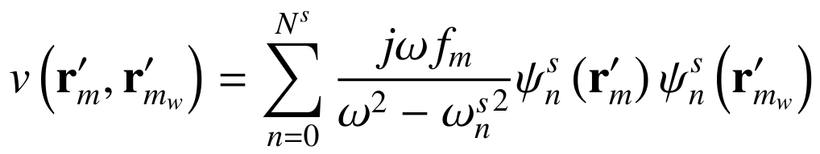
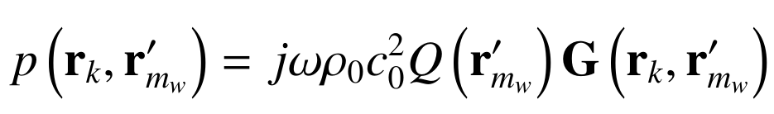
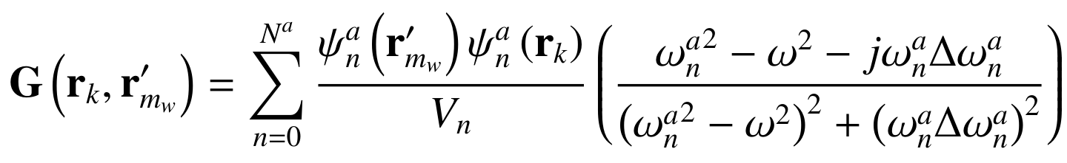
Finite Element Component
Populating H_{m,k}=p_{k}/f_{m} at low frequencies using FE modal decomposition...
unit force
mode shapes
natural frequencies
Green's function for enclosed acoustic volume

Slide 9
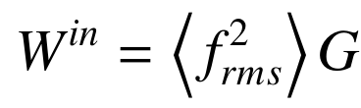
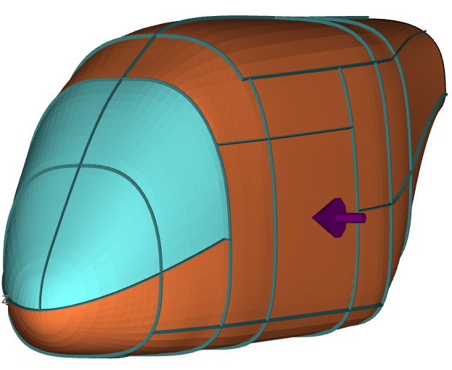
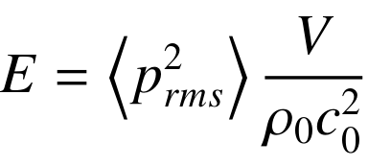
SEA Component I
Populating H_{m,k}=p_{k}/f_{m} at high frequencies using SEA...
1) Power input ( ) is now applied to a subsystem by specifying a spatially nonspecific MS normal force:
2) (Solve) Loss factor matrices are inverted resulting in subsystem energies
3) Average MS pressure within the interior determined:
mechanical conductance
*J. E. Manning, Formulation of SEA parameters using mobility functions. Phil. Trans. R. Soc. Lond. A, 346:477–488, 1994.

Slide 10

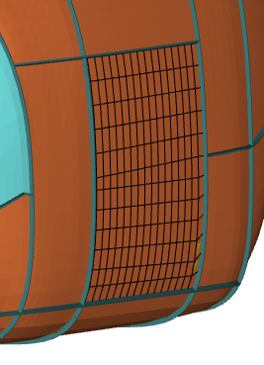
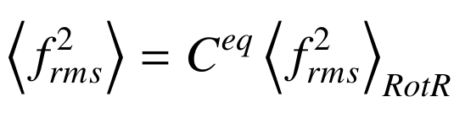
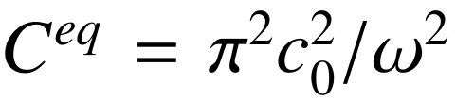
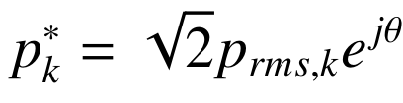
SEA Component II
4) MS force and resulting MS interior pressures are "projected" onto FE resolution to populate
5) Phase is reintroduced assuming interior diffuse field (θ uniformly sampled from [-π, π])
NOTE: An equivalent MS force is determined assuming diffuse field conditions on exterior (approx.) by using a correction factor*
*M. N. Ichchou, et al. Equivalent “rain on the roof” loads for random spatially correlated excitations in the mid-high frequency range. JSV, 322:926–940, 2009.

Slide 11
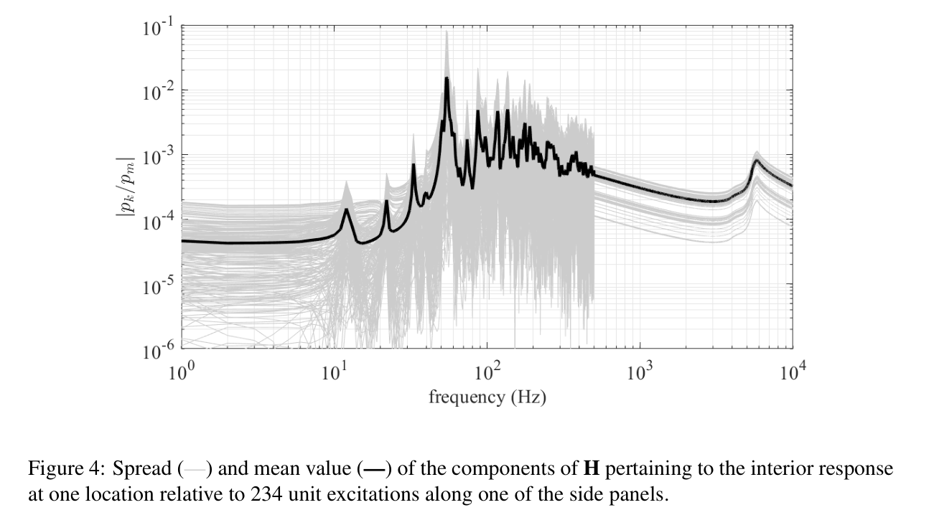
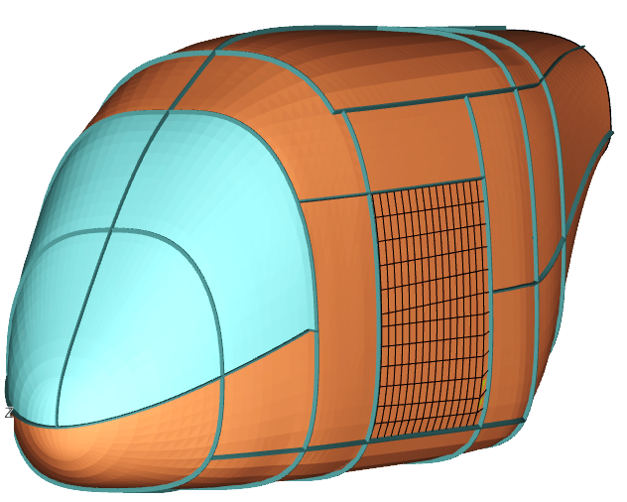
Transfer Function Dataset
500 Hz

Slide 12
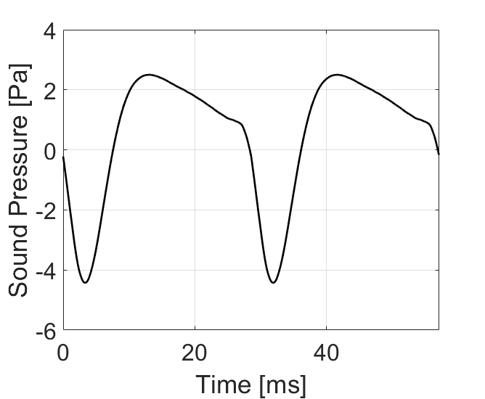
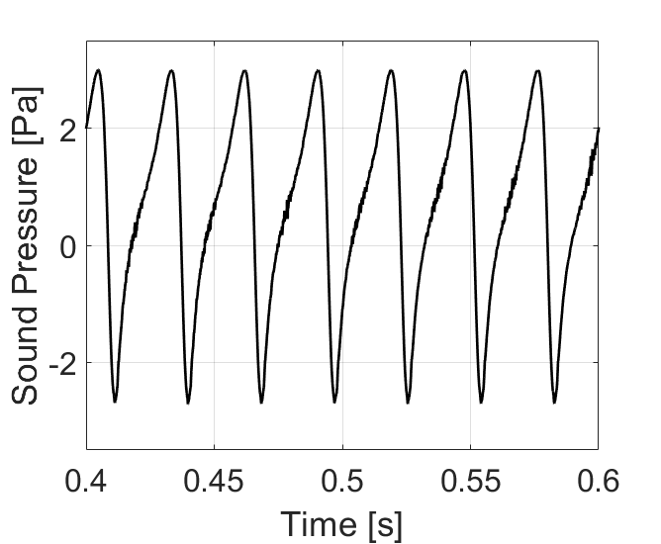

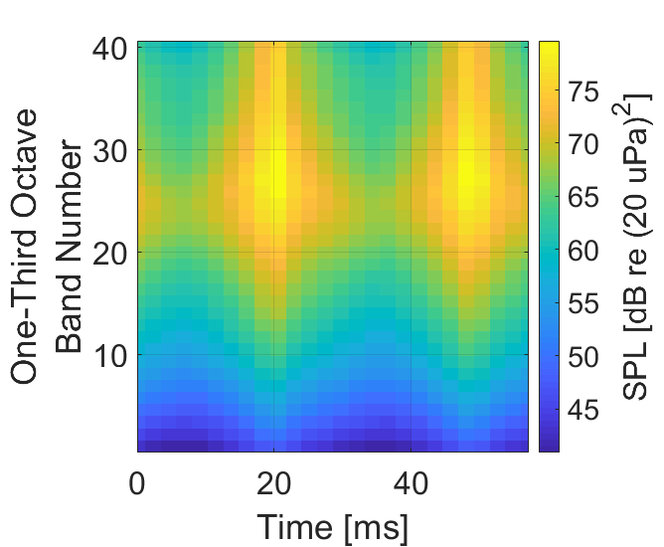
Noise Source
Fuselage exterior acoustic field due to propulsors during hover
1. Acoustic Predictions for each Rotor
Periodic Loading + Blade Thickness Noise
2. Sound Synthesis and Propagation
3. Auralized sound on fuselage exterior
NASA Auralization Framework
Broadband Self Noise

Slide 13
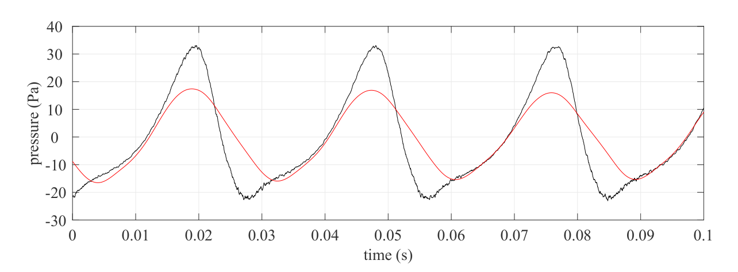


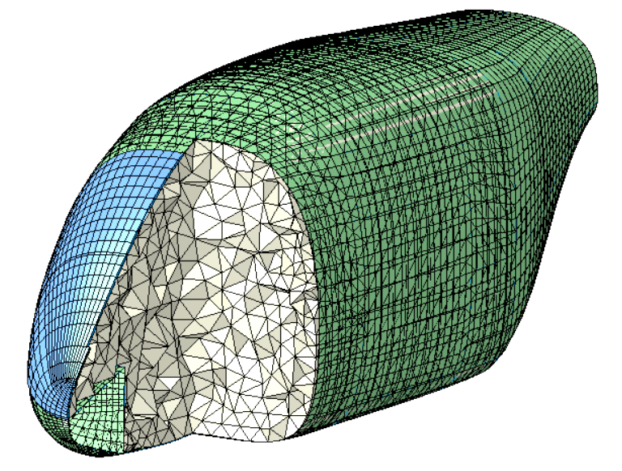
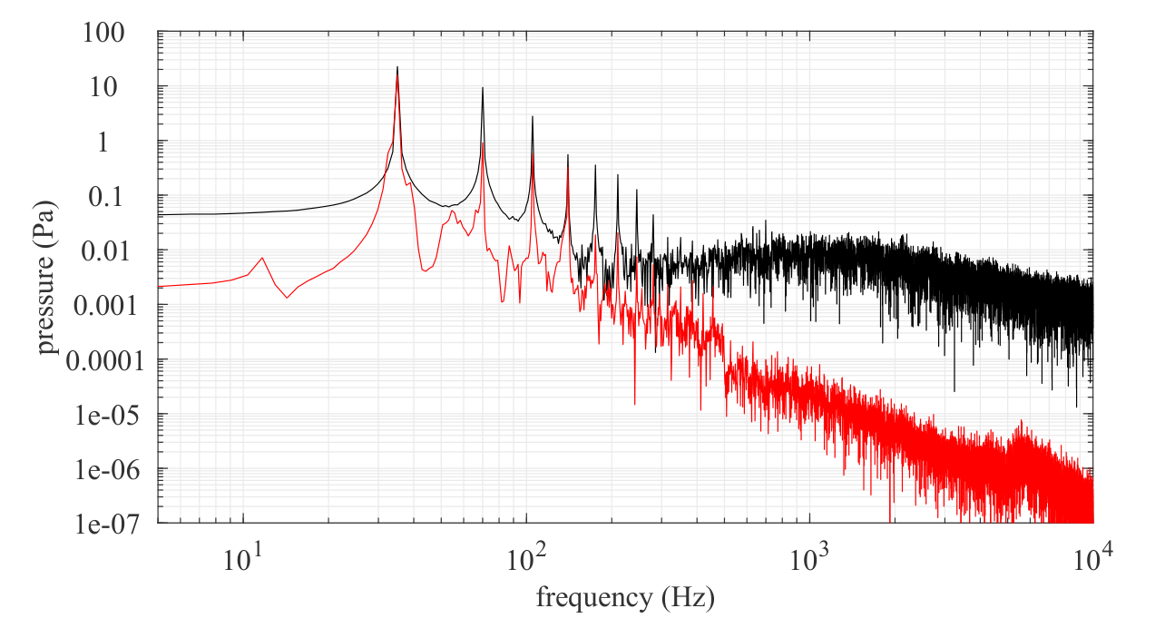
Auralization
exterior
interior

Slide 14
Conclusions
Hybrid auralization procedure demonstrated
  Deterministic, FE-based detail at low frequencies
  May be likened to an equalizer array with detail corresponding to the SEA subsystem partitioning scheme at high frequencies
  Congruous transfer function dataset amenable to various dynamic loads
  Adjustable simulation fidelity
Future Focus
Turbulent boundary layer excitation
Implementation within flight simulator systems

Slide 15
Backup Slides

Slide 16
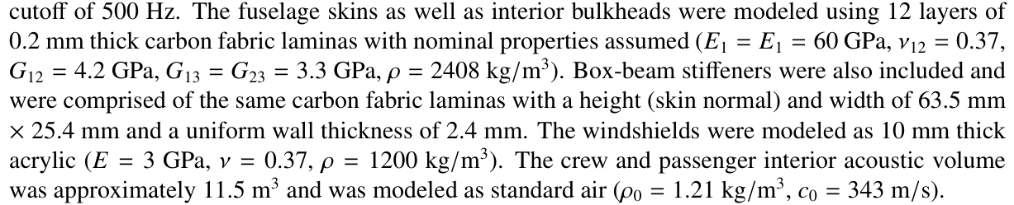
Fuselage Properties

Slide 17
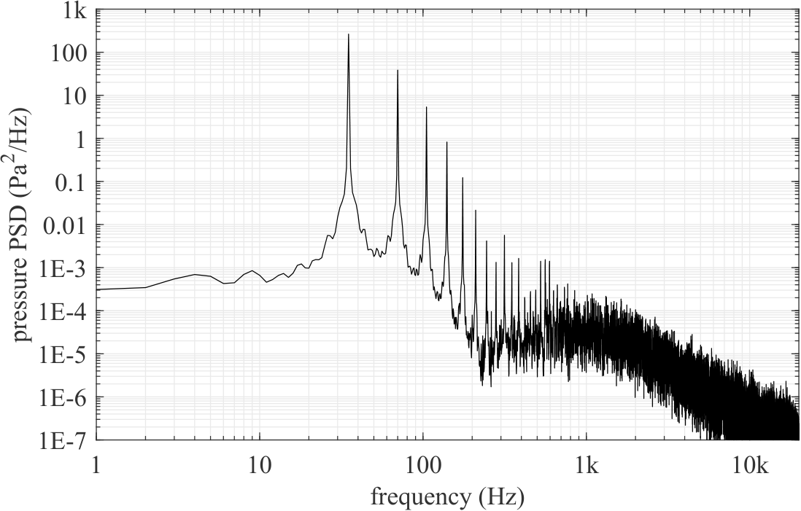
Representative pressure spectrum from eight propulsors

Slide 18
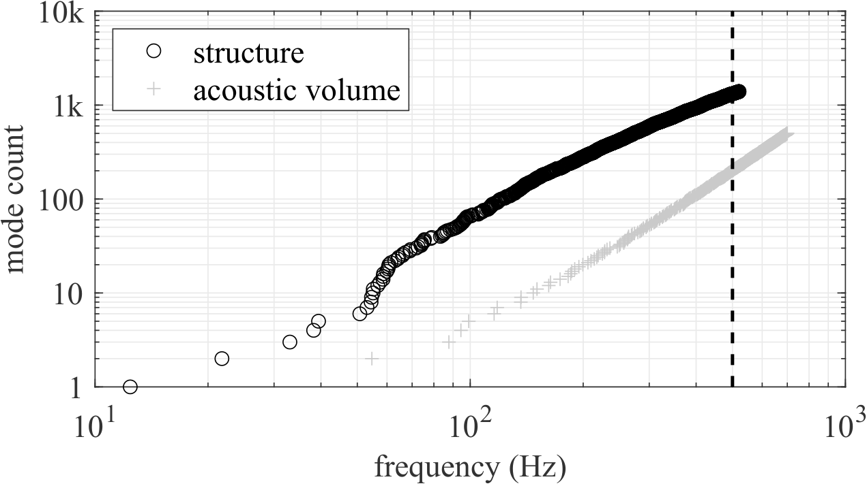
Fuselage/Interior Mode Count
1393 structural modes
502 acoustic modes
Modes included in analysis based on sliding envelope sized by a rudimentary convergence study

Slide 19
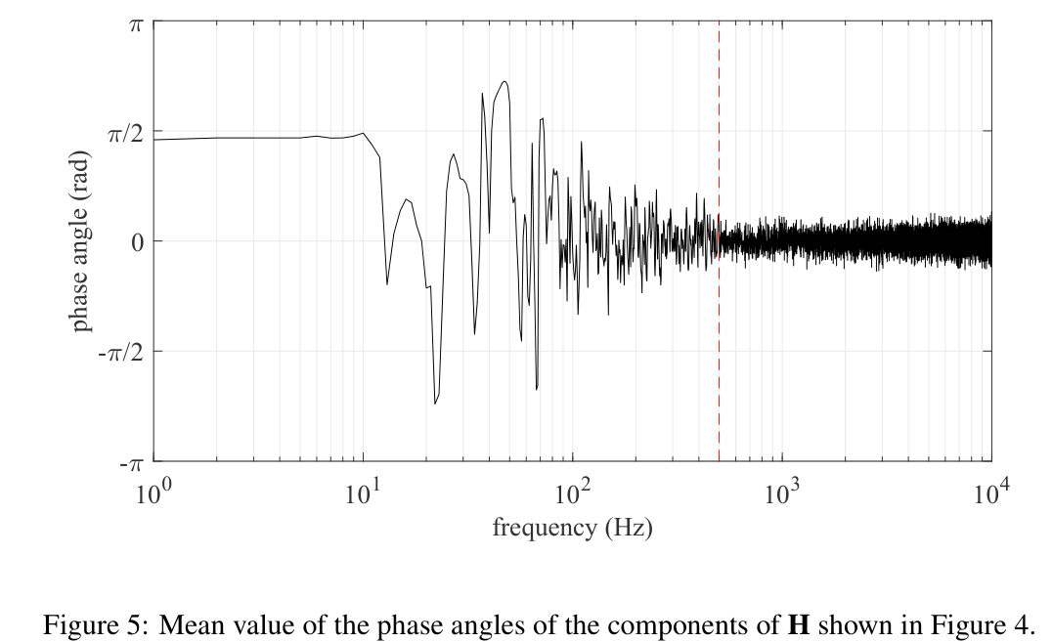
Interior Sound Field Diffusivity

Slide 20
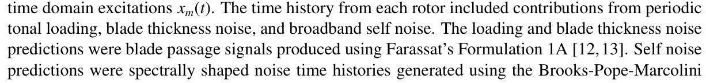
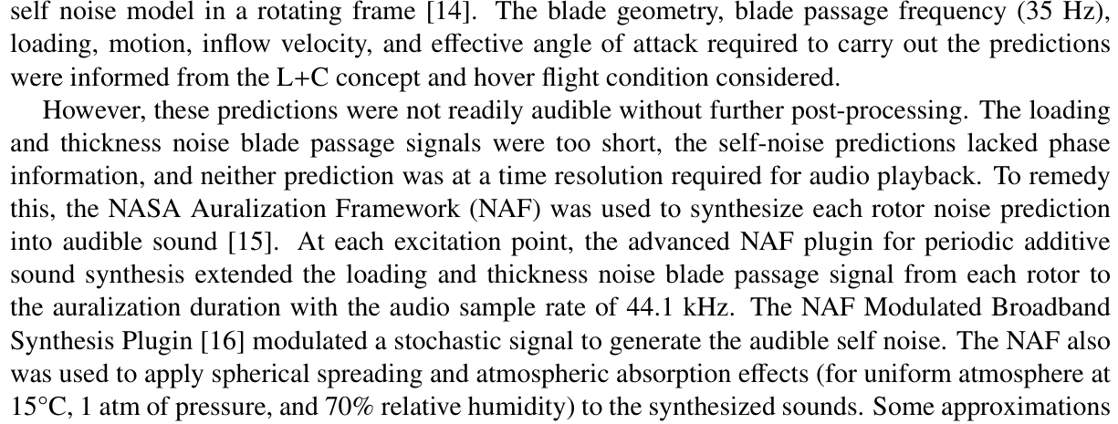
Source Modeling

Slide 21
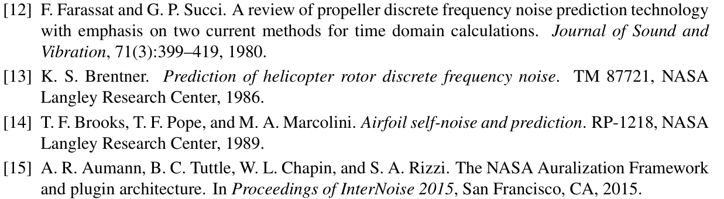
Source Modeling

