Slide 1



CERES DATA Management
Working group report
Spring 2023 CERES Science Team Meeting
Katie Dejwakh, Walter Miller & the CERES DMT
5.9.23

Slide 2
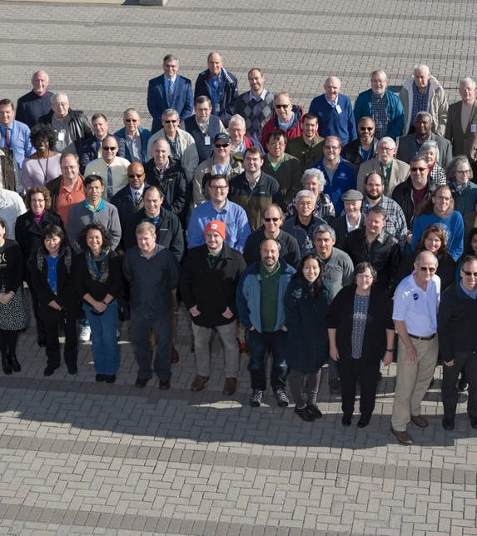
Agenda
TEAM
HIGHLIGHTS
CODE-REARCHITECTURE
SYSTEMS

Slide 3
Data Management Team
Instrument
Denise Cooper
Thomas Grepiotis
Dianne Snyder
Hunter Winecoff
ERBE-like
Dale Walikainen
Jeremie Lande
Inversion
Victor Sothcott
Igor Antropov

Slide 4
Data Management Team
SARB
Tom Caldwell
Clouds
Sunny Sun-Mack
Ricky Brown
Rita Smith
Elizabeth Heckert
Yan Chen
Steve Kohler
Walt Miller

Slide 5
Data Management Team
CM & Infrastructure
Nelson Hillyer
Tammy Ayers
Willinda Evans
Dennis Keyes
PR Tool
Carla Grune
Elizabeth Heckert

Slide 6
Data Management Team
TISA
Josh Wilkins
Beau Branch
Cathy Nguyen
Ed Kizer
FLASHFLux
PC Sawaengphokhai
Jay Garg
Hunter Winecoff

Slide 7
Data Management Team
CERES Ordering Tool
Pamela Mlynczak
Churngwei Chu
Babak Samani
ASDC Support
Sharon Dukes-Allen
Karen Brown
Chris Harris

Slide 8
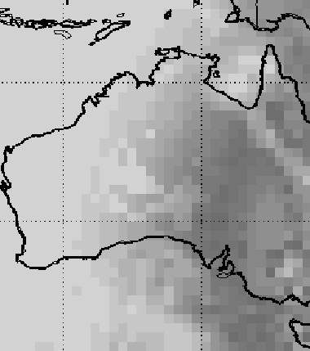
Highlights
DEVELOPMENT

Slide 9
Key deliveries
Cloud Radiative Swath (CRS) – new Edition 4 product
Incorporating NOAA-20 into Edition 4A
  FLASH-TISA
  TSIB/SYN1deg
  CldTypHist
PR Tool
  PHP 8.1
  OCP4
Edition 4A to 4B support
  Gridded GEO
  TSIB/SYN1deg
Support for metadata updating
Notes:
Also improved GEO Clouds in the switch to Edition 4B.

Slide 10
Edition 4A Product Availability
Product | Platform | Processed Thru | Publicly Available?
BDS | Terra, Aqua | January ’23 | Yes
SSF
CRS |  | 2018 - 2022
 | Terra, NOAA-20 | N/A | No

Slide 11
Edition 4A Product Availability
Product | Platform | Processed Thru | Publicly Available?
SSF1deg-Hour* | Terra, Aqua | January ’23 | Yes
SSF1deg-Day/-Month*
SYN1deg-1Hour/Mhour** | Terra+Aqua | March ‘22
SYN1deg-Day/-Month**
SYN1deg-1Hour/MHour | Terra+NOAA-20 | April ‘22 – December ’22
SYN1deg-Day/-Month
* Aqua processing suspended February 2023. Instrument in RAPS mode.
** Terra+Aqua ended in March 2022. Terra+NOAA-20 began in April 2022.

Slide 12
Edition 4A Product Availability
Product | Platform | Processed Thru | Publicly Available?
CldTypHist | Terra+Aqua | December ‘22 | Yes
FluxByCldTyp |  | March ‘22
EBAF | Terra+Aqua, NOAA-20 | March ‘22
EBAF ToA |  | February ‘23

Slide 13
Edition 2A S-NPP Product Availability
Product | Platform | Processed Thru | Publicly Available?
BDS | S-NPP | January ‘23 | Yes
SSF
SSF1deg-Hour |  | Sept. ’19*
SSF1deg-Day/-Month
* L3 processing stopped. Instrument in RAPS mode.

Slide 14
Edition 1B NOAA-20 Product Availability
Product | Platform | Processed Thru | Publicly Available?
BDS | NOAA-20 | February ‘23 | Yes
SSF
SSF1deg-Hour
SSF1deg-Day/-Month

Slide 15
Edition 5 DEVELOPMENT - CODE
Instrument
Enhanced BDS (L1B) Product
Inversion
land surface emissivity
climatology
MODIS land cover dataset
Clouds
SARB
TISA
neural net for cloud fraction
updated snow and ice maps
GEOS-IT MOA in netCDF4
MODIS C7
GEOS-IT MOA
MATCH (CAM6??)
Utilizing new C++ Gridding Codebase
0.5° x 0.5° grid
Decoupled files & functions
ALL subsystems will:
Output in HDF5 or netCDF4
Eliminate usage of binary files
Follow metadata best practices

Slide 16
Edition 5 DEVELOPMENT - INPUTS
MOA
GMAO
GEOS-IT-based
MODIS
MODIS C7
radiance &
geolocation
ESNOW &
EICE
NSIDC
NOAA CDR sea ice & real time data
Interactive, multisensor snow & ice (NH)
0.5° x 0.5° lat/lon
Aerosols

Slide 17
Edition 5 DEVELOPMENT - Strategy
Iterate early and as often as possible:
Running “Alpha 1” Edition 5 SSFs starting September 2023
    Largely Ed4 codebase
    Any available input test data/file formats
Initial delivery of MODIS → initial production of ADMs →
Beta production of downstream products
Formal scheduler on board
Schedule largely driven by availability of updated input data

Slide 18
Edition 5 DATA PRODUCT Availability
Product | Terra and Aqua | S-NPP and NOAA-20
BDS | SEP 2023 | DEC 2023
SSF | JUL 2025 | MAR 2026
CRS | APR 2026 | AUG 2026
SSF1deg-Hour | SEP 2025 | APR 2026
SSF1deg-Day/Month | OCT 2025 | MAY 2026
SYN1deg-1Hour/Mhour/Day/Month | MAY 2026 | JUL 2026
CldTypHist | NOV 2026 | SEP 2026
FluxByCldTyp | NOV 2025 | MAY 2026
EBAF-TOA |  | SEP 2026
EBAF |  | DEC 2026

Slide 19
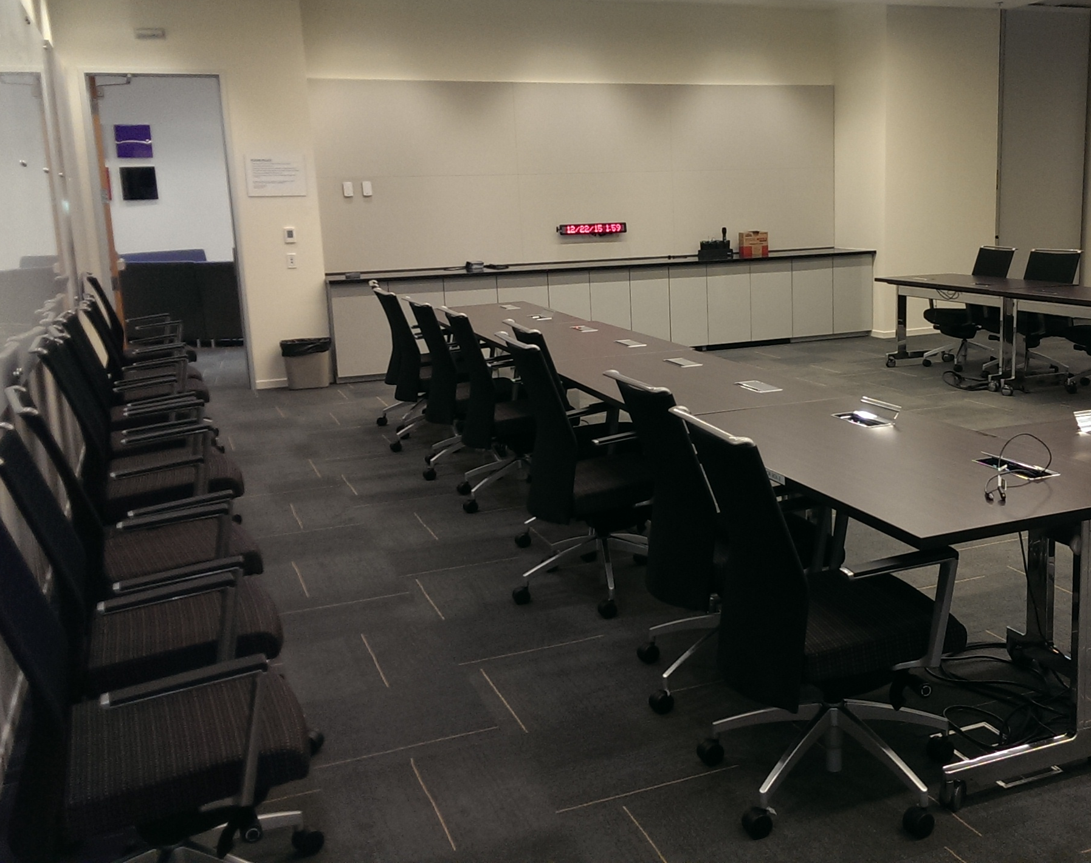
Libera
DATA MANAGEMENT WORKING GROUP
LASP-RBSP every-other-week meetings
First in-person DMWG meeting held September 8-9, 2023
Working on ICDs:
  LASP-ASDC
  ASDC-RBSP
Access to software repository; open communication

Slide 20

Code
Re-architecture
TISA and Clouds

Slide 21

Code Re-architecture
Clouds
CLOUD COMPUTING WORK:
2 PGEs run successfully in NASA’s Science Managed Cloud Environment (SMCE) in AWS
  CER4.1-4.1P6 (Clouds hourly)
  CER4.1-4.2P5 (Clear sky map)
Runtime equivalent to on-premises processing environment
Currently validating test data
Next step:
How to simplify configuration and testing?
Notes:
Image from: https://www.rawpixel.com/image/5906639/photo-image-light-desktop-wallpapers-public-domain (Creative Commons)

Slide 22
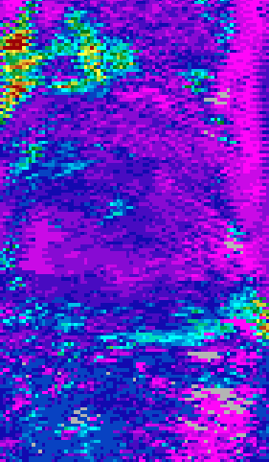
Code Re-architecture – Clouds
CLOUD MASK WORK:
C++ core structure in place
Configuration files in place
Day, night, twilight
  Polar tests ✓
  Non-polar tests ✓
  Magic numbers ✓
More nuanced cloud test logic in progress

Slide 23
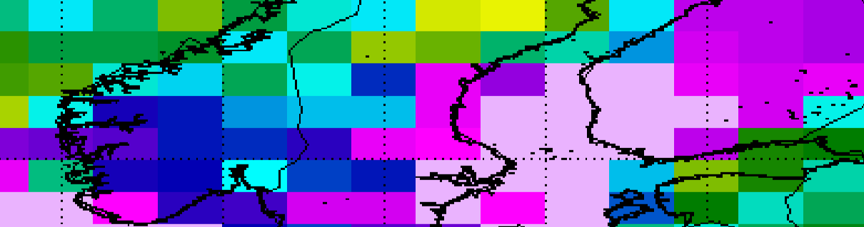
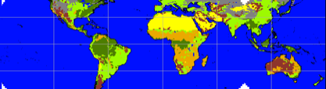
CODE RE-ARCHITECTURE – TISA
GRIDDING WORK – C++
TEMPORAL INTERPOLATION/SPATIAL AVERAGING WORK – MODERN FORTRAN
Ongoing development
CRS1Deg:
  extension of C++ codebase
  (estimated release – August 2023)
  exercising codebase
Access functions:
  IGBP Type (decoupled from SSF1deg) using Daily SNOW/SEA-ICE Updated 10-minute base maps. netCDF4 format.
  ADM SW Scene Type ID
  ADM Factor
Unit testing for above components
Notes:
ADM SW Scene type ID – validated against Edition 4 (latest sea ice/ snow models)
ADM factor – tested and validated with CERES TRMM ADM tables
(Previously, everything above was intertwined with TSI code.)

Slide 24
CODE RE-ARCHITECTURE – TISA
NB RADIANCE TO BB FLUX:
xGLB files of global statistics
CERES-GEO Flux Normalization: Analyzing impact at 1 X 1 degrees, of various CERES-GEO spatial/temporal filter matching window sizes
  bias/rms error
  perceived continental boundaries
GENERAL REFACTORING:
SSF1deg-Hour, three-day-Interpolation/Averaging development for Cloud Properties
Isolating functionality among modules, functions, subroutines
Variable and function naming improvements
Ancillary files → netCDF4 format
Notes:
NB2BB work – only LW done and tested. SW components are in place but unfinished. 1x1 data doesn’t highlight continental boundaries. 5 x 5 does. Optimal size for matching window so that interplay between GEO boundaries and window size.
xGLB files are now netCDF4 (global stats for 1 x 1 degree, 5 x 5 degree, etc.)
SSF1deg-Hour work → temporal interpolation of 360, 180, 24, 5:
- 360 and 180 (lat long)
- 24 hours
- 5 cloud layers (4 individual layers + 1 total layer)
Had artificially introduced boundaries at the day level. Now doing 72 hours across.

Slide 25
SYSTEMS
ASDC & Ordering Tool

Slide 26
CERES ORDERING TOOL
Accommodated:
  Edition 4.2 EBAF and EBAF ToA
  new Level-2 CRS product
Seamlessly merged Terra-Aqua and Terra-NOAA20 records in SYN1deg
Increasing reliability of internal/testbed tool infrastructure, moving to VMs
Several feature/bug fix releases

Slide 27
ASDC and SCF SUPPORT
Continued support for processing and storage infrastructure
OpenShift4 transition underway – CERES website, internal sites
Collection-level metadata issue still resolving
  Core CERES and FLASHFlux products ~80% complete
  GEO Clouds still outstanding

