Slide 1

An Overview of the Proprotor Performance Test in the 14- by 22-Foot Subsonic Tunnel
Nikolas Zawodny, Kyle Pascioni, and Christopher Thurman
Aeroacoustics Branch
NASA Langley Research Center
Funding provided by the NASA RVLT project
Vertical Flight Society 79th Annual Forum & Technology Display
16-18 May 2023

Slide 2
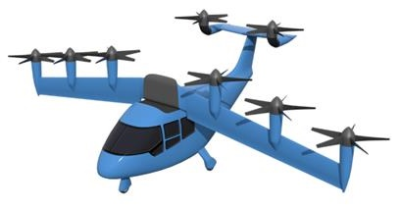
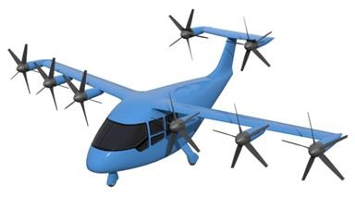
Introduction and Objectives
Propellers historically designed as a means of thrust generation in axial forward flight
Rotors historically designed as a means of providing vertical lift during takeoff and landing and operate in edgewise forward flight
Urban Air Mobility (UAM) vehicle platforms that utilize articulating propulsors require elements of both
Such proprotors experience complex aerodynamics and acoustics during transition phases of flight
Objectives:
  Acquire data emulating transition flight conditions representative of AAM configurations
  Compare results with existing low- and mid-fidelity prediction techniques to identify shortcomings
Tiltwing Concept Vehicle
VTOL mode
Cruise mode

Slide 3
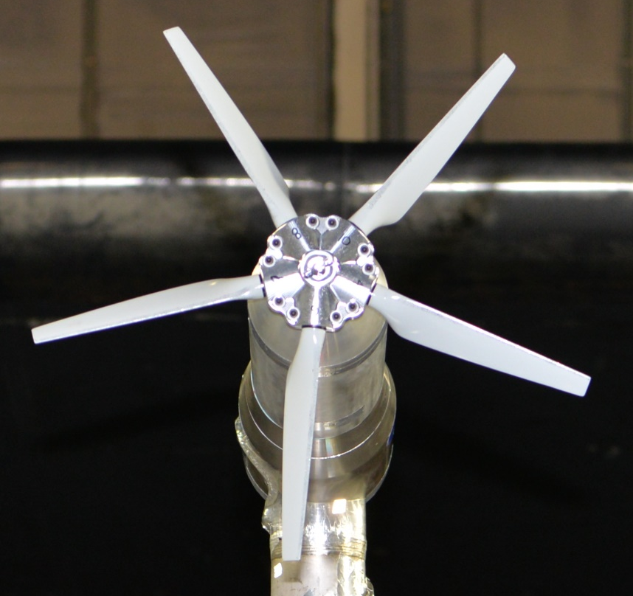
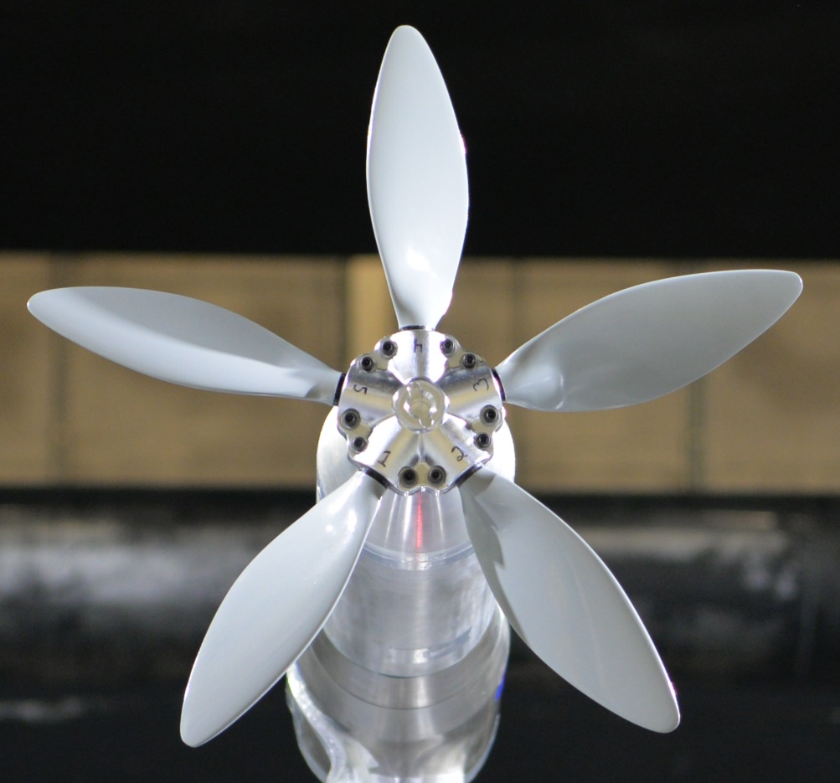
Proprotor Designs
OPT5
COPR5
Two proprotor designs considered in this study
  2 ft. diameter
  NACA 0012 airfoil profiles
OPT5
  Conventional “optimum hovering rotor” design
  Model-scale representation of rotor designed for RVLT tiltwing concept*
COPR5**
  Computationally optimized for maximum cruise efficiency
  Constraints of target thrust and radiated tonal noise
Source: NASA
Source: NASA
Twist Distributions
Chord Distributions
*Whiteside et al., NASA TM 20210017971, NASA Langley Research Center, 2021.
**Zawodny et al., NASA TM 20220015637, NASA Langley Research Center, 2023.

Slide 4
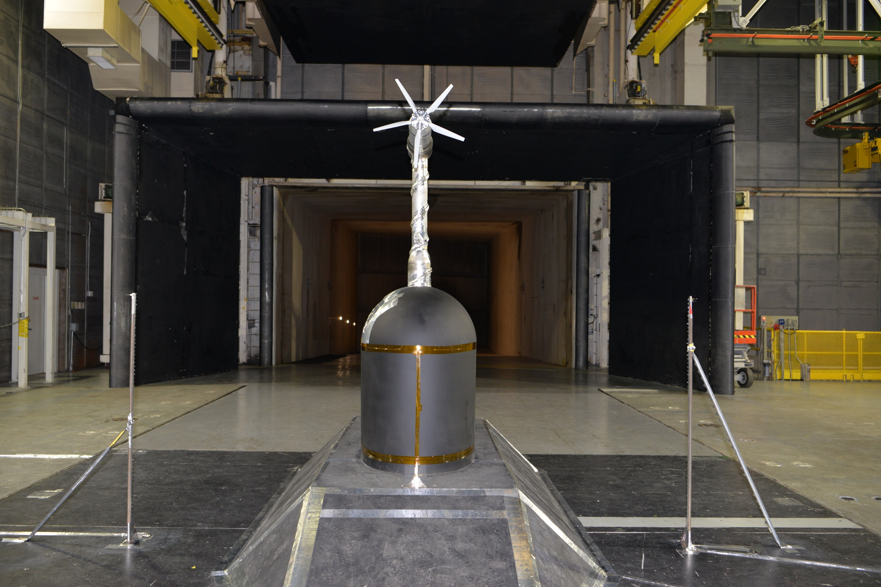
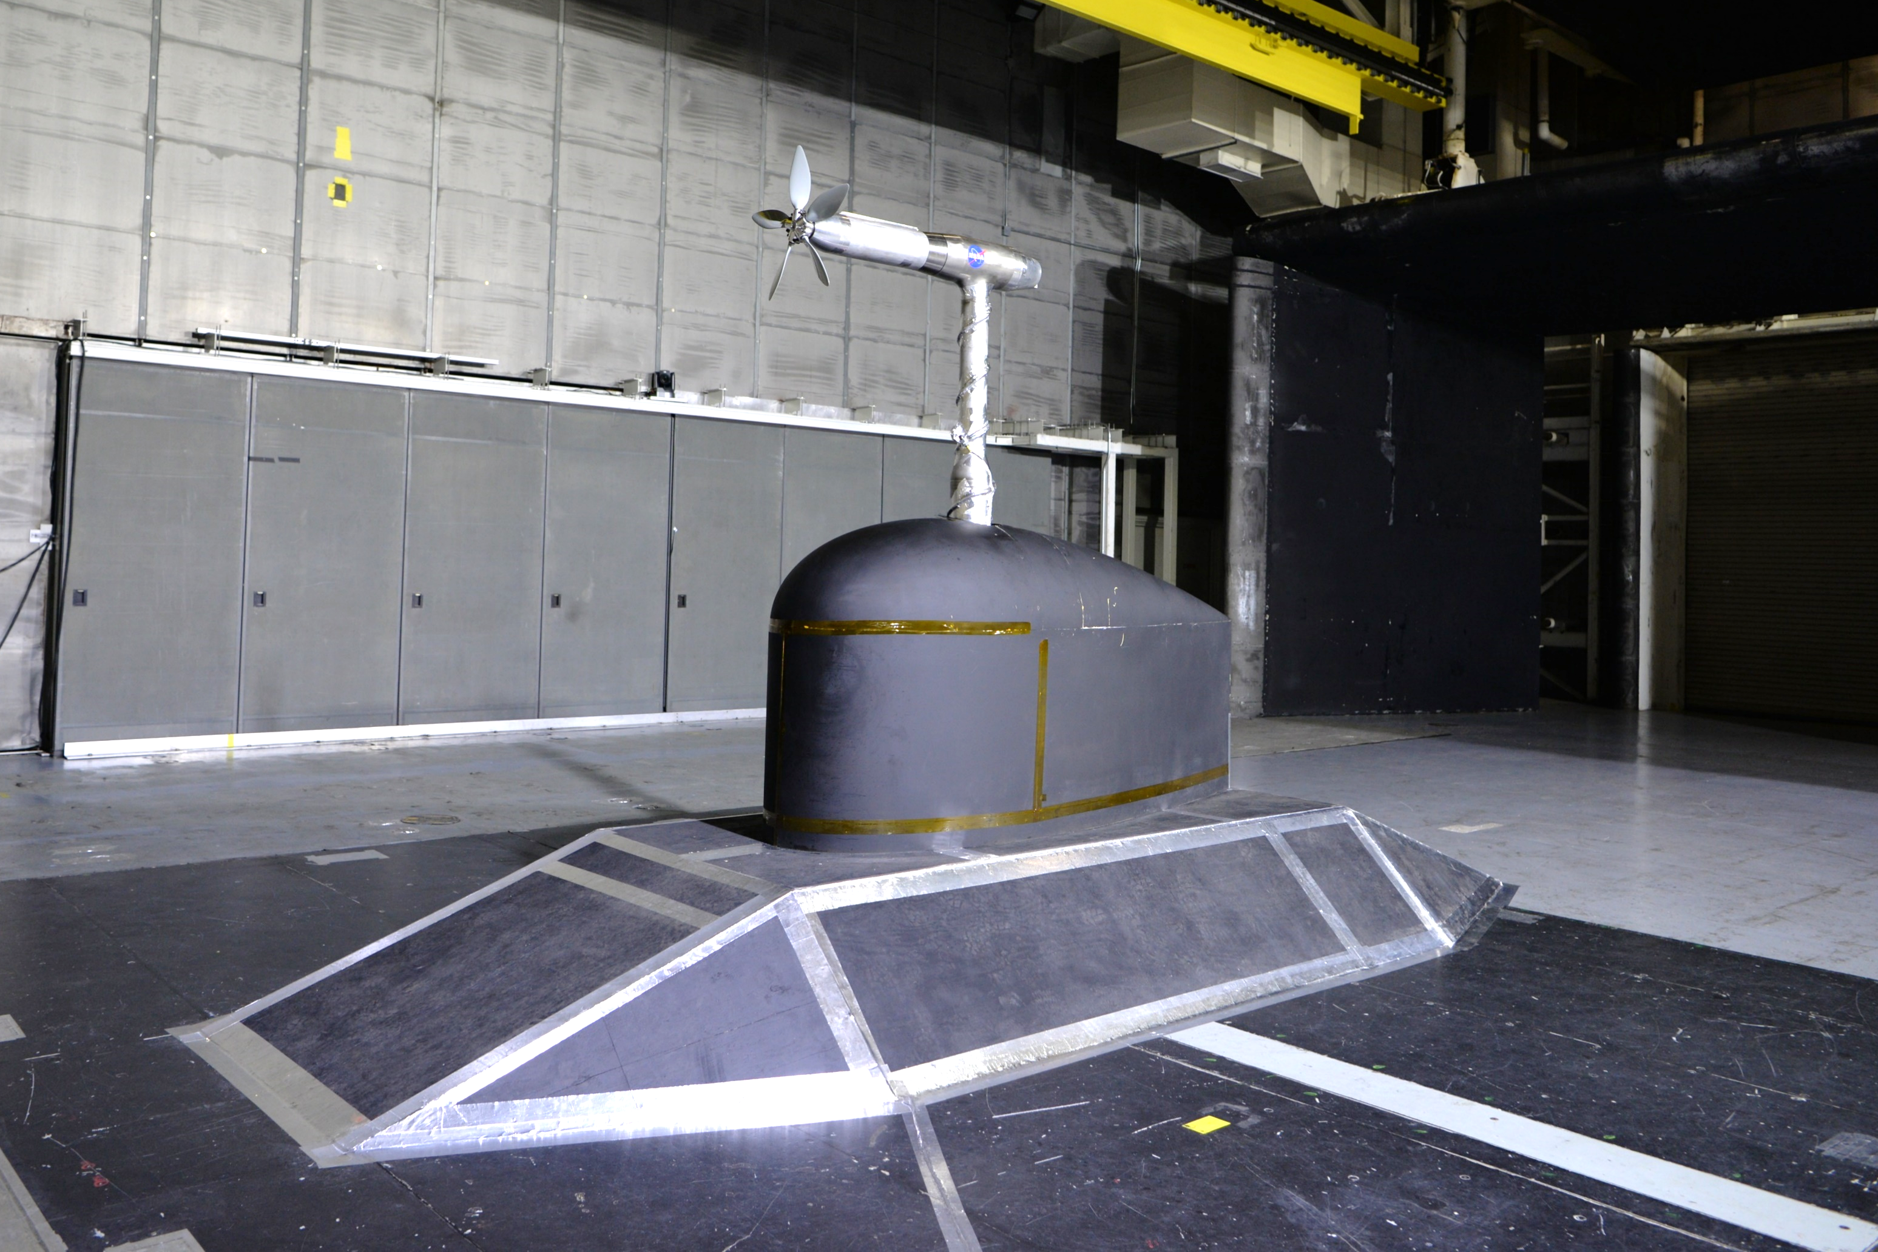
Experimental Setup: Wind Tunnel Facility
Downstream View
14- by 22-Foot Subsonic Tunnel
  Used extensively for both aerodynamic and acoustic studies
  Utilized the open-jet test section configuration
  Large test section size relative to proprotor diameters
Airfoil with “tear drop” base fairing and floor ramp structure
Inflow microphone and hotwire probes
  Initial insight for future acoustic testing
  Assessment of freestream turbulence
Proprotor
Propeller
Test Stand
Inflow Microphone
Hotwire Probe
Fairing
Source: NASA
Floor Ramp
Sideline View
Source: NASA

Slide 5
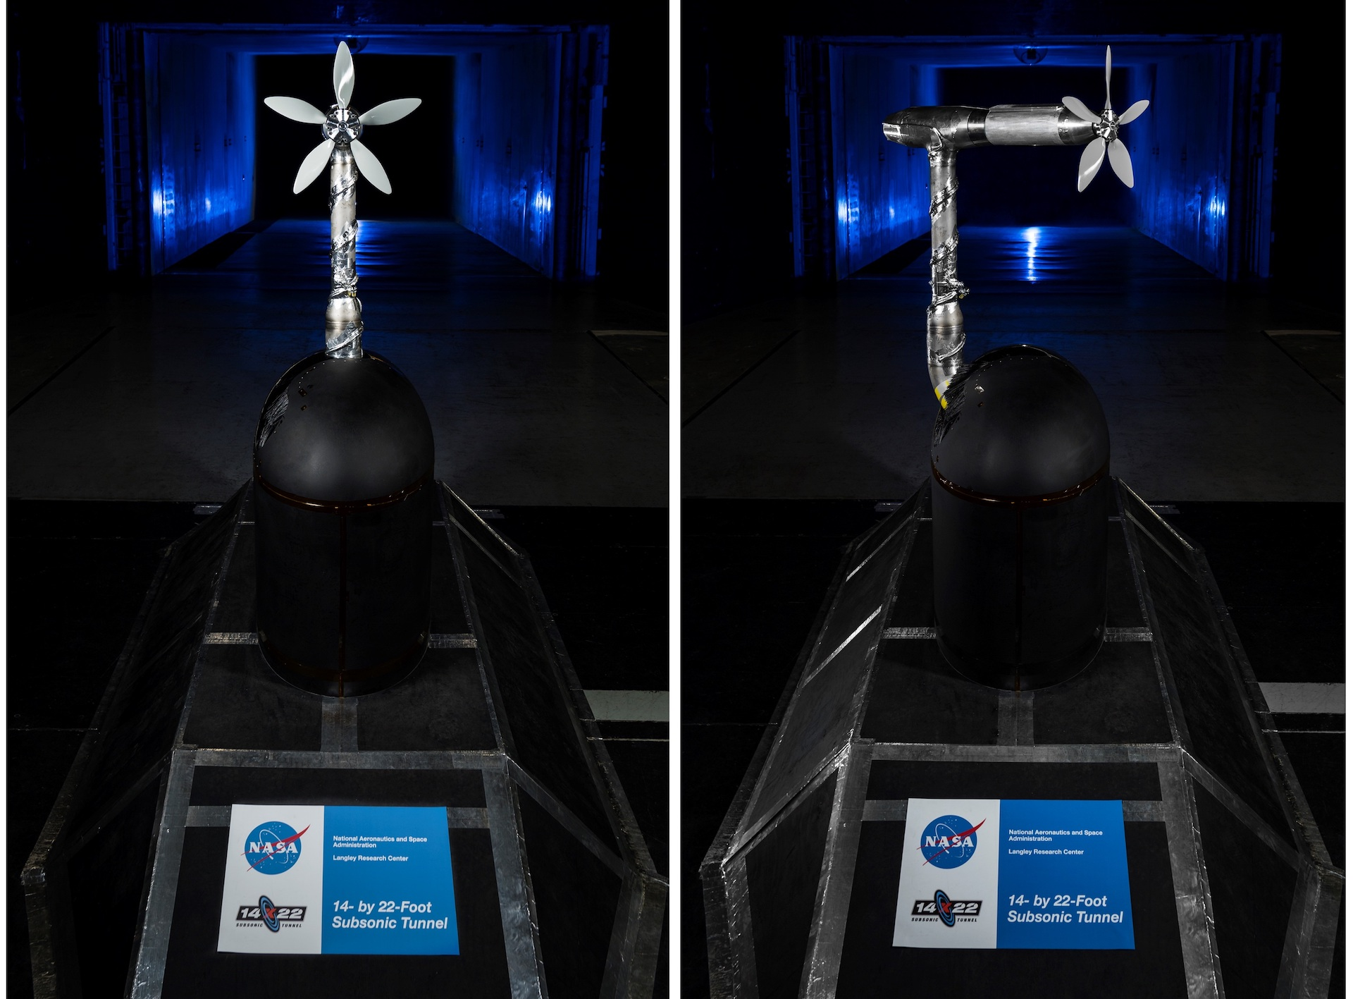
Experimental Setup: Propeller Test Stand (PTS)
Designed to evaluate installed propeller/rotor noise and performance in NASA’s wind tunnel facilities
Wide range of operational capabilities
  Roll, pitch, and yaw articulations
  Operational speed range of 250 to 16k RPM
  Capable of 52 kW continuous operation
Onboard measurements
  Six-component multiaxis load cell (Mini85)
  Aft-mounted triaxial accelerometer
  Thermal probes
  Laser tachometer for rotation rate monitoring
Illustration of PTS Articulation
Source: NASA

Slide 6
Experimental Setup: Propeller Test Stand (PTS)
Designed to evaluate installed propeller/rotor noise and performance in NASA’s wind tunnel facilities
Wide range of operational capabilities
  Roll, pitch, and yaw articulations
  Operational speed range of 250 to 16k RPM
  Capable of 52 kW continuous operation
Onboard measurements
  Six-component multiaxis load cell (Mini85)
  Aft-mounted triaxial accelerometer
  Thermal probes
  Laser tachometer for rotation rate monitoring
Cutaway View of PTS Motor Assembly

Slide 7
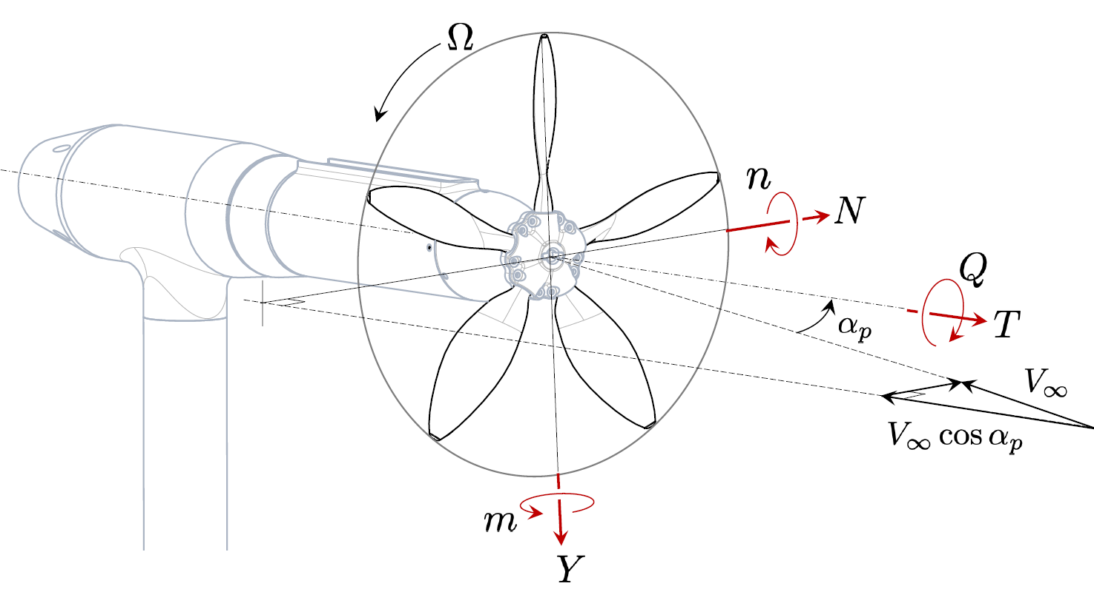
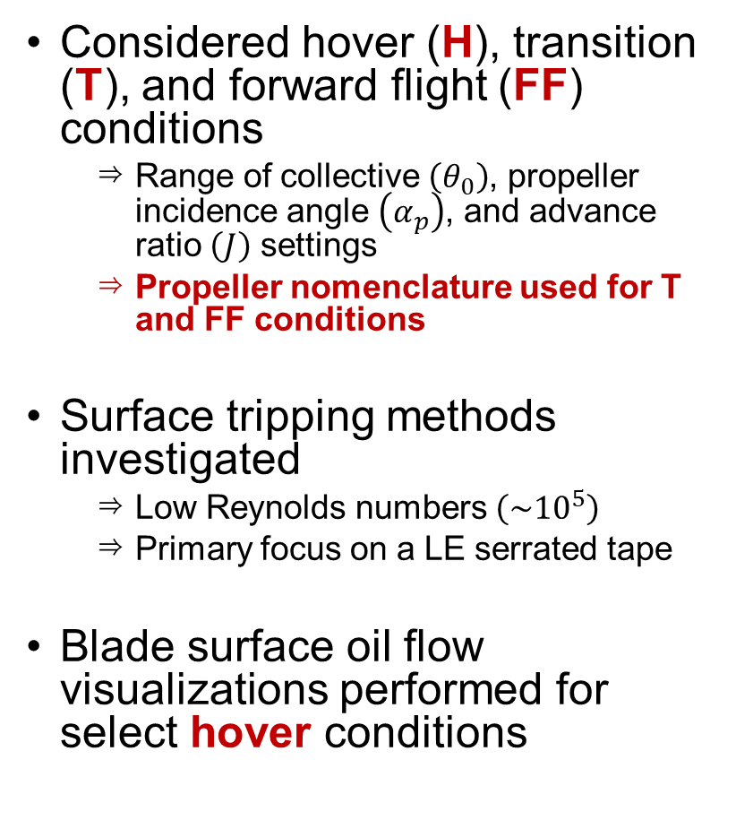
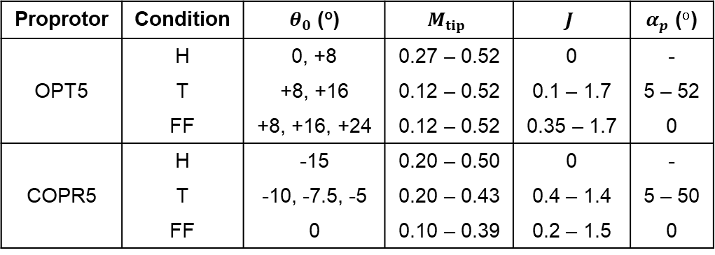
Experimental Setup: Test Conditions
Considered hover (H), transition (T), and forward flight (FF) conditions
  Range of collective $\left(θ_{0}\right)$, propeller incidence angle $\left(α_{p}\right)$, and advance ratio $\left(J\right)$ settings
  Propeller nomenclature used for T and FF conditions
Surface tripping methods investigated
  Low Reynolds numbers $\left(\sim {10}^{5}\right)$
  Primary focus on a LE serrated tape
Blade surface oil flow visualizations performed for select hover conditions
Tested Conditions
Proprotor | Condition | $θ_{0}$ (º) | $$M_{tip}$$ | $$J$$ | $α_{p}$ (º)
OPT5 | H | 0, +8 | 0.27 – 0.52 | 0 | -
 | T | +8, +16 | 0.12 – 0.52 | 0.1 – 1.7 | 5 – 52
 | FF | +8, +16, +24 | 0.12 – 0.52 | 0.35 – 1.7 | 0
COPR5 | H | -15 | 0.20 – 0.50 | 0 | -
 | T | -10, -7.5, -5 | 0.20 – 0.43 | 0.4 – 1.4 | 5 – 50
 | FF | 0 | 0.10 – 0.39 | 0.2 – 1.5 | 0
Schematic of Proprotor Forces and Moments

Slide 8
Experimental Setup: Measurement Uncertainty
Load cell prone to DC thermal drift issues
  Thermal gradients
  Prominent constant cantilever load
  Required use of highest load calibration range for sensor
Thermal soaking processes implemented
Repeatability errors assessed
  Repeated operating conditions during run sequences
  Used to compute force/moment and coefficient uncertainties
Measurement Uncertainties of Thrust and Power Coefficients
Measurement Uncertainties of Normal Force and Yaw Moment Coefficients
Force and Moment Repeatability Errors
Flight Condition | T, N, Y (N) | Q, n, m (Nm)
H | 4.448 | 0.113
FF, T | 2.224 | 0.057

Slide 9
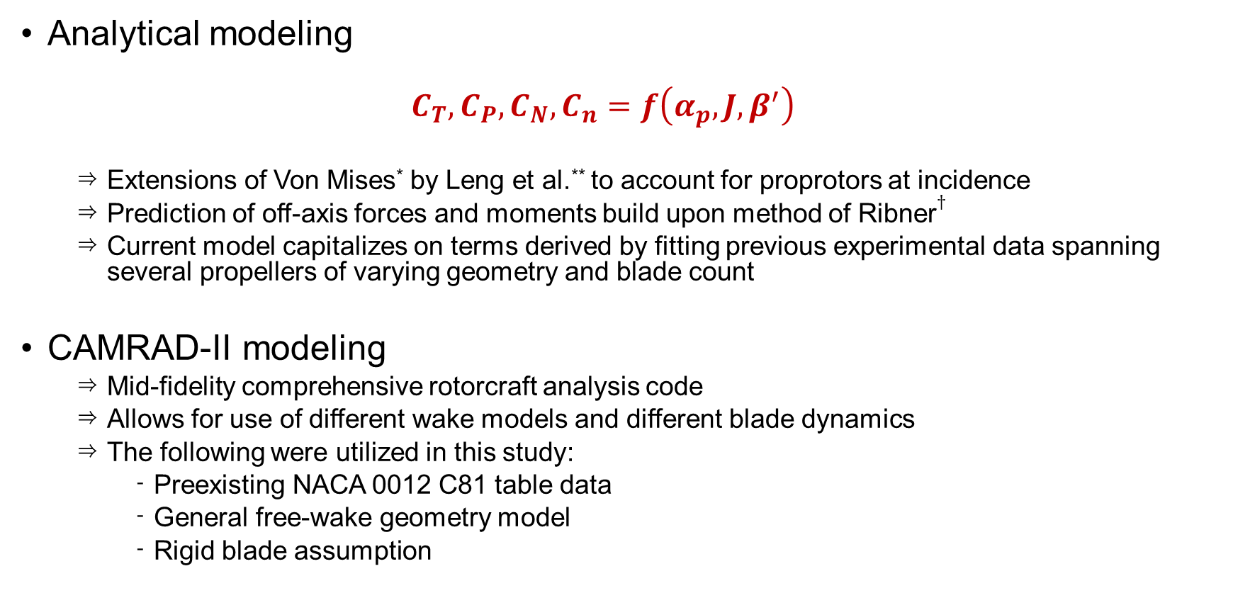
Computational Tools
Analytical modeling
  $$C_{T}, C_{P}, C_{N}, C_{n}=f\left(α_{p}, J, β^{′}\right)$$
  Extensions of Von Mises* by Leng et al.** to account for proprotors at incidence
  Prediction of off-axis forces and moments build upon method of Ribner$†$
  Current model capitalizes on terms derived by fitting previous experimental data spanning several propellers of varying geometry and blade count
CAMRAD-II modeling
  Mid-fidelity comprehensive rotorcraft analysis code
  Allows for use of different wake models and different blade dynamics
  The following were utilized in this study:
    Preexisting NACA 0012 C81 table data
    General free-wake geometry model
    Rigid blade assumption
*Von Mises, R., Theory of flight, Courier Corporation, 1959.
**Leng, Y., Moschetta, J.M., Jardin, T., and Bronz, M., “An Analytical Model for Propeller Aerodynamic Efforts at High Incidence,” 54th 3AF International Conference on Applied Aerodynamics, Paris, France, March 2019.
$†$Ribner, H. S., “Propellers in Yaw,” NACA Report No.820, 1945.

Slide 10
Results: Hover Performance
OPT5
  Clean blades found to exhibit very low FM values
  FM predicted to be around 0.76 using CAMRAD II*
  Application of trip tape seen to dramatically improve FM, yet still low compared to prediction
  Unable to achieve design target disk loading (20 psf)
COPR5
  Little to no change in performance with trip tape application
  Higher FM levels than those of OPT5
  Excellent comparison with measurements from previous study**
Figure of Merit vs. Tip Mach Number
*Thurman, C., Zawodny, N., and Pascioni, K., “Computational Study of Vortex-Induced Separation for a 5-Bladed Rotor,” VFS International 79th Annual Forum & Technology Display, West Palm Beach, FL, May 2023.
**Zawodny, N. S., Pettingill, N. A., Lopes, L. V., and Ingraham, D. J., “Experimental Validation of an Acoustically and Aerodynamically Optimized UAM Proprotor – Part 1: Test Setup and Results,” NASA TM 20220015637, NASA Langley Research Center, 2023.

Slide 11
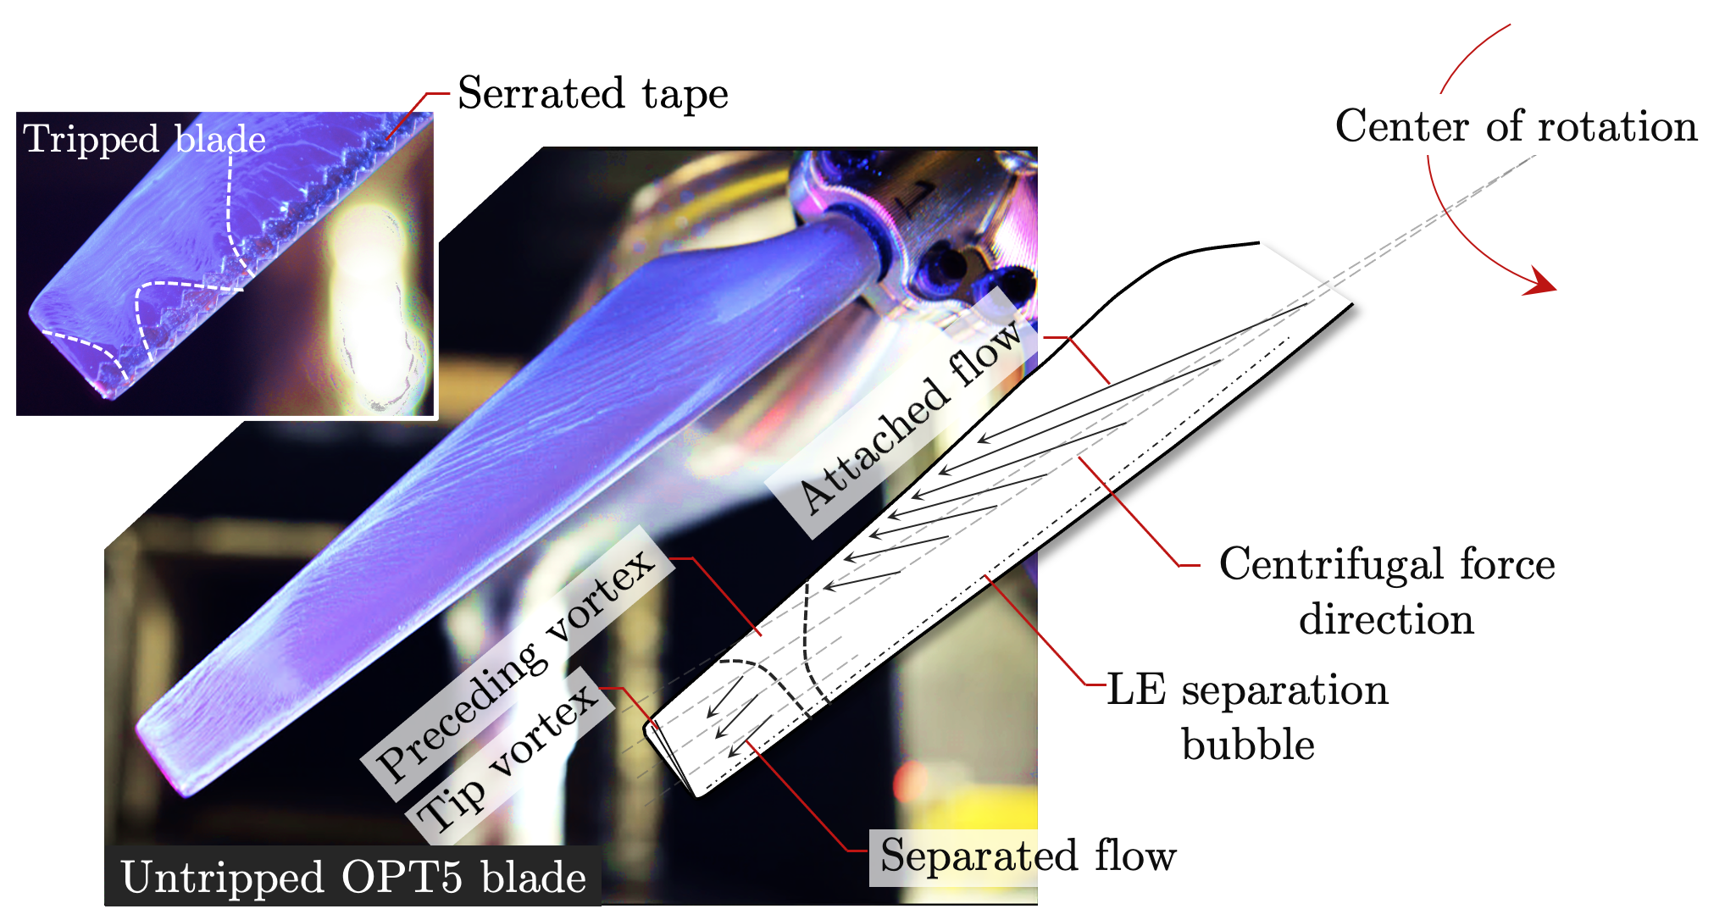
Results: Surface Oil Flow Visualizations
OPT5 (M_{tip} = 0.50)
Severe flow separation on outer 12% of blade span
Tip vortex impingement from previous blade visible
Trip tape appears to delay separation
Source: NASA

Slide 12
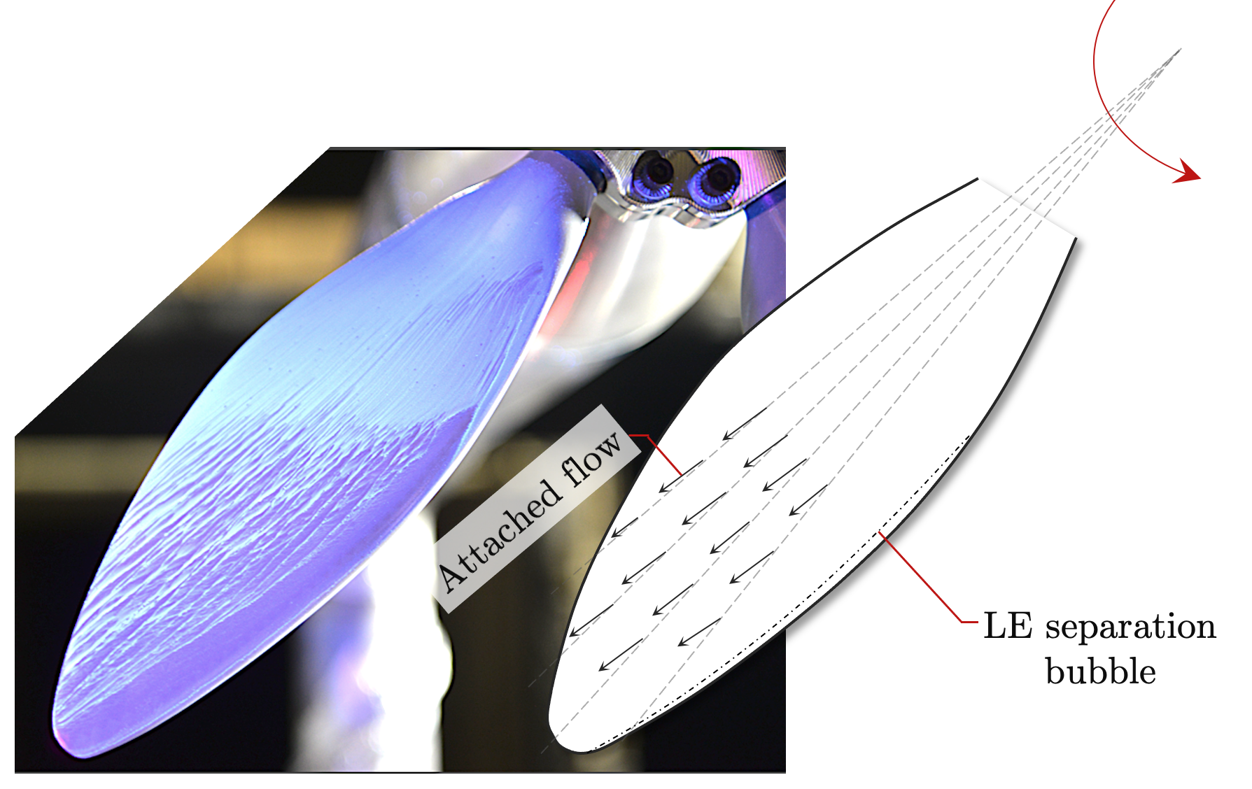
Results: Surface Oil Flow Visualizations (contd.)
COPR5 (M_{tip} = 0.45)
Attached flow across majority of blade span
No prominent indications of vortex impingement
Difficult to visually identify tip vortex formation
Source: NASA

Slide 13
Results: Forward Flight
COPR5
  Well-defined propulsive efficiency profile
  Good agreement with previous measurements in LSAWT facility
  Slight divergence at low advance ratios, potentially due to tripping configurations
OPT5
  Baseline collective setting performs poorly
  Found to be too aggressive, promotes stall on blades
  Reduced collective setting seen to perform much better, similar peak performance as COPR5
Large error bars indicative of low thrust and/or power settings
COPR5 selected for further interrogation of transition flight conditions
Propulsive Efficiency vs. Advance Ratio

Slide 14
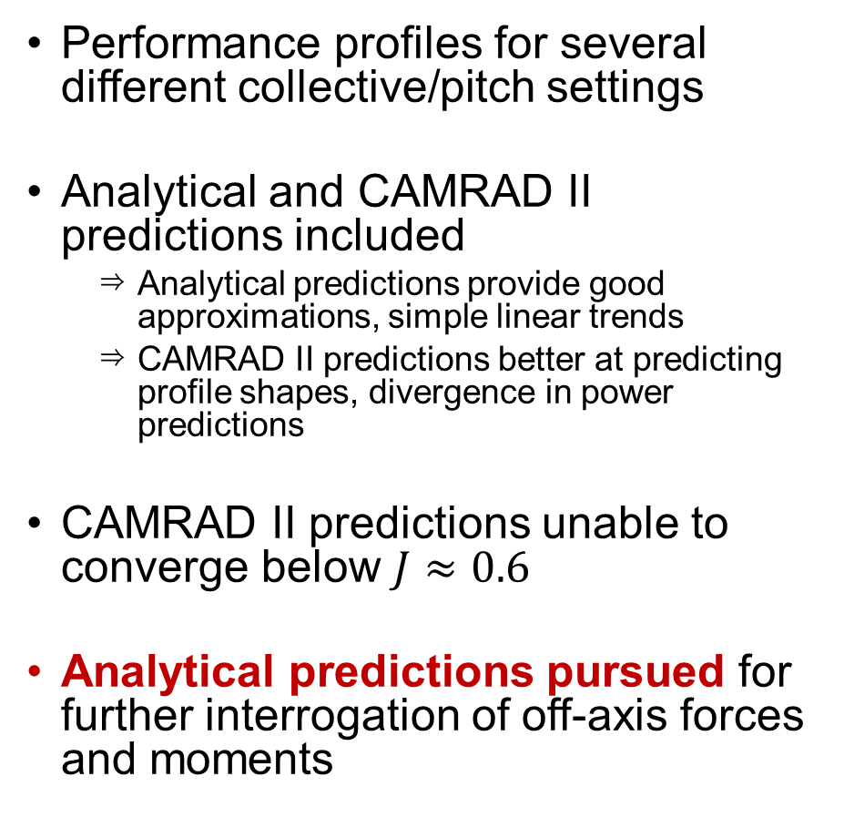
Results: Transition
Performance profiles for several different collective/pitch settings
Analytical and CAMRAD II predictions included
  Analytical predictions provide good approximations, simple linear trends
  CAMRAD II predictions better at predicting profile shapes, divergence in power predictions
CAMRAD II predictions unable to converge below $J≈0.6$
Analytical predictions pursued for further interrogation of off-axis forces and moments
Thrust Coeff. vs. Axial Advance Ratio
Power Coeff. vs. Axial Advance Ratio

Slide 15
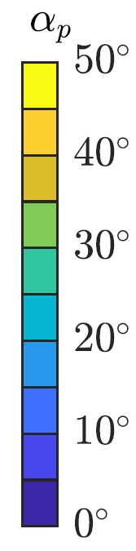
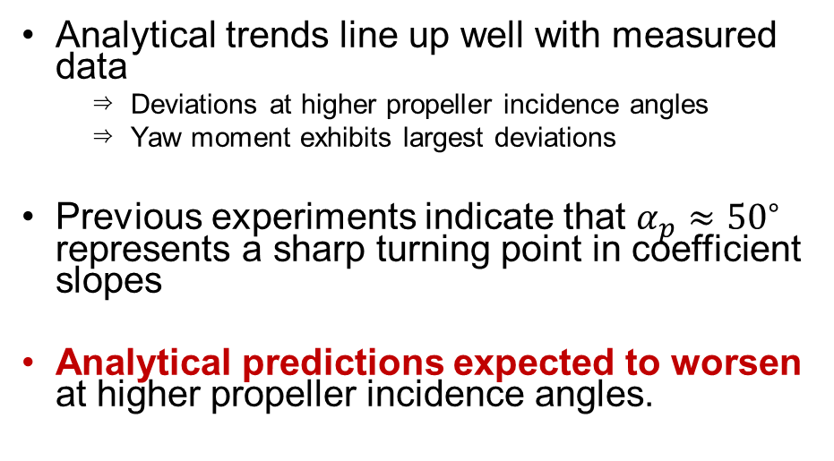
Results: Transition (contd.)
Normal Force Coeff. vs. Axial Advance Ratio
Analytical trends line up well with measured data
  Deviations at higher propeller incidence angles
  Yaw moment exhibits largest deviations
Previous experiments indicate that $α_{p}≈{50}^{∘}$ represents a sharp turning point in coefficient slopes
Analytical predictions expected to worsen at higher propeller incidence angles.
Yaw Moment Coeff. vs. Axial Advance Ratio

Slide 16
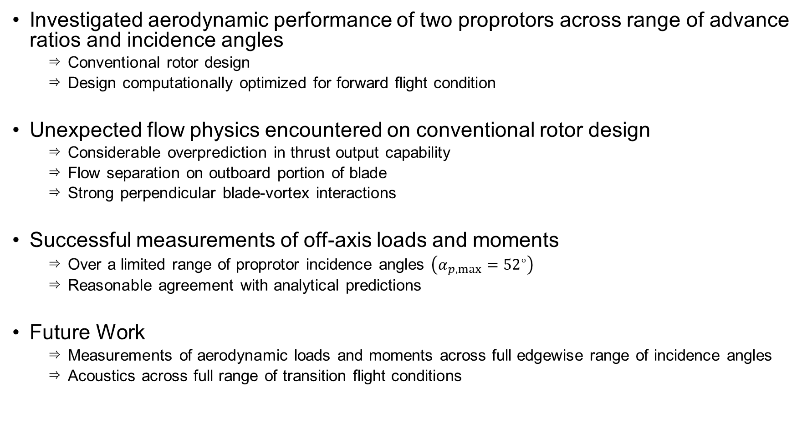
Concluding Remarks
Investigated aerodynamic performance of two proprotors across range of advance ratios and incidence angles
  Conventional rotor design
  Design computationally optimized for forward flight condition
Unexpected flow physics encountered on conventional rotor design
  Considerable overprediction in thrust output capability
  Flow separation on outboard portion of blade
  Strong perpendicular blade-vortex interactions
Successful measurements of off-axis loads and moments
  Over a limited range of proprotor incidence angles $\left(α_{p,max}={52}^{∘}\right)$
  Reasonable agreement with analytical predictions
Future Work
  Measurements of aerodynamic loads and moments across full edgewise range of incidence angles
  Acoustics across full range of transition flight conditions

Slide 17
Acknowledgments
Assistance with testing
  Aeroacoustics Branch: Niki Pettingill, Stefan Letica
  Flow Physics and Control Branch: Mehti Koklu
Test development and operations
  LSAWT personnel: John Swartzbaugh, Stan Mason, Bryan Lamb, Jeff Collins, Tyrone Pilgrim
  14x22 personnel: Abby Cayton, Frank Quinto
  RVLT leadership: Benny Lunsford, Susan Gorton

Slide 18

Thank you.
Nikolas Zawodny | Kyle Pascioni | Christopher Thurman
nikolas.s.zawodny@nasa.gov | kyle.a.pascioni@nasa.gov | christopher.thurman@nasa.gov
Aeroacoustics Branch
NASA Langley Research Center
Vertical Flight Society 79th Annual Forum & Technology Display
16-18 May 2023

Slide 19
Backup Slides

Slide 20
Results: Transition (concl.)
Side Force Coeff. vs. Axial Advance Ratio
Side force and pitching moment also measured
  No analytical predictions currently available
  Previously regarded as being of secondary importance
  Situation will change with installation configurations (i.e., proprotor-wing)
Trends align well with normal force and yaw moment data
Pitch Moment Coeff. vs. Axial Advance Ratio

