Slide 1

Initial Characterization of the Tiltrotor Aeroelastic Stability Testbed
79th Annual VFS Forum
May 17, 2023
Field Element at NASA Langley Research Center
NASA
Andrew Kreshock, Research Aerospace Engineer, ARL
Robert Thornburgh, Research Aerospace Engineer, ARL
Matthew Wilbur, Research Aerospace Engineer, ARL – Retired
Hao Kang, Research Aerospace Engineer Team Lead, ARL (APG)
David Piatak, Research Aerospace Engineer, NASA-AB
Martin Sekula, Research Aerospace Engineer, NASA-AB
Distribution A. Approved for Public Release
Notes:
The Army is replacing the black hawk and we are looking at Future Vertical Lift.

Slide 2
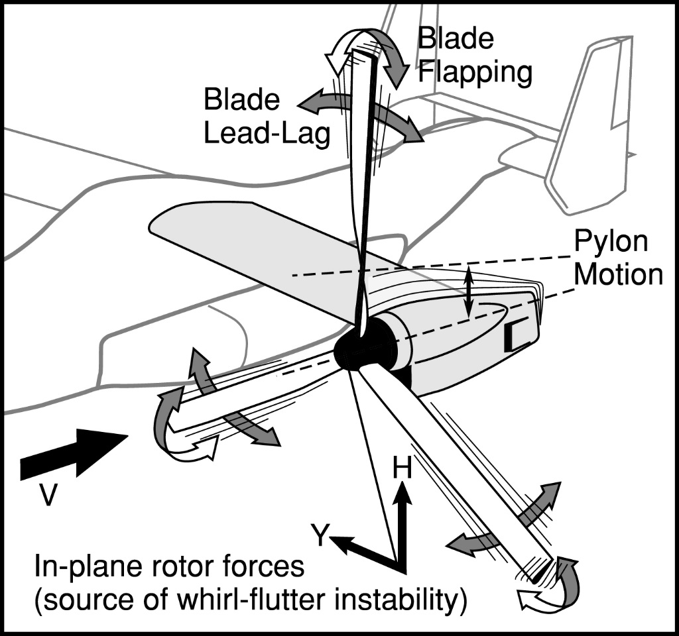
Review of Whirl Flutter
Notes:
Small perturbations from the rotor system can excite fixed system aircraft modes causing a rotation of the pylon. This rotation induces forces in the rotor system which again feedback into the fixed system. Whether or not these perturbations grow determines if the system is stable. For tiltrotor aircraft these forces are further complicated by the flapping and lead-lag motion of the blades.

Slide 3
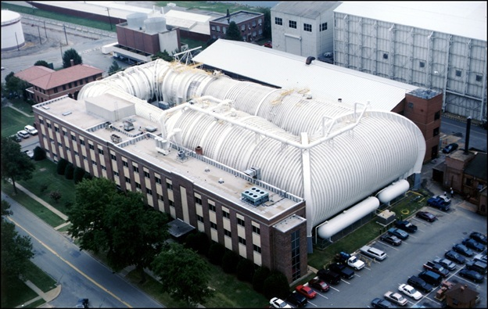
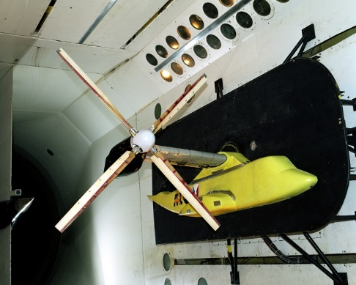
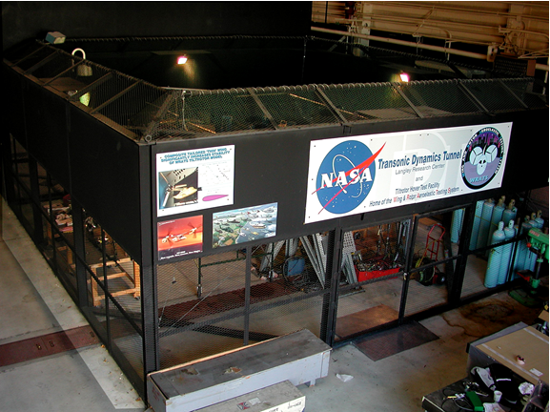
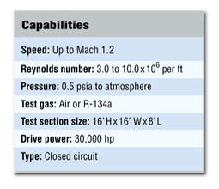
Transonic Dynamics Tunnel (TDT) and Hover facility
Transonic Dynamics Tunnel (TDT)
The Rotorcraft Hover Test Facility (RHTF)

Slide 4
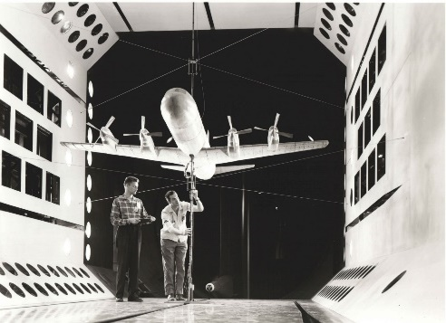
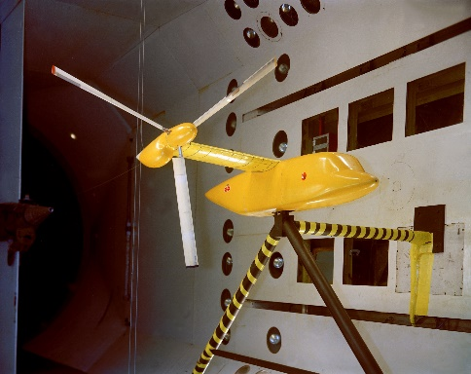
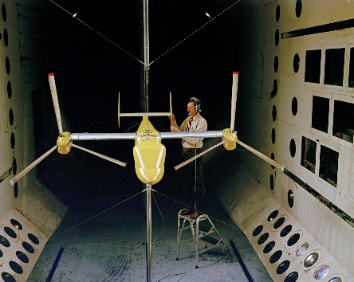
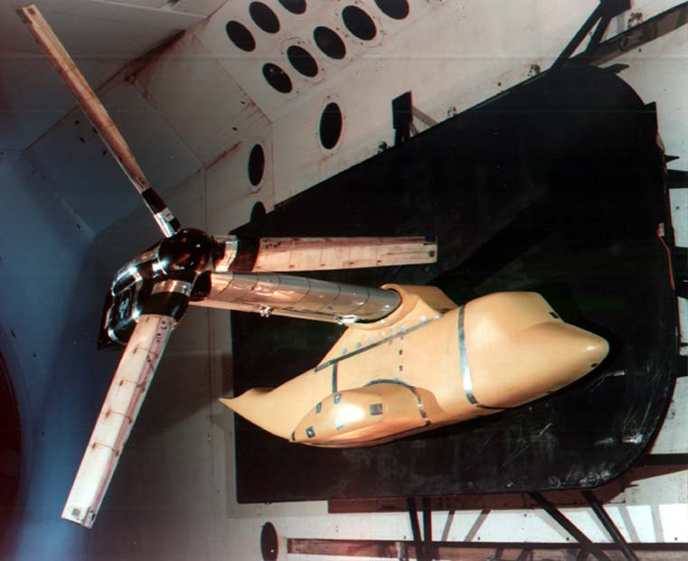
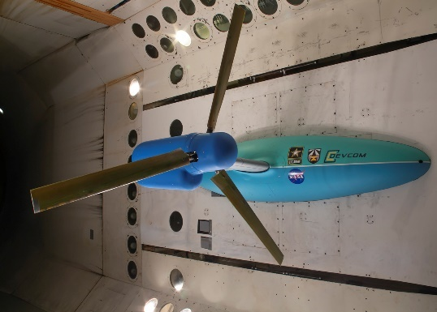
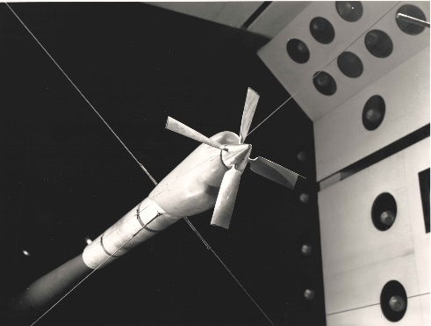
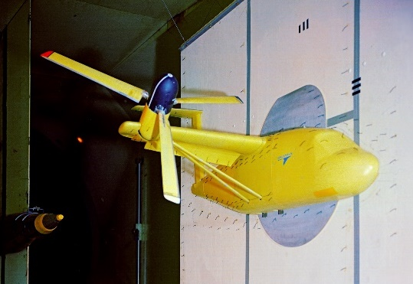
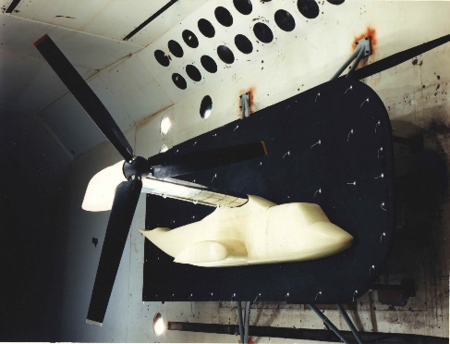
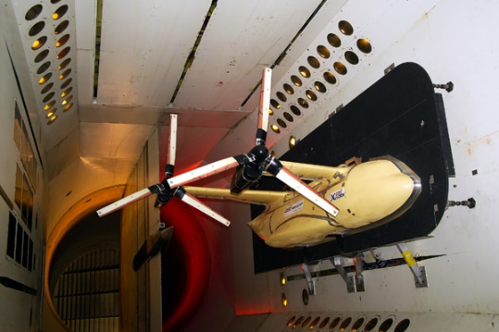
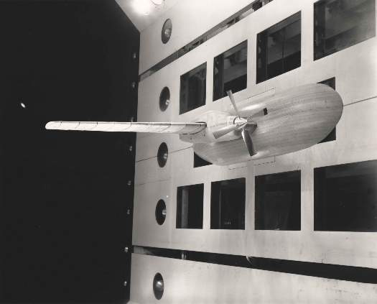
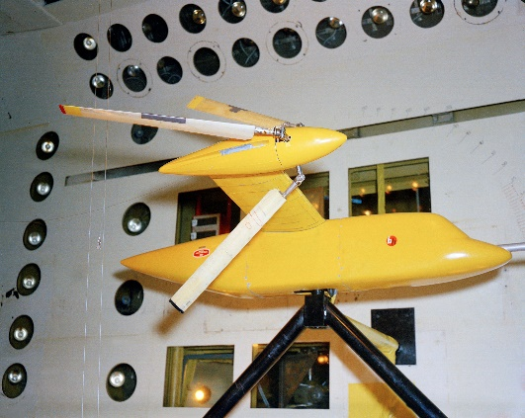
Transonic dynamics tunnel (TDT)
Whirl Flutter Timeline
1960 | 1970 | 1980 | 1990 | 2000 | 2010 | 2020
Propeller Aircraft | Early Tiltrotors | V-22 & WRATS ERA Testing | TRAST

Slide 5
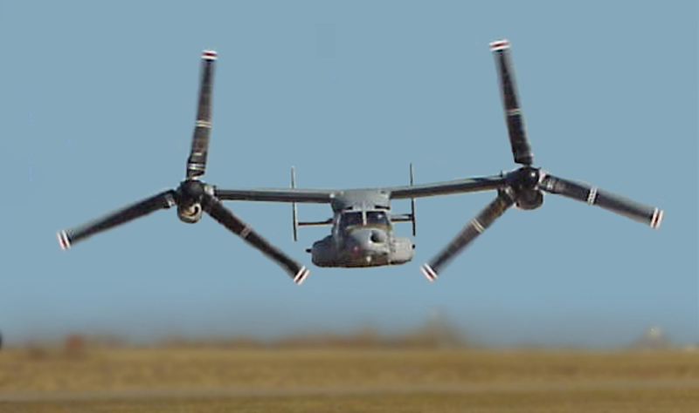
V-22 Development

Slide 6
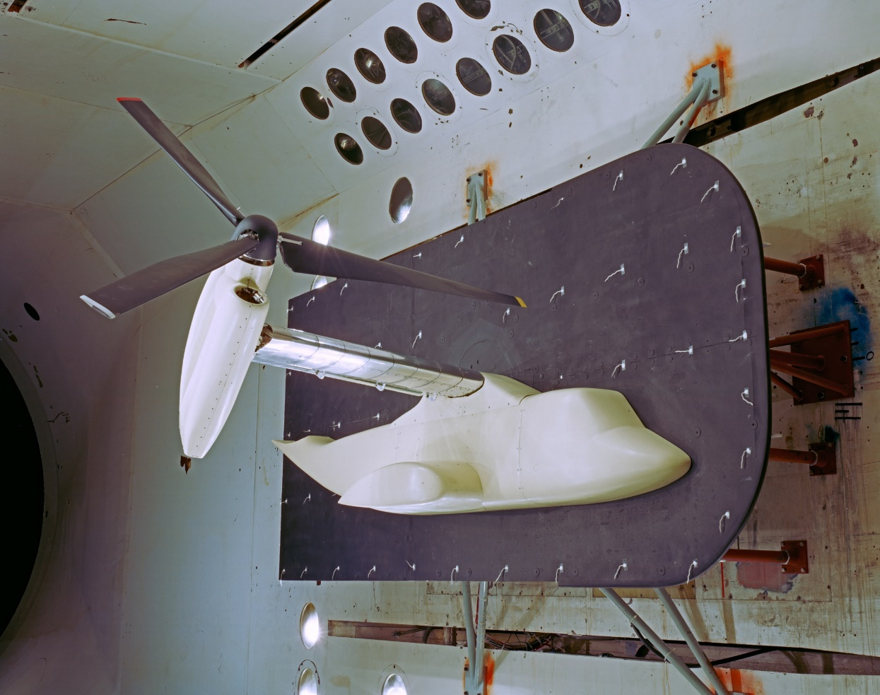
JVX TESTING
Coning Hinge Hub
Rigid Hub

Slide 7
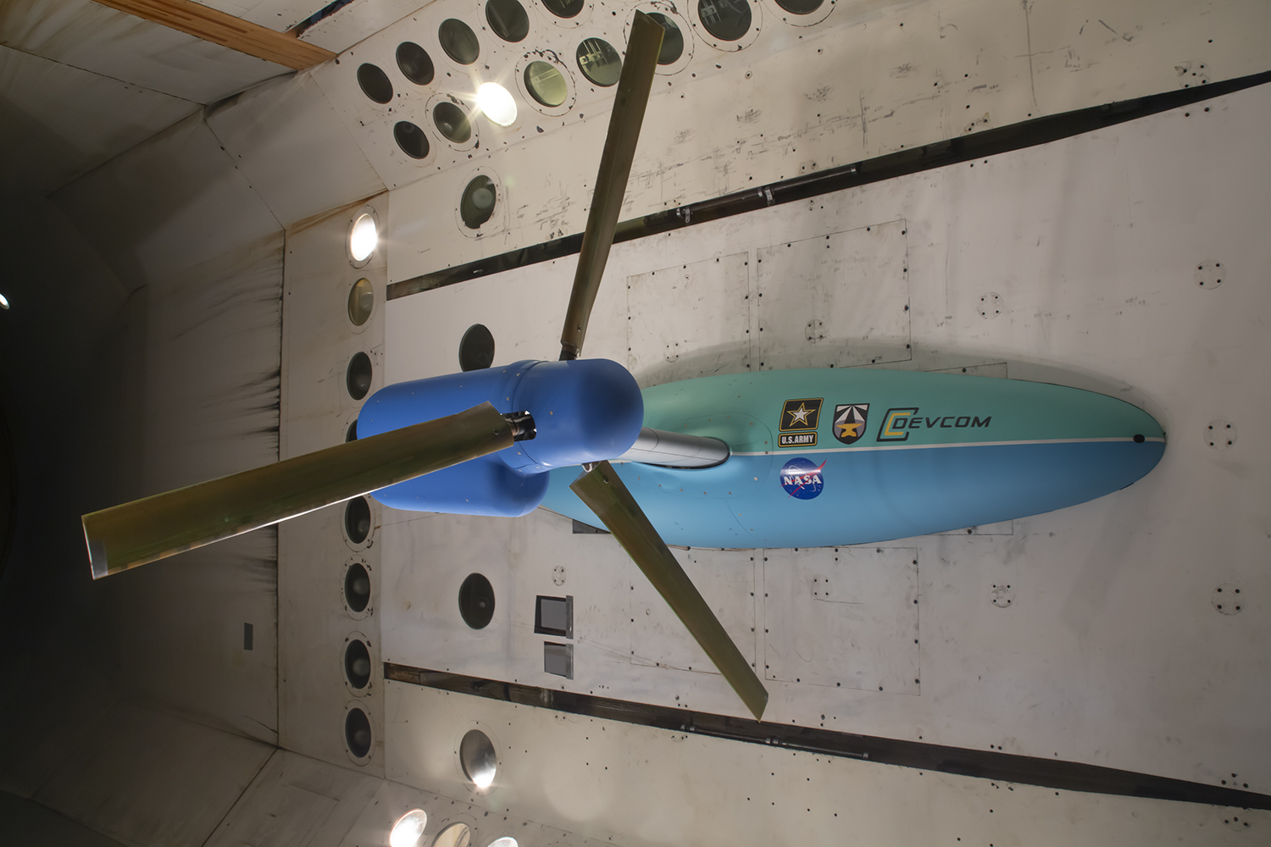
TiltRotor Aeroelastic Stability Testbed (TRAST)
Component
Hub | Gimbal
Number of Blades | 3
Rotor Radius | 4.0 ft
Delta-3 | -15°
Rotor Speed: Hover Cruise | 909 RPM (100%) 727 RPM (80%)
Blade Twist | XV-15
Blade Airfoil | NACA 64-Xxx
Precone | 2.5 deg
Notes:
As stated the first test entry has just been completed this fall. The paper doesn’t have any results from the test but I wanted to give a little sneak previous of the results.

Slide 8
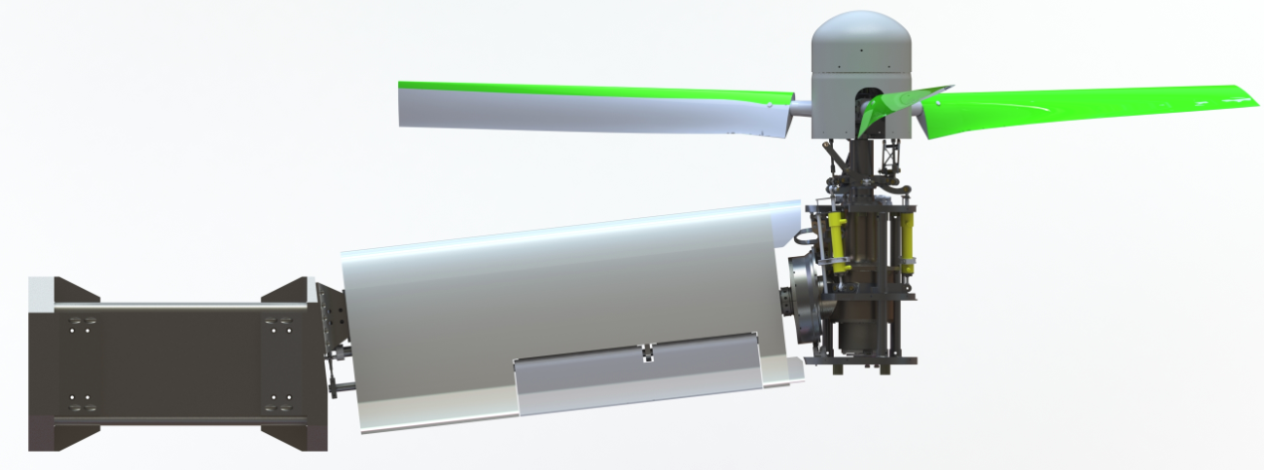
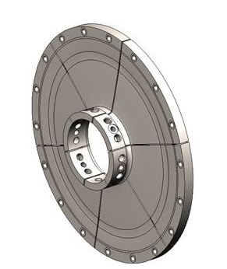
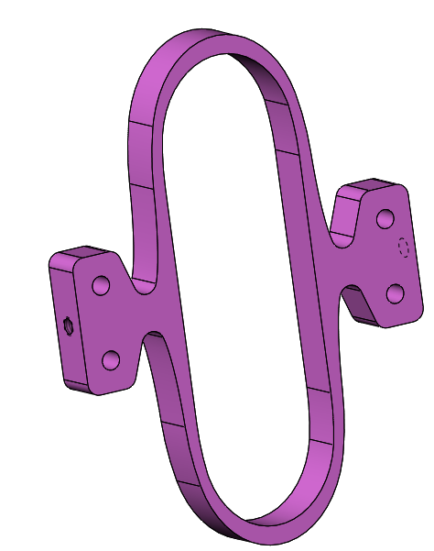
TiltRotor Aeroelastic Stability Testbed (TRAST)
8ft diameter
Hydraulic Swashplate
Top View
Notes:
This is the TRAST model. There are a couple of key features I want to point out.
click
The first is the rise and fall swashplate, as well as hydraulic actuators. This is the primary method of how we want to excite the model.
click
There are two key tunning springs, The first is the pitch spring which can tune the pitching motion.
click
The second is the diaphragm spring which can tune the yaw and roll motion.

Slide 9
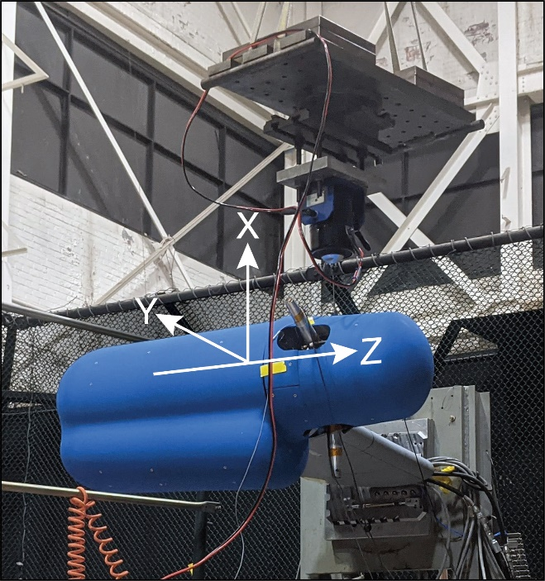
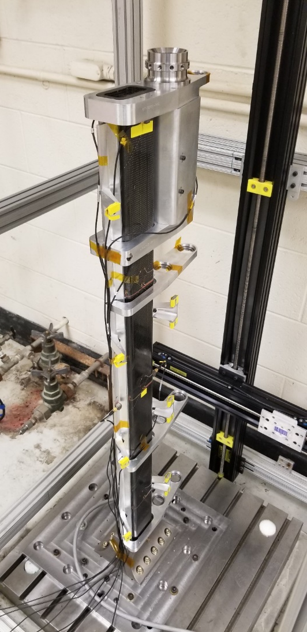
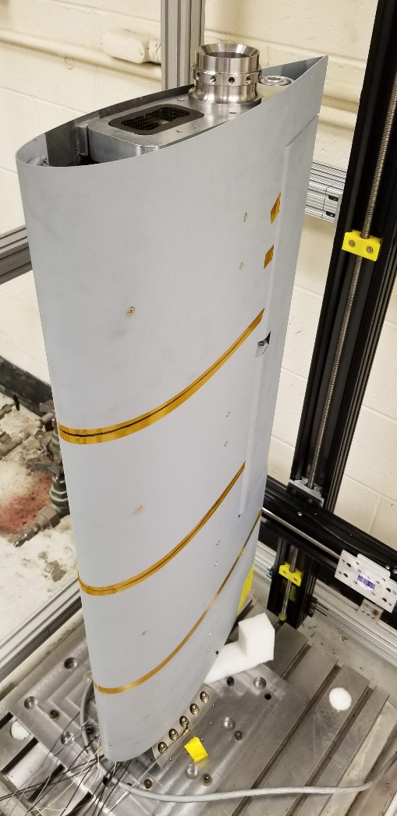
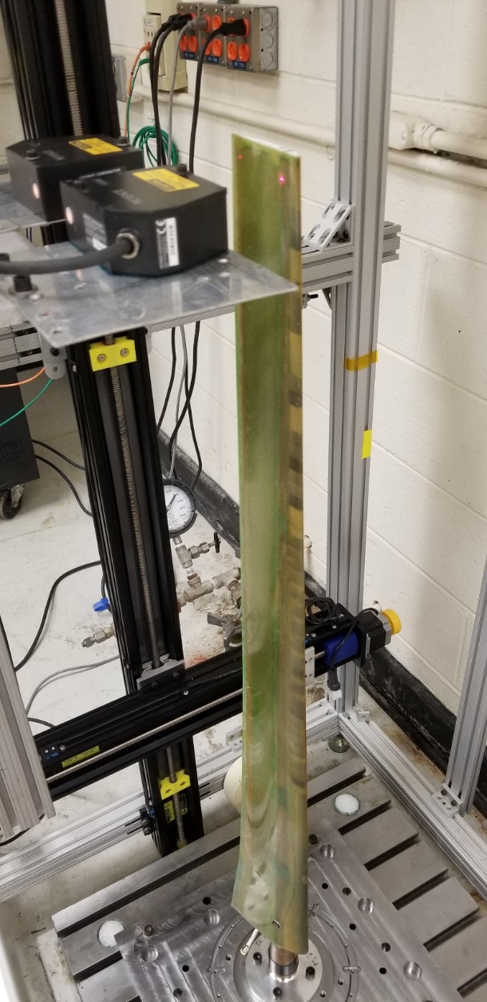
vibration Testing
Bare wing spar
Built-up wing
Blade

Slide 10
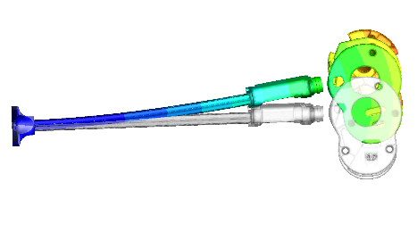
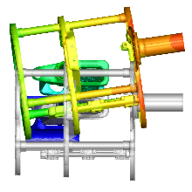
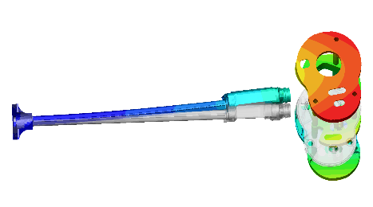
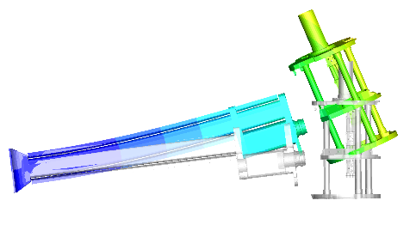
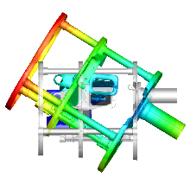
System Mode shapes
Side View
Aft View
Mode 1. Wing Beam
Mode 3. Wing Torsion
Top View
Mode 2. Wing Chord
Aft View
 | 8k Pitch Spring |  |  |  | 4k Pitch Spring
 | Measured | NASTRAN |  |  | Measured | NASTRAN
Wing Mode |  | Rigid Boundary | TDT Tuned Stiffness |  |  | Rigid Boundary | TDT Tuned Stiffness
Wing Vertical Bending | 5.36 | 5.47 | 5.34 |  | 5.23 | 5.38 | 5.26
Wing In-Plane Bending | 8.35 | 8.55 | 8.29 |  | 8.20 | 8.54 | 8.28
Pylon Pitch | 11.75 | 12.19 | 11.88 |  | 9.81 | 9.96 | 9.78
Aileron Pitch |  | 14.03 | 14.03 |  |  | 14.02 | 14.02
Pylon Yaw | 20.50 | 20.55 | 20.19 |  | 19.89 | 20.55 | 20.20
Pylon Roll |  | 36.92 | 36.58 |  |  | 36.85 | 36.50
Mode 3. Wing Torsion
Side View
Notes:
Three modes of interest for stability are wing beam which is an out-of-plane wing bending motion, wing chord, an in-plane mode, and wing torsion which includes a twisting of the wing with pylon pitch.
Shake testing was conducted with and without blades. As expected the frequency changes a little bit,
Click
however a surprise to us was that the wing beam damping increases from 0.7% damping to 2.5%. The current theory is that due to the rotor inertia the gimbal allowed to rotate and there is relative motion between the pylon and the rotor. This basically means we have friction in our gimbal and any rotation of the gimbal is removing energy from the system. Since this is a vibration test without spinning the rotor, it is hard to tell how much this translates into actual damping when the rotor is rotating.

Slide 11
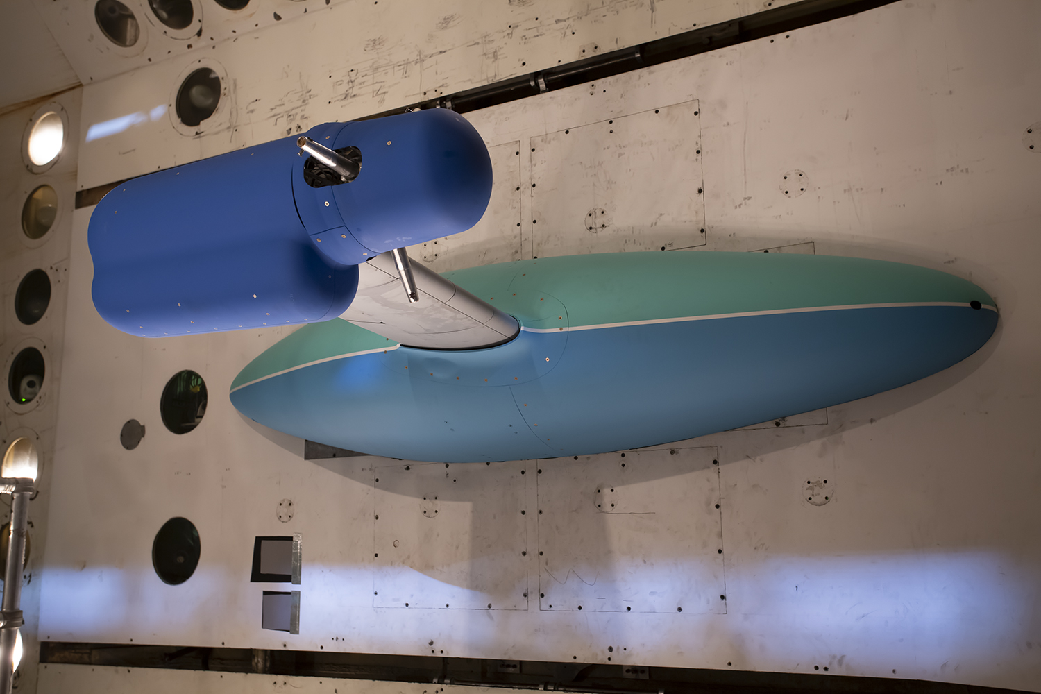
Test overview
Wing/Pylon testing (no rotor)
Whirl Flutter
  8k Pitch Spring (Powered)
  8k Pitch Spring (Windmilling)
  4k Pitch Spring (Windmilling)

Slide 12
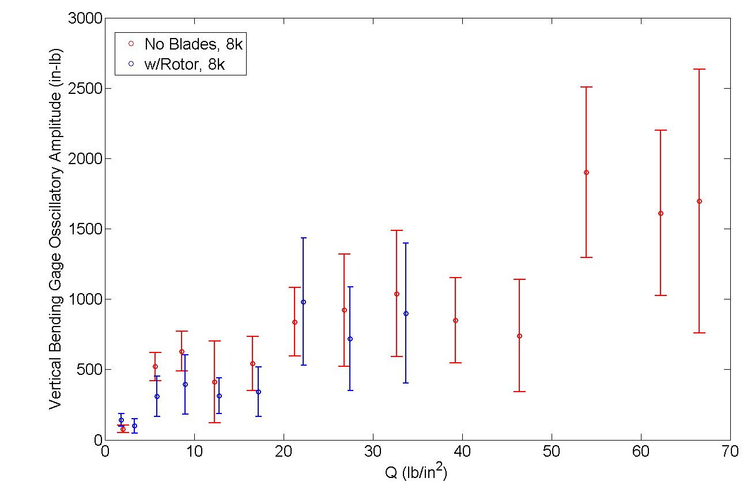
Steady State WinG mode oscillations
**DFT at the wing frequency over a steady point

Slide 13
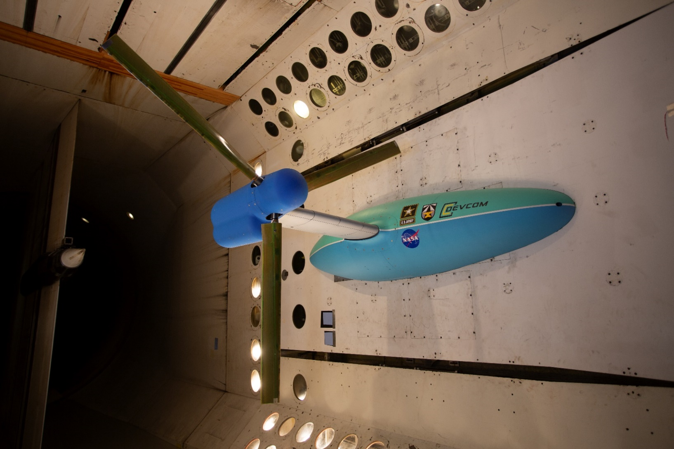
Test overview
Wing/Pylon testing (no rotor)
Whirl Flutter
  8k Pitch Spring (Powered)
  8k Pitch Spring (Windmilling)
  4k Pitch Spring (Windmilling)

Slide 14
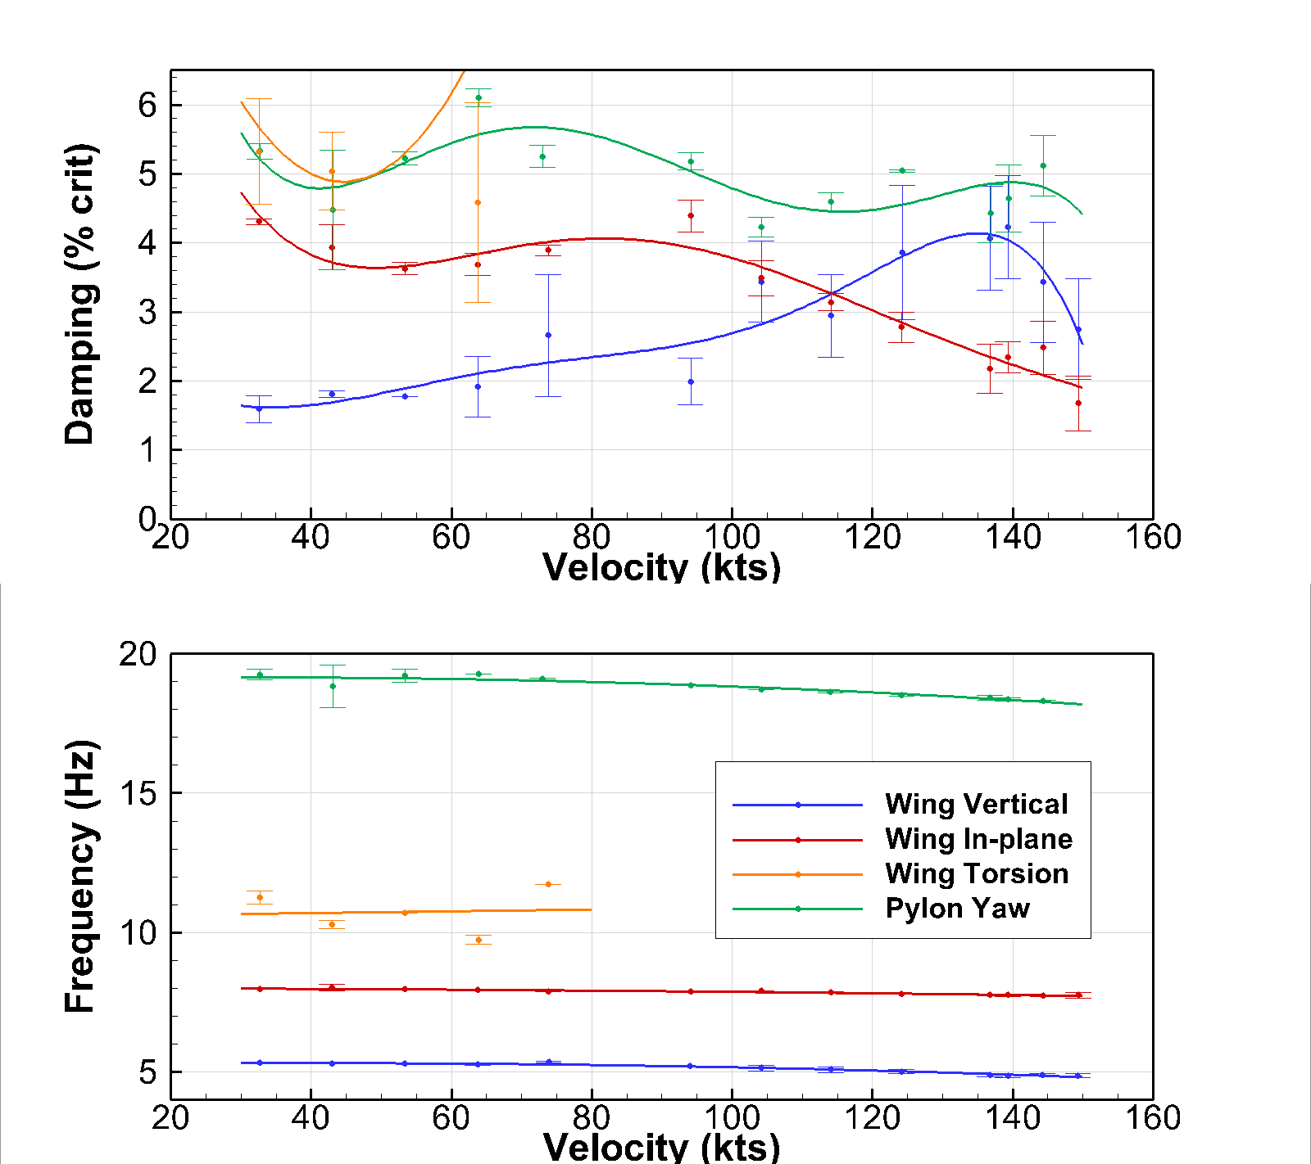
Comparison of Damping and Frequency for 8k Pitch Spring at 727 RPM: Powered.
Wing Beam & Wing Chord
Both starting to decrease in damping
Torsion & Pylon Yaw
Very stable
Powered Operation - Motor engaged
Trimmed rotor to 300 in-lb of torque
Pitch Spring: 8k
Rotor Speed: 727 RPM
Powered

Slide 15
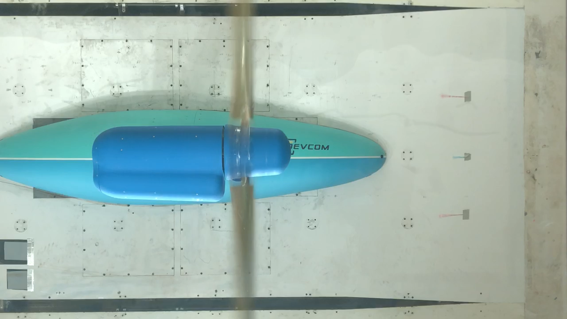
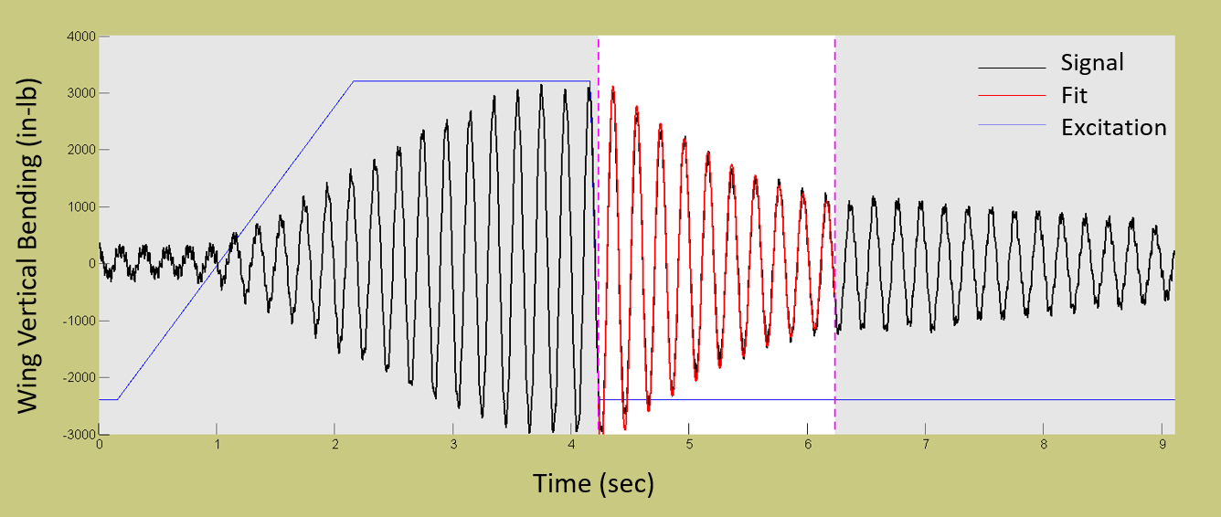
Model Excitation
Notes:
But first I want to go over model excitation. Here is a video of the wing beam excitation. We start off by exciting the swashplate at the frequency of interest. As the swashplate ramps to a constant amplitude the wing response keeps growing and the excitation is cut off. What we are trying to measure is the free decay potion of this excitation.

Slide 16
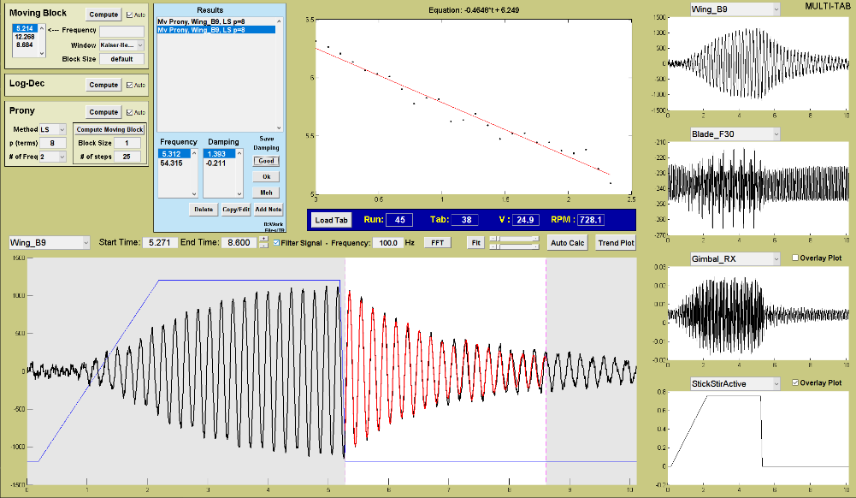
Damping Tool

Slide 17
Damping Tool

Slide 18
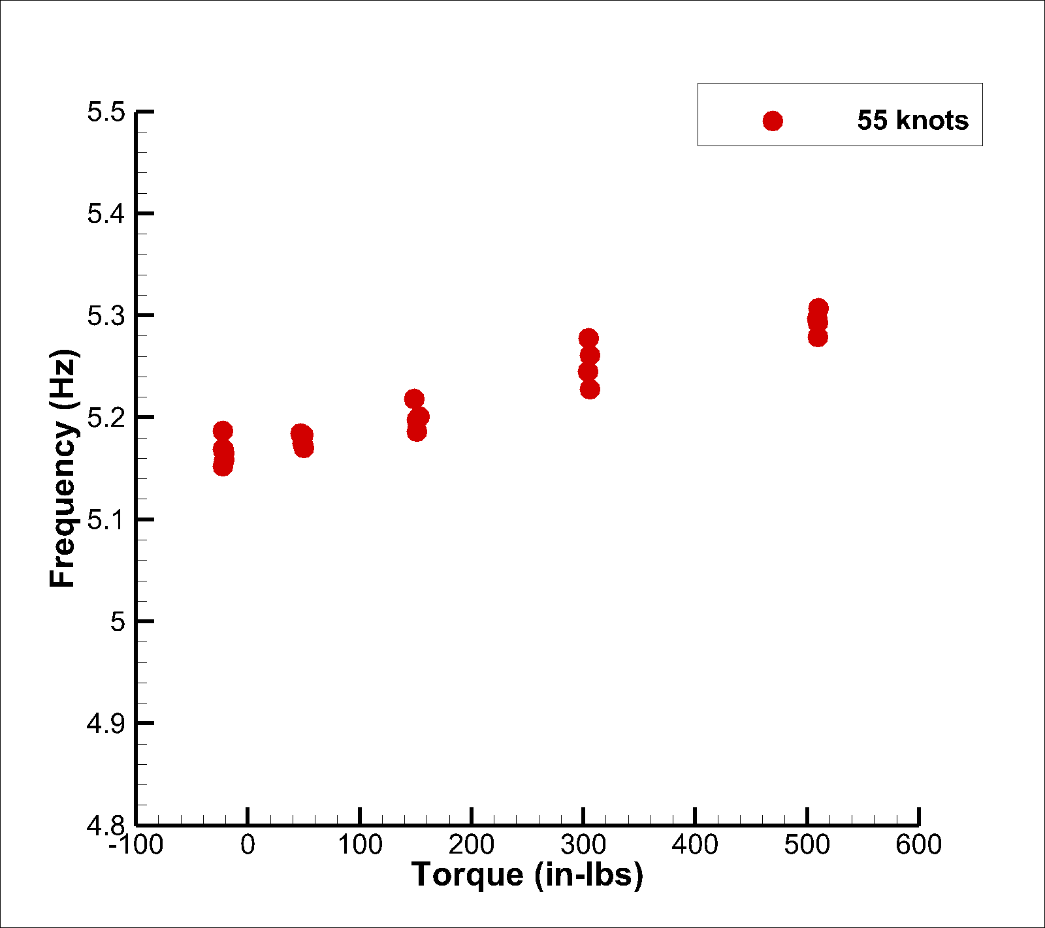
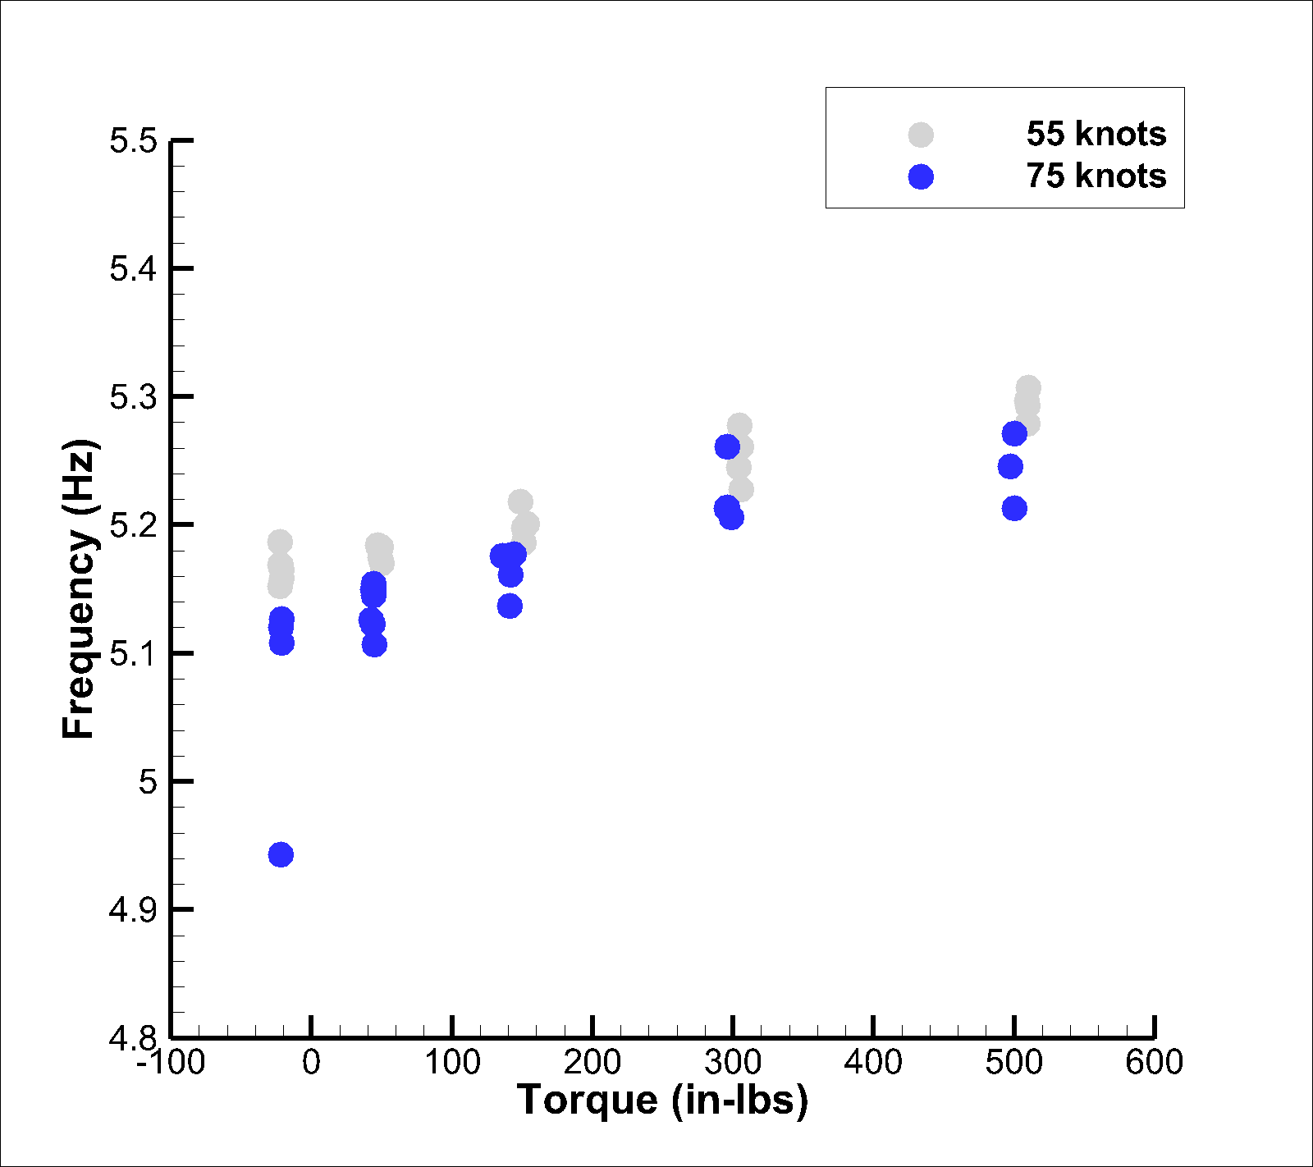
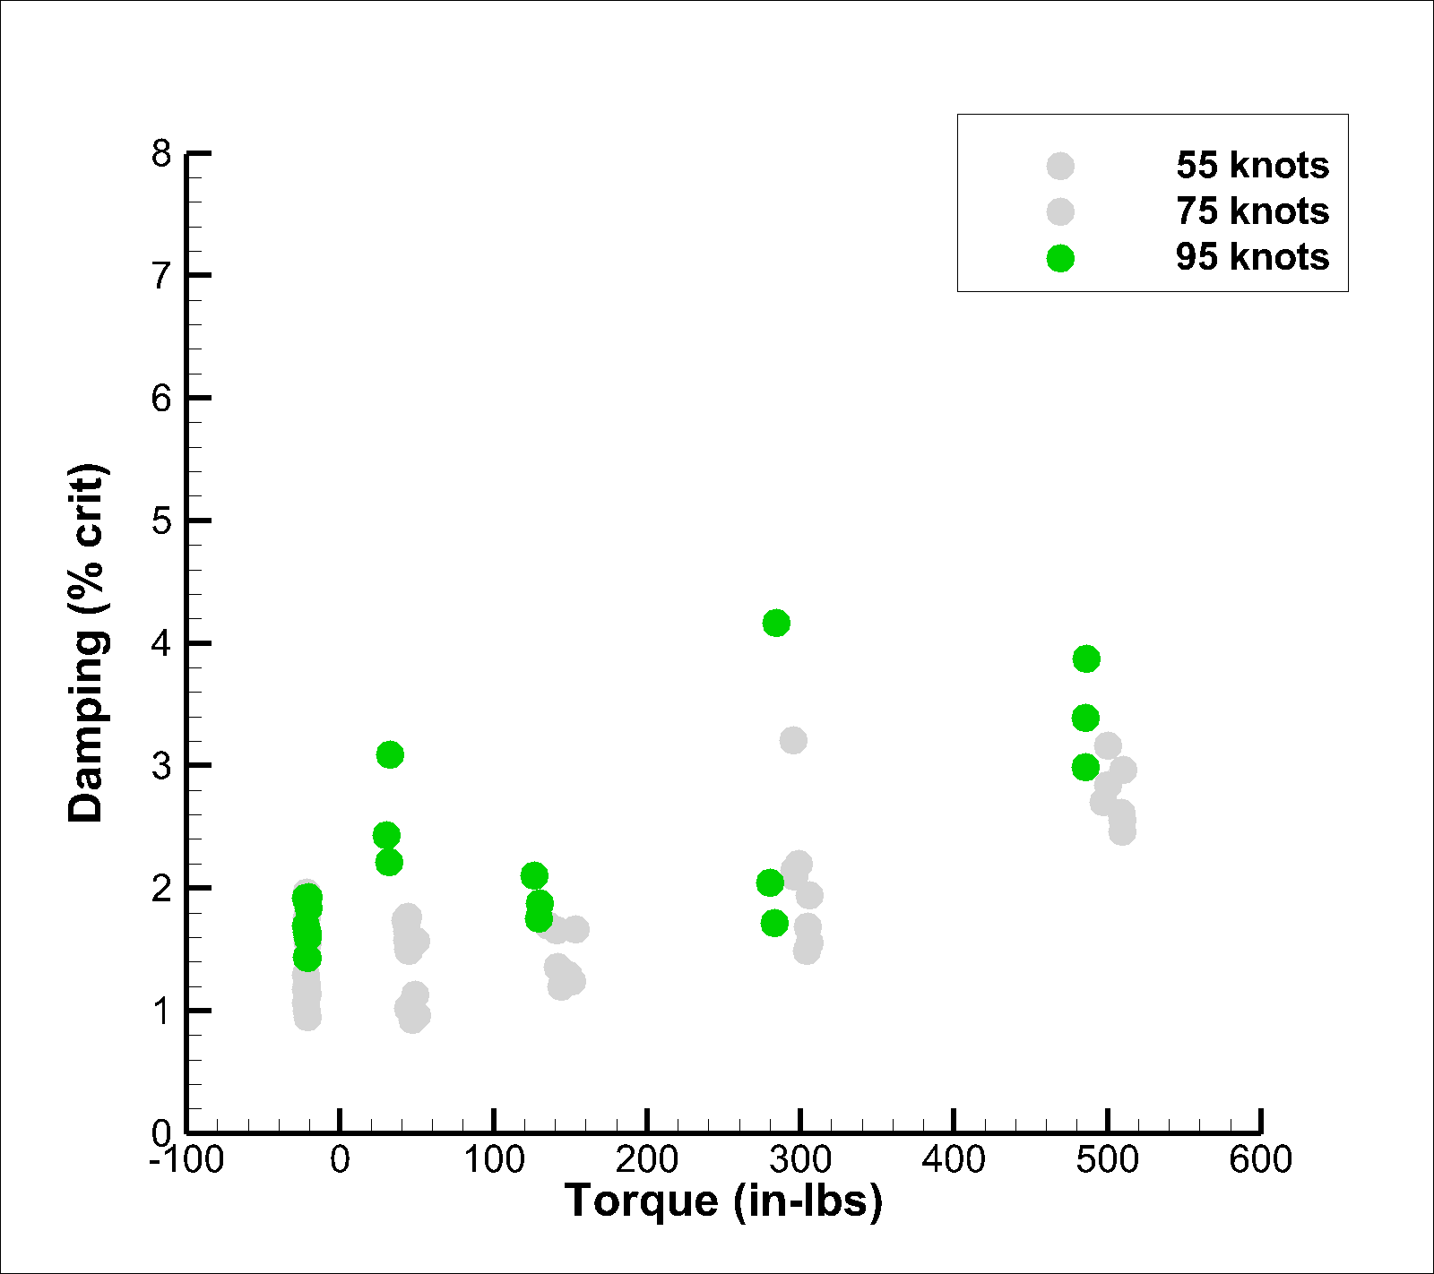
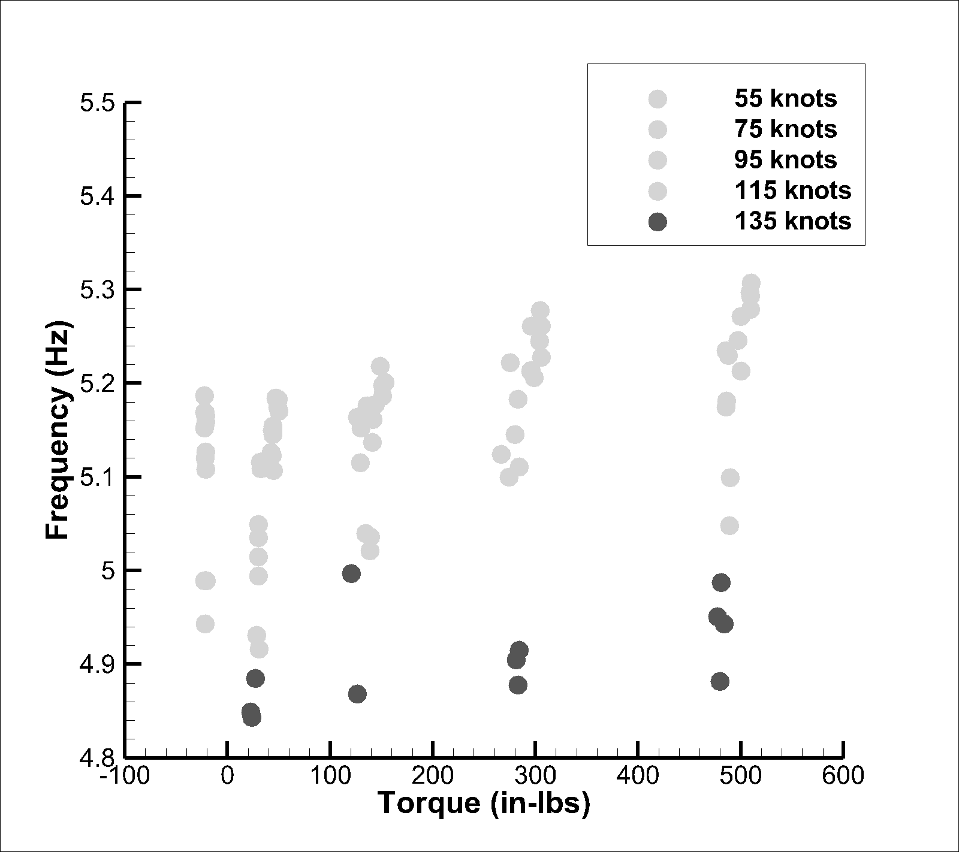
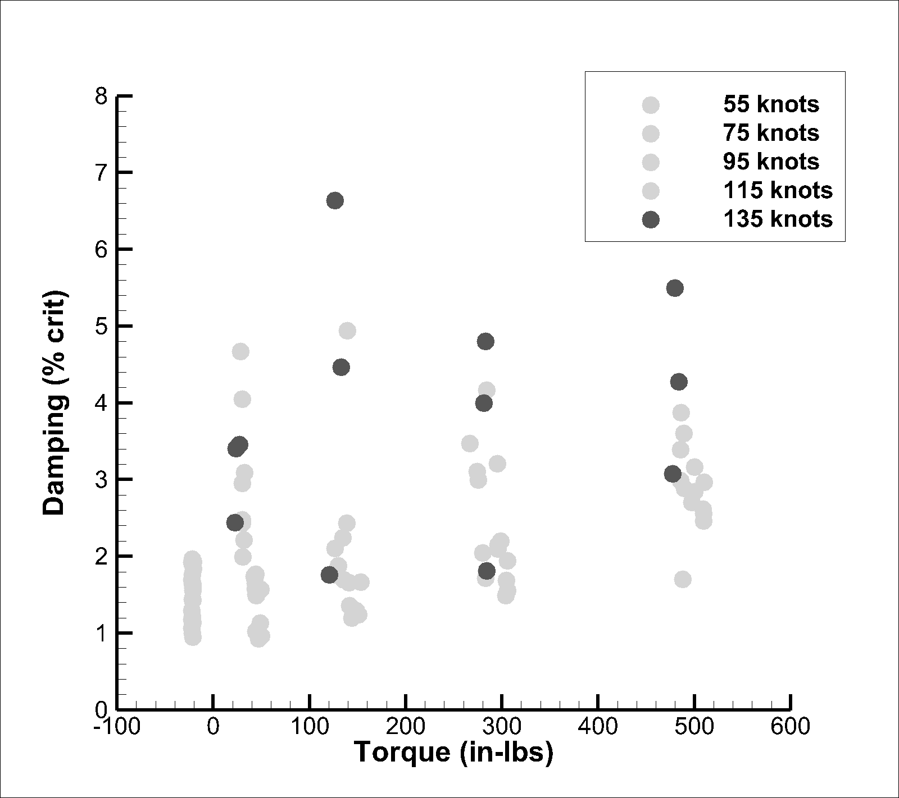
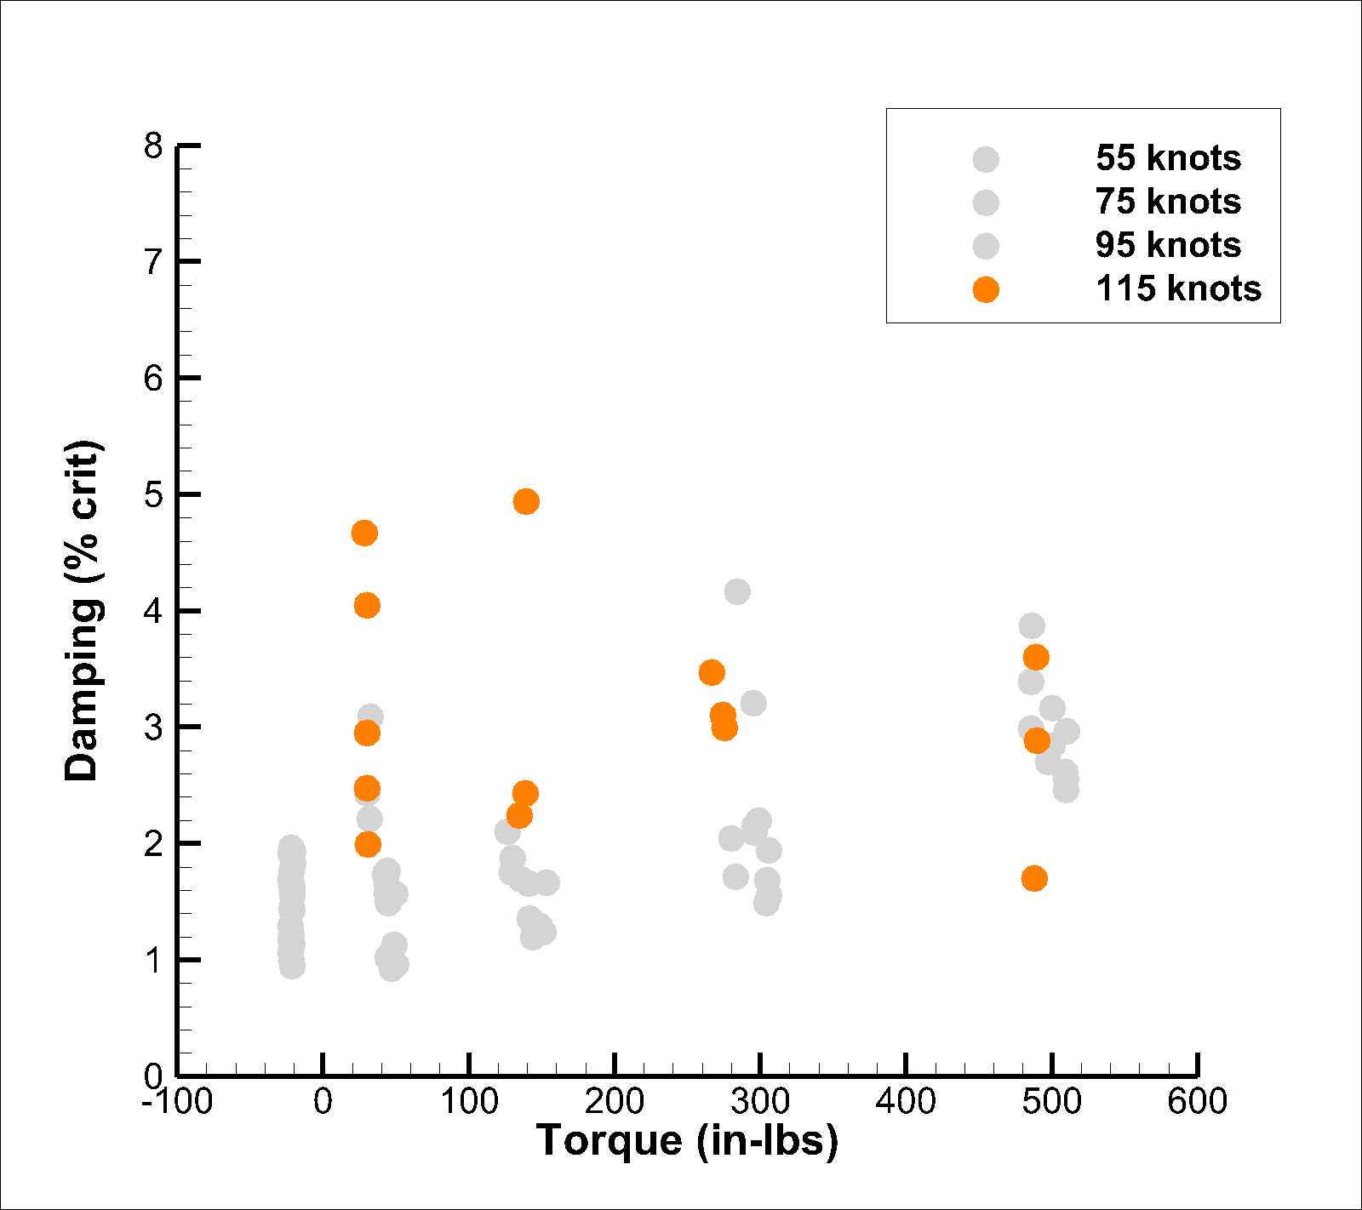
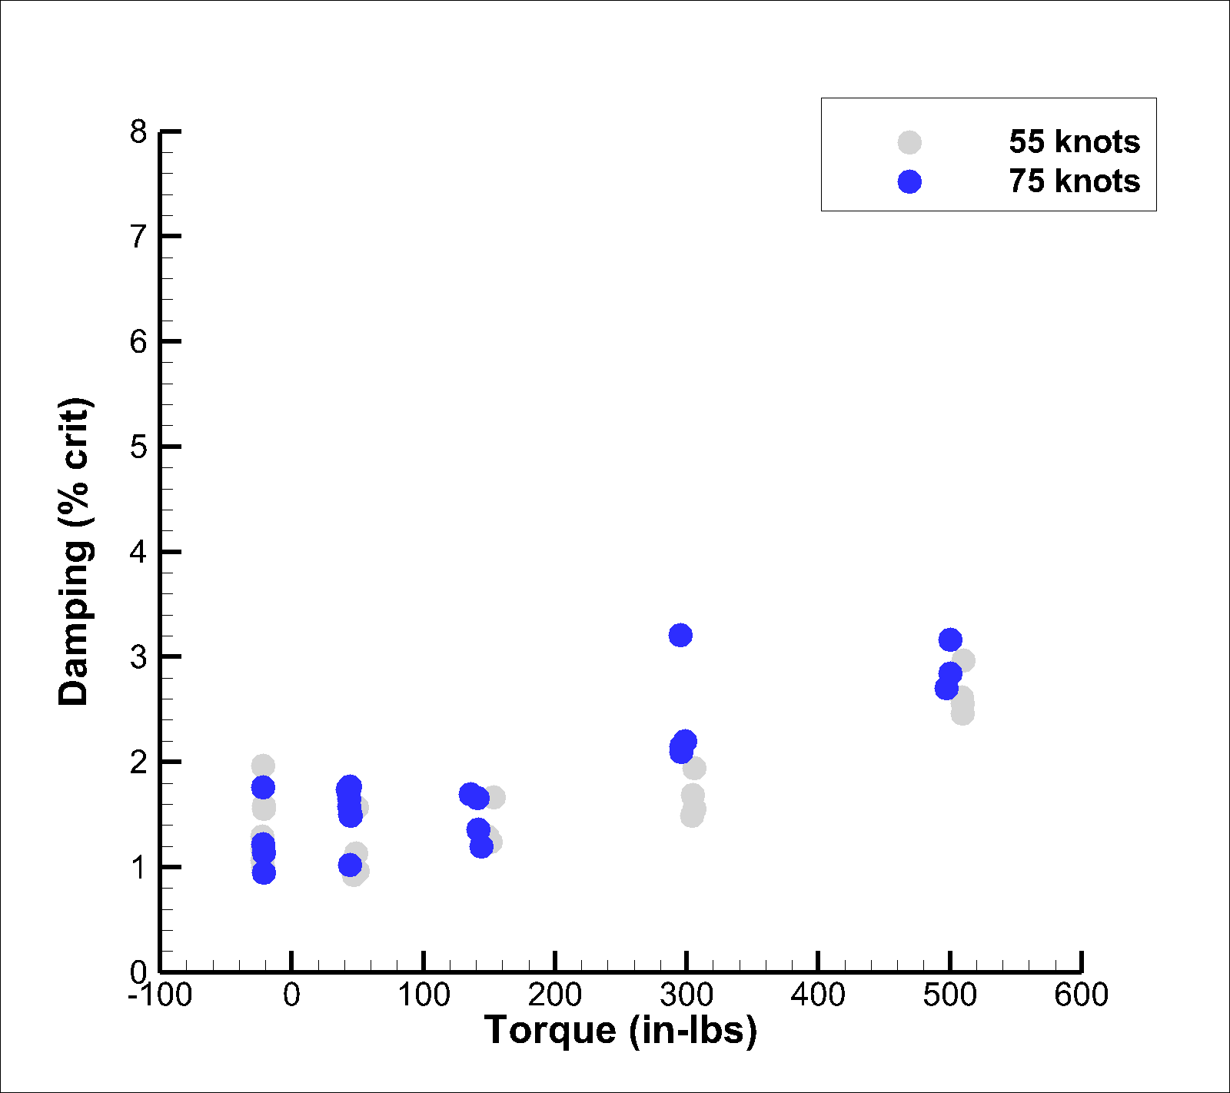
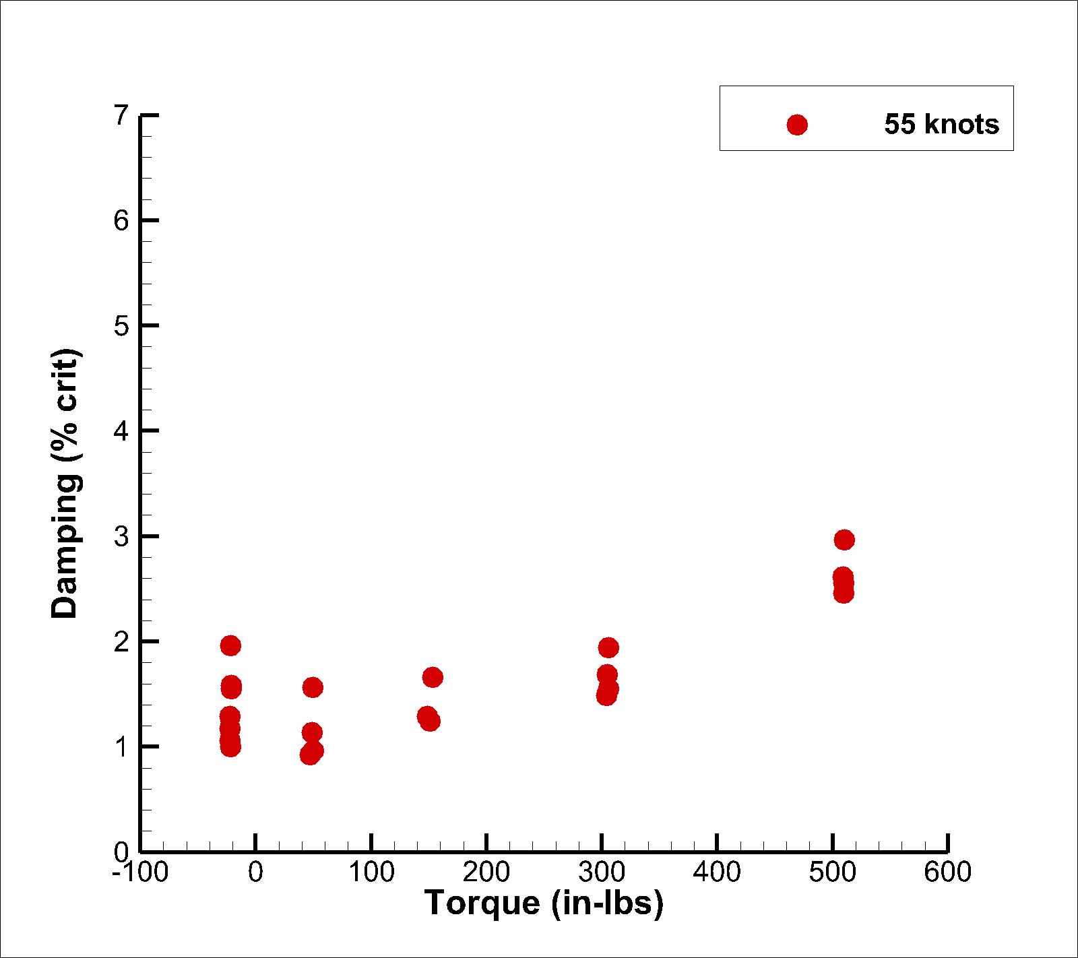
Torque Sweeps

Slide 19
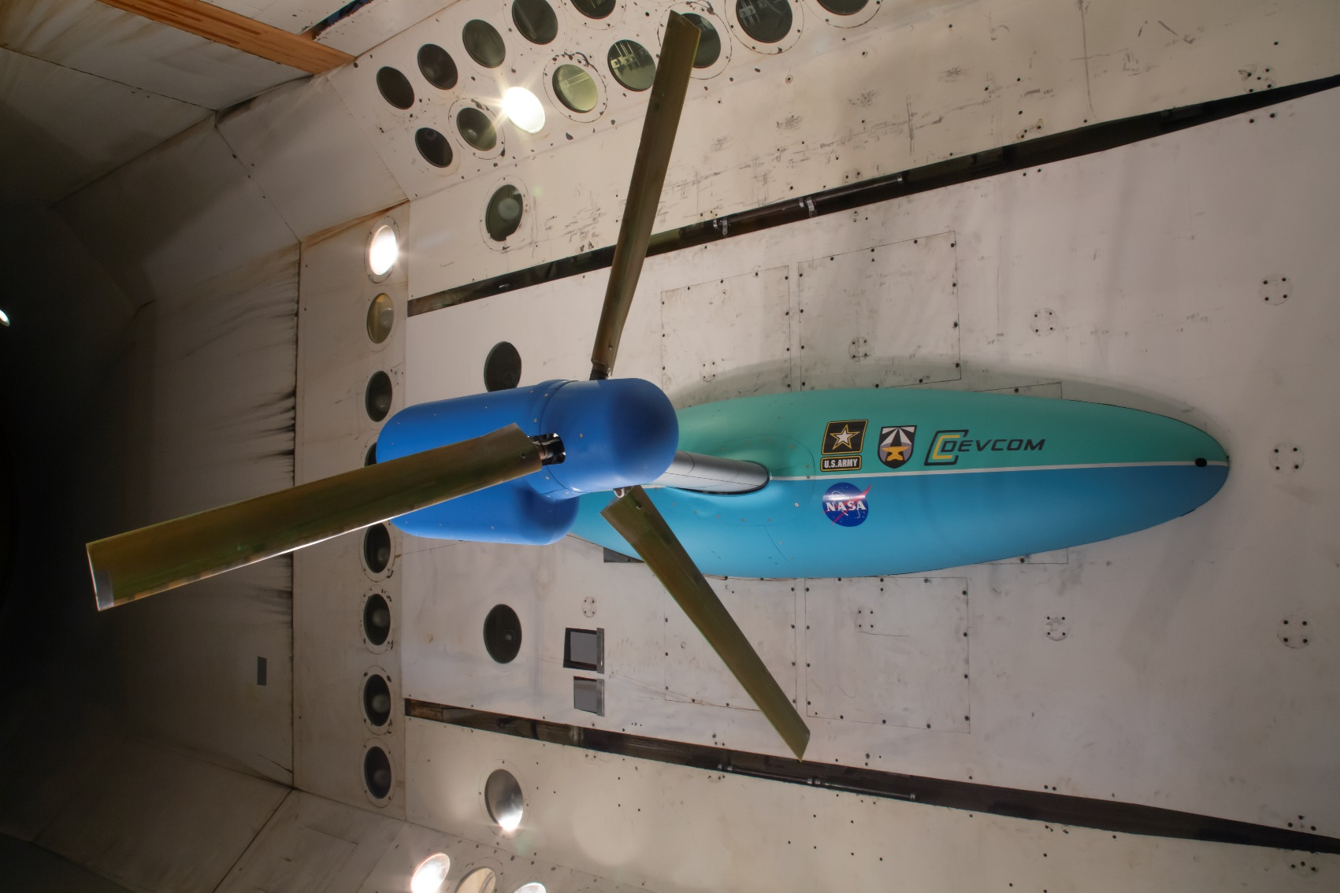
Test overview
Wing/Pylon testing (no rotor)
Whirl Flutter
  8k Pitch Spring (Powered)
  8k Pitch Spring (Windmilling)
  4k Pitch Spring (Windmilling)

Slide 20
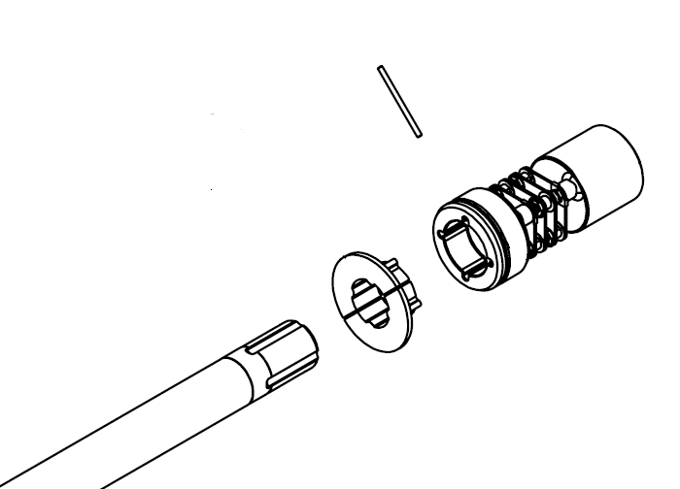
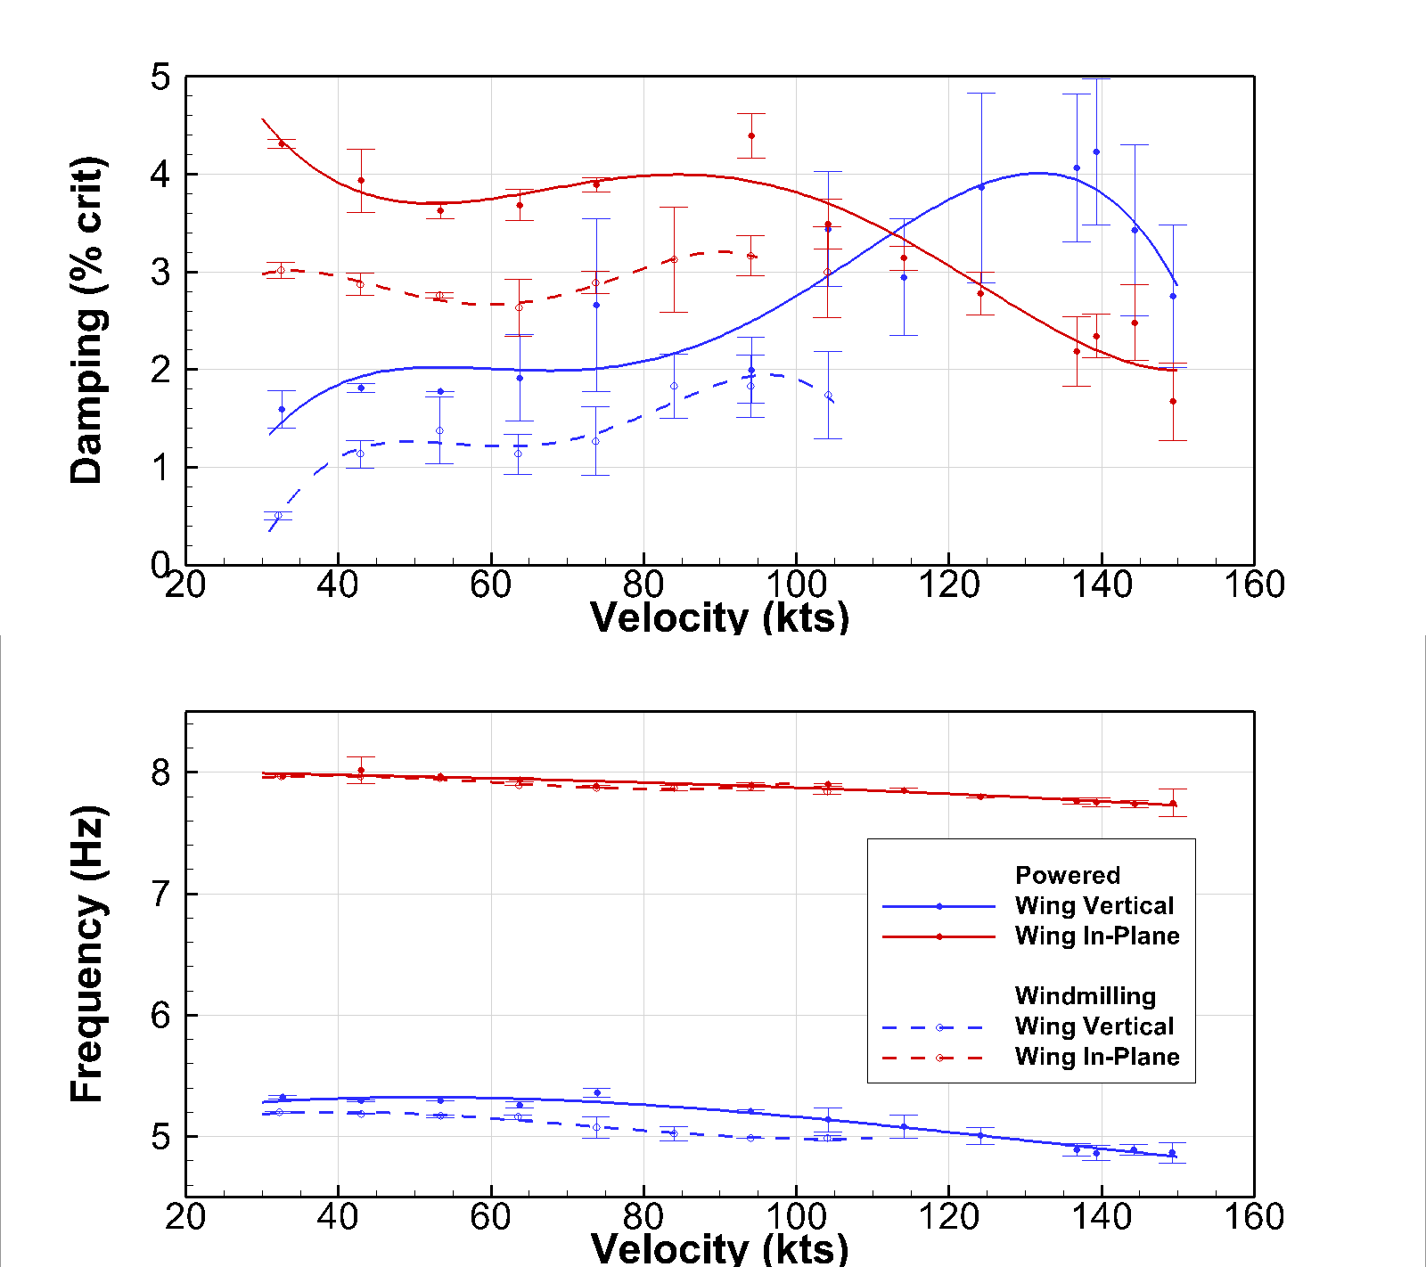
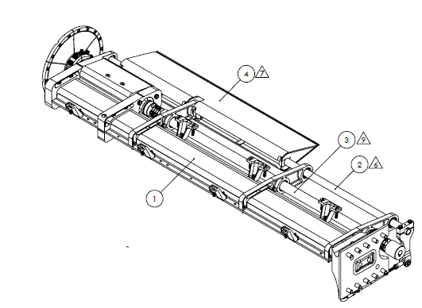
Comparison of Damping and Frequency for 8k Pitch Spring at 727 RPM: Powered vs Windmilling.
Pitch Spring: 8k
Rotor Speed: 727 RPM
Powered vs Windmilling

Slide 21

Comparison of Damping and Frequency for 8k Pitch Spring at 909 RPM: Powered vs Windmilling.
Powered is more stable
Pitch Spring: 8k
Rotor Speed: 909 RPM
Powered vs Windmilling

Slide 22

Test overview
Wing/Pylon testing (no rotor)
Whirl Flutter
  8k Pitch Spring (Powered)
  8k Pitch Spring (Windmilling)
  4k Pitch Spring (Windmilling)

Slide 23

4k & 8K Pitch spring, Windmilling, 727 RPM
4k pitch spring vs 8k pitch spring
Low speed damping should not be drastically different from the structural damping.
The damping in the 4k pitch spring nearly 0.5-1% more damping.
This is not likely from the spring
Not the rotor coupled with the wing.
Most likely when the pitch spring was swapped the damping went up due to friction.
Either physical change cause more rubbing in parts
The compliance allow for higher damping.
Pitch Spring: 4k vs 8k
Rotor Speed: 727 RPM
Windmilling

Slide 24

4k & 8K Pitch spring, Windmilling, 909 RPM
4k pitch spring vs 8k pitch spring
Similar result at different rotor speeds.
Another note is since the mode shape of the wing chord mode does not change the damping is very similar.
Pitch Spring: 4k vs 8k
Rotor Speed: 909 RPM
Windmilling

Slide 25

4k Pitch spring, Windmilling, 727 & 909 RPM
Reducing the rotor speeds does increase the damping, classical whirl flutter trend.
Also note the frequency change.
Pitch Spring: 4k
Rotor Speed: 727 & 909 RPM
Windmilling

Slide 26


Slide 27
Automated Damping
Stockwell Transform

Slide 28

Stockwell Transform
Multiresolution time-frequency method
  Transform similar to a wavelet transform
  Basis function: Gaussian wavelet with a phase correction
    Finite length function
    Scaled in time to change frequency
Key features
  Averaging in time collapses into a Fourier transform
  Provides global phase
  Perfectly invertible
  High frequency and time resolution
$$S\left(τ,f\right)=\int_{−∞}^{∞}{h\left(t\right)\frac{\left|f\right|}{\sqrt{2π}}e^{\frac{{−\left(τ−t\right)}^{2}f^{2}}{2}}e^{−i2πft}dt}$$
Gaussian Wavelet
Basis function
Larger scale
Lower freq.
Smaller scale
Higher freq.

Slide 29





Automated Damping Calculation
Statistical method utilizing the Stockwell transform
  Inputs: Excitation frequency and cutoff
  Moving windows of varying time length
    Identify dominant frequency
    Identify exponential decay
  Single calculation of the transform
f = 18.12 Hz
ζ = 3.4%

Slide 30
Comparison to Manual Methods
Beam mode
Chord mode
Manual methods
  Moving block
  Prony
Automated
  3-4 sec per point
  Utilized more data points for trends
  Good agreement in beam and chord
  Slightly different tends in torsion and yaw
Yaw mode
Torsion mode

Slide 31

First test Conclusions
Completed function checks of the model
Model performed as expected
Performance Testing
  Collective vs Thrust: 0-15 degrees collective
Tested 3 configurations at multiple rotor speeds (636-909 RPM)
  8k Powered
  8k Wind Milling
  4k Wind Milling
Discovered significant model behavior where extra damping from friction was introduced in joints which increases the flutter boundary

Slide 32

Questions?

Slide 34
Publications
Conference Proceedings and Presentations
Kreshock, Andrew; Thornburgh, Robert; Wilbur, Matthew; “Overview of the TiltRotor Aeroelastic Stability Testbed,” Proceedings of the AIAA Science and Technology Forum and Exposition (AIAA SciTech 2022), San Diego, CA January 3-7, 2022
Ivanco, Thomas; Kang, Hao; Kreshock, Andrew; Thornburgh, Robert; Newman, Brett; “Generalized Predictive Control for Active Stability Augmentation and Vibration Reduction on an Aeroelastic Tiltrotor Model,” Proceedings of the AIAA Science and Technology Forum and Exposition (AIAA SciTech 2022), San Diego, CA January 3-7, 2022
Hyeonsoo Yeo, Hao Kang, Andrew Kreshock, “Modeling and Analysis of Proprotor Whirl Flutter,” presented at the AHS 77th Annual Forum, Virtual Conference, May 10-14 2021.
Baggett, Jennifer; Shen, Jinwei; Kreshock, Andrew; “Comparison of Wind Tunnel Tiltrotor Loads of Two Hub Types Under Different Pylon Angles with Multibody Dynamic Analyses” presented at the AHS 77th Annual Forum, Virtual Conference, May 10-14 2021.
Kreshock, A. R., Thornburgh, R. P., Kang, H., Yeo, H., Shen, J., and Baggett, J., “Pretest Flutter Predictions of the Upcoming Aeroelastic Tiltrotor Wind Tunnel Test,” Proceedings of the 76th Annual Forum of the Vertical Flight Society, Virtual Conference, October 6-8, 2020.
Kreshock, A. R., Kang, H., Acree, C. W., and Yeo, H., “Development of a New Aeroelastic Tiltrotor Wind Tunnel Testbed,” Proceedings of the AIAA Science and Technology Forum and Exposition (AIAA SciTech 2019), San Diego, CA, January 7-11, 2019.

Slide 35
Backup Slides

Slide 36
Program Overview
Key Technical Goals
Gather stability data for validating the tools used in FVL assessment
Gather stability data for variety of configurations
Improve Whirl Flutter predictions
Develop Technologies for Whirl Flutter mitigation
Project Status
Fabrication and Delivery (FY19)
First Wind Tunnel Test (FY22)
Anticipate Second Entry (FY23 – Q4)
Collaborators
DEVCOM Aviation and Missile Center (Funding, Modeling & Transition)
NASA (Wind Tunnel Support & Funding)
University of Alabama (Modeling)
Penn State (Technology Development)
ATA Engineering (Modeling)
Bell Helicopter (Advisory)
Notes:
Small/medium/large funding/staffing
Small <$250K (~1 man year)
Medium $250K - $750k
Large > $750k

Slide 37

8k Pitch Spring, powered
Wing Beam & Wing Chord
Both starting to decrease in damping
Pitch Spring: 8k
Rotor Speed: 727 & 909 RPM
Powered

