Slide 1
SLS Real Time Rollout Monitoring for MPCV
Date: 6/27-29/2023
Dr. Steve Hahn MSFC/EV31/ESSCA/DCI
Nathan Lunetta MSFC/EV31/ESSCA/DCI
James Weathers MSFC/EV31/ESSCA/DCI
Dr. Ken Zuo MSFC/EV31/ESSCA/DCI
Austin Decker MSFC/EV31
Approved for Public Release

Slide 2
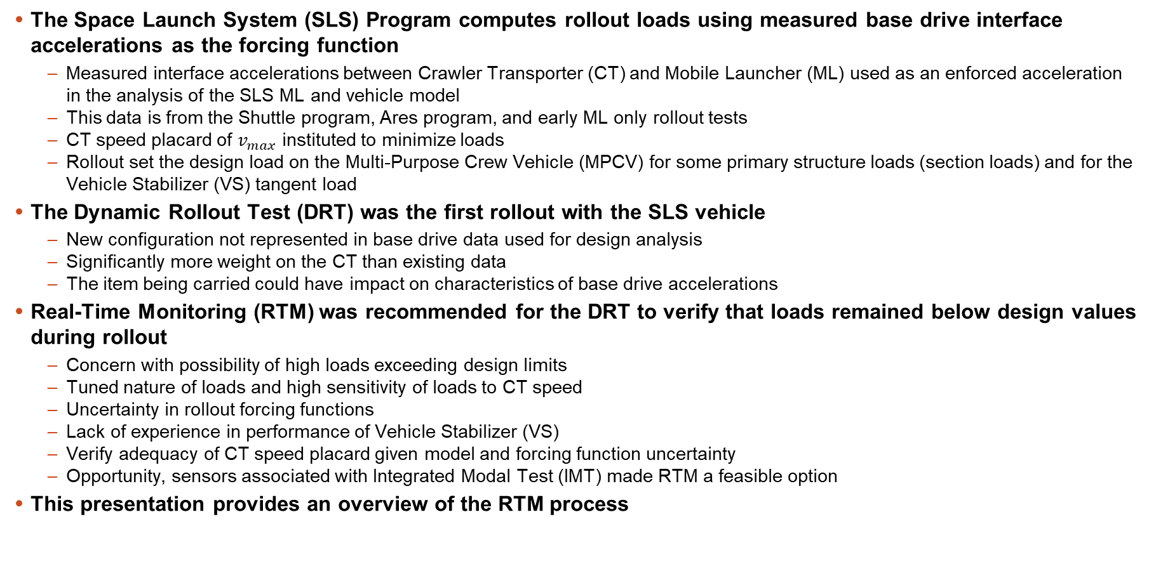
Introduction
The Space Launch System (SLS) Program computes rollout loads using measured base drive interface accelerations as the forcing function
  Measured interface accelerations between Crawler Transporter (CT) and Mobile Launcher (ML) used as an enforced acceleration in the analysis of the SLS ML and vehicle model
  This data is from the Shuttle program, Ares program, and early ML only rollout tests
  CT speed placard of $v_{max}$ instituted to minimize loads
  Rollout set the design load on the Multi-Purpose Crew Vehicle (MPCV) for some primary structure loads (section loads) and for the Vehicle Stabilizer (VS) tangent load
The Dynamic Rollout Test (DRT) was the first rollout with the SLS vehicle
  New configuration not represented in base drive data used for design analysis
  Significantly more weight on the CT than existing data
  The item being carried could have impact on characteristics of base drive accelerations
Real-Time Monitoring (RTM) was recommended for the DRT to verify that loads remained below design values during rollout
  Concern with possibility of high loads exceeding design limits
  Tuned nature of loads and high sensitivity of loads to CT speed
  Uncertainty in rollout forcing functions
  Lack of experience in performance of Vehicle Stabilizer (VS)
  Verify adequacy of CT speed placard given model and forcing function uncertainty
  Opportunity, sensors associated with Integrated Modal Test (IMT) made RTM a feasible option
This presentation provides an overview of the RTM process

Slide 3
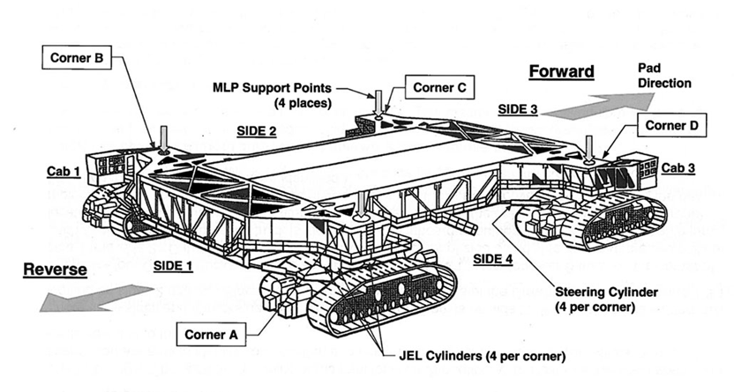
Crawler Transporter Description
The ML is picked up at 4 CT interfaces using Jacking, Equalizing and Leveling System (JELS) cylinders
Vibrations at drive trucks are transmitted through the JELS to the ML interface

Slide 4
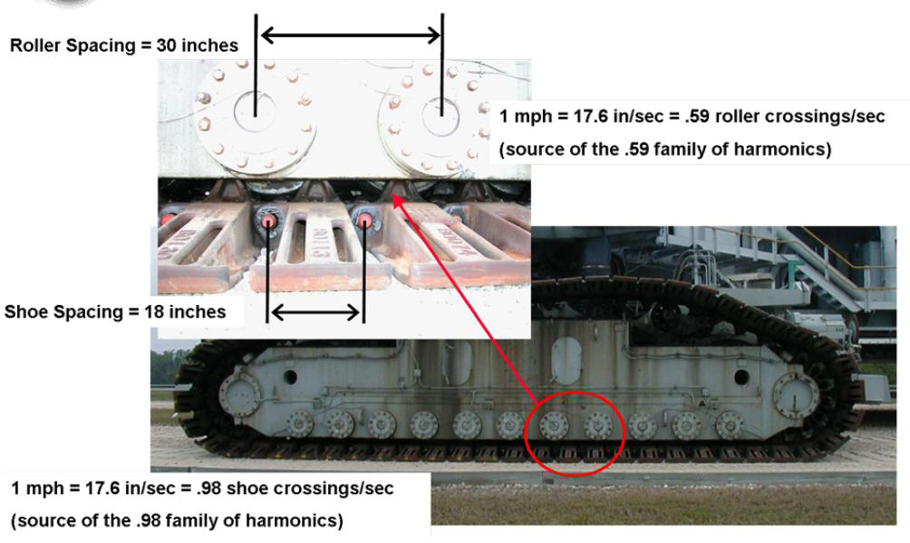




Geometry Determines Base Drive Frequency Content
Base Drive accelerations are influenced by impulses between rollers and shoe hinges
Resulting narrow-band random frequency content is a function of crawler speed
Roller Spacing = $d_{1}$
There are $D_{1}$ roller crossings / sec (source of $D_{1}$ family of harmonics)
Shoe Spacing = $d_{2}$
There are $D_{2}$ roller crossings / sec (source of $D_{2}$ family of harmonics)

Slide 5
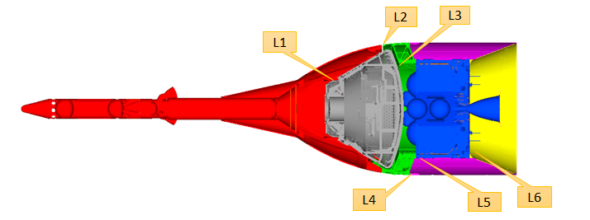
Critical Load Indicators
MPCV Critical Load Indicators
  Primary structure load indicators associated with section loads at key section cuts
  Shear loads are relatively low during rollout, moments dominate
  Axial Equivalent (PEQ) loads are often used as a more general load that reflects the combined impact of moments and axial loads

Slide 6
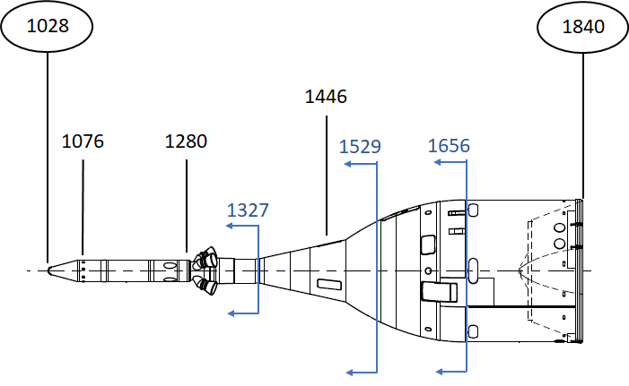

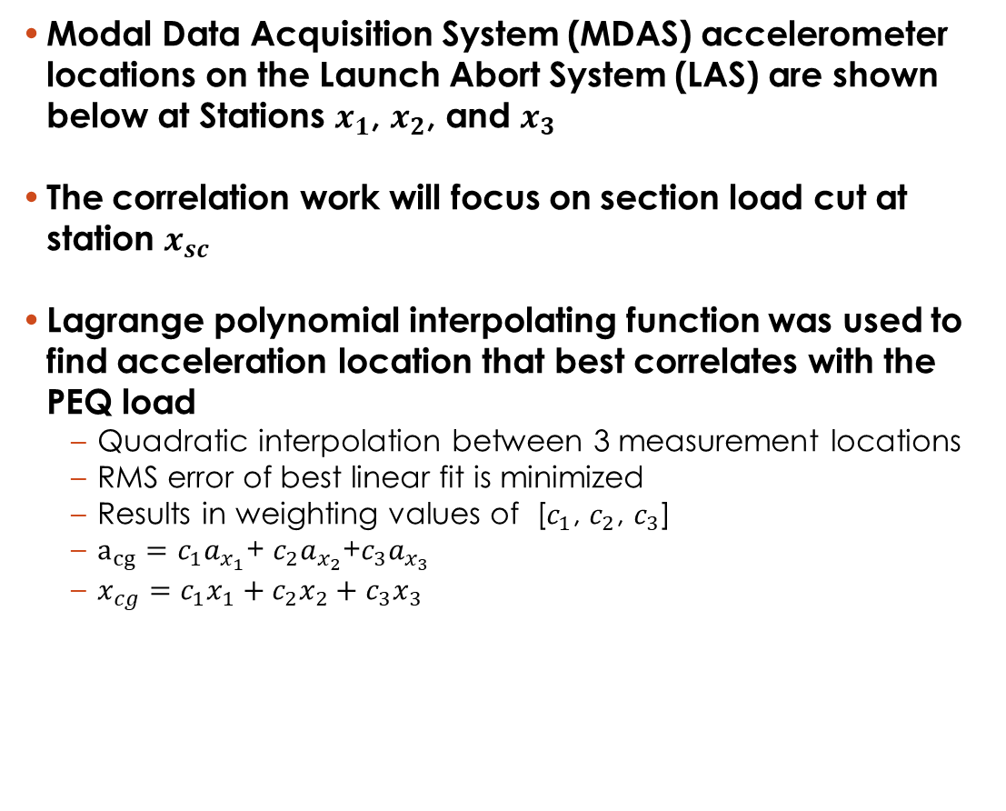



Available MDAS Accelerometer Locations
Modal Data Acquisition System (MDAS) accelerometer locations on the Launch Abort System (LAS) are shown below at Stations $x_{1}$, $x_{2}$, and $x_{3}$
The correlation work will focus on section load cut at station $x_{sc}$
Lagrange polynomial interpolating function was used to find acceleration location that best correlates with the PEQ load
  Quadratic interpolation between 3 measurement locations
  RMS error of best linear fit is minimized
  Results in weighting values of [$c_{1}$, $c_{2}$, $c_{3}$]
  $a_{cg}=c_{1}a_{x_{1}}$+ $c_{2}a_{x_{2}}$+$c_{3}a_{x_{3}}$
  $x_{cg}=c_{1}x_{1}+c_{2}x_{2}+{c_{3}x}_{3}$
$$x_{3}$$
$$x_{1}$$
$$x_{2}$$
$$x_{sc}$$
P(t)
(-1,1)
(0,1)
(1,1)
t

Slide 7
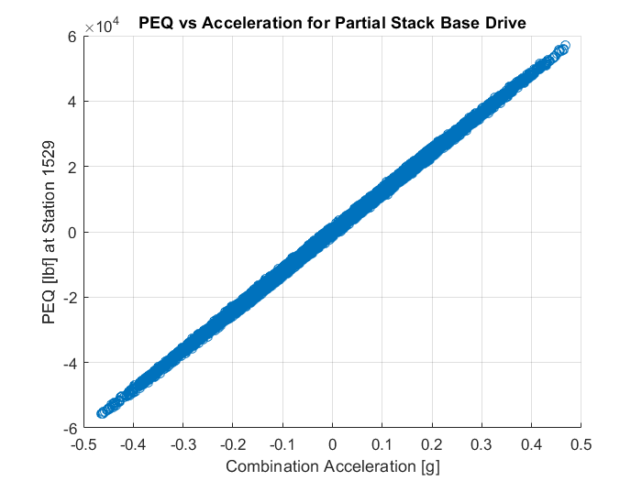
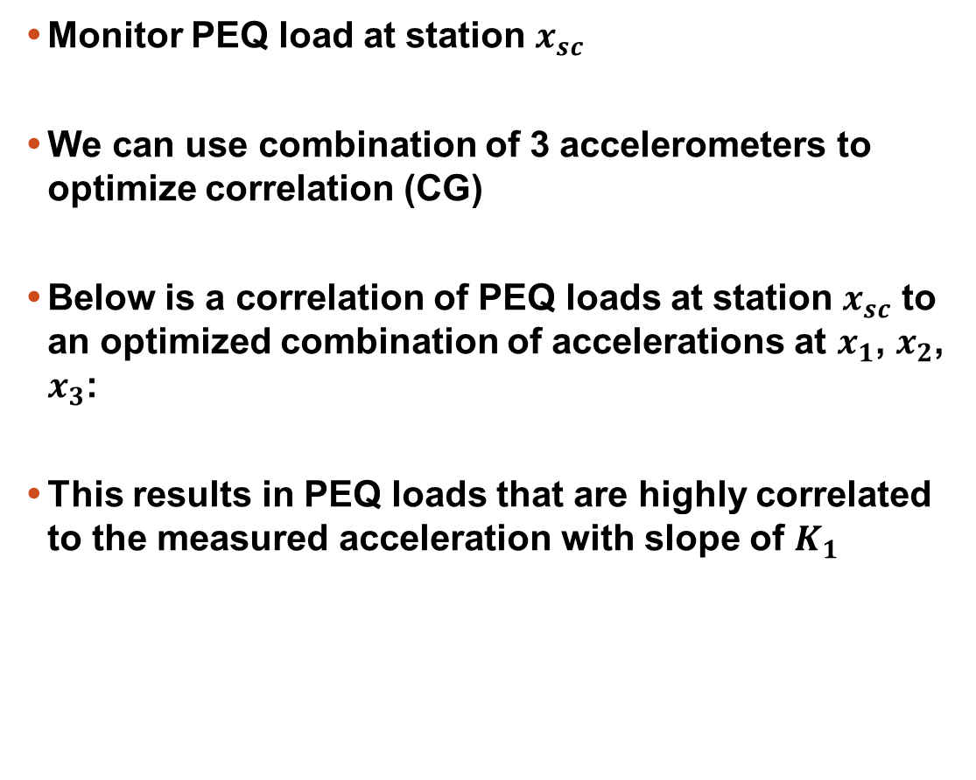

Indirect Monitoring Options, Optimized Weighting
Monitor PEQ load at station $x_{sc}$
We can use combination of 3 accelerometers to optimize correlation (CG)
Below is a correlation of PEQ loads at station $x_{sc}$ to an optimized combination of accelerations at $x_{1}$, $x_{2}$, $x_{3}$:
This results in PEQ loads that are highly correlated to the measured acceleration with slope of $K_{1}$
PEQ at Station $x_{sc}$
Combined Acceleration: $c_{1}a_{x_{1}}\text{+ }c_{2}a_{x_{2}}\text{+}c_{3}a_{x_{3}}$
Combined Acceleration

Slide 8














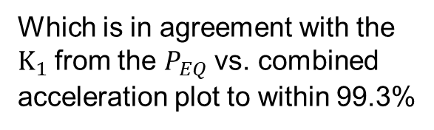
PEQ Optimization, Inertial Force Relationship
Note this slope is consistent with the mass above section $x_{sc}$ and moment arm to station $x_{cg}$
The Free Body Diagram below illustrates the relationship between the moment at the section cut and inertial force due to lateral acceleration
This relationship and high correlation between the PEQ and lateral acceleration suggest this load is purely inertial
$$x_{1}$$
$m_{sc}$ = mass above $x_{sc}$
$$F_{inertial}=m_{sc}a_{cg}$$
$$x_{cg}$$
$$M_{inertial}=\left(m_{SC}a_{cg}\right)\left(x_{sc}−x_{cg}\right)$$
$$x_{2}$$
$$P_{EQ}=\frac{2M_{inertial}}{r}$$
$$\frac{P_{EQ}}{a_{cg}}=K_{2}≅K_{1}$$
$$x_{3}$$
$$x_{sc}$$
Which is in agreement with the $K_{1}$from the $P_{EQ}$ vs. combined acceleration plot to within 99.3%
$$M_{inertial}=F_{inertial}X_{MA}$$

Slide 9
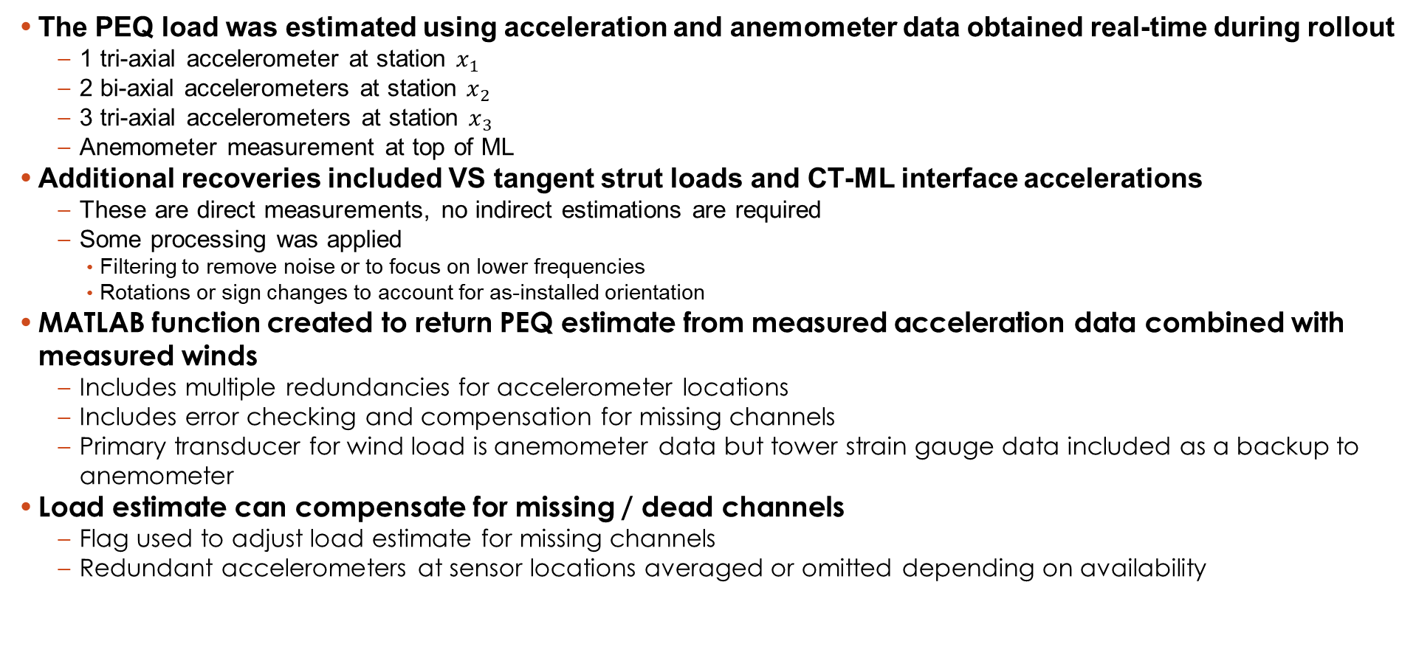
Measurement Requirements
The PEQ load was estimated using acceleration and anemometer data obtained real-time during rollout
  1 tri-axial accelerometer at station $x_{1}$
  2 bi-axial accelerometers at station $x_{2}$
  3 tri-axial accelerometers at station $x_{3}$
  Anemometer measurement at top of ML
Additional recoveries included VS tangent strut loads and CT-ML interface accelerations
  These are direct measurements, no indirect estimations are required
  Some processing was applied
    Filtering to remove noise or to focus on lower frequencies
    Rotations or sign changes to account for as-installed orientation
MATLAB function created to return PEQ estimate from measured acceleration data combined with measured winds
  Includes multiple redundancies for accelerometer locations
  Includes error checking and compensation for missing channels
  Primary transducer for wind load is anemometer data but tower strain gauge data included as a backup to anemometer
Load estimate can compensate for missing / dead channels
  Flag used to adjust load estimate for missing channels
  Redundant accelerometers at sensor locations averaged or omitted depending on availability

Slide 10
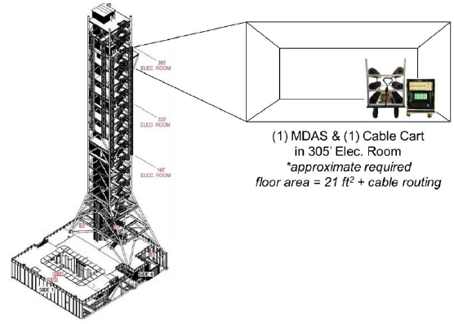
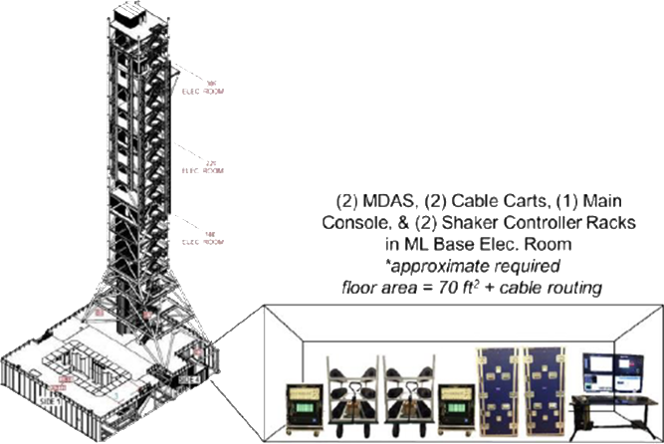
Data Acquisition Overview
SLS provided data acquisition hardware and software
  Channels teed off the MDAS to the monitoring hardware
Personnel for the real-time monitoring were located in the ML Base Electrical Room
MATLAB based application for data acquisition, monitoring setup and display, data logging to disk
  Real time data computation, statistics and response level verification
Alert conditions and communication plan defined

Slide 11
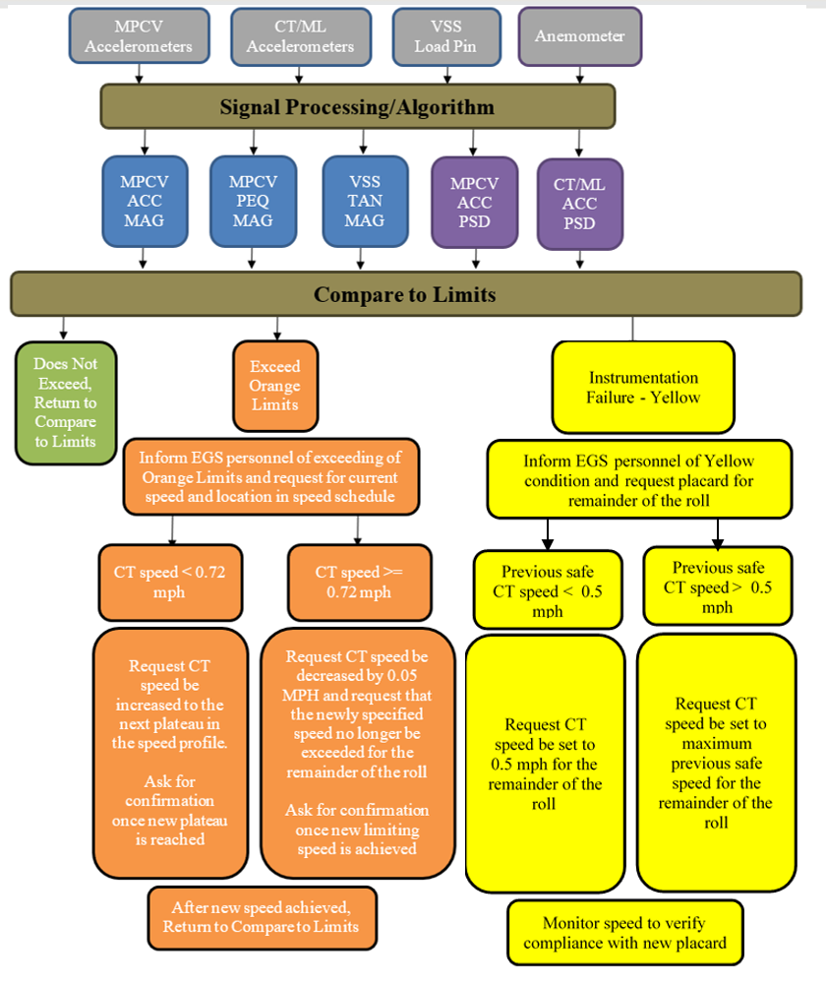



RTM Communications Plan
Two alert conditions were defined
  Orange – loads reaching limits
  Yellow – instrumentation failures preclude continued RTM process
  Alert conditions communicated to test director for decision
Orange alert condition
  RTM indicates loads reaching limits
  Request speed change, confirm new speed, DRT profile
Yellow alert condition
  Insufficient instrumentation remains to carry out RTM process
  Advise test director to complete roll at minimum risk
$$v_{o}$$
$$v_{y}$$
$$v_{y}$$
$$v_{o}$$

Slide 12
Observed Response Levels
DRT Rollout Overview
  Speed profile included stair stepping to increase frequency content and support Operational Modal Analysis (OMA) work
  Observed acceleration and PEQ estimates were well below design values but did poke out above expected values for base drive
    Expected value includes uncertainty factor
    Limit includes uncertainty factor and wind contributions
    Fortunately, winds were very light for DRT
Acceleration
PEQ
CT Speed

Slide 13
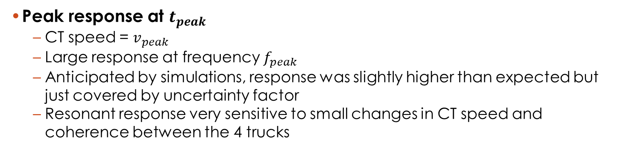
DRT Observed Peak Response
Peak response at $t_{peak}$
  CT speed = $v_{peak}$
  Large response at frequency $f_{peak}$
  Anticipated by simulations, response was slightly higher than expected but just covered by uncertainty factor
  Resonant response very sensitive to small changes in CT speed and coherence between the 4 trucks
CT Speed
PEQ
Time
Time

Slide 14
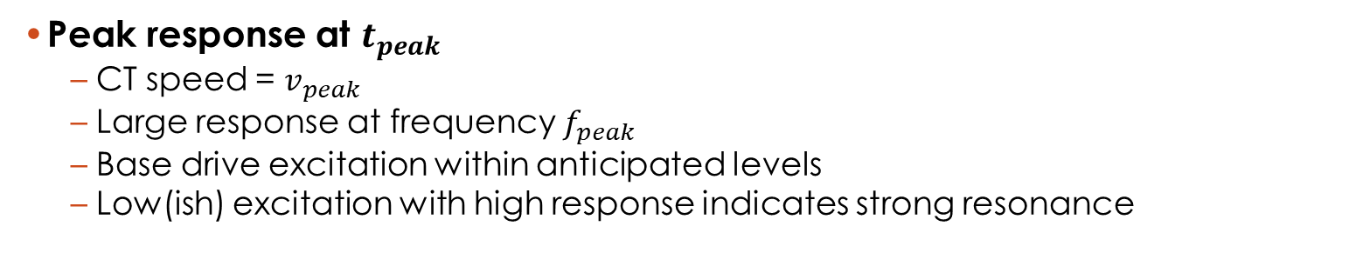
DRT Observed Peak Response
Peak response at $t_{peak}$
  CT speed = $v_{peak}$
  Large response at frequency $f_{peak}$
  Base drive excitation within anticipated levels
  Low(ish) excitation with high response indicates strong resonance
Acceleration
Acceleration
Frequency
Frequency

Slide 15
Summary
An indirect real time metric was used to estimate MPCV loads
  Acceleration at LAS shows good correlation with MPCV PEQ loads
  Signal processing used to combine accelerations from multiple locations to estimate CG acceleration and lower load projection sensitivity to model errors.
VS tangent loads were measured directly
Metrics were based on peak load
  Monitored to ensure PEQ and VS loads stay below enveloped design loads
  Did not directly take into account fatigue/fracture concerns, but was consistent with provided time histories for fatigue
While there were some minor data acquisition and software challenges, the effort was largely successful
  The ability to monitor vehicle response during rollout in real-time was established
  Processes for modifying rollout speed or even halting the CT can be implemented if future needs dictate
  Load estimates were largely in the expected range with minor exceedances
Post rollout reconstruction
  Simulations are accurate to within range of design uncertainty values
  Observed loads can be better recreated in simulations with minor modeling updates.
    VS stiffness increased and VS damping reduced for low amplitude responses
    Post-IMT ML model update implemented

Slide 16
Backup

Slide 17
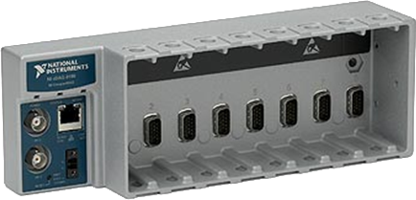
Working Concept
National Instruments CompactDAQ chassis
  Ethernet interface (cDAQ-9188)
  4 channel analog input (NI-9234)
  4 channel analog input (NI-9237)
  Channels fed from MDAS
MATLAB based application for acquisition and monitoring
  GUI used for channelization, real time display, playback
  Pseudo channels used for processing
  Throughput data to disk
  IRIG-B synchronization
Hardware implementation dry run with ISVV10 rollout
  Signal condition
  NI hardware signal to ML base monitoring station
  Monitoring station workspace
    Personnel training
  Communication protocols
  Software development and refinement

Slide 18
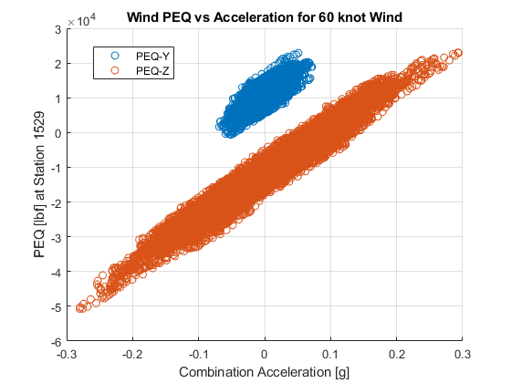
Indirect Monitoring Options, Wind Contributions
Most of the PEQ load due to wind is also inertial and is captured by the acceleration measurements
There is a contribution due to the static wind loading
  Pseudo-static increment can be seen as an offset from 0 in scatter plot
  Can be estimated based on real-time wind speed measurements from ML tower anemometer and drag models
PEQ
Combined Acceleration

