Slide 1
Artemis Navigation Architecture:
Early Capabilities and Long Term Evolvability and Evolution
ESA GNC Conference, June 12, 2023
Evan Anzalone, NASA/Marshall Space Flight Center, Evan.J.Anzalone@nasa.gov
Cheryl Gramling, NASA/Goddard Space Flight Center, Cheryl.J.Gramling@nasa.gov

Slide 2
ACD-SCaN PNT Trade Study Membership
Co-Leads: Evan Anzalone (ACD), Cheryl Gramling (SCaN)
ACD S&MA – Dan Londa
ACD Surface System Integration (SSI): Toni Ranos, Alex Osorio
EHP: Brian Lewis, Claude Wallace, Michael Khayat, John Lewis, Mike Cooke, Scott Bleisath, with additional support
ESDMD TIO/ADO Lunar Architecture Team: Ben Sellari, Kevin Larman
Flight Operations Directorate: John Sangree, Glenn Pogue, Paul Lane, Daren Welsh
Gateway: Chris Woodland, Scott Cryan
HLS: Juan Orphee, Dave Woffinden, Greg Dukeman, Todd Freestone
JSC Navigation Mode Team – Greg Holt
LunaSAR: Cody Kelly, Lisa Mazzuca
Mars Exploration Capabilities – Denise Varga
SCaN: Laurie Mann, Juan Crenshaw, Nick Speciale
Steering Committee:
Primary Customer: Mark Kirasich
Artemis: Erika Alvarez, Lawrence Jones, Ted Kenny
SCaN: Greg Heckler, Jason Mitchell, Jim Armitage, Jaime Esper, Jim Schier

Slide 3
Artemis Exploration Goals Dependent on PNT
Artemis III
Artemis IV
Artemis V
Artemis V+
Demonstrate Autonomy and Operations in NRHO for Moon to Mars Objectives
Gateway
RPOD in NRHO
Maintain Gateway in NRHO Orbit
21 Day Autonomous Operations
Demonstrate Capability and Deploy Assets to Build Out Artemis Base Camp
HLS, Cargo, ISRU, LTV, SH, PR, Logistics
Demonstrate Precision Landing
Remove Approach Constraints and Improve Precision
Deploy and Protect Base Camp Area
Autonomous Rover (LTV/PR) Cargo Transfer
EVA, PR, LTV
Increasingly Complex & Longer Traverse
2 km range with EVA
10 km range w/ EVA + LTV
20+ km range w/ EVA + LTV + PR
Telerobotic Rover Operation
Explore Areas of Scientific Interest
Science
Near Lander
Into PSR
Into Lava Tubes, etc.
Autonomous Rover (LTV/PR) Exploration
PNT is required across the architecture to ensure safe and successful Artemis Campaigns.

Slide 4

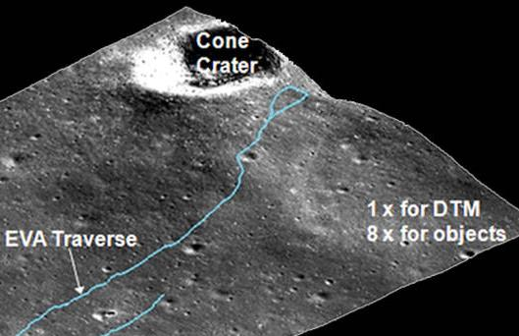
Lunar Navigation From An Apollo Crew Perspective
“Maps are primarily only useful for large surface features”
“Even when the crewmen climbed to a ridge, the landmark often was not clearly in sight.”
“Distances are deceiving”
“Craters were hidden behind other craters, ridges, and old worn-down mounds”
“It is, however, potentially dangerous to proceed on the assumption that no navigation aids are needed and to discover in the middle of a mission that ‘seat of the pants’ navigation is inadequate”
  “Navigation is more difficult with so much dark terrain and crude nav aids” – DRATS 2021 Summary
Apollo 14 Crew Came within 20 m of
Cone Crater objective without realizing It (LROC)

Slide 5
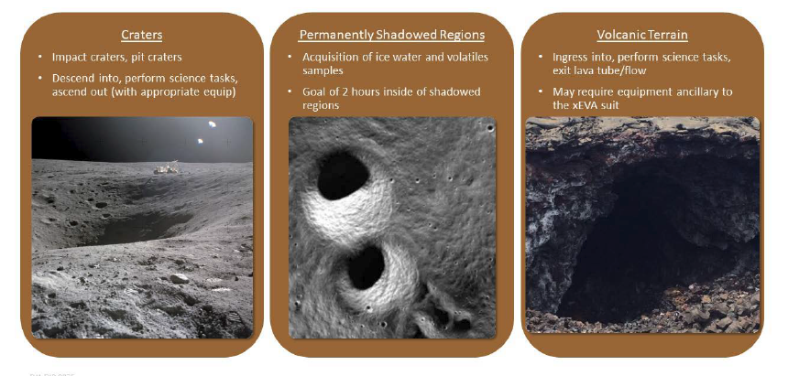
Comparison of Artemis to other NASA Planetary Surface Missions
Apollo
VIPER
Mars Rovers
Artemis
Decreasing Availability of Line of Sight to Earth
Mars Rovers
VIPER
Apollo (300m/6km)
Artemis
Increasing Daily Traverse Distance
Mars Rovers
VIPER
Apollo
Artemis
Increasing Speed
Mars Rovers
Apollo
VIPER
Artemis
Decreasing Availability of Lighting During Operations
Mars Rovers
VIPER
Apollo
Artemis
Increasing Navigation Accuracy & Timeliness Required
Artemis at Lunar South Pole presents more stressing distance, lighting, earth availability, and navigation challenges than previous programs.

Slide 6
Architecture Trade Study Flow and Process
Products
PRODUCTS
Map ConOps Requirements to Artemis Mission
Requirements
Req: Art# Map
Current Requirement Set:
Template + Justification
ConOps:
Identify All
Currently Perceived/Known Use Cases
PNT Sources, Technologies Perceived/Known:
Template
Architecture:
Art# Map
Architecture:
Use Case Map
Requirement Set:
Template + Justification
Briefing Material
Requirements
Gaps
Tech TRL
RFI Material Prep
Forward Work
Plans & Integration Roadmap

Slide 7
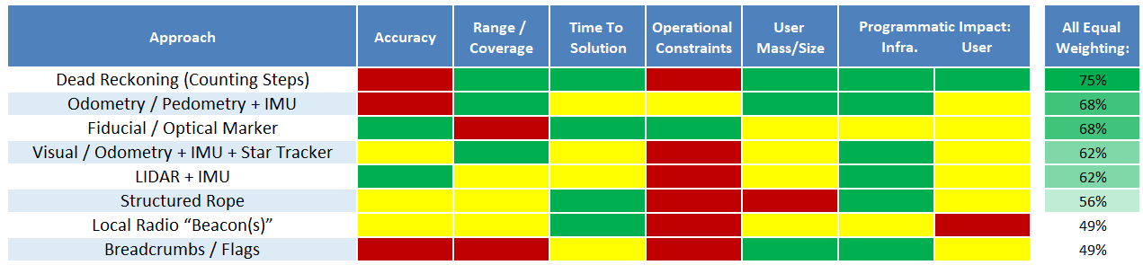
Early Missions Assessment & Recommendation – Artemis III And IV
Focused on relative PNT solutions due to limited implementation schedule, scored on 1, 5, 9 scale
If programmatic concerns are primary driver → Dead Reckoning and Motion Sensors (IMU)
Combining multiple relative techniques may reduce operational constraints and improve accuracy
  Fiducials and Optical: Star Trackers / Camera / LIDAR could provide best benefit
Approaches could be augmented with initial deployments of orbital and surface infrastructure
  Requires funding and development of user terminal (needed for long-term infrastructure)
Recommendation: Perform subsequent ACD and EHP co-led detailed trade study (includes traverse, cost, and schedule impacts) for down-select and deployment on Artemis III and IV. Focus on EVA navigation with applicability to LTV.

Slide 8
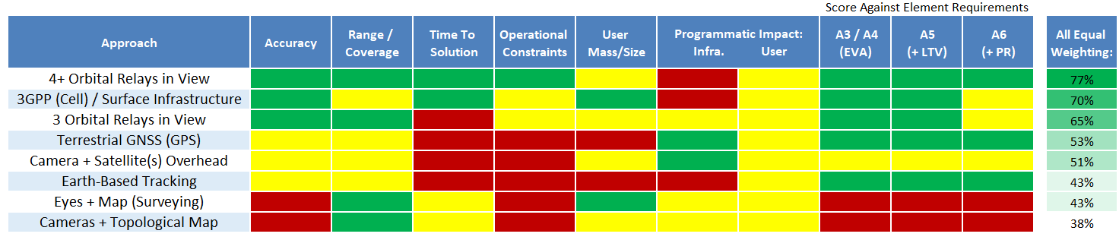
Sustaining Missions PNT Assessment - Artemis V+
ESDMD requirement for localization of crew on surface
Considered additional solutions with longer lead time from relative-only options
Ranked technologies for absolute surface nav that could provide ~1’s to ~100’s of meters
Assessed qualitatively based on 1,5,9 (red, yellow, green) scale
Included scoring for ability to meet relevant Artemis use cases identified
  Multiple weighting scenarios assessed (equal shown below)
Orbital Relays and 3GPP Infrastructure provide robust approaches to meet Artemis PNT architecture absolute localization needs but have large programmatic impacts.
Notes:
Field testing shows optimistic capability to orienteer to ~150 m on average
Results:
Absolute Navigation: Orbital Relays and/or 3GPP
Relative Navigation: Fiducials and/or Odometer/Pedometer w/ IMU and/or Dead Reckoning
Fiducials provide high accuracy for near-field support and awareness of nearby assets
Motion Sensing (IMU + Odometry) enables propagation over short distances
Dead Reckoning allows astronaut to be grossly aware of their location (but could still get lost)
Does not support tele-robotics or high speed vehicle motion

Slide 9
As perspectives change, requirements and approaches change
Primary needs are for real-time operations; can improve via post-processing
Mission Phase:
Coverage Area:
Type of Knowledge:
Accuracy:
Orbit
Global
100 m
Absolute
50 m
Landing
Traverse
10 m
Relative
Return to Hab (Contingency)
Understood and well-captured in requirements
Forward work needed to define approaches and requirements
Localization with 10 m
~1 m
Surface & Rendezvous
Immediate Surroundings
Local
~10 cm

Slide 10
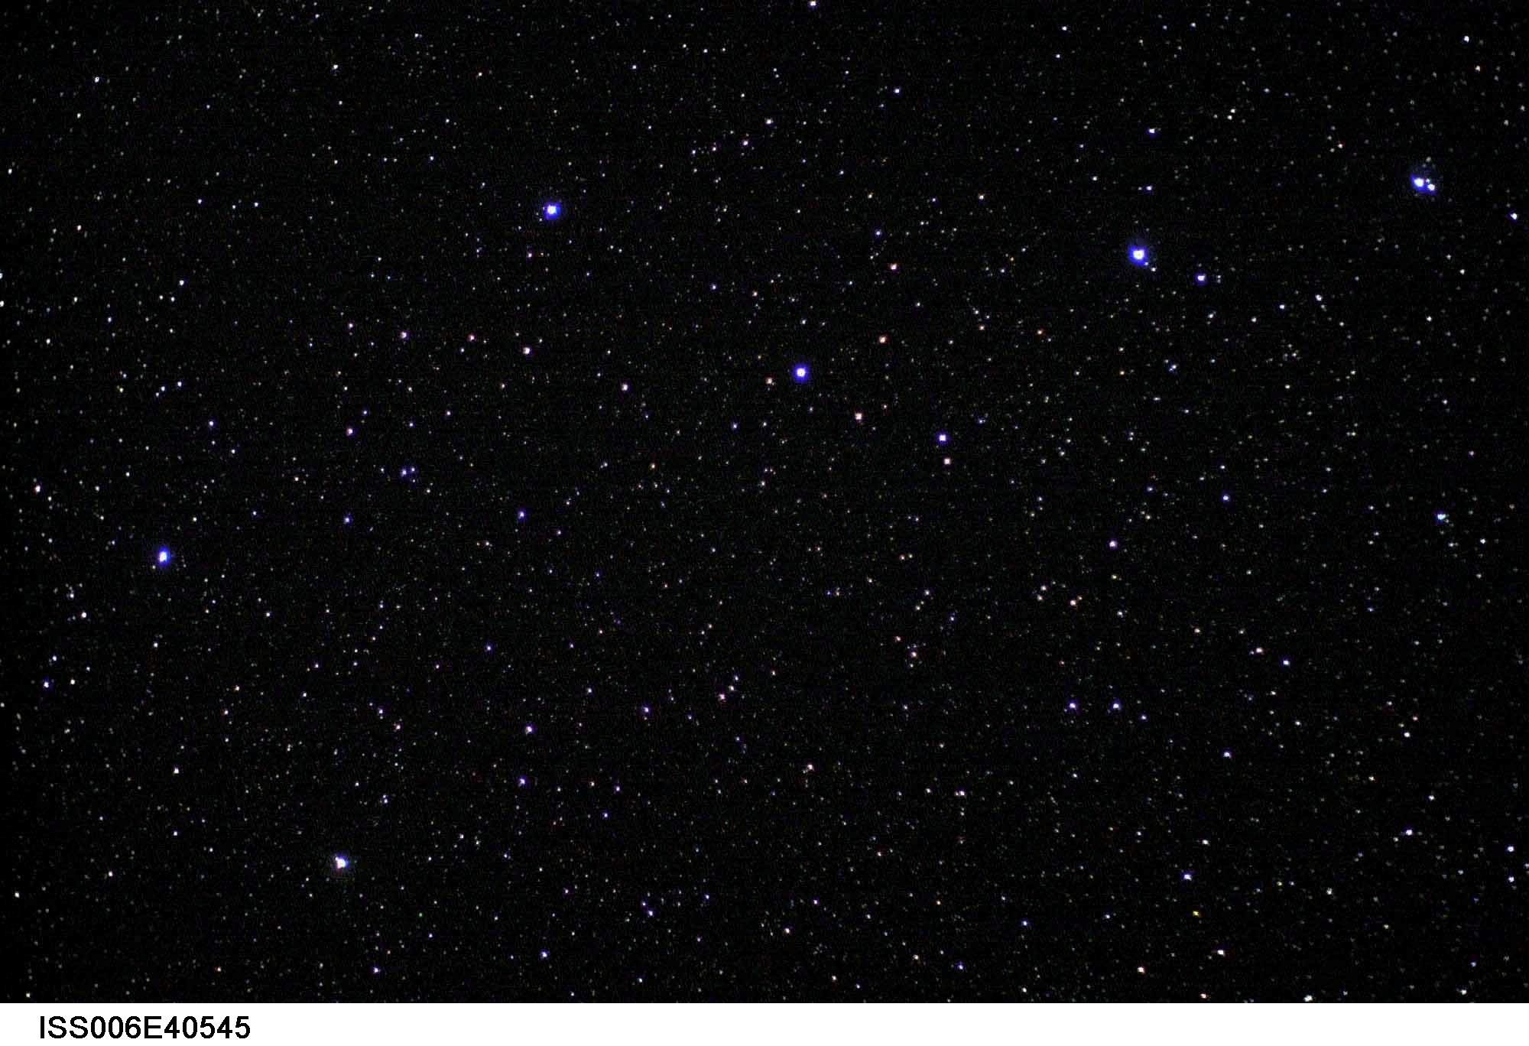
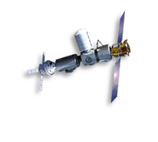
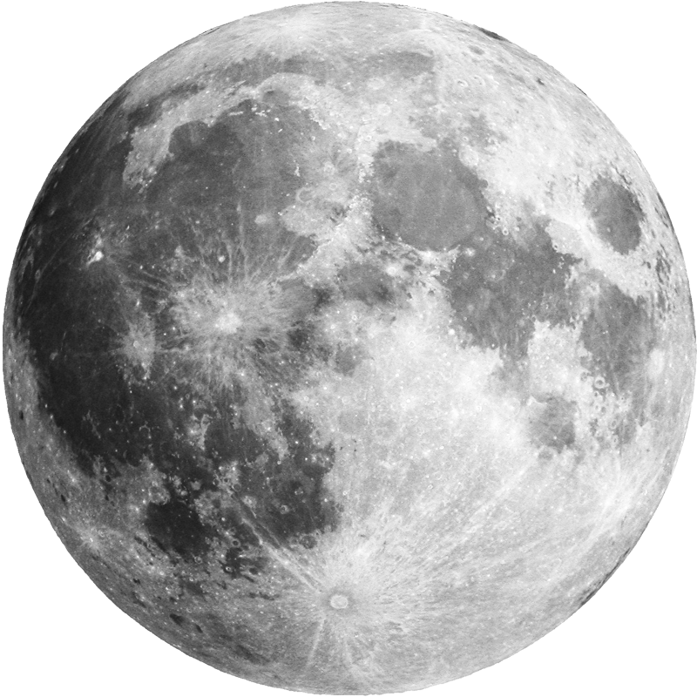
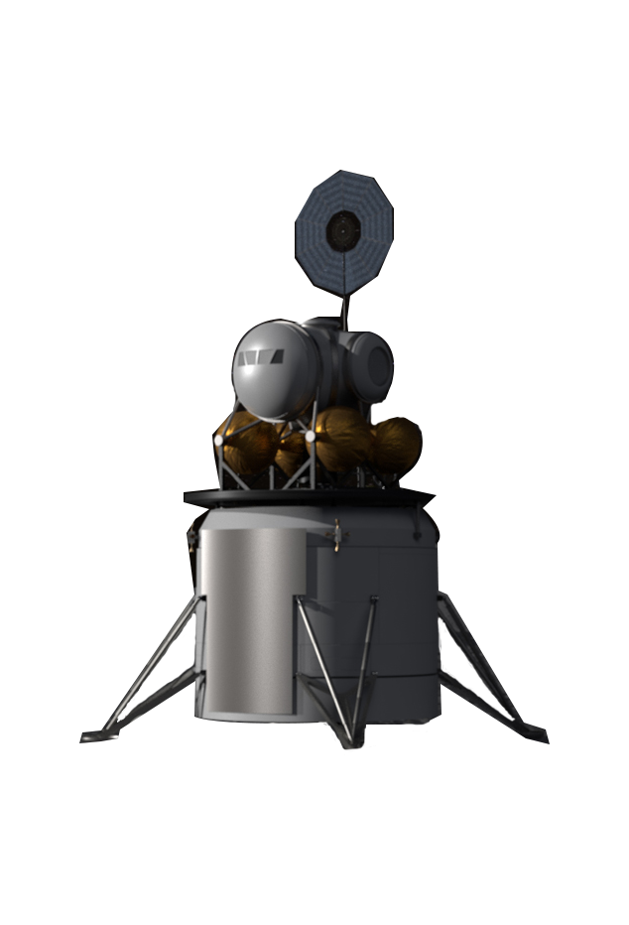
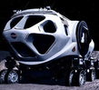

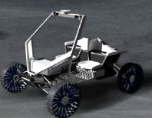
Use Case/Requirements/Solution
Foundation
Baseline Recommendation
Future Deployment
Real Time
Post-Processed
X km radius from HLS
Science/ Technology
NRHO
LL0 → DOI
PDI
Landing
Traverse
10km
0.1 m/s
TBD
100 m
0.1m/s
50/25m
50/ 25 m
10m
<<=1 m
Lunar Reference System (Frame, Time, and Products)
Orbital Relays/LCRNS
Differential
Earth GNSS, Inverted PNT
LIDAR
RPOD Suite
Fiducials*
Earth DTE
Breadcrumbs*
Retro-Reflector
Motion Sensors (IMU, Odom, etc.)*
3GPP/PL Infrastructure
Optical Navigation (Camera)*
Lighting*
*- Traverse options without relay
10

Slide 11
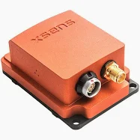
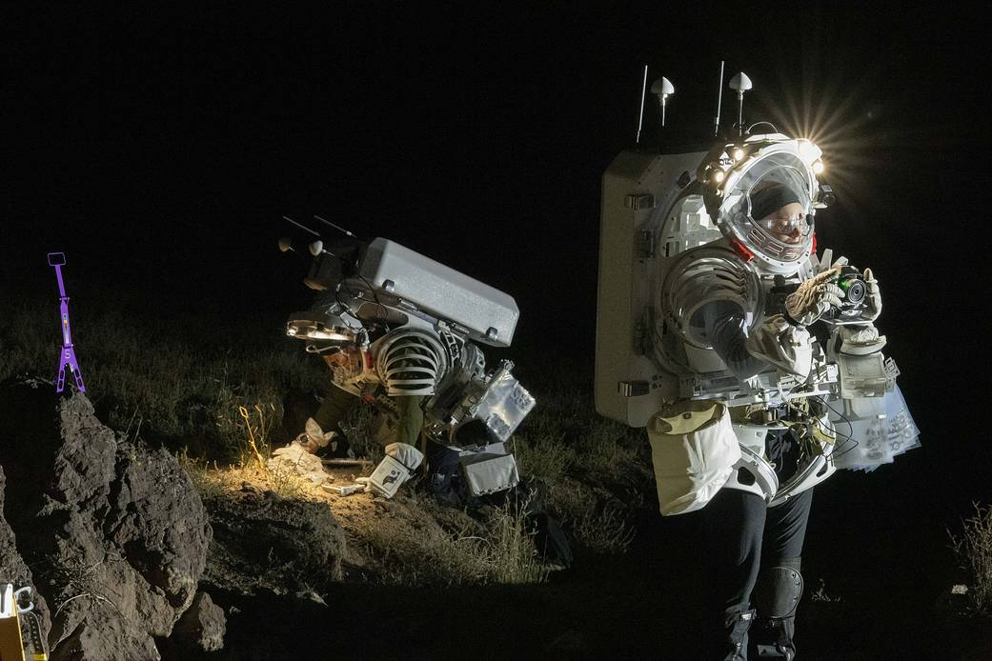
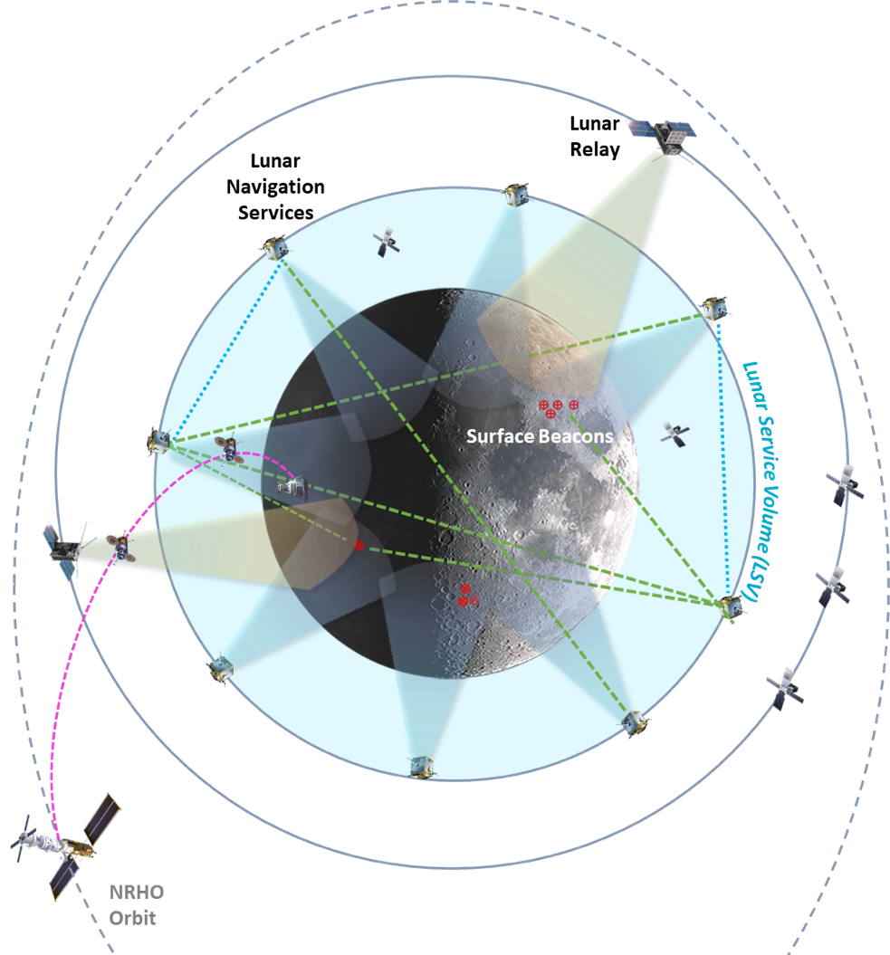
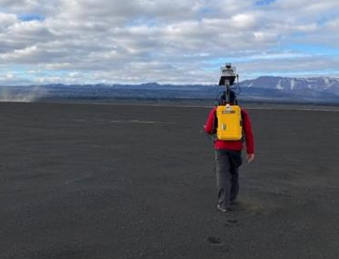
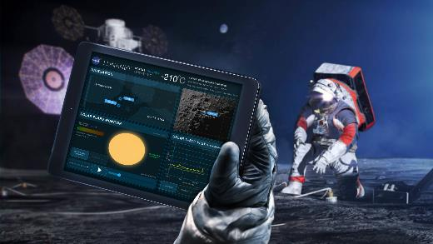
Forward Work
Lunar Navigation System
Gateway
Assessment of Orienteering Approach in Field Studies and Generated Imagery
Image/NASA/Bill Stafford
Cross-element Integration and Development of Test Objectives in Flight Campaign
Development and Implementation of Navigation Aids

Slide 12

Many Thanks To All Who Supported This Trade Study!

Slide 13
Acronym List
Acronym | Description
3GPP | 3rd Generation Partnership Project (cell)
ACD | Artemis Campaign Development
DRATS
DTE | Direct to Earth
DTM
EHP | EVA Human Mobility Program
ESDMD | Exploration Systems Development Mission Directorate
EVA | Extra Vehicular Activity
GNSS | Global Navigation Satellite Systems
IMU | Inertial Measurement Unit
ISRU | In Situ Resource Utilization
HLS | Human Landing System
JSC | Johnson Space Center
LiDAR | Light Detection And Ranging
LLO | Low Lunar Orbit
Acronym | Description
LTV | Lunar Terrain Vehicle
NRHO | Near Rectilinear Halo Orbit
Odom | Odometer
OSLAP | Orbital and Surface Lunar Architecture for PNT
PDI
PNT | Position, Navigation, and Timing
PR | Pressurized Rover
PSR | Permanently Shadowed Region
RFI | Request for Information
RPOD | Rendezvous, Proximity Operations, and Docking
SAR | Search and Rescue
SCaN | Space Communications and Navigation
SH | Surface Habitat
S&MA | Safety and Mission Assurance
SSI
TRL | Technology Readiness Level

