Slide 1
A Field-Deployable Wireless Data Acquisition System for Ground-Test Arrays
William C Patterson
Interdisciplinary Consulting Corp. (IC2)
Aviation Forum San Diego, June 12-16th 2023
Copyright © by William C Patterson Interdisciplinary Consulting Corp.
Published by the American Institute of Aeronautics and Astronautics, Inc., with permission

Slide 2
Development and Array Deployment Team
Interdisciplinary Consulting Corp. (IC2)
William C. Patterson
James R. Underbrink
Rachel Collins
Austin Kee
Alan Gurlaskie
Dan D’Andrea
David A. Mills
NASA Langley Research Center
William M. Humphreys, Jr.

Slide 3
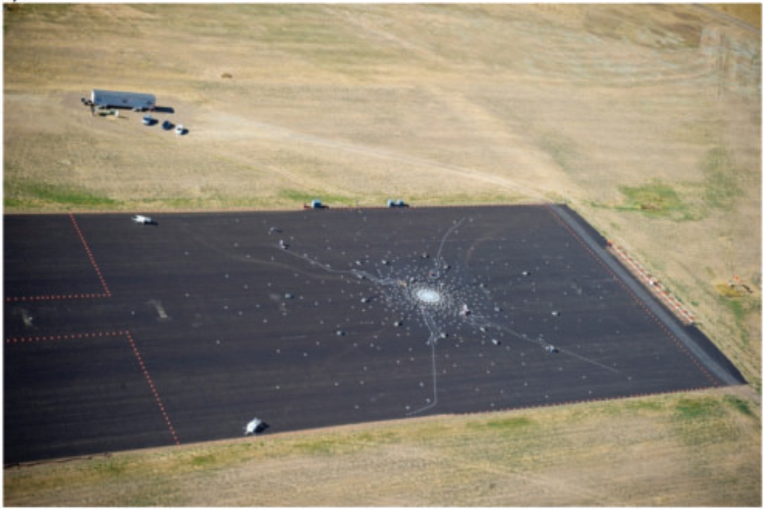
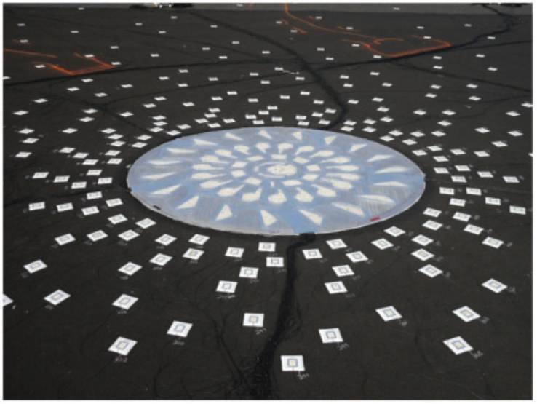
Introduction: Current State of the Art
Current fly-over ground arrays are massive efforts that require hundreds of labor hours and miles of cabling to deploy
Limitations
  Manufacturing greater than a 12 ft semimonolithic central plate is unrealistic which requires the use of individually placed microphones in the spiral arms, leading to reduced accuracy.
  Per-microphone temperature changes affect sensitivity. Using current array deployment/construction techniques, individual sensor temperature compensation is unrealistic.
  Huge distance from sensors to data acquisition systems results in sensor drive issues caused by long cabling.
  The current maximum size and density of the spiral array is limited by wiring and total system cost.
  The data acquisition mainframe is extremely specialized and nearly single-purpose. Both cost and power prevent the reasonable expansion of the number of microphones in the arrays.
Ref: J. Underbrink “Pletharrays for aeroacoustic phase array applications,”
International Journal of Aeroacoustics, 2017.

Slide 4
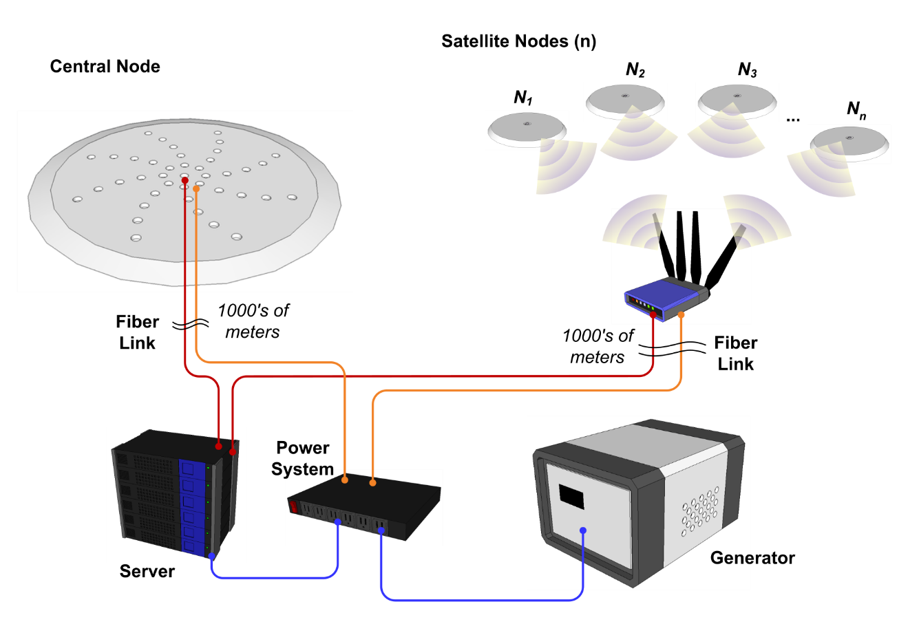
Wireless Data Acquisition System (DAQ)
Field-deployable wireless data acquisition system with a microphone front end
Target applications
  Primary: Full-scale air-frame noise source testing
  Secondary: Engine stand noise testing
Approach
  Wi-Fi satellite nodes for large array arms
  Central plate with high-density mics and distributed wired DAQ’s
  COTS networking/computing hardware for system network

Slide 5
Wireless Data Acquisition System (DAQ)
Original requirements (~2020)
Achieved specification of deployed prototype array
All requirements achieved (redefinition for improved customer applicability)
 | Requirement | Achieved Specification
Acoustic
Freq. Resp (3db): | 44.7 Hz to 11.2 kHz | <10 Hz – 16.9 kHz
Upper Range: | 128 dBSPL @ 3% THD | > 140 dBSPL (11% THD)
Dynamic Range: | 75 dBSPL | MDP 16 dBSPL @ 1kHz
Amp. Accuracy: | ±0.3 dBSPL | Mic. Driven, DAQ < 0.1 dB
Phase° Uncert.: | 7° @ 11.2kHz or 1.7 µs | Mic. Driven, DAQ < 100 ns
Data Acquisition
Sample Rate: | >40 kS/s | 62.1 kS/s
Sampling Synch: | <100 ns | <90 ns
Data Storage: | 10 runs @ 30 s/run | 32GB
Communications
Wireless Range: | 15 m | 16 m
Data Upload Speed: | <1 s after request per 30 s run | ~2MB/s (wifi) 10MB/s (wire)
Power:
 | 50x 30s runs/day for >3 days | 25 hours of acquisition
Enclosure And Env.
Size: | < 18 cm in dia., < 8 cm height | 11.5 dia., 5.5 height
IP Rating: | IP65 | IPX5
Operating Temp: | 0 – 60°C humidity 20-90% | 0 – 60°C humidity 20-90%

Slide 6
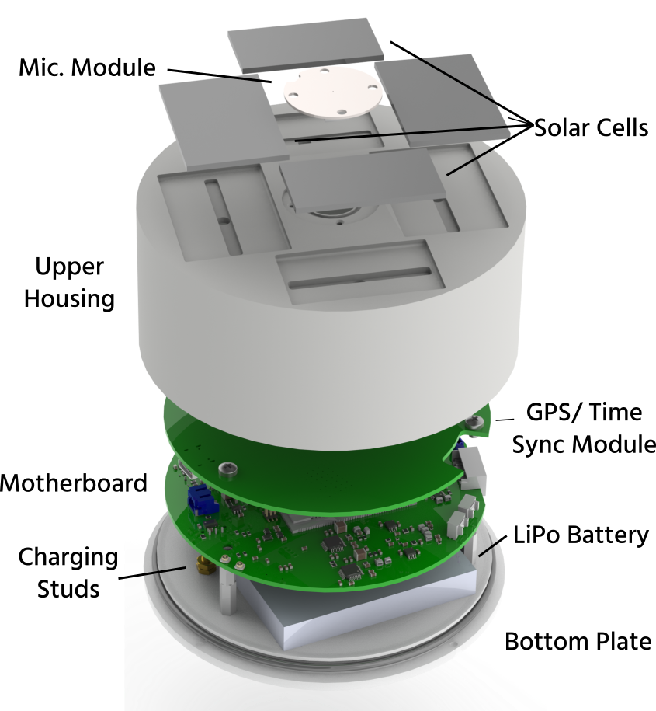
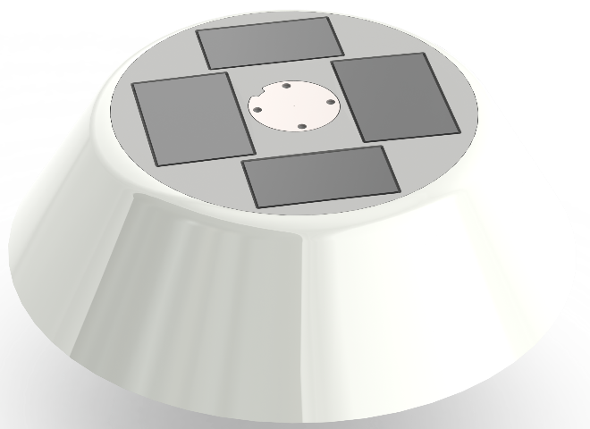
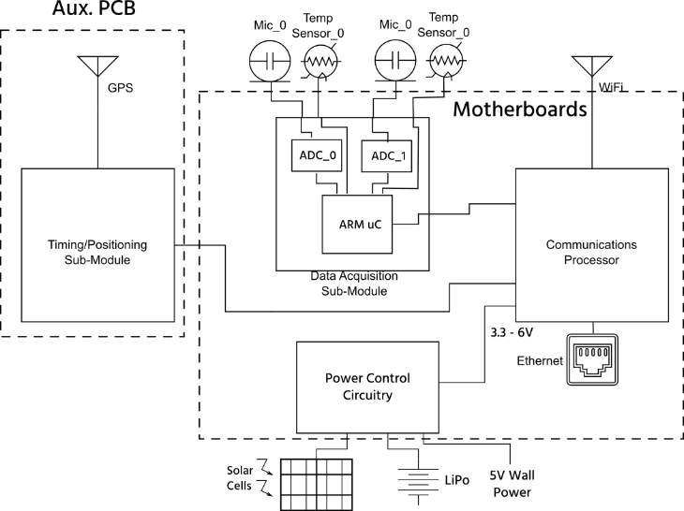
Wireless DAQ: Satellite Node
Housing and microphone are environmentally hardened (IPX7)
Wi-Fi provides wireless communication
GPS timing synchronization (<100ns)
High SPL MEMS microphone
Acquisition System: 24-bit ADC @ 62.5 kS/s
Common motherboard between wireless node and central plate node
  Acquisition, data storage, system control, and communication
Solar panels and LiPo battery provide power for indefinite length deployments
Final enclosure dimensions
  Central Case Diameter: 113 mm [4.4 in]
  45° Fairing Diameter: 225 mm [8.9 in]
  Height: 55 mm [2.1 in]

Slide 7
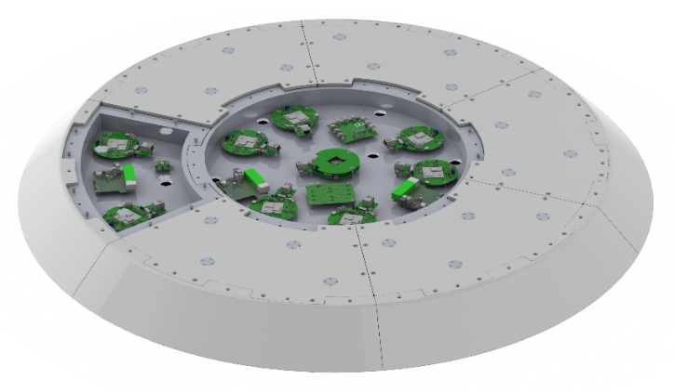
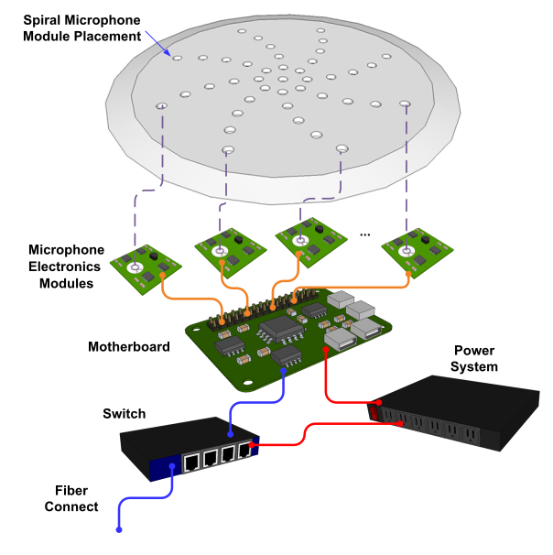
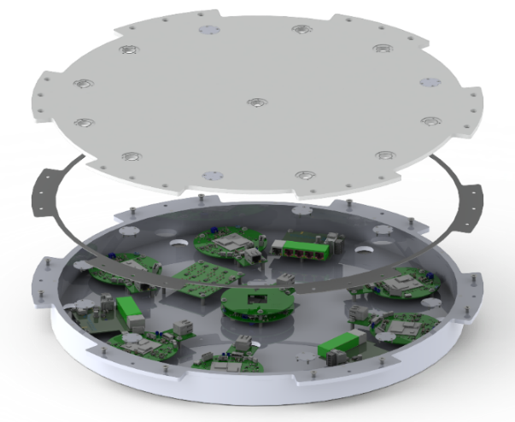
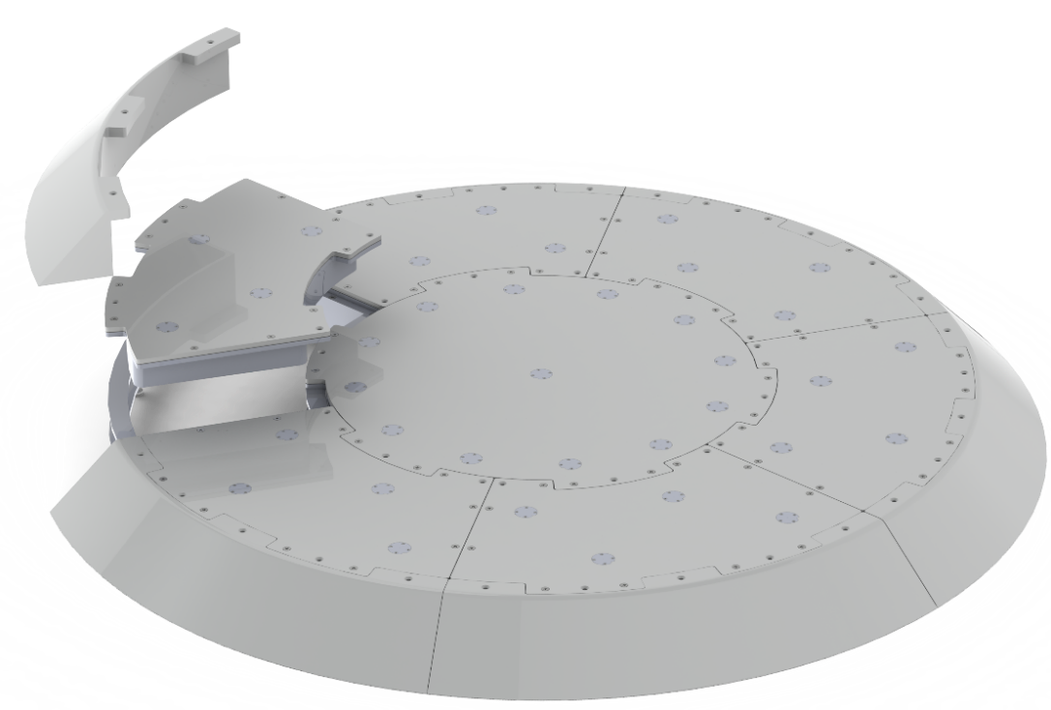
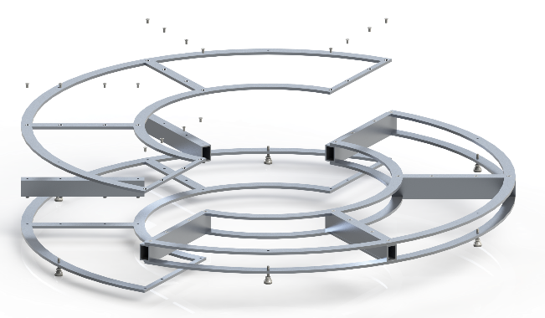
Wireless DAQ: Central Plate
High-density microphone arrangement for localizing higher frequency signals
Custom central plate design
  Premeasured locations of microphones
  Environmentally hardened modular enclosure
  Frame provides structure, and can be disassembled for shipping
  Tub-based enclosures provide waterproofing and easy installation

Slide 8
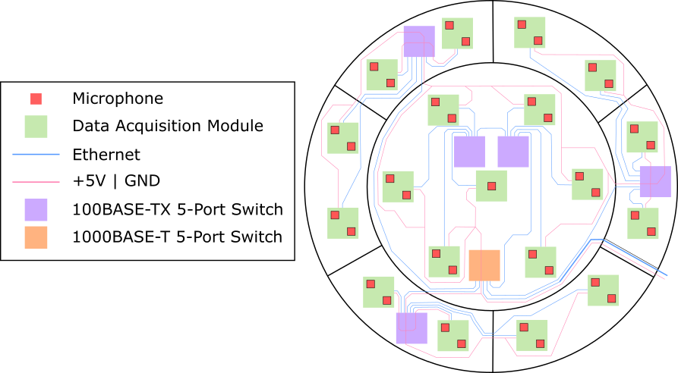
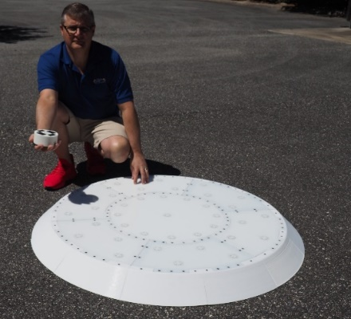
Wireless DAQ: Central Plate
Central plate electrical design
  37 microphones
  19 node motherboards (2x mics per node)
  1x time sync module and clock buffer board
  Internal communication over wired ethernet
  4x 5-port 1Gb and 1x 8-port switch
  System is power by 120 Vac to 5 V converted in auxiliary enclosure to minimize 60 Hz noise and reduce heat
Wiring:
  Communication over ethernet
  Hardwired power
  Single GPS for wired time-sync signal distribution
Common components for central and wireless nodes:
  Acoustic modules
  Motherboard for acquisition, data storage, system control, and communication

Slide 9
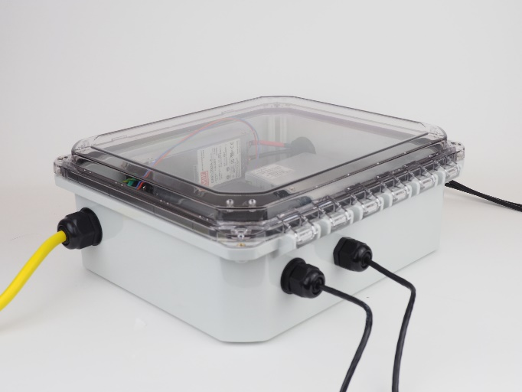
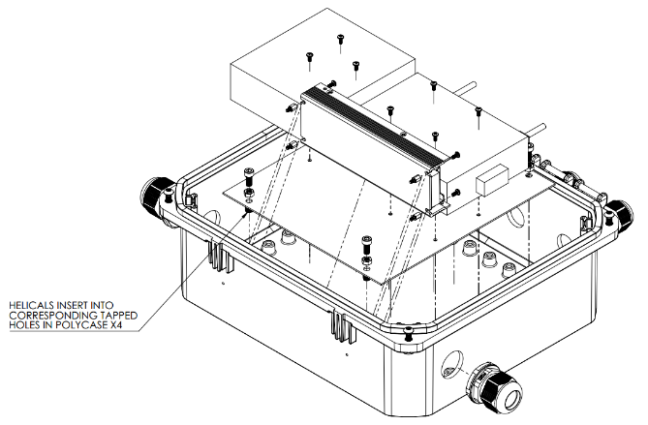
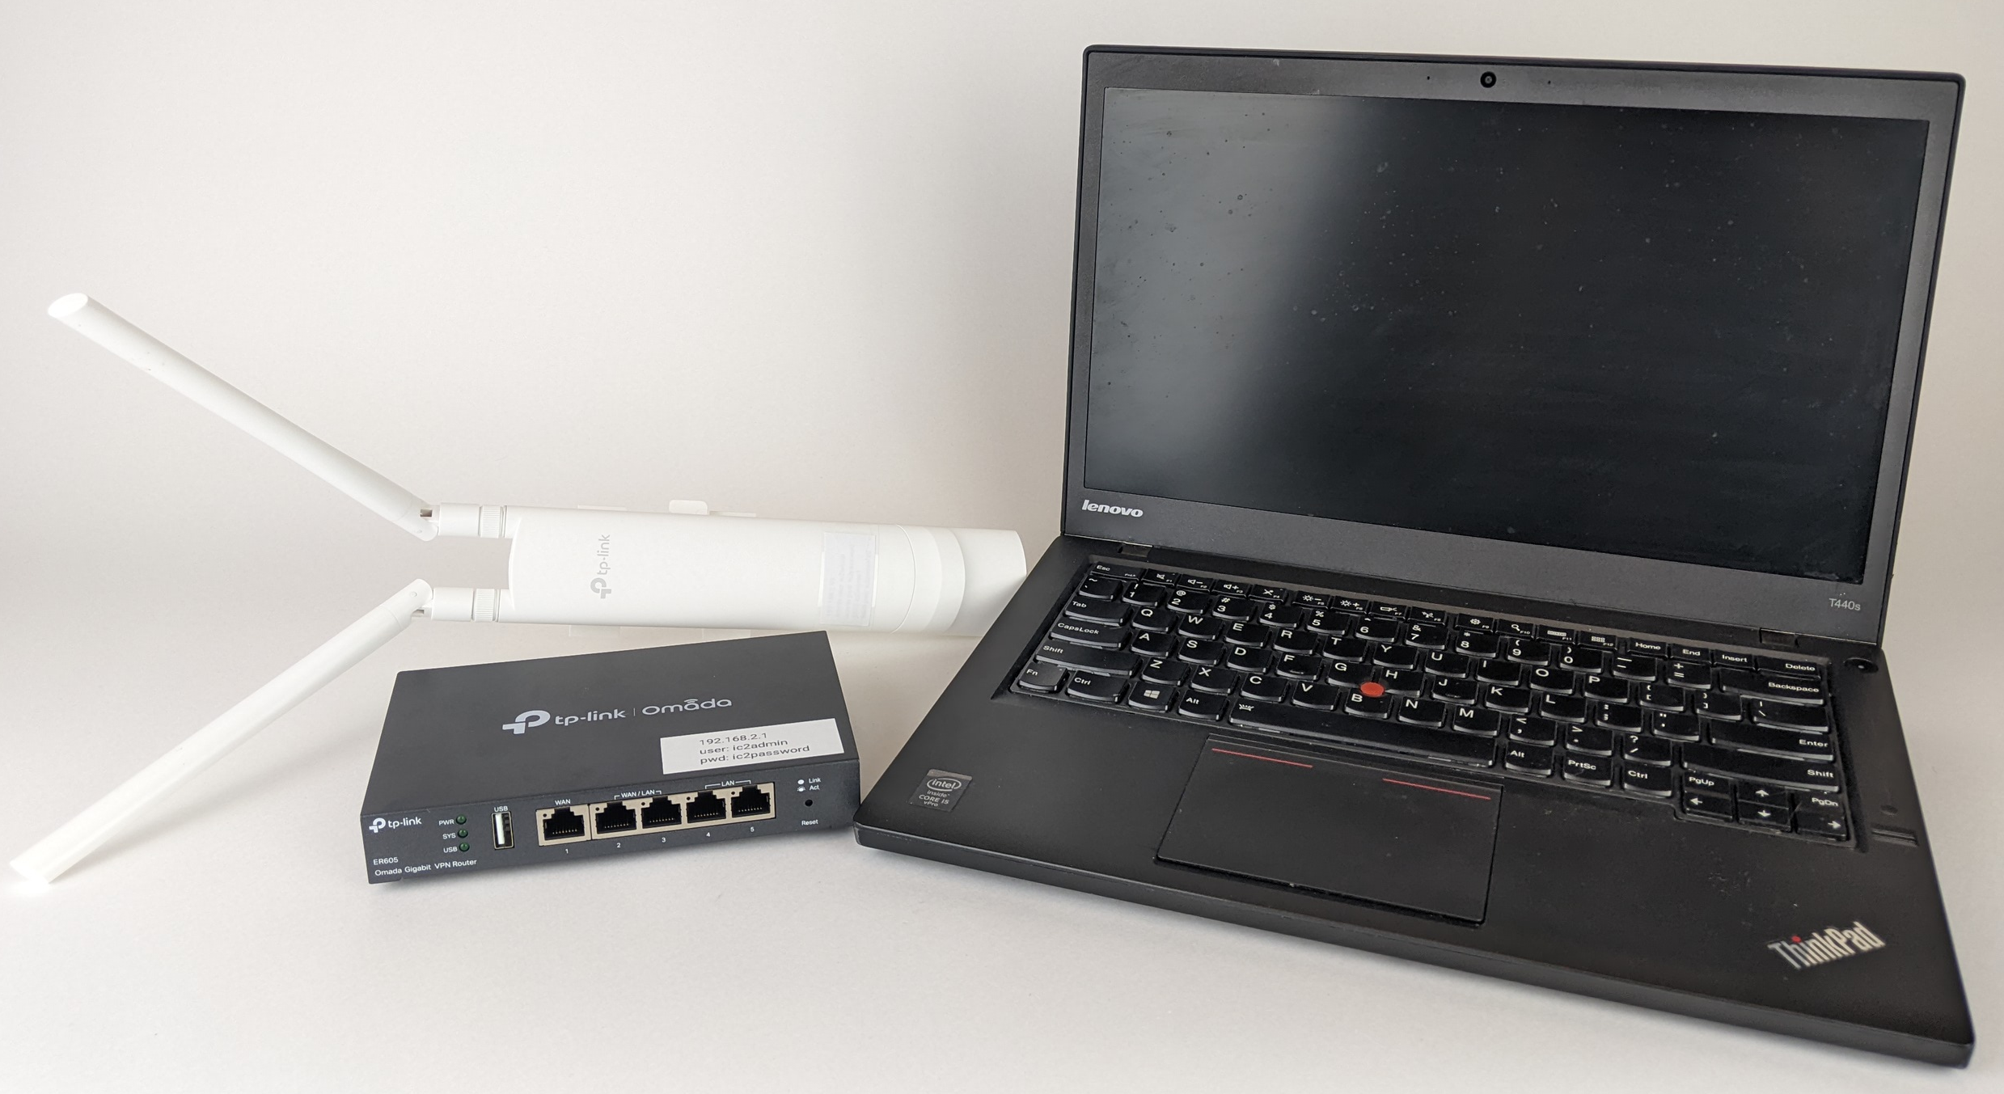
Wireless DAQ: Network Hardware
Network consists of low-cost COTS networking and computing hardware, due to round-robin data collection and comms.
2x POE IP65 WAPs
1x 5 port 1Gb Router + optical interface
1x Business Class Laptop
1x custom IP67 network enclosure includes:
  1Gb POE switch
    Optical connection back to control room
    Connection to central plate
    POE and connectivity for WAPs
  48V POE power supply
  120 Vac to DC converter to provide power to central plate
    Placed 60Hz signal further from central plate DAQs

Slide 10
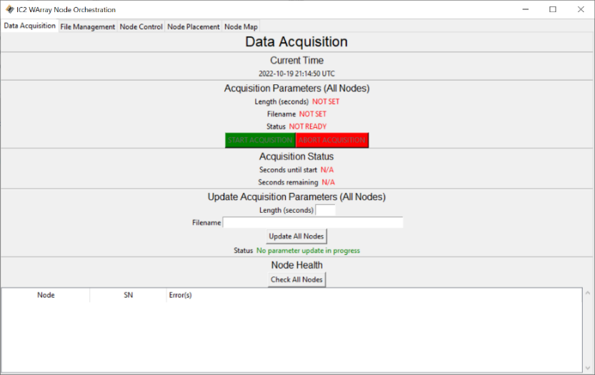
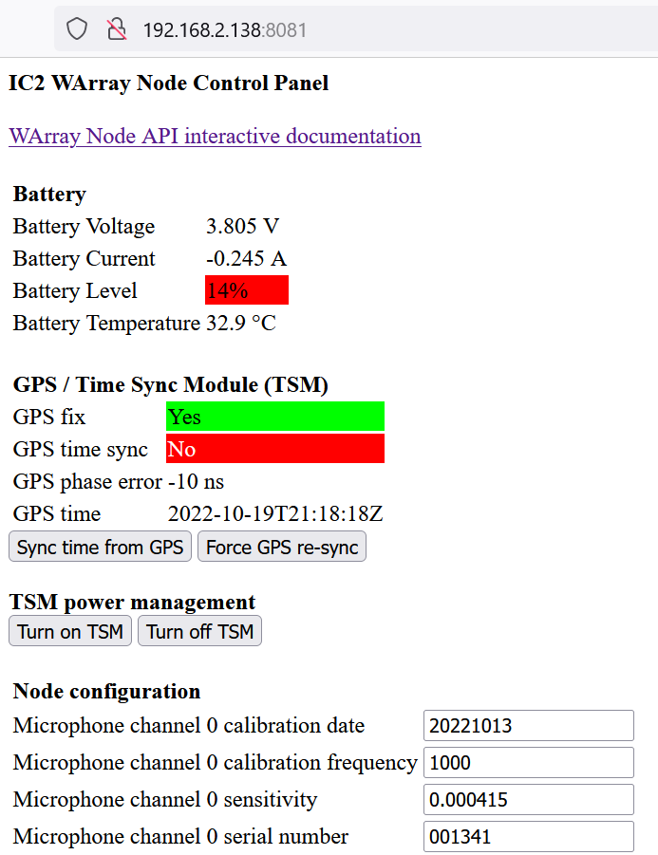
Wireless DAQ: Software
Rest API
  Programmatic interface for mass control of multiple nodes. Uses standard HTTP and JSON based protocol
Node GUI
  Provides simple GUI for a single nodes current state. Useful for single point test, calibration, monitoring, and debugging
Array Orchestration Software
  Provides interface to control data acquisition of full array of nodes
  Offers array file download functionality
  Node placement tools are also integrated

Slide 11
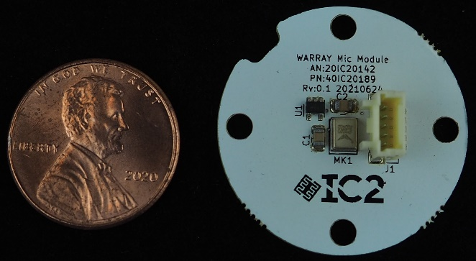
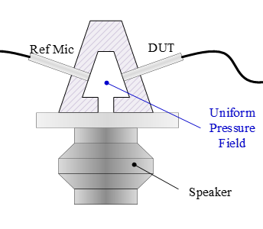
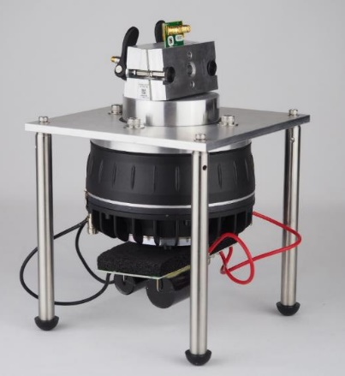
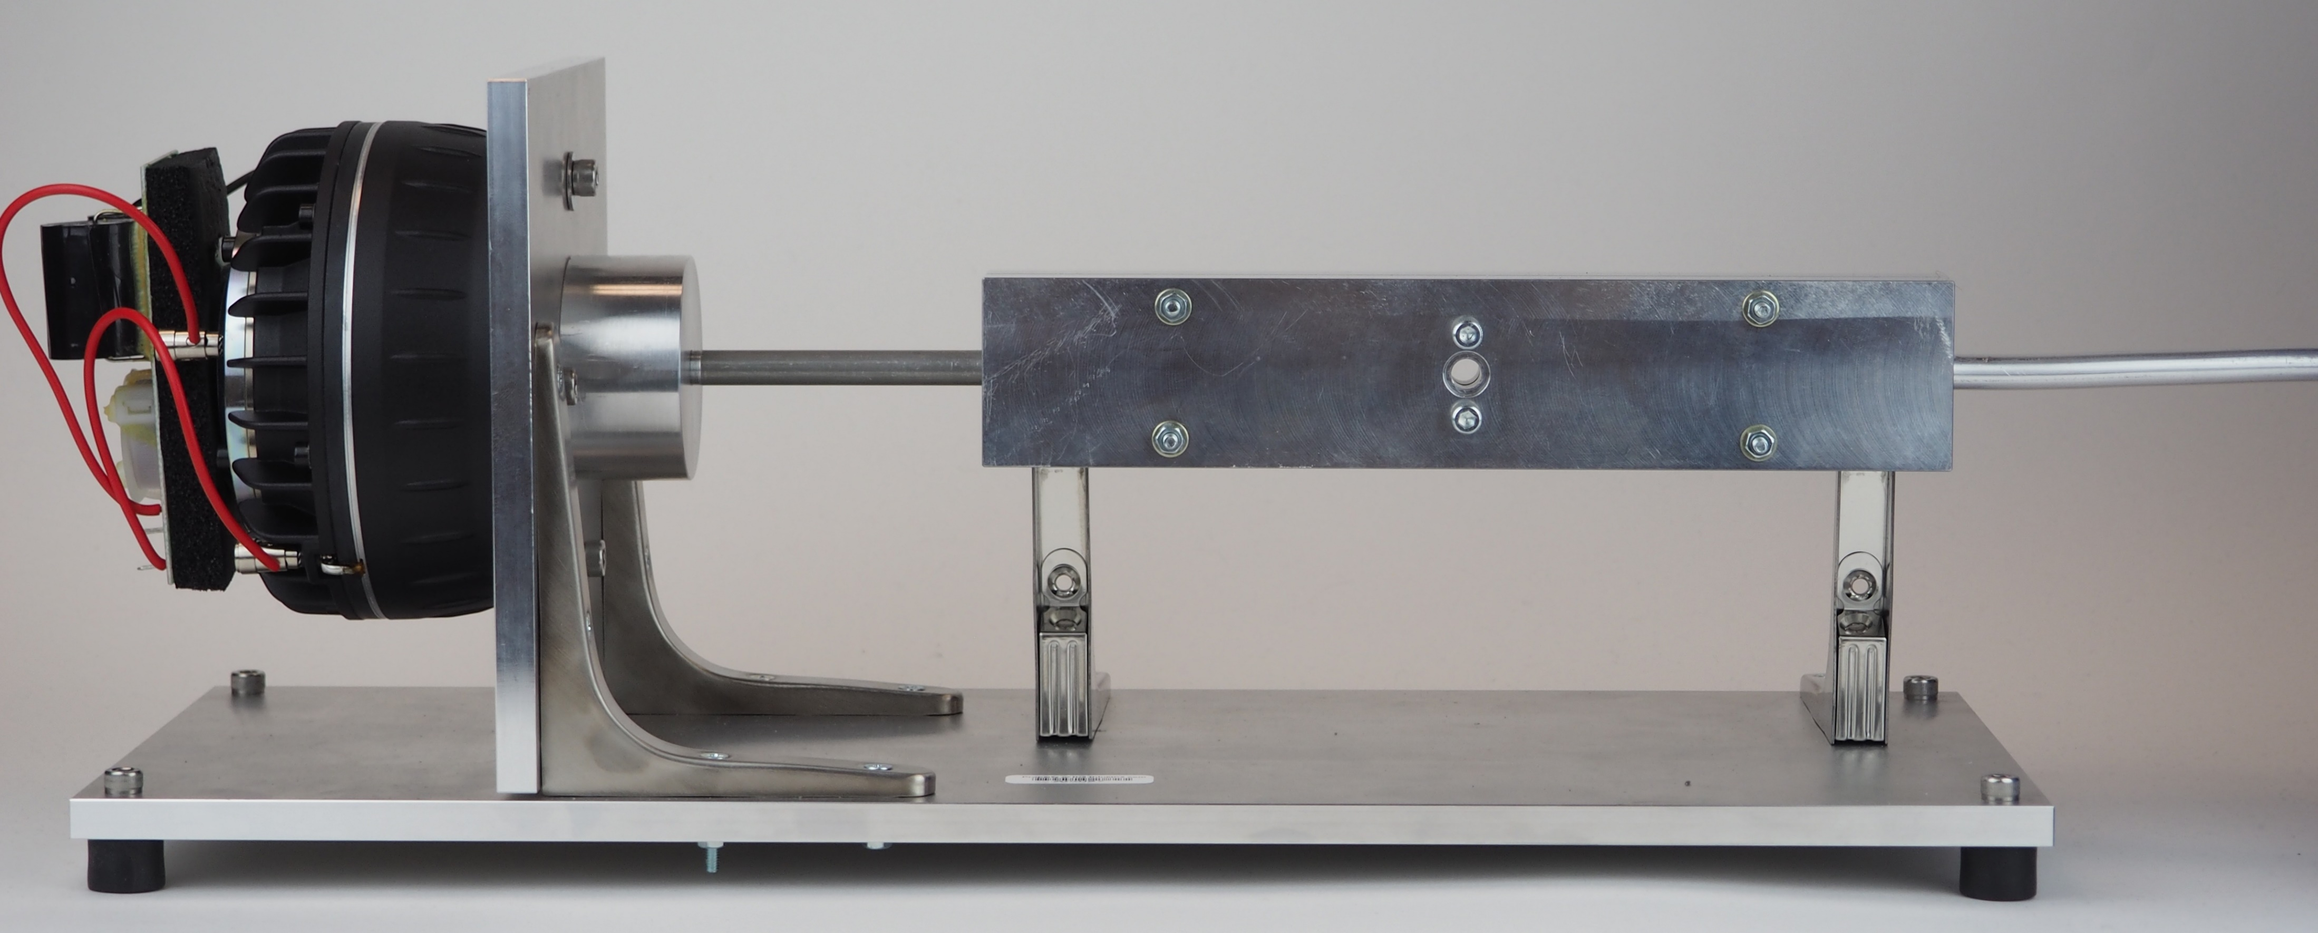
Laboratory Testing: Experimental Setup
Acoustic Wedge Testing
  Provides small acoustic volume that acts as a pressure coupler between driver, DUT, and Ref
  Used for Sensitivity and THD Testing
Infinite Tube Testing
  Thin symmetric channel with Ref and DUT mounted across from one another terminated in ‘infinite’ tube, resulting in minimal reflections
  Used for frequency response and phase measurement

Slide 12
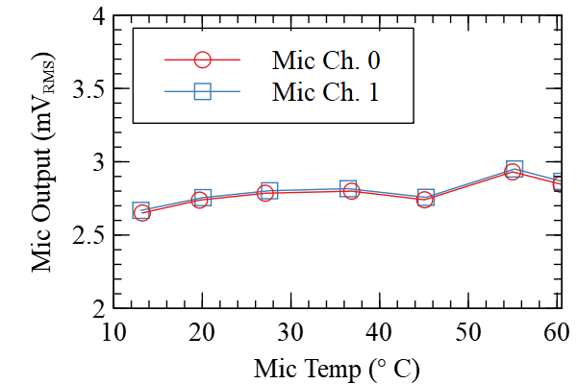
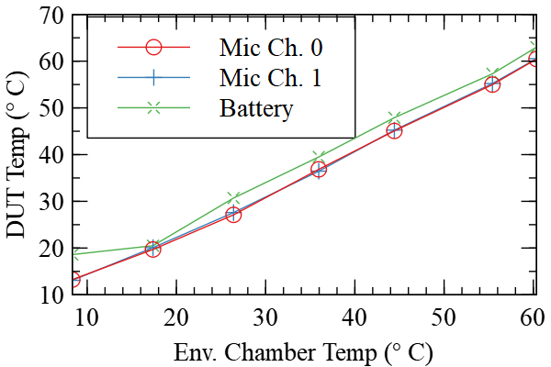
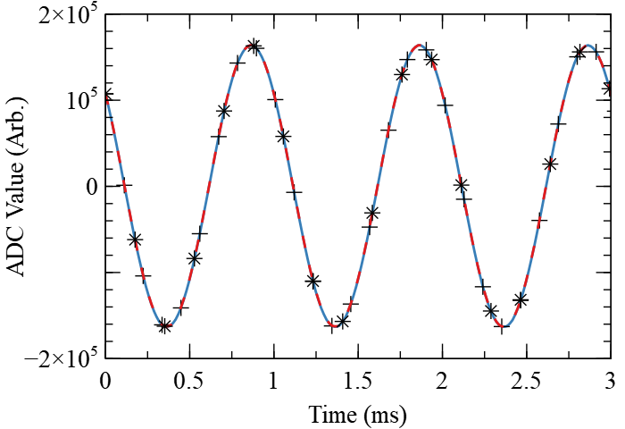
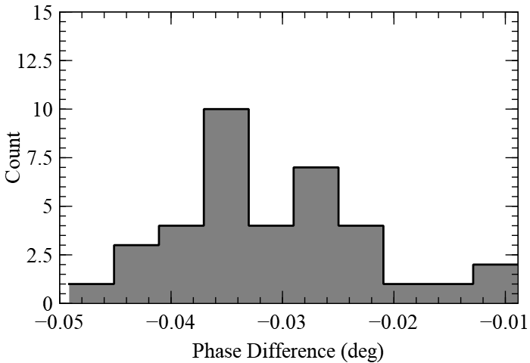
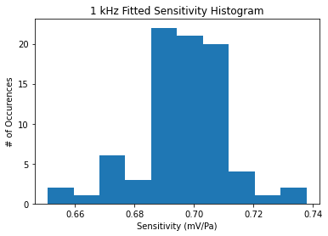
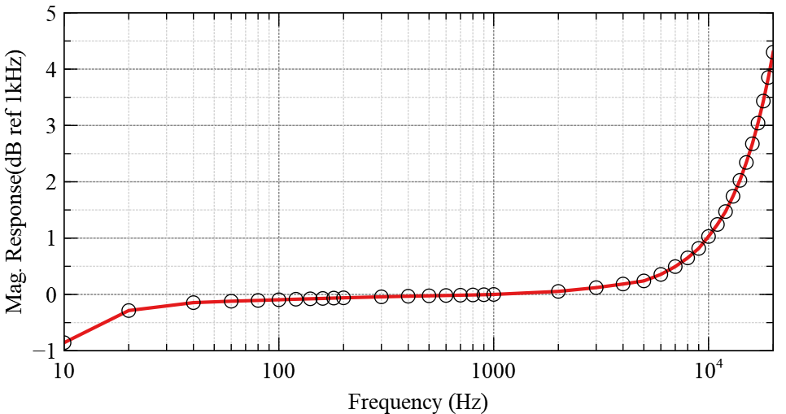
Laboratory Testing: Testing Results
Temperature Testing
  Mics temps are measured and can be compensated per acquisition
  System fully functional from 10 – 60C
Time Synchronization Testing
  Nodes tested with common input
  Result: < 100nS sync error.
Microphone Testing:
  Frequency Response: <10Hz – 16.9kHz
  Sensitivity: 0.7mV/Pa
  THD @ 128 dBSPL: 0.04%
  Noise Floor dB (A): 54.1 dBSPL
  MDS@ 1kHz: 16 dBSPL

Slide 13
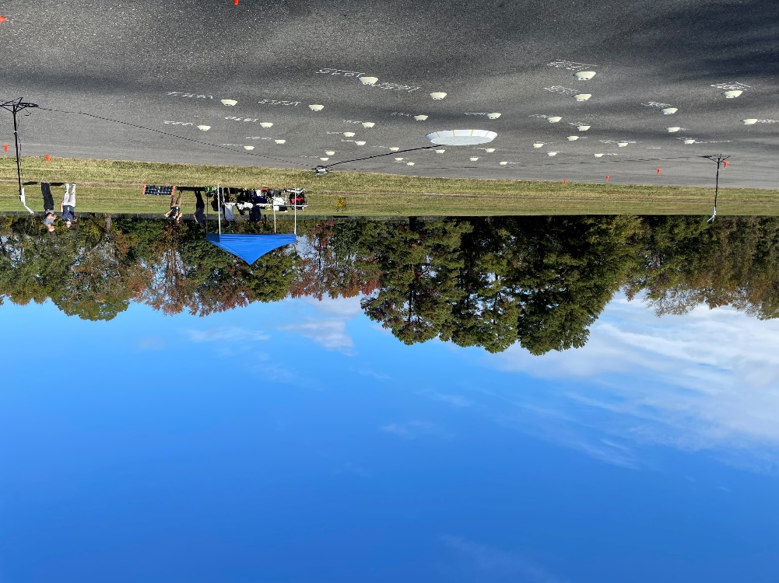
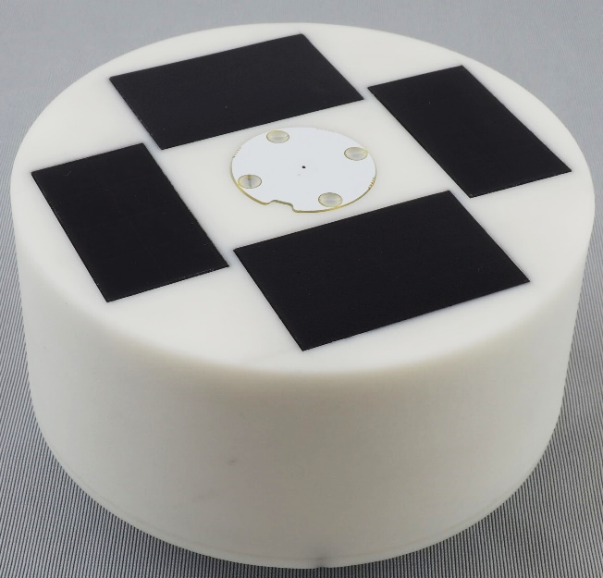
Array Deployment: Final System
The array was deployed on a paved runway at the NASA Langley City Environment Range Testing for Autonomous Integrated Navigation (CERTAIN) site for a week in late October 2022
Array dimensions: 50 ft diameter, control panel ~70 ft off the runway centerline
Array node were initially positioned using an RTK GPS system (1.4cm). Final survey-in was performed with a laser total-station instrument (< 2 mm).
Test articles included: an elevated acoustic source at heights up to 70 ft., and a commercial UAS quadcopter both hovering and forward flight passes.

Slide 14
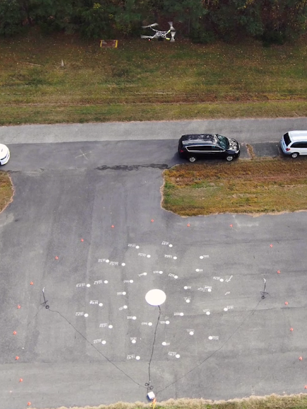
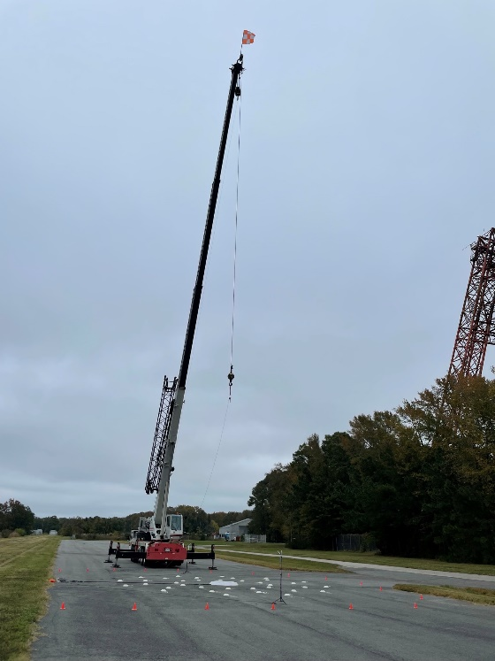
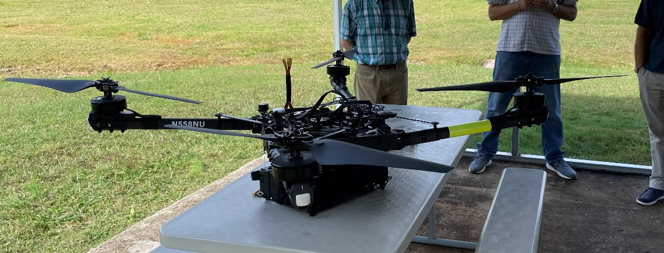
Array Deployment: Test Articles
Static Source
  JBL driver with 1 in. pipe filled with acoustic foam
  250Hz – 12kHz pure tones and band-limited white noise
Moving Source:
  UAS Type: Multirotor, 4 brushless motors
  Manufacturer: Freefly Systems
  Diag. Length: 55.7 inches (no rotors)
  Max Weight: 76.9 lbs (41.9 lbs with no payload)
  Speed: 0 – 50.5 knots
  Endurance: 50 minutes, no payload
  Command and Control: Remote control ground station

Slide 15
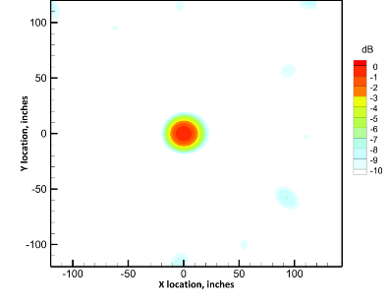
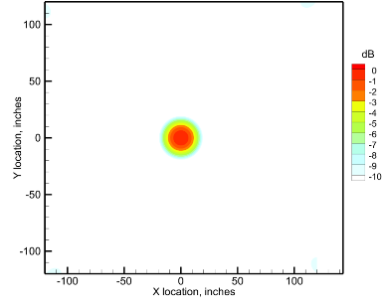
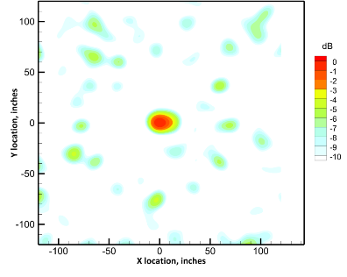
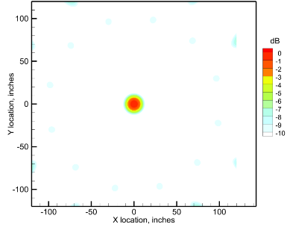
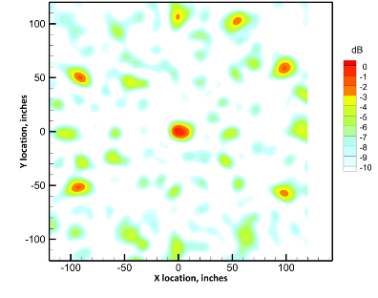
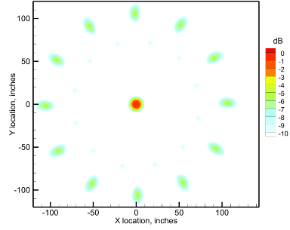
Array Deployment: Testing Results
Static Source Testing
Pseudo point source emulated with JBL driver w/ 1 in. tube filled w/ acoustic foam
Crane lifted the source above the center of the array. Heights of 23, 42, and 60 ft.
Test signals: Series of pure tones from 250 – 12,000 Hz and; band-limited white noise.
Acquisition Parameters: Length: 10s per tone / 20s white noise; Sample Rate: 62.5 kS/sec
Beamform graphs:
  Columns (left/right): Measured / Simulated
  Rows (top to bottom): 4k, 6k, 8kHz tone
Good qualitative agreement between measured and theoretical
Deviation at higher freq. due to non theoretical monopole and env. effects

Slide 16
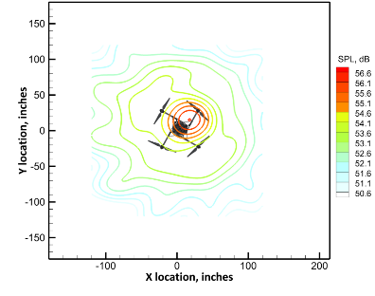
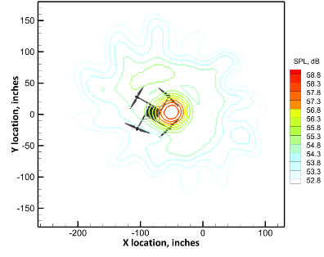
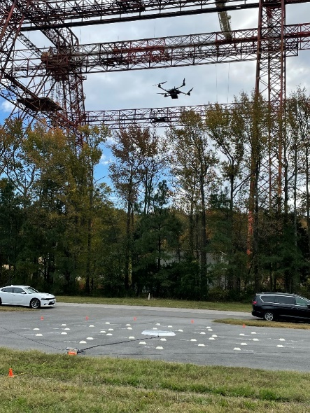
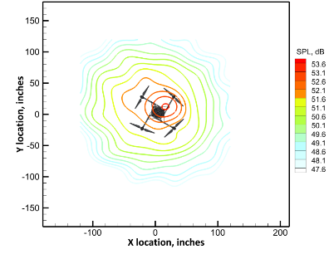
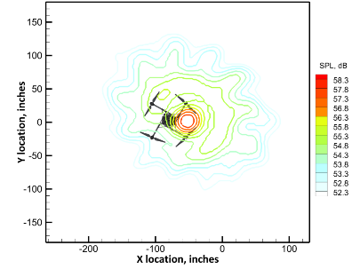
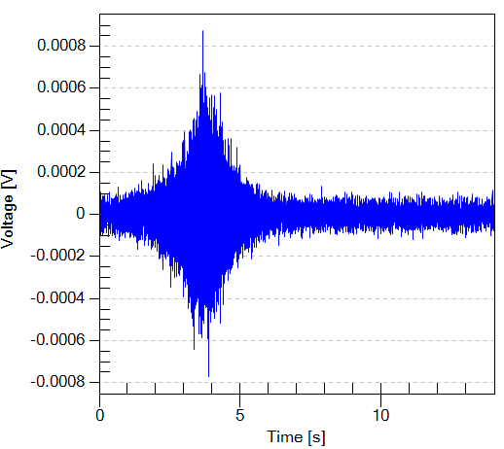
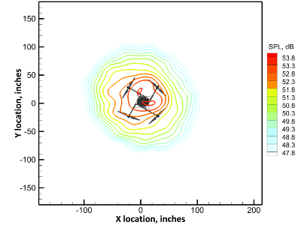
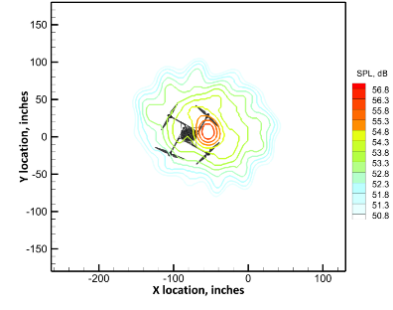
Array Deployment: Testing Results
Moving Source Testing
Height (hover/flight): 30ft / 26ft
Vehicle velocity: 32.5 ft/sec
Beamform graphs:
  Columns (left/right): Hover / forward flight
  Rows (top to bottom): 500, 600, 800 Hz
Hover and forward flight results qualitatively agree

Slide 17
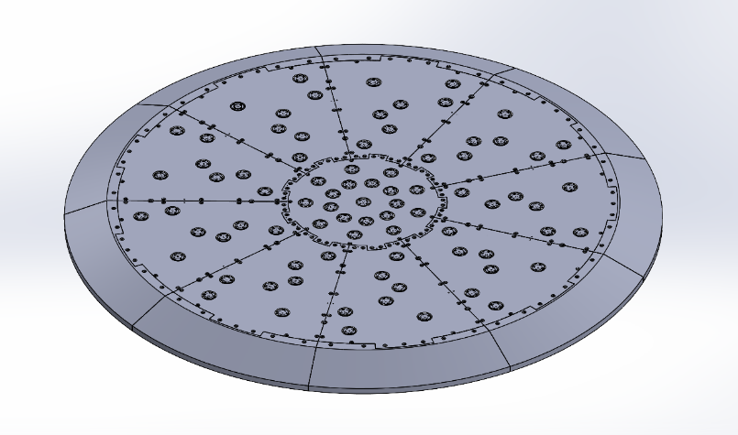
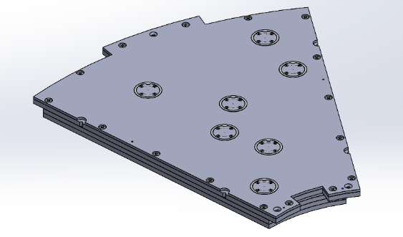
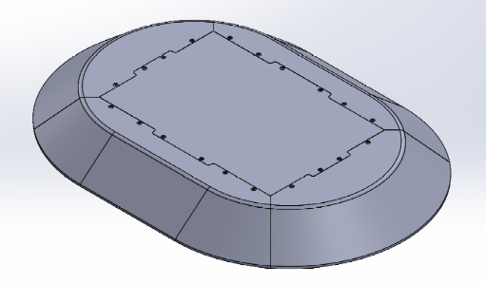


Future Work: System Improvements
Central Plate:
  Higher microphone density, and lower profile, improved modularity
  New network equipment enclosure
  82 mics in 9 arm log spiral vs 37 mics in 12 arm log spiral
  Height: 2.14 in. vs 4.6 in
  Diameter: 53.5 in. vs 51.5 in.
Satellite Node:
  Smaller size with integrated faring
  Lower power consumption for longer data acquisitions per day
  Diameter: 5.1 in w/ integrated fairing vs 8.9 in w/ removeable fairing
  Height: 1.1 in. vs 2.1 in.
  Power consumption 50mA average vs 200mA

Slide 18
Acknowledgements and Questions
The presenter gratefully acknowledges the support and expertise of:
  The NASA Langley Research Center UAS Operations Office in coordinating the UAS testing conducted on the CERTAIN range.
  The Langley Center Operations Directorate in providing the use of the crane for static sound source testing of the array.
Questions from the Audience?

Slide 19
Contact
Interdisciplinary Consulting Corp (IC2)
Official Corporate Address (Permanent)
2405 NW 66th Court
Gainesville, FL 32653
Presenter and Point of Contact:
William (Chip) Patterson
cpatterson@thinkIC2.com
352-283-8110

