Slide 1
NASA GRC – OSU
Advanced Materials and Manufacturing
GRC Magnetic Alloys
GRC Team
Alex Leary GRC LMA
Ron Noebe GRC LM
Maria Willard GRC LMA
Vladimir Keylin HX5
Grant Feichter HX5
5/18/2023

Slide 2
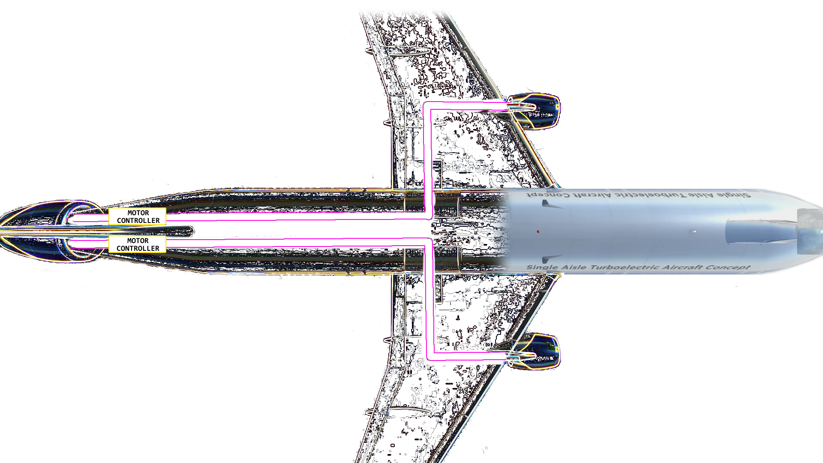
• Power electronics: Conversion and Control
- AC/DC, DC/AC, voltage, frequency, etc…
- Reliability and redundancy
• MW of power managing kW of heat
• Turbine propulsion ~12kW/kg
- Hybrid Electric propulsion systems
must compete
- Magnetic materials can comprise
½ of inverter mass
- Breakdown voltage decreases with
altitude
- Aircraft EMI requirements
Modified from Madonna, et al. IEEE Trans Trans Elect (2018)
1 MW = 1341 HP
STARC-ABL concept
Boundary layer ingestion
Notes:
Electrical requirements are increasing in aircraft and magnetic materials can account for large portions of the system mass

Slide 3

Example Aircraft Electrical System
Motor
AC / DC
DC / AC
Motor
DC
Generator
AC / DC
DC / AC
Generator
Circuit Breakers
High Voltage
Filter
Magnetics
• Broad use of soft magnetic materials in subsystem components that in some cases, account for significant size / mass
• Many potential system configurations and subsystem component topologies available -> drives variety of magnetics requirements
• Power density – EMI – cost – reliability is a complex trade space
• Optimized system will be improved with advanced materials – GRC is working to make nanocomposites an option for designers
Converter
Magnetics
DC / DC
Low Voltage
Fuel Cell
Battery
AC
DC
Common use of soft magnetic materials

Slide 4
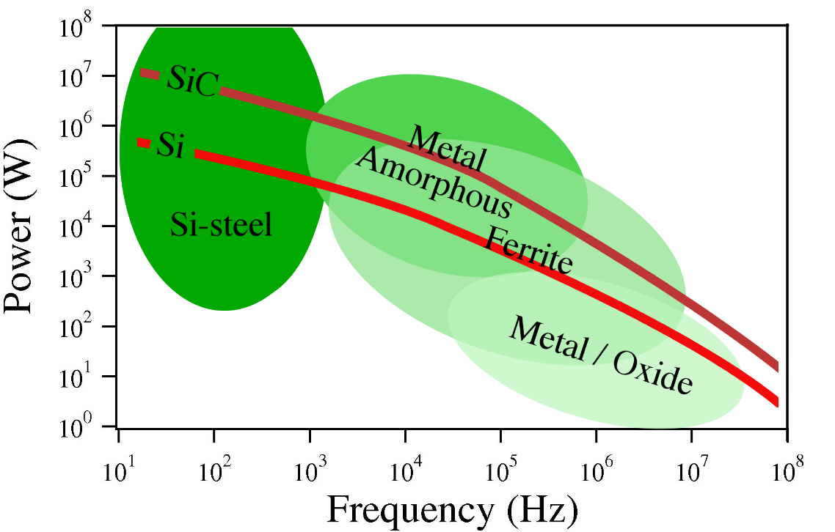
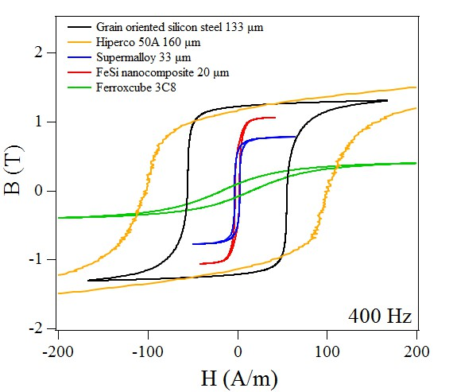
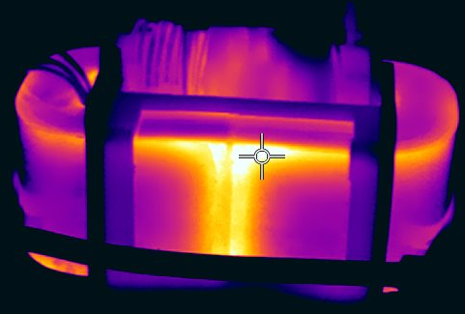
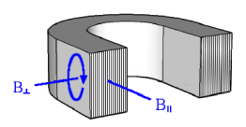

Soft Magnetic Materials
Target applications
$$power density∝frequency$$
Figures of merit:
- Saturation induction (B_{sat})
- Power loss under operation conditions
- Power density (volume and/or mass)
- Temperature capability
- Tolerances
Local heating associated with air gaps
Notes:
Annealing options and anisotropy

Slide 5

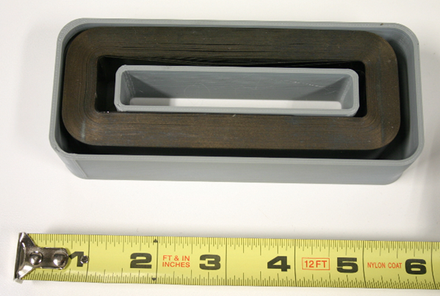
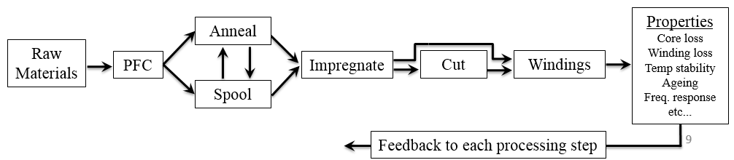
Prototype Inductors, Transformers, Chokes, etc…
Planar flow casting (PFC)
Rapid solidification to form amorphous ribbon
Ceramic nozzle constrains puddle
Wheel speeds ~20-30 m/s
Ribbon thickness ~20 μm
Variable width up to 5 cm
Batch sizes 50g up to 3 kg
*Many unknown alloy melt properties
System level
requirements
Circuit
Topology
Magnetic requirements
GRC Magnetics
Excellent magnetic properties,
Poor mechanical properties
Feedback to system and circuit design
Notes:
Planar flow casting to make precursor material

Slide 6
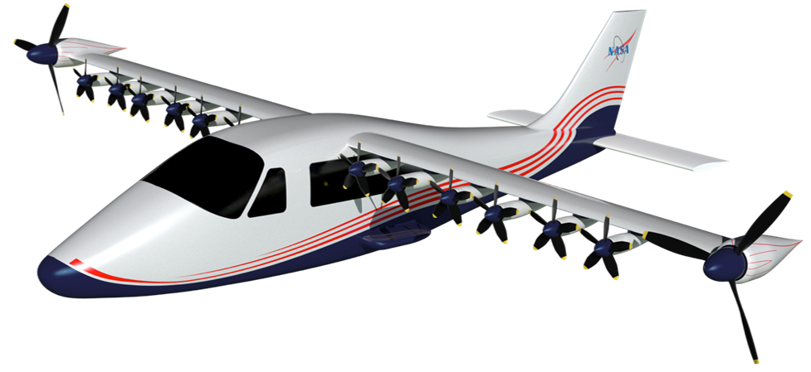
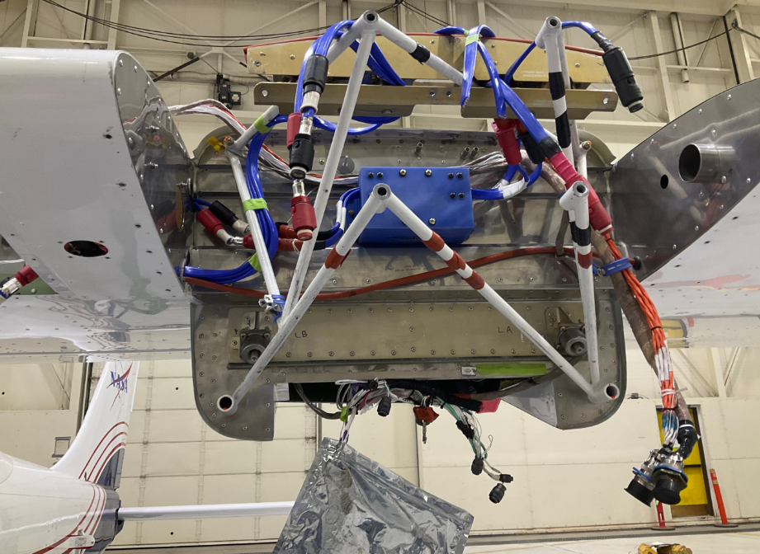
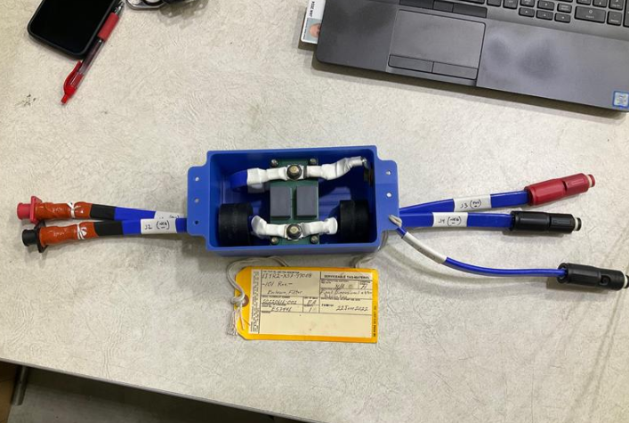
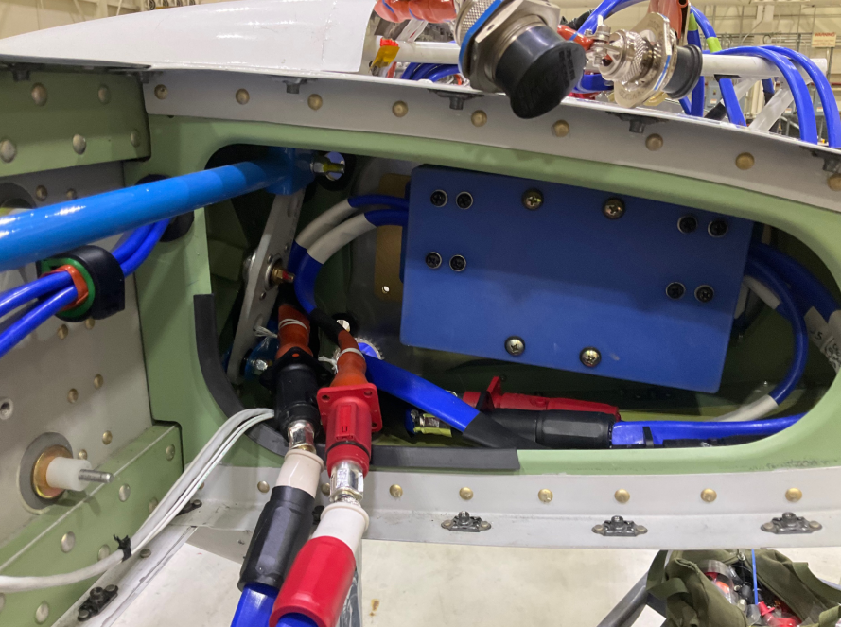
EMI is currently a significant challenge in aircraft power systems and nanocomposite chokes are not commercially available
X-57 EMI Filters
Design requirements
L = 14μH, Ic = 10A_{p}, ID > 17 mm
Design comparison
Ferrite (SOA) Nanocomposite
Toroid 21x53x51 (mm) 21x40x25 (mm)
B_{m} (T) 0.3 0.8
μ_{r} 1600 5300
Mass (g) 454 145
Significant benefit – reduction in size and mass – compared to SOA
Firewall
3X
X-57 mounting locations
cores
Capabilities / Requirements
• Filter design by GRC LED
• Fast prototyping by GRC magnetics
* Integration and mechanical requirements
* GRC QA function prior to shipping
* AFRC determines flight worthiness
• Required for benchtop development
* Required for flight testing
Wing web
Prototype filter

Slide 7
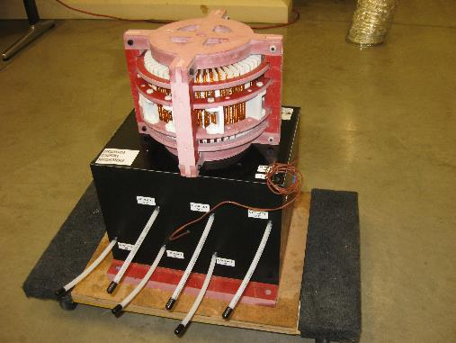
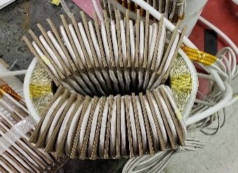
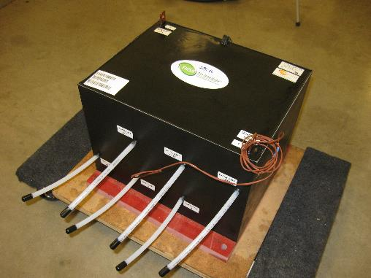
Low Permeability Application
Co-based nanocomposite: Tunable anisotropy gapless core
Filter inductor for MW scale gas compressor
GRC ribbon
Commercial core materials
  Stress Annealed
  Kool Mµ powder
  Iron-alloy powder
  Gapless Design
  Oil Immersion
  12 kg Ribbon Mass
  20 kg Total Mass
  2 – 2.5X Smaller Volume
  Distributed Gap
  Glued Arc/Bar Segments
  Edge-Wound Coil
  Liquid Cooling with Pump
  60 kg Total Mass
  Distributed Gap
  Potted Assembly
  Liquid Cooling with Pump
  100 kg Total mass
Notes:
Example application

Slide 8
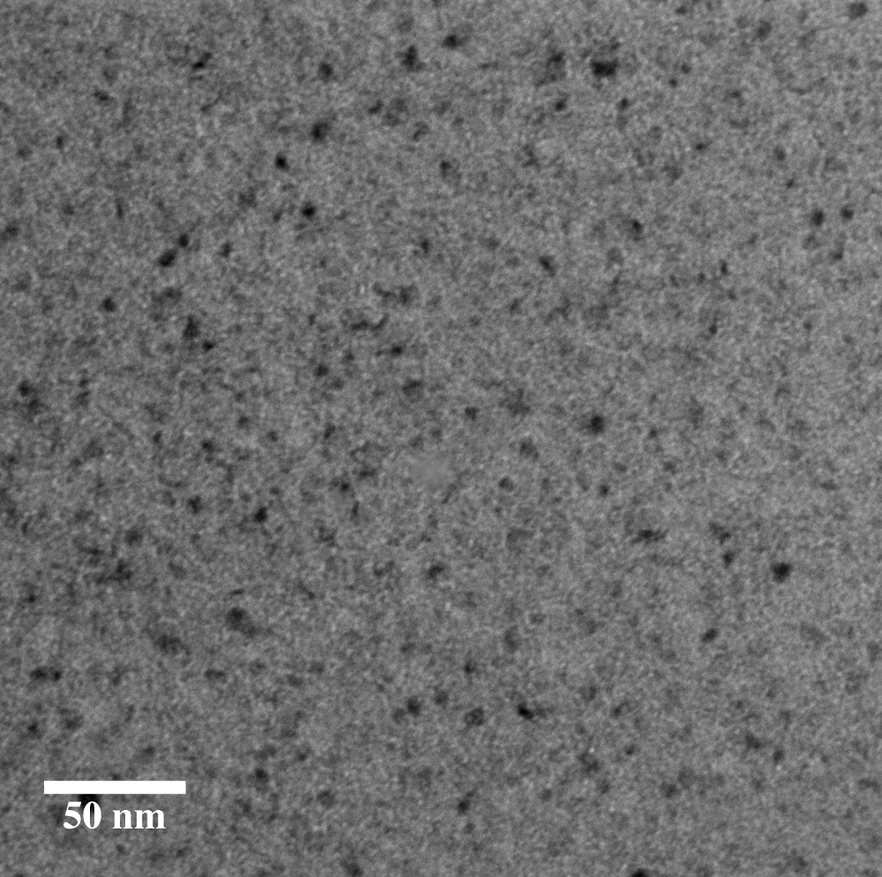
GRC Magnetics Collaboration Areas
1. Interaction with power electronics designers for prototypes requiring > 100kW
  GRC able to design/build/test custom prototype cores
  Application space relevant to many emerging grid/vehicle efforts
2. Material characterization and modelling under relevant conditions
  Excitation fields specific to converter topologies
  Scalable models for system level optimization
3. Structural characterization of nanocomposites with ~10nm grains
TEM: Typical nanocomposite

