Slide 1



AM Powder Flowability Capabilities at NASA Marshall Space Flight Center (MSFC)
NASA Marshall Space Flight Center
Contamination Control Team
Justin McElderry (EM22)
Richard Boothe (EM22)
2022 The NSMMS & CRASTE Joint Symposia
Statement A: Approved for public release; distribution is unlimited.
Notes:
Hi, my name is Justin here with NASA MSFC. Y’all might be thinking I’m crazy for doing 2 presentations,, and you’re right. But I’m passionate about AM! I also gotta give credit to Richard Boothe because some of this data was his before I became full time
Having consistent powder characteristics are important for ensuring repeatable manufacture of metal parts.
The benefits of testing the powder through contamination teams likes us is that we have the test equipment and capabilities that can spot potential issues with powders without having to print anything at all

Slide 2
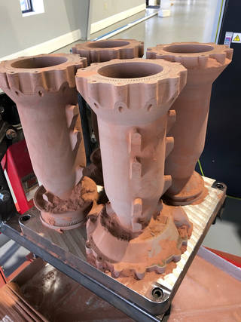
Introduction
Powder characterization is helpful for additive manufacturing (AM) in:
  Optimizing the printing process
  Reducing defects
  Improving overall product quality
Accurate characterization data is critical for
  Selecting and qualifying powders for use in AM
  Ensuring consistent and reproducible outcomes
  Reducing the need for trial and error
Finding acceptable flowability and morphological characteristics can prevent defects and manufacturing issues
An additive manufactured combustion chamber printed at NASA MSFC.
Notes:
In recent years, the CCT has helped support the following:
Powder feedstock is the most common form of filament for metal 3D printing, and that powder needs to be good before being used. That includes cleanliness from outside contamination or reuse.

Slide 3
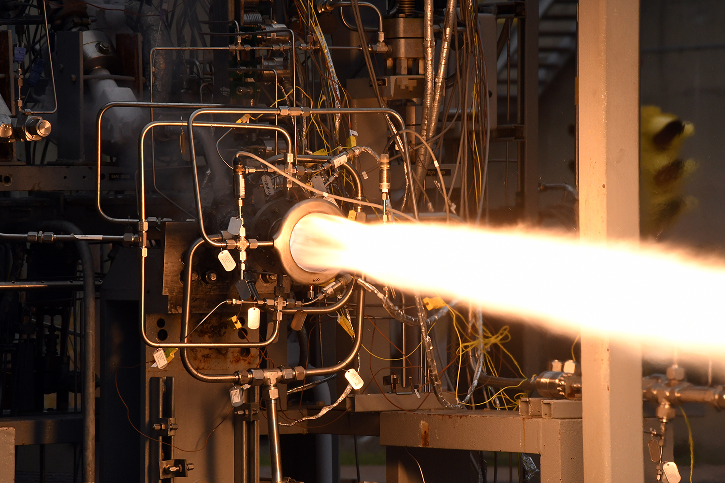
Introduction
NASA MSFC’s powder team has supported:
NASA’s Additive Manufacturing Team
NASA’s Rapid Analysis and Manufacturing Propulsion Technology (RAMPT)
NASA’s Moon-to-Mars Planetary Autonomous Construction Technology (MMPACT)
ASTM Proficiency Testing for AM and Powder Metallurgy Program
RAMPT SLM GRCop84 with directed energy deposition nozzle.
Notes:
In recent years, the CCT has helped support the following:
Powder feedstock is the most common form of filament for metal 3D printing, and that powder needs to be good before being used. That includes cleanliness from outside contamination or reuse.

Slide 4
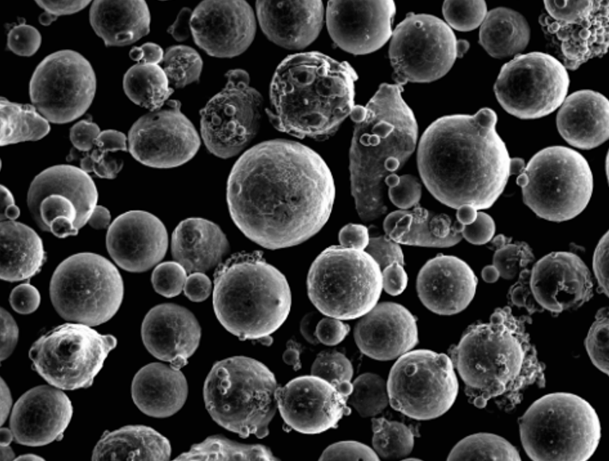
Introduction
MSFC’s Materials and Processes lab has invested in powder characterization techniques to support the following groups by finding these powder characteristics:
  Density
  Flow
  Particle Size Distribution (PSD)
  Morphology
C103 Niobium characterized at MSFC
Notes:
In recent years, the CCT has helped support the following:
Powder feedstock is the most common form of filament for metal 3D printing, and that powder needs to be good before being used. That includes cleanliness from outside contamination or reuse.

Slide 5
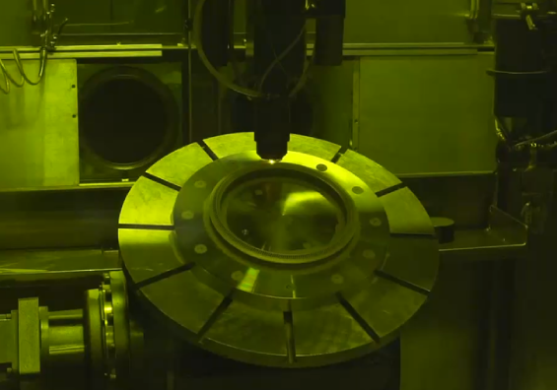
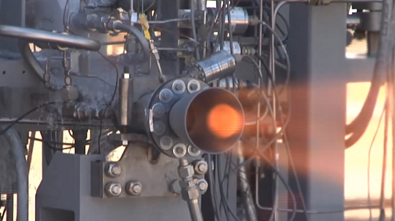
Importance at NASA
Better understanding powders is critical for space hardware
  Specifically for techniques that develop AM parts to melt and fuse metallic powders via high-power laser through
    Laser Powder Bed Fusion (LPBF) printing
    Directed Energy Deposition (DED) printing
Better understand regolith simulant to simulate lunar regolith as closely as possible
  Ultimately can lead to building infrastructure on the Moon’s surface
Work with other laboratories to ensure all laboratories are proficient in testing
  Out of family results can lead to other inaccuracies of powder measurements
DED Printing at MSFC through the AM Team.
Successful hot-fire testing of additively manufactured injector at MSFC.

Slide 6
ASTM AM Powder Standards Supported at MSFC
ASTM Method | Description
B214 | Standard Test Method for Sieve Analysis of Metal Powders
B417 | Standard Test Method for Apparent Density of Non-Free-Flowing Metal Powders using the Carney Funnel
B212 | Standard Test Method for Apparent Density of Free-Flowing Metal Powders using the Hall Flowmeter Funnel
B329 | Standard Test Method for Apparent Density of Metal Powders using the Scott Volumeter
B964 | Standard Test Methods for Flow Rate of Metal Powders using the Carney Funnel
B213 | Standard Test Methods for Flow Rate of Metal Powders using the Hall Flowmeter Funnel
B923 | Standard Test Method for Metal Skeletal Density by He or N2 Pycnometry
None Yet | Optical Analysis
B822-20 | Light Scattering Analysis for Particle Size Distribution
As the equipment purchases were underway, we became aware of the “ASTM Proficiency Testing for AM and Powder Metallurgy” program
  A standardized metal powder with unrevealed characteristics is provided to participating labs to evaluate using ATSM methods, and the results are statistically compared and analyzed
  Participation in the program is a good opportunity to stay sharp with the various characterization methods, to see how MSFC results compare to other labs, and to identify test techniques that may need additional work in order to maintain proficiency

Slide 7
Testing Methods:
Powder Densities

Slide 8
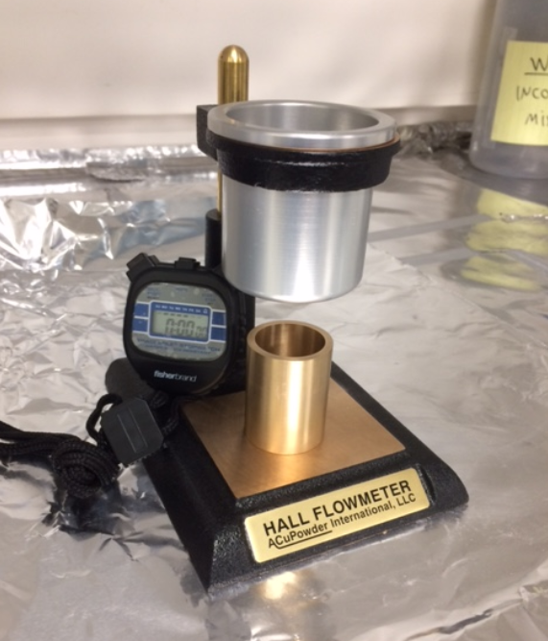
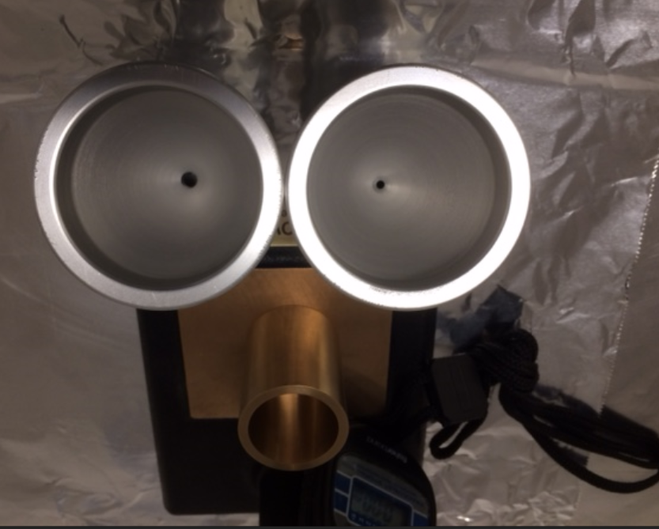
Carney and Hall Funnels; Density Cup
Density Cup: Powder flowed through a funnel is collected in the cup
  Apparent density
    Weighed collected powder/cup volume (25 cm³)
Carney/Hall Funnels: Used for flow rate testing. A measured quantity (weight) of powder is timed as it flows through the cup.
  Carney Funnel is used for non-free-flowing powders
  Hall Funnel is used for free-flowing powders
Carney/Hall Funnel
Density Cup
Hall Flowmeter used for density
Carney
Ø 5.46 mm
Hall
Ø 2.54 mm
Types of funnels used to calculate flow

Slide 9
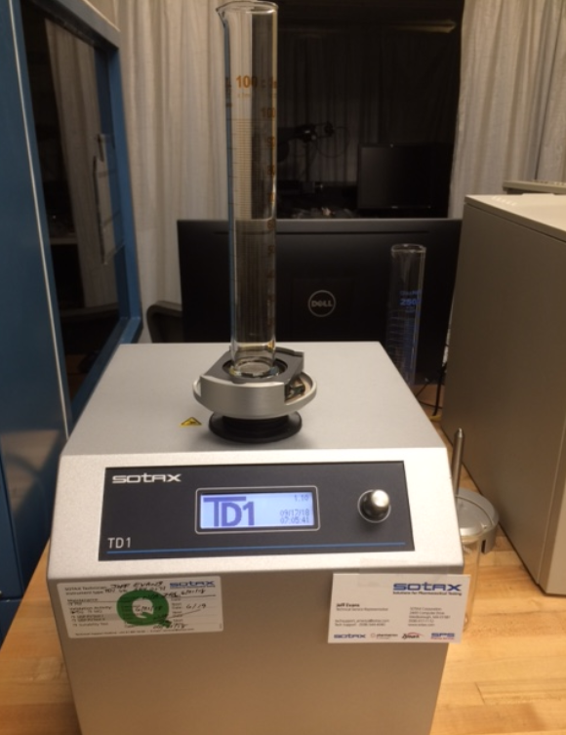
Tap Density
A measured quantity (weight) of powder is placed in a graduated cylinder
Machine taps rapidly using a specified drop height and tap rate
The final volume of the powder is used to calculate the tap density
Sotax machine used for measuring tap density.
Notes:
Mass/tapped volume
Important because its random dense packing

Slide 10
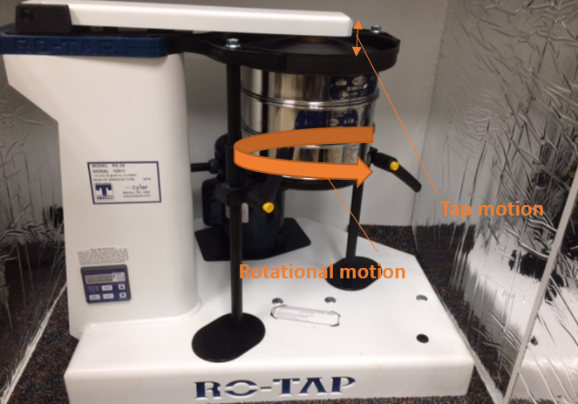
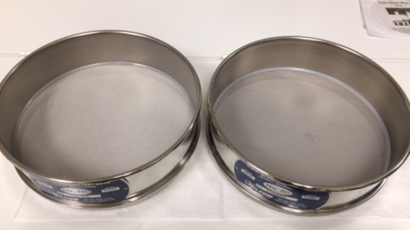
Ro-Tap Sieve Shaker
A measured quantity (weight) of powder is passed through a series of nested sieves with different mesh sizes (coarsest on top, finest at the bottom)
  Fractions of powder collected on each screen are weighed
Vigorous tapping and rotational motion cause the powder to flow through the screens (see right)
RC-Tap machine used for density
RC-Tap machine used for density
Notes:
Taps at a certain frequency
Timer can set a

Slide 11
Testing Methods:
Powder Size, Shape, and Flowability

Slide 12
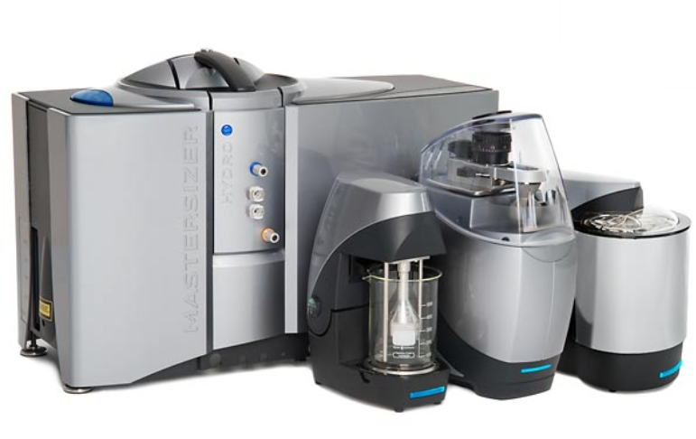
Light Scattering Analyzer
Uses laser diffraction to measure the particle size and particle size distribution of materials
Does this by measuring the intensity of light scattered as a laser beam passes through a powder sample that has been dispersed in liquid (distilled water for this study)
Instrument analyzes/processes the light scattering pattern caused by the powder particles
30 seconds per test; 5 scans for each sample; 600 mL of distilled water
Helps calculate size of powder and the particle size distribution
Light Scattering Analyzer that MSFC uses

Slide 13
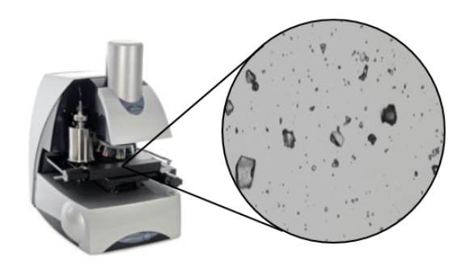
Malvern Morphologi Optical Analyzer
Optical particle size and shape analysis tool (ranges from 0.5 microns to several millimeters)
Measures the size and shape of particles by static image analysis (lenses ranging from 2.5-50X magnification
Once powder is loaded (1-3mm³) and plate is clean, the process is completely automated
Collects the following particle characteristics:
  Circular Equivalent (CE) diameter
  Length
  Width
Morphology lab equipment at MSFC
Notes:
When we load samples, we don’t need much powder at all. We only need enough to spread across a glass slide.
Depending on the sample volume, you can get

Slide 14
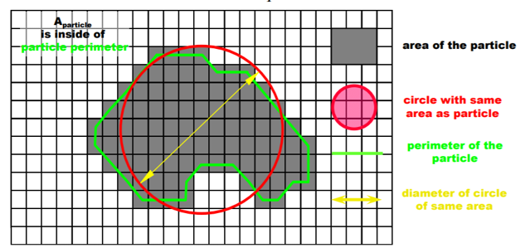

Terminology
Circularity - circumference of equivalent area circle/actual perimeter of the particle
Convexity – convex hull perimeter/actual perimeter
Perimeter (left) and convex hull perimeter (right)

Slide 15
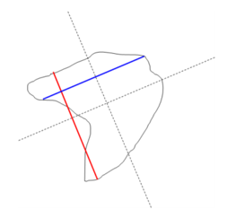
Terminology
Aspect Ratio – width (μm)/length (μm) of particle
Elongation – 1 minus aspect ratio
Example of dimensions on a particle
Perimeter (left) and convex hull perimeter (right)

Slide 16
Results from Testing Methods

Slide 17
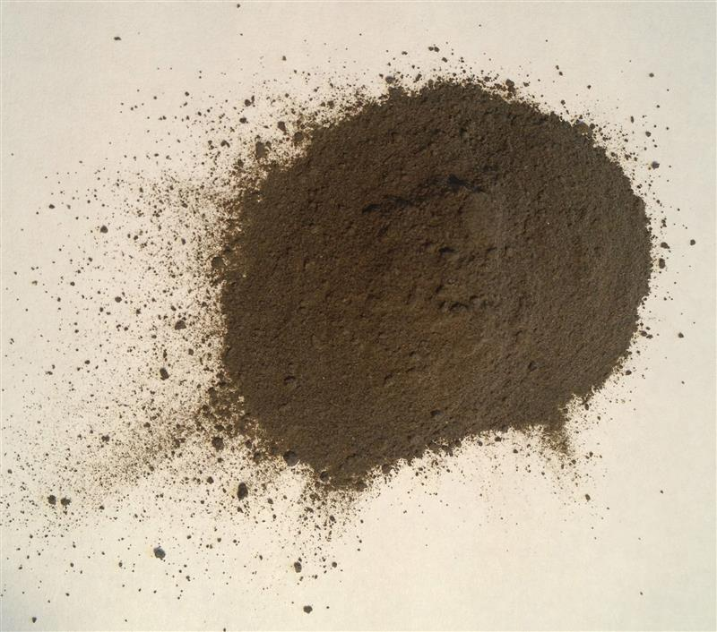
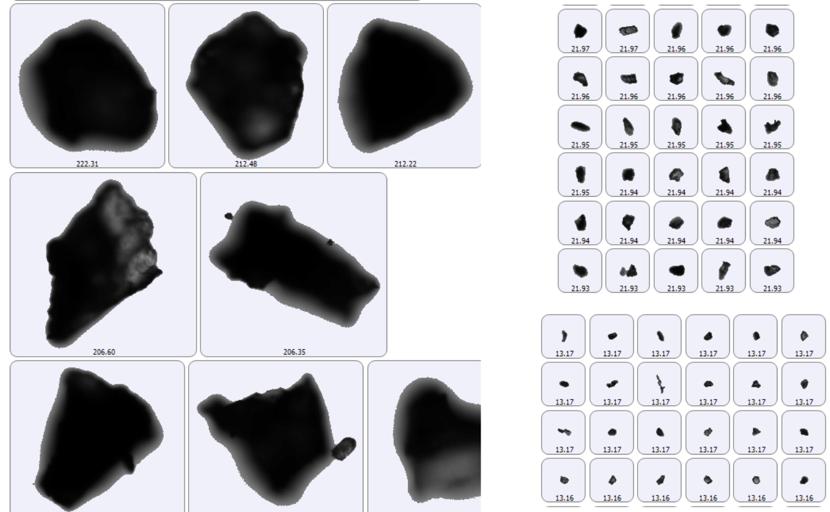
MMPACT Powder Data
Contributing to the Moon-to-Mars Planetary Autonomous Construction Technology (MMPACT) project
Goal is to find regolith simulant that best represents lunar simulant
Comparing example regolith simulants
  JSC-1A vs JSC-2A: same material different milling procedure
  JSC-1A vs NU-LHT-2M: simple milling vs agglutinization
  JSC-1A vs true lunar mare
  NU-LHT vs true lunar highlands
JSC-1A (Baseline)
Static images of JSC-1A (Baseline)

Slide 18
MMPACT Morphology Results
Summary of morphology data gathered on regolith simulant
Found that fine particles dominated the results and CE diameter means were not the most effective method to analyze the powder
Sample | Particles | CE Diameter Mean (um) | Circularity Mean | Elongation Mean | Convexity Mean | Aspect Ratio Mean
JSC-1A | 2686475 | 11.84 | 0.713 | 0.321 | 0.987 | 0.679
JSC-1A 750°C with H₂ | 1999799 | 10.95 | 0.909 | 0.322 | 0.991 | 0.678
NUW-LHT-5M | 3405750 | 8.49 | 0.836 | 0.356 | 0.966 | 0.644
JSC-2A | 2227962 | 7.60 | 0.904 | 0.335 | 0.992 | 0.665

Slide 19
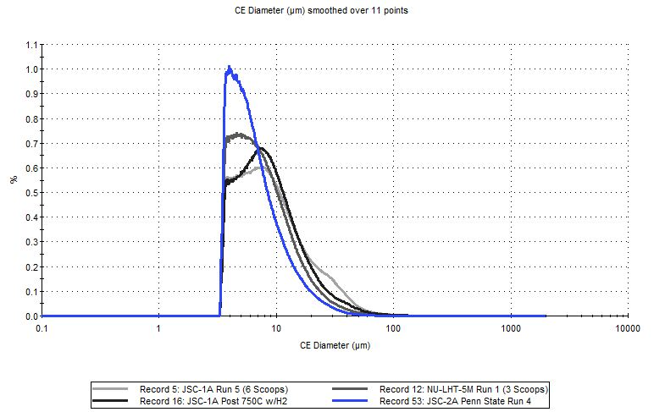
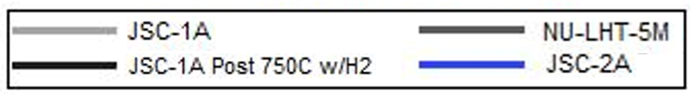
MMPACT CE Diameter

Slide 20
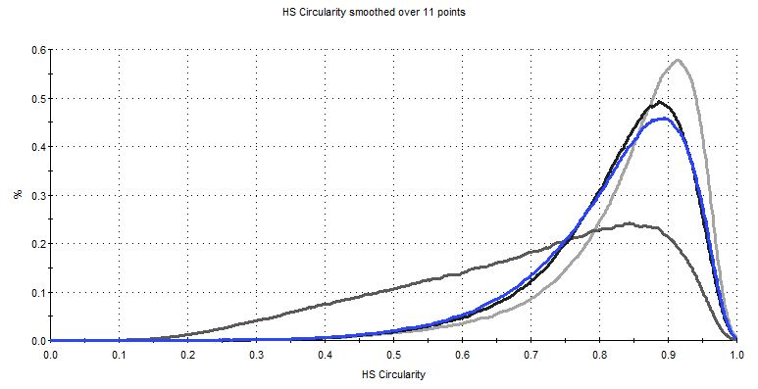
MMPACT Circularity

Slide 21
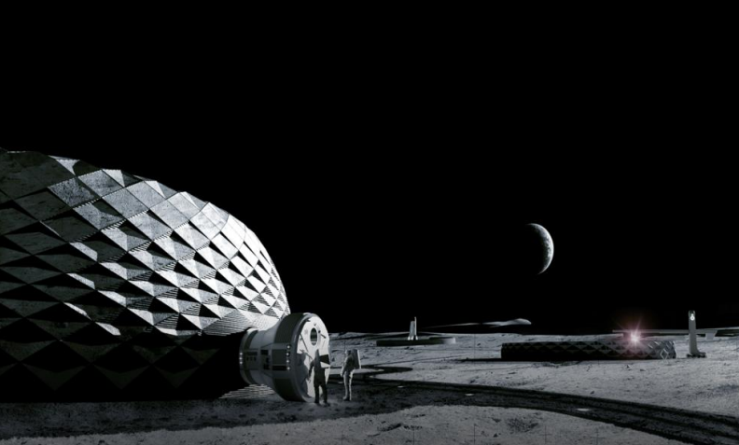
MMPACT Conclusions
NASA and MMPACT can use this powder characterization data for determining baseline regolith simulant
Data is also helpful in future comparisons of actual lunar regolith
Human Landing System can also utilize the data for dust mitigation issues
Concept art of lunar architecture

Slide 22
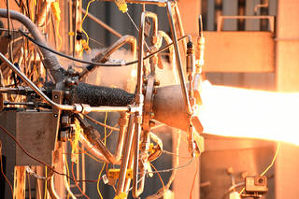
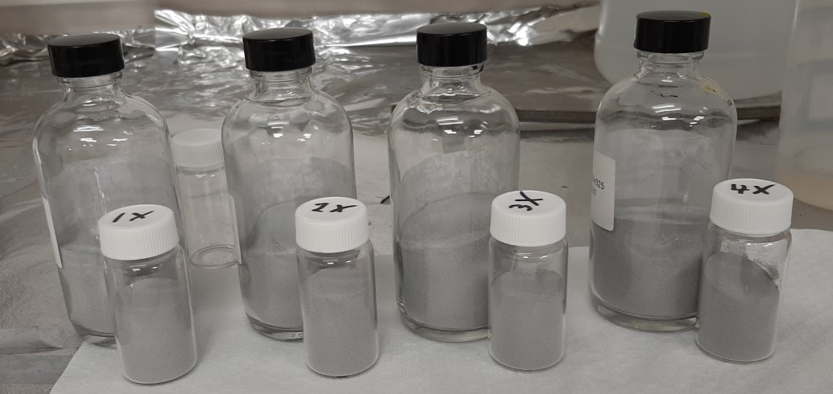
NASA RAMPT A6061-RAM2 Reuse Study
AM powder reuse study for the Rapid Analysis and Manufacturing Propulsion Technology (RAMPT) project
Studying Aluminum 6061-RAM2 for Directed Energy Deposition (DED) metal 3D printing
Goal is to characterize and understand physical effects of the high strength powder
  Specifically for rocket thrust chambers, nozzles, and joints
Reused powder four times to look at the effects
  Baseline, 1X, 2X, 3X, & 4X
3D printed rocket thrust chamber tested at NASA MSFC (made of copper).
Reused powder samples

Slide 23
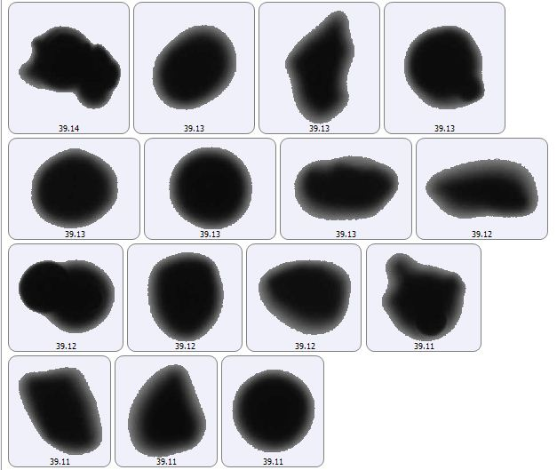
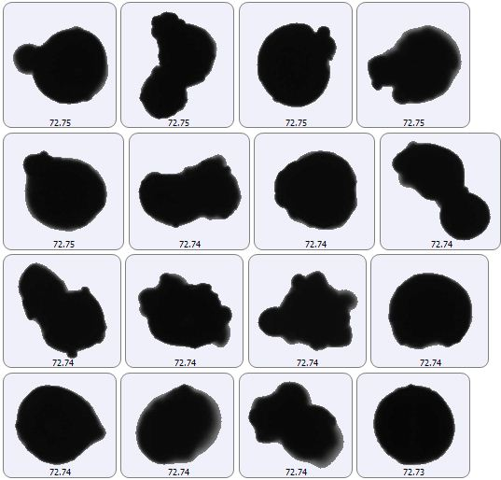
NASA RAMPT A6061-RAM2 Reuse Study
Baseline
(smooth and round)
Fourth Reuse
(rougher and elongated)
A6061-RAM2 powder static image comparisons between baseline and fourth reuse in DED printer.

Slide 24
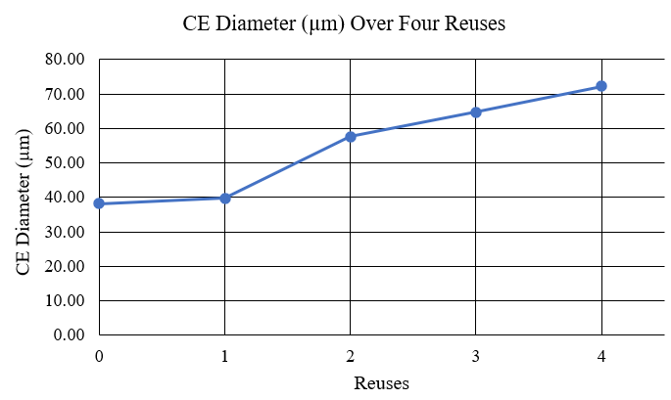
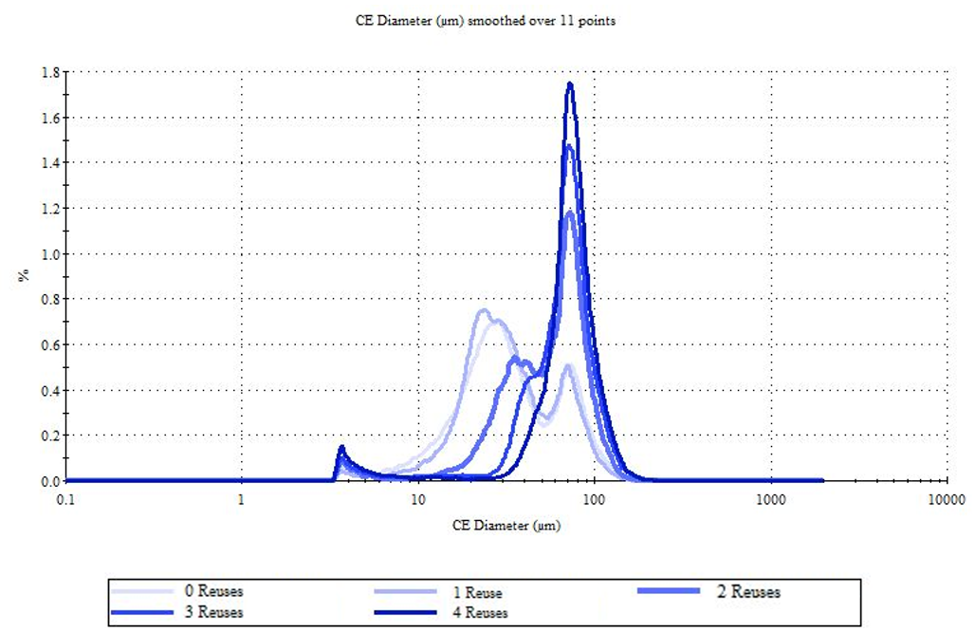
NASA RAMPT A6061-RAM2 Reuse Study
CE Diameter comparison across Baseline and 1X-4X

Slide 25
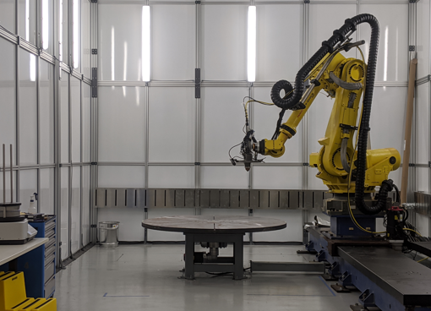
NASA RAMPT A6061-RAM2 Reuse Study
Per reuse, particles began to lack sphericity and smoothness and bonded together
Major abnormalities begin to show after two reuses
The physical effects found can influence flowability in the printer
Flow properties of metal powder strongly influence
  Process efficiency
  Quality of finished part
RAMPT will use this data to consider how many reuses they can use along with mechanical testing
DED Printing table setup used at MSFC

Slide 26
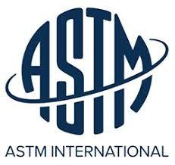
ASTM Proficiency Test
EM22 participated in “ASTM Proficiency Testing for AM and Powder Metallurgy” program
A standardized metal powder with unrevealed characteristics is provided to participating labs to evaluate using ATSM methods
Results are statistically compared and analyzed
Benefits in participation include:
  Staying sharp with the various characterization methods
  How MSFC results compare to other labs
  Identify test techniques that may need additional work in order to maintain proficiency

Slide 27
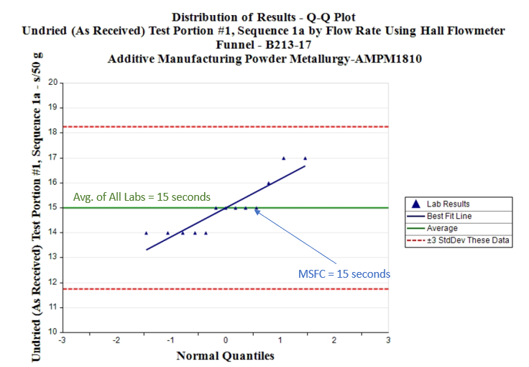
ASTM Proficiency Test (Density Cup)
Hall Funnel Flow Results

Slide 28
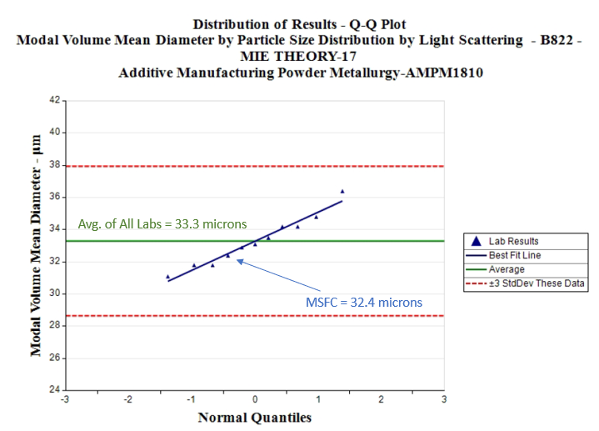
ASTM Proficiency Test (PSD)
Light Scattering Analyzer Results
Mean Diameter

Slide 29
ASTM Proficiency Conclusions
All of the MSFC data were within-family compared to the other participating labs
The successful performance of these analyses provides confidence going forward
  Can successfully measure powder properties using the ASTM methods and techniques evaluated
  Measuring powder is difficult, so these tests are critical in providing accurate results to customers

Slide 30
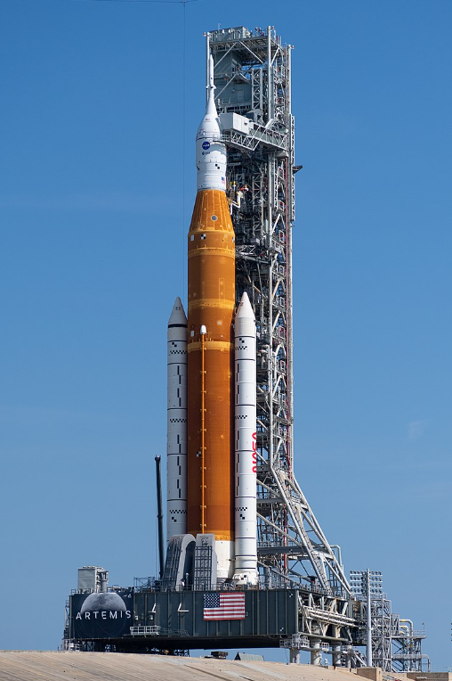
Forward Work
Current Work
  Supporting powders for combustion and AM team
    Mostly GRCop-42, Inconel 718, HR-1, A6061-RAM2
  Liquid Engines Office (LEO) AM Powder acceptance and lot-to-lot comparison
  Finalizing data for MMPACT
    Contributing to publication
Future Possible Work/Partnerships

Slide 31

Reach Out
Interested in partnering with NASA?
Contact the following at NASA MSFC mechanical testing, contamination control, and chemistry related-work
Justin McElderry
Materials Engineer, AST
NASA Marshall Space Flight Center
EM22 Materials Test, Chemistry, and Contamination Control
justin.r.mcelderry@nasa.gov
Richard Boothe
Acting Branch Chief
NASA Marshall Space Flight Center
EM22 Materials Test, Chemistry, and Contamination Control
richard.e.boothe@nasa.gov

Slide 32
Acknowledgements
The NASA MSFC’s Contamination Control Team would like to thank the following:
NASA MSFC’s AM team
NASA MSFC’s Combustion Team
ASTM
NASA’s MMPACT Program

Slide 33
Any Questions?

