Slide 1
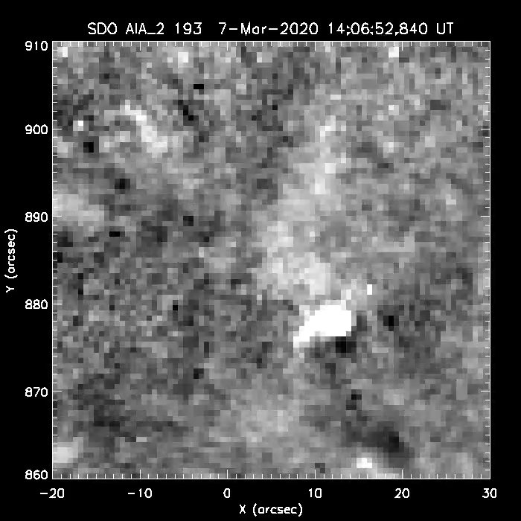
Inconspicuous Solar Polar Coronal X-Ray Jets as the Source of Conspicuous Hinode/EUV Imaging Spectrometer Doppler Outflows
  A. C. Sterling, C. Schwanitz, L. K. Harra, N. E. Raouafi, N. K. Panesar, & R. L. Moore
Following up from Schwanitz et al. (2021), we examined five localized locations in a solar polar coronal hole that show transient EUV outflows in Hinode/EIS spectroscopic Doppler data.
The corresponding locations show weak, feeble features in Hinode/XRT and SDO/AIA images; Schwanitz et al. could not definitively identify those features.
We observe more closely, and find that all five are consistent with being inconspicuous (small and faint) coronal jets, including hard-to-see erupting minifilaments, weak jet spires, and flux convergence (one event with HMI).
X-ray coronal-jet may occur and make outflows on smaller size scales than previously realized, perhaps contributing to the solar wind and to switchbacks.
See Sterling et al. (2022) for details.

