Slide 1
Active Thermography
Nathan Trepal, nathan.trepal@nasa.gov
June 14, 2023
NOT EXPORT CONTROLLED
This document has been reviewed by the KSC Export Control Office and it has been determined that it does not meet the criteria for control under the International Traffic in Arms Regulations (ITAR) or Export Administration Regulations (EAR).
Reference EDR Log #: 140852 NASA KSC Export Control Office, (321) 867-9209
Notes:
ANIMATED

Slide 2
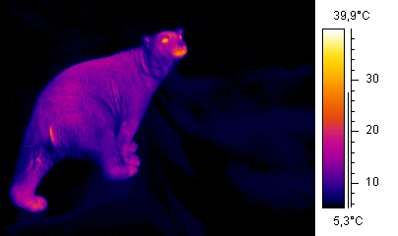
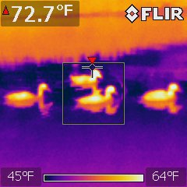
Thermography
Most people are familiar with passive thermography: infrared (IR) cameras present false color images that relate to the quantity of infrared energy (heat) being emitted and/or reflected from objects within the camera’s field of view.
Notes:
Polar bear on the left – note the differences in thermal emission by various parts of the body, as well as the difference from the environment in the background.
Ducks on the right – note the emitted thermal radiation from the ducks’ bodies, but also the reflected thermal radiation from the ducks’ bodies reflecting off the water surface.

Slide 3
Active Thermography
Active thermography (a.k.a., pulsed thermography or flash IR) is where a controlled pulse of infrared energy is emitted (e.g., from flash halogen lamps) onto the surface of a test object and an IR camera is used to monitor the change in the infrared energy radiated back from the test object over time following the initial flash of IR energy.
Notes:
Animation:
Blue objects are flash lamps. IR camera sits in between. All are aimed at test specimen with an embedded defect
All objects emit thermal radiation. If an object doesn’t have a source of energy, they will reach equilibrium with the environment and the only differences you will see with an IR camera are due to differences in emissivity, reflectivity, and transmissivity.
With active thermography, we send a pulse of thermal energy into the part and then monitor the part’s surface as the thermal energy dissipates and the part returns to equilibrium. A defect will cause a change in how the thermal energy dissipates relative to how the thermal energy dissipates where there is no defect.

Slide 4
Active Thermography
Sample Requirements:
  Need non-reflective surfaces
    Carbon fiber reinforced polymers are usually good IR surfaces
    Metals can be problematic due to reflectivity
    Scuffing the surface or applying tape or a washable paint over the surface are methods used to perform thermal inspections of reflective surfaces
  Need to be able to get thermal energy to the inspection depth and then back out
    Higher thermally conductive materials (e.g., metals) are more difficult to interrogate
General rule of thumb: You can identify a planar defect with a diameter that is equal or greater than twice its depth

Slide 5
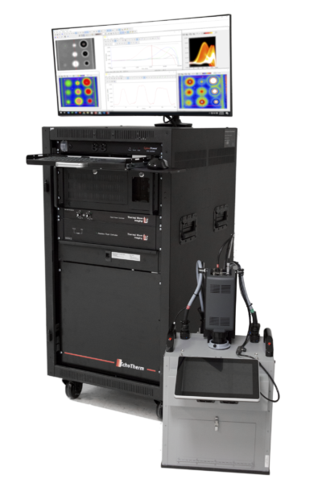

Thermal Wave Imaging EchoTherm
  Controlled thermal pulse intensity and duration
  TWI Virtuoso Software
    Captures movie of raw thermal image
    Processes movie to analyze 1st and 2nd order derivatives (thermal velocity and thermal acceleration)
    Analysis and measurement tools
FLIR X8500sc Infrared Camera
  1280x1024 resolution
  12µm detector pitch
  Frame rate programmable from 1 Hz to 181 Hz

Slide 6
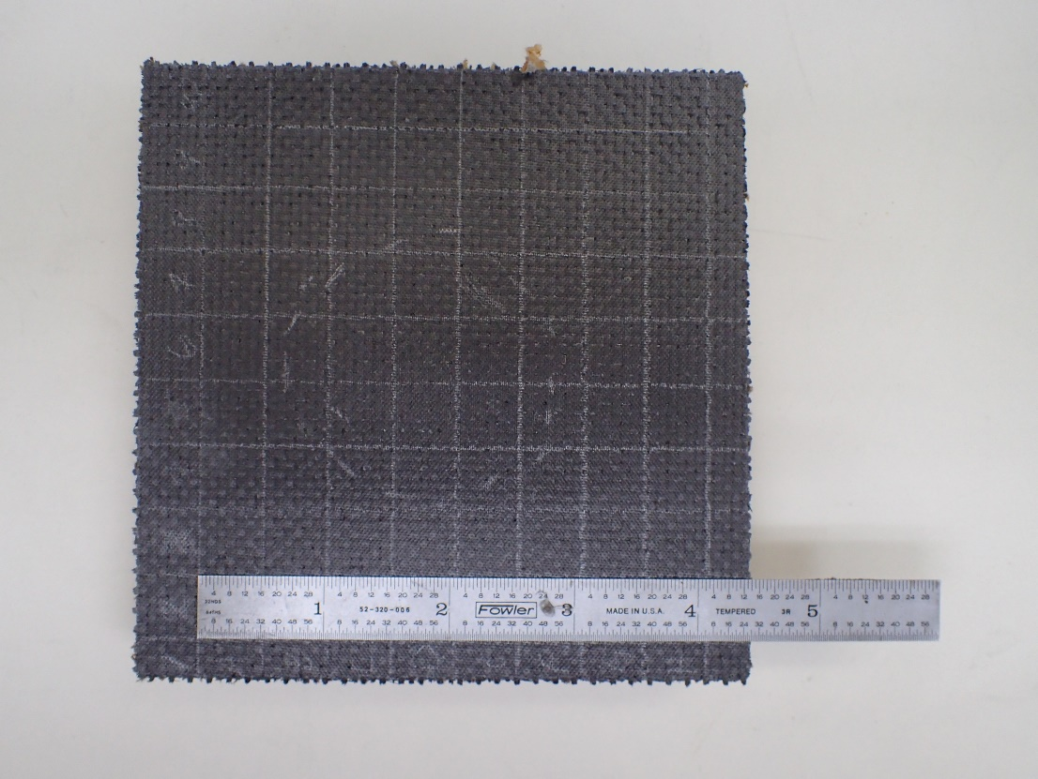
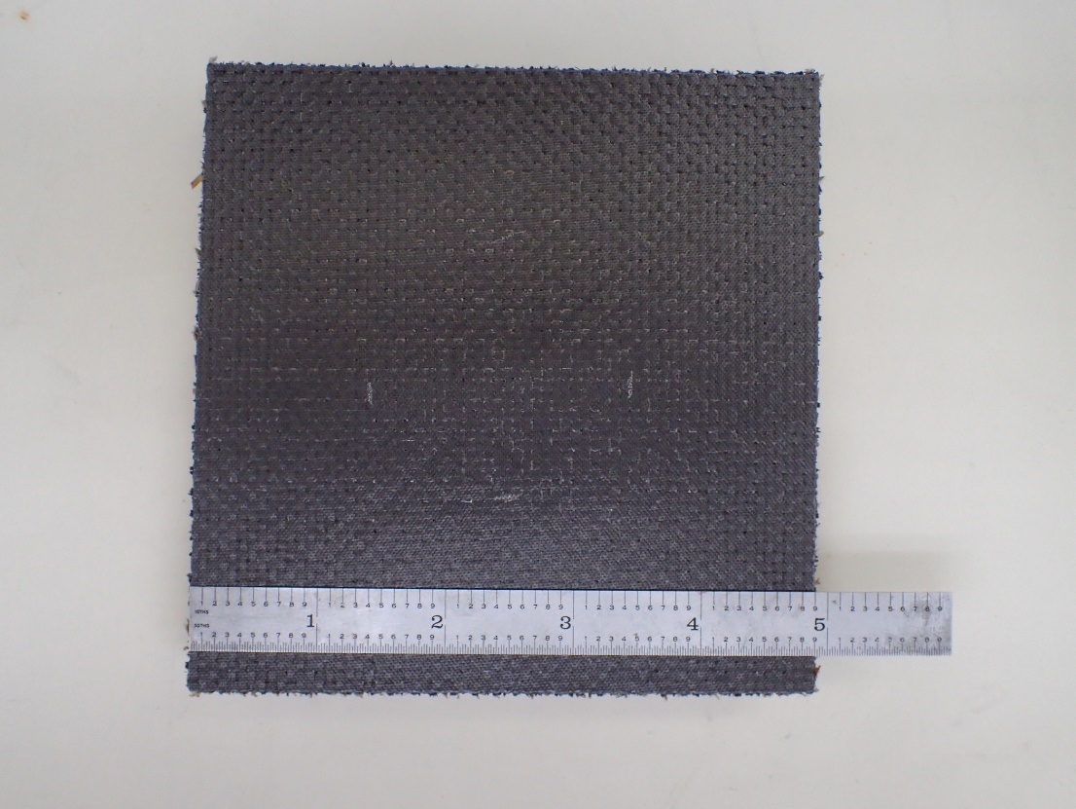
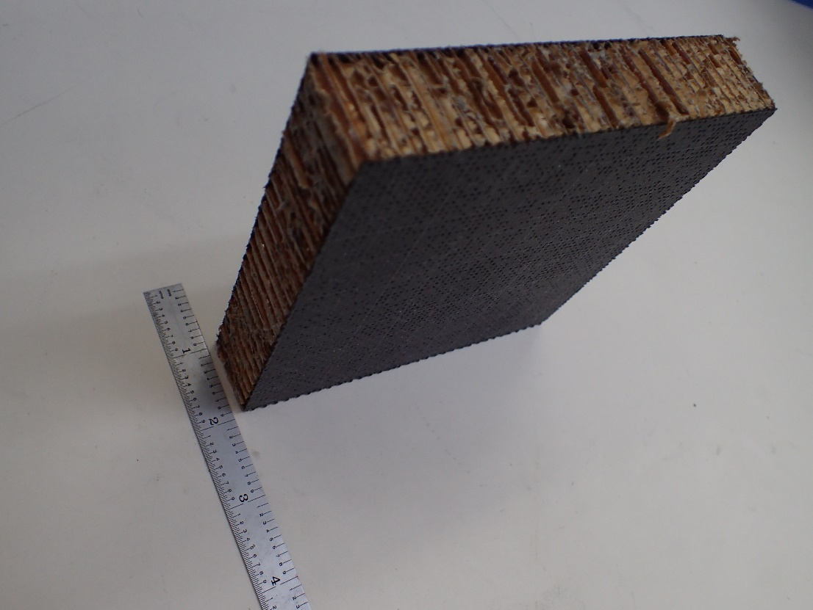
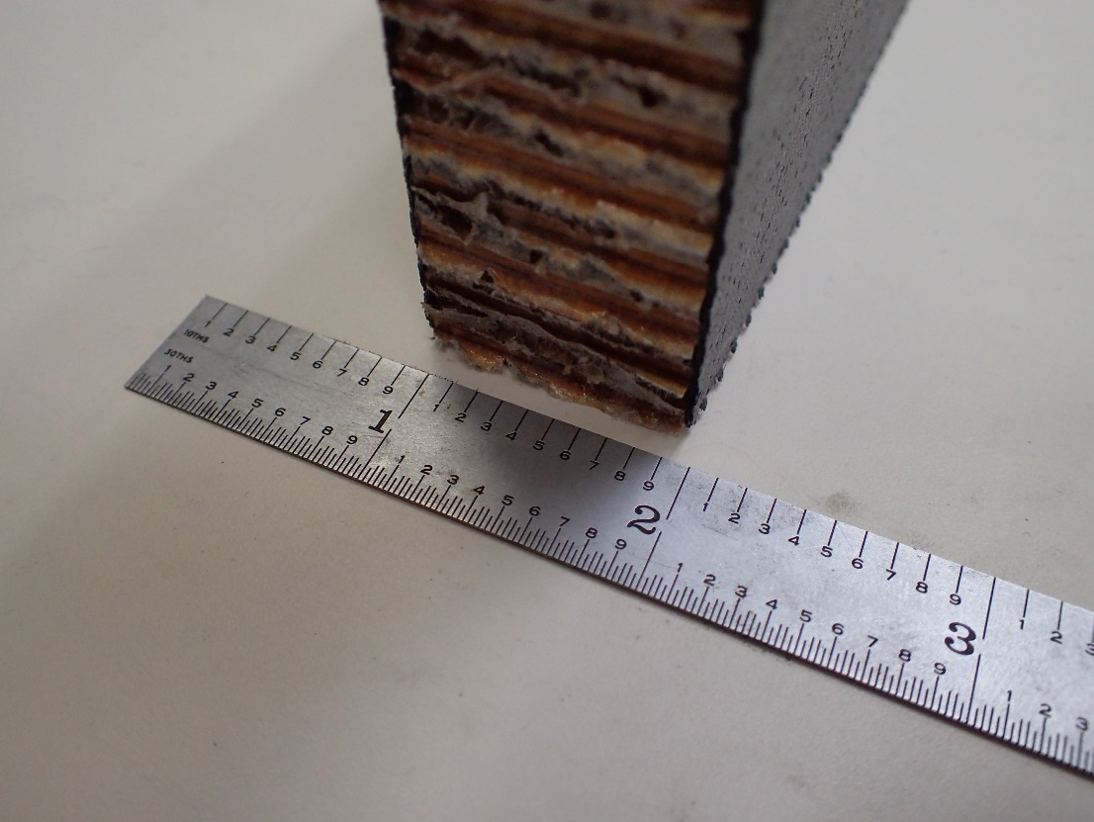
Carbon Fiber Honeycomb Core Impact Coupon
Surface: ~ 5 in x 5 in
Thickness: 1.06 in

Slide 7
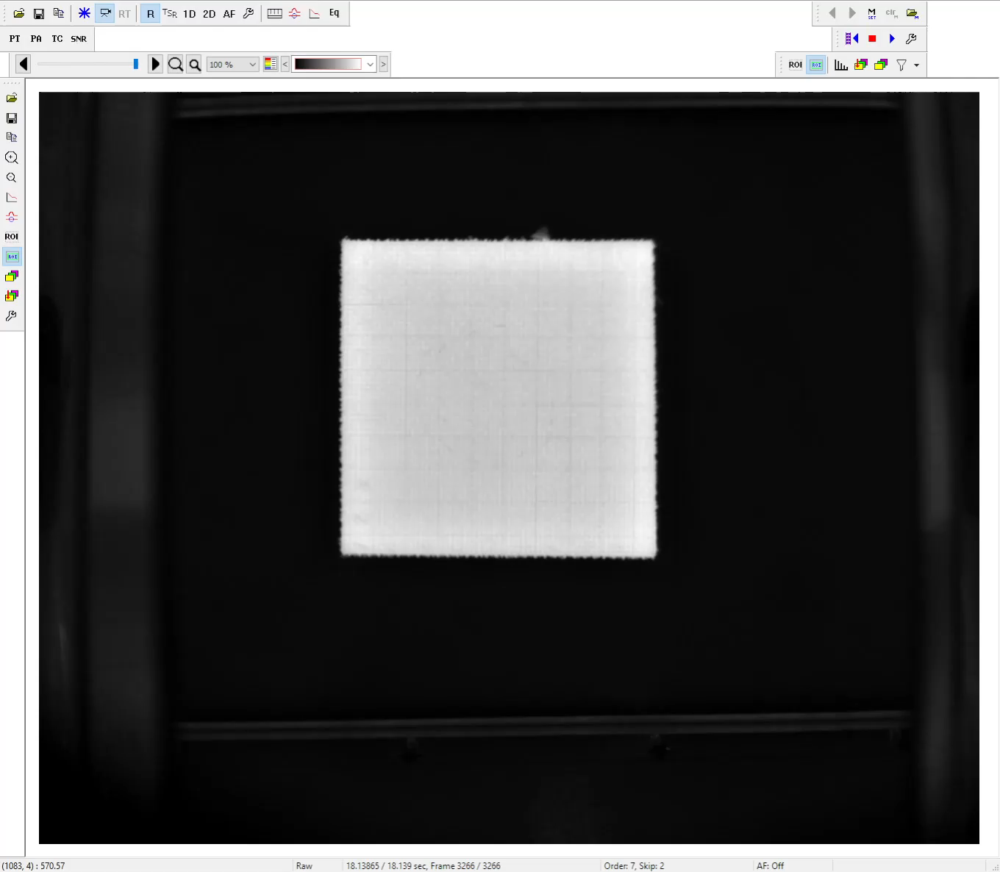
Thermal Intensity Movie

Slide 8
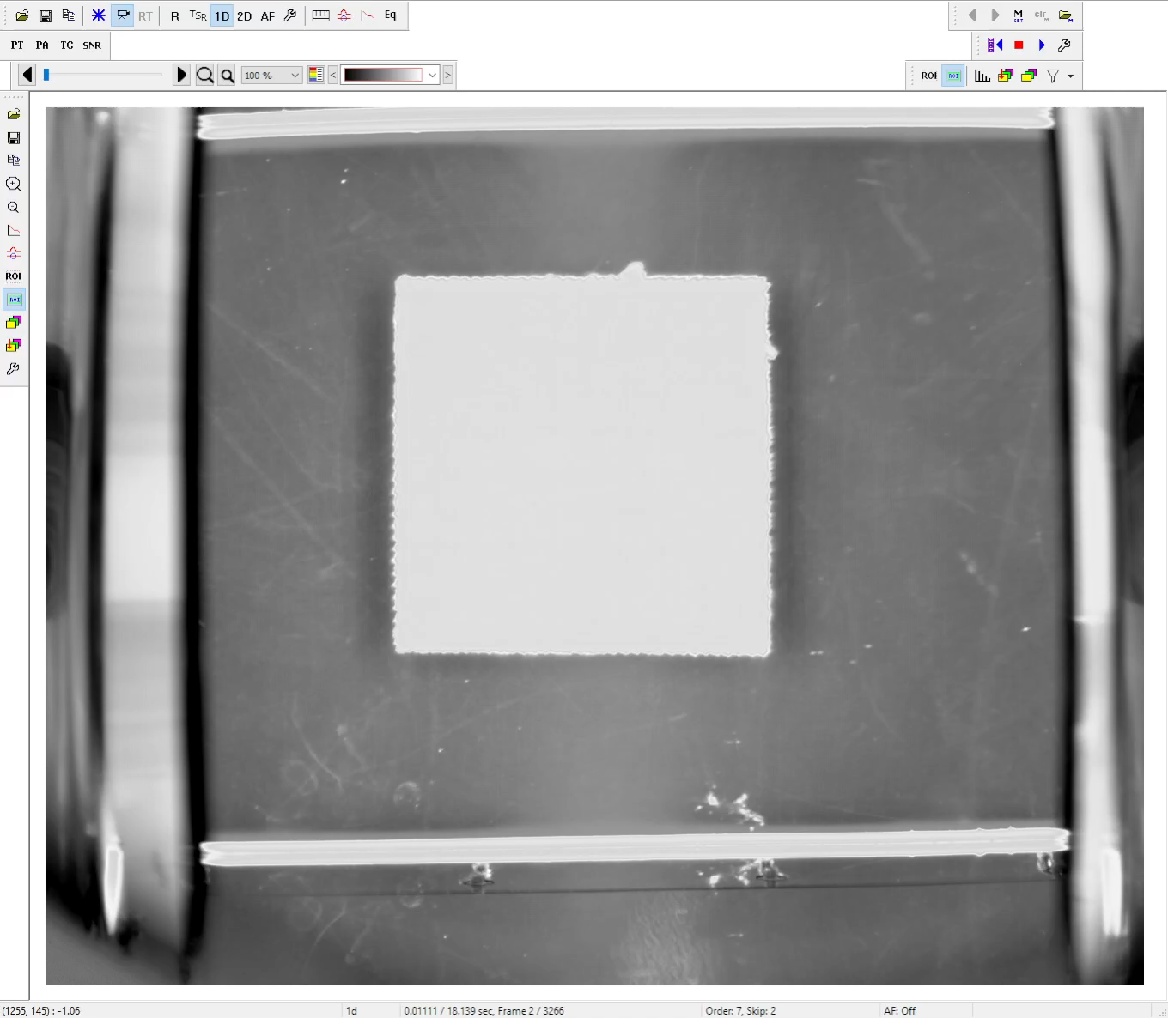
Velocity of the Thermal Intensity Movie (1st Derivative)

Slide 9
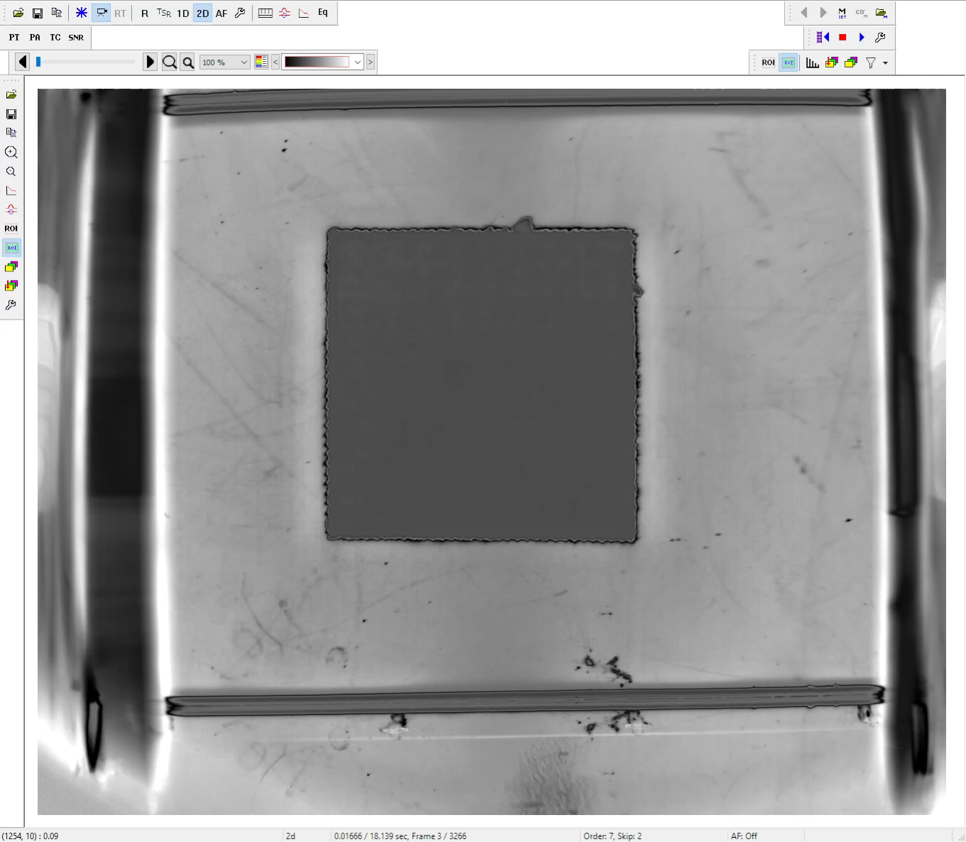
Acceleration of the Thermal Intensity Movie (2nd Derivative)

Slide 10
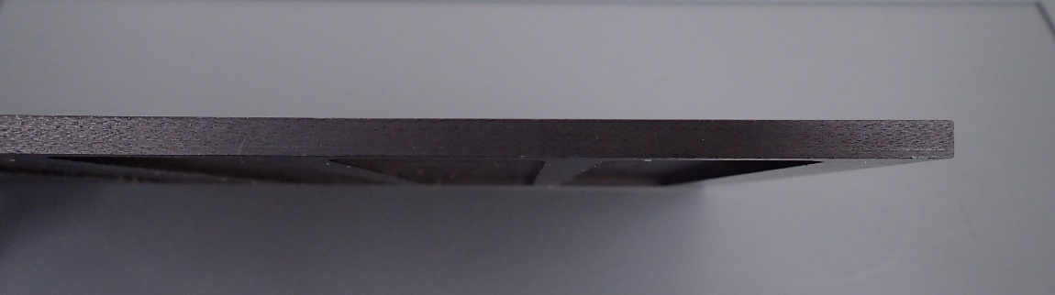
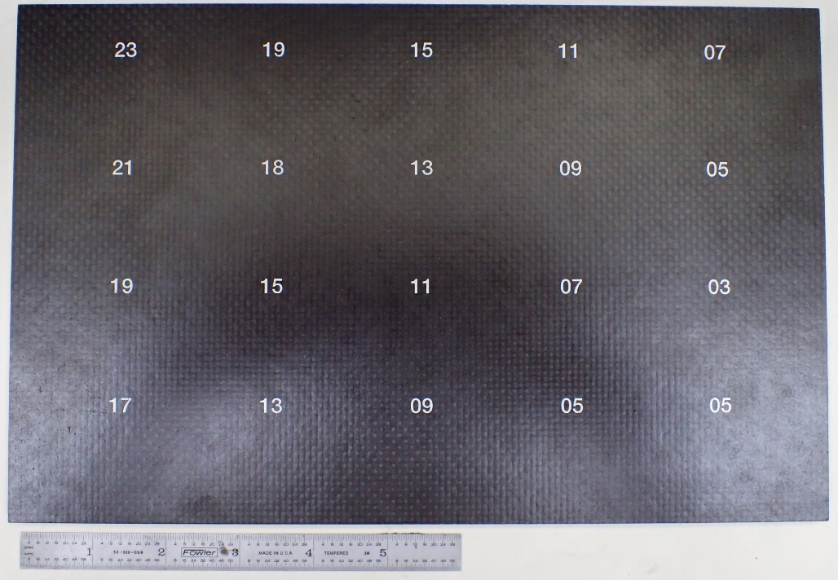
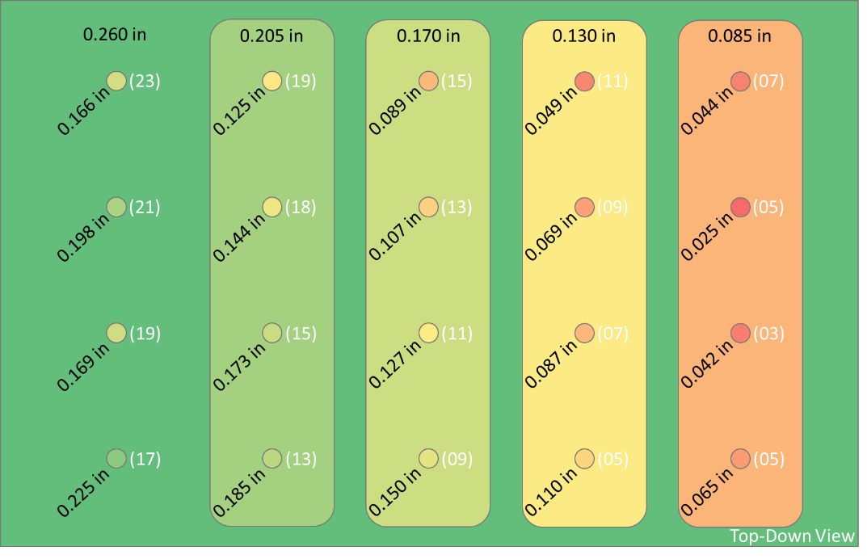
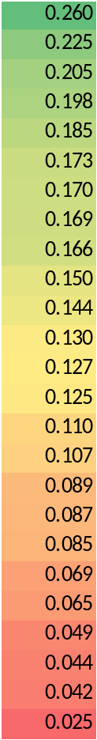
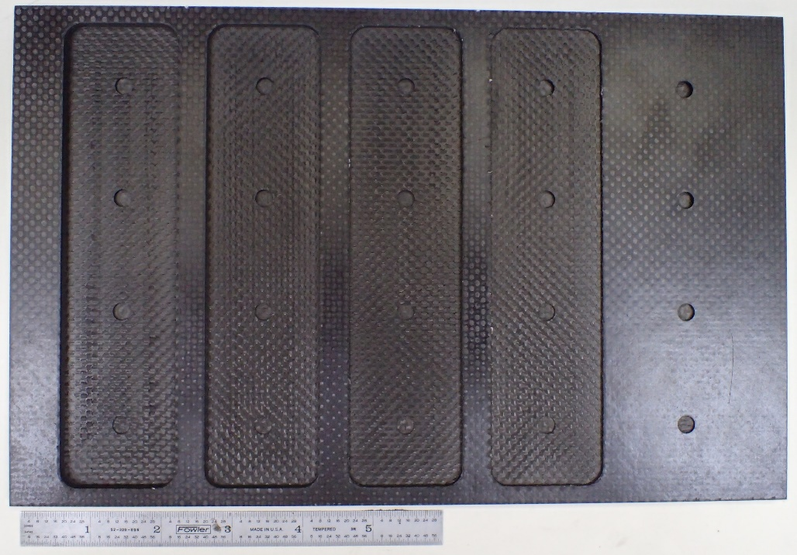
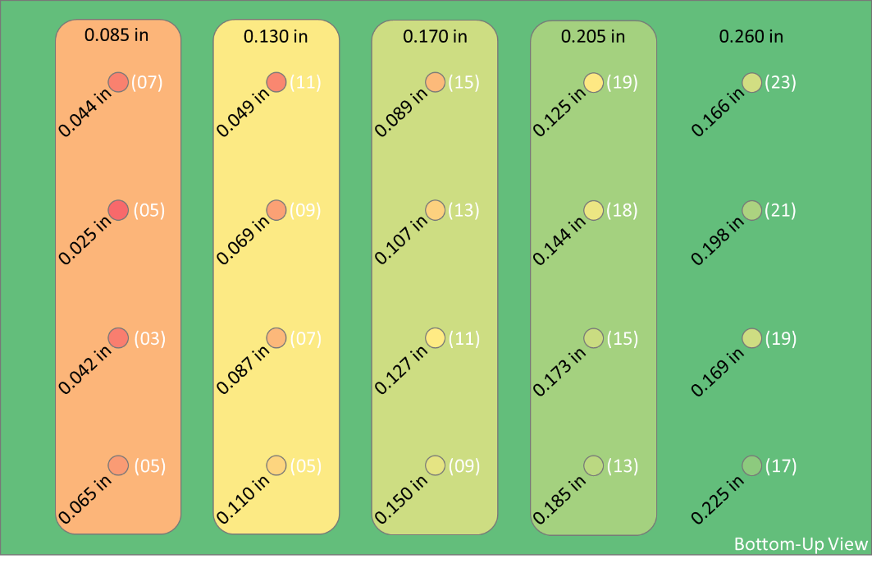
Carbon Fiber Reinforced Polymer (CFRP) Flat Bottom Hole (FBH) Coupon
Surface: ~ 7 in x 11 in
Thickness: 0.26 in
FBH diameters: 0.25 in

Slide 11
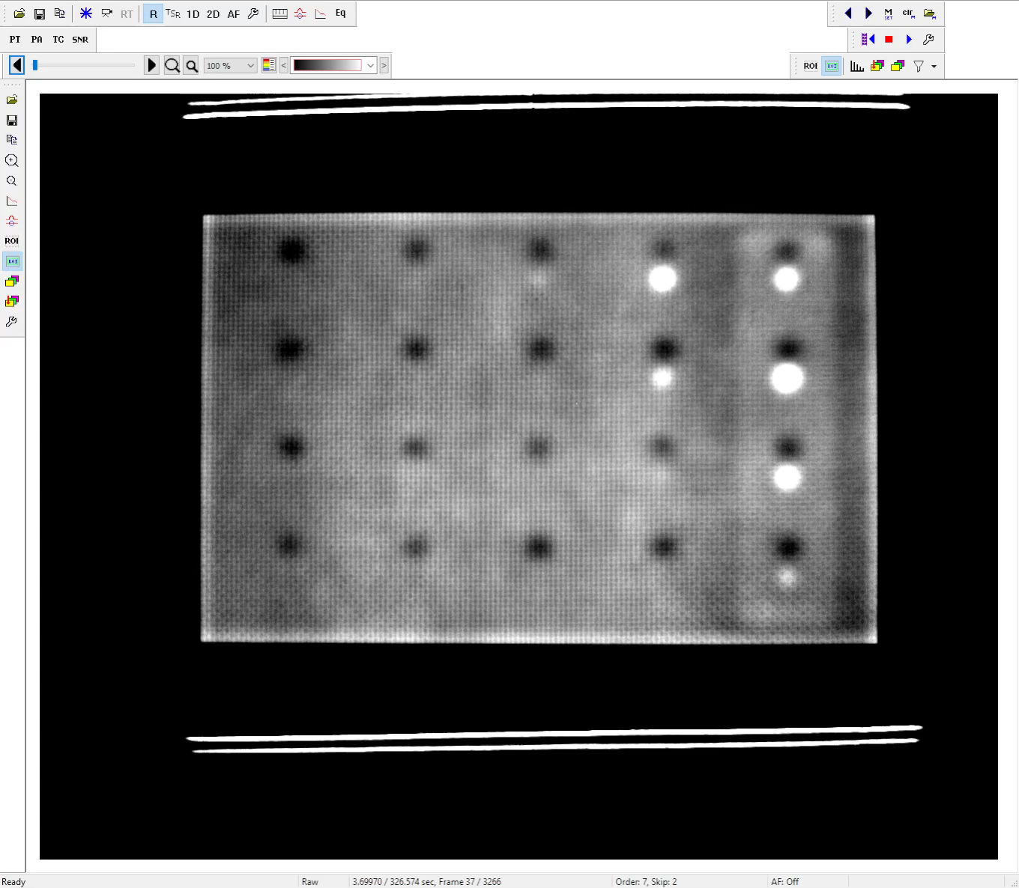
Thermal Intensity Movie

Slide 12
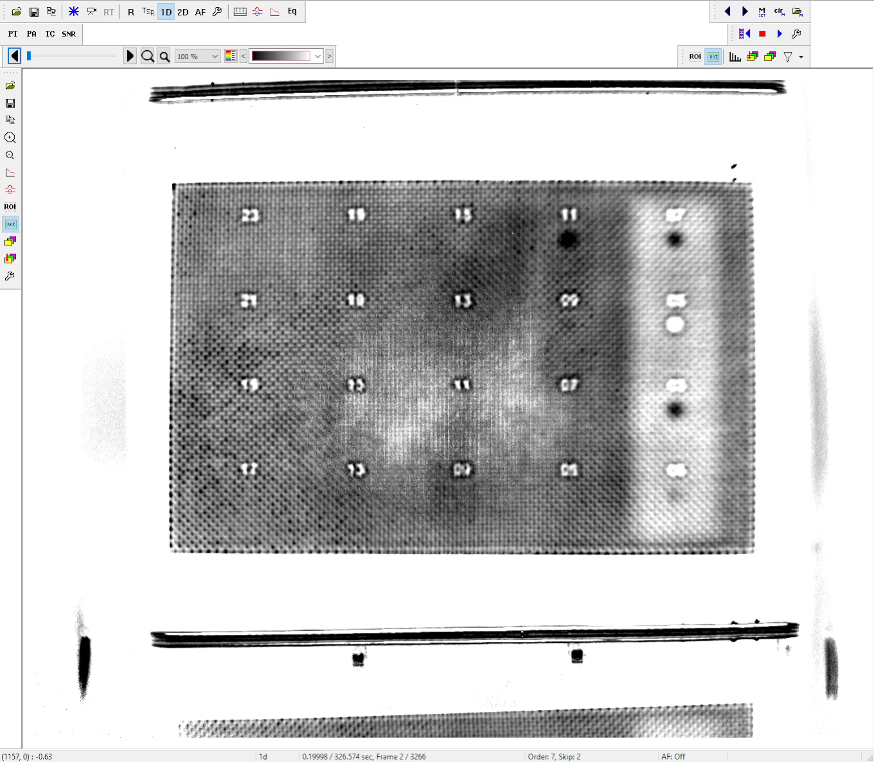
Velocity of the Thermal Intensity Movie (1st Derivative)

Slide 13
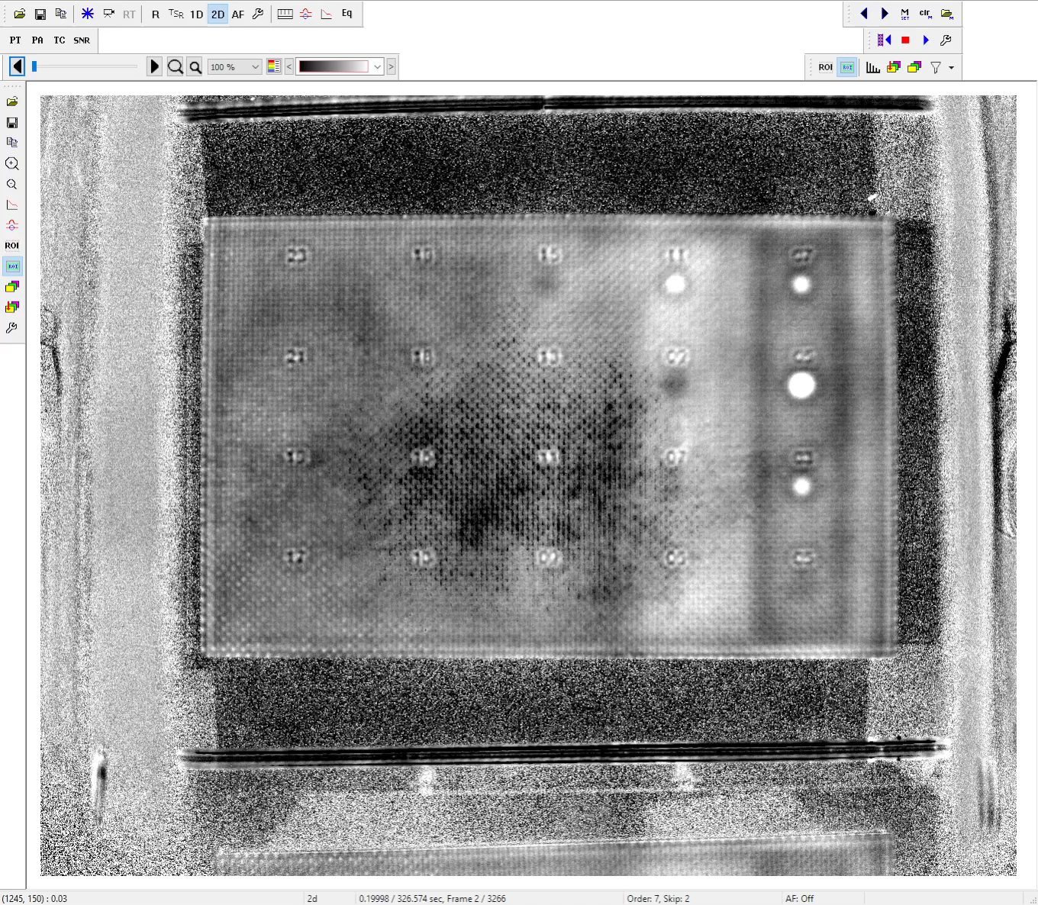
Acceleration of the Thermal Intensity Movie (2nd Derivative)

Slide 14
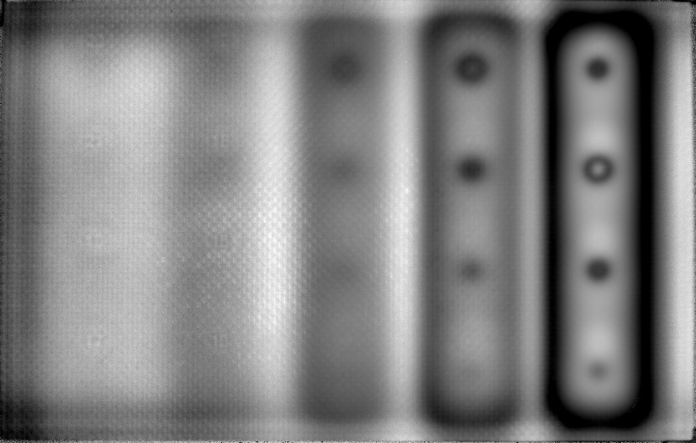
Carbon Fiber Reinforced Polymer (CFRP) Flat Bottom Hole (FBH) Coupon
1D Peak Amplitude (max)
Capture Frequency: 10 Hz
  3276 frames
  327 seconds
Flash
  Frame: 10
  Delay 1.7 ms
  Duration: 6 ms

Slide 15
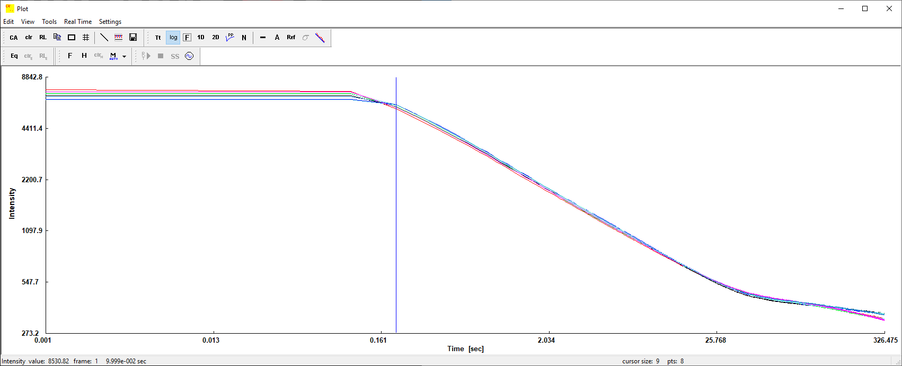
log(T) log(t) Plot
log (T)
log (t)

Slide 16
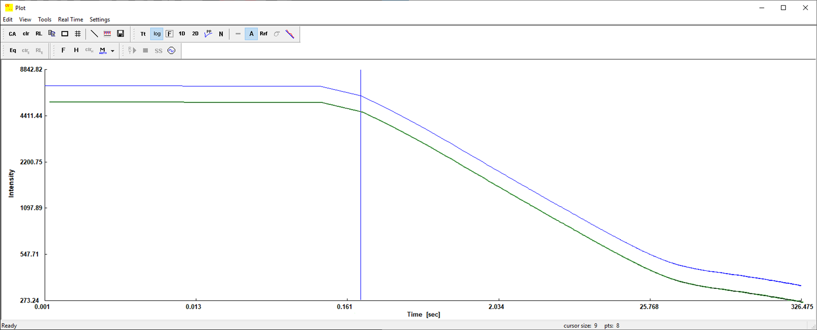
Flash Energy and the Initial Capture Frames
Reducing flash energy doesn’t change the shape or timing of the curve; just the y-intercept
Saturated. May need to reduce flash energy, timing, or reflectivity for thinner parts and near-surface defects
So, we ignore these frames
But it may bring you down into the noise of your camera when looking at the thicker regions

Slide 17
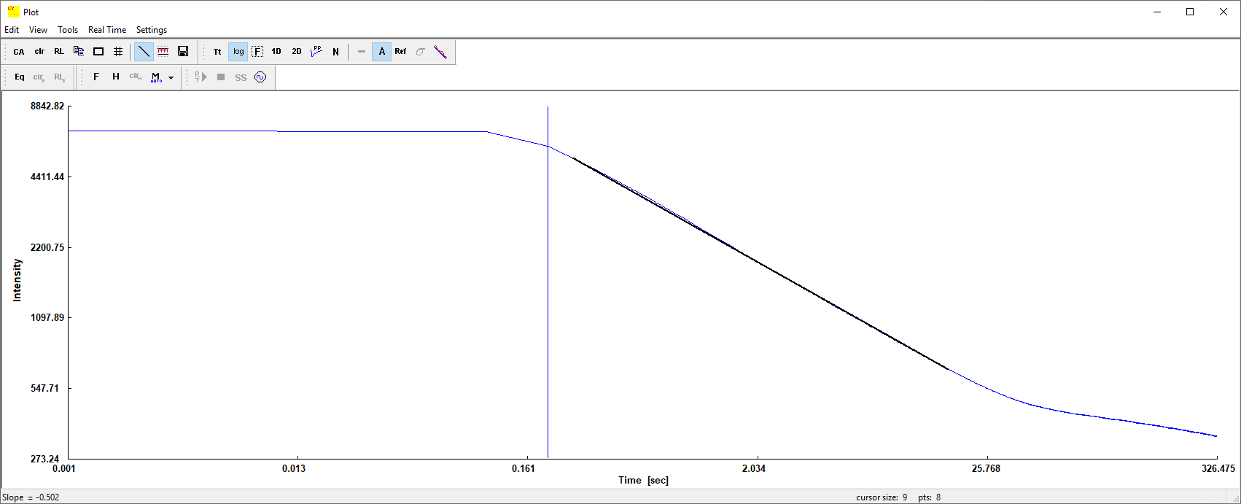
Mid and Late Capture Frames
Analyze these frames
Lower slopes may be due to reflections, background radiation, and low absorption of the test subject
Slope range of
-0.4 to -0.5 = normal diffusion rate (no defect)
t* = backwall

Slide 18
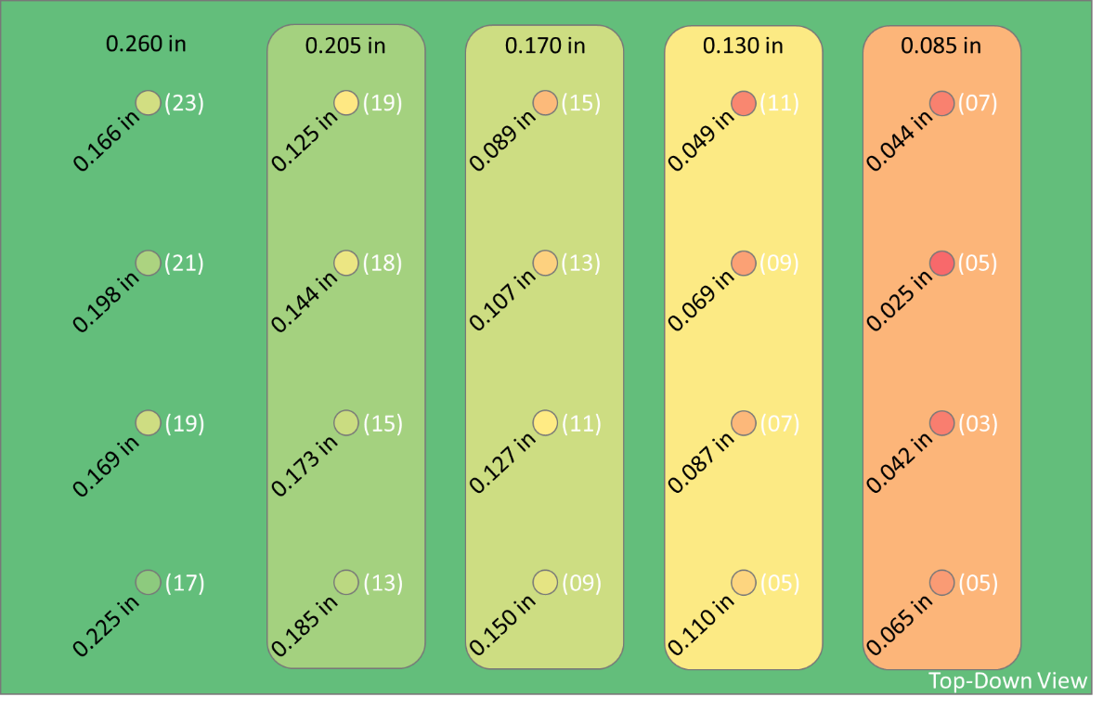
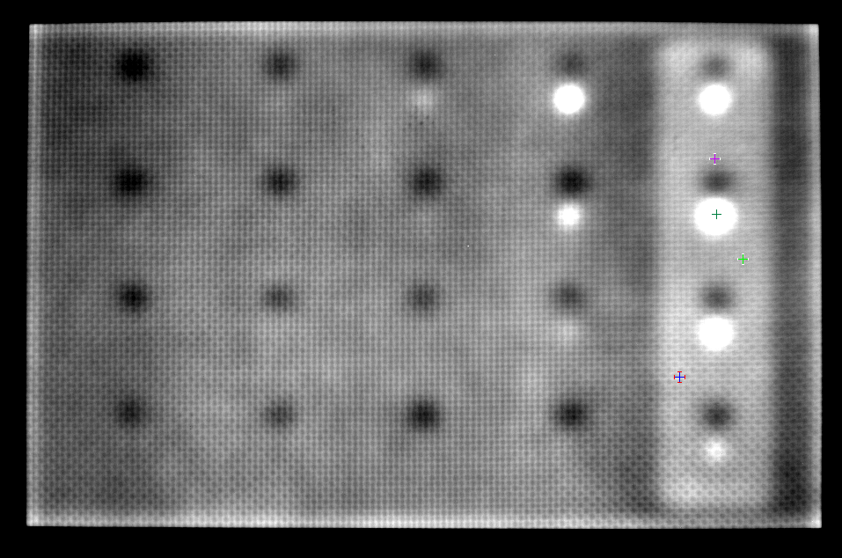
Measurement Locations
Thin-Out
FBH
Couple Extra Thin-Out Measurements

Slide 19
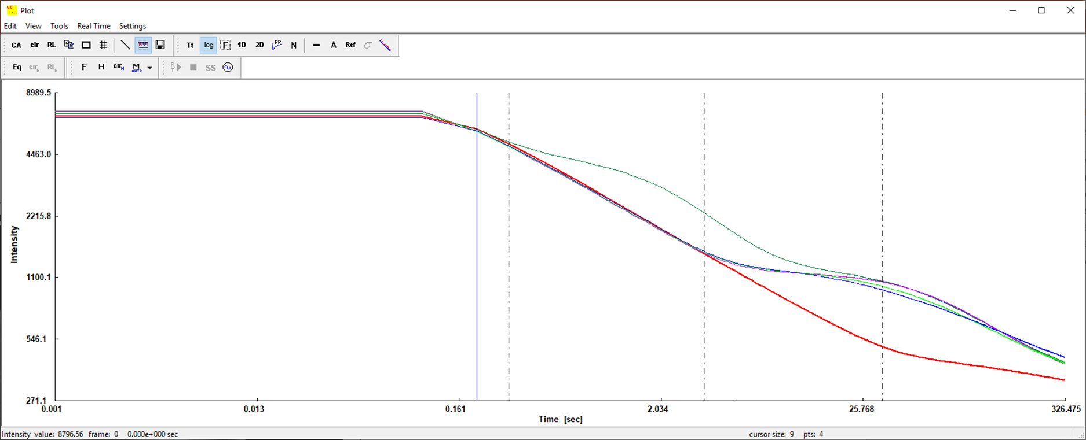
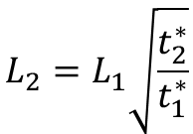
Defect Depth Calculation
0.025 in
$$L_{2}=L_{1}\sqrt{\frac{t_{2}^{∗}}{t_{1}^{∗}}}$$
0.085 in
0.260 in
0.300 s
3.500 s
32.697 s
t* = FBH
t* = thin-out
t* = backwall

Slide 20
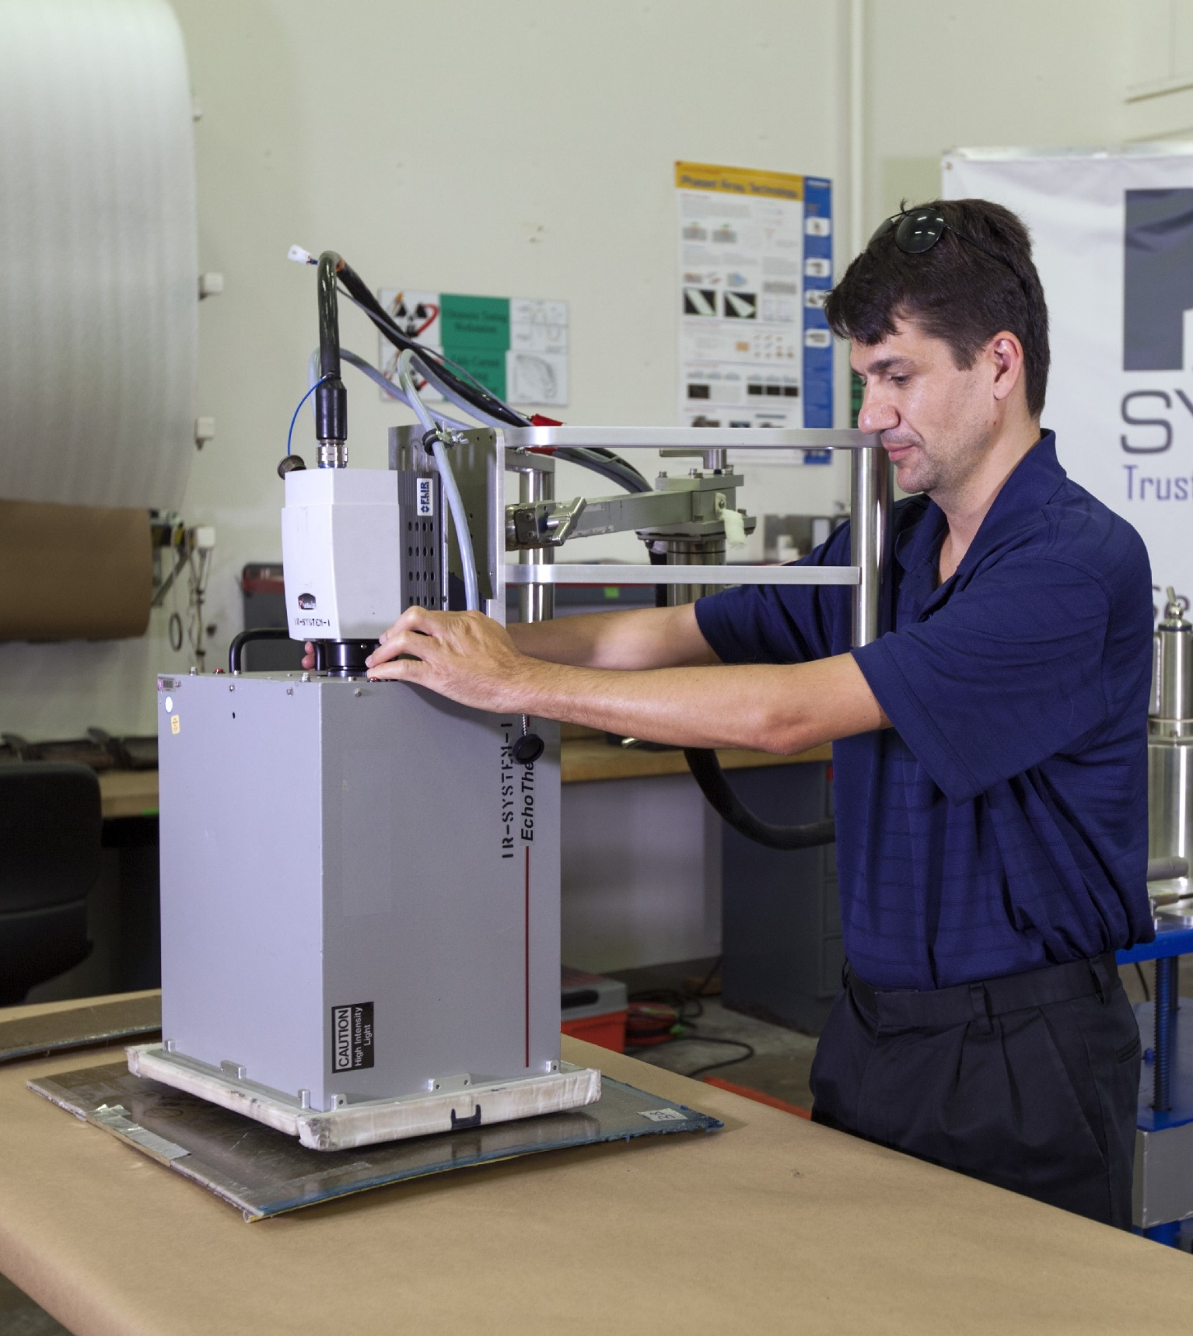
Conclusions
Active thermography provides an additional nondestructive option to the typical choices of ultrasound and radiography, for quickly collecting data on volumetric defects over relatively large inspection areas
It works best on thinner parts with lower thermal conductivity
As a general rule of thumb, you can anticipate being capable of identifying planar defects with diameters equal or greater than twice their depth
To get the most out of an active thermographic inspection, you want to be able to control the thermal input, capture the dissipation of thermal energy over time from your inspection surface, and be able to analyze that data

Slide 21


