Slide 1
May 2023
Day of Launch Loads for Artemis I
Jayme Allgood/EV31/ESSCA/DCI
Austin Decker/EV31

Slide 2
Agenda
Day of Launch (DOL) Integrated Vehicle Loads Overview
DOL-VLI Tool
DOL Loads Wind Methodology
DOL Loads Increments and Combination
Critical Load Indicators (CLI) and Launch Availability
Artemis I Launch
Summary

Slide 3
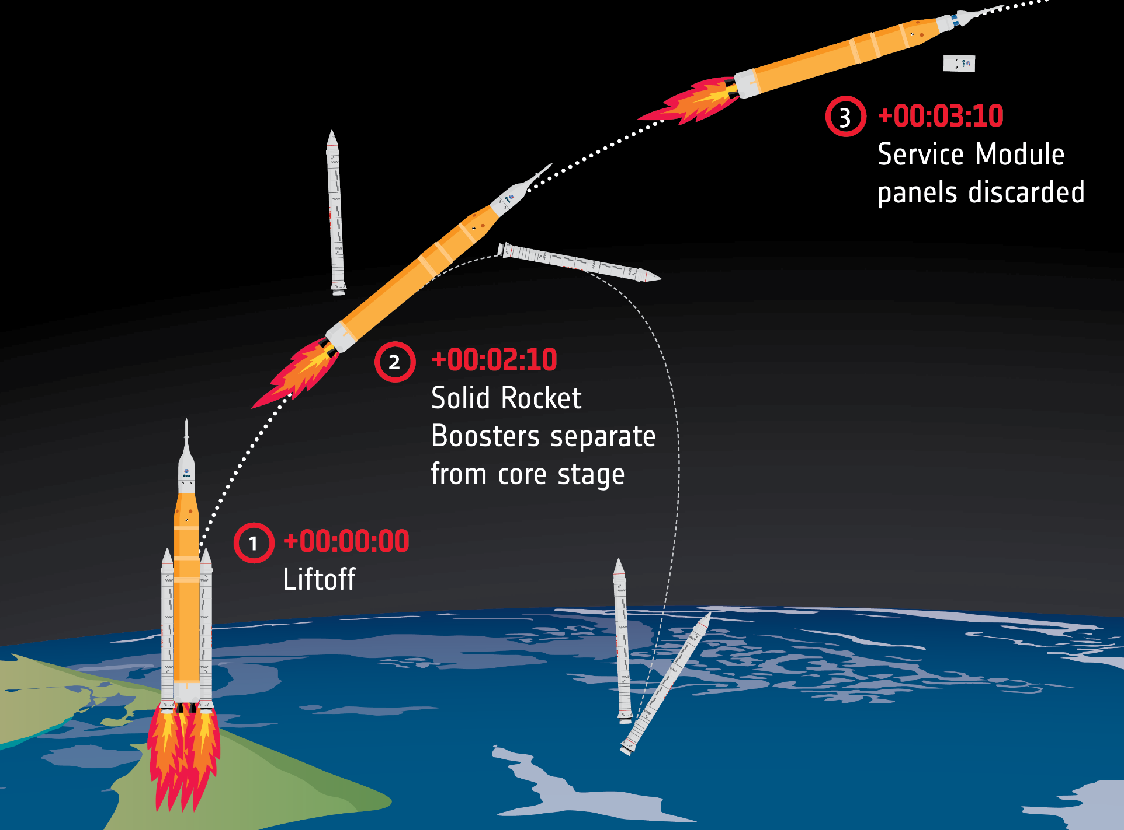
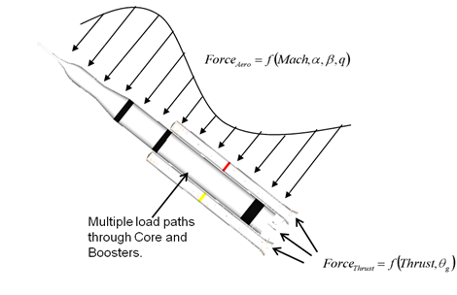
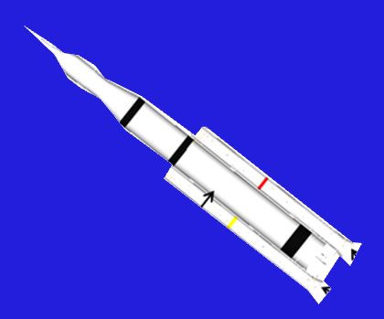
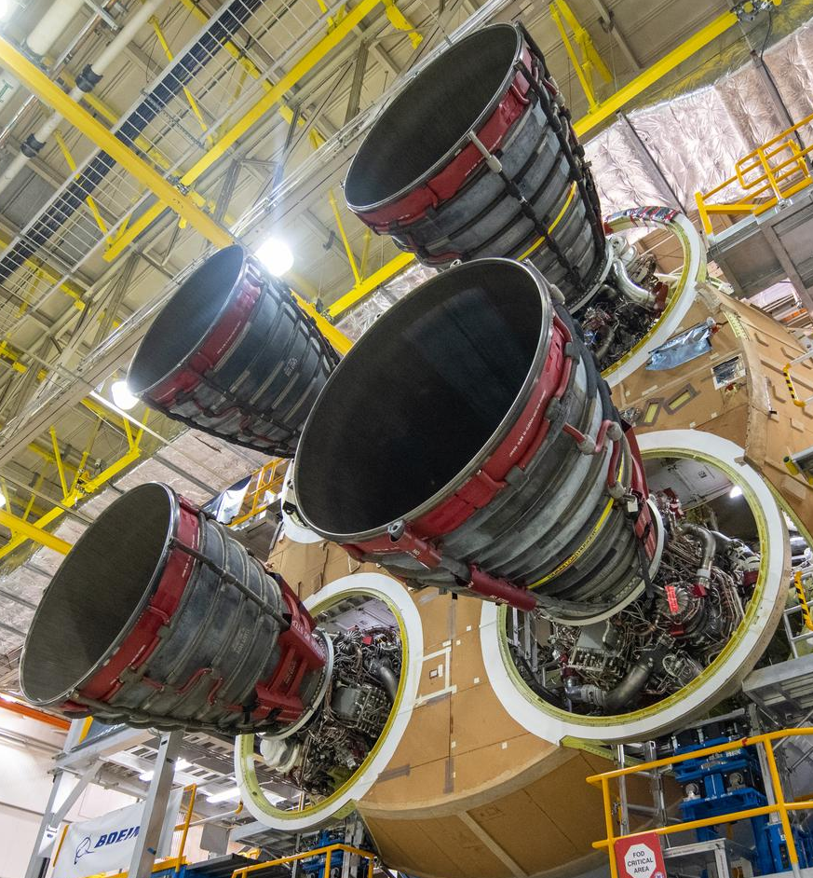
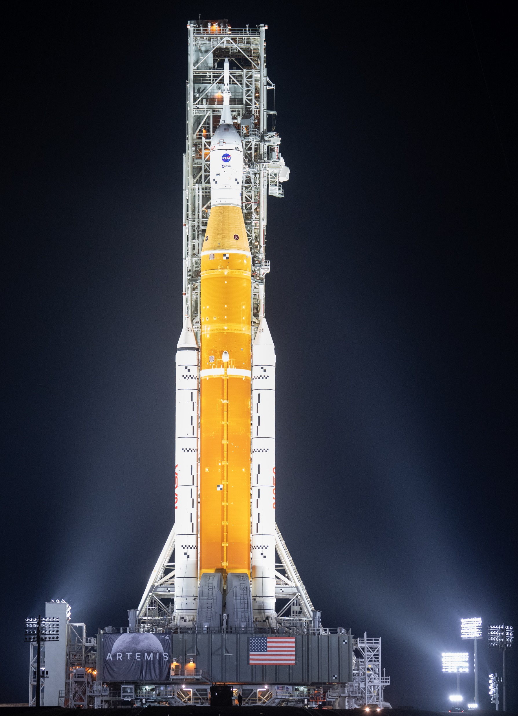
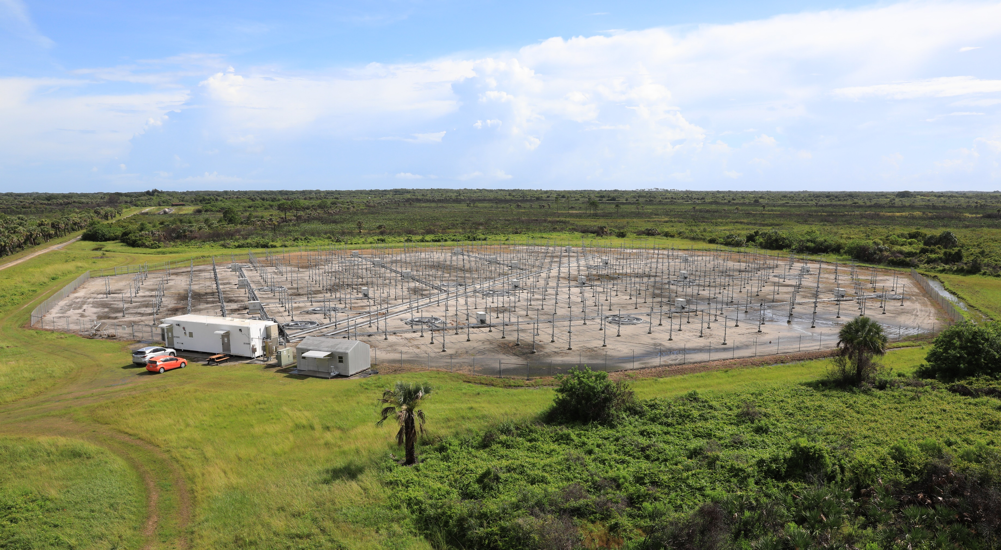
Day of Launch Process Overview
Create 6-DOF Trajectory
Assess Loads Constraints
and Trajectory Constraints
Upload Guidance Commands to Vehicle if Constraints are Clear
Generate Guidance Commands (I-Loads)
Photo: ESA
Photo: Aerojet Rocketdyne
Photo: NASA
Measure Winds
(balloon and radar sources)
Continue to Assess DOL Winds Before Flight
Photo: NASA

Slide 4
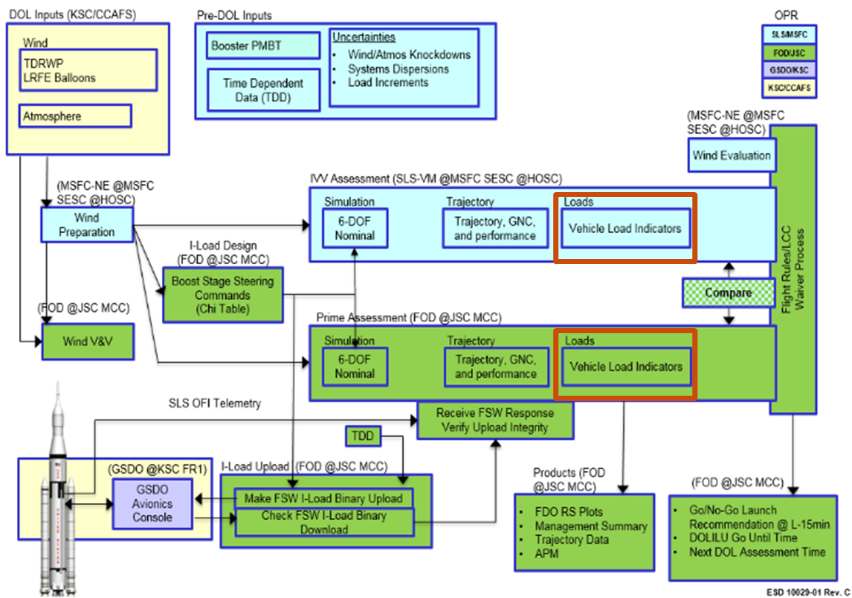
Brief Introduction to DOLILU Loads
DOLILU - Day of Launch I-Load Update
Process by which the first stage flight trajectory is designed, verified, and uploaded on DOL in order to ensure a safe flight.
On DOL, winds are measured shortly before flight to verify that the pre-planned vehicle open-loop guidance commands yield acceptable structural loading.
A tool called DOL-VLI, which can quickly compute critical load indicators (CLI) for boost phase flight, has been developed and certified for use on DOL. This tool serves as the IV&V for the Flight Operations Directorate (FOD) DOL load evaluation tool.
Evaluation of the DOL loads is only one of the complex series of tasks necessary to launch the vehicle on any given day.

Slide 5
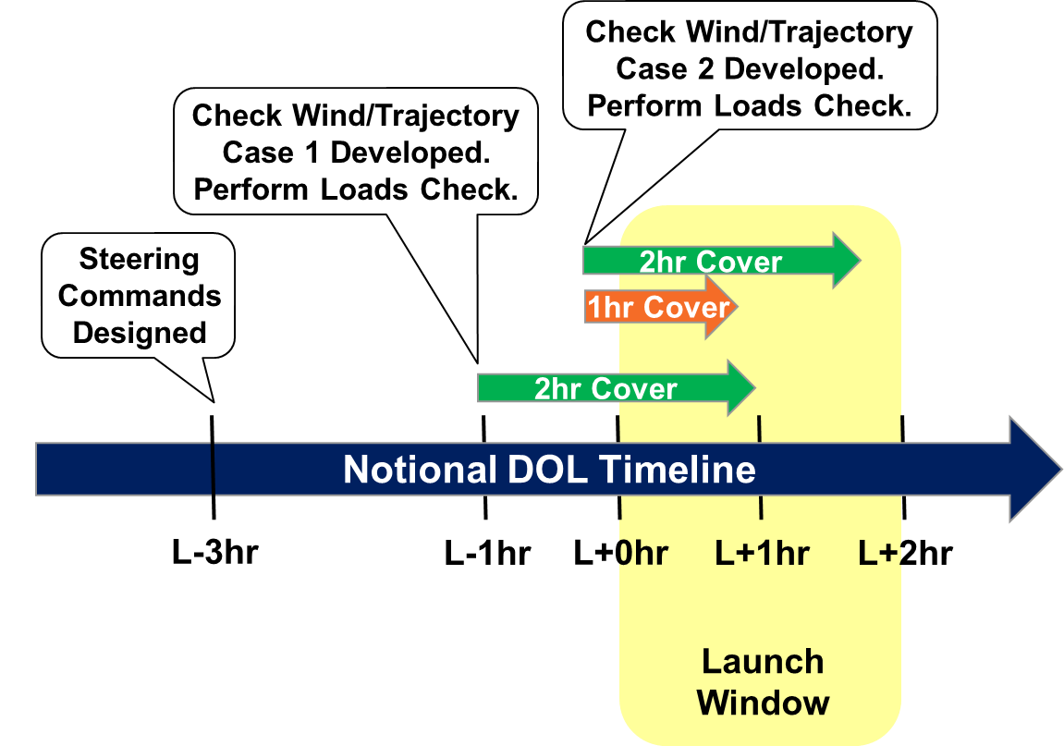
DOL Timeline (Simplified)

Slide 6
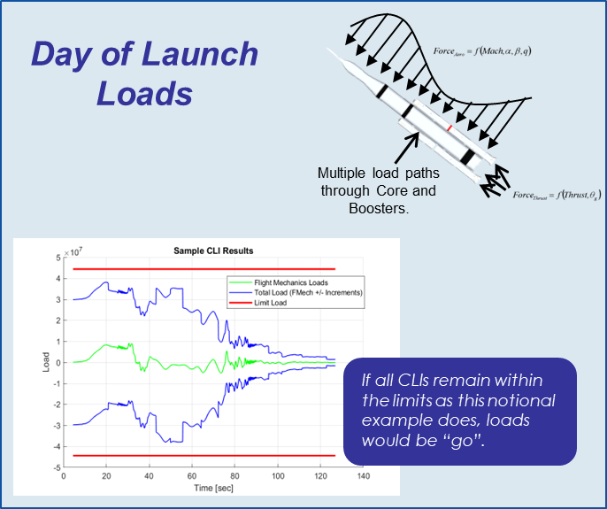
DOL-VLI Tool
Class C Safety Critical tool developed by the SLS DOL loads team
Executes in less than one minute
Extensive documentation and testing has been performed to comply with the requirements of NASA Procedural Requirements (NPR) 7150.2B
9/24/2019: Software Acceptance Review (SAR) with management from EV31, the SLS Structures and Environments Discipline Lead Engineer (DLE), and S&MA
Utilizes a 6-DOF trajectory developed with measured check winds and associated pre-planned guidance commands to assess CLI on DOL
Calculates pseudo-static flight mechanics loads due to applied aerodynamics, thrust, and thrust vector control forces (parameters all found in the 6-DOF trajectory)
Incorporates pre-calculated load increments including:
Turbulent and Tuned Gust
Transonic Buffeting
Thrust Oscillation
Elastic Maneuvering
Lack of Wind Persistence
System Dispersions
Atmosphere Increment
These increments are taken from a recent “normal” coupled loads analysis cycle
These increments are unique to the DOL process

Slide 7
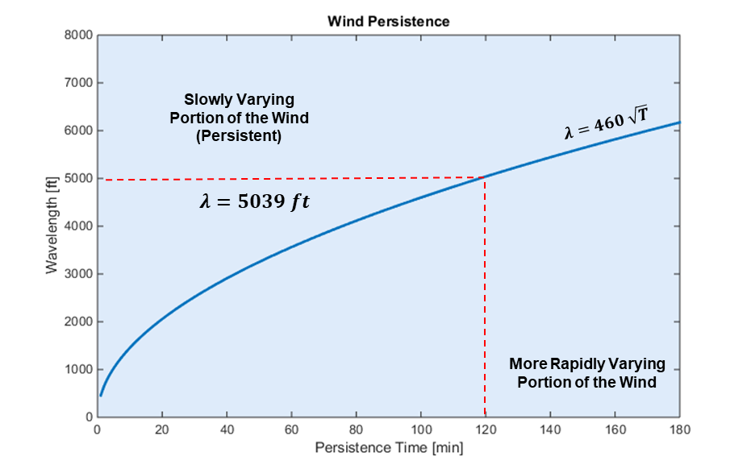
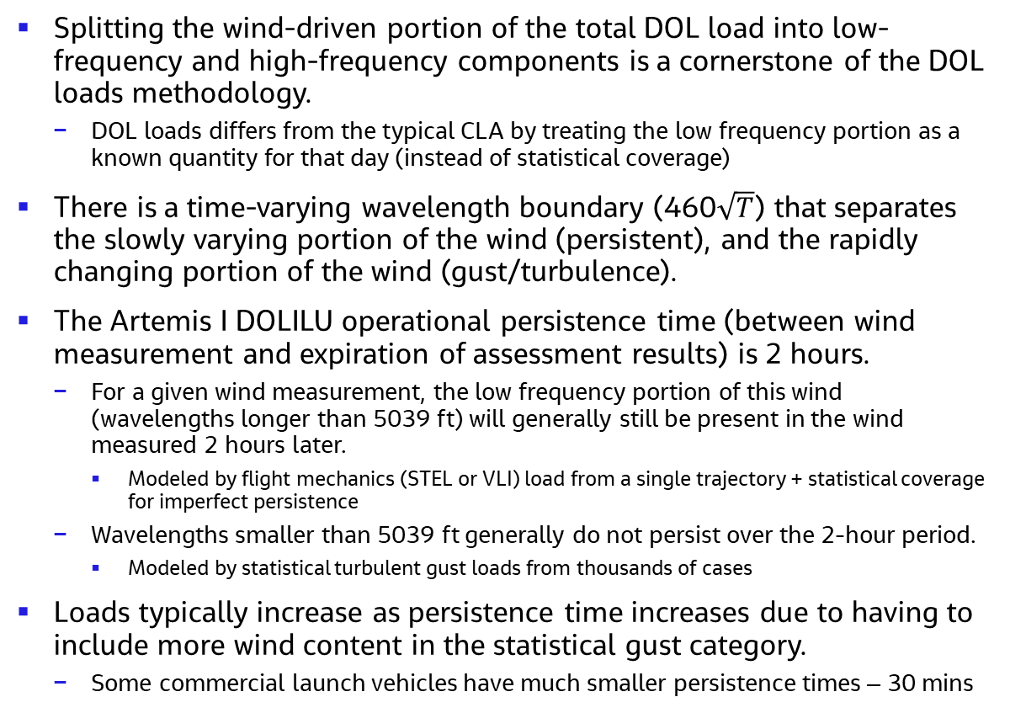
DOL Loads Wind Methodology
Splitting the wind-driven portion of the total DOL load into low-frequency and high-frequency components is a cornerstone of the DOL loads methodology.
DOL loads differs from the typical CLA by treating the low frequency portion as a known quantity for that day (instead of statistical coverage)
There is a time-varying wavelength boundary (460$\sqrt{T}$) that separates the slowly varying portion of the wind (persistent), and the rapidly changing portion of the wind (gust/turbulence).
The Artemis I DOLILU operational persistence time (between wind measurement and expiration of assessment results) is 2 hours.
For a given wind measurement, the low frequency portion of this wind (wavelengths longer than 5039 ft) will generally still be present in the wind measured 2 hours later.
Modeled by flight mechanics (STEL or VLI) load from a single trajectory + statistical coverage for imperfect persistence
Wavelengths smaller than 5039 ft generally do not persist over the 2-hour period.
Modeled by statistical turbulent gust loads from thousands of cases
Loads typically increase as persistence time increases due to having to include more wind content in the statistical gust category.
Some commercial launch vehicles have much smaller persistence times – 30 mins
STEL or VLI
Turbulent Gust

Slide 8
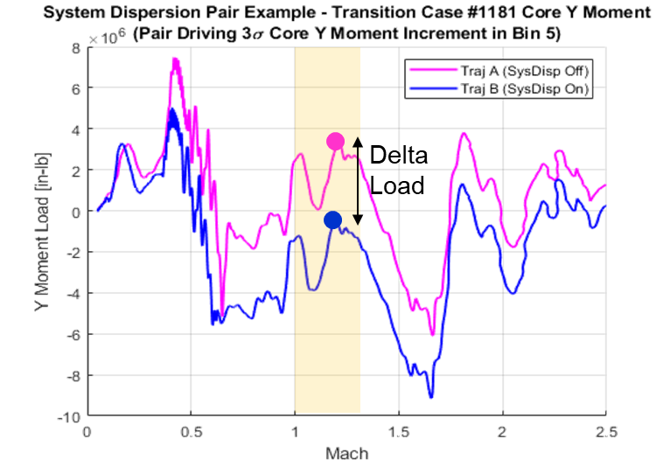
DOL Loads Increment Development
DOL loads increments are developed to account for load events that are not covered by other typical load analyses:
Lack of Wind Persistence (LOWP) – covers for changes in the “persistent” portion of the wind load over the span of 2hrs (winds are not perfectly persistent)
System Dispersions – accounts for potential variations in the many 6-DOF input parameters, since the DOL 6-DOF trajectory utilizes nominal models/parameters. This increment picks up the non-wind variations that would typically be included in a Monte Carlo trajectory set (TVC offsets, booster dispersions, etc.)
Atmosphere Increment – covers for having balloon-measured thermal data that is recorded up to 8-hrs prior to launch
Worked closely with trajectory analysts in EV42 and loads analysts at JSC engineering to develop the ground rules and methodology for increment calculations.
From thousands of pairs of trajectories, increments are computed by taking pairwise differences in loads (as illustrated in the plot), then calculating statistical 3-sigma and mean increment loads.

Slide 9
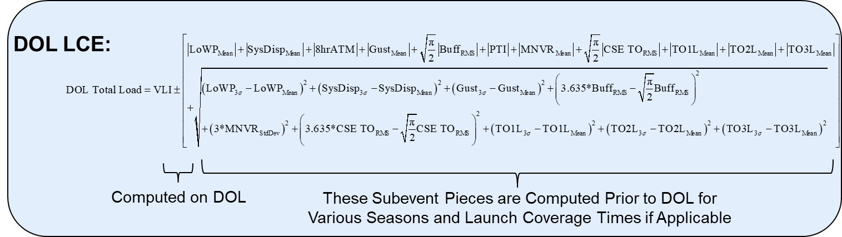
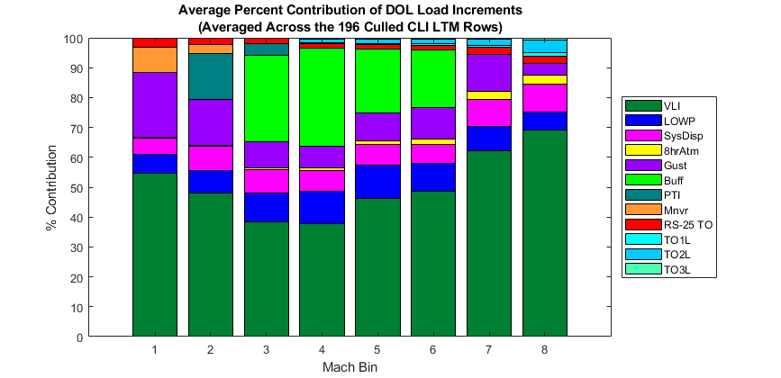
DOL Load Combination
DOL-VLI uses this Load Combination Equation (LCE) to develop a total combined load:
A breakdown of the average contributions of each load component is illustrated here. Typically, about 50% of the total load comes from the VLI-computed flight mechanics part of the load. Buffet is a large player in the transonic bins.

Slide 10
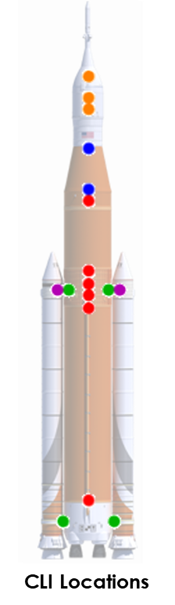
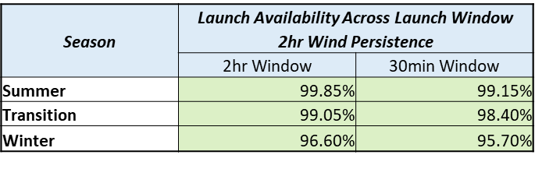
Critical Load Indicators (CLI) and Launch Availability
Critical Load Indicators (CLI): A set of integrated vehicle load recovery items and associated redlines provided by the elements and programs to protect their hardware
Artemis I: 78 general load types, represented by 190 recovery items
DOL loads team worked with Orion/Booster/Stages/SPIE to refine the list of CLI over the course of a few years
Launch availability: Prediction of the percentage of launch attempts that would be “go”, based upon Monte Carlo check case simulations
Final Artemis I DOLILU launch availability predictions, with both loads and trajectory constraints, was ~96% for winter and 99% for summer seasons
Results presented to SLS Chief Engineer and Joint Integrated Control Board (JICB)

Slide 11
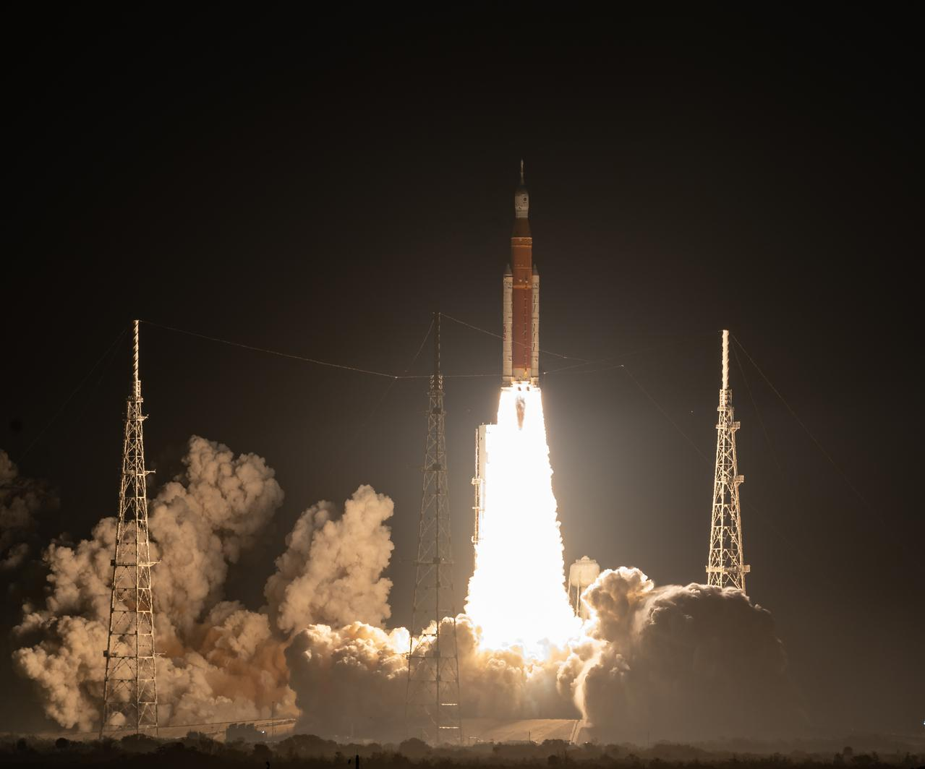
Artemis I Launch
Leading up to launch, the SLS DOL loads team participated in >30 simulations/tests. This made the launch support feel very routine.
DOL-VLI was operated from the Huntsville Operations Support Center (HOSC).
For the Artemis I launch (11/16/22, 12:47am CST), DOL-VLI was utilized to assess loads for winds measured leading up to launch.
Cycle A – 11/14/22, 6:34pm CST
Cycle B – 11/15/22, 7:04pm CST
Cycle C – 11/15/22, 9:04pm CST
Cycle D – 11/15/22, 10:34pm CST
Cycle E – 11/15/22, 11:19pm CST
Cycle F – 11/16/22, 12:04am CST
For all cycles, the CLI were within their redlines, and therefore DOL-VLI was “go”.
DOL-VLI’s percent margin results matched FOD’s results within the defined 3% tolerance and supported the overall DOLILU “go” recommendation that was provided to the Flight Director.
Photo: NASA

Slide 12
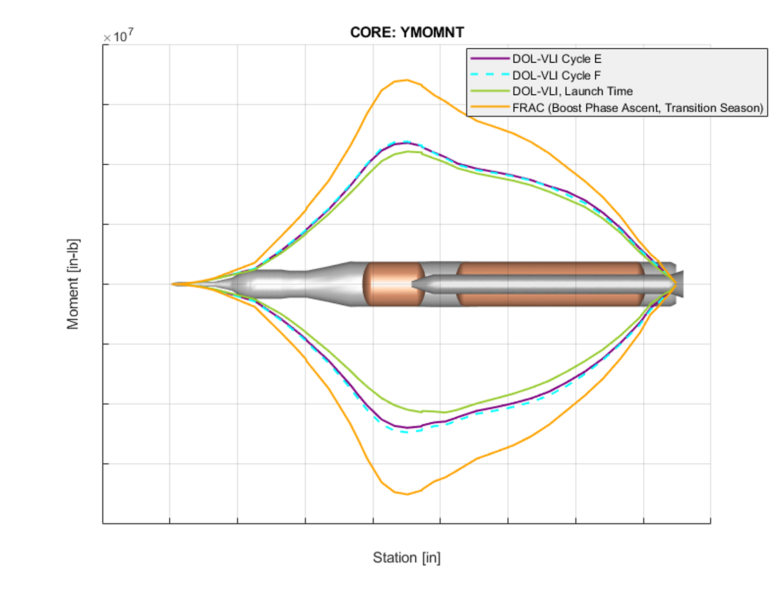
Post-Launch DOL-VLI Results
As a first step in EV31’s Artemis I reconstruction efforts, DOL-VLI has been executed using a post-flight MAVDOL trajectory which utilizes winds measured at the time of flight.
Removed the lack of wind persistence increment since winds were measured at launch time
Combined, total ascent loads were produced, and results were as-expected:
For primary y- and z-moment section loads, launch time results were well within the bounds of FRAC (which is the final Artemis I load cycle).
Results were generally a little lower than the loads produced during the DOLILU cycles, likely because of the 3-sigma LOWP increment used during DOLILU to cover for wind changes.

Slide 13
Summary
The SLS Day of Launch loads task has been an exciting and multi-faceted project over past several years:
Methodology development
Software development
Software testing and certification activities
Operator training
DOL simulation participation
Launch support
First-look flight results
We plan to build upon the success of the Artemis I DOL loads project and continue refining and supporting for Artemis II and beyond.

Slide 14
Backup

Slide 15
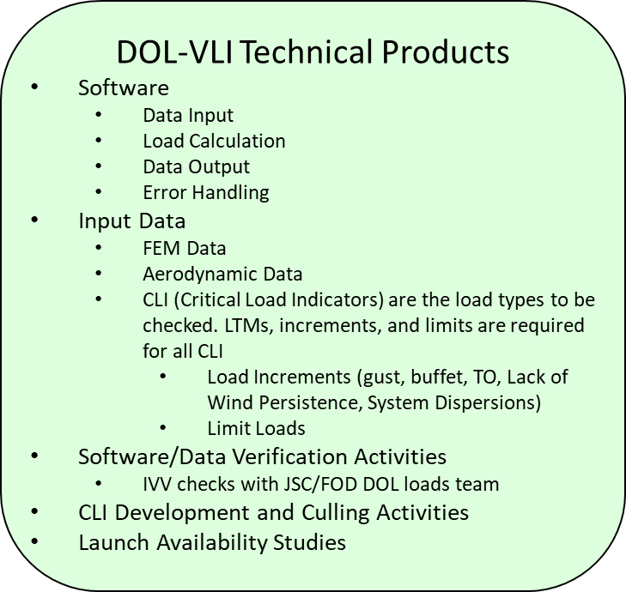
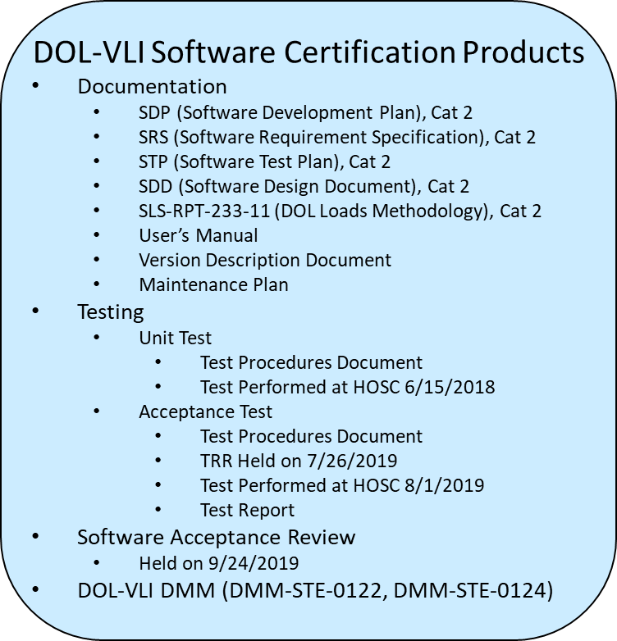
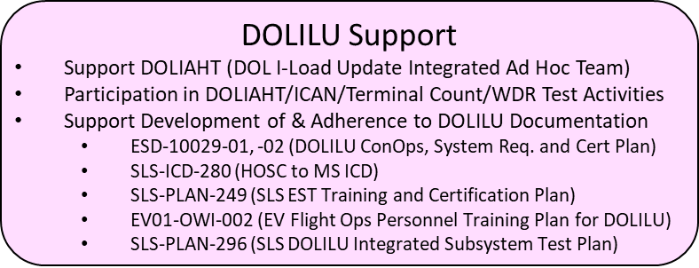
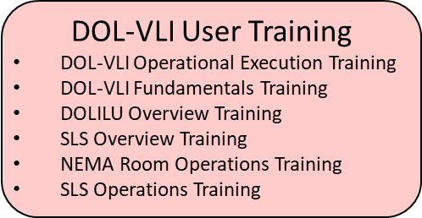
Day of Launch Loads Introduction
Over the past several years, the SLS Day-of-Launch (DOL) loads team has developed the capability to assess integrated vehicle loads as part of the Artemis I DOL process
Support of this task has required the development and support of a variety of products and activities
Highlights from the Artemis I DOL loads task will be presented today

Slide 16
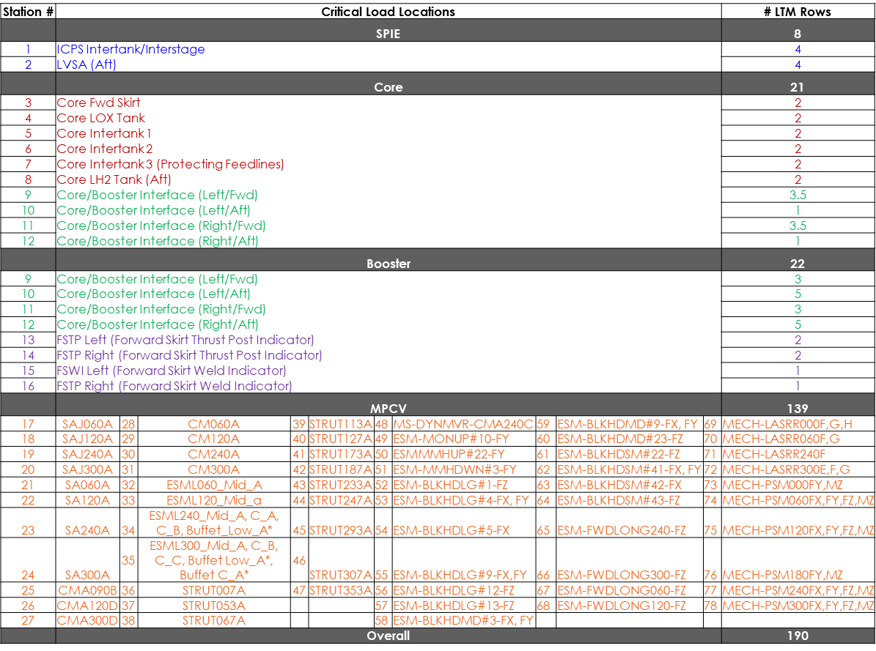
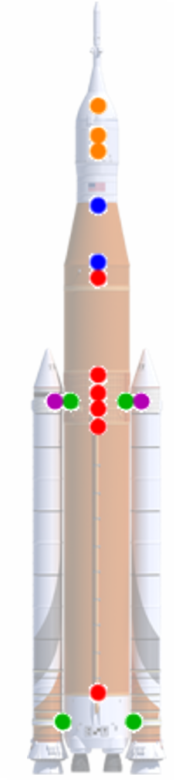
Artemis I Critical Load Indicators

Slide 17
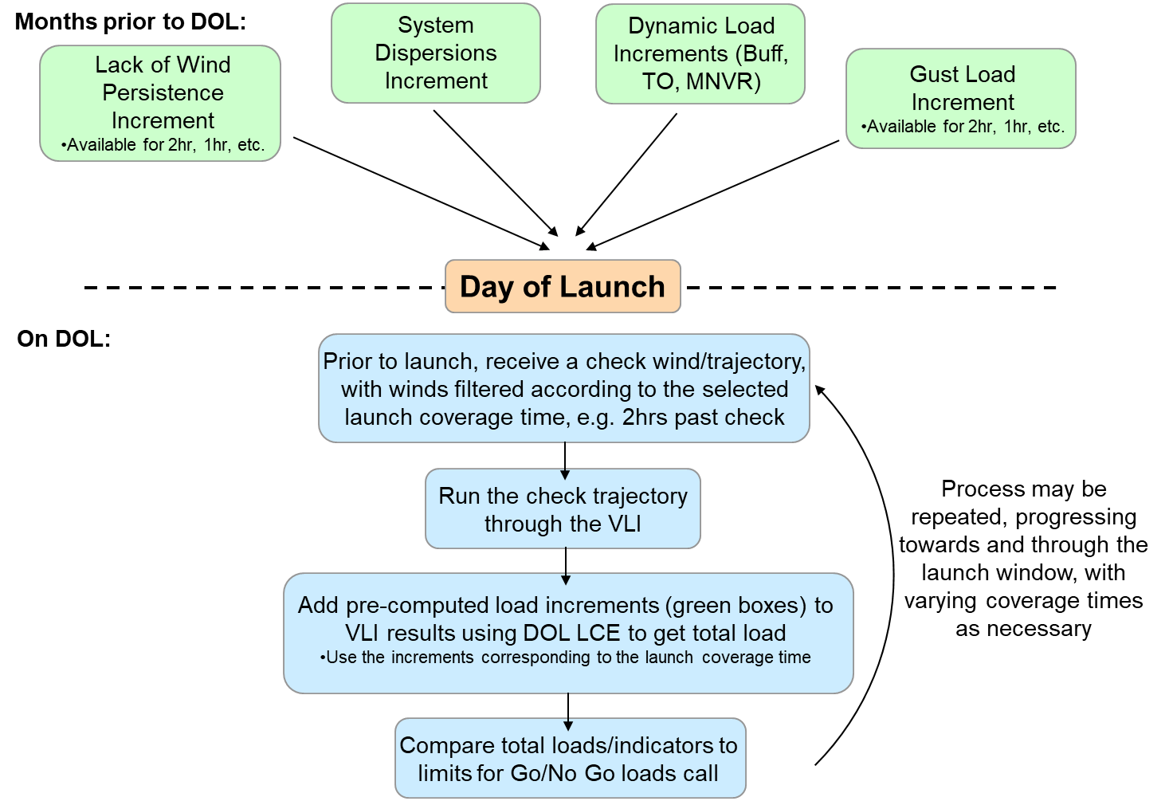
DOLILU Loads Process

