Slide 1
Alternate Approach to Multi-Layer Insulation Modeling to Reduce Node Count
Hume Peabody and Chris Evans
International Conference on Environmental Systems
July 15-19, 2023

Slide 2
Outline
Introduction and Motivation
Derivation and Assumptions
The One Node Insulation Approach
Implementation in Thermal Desktop®
Evaluation Model
Performance Predictions
Evaluation of Performance
Lessons Learned
Conclusions and Path Forward

Slide 3
Introduction and Motivation
Often, vendors at higher levels of assembly may require reduced thermal models. This is particularly true for launch vehicle providers
Node count limitations on reduced models can be severely constraining
  Rather than using finite elements, modelers often revert to centroid, shape based approaches to minimize the node count
  This eliminates the ability to take advantage of modern codes’ capabilities to the fullest extent and may result in considerable effort to develop the network matrix in some tools
It was identified, however, that a considerable portion of the node count was dedicated to Multi Layer Insulation (MLI) nodes, which traditionally include an outer layer node, and underlying structure node, and a radiative coupled between them based on area and an effective emissivity (ε*)
  An informal survey at GSFC showed that about 25-30% of models were MLI nodes
The hope was that a method could be devised that eliminated the MLI nodes themselves, but still accounted for the effect of the MLI on the underlying structure
  Such a method was proposed and implemented in Thermal Desktop
  The method was then applied on a reasonably sized sample model for evaluation before committing to the larger need for a launch model for the Roman Space Telescope (RST) project

Slide 4
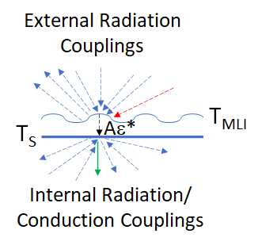
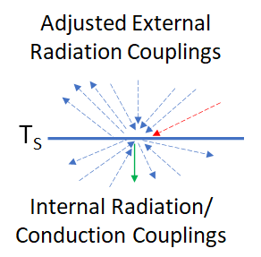
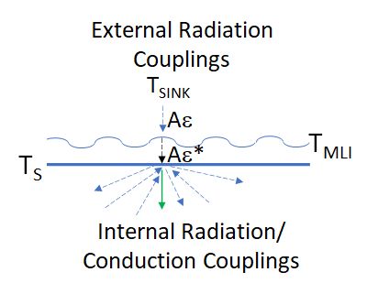
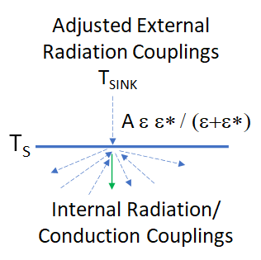
Derivation and Assumptions
Typical MLI modeling includes an outer layer node, an underlying structure node, and an Aε* coupling between them. Internal radiation and conduction to the underlying surface would remain the same.
The hope was that a set of Adjusted couplings exist such that heat that makes it through the blanket can be applied to the underlying surface
The initial concept sought to represent the external loads as an equivalent sink temperature and a single coupling to it based on Aε. Then two radiative conductors in series can be represented as A(ε ε*/(ε+ε*).
Extending this approach to emissivity, allows the ε of the surface to be recast as ε_{ADJ} = (ε ε*/(ε+ε*))
What about α? … It gets recast as α_{ADJ} = (α ε*/(α+ε*))
  Is this legal? Since for IR computations, α_{IR} ≈ ε, if an assumption is made that the sink (or portion of the sink) is in the Solar spectrum, where the α should be used for absorptivity, then this is not unreasonable
Another assumption is that a majority of environmental load is eventually rejected to space, since the purpose of MLI is to inhibit heat flow. As such, having lower α,ε values is consistent with this assumption
However, if the α_{ADJ} and ε_{ADJ} are made smaller, what should be done with τ and ρ?

Slide 5
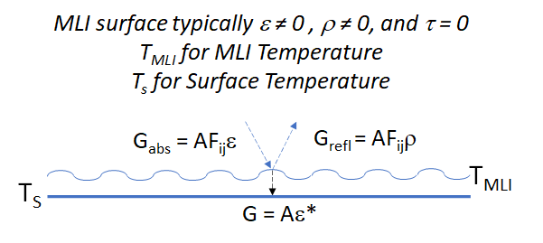
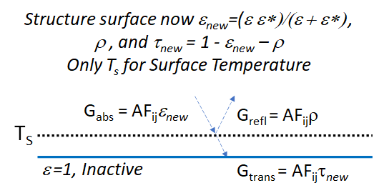
The One-Node Insulation Approach
Since α + ρ + τ = 1, reductions in α (or ε), must have an impact on τ and ρ
Reflectivity (ρ) should remain the same since to be justifiable, the proper proportion of reflected energy should be the same as a baseline case
This then infers that the transmissivity (τ) must be adjusted to preserve unity, where τ_{ADJ,IR} = (1 – ε_{ADJ} – ρ_{IR} ) and τ_{ADJ,SOL} = (1 – α_{ADJ} – ρ_{SOL} )
But MLI surfaces are generally non-transmissive, how to handle this?
  The addition of a fully absorptive blocker surface just behind the underlying surface will “trap” any energy that is transmitted, essentially removing it from consideration in the network.
But isn’t this “junked” energy violating Conservation of Energy?
  Recall that an assumption was that a majority of environmental loading eventually reaches space. So, if a control volume is drawn around a spacecraft, but just inside the MLI and not including the outer layer, much of the environmental heating would never enter this control volume, being reflected or absorbed and re-radiated to space, therefore conservation holds, to first order
  Further consider that the purpose of MLI is to inhibit any heat flow (in either direction), so internally generated heat that gets through a blanket should also be a relatively small contributor to the overall energy balance
Traditional 2-Node Approach
Proposed 1-Node Approach

Slide 6
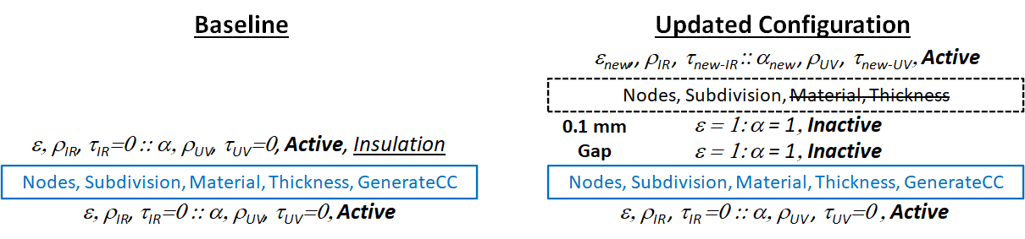
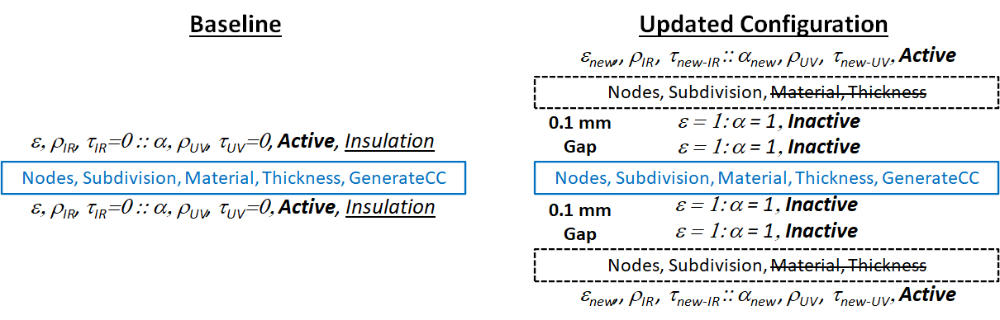
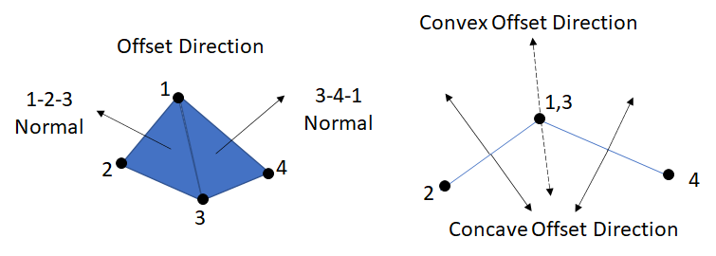
Implementation in Thermal Desktop
To implement this approach in Thermal Desktop, the OpenTD v63 Application Programming Interface (API) was utilized. An argument is passed to the routine of all the surfaces to which the method should be applied
A copy of the surface is created, offset by a fixed distance on the MLI side of the underlying surface
  For revolved surfaces (e.g. cones, cylinders, paraboloids, etc), the radii and/or heights are adjusted by the offset distance
  For MLI applied to both sides, two surfaces are created on each side offset by fixed distance
For the new, offset surface…dashed black box
  MLI assignments are removed; MLI side: surface property assignments are made to adjusted values, activity set to ACTIVE; Anti-MLI side: the surface property is assigned as ε = α = 1, activity set to INACTIVE
  Node subdivision/numbering/thickness remains the same, Conductors/Nodes not generated
For the original, underlying surface (MLI surface side(s))…light blue box
  MLI assignments are removed, MLI side: surface property is assigned as ε = α = 1, activity set to INACTIVE; Anti-MLI side: remains the same (Assuming no original MLI assignment)
  Node subdivision/numbering/thickness remains the same, Conductors/Nodes generated
MLI on One Side
MLI on Both Sides
For quad Finite Elements, where planarity is not strictly enforced, element normal of combined triangles are averaged to determine offset direction

Slide 7
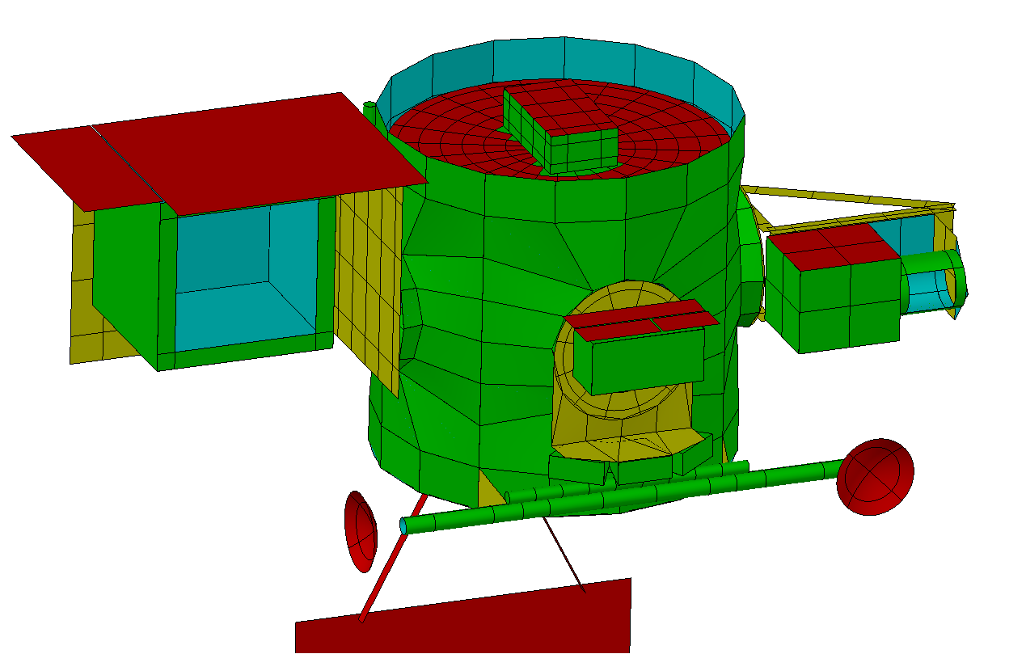
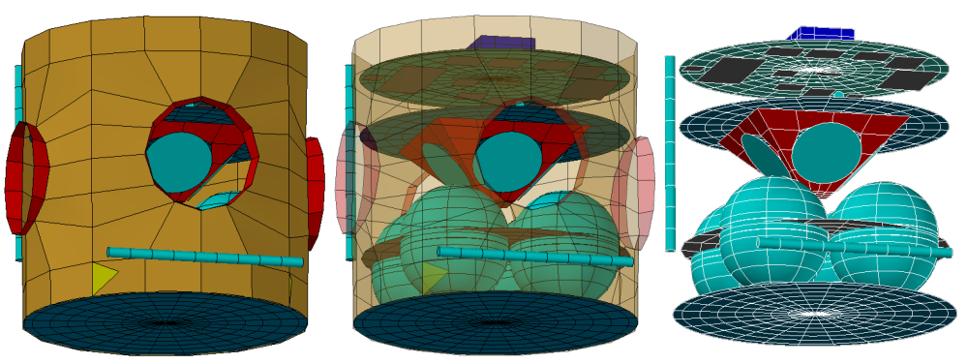
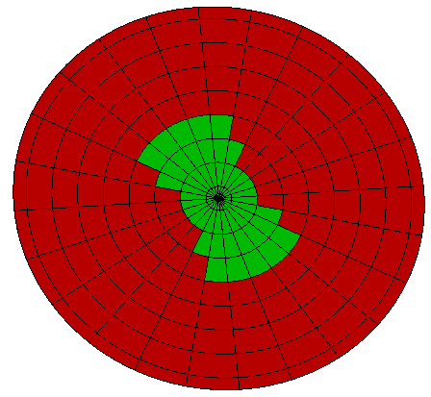
Evaluation Model
Sample model for development and evaluation had many common features to be addressed:
  Quad and Tri Finite Elements
  Revolved Surfaces
  Partial MLI/Optical Property Assignments
  MLI on One and Both Sides
MLI on instruments ignored
Suitable complexity after first manually testing on simple model…
Green: MLI on visible side
Blue: MLI on Non-Visible side
Yellow: MLI on both side
Red: No MLI

Slide 8
Performance Predictions
Avg Temperature | Baseline | One-Node | Avg Heater Power | Baseline | OneNode
 | (°C) | (°C) |  | (W) | (W)
Dissipation on Component A (66 W) | 1.7 | 5.0 | Comp H Surv Heater | 24.2 | 22.5
Dissipation on Component B (13 W) | -2.8 | -0.4 | Comp N2 - Mid | 6.7 | 3.1
Dissipation for Component C-1 (22 W) | 12.7 | 19.0 | Comp N1 - Mid | 7.2 | 3.2
Dissipation for Component C-2 (22 W) | 12.7 | 18.9 | Comp N3 - Mid | 6.9 | 3.2
Dissipation for Component C-3 (22 W) | 12.8 | 19.0 | Comp N4 - Mid | 6.6 | 3.2
Dissipation for Component C-4 (22 W) | 12.8 | 19.0 | Deck 1 Surv Heater B | 32.1 | 20.1
Dissipation of Comp_D (2 W / 3 Loc) | -0.3 | 3.8 | Deck 1 Surv Heater A | 28.4 | 17.8
Dissipation on Component E (1 W) | -3.4 | -0.5 | Total | 112.2 | 73.1
Dissipation on Component F (8 W) | -1.0 | 1.9
Dissipation on Component G (12 W) | -1.8 | 1.4
Dissipation for Component H (46 W) | 19.1 | 19.1
Dissipation on Component I (34 W) | -2.4 | -0.8
Dissipation on Component J (9 W) | -1.0 | 1.6
Dissipation on Component K (Varies) | 1.8 | 2.6
Dissipation on Component L (Varies) | 1.2 | 3.3
Dissipation on Component M (2 W) | -2.5 | -0.4
An initial look at the temperature predicts shows fairly good agreement (with the exception of Component C), however, this may well be governed by the heater power, which in general under predicts the baseline approach

Slide 9
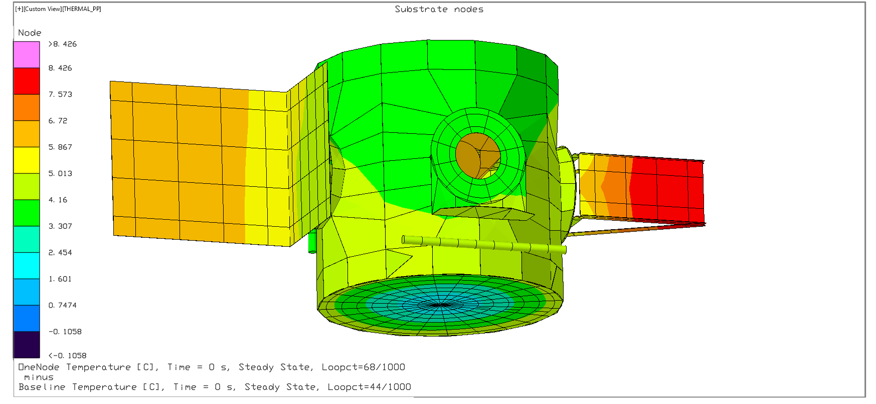
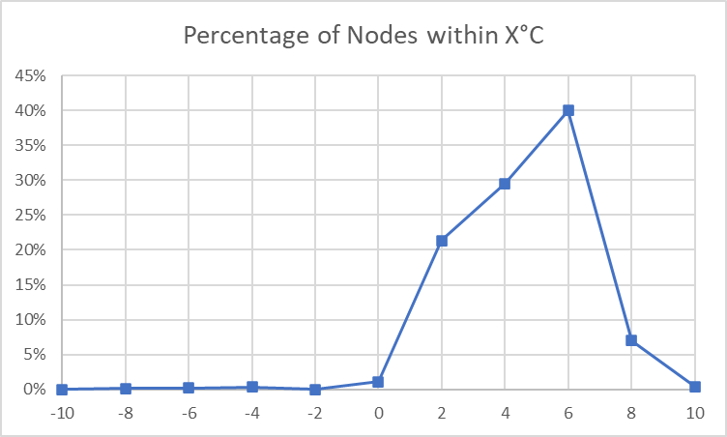
Performance Predictions
Investigating a contour plot of the differences shows many external structure nodes within a reasonable difference, but a large different on one of the instrument support brackets
Examining a histogram, shows a definite trend of warmer predictions using the One-Node approach over the traditional two node approach

Slide 10
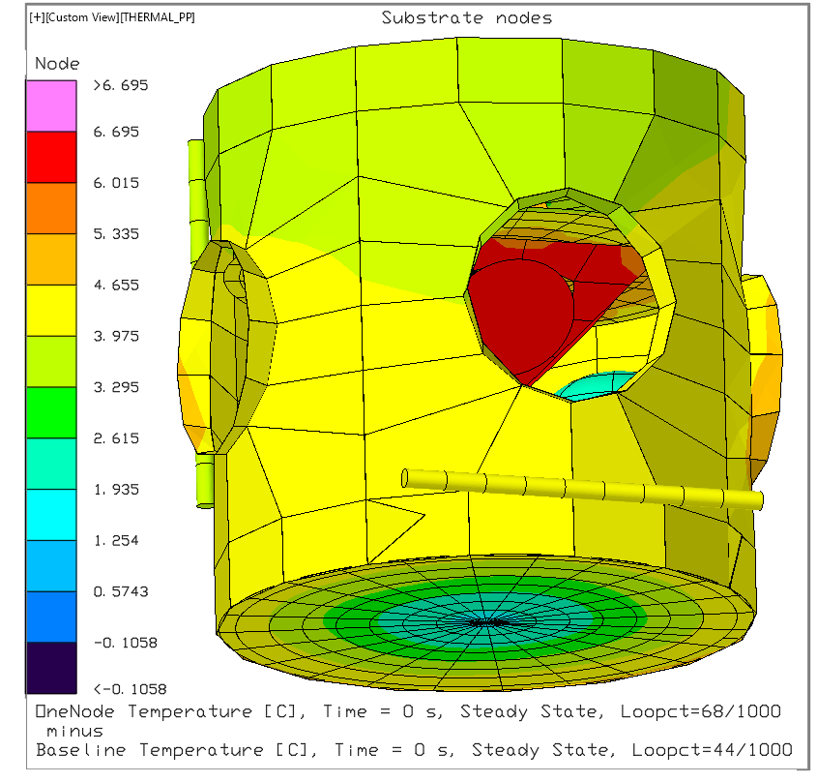
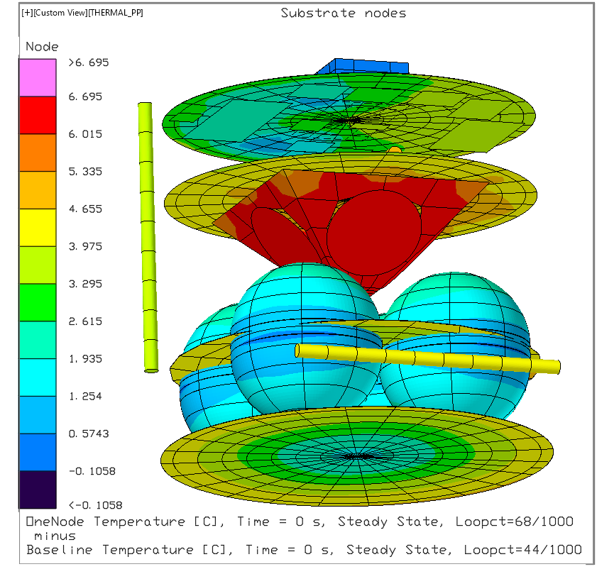
Performance Predictions
Overall, the temperature agreement is not too bad, but the pyramid in the center supporting Component C shows the worst agreement
Heater controlled areas show good temperature agreement, but as discussed before, not so good heater power agreement

Slide 11
Evaluation of Performance (Heat Flows)
 | Baseline | One-Node |  | Baseline | One-Node
Structure |  |  | Deck 3
Environment | 47.1 | 137.8 | Environment | 2.1 | 0.4
Dissipation | 0 | 0 | Dissipation | 30 | 18.8
To Space | 122 | 207 | To Structure | 28.3 | 18.2
To Insulation | 0.1 | 0 | To Space | 2.5 | 0.7
To Deck 1 | -10.1 | 4.2 | To Insulation | 1.3 | 0
To Deck 2 | -57.7 | -64.6 | To Deck 2 | -9.3 | -2.7
To Deck 3 | -28.3 | -18.2 | To Deck Closeout | 6.4 | 3
To Deck Closeout | 12.5 | 15.8
Deck1 |  |  | Deck Closeout
Environment | 59.2 | 58.7 | Environment | 0.4 | 0.4
Dissipation | 252.8 | 236 | Dissipation | 0 | 0
To Structure | 10.1 | -4.2 | To Structure | -12.5 | -15.8
To Space | 307 | 317.8 | To Space | 1.5 | 27
To Deck2 | -11.6 | -17.7 | To Insulation | 18.9 | 0
Deck2
Environment | 4 | 4
Dissipation | 88 | 88
To Structure | 57.6 | 64.6
To Space | 6.8 | 7
To Deck 1 | 11.6 | 17.7
To Deck 3 | 9.3 | 2.7
Heat flows were investigated and compared between the major decks in the design
While the Environment and Heat Flow to Space for the Structure appears quite different, the net is very similar (122 - 47.1 = 74.9 vs. 207-137.8 = 69.2)
Dissipation differences on Decks 1 and 3 are largely driven by heater power differences.
Deck 2 showed considerable differences in heat flow radiatively to Deck 1 and 3. It should be noted that Component C is located on Deck 2, where some of the larger temperature differences were seen
Deck Closeout appears different, but heat to insulation is eventually rejected to space, so comparing (1.5 + 18.9 = 20.4 is closer to the 27 in the One Node approach than appears)
In Short: no conclusive cause was found for the discrepancies

Slide 12
Code Development Lessons Learned
During code development, three obstacles were encountered and their resolution is shared here for the benefit of other potential developers
When copying an object, the API includes a CopyProperties method under the Utility namespace. However, caution is advised when utilizing this as it copies all properties, including the Handle, which is the unique identifier used by AutoCAD to keep track of each object. The advisable way to make a copy is:
  Create a new object of the type to be copied and store its handle
  Use the CopyProperties method to make a copy of the base object
  Assign the handle from Step 1 to the new instance
  Call the Update method of the new instance
  Gall the GetObjType (where ObjType may be Rectangle, Disk, Etc) with the new handle as an argument and assign to the code object for further manipulation
There is not a method to determine if a Symbol, Optical or ThermoPhysical property already exists. This check is needed when adding new properties to prevent an error from being throw.
  Using a Try…Catch solved this problem by adding code in the Try portion that accessed the Symbol/Property. If it already exists, no error is generated. However, if it did not exist, than the Catch portion could create and further manipulate it
MLI and Property Overrides also need to be carefully considered
  Insulation overrides that also include a property over ride may be handled in one of two ways: 1) the property over rides apply to the insulation nodes, or 2) the property overrides apply to everything but the insulation nodes
  Since both ways are legal, a developer must determine which scheme is being used to handle it properly

Slide 13
Conclusions and Path Forward
The One-Node MLI approach did not perform as well as hoped
  However it also did not perform so poorly as to be outright rejected.
  In the author’s judgement, “The jury is still out”
Further investigation should be undertaken on localized areas to further determine weak points in the approach, as no obvious issue was found that explains the discrepancies
This work is presented as a possible starting point, if any others in the community wish to explore this approach further
The RST project may explore this further, if schedule and resources permit, including:
  Only external blankets
  Only internal blankets
  Compare temperature differences with identical heater powers
  Additional environmental cases
The possibility to reduce node count by eliminating MLI nodes is of great benefit to Thermal Engineers, allowing them to more wisely “spend” their nodal allocations on critical areas
It is hoped that further study will either enable this technique or eliminate it from consideration
The Authors would like to acknowledge the Roman Space Telescope project, whose support allowed for the exploration of these capabilities

