Slide 1

...And the beats keep runnin runnin (in space)
Brian “Stitch” Hanshaw, Maj, USAF, MC, FS
Michael LaBarbera, MD, PhD
AsMA Grand Rounds 2023
This Photo by Unknown author is licensed under CC BY.
Notes:
Title: Medical Evaluation and Clearance of NASA Astronauts with Atrial Fibrillation
Special Thanks to Dr. James Pavela and NASA’s LSAH program

Slide 2
Disclosure Information
93rd Annual Scientific Meeting
Brian “Stitch” Hanshaw, Maj, USAF, MC, FS
Michael LaBarbera, MD, PhD
I have no financial relationships to disclose.
I will not discuss off-label use and/or investigational use in my presentation

Slide 3
Outline
Learning Objectives
Aeromedical and Spaceflight Considerations
NASA Historical Cases
NASA Waiver Review
DoD Services Waiver Guide
Questions
Notes:
Discuss aeromedical significance of atrial fibrillation
Describe medical clearance of NASA astronauts after diagnosis of atrial fibrillation seeking to fly to ISS
Compare approach to medical waiver among NASA, FAA, USAF, Navy

Slide 4
Learning objectives
The audience will gain an appreciation for the potential crew health and mission considerations for considering medical waiver in cases of atrial fibrillation.
The audience will gain an appreciation for the impact of spaceflight, crew performance, and health risks in treatment of atrial fibrillation.

Slide 5
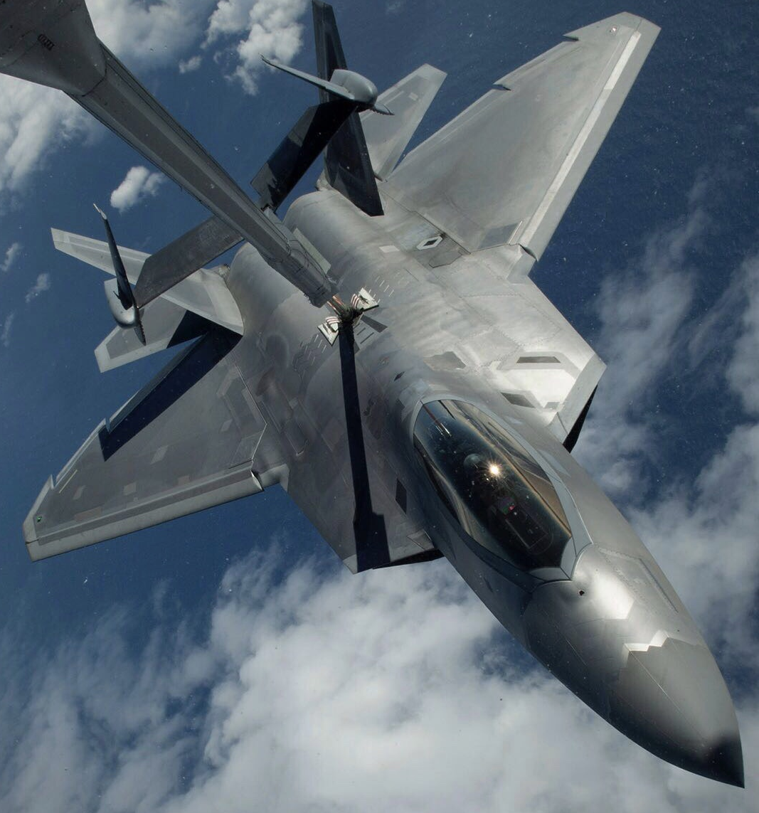
Aeromedical concerns
Most common arrhythmia in aircrew
Lifetime incidence is 10%, increasing with age
Distracting symptoms, hemodynamic instability, and possible stroke
  Reduces cardiac output → degrade G tolerance
Etiologies: stress, caffeine, alcohol, electrolytes, thyroid, valvular disease, infection, cardiomyopathy
*Risk to life, crew, and mission
Notes:
Most common type of arrhythmia in aircrew (0.4-1% of general population with lifetime incidence of 10%)
Affects all ages and genders
Impaired atrial contraction in AF decreases cardiac output by up to 25%!!! Adding in nodal blockers will further decrease CO!!!
Paroxysmal (terminates <7 days); Persistent (>7 days), Long-standing (>12 months)
Stroke risk is 17x in valvular A-fib, 5x in non-valvular A-fib
Watchman device / LAAO also an anti-embolic strategy
Permanent when patient/clinician make joint decision to stop attempts to restore /maintain NSR
Though Lone AF < 60 has gen pop risk

Slide 6

spaceflight concerns
Unknown spaceflight impact on cardioembolic event
Reduced G tolerance
Limited available resources
  Diagnostic capability
  Rate or rhythm control
  Cardioversion capability considerations
  LEO vs exploration class missions
Environmental effects
  Fluid shifts and atrial stretch
  Sympathetic activation
  High sodium diet
*Risk to life, crew, and mission
Notes:
Underlying cardiac disease?
Microgravity-related fluid shifts and atrial stretch
- microG: cardiac output, stroke volume, LV volume, Renin-Angiotensin pathway ALL ARE HALFWAY BETWEEN EARTH supine and upright
- exercise in space transiently enlarges LA slightly, theoretical risk for AF moments
Space flight-induced sympathetic activation
- mild in space, less than standing on earth, but 50% ECGs on orbit in a study had sinus arrhythmia (unpublished as of 2010)
Role of a high sodium diet
- high salt ~ bone loss/papilledema; no known connection with AF independent of HTN, but recommend limited sodium diet (<5g/day)
Chronic radiation exposure
- hypothetical contribution over time

Slide 7
NASA WAIVER HISTORY FOR AFIB / FLUTTER
2 symptomatic
No hemodynamic instability
Cardiology consult, ECHO, Holter, stress test, comorbidity assessment
PAROXYSMAL
PERSISTANT
No valvular Afib, thyroid d/z, OSA
3 with mild LA enlargement
2 positive stress tests in 15 months
RFA
DCCV
SCV
SHORT-DURATION
LONG
1 recurrence
Spaceflight 7m-16y post-diagnosis
ASA/MAINTENANCE MEDS
Notes:
6 waivered to ISS
Sxs: “neck throbbing”, “palpitations”, “pulse awareness”

Slide 8
Nasa waiver review
Waiver potential:
Lone Afib, isolated episode <10 min
No secondary cause or hemodynamic instability
Single episode may be considered (after selection)
DCCV or prior temporary med use considered
Ablation may be considered for waiver (including astronaut selection, long-term missions)
12 months post-ablation and off meds
Disqualifying for spaceflight → special consideration by the Multilateral Space Medicine Board (MSMB)
Prior to waiver consideration:
Cardiology consultation
Thyroid testing, ECG, ECHO, ETT, 24hr Holter x3
Observe 6 months after episode
Not eligible for waiver:
Hemodynamic instability
Recurrent sustained episodes
Require maintenance medications
Spaceflight participants on antiarrhythmics:
Possible if ETT and serial Holters reassuring
Consider centrifuge for questionable cases
Notes:
Single episode considered – if no hemodynamic compromise, unremarkable post event cardiac evaluation

Slide 9

Aeromedical Waiver considerations
FAA
Initial application for AME Assisted Special Issuance (AASI): Must defer
AASI renewal considerations
  Cardiologist evaluation
    24-hr cardiac monitor (<90d)
  Emboli mitigation for CHA₂DS₂-VASc > 2
    Appropriate observation periods for Rx therapy
  Rate and rhythm well controlled
  No evidence of CVA, TIA, or other thromboembolic event
Notes:
AME Assisted Special Issuance (AASI)
All the same basics…
Observation period, Cardiologist evaluation, assess correctable etiology (stop the cause like alcohol/caffeine, use med to convert, underlying cause like hyperthyroid, and possible need for ablation or repeated ablation), assess need for rate/rhythm control, stroke risk and potential need for anticoagulant
Ablation has relapse rate
85% success rate in young with paroxysmal afib, but as low as 40% in persistent afib…may require repeat ablations with higher success rates.
FAA:
AASI renewal requires “FAA Afib/A-Flutter Recertification Status Report”
Emboli Mitigation tool
Re-issue considerations:
Minimum 24-hour cardiac monitor within past 90 days
Completed FAA Afib/A-flutter Recertification Status Report OR* Cardiologist evaluation that addresses all on status report
*No evidence or suspicion of stroke/TIA/thromboembolic event
HR well controlled
If CHA2DS2 risk >2 must verify emboli mitigation is in place without side effects
Observation Periods
DOAC: 2 weeks
Warfarin: 6 weeks, 1 INR per week 80% in-range
Ablation: 3 months then Holter

Slide 10
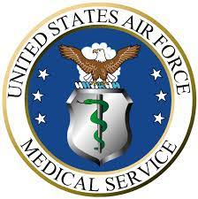


USAF
NAVY
ARMY
Candidates: waiver (maybe)
Single episode, clear precipitant cause, waiver possible after 3 months
Cardiologist evaluation
  CHA₂DS₂-VASc score
  ECG, echo, stress test
  Holter monitor tracings final month of observation
  All reports and images
Labs: CBC, CMP, and TSH
Ablation therapy – more requirements
Candidates: waiver (maybe)
Single episode, clear precipitant cause, waiver possible after 6 months
Cardiologist evaluation
  CHA₂DS₂-VASc
  ECG, echo, stress test
  Ambulatory ECG (final month preferred)
  All reports and images
Labs: as required
Ablation therapy – more requirements
Candidates: waiver (maybe)
Single episode, clear precipitant cause, waiver possible after 6 months
Cardiology evaluation
  CHA₂DS₂-VASc
  ECG, echo, stress test
  Three 24-hr Holter monitors at 2-mo intervals
  All reports and images
Labs: TSH
6-month observation off medications
Notes:
***Catheter ablation is DQ for all flying classes and addressed in separate waiver guide “Catheter ablation of Tachyarrhythmias”
***If associated with another condition, such as Hyperthyroidism, then waiver may be considered after treatment of hyperthyroidism
***Consider retention standards, no meds are waivered***
BB and CCB limits aircrew to non-high-performance…unable to fly on anticoagulation
Ablation – different waiver guide, range of success rates, but repeat ablations do carry higher success rates
Waiver limited to no single seat, high performance aircraft (unless single episode, <24hrs, clear precipitant, or >6months after ablation maintaining NSR off all meds and s/p ACS eval with centrifuge testing)
All the same basics…
***Observation period, Cardiologist evaluation, assess correctable etiology (stop the cause like alcohol/caffeine, use med to convert, underlying cause like hyperthyroid, and possible need for ablation or repeated ablation), assess need for rate/rhythm control, stroke risk and potential need for anticoagulant.***
- 85% success rate in young with paroxysmal afib, but as low as 40% in persistent afib…may require repeat ablations with higher success rates.
- Holter/ambulatory ECG – while no longer on medications***
USAF
****Return to flight if not hemodynamically significant, rate controlled and low stroke risk with negative cardiac evaluation****
Single episode afib clearly associated with reversible cause (meets retention standards) – still needs aeromed waiver***
Catheter ablation is also disqualifying and addressed in separate waiver
ECG during AFIB…if cardioversion, then repeat after showing sinus
After single episode – wait 3 months after conversion to sinus rhythm, requires off antiarrhythmic meds for 2 months. Minimum 6 months observation for paroxysmal and chronic afib.
ARMY
Three 24-hr holter at 2 month intervals
Pilot applicants – ETP possible for single episode in full remission. Not classified as severe, recurrent, or chronic.
NAVY
10 day ambulatory (event monitor) while off meds. Last month of observation.
No labs specified in waiver guide. Just what is needed to rule out precipitating causes.

Slide 11
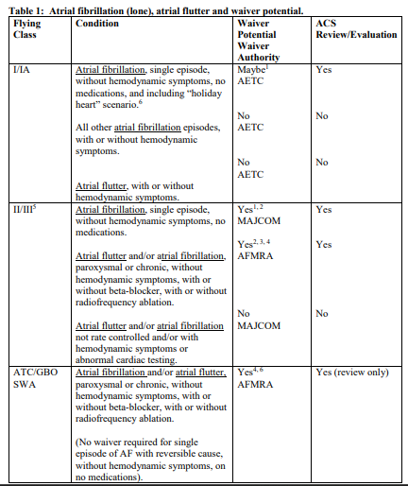

Slide 12
Future considerations
Newer screening/diagnostic modalities for cardiac risk stratification
Wearable devices
AI technology

Slide 13

Questions?

Slide 14
references
Barr, Y. Atrial Arrhythmia Summit: Summary Report. NASA/TP-2010.
USAF Waiver Guide (17 Mar 2023)
U.S. Navy Aeromedical Reference and Waiver Guide (07 Feb 2023)
Army Flight Surgeon Checklist. Aeromedical Policy Letters and Technical Bulletins (Dec 2021)
Notes:
FAA AME Guide
USAF Waiver Guide
NASA Waiver Guide
Reference for Afib background slide?

