Slide 1

Learning about Routine
Successful Pilot Techniques using a
Cued Retrospective Think-Aloud Task
Jon Holbrook¹, Chad Stephens¹, Lawrence Prinzel III¹, Sepehr Bastami¹, & Daniel Kiggins²
31 May – 3 June, 2023
Rochester, NY
¹NASA | ²San Jose State University Research Foundation

Slide 2
Background
Analysis of flight crew operational performance suggests that pilots intervene to keep flights safe over 157,000 times for every time that pilot error contributes to an accident (Holbrook, 2021)
Understanding what pilots routinely do to produce safety represents a significant additional source of aviation safety data
Self-report can provide data about goals & motivations that are not readily observable
Details of routinely successful performance may go unreported, be deemed unimportant, or may not be recalled at time of reporting
Think-aloud protocols have been used extensively in fields from cognitive psychology to usability testing (see Boren & Ramey, 2000, for a review)
The current study used a cued retrospective think-aloud protocol to collect data on pilots’ accounts of what they were thinking while flying a simulated arrival

Slide 3
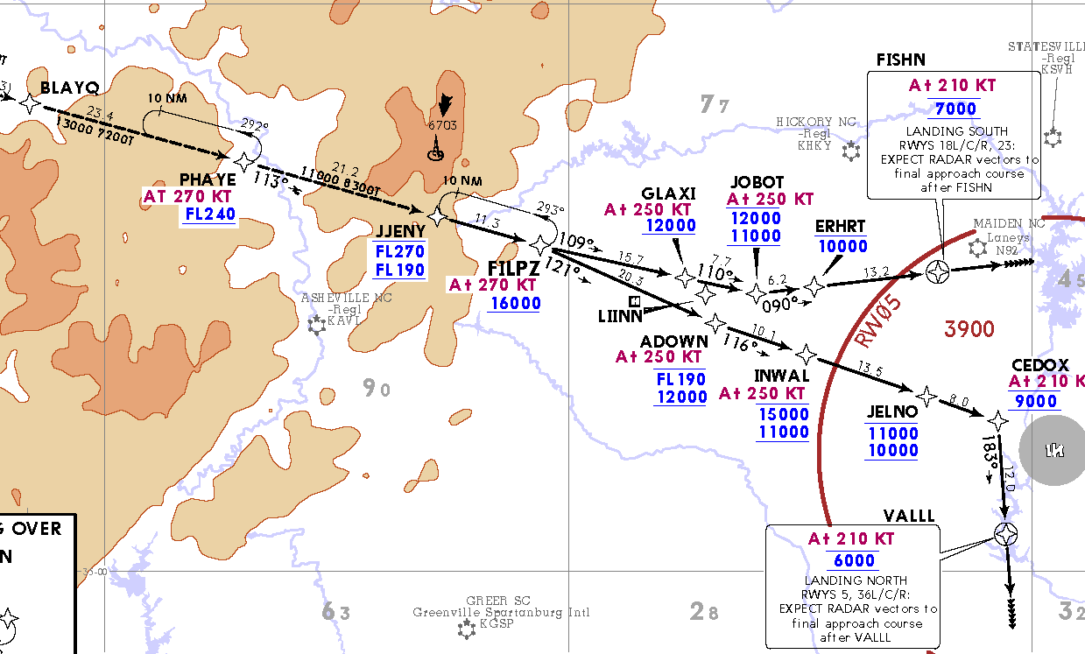
FILPZ3 KCLT Arrival Scenario
START
Flight Attendant reports passenger barricaded in lavatory
Hear other aircraft deviating L/R of course for weather
Dynamically evolving weather
ATC reports microburst activity at KCLT
Start: BLAYQ, a few min prior to top of descent
Initial Alt: FL330
Initial Speed: 270kts
Expecting RWY 18R
NOTAM: Convective activity along route of flight
FO is PF / CA is PM

Slide 4
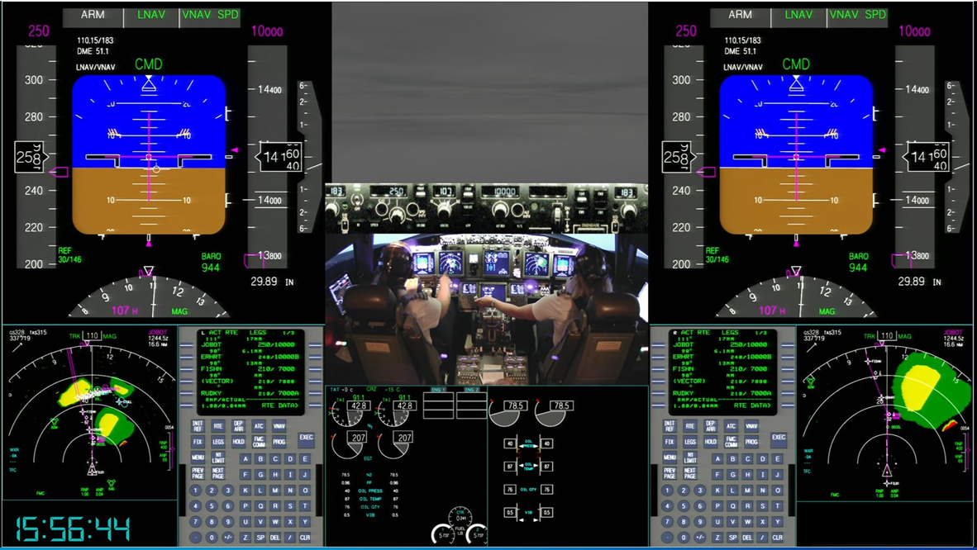
Over-the-Shoulder Video

Slide 5
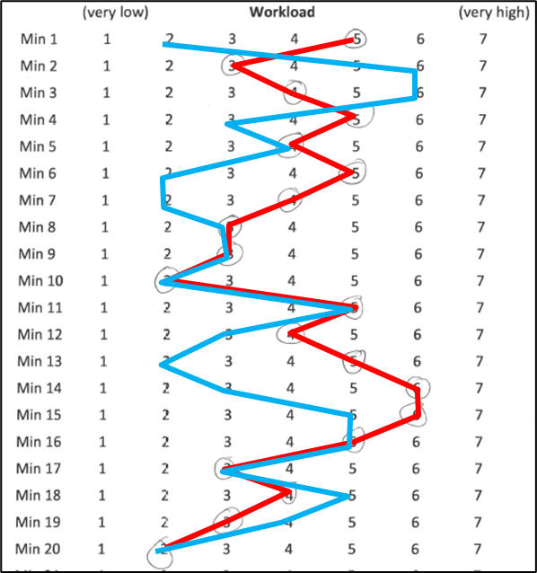
Cue Retrospective Think-Aloud Procedure
CA/PM (red) | FO/PF (blue)
One day after sim flight, video played on a 55-inch high-definition television
Crew seated together 6-8 ft from display
Video paused after each minute
Crew asked to describe what they were doing and, more importantly, thinking, during that 1-min interval
FO always spoke first
Crew assigned a personal workload rating for that interval

Slide 6
Coding Process
Transcript parsed into distinct statements by topic
  “Intelligent verbatim” transcription
  Speaker (FO / CA)
  Minute (numbered sequentially)
Coding included
  Semantic pairing between FO and CA statements
  Was described thinking observable?
  Was described thinking covered in formal training?
  Most applicable American Airlines Learning & Improvement Team code
  Most applicable macrocognitive function and process
Independently coded by two authors & discussed to consensus
  As necessary, consulted with a commercial airline pilot SME

Slide 7
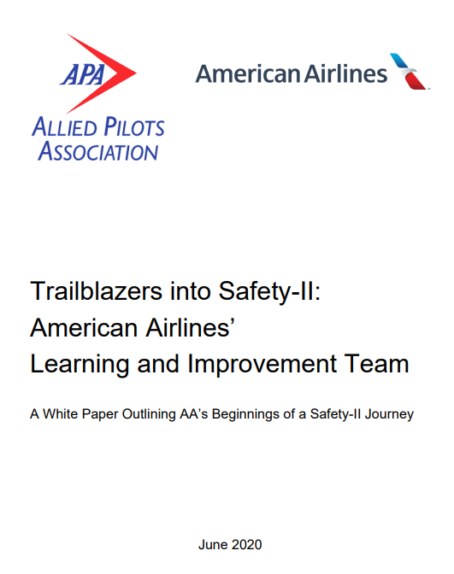
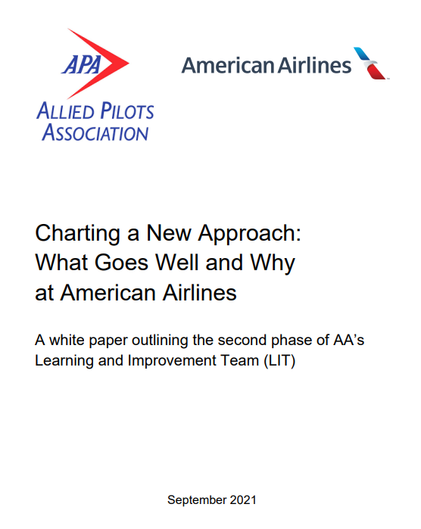
Learning & Improvement Team (LIT) Coding
LEARN (4 codes)
  What will I do next time?
  Share past experiences
PLAN (7 codes)
  Think ahead
  Enhance future situational awareness
  Threat-forward
ADAPT (9 codes)
  Act given the current conditions
COORDINATE (7 codes)
  Get the team on the same page
  Stay engaged
https://www.skybrary.aero/articles/trailblazers-safety-ii-american-airlines-learning-and-improvement-team

Slide 8
Macrocognitive Functions and Processes
Maintaining Common Ground
Functions (center) describe the goal the person is trying to achieve
Processes (outside) describe means for achieving the functions
Mental Simulation
Developing Mental Models
Sensemaking
Planning
Decision Making
Problem Detection
Adaptation
Coordination
Managing Attention
Managing Uncertainty
Leveraging Opportunities
Adapted from Klein et al., 2003

Slide 9
Coding Results (illustration from single crew)
100 statements coded
55% by FO | 45% by CA
50% of statements were “paired” (same topic discussed by FO and CA)
33% coded as “not readily observable”
20% described positive actions not directly covered in formal training
LIT Potentials
 | Learn | Plan | Adapt | Coord.
Planning | 1 | 17 | 0 | 0
Adaptation | 0 | 0 | 16 | 0
Coordination | 1 | 0 | 0 | 27
Decision Making | 5 | 0 | 4 | 1
Sensemaking | 2 | 10 | 0 | 3
Problem Detection | 3 | 8 | 2 | 0
Macrocognitive
Functions

Slide 10
Insights
Pilots used informal body language cues and gestures to communicate
Pilots generalized application of formally learned techniques to other situations
Pilots described instances in which they were trying to ascertain the “right time” or a “good time” to perform a task
Pilots used tactile cues to maintain situational awareness
Pilots adapted how they communicated to support shared situational awareness
Pilots gauged the competency of their copilots, and this determination impacted their decision making
CAs thought about their role as “mentor” to the FO
Paired statements by the FO and the CA do not always reflect paired thinking
Automating a procedure does not necessarily reduce crew workload

Slide 11
Key Take-Aways
Understanding the routine resilient performance of flight crews has the potential to massively expand the pool of available safety-relevant data
Cued retrospective think-aloud represents a useful method for revealing insights into how pilots contribute to safety
This method enables collection of data that are otherwise difficult or impossible to obtain
A more complete understanding of what pilots do and think about could inform the design of automated tools intended to support or supplement pilot performance

Slide 12
Thank you!
Contact email:
jon.holbrook@nasa.gov

