Slide 1


Pilots’ Perspectives on Urban Air Mobility Safety Challenges and Potential Solutions
Rania W. Ghatas, Saeideh E. Samani,
Victoria L. Dulchinos, and Dr. Richard H. Mogford
22nd International Symposium on Aviation Psychology (ISAP)
Rochester, New York
May 31 – June 3, 2023

Slide 2
Overview
Key Takeaways
Background
Literature Review Highlights
Method
In-flight Incapacitated Pilot Scenario
Results and Discussion
Questions and Answers

Slide 3
Key Takeaways
There are limited current-day pilot incapacitation procedures that exist
A pilot emergency in single-pilot operations is an aircraft emergency
Considerations are needed for electric vertical takeoff and landing (eVTOL) vehicle design and performance characteristics
Altitude and urban environment pose challenges
Potential solutions pose their own unique challenges and potential security concerns

Slide 4
Background
Why does this research matter?
Pilot Study Research Objective
Urban Air Mobility Overview

Slide 5
Why does this research matter?
On-demand air mobility is now driving the future of flight the airspace to enable on-demand urban air travel as a safe and cost-effective alternative to other transportation
There is a need to identify and understand gaps, challenges, and human factors issues in order to support the influx of these new air vehicles over highly dense, urban communities
In-flight pilot incapacitation is seldomly researched, and it is crucial with the anticipated increase in single pilot operations
Maintaining safety is a priority for those in the air and on the ground

Slide 6
Pilot Study Research Objective
Research Objective for UAM PIE CAMP
  To gather information about respondents’ general experience within the aviation community in order to:
      Provide a first look at information exchange requirements between the on-board UAM Pilot-in-Command (PIC) and other key players, including Air Traffic Control, the dispatcher/flight follower, the Provider of Services for UAM (PSU), and vertiport manager
      Leverage current-day airspace and operational procedures while identifying needed improvements and gaps to address the future needs of UAM vehicles operating in the National Airspace System (NAS)
      Inform pilot roles and responsibilities
      Inform future research efforts and NASA’s UAM Concept of Operations
UAM PIE CAMP: Urban Air Mobility Pilot/Providers of Services for UAM Information Exchange and Contingency Airspace Management Procedures

Slide 7
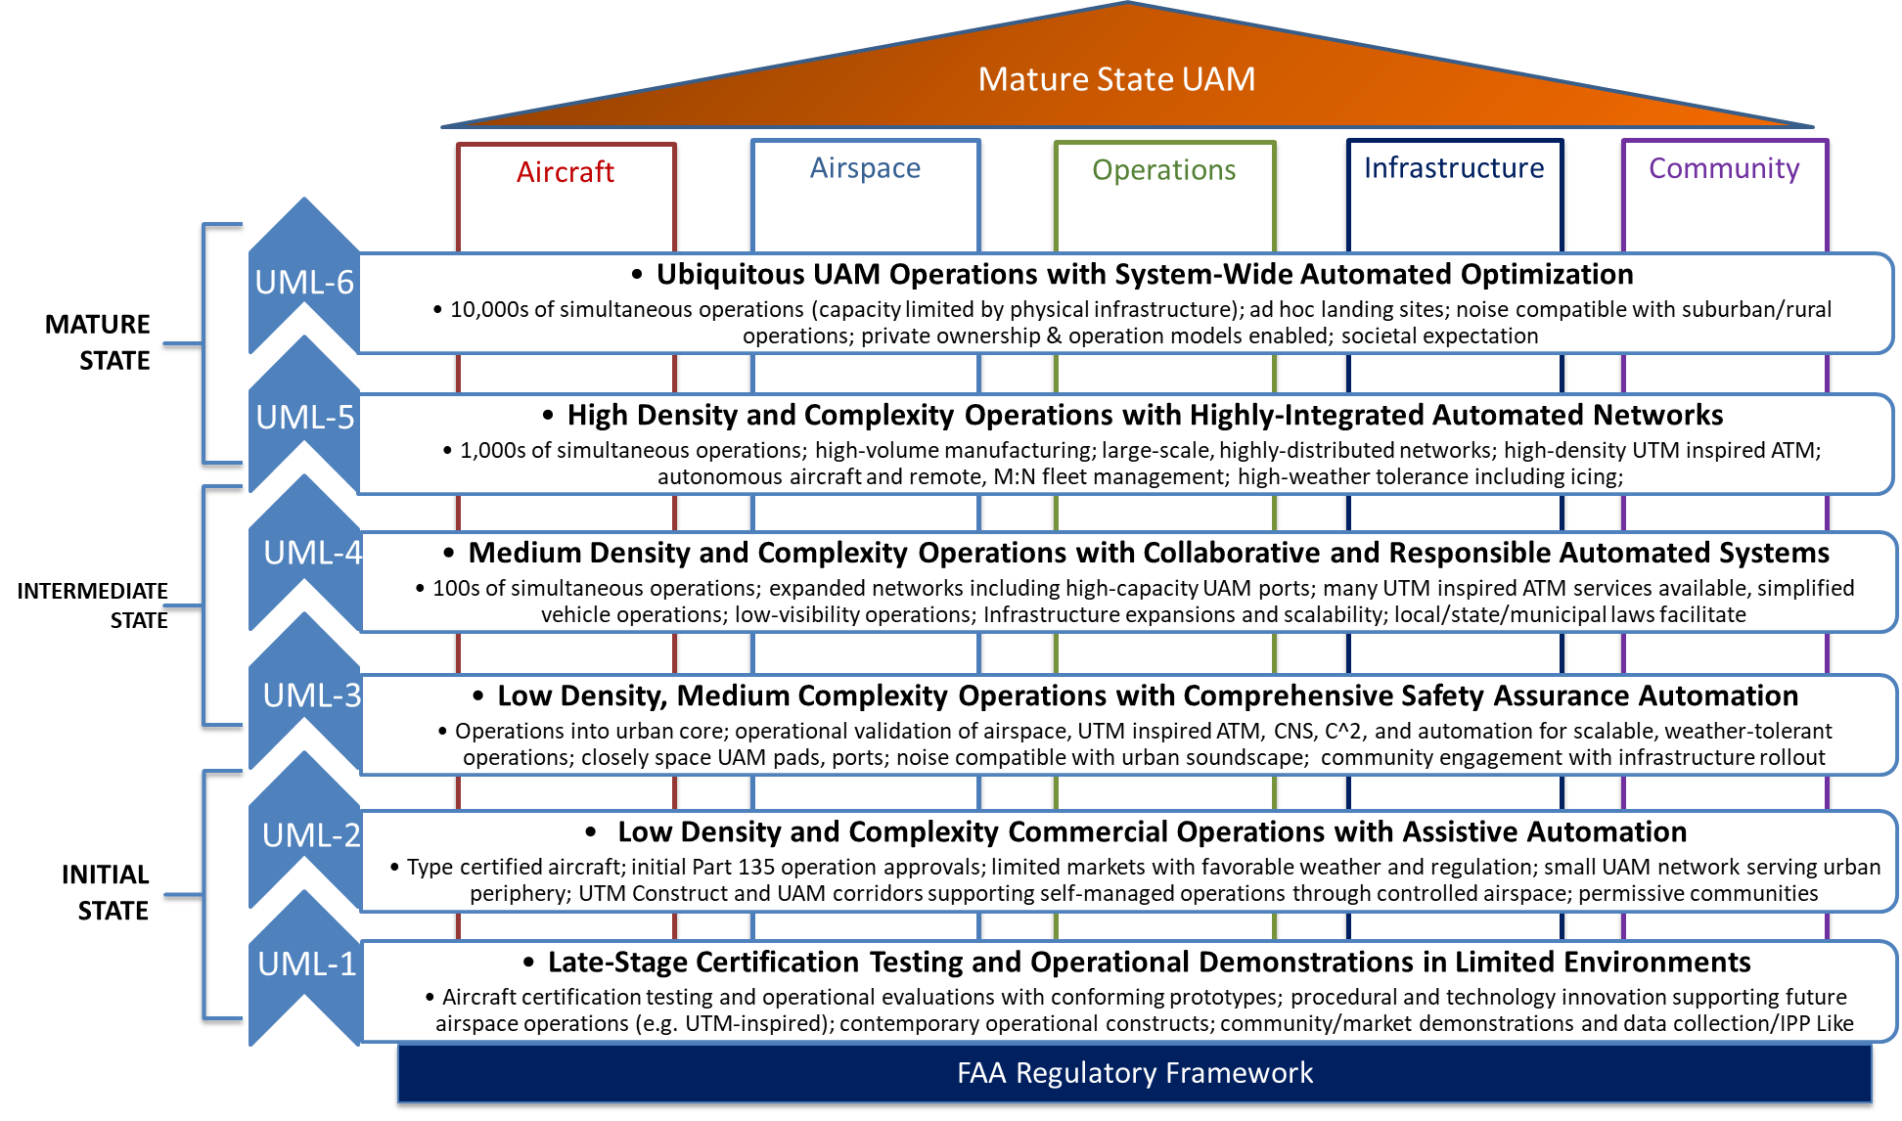
UAM Maturity Levels
Source: FAA NextGen UAM ConOps v1.0

Slide 8
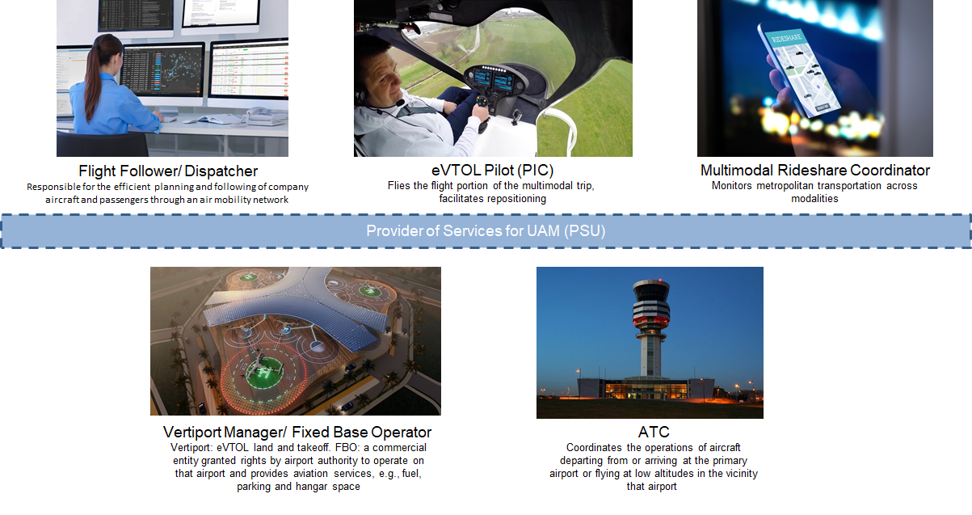
Key Players in UAM Ecosystem
Provider of Services for UAM (PSU)
Provider of Services
for UAM
Information exchange
Flight operations planning
Demand-capacity balancing
Air Traffic Control (ATC)

Slide 9
Operational Concept Overview
A conceptual community-based environment in which UAM operators (companies) are responsible for coordination, execution, and management of operations
A set of PSUs that form a PSU Network is expected to support UAM operations (FAA NextGen UAM ConOps v1.0)
  The PSU is envisioned to be a digital framework used for exchanging aircraft (and other) information and could relieve ATC of voice, radio-based, communications and other UAM traffic management tasks
Other operational concepts include the potential for segregated airspace, such as having corridors specific for UAM operations
  Aircraft entering these corridors would need to meet the performance characteristics and participation requirements of the UAM environment
  Part 121 aircraft would not enter these designated corridors; these aircraft are generally large, U.S. based-airlines, regional air carriers, and cargo operators

Slide 10
Literature Review Highlights

Slide 11
Highlights from Literature Review
Pilot incapacitation is the term used to describe the inability of a pilot “to carry out their normal duties because of the onset, during flight, of the effects of physiological factors” (Flight Safety Foundation, n.d.).
Several causes that could lead to an incapacitated pilot, including but not limited to:
  Cardiovascular problems
  Gastro-intestinal problems
  Hypoxia
  Heat fatigue
  Bird strike
  Smoke or fumes that enter cabin due to vehicle malfunction
  Malicious or hostile act
    In-flight assault
    High-powered lasers by person(s) on the ground

Slide 12
Highlights from Literature Review, cont.
There has been some research done highlighting the complex safety challenges faced by pilots in the aviation industry, including the need for improved safety culture, strategies for mitigating human factors-related challenges, and effective management of cockpit automation
Smith and Jones (2019) presented findings from a survey of pilots regarding their perspectives on safety culture in the aviation industry. The study found that pilots perceived safety culture as a key factor in improving safety outcomes and identified several areas where safety culture could be improved, including communication, management support, and training.
Brown et al. (2018) discussed the human factors challenges faced by pilots in the commercial aviation industry. The authors identify several factors that can impact pilot performance, including fatigue, stress, and cognitive workload. The paper also discusses the importance of crew resource management and other strategies for mitigating human factors-related safety challenges.
Lee and Kim (2020) explored the challenges associated with managing cockpit automation from a pilot's perspective. The study found that pilots often struggle with the workload associated with managing multiple automated systems and can experience a sense of reduced situational awareness. The authors suggest that improved automation design and better training can help mitigate these challenges.

Slide 13
Method
Phase I Participants
Cognitive Task Analysis Interview Questionnaire and Use Case Scenario Activity
Airspace Structure
Corridor Design Vision

Slide 14
Method: Phase I Participants
Phase I Participants (12 Total):
    9 helicopter pilots
      3 – Helicopter air tour rides
      3 – Medical evacuation (MedEvac) or air ambulance operations
      3 – Private business air charter services
    3 General Aviation fixed-wing pilots
Minimum requirements for participation (acknowledged upfront)
    Be a U.S. citizen currently flying helicopter and/or fixed-wing aircraft or providing airline dispatching
    Experience flying for Part 135 operators (for helicopter pilots)
    Minimum of two years’ work of experience
    Have access to a computer with reliable internet and video/camera capability
    Be willing to be audio recorded
Each pilot participated for an average of 16-18 hours over the course of two consecutive days
Participants were recruited via the Langley Recruitment Registration Portal and a recruitment solicitation was advertised in Helicopter Association International’s weekly Rotor newsletter, reaching approximately 37,000 helicopter pilots

Slide 15
Method:
CTA Questionnaire and Use Case Scenario Activity
A semi-structured cognitive task analysis (CTA) interview questionnaire consisted of questions designed to elicit the knowledge and experience of experts in the aviation field, including helicopter and fixed-wing pilots and airline dispatchers
Scenario narratives were composed of 11 use cases (~20 questions each)
Nine of the eleven use case scenario narratives included alternate scenarios (AS) (~15 questions each)
  Added layers of hazards
  Presented on Day 2 of participation
Use Case Scenarios (in order of presentation):
Nominal
Go-Around Procedure (AS)
Diversion to Alternate Landing (AS)
Vehicle Malfunction (AS)
In-flight Passenger Medical Emergency (AS)
In-flight Incapacitated PIC (AS)
Rogue Pilot in Airspace
Rogue PSU (AS)
Bird Strike (AS)
Pre-Flight Convective Weather (AS)
En-route Convective Weather (AS)

Slide 16
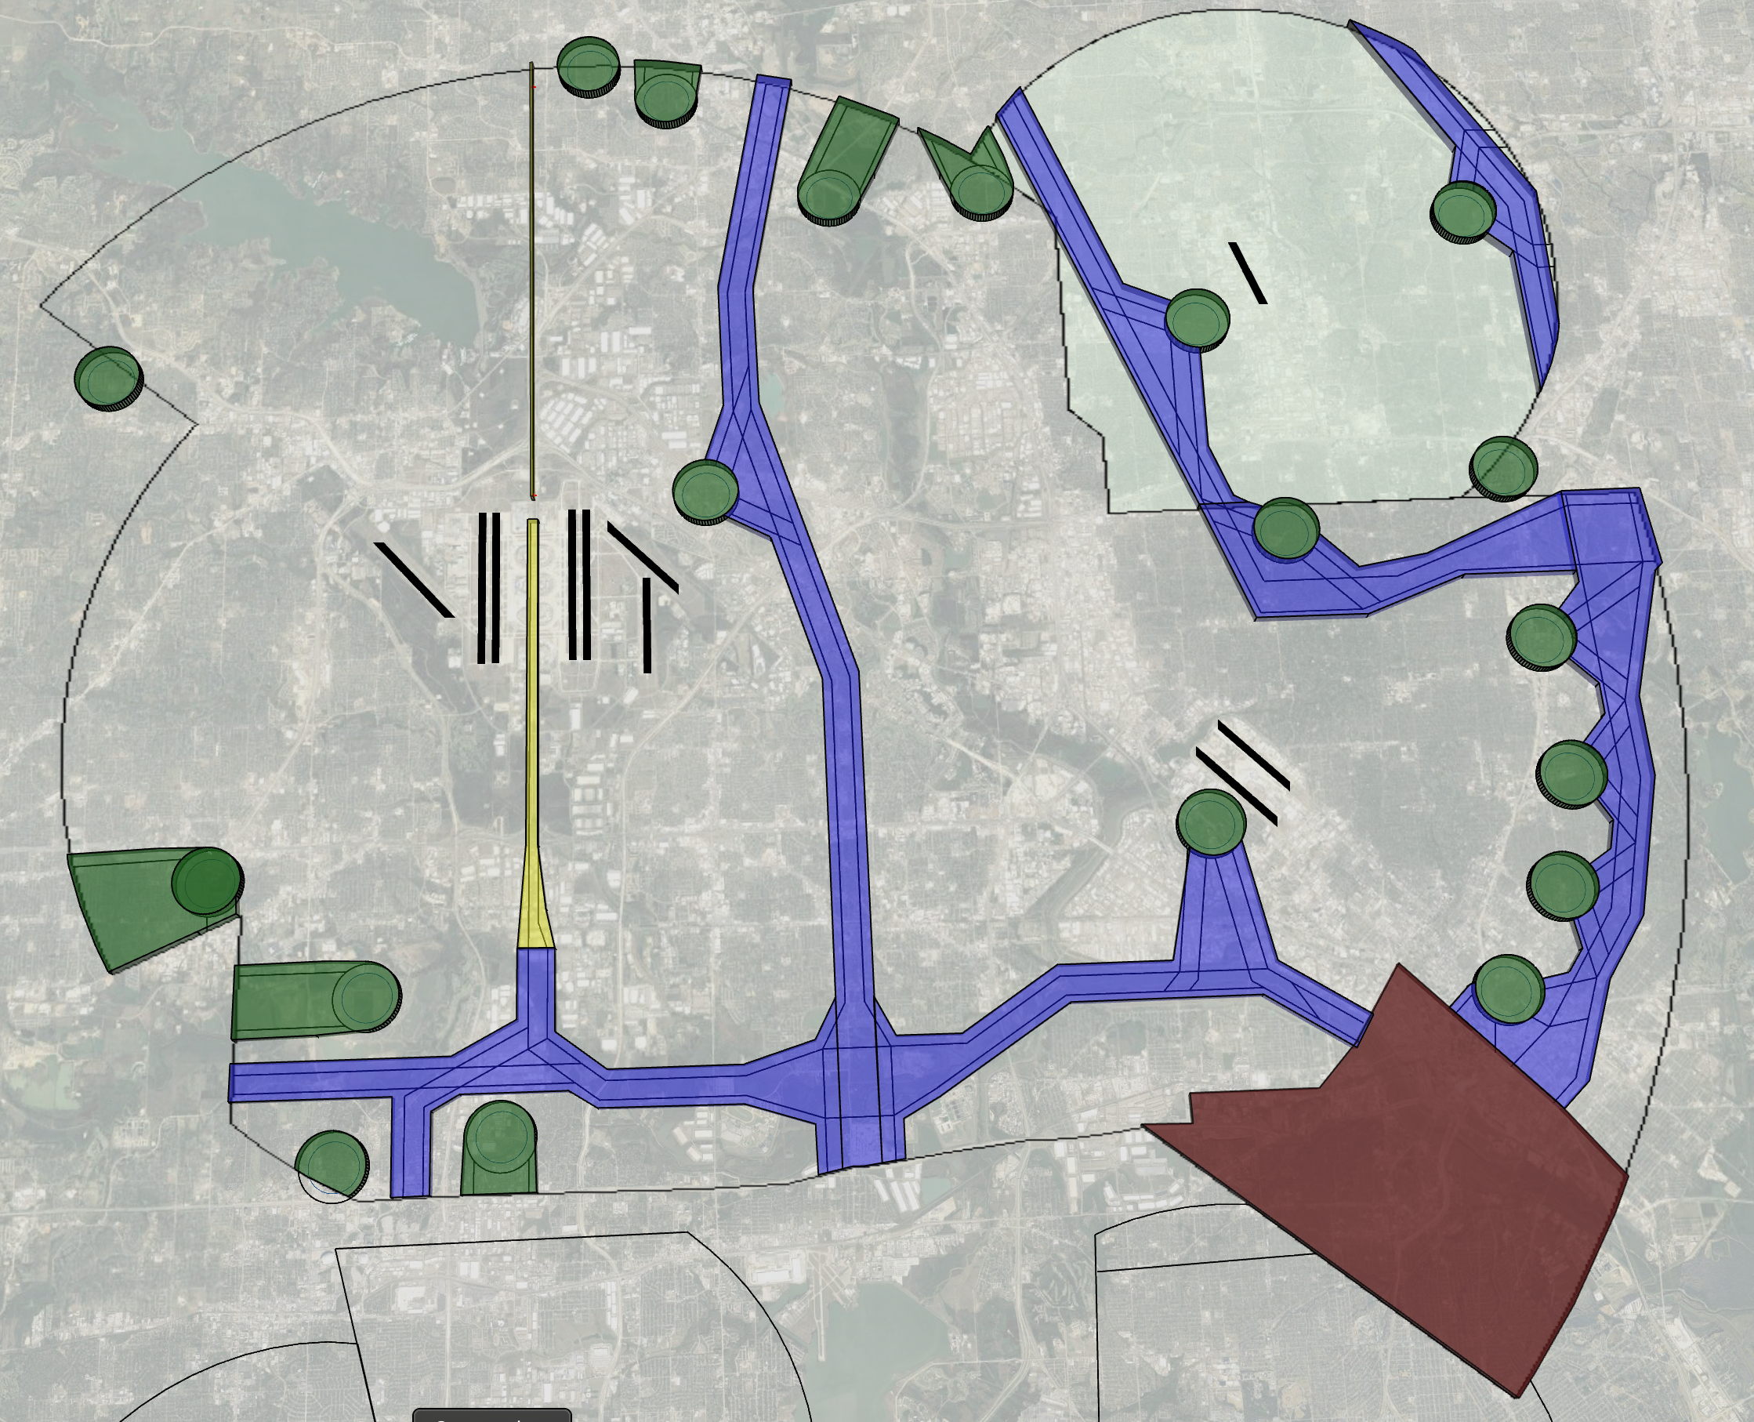
Method: Airspace Structure
Dallas Fort-Worth airspace area (Class Bravo) was used for this research
Corridors are in use and a UAM Operating Environment is introduced
Vertiports limited to medium-high capacity (15 - 35 flights/hour)
Vertiports located in medium density urban periphery areas
Visual Meteorological Conditions/Visual Flight Rules operations with some limited testing of Instrument Meteorological Conditions/Instrument Flight Rules operations
Visual representation of the Dallas Fort-Worth airspace area. Corridor and vertiport volumes are shown in dark green, purple, and magenta. The remaining area inside Class Bravo airspace is the "ATM Environment" where ATC services will be needed (Google, 2021).

Slide 17
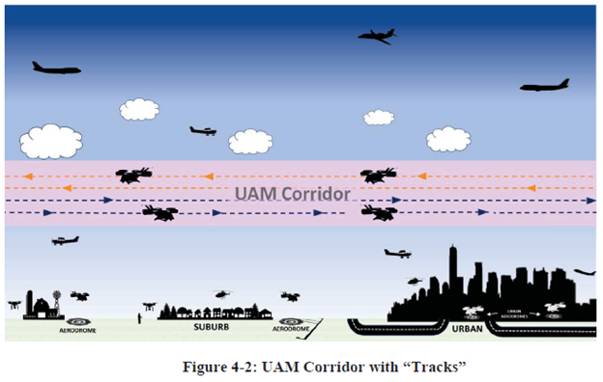
Method: Corridor Design Vision
UAM corridors were presented as performance-based airspaces of defined dimensions in which aircraft abide by UAM-specific rules, procedures, and performance requirements.
Corridors consisted of tracks, which are an additional structure within the corridor to help organize UAM traffic at higher operational tempo.
Routes are a series of interconnected tracks, corridors, and terminal procedures that define the operation from origin to destination
Source: FAA NextGen UAM ConOps v1.0

Slide 18
In-flight Incapacitated Pilot Scenario
Scenario Narrative Highlights
Scenario Assumptions

Slide 19
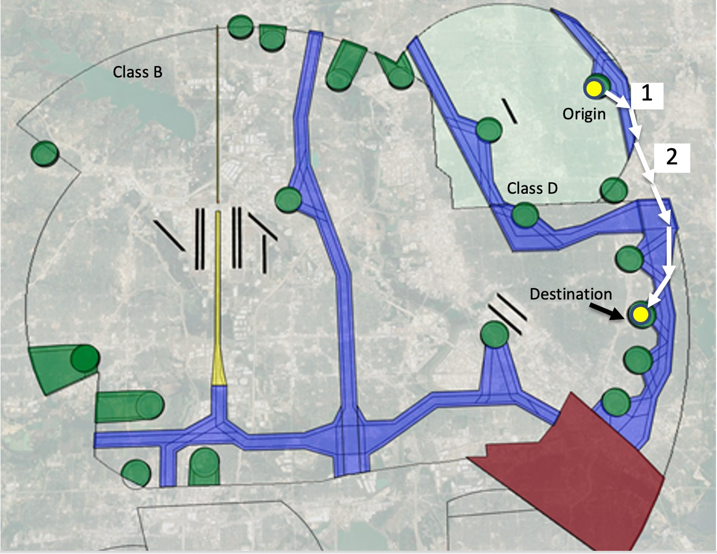
In-flight Incapacitated Pilot Scenario:
Narrative Highlights
Sixth scenario shown to participants on Day 1 of data collection
UAM flight with a single pilot on board who experiences physically incapacitating symptoms
Flight origin (Waypoint 1), destination, and planned route are described to the participant using the graphic depicted on the right
Waypoint 2 (corridor transition point) is where the eVTOL pilot feels incapacitating symptoms
There are currently no defined UAM contingency management or safeguards available to address this type of emergency
The aircraft is not fully automated, does not have auto-land capability, and cannot be remotely controlled from the ground or by the PSU
A visual representation of the in-flight incapacitated pilot scenario within the DFW airspace area (Google, 2021).

Slide 20
In-flight Incapacitated Pilot Scenario:
Assumptions
The following assumptions were considered for each of the use-case scenarios presented:
  Participant’s Role: Single, on-board, Pilot-in-Command (PIC)
  On-board Crew Support: None
  Number of Passengers: 3 to 5
  Vehicle Type: electric Vertical Takeoff and Landing (eVTOL)
  Weather: Visual Meteorological Conditions
  Operations: Visual Flight Rules traveling from in both controlled and uncontrolled airspace surrounding the Dallas Area
    Several routes are in the area with approximately 50 other tilt-rotor vehicles simultaneously operating along those routes

Slide 21
In-flight Incapacitated Pilot Scenario:
Research Questions
A significant amount of data (~205 hours worth) was collected from the 12 pilot participants throughout the course Phase I data collection
Approximately 20 questions were asked, not including follow-on questions, for each use case scenario
The following results and discussion focus on three of those questions:
  First question pertained to asking about current-day airspace and operational procedures for situations involving an incapacitated pilot in single pilot operations, and if there are any gaps or areas of improvement that should be considered with the introduction of UAM aircraft into the NAS;
  Second question pertained to communications; and
  The third question asked about potential solutions

Slide 22
Results and Discussion
Limited Pilot Incapacitation Procedures Exist
eVTOL Design and Performance Characteristics
eVTOL Altitude and Urban Environment Challenges
Summary

Slide 23
Results and Discussion:
Limited Pilot Incapacitation Procedures Exist
Current-day procedures are not well designed to address the situation of an incapacitated pilot in single-pilot operation
Consensus among the participants that:
  There is a gap and areas of improvement needed to address this difficult issue
  The primary responsibility of a pilot is to aviate the aircraft and the pilot will only communicate if able
If communication is possible, most participants said they would make an emergency call to whichever frequency they are currently dialed into
  Likely their operator, such as their dispatch or flight follower, or the common traffic advisory frequency
It was noted that ATC would be the best entity to announce this emergency to, if able
ATC can provide:
  Separation to other aircraft in the vicinity to stay well clear from the vehicle with the incapacitated pilot
  Contact emergency services on the ground
  Advise other traffic in the vicinity to observe and relay back what is happening as long as the observing aircraft are within an appropriate distance and observation would not result in additional disruption to the airspace
Notes:
Although emergency pilot incapacitation procedures do exist, such as lost comm and “request assistance immediately” (Aeronautical Information Manual 6-1-1; 6-1-2), they are not well suited to case of sudden pilot incapacitation

Slide 24
Results and Discussion: eVTOL Design and Performance Characteristics
Significant difference between a pilot experiencing a medical emergency in a fixed-wing versus a rotorcraft
Rotorcraft are:
  Known to be less stable than fixed-wing aircraft and have different performance characteristics when it comes to controls
  Unable to glide, even with autorotation capabilities, and require constant pedal input at hover and low forward speed to keep the tail behind the nose
The design of the rotorcraft flight deck controls can have a significant impact on how the aircraft responds if a pilot suddenly becomes incapacitated and leans over or blocks certain controls
A pilot medical emergency in single pilot operations is also a vehicle emergency

Slide 25
Results and Discussion: eVTOL Altitude and Urban Environment Challenges
Altitude and urban environments pose challenges
Limited time to reach a recovery maneuver
Potential for landing over a populated area or crashing into urban terrain
Inability to autorotate to a safe landing (Prouty, 1986) in a sudden in-flight pilot incapacitation
“[A]n airplane by its nature wants to fly and, if not interfered with too strongly by unusual events or by a deliberately incompetent pilot, it will fly. A helicopter does not want to fly. It is maintained in the air by a variety of forces and controls working in opposition to each other, and if there is any disturbance in the delicate balance, the helicopter stops flying, immediately and disastrously. There is no such thing as a gliding helicopter.”
US journalist Harry Reasoner in 1973
Source: Flight Safety Australia, 2019

Slide 26
Results and Discussion:
Summary
Potential Solutions
  Onboard Technology (e.g., Garmin Autoland)
  Onboard and Remote Resources
    Assistance from passengers
    Assistance from a remote operator
It is important to note that each solution comes with its own challenges and potential security concerns
Important Upfront Considerations
  Airspace design
  eVTOL Design and Performance Characteristics
  Onboard Assistive Technology
  Urban Environment Infrastructure

Slide 27
References
Arneson & Thiphavong (2020). “ATM-X and Urban Air Mobility Overview.” Retrieved from https://ntrs.nasa.gov/citations/20205000435
Brown, A., Green, B., & Johnson, C. (2018). Human factors challenges in commercial aviation. Proceedings of the 2018 International Conference on Aviation Psychology, Daytona Beach, FL, USA, May 7-10, 2018, pp. 1-6.
Craven et al. (2021). “Preliminary Evaluation of National Campaign Scenarios for Urban Air Mobility.” Retrieved from https://ntrs.nasa.gov/citations/20210018334
Federal Aviation Administration (2021). “Charting Aviation’s Future: Operations in an Info-Centric National Airspace System,” 2021.
Federal Aviation Administration (2020). “Concept of Operations V1.0 Urban Air Mobility (UAM),” Federal Aviation Administration, Washington, D.C., 2020.
Flight Safety Australia (2019). “Human Factors and the Helicopter.” April 2, 2019. Retrieved from https://www.flightsafetyaustralia.com/2019/04/human-factors-and-the-helicopter/
Flight Safety Foundation (n.d.). “Pilot Incapacitation.” Retrieved from https://www.skybrary.aero/articles/pilot-incapacitation
Google (n.d.). Retrieved 2021, from https://maps.google.com
Lee, S., & Kim, Y. (2020). Managing cockpit automation: A pilot's perspective. Proceedings of the 2020 International Conference on Human-Computer Interaction in Aerospace, Moscow, Russia, October 20-22, 2020, pp. 1-8.
MITRE Corporation (2020). “The Future of Aerospace: Interconnected from Surface to Space.” FAA Managers Association Managing the Skies. Retrieved from www.faama.org
National Aeronautics and Space Administration, “Sky for All Portal,” 2022. Retrieved from https://nari.arc.nasa.gov/skyforall/
Price et al. (2020). Urban Air Mobility Operational Concept (OpsCon) Passenger-Carrying Operations. Retrieved from https://ntrs.nasa.gov/citations/20205001587
Prouty, R. (1986). “Helicopter Performance, Stability, and Control.” Wadsworth.
Smith, J., & Jones, R. (2019). Pilot perspectives on safety culture in the aviation industry. Proceedings of the 2019 Aviation Technology, Integration, and Operations Conference, Reston, VA, USA, June 24-28, 2019, pp. 1-10.
Thipphavong et al. (2018). Urban Air Mobility Airspace Integration Concepts and Considerations. Retrieved from https://ntrs.nasa.gov/citations/20180005218
Federal Aviation Administration (2023). Aeronautical Information Manual. Retrieved from https://www.faa.gov/air_traffic/publications/atpubs/aim_html/chap6_section_1.html

Slide 28
Thank You!
For any questions or follow-ups, please contact:
Rania W. Ghatas
NASA Langley Research Center
rania.w.ghatas@nasa.gov
Website: https://csaob.larc.nasa.gov

